Slide 1

Mold:
The Hidden Link To Disease
“The emanations from damp, moldy rooms and clothing are poisonous to the system.”--{HL 142.2}
Notes:
I woke up one morning all stiff, sore and tired, and I got to thinking, ...: Camper Mold. click

Slide 2

Notes:
I woke up one morning all stiff, sore and tired, and I got to thinking, ...: Camper Mold.

Slide 3

Common Symptoms From Mold
Muscle and/or joint pain (71%),
Fatigue/weakness (70%),
Neurocognitive dysfunction (67%),
Sinusitis (65%),
Headache (65%),
Gastrointestinal problems (58%)
Shortness of breath (54%),
Anxiety/depression/irritability (54%),
Vision problems (42%),
Chest tightness (42%),
Insomnia (40%),
Dizziness (38%),
Numbness/tingling (35%),
Laryngitis (35%),
Nausea (33%),
Skin rashes (27%),
Tremors (25%)
Heart palpitations (21%).
Journal of Nutritional & Environmental Medicine 14(3), 261–274
Notes:
CURTIS L, LIEBERMAN A, STARK M, REA W, VETTER M, Adverse Health Effects of Indoor Molds. Journal of Nutritional & Environmental Medicine (September 2004) 14(3), 261–274.

Slide 4
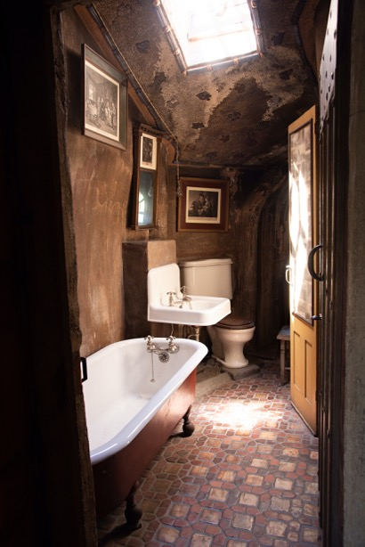
Dampness and Mold Go Hand in Hand!
Keep your home dry, well ventilated, dehumidified or air-conditioned.
Environ Health Perspect. 119(6):748-56.
Notes:
Mendell MJ, Mirer AG, Cheung K, Tong M, Douwes J. Respiratory and allergic health effects of dampness, mold, and dampness-related agents: a review of the epidemiologic evidence. Environ Health Perspect. 2011 Jun;119(6):748-56. doi: 10.1289/ehp.1002410. Epub 2011 Jan 26. PMID: 21269928; PMCID: PMC3114807.

Slide 5

If your place smells moldy you will get sick!
Environ Sci Pollut Res Int. 22(18):14234-40.

Slide 6

Sick Building Syndrome
Mycotoxins have been shown to be very toxic and harmful and it is no wonder that many inhabitants of these living spaces are constantly ill, mainly upper respiratory tract infections, lethargy, constant headaches, nausea and a general ill feeling. Inhabiting these living spaces for a considerable period may lead to cancer.
Przegl Lek. 57(7-8):419-23.
Notes:
Straus DC. Molds, mycotoxins, and sick building syndrome. Toxicol Ind Health. 2009 Oct-Nov;25(9-10):617-35.
The following is a review of some of the work we have done since 2004 regarding the importance of molds and their mycotoxins in the phenomenon of sick building syndrome (SBS). In these studies we showed that the macrocyclic trichothecene mycotoxins (MTM) of Stachybotrys chartarum (SC) are easily dissociated from the surface of the organism as it grows and could therefore be consequently spread in buildings as the fungus experiences additional water events. We then showed that SC and Penicillium chrysogenum (PC) colonies remain viable long after a water source has been removed, and the MTM produced by SC remain toxic over extended periods of time. We next showed that PC when inhaled, can release in vivo, a protease allergen that can cause a significant allergic inflammatory reaction in the lungs of mice. We then showed, in a laboratory study, that the MTM of SC can become airborne attached to spores or SC particulates smaller than spores. Following that study, we next showed that the same phenomenon actually occurred in SC infested buildings where people were complaining of health problems potentially associated with SBS. Finally, we were able to demonstrate the presence of MTM in the sera of individuals who had been exposed to SC in indoor environments. This last study was done with enough mold exposed individuals to allow for the statistical significance of SC exposure to be evaluated.
Ochmański W, Barabasz W. Mikrobiologiczne zagrozenia budynków i pomieszczeń mieszakalnych oraz ich wpływ na zdrowie (syndrom chorego budynku) [Microbiological threat from buildings and rooms and its influence on human health (sick building syndrome)]. Przegl Lek. 2000;57(7-8):419-23. Polish. PMID: 11109318.
In buildings we can observe many different strains of bacteria, over 400 species of mould fungi, many strains of fungus causing the rotting of wood and wood like materials, many species of algae, aphids, and other types of growths and seed plants and also over 30 types of mites especially those seen in house dust. Buildings, especially their interiors have a very specific microclimate. Within it areas of so called ecological lows are formed in which conditions for settlement, growth and reproduction of these organisms take place. A building, which is a hazard to the health of its residents, is called a "sick building" from the term "sick building syndrome". The incidence and development of some types of mould fungus is associated with the production of very toxic metabolites which are called secondary metabolites i.e. mycotoxins. Long term human, especially in relation to children, contact with the species producing the most potent mycotoxins like aflatoxin--Apergillus flavus, ochratoxins--Aspergillus ochraceus, rubratoxins--Penicillium rubrum or strachybotrytoxins--Strachybotrys chartarum may even be the cause of death. Mould fungus or just mould is a saprophytic fungus derived from many different systemic groups (Mucor, Aspergillus, Penicillium, Fusarinum). Fungi can produce lethal mycotoxins such as: alternariol, aflatoxins, gliotoxins, ochratoxins, nivalenol, cytinine, dicumarol, rugulosine, trichoviridine and about 200 more which considering their mutagenicity are potentially dangerous to humans, animals, flora and microorganisms. Research which was begun by Prof. Julian Aleksandrowicz and Prof. Bolesław Smyk in 1970 and 1971 showed that the so called "leukaemia houses" of leukaemia victims had an abundance of toxinogenic fungus in them, particularly the most potent fungus which turned out to be Aspergillus flavus. Toxinogenic funguses are abundant in many living spaces and cellars in older and also in new housing. Mycotoxins have been shown to be very toxic and harmful and it is no wonder that many inhabitants of these living spaces are constantly ill, mainly upper respiratory tract infections, lethargy, constant headaches, nausea and a general ill feeling. Inhabiting these living spaces for a considerable period may lead to cancer.

Slide 7

Coming Up For Air
Indoor air contaminants are a source of inflammation.
Contaminants include:
  Aspergillus aflatoxins.
  Breathable dust.
  Nitrogen dioxide.
  Formaldehyde.
  Mold.
  Traffic.
Allergy. 2000 Feb;55(2):163-70.
Notes:
Hot indoor air
Many labor under the mistaken idea that if they have taken cold, they must carefully exclude the outside air and increase the temperature of their room until it is excessively hot. The system may be deranged, the pores closed by waste matter, and the internal organs suffering more or less inflammation, because the blood has been chilled back from the surface and thrown upon them. At this time, of all others, the lungs should not be deprived of pure, fresh air. If pure air is ever necessary, it is when any part of the system, as the lungs or stomach, is diseased. Judicious exercise would induce the blood to the surface, and thus relieve the internal organs. Brisk, yet not violent exercise in the open air, with cheerfulness of spirits, will promote the circulation, giving a healthful glow to the skin, and sending the blood, vitalized by the pure air, to the extremities. The diseased stomach will find relief by exercise. Physicians frequently advise invalids to visit foreign countries, to go to the springs, or to ride upon the ocean, in order to regain health; when, in nine cases out of ten, if they would eat temperately and engage in healthful exercise with a cheerful spirit, they would regain health and save time and money. Exercise, and
531
a free and abundant use of the air and sunlight,--blessings which Heaven has freely bestowed upon all,--would give life and strength to the emaciated invalid. {2T 530.2}
A large class of women are content to hover over the stove, breathing impure air for one half or three fourths of the time, until the brain is heated and half benumbed. They should go out and exercise every day, even though some things indoors have to be neglected. They need the cool air to quiet their distracted brains. They need not go to their neighbors to gossip, but should make it their object to do some good, working to the end of benefiting others. Then they will be an example to others and receive real benefit themselves. {2T 531.1}
Perfect health depends upon perfect circulation. Special attention should be given to the extremities, that they may be as thoroughly clothed as the chest and the region over the heart, where is the greatest amount of heat. Parents who dress their children with the extremities naked, or nearly so, are sacrificing the health and lives of their children to fashion. If these parts are not so warm as the body, the circulation is not equalized. When the extremities, which are remote from the vital organs, are not properly clad, the blood is driven to the head, causing headache or nosebleed; or there is a sense of fullness about the chest, producing cough or palpitation of the heart, on account of too much blood in that locality; or the stomach has too much blood, causing indigestion. {2T 531.2}
I thought then I was cut off from doing anything for the
people, but our brethren said they had found out a way that the
room could be ventilated, so I put on the armor again and did
very well until Sunday night. I spoke to a hall filled with
outsiders. I knew the moment I attempted to speak that our
brethren had forgotten to ventilate the hall, and the outdoor air
had not been introduced into the hall after the last meeting had
been held. I got through with the discourse wearied out. {3BIO 353.4}
I walked home. I could not sleep that night, and the next
morning I looked haggard and felt two years older than I did
before I made the attempt to speak. I became very sick with
nervous prostration. . . . I was suffering much with inflammation
of head, stomach, and lungs.--Letter 114, 1886. {3BIO 353.5}
Int J Epidemiol. 1989 Jun;18(2):390-6.Click here to read Links
The effect of domestic factors on respiratory symptoms and FEV1.
Hosein HR, Corey P, Robertson JM.
Occupational Health Unit, University of Toronto, Ontario, Canada.
This study was conducted to determine whether indoor air pollution factors affected respiratory function and symptoms in 1357 non-smoking Caucasian children. Interviews were conducted to determine: exposure to pets and to gases, vapours and dusts from hobbies; the use of gas stoves; fireplaces, air conditioners and humidifiers; type of heating systems; and the number of residents, and the number of smokers in the home. The forced expiratory volume in one second (FEV1) was obtained from maximum expiratory flow volume curves, and symptoms from the application of a standardized questionnaire. Indoor pets and the use of fireplaces and humidifiers had no consistent relationships with FEV1 when considered individually or in combination with the other factors. Hobbies, the use of gas stoves, the absence of air conditioning, the use of hot water heating, crowded homes, and the presence of smokers in the home all had negative relationships with FEV1. The largest effect on lung function was observed in children from homes with hot water heating systems, whereas the smallest effect was observed in children with smokers in the home. Children who lived in homes with hot water heating systems with no air conditioning had mean FEV1 of up to 0.4 litres lower than did their counterparts who lived in homes with forced air heating and air conditioning. Pets, heating systems, cooking fuel, crowding and passive smoking showed no consistent effects on the reporting of any of the symptoms. Girls who were exposed to the emissions from indoor hobbies reported more phlegm, wheeze and dyspnoea.
PMID: 2767853 [PubMed - indexed for MEDLINE
J Trop Med Hyg. 1988 Apr;91(2):77-82.Links
The effect of a hot dry climate on the haemorrheology of healthy males and patients with acute myocardial infarction.
Kolar J, Bhatnagar SK, Hudak A, Smid J, al-Yusuf AR.
Faculty of Medicine, Kuwait University.
We studied the influence of an extremely hot dry summer and temperate winter on the haemorrheology of 82 healthy males (controls) and 101 male patients with acute myocardial infarction (AMI). The haematocrit (Hct), blood viscosity (B1V) and Hct/B1V ratio were measured in these subjects working 'outdoors' and in an air-conditioned environment ('indoors'). The 'summer outdoor' controls had a higher B1V and a lower Hct/B1V when compared to the 'winter outdoor' controls (P less than 0.01), and the 'summer indoor' controls had a lower Hct and Hct/B1V when compared to the 'winter indoor' control group (P less than 0.02). The haemorrheology of 'winter indoor' AMI patients was not different from the controls, except for the Hct/B1V. The 'summer indoor' group had a higher Hct (P less than 0.05) and B1V (P less than 0.001) and a lower Hct/B1V (P less than 0.02) when compared to the controls. 'Summer outdoor' AMI patients had the most abnormal haemorrheology of all groups. AMI patients with Hct/B1V less than 7 had a significantly higher prevalence of hypotension and shock syndrome compared to those whose Hct/B1V was greater than or equal to 7 (P less than 0.05). We conclude that in healthy males, there was a seasonal difference in haemorrheology which was due to acclimatization to heat. During summer, AMI patients working outdoors had the most abnormal haemorrheology on admission and the occurrence of complications was also higher in them. We believe that these abnormalities resulted due to inadequate adjustments to heat.
PMID: 3379656 [PubMed - indexed for MEDLINE]
Clin Exp Allergy. 2001 Dec;31(12):1913-22.Click here to read Links
Hot, humid air increases cellular influx during the late-phase response to nasal challenge with antigen.
Assanasen P, Baroody FM, Naureckas E, Naclerio RM.
The Section of Otolaryngology-Head and Neck Surgery, The Pritzker School of Medicine, The University of Chicago, Chicago, Illinois 60637, USA.
BACKGROUND: Inhalation of hot, humid air (HHA: 37 degrees C, > 95% relative humidity (RH)) partially inhibits the early response to nasal challenge with antigen. OBJECTIVE: To investigate whether HHA inhibited the late-phase response to nasal challenge with antigen and increased hyper-responsiveness of the nasal mucosa to histamine. METHODS: Twenty subjects with seasonal allergic rhinitis, outside of their allergy season, participated in a randomized, 2-way cross-over study. The subjects continuously breathed room air (25 degrees C, 30% RH) or HHA delivered via a face mask during the entire experiment. Subjects were challenged intranasally with antigen 1 h after beginning conditioning. The response was monitored by symptoms and nasal lavage at 2-h intervals after the last antigen challenge. Eight hours after antigen challenge, nasal challenge with histamine was performed. RESULTS: Exposure to HHA significantly increased nasal mucosal temperature from baseline without affecting nasal secretion osmolality. HHA significantly inhibited antigen-induced sneezes, congestion, pruritus, and human serum albumin levels during the early response to antigen challenge. HHA exposure, however, was associated with an 8-fold increase in the eosinophil influx and a 15-fold increase in the levels of eosinophil cationic protein during the late-phase response compared to room air. There were no significant differences in nasal hyper-responsiveness to histamine during either exposure. CONCLUSION: HHA partially decreases the early response to nasal challenge with antigen, but dramatically increases eosinophil influx. Increasing eosinophil number had no effects on the hyper-responsiveness to histamine. We speculate that the physical conditions of air differentially impact the stages of allergic inflammation.
PMID: 11737044 [PubMed - indexed for MEDLINE]
Allergy. 2000 Feb;55(2):163-70.Click here to read Links
Indoor air pollutants in schools: nasal patency and biomarkers in nasal lavage.
Norbäck D, Wålinder R, Wieslander G, Smedje G, Erwall C, Venge P.
Department of Medical Sciences/Occupational and Environmental Medicine, University of Uppsala, University Hospital, Sweden.
BACKGROUND: There is growing concern about the respiratory health aspects of the indoor air quality in schools. METHODS: A standardized investigation, including nasal lavage (NAL), measurement of the nasal cavity by acoustic rhinometry, and hygienic measurements of airborne pollutants, was performed in classrooms, outside the pollen season. All 279 school personnel working in the main buildings of 12 randomly selected primary schools in an urban community in central Sweden (Uppsala) were invited to enroll in the study; 234 (84%) participated. Eosinophil cationic protein (ECP), myeloperoxidase (MPO), lysozyme, and albumin were analyzed in NAL fluid. Crude statistical analysis, as well as multiple regression analysis, was performed, controlling for room temperature, age, sex, current smoking, and a history of atopy. RESULTS: Most classrooms (83%) did not meet the Swedish ventilation standards. A lower degree of nasal patency was found at higher concentrations of respirable dust, nitrogen dioxide (NO2), formaldehyde, and total molds, and in the presence of Aspergillus spp. in the classroom air. The most consistent findings were observed for formaldehyde, NO2, and Aspergillus spp., related to both decreased nasal patency and increase of ECP and lysozyme in NAL. The presence of yeast was associated with an increase of ECP and lysozyme in NAL, but was not related to nasal patency. CONCLUSIONS: Ventilation flow was below current hygienic standards in the classrooms. Air pollutants in the classroom air may influence nasal patency and inflammatory response in the nasal mucosa.
PMID: 10726731 [PubMed - indexed for MEDLINE]

Slide 8
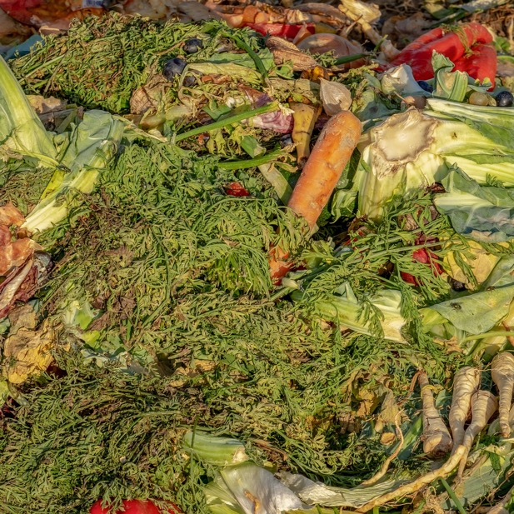
Every form of uncleanliness tends to disease. Death-producing germs abound in dark, neglected corners, in decaying refuse, in dampness and mold and must.
No waste vegetables or heaps of fallen leaves should be allowed to remain near the house to decay and poison the air. Nothing unclean or decaying should be tolerated within the home.
In towns or cities regarded perfectly healthful, many an epidemic of fever has been traced to decaying matter about the dwelling of some careless householder. {MH 276.4}
Notes:
van Kampen V, Hoffmeyer F, Deckert A, Kendzia B, Casjens S, Neumann HD, Buxtrup M, Willer E, Felten C, Schöneich R, Brüning T, Raulf M, Bünger J. Effects of bioaerosol exposure on respiratory health in compost workers: a 13-year follow-up study. Occup Environ Med. 2016 Dec;73(12):829-837.
Abstract
Objectives: To determine the risk of German compost workers developing chronic respiratory effects from long-term exposure to bioaerosols.
Methods: Respiratory health was determined in 74 currently exposed compost workers and 37 non-exposed controls after 13 years of follow-up. In addition, 42 former compost workers (drop-outs) who left their work during the follow-up period were also examined. Respiratory symptoms and working conditions were assessed using identical questionnaires as at baseline. In addition, lung function was measured using the same spirometer as in the initial study. Sera from both surveys were tested for specific IgE and IgG antibodies to moulds and the risk of work-related symptoms was evaluated using regression approaches for prospective studies with binary data.
Results: In the follow-up period, the number of participants reporting cough significantly increased in compost workers and drop-outs compared to the controls. Working as a compost worker for at least 5 years increased the relative risk for cough (RR 1.28; 95% CI 1.2 to 1.4) and for cough with phlegm (RR 1.32; 95% CI 1.2 to 1.5). Current and former compost workers had slightly lower predicted percentage of forced expiratory volume in 1 s and predicted percentage of forced vital capacity than controls, but decrease in lung function during follow-up was not different among the 3 groups. In addition, no significant changes could be detected in antibody concentrations.
Conclusions: Our results suggest that chronic exposure to bioaerosols in composting plants is related to a significantly higher risk for cough with phlegm, indicating chronic bronchitis. However, compost workers showed no higher incidence of deterioration of pulmonary function over the study.

Slide 9
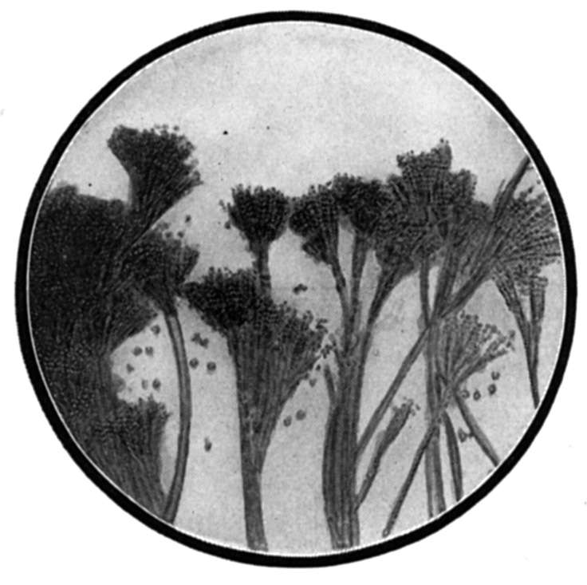

Exposure to Mixed Mold: Mycotoxicosis
Mold exposure in water-damaged buildings reduces natural killer cells and initiates inflammatory processes.
Living in a home with mold problems increases the risk of respiratory infections and symptoms.
Arch Environ Health. 2003 Jul;58(7):410-20. Eur Respir J. 1996 Dec;9(12):2618-22.
Notes:
Arch Environ Health. 2003 Jul;58(7):410-20. Related Articles, Links
Mixed mold mycotoxicosis: immunological changes in humans following exposure in water-damaged buildings.
Gray MR, Thrasher JD, Crago R, Madison RA, Arnold L, Campbell AW, Vojdani A.
Progressive Healthcare Group, Benson, Arizona, USA. docmike007@aol.com
The study described was part of a larger multicenter investigation of patients with multiple health complaints attributable to confirmed exposure to mixed-molds infestation in water-damaged buildings. The authors present data on symptoms; clinical chemistries; abnormalities in pulmonary function; alterations in T, B, and natural killer (NK) cells; the presence of autoantibodies (i.e., antinuclear autoantibodies [ANA], autoantibodies against smooth muscle [ASM], and autoantibodies against central nervous system [CNS] and peripheral nervous system [PNS] myelins). A total of 209 adults, 42.7 +/- 16 yr of age (mean +/- standard deviation), were examined and tested with (a) self-administered weighted health history and symptom questionnaires; (b) standardized physical examinations; (c) complete blood counts and blood and urine chemistries; (d) urine and fecal cultures; (e) thyroid function tests (T4, free T3); (f) pulmonary function tests (forced vital capacity [FVC], forced expiratory volume in 1 sec [FEV1.0], and forced expiratory flow at 25%, 50%, 75%, and 25-75% of FVC [FEF25, FEF50, FEF75, and FEF2(25-75)]); (g) peripheral lymphocyte phenotypes (T, B, and NK cells) and mitogenesis determinations; and (h) a 13-item autoimmune panel. The molds-exposed patients reported a greater frequency and intensity of symptoms, particularly neurological and inflammatory symptoms, when compared with controls. The percentages of exposed individuals with increased lymphocyte phenotypes were: B cells (CD20+), 75.6%; CD5+CD25+, 68.9%; CD3+CD26+, 91.2%; CD8+HLR-DR+, 62%; and CD8+CD38+, 56.6%; whereas other phenotypes were decreased: CD8+CD11b+, 15.6% and CD3-CD16+CD56+, 38.5%. Mitogenesis to phytohemagglutinin was decreased in 26.2% of the exposed patients, but only 5.9% had decreased response to concanavalin A. Abnormally high levels of ANA, ASM, and CNS myelin (immunoglobulins [Ig]G, IgM, IgA) and PNS myelin (IgG, IgM, IgA) were found; odds ratios for each were significant at 95% confidence intervals, showing an increased risk for autoimmunity. The authors conclude that exposure to mixed molds and their associated mycotoxins in water-damaged buildings leads to multiple health problems involving the CNS and the immune system, in addition to pulmonary effects and allergies. Mold exposure also initiates inflammatory processes. The authors propose the term "mixed mold mycotoxicosis" for the multisystem illness observed in these patients.
Publication Types:
Clinical Trial
Controlled Clinical Trial
Multicenter Study
PMID: 15143854 [PubMed - indexed for MEDLINE]
Eur Respir J. 1996 Dec;9(12):2618-22. Related Articles, Links
Home dampness, moulds and their influence on respiratory infections and symptoms in adults in Finland.
Pirhonen I, Nevalainen A, Husman T, Pekkanen J.
Dept of Environmental Epidemiology, National Public Health Institute, Kuopio, Finland.
The aim of this study was to analyse the prevalence of mouldy homes and their association with respiratory symptoms and diseases in a subarctic climate. A questionnaire was mailed to a random sample of 2,000 males and females, aged 25-64 yrs, living in the county of Kuopio, Finland. A total of 1,521 (76%) responded and 1,460 were selected for the final analysis. The prevalence of homes with visible mould was 4%; with the odour of mould 5%; with damp spots, visible mould or the odour of mould 15%; and with moisture/ water damage, damp spots, visible mould or the odour of mould 23%. The number of reports of bronchitis, common cold, atopy, allergic rhinitis, rhinitis, fever and chills, hoarseness, fatigue, difficulties in concentration, lumbar backache and stomach ache were strongly associated with living in a damp home. Bronchitis, hoarseness and difficulties in concentration had the strongest associations, with adjusted odds ratios (95% confidence limits) of: 2.04 (1.49-2.78), 2.23 (1.37-3.63) and 2.17 (1.35-3.50), respectively. After controlling for a possible reporting bias by excluding those subjects reporting lumbar backache and recurrent stomach pain, eye irritation and tiredness remained significant. In conclusion, living in a home with mould problems may increase the risk of respiratory infections and symptoms in adults.
PMID: 8980978 [PubMed - indexed for MEDLINE]

Slide 10

Shade trees and shrubbery too close and dense around a house are unhealthful; for they prevent a free circulation of air and shut out the rays of the sun. In consequence of this, dampness gathers in the house.
Especially in wet seasons the sleeping rooms become damp, and those who occupy them are troubled with rheumatism, neuralgia, and lung complaints which generally end in consumption.
Numerous shade trees cast off many leaves, which, if not immediately removed, decay and poison the atmosphere. A yard beautified with trees and shrubbery, at a proper distance from the house, has a happy, cheerful influence upon the family, and, if well taken care of, will prove no injury to health.
Dwellings, if possible, should be built upon high and dry ground. If a house is built where water settles around it, remaining for a time, and then drying away, a poisonous miasma arises, and fever and ague, sore throat, lung diseases, and fevers will be the result. {CH 58.2}

Slide 11

Mold exposure in water-damaged buildings initiates inflammatory processes and reduces your cancer fighting natural killer cells.
J Environ Pub Health, Article ID 312836
Notes:
J Environ Public Health. 2012;2012:312836. doi: 10.1155/2012/312836. Epub 2011 Dec 15.
A water-damaged home and health of occupants: a case study.
Thrasher JD, Gray MR, Kilburn KH, Dennis DP, Yu A.
Arch Environ Health. 2003 Jul;58(7):410-20. Related Articles, Links
Mixed mold mycotoxicosis: immunological changes in humans following exposure in water-damaged buildings.
Gray MR, Thrasher JD, Crago R, Madison RA, Arnold L, Campbell AW, Vojdani A.
Progressive Healthcare Group, Benson, Arizona, USA. docmike007@aol.com
The study described was part of a larger multicenter investigation of patients with multiple health complaints attributable to confirmed exposure to mixed-molds infestation in water-damaged buildings. The authors present data on symptoms; clinical chemistries; abnormalities in pulmonary function; alterations in T, B, and natural killer (NK) cells; the presence of autoantibodies (i.e., antinuclear autoantibodies [ANA], autoantibodies against smooth muscle [ASM], and autoantibodies against central nervous system [CNS] and peripheral nervous system [PNS] myelins). A total of 209 adults, 42.7 +/- 16 yr of age (mean +/- standard deviation), were examined and tested with (a) self-administered weighted health history and symptom questionnaires; (b) standardized physical examinations; (c) complete blood counts and blood and urine chemistries; (d) urine and fecal cultures; (e) thyroid function tests (T4, free T3); (f) pulmonary function tests (forced vital capacity [FVC], forced expiratory volume in 1 sec [FEV1.0], and forced expiratory flow at 25%, 50%, 75%, and 25-75% of FVC [FEF25, FEF50, FEF75, and FEF2(25-75)]); (g) peripheral lymphocyte phenotypes (T, B, and NK cells) and mitogenesis determinations; and (h) a 13-item autoimmune panel. The molds-exposed patients reported a greater frequency and intensity of symptoms, particularly neurological and inflammatory symptoms, when compared with controls. The percentages of exposed individuals with increased lymphocyte phenotypes were: B cells (CD20+), 75.6%; CD5+CD25+, 68.9%; CD3+CD26+, 91.2%; CD8+HLR-DR+, 62%; and CD8+CD38+, 56.6%; whereas other phenotypes were decreased: CD8+CD11b+, 15.6% and CD3-CD16+CD56+, 38.5%. Mitogenesis to phytohemagglutinin was decreased in 26.2% of the exposed patients, but only 5.9% had decreased response to concanavalin A. Abnormally high levels of ANA, ASM, and CNS myelin (immunoglobulins [Ig]G, IgM, IgA) and PNS myelin (IgG, IgM, IgA) were found; odds ratios for each were significant at 95% confidence intervals, showing an increased risk for autoimmunity. The authors conclude that exposure to mixed molds and their associated mycotoxins in water-damaged buildings leads to multiple health problems involving the CNS and the immune system, in addition to pulmonary effects and allergies. Mold exposure also initiates inflammatory processes. The authors propose the term "mixed mold mycotoxicosis" for the multisystem illness observed in these patients.
Publication Types:
Clinical Trial
Controlled Clinical Trial
Multicenter Study
PMID: 15143854 [PubMed - indexed for MEDLINE]
Eur Respir J. 1996 Dec;9(12):2618-22. Related Articles, Links
Home dampness, moulds and their influence on respiratory infections and symptoms in adults in Finland.
Pirhonen I, Nevalainen A, Husman T, Pekkanen J.
Dept of Environmental Epidemiology, National Public Health Institute, Kuopio, Finland.
The aim of this study was to analyse the prevalence of mouldy homes and their association with respiratory symptoms and diseases in a subarctic climate. A questionnaire was mailed to a random sample of 2,000 males and females, aged 25-64 yrs, living in the county of Kuopio, Finland. A total of 1,521 (76%) responded and 1,460 were selected for the final analysis. The prevalence of homes with visible mould was 4%; with the odour of mould 5%; with damp spots, visible mould or the odour of mould 15%; and with moisture/ water damage, damp spots, visible mould or the odour of mould 23%. The number of reports of bronchitis, common cold, atopy, allergic rhinitis, rhinitis, fever and chills, hoarseness, fatigue, difficulties in concentration, lumbar backache and stomach ache were strongly associated with living in a damp home. Bronchitis, hoarseness and difficulties in concentration had the strongest associations, with adjusted odds ratios (95% confidence limits) of: 2.04 (1.49-2.78), 2.23 (1.37-3.63) and 2.17 (1.35-3.50), respectively. After controlling for a possible reporting bias by excluding those subjects reporting lumbar backache and recurrent stomach pain, eye irritation and tiredness remained significant. In conclusion, living in a home with mould problems may increase the risk of respiratory infections and symptoms in adults.
PMID: 8980978 [PubMed - indexed for MEDLINE]

Slide 12

Biblical Cleanliness
When ye be come into the land of Canaan, which I give to you for a possession, and I put the plague of leprosy in a house of the land of your possession; And he that owneth the house shall come and tell the priest, saying, It seemeth to me there is as it were a plague in the house: Then the priest shall command that they empty the house, before the priest go into it to see the plague, that all that is in the house be not made unclean: and afterward the priest shall go in to see the house: And he shall look on the plague, and, behold, if the plague be in the walls of the house with hollow strakes, greenish or reddish, which in sight are lower than the wall; Then the priest shall go out of the house to the door of the house, and shut up the house seven days: And the priest shall come again the seventh day, and shall look: and, behold, if the plague be spread in the walls of the house; Then the priest shall command that they take away the stones in which the plague is, and they shall cast them into an unclean place without the city: And he shall cause the house to be scraped within round about, and they shall pour out the dust that they scrape off without the city into an unclean place: And they shall take other stones, and put them in the place of those stones; and he shall take other morter, and shall plaister the house. And if the plague come again, and break out in the house, after that he hath taken away the stones, and after he hath scraped the house, and after it is plaistered; Then the priest shall come and look, and, behold, if the plague be spread in the house, it is a fretting leprosy in the house: it is unclean. And he shall break down the house, the stones of it, and the timber thereof, and all the morter of the house; and he shall carry them forth out of the city into an unclean place. Moreover he that goeth into the house all the while that it is shut up shall be unclean until the even. And he that lieth in the house shall wash his clothes; and he that eateth in the house shall wash his clothes. And if the priest shall come in, and look upon it, and, behold, the plague hath not spread in the house, after the house was plaistered: then the priest shall pronounce the house clean, because the plague is healed. And he shall take to cleanse the house two birds, and cedar wood, and scarlet, and hyssop: And he shall kill the one of the birds in an earthen vessel over running water: And he shall take the cedar wood, and the hyssop, and the scarlet, and the living bird, and dip them in the blood of the slain bird, and in the running water, and sprinkle the house seven times: And he shall cleanse the house with the blood of the bird, and with the running water, and with the living bird, and with the cedar wood, and with the hyssop, and with the scarlet: But he shall let go the living bird out of the city into the open fields, and make an atonement for the house: and it shall be clean. This is the law for all manner of plague of leprosy, and scall, And for the leprosy of a garment, and of a house, And for a rising, and for a scab, and for a bright spot: To teach when it is unclean, and when it is clean: this is the law of leprosy. Leviticus 14:34-57.

Slide 13

Mold in your foods can cause inflammation, immunosuppression and cancer.
Med Mycol. 38 Suppl 1:17-22.
Notes:
Med Mycol. 2000;38 Suppl 1:17-22.
Toxigenic fungi: which are important?
Pitt JI.
Source
Food Science Australia, North Ryde, NSW, Australia. John.Pitt@foodscience.afisc.csiro.au
Abstract
Growth of commonly occurring filamentous fungi in foods may result in production of mycotoxins, which can cause a variety of ill effects in humans, from allergic responses to immunosuppression and cancer. According to experts, five kinds of mycotoxins are important in human health around the world: aflatoxins, ochratoxin A, fumonisins, certain trichothecenes, and zearalenone. These toxins are produced by only a few species of fungi, in a limited range of commodities. Aflatoxins are potent carcinogens, produced by Aspergillus flavus and A. parasiticus in peanuts, maize and some other nuts and oilseeds. Ochratoxin A is a kidney toxin and probable carcinogen. It is produced by Penicillium verrucosum in cereal grains in cold climates, by A. carbonarius in grapes, wines and vine fruits, and by A. ochraceus sometimes in coffee beans. Fumonisins, which may cause oesophageal cancer, are formed by Fusarium moniliforme and F. proliferatum, but only in maize. Trichothecenes are highly immunosuppressive and zearalenone causes oestrogenic effects; both are produced by F. graminearum and related species. Current reporting probably underestimates the effect of mycotoxins as a cause of human mortality.
PMID: 11204142 [PubMed - indexed for MEDLINE]

Slide 14

On Finding A Good Banana In The Dumpster
Aflatoxins, formed in the process of aging or fermenting, are a source of inflammation.
Dietary sources of aflatoxins include:
  Cheese
  Wine
  Vinegar
  Any food created by rotting or fermentation.
Toxicol Sci. 2003 Jun;73(2):362-77
Notes:
J Gastroenterol. 1995 Nov;30 Suppl 8:9-12.Links
A case-control study of ulcerative colitis in relation to dietary and other factors in Japan. The Epidemiology Group of the Research Committee of Inflammatory Bowel Disease in Japan.
[No authors listed]
The etiology of ulcerative colitis is essentially unknown. A hospital-based case-control study examined the risk of ulcerative colitis in relation to dietary and other factors. Recruited at 20 hospitals across the nation were 101 ulcerative colitis patients who were 10-39 years old at the time of disease onset and whose disease had been diagnosed within the past 3 years. One hundred and forty-three control subjects were also examined. Information on factors was obtained by using a self-administered questionnaire. Combined consumption of western foods (bread for breakfast, butter, margarine, cheese, meats, and ham/ sausage) was significantly related to an increased risk of ulcerative colitis (trend P = 0.04). Of the six food items of the western food group, margarine was positively and significantly associated with ulcerative colitis (trend P = 0.005), and bread for breakfast tended to be positively associated with the risk (trend P = 0.07). No appreciable association was found for the consumption of Japanese foods, vegetables and fruits, confectionery, or soft drinks. Compared with lifelong nonsmokers, current smokers had a decreased risk, and former smokers had an increased risk. This study confirmed a protective association between smoking and ulcerative colitis, and suggested that margarine or chemically modified fat may play an etiological role in the development of ulcerative colitis.
PMID: 8563901 [PubMed - indexed for MEDLINE]
J Clin Gastroenterol. 1994 Sep;19(2):166-71.Links
Dietary and other risk factors of ulcerative colitis. A case-control study in Japan. Epidemiology Group of the Research Committee of Inflammatory Bowel Disease in Japan.
[No authors listed]
A multisite, hospital-based, case-control study examined the risk of ulcerative colitis in relation to dietary factors, smoking and drinking habits, past history of diseases, and childhood factors. Information was obtained from self-administered patient questionnaires. Study subjects included 101 ulcerative colitis patients who were 10-39 years old at the time of disease onset, which was within the previous 3 years, and 143 control subjects. Combined consumption of Western foods (bread for breakfast, butter, margarine, cheese, meats, and ham and sausage) was significantly related to an increased risk of ulcerative colitis (trend, p = 0.04). Margarine (as an individual Western food item) was positively associated with ulcerative colitis (trend, p = 0.005). There was also a tendency toward positive association of bread for breakfast with ulcerative colitis (trend, p = 0.07). The risk did not measurably vary with the consumption of typical Japanese foods, vegetables and fruits, confectioneries, or soft drinks. As compared with lifelong nonsmokers, current smokers tended to have a decreased risk of ulcerative colitis and former smokers had an increased risk. There was no association between breastfeeding in infancy and the risk of ulcerative colitis.
PMID: 7963367 [PubMed - indexed for MEDLINE]
Toxicol Sci. 2003 Jun;73(2):362-77. Epub 2003 Apr 15.
Related Articles, Links
Click here to read
Immunotoxicity of aflatoxin B1 in rats: effects on lymphocytes and the inflammatory response in a chronic intermittent dosing study.
Hinton DM, Myers MJ, Raybourne RA, Francke-Carroll S, Sotomayor RE, Shaddock J, Warbritton A, Chou MW.
United States Food and Drug Association, Center for Food Safety and Applied Nutrition, Laurel, Maryland 20708, USA. dhinton@cfsan.fda.gov
We investigated the effects of aflatoxin B1 (AFB1) on isolated splenic lymphocytes and the histo-morphologic changes in the spleens and liver of Fisher-344 male rats. Weaned animals were fed chow diets that contained 0, 0.01, 0.04, 0.4, or 1.6 ppm AFB1, using an intermittent dosing regimen (4 weeks on and 4 weeks off AFB1), for 40 weeks. An additional group of animals was fed the 1.6 ppm AFB1 diet continuously. The intermittent dosing regimen was designed to evaluate effects of cumulative dose and exposure for risk assessment comparisons. The percentages of T and B cells were affected as shown by flow cytometric analysis after the dosing cycles. The observed changes appeared to reverse or compensate to some extent after the off cycles. Lymphocytes were stimulated in culture for analysis of the production of IL-2, IL-1, and IL-6. Significantly increased production of IL-1 and IL-6 was seen in the second dosing cycle (12 weeks) and the second "off" cycle (16 weeks) at the higher doses. Inflammatory infiltrates were seen in the liver after eight weeks of continuous and intermittent dosing and were increased in size and number at 12 weeks in both 1.6 ppm dose groups correlating with the peak production of Il-1 and IL-6. We concluded that AFB1 effects on the immune system can be either stimulatory or suppressive dependent on a critical exposure window of dose and time. Immune cells in spleen such as T-lymphocytes and macrophages, both important mediators of inflammatory responses to tissue damage, were affected differently in the continuous and intermittent exposures to AFB1.
PMID: 12700391 [PubMed - indexed for MEDLINE]
J R Soc Health. 1992 Dec;112(6):277-9.Links
Crohn's disease & aflatoxins.
Roy RN, Russell RI.
Faculty of Health Studies, Queen's College, Glasgow.
An investigation to examine the relationship between Crohn's disease and aflatoxins, a group of structurally related toxic and carcinogenic metabolites, was carried out on 24 patients. Extracts of serum and urine from the patients were assayed qualitatively by thin layer chromatography and the Aflatest method, and quantitatively by fluorimetry. There was evidence that some patients suffering from Crohn's Disease, together with some having coeliac disease and ulcerative colitis, did have varying amounts of aflatoxins in their serum and urine. The presence of aflatoxins may have been due to exposure to food containing these toxins or inability of the patient to excrete aflatoxins on account of some gastro-intestinal derangement. Only long-term investigation would establish the link between dietary history and the presence of aflatoxins in these patients.
PMID: 1469674 [PubMed - indexed for MEDLINE]

Slide 15

Inflammatory foods include:
Foods with aflatoxins.

Slide 16
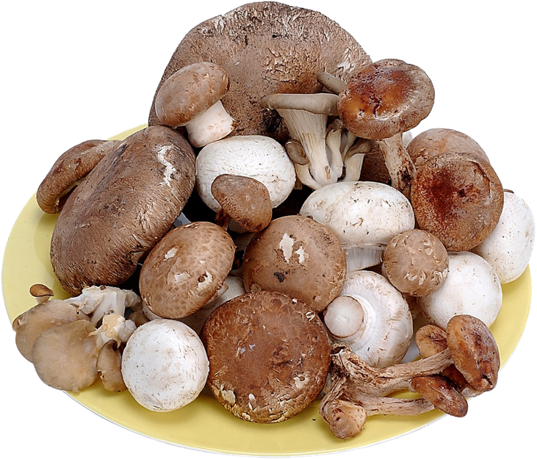
Inflammatory foods include:
Foods with aflatoxins.

Slide 17

Inflammatory foods include:
Foods with aflatoxins.
Some Peanut butter

Slide 18

Fermentation
Alcoholic beverages
Vinegar
Cheese
Sour cream
Yogurt
Soy sauce
Tempeh
Sauerkraut
Salami
Chocolate
Vanilla
Brown rice syrup
Nutritional yeast
Crit Rev Microbiol. 19(3):137-88.

Slide 19

Let’s Put Mold To Work For Us
Mold Is Used To Manufacture:
Citric Acid.
Soy Sauce.
Lovastatin.
Amylases.
Lipases.
And Is Toxic:
Carcinogenic.
Hepatocarcinogenicity.
Immunotoxic.
Nephrotoxin.
Teratogenic.
Methods Mol Biol. 1542:33-49.
Notes:
Perrone G, Gallo A. Aspergillus Species and Their Associated Mycotoxins. Methods Mol Biol. 2017;1542:33-49.
The genus Aspergillus is among the most abundant and widely distributed organism on earth, and at the moment comprises 339 known species. It is one of the most important economically fungal genus and the biotechnological use of Aspergillus species is related to production of soy sauce, of different hydrolytic enzymes (amylases, lipases) and organic acid (citric acid, gluconic acid), as well as biologically active metabolites such as lovastatin. Although they are not considered to be major cause of plant diseases, Aspergillus species are responsible for several disorders in various plants and plant products, especially as opportunistic storage moulds. The notable consequence of their presence is contamination of foods and feeds by mycotoxins, among which the most important are aflatoxins, ochratoxin A, and, at a less extent, fumonisins. Aflatoxins B₁, B₂, G₁, G₂ are the most toxic and carcinogenic mycotoxins, due to their extreme hepatocarcinogenicity; ochratoxin A is a potent nephrotoxin, it is also carcinogenic, teratogenic, and immunotoxic in rats and possibly in humans; fumonisins are hepatotoxic and nephrotoxic with potential carcinogenic effects on rat and mice. In this chapter we summarize the main aspects of morphology, ecology, epidemiology, and toxigenicity of Aspergillus foodborne pathogens which belong to sections Flavi, Circumdati, and Nigri, occurring in several agricultural products and responsible of aflatoxin, ochratoxin A, and fumonisins contamination of food and feed.
https://www.americanscientist.org/article/statins-from-fungus-to-pharma

Slide 20
Estrogenic Effects Of Mycotoxins
The estrogenic effects of mycotoxins in humans and animals include:
Infertility or reduced fertility,
Enlargement of the uterine,
Inflammation of the uterus and cyst formation on the ovaries,
Placental retention,
Vaginal prolapse,
Vulvar swelling
decreased libido,
Vaginitis,
Inflammation of breasts,
Breast enlargement in females,
Miscarriages,
Stillbirths,
Reduced fetal weight, as well as
Decreased milk production.
In men: feminization,
Testicular atrophy,
Decreased spermatogenesis,
Decreased sperm viability,
Male breast enlargement,
Premature puberty.
. Toxins (Basel). 13(1):35.
Notes:
Ropejko K, Twarużek M. Zearalenone and Its Metabolites-General Overview, Occurrence, and Toxicity. Toxins (Basel). 2021 Jan 6;13(1):35.

Slide 21

Miscarriage and Mold
Environmental mold exposure increases risk of miscarriage, loss of pregnancy, or spontaneous abortion.
BMC Pregnancy Childbirth. 14:146.
Notes:
BMC Pregnancy Childbirth. 2014 Apr 23;14:146. doi: 10.1186/1471-2393-14-146.
Seasonal ambient air pollution correlates strongly with spontaneous abortion in Mongolia.
Enkhmaa D, Warburton N, Javzandulam B, Uyanga J, Khishigsuren Y, Lodoysamba S, Enkhtur S, Warburton D1.
Author information
Abstract
BACKGROUND:
Air pollution is a major health challenge worldwide and has previously been strongly associated with adverse reproductive health. This study aimed to examine the association between spontaneous abortion and seasonal variation of air pollutants in Ulaanbaatar, Mongolia.
METHODS:
Monthly average O3, SO2, NO2, CO, PM10 and PM2.5 levels were measured at Mongolian Government Air Quality Monitoring stations. The medical records of 1219 women admitted to the hospital due to spontaneous abortion between 2009-2011 were examined retrospectively. Fetal deaths per calendar month from January-December, 2011 were counted and correlated with mean monthly levels of various air pollutants by means of regression analysis.
RESULTS:
Regression of ambient pollutants against fetal death as a dose-response toxicity curve revealed very strong dose-response correlations for SO2 r > 0.9 (p < 0.001) while similarly strongly significant correlation coefficients were found for NO2 (r > 0.8), CO (r > 0.9), PM10 (r > 0.9) and PM2.5 (r > 0.8), (p < 0.001), indicating a strong correlation between air pollution and decreased fetal wellbeing.
CONCLUSION:
The present study identified alarmingly strong statistical correlations between ambient air pollutants and spontaneous abortion. Further studies need to be done to examine possible correlations between personal exposure to air pollutants and pregnancy loss.
PMID: 24758249
Fertil Steril. 2017 Nov 14. pii: S0015-0282(17)31973-8. doi: 10.1016/j.fertnstert.2017.09.037. [Epub ahead of print]
Ambient air pollution and the risk of pregnancy loss: a prospective cohort study.
Ha S1, Sundaram R2, Buck Louis GM3, Nobles C4, Seeni I4, Sherman S5, Mendola P6.
Author information
Abstract
OBJECTIVE:
To estimate the association of pregnancy loss with common air pollutant exposure. Ambient air pollution exposure has been linked to adverse pregnancy outcomes, but few studies have investigated its relationship with pregnancy loss.
DESIGN:
Prospective cohort study.
SETTING:
Not applicable.
PATIENT(S):
A total of 343 singleton pregnancies in a multisite prospective cohort study with detailed protocols for ovulation and pregnancy testing.
INTERVENTION(S):
None.
MAIN OUTCOME MEASURE(S):
Timing of incident pregnancy loss (from ovulation).
RESULT(S):
The incidence of pregnancy loss was 28% (n = 98). Pollutant levels at women's residences were estimated using modified Community Multiscale Air Quality models and averaged during the past 2 weeks (acute) and the whole pregnancy (chronic). Adjusted Cox proportional hazards models showed that an interquartile range increase in average whole pregnancy ozone (hazard ratio [HR] 1.12, 95% confidence interval [CI] 1.07-1.17) and particulate matter <2.5 μm (HR 1.13, 95% CI 1.03-1.24) concentrations were associated with faster time to pregnancy loss. Sulfate compounds also appeared to increase risk (HR 1.58, 95% CI 1.07-2.34). Last 2 weeks of exposures were not associated with loss.
CONCLUSION(S):
In a prospective cohort of couples trying to conceive, we found evidence that exposure to air pollution throughout pregnancy was associated with loss, but delineating specific periods of heightened vulnerability await larger preconception cohort studies with daily measured air quality.
Copyright © 2017 American Society for Reproductive Medicine. All rights reserved.
KEYWORDS:
Pregnancy loss; air pollution; fetal loss; fine particulate; spontaneous abortion
PMID: 29153729
Rev Med Vet (Toulouse). 1975 Nov;126(11):1371-88.
[Abortifacient agents in the sow].
[Article in English, French, German]
Berthelon M, Tainturier D.
Abstract
PIP:
Abortion in sows may be complete, or much more often partial, since the average litter size is about 10. This review describes the clinical and serological findings, mode of transmission and recommended treatment for the most common parasitic, fungal, mycotoxin, deficient, and toxic causes of abortion in sows. The most likely possibilities in France are brucellosis, leptospirosis, Aujeszky virus, mycotoxin, or dietary deficiencies. The bacterialtion in French sows are Brucella species, Leptospira species, E. coli, streptococci, staphylococci, Pseudomonas, Hemophilus, Corynebacterium pyogenes, salmonellae, Listeria monocytogenes, Mycobacteriumr fetus, Chlamydia and Mycoplasma bovi genitalium. Toxoplasma gondii are parasites known to cause abortion in sows. Mycotoxins from Fusarium species may contaminate feed. Noninfectious causes include poisoning from nitrates, nitrites, estrogens, or insecticides and deficiencies of Vitamins-A, -B, in abortion.
PMID: 12308261
Jpn J Exp Med. 1980 Jun;50(3):167-72.
Effects of fusarenon-X, a trichothecene produced by Fusarium nivale, on pregnant mice and their fetuses.
Ito Y, Ohtsubo K, Saito M.
Abstract
Pregnant DDD female mice received fusarenon-X, a trichothecene mycotoxin produced by Fusarium nivale, by subcutaneous infection or mixed in the diet. An abortion was induced by a single injection of 0.63 to 2.6 mg/kg body weight, with increasing frequency and shortening of the latent period corresponding to the increasing doses given. When the mice were fed with diet containing 5, 10 or 20 ppm throughout pregnancy or early phase of pregnancy, fusarenon-X inhibited embryonal implantation. Seven day-feeding during the middle phase of pregnancy was sufficient to cause abortion in 100% of dams at the concentration of 20 ppm, and at 10 ppm, in 40% of dams. Fetal body weight and length were significantly reduced by administration of the toxin, especially when it was given in the middle or late phase of pregnancy. Teratogenic effects were not apparent as the result of these studies. Direct effect of fusarenon-X on the fetuses may be the cause of embryonal deaths and stillbirths as well as growth retardation.
PMID: 7431674
Vet Rec. 1986 Jan 11;118(2):48-9.
Outbreak of bovine abortion attributed to ergot poisoning.
Appleyard WT.
Abstract
Eleven out of 36 suckler cows, all in late pregnancy, aborted seven to 10 days following introduction to a rye grass pasture heavily infested with ergot. On the basis of known heavy exposure to ergot infested grass and negative findings in a range of other investigations, details of which are given, a diagnosis of ergotism was made.
PMID: 3946070
Schweiz Arch Tierheilkd. 2017 Dec;159(12):647-656. doi: 10.17236/sat00136.
Bacterial, fungal, parasitological and pathological analyses of abortions in small ruminants from 2012-2016.
Schnydrig P1, Vidal S1,2, Brodard I1, Frey C3, Posthaus H4, Perreten V1, Rodriguez-Campos S1.
Author information
Abstract
Abortion in small ruminants presents a clinical and economic problem with legal implications regarding animal health and zoonotic risk by some of the abortive pathogens. Several bacteria, fungi and parasites can cause abortion, but cost-orientated routine diagnostics only cover the most relevant epizootic agents. To cover a broad-range of common as well as underdiagnosed abortifacients, we studied 41 ovine and 36 caprine abortions by Stamp's modification of the Ziehl-Neelsen stain, culture for classical and opportunistic abortive agents, real-time PCR for C. burnetii, C. abortus, pathogenic Leptospira spp., Toxoplasma gondii and Neospora caninum. When the dam's serum was available detection of antibodies against B. melitensis, C. burnetii, C. abortus and Leptospira spp. was performed. In 37 cases sufficient placental tissue was available for pathological and histopathological examination. From the 77 cases 11 (14.3%) were positive by staining whereas real-time PCR detected C. burnetii and C. abortus in 49.3% and 32.5% of the cases. Antibodies against C. abortus and Leptospira spp. (33.3 and 26.7%) were detected. In 23.4% a bacterial culturable pathogen was isolated. Fungal abortion was confirmed in 1.3% of cases. A single abortive agent was identified in 44.2% of the cases and in 31.2% multiple possible abortifacients were present. Our study shows that the highest clarification rate can only be achieved by a combination of methods and evidences the role that multi-infections play as cause of abortion.
KEYWORDS:
Abort; Breitspektrum; Kleinwiederkäuer; Molekulardiagnostik; Tierseuchen; abortion; broadspectrum; epizootics; molecular diagnostics; small ruminants
PMID: 29208582 DOI: 10.17236/sat00136
Free full text
Similar articles
Icon for Gesellschaft Schweizer Tieraerztinnen und TieraerzteIcon for Loma Linda University Libraries
Select item 26316211
2.
Med Mycol. 2015 Nov;53(8):765-97. doi: 10.1093/mmy/myv067. Epub 2015 Aug 26.
Aspergillus and aspergilloses in wild and domestic animals: a global health concern with parallels to human disease.
Seyedmousavi S1, Guillot J2, Arné P3, de Hoog GS4, Mouton JW5, Melchers WJ6, Verweij PE6.
Author information
Abstract
The importance of aspergillosis in humans and various animal species has increased over the last decades. Aspergillus species are found worldwide in humans and in almost all domestic animals and birds as well as in many wild species, causing a wide range of diseases from localized infections to fatal disseminated diseases, as well as allergic responses to inhaled conidia. Some prevalent forms of animal aspergillosis are invasive fatal infections in sea fan corals, stonebrood mummification in honey bees, pulmonary and air sac infection in birds, mycotic abortion and mammary gland infections in cattle, guttural pouch mycoses in horses, sinonasal infections in dogs and cats, and invasive pulmonary and cerebral infections in marine mammals and nonhuman primates. This article represents a comprehensive overview of the most common infections reported by Aspergillus species and the corresponding diseases in various types of animals.
KEYWORDS:
Animals; Aspergillosis; Aspergillus
PMID: 26316211 DOI: 10.1093/mmy/myv067
[Indexed for MEDLINE]
Similar articles
J Egypt Public Health Assoc. 2001;76(1-2):1-16.
Socioenvironmental predictors of abortion and stillbirths in an industrial community in Egypt.
Hafez AS1, Fahim HI, Badawy HA.
Author information
Abstract
Air pollution is considered to be one of the overgrowing problems of cosmopolitan distribution, due to marked progress in industrialization. The applied epidemiological and environmental studies related to reproductive health in the community, are considered as the main principles for comprehensive health development in industrial cities. The present study focused on the role of air pollution on the occurrence of abortion and stillbirths among married fertile women during the childbearing age (15-50 years) in two industrial areas, namely Helwan in Cairo Governorate and Tenth of Ramadan City in Sharqyia Governorate. A cross-sectional epidemiological study based on community background was implemented in the two studied areas. The unit of observation was the family including married fertile women based on specific inclusion criteria. Cluster sampling procedure was used in which the unit of sampling was the household, selected within a radius of not less than five Kilometers around the factories. Using Epi-info program, the total sample size in the two studied areas was 1934 women. The interview questionnaire was the tool adopted for data collection, which includes gynecological and obstetric data related to reproductive health. The socio-economic status of studied women was determined using scoring system that includes the education and occupation of both couples. The environmental study was carried-out in the two areas in order to assess the levels of air pollutants and their chemical nature. Data management using Logistic regression analysis was done to determine the effect of independent variables, such as socioeconomic factor, exposure to air pollutants on the occurrence of abortion and stillbirths as examples of reproductive health problems. The mean age of the studied women was 33.8+/-8.8 years in Helwan and 28.1+/-6.5 years in Tenth of Ramadan. Also the study showed significant differences in both the socioeconomic status, smoking inside houses and parity between the studied women in Helwan and Tenth of Ramadan City. The overall prevalence of abortion and stillbirths among women in the studied areas were 29.2% and 4.5%, respectively. However, the prevalence of such reproductive health hazards among women in Helwan was significantly higher than in Tenth of Ramadan City. Also the results of environmental study indicated that Helwan has higher mean values of total dust count, suspended and respirable dust concentrations as well as lead concentration in the ambient air than in Tenth of Ramadan City. The Logistic regression analysis showed that the respirable dust concentration in the air and smoking inside houses are the significant independent factors for the occurrence of abortion. Moreover, Lead concentration in the air and women education is the main predictors of both abortion and stillbirths. Accordingly, the Egyptian authorities should attempt to improve air quality in urban industrial communities to promote reproductive health and prevent woman' s health hazards.
PMID: 17216978

Slide 22

Breast cancer risk rises by 54% with exposure to environmental molds and their toxic metabolites.
Chemosphere. 128:1-6.
Notes:
Belhassen H, Jiménez-Díaz I, Arrebola JP, Ghali R, Ghorbel H, Olea N, Hedili A. Zearalenone and its metabolites in urine and breast cancer risk: a case-control study in Tunisia. Chemosphere. 2015 Jun;128:1-6.
Zearalenone (ZON) is a non-steroidal estrogenic mycotoxin produced by Fusarium species. The exposure risk to humans and animals is the consumption of contaminated food and animal feeds. It has been reported that ZON and some of its metabolites promote the development of hormone-dependent tumors. The aim of this case-control study was to estimate exposure to ZON and its five metabolites (α-zearalenol [α-ZOL], β-zearalenol [β-ZOL], α-zearalanol [zeranol, α-ZAL], β-zearalanol [teranol, β-ZAL] and zearalanone [ZAN]) by measuring urinary concentrations of these compounds, and to evaluate the risk of breast cancer related to this exposure. Chemical analyses were carried out by liquid-liquid extraction (LLE) and ultra-high performance liquid chromatography with tandem mass spectrometry detection (UHPLC-MS/MS). Statistical analyses were performed in order to determine the association between exposure to these compounds and the development of breast cancer. Crude and adjusted odds ratios (ORs) with 95% confidence intervals (CIs) were calculated by unconditional logistic regression to estimate the magnitude of the associations. The obtained results (adjusted OR=1.54, 95% CI=1.10-2.77) suggest a potential role of α-ZAL in the risk of developing breast cancer.
Wan MLY, Co VA, El-Nezami H. Endocrine disrupting chemicals and breast cancer: a systematic review of epidemiological studies. Crit Rev Food Sci Nutr. 2022;62(24):6549-6576. doi: 10.1080/10408398.2021.1903382. Epub 2021 Apr 5. PMID: 33819127.
Abstract
Background: Endocrine-disrupting compounds (EDCs) are ubiquitous substances that are found in our everyday lives, including pesticides, plasticizers, pharmaceutical agents, personal care products, and also in food products and food packaging. Increasing epidemiological evidence suggest that EDCs may affect the development or progression of breast cancer and consequently lead to lifelong harmful health consequences, especially when exposure occurs during early life in humans. Yet so far no appraisal of the available evidence has been conducted on this topic.
Objective: To systematically review all the available epidemiological studies about the association of the levels of environmental exposures of EDCs with breast cancer risk.
Methods: The search was performed in accordance with the PRISMA guidelines. We retrieved articles from PubMed (MEDLINE) until 10 March 2021. The key words used in this research were: "Endocrine disruptor(s)" OR "Endocrine disrupting chemical(s)" OR any of the EDCs mentioned below AND "Breast cancer" to locate all relevant articles published. We included only cohort studies and case-control studies. All relevant articles were accessed in full text and were evaluated and summarized in tables.
Results: We identified 131 studies that met the search criteria and were included in this systematic review. EDCs reviewed herein included pesticides (e.g. p,p'-dichlorodiphenyltrichloroethane (DDT), p,p'-dichlorodiphenyldichloroethylene (DDE), atrazine, 2,3,7,8-tetrachloridibenzo-p-dioxin (TCDD or dioxin)), synthetic chemicals (e.g. bisphenol A (BPA), phthalates, per- and polyfluoroalkyl substances (PFAS), parabens, polychlorinated biphenyls (PCBs), polybrominated diphenyl ethers (PBDEs), contraceptive pills), phytoestrogens (e.g. genistein, resveratrol), and certain mycotoxins (e.g. zearalenone). Most studies assessed environmental EDCs exposure via biomarker measurements.
Conclusion: We identified certain EDC exposures could potentially elevate the risk of breast cancer. As majority of EDCs are highly persistent in the environment and bio-accumulative, it is essential to assess the long-term impacts of EDC exposures, especially multi-generational and transgenerational. Also, since food is often a major route of exposure to EDCs, well-designed exposure assessments of potential EDCs in food and food packing are necessary and their potential link to breast cancer development need to be carefully evaluated for subsequent EDC policy making and regulations.

Slide 23
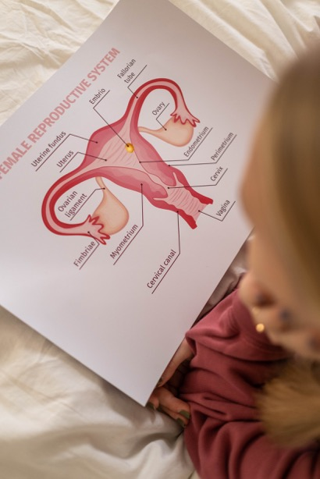
Mold increases cervical cancer risk 6 times
Food Addit Contam Part A Chem Anal Control Expo Risk Assess. 29(2):258-68.
Notes:
The presence of aflatoxin B₁-FAPY adduct and human papilloma virus in cervical smears from cancer patients in Mexico.
Food Addit Contam Part A Chem Anal Control Expo Risk Assess. 2012;29(2):258-68. doi: 10.1080/19440049.2011.647098.
Carvajal M, Berumen J, Guardado-Estrada M.
Author information
Abstract
The carcinogenic biomarker aflatoxin B(1)-formamidopyrimidine 2,3-dihydro-2-(N-formyl)-2',5',6'-triamino-4'-4'-oxy-N-pyrimidyl-3-hydroxy-AFB(1) called AFB(1)-FAPY adduct, and Human Papilloma Virus (HPV) types 16 and 18 were quantified from DNA cervical scrapes from 40 women with cervical cancer (CC) and 14 healthy women as controls. The relationship between the AFB(1)-FAPY adduct and HPV types 16 and 18 was determined. Competitive inhibitory indirect ELISA was validated with 94% inhibition to quantify the AFB(1)-FAPY adducts in picograms per milligram of DNA (limit of detection = 0.1 pg/mg, and limit of quantification = 10 pg/mg), polymerase chain reaction and DNA sequencing to identify HPV types. The average concentration of AFB(1)-FAPY adducts/mg DNA in the CC cases was 1025 pg, 1420 pg with HPV16 and 630 pg sharing HPV18 (p = 0.03). In comparison, healthy controls had ≤ 2.6 pg/mg DNA, a statistically significant difference (p = 0.00006). The presence of AFB(1)-FAPY adduct increased six-fold the risk for CC between cases and controls, the odds ratio was 6.1 (95% CI = 1.4-25.4). There was a close relationship between the AFB(1)-FAPY adducts and HPV16 in CC samples.
PMID: 22273520 [PubMed - indexed for MEDLINE]

Slide 24

60,000 of your friends and neighbors die each year from cancers causes by alcohol: throat, mouth, voice box, liver, colon, prostate and breast.
Maxcy-Rosenau-Last Public Health & Preventive Medicine,13 ed. p.816.
Notes:
75% of esophageal cancers.
50% of mouth and larynx cancers.
30% of liver cancers.
Increases risk of colon, rectal and breast cancer.
60,000 cancer deaths per year related to alcohol.
Maxcy-Rosenau-Last Public Health & Preventive Medicine,13 ed. 1992 p.816.
Eur J Cancer Prev. 2000 Apr;9(2):125-30. Links
Tea and other beverage consumption and prostate cancer risk: a Canadian retrospective cohort study.
Ellison LF.
Cancer Bureau, Laboratory Centre for Disease Control, Tunney's Pasture, Ottawa, Canada. larry_ellison@hc_sc.gc.ca
Using participants in the 1970-1972 Nutrition Canada Survey (NCS), a retrospective cohort study was conducted to assess the relationship between tea, as well as coffee, cola and alcohol, and the risk of developing prostate cancer. The mortality and cancer experience of male NCS participants aged 50-84 years was determined up to 31 December 1993. Among the 3400 survey participants included in the study, 145 developed prostate cancer. No association was observed between tea (predominantly black tea) intake and prostate cancer. Subjects who drank more than 500 ml of tea per day experienced virtually the same risk as those who reported no tea consumption (rate ratio (RR) 1.02, 95% confidence interval (CI) 0.62-1.65). Compared to those who reported no coffee drinking, men who averaged more than 250-ml per day experienced a 40% increase in risk (95% CI 0.84-2.32). Cola consumption was not associated with an increased risk of prostate cancer. Total alcohol consumption was not related to subsequent development of prostate cancer, although very moderate consumption of wine (< 10 g per day), relative to no consumption, showed an RR of 1.48 (95% CI 1.05-2.09). These data do not support an association between consumption of tea and prostate cancer risk.
PMID: 10830580 [PubMed - indexed for MEDLINE

Slide 25
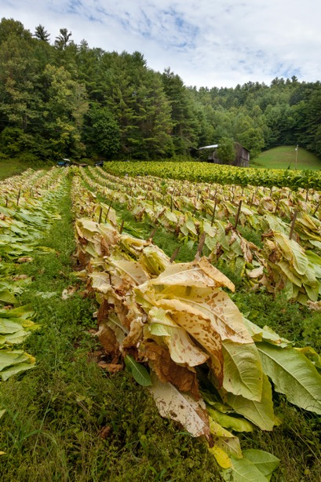
Tobacco
The carcinogenicity of tobacco is due in part to the presence of toxic fungi metabolites accumulated during curing in moldy buildings.
. J Oncol. 2011:819129.
Notes:
Pauly JL, Paszkiewicz G. Cigarette smoke, bacteria, mold, microbial toxins, and chronic lung inflammation. J Oncol. 2011;2011:819129. doi: 10.1155/2011/819129. Epub 2011 Jul 9.
Chronic inflammation associated with cigarette smoke fosters malignant transformation and tumor cell proliferation and promotes certain nonneoplastic pulmonary diseases. The question arises as to whether chronic inflammation and/or colonization of the airway can be attributed, at least in part, to tobacco-associated microbes (bacteria, fungi, and spores) and/or microbial toxins (endotoxins and mycotoxins) in tobacco. To address this question, a literature search of documents in various databases was performed. The databases included PubMed, Legacy Tobacco Documents Library, and US Patents. This investigation documents that tobacco companies have identified and quantified bacteria, fungi, and microbial toxins at harvest, throughout fermentation, and during storage. Also characterized was the microbial flora of diverse smoking and smokeless tobacco articles. Evidence-based health concerns expressed in investigations of microbes and microbial toxins in cigarettes, cigarette smoke, and smokeless tobacco products are reasonable; they warrant review by regulatory authorities and, if necessary, additional investigation to address scientific gaps.

Slide 26
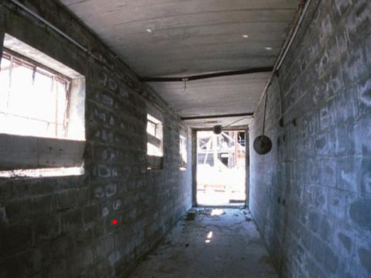
Liver Cancer and Aflatoxin From Mold
Risk of liver cancer skyrockets in the presence of mold and its toxic metabolites!
Zhonghua Yu Fang Yi Xue Za Zhi. 51(6):539-545.
Notes:
Objective: To investigate the association between aflatoxin exposure and primary hepatocellular carcinoma (PHC) development. Methods: From December 2013 to May 2016, we selected 214 patients newly diagnosed with PHC as cases, and 214 patients as controls from three hospitals in Chongqing. Cases were confirmed with PHC diagnosis standard. And cases caused by clear reasons such as drug-induced liver injury, alcoholic liver damage, fatty liver and gallstones etiology, were excluded. Controls were included with no cancer and no digestive system disease, and recruited simultaneously with cases. Cases and controls were frequency-matched (1∶1) by same gender and age (±3 years). Peripheral blood and random urine samples were collected and analyzed for serum HBsAg status by biochemistry analyzer, and serum AFB(1)-ALB adduct and urinary AFB(1)-N(7)-GUA adduct by ELISA. Basic information, living habits and history of disease for patients were obtained by questionnaires. We used wilcoxon rank sum test to compare the median of serum AFB(1)-ALB adduct and urinary AFB(1)-N(7)-GUA adduct in cases and controls. Logistic regression analyses were performed to assess risk factors for PHC, and synergism index (S) of aflatoxin with other factors was estimated by the method of Andersson. Results: There was no significant difference in age between PHC cases (50.74±9.67) years and controls (51.15±9.90) years. Logistic regression showed that the odds ratio of HBV infection for PHC development was 46.3 (95% CI: 23.3-88.0). There was a significant difference in median concentrations of serum AFB(1)-ALB adduct (cases vs controls: 146.23 vs 74.42 ng/g albumin, P<0.001), but no difference in median concentrations of urinary AFB(1)-N(7)-GUA adduct was observed (cases vs controls: 0.17 vs 0.14 ng/mg creatinine, P<0.210). The odd ratios for PHC risk after adjustment were 1.9 (95%CI: 1.1-3.4) for AFB(1)-ALB adduct, and 2.1 (95%CI: 1.0-4.2) for AFB(1)-N(7)-GUA adduct. Moreover, we observed a positive interaction of aflatoxin exposure with HBV, alcohol drinking, and diabetes. The S was 4.7 (95%CI: 2.8-7.9), 3.5 (95%CI: 1.0-12.0), and 12.4 (95%CI: 1.8-84.2), respectively for serum AFB(1)-ALB adduct with each of the three factors mentioned, and was 1.9 (95%CI:1.1-3.1), 2.0 (95%CI: 1.1-3.6), and 2.0 (95%CI: 1.1-3.6), respectively for urinary AFB(1)-N(7)-GUA adduct with each of the three factors mentioned. Conclusion: HBV was still the main risk factor, and AFB(1) exposure was also an independent risk factor for PHC in Chongqing. There was a positive interaction of aflatoxin with HBV, alcohol drinking, and diabetes.
Zheng CF1, Zeng H, Wang J, Lin H, Feng XB, Chen JA, Qiu ZQ, Luo JH, Xu AW, Wang LQ, Tan Y, Chen S, Jiang P, Shu WQ. The association between aflatoxin exposure and primary hepatocellular carcinoma risks: a case-control study in Chongqing. Zhonghua Yu Fang Yi Xue Za Zhi. 2017 Jun 6;51(6):539-545. PMID: 28592100

Slide 27
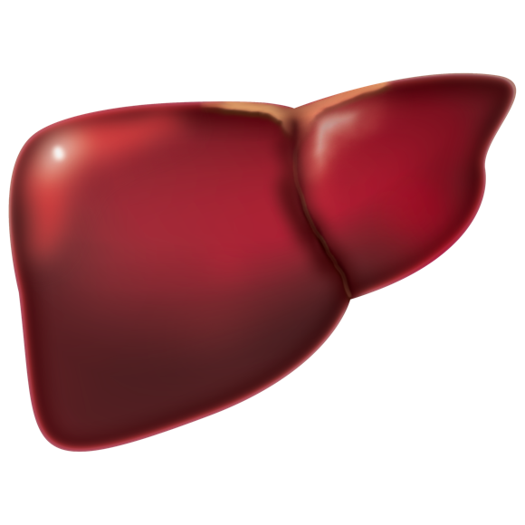
Liver cancer: mold and hepatitis B or C
Risk of liver cancer from Hepatitis B virus infection is bad enough, but add mold toxins and the risk goes up 60 times!
. Gastroenterology. 142(6):1264-1273.e1.
Notes:
El-Serag HB. Epidemiology of viral hepatitis and hepatocellular carcinoma. Gastroenterology. 2012 May;142(6):1264-1273.e1. doi: 10.1053/j.gastro.2011.12.061.
Most cases of hepatocellular carcinoma (HCC) are associated with cirrhosis related to chronic hepatitis B virus (HBV) or hepatitis C virus (HCV) infection. Changes in the time trends of HCC and most variations in its age-, sex-, and race-specific rates among different regions are likely to be related to differences in hepatitis viruses that are most prevalent in a population, the timing of their spread, and the ages of the individuals the viruses infect. Environmental, host genetic, and viral factors can affect the risk of HCC in individuals with HBV or HCV infection. This review summarizes the risk factors for HCC among HBV- or HCV-infected individuals, based on findings from epidemiologic studies and meta-analyses, as well as determinants of patient outcome and the HCC disease burden, globally and in the United States.
Areas in which AFB1 exposure is an environmental problem also have a high prevalence of
chronic HBV infection. Although AFB1 might contribute to hepatocarcinogenesis by other
mechanisms, its role in pathogenesis of HCC is primarily mediated by its effects on chronic
HBV infection. For example, prospective studies in Shanghai, China showed that urinary
excretion of aflatoxin metabolites increased the risk of HCC up to 4-fold, and HBV infection
increased the risk 7-fold. However, individuals who excreted AFB1 metabolites and were
carriers of HBV had as much as a 60-fold increase in risk of HCC22. Importantly, prevention
of HBV-related HCC would reduce the effects of aflatoxin on HCC risk.

Slide 28
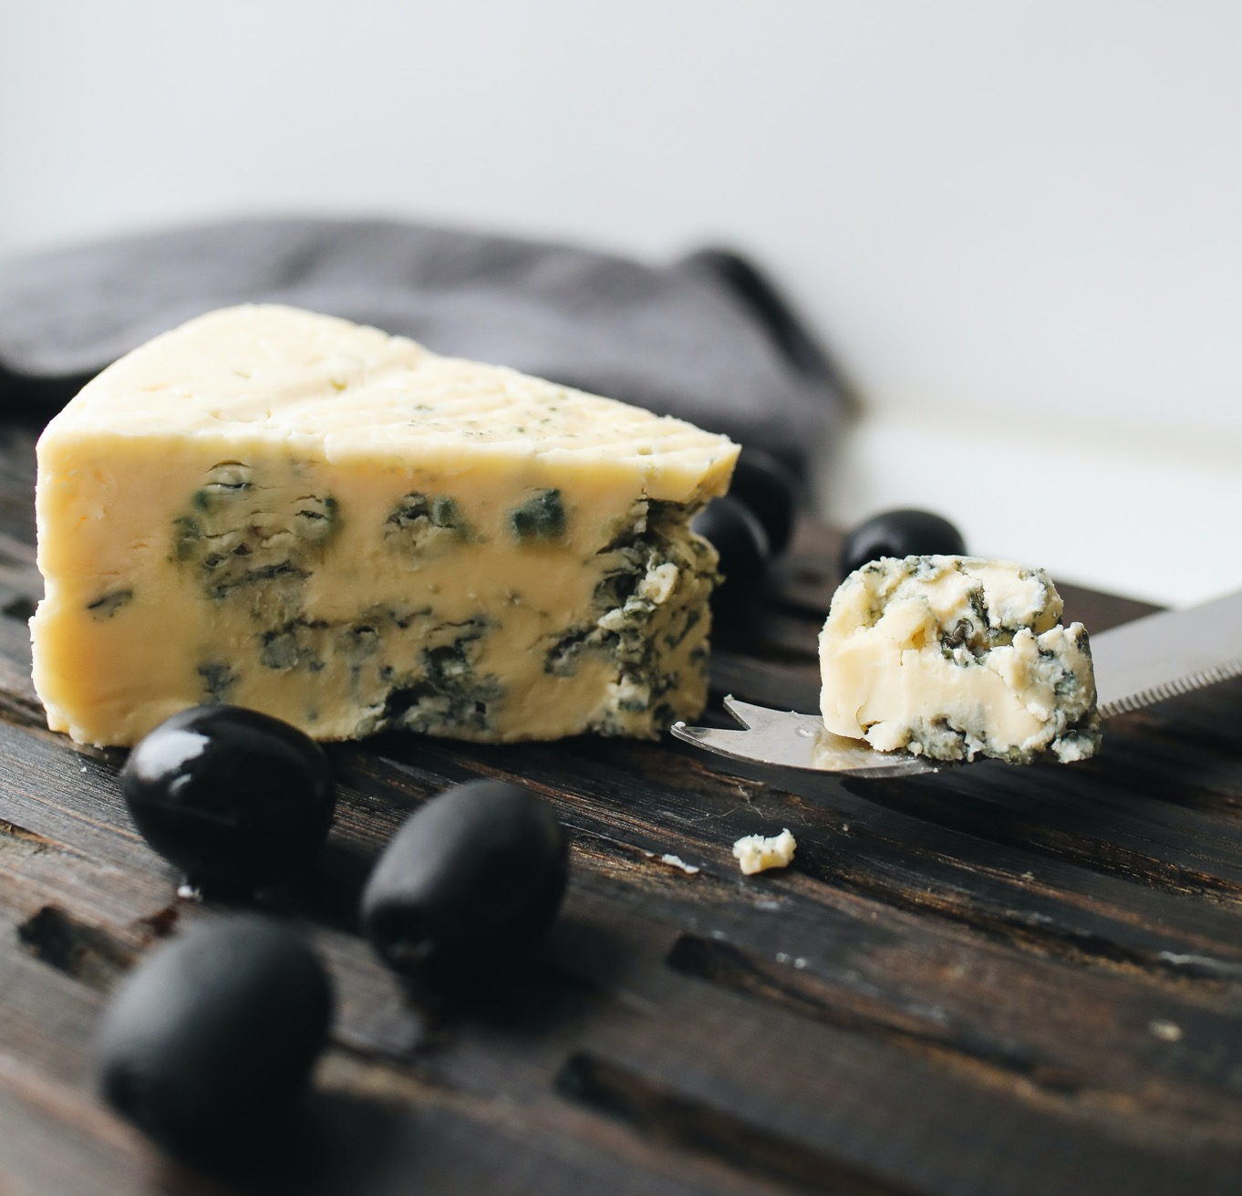
Throw the moldy food out!
Eating foods containing mold nearly doubles the risk of stomach cancer.
Asian Pac J Cancer Prev. 16(1):283-90.
Notes:
Somi MH, Mousavi SM, Naghashi S, Faramarzi E, Jafarabadi MA, Ghojazade M, Majidi A, Naseri Alavi SA. Is there any relationship between food habits in the last two decades and gastric cancer in North-Western Iran? Asian Pac J Cancer Prev. 2015;16(1):283-90.

Slide 29

Consumption of specialty cheeses increased the risk of gastric cancer by 12.6 fold.
Asian Pac J Cancer Prev. 16(1):283-90
Notes:
Somi MH, Mousavi SM, Naghashi S, Faramarzi E, Jafarabadi MA, Ghojazade M, Majidi A, Naseri Alavi SA. Is there any relationship between food habits in the last two decades and gastric cancer in North-Western Iran? Asian Pac J Cancer Prev. 2015;16(1):283-90.
In this study, over-eating, consumption of high fat milk and yogurt and especial types of cheese increased the risk of gastric cancer (All<0.05). Consumption of such especial cheeses such as Koze and Khiki increased the risk of gastric cancer by 12.6 fold (95% CI:1.99-79.36) and 7.36 fold (95% CI:1.33- 40.54), respectively. In addition, high fat food, moldy food, and pickled vegetables consumption as well as reuse of cooking oil for frying were significantly associated with gastric cancer risk. Furthermore, intake of Ghorme (deep fried meat) was positively correlated with gastric cancer risk (OR:1.31;95%CI: 0.91-1.87).

Slide 30
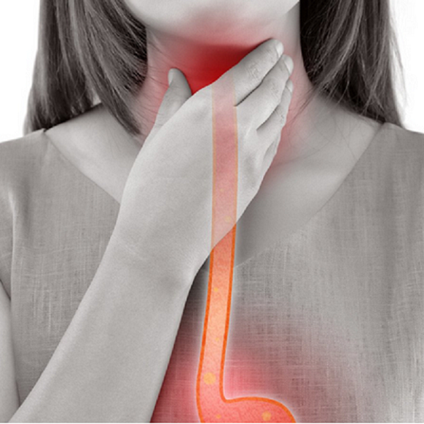
Esophageal Cancer Increased by Mold Exposure
Foods contaminated with molds such as wheat, corn and barley, increase esophageal cancer risk.
Toxins (Basel). 12(5):299
Notes:
Ghasemi-Kebria F, Joshaghani H, Taheri NS, Semnani S, Aarabi M, Salamat F, Roshandel G. Aflatoxin contamination of wheat flour and the risk of esophageal cancer in a high risk area in Iran. Cancer Epidemiol. 2013 Jun;37(3):290-3.
Wang S, Pan D, Zhang T, Su M, Sun G, Wei J, Guo Z, Wang K, Song G, Yan Q. Corn Flour Intake, Aflatoxin B₁ Exposure, and Risk of Esophageal Precancerous Lesions in a High-Risk Area of Huai'an, China: A Case-Control Study. Toxins (Basel). 2020 May 6;12(5):299.
Sun G, Wang S, Hu X, Su J, Zhang Y, Xie Y, Zhang H, Tang L, Wang JS. Co-contamination of aflatoxin B1 and fumonisin B1 in food and human dietary exposure in three areas of China. Food Addit Contam Part A Chem Anal Control Expo Risk Assess. 2011 Apr;28(4):461-70.
Wang YP, Han XY, Su W, Wang YL, Zhu YW, Sasaba T, Nakachi K, Hoshiyama Y, Tagashira Y. Esophageal cancer in Shanxi Province, People's Republic of China: a case-control study in high and moderate risk areas. Cancer Causes Control. 1992 Mar;3(2):107-13.

Slide 31
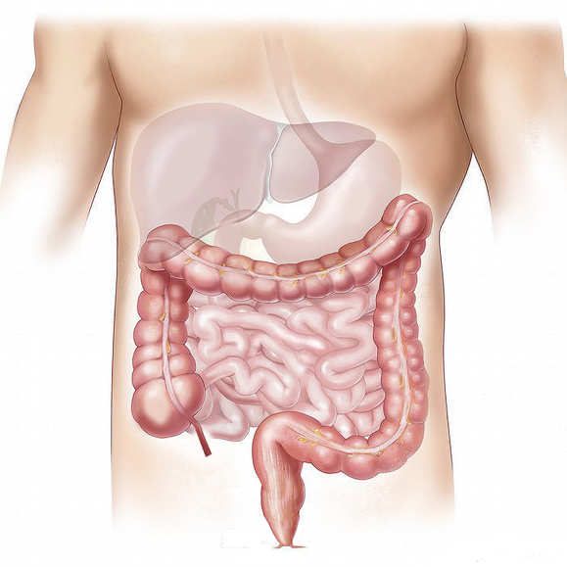
Gut Mold Connection
Gastrointestinal infections are associated with the presence of mold and mildew.
Int J Environ Res Public Health. 15(12):2827.
Notes:
gastrointestinal infections are associated with the presence of mould and mildew
Ali SH, Foster T, Hall NL. The Relationship between Infectious Diseases and Housing Maintenance in Indigenous Australian Households. Int J Environ Res Public Health. 2018 Dec 11;15(12):2827.

Slide 32

Mold exposure increases inflammation and causes leaky gut syndrome.
Toxicol Lett333:159 -169.
Notes:
Jia R, Liu W, Zhao L, Cao L, Shen Z. Low doses of individual and combined deoxynivalenol and zearalenone in naturally moldy diets impair intestinal functions via inducing inflammation and disrupting epithelial barrier in the intestine of piglets. Toxicol Lett. 2020 Oct 15;333:159-169.
The intestinal epithelium is the first barrier against food contaminants and is highly sensitive to Fusarium toxins, especially deoxynivalenol (DON) and zearalenone (ZEA). Here, we explored the effects of low doses of DON and/or ZEA in naturally moldy diets on intestinal functions in piglets, including inflammatory responses, epithelial barrier, and microbial composition. Piglets were treated with a control diet (CON), DON diet (1000.6 μg/kg), ZEA diet (269.1 μg/kg), and DON + ZEA diet (1007.5 + 265.4 μg/kg), respectively, for 3 weeks and then switched to the same CON diet for another 2 weeks. In the first period, even the selected low doses of DON or ZEA in the diet resulted in intestinal inflammation, diminish protein expression (claudin-4) and altered gut microbiota populations. Whereas upon switching to the CON diet for another 2 weeks, the deleterious effect of ZEA and DON on IL-1β and Bifidobacterium population could not be recovered. Additionally, combined DON and ZEA negatively affected body weight gain and feed consumption of piglets, as well as shown synergistic effects on evoking pro-inflammatory cytokines contents (TNF-α, IL-1β, and IL-6) and perturbing the cecum microbiota profile (E. coli, Lactobacillus, and Bifidobacterium). Collectively, chronic consumption of DON and ZEA contaminated feed or food, even at low doses, can induce intestinal damage and may have consequences for animal and human health.

Slide 33

Allergic Rhinitis
Studies have repeatedly demonstrated that sensitization to fungi, such as Alternaria, is strongly associated with allergic rhinitis.
Environ Health Perspect. 2005 Oct;113(10):1405-9.
Notes:
Stark PC, Celedón JC, Chew GL, Ryan LM, Burge HA, Muilenberg ML, Gold DR. Fungal levels in the home and allergic rhinitis by 5 years of age. Environ Health Perspect. 2005 Oct;113(10):1405-9.
Studies have repeatedly demonstrated that
sensitization to fungi, such as Alternaria, is
strongly associated with allergic rhinitis and
asthma in children

Slide 34

Skeletons in Your Closet?
Mold in the environment increases the risk of autoimmune inflammatory: 180% for the lungs and 360% for joints.
Mycopathologia. 69(1-2):67-81. Clin Allergy. 6(3):209-17.
Allergy. 56(3):224-30. Ann Rheum Dis. 60(10):934-9.
Notes:
Shade trees and shrubbery close and dense around a house, leaves decaying.
A yard beautified with scattering trees and some shrubbery, at a proper distance from the house, has a happy influence upon the family, and, if well taken care of, will prove no injury to the health. But shade trees and shrubbery close and dense around a house, make it unhealthful; for they prevent the free circulation of air, and shut out the rays of the sun. In consequence, a dampness gathers in the house, especially in wet seasons. Those who occupy the sleeping-rooms are troubled with rheumatism, neuralgia, and lung complaints. Then the great quantities of fallen leaves, if not removed immediately, decay, and poison the atmosphere. Dwellings, if possible, should be built on high ground. If a house is built where the water will settle around it, remaining for a time and slowly drying away, there is a poisonous miasma continually rising from the damp ground, which breeds sore throat, fevers, ague, or lung diseases. {CTBH 107.2}
Many expect that God will keep them from sickness merely because they ask him to do so. But the prayers of those who do not regard the laws of life, God cannot answer, because their faith is not made perfect by works. When we do all on our part to insure health, then we may expect that good results will follow, and we can ask God in faith to bless our efforts. And he will answer our prayer, if his name can be glorified thereby. But let all understand that they have a work to do. God will not work in a miraculous manner to preserve the health of persons who are, by their careless inattention to the laws of health, taking a sure course to make themselves sick. {CTBH 108.1}
Mycopathologia. 1979 Nov 30;69(1-2):67-81.
Related Articles, Links
A guide to the recent literature on aspergillosis as caused by Aspergillus fumigatus, a fungus frequently found in self-heating organic matter.
Marsh PB, Millner PD, Kla JM.
Spores of Aspergillus fumigatus have been found to be abundantly present in the outdoor air at a site where large scale experimental composting of sewage sludge is in progress at Beltsville, Maryland. The health significance of this finding, for that site and for others in the future, is still only incompletely understood. Further studies are in progress to characterize absolute concentrations of the spores of the fungus in air at the site, spore dispersal by air from composting operations, and background environmental spore levels in air. The present paper contains a list of references to papers on health effects of A. fumigatus, many published in the past ten years, along with a review of the same designed to assist the reader in finding information on particular aspects of the subject in the literature. It is intended primarily as an aid to individuals interested in sludge composting and wishing to attain an insight into the A. fumigatus-composting situation, but it may also interest others concerned with other substrates which become moldy at 40--50 C. A. fumigatus has been found in great numbers in naturally and artificially heated environments such as decaying leaves, compost heaps, solar heated sloughs, cooling canals for nuclear power generators, silos, grain storage bins, boiler rooms, detritus around steam turbines and sauna baths. The evident practical merits of sludge composting have been described elsewhere; the information presented here has its main significance in respect to requirements for choice of locations for composting sites and to process and design criteria.
Publication Types:
* Bibliography
* Review
PMID: 396477 [PubMed - indexed for MEDLINE]
2: Clin Allergy. 1976 May;6(3):209-17.
Related Articles, Links
Sources and incidence of airborne Aspergillus fumigatus (Fres).
Mullins J, Harvey R, Seaton A.
Specific surveys of the air for Aspergillus fumigatus were carried out in rural and urban situations over a 2-year period. Overall, low concentrations of spores were recorded with a higher incidence during the "winter" months. Counts in the open air and in a hospital ward showed similar fluctuations, the indoor counts being consistently lower. Plant debris in the form of compost heaps and stacks of hay and straw baled with a high moisture content in which self-heating occurs, produces large numbers of spores which may be liberated into the air causing high but localized counts if disturbed. The widespread distribution of decaying leaves following leaf fall represents a potential source of smaller concentrations of spores but over a much larger area. This availability of decaying plant debris with high water content fulfils the growth requirements of Aspergillus fumigatus and is the probable explanation of its winter seasonality.
PMID: 780000 [PubMed - indexed for MEDLINE]
Dampness in the house
Even affliction has not caused me to cease writing. Not long after going to Australia, I was stricken with disease. Because of the dampness of the houses, I suffered an attack of inflammatory rheumatism, which prostrated me for eleven months. At times I was in intense agony. I could sleep in one position for only about two hours, then I had to be moved so that I could lie in another position. My rubber air mattress gave me very little relief, and I passed through periods of great suffering. {1SM 104.3}
My mind goes back to Oak Hill Cemetery in Battle Creek, Michigan. I see there two graves. My noble first-born son fills the long grave. Next comes a short grave where lies my darling babe, my last-born. The first died of inflammation of the lungs after a sickness of eight days, in consequence of thoughtlessly resting his head upon a pile of damp charts and falling asleep. The second died from sleeping in a room that had not been used for two weeks. A fire was kept burning for two hours in this room which was thought sufficient to warm it. The bed had accumulated dampness. Myself and child took cold; he was a great sufferer for four weeks, and died in consequence of that damp bed.
{HR, February 1, 1874 par. 13}
In all Australia we have but one meeting house where we can worship God. This one has been erected in Parramatta, a town near Sydney, where a company has recently been raised up to obey the truth. All our other churches are dependent upon hired halls in which to hold their meetings. In winter these are so cold and damp that I am unable to meet with the churches, and I know that many endanger health and life in these places. During the winter they are not safe for even the Australians themselves. Some who are full of blood in good circulation may endure this tax with no special ill effects, but for women and children and those who are rheumatic or have lung difficulties, it is presumption to remain in these places during divine services. {GCDB, January 28, 1893 par. 7}
At the first two places we visited, we took severe colds by sleeping in their damp, unused beds, and we suffered greatly with rheumatism; but tried to fill our appointments. In the third damp bed, we lay nearly one hour trying to get warm; but the clothing was literally wet. We were under the unpleasant necessity of calling our friends; for we felt that it would be positively fatal to life and health to remain in that damp bed. Our friends cheerfully renewed their fires, and the bedding was removed from the bed and thoroughly dried. {HR, January 1, 1872 par. 5}
We returned home from that journey, and exposure, to suffer for months. I feared that I should be a cripple for life. My husband was afflicted with pain in the chest and lungs, and he had a severe cough for months. After three months of almost helpless suffering, and careful treatment, by the mercy of God, I was able to walk. {HR, January 1, 1872 par. 6}
I observe in California that many, during the rainy season, are suffering with colds, catarrh, sore throat, lung difficulties, neuralgia, and rheumatism. I can understand the reason of these maladies. The main parts of most of the houses are destitute of fire-places and stoves. In the rainy season dampness must affect rooms that have no fires. These sleeping apartments cannot be dried in continuous wet weather. The bedding must become damp, and will be musty unless dried before a fire. This is seldom done. In addition to this neglect of fires in sleeping apartments, air and light are generally excluded by closed windows and heavy curtains. But few seem to understand that the air in these closed rooms becomes impure and unfit for the lungs. Those who occupy such apartments cannot have health. The emanations from damp, moldy rooms and clothing are poisonous to the system. {HR, February 1, 1874 par. 6}
Many seem to think that if they exclude the air from their rooms because it is damp and foggy, they have an atmosphere in their houses perfectly safe to breathe. But we have to breathe in damp and foggy days as well as in pleasant, sunny weather. We must accept the air which God gives us, which is subject to atmospheric changes, sometimes dry and invigorating, while again it is damp, chill, and penetrating. We must meet these changes as they come, and make provision the best we can to guard ourselves from the effects of damp and chilly atmosphere, and not subject ourselves to a greater evil by breathing air over and over again that has lost its vital properties. {HR, February 1, 1874 par. 7}
I find it almost impossible to convince those who are accustomed to live in rooms from which the fresh air has been excluded, of the unhealthfulness of such rooms. Like faithful sentinels they guard windows and doors as if fearful the impure air would escape and fresh air take its place. When we enter such houses the confined air of unventilated rooms meets us with sickening odors of mildew and mold, and the impurities exhaled from its inmates. I could not live in such an atmosphere. It is painful for me to remain there even but a short time. {HR, February 1, 1874 par. 8}
During the rainy season in California, or anywhere else, when the sun does shine, we should make the most of it. Every room in our dwellings should be daily thrown open to the healthful rays of the sun, and the purifying air should be invited in. This will be a preventive of disease. We would say to our friends, If you think that clouds and rain bring dampness and endanger health, God sends to you his blessed, healthful sunshine, and pure, dry air. Will you welcome these great blessings by opening to these guests every room in your dwellings? If all would appreciate the sunshine, and expose every article of clothing to its drying, purifying rays, mildew and mold would be prevented. {HR, February 1, 1874 par. 9}
The idea that night air is unhealthful and must be excluded from our sleeping apartments, is a mistake. In the night God designed that we should breathe night air, for we have no other. Our Creator would not make night air dangerous to health and yet compel us to breathe it. Night air is as healthy for us to breathe in the night as day air is in the day. {HR, February 1, 1874 par. 10}
I plead for fresh air in the night--fresh air during the day--in storm as well as in sunshine. It is certainly more pleasurable to have days of sunshine than those that are damp and foggy. But we must breathe in damp, unpleasant weather as well as in sunshine. We should labor to have the air in our houses pure as possible. Even during the rainy season of California, I shall plead for fresh air, and to be excused from sleeping in the spare bed. {HR, February 1, 1874 par. 11}
Those who occupy the same beds every night near a fire cannot understand the dangers of that spare bed. If they think that there is needless fear of it, we propose that they take the spare bed, and let their visitors sleep in their beds, and thus test the matter. After they have tried this a few times, they may become enlightened in regard to the danger of that spare bed. {HR, February 1, 1874 par. 12}
My mind goes back to Oak Hill Cemetery in Battle Creek, Michigan. I see there two graves. My noble first-born son fills the long grave. Next comes a short grave where lies my darling babe, my last-born. The first died of inflammation of the lungs after a sickness of eight days, in consequence of thoughtlessly resting his head upon a pile of damp charts and falling asleep. The second died from sleeping in a room that had not been used for two weeks. A fire was kept burning for two hours in this room which was thought sufficient to warm it. The bed had accumulated dampness. Myself and child took cold; he was a great sufferer for four weeks, and died in consequence of that damp bed. {HR, February 1, 1874 par. 13}
Ann Rheum Dis. 2001 Oct;60(10):934-9.Related Articles, Links
Erratum in:
Ann Rheum Dis 2001 Dec;60(12):1161.
Comorbidity and lifestyle, reproductive factors, and environmental exposures associated with rheumatoid arthritis.
Reckner Olsson A, Skogh T, Wingren G.
Division of Occupational and Environmental Medicine, Department of Health and Environment, Faculty of Health Sciences, Linköping University, Sweden. asa.reckner-olsson@ymk.liu.se
OBJECTIVE: To evaluate the influence of lifestyle, reproduction, and some external factors on the development of rheumatoid arthritis (RA) and to describe its comorbidity. METHODS: Cases were identified retrospectively from 1980 to 1995 at the University Hospital in Linköping, Sweden. The study comprised 422 cases and 859 randomly selected population referents. Data on possible aetiological factors and comorbidity were collected by postal questionnaire. RESULTS: The response rates were 67% among cases and 59% among referents. A decrease in the occurrence of atopic allergy was seen in the cases (odds ratio (OR) 0.6, 95% confidence interval (CI) 0.4 to 1.0). There was a positive association between RA and insulin treatment (OR 10.2, 95% CI 1.7 to 60.8) in women, and women with a short fertile period had an increased risk of RA (OR 2.5, 95% CI 1.1 to 5.4). Current and previous smoking were associated with increased risks for RA in both sexes, and in men a dose-response relationship was found with number of tobacco pack years (p for trend <0.005). The risk for RA decreased with increasing level of education in both men and women. Increased risks were seen in men born into households with private wells (OR 2.8, 95% CI 1.5 to 5.2), residentially exposed to mould (OR 4.6, 95% CI 1.1 to 20.2), or exposed to farm animals (OR 3.3, 95% CI 0.7 to 16.6). In women there were positive associations between RA and reporting a previous joint injury (OR 2.5, 95% CI 1.0 to 6.6) and prolonged exposure to hair dyes (OR 1.9, 95% CI 0.8 to 4.5). CONCLUSIONS: RA, a disease with features of T helper 1 (Th1) dominated immune response, was inversely associated with atopic allergy, a Th2 dominated condition, while there were indications of a strong positive association with Th1 related diabetes mellitus. The results support a causal relationship between smoking and RA. The level of education was inversely associated with RA, while there was a positive association between RA and certain residential factors in men and a short fertile period in women.
Publication Types:
Research Support, Non-U.S. Gov't
PMID: 11557649 [PubMed - indexed for MEDLINE]
PMCID: PMC1753392
Arch Environ Health. 2003 Jul;58(7):410-20. Related Articles, Links
Mixed mold mycotoxicosis: immunological changes in humans following exposure in water-damaged buildings.
Gray MR, Thrasher JD, Crago R, Madison RA, Arnold L, Campbell AW, Vojdani A.
Progressive Healthcare Group, Benson, Arizona, USA. docmike007@aol.com
The study described was part of a larger multicenter investigation of patients with multiple health complaints attributable to confirmed exposure to mixed-molds infestation in water-damaged buildings. The authors present data on symptoms; clinical chemistries; abnormalities in pulmonary function; alterations in T, B, and natural killer (NK) cells; the presence of autoantibodies (i.e., antinuclear autoantibodies [ANA], autoantibodies against smooth muscle [ASM], and autoantibodies against central nervous system [CNS] and peripheral nervous system [PNS] myelins). A total of 209 adults, 42.7 +/- 16 yr of age (mean +/- standard deviation), were examined and tested with (a) self-administered weighted health history and symptom questionnaires; (b) standardized physical examinations; (c) complete blood counts and blood and urine chemistries; (d) urine and fecal cultures; (e) thyroid function tests (T4, free T3); (f) pulmonary function tests (forced vital capacity [FVC], forced expiratory volume in 1 sec [FEV1.0], and forced expiratory flow at 25%, 50%, 75%, and 25-75% of FVC [FEF25, FEF50, FEF75, and FEF2(25-75)]); (g) peripheral lymphocyte phenotypes (T, B, and NK cells) and mitogenesis determinations; and (h) a 13-item autoimmune panel. The molds-exposed patients reported a greater frequency and intensity of symptoms, particularly neurological and inflammatory symptoms, when compared with controls. The percentages of exposed individuals with increased lymphocyte phenotypes were: B cells (CD20+), 75.6%; CD5+CD25+, 68.9%; CD3+CD26+, 91.2%; CD8+HLR-DR+, 62%; and CD8+CD38+, 56.6%; whereas other phenotypes were decreased: CD8+CD11b+, 15.6% and CD3-CD16+CD56+, 38.5%. Mitogenesis to phytohemagglutinin was decreased in 26.2% of the exposed patients, but only 5.9% had decreased response to concanavalin A. Abnormally high levels of ANA, ASM, and CNS myelin (immunoglobulins [Ig]G, IgM, IgA) and PNS myelin (IgG, IgM, IgA) were found; odds ratios for each were significant at 95% confidence intervals, showing an increased risk for autoimmunity. The authors conclude that exposure to mixed molds and their associated mycotoxins in water-damaged buildings leads to multiple health problems involving the CNS and the immune system, in addition to pulmonary effects and allergies. Mold exposure also initiates inflammatory processes. The authors propose the term "mixed mold mycotoxicosis" for the multisystem illness observed in these patients.
Publication Types:
Clinical Trial
Controlled Clinical Trial
Multicenter Study
PMID: 15143854 [PubMed - indexed for MEDLINE]
Eur Respir J. 1996 Dec;9(12):2618-22. Related Articles, Links
Home dampness, moulds and their influence on respiratory infections and symptoms in adults in Finland.
Pirhonen I, Nevalainen A, Husman T, Pekkanen J.
Dept of Environmental Epidemiology, National Public Health Institute, Kuopio, Finland.
The aim of this study was to analyse the prevalence of mouldy homes and their association with respiratory symptoms and diseases in a subarctic climate. A questionnaire was mailed to a random sample of 2,000 males and females, aged 25-64 yrs, living in the county of Kuopio, Finland. A total of 1,521 (76%) responded and 1,460 were selected for the final analysis. The prevalence of homes with visible mould was 4%; with the odour of mould 5%; with damp spots, visible mould or the odour of mould 15%; and with moisture/ water damage, damp spots, visible mould or the odour of mould 23%. The number of reports of bronchitis, common cold, atopy, allergic rhinitis, rhinitis, fever and chills, hoarseness, fatigue, difficulties in concentration, lumbar backache and stomach ache were strongly associated with living in a damp home. Bronchitis, hoarseness and difficulties in concentration had the strongest associations, with adjusted odds ratios (95% confidence limits) of: 2.04 (1.49-2.78), 2.23 (1.37-3.63) and 2.17 (1.35-3.50), respectively. After controlling for a possible reporting bias by excluding those subjects reporting lumbar backache and recurrent stomach pain, eye irritation and tiredness remained significant. In conclusion, living in a home with mould problems may increase the risk of respiratory infections and symptoms in adults.
PMID: 8980978 [PubMed - indexed for MEDLINE]
Allergy. 2001 Mar;56(3):224-30.Click here to read Links
Involvement of urban living environments in atopy and enhanced eosinophil activity: potential risk factors of airway allergic symptoms.
Kuwahara Y, Kondoh J, Tatara K, Azuma E, Nakajima T, Hashimoto M, Komachi Y.
Department of Social and Environmental Medicine, Osaka University Medical School, Japan.
BACKGROUND: Airway allergic diseases, such as bronchial asthma and allergic rhinitis, have increased, especially in urban areas. These diseases are characterized by airway inflammation with enhanced eosinophil activity, and the risk of disease development has been shown to increase with the prevalence of atopy. METHODS: Questionnaires were administered to 426 healthy adult women aged 30-74 years, living in an urban area of Osaka, Japan, to survey individual living environments and airway allergic symptoms such as cough, sputum, and wheezing. Moreover, serum house-dust-mite (Dermatophagoides pteronyssinus, [Der p])-specific immunoglobulin E (IgE) and serum eosinophil cationic protein (ECP) were examined by radioimmunoassay, and the atopic status (atopic sensitization) and enhanced eosinophil activity were assessed as Der p-specific IgE RAST scores of 2-6 and ECP levels of more than 10 ng/ml, respectively. RESULTS: Intensive use of electric air conditioners in hot weather (odds ratio: 2.07 [95% CI: 1.11-3.87]) and mold proliferation in the kitchen (2.77 [1.34-5.73]) significantly increased the risk of atopic sensitization. Poor home ventilation and family smoking appeared to be positively but not significantly associated with atopic sensitization. Personal smoking and intensive use of the air conditioner appeared to be positively related to enhanced eosinophil activity. Atopic status showed significant involvement in the development of wheezing, and the development of cough was significantly associated with enhanced eosinophil activity. CONCLUSIONS: The results suggest that some urban styles of living are involved in atopic sensitization and enhanced eosinophil activity in the Japanese urban population, probably due to living conditions, such as indoor dampness and poor home ventilation, caused by tight insulation, which increase exposure to indoor air pollutants, such as respirable mite allergens and tobacco smoke.
PMID: 11251402 [PubMed - indexed for MEDLINE]
Inhal Toxicol. 2002 Dec;14(12):1261-77.
Related Articles, Links
Click here to read
Spores of Aspergillus versicolor isolated from indoor air of a moisture-damaged building provoke acute inflammation in mouse lungs.
Jussila J, Komulainen H, Kosma VM, Nevalainen A, Pelkonen J, Hirvonen MR.
Laboratory of Toxicology, National Public Health Institute, PO Box 95, FIN-70701 Kuopio, Finland. Juha.Jussila@ktl.fi
Microbial growth in moisture-damaged buildings has been associated with respiratory health effects, and the spores of the mycotoxin producing fungus Aspergillus versicolor are frequently present in the indoor air. To characterize the potential of these spores to cause harmful respiratory effects, mice were exposed via intratracheal instillation to a single dose of the spores of A. versicolor (1 x 10(5), 1 x 10(6), 5 x 10(6), 1 x 10(7), or 1 x 10(8) spores), isolated from the indoor air of a moisture-damaged building. Inflammation and toxicity in lungs were evaluated 24 h later by assessment of biochemical markers and histopathology. The time course of the effects was investigated with the dose of 5 x 10(6) spores for up to 28 days. The exposure to the spores increased transiently proinflammatory cytokine levels (tumor necrosis factor [TNF] alpha and interleukin [IL]-6) in bronchoalveolar lavage fluid (BALF). The cytokine responses were dose and time dependent. The highest cytokine concentrations were measured at 6 h after the dose, and they returned to the control level by 3 days. Moreover, the spores of A. versicolor recruited inflammatory cells into airways: Neutrophils peaked transiently at 24 h, macrophages at 3 days, and lymphocytes at 7 days after the dosing. The inflammatory cell response did not completely disappear during the subsequent 28 days, though no histopathological changes were seen at that time point. The spores did not induce expression of inducible nitric oxide synthase in lavaged cells. Only the highest spore dose (1 x 10(8)) markedly increased serum IL-6, increased vascular leakage, and caused cytotoxicity (i.e., increased levels of albumin, total protein, lactate dehydrogenase [LDH], and hemoglobin in BALF) in the airways. In summary, the spores of A. versicolor caused acute inflammation in mouse lungs. This indicates that they have potential to provoke adverse health effects in the occupants of moisture-damaged buildings.
Publication Types:
* Research Support, Non-U.S. Gov't
PMID: 12454790 [PubMed - indexed for MEDLINE]
2: Environ Health Perspect. 2002 Nov;110(11):1119-25.
Related Articles, Links
Click here to read Click here to read
Mycobacterium terrae isolated from indoor air of a moisture-damaged building induces sustained biphasic inflammatory response in mouse lungs.
Jussila J, Komulainen H, Huttunen K, Roponen M, Iivanainen E, Torkko P, Kosma VM, Pelkonen J, Hirvonen MR.
Laboratory of Toxicology, National Public Health Institute, Kuopio, Finland. Juha.Jussila@ktl.fi
Occupants in moisture-damaged buildings suffer frequently from respiratory symptoms. This may be partly due to the presence of abnormal microbial growth or the altered microbial flora in the damaged buildings. However, the specific effects of the microbes on respiratory health and the way they provoke clinical manifestations are poorly understood. In the present study, we exposed mice via intratracheal instillation to a single dose of Mycobacterium terrae isolated from the indoor air of a moisture-damaged building (1 X 10(7), 5 X 10(7), or 1 X 10(8) microbes). Inflammation and toxicity in lungs were evaluated 2 hr later. The time course of the effects was assessed with the dose of 1 X 10(8) bacterial cells for up to 28 days. M. terrae caused a sustained biphasic inflammation in mouse lungs. The characteristic features for the first phase, which lasted from 6 hr to 3 days, were elevated proinflammatory cytokine [i.e., tumor necrosis factor alpha (TNF-alpha) and interleukin-6 (IL-6)] levels in the bronchoalveolar lavage fluid (BALF). TNF-alpha was produced in the lungs more intensively than was IL-6. Neutrophils were the most abundant cells in the airways during the first phase, although their numbers in BALF remained elevated up to 21 days. The characteristics of the second phase, which lasted from 7 to 28 days, were elevated TNF-alpha levels in BALF, expression of inducible nitric oxide synthase in BAL cells, and recruitment of mononuclear cells such as lymphocytes and macrophages into the airways. Moreover, total protein, albumin, and lactate dehydrogenase concentrations were elevated in both phases in BALF. The bacteria were detected in lungs up to 28 days. In summary, these observations indicate that M. terrae is capable of provoking a sustained, biphasic inflammation in mouse lungs and can cause a moderate degree of cytotoxicity. Thus, M. terrae can be considered a species with potential to adversely affect the health of the occupants of moisture-damaged buildings.
Publication Types:
* Research Support, Non-U.S. Gov't
PMID: 12417483 [PubMed - indexed for MEDLINE]
PMCID: PMC1241068
3: Toxicol Appl Pharmacol. 2001 Feb 15;171(1):61-9.
Related Articles, Links
Click here to read
Inflammatory responses in mice after intratracheal instillation of spores of Streptomyces californicus isolated from indoor air of a moldy building.
Jussila J, Komulainen H, Huttunen K, Roponen M, Hälinen A, Hyvärinen A, Kosma VM, Pelkonen J, Hirvonen MR.
Division of Environmental Health, National Public Health Institute, Kuopio, FIN-70701, Finland. juha.jussila@ktl.fi
Microbial growth in buildings is associated with respiratory symptoms in the occupants. However, the specific effects of the microbes and the way they provoke clinical manifestations are poorly understood. In the current study, mice were exposed via intratracheal instillation to single doses of the spores of Streptomyces californicus, isolated from indoor air of a moisture-damaged building (2.2 x 10(7), 1.1 x 10(8), and 3.3 x 10(8) spores), or lipopolysaccharide (50 microg). Inflammation and toxicity in lungs were evaluated 24 h later. The time course of the effects was explored with the dose of 1.1 x 10(8) spores for up to 7 days. The microbial spores elevated proinflammatory cytokine (i.e., TNFalpha and IL-6) levels in bronchoalveolar lavage fluid (BALF) and in serum in a dose- and time-dependent manner and evoked expression of inducible nitric oxide synthase in BAL cells. Both TNFalpha and IL-6 responses peaked at 6 h after instillation, but TNFalpha leveled off more quickly than IL-6. The cytokine surge was followed by inflammatory cell recruitment into airways. Moreover, the spores increased dose- and time-dependently total protein, albumin, hemoglobin, and lactate dehydrogenase concentrations in BALF during the first 24 h. Histopathological examination of lungs confirmed the inflammatory changes. With the exception of macrophage and lymphocyte numbers, all parameters returned to control level at 7 days. In summary, these observations indicate that the spores of S. californicus are capable of provoking an acute inflammation in mouse lungs and can cause cytotoxicity. Thus, S. californicus can be considered as a species with potential to cause adverse health effects in occupants of moisture-damaged buildings.
Publication Types:
* Research Support, Non-U.S. Gov't
PMID: 11181112 [PubMed - indexed for MEDLINE]
Jahreis S, Kuhn S, Madaj AM, Bauer M, Polte T. Mold metabolites drive rheumatoid arthritis in mice via promotion of IFN-gamma- and IL-17-producing T cells. Food Chem Toxicol. 2017 Nov;109(Pt 1):405-413.

Slide 35
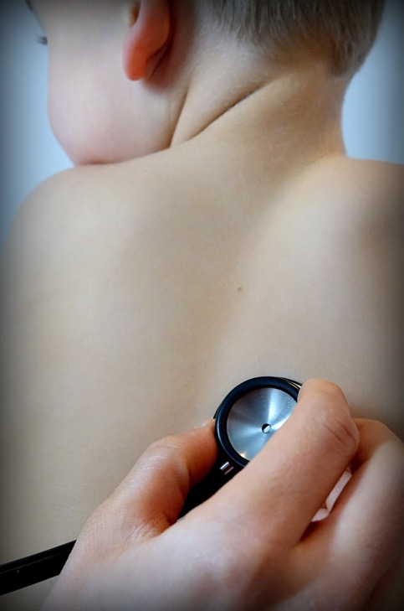
Bronchitis is increased by mold or mildew by 21%.
BMC Pulm Med. 17(1):95.
Notes:
Pahwa P, Karunanayake CP, Rennie DC, Lawson JA, Ramsden VR, McMullin K, Gardipy PJ, MacDonald J, Abonyi S, Episkenew JA, Dosman JA; First Nations Lung Health Project Research Team. Prevalence and associated risk factors of chronic bronchitis in First Nations people. BMC Pulm Med. 2017 Jun 29;17(1):95. doi: 10.1186/s12890-017-0432-4. PMID: 28662706; PMCID: PMC5492442.

Slide 36

Asthma
Asthma increases and is made much worse in moldy damp environments.
Mold associated with household dust also increases asthma.
Environ Health Perspect. 119(6):748-56.
Notes:
Bonner S, Matte TD, Fagan J, Andreopoulos E, Evans D. Self-reported moisture or mildew in the homes of Head Start children with asthma is associated with greater asthma morbidity. J Urban Health. 2006 Jan;83(1):129-37. doi: 10.1007/s11524-005-9012-7. PMID: 16736360; PMCID: PMC2258328.
Gasana J, Ibrahimou B, Albatineh AN, Al-Zoughool M, Zein D. Exposures in the Indoor Environment and Prevalence of Allergic Conditions in the United States of America. Int J Environ Res Public Health. 2021 May 6;18(9):4945.
Gent JF, Belanger K, Triche EW, Bracken MB, Beckett WS, Leaderer BP. Association of pediatric asthma severity with exposure to common household dust allergens. Environ Res. 2009 Aug;109(6):768-74. doi: 10.1016/j.envres.2009.04.010.
Nowak D, Heinrich J, Jörres R, Wassmer G, Berger J, Beck E, Boczor S, Claussen M, Wichmann HE, Magnussen H. Prevalence of respiratory symptoms, bronchial hyperresponsiveness and atopy among adults: west and east Germany. Eur Respir J. 1996 Dec;9(12):2541-52.

Slide 37

Behavioral Effects Of Mycotoxins
Mycotoxins increase aggressive behavioral and hyperactivity.
African Journal of Microbiology Research. 7. 1371-1377.
Notes:
Mansour, Attia & Abeer, M. (2013). Neurophysiological and behavioral effects of mycotoxin deoxynivalenol and fumonisin. African Journal of Microbiology Research. 7. 1371-1377. 10.5897/AJMR12.1630.

Slide 38

Mold Exposure and Pain or Neuralgia
Human exposure to molds, mycotoxins, and water-damaged buildings can cause neurologic and neuropsychiatric signs and symptoms. Many of these clinical features can partly mimic or be similar to classic neurologic disorders including pain syndromes, movement disorders, delirium, dementia, and disorders of balance and coordination.
Toxicol Ind Health. 25(9-10):577-81.
Notes:
Empting LD. Neurologic and neuropsychiatric syndrome features of mold and mycotoxin exposure. Toxicol Ind Health. 2009 Oct-Nov;25(9-10):577-81.
Human exposure to molds, mycotoxins, and water-damaged buildings can cause neurologic and neuropsychiatric signs and symptoms. Many of these clinical features can partly mimic or be similar to classic neurologic disorders including pain syndromes, movement disorders, delirium, dementia, and disorders of balance and coordination. In this article, the author delineates the signs and symptoms of a syndrome precipitated by mold and mycotoxin exposure and contrasts and separates these findings neurodiagnostically from known neurologic diseases. This clinical process is designed to further the scientific exploration of the underlying neuropathophysiologic processes and to promote better understanding of effects of mold/mycotoxin/water-damaged buildings on the human nervous system and diseases of the nervous system. It is clear that mycotoxins can affect sensitive individuals, and possibly accelerate underlying neurologic/pathologic processes, but it is crucial to separate known neurologic and neuropsychiatric disorders from mycotoxin effects in order to study it properly.

Slide 39

Thank your moldy basement for your failing memory
Mold mycotoxins increase oxidative-stress, inflammation and neurodegeneration in the brain leading to diseases such as Alzheimer’s and Parkinson’s.
Int J Mol Sci. 12(8):5213-37.
Notes:
Doi K, Uetsuka K. Mechanisms of mycotoxin-induced neurotoxicity through oxidative stress-associated pathways. Int J Mol Sci. 2011;12(8):5213-37.
Among many mycotoxins, T-2 toxin, macrocyclic trichothecenes, fumonisin B(1) (FB(1)) and ochratochin A (OTA) are known to have the potential to induce neurotoxicity in rodent models. T-2 toxin induces neuronal cell apoptosis in the fetal and adult brain. Macrocyclic trichothecenes bring about neuronal cell apoptosis and inflammation in the olfactory epithelium and olfactory bulb. FB(1) induces neuronal degeneration in the cerebral cortex, concurrent with disruption of de novo ceramide synthesis. OTA causes acute depletion of striatal dopamine and its metabolites, accompanying evidence of neuronal cell apoptosis in the substantia nigra, striatum and hippocampus. This paper reviews the mechanisms of neurotoxicity induced by these mycotoxins especially from the viewpoint of oxidative stress-associated pathways.

Slide 40
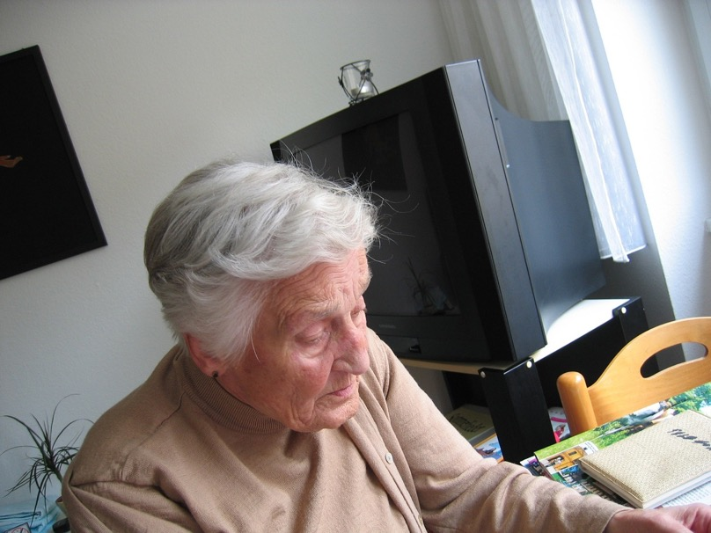
Mold Exposure Increases Your Risk Of Dementia
Mol Neurobiol. 53(4):2550-71
Notes:
Morris G, Berk M, Walder K, Maes M. e putative role of viruses, bacteria, and chronic fungal biotoxin exposure in the genesis of intractable fatigue accompanied by cognitive and physical disability. Mol Neurobiol (2016) 53(4):2550–71.
Mol Neurobiol. 2016 May;53(4):2550-71. doi: 10.1007/s12035-015-9262-7. Epub 2015 Jun 17.
The Putative Role of Viruses, Bacteria, and Chronic Fungal Biotoxin Exposure in the Genesis of Intractable Fatigue Accompanied by Cognitive and Physical Disability.
Morris G, Berk M, Walder K, Maes M.
Author information
Abstract
Patients who present with severe intractable apparently idiopathic fatigue accompanied by profound physical and or cognitive disability present a significant therapeutic challenge. The effect of psychological counseling is limited, with significant but very slight improvements in psychometric measures of fatigue and disability but no improvement on scientific measures of physical impairment compared to controls. Similarly, exercise regimes either produce significant, but practically unimportant, benefit or provoke symptom exacerbation. Many such patients are afforded the exclusionary, non-specific diagnosis of chronic fatigue syndrome if rudimentary testing fails to discover the cause of their symptoms. More sophisticated investigations often reveal the presence of a range of pathogens capable of establishing life-long infections with sophisticated immune evasion strategies, including Parvoviruses, HHV6, variants of Epstein-Barr, Cytomegalovirus, Mycoplasma, and Borrelia burgdorferi. Other patients have a history of chronic fungal or other biotoxin exposure. Herein, we explain the epigenetic factors that may render such individuals susceptible to the chronic pathology induced by such agents, how such agents induce pathology, and, indeed, how such pathology can persist and even amplify even when infections have cleared or when biotoxin exposure has ceased. The presence of active, reactivated, or even latent Herpes virus could be a potential source of intractable fatigue accompanied by profound physical and or cognitive disability in some patients, and the same may be true of persistent Parvovirus B12 and mycoplasma infection. A history of chronic mold exposure is a feasible explanation for such symptoms, as is the presence of B. burgdorferi. The complex tropism, life cycles, genetic variability, and low titer of many of these pathogens makes their detection in blood a challenge. Examination of lymphoid tissue or CSF in such circumstances may be warranted.
KEYWORDS:
Chronic fatigue syndrome; Cognition; Depression; Immune; Inflammation; Neurology; Oxidative stress; Psychiatry; Toll-like receptor
PMID: 26081141
Gordon WA, Cantor JB, Johanning E, Charatz HJ, Ashman TA, Breeze JL, et al. Cognitive impairment associated with toxigenic fungal exposure: a replication and extension of previous findings. Appl Neuropsychol (2004) 11(2):65–74. doi:10.1207/s15324826an1102_1
Appl Neuropsychol. 2004;11(2):65-74.
Cognitive impairment associated with toxigenic fungal exposure: a replication and extension of previous findings.
Gordon WA1, Cantor JB, Johanning E, Charatz HJ, Ashman TA, Breeze JL, Haddad L, Abramowitz S.
Author information
Abstract
In this study, neuropsychological data and symptom reports from 31 individuals exposed to toxic mold were examined. Most participants were found to have reduced cognitive functioning in multiple domains, with memory and executive functions the most commonly affected areas. Rates of dysfunction were significantly greater than chance on more than half of the tests. Number of cognitive impairments was found to be related to depression, although few neuropsychological test scores were correlated with depression. Results also indicated that symptom report of the mold-exposed participants was not significantly different from that of matched groups of 65 persons with mild traumatic brain injury (TBI) and 26 individuals with moderate TBI. The mold-exposed participants reported significantly more symptoms than 47 people with no disability. This study adds to a growing body of literature (e.g., Baldo, Ahmad, & Ruff, 2002; Gordon, Johanning, & Haddad, 1999) relating exposure to mycotoxins to cognitive dysfunction.
Comment in
Commentary on cognitive impairment with toxigenic fungal exposure. [Appl Neuropsychol. 2005]
"Cognitive impairment associated with toxigenic fungal exposure": a critique and critical analysis. [Appl Neuropsychol. 2005]
PMID: 15477176
Campbell AW, rasher JD, Madison RA, Vojdani A, Gray MR, Johnson A. Neural autoantibodies and neurophysiologic abnormalities in patients exposed to molds in water-damaged buildings. Arch Environ Health (2003) 58(8):464–74. doi:10.3200/AEOH.58.8.464-474
Arch Environ Health. 2003 Aug;58(8):464-74.
Neural autoantibodies and neurophysiologic abnormalities in patients exposed to molds in water-damaged buildings.
Campbell AW1, Thrasher JD, Madison RA, Vojdani A, Gray MR, Johnson A.
Author information
Abstract
Adverse health effects of fungal bioaerosols on occupants of water-damaged homes and other buildings have been reported. Recently, it has been suggested that mold exposure causes neurological injury. The authors investigated neurological antibodies and neurophysiological abnormalities in patients exposed to molds at home who developed symptoms of peripheral neuropathy (i.e., numbness, tingling, tremors, and muscle weakness in the extremities). Serum samples were collected and analyzed with the enzyme-linked immunosorbent assay (ELISA) technique for antibodies to myelin basic protein, myelin-associated glycoprotein, ganglioside GM1, sulfatide, myelin oligodendrocyte glycoprotein, alpha-B-crystallin, chondroitin sulfate, tubulin, and neurofilament. Antibodies to molds and mycotoxins were also determined with ELISA, as reported previously. Neurophysiologic evaluations for latency, amplitude, and velocity were performed on 4 motor nerves (median, ulnar, peroneal, and tibial), and for latency and amplitude on 3 sensory nerves (median, ulnar, and sural). Patients with documented, measured exposure to molds had elevated titers of antibodies (immunoglobulin [Ig]A, IgM, and IgG) to neural-specific antigens. Nerve conduction studies revealed 4 patient groupings: (1) mixed sensory-motor polyneuropathy (n = 55, abnormal), (2) motor neuropathy (n = 17, abnormal), (3) sensory neuropathy (n = 27, abnormal), and (4) those with symptoms but no neurophysiological abnormalities (n = 20, normal controls). All groups showed significantly increased autoantibody titers for all isotypes (IgA, IgM, and IgG) of antibodies to neural antigens when compared with 500 healthy controls. Groups 1 through 3 also exhibited abnormal neurophysiologic findings. The authors concluded that exposure to molds in water-damaged buildings increased the risk for development of neural autoantibodies, peripheral neuropathy, and neurophysiologic abnormalities in exposed individuals.
PMID: 15259425
Chen R; Ma F; Li PW; Zhang W; Ding XX; Zhang Q; Li M; Wang YR; Xu BC. Effect of ozone on aflatoxins detoxification and nutritional quality of peanuts. Food Chem. 2014; 146:284-8.
Aflatoxins are a group of secondary metabolites produced by Aspergillus flavus and Aspergillus parasiticus with carcinogenicity, teratogenicity, and mutagenicity. Aflatoxins may be found in a wide range of agri-products, especially in grains, oilseeds, corns, and peanuts. In this study, the conditions for detoxifying peanuts by ozonation were optimised. Aflatoxins in peanuts at moisture content of 5% (w/w) were sensitive to ozone and easily degraded when reacted with 6.0mg/l of ozone for 30min at room temperature. The detoxification rates of the total aflatoxins and aflatoxin B1 (AFB1) were 65.8% and 65.9%, respectively. The quality of peanut samples was also evaluated in this research. No significant differences (P>0.05) were found in the polyphenols, resveratrol, acid value (AV), and peroxide value (PV) between treated and untreated samples. The results suggested that ozonation was a promising method for aflatoxin detoxification in peanuts.

Slide 41

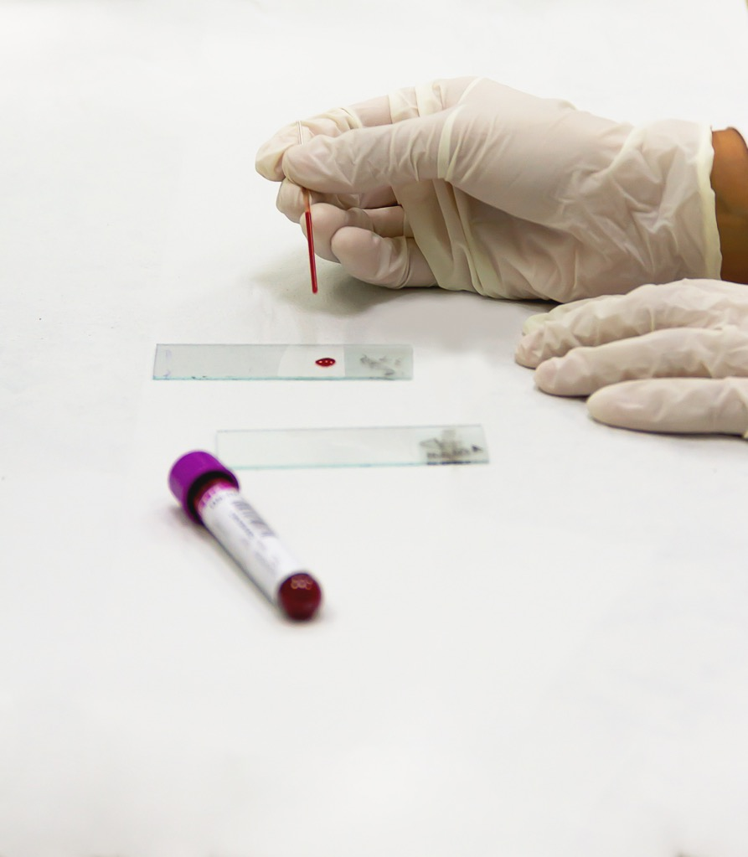
Mold Raises Cholesterol
. Indian J Physiol Pharmacol. 38(2):89-94
Notes:
The plasma cholesterol and phospholipid levels as well as the bleeding time of chicks treated with single oral doses of scopoletin (60 micrograms/kg, body wt) and aflatoxin B1 (50 micrograms/kg, body wt) were measured at intervals for a period of one week (168 h). Both compounds generally increased the bleeding time (AFB1 0.8-28.7%, Scopoletin 0.5-38.2%), serum total and free cholesterol, and the serum phospholipid levels but decreased the levels of the serum esterified cholesterol fraction relative to control throughout the period of study. The extent of these changes elicited by the respective compounds and the variation in the differences between their respective effects varied with the measured parameters. The importance of the similarities in the effects elicited by aflatoxin B1 and Scopoletin was highlighted.
Obasi SC1, Njoku OU, Obidoa O. Effects of single oral doses of scopoletin and aflatoxin B1 on the clotting time, serum cholesterol and phospholipid levels of chicks. Indian J Physiol Pharmacol. 1994 Apr;38(2):89-94. PMID: 8063368

Slide 42

Mold Raises Blood Pressure
Sci Total Environ. 2016 Jan 1;539:271-276.
Notes:
Sci Total Environ. 2016 Jan 1;539:271-276. doi: 10.1016/j.scitotenv.2015.08.158. Epub 2015 Sep 10.
Association between indoor air pollutant exposure and blood pressure and heart rate in subjects according to body mass index.
Jung CC1, Su HJ2, Liang HH1.
Author information
1
Dept. of Environmental and Occupational Health, College of Medicine, National Cheng Kung University, Tainan City, Taiwan.
2
Dept. of Environmental and Occupational Health, College of Medicine, National Cheng Kung University, Tainan City, Taiwan. Electronic address: hjsu@mail.ncku.edu.tw.
Abstract
This study investigates the effects of high body mass index (BMI) of subjects on individual who exhibited high cardiovascular disease indexes with blood pressure (BP) and heart rate (HR) when exposed to high levels of indoor air pollutants. We collected 115 office workers, and measured their systolic blood pressure (SBP), diastolic blood pressure (DBP) and HR at the end of the workday. The subjects were divided into three groups according to BMI: 18-24 (normal weight), 24-27 (overweight) and >27 (obese). This study also measured the levels of carbon dioxide (CO2), total volatile organic compounds (TVOC), particulate matter with an aerodynamic diameter less than 2.5μm (PM2.5), as well as the bacteria and fungi in the subjects' work-places. The pollutant effects were divided by median. Two-way analysis of variance (ANOVA) was used to analyze the health effects of indoor air pollution exposure according to BMI. Our study showed that higher levels of SBP, DBP and HR occurred in subjects who were overweight or obese as compared to those with normal weight. Moreover, there was higher level of SBP in subjects who were overweight or obese when they were exposed to higher levels of TVOC and fungi (p<0.05). We also found higher value for DBP and HR with increasing BMI to be associated with exposure to higher TVOC levels. This study suggests that individuals with higher BMI have higher cardiovascular disease risk when they are exposed to poor indoor air quality (IAQ), and specifically in terms of TVOC.
Copyright © 2015. Published by Elsevier B.V.
KEYWORDS:
Blood pressure; Heart rate; Indoor air quality; Obesity
PMID: 26363400

Slide 43

Mold exposure may increase gestational diabetes
Clin Chim Acta. 487:46-47
Notes:
Clin Chim Acta. 2018 Dec;487:46-47. doi: 10.1016/j.cca.2018.09.025. Epub 2018 Sep 13.
Characterization of cord blood interleukin 10 on aflatoxinB1-exposed patients with gestational diabetes.
Xie G1, Liu M2, Xia C3, Li R4.
BACKGROUND:
Interleukin 10 (IL10) refers to a pleiotropic cytokine exerted immunoregulation. Aflatoxin B1 (AFB1) is a strong carcinogen, marked by causing immunosuppression. We determined the possible association between cord blood IL10 and AFB1-exposed patients with gestational diabetes (GD).
METHODS:
Cord blood samples from non-GD adults (n = 3) and GD patients (n = 3) were harvested for determining representative serological parameters by use of biochemical assays and enzyme linked immunosorbent assay (ELISA) tests.
RESULTS:
As results, GD patients showed no statistical comparable clinical data (hepatic function, lipids metabolism, immune cell count) to those in controls or references. Interestingly, cord blood contents of AFB1 in GD patients were significantly increased when compared to those in non-GD controls, characterized with visibly increased cord blood IL10.
CONCLUSIONS:
Preliminary clinical data reveal that IL10 may function as a biomarker for immunoregulation in AFB1-exposed GD patients.
PMID: 30219567

Slide 44

Mold increases type I diabetes
Infect Drug Resist. 2019 Jul 29;12:2323-2334.
Notes:
Infect Drug Resist. 2019 Jul 29;12:2323-2334. doi: 10.2147/IDR.S207138. eCollection 2019.
Potential effects of microbial air quality on the number of new cases of diabetes type 1 in children in two regions of Poland: a pilot study.
Michalska M#1, Wąż P#2, Zorena K1, Bartoszewicz M1, Korzeniowska K3, Krawczyk S4, Beń-Skowronek I4, Myśliwiec M3.
Author information
1
Department of Immunobiology and Environment Microbiology, Faculty of Health Sciences, Medical University of Gdańsk, Gdańsk, Poland.
2
Department of Nuclear Medicine, Faculty of Health Sciences, Medical University of Gdańsk, Gdańsk, Poland.
3
Clinic of Pediatrics, Diabetology and Endocrinology, Faculty of Medicine, Medical University of Gdańsk, Gdańsk, Poland.
4
Department of Pediatric Endocrinology and Diabetology, Faculty of Medicine, Medical University of Lublin, Lublin, Poland.
#
Contributed equally
Abstract
Aim: The aim of the study was to investigate the relationship between the concentration of psychrophilic bacteria, mesophilic bacteria and mold fungi in bioaerosols, and the number of new cases of type 1 diabetes mellitus (T1DM) in children. Methods: Air samples from the Lubelskie and Pomeranian voivodeships in Poland were collected from January 2015 to December 2016 in winter, spring, summer and autumn. Thirty-three samples were collected in the Pomeranian and 27 in the Lubelskie voivodeship. The air samples were collected on the first day of each month at 1:00 pm for 10 mins at a height of 1.5 m above the ground. The number of mesophilic bacteria was detected after 24-48 hrs incubation at 37°C on tryptone soya agar (TSA; Merck, Darmstadt, Germany). The number of psychrophilic bacteria was detected after 72 hrs incubation at 22°C on TSA. The number of fungi was detected by a 5-day long incubation at 28°C on chloramphenicol yeast glucose agar. Results: In the Lubelskie voivodeship, the mean concentration of psychrophilic bacteria was significantly higher than in the Pomeranian voivodeship (2739 vs 608 CFU/m3, respectively), the mean concentration of mesophilic bacteria was significantly higher (2493 vs 778/m3, respectively) and the concentration of fungi was significantly higher (3840 vs 688 CFU/m3, respectively). We also showed a statistically significant relationship between the number of children with recently diagnosed T1DM and the mean concentration of psychrophilic and mesophilic bacteria in the Pomeranian and Lubelskie voivodeships (P<0.001). Moreover, we found a significant relationship between the number of new cases of T1DM in children and the mean concentration of fungi in bioaerosols in the Lubelskie voivodeship (P<0.001), but not in the Pomeranian voivodeship (P=NS). Conclusion: The results of our research showed that there is a higher concentration of microbial particles in the Lublin voivodeship. Therefore, we recommend changes in climate for children (trips to the sea, mountains, etc) as often as possible.
KEYWORDS:
children; incidence of type 1 diabetes mellitus; mesophilic bacteria; mold fungi; psychrophilic bacteria
PMID: 31534351

Slide 45

Thyroid and Mold
Mycotoxins are endocrine disruptors and cause thyroid inflammation, hormone disruption and negative thyroid receptor changes.
Int J Mol Sci. 19(5):1440
Notes:
Thyroid and mold
Williams JA, Wolff J. Cytochalasin B inhibits thyroid secretion. Biochem Biophys Res Commun. 1971 Jul 16;44(2):422-5.
The addition of cytochalasin B at concentrations of 0.5–3.0 μg/ml to prelabeled mouse thyroid glands interferes with release of iodine derived from thyroglobulin and blocks colloid endocytosis. It is suggested that cytoplasmic microfilaments are involved in the secretory process.
Rotter BA, Thompson BK, Lessard M, Trenholm HL, Tryphonas H. Influence of low-level exposure to Fusarium mycotoxins on selected immunological and hematological parameters in young swine. Fundam Appl Toxicol. 1994 Jul;23(1):117-24.
The effects of low dietary concentrations of Fusarium mycotoxins (deoxynivalenol (DON), 15-acetyl-DON, and zearalenone) on growth, immunological, and hematological parameters were determined in young pigs during a 28-day feeding experiment. Clean and naturally contaminated corn were incorporated into basal diets formulated to contain 0.00, 0.75, 1.50, and 3.00 mg DON/kg diet. A pair-fed control animal was used for comparison with each animal receiving the highest level of contamination (diet 4). Skin temperature, measured during the first week of the experiment, decreased linearly as the dietary mycotoxin concentration increased. Several other linear effects were observed: depressed feed intake throughout the experiment, reduction in thyroid size (absolute/relative), and changes in the appearance of the esophageal region of the stomach (thicker and higher degree of folding with increasing toxin concentration). Serum T4 (thyroxine) levels increased quadratically after 7 and 28 days of exposure compared to control animals. This change coincided with an increase in albumin levels, a decrease in α-globulin levels, and an overall increase in albumin/globulin ratio as the level of contamination increased. After immunization with sheep red blood cells (SRBC), animals fed contaminated diets showed a delayed response in peak titers. At the end of the experiment an increase in the segmented neutrophil count was observed. The following observations were made for animals consuming diet 4 as compared to the pair-fed controls: lower skin temperature, better feed efficiency, more corrugated stomachs, reduced α-globulin levels, and lower antibody titers to SRBC. The study showed a physiobiochemical adaptation response of animals exposed to mycotoxin-contaminated diets. Although most changes seem to be related to the nutritional status of the animal, others such as reduced skin temperature, altered stomach condition, and reduced α-globulin levels suggest specific effects due to the Fusarium toxins. The pair-feeding treatment was important in reaching these conclusions, but it is also evident that the treatment itself introduces changes in response to a reduced feed intake.
Ványi A, Glávits R, Gajdács E, Sándor G, Kovács F. Changes induced in newborn piglets by the trichothecene toxin T-2. Acta Vet Hung. 1991;39(1-2):29-37.
Three pregnant sows, being in the last quarter of gestation, were used in an experiment to study the changes induced in newborn piglets by T-2 toxin. One sow was used as control (C). The other two received 24 mg (sow A) and 6 mg (sow B) T-2 toxin, respectively, mixed in the feed, daily, up to the time of farrowing. The piglets of sow A became ill by 48-72 h after birth, while the litters of sow B and C remained healthy. The clinical symptoms included faintness, diarrhoea, decreased blood glucose level, and collapse followed by death. The milk and urine of sow A and the stomach contents of affected and dead piglets contained T-2 toxin and its metabolites. Pathological changes seen at necropsy included acute enteritis, degeneration of the liver and kidneys, and oedema of the mesentery. The stomach was filled with clotted milk. Histopathological and electron-microscopic findings consisted of reduced glycogen content and pathological simple fatty infiltration of the liver cells, lymphocyte depletion and necrosis in the lymphoid follicles of the intestinal mucosa, atrophy of the thymic cortex, and hyperfunction of the adrenal and thyroid glands compared to the control.
Gesing A, Jagiela J, Lewinski A. Effects of melatonin on the process of apoptosis in rat thyroid follicular cells. Neuro Endocrinol Lett. 2006 Feb-Apr;27(1-2):81-4.
Objectives: Apoptosis, or programmed cell death, is a normal component in the development of multicellular organisms and is essential for many physiological processes. Apoptosis is a process in which cells play an active role in their own death (apoptosis is often referred to as "cell suicide"). Disturbances of apoptosis regulation can result in many diseases. Certain substances (for example--aflatoxin B1; AFB1) can induce apoptosis in various organs and tissues. Melatonin (Mel) is a hormone (indoleamine) which has antioxidant, antiproliferative and, potentially, anticancerogenic activities. The aim of our study was to examine the influence of late-afternoon (1600-1800) intraperitoneal (i.p.) Mel injections, administered for 3 weeks, on the process of apoptosis in male Wistar rat thyroid follicular cells (TFC); Mel was injected alone or together with AFB1 (i.p., also once daily for 3 weeks).
Selmanoglu G, Koçkaya EA. Investigation of the effects of patulin on thyroid and testis, and hormone levels in growing male rats. Food Chem Toxicol. 2004 May;42(5):721-7.
Patulin is a mycotoxin produced by several species of Penicillium, Aspergillus and Byssachlamys. Patulin can be produced on different food products including fruits, grains, cheese, cured meats, but in natural situations patulin is usually found in apple and apple products. In the present study, the time-dependent effects of patulin on the T3, T4, thyroid stimulating hormone, testosterone, luteinizing hormone and growth hormone levels of growing male rats were investigated. Patulin, at a dose of 0.1 mg/kg bw/day, was administered by gavage to growing male rats aged 5-6 weeks for a period of 60 or 90 days. The dose of patulin used in the present study was based on estimated human exposure levels. At the end of the experiment, serum T3, T4, TSH, testosterone, LH and GH levels of rats in control and treatment groups were analysed. In addition, the thyroid and testes were histopathologically examined by light microscopy. Results revealed that while patulin caused an increase (66.6%) in testosterone levels and a decrease (17.3%) in T4 levels of rats treated for 60 days, there was no change in the other hormone levels compared to those of the control group. When patulin treatment was extended to 90 days, increased serum testosterone (75%) and LH levels (146%) were observed. In histological examinations of the testes of rats treated with patulin, oedema, fibrosis and local Leydig cell hyperplasia in the interstitial tissue, and disorganization of seminiferous tubule epithelium were also observed. In addition, the thyroid of rats treated with patulin revealed lymphoid cell inflitration and enlargement of interstitial tissue between follicles, and degenerated colloid.
Kiss DS, Ioja E, Toth I, Barany Z, Jocsak G, Bartha T, Horvath TL, Zsarnovszky A. Comparative Analysis of Zearalenone Effects on Thyroid Receptor Alpha (TRα) and Beta (TRβ) Expression in Rat Primary Cerebellar Cell Cultures. Int J Mol Sci. 2018 May 11;19(5):1440.
Thyroid receptors play an important role in postnatal brain development. Zearalenone (ZEN), a major mycotoxin of Fusarium fungi, is well known to cause serious health problems in animals and humans through various mechanisms, including the physiological pathways of thyroid hormone (TH). In the present study, we aimed to investigate the expression of thyroid receptors α (TRα) and β (TRβ) in primary cerebellar neurons in the presence or absence of glia and following ZEN treatment, using quantitative reverse transcription-polymerase chain reaction (qRT-PCR) and Western blot. Primary cerebellar granule cells were treated with low doses of ZEN (0.1 nM) in combination with physiologically relevant concentrations of l-thyroxine (T4), 3,3',5-triiodo-l-thyronine (T3) and 17β-estradiol (E2). Expression levels of TRα and TRβ at mRNA and protein levels were slightly modified by ZEN administered alone; however, along with thyroid and steroid hormones, modelling the physiological conditions, expression levels of TRs varied highly depending on the given treatment. Gene expression levels were also highly modulated by the presence or absence of glial cells, with mostly contrasting effects. Our results demonstrate divergent transcriptional and translational mechanisms involved in the expression of TRs implied by ZEN and hormonal milieu, as well as culturing conditions.
Van Middlesworth L. T-2 mycotoxin intensifies iodine deficiency in mice fed low iodine diet. Endocrinology. 1986 Feb;118(2):583-6.
Mice were depleted of iodine and fed a 125I-labeled low iodine diet. After they developed isotopic equilibrium they were given T-2 mycotoxin, in doses 34% to 14% of LD50/day for 4 to 12 days. In all cases T-2 toxin caused loss of thyroid iodine from which the animals recovered when the T-2 toxin was stopped. When iodine intake was adequate, the T-2 toxin had no statistically significant effect on the thyroid iodine content. Since T-2 toxin is known to block the initiation of some protein synthesis, it may block thyroglobulin synthesis, and, in stimulated thyroids, limited hydrolysis may continue. Therefore, when the thyroids were stimulated and thyroglobulin was depleted, a blockade of thyroglobulin synthesis may have caused further depletion of thyroidal iodine.
Somppi TL. Non-Thyroidal Illness Syndrome in Patients Exposed to Indoor Air Dampness Microbiota Treated Successfully with Triiodothyronine. Front Immunol. 2017 Aug 7;8:919. doi: 10.3389/fimmu.2017.00919.
Long-term exposure to dampness microbiota induces multi-organ morbidity. One of the symptoms related to this disorder is non-thyroidal illness syndrome (NTIS). A retrospective study was carried out in nine patients with a history of mold exposure, experiencing chronic fatigue, cognitive disorder, and different kinds of hypothyroid symptoms despite provision of levothyroxine (3,5,3',5'-tetraiodothyronine, LT4) monotherapy. Exposure to volatile organic compounds present in water-damaged buildings including metabolic products of toxigenic fungi and mold-derived inflammatory agents can lead to a deficiency or imbalance of many hormones, such as active T3 hormone. Since the 1970s, the synthetic prohormone, levothyroxine (LT4), has been the most commonly prescribed thyroid hormone in replacement monotherapy. It has been presumed that the peripheral conversion of T4 (3,5,3',5'-tetraiodothyronine) into T3 (3,5,3'-triiodothyronine) is sufficient to satisfy the overall tissue requirements. However, evidence is presented that this not the case for all patients, especially those exposed to indoor air molds. This retrospective study describes the successful treatment of nine patients in whom NTIS was treated with T3-based thyroid hormone. The treatment was based on careful interview, clinical monitoring, and laboratory analysis of serum free T3 (FT3), reverse T3 (rT3) and thyroid-stimulating hormone, free T4, cortisol, and dehydroepiandrosterone (DHEA) values. The ratio of FT3/rT3 was calculated. In addition, some patients received adrenal support with hydrocortisone and DHEA. All patients received nutritional supplementation and dietary instructions. During the therapy, all nine patients reported improvements in all of the symptom groups. Those who had residual symptoms during T3-based therapy remained exposed to indoor air molds in their work places. Four patients were unable to work and had been on disability leave for a long time during LT4 monotherapy. However, during the T3-based and supportive therapy, all patients returned to work in so-called "healthy" buildings. The importance of avoiding mycotoxin exposure via the diet is underlined as DIO2 genetic polymorphism and dysfunction of DIO2 play an important role in the development of symptoms that can be treated successfully with T3 therapy.

Slide 46
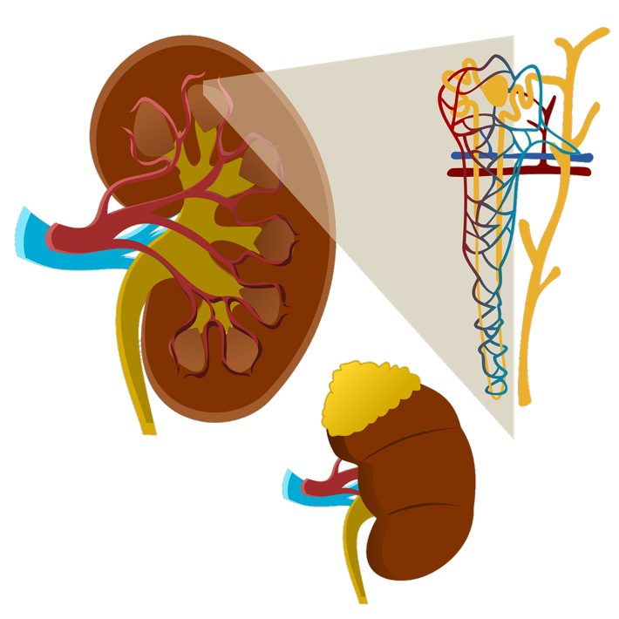
Nephrotoxicity
Mold exposure leads to kidney damage and compromise.
Toxicon. 175:28-35.
Notes:
Ben Salah-Abbès J, Belgacem H, Ezzdini K, Abdel-Wahhab MA, Abbès S. Zearalenone nephrotoxicity: DNA fragmentation, apoptotic gene expression and oxidative stress protected by Lactobacillus plantarum MON03. Toxicon. 2020 Feb;175:28-35.
Anyanwu E, Campbell AW, Vojdani A, Ehiri JE, Akpan AI. Biochemical changes in the serum of patients with chronic toxigenic mold exposures: a risk factor for multiple renal dysfunctions. ScientificWorldJournal. 2003 Nov 3;3:1058-64.
This paper analyzes and presents the biochemical abnormalities in the sera of patients presenting with chronic mycosis in order to investigate the relationship with the risks of multiple renal disorders. The study population (n = 10) consisted of six females and four males (mean age 36.3 years) exposed by toxic molds in their homes and offices for an average of 2.8 years. The control group comprised ten people, five males and five females (mean age 35.9 years) without any known exposures to toxic molds. Blood samples were obtained from both the patients and the controls and were processed using specific biochemical methods that included enzyme-linked immunoabsorbent assay (ELISA). There were biochemical abnormal concentrations in creatinine, uric acid, phosphorus, alkaline phosphotase, cholesterol, HDH, SGOT/AST, segmented neutrophils, lymphocytes, total T3, IgG and IgA immunoglobulins with significant differences between patients and controls. These abnormalities were consistent with multiple renal disorders. The major complaints of the mycosis patients were headaches, pulmonary symptoms, allergic reactions, memory loss, skin rashes, blurred vision symptoms, fatigue, and runny nose. These findings were depictive of a strong association of chronic mycosis with abnormal renal indicators. It was concluded that, although this research was a pilot investigation, based on the overall results, people exposed to chronic indoor environmental toxic molds were at risk of multiple renal complications.
PMID: 14612611
The present study was conducted to determine the abilities of the living Lactobacillus plantarum MON03 cells to degrade Zearalenone (ZEN) in liquid medium, and to elucidate the preventive effect in ZEN-contaminated balb/c mice showing kidney damage. The DNA fragmentation, Bcl-2 and Bax gene expression, caspase-3 activity, mRNA level of inflammation-regulating cytokines and histology of kidney tissues were examined. Female Balb/c mice were divided into four groups (10/group) and treated daily for 2 wk by oral gavage with lactic acid bacteria (L. plantarum MON03) 2 × 109 CFU/L, ~2 mg/kg only, ZEN (40 mg/kg BW) only, ZEN (40 mg/kg BW) + lactic acid bacteria (L. plantarum MON03, 2 × 109 CFU/L, ~2 mg/kg). Control group received vehicle. At the end of experiment, the kidney was collected for the determination of DNA fragmentation, Bcl-2 and Bax gene expression,caspase-3 activity, Malondialdehyde (MDA), and glutathione peroxidase (GSH-Px) content, as well as for any alterations in expression of total antioxidant activity (TAC) and mRNA levels of inflammation-regulating cytokines (e.g., IL-10, IL-6, TNF-alpha). The results indicated that, kidney cells exposure to ZEN led to increased caspase-3 activity, MDA, and IL-10, IL-6, TNF-alpha and Bax mRNA levels, but decreased TAC content and down-regulated expression of GSH-Px and CAT and Bcl-2 mRNA. Co-treatment with ZEN plus LP suppressed the levels of DNA fragmentation; normalized kidney MDA and increased CAT levels, up-regulated expression of GSH-Px and CAT, and normalized mRNA levels of the analyzed cytokines. It's concluded that ZEN might have toxic effects in kidney. Further, it can be seen that use of LP induced protective effects against the oxidative stress and kidney toxicity of ZEN in part through adhesion (and so likely diminished bioavailability).

Slide 47
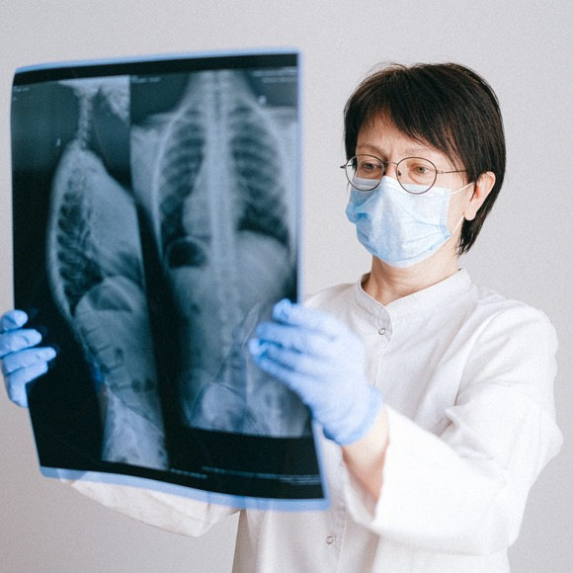
TB and Mold
Mold may predispose to TB by weakening the immune system and compromising lung tissue.
Front Pediatr. 25;7:233.
Notes:
Whittaker E, López-Varela E, Broderick C, Seddon JA. Examining the Complex Relationship Between Tuberculosis and Other Infectious Diseases in Children. Front Pediatr. 2019 Jun 25;7:233.

Slide 48

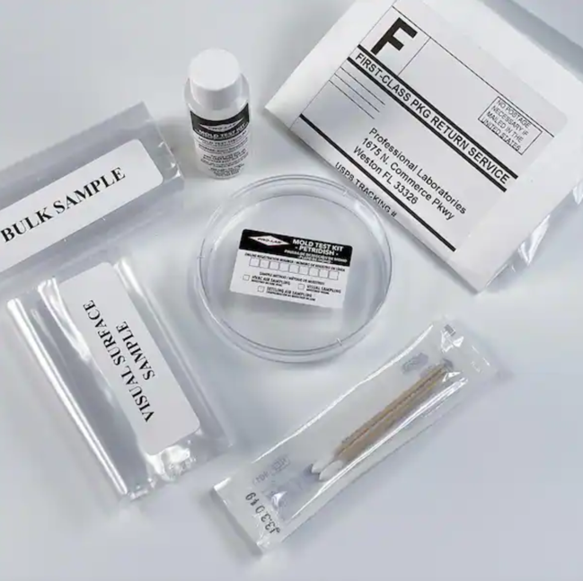
https://www.homedepot.com/p/PRO-LAB-Mold-Test-Kit-MO109/202534174

Slide 49

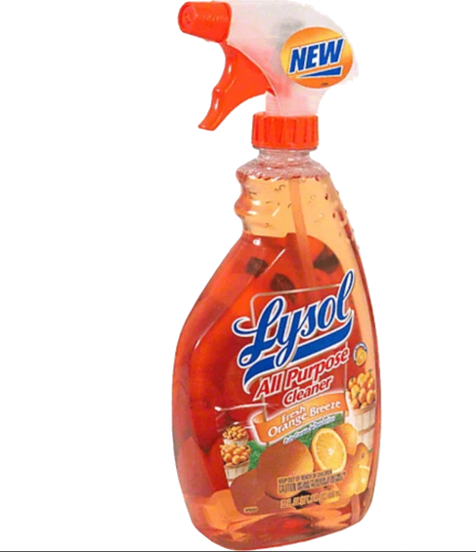

Cleaning up
For Plain sheet rock, no paint, the best cleaners were Borax, Lysol All-Purpose Cleaner-Orange Breeze (full strength), Orange Glo Multipurpose Degreaser, and Fantastik Orange Action.
Environ Sci Pollut Res Int. 14(7):523-8.

Slide 50

Clove Oil is Antifungal
Clove oil makes an excellent antifungal, especially when combined with a carrier oil.
Food Funct. 9(5):2872-2882.
Notes:
Wan J , Zhong S , Schwarz P , Chen B , Rao J . Influence of oil phase composition on the antifungal and mycotoxin inhibitory activity of clove oil nanoemulsions. Food Funct. 2018 May 23;9(5):2872-2882.

Slide 51
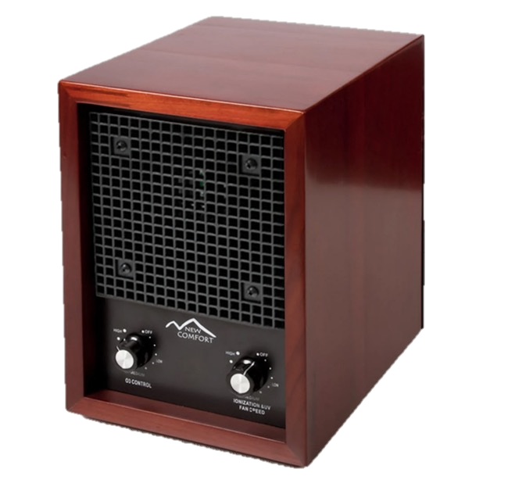
Ozone
Molds are sensitive to ozone treatment.
Drug Metab Rev. 2010 Nov;42(4):612-20.
Notes:
Freitas-Silva O, Venâncio A. Ozone applications to prevent and degrade mycotoxins: a review. Drug Metab Rev. 2010 Nov;42(4):612-20.
Ozone, a powerful oxidant, may be used for the inactivation of various microorganisms and the degradation of chemical contaminants. Although there are not many reports on the use of ozone against filamentous fungi or their mycotoxins, promising results have been reported. With a short half-time, at neutral pH and ambient temperature, ozone is able to inactivate microorganisms and decompose their toxic metabolites, leaving no traces of ozone in the treated commodity. This fact makes the use of ozone safe in food applications. There has been relatively limited research in this topic, especially with the use of aqueous ozone. The best management strategy still remains to be developed, but initial studies have indicated that an application of ozone for a short period of exposure is capable of controlling the proliferation of filamentous fungi and of degrading many mycotoxins.
Serra R, Abrunhosa L, Kozakiewicz Z, Venâncio A, Lima N. Use of ozone to reduce molds in a cheese ripening room. J Food Prot. 2003 Dec;66(12):2355-8.
Cheese ripening rooms have an unusual environment, an environment that encourages mold growth. Ozone has been applied in various ways in the food industry. One useful advantage of ozone is that it inactivates molds. In this study, a cheese ripening room was ozonated, and the effectiveness of this treatment was evaluated both in air and on surfaces through sampling on a weekly basis over a 3-month period. The results obtained indicate that ozone treatment reduced the viable airborne mold load but did not affect viable mold on surfaces. Only by wiping the surfaces with a commercial sanitizer was it possible to decrease the viable mold load on surfaces. To improve overall hygiene in the ripening room, a combination of cleaning regimes is recommended. The mold genera occurring most frequently in the air of the cheese ripening room were Penicillium, Cladosporium, and Aspergillus, which accounted for 89.9% of the mold isolates. Penicillium and Aspergillus were identified to the species level, and data showed that P. brevicompactum and P. aurantiogriseum, as well as A. versicolor, were the species most frequently isolated.

Slide 52

Sunlight
Studies show that increased home sun exposure significantly reduces mold problems.
Indoor Air. 15(6):469-76.
Notes:
Howden-Chapman P, Saville-Smith K, Crane J, Wilson N. Risk factors for mold in housing: a national survey. Indoor Air. 2005 Dec;15(6):469-76.
A national random telephone survey was undertaken to determine the prevalence of reported mold in New Zealand houses and the risk factors for it. A total of 613 households provided responses. Mold in one or more rooms was reported by 35.1% of respondents in the sample. House design and construction factors that were independently associated with reported mold in the multivariate analysis included: poorer house condition, older house age (>22 years), relative lack of sun exposure, and having no insulation (e.g. for poorer house condition: odds ratio=1.97, 95% CI=1.25, 3.11). Univariate analyses also showed increased risk associated with high locality rainfall, and living in the most northern part of the country. The number of residents was significantly associated with reported mold in the multivariate analysis as were various behaviors in the univariate analysis (i.e. frequency of baths, showering and clothes washing). The high prevalence of unflued gas heating (32.9%) found in this sample is of potential concern given the potential respiratory hazards. Although this survey has a number of limitations, it does suggest that there are a number of potentially modifiable risk factors for mold that could be reduced by a range of policy responses.

Slide 53

Keep It Clean!
“Fresh air, exercise, pure water, and clean, sweet premises are within the reach of all with but little expense, ...” {5T 443.1}
Notes:
Remodel!

Slide 54
CD4 T Cells Orchestrate The Immune Response To Mold
Improved by:
Iodine.
Garlic.
Papaya.
Selenium.
Zinc.
Lycopene.
omega-3 fatty acids (flax walnuts).
α-lipoic acid (spinach, broccoli, tomatoes, brussels sprouts, peas, potatoes, yams, beets, carrots, and Swiss chard).
Vitamins A, B7 (Biotin), and D.
Exercise.
Caloric restriction.
Fasting.
Hampered by:
Obesity
High Fat Diet
Sugar.
Butter.
High salt diet.
Pesticides.
Notes:
Pine
Peanuts
Cuellar-Rufino S, Arroyo-Xochihua O, Salazar-Luna A, Arroyo-Helguera O. Iodine induces toxicity against Candida albicans and Candida glabrata through oxidative stress. Iran J Microbiol. 2022 Apr;14(2):260-267.
Rogers SA. Lipoic acid as a potential first agent for protection from mycotoxins and treatment of mycotoxicosis. Arch Environ Health. 2003 Aug;58(8):528-32.
Hoffmann FW, Hashimoto AC, Shafer LA, Dow S, Berry MJ, Hoffmann PR. Dietary selenium modulates activation and differentiation of CD4+ T cells in mice through a mechanism involving cellular free thiols. J Nutr. 2010 Jun;140(6):1155-61.
Abdullah M, Chai PS, Loh CY, Chong MY, Quay HW, Vidyadaran S, Seman Z, Kandiah M, Seow HF. Carica papaya increases regulatory T cells and reduces IFN-γ+ CD4+ T cells in healthy human subjects. Mol Nutr Food Res. 2011 May;55(5):803-6.
Arreola R, Quintero-Fabián S, López-Roa RI, Flores-Gutiérrez EO, Reyes-Grajeda JP, Carrera-Quintanar L, Ortuño-Sahagún D. Immunomodulation and anti-inflammatory effects of garlic compounds. J Immunol Res. 2015;2015:401630.

Slide 55
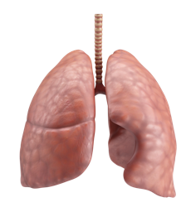
Summary
Mold increases inflammation and suppresses the immune system.
Mold increases cancer, autoimmune diseases respiratory tract and other diseases.
Solutions include cleaning your house, your yard or moving to a dryer area.
Fresh air and sunshine.
Eat a nutrient dense immune boosting diet.

