Slide 1
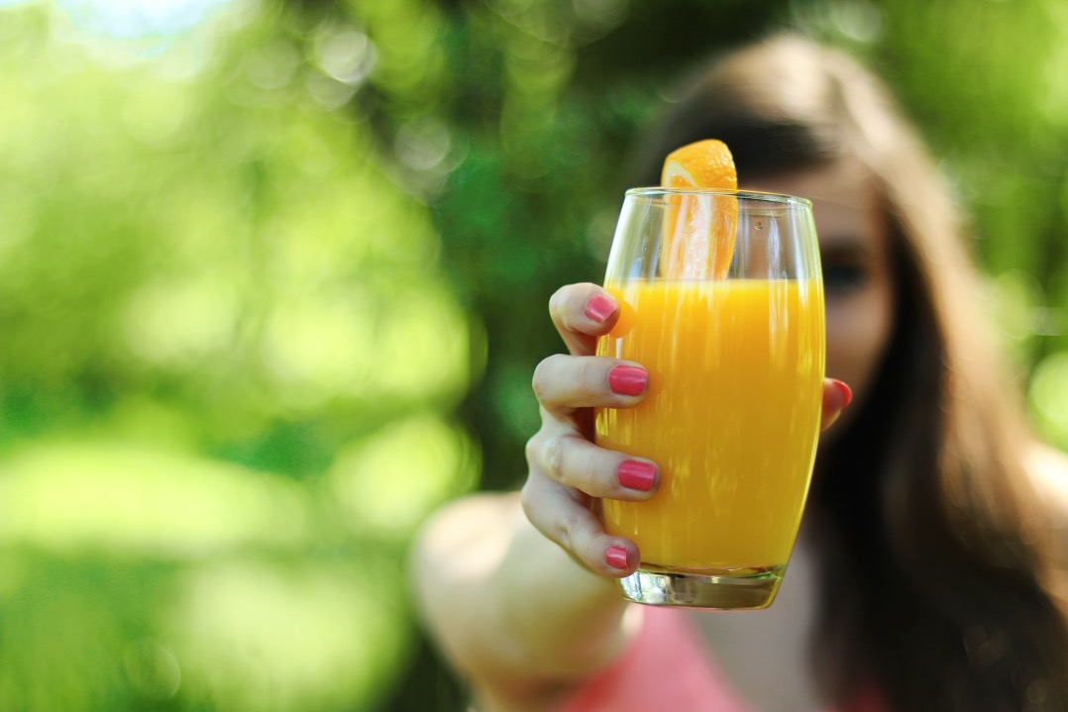
What About Juicing?

Slide 2
“Have you heard the news? Purchasing A juicer; squeezing fresh juices from raw carrots, beets, celery, kale, lemons, apples, and grapes; and ‘juice fasting’ have suddenly gone mainstream.”
Notes:
“Juicing” has become so popular that it is the subject of books, web sites, and films.
https://www.amazon.com/Juice-Your-Way-Fabulous-Health-ebook/dp/B00CLWVIYC

Slide 3

On the other hand, a famous heath advocate declares,
“I am advising the people wherever I go to give up liquid food as much as possible.”
“Taken in a liquid state, your food would not give healthful vigor or tone to the system.”
“Solid foods requiring mastication will be far better than mush or liquid foods.”
Notes:
As a medical doctor, who lectures on lifestyle medicine concerns, I am frequently approached with questions about the health benefits of juicing and/or smoothies.

Slide 4
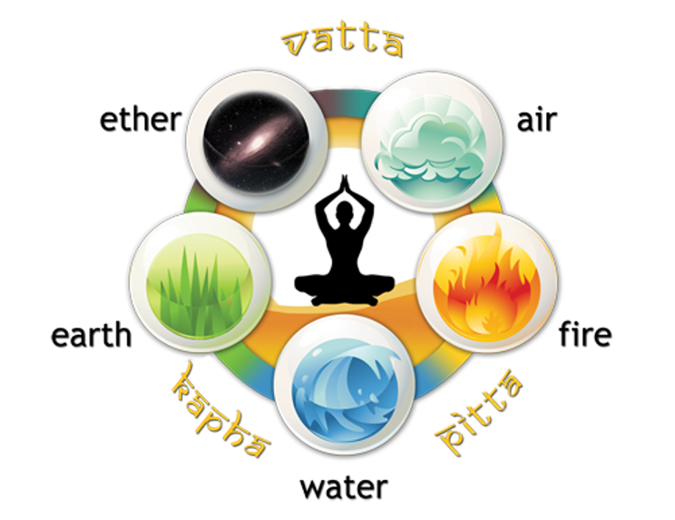
“Juice therapy has long been a component of the 5,000 year-old tradition of ayurveda.”
Juice is designed to bring balance among the three doshas: vata, pitta, and kapha. The main goal of ayurveda is to improve and maintain health by balancing the three doshas and nourishing the seven dhatus.
Notes:
https://www.yourcareeverywhere.com/article/krames/en/article/health-research/drugs-and-supplements/complementary-and-alternative-medicine/juice-therapy.html
https://kottakkal.shop/blogs/healing-with-kottakkal-ayurveda/the-fundamentals-of-ayurvedic-juicing

Slide 5

It is important to note that your body handles liquid foods differently than it handles solid foods.
“Your stomach was not receiving that vigor that it should from your food. Taken in a liquid state, your food would not give healthful vigor or tone to the system. But when you change this habit, and eat more solids and less liquids, your stomach will feel disturbed. Notwithstanding this, you should not yield the point; you should educate your stomach to bear a more solid diet.” {CD 105.1}

Slide 6
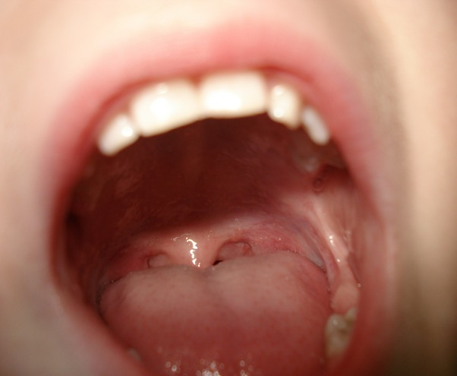
Identifying the incoming antigens.

Slide 7

Liquid Diet Fad: Like Man Falling Into Sin
“Man has fallen by sin; but there is no need of his continually repeating the transgression of Adam and Eve. There is no necessity for pleasing and gratifying the appetite by indulging in forbidden things. All should understand that by indulging perverted appetite, they violate the laws of health and life. Many have misinterpreted health-reform, and have received perverted ideas of what constitutes right living. Some honestly think that a proper dietary consists chiefly of porridge. To eat largely of porridge would not insure health to the digestive organs; for it is too much like liquid. Encourage the eating of fruit and vegetables and bread.” {YI, may 31, 1894 par. 7}.

Slide 8
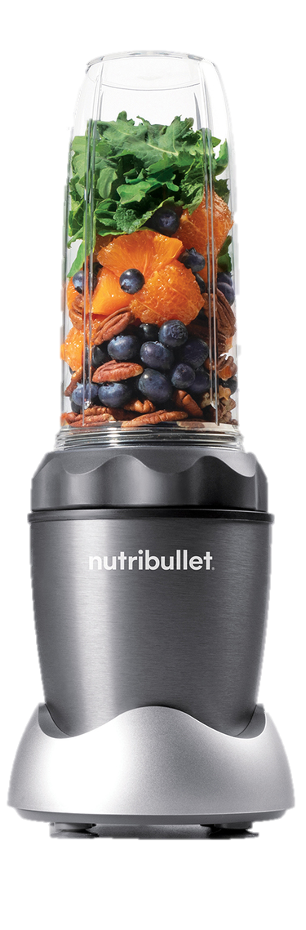
Food Combining Principles
Notes:
Most people making liquid meals are not careful to follow good food combining principles. They intake a large variety of food at each meal in their smoothies or juices as though they had to balance their entire life’s nutritional requirements in one sitting. This confuses the stomach.

Slide 9
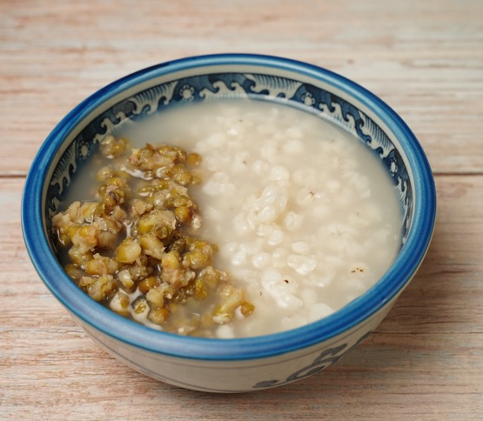
“To eat largely of porridge would not insure health to the digestive organs; for it is too much like liquid. Encourage the eating of fruit and vegetables and bread. … If we would preserve the best health, we should avoid eating vegetables and fruit at the same meal. If the stomach is feeble, there will be distress, the brain will be confused, and unable to put forth mental effort. Have fruit at one meal and vegetables at the next.” {YI, may 31, 1894 par. 7}

Slide 10
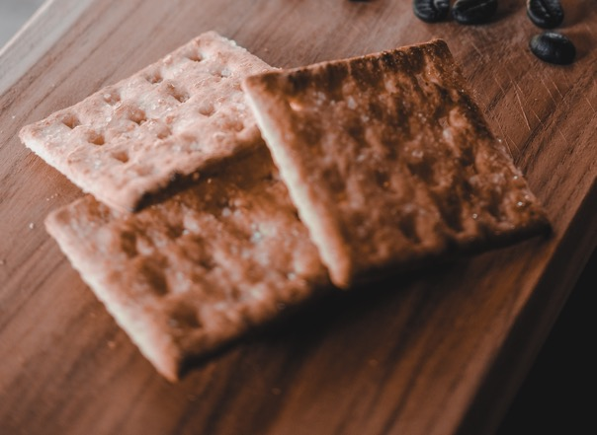
Liquid foods are not wholesome
“Grains used for porridge or ‘mush’ should have several hours' cooking. But soft or liquid foods are less wholesome than dry foods, which require thorough mastication. Zwieback, or twice-baked bread, is one of the most easily digested and most palatable of foods. Let ordinary raised bread be cut in slices and dried in a warm oven till the last trace of moisture disappears. Then let it be browned slightly all the way through. In a dry place this bread can be kept much longer than ordinary bread, and, if reheated before using, it will be as fresh as when new.” {Mh 301.3}

Slide 11
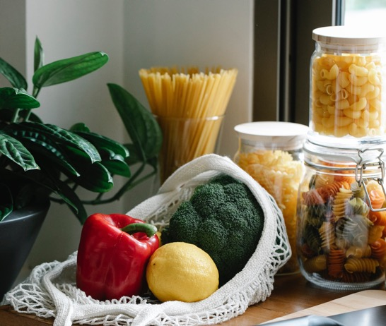
Each type of food takes a different digestive approach, and each its own unique probiotic flora.
Notes:
Each type of food takes a different digestive approach. You may realize that your body reacts very differently to a lemon than it does to broccoli. Excessive variety, as encountered in a complex meal composed of multiple diverse foods or complex smoothies, can provoke allergy, inflammation and autoimmunity.
Ferguson AC. Food allergy. Prog Food Nutr Sci. 1984;8(1-2):77-107.

Slide 12

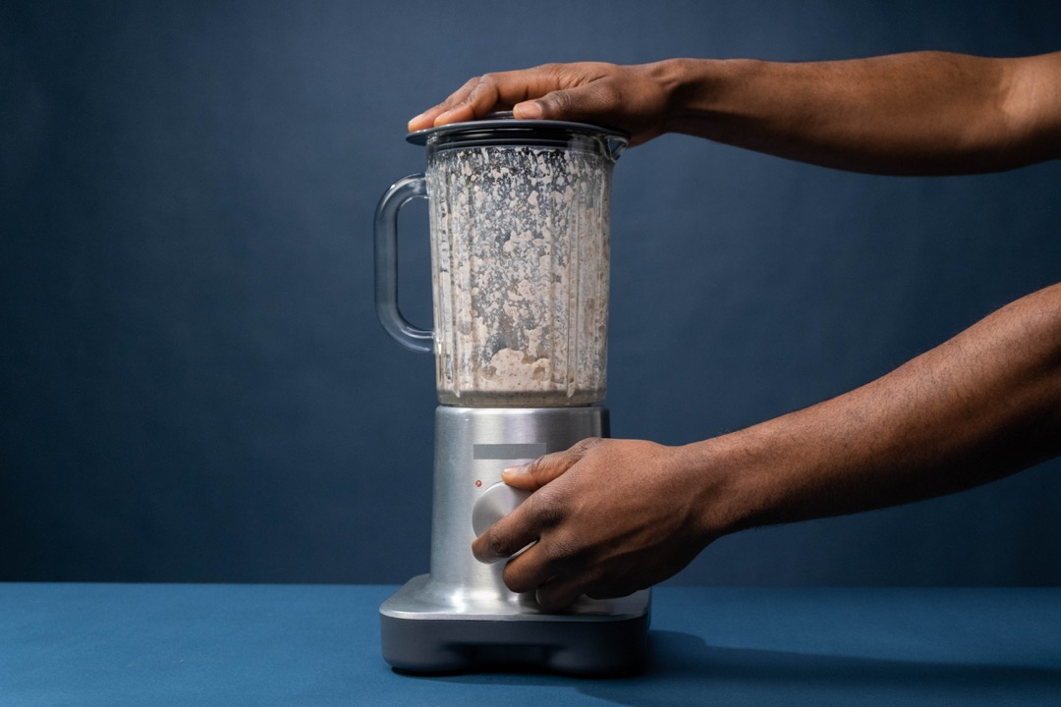
Nano-particles

Slide 13
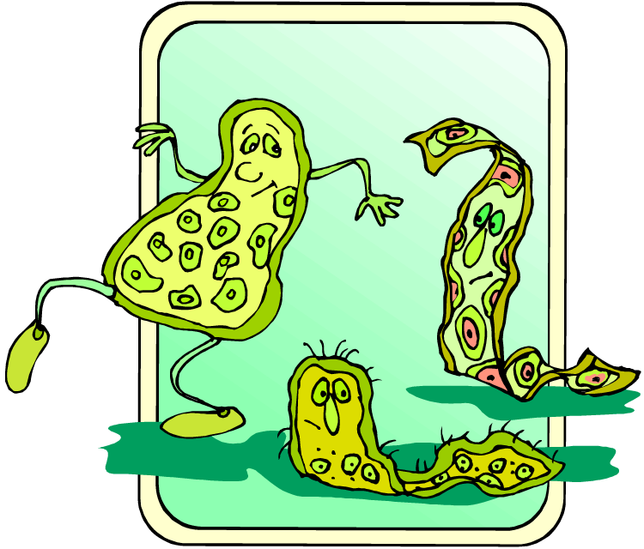
Leaky GUT?
A juice diet has been found to increase microbiota associated with gut permeability, inflammation, and cognitive decline.
In contrast, a diet consisting of whole organic fresh fruits, vegetables, gluten-free whole grains, has beneficial effects on gut microbiota, increasing bacteria that support gut inflammation control, immune balance, and resistance to dangerous pathogens.
Nutrients. 17(3):458.
Notes:
Sardaro MLS, Grote V, Baik J, Atallah M, Amato KR, Ring M. EOrally a juice diet increases pro-inflammatory bacteria.
ffects of Vegetable and Fruit Juicing on Gut and Oral Microbiome Composition. Nutrients. 2025 Jan 27;17(3):458.
Orally a juice diet increases pro-inflammatory bacteria.

Slide 14

13 glasses of juice made from fresh, organic fruits, vegetables and calves' livers.

Slide 15
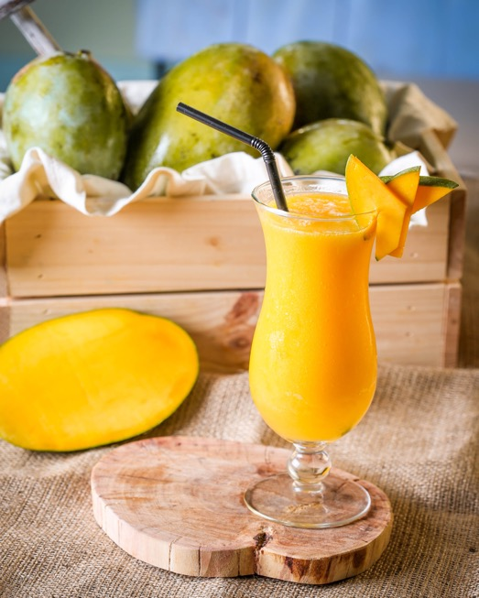
Interesting to note that studies have been unable to demonstrate any antioxidant advantage for consuming fruit as juice over eating the whole fruit.
J Am Coll Nutr. 28(5):574-82.

Slide 16

Juice
3
One study showed a 3 times higher risk for stomach cancer in juice drinkers.
No Juice
1
Normal Risk
Cancer Risk
Asian Pac J Cancer Prev. 5(1):58-65
Notes:
One slide showed that consumption of the recommended servings of whole vegetables reduced the risk of cancer by 30% (OR 0.7), while for the same population, consumption of the same vegetables as juice raised the risk for cancer by 30% (OR 1.3). In other words, juicing increases the risk of cancer. One study showed a 3 times higher risk for stomach cancer in juice drinkers.
http://www.vegetariannutrition.org/fifthcongress.html
Khan MM, Goto R, Kobayashi K, Suzumura S, Nagata Y, Sonoda T, Sakauchi F, Washio M, Mori M. Dietary habits and cancer mortality among middle aged and older Japanese living in hokkaido, Japan by cancer site and sex. Asian Pac J Cancer Prev. 2004 Jan-Mar;5(1):58-65..

Slide 17
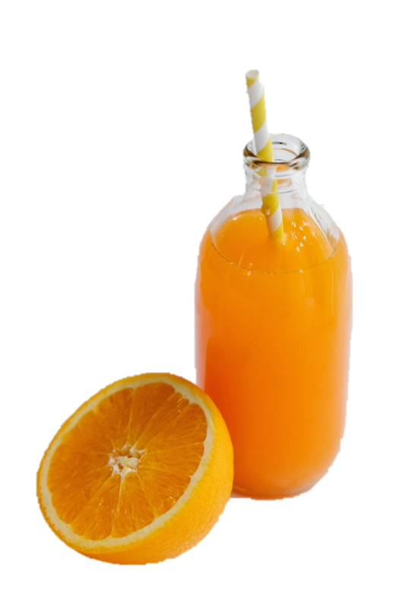
Citrus Juice
Citrus Beverages
Examples: Orange Juice
1 or more drinks per day increase the risk for Basal Cell Carcinoma, Squamous Cell Carcinoma, and Malignant Melanoma.
Yale J Biol Med. 2023 Jun 30;96(2):205-210.
Notes:
Paiva M, Yumeen S, Kahn BJ, Nan H, Cho E, Saliba E, Qureshi A. Coffee, Citrus, and Alcohol: A Review of What We Drink and How it May Affect our Risk for Skin Cancer. Yale J Biol Med. 2023 Jun 30;96(2):205-210.
Climate change and environmental health are closely linked with agriculture and food supply. The environment influences accessibility, quality, and variety of foods and drinks that are available for consumption, which in turn influences population health. A growing area of research is the role of dietary intake of nutrients and how they may influence risk for skin cancer. In recent years, our group has studied dietary nutrients, particularly those found in commonly consumed beverages, such as those containing caffeine, citrus products, and alcohol, in large prospective cohorts to evaluate how their intake may influence risk for skin cancer. Our data suggest that intake of citrus juices, when consumed around once per day or more, or around 5 to 6 times per week, may be associated with increased risk for both keratinocyte carcinomas (KC) and malignant melanoma (MM). With regards to alcohol consumption, we have found that intake of white wine may be associated with increased risk for both KC and MM, while beer and red wine have not shown such associations. Lastly, our work suggests caffeinated beverages, including coffee, tea, and cola, may be associated with decreased risk for basal cell carcinoma (BCC) and MM. While the associations between food intake and skin cancer development are complex, and remain to be further analyzed in future studies, we hope that our summary may help guide individuals to small changes they may make towards potentially reducing their risk for certain skin cancers.

Slide 18
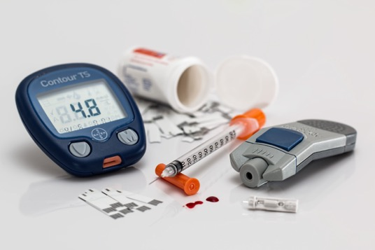
Nutrients are absorbed more quickly and go straight to the blood stream.
One example: sugar.
The removal of fiber.
Excessive insulin production (hypoglycemia).
Get hungry sooner.
Orange juice proved to be no better than a cola drink in its effect on blood sugar.

Slide 19
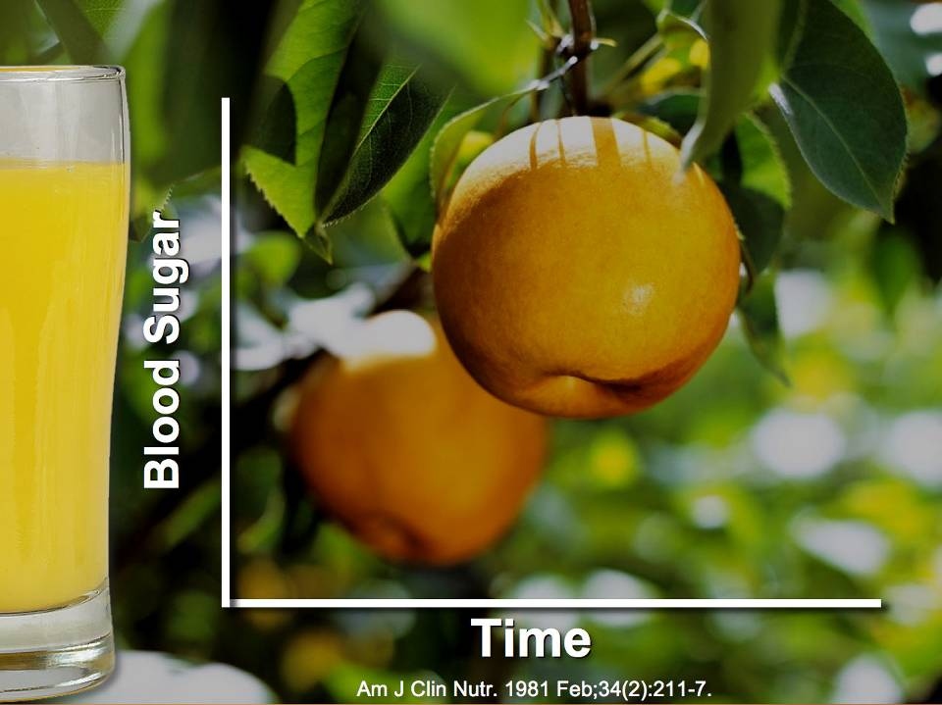

Slide 20
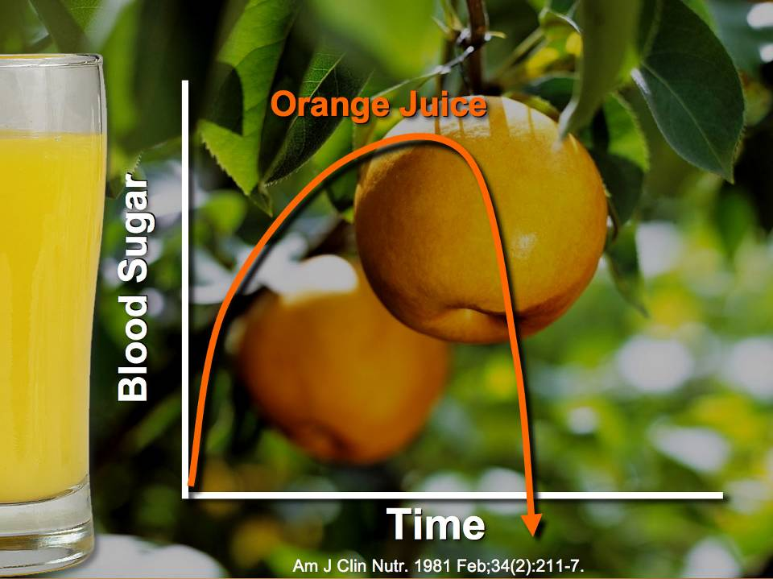

Slide 21
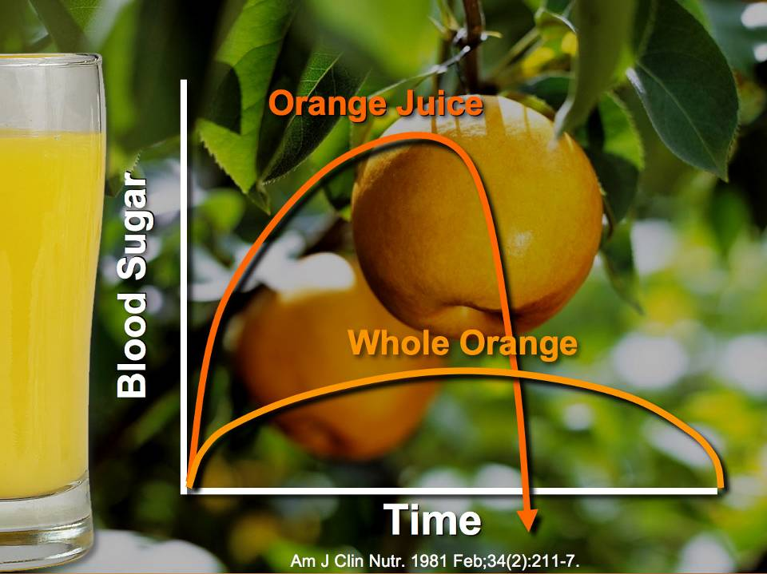

Slide 22
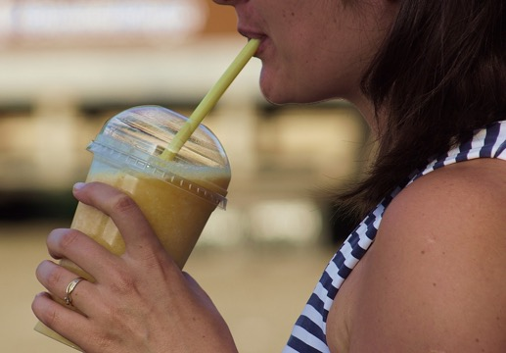
Liquid Diabetes
The faster the sugar hits your blood stream the higher the risk of diabetes. Juice shoots sugar quickly into the blood stream. Drinking fruit juices significantly increases the risk of diabetes.
Diabetes Care. 31(7):1311-7
Notes:
Bazzano LA, Li TY, Joshipura KJ, Hu FB. Intake of fruit, vegetables, and fruit juices and risk of diabetes in women. Diabetes Care. 2008 Jul;31(7):1311-7.

Slide 23
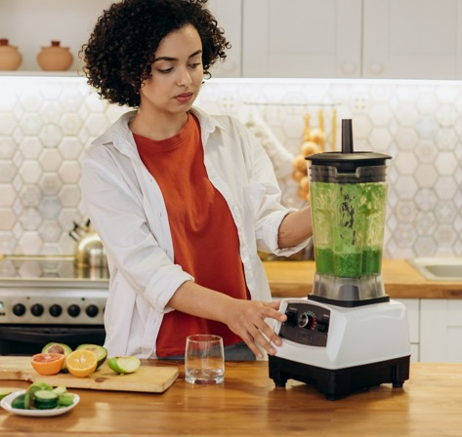
Oxalate as found in such commonly liquefied foods as spinach.
Kale juice can even drive down thyroid function due to anthocyanins.
Carrots are exceptionally sweet, juices discard their filtering fiber, blood sugars escalate.

Slide 24
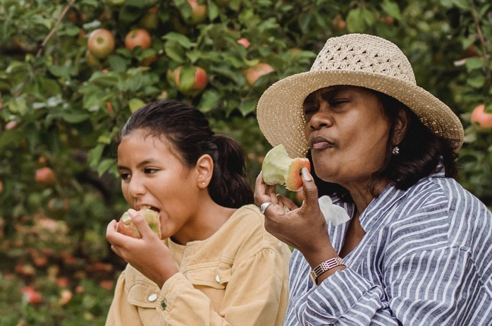
Hearty Chewing Is Part Of Good Appetite Control.
Notes:
Hearty chewing is part of good appetite control. Juices are significantly less satisfying than purées, sauces or smoothies. Purées, sauces or smoothies are significantly less satisfying than whole fruit.,, The faster food is eaten the more calories that are typically eaten. People drinking more liquid food tend to eat faster and can gain more weight.,
Haber GB, Heaton KW, Murphy D, Burroughs LF. Depletion and disruption of dietary fibre. Effects on satiety, plasma-glucose, and serum-insulin. Lancet. 1977 Oct 1;2(8040):679-82.
Flood-Obbagy JE, Rolls BJ. The effect of fruit in different forms on energy intake and satiety at a meal. Appetite. 2009 Apr;52(2):416-22.
Mourao DM, Bressan J, Campbell WW, Mattes RD. Effects of food form on appetite and energy intake in lean and obese young adults. Int J Obes (Lond). 2007 Nov;31(11):1688-95.
Schulze MB, Manson JE, Ludwig DS, Colditz GA, Stampfer MJ, Willett WC, Hu FB. Sugar-sweetened beverages, weight gain, and incidence of type 2 diabetes in young and middle-aged women. JAMA. 2004 Aug 25;292(8):927-34.
Wojcicki JM, Heyman MB. Reducing childhood obesity by eliminating 100% fruit juice. Am J Public Health. 2012 Sep;102(9):1630-3.

Slide 25
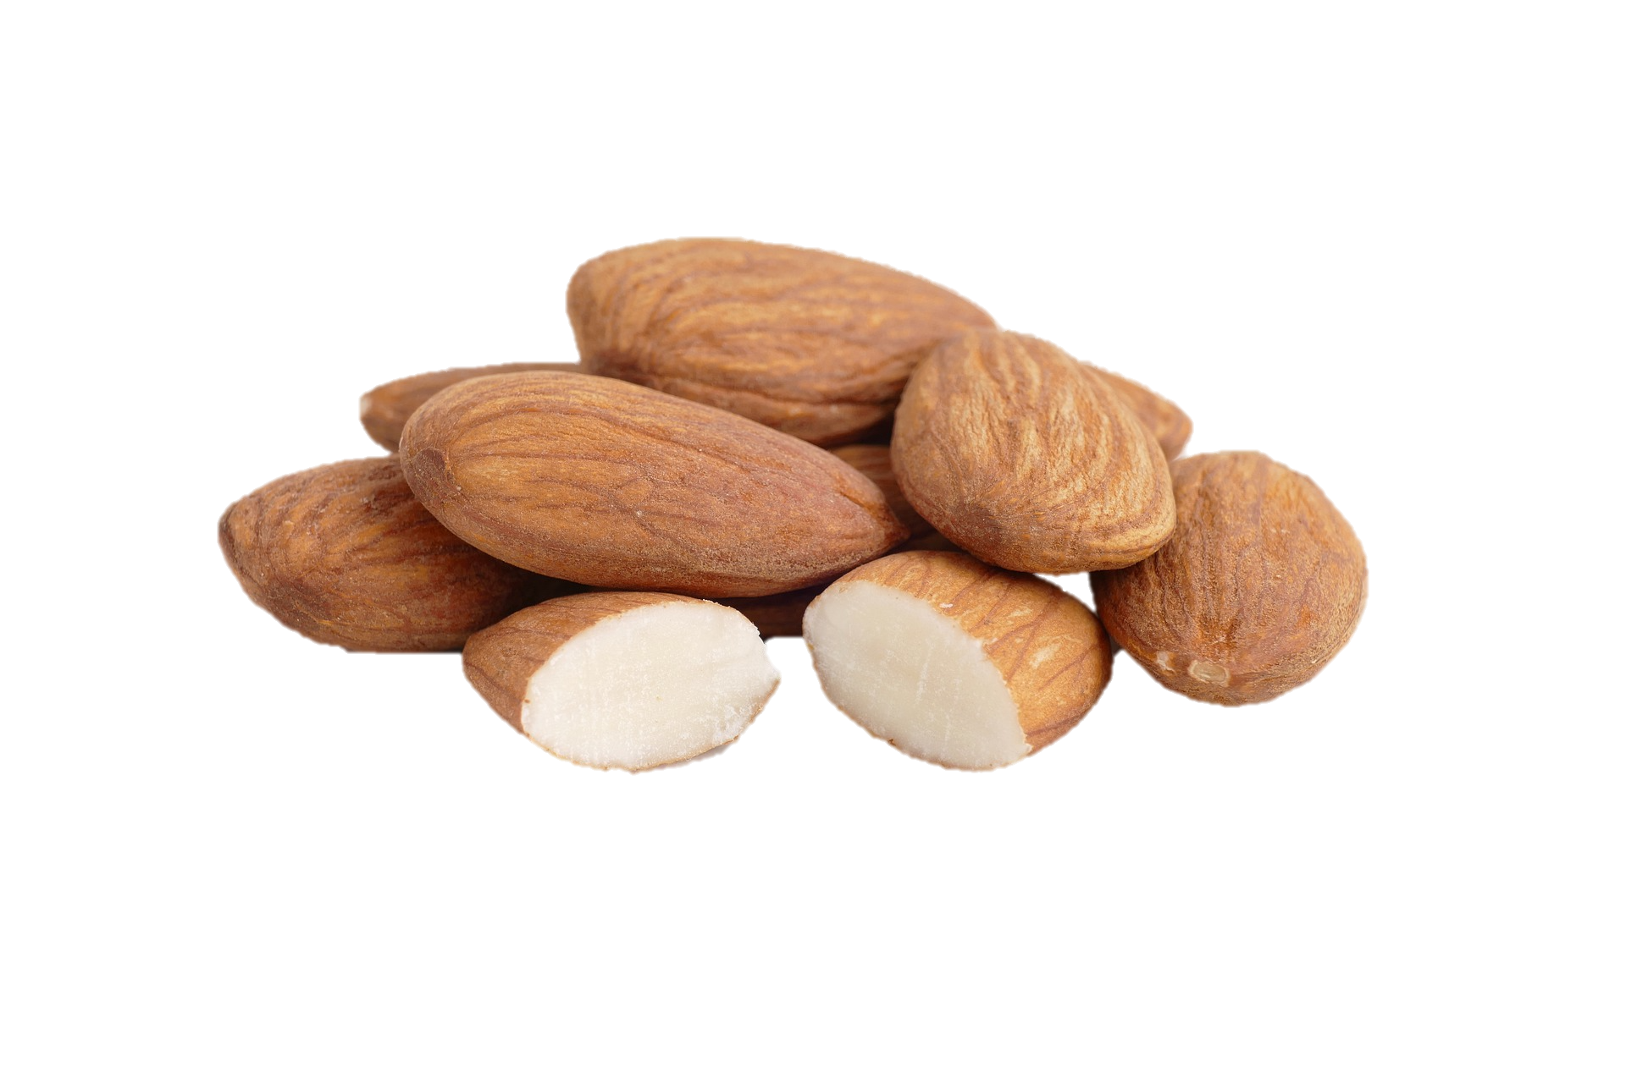
The More You Chew, The Less Food It Takes To Satisfy Your Appetite
Notes:
Choosing foods that require more chewing can help reduce the number of calories eaten and help with weight management. Thorough chewing increases food satisfaction and decreases appetite. The more you chew, the less food it takes to satisfy your appetite. Appetite is reduced by nerve feedback from the teeth to the brain when you chew something that is hard. Liquid nutrition does not engage the teeth as solid foods do, therefore they do not satisfy the appetite as do solid foods.
Li J, Zhang N, Hu L, Li Z, Li R, Li C, Wang S. Improvement in chewing activity reduces energy intake in one meal and modulates plasma gut hormone concentrations in obese and lean young Chinese men.Am J Clin Nutr. 2011 Sep;94(3):709-16.
Smeets AJ, Westerterp-Plantenga MS. Oral exposure and sensory-specific satiety. Physiol Behav. 2006 Sep 30;89(2):281-6.
Sakata T, Yoshimatsu H, Masaki T, Tsuda K. Anti-Obesity Actions of Mastication Driven by Histamine Neurons in Rats. Exp Biol Med 228:1106–1110, 2003.

Slide 26
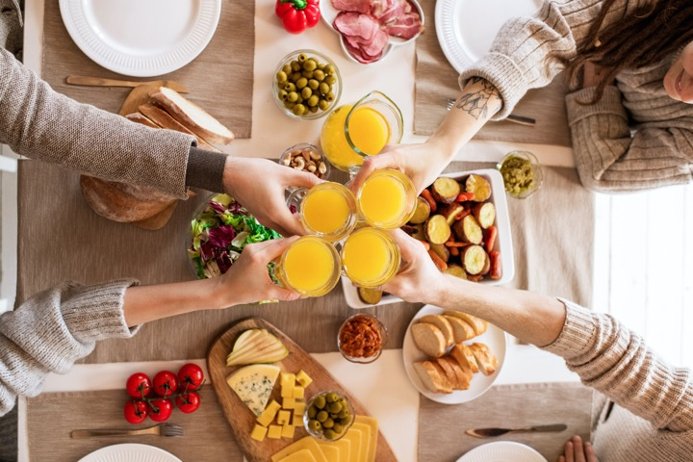
Liquids Consumed With A Solid Food Meal Do Not Decrease The Amount Of Food Eaten
Notes:
Liquids consumed with a solid meal do not decrease the amount of food eaten, they just tend to add to the total number of calories consumed. If you drink with your meal you will tend to eat the same amount of food, the liquid just adds calories, this will just add to your weight gain.
Panahi S, Khoury DE, Luhovyy BL, Douglas Goff H, Harvey Anderson G. Caloric Beverages Consumed Freely at Meal-time Add Calories to an Ad libitum Meal. Appetite. 2013 Feb 9. [Epub ahead of print].

Slide 27
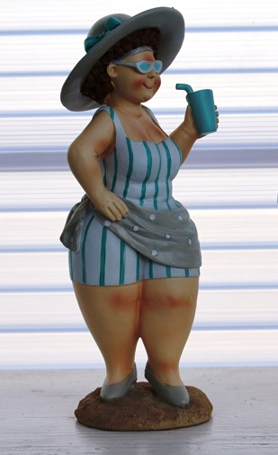
People who eat more fiber will tend to eat fewer calories and be less apt to become obese and get diabetes.
Notes:
When the intestines do not sense the presence of substantial fiber in the food the appetite is not suppressed and over nutrition can result., People who eat more fiber will tend to eat fewer calories and be less apt to become obese and get diabetes., This effect is not limited to the meal currently being eaten, low natural fiber content in food makes it so the person will eat a greater amount of food at the next meal too.
Davis JD, Collins BJ. Distention of the small intestine, satiety, and the control of food intake. Am J Clin Nutr. 1978 Oct;31(10 Suppl):S255-S258.
St-Pierre DH, Rabasa-Lhoret R, Lavoie ME, Karelis AD, Strychar I, Doucet E, Coderre L. Fiber intake predicts ghrelin levels in overweight and obese postmenopausal women. Eur J Endocrinol. 2009 Jul;161(1):65-72.
Burton-Freeman B. Dietary fiber and energy regulation. J Nutr. 2000 Feb;130(2S Suppl):272S-275S.
Howarth NC, Saltzman E, Roberts SB. Dietary fiber and weight regulation. Nutr Rev. 2001 May;59(5):129-39.
Levine AS, Tallman JR, Grace MK, Parker SA, Billington CJ, Levitt MD. Effect of breakfast cereals on short-term food intake. Am J Clin Nutr. 1989 Dec;50(6):1303-7.

Slide 28
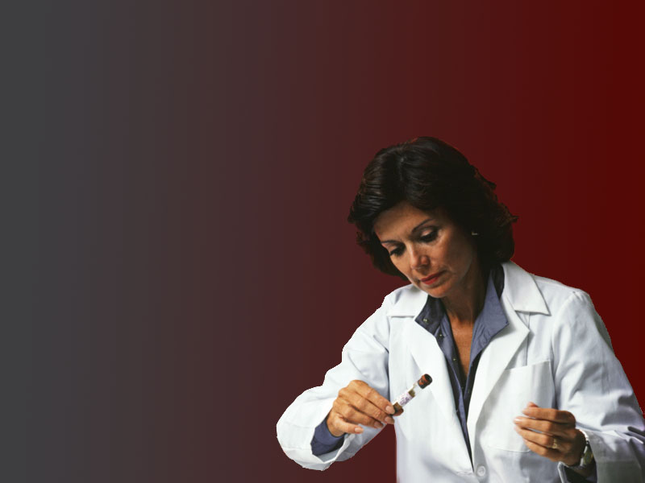
Drinks That Increase Your Insulin Levels Will Also Raise Your Cholesterol.

Slide 29
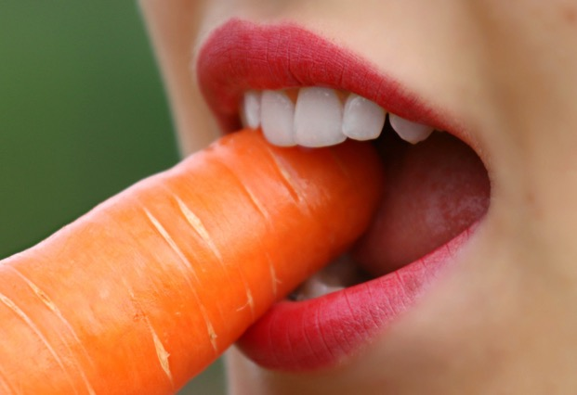
Digestion begins in your mouth.
Notes:
Digestion begins in your mouth. You need saliva with amylase and other enzymes to digest your food properly and for you to get all the nutrients you need from it. Solid foods in your mouth that require extensive chewing stimulate the saliva glands to produce a greater volume and better quality of saliva to begin digestion.,
Korot'ko GF, Kadirov Sh. The bilateral autonomy of enzyme secretion by human salivary glands. Stomatologiia (Mosk). 1994 Jan-Mar;73(1):26-8.
Mackie DA, Pangborn RM. Mastication and its influence on human salivary flow and alpha-amylase secretion. Physiol Behav. 1990 Mar;47(3):593-5.

Slide 30
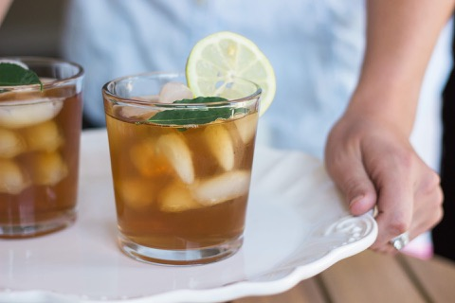
“Many make a mistake in drinking cold water with their meals. Taken with meals water diminishes the flow of the salivary glands; and the colder the water, the greater the injury to the stomach. Ice water or iced lemonade, drank with meals, will arrest digestion until the system has imparted sufficient warmth to the stomach to enable it to take up its work again. Hot drinks are debilitating; and besides, those who indulge in their use become slaves to the habit. Food should not be washed down; no drink is needed with meals. Eat slowly, and allow the saliva to mingle with the food. The more liquid there is taken into the stomach with the meals, the more difficult it is for the food to digest; for the liquid must first be absorbed. … But if anything is needed to quench thirst, pure water drank some little time before or after the meal is all that nature requires. Never take tea, coffee, beer, wine, or any spirituous liquors. Water is the best liquid possible to cleanse the tissues.” {RH, july 29, 1884 par. 7}

Slide 31
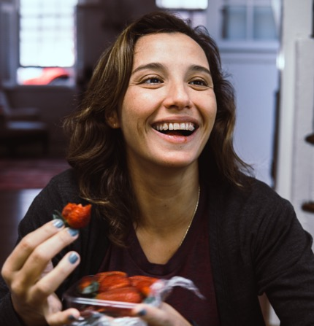
Saliva Is Rich In Enzymes, Cofactors And Water Necessary To Process Your Food.
Notes:
Saliva is rich in enzymes, cofactors and water necessary to process your food. How hard you chew determines how much saliva will be produced and how loaded it will be in enzymes. Dry foods stimulate the glands to produce even more saliva higher in amylase than liquid foods. If you are quickly drinking down smoothies or juices, enzymes will be missing from your digestion, digestion will be incomplete, nutrients from the valuable food you are eating will be lost to you and you could become deficient in some necessary nutrient.
Kurahashi M, Inomata K. Effects of dietary consistency and water content on parotid amylase secretion and gastric starch digestion in rats. Arch Oral Biol. 1999 Dec;44(12):1013-9.

Slide 32
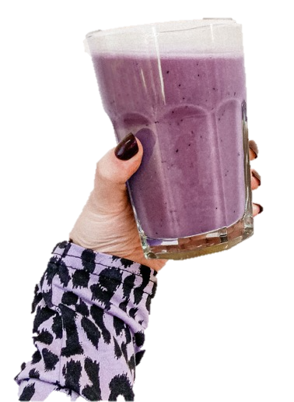
Don’t Have Enough Time To Eat? In A Hurry! Stress Decreases Saliva Production.
Notes:
“But I don’t have enough time to eat, I’m in a hurry!” Stress decreases saliva production. If you do not have enough time to eat, better to skip the meal and just drink water than to slurp down a smoothie. Stressed living is the source of many modern ailments. Failing to plan adequate time for meals and substituting with liquid nutrition are not healthy. Interestingly, thorough chewing helps relieve the physiological effects of stress.
Morse DR, Schacterle GR, Furst L, Zaydenberg M, Pollack RL. Oral digestion of a complex-carbohydrate cereal: effects of stress and relaxation on physiological and salivary measures. Am J Clin Nutr. 1989 Jan;49(1):97-105.
Hori N, Lee MC, Sasaguri K, Ishii H, Kamei M, Kimoto K, Toyoda M, Sato S. Suppression of stress-induced nNOS expression in the rat hypothalamus by biting. J Dent Res. 2005 Jul;84(7):624-8.

Slide 33
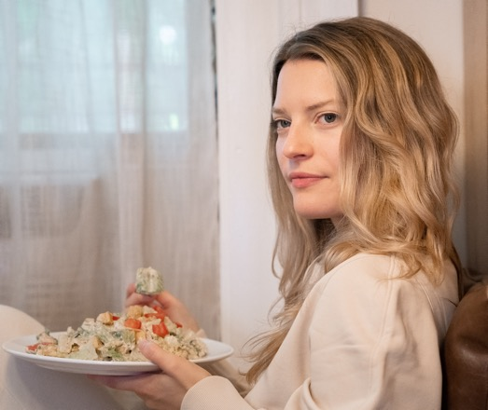
Longer In The Mouth Better For The Health
“The benefit you derive from your food does not depend so much on the quantity eaten as on its thorough digestion, nor the gratification of the taste so much on the amount of food swallowed as on the length of time it remains in the mouth. Those who are excited, anxious, or in A great hurry, would do well not to eat until they have found rest or relief; for the vital powers, already severely taxed, cannot supply the necessary gastric juice.” {RH, july 29, 1884 par. 9}

Slide 34
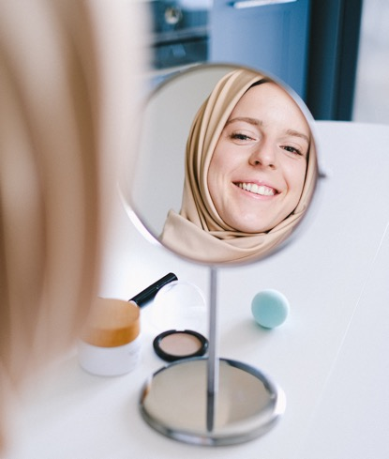
Straight Teeth
Notes:
For children, eating foods that require more chewing builds the jaw, spreads the teeth and makes it less likely that they will need braces from an orthodontist to straighten out their bite.,
Limme M. The need of efficient chewing function in young children as prevention of dental malposition and malocclusion. Arch Pediatr. 2010 Dec;17 Suppl 5:S213-9.
Varrela J. Occurrence of malocclusion in attritive environment: a study of a skull sample from southwest Finland. Scand J Dent Res. 1990 Jun;98(3):242-7.

Slide 35
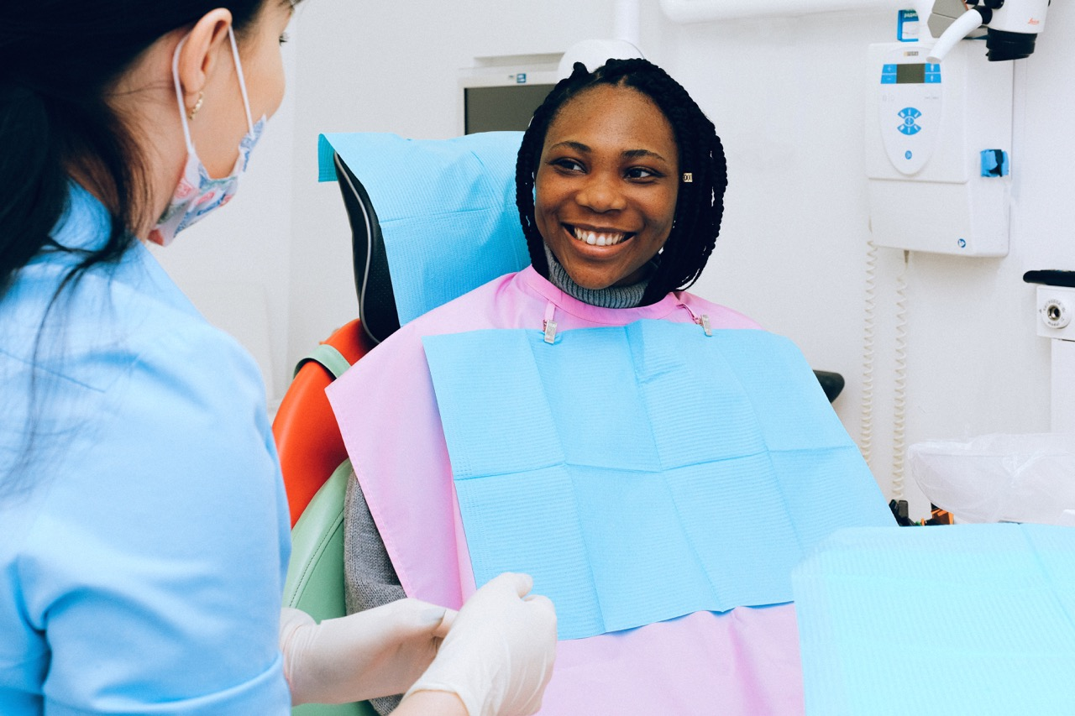
Fruit smoothies are acidic and soften teeth and cause dental erosion.
J Dent 43(8):865–75.
Notes:
Fruit smoothies tend to be acidic and have been shown to soften teeth and cause dental erosion. The article concludes, In order to minimize the risk of developing dental erosion their consumption should be confined to mealtimes. Which goes without saying, since eating juices or smoothies between meals is not something people pursuing optimal health would choose to do. Dental cavities or decay are significantly higher in juice drinkers.
Blacker SM, Chadwick RG. An in vitro investigation of the erosive potential of smoothies. Br Dent J. 2013 Feb;214(4):E9.
Salas MM, Nascimento GG, Vargas-Ferreira F, Tarquinio SB, Huysmans MC, Demarco FF. Diet influenced tooth erosion prevalence in children and adolescents: results of a meta-analysis and meta-regression. J Dent 2015;43(8):865–75.

Slide 36

Not whole nutritious food
Notes:
Juicing separates juice from the whole fruit or vegetable. The processing results in a reduction in vitamins and minerals, because the nutrient-rich skin and fiber is left behind or the fiber is disrupted with blending.

Slide 37
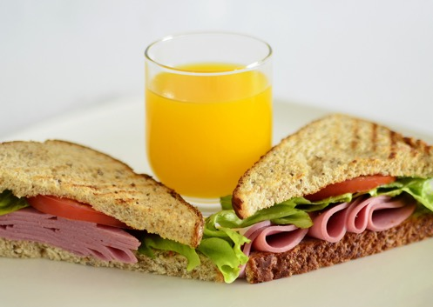
Liquid Food Classified With Meat
“The dishes of soft foods, the soups and liquid foods, or the free use of meat, are not the best to give healthful muscles, sound digestive organs, or clear brains. O how slow we are to learn! … Solid foods requiring mastication will be far better than mush or liquid foods.” {Fe 225.2}

Slide 38
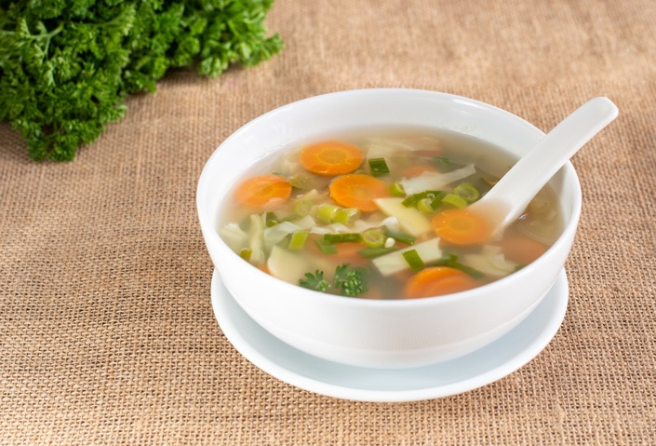
Excess Fluid Must Be Adsorbed Before Serious Digestion Can Begin
“In fact, the more liquid there is taken with the meals, the more difficult it is for the food to digest; for the liquid must be absorbed before digestion can begin.” {Cch 224.5}
Notes:
In the stomach, a liquid meal just makes for more work; the excess fluid must be adsorbed before serious digestion can begin., Having not spent much time in the mouth, the fluid is in danger of being warmer or colder than what the stomach likes, thus hampering or even delaying digestion.
Houghton LA, Read NW, Heddle R, Horowitz M, Collins PJ, Chatterton B, Dent J. Relationship of the motor activity of the antrum, pylorus, and duodenum to gastric emptying of a solid-liquid mixed meal. Gastroenterology. 1988 Jun;94(6):1285-91.
Horowitz M, Collins PJ, Shearman DJ. Effect of increasing the caloric/osmotic content of the liquid component of a mixed solid and liquid meal on gastric emptying in obese subjects. Hum Nutr Clin Nutr. 1986 Jan;40(1):51-6.
Sun WM, Houghton LA, Read NW, Grundy DG, Johnson AG. Effect of meal temperature on gastric emptying of liquids in man. Gut. 1988 Mar;29(3):302-5.

Slide 39
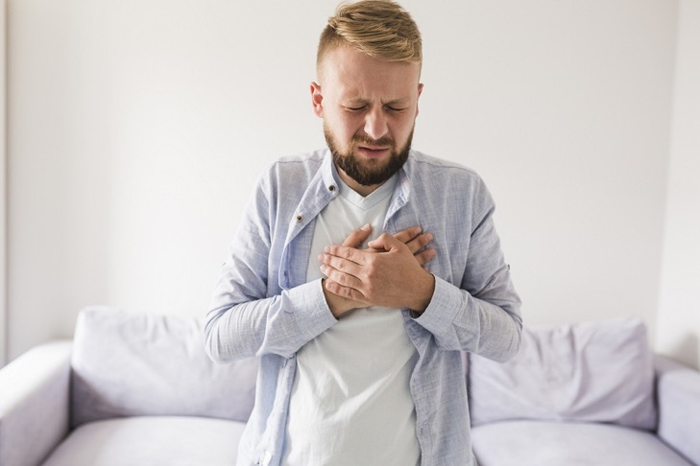
Reflux And Heartburn
Notes:
Many people suffer with reflux disease. For the esophagus, a liquid taken into the stomach just tends to put it at greater risk for reflux and its associated heart burn., Solid food stays down much better.
Kusunoki H, Haruma K, Hata J, Tani H, Okamoto E, Sumii K, Kajiyama G. Real-time ultrasonographic assessment of antroduodenal motility after ingestion of solid and liquid meals by patients with functional dyspepsia. J Gastroenterol Hepatol. 2000 Sep;15(9):1022-7.
Aksglaede K, Thorsen B, Christiansen T, Thommesen P. Gastrooesophageal reflux during liquid and solid meals. A reevaluation of the de Carvalho test. Rofo. 1986 Oct;145(4):434-6.

Slide 40
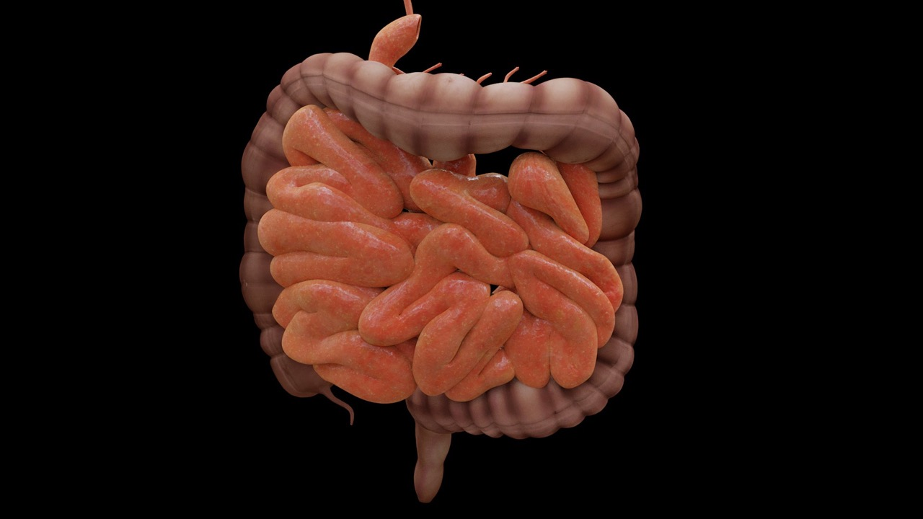
Fiber Provides Bulk
Notes:
Fiber is the bulk in food that gives it body or fullness. When a meal, complete with unprocessed natural fiber enters the intestines, it provides bulk, which stretches the intestinal walls. When the walls or the intestines sense stretching, they send a signal to the stomach to cut back on digestive acid. Juices and smoothies with disrupted fiber do not provide this stimulus for acid reduction; the stomach continues to make too much acid, and heart burn, reflux and indigestion can be the result.²⁸

Slide 41
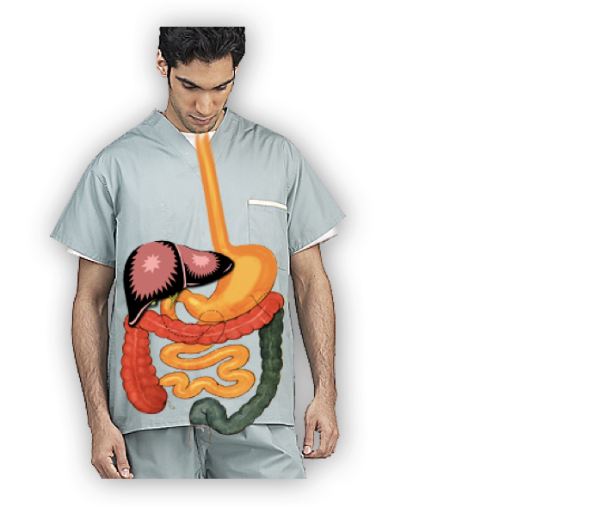
If You Don’t Use It, You Loose It!
Notes:
When predigested liquid meals such as juices are substituted instead of whole foods the intestines atrophy. Intestines that are atrophied are more prone to disease and poor adsorption of nutrients.
Playford RJ, Woodman AC, Clark P, Watanapa P, Vesey D, Deprez PH, Williamson RC, Calam J. Effect of luminal growth factor preservation on intestinal growth. Lancet. 1993 Apr 3;341(8849):843-8.

Slide 42
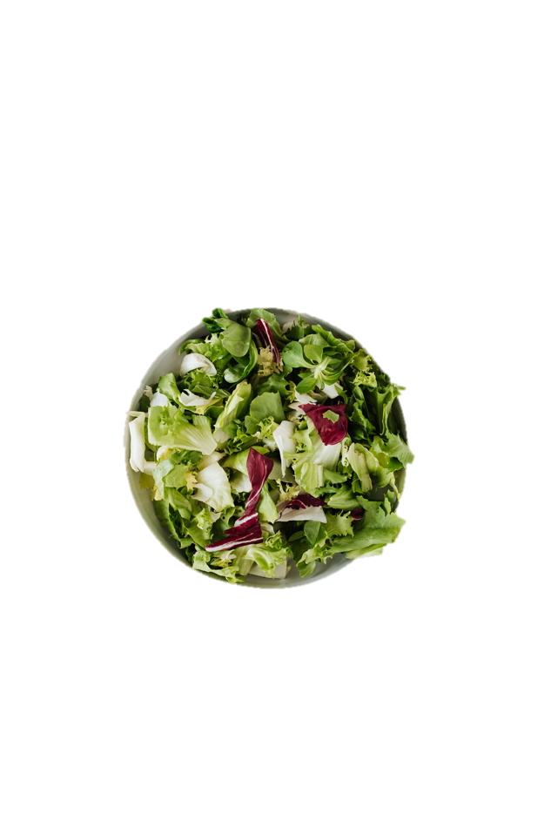
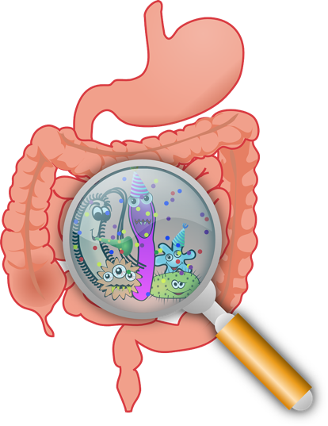
Feeding The Flora
Notes:
Good dietary fiber is important for the health of the intestines, it reduces inflammation and as it breaks down it actually feeds healthy intestinal flora. We call this good fiber prebiotics.
Hamer HM, Jonkers D, Venema K, Vanhoutvin S, Troost FJ, Brummer RJ. Review article: the role of butyrate on colonic function.Aliment Pharmacol Ther. 2008 Jan 15;27(2):104-19

Slide 43
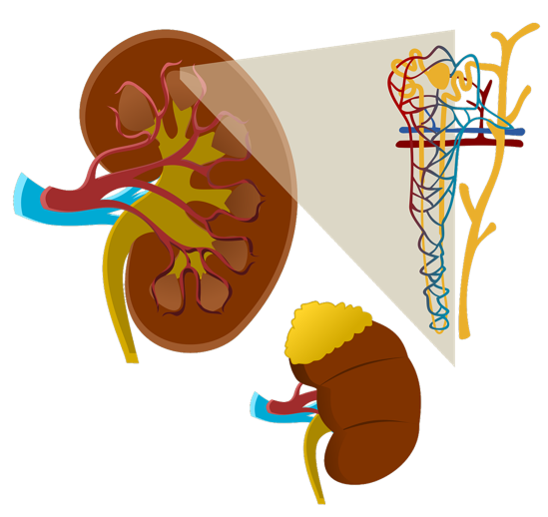
Blood sludges, kidneys plug and Brain fogs
Notes:
Where does all this liquid food end up that goes rushing into the blood stream? The filters are the kidneys and they really suffer, not to mention, until the kidneys do clear the murk out of the blood you may experience some brain fog. Liquid food is a major hazard for people with kidney failure and increases the risk of kidney cancer.,
Handa K, Kreiger N. Diet patterns and the risk of renal cell carcinoma.
Public Health Nutr 2002;5:757– 67.
Rashidkhani B, Lindblad P, Wolk A. Fruits, vegetables and risk of renal cell carcinoma: a prospective study of Swedish women. Int J Cancer. 2005 Jan 20;113(3):451-5.

Slide 44
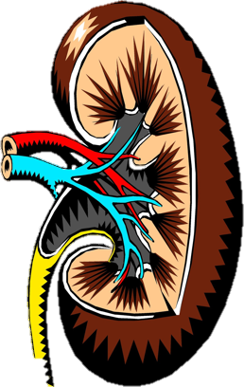
“I told them that the preparation of their food was wrong, and that living principally on soups and coffee and bread was not health reform; that so much liquid taken into the stomach was not healthful, and that all who subsisted on such a diet placed a great tax upon the kidneys, and so much watery substance debilitated the stomach.” {CD 105.2}
Notes:
Liquid food taxes the kidneys
I told them that the preparation of their food was wrong, and that living principally on soups and coffee and bread was not health reform; that so much liquid taken into the stomach was not healthful, and that all who subsisted on such a diet placed a great tax upon the kidneys, and so much watery substance debilitated the stomach. {CD 105.2}

Slide 45

Notes:
A lot of people fight high blood pressure. Studies of people consuming liquid nutrition demonstrate that juices are no aid in controlling hypertension, in fact they compound the problem by increasing, especially diastolic blood pressure.
Kelsay JL, Behall KM, Prather ES. Effect of fiber from fruits and vegetables on metabolic responses of human subjects I. Bowel transit time, number of defecations, fecal weight, urinary excretions of energy and nitrogen and apparent digestibilities of energy, nitrogen, and fat. Am J Clin Nutr. 1978 Jul;31(7):1149-53.

Slide 46
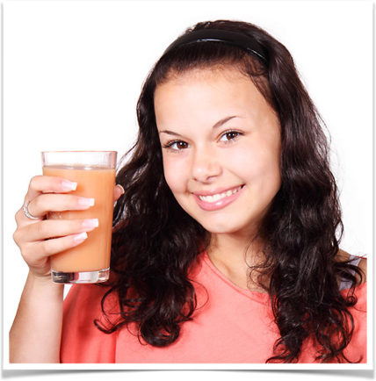
Studies show that chewing actually has a positive effect on brain function, cognition, and reduces depression.
People who drink juice every day have lower brain volumes and poorer memories.
Alzheimers Dement. 13(9):955-964.
Notes:
In case I forget, I want to mention, people who drink juice every day have lower total brain volume, lower hippocampal volume, and poorer memories, making juice drinking a serious risk factor for Alzheimer’s dementia. Studies show that chewing actually has a positive effect on brain function, cognition, and reduces depression. In fact, poor dentition correlates with cognitive decline.
Pase MP, Himali JJ, Jacques PF, DeCarli C, Satizabal CL, Aparicio H, Vasan RS, Beiser AS, Seshadri S. Sugary beverage intake and preclinical Alzheimer's disease in the community. Alzheimers Dement. 2017 Sep;13(9):955-964.
Chen H, Iinuma M, Onozuka M, Kubo KY. Chewing Maintains Hippocampus-Dependent Cognitive Function. Int J Med Sci. 2015 Jun 9;12(6):502-9.
Galindo-Moreno P, Lopez-Chaichio L, Padial-Molina M, Avila-Ortiz G, O'Valle F, Ravida A, Catena A. The impact of tooth loss on cognitive function. Clin Oral Investig. 2021 Dec 8.
People who drink juice every day have lower total brain volume, lower hippocampal volume, and poorer memories.
doi: 10.1016/j.jalz.2017.01.024. Epub 2017 Mar 6.
Pase MP, Himali JJ, Jacques PF, DeCarli C, Satizabal CL, Aparicio H, Vasan RS, Beiser AS, Seshadri S. Sugary beverage intake and preclinical Alzheimer's disease in the community. Alzheimers Dement. 2017 Sep;13(9):955-964.
Author information
Abstract
INTRODUCTION:
Excess sugar consumption has been linked with Alzheimer's disease (AD) pathology in animal models.
METHODS:
We examined the cross-sectional association of sugary beverage consumption with neuropsychological (N = 4276) and magnetic resonance imaging (N = 3846) markers of preclinical Alzheimer's disease and vascular brain injury (VBI) in the community-based Framingham Heart Study. Intake of sugary beverages was estimated using a food frequency questionnaire.
RESULTS:
Relative to consuming less than one sugary beverage per day, higher intake of sugary beverages was associated with lower total brain volume (1-2/day, β ± standard error [SE] = -0.55 ± 0.14 mean percent difference, P = .0002; >2/day, β ± SE = -0.68 ± 0.18, P < .0001), and poorer performance on tests of episodic memory (all P < .01). Daily fruit juice intake was associated with lower total brain volume, hippocampal volume, and poorer episodic memory (all P < .05). Sugary beverage intake was not associated with VBI in a consistent manner across outcomes.
DISCUSSION:
Higher intake of sugary beverages was associated cross-sectionally with markers of preclinical AD.
Copyright © 2017 the Alzheimer's Association. Published by Elsevier Inc. All rights reserved.
KEYWORDS:
Alzheimer's disease; Dementia; Diet; Framingham Heart Study; Sugar
PMID: 28274718
Of Daniel and his fellows the Scripture states: “As for these four children, God gave them knowledge and skill in all learning and wisdom: and Daniel had understanding in all visions and dreams.” In what manner are you fitting yourselves to co-operate with God? “Draw nigh to God, and He will draw nigh to you.” “Resist the devil, and he will flee from you.” Let the diet be carefully studied; it is not healthful. The various little dishes concocted for desserts are injurious instead of helpful and healthful, and from the light given me, there should be a decided change in the preparation of food. There should be a skillful, thorough cook, that will give ample supplies of substantial dishes to the hungry students. The education in this line of table supplies is not correct, healthful, or satisfying, and a decided reform is essential. These students are God’s inheritance, and the most sound and healthful principles are to be brought into the boarding-school in regard to diet. The dishes of soft foods, the soups and liquid foods, or the free use of meat, are not the best to give healthful muscles, sound digestive organs, or clear brains. O how slow we are to learn! And of all institutions in our world the school is the most important! Here the diet question is to be studied; no one person’s appetite, or tastes, or fancy or notion is to be followed; but there is need of great reform; for lifelong injury will surely be the result of the present manner of cooking. Of all the positions of importance in that college, the first is that of the one who is employed to direct in the preparation of the dishes to be placed before the hungry students; for if this work is neglected, the mind will not be prepared to do its work, because the stomach has been treated unwisely and cannot do its work properly. Strong minds are needed. The human intellect must gain expansion and vigor and acuteness and activity. It must be taxed to do hard work, or it will become weak and inefficient. Brain power is required to think most earnestly; it must be put to the stretch to solve hard problems and master them, else the mind decreases in power and aptitude to think. The mind must invent, work, and wrestle, in order to give hardness and vigor to the intellect; and if the physical organs are not kept in the most healthful condition by substantial, nourishing food, the brain does not receive its portion of nutrition to work. Daniel understood this, and he brought himself to a plain, simple, nutritious diet, and refused the luxuries of the king’s table. The desserts which take so much time to prepare, are, many of them, detrimental to health. Solid foods requiring mastication will be far better than mush or liquid foods. I dwell upon this as essential. I send my warning to the College at Battle Creek, to go from there to all our institutions of learning. Study up on these subjects, and let the students obtain a proper education in the preparation of wholesome, appetizing, solid foods that nourish the system. They do not have now, and have not had in the past, the right kind of training and education as to the most healthful food to make healthful sinews and muscle, and give nourishment to the brain and nerve powers. { FE 225.2}

Slide 47

Do Not Give Liquid Food To Students
“I know not who is cook at the boarding hall, but I beseech you, do not place any persons to oversee the cooking of food for the college students unless they have a thorough knowledge of the right kind of cooking, that the students shall take away with them the very best intelligence of what hygienic cooking means. The much-liquid food, the pastries, the desserts, prepared for the table after european hotel fashion, is not the proper food to place before a hungry lot of students, whose appetites are keen to devour the most substantial food. … The students pay for their board; give them good, solid, nourishing food.”-- {2MR 217.2}
Notes:
Do not give liquid food to students
I know not who is cook at the boarding hall, but I beseech you, do not place any persons to oversee the cooking of food for the college students unless they have a thorough knowledge of the right kind of cooking, that the students shall take away with them the very best intelligence of what hygienic cooking means. The much-liquid food, the pastries, the desserts, prepared for the table after European hotel fashion, is not the proper food to place before a hungry lot of students, whose appetites are keen to devour the most substantial food. … The students pay for their board; give them good, solid, nourishing food.--Letter 46, 1893, p. 5. (To W. W. Prescott, Sept. 5, 1893.) {2MR 217.2}

Slide 48
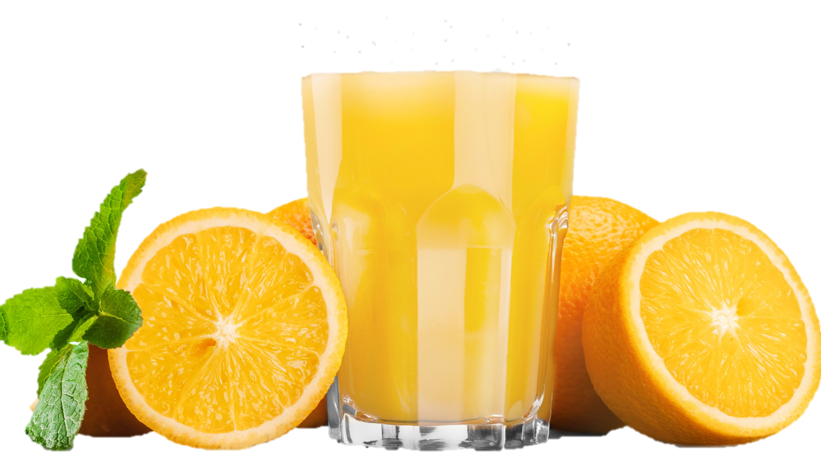
Dying for a drink?
Notes:
I am not saying to never take a sip of juice. Pointing out the disadvantages of some lifestyle practice is not a complete condemnation of it entirely. Situations where a little liquid food could be lifesaving would include someone with dangerously low blood sugar, or someone who has extreme debilitating fatigue.

Slide 49
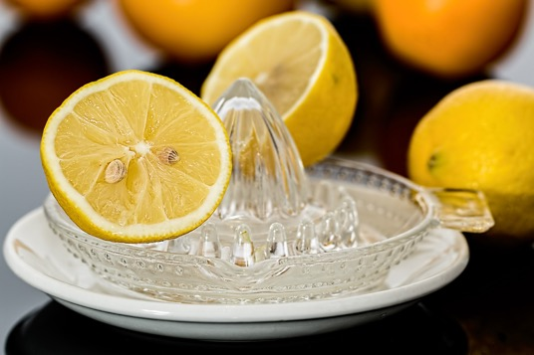
“It is a treat to have all the oranges we want. I use lemon juice freely. It is the best thing you could use for rheumatism, for your head, and for malaria.”-- {2MR 48.1}

Slide 50
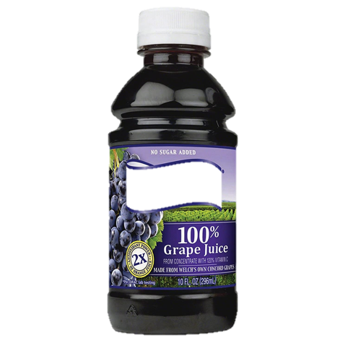
“I was weak, and my heart pained me. I felt the need of a strong cordial, but there was nothing in the house but grape juice. I took some of this, and it strengthened me, but I was much exhausted.” {17MR 61.2}

Slide 51

“It is many years since I have had meat on my table at home. We never use tea or coffee. Occasionally I have used red-clover-blossom tea for a warm drink, but few of my family drink any fluid at our meals. The table is provided with cream instead of butter, even though we have company present. I have not used butter for many years.” {Cd 492.1}

Slide 52
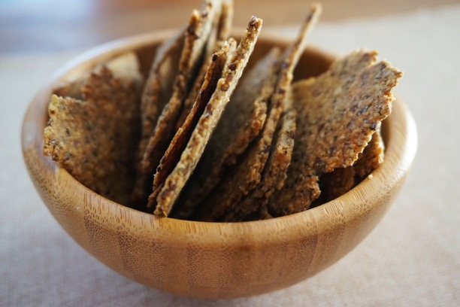
“I have recently left off the use of all liquids, such as homemade coffee, with my meals. I eat my food as dry as possible. The result is excellent. In the morning I take lemon and water. I drink nothing between meals unless it be occasionally some lemon and water. At the table I do not eat many things either. I use dry peas boiled, then strained, then baked, and canned tomatoes. When fresh, I use the tomatoes uncooked with bread. This is my principal article of food.” {21MR 290.6}

Slide 53
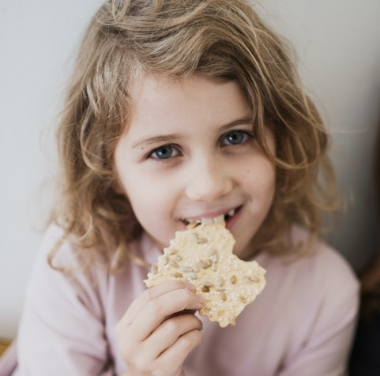
Summary
Chew your food long and well for best nutrition!
Choose whole foods that you can chew well.
Eat foods dry and let your saliva start the digestion.
Eat whole plant foods complete with natural healthy fiber.

Slide 54
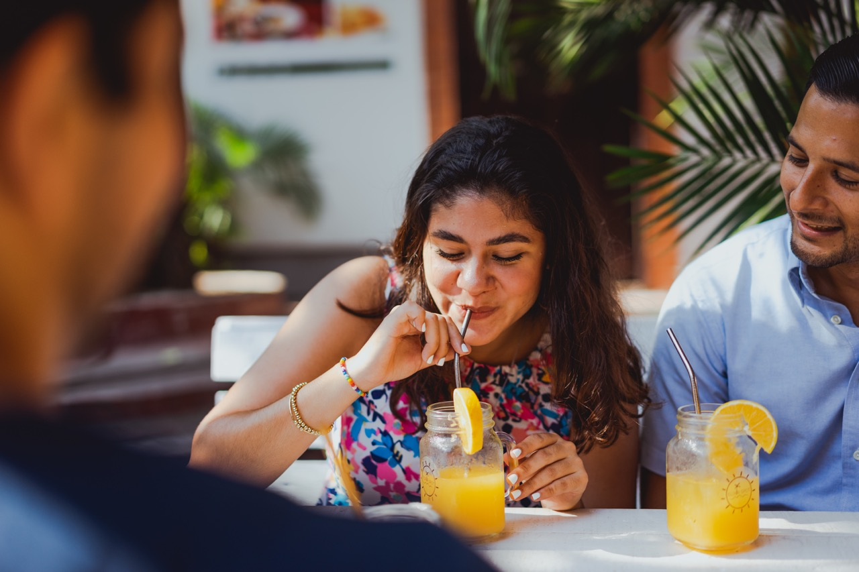
Habits are difficult to change, and some of these practices we have embraced unwittingly.
But God loves us and is willing to supply the power for positive change.
Aren’t you glad we serve a God like that?

