Slide 1

Hydrotherapy or
Water Therapy
Notes:
Diabetic foot in MD

Slide 2
“God’s miracles do not always bear the outward semblance of miracles. Often they are brought about in a way which looks like the natural course of events.
“When we pray for the sick, we also work for them. We answer our own prayers by using the remedies within our reach.
“Water, wisely applied, is a most powerful remedy. As it is used intelligently, favorable results are seen.
“God has given us intelligence, and He desires us to make the most of His health-giving blessings.” {2SM 346.3}

Slide 3
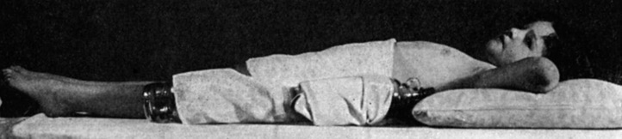
What is hydrotherapy?
Hydrotherapy may be defined as the use of water, in any of its forms, for the maintenance of health, or the treatment of disease.
Hot water applied to the body dilates local blood vessels and increases blood flow, relieving pain, congestion, muscle cramps and inflammation. It moves blood by attracting it to the place of warmth and by reflex reaction.
Cold water applied to the body tends to constrict local blood vessels and decrease local blood flow. It moves blood away from the area both by local effects and by reflex reaction.

Slide 4
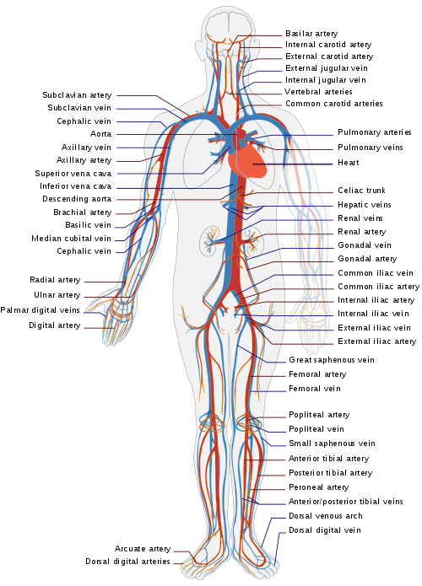
Perfect Health Depends on Perfect Circulation.
Decongest:
  Decrease inflammation.
  Reduce areas of thermal overload, i.e. fever.
Notes:
Fasciitis H & C

Slide 5
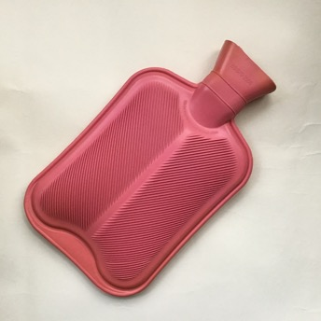
Understanding Hydrotherapy
Physiological responses
Hot dilates capillaries—skin turns red. Metabolic activity increases.
Cold constricts capillaries—skin can become white. Metabolic activity decreases.
Underlying organs respond with either relaxation or increased activity.
Body temperature responds accordingly.
Metabolism, or body chemistry is accelerated/digestion improved.

Slide 6
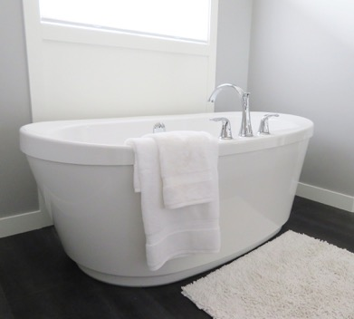
Benefits of Hydrotherapy
The most effective therapy modality known to fight disease, ageing, infections, pain.
Improved digestive tract functions.
Sets the stage for detoxification.
Brain and nervous system toned and calmed.
Heart rate is increased and strengthened.
Notes:
Trent Sitz

Slide 7
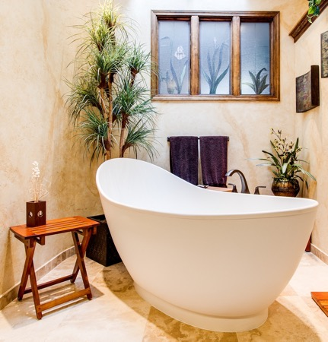
Mental clarity, increased emotional stability.
Immune system strengthened and enabled.
Lymph flow increased and activity increase.
White blood cells increase in numbers and chemistry, lymphocytes increase in numbers.
Notes:
IV drug users

Slide 8
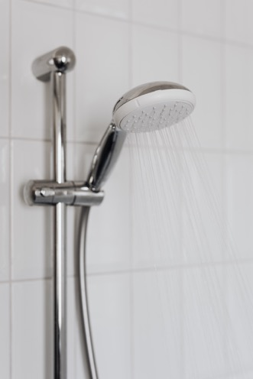
Increased interferon production.
Increased ability and strength to resistance disease.
Quicker healing from trauma with minimal tissue damage.
Less burn scaring, quicker healing due to increased circulation in capillaries.
Notes:
Lick a flu in its infancy

Slide 9
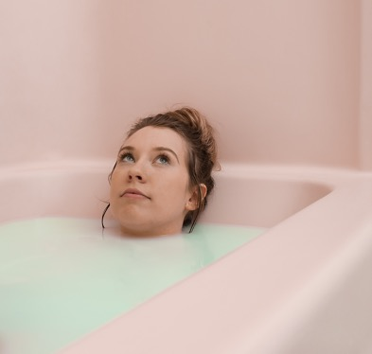
Lists of various types of hydrotherapy
There are two kinds of hydrotherapy
Fever Therapies:
Hot fomentations.
Hot tub soaks-can be medicated.
Wet sheet pack.
Russian steam bath.
Hot foot bath.
Notes:
Wellness secrets cancer man in Russian steam bath

Slide 10
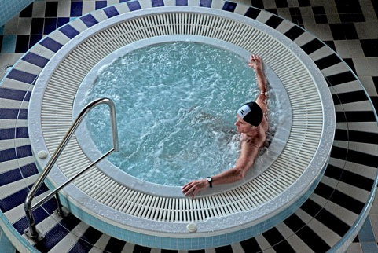
Contrast Therapies
Shower or spray type.
Plunges or underwater therapy.
There are several ways to apply contrast
Local treatments
Hot &/or cold to extremities.
Local thermal applications.
Paraffin baths.
Cold mitten friction.
Notes:
Pneumonia in Boulder CO

Slide 11
Water Temperatures and their effect
Painfully hot 110-120F 42.8-46 C constriction
Very hot 104-110 40-42.8 extreme dilatation
Hot 100-104 38-40 dilatation
Warm 92-100 34-38 refreshing
Neutral 94-97 34.4-37 calming, relaxing
Tepid 80-92 27-34 wound cleansing
Cool 70-80 21-27 constricting
Cold 55-70 13-21 therapeutically constricts
Very Cold 32-55 0 -13 severe constriction anesthetic
Notes:
An

Slide 12
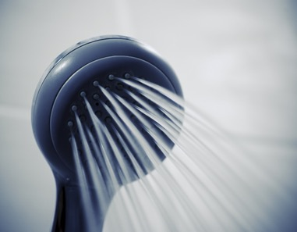
The effects of contrast shower
Toning to the whole body.
Increases the mobility of cell membrane gate openings and closings and the traffic of nutrients/waste in and out.
Strengthens and mobilizes the immune system cells and their chemistry.
Helps build muscle, including the heart muscle.

Slide 13
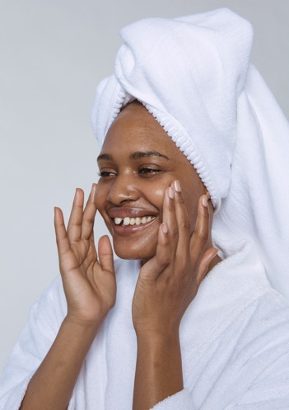
The effects of contrast shower
Aides in detoxing and cleansing the body.
Opens and activates the skin pores.
Increases mental clarity, increases quality of brain chemistry.
Stimulates good hormone production and utilization of such.

Slide 14
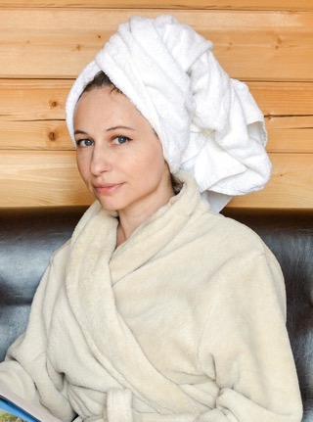
The effects of contrast shower
Stimulates joints to lubricate and de-mineralize crystal buildup, therefore aiding in the rebuilding of joint cartilage, reduces pain.
Increases lymph circulation, increasing the ability to fight infections.
Enables the body to be more oxygenated and utilize oxygen more effectively.

Slide 15
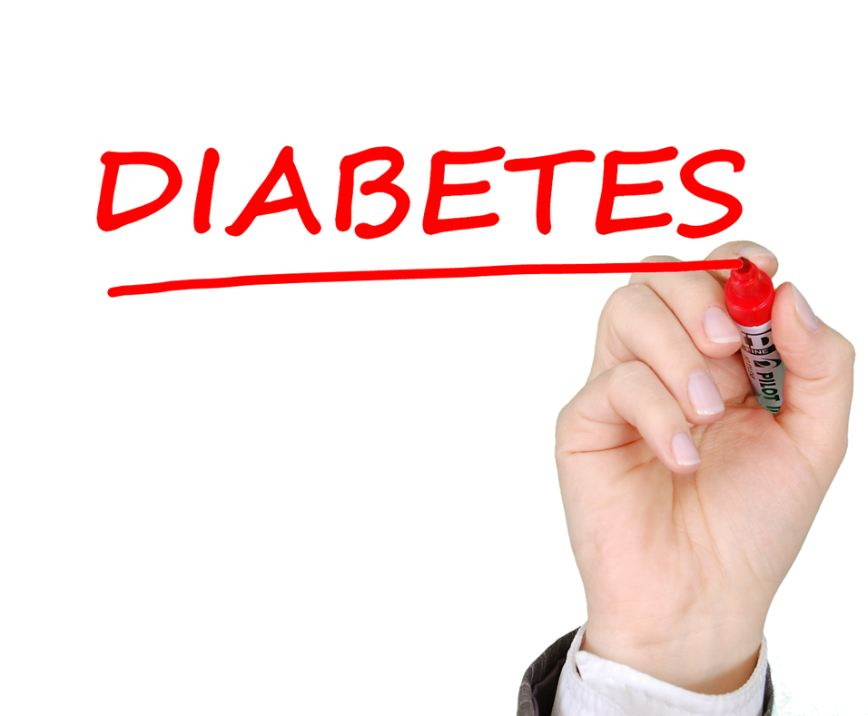
Heart patients, diabetics, stroke, trauma, and critically compromised disease patients begin easy and work into more intense.
Be sure to do treatments in warm area-no drafts.
Monitor your patient at all times, be prepared to help.
Rest one hour, covered, immediately following treatment.

Slide 16
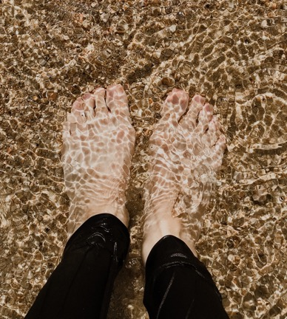
Hot foot bath
This is local immersion bath covering the feet, ankles, and lower legs at temperatures from 100-115F or 38-41C.
Head cooled with cool cloth.
Local and reflex pathways increase the blood flow through the feet and entire skin surface producing decongestion in internal organs and brain.

Slide 17
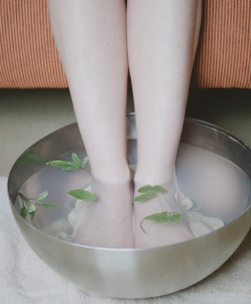
Benefits of the Hot Foot Bath
Relieves congestive headache.
Relieves chest congestion.
Lowers blood pressure.
Improves blood flow.
Improves lung function.
Relieves pelvic congestion.
Stops epitasis or nose bleeding.
Aides in recovery from colds and infections of lungs; this includes pneumonia all respiratory diseases.
Improves sleep.
Reduces psychological symptoms.
Improves fatigue.
Reduces fever.
Notes:
Eyes Amanda

Slide 18
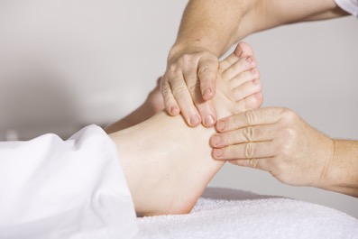
General Warming purposes
This will prepare the patient for massage, general application of heat, tonic procedures, prevention of colds; or to abort one.
To aid in relaxation and comfort, and to detox the body through herbs in the water.
To produce sweating—TX must be prolonged.

Slide 19
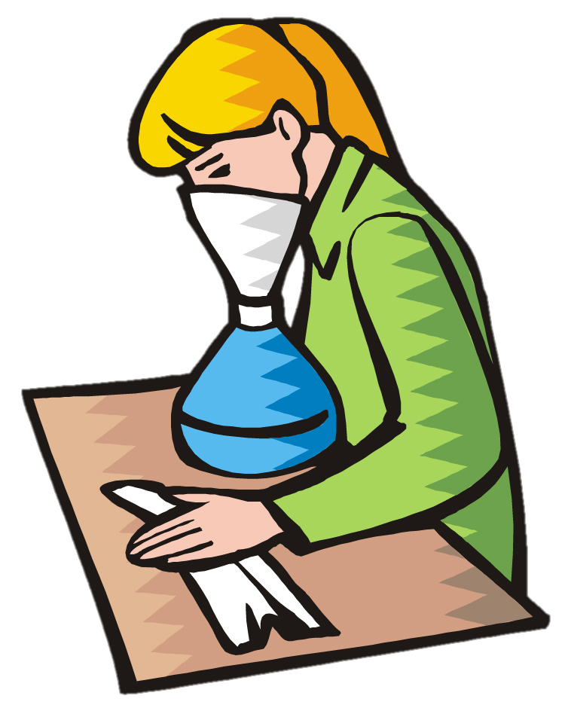
Indications
Medicated Steam Inhalation
Inflammation and congestion of mucous membranes of upper respiratory tract--runny nose and post nasal drip.
To relieve irritation (throat tickle) by moistening air.
To loosen secretions and to stimulate expectoration.
To relieve spasmodic breathing.
To relieve coughing (relax muscles).
To prevent excessive dryness of mucous membranes.

Slide 20
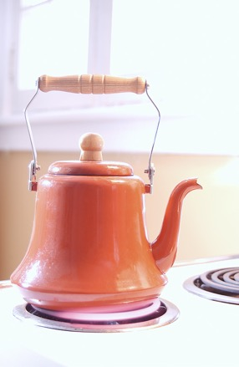
Articles Needed
Bedside stand.
Vaporizer or kettle with a spout.
Hot plate (for continuous inhalation).
Boiling Water.
Medication. Oil of eucalyptus, 1 teaspoon to pint. (Compound tincture of benzoin, 1 teaspoon to the pint, may also be added.)
Newspaper cone.

Slide 21
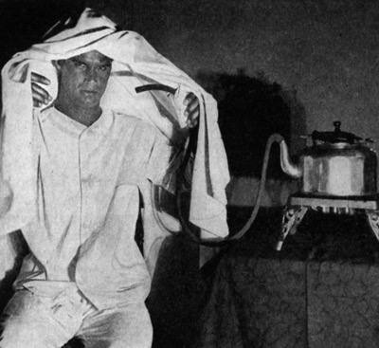
Procedure
Fill vaporizer or kettle with boiling water just below level of spout; add medication to water.
Carry to bedside and place on stand.
Cover spout with a cone made of newspaper to carry steam directly to patient. Time—usually one-half to one hour, two or three times a day.

Slide 22
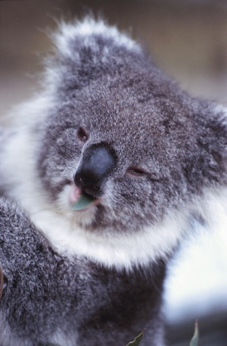
Procedure Continued
Medication: oil of eucalyptus may be applied directly to the newspaper cone, to avoid having to put it in the kettle.
For continuous inhalation the vaporizer or kettle may be placed on the floor without a paper cone.

Slide 23

Precautions
Check patient’s inhalation often.
Avoid all risk of burning.
Avoid drafts during time of treatment.
Extra care must be exercised when giving treatment to children to avoid accidents.

Slide 24
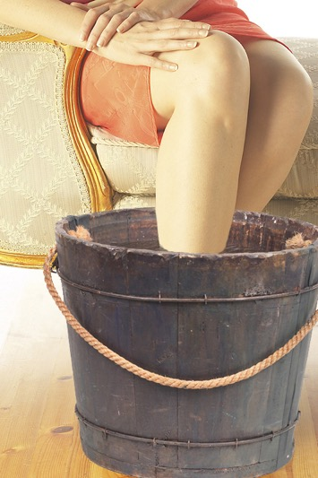
Joint Pain and Swelling: Hydrotherapy
3 minutes in a bucket of hot water.
1 minute in an bucket of ICE cold water.
Alternate 3 times.
End in the cold bucket.
Cover and rest for half an hour.

Slide 25
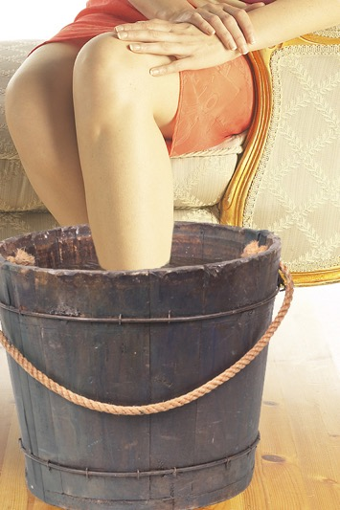
Why All The Hot And Cold Treatment?
Hot increases blood flow to the area.
Cold drives the blood deep.
Alternating pumps the edema out and wakes up the white cells.
The body warms the area up when you end in cold.

Slide 26
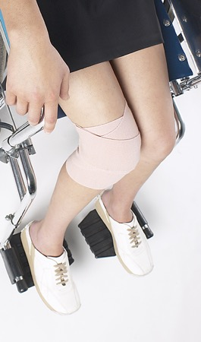
Where can this be used?
Fresh injuries where there is not excessive swelling or bruising.
Injured bones, joints, ligaments, tendons, or muscles.
Do not use on the head or genitals.

Slide 27
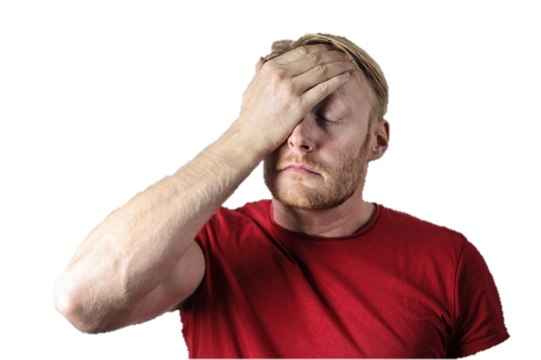
Head Hydrotherapy
Hot and cold treatments to the head. Start with a hot pack over the forehead and a cold pack over the upper neck and lower skull, keep them in place for 3 minutes, then switch them to cold in front and hot in back for three minutes. I find it easiest to have the patient lay down with the back of their head on one pack while the other is place over the forehead. Keep switching every three minutes, keeping the hot pack hot and the cold pack cold. Switch about 7 or 8 times and then set the hot aside and finish with a cold pack on the last side you had applied the hot pack. Then have the patient lay down for about 20 minutes.

Slide 28
If the physicians are so busy that they cannot treat the sick outside of the institution, would it not be wiser for all to educate themselves in the use of simple remedies, than to venture to use drugs that are given a long name to hide their real qualities.
Why need anyone be ignorant of God's remedies--hot-water fomentations and cold and hot compresses. It is important to become familiar with the benefit of dieting in case of sickness. All should understand what to do {for} themselves. {2SM 289.4}

