Slide 1
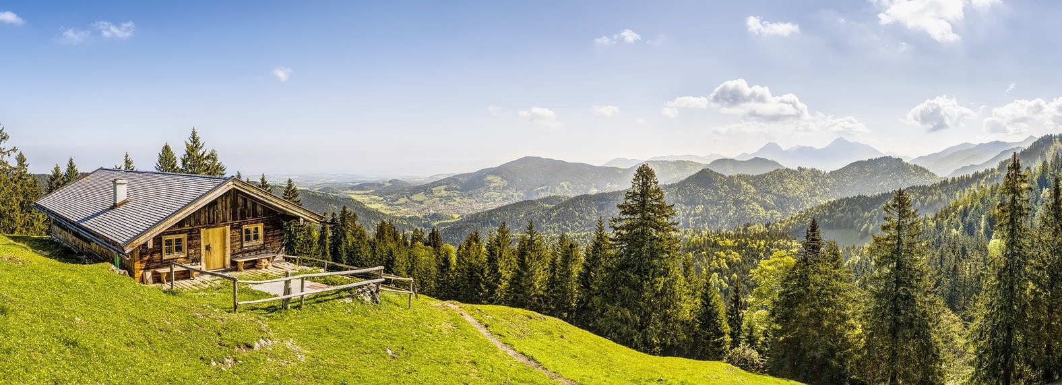
Why Country Living?

Slide 2
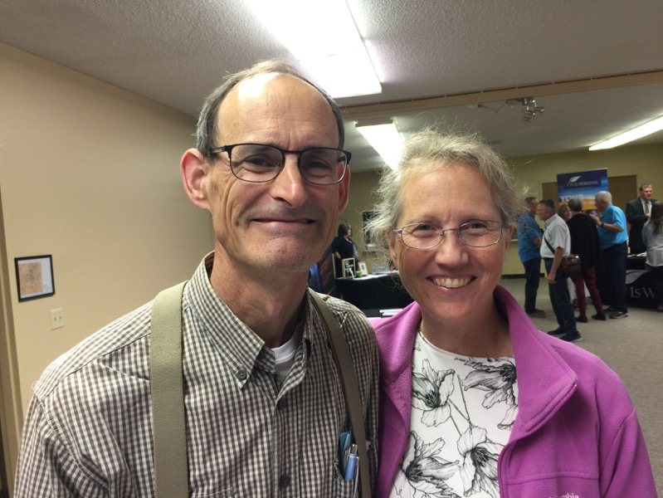

Slide 3
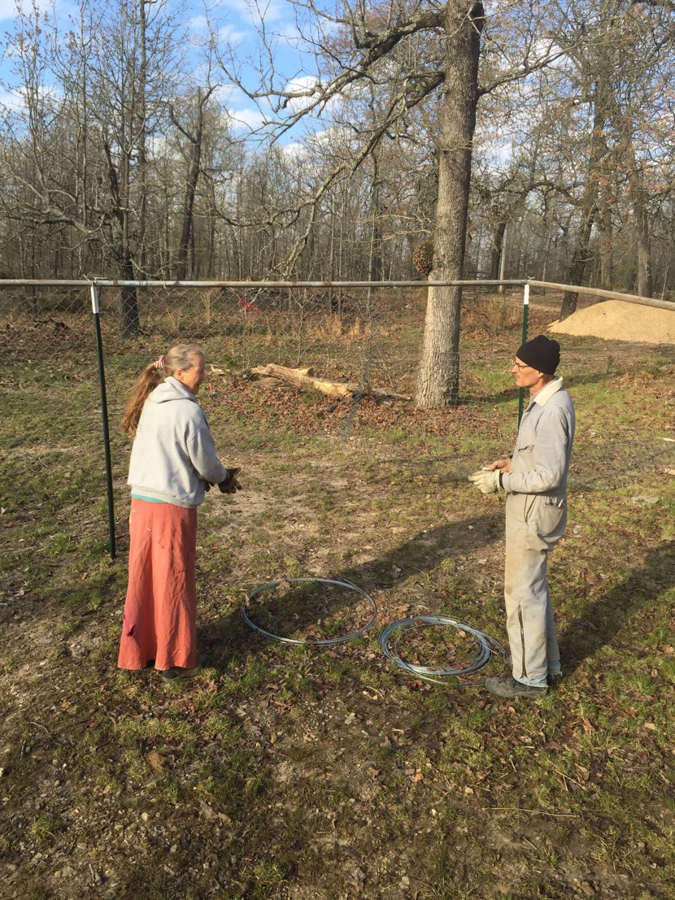

Slide 4
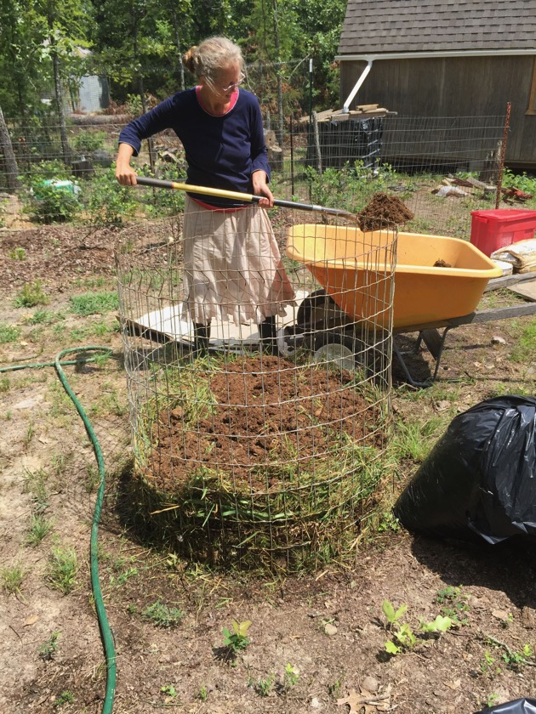
Notes:
Plan move to carefully
Industry
Soil well drained, sun facing,
Water
Debt (Later)
Off Grid (our experience)
Solar

Slide 5
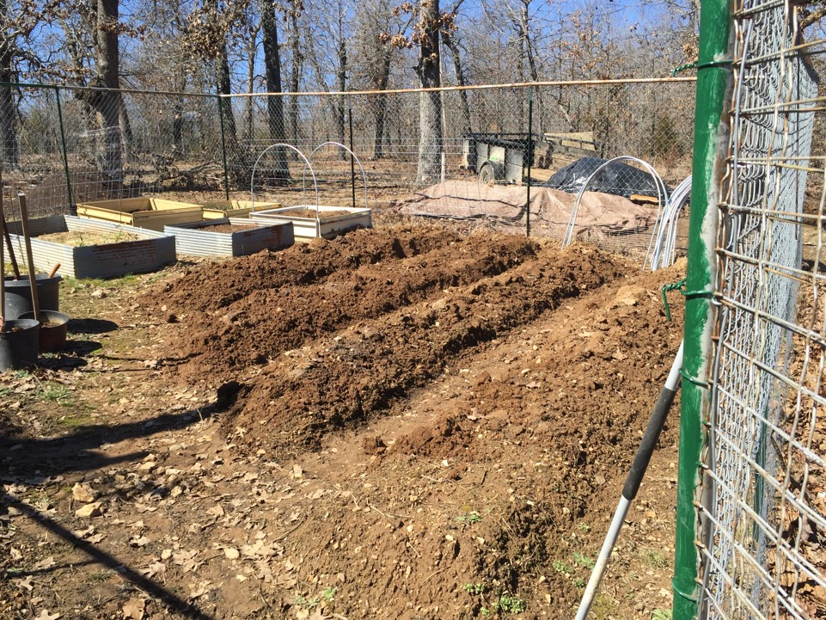

Slide 6
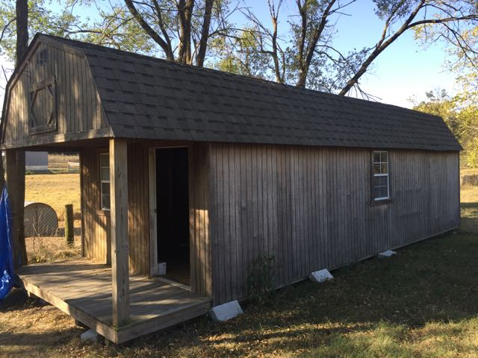

Slide 7
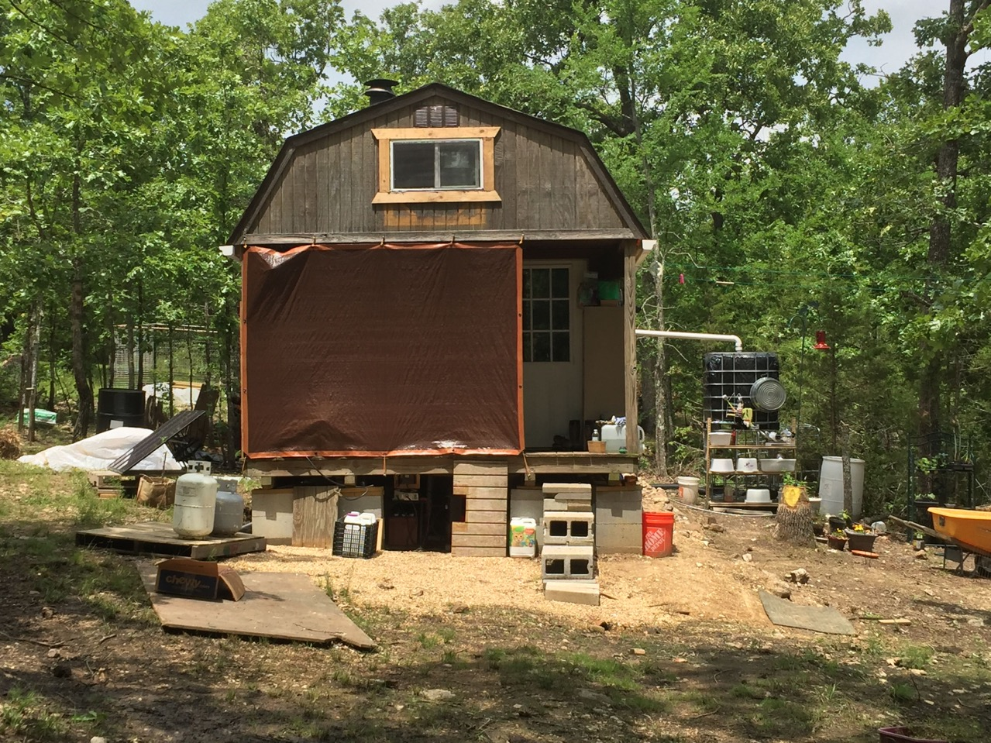

Slide 8
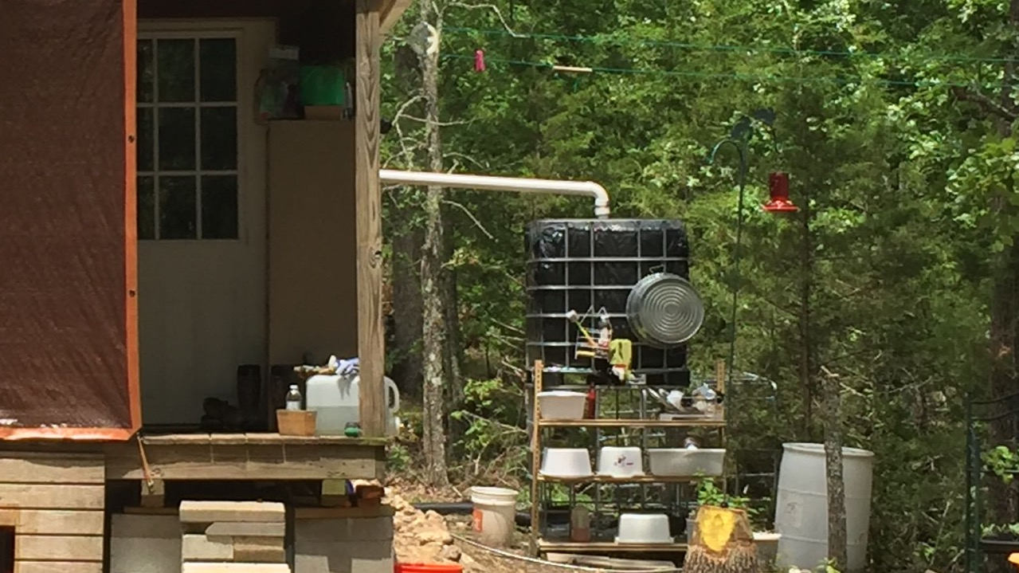

Slide 9
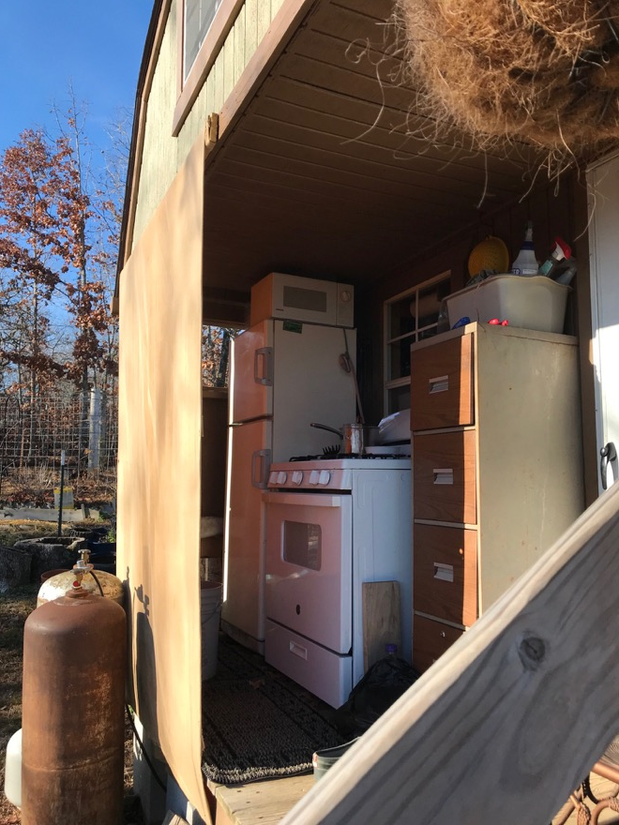

Slide 10
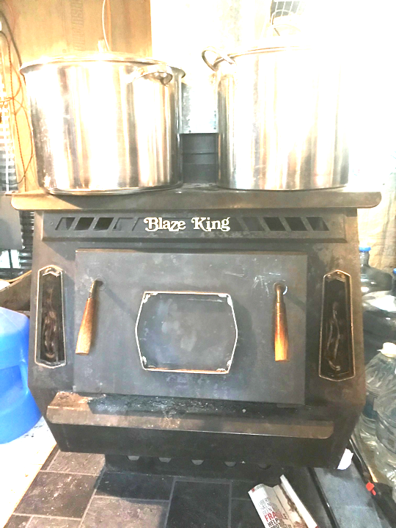

Slide 11
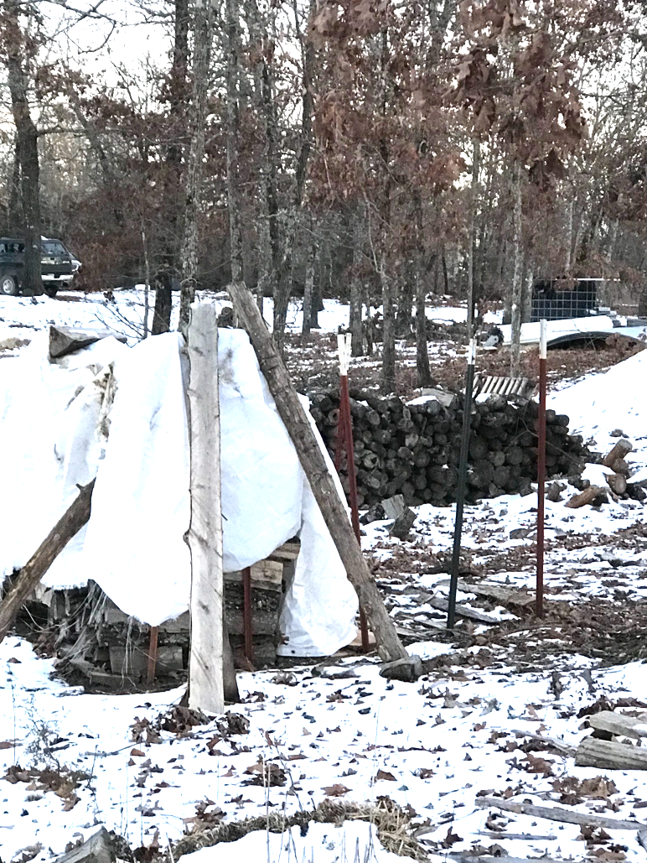
Notes:
Need to build a wood shed.

Slide 12
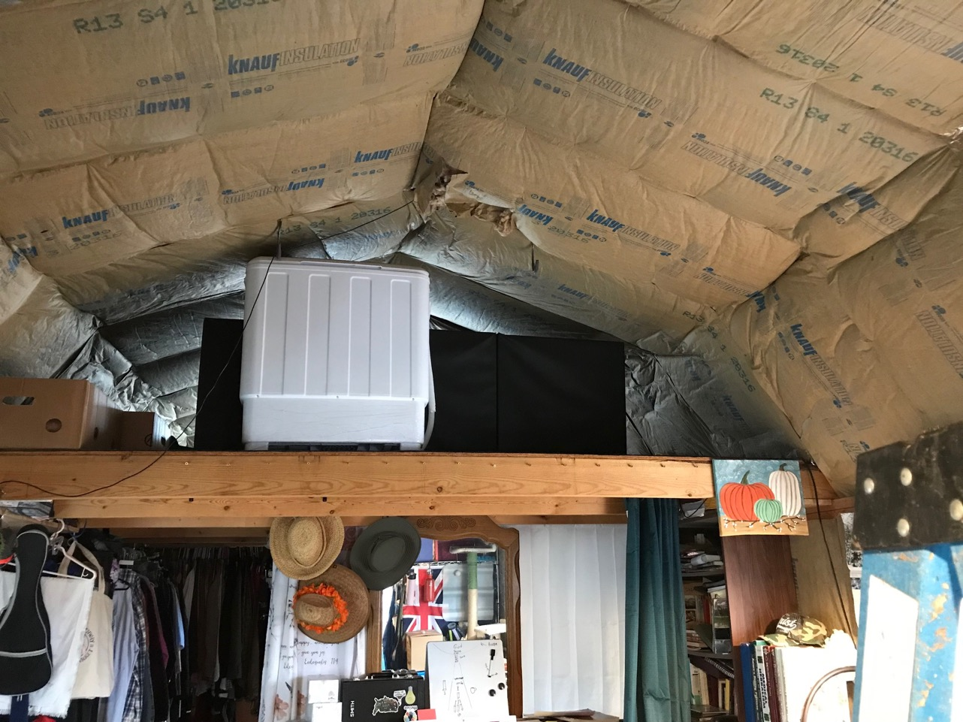

Slide 13
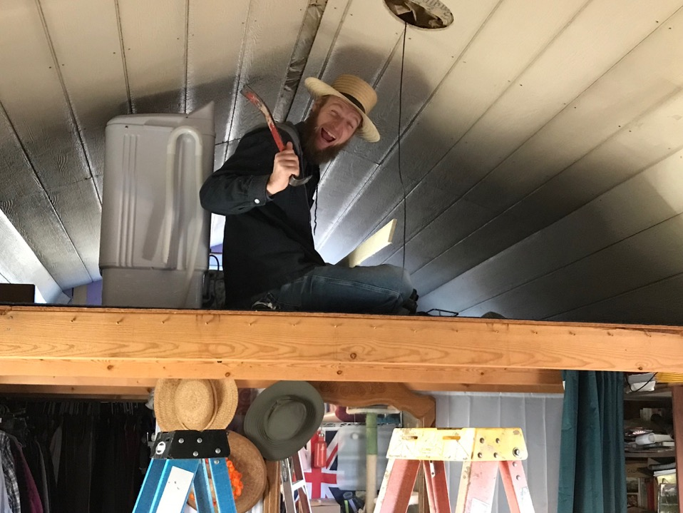

Slide 14
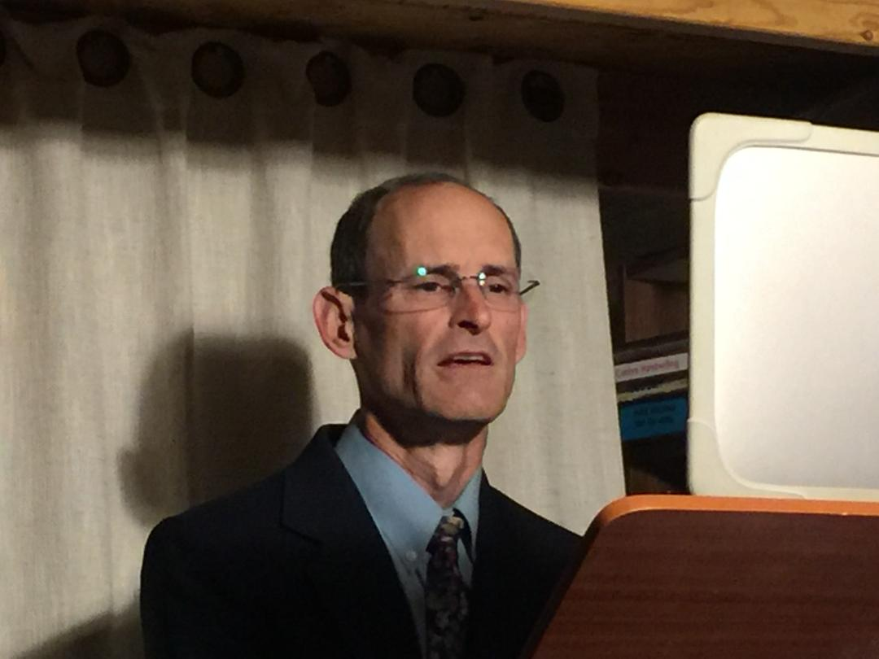

Slide 15
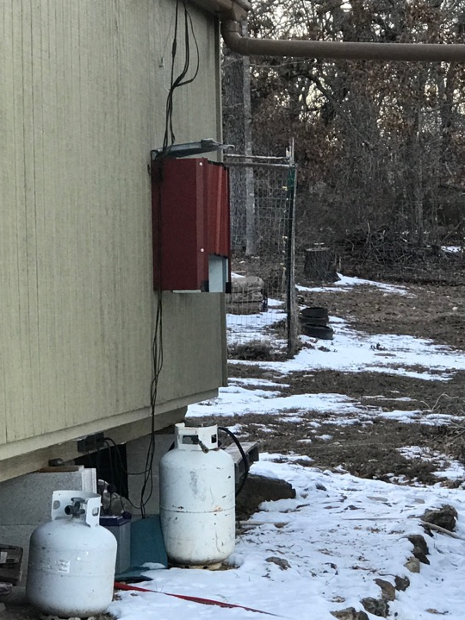

Slide 16
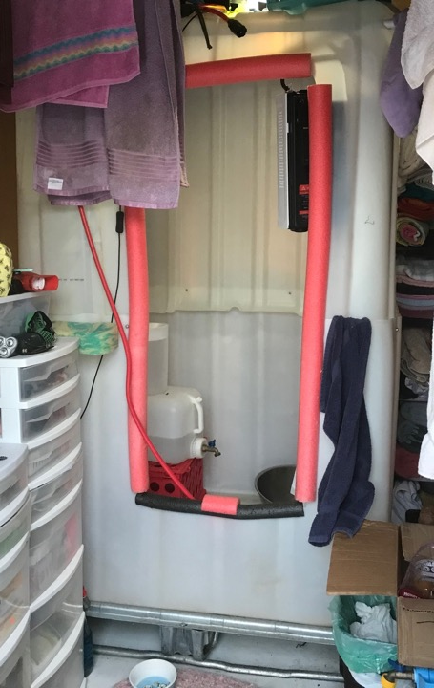

Slide 17
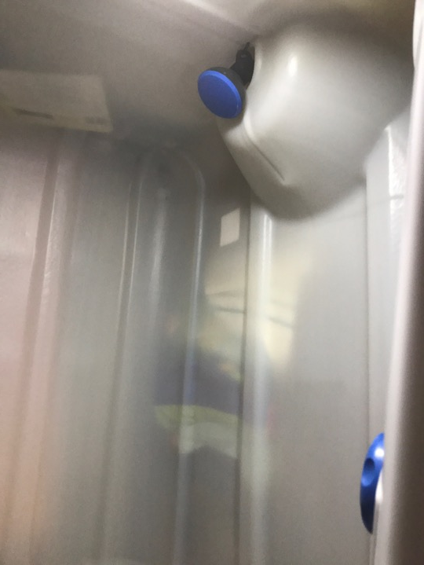

Slide 18
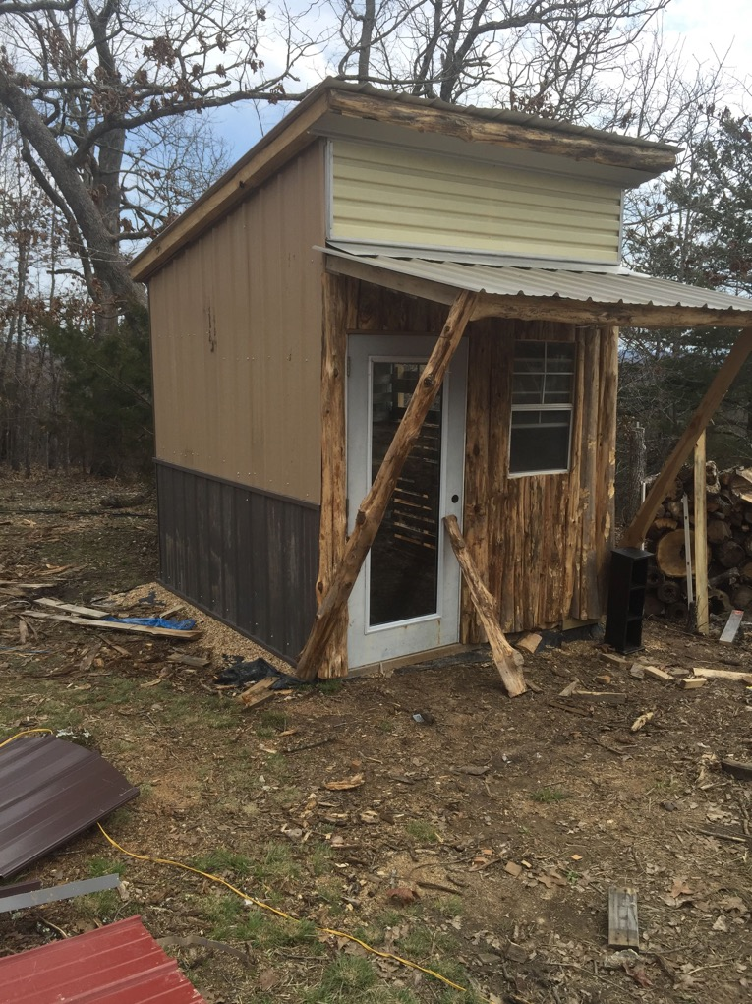

Slide 19
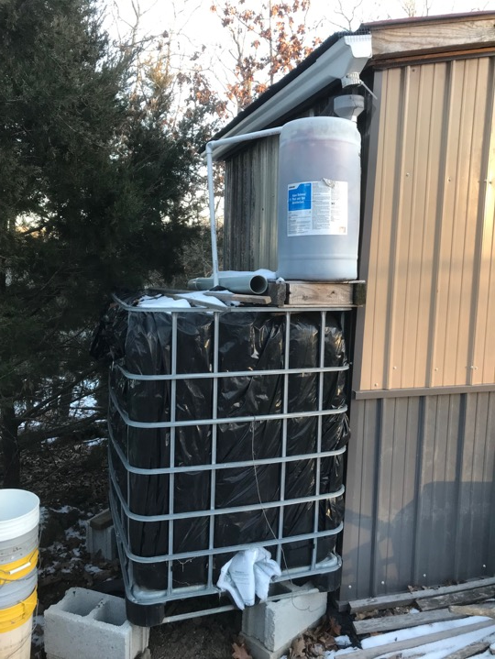

Slide 20
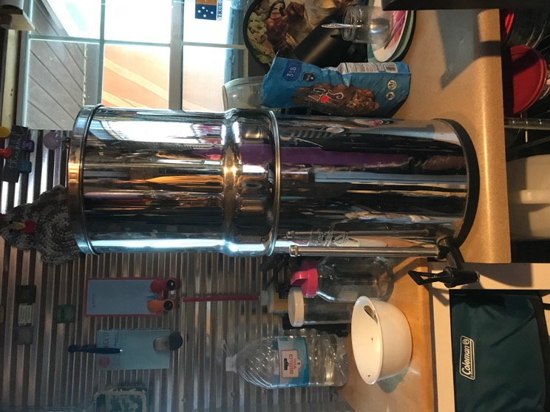

Slide 21
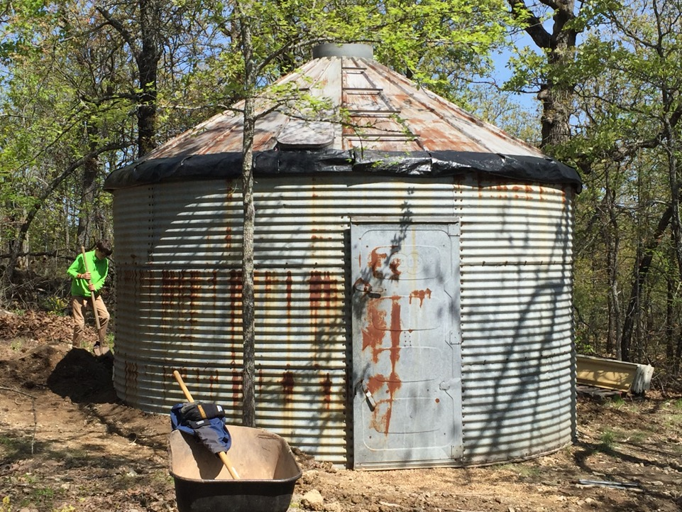

Slide 22
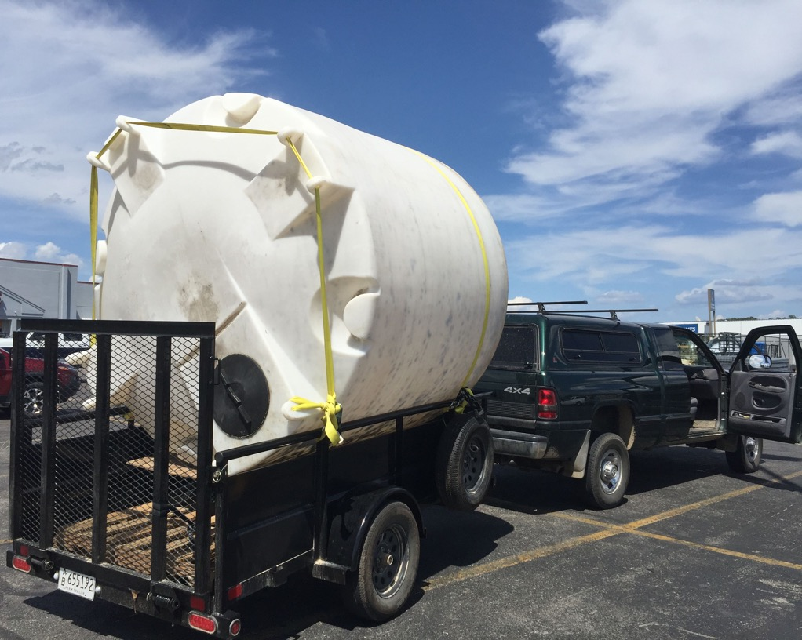

Slide 23
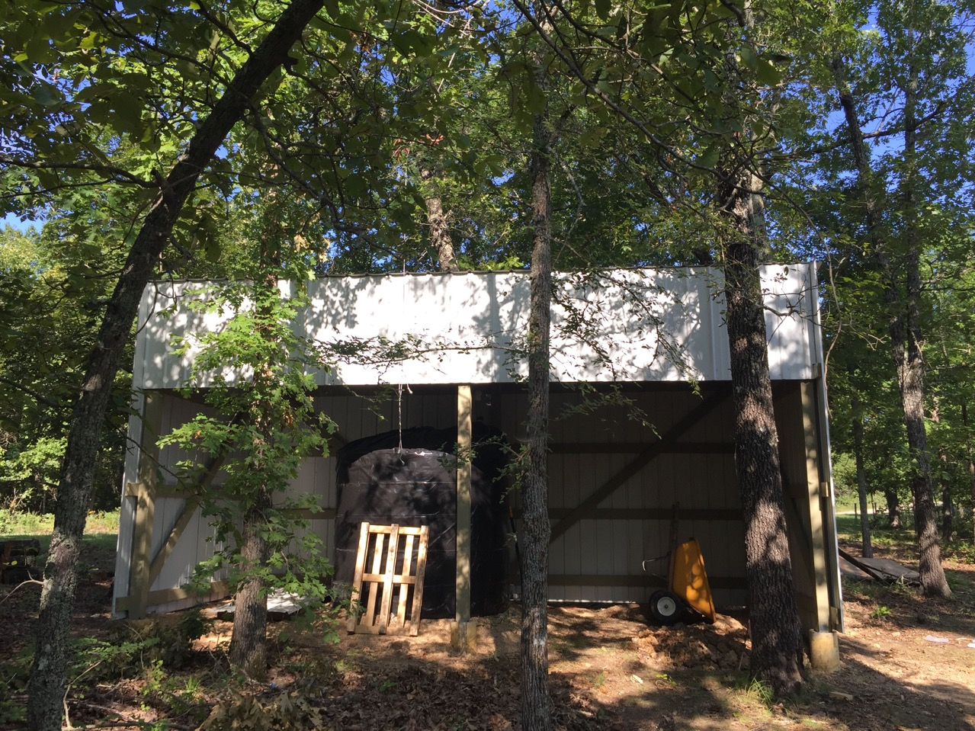

Slide 24
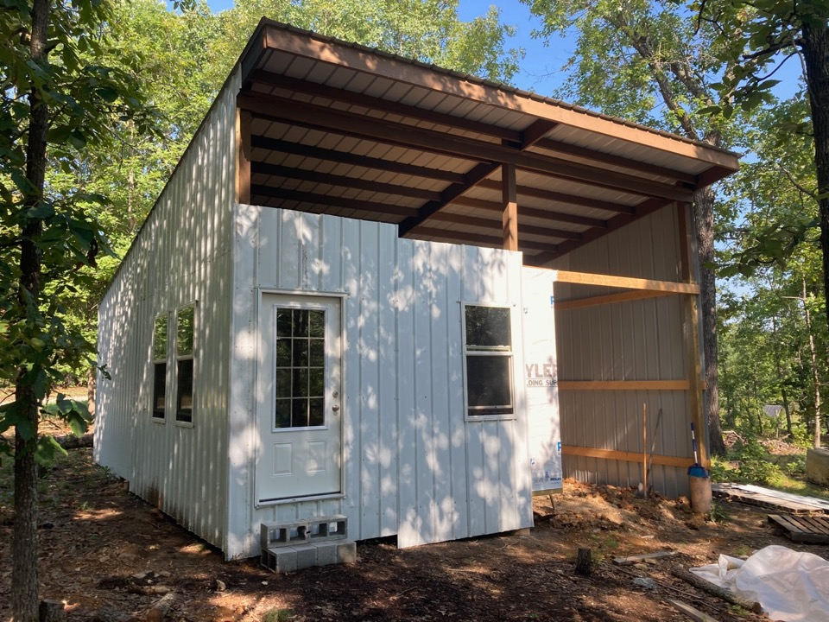

Slide 25
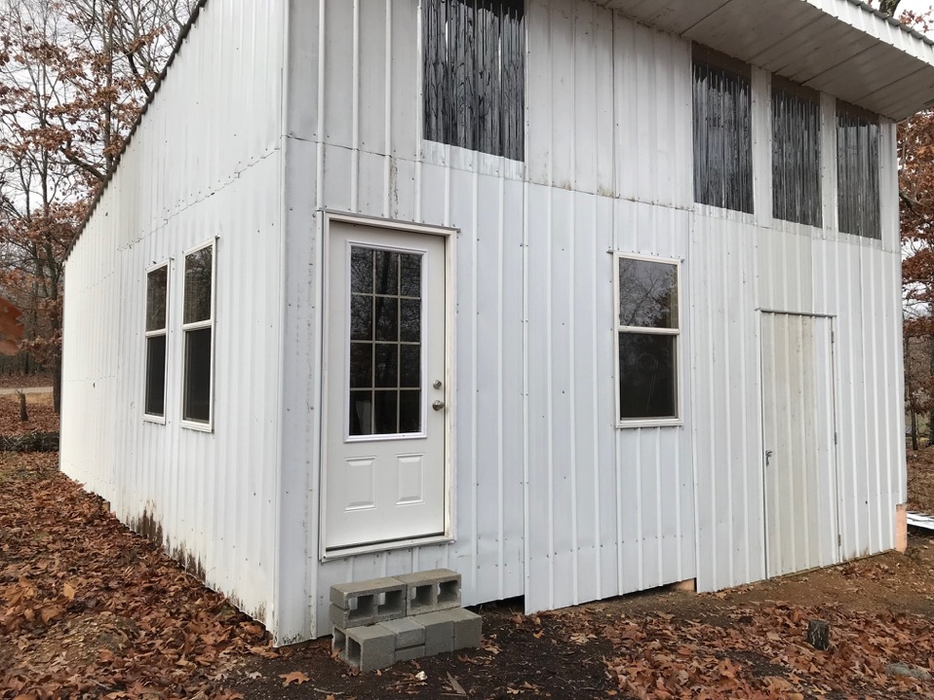

Slide 26
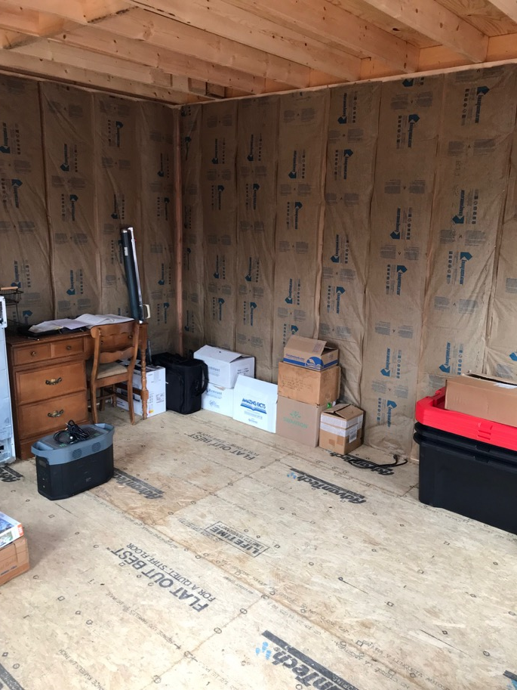

Slide 27
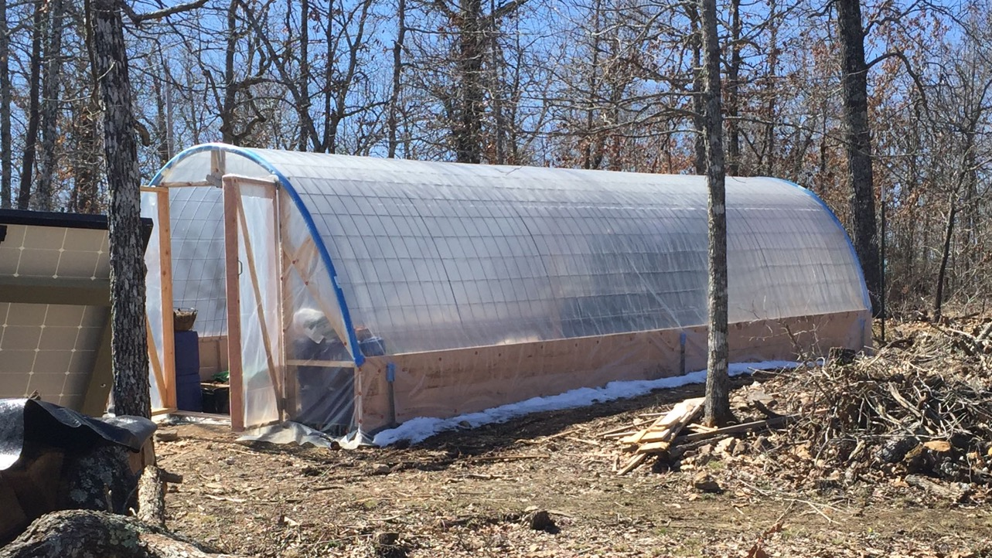

Slide 28
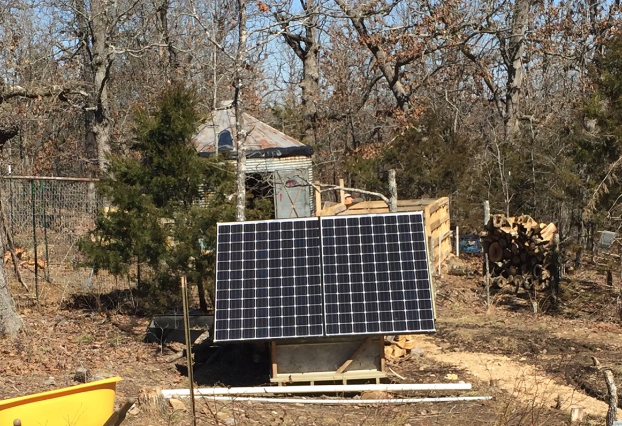

Slide 29
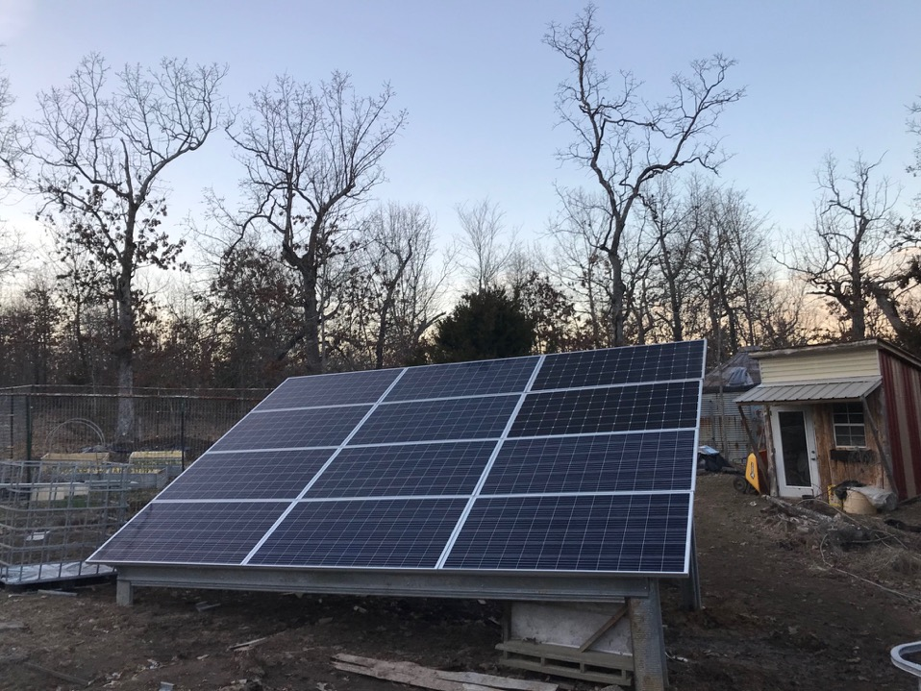

Slide 30
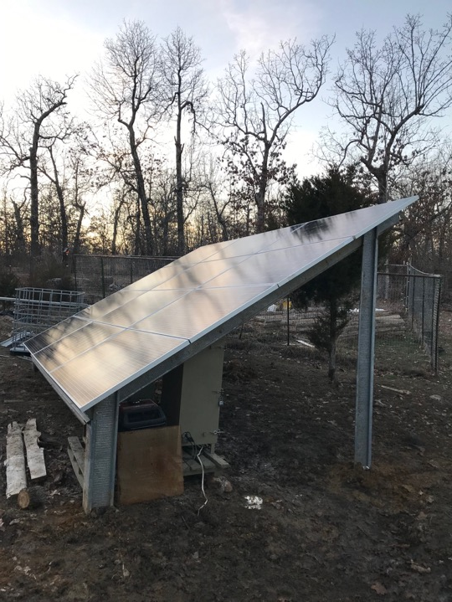

Slide 31
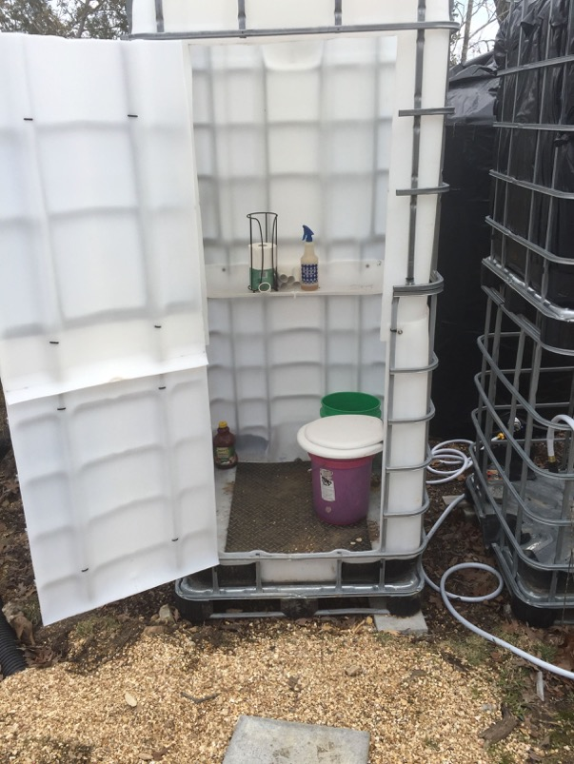

Slide 32
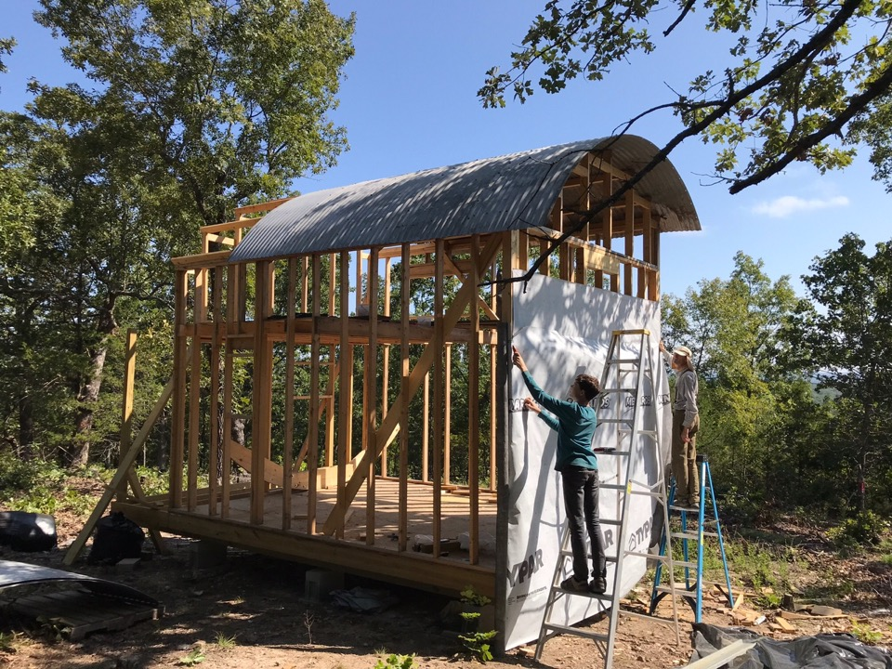

Slide 33
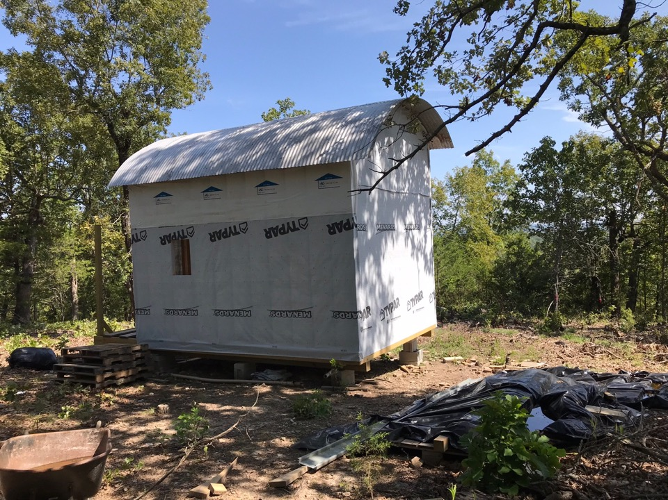

Slide 34

“And the LORD God planted a garden eastward in Eden; and there he put the man whom he had formed.” Genesis 2:8.
Notes:
Without any oven, BBQ, microwave, or way of heat denaturization of food.

Slide 35
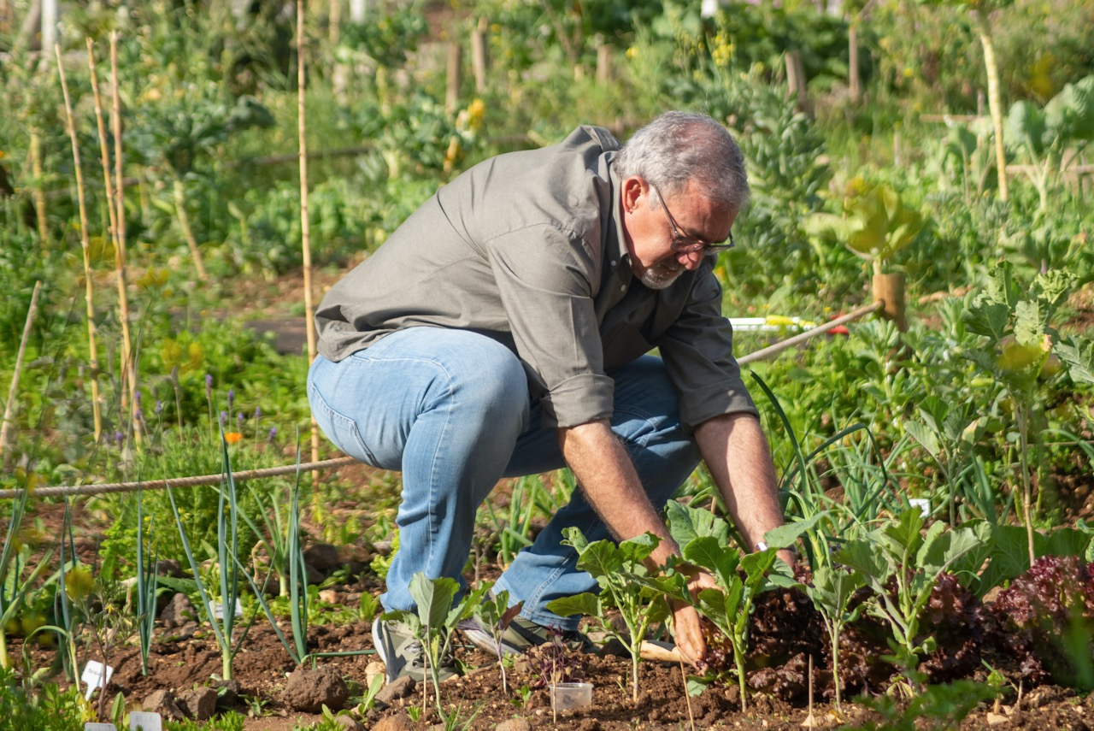
Notes:
I’m John Clark, I am a medical missionary in training, and I’m here to discuss with you, health from your country property.

Slide 36


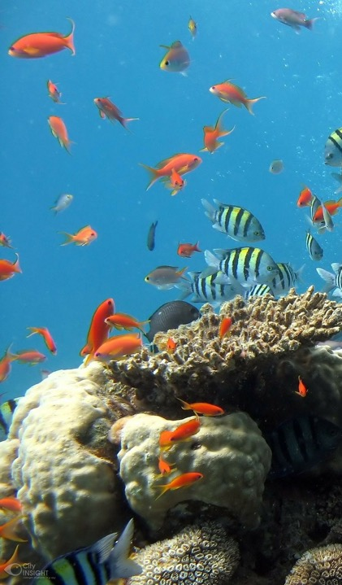
Notes:
Birds in sky, fish in sea, Ecological niche: MAN IN GARDEN

Slide 37
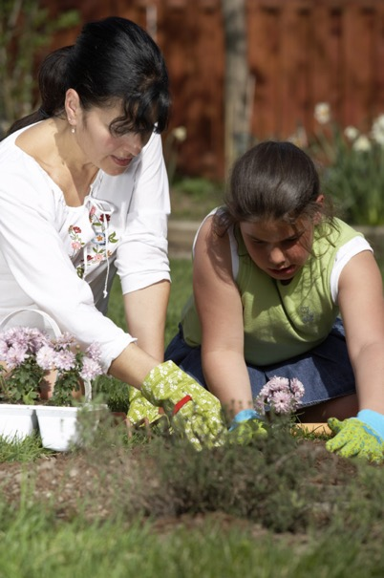
“In the cultivation of the soil the thoughtful worker will find that treasures little dreamed of are opening up before him.
“No one can succeed in agriculture or gardening without attention to the laws involved.
“The special needs of every variety of plant must be studied. Different varieties require different soil and cultivation, and compliance with the laws governing each is the condition of success.
“The attention required in transplanting, that not even a root fiber shall be crowded or misplaced, the care of the young plants, the pruning and watering, the shielding from frost at night and sun by day, keeping out weeds, disease, and insect pests, the training and arranging, not only teach important lessons concerning the development of character, but the work itself is a means of development.
“In cultivating carefulness, patience, attention to detail, obedience to law, it imparts a most essential training.
“The constant contact with the mystery of life and the loveliness of nature, as well as the tenderness called forth in ministering to these beautiful objects of God's creation, tends to quicken the mind and refine and elevate the character.
{AH 142.3}

Slide 38
Gardeners get more sun and fresh air.
Enjoy lower cholesterol levels.
Have higher vitamin D levels.
QJM. 1996 Aug;89(8):579-89.
Notes:
38
QJM. 1996 Aug;89(8):579-89.
Sunlight, cholesterol and coronary heart disease.
Grimes DS, Hindle E, Dyer T.
Department of Medicine, Blackburn Royal Infirmary, UK.
We investigated the relationship between geography and incidence of coronary heart disease, looking at deficiency of sunlight and thus of vitamin D as a factor that might influence susceptibility and thus disease incidence. Sunlight deficiency could increase blood cholesterol by allowing squalene metabolism to progress to cholesterol synthesis rather than to vitamin D synthesis as would occur with greater amounts of sunlight exposure, and the increased concentration of blood cholesterol during the winter months, confirmed in this study, may well be due to reduced sunlight exposure. We show evidence that outdoor activity (gardening) is associated with a lower concentration of blood cholesterol in the summer but not in the winter. We suggest that the geographical variation of coronary heart disease is not specific, but is seen in other diseases and sunlight influences susceptibility to a number of chronic diseases, of which coronary heart disease is one.
PMID: 8935479 [PubMed - indexed for MEDLINE]

Slide 39

“Fathers and mothers who possess a piece of land and a comfortable home are kings and queens.”
{AH 141.2}.
Notes:
Kings and Queens – poor nutrition, chemicals, GMO, famine, Sunday laws- next slide.

Slide 40

“Again and again the Lord has instructed that our people are to take their families away from the cities, into the country, where they can raise their own provisions; for in the future the problem of buying and selling will be a very serious one.
“We should now begin to heed the instruction given us over and over again: Get out of the cities into rural districts, where the houses are not crowded closely together, and where you will be free from the interference of enemies.”
{AH 141.4}

Slide 41

“We need a genuine education in the art of cooking. . . . Form classes where you may teach the people how to make good bread and how to put together ingredients to make healthful food combinations from the grains and the vegetables.
“Such an education will assist in creating a desire among our people to move out of the cities, to secure land in the country, where they can raise their own fruit and vegetables.”--MS. 150, 1905.
{MM 267.5}
Notes:
4 year storage....Smart Fresh

Slide 42

A 6 month fresh fruit and vegetable diet produced an 8 pound weight loss and a 18mm Hg blood pressure decrease.
Serendipitously, 80% of those in this study who smoked or drank alcohol abstained spontaneously.
South Med J. 78(7):841-4.

Slide 43
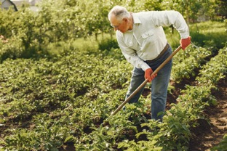
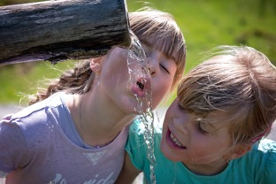






Exercise
Water
Food
Sun
8 Natural Remedies
Temperance
Trust In God
Fresh Air
Rest

Slide 44
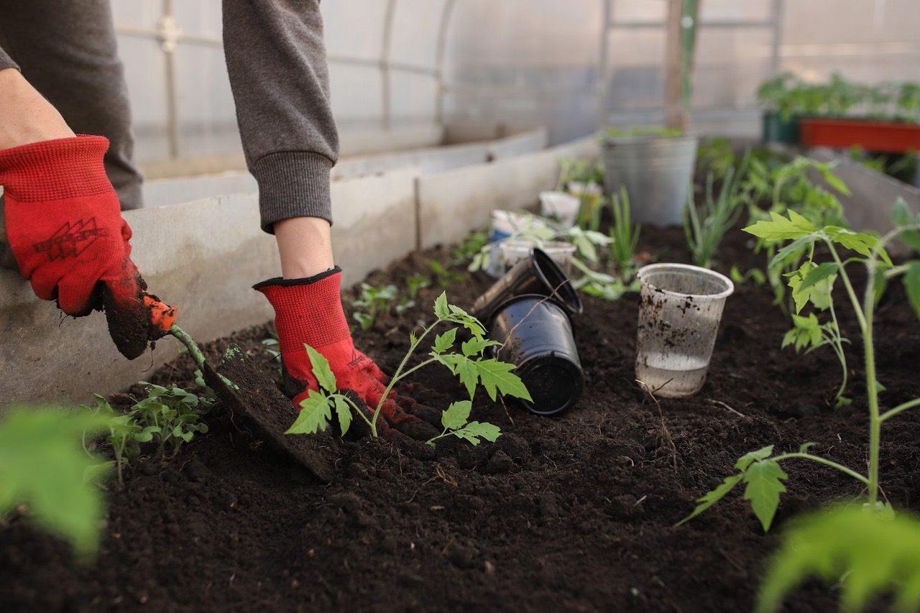
Notes:
In the garden, you do a little here and a little there, we call it interval training.

Slide 45

“He causeth the grass to grow for the cattle, and herb for the service of man: that he may bring forth food out of the earth;” Psalms 104:14.
Notes:
Herbal remedies
Skull Cap
Velvet beans
Comfrey

Slide 46
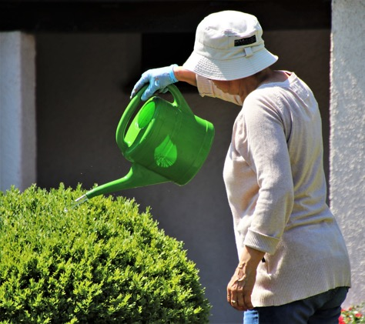
“Inactivity is the greatest curse that could come upon most invalids. Light employment in useful labor, while it does not tax mind or body, has a happy influence upon both.
“It strengthens the muscles, improves the circulation, and gives the invalid the satisfaction of knowing that he is not wholly useless in this busy world.”
{MH 240.1}
Notes:
Meaningful purposeful useful labor.

Slide 47

“Working the soil is one of the best kinds of employment, calling the muscles into action and resting the mind.
“Study in agricultural lines should be the A, B, and C of the education given in our schools. This is the very first work that should be entered upon.
“Our schools should not depend upon imported produce, for grain and vegetables, and the fruits so essential to health. Our youth need an education in felling trees and tilling the soil as well as in literary lines.”
{6T 179.2}
Notes:
A B and C

Slide 48
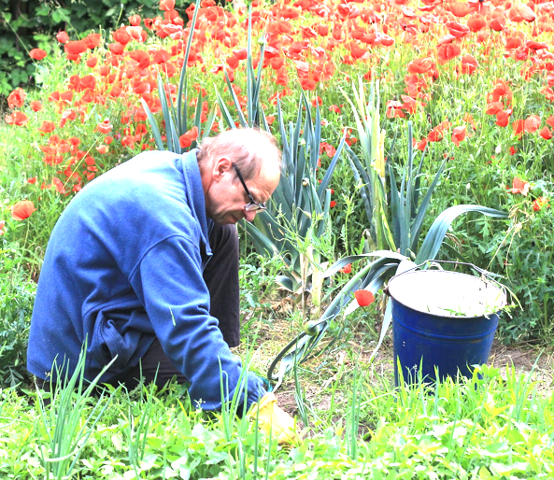
“The true joy of life is found only by the working men and women.” {PP 50.1}
“If the poor now crowded into the cities could find homes upon the land, they might not only earn a livelihood, but find health and happiness now unknown to them.
“What a blessing would be theirs in leaving the city, with its enticements to evil, its turmoil and crime, misery and foulness, for the country's quiet and peace and purity.”
{MH 190.2}
Notes:
True joy in life found only by working men and women.
Country Property

Slide 49

Notes:
cheaper for the poor to live in, than in city 4T 510
There are youth, and men and women, who need to be taught how to employ their ability just where they are. This is no pleasant duty; but every church is responsible for its individual members, and it should not allow a class who cannot obtain a living where they are in the country, to move to Battle Creek. Brethren in the country have farms and can raise their own supplies. It is therefore much less expensive for the poor to be supported in the country, where provisions are cheap, than to have them come to Battle Creek, where, instead of helping the church and our institutions, means must be continually drawn from the treasury to help them. Those living in the city have to buy nearly all their provisions, and it costs something to take care of the poor. {4T 509.4}

Slide 50

And True Joy Brings Health!
“The love which Christ diffuses through the whole being is a vitalizing power. Every vital part--the brain, the heart, the nerves--it touches with healing.
“By it the highest energies of the being are roused to activity.
“It frees the soul from the guilt and sorrow, the anxiety and care, that crush the life forces.
“It implants in the soul, joy that nothing earthly can destroy,--joy in the Holy Spirit,--health-giving, life-giving joy.
{MH 115.3}
Notes:
And joy brings health. — Afib

Slide 51
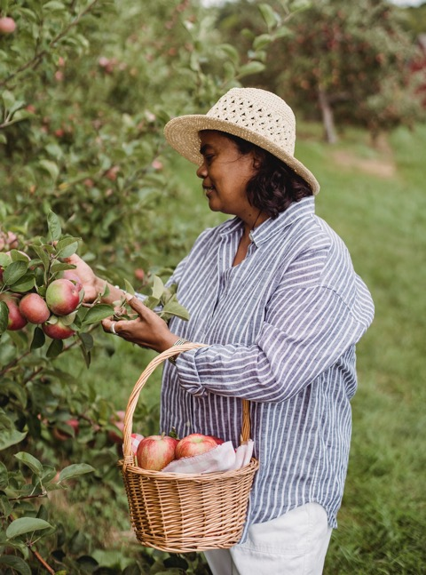
“More people die for want of exercise than through overfatigue; very many more rust out than wear out.
“Morning exercise, in walking in the free, invigorating air of heaven, or cultivating flowers, small fruits, and vegetables, is necessary to a healthful circulation of the blood.
“It is the surest safeguard against colds, coughs, congestions of brain and lungs, inflammation of the liver, the kidneys, and the lungs, and a hundred other diseases.”
{ML 136}
Notes:
Patients return to ecological niche for healing, pick fruit, tend flowers,

Slide 52

Walking Outdoors amongst trees, flowers, and other wonders of God’s great nature, lower blood pressure and stress.
J Environ Psychol 23:109-123.
Notes:
MAN’s Ecological Niche

Slide 53
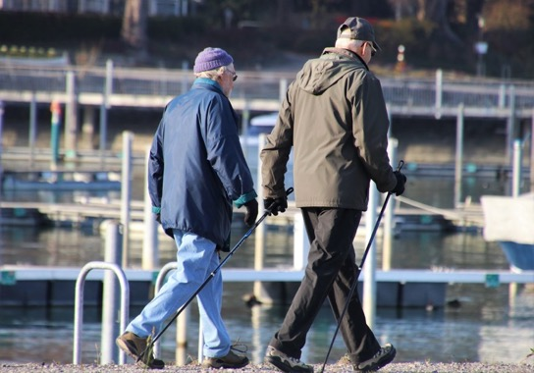
Walking for Prostate Health
Regular exercise helps reduce the risk of BPH by 19%.
Men who walk 2 to 3 h/wk have a 25% lower risk of total BPH.
Arch Intern Med. 158(21):2349-56.
Notes:
Platz EA, Kawachi I, Rimm EB, Colditz GA, Stampfer MJ, Willett WC, Giovannucci E. Physical activity and benign prostatic hyperplasia. Arch Intern Med. 1998 Nov 23;158(21):2349-56.
Abstract
Background: Benign prostatic hyperplasia (BPH) leading to prostatic enlargement and lower urinary tract symptoms is highly prevalent among older men. Sympathetic nervous system activity, which is decreased by physical activity, is associated with increased prostatic smooth-muscle tone and prostatic symptoms. Therefore, we assessed whether physical activity leads to fewer lower urinary tract symptoms in the Health Professionals Follow-up Study.
Methods: We observed men who were aged 40 to 75 years at baseline in 1986 for subsequent incidence of surgery for BPH. The men were free of diagnosed cancer, including prostate cancer at baseline and during follow-up, had not had a radical prostatectomy, and provided data on physical activity. Cases were men who under-went BPH surgery between 1986 and 1994 (n = 1890) or, among those who did not have surgery, who scored 15 or more points of 35 (n = 1853) on 7 questions about lower urinary tract symptoms modified from the American Urological Association Symptom Index. Noncases were men who scored 7 points or less (n = 21745). Odds ratios (ORs) and 95% confidence intervals (CIs) were calculated from multiple logistic regression models.
Results: After controlling for age, race or ethnicity, alcohol consumption, and smoking, physical activity was inversely related with total BPH (extreme quintiles: OR, 0.75; 95% CI, 0.67-0.85; P for trend, <.001), surgery for BPH (OR, 0.76; 95% CI, 0.64-0.90; P for trend, <.001), and symptomatic BPH (OR, 0.75; 95% CI, 0.64-0.87; P for trend, <.001). Walking, the most prevalent activity, was inversely related to BPH risk; men who walked 2 to 3 h/wk had a 25% lower risk of total BPH.
Conclusion: Our results indicate that more physically active men have a lower frequency of lower urinary tract symptoms.
Foster SA, Shortridge EF, DiBonaventura M, Viktrup L. Predictors of self-reported benign prostatic hyperplasia in European men: analysis of the European National Health and Wellness Survey. World J Urol. 2015 May;33(5):639-47.
Abstract
Purpose: This study aimed to identify predictors of European men who self-reported being diagnosed with benign prostatic hyperplasia (DxBPH) compared to men with moderate-to-severe lower urinary tract symptoms [American Urological Association Symptom Index (AUA-SI) score ≥8] who did not self-report a BPH diagnosis (non-DxBPH).
Methods: Data were taken from the 2010 European National Health and Wellness Survey; a cross-sectional, self-administered, Internet-based questionnaire. This analysis included males ≥40 years with DxBPH or without DxBPH, but with AUA-SI ≥8. Chi-square tests were used for categorical variables and independent samples t tests were used for continuous variables. Logistic regressions were conducted among all men ≥40 years to predict being DxBPH.
Results: About 1,638 DxBPH and 3,676 non-DxBPH men were included. The estimated prevalence of DxBPH and non-DxBPH was 8.53 and 19.13 %. Men with DxBPH were older than non-DxBPH males (mean age 66.1 and 58.3, P < 0.001). The mean AUA-SI score was 11.3 for DxBPH and 13.2 for non-DxBPH. Being older (OR = 1.077), having a university education (OR = 1.252), having private health insurance (OR = 1.186), and specific health behaviors/attitudes [regular exercise (OR = 1.191), visiting a doctor within the previous 6 months (OR = 2.398), consulting with a medical professional when not feeling well (OR = 1.097), reporting having an attentive doctor (OR = 1.112)], and higher voiding symptoms (OR = 1.032) were significant predictors of DxBPH.
Conclusions: Older men with higher education and access to care and more engagement in their healthcare were more likely to self-report being diagnosed.

Slide 54

“And why take ye thought for raiment? Consider the lilies of the field, how they grow; they toil not, neither do they spin: And yet I say unto you, That even Solomon in all his glory was not arrayed like one of these. Wherefore, if God so clothe the grass of the field, which to day is, and to morrow is cast into the oven, shall he not much more clothe you, O ye of little faith? Therefore take no thought, saying, What shall we eat? or, What shall we drink? or, Wherewithal shall we be clothed?” Matthew 6:28-31.
Notes:
Well clothed flowers.
Attract pollinators
Companion planting
Pest control

Slide 55

Notes:
The experience of Awe Has been found to promote physical and mental health.

Slide 56

Awe
Notes:
Looking at something bigger and grander than your self brings humility.
https://www.canr.msu.edu/news/the_influence_of_awe

Slide 57

Notes:
People who take the time to experience the awe are found to have better health, and healthier blood pressures.

Slide 58
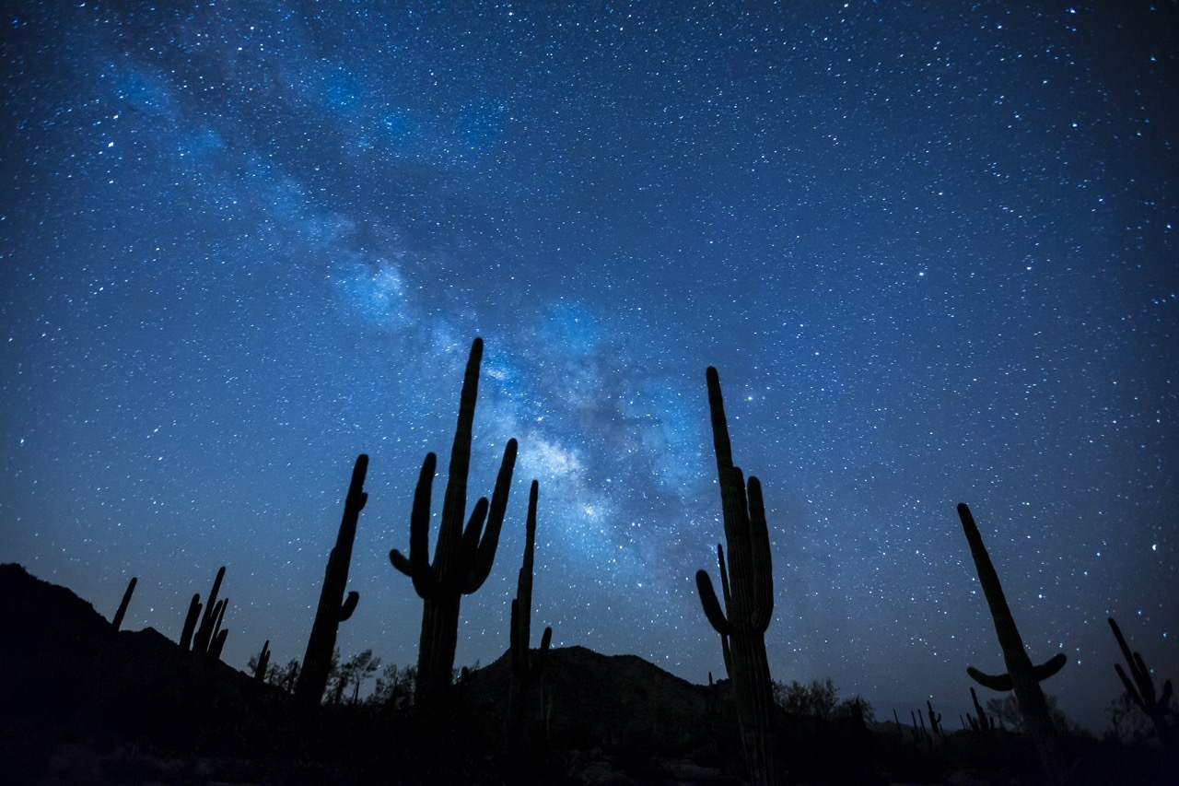
Notes:
Whether it’s big things like the sky, mountains, or sea

Slide 59

Notes:
Or small things like intricate beautiful flowers.

Slide 60

Notes:
The beauties of God’s great creation are there for our health and appreciation.
Also the contemplation of the grandest themes,

Slide 61


“Greater love hath no man than this, that a man lay down his life for his friends.” John 15:13.
Notes:
As salvation and the unselfish generosity of Jesus on the cross, the awe, drawing us away from our selfish selves leads us to more vigorous health.

Slide 62
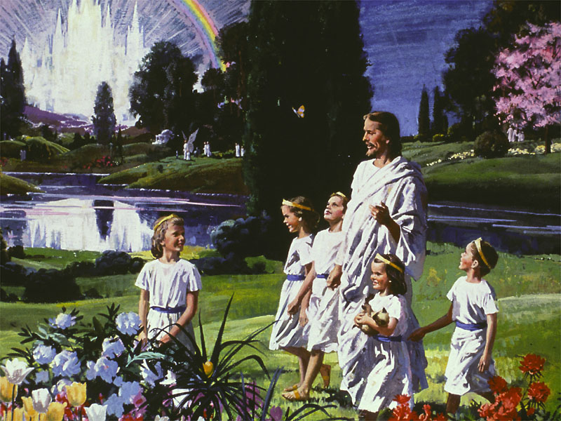
“Eye hath not seen, nor ear heard, neither have entered into the heart of man, the things which God hath prepared for them that love him.”
1 Corinthians 2:9.
Notes:
And think of the awe to be experience in the heaven, that Jesus has gone to prepare for us, where every tear will be wiped away and all that we have experienced here will be explained.
click
Can we help but trust the God that has done so much for us.

Slide 63
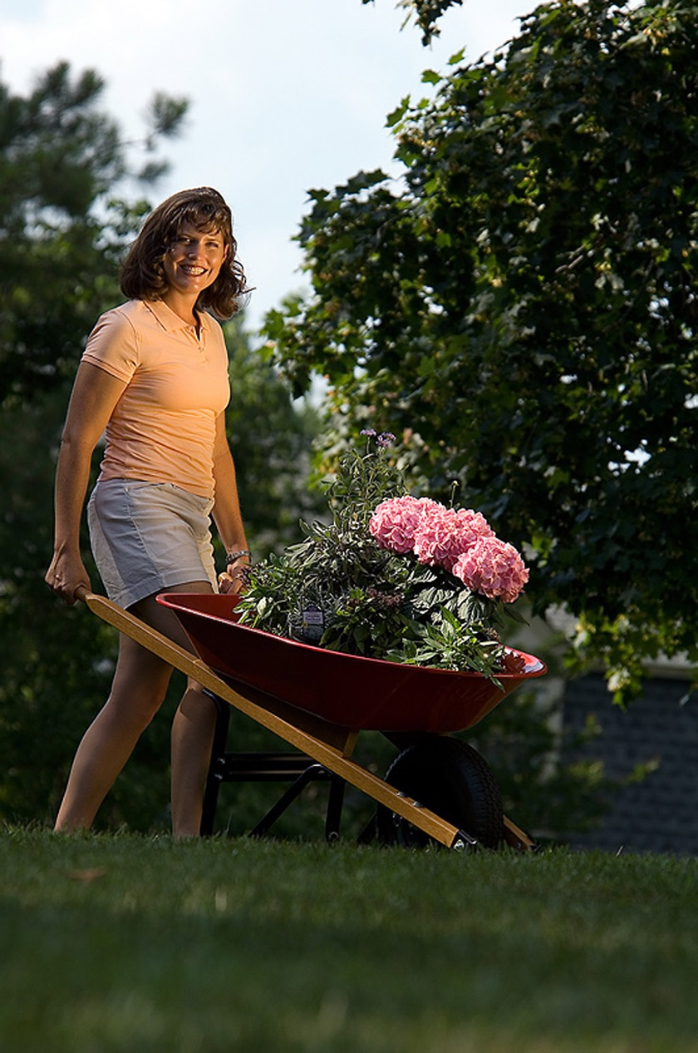
Notes:
Gardening raises mood away from depression

Slide 64
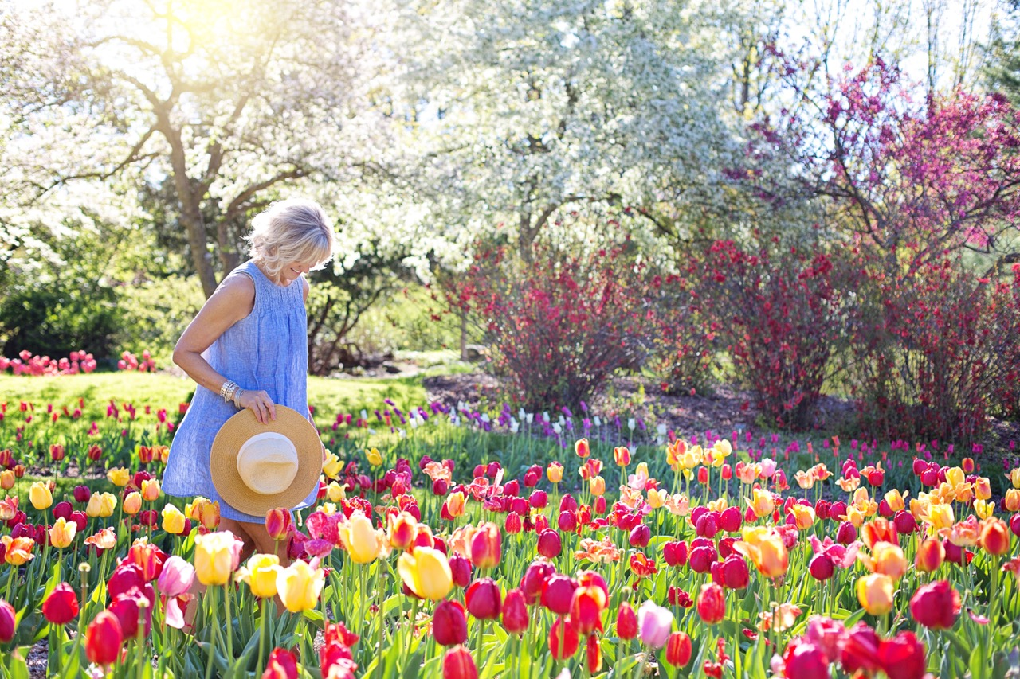
Notes:
Sunlight lifts spirits, Vit D from Cho. Melatonin

Slide 65

Notes:
Positive Bacteria and the IQ boost.
Matthews DM, Jenks SM. Ingestion of Mycobacterium vaccae decreases anxiety-related behavior and improves learning in mice. Behav Processes. 2013 Jun;96:27-35.

Slide 66
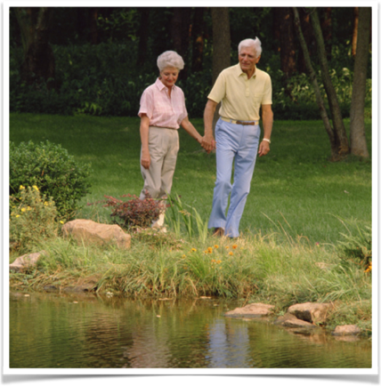
A Healthy Life Style With Daily Outdoor Activity Reduces Your Risk Of Dementia.
Countries with lower average sunlight have higher Alzheimer’s death rates.
Outdoor air improves mental performance.
J Environ Psych 23(2):109-23. Am J Hypertens. 29(2):149-57.
Notes:
Hartig T, Evansb GW, Jamnerc LD, Davisd DS, Gärlinge T. Tracking restoration in natural and urban field settings. J Environ Psych 2003 23(2):109-23.
Abstract
We compared psychophysiological stress recovery and directed attention restoration in natural and urban field settings using repeated measures of ambulatory blood pressure, emotion, and attention collected from 112 randomly assigned young adults. To vary restoration needs, we had half of the subjects begin the environmental treatment directly after driving to the field site. The other half completed attentionally demanding tasks just before the treatment. After the drive or the tasks, sitting in a room with tree views promoted more rapid decline in diastolic blood pressure than sitting in a viewless room. Subsequently walking in a nature reserve initially fostered blood pressure change that indicated greater stress reduction than afforded by walking in the urban surroundings. Performance on an attentional test improved slightly from the pretest to the midpoint of the walk in the nature reserve, while it declined in the urban setting. This opened a performance gap that persisted after the walk. Positive affect increased and anger decreased in the nature reserve by the end of the walk; the opposite pattern emerged in the urban environment. The task manipulation affected emotional self-reports. We discuss implications of the results for theories about restorative environments and environmental health promotion measures.
doi: 10.1093/ajh/hpv180. Epub 2015 Nov 11.
Hughes TM, Sink KM. Hypertension and Its Role in Cognitive Function: Current Evidence and Challenges for the Future. Am J Hypertens. 2016 Feb;29(2):149-57.
Author information
Abstract
This review summarizes evidence from studies of blood pressure and dementia-related biomarkers into our understanding of cognitive health and highlights the challenges facing studies, particularly randomized trials, of hypertension and cognition. Several lines of research suggest that elevated blood pressure, especially at midlife, is associated with cognitive decline and dementia and that treatment of hypertension could prevent these conditions. Further, studies of hypertension and brain structure show that blood pressure is associated with several forms of small vessel disease that can result in vascular dementia or interact with Alzheimer's pathology to lower the pathologic threshold at which Alzheimer's signs and symptoms manifest. In addition, recent studies of hypertension and Alzheimer's biomarkers show that elevated blood pressure and pulse pressure are associated with the extent of brain beta amyloid (Aβ) deposition and altered cerebral spinal fluid profiles of Aβ and tau indicative of Alzheimer's pathology. However, in spite of strong evidence of biological mechanisms, results from randomized trials of antihypertensive therapy for the prevention of cardiovascular or cerebrovascular disease that include cognitive endpoints do not strongly support the observational evidence that treatment of hypertension should be better for cognition. We propose that future clinical trials should consider including dementia biomarkers and assess genetic and cardiometabolic risk factors that have been associated with progression of the underlying disease pathology to help bridge these gaps.
KEYWORDS:
Alzheimer’s disease; blood pressure; cognition; dementia; hypertension; review.
PMID: 26563965
doi: 10.1016/j.neurobiolaging.2011.02.012. Epub 2011 May 6.
Glodzik L, Mosconi L, Tsui W, de Santi S, Zinkowski R, Pirraglia E, Rich KE, McHugh P, Li Y, Williams S, Ali F, Zetterberg H, Blennow K, Mehta P, de Leon MJ. Alzheimer's disease markers, hypertension, and gray matter damage in normal elderly. Neurobiol Aging. 2012 Jul;33(7):1215-27.
Author information
Abstract
It is not well known whether Alzheimer's disease (AD) cerebrospinal fluid (CSF) biomarkers are associated with brain damage in cognitively normal elderly. The combined influence of CSF biomarkers and hypertension (HTN) on the gray matter (GM) is also not well described. One hundred fifteen cognitively healthy subjects (mean age 62.6 ± 9.5%, 62% women) received clinical assessment, a high resolution magnetic resonance imaging (MRI), and a lumbar puncture. The CSF levels of total tau (t-tau), hyperphosphorylated tau (p-tau(231)), amyloid beta (Aβ42/Aβ40), p-tau(231)/Aβ42, and t-tau/Aβ42 were dichotomized as "high" and "low" based on accepted cut off values. Statistical parametric mapping was used to examine MRI scans for regional GM density, studied as a function of the CSF markers, HTN, and combination of both. Global and medial temporal lobe (MTL) GM was also assessed. Voxel based morphometry revealed that higher t-tau was associated with lower GM density in the precunei. Subjects with higher p-tau(231) and p-tau(231)/Aβ42 had less GM in temporal lobes. Low Aβ42/Aβ40 was related to less GM in the thalami, caudate, and midbrain. Subjects with hypertension showed more GM atrophy in the cerebellum, occipital, and frontal regions. Simultaneous presence of elevated CSF AD biomarkers and HTN was associated with more GM atrophy than either marker individually, but no interaction effects were identified. In conclusion, in normal elderly CSF tau markers were associated predominantly with lower GM estimates in structures typically affected early in the AD process. In this presymptomatic stage when no cognitive impairment is present, AD biomarkers and HTN have additive effects on gray matter damage.
PMID: 21530003
Kornhuber HH. Prevention of dementia (including Alzheimer's disease).Gesundheitswesen. 2004 May;66(5):346-51.
[Article in German]
Author information
Abstract
Prevention of dementia: Life expectancy still increases linearly, and the elderly part of the European population grows rapidly in relation to the young. Dementia, however, grows even more rapidly, because it increases exponentially after age 65; it will become a great burden if nothing is done. The discussion so far is concentrated on treatment, whereas prevention is neglected. The therapy of dementia, however, has limited effect. Contrary to a widespread opinion prevention is possible. Genetic factors alone dominate the fate of cognition only in about 3 % of the cases. Besides age, lifestyle and the vascular risk factors exercise a great influence. High blood pressure carries a fourfold risk, diabetes more than doubles the risk both of the vascular and of the Alzheimer type; combined even more. Especially cerebral microangiopathy is strongly associated with Alzheimer's dementia, it triggers the vicious circle which leads to amyloid deposition. The importance of the circulation is underestimated, because most of the microvascular cerebral lesions are not perceived by the patient. All the risk factors for Alzheimer's disease after age 65 are also vascular risk factors especially for microangiopathy: Apo-E4, oestrogen deficiency, insulin resistance, diabetes, arterial hypertension, high cholesterol, old age and increased plasma homocystin which is often caused by alcohol consumption even in moderate doses. A healthy life style with daily outdoor activity and a Mediterranean diet not only reduces the risk of dementia, but also of coronary death and cancer. Cognitively stimulating activity protects even more than physical activity against dementia; the basis for this is acquired in youth by education. Therapy with statins is advisable if atherosclerosis cannot be reasonably counteracted by physical activity and diet.
PMID: 15141356

Slide 67
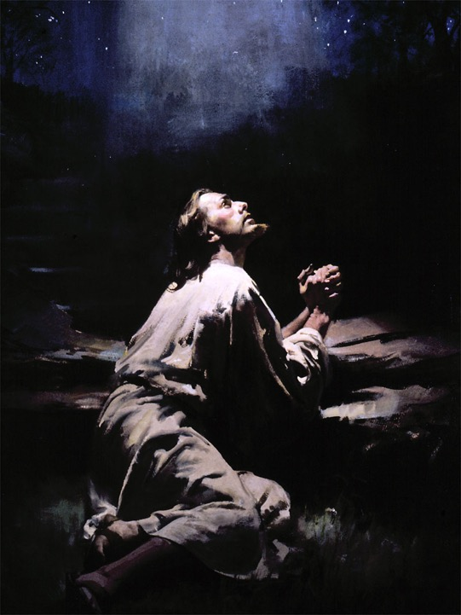
Notes:
Jesus – garden to pray – spirituality
John 18:1,2

Slide 68
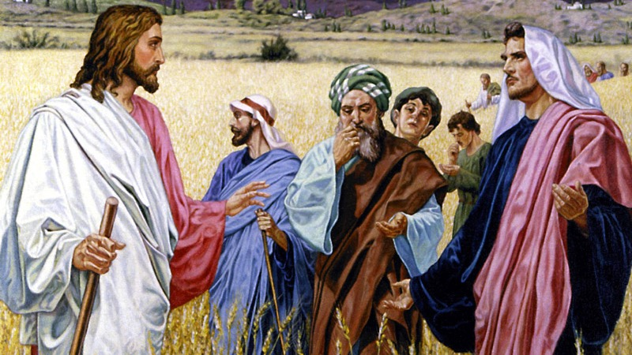
Notes:
Parables to be studied out in nature where they were given,
“We should study the Saviour's parables where He spoke them, in the fields and groves, under the open sky, among the grass and flowers. As we come close to the heart of nature, Christ makes His presence real to us, and speaks to our hearts of His peace and love.” {COL 25.1}

Slide 69

“God has surrounded us with nature's beautiful scenery to attract and interest the mind. It is His design that we should associate the glories of nature with His character. If we faithfully study the book of nature, we shall find it a fruitful source for contemplating the infinite love and power of God.”
{AH 144.1}
Notes:
Natures God, second lesson book,

Slide 70

Notes:
Knowledge of good and evil.
Although the earth was blighted with the curse, nature was still to be man's lesson book. It could not now represent goodness only; for evil was everywhere present, marring earth and sea and air with its defiling touch. Where once was written only the character of God, the knowledge of good, was now written also the character of Satan, the knowledge of evil. From nature, which now revealed the knowledge of good and evil, man was continually to receive warning as to the results of sin. {Ed 26.2}
Darwin, cat mouse.

Slide 71

“Ungovernable passion will not be subdued in a moment; but your lifework is before you to rid the garden of the heart of the poisonous weeds of impatience, faultfinding, and an overbearing disposition.”
{4T 365.3}
Notes:
The weeds!
Ungovernable passion will not be subdued in a moment; but your lifework is before you to rid the garden of the heart of the poisonous weeds of impatience, faultfinding, and an overbearing disposition. "The fruit of the Spirit is love, joy, peace, long-suffering, gentleness, goodness, faith, meekness, temperance." They that are Christ's have crucified the flesh, with its affections and lusts; but the brutish part of your nature takes the lines of control and guides the spiritual. This is God's order reversed. {4T 365.3}

Slide 72

Notes:
Share with neighbors/ poor, food/lessons.

Slide 73

Your Wilderness Experience
And thou shalt remember all the way which the LORD thy God led thee these forty years in the wilderness, to humble thee, and to prove thee, to know what was in thine heart, whether thou wouldest keep his commandments, or no. And he humbled thee, and suffered thee to hunger, and fed thee with manna, which thou knewest not, neither did thy fathers know; that he might make thee know that man doth not live by bread only, but by every word that proceedeth out of the mouth of the LORD doth man live. Thy raiment waxed not old upon thee, neither did thy foot swell, these forty years. Thou shalt also consider in thine heart, that, as a man chasteneth his son, so the LORD thy God chasteneth thee. Deuteronomy 8:2-5.
Notes:
1000 ways

Slide 74

Live to give
“The law of self-renouncing love is the law of life for earth and heaven;”
Notes:
Desire of Ages P.19

Slide 75

“There is nothing, save the selfish heart of man, that lives unto itself.”

Slide 76

“No bird that cleaves the air, no animal that moves upon the ground, but ministers to some other life.”

Slide 77

“There is no leaf of the forest, or lowly blade of grass, but has its ministry.”

Slide 78
“Every tree and shrub and leaf pours forth that element of life without which neither man nor animal could live; and man and animal, in turn, minister to the life of tree and shrub and leaf.”

Slide 79
“The flowers breathe fragrance and unfold their beauty in blessing to the world.”

Slide 80

“The sun sheds its light to gladden a thousand worlds.”

Slide 81

“The ocean, itself the source of all our springs and fountains, receives the streams from every land, but takes to give. The mists ascending from its bosom fall in showers to water the earth, that it may bring forth and bud.”
Notes:
DA 20

Slide 82


“`I seek not Mine own glory,’ `but the glory of Him that sent Me.’ In these words is set forth the great principle which is the law of life for the universe.”
{DA.21}
Notes:
Desire of Ages P.21

Slide 83

“By the casting of the grain into the soil, Christ represents the sacrifice of Himself for our redemption. "Except a corn of wheat fall into the ground and die," He says, "it abideth alone; but if it die, it bringeth forth much fruit." John 12:24. So the death of Christ will result in fruit for the kingdom of God. In accordance with the law of the vegetable kingdom, life will be the result of His death.” {COL 86.2}
“And all who would bring forth fruit as workers together with Christ must first fall into the ground and die. The life must be cast into the furrow of the world's need. Self-love, self-interest, must perish. But the law of self-sacrifice is the law of self-preservation. The seed buried in the ground produces fruit, and in turn this is planted. Thus the harvest is multiplied. The husbandman preserves his grain by casting it away. So in human life, to give is to live. The life that will be preserved is the life that is freely given in service to God and man. Those who for Christ's sake sacrifice their life in this world, will keep it unto life eternal.”
{COL 86.3}
Notes:
the sower went forth to sow, casting his seeds into the furrow.
Cast life into the furrow of the worlds need,
Unless it dieth,

Slide 84

Servants Of The Earth
“And the LORD God took the man, and put him into the garden of Eden to dress it and to keep it.” Genesis 2:15.
“And God blessed them, and God said unto them, Be fruitful, and multiply, and replenish the earth, and subdue it: and have dominion over the fish of the sea, and over the fowl of the air, and over every living thing that moveth upon the earth.” Genesis 1:28.
Notes:
servants of the earth.
And the LORD God took the man, and put him into the garden of Eden to dress it and to keep it.
Genesis 2:15.
And God blessed them, and God said unto them, Be fruitful, and multiply, and replenish the earth, and subdue it: and have dominion over the fish of the sea, and over the fowl of the air, and over every living thing that moveth upon the earth.
Genesis 1:28.

Slide 85

“The pleasure of doing good to others imparts a glow to the feelings which flashes through the nerves, quickens the circulation of the blood, and induces mental and physical health.”
{4T 56.2}
Notes:
Depression, ms or tremors, heart disease, chronic fatigue, fibromyalgia?
The pleasure of doing good to others imparts a glow to the feelings which flashes through the nerves, quickens the circulation of the blood, and induces mental and physical health. {4T 56.2}

Slide 86

Notes:
God’s blessing causes the land to flourish.
While the earth remaineth, seedtime and harvest, and cold and heat, and summer and winter, and day and night shall not cease.
Genesis 8:22.

Slide 87


“God does not annul His laws, but He is continually working through them, using them as His instruments. They are not self-working. God is perpetually at work in nature.
“She is His servant, directed as He pleases. Nature in her work testifies of the intelligent presence and active agency of a being who moves in all His works according to His will.
“It is not by an original power inherent in nature that year by year the earth yields its bounties and continues its march around the sun. The hand of infinite power is perpetually at work guiding this planet. It is God's power momentarily exercised that keeps it in position in its rotation.”
“The God of heaven is constantly at work. It is by His power that vegetation is caused to flourish, that every leaf appears and every flower blooms. Every drop of rain or flake of snow, every spire of grass, every leaf and flower and shrub, testifies of God.”
“It is not as the result of a mechanism, which, once set in motion, continues its work, that the pulse beats and breath follows breath. In God we live and move and have our being. Every breath, every throb of the heart, is a continual evidence of the power of an ever-present God.”
{8T 259-60}
Notes:
Not self-working.
Laws of Nature

Slide 88
Atonement For Every Drink Of Water, Breath Of Air, Bite Of Food.
“The moment the workmanship of God refused obedience to the laws of God's kingdom, that moment he became disloyal to the government of God and he made himself entirely unworthy of all the blessings wherewith God had favored him.”
“This was the position of the human race after man divorced himself from God by transgression. Then he was no longer entitled to a breath of air, a ray of sunshine, or a particle of food.
“And the reason why man was not annihilated was because God so loved him that He made the gift of His dear Son that He should suffer the penalty of his transgression. Christ proposed to become man's surety and substitute, that man, through matchless grace, should have another trial--a second probation--having the experience of Adam and Eve as a warning not to transgress God's law as they did.
“And inasmuch as man enjoys the blessings of God in the gift of the sunshine and the gift of food, there must be on the part of man a bowing before God in thankful acknowledgment that all things come of God.”
“Every gift is stamped with the cross and bears the image and superscription of Jesus Christ. All things come of God. From the smallest benefits up to the largest blessing, all flow through the one Channel--a superhuman mediation sprinkled with the blood that is of value beyond estimate because it was the life of God in His Son.”
{FW 21-2}
Notes:
Atonement for every drink of water, breath of air, bite of food.

Slide 89

“To the death of Christ we owe even this earthly life. The bread we eat is the purchase of His broken body. The water we drink is bought by His spilled blood.
“Never one, saint or sinner, eats his daily food, but he is nourished by the body and the blood of Christ.
“The cross of Calvary is stamped on every loaf. It is reflected in every water spring…. The family board becomes as the table of the Lord, and every meal a sacrament.”
{DA 660.3}
Notes:
Cross on every loaf,
Our Lord has said, "Except ye eat the flesh of the Son of man, and drink His blood, ye have no life in you. . . . For My flesh is meat indeed, and My blood is drink indeed." John 6:53-55. This is true of our physical nature. To the death of Christ we owe even this earthly life. The bread we eat is the purchase of His broken body. The water we drink is bought by His spilled blood. Never one, saint or sinner, eats his daily food, but he is nourished by the body and the blood of Christ. The cross of Calvary is stamped on every loaf. It is reflected in every water spring. All this Christ has taught in appointing the emblems of His great sacrifice. The light shining from that Communion service in the upper chamber makes sacred the provisions for our daily life. The family board becomes as the table of the Lord, and every meal a sacrament. {DA 660.3}

Slide 90

“Physicians and nurses should encourage their patients to be much in the open air.
“ It has a wonderful power to heal diseases caused by the excitements and excesses of fashionable life, a life that weakens and destroys the powers of body, mind, and soul.
“How grateful to the invalids weary of city life, the glare of many lights, and the noise of the streets, are the quiet and freedom of the country! How eagerly do they turn to the scenes of nature!
“How glad would they be to sit in the open air, rejoice in the sunshine, and breathe the fragrance of tree and flower!
“There are life-giving properties in the balsam of the pine, in the fragrance of the cedar and the fir, and other trees also have properties that are health restoring.”
{MH 264}
Notes:
Fresh air(see MH 367.1 below), Negative Ions, Oxygen, vitality
Physicians and nurses should encourage their patients to be much in the open air. Outdoor life is the only remedy that many invalids need. It has a wonderful power to heal diseases caused by the excitements and excesses of fashionable life, a life that weakens and destroys the powers of body, mind, and soul. {MH 264.1}
How grateful to the invalids weary of city life, the glare of many lights, and the noise of the streets, are the quiet and freedom of the country! How eagerly do they turn to the scenes of nature! How glad would they be to sit in the open air, rejoice in the sunshine, and breathe the fragrance of tree and flower! There are life-giving properties in the balsam of the pine, in the fragrance of the cedar and the fir, and other trees also have properties that are health restoring. {MH 264.2}

Slide 91

Sunlight decreases your mortality from cancer. Vitamin D is a potent inhibitor of cancer.
Anticancer Res. 26(4A):2515-24.
Notes:
Anticancer Res. 2006 Jul-Aug;26(4A):2515-24. Related Articles, Links
Vitamin D and cancer.
Spina CS, Tangpricha V, Uskokovic M, Adorinic L, Maehr H, Holick MF.
Vitamin D, Skin and Bone Research Laboratory, Division of Endocrinology, Diabetes and Nutrition, Department of Medicine, Boston University School of Medicine, Boston, MA 02118, USA.
The correlation between decreased morbidity and mortality of cancer and exposure to sunlight is known. The many biological functions of vitamin D that contribute to cancer prevention have only recently begun to be appreciated. Once activated 1,25-dihydroxyvitamin D [1,25(OH)2D3] functions as a potent inhibitor of normal and cancer cellular proliferation. Vitamin D deficiency in mice led to a 60% increase in colon tumor growth, compared to vitamin D-sufficient mice. The ligand binding domain of the Vitamin D receptor was shown to accommodate a class of 1,25(OH)2D3-analogs that possess an additional side-arm. These novel Gemini analogs were evaluated in vitro and in vivo. Select Gemini analogs were 100 times or more effective in inhibiting colon tumor growth in mice, compared to their parent compound. Correcting vitamin D deficiency may decrease the risk of developing colon cancer, while the novel Gemini 1,25(OH)2D3-analogs have the potential for therapeutic application in human colon cancer.
Publication Types:
Review
PMID: 16886659 [PubMed - indexed for MEDLINE]

Slide 92

Sunshine lowers blood pressure by relaxing blood vessels and raising vitamin D levels.
Circ Res. 105(10):1031-40.
Notes:
Sunshine lowers blood pressure by relaxing blood vessels and raising vitamin D levels.
Johnson RS, Titze J, Weller R. Cutaneous control of blood pressure. Curr Opin Nephrol Hypertens. 2016;25(1):11-15.
Abstract
Purpose of review: Textbook theory holds that blood pressure (BP) is regulated by the brain, by blood vessels, or by the kidney. Recent evidence suggests that BP could be regulated in the skin.
Recent findings: The skin holds a complex capillary counter current system, which controls body temperature, skin perfusion, and apparently systemic BP. Epidemiological data suggest that sunlight exposure plays a role in controlling BP. Ultraviolet A radiation produces vasodilation and a fall in BP. Keratinocytes and immune cells control blood flow in the extensive countercurrent loop system of the skin by producing nitric oxide, a key regulator of vascular tone. The balance between hypoxia-inducible factor-1α and hypoxia-inducible factor-2α activity in keratinocytes controls skin perfusion, systemic thermoregulation, and systemic BP by nitric oxide-dependent mechanisms. Furthermore, the skin accumulates Na which generates a barrier to promote immunological host defense. Immune cells control skin Na metabolism and the clearance of Na via the lymphatic system. Reduced lymphatic clearance increases BP.
Summary: Apart from the well-known role of the brain, blood vessels, and the kidney, the skin is important for systemic BP control in humans and in experimental animals.

Slide 93

Sunshine Vitamin
Low vitamin D increases Hashimoto’s autoimmune hypothyroidism and more aggressive thyroid cancers.
Vitamin D increases can be achieved equally by supplementation or sun exposure.
Hormones (Athens). 15(3):385-393
Notes:
(1) Kim D. Low vitamin D status is associated with hypothyroid Hashimoto's thyroiditis. Hormones (Athens). 2016 Jul;15(3):385-393. doi: 10.14310/horm.2002.1681. PMID: 27394703.

Slide 94

Coming Up For Air
Indoor air contaminants are a source of inflammation.
Contaminants include:
  Aspergillus aflatoxins.
  Breathable dust.
  Nitrogen dioxide.
  Formaldehyde.
  Mold.
  Traffic.
Allergy. 2000 Feb;55(2):163-70.
Notes:
Hot indoor air
Many labor under the mistaken idea that if they have taken cold, they must carefully exclude the outside air and increase the temperature of their room until it is excessively hot. The system may be deranged, the pores closed by waste matter, and the internal organs suffering more or less inflammation, because the blood has been chilled back from the surface and thrown upon them. At this time, of all others, the lungs should not be deprived of pure, fresh air. If pure air is ever necessary, it is when any part of the system, as the lungs or stomach, is diseased. Judicious exercise would induce the blood to the surface, and thus relieve the internal organs. Brisk, yet not violent exercise in the open air, with cheerfulness of spirits, will promote the circulation, giving a healthful glow to the skin, and sending the blood, vitalized by the pure air, to the extremities. The diseased stomach will find relief by exercise. Physicians frequently advise invalids to visit foreign countries, to go to the springs, or to ride upon the ocean, in order to regain health; when, in nine cases out of ten, if they would eat temperately and engage in healthful exercise with a cheerful spirit, they would regain health and save time and money. Exercise, and
531
a free and abundant use of the air and sunlight,--blessings which Heaven has freely bestowed upon all,--would give life and strength to the emaciated invalid. {2T 530.2}
A large class of women are content to hover over the stove, breathing impure air for one half or three fourths of the time, until the brain is heated and half benumbed. They should go out and exercise every day, even though some things indoors have to be neglected. They need the cool air to quiet their distracted brains. They need not go to their neighbors to gossip, but should make it their object to do some good, working to the end of benefiting others. Then they will be an example to others and receive real benefit themselves. {2T 531.1}
Perfect health depends upon perfect circulation. Special attention should be given to the extremities, that they may be as thoroughly clothed as the chest and the region over the heart, where is the greatest amount of heat. Parents who dress their children with the extremities naked, or nearly so, are sacrificing the health and lives of their children to fashion. If these parts are not so warm as the body, the circulation is not equalized. When the extremities, which are remote from the vital organs, are not properly clad, the blood is driven to the head, causing headache or nosebleed; or there is a sense of fullness about the chest, producing cough or palpitation of the heart, on account of too much blood in that locality; or the stomach has too much blood, causing indigestion. {2T 531.2}
I thought then I was cut off from doing anything for the
people, but our brethren said they had found out a way that the
room could be ventilated, so I put on the armor again and did
very well until Sunday night. I spoke to a hall filled with
outsiders. I knew the moment I attempted to speak that our
brethren had forgotten to ventilate the hall, and the outdoor air
had not been introduced into the hall after the last meeting had
been held. I got through with the discourse wearied out. {3BIO 353.4}
I walked home. I could not sleep that night, and the next
morning I looked haggard and felt two years older than I did
before I made the attempt to speak. I became very sick with
nervous prostration. . . . I was suffering much with inflammation
of head, stomach, and lungs.--Letter 114, 1886. {3BIO 353.5}
Int J Epidemiol. 1989 Jun;18(2):390-6.Click here to read Links
The effect of domestic factors on respiratory symptoms and FEV1.
Hosein HR, Corey P, Robertson JM.
Occupational Health Unit, University of Toronto, Ontario, Canada.
This study was conducted to determine whether indoor air pollution factors affected respiratory function and symptoms in 1357 non-smoking Caucasian children. Interviews were conducted to determine: exposure to pets and to gases, vapours and dusts from hobbies; the use of gas stoves; fireplaces, air conditioners and humidifiers; type of heating systems; and the number of residents, and the number of smokers in the home. The forced expiratory volume in one second (FEV1) was obtained from maximum expiratory flow volume curves, and symptoms from the application of a standardized questionnaire. Indoor pets and the use of fireplaces and humidifiers had no consistent relationships with FEV1 when considered individually or in combination with the other factors. Hobbies, the use of gas stoves, the absence of air conditioning, the use of hot water heating, crowded homes, and the presence of smokers in the home all had negative relationships with FEV1. The largest effect on lung function was observed in children from homes with hot water heating systems, whereas the smallest effect was observed in children with smokers in the home. Children who lived in homes with hot water heating systems with no air conditioning had mean FEV1 of up to 0.4 litres lower than did their counterparts who lived in homes with forced air heating and air conditioning. Pets, heating systems, cooking fuel, crowding and passive smoking showed no consistent effects on the reporting of any of the symptoms. Girls who were exposed to the emissions from indoor hobbies reported more phlegm, wheeze and dyspnoea.
PMID: 2767853 [PubMed - indexed for MEDLINE
J Trop Med Hyg. 1988 Apr;91(2):77-82.Links
The effect of a hot dry climate on the haemorrheology of healthy males and patients with acute myocardial infarction.
Kolar J, Bhatnagar SK, Hudak A, Smid J, al-Yusuf AR.
Faculty of Medicine, Kuwait University.
We studied the influence of an extremely hot dry summer and temperate winter on the haemorrheology of 82 healthy males (controls) and 101 male patients with acute myocardial infarction (AMI). The haematocrit (Hct), blood viscosity (B1V) and Hct/B1V ratio were measured in these subjects working 'outdoors' and in an air-conditioned environment ('indoors'). The 'summer outdoor' controls had a higher B1V and a lower Hct/B1V when compared to the 'winter outdoor' controls (P less than 0.01), and the 'summer indoor' controls had a lower Hct and Hct/B1V when compared to the 'winter indoor' control group (P less than 0.02). The haemorrheology of 'winter indoor' AMI patients was not different from the controls, except for the Hct/B1V. The 'summer indoor' group had a higher Hct (P less than 0.05) and B1V (P less than 0.001) and a lower Hct/B1V (P less than 0.02) when compared to the controls. 'Summer outdoor' AMI patients had the most abnormal haemorrheology of all groups. AMI patients with Hct/B1V less than 7 had a significantly higher prevalence of hypotension and shock syndrome compared to those whose Hct/B1V was greater than or equal to 7 (P less than 0.05). We conclude that in healthy males, there was a seasonal difference in haemorrheology which was due to acclimatization to heat. During summer, AMI patients working outdoors had the most abnormal haemorrheology on admission and the occurrence of complications was also higher in them. We believe that these abnormalities resulted due to inadequate adjustments to heat.
PMID: 3379656 [PubMed - indexed for MEDLINE]
Clin Exp Allergy. 2001 Dec;31(12):1913-22.Click here to read Links
Hot, humid air increases cellular influx during the late-phase response to nasal challenge with antigen.
Assanasen P, Baroody FM, Naureckas E, Naclerio RM.
The Section of Otolaryngology-Head and Neck Surgery, The Pritzker School of Medicine, The University of Chicago, Chicago, Illinois 60637, USA.
BACKGROUND: Inhalation of hot, humid air (HHA: 37 degrees C, > 95% relative humidity (RH)) partially inhibits the early response to nasal challenge with antigen. OBJECTIVE: To investigate whether HHA inhibited the late-phase response to nasal challenge with antigen and increased hyper-responsiveness of the nasal mucosa to histamine. METHODS: Twenty subjects with seasonal allergic rhinitis, outside of their allergy season, participated in a randomized, 2-way cross-over study. The subjects continuously breathed room air (25 degrees C, 30% RH) or HHA delivered via a face mask during the entire experiment. Subjects were challenged intranasally with antigen 1 h after beginning conditioning. The response was monitored by symptoms and nasal lavage at 2-h intervals after the last antigen challenge. Eight hours after antigen challenge, nasal challenge with histamine was performed. RESULTS: Exposure to HHA significantly increased nasal mucosal temperature from baseline without affecting nasal secretion osmolality. HHA significantly inhibited antigen-induced sneezes, congestion, pruritus, and human serum albumin levels during the early response to antigen challenge. HHA exposure, however, was associated with an 8-fold increase in the eosinophil influx and a 15-fold increase in the levels of eosinophil cationic protein during the late-phase response compared to room air. There were no significant differences in nasal hyper-responsiveness to histamine during either exposure. CONCLUSION: HHA partially decreases the early response to nasal challenge with antigen, but dramatically increases eosinophil influx. Increasing eosinophil number had no effects on the hyper-responsiveness to histamine. We speculate that the physical conditions of air differentially impact the stages of allergic inflammation.
PMID: 11737044 [PubMed - indexed for MEDLINE]
Allergy. 2000 Feb;55(2):163-70.Click here to read Links
Indoor air pollutants in schools: nasal patency and biomarkers in nasal lavage.
Norbäck D, Wålinder R, Wieslander G, Smedje G, Erwall C, Venge P.
Department of Medical Sciences/Occupational and Environmental Medicine, University of Uppsala, University Hospital, Sweden.
BACKGROUND: There is growing concern about the respiratory health aspects of the indoor air quality in schools. METHODS: A standardized investigation, including nasal lavage (NAL), measurement of the nasal cavity by acoustic rhinometry, and hygienic measurements of airborne pollutants, was performed in classrooms, outside the pollen season. All 279 school personnel working in the main buildings of 12 randomly selected primary schools in an urban community in central Sweden (Uppsala) were invited to enroll in the study; 234 (84%) participated. Eosinophil cationic protein (ECP), myeloperoxidase (MPO), lysozyme, and albumin were analyzed in NAL fluid. Crude statistical analysis, as well as multiple regression analysis, was performed, controlling for room temperature, age, sex, current smoking, and a history of atopy. RESULTS: Most classrooms (83%) did not meet the Swedish ventilation standards. A lower degree of nasal patency was found at higher concentrations of respirable dust, nitrogen dioxide (NO2), formaldehyde, and total molds, and in the presence of Aspergillus spp. in the classroom air. The most consistent findings were observed for formaldehyde, NO2, and Aspergillus spp., related to both decreased nasal patency and increase of ECP and lysozyme in NAL. The presence of yeast was associated with an increase of ECP and lysozyme in NAL, but was not related to nasal patency. CONCLUSIONS: Ventilation flow was below current hygienic standards in the classrooms. Air pollutants in the classroom air may influence nasal patency and inflammatory response in the nasal mucosa.
PMID: 10726731 [PubMed - indexed for MEDLINE]

Slide 95


Fresh Air Therapy
Patients who overflowed conventional hospital facilities into outdoor tents had much better survival rates.
Am J Public Health. 99 Suppl 2:S236-42.
Notes:
Am J Public Health. 2009 Oct;99 Suppl 2:S236-42. Epub 2009 May 21.
The open-air treatment of pandemic influenza.
Hobday RA, Cason JW.
Department of Architectural Studies, University of Wales Institute, Cardiff, Llandaff Campus, Western Avenue, Cardiff, CF5 2YB, United Kingdom. ra.hobday@virgin.net
Abstract
The H1N1 "Spanish flu" outbreak of 1918-1919 was the most devastating pandemic on record, killing between 50 million and 100 million people. Should the next influenza pandemic prove equally virulent, there could be more than 300 million deaths globally. The conventional view is that little could have been done to prevent the H1N1 virus from spreading or to treat those infected; however, there is evidence to the contrary. Records from an "open-air" hospital in Boston, Massachusetts, suggest that some patients and staff were spared the worst of the outbreak. A combination of fresh air, sunlight, scrupulous standards of hygiene, and reusable face masks appears to have substantially reduced deaths among some patients and infections among medical staff. We argue that temporary hospitals should be a priority in emergency planning. Equally, other measures adopted during the 1918 pandemic merit more attention than they currently receive.
PMID: 19461112 [PubMed - indexed for MEDLINE]

Slide 96


Fresh As The Morning Air
Occupations involving physical work in the open air are protective, while working in artificial, air conditioned environments increase the risk of contracting an autoimmune inflammatory disease.
Gut. 31(9):1037-40.
Notes:
Exercise in open air
Our limbs and feet are suitably protected from cold and damp, to secure the circulation of the blood to them, with all its blessings. We can take exercise in the open air, in the dews of morning or evening, or after the falling storm of snow or rain, without fears of taking cold. Morning exercise, in walking in the free, invigorating air of heaven, or cultivating flowers, small fruits, and vegetables, is necessary to a healthful circulation of the blood. It is the surest safeguard against colds, coughs, congestions of the brain and lungs, inflammation of the liver, the kidneys, and the lungs, and a hundred other diseases. {RH, April 14, 1868 par. 25}
Gut. 1990 Sep;31(9):1037-40.Click here to read Click here to read Links
Occupational distribution of inflammatory bowel disease among German employees.
Sonnenberg A.
Division of Gastroenterology, Veterans Administration Medical Center, Milwaukee, WI 53295.
Previous reports have shown that both Crohn's disease and ulcerative colitis affect people in white collar occupations associated with higher income and higher social class more frequently than other groups in the population. This study sought to carry these analyses one step further and investigate the distribution of inflammatory bowel disease by individual occupations. The German social security statistics for 'rehabilitation' were used to assess the occupational distribution of Crohn's disease and ulcerative colitis. From 1982 to 1988, a total of 12,014 people were granted rehabilitation as a result of inflammatory bowel disease. Low male prevalence of inflammatory bowel disease was found among bricklayers, road construction workers, unskilled workers in brick and stone, unskilled labourers, and security personnel. Low rates were found among women employed in cleaning and maintenance, and in those without occupation. In contrast, a high male prevalence was found among instrument makers, electricians, bakers, and technical assistants. Among female employees, inflammatory bowel disease was significantly associated with sales representatives, office workers, health occupations, and hairdressers. These associations were found in the complete data for 1982-8 as well as in the separate data for the two half periods 1982-5 and 1986-8. Highly significant correlations between the occupational distribution of Crohn's disease and ulcerative colitis were found among both male and female employees. It seems that occupations involving work in the open air and physical exercise are protective, while being exposed to air conditioned artificial working conditions or extended and irregular shift working confer a risk of contracting inflammatory bowel disease.
PMID: 2210450 [PubMed - indexed for MEDLINE]
J Rheumatol. 2002 Jan;29(1):202-4. Links
Beneficial effect of being outdoors in rheumatoid arthritis.
Patberg WR.
To the Editor:
The widespread opinion of patients with rheumatoid arthritis (RA) that weather influences their complaints has remained scientifically elusive1-7. A factor that might have masked the relationship between RA variables and the weather is the extent to which the patients studied were actually exposed to it. For example, outdoor frost will have little effect on patients staying indoors all day.
One of the authors (WRP), a 54-year-old man, nonsmoker, has had rheumatoid factor positive RA since 1979 (revised American College of Rheumatology criteria8). Over a period of 4 years, he daily quantified his joint pain (n = 848 days) as described3 (trace 3 in Figure 1), and the time he spent outdoors (n = 1200 days) (Figure 1, trace 2). The erythrocyte sedimentation rate (ESR) was determined regularly (n = 107) (Figure 1, bottom trace). During the study, medication was stable.
During all periods in which about 3 hours were spent outdoors daily (shaded in Figure 1) and with a relatively low outdoor temperature (top trace), the pain score as well as the ESR decreased, or remained at a low level (B, D, H, begin and end J, and L in Figure 1). At high outdoor temperatures the pain score and the ESR increased slightly (F and J). During the remaining periods (mostly < 3 hours outdoors), the RA variables in general varied with outdoor temperature, but periods in which he was only briefly outdoors (< 1 hour daily) were associated with an increase in pain score and ESR (second half of period G, the last quarter of period I, and period K).
Figure 1. Plot of 24 hour mean outdoor temperature, time outdoors per 24 hours, daily joint pain score, and ESR. Periods during which the daily time outdoors was about 3 hours are shaded. Broken lines (JS) indicate days on which joint surgery was carried out.
Joint surgery ("JS" in Figure 1) that was carried out during the study hardly influenced the RA variables since none of the joints involved was severely inflamed and the main indication for surgery was deformity and not pain.
The delayed effect on pain score of time spent outdoors is shown in Figure 2 as the average change in pain score for 30 days following all days that satisfied a certain criterion — as described in A, B, C, and D. The difference between the curves is the number of successive days that met the criterion (1 to 20), as indicated by the length of the first part of the curve (bold line). For example, the bottom line in Figure 2D shows the course of the average change in pain score during (bold line) and after (regular line) 20 successive days with outdoor temperature < 6ｰC and time outdoors ｳ 2 hours. The change in pain score was always calculated with respect to the pain score on the first of the successive days that met the criteria.
Figure 2. Average change in pain score following one or more successive days (up to 20) meeting 4 different criteria (A to D) of daily outdoor temperature and time outdoors (1995-98). Limited data restricted the analysis to responses following maximally 6 and 17 successive criterion days in A and C, respectively. Curves were truncated when < 3 pain scores contributed to the average (A). Number of data of the averages plotted varies considerably: 3-55 (A), 95-435 (B), 3-74 (C), and 11-160 (D). Differences from zero were tested for significance with Student t test. In A, significant values are indicated with asterisks. In B, significant values occurred beyond Day 4 and before Day 26 (on Days 9 through 13, and on Day 16, all values were significant). In C, most values beyond Day 12 were significant. In D, all values beyond Day 2 were significant.
Being outdoors briefly on warmer days (ｳ 6ｰC) increased the pain score as long as the criterion was satisfied (A). Thereafter, the curves level off, which is likely due to the contribution of warm days with time outdoors > 2 hours. Figure 2B illustrates this contribution: staying outdoors for 2 hours or more on days warmer than 6ｰC hardly affected the pain score.
Being outdoors briefly on cold days had little effect on the pain score (C). After the periods satisfying the criterion (bold line on curve) the curves tend to decrease steeply (thin lines). The explanation may be that cold days with outdoor times > 2 hours did contribute to the averages here as well. A clear decrease in pain score was found for staying outdoors > 2 hours (D). The longer the period of successive days that satisfied the cold criterion, the greater was the decrease.
Depending on the average time outdoors of the preceding 14 days, the ESR data were grouped in 1 hour periods. The mean ESR per period decreased with increasing time outdoors: 0 to 1 h: 18.00 (SD 7.03), 1-2 h: 15.53 (SD 7.03), 2-3 h: 14.60 (SD 4.05), 3-4 h: 12.50 mm/h (SD 2.46). The mean ESR in the last period was significantly lower than in the first (p < 0.05, ANOVA with Tukey correction).
The effect of daily time spent outdoors is in accord with the earlier reported effect of outdoor temperature on pain and ESR9: a low outdoor temperature as well as being outdoors (on most days in a marine climate) will have a cooling effect on the microclimate. In general, outdoor activities were light, and the chilly feeling during stays outdoors was the main experience of the (mostly lightly dressed) patient in this study.
A possible explanation for the effect of exposure to a cool environment might be related to skin vasoconstriction, or to the well known increased production of cortisol10. Whatever the influencing variable(s) might be, this 4 year study shows that being outdoors for 3 hours per day or longer appears to have a beneficial effect on this patient's RA.
WIEBE R. PATBERG, MSc, Department of Medical Physiology, University of Groningen, PO Box 196, 9700 AD Groningen; JOHANNES J. RASKER, MD, Departments of Rheumatology and Communication Studies, Medical Spectrum, and University of Twente, PO Box 217, 7500 AE Enschede, The Netherlands
REFERENCES
1. Patberg WR, Nienhuis RLF, Veringa F. Relation between meteorological factors and pain in rheumatoid arthritis in a marine climate. J Rheumatol 1985;12:711-5.
2. Rasker JJ, Peters HJ, Boon KL. Influence of weather on stiffness and force in patients with rheumatoid arthritis. Scand J Rheumatol 1986;15:27-36.
3. Patberg WR. Effect of temperature and humidity on daily pain score in a patient with rheumatoid arthritis [letter]. Arthritis Rheum 1989;32:1627-9.
4. Aikman H. The association between arthritis and the weather. Int J Biometeorol 1997;40:192-9.
5. Latman NS. Annual fluctuations in rheumatoid arthritis. J Rheumatol 1981;8:725-9.
6. Van de Laar MAFJ, Bernelot Moens HJ, van der Stadt RJ, van der Korst JK. Assessment of inflammatory joint activity in rheumatoid arthritis and changes in atmospheric conditions. Clin Rheumatol 1991;10:426-33.
7. Drane D, Berry G, Bieri D, McFarlane AC, Brooks P. The association between external weather conditions and pain and stiffness in women with rheumatoid arthritis. J Rheumatol 1997;24:1309-16.
8. Arnett FC, Edworthy SM, Bloch DA, et al. The American Rheumatism Association 1987 revised criteria for the classification of rheumatoid arthritis. Arthritis Rheum 1988;31:315-24.
9. Patberg WR. Correlation of erythrocyte sedimentation rate and outdoor temperature in a patient with rheumatoid arthritis [letter]. J Rheumatol 1997;24:1017-8.
10. The adrenocortical hormones. In: Guyton AC. Textbook of medical physiology. Philadelphia: WB Saunders; 1986:909-22.
PMID: 11824963 [PubMed - indexed for MEDLINE]

Slide 97

Indoor rat’s cancers grow twice as fast and twice as large as rats living outdoors in fresh air and sunshine.
Environ Health Perspect. 114(10):1558-66.

Slide 98

”All patients should keep out of doors as much as possible, and many will be benefited by sleeping in the open air.”
{PH095 19.5}
Notes:
Patients to sleep outdoors. 1918.
"I shall have more to say about these matters later, but I wish now to say that all patients should keep out of doors as much as possible, and many will be benefited by sleeping in the open air. {PH095 19.5}

Slide 99

“During His ministry Jesus lived to a great degree an outdoor life. His journeys from place to place were made on foot, and much of His teaching was given in the open air.
“In training His disciples He often withdrew from the confusion of the city to the quiet of the fields, as more in harmony with the lessons of simplicity, faith, and self-abnegation He desired to teach them.”
{MH 52.2}

Slide 100

Sights and sounds of evil.
“Instead of dwelling where only the works of men can be seen, where the sights and sounds frequently suggest thoughts of evil, where turmoil and confusion bring weariness and disquietude, go where you can look upon the works of God.
“Find rest of spirit in the beauty and quietude and peace of nature. Let the eye rest on the green fields, the groves, and the hills.
“Look up to the blue sky, unobscured by the city's dust and smoke, and breathe the invigorating air of heaven. Go where, apart from the distractions and dissipations of city life, you can give your children your companionship, where you can teach them to learn of God through His works, and train them for lives of integrity and usefulness.”
{MH 367.1}

Slide 101

1. All products will have become services. “I don't own anything. I don't own a car. I don't own a house. I don't own any appliances or any clothes,” writes Danish MP Ida Auken. Shopping is a distant memory in the city of 2030, whose inhabitants have cracked clean energy and borrow what they need on demand. It sounds utopian, until she mentions that her every move is tracked and outside the city live swathes of discontents, the ultimate depiction of a society split in two.
Notes:
Shopping is a distant memory in the city of 2030, whose inhabitants have cracked clean energy and borrow what they need on demand. It sounds utopian, until she mentions that her every move is tracked and outside the city live swathes of discontents, the ultimate depiction of a society split in two.

Slide 102

Cities a Trap
But erelong there will be such strife and confusion in the cities, that those who wish to leave them will not be able. We must be preparing for these issues. This is the light that is given me.
{CL 11.1}

Slide 103

“Among the mountains of Gilead, east of the Jordan, there dwelt in the days of Ahab a man of faith and prayer whose fearless ministry was destined to check the rapid spread of apostasy in Israel. Far removed from any city of renown, and occupying no high station in life, Elijah the Tishbite nevertheless entered upon his mission confident in God's purpose to prepare the way before him and to give him abundant success.”
{PK 119.1}
Notes:
Country advantage
Elijah
People of the Elijah message

Slide 104

“John the Baptist, the forerunner of Christ, received his early training from his parents. The greater portion of his life was spent in the wilderness, that he might not be influenced by beholding the lax piety of the priests and rabbis or by learning their maxims and traditions, through which right principles were perverted and belittled.
“It was John's choice to forgo the enjoyments and luxuries of city life for the stern discipline of the wilderness. Here his surroundings were favorable to habits of simplicity and self-denial. Uninterrupted by the clamor of the world, he could here study the lessons of nature, of revelation, and of providence.
“To him the solitude of the desert was a welcome escape from the society in which suspicion, unbelief, and impurity had become well-nigh all-pervading. He distrusted his own power to withstand temptation and shrank from constant contact with sin lest he should lose the sense of its exceeding sinfulness.”
{8T 221.1}

Slide 105

Notes:
WV – Glenn – garden – baptized – Q
What would happen if you spent more time in your garden with the Lord of all the earth?

Slide 106

In Summary
Country living is our ecological niche.
It promotes our health: mentally, physically, and spiritually.
It helps protect us from the sights and sounds of evil.
Through it God promises to feed us in times of trouble.
It helps us in the development of Christian character destined for Heaven.
Notes:
Summary

