Slide 1

The Jab
Notes:
Why God’s Children Don’t Take Vaccinations
Eternal Father Strong To Save
Vaccinated With Complications
Freedom of informed conscience!
TP: Plea for help!

Slide 2

Dear Dr Clark,
I am a Seventh Day Adventist from Australia. I commenced my physical therapy job today at an aged care facility. I was previously told in an email that I wouldn’t be allowed to enter the building unless I provided evidence of a recent influenza vaccination. After much prayer, I decided to turn up to my placement anyway. Thankfully, they allowed me to start my placement today, but I was told that I must provide a letter by tomorrow morning (written by someone in health) saying that I didn’t receive the vaccination due to religious reasons. Are you able to help me out in any way or know anyone that could? Thank you for your time.
            Regards,
            Joseph
Notes:
What would you do if you were give a 24hr vaccine mandate?
TP: Bill Gates bunkers, The Vaccine is the World’s bunker against fearful disease.

Slide 3

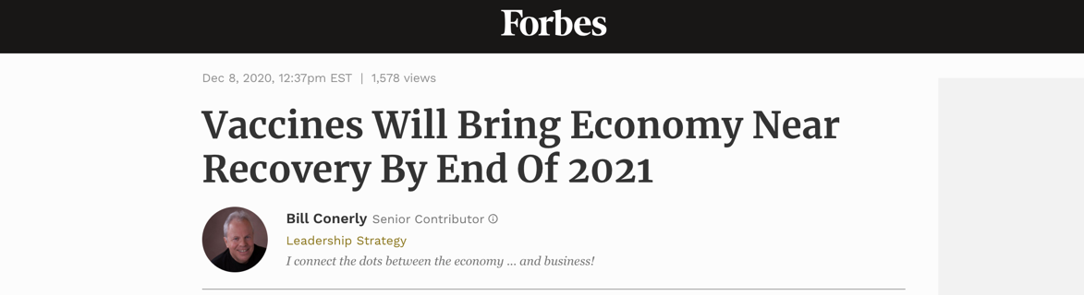
World Sees Vaccine As Solution
Revelation 18:23 “And the light of a candle shall shine no more at all in thee; and the voice of the bridegroom and of the bride shall be heard no more at all in thee: for thy merchants were the great men of the earth; for by thy sorceries [pharmakeia] were all nations deceived.”
Notes:
TP: what is the worlds reaction going to be when you say no to their vaccine saviour?

Slide 4
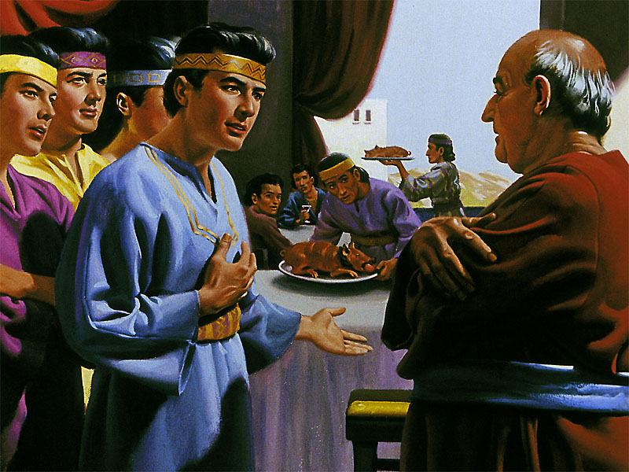
“But Daniel purposed in his heart that he would not defile himself with the portion of the king's meat, nor with the wine which he drank: therefore he requested of the prince of the eunuchs that he might not defile himself.” Daniel 1:8.
Notes:
TP: Are you afraid of the hornets nest? Will you stand or fall?

Slide 5
Disease, Uncleanness, Defilement: Leviticus 15:3-12.
3 And this shall be his uncleanness in his issue: whether his flesh run with his issue, or his flesh be stopped from his issue, it is his uncleanness.
4 Every bed, whereon he lieth that hath the issue, is unclean: and every thing, whereon he sitteth, shall be unclean.
5 And whosoever toucheth his bed shall wash his clothes, and bathe himself in water, and be unclean until the even.
6 And he that sitteth on any thing whereon he sat that hath the issue shall wash his clothes, and bathe himself in water, and be unclean until the even.
7 And he that toucheth the flesh of him that hath the issue shall wash his clothes, and bathe himself in water, and be unclean until the even.
8 And if he that hath the issue spit upon him that is clean; then he shall wash his clothes, and bathe himself in water, and be unclean until the even.
9 And what saddle soever he rideth upon that hath the issue shall be unclean.
10 And whosoever toucheth any thing that was under him shall be unclean until the even: and he that beareth any of those things shall wash his clothes, and bathe himself in water, and be unclean until the even.
11 And whomsoever he toucheth that hath the issue, and hath not rinsed his hands in water, he shall wash his clothes, and bathe himself in water, and be unclean until the even.
12 And the vessel of earth, that he toucheth which hath the issue, shall be broken: and every vessel of wood shall be rinsed in water.
Notes:
TP: It’s unclean, but is it really a sin?

Slide 6
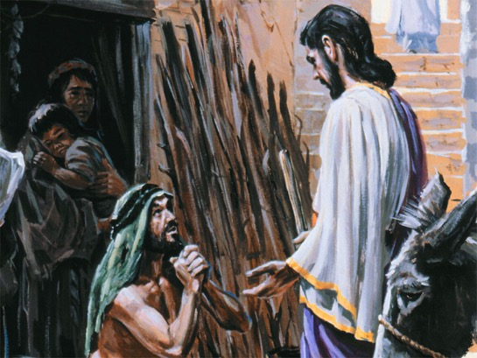
Is deliberate contact with disease a salvational issue?
Leviticus 5:2-6
2. Or if a soul touch any unclean thing, whether it be a carcase of an unclean beast, or a carcase of unclean cattle, or the carcase of unclean creeping things, and if it be hidden from him; he also shall be unclean, and guilty.
3. Or if he touch the uncleanness of man, whatsoever uncleanness it be that a man shall be defiled withal, and it be hid from him; when he knoweth of it, then he shall be guilty.
5. And it shall be, when he shall be guilty in one of these things, that he shall confess that he hath sinned in that thing:
6. And he shall bring his trespass offering unto the LORD for his sin which he hath sinned, a female from the flock, a lamb or a kid of the goats, for a sin offering; and the priest shall make an atonement for him concerning his sin.
Notes:
TP: if defilement is a sin, what does that make vaccination?

Slide 7
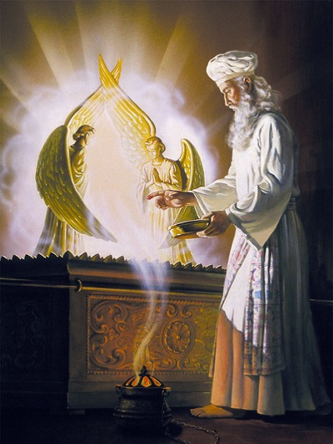
“Know ye not that ye are the temple of God, and that the Spirit of God dwelleth in you? If any man defile the temple of God, him shall God destroy; for the temple of God is holy, which temple ye are.” 1 Corinthians 3:16-17.
SALVATIONAL ISSUE?!
“For this ye know, that no whoremonger, nor unclean person, nor covetous man, who is an idolater, hath any inheritance in the kingdom of Christ and of God.” Ephesians 5:5

Slide 8
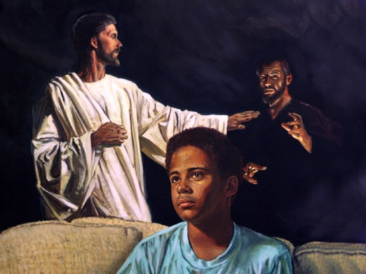
Satan Wants You Defiled, Unclean, Cut Off
“But the man that shall be unclean, and shall not purify himself, that soul shall be cut off from among the congregation, because he hath defiled the sanctuary of the LORD:” Numbers 19:20.
TEST OF FELLOWSHIP?!

Slide 9
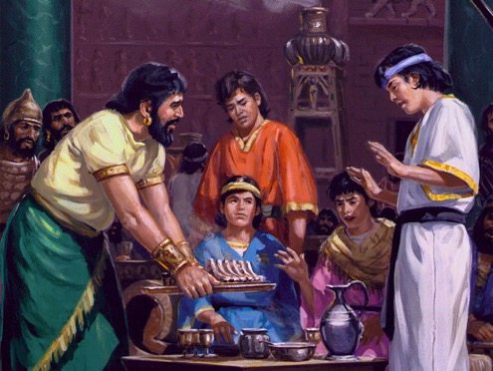
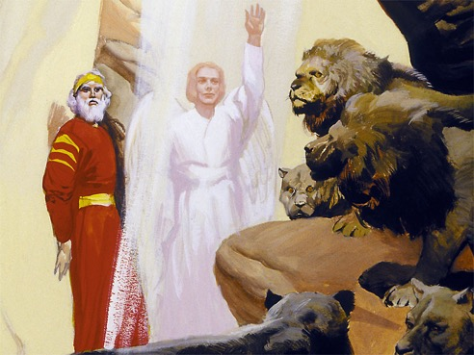
Daniel’s Test On Health First
Notes:
TP: “You put my children and grandparents lives at risk by clinging to those old Levitical rules that were nailed to the cross!”

Slide 10
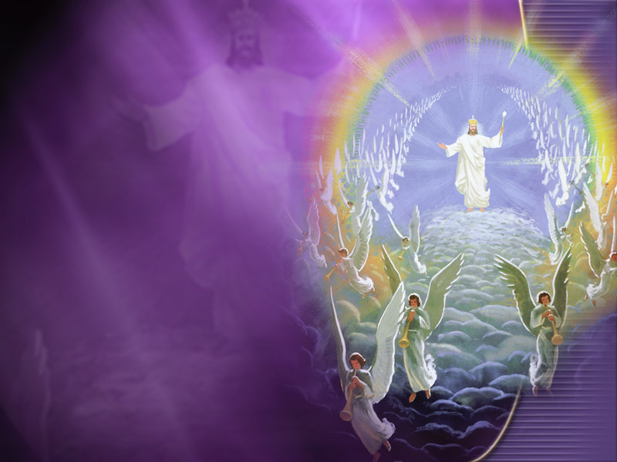
When Jesus Returns In All His Glory
“When the Son of man shall come in his glory, and all the holy angels with him, then shall he sit upon the throne of his glory:” Matthew 25:31.

Slide 11
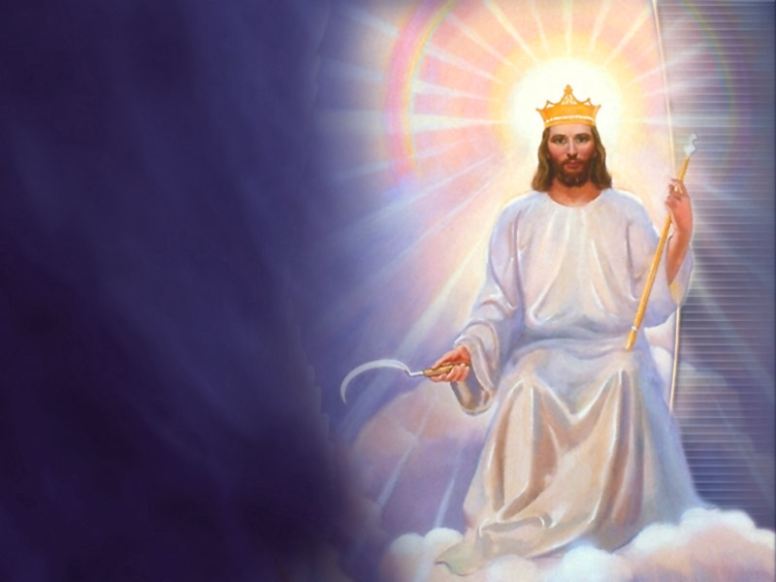
To Judge The Quick And The Dead
“I charge thee therefore before God, and the Lord Jesus Christ, who shall judge the quick and the dead at his appearing and his kingdom;” 2 Timothy 4:1.

Slide 12
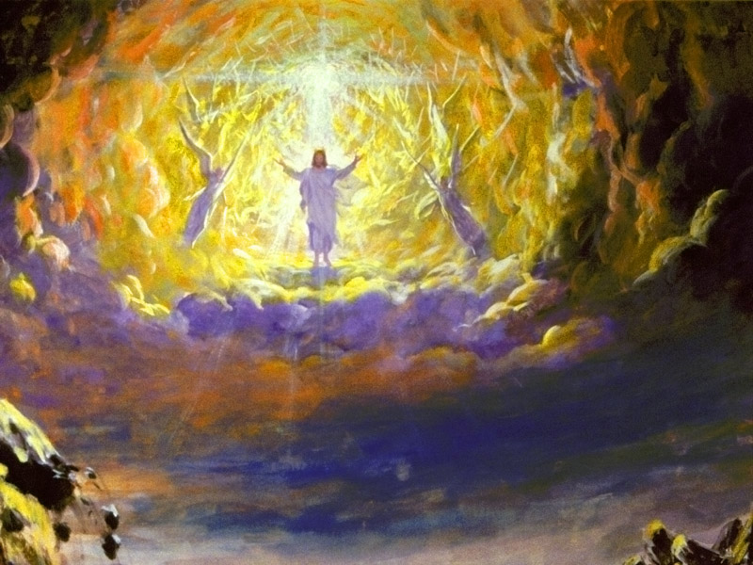
All The Elements Will Melt With Fervent Heat
“But the day of the Lord will come as a thief in the night; in the which the heavens shall pass away with a great noise, and the elements shall melt with fervent heat, the earth also and the works that are therein shall be burned up.” 2 Peter 3:10.

Slide 13
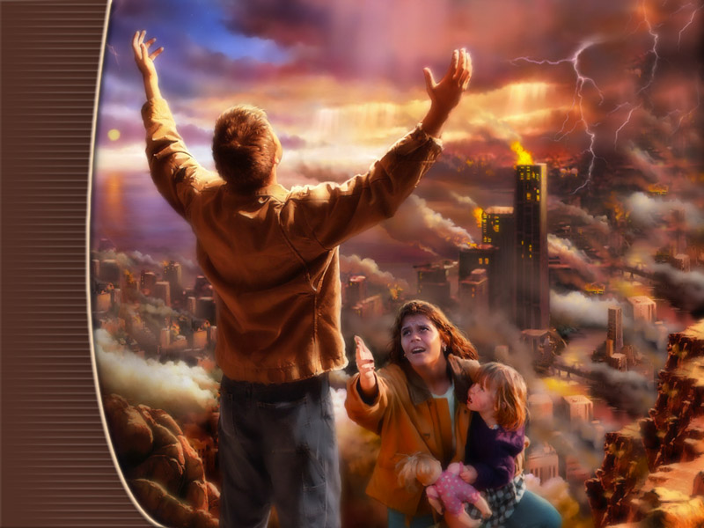
At that time those who are in violation of the health laws of Moses will receive their reward by fire, to be consumed with the wicked.

Slide 14

“For, behold, the LORD will come with fire, …and the slain of the LORD shall be many…. They that … eat swine's flesh, and the abomination, and the mouse, shall be consumed together, saith the LORD.” Isaiah 66:15-17
“And the swine, though he divide the hoof, and be clovenfooted, yet he cheweth not the cud; he is unclean to you. Of their flesh shall ye not eat, and their carcase shall ye not touch; they are unclean to you.” Leviticus 11:7-8.
Nailed to cross?
Notes:
2 Peter 3:10-12.
TP: Even your own church members, “you’re wasting time on the health message when we need to be preaching the love of Jesus? Or the three angel’s message.”

Slide 15
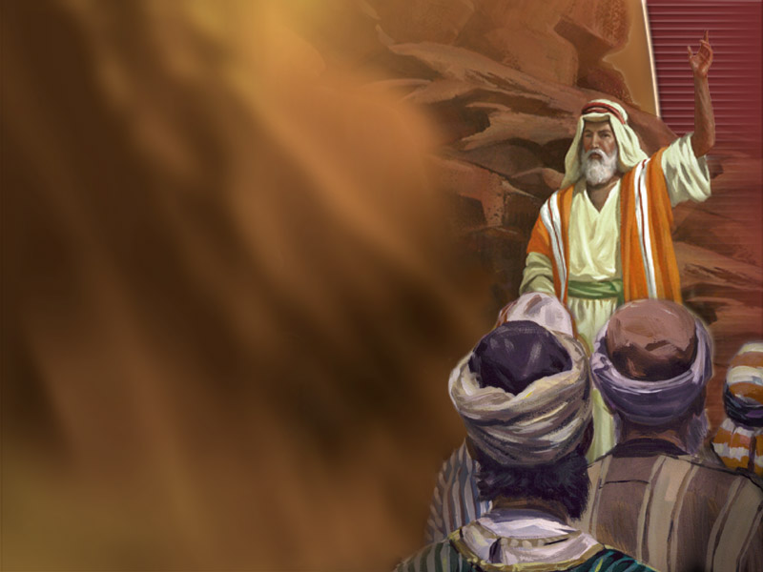
Is there any increased significance in the last days for the laws God gave through Moses?
“Remember ye the law of Moses my servant, which I commanded unto him in Horeb for all Israel, with the statutes and judgments. Behold, I will send you Elijah the prophet before the coming of the great and dreadful day of the LORD:” Malachi 4:4-5.
Notes:
TP: Only the pure shall see God, who is of purer eyes than to behold evil. Who can stand in His presence? The undefiled in the way. What defiles?

Slide 16

The Jab
Vaccination is deliberate defilement of your body with disease in flagrant violation of God’s health statutes.
“Who can bring a clean thing out of an unclean? not one.” (Job 14:4).
“Come out from among them, and be ye separate, saith the Lord, and touch not the unclean thing;” 2 Corinthians 6:16-17.

Slide 17
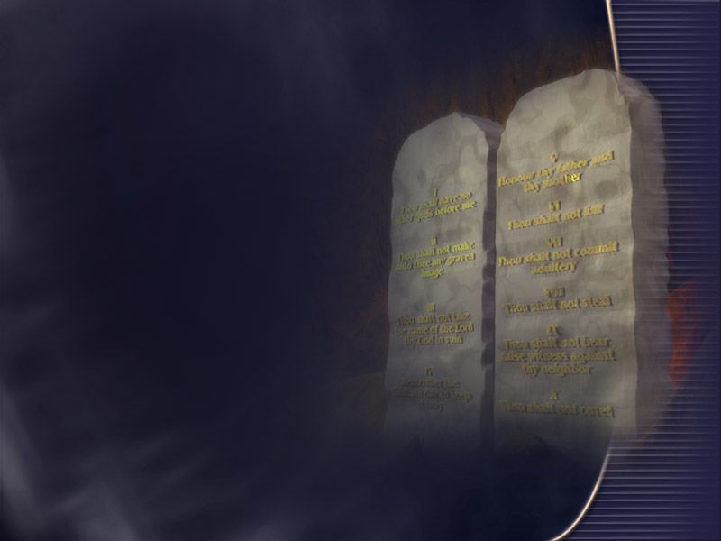
“And said, If thou wilt diligently hearken to the voice of the LORD thy God, and wilt do that which is right in his sight, and wilt give ear to his commandments, and keep all his statutes, I will put none of these diseases upon thee, which I have brought upon the Egyptians: for I am the LORD that healeth thee.” Exodus 15:26.

Slide 18
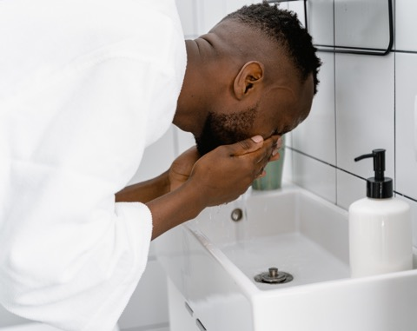
We Are Asked To Take Care Of Our Bodies Intelligently
“That every one of you should know how to possess his vessel in sanctification and honour;” 1 Thessalonians 4:4.

Slide 19

We Are Accountable For Our Care Of Our Body
“For we must all appear before the judgment seat of Christ; that every one may receive the things done in his body, according to that he hath done, whether it be good or bad.” 2 Corinthians 5:10.

Slide 20

Notes:
TP: FEMA, Adventist administrator, Obey the higher powers, ROMANS 13.

Slide 21

What if they mandate vaccinations, aren’t Governments ordained of God?
Romans 13:1-3
1. Let every soul be subject unto the higher powers. For there is no power but of God: the powers that be are ordained of God.
2. Whosoever therefore resisteth the power, resisteth the ordinance of God: and they that resist shall receive to themselves damnation.
Notes:
TP: What if the laws of the government clash with the law of God?

Slide 22
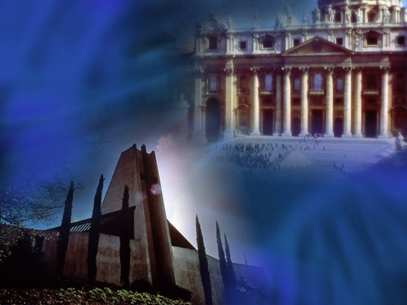
Is the government supposed to have jurisdiction over the things of God?
“And Jesus answering said unto them, Render to Caesar the things that are Caesar's, and to God the things that are God's. And they marvelled at him.” Mark 12:17.
Notes:
TP: A case of massive identity theft.

Slide 23
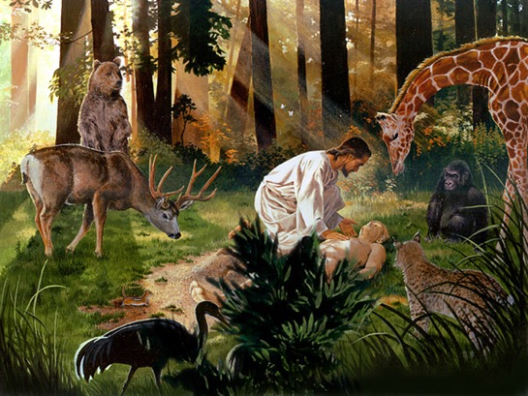
To whom does our body belong, the government or God? And Why?
“But now thus saith the LORD that created thee, O Jacob, and he that formed thee, O Israel, Fear not: for I have redeemed thee, I have called thee by thy name; thou art mine.” (Isaiah 43:1,2).
“For by him were all things created, …and by him all things consist.” Colossians 1:16-17.
“What? know ye not that your body is the temple of the Holy Ghost which is in you, which ye have of God, and ye are not your own? For ye are bought with a price: therefore glorify God in your body, and in your spirit, which are God's.” (1 Corinthians 6:19,20).
Notes:
TP: if the pandemic had you spinning, look what’s coming next!

Slide 24
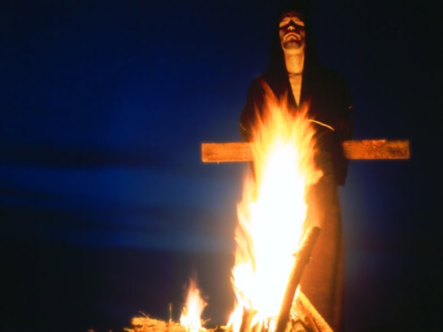
What does God tells will follow on the heals of pestilence?
Matthew 24:7-10
7. For nation shall rise against nation, and kingdom against kingdom: and there shall be famines, and pestilences, and earthquakes, in divers places….
9. Then shall they deliver you up to be afflicted, and shall kill you: and ye shall be hated of all nations for my name's sake.
10. And then shall many be offended, and shall betray one another, and shall hate one another.
Notes:
TP: they are following a script, Have we seen this script before?

Slide 25
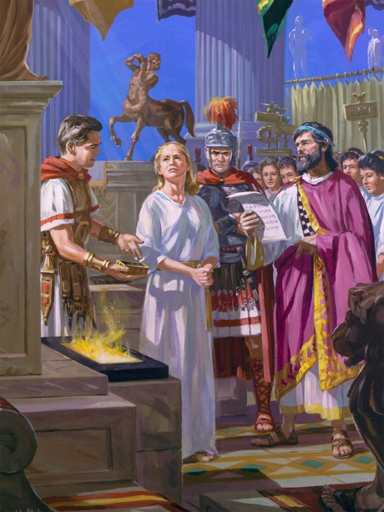
Déjà vu
“So hast thou also them that hold the doctrine of the Nicolaitans, which thing I hate.” Revelation 2:15.
The Nicolaitans were a group who taught a radical dualism between the body and the soul. They believed that what is done with the body cannot in any way defile the soul.
The city of Smyrna was the center of emperor worship in the Roman Empire. Once a year Roman citizens were required to burn incense in honor of the godhood the emperor and they were issued a certificate indicating that they had complied. To refuse to do so entailed certain death.
Notes:
TP: The authorities tell you that you have 18 days to come into compliance on vaccination, What’s you next move going to be?
Rev 2:6 But this you have, that you hate the deeds of the Nicolaitans, which I also hate.
The Nicolaitans were a group who taught a radical dualism between the body and the soul. They believed that what is done with the body cannot in any way defile the soul.
6 (Jude 4). The Sin of the Nicolaitans—Is it [our sin] the sin of the Nicolaitans, turning the grace of God into lasciviousness (The Review and Herald, June 7, 1887)? 7BC 957.5
(Romans 3:31.) Doctrine of the Nicolaitans—The doctrine is now largely taught that the gospel of Christ has made the law of God of no effect; that by “believing” we are released from the necessity of being doers of the Word. But this is the doctrine of the Nicolaitans, which Christ so unsparingly condemned (The Signs of the Times, January 2, 1912). 7BC 957.6
The city of Smyrna was the center of emperor worship in the Roman Empire. Once a year Roman citizens were required to burn incense in honor of the godhood the emperor and they were issued a certificate indicating that they had complied. To refuse to do so entailed certain death. Ignatius, bishop of Antioch, was thrown to the lions in the amphitheater in Smyrna (AD 107) and Polycarp, who was born in Smyrna in AD 69, was burned at the stake (AD 156).

Slide 26
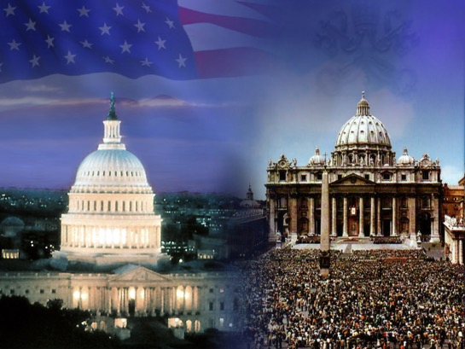
Is the government supposed to make anti-Biblical laws that are a terror to good people who do good works?
“For rulers are not a terror to good works, but to the evil. Wilt thou then not be afraid of the power? do that which is good, and thou shalt have praise of the same:” Romans 13:3.
Notes:
TP: Are you praying to God for a good government?!

Slide 27

“For rulers are not a terror to good works, but to the evil.”
“Let the priests, the ministers of the LORD, weep between the porch and the altar, and let them say, Spare thy people, O LORD, and give not thine heritage to reproach, that the heathen should rule over them: wherefore should they say among the people, Where is their God?” Joel 2:17.
“Righteousness exalteth a nation: but sin is a reproach to any people.” Proverbs 14:34.
“And I will bless them that bless thee, and curse him that curseth thee:” Genesis 12:3.
Notes:
TP: What is of more value, civil liberties or freedom of conscience?

Slide 28


Liberty Of Conscience
“Let every man be fully persuaded in his own mind.” Romans 14:5.
“Choose you this day whom ye will serve;” Joshua 24:15.
“Be not deceived; God is not mocked: for whatsoever a man soweth, that shall he also reap. For he that soweth to his flesh shall of the flesh reap corruption; but he that soweth to the Spirit shall of the Spirit reap life everlasting.” Galatians 6:7-8.
Notes:
TP: Bible Prophecy points to total Body control, are you ready?

Slide 29
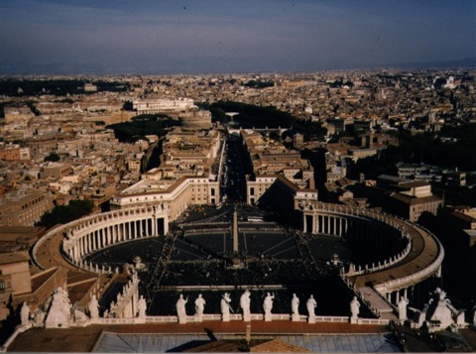
Who falsely claims jurisdiction over the bodies and souls of people?
Revelation 18:11-13
11. And the merchants of the earth shall weep and mourn over her; for no man buyeth their merchandise any more:
12. The merchandise of gold, and silver, and precious stones, and of pearls, and fine linen, and purple, and silk, and scarlet, and all thyine wood, and all manner vessels of ivory, and all manner vessels of most precious wood, and of brass, and iron, and marble,
13. And cinnamon, and odours, and ointments, and frankincense, and wine, and oil, and fine flour, and wheat, and beasts, and sheep, and horses, and chariots, and slaves (bodies), and souls of men.
Notes:
TP: Who is the big guy who wants you vaccinated?

Slide 30
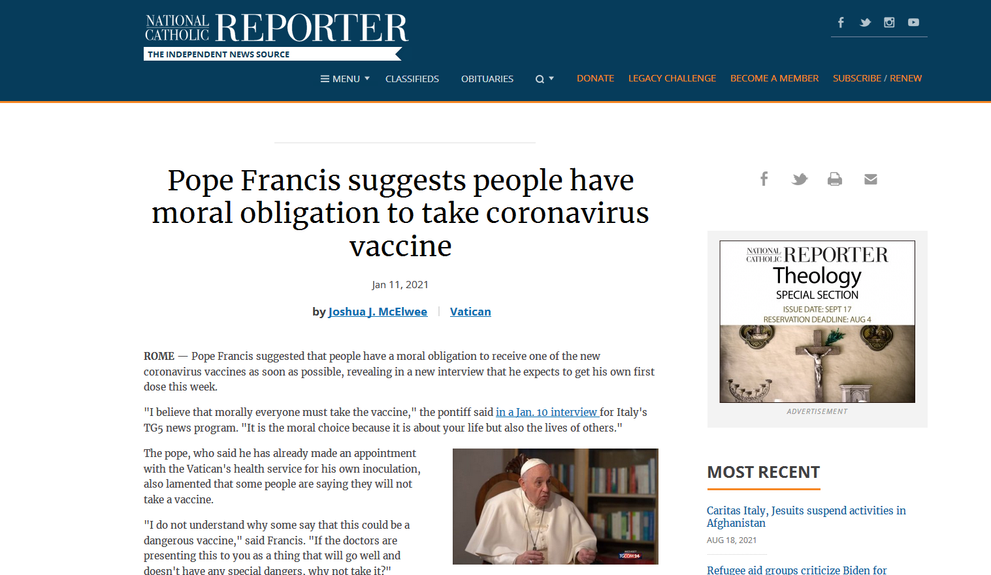
Notes:
TP: What is the Bibles name for a government that enforces such mandates?
https://www.ncronline.org/news/vatican/pope-francis-suggests-people-have-moral-obligation-take-coronavirus-vaccine

Slide 31
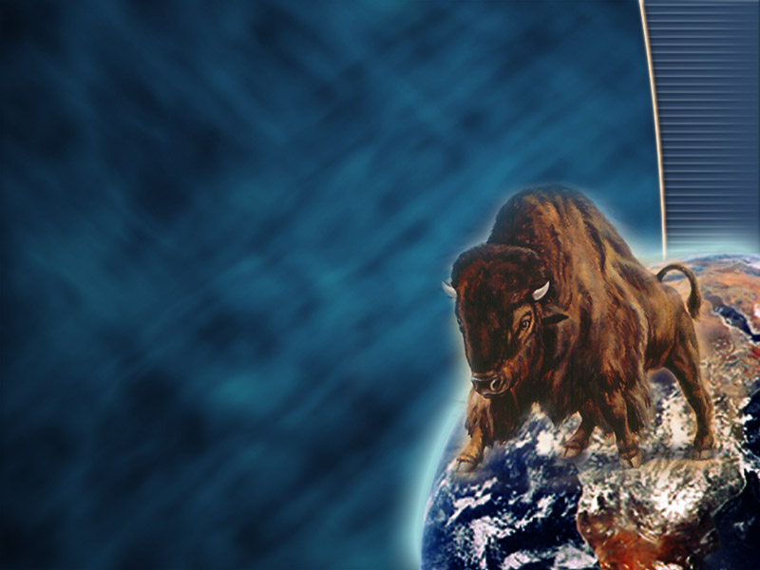
What symbolism doe the Bible use for a government which presumes to enforce an anti-Biblical laws?
Revelation 13:14-15
14. And deceiveth them that dwell on the earth by the means of those miracles which he had power to do in the sight of the beast; saying to them that dwell on the earth, that they should make an image to the beast, which had the wound by a sword, and did live.
15. And he had power to give life unto the image of the beast, that the image of the beast should both speak, and cause that as many as would not worship the image of the beast should be killed.
Notes:
TP: How do you spell fire?

Slide 32
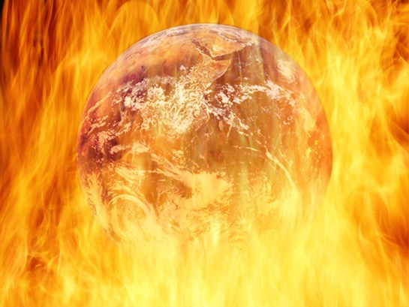
What happens to us if we worship the image of the beast by bowing to the governments enforcement of anti-Biblical laws?
“And the third angel followed them, saying with a loud voice, If any man worship the beast and his image, and receive his mark in his forehead, or in his hand, The same shall drink of the wine of the wrath of God, which is poured out without mixture into the cup of his indignation; and he shall be tormented with fire and brimstone in the presence of the holy angels, and in the presence of the Lamb: And the smoke of their torment ascendeth up for ever and ever: and they have no rest day nor night, who worship the beast and his image, and whosoever receiveth the mark of his name.” Revelation 14:9-11.
Notes:
TP: So your church just threw you under the bus on vaccination mandates! You asked for a religious exemption and they said follow the government mandates:

Slide 33
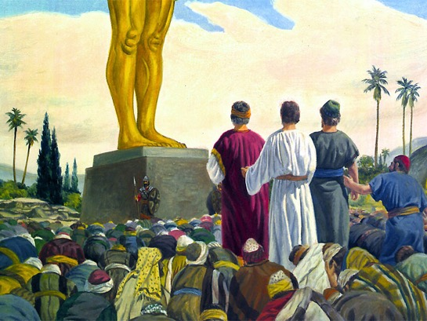
Will all worship the image of the beast by bowing to government enforcement of anti-Biblical laws?
“And I saw as it were a sea of glass mingled with fire: and them that had gotten the victory over the beast, and over his image, and over his mark, and over the number of his name, stand on the sea of glass, having the harps of God.” Revelation 15:2.
Notes:
They just worshiped the image of the beast!
TP: Genocide, who’s the perpetrator?

Slide 34
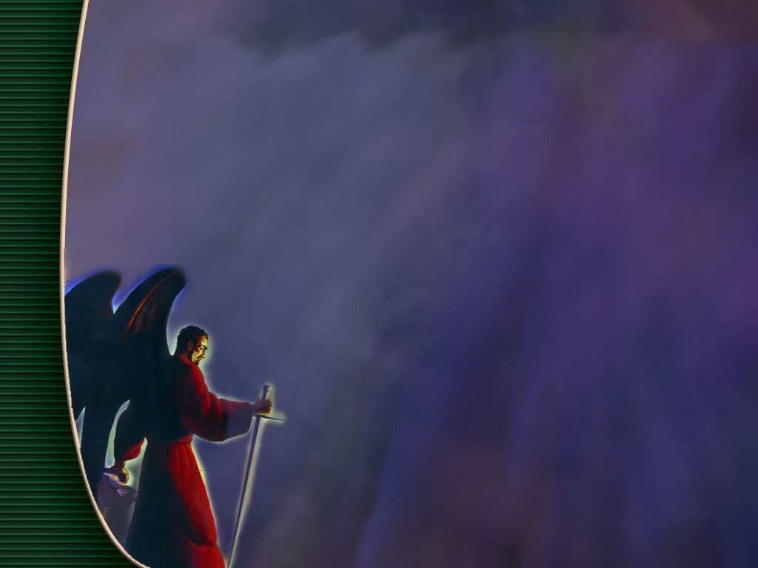
Kill Destroy
“The thief cometh not, but for to steal, and to kill, and to destroy:”
John 10:10.
“For we wrestle not against flesh and blood, but against principalities, against powers, against the rulers of the darkness of this world, against spiritual wickedness in high places.” Ephesians 6:12.
Notes:
Satan’s agents know why they are injecting you! Are you aware of that?

Slide 35
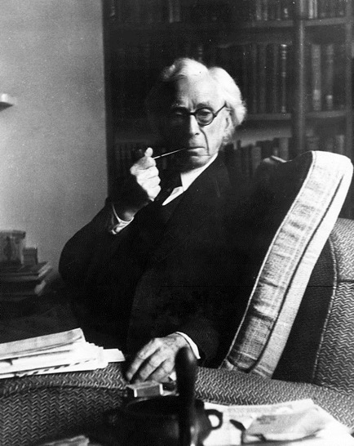
"It is to be expected that advances in physiology and psychology will give governments much more control over individual mentality than they now have even in totalitarian countries.
Fichte laid it down that education should aim at destroying free will, so that, after pupils have left school, they shall be incapable, throughout the rest of their lives, of thinking or acting otherwise than as their schoolmasters would have wished.
Diet, injections, and injunctions will combine, from a very early age, to produce the sort of character and the sort of beliefs that the authorities consider desirable, and any serious criticism of the powers that be will become psychologically impossible. . . .”
-Bertrand Russell, The Impact of Science on Society, 1952, p. 61-62
Notes:
TP: They will butter you up, spin a positive motive for your choice:

Slide 36
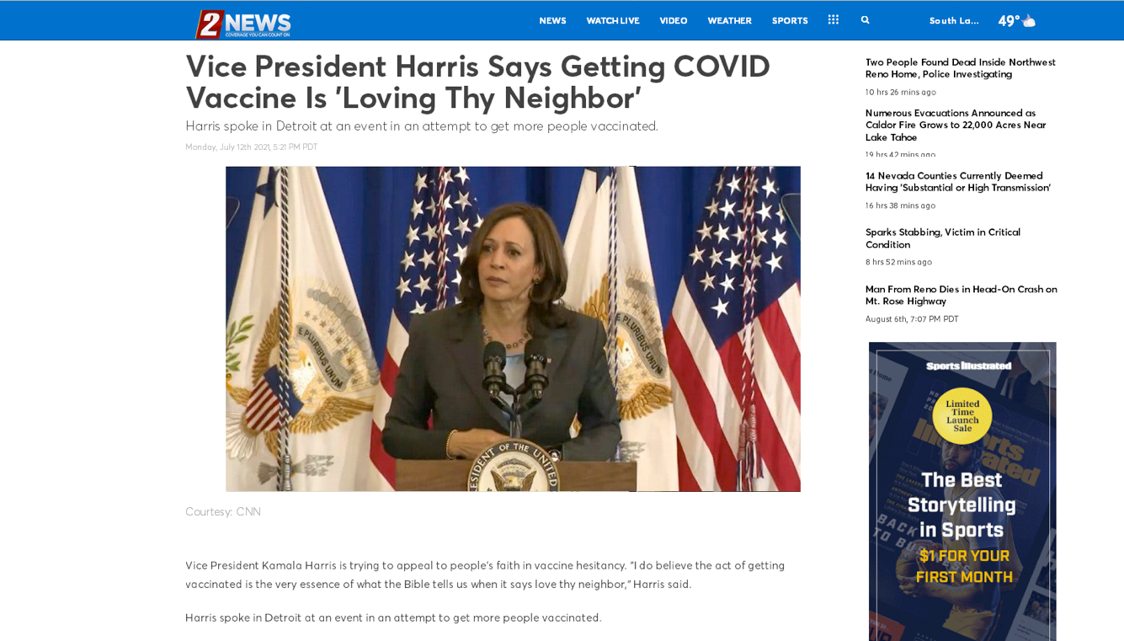
Notes:
TP: For the better good: So you can see your…, minister to…, save the planet….
https://www.ktvn.com/story/44289362/vice-president-harris-says-getting-covid-vaccine-is-loving-thy-neighbor

Slide 37
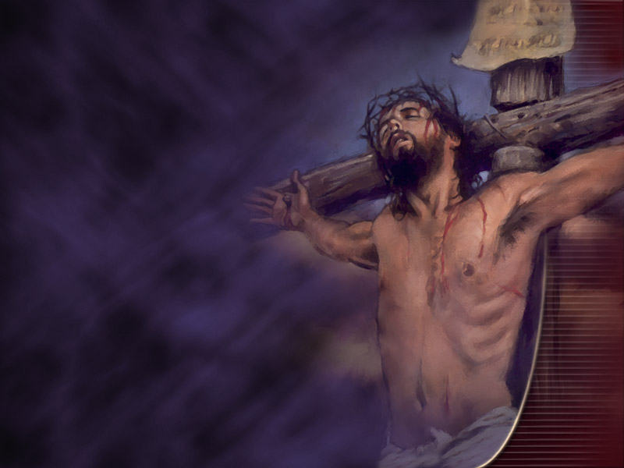
The Better Good
“And one of them, named Caiaphas, being the high priest that same year, said unto them, Ye know nothing at all, Nor consider that it is expedient for us, that one man should die for the people, and that the whole nation perish not.” John 11:49-50.
Notes:
TP: Satan says, “We have results on our side”! What if you refuse the vaccine, get sick, and die!

Slide 38
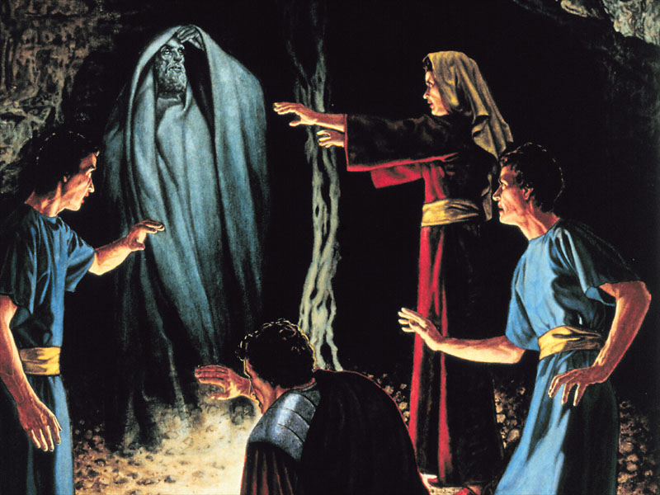
Efficacy Argument
“If there arise among you a prophet, or a dreamer of dreams, and giveth thee a sign or a wonder, And the sign or the wonder come to pass, whereof he spake unto thee, saying, Let us go after other gods, which thou hast not known, and let us serve them; Thou shalt not hearken unto the words of that prophet, or that dreamer of dreams: for the LORD your God proveth you, to know whether ye love the LORD your God with all your heart and with all your soul. Ye shall walk after the LORD your God, and fear him, and keep his commandments, and obey his voice, and ye shall serve him, and cleave unto him.” Deuteronomy 13:1-4.
Notes:
TP: so what become of the request for an exemption letter?

Slide 39
Dear Dr John Clark,
Thank you so much for taking the time to write this letter. Words cannot express my gratitude! This letter has been the biggest answer to prayer and a significant faith-building experience. After trying to contact multiple people and getting rejected, I left the situation in God's hands when I went to sleep last night. I woke this morning to see your email...this is truly a miracle! This has helped me to learn to trust God no matter the situation and that His plan and timing is always best. I praise God for your ministry and pray that he continues to bless you and your family.
            Sincerely,
            Joseph
Notes:
TP: Does God need our help running the universe? Fighting disease down here on earth?

Slide 40

“Neither is worshipped with men's hands, as though he needed any thing, seeing he giveth to all life, and breath, and all things;” “For in him we live, and move, and have our being; as certain also of your own poets have said, For we are also his offspring.” Acts 17:25,28.
Notes:
TP: How clean does God want Christians? 50% 98% On the outside?

Slide 41
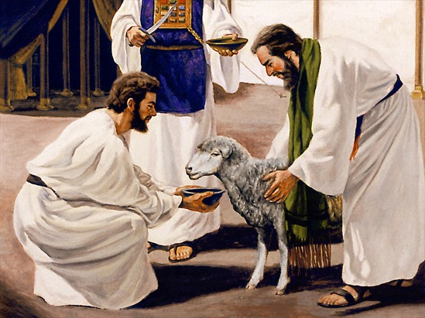
True Believers
“I beseech you therefore, brethren, by the mercies of God, that ye present your bodies a living sacrifice, holy, acceptable unto God, which is your reasonable service (Spiritual Worship NRV).
“And be not conformed to this world: but be ye transformed by the renewing of your mind, that ye may prove what is that good, and acceptable, and perfect, will of God.” Romans 12:1-2.
Notes:
TP: What letter did God lead me to write?

Slide 42
To Whom It May Concern:
I am writing on behalf of Joseph.
Joseph’s competency and exceptional value as an honorable employ stem from the impact his implicit faith in the Word of God has had on him as a person.
As a Bible based Christian, he knows of God’s investment in him, both by creating him, and by saving him from sin. “What? know ye not that your body is the temple of the Holy Ghost which is in you, which ye have of God, and ye are not your own? For ye are bought with a price: therefore glorify God in your body, and in your spirit, which are God's.” 1 Corinthians 6:19-20. Joseph wants to truly glorify God in his body.
As a Christian who bases his faith on verifiable Bible doctrine, he knows that introducing anything defiling into his body would compromise his ability to render the performance on the job for which he is valued. The Word of God says, “Know ye not that ye are the temple of God, and that the Spirit of God dwelleth in you? If any man defile the temple of God, him shall God destroy; for the temple of God is holy, which temple ye are.” (1 Corinthians 3:16-17). Joseph chooses not to defile his body with injections of disease samples (Leviticus 15:3-12). He knows that, not only does God require him to maintain the body He has given him in good health, but He will also hold him accountable for any damage he does to it. “For we must all appear before the judgment seat of Christ; that every one may receive the things done in his body, according to that he hath done, whether it be good or bad.” 2 Corinthians 5:10.
God tells each Christian that they need to have a personal knowledge of how to preserve the health of their bodies: “That every one of you should know how to possess his vessel (body) in sanctification and honour;” (1 Thessalonians 4:4). God has given Joseph definite instruction on how to avoid disease: “And said, If thou wilt diligently hearken to the voice of the LORD thy God, and wilt do that which is right in his sight, and wilt give ear to his commandments, and keep all his statutes, I will put none of these diseases upon thee, which I have brought upon the Egyptians: for I am the LORD that healeth thee.” Exodus 15:26. Joseph wants God to be his protector from disease and, if he is sick, Joseph appeals to God to be his healer. He knows that God expects him to follow all the Biblical health laws, and if he does this he can commit the keeping of his health to Him. If Joseph breaks any of the health laws, he realizes that God cannot protect him, or anyone else , from disease. (Deuteronomy 7:9-15). Joseph’s conscience constrains him to commit himself entirely to God’s healing power exercised in his behalf as he follows God’s health laws and plan for disease prevention.
It is my hope that Joseph’s employer will exempt him from participation in any vaccination program based on his religious convictions.
          Sincerely,
          John Clark, M.D.
          Medical Doctor
Notes:
TP: Ok, Ok, but the chruchies say EGW was pro vaccine! Was She?
Can you endure a little sound doctrine as I go though this?

Slide 43
“Her priests have violated my law, and have profaned mine holy things: they have put no difference between the holy and profane, neither have they shewed difference between the unclean and the clean,” Ezekiel 22:26.
Wise laws….
Granted, a lot of nationally prominent evangelical leaders are trying to talk sense to their parishioners. Rick Warren is telling his people to get vaccinated: “God revealed a lot of his will when he gave you that brain. And he expects you to use it.”
Notes:
https://www.penncapital-star.com/commentary/some-evangelical-christians-have-forgotten-their-moral-duty-to-get-vaccinated-dick-polman/
TP: How would you expect these lords many and gods many to treat Godly purity?

Slide 44

Spiritual Things Are Spiritually Discerned
“Unto the pure all things are pure: but unto them that are defiled and unbelieving is nothing pure; but even their mind and conscience is defiled.” Titus 1:15.
Notes:
TP: what happens when this all goes pair shapped?

Slide 45

Shaking Message
“See that you do not refuse Him who speaks. For if they did not escape who refused Him who spoke on earth, much more shall we not escape if we turn away from Him who speaks from heaven, whose voice then shook the earth; but now He has promised, saying, ’Yet once more I shake not only the earth, but also heaven.’ Now this, ’Yet once more,’ indicates the removal of those things that are being shaken, as of things that are made, that the things which cannot be shaken may remain.” Hebrews 12:25-27.
Notes:
TP: Do you have the Faith of Jesus to carry you through the vaccine mandates?

Slide 46

Pharmaceutical Products
“And the light of a candle shall shine no more at all in thee; and the voice of the bridegroom and of the bride shall be heard no more at all in thee: for thy merchants were the great men of the earth; for by thy sorceries [pharmakeia] were all nations deceived.” Revelation 18:23.
Notes:
TP: who’s your healer?

Slide 47
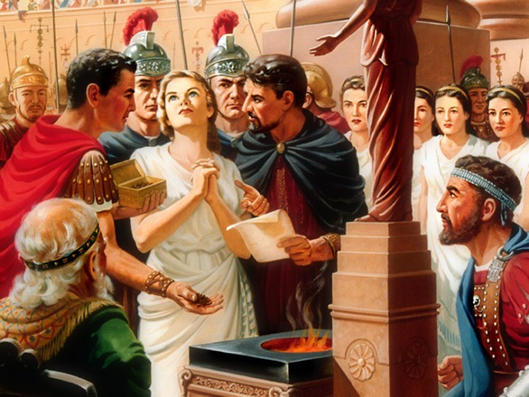

“‘Is it not a little one?’ and my soul shall live.” Genesis 19:20.
Digital Vaccines In An Age Of Rationalism
“What therefore God hath joined together, let not man put asunder.” Mark 10:9.
Notes:
Thank you Jo for that insight, I'll put something in the talk on this. A good caption would be, "Digital Vaccines In An Age of Rationalism" And a good text would be "Behold now, this city is near to flee unto, and it is a little one: Oh, let me escape thither, (is it not a little one?) and my soul shall live." Genesis 19:20. And a good quote would be, “But if there was one sin above another which called for the destruction of the race by the flood, it was the base crime of amalgamation of man and beast which defaced the image of God, and caused confusion everywhere.” {1SP 69.1} And a good historical reference from the dark ages would be, just putting a pinch of incense before an idol so that you do not have to face the lions in the Colosseum. How much sin contaminates you? How much of a disease contaminates you? What if it is just a little of its RNA or DNA? What if I just have a painting of a naked woman, but don't actually touch a living female body? What if I pretend to bow down to the image on the plain of Dura, but my heart isn't really bowing?
True it's not a virus, we are playing God, we are messing with molecular anatomy, (genetic modifying). All the previous trials of this type of modification in living organisms had disastrous results. The animals that were given this type of injection seemed fine at first but than later on when another strain of the virus came along there bodies over reacted and it resulted in certain death. What God hath put together, let no man put asunder. In our minds this is equal to or worse than injecting a virus.
Hi John
I listened to your talk on Why God's Children Don't Take Vaccines that you did on a podcast recently. Would it be possible for you to explain in your upcoming talk this Sabbath why the Pfizer one is still not something we should be having. My understanding, very limited mind you, is that it doesn't contain the virus as such, but the genetic code to the spike protein part of the virus. The Pfizer website says this:
mRNA, delivered to your body's cells by lipid nanoparticles, instructs the cells to generate the spike protein found on the surface of the novel coronavirus that initiates infection.^{1,2} Instructing cells to generate the spike protein spurs an immune response, including generation of antibodies specific to the SARS-CoV-2 spike protein.³
mRNA vaccines do not contain any virus particles, meaning that they don't contain weakened or dead parts of a virus or bacterium.²
Would you be able to explain the above in plain English? In my mind, it is essentially the same thing as having a vaccine with weakened or dead parts of the virus. Am I correct in assuming that? In other words, does it still render someone unclean if they get this vaccine according to the Bible's definition of unclean? I'm not looking for a reason to have it as I've made up my mind not to, but just want to be able to respond to comments along these lines.

Slide 48
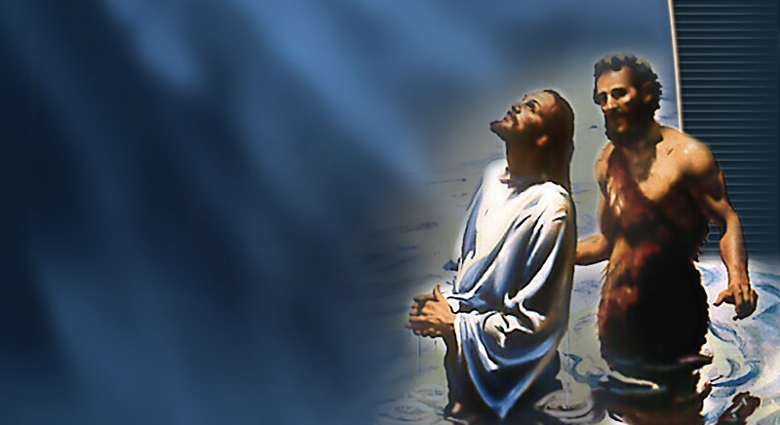
One Lord, One Faith, One Baptism, One Medical Practice
“And Asa in the thirty and ninth year of his reign was diseased in his feet, until his disease was exceeding great: yet in his disease he sought not to the LORD, but to the physicians.” 2 Chronicles 16:12.
“And Ahaziah fell down through a lattice in his upper chamber that was in Samaria, and was sick: and he sent messengers, and said unto them, Go, enquire of Baalzebub the god of Ekron whether I shall recover of this disease. But the angel of the LORD said to Elijah the Tishbite, Arise, go up to meet the messengers of the king of Samaria, and say unto them, Is it not because there is not a God in Israel, that ye go to enquire of Baalzebub the god of Ekron? Now therefore thus saith the LORD, Thou shalt not come down from that bed on which thou art gone up, but shalt surely die. And Elijah departed.” 2 Kings 1:2-4.
“And ye will not come to me, that ye might have life.” John 5:40.
Notes:
TP: persecution, are you ready to suffer for God’s health message?

Slide 49
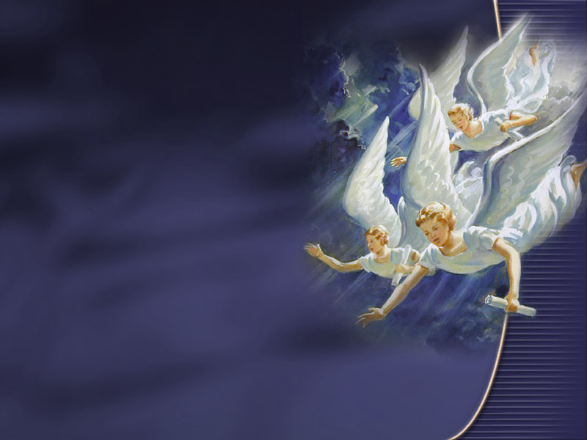
Final Test And False Healings
“For they have healed the hurt of the daughter of my people slightly, saying, Peace, peace; when there is no peace.” Jeremiah 8:11.
“For yourselves know perfectly that the day of the Lord so cometh as a thief in the night. For when they shall say, Peace and safety; then sudden destruction cometh upon them, as travail upon a woman with child; and they shall not escape.” 1 Thessalonians 5:2-3.
Notes:
TP: OK, I’m ready for God’s plan, what is it?

Slide 50
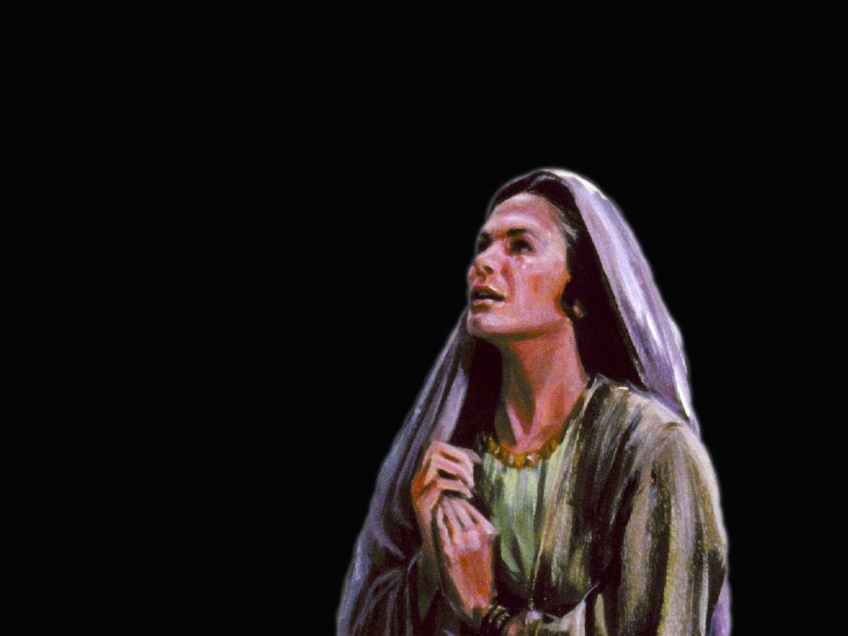
True Healing Of Pestilence Only In Cooperation
“If I shut up heaven that there be no rain, or if I command the locusts to devour the land, or if I send pestilence among my people; If my people, which are called by my name, shall humble themselves, and pray, and seek my face, and turn from their wicked ways; then will I hear from heaven, and will forgive their sin, and will heal their land.” 2 Chronicles 7:13-14.
Notes:
TP: What will the government backed Medical system say?

Slide 51
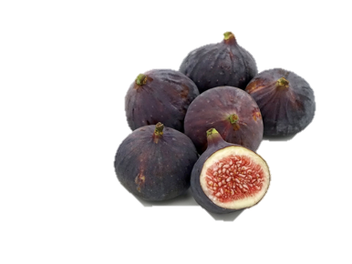
Natural Remedies or Quackery?
“And Isaiah said, Take a lump of figs. And they took and laid it on the boil, and he recovered.” 2 Kings 20:7.
“When he had thus spoken, he spat on the ground, and made clay of the spittle, and he anointed the eyes of the blind man with the clay, And said unto him, Go, wash in the pool of Siloam, (which is by interpretation, Sent.) He went his way therefore, and washed, and came seeing.” John 9:6-7.
“And Elisha sent a messenger unto him, saying, Go and wash in Jordan seven times, and thy flesh shall come again to thee, and thou shalt be clean.” “Then went he down, and dipped himself seven times in Jordan, according to the saying of the man of God: and his flesh came again like unto the flesh of a little child, and he was clean.” 2Kings 5:10,14.
Medical Technocracy. (P<0.001).
Notes:
TP: Yah, but that’s all Old Testament!

Slide 52
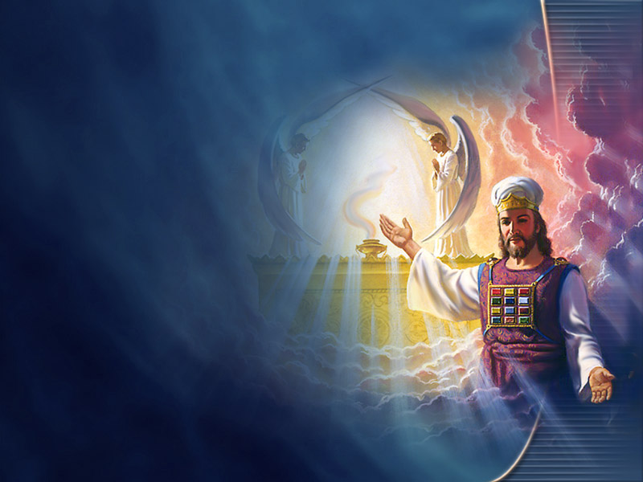
Separate Clean From Unclean
“And what agreement hath the temple of God with idols? for ye are the temple of the living God; as God hath said, I will dwell in them, and walk in them; and I will be their God, and they shall be my people. Wherefore come out from among them, and be ye separate, saith the Lord, and touch not the unclean thing; and I will receive you,” 2 Corinthians 6:16-17.
“And I heard another voice from heaven, saying, Come out of her, my people, that ye be not partakers of her sins, and that ye receive not of her plagues.” Revelation 18:4.
Notes:
TP: Is the vaccine a passport to heaven?

Slide 53

Undefiled New Earth
“And there shall in no wise enter into it any thing that defileth, neither whatsoever worketh abomination, or maketh a lie: but they which are written in the Lamb's book of life.” Revelation 21:27.
Notes:
TP: What are you going to say when Jesus askes, were you faithful unto death or were you overcome by the Image of the Beast?

Slide 54
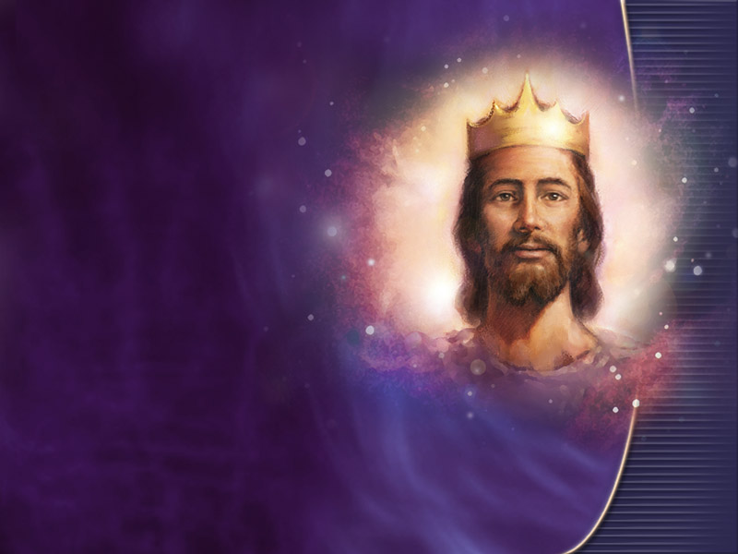
“But who may abide the day of his coming? and who shall stand when he appeareth? for he is like a refiner's fire, and like fullers' soap:” Malachi 3:2.
Notes:
TP: SO what happed with the exemption letter?

Slide 55
Dear John Clark,
God is so good! The facility allowed me to continue the placement after I gave them your letter. It is uncommon for aged care facilities in Australia to consider religious exemptions so this has been a huge answer to prayer. Furthermore, this experience helped open up a positive religious conversation with my placement supervisor who was very interested in my faith. Thank you so much again for taking the time to write the letter and for your help with this situation. I am truly grateful.
          God bless,
          Joseph

Slide 56
When Jesus returns in all His glory (Matthew 25:31) to judge the quick and the dead (2 Timothy 4:1) and all the elements will melt with fervent heat (2 Peter 3:10-12), at that time those who are in violation of the health laws of Moses (Leviticus 11:7-8) will receive their reward by fire, to be consumed with the wicked (Isaiah 66:15-17).
This is why the health message (health laws of Moses) is part and parcel of the last days Elijah message (Mal 4:1-6) to prepare a people to meet their Lord in glory (Amos 4:12).
God’s health statutes given through Moses clearly state that: disease is unclean; that any contact with disease brings defilement (Leviticus 15:1-15); that defilement with disease is a sin for which the transgressor bears guilt, and for which only a sin offering can make atonement (Leviticus 5:2-13).
Vaccination is deliberate defilement of your body with disease in flagrant violation of God’s health statutes.
Failure to purify oneself from such defilement results in one being cut off from the congregation of Israel (Numbers 19:20).
To put it is modern terms, contact with disease is sin, therefore it is a salvational issue; failure to be cleansed from this sin is a test of fellowship, and the church should withdraw from such a person (2 Thessalonians 3:6).
Does God say that this defilement with unclean disease will be beneficial, “Who can bring a clean thing out of an unclean? not one.” Job 14:4. Who is right, God or Man?

Slide 57
“Who can bring a clean thing out of an unclean? not one.” (Job 14:4).
“If any man defile the temple of God, him shall God destroy;” 1 Corinthians 3:16-17.
“Wherefore come out from among them, and be ye separate, saith the Lord, and touch not the unclean thing; and I will receive you,” 2 Corinthians 6:16-17.
Notes:
Hesikiah

Slide 58
Your Creator God sustains your life and watches over you every moment.
God’s goal is a pure and holy human family who will be comfortable in His glorious presence.
Satan desires to steal, kill and destroy. He wants you to be abominably unclean, defiled and destroyed by God eternal glory.
The 8 natural remedies are a summery of God’s health plan.
Satan’s counterfeit health plan involves taking disease, which is unclean in God’s presence, and injecting your body with it.
“Every man that hath this hope in him purifieth himself, even as he is pure.” 1 John 3:3.
How many want to be God’s pure and Holy People ready for His return?

