Slide 1


Slide 2
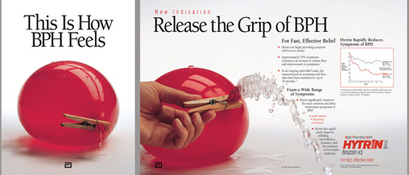
Benign Prostatic Hyperplasia (BPH)
https://www.mahf.com/heritage-award-winners/

Slide 3

BPH: enlarged prostate.
PSA: Prostatic specific antigen.
Notes:
bigger is not better...

Slide 4

BPH
Nat Rev Dis Primers. 2016 May 5;2:16031.
Benign prostatic hyperplasia (BPH), which causes lower urinary tract symptoms, is a common diagnosis among the ageing male population with increasing prevalence.
The symptoms can be:
Obstructive (resulting in urinary hesitancy, weak stream, straining or prolonged voiding).
Irritative (resulting in increased urinary frequency and urgency, nocturia, urge incontinence and reduced voiding volumes).
Can affect the patient after micturition (for example, postvoid dribble or incomplete emptying).
BPH occurs when both stromal and epithelial cells of the prostate in the transitional zone proliferate by processes that are thought to be influenced by inflammation and sex hormones, causing prostate enlargement.
Notes:
Chughtai B, Forde JC, Thomas DD, Laor L, Hossack T, Woo HH, Te AE, Kaplan SA. Benign prostatic hyperplasia. Nat Rev Dis Primers. 2016 May 5;2:16031.
Benign prostatic hyperplasia (BPH), which causes lower urinary tract symptoms (LUTS), is a common diagnosis among the ageing male population with increasing prevalence. Many risks factors, both modifiable and non-modifiable, can increase the risk of development and progression of BPH and LUTS. The symptoms can be obstructive (resulting in urinary hesitancy, weak stream, straining or prolonged voiding) or irritative (resulting in increased urinary frequency and urgency, nocturia, urge incontinence and reduced voiding volumes), or can affect the patient after micturition (for example, postvoid dribble or incomplete emptying). BPH occurs when both stromal and epithelial cells of the prostate in the transitional zone proliferate by processes that are thought to be influenced by inflammation and sex hormones, causing prostate enlargement. Patients with LUTS undergo several key diagnostic investigations before being diagnosed with BPH. Treatment options for men with BPH start at watchful waiting and progress through medical to surgical interventions. For the majority of patients, the starting point on the treatment pathway will be dictated by their symptoms and degree of bother.

Slide 5
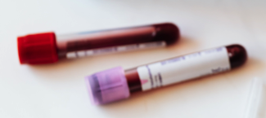
PSA
PSA levels are measured in terms of the amount of PSA per volume of fluid tested, ng/mL.
Doctors often use a value of 4 nanograms (ng) or higher per milliliter (mL) of blood as a sign that further tests, such as a prostate biopsy, are needed.
Notes:
https://www.cancer.gov/types/prostate/understanding-prostate-changes

Slide 6
PSA
The percentage of free PSA can help tell what kind of prostate problem you have.
If both total PSA and free PSA are higher than normal (high percentage of free PSA), this suggests BPH rather than cancer.
If total PSA is high but free PSA is not (low percentage of free PSA), cancer is more likely.
Notes:
https://www.cancer.gov/types/prostate/understanding-prostate-changes

Slide 7

Does BPH Progress To Prostate Cancer?
BPH is associated with a 300% increased risk of prostate cancer and 150% increased risk of bladder cancer.
Medicine (Baltimore). 95(18):e3493.
Notes:
Dai X, Fang X, Ma Y, Xianyu J. Benign Prostatic Hyperplasia and the Risk of Prostate Cancer and Bladder Cancer: A Meta-Analysis of Observational Studies. Medicine (Baltimore). 2016 May;95(18):e3493.
Abstract
Benign prostatic hyperplasia (BPH) has been suggested to be a risk factor for certain urologic cancers, but the current evidence is inconsistent.
The aim of this study was to investigate the association between BPH and urologic cancers.
MEDLINE, EMBASE, Cochrane Library, and Web of Science were searched for potential eligible studies.
We included case-control studies or cohort studies, which evaluated the association between BPH and urologic cancers (including prostate cancer, bladder cancer, kidney cancer, testicular cancer, or penile cancer).
Overall effect estimates were calculated using the DerSimonian–Laird method for a random-effects model. Summary effect-size was calculated as risk ratio (RR), together with the 95% confidence interval (CI).
This systematic review included 16 case-control studies and 10 cohort studies evaluating the association of BPH and prostate or bladder cancer; we did not identify any study about other urologic cancers. Meta-analyses demonstrated that BPH was associated with an increased incidence of prostate cancer (case-control study: RR = 3.93, 95% CI = 2.18–7.08; cohort-study: RR = 1.41, 95% CI = 1.00–1.99) and bladder cancer (case-control study: RR = 2.50, 95% CI = 1.63–3.84; cohort-study: RR = 1.58, 95% CI = 1.28–1.95). Subgroup analysis by ethnicity suggested that the association between BPH and prostate cancer was much stronger in Asians (RR = 6.09, 95% CI = 2.96–12.54) than in Caucasians (RR = 1.54, 95% CI = 1.19–2.01). Egger's tests indicated low risk of publication bias (prostate cancer: P = 0.11; bladder cancer: P = 0.95).
BPH is associated with an increased risk of prostate cancer and bladder cancer. The risk of prostate cancer is particularly high in Asian BPH patients. Given the limitations of included studies, additional prospective studies with strict design are needed to confirm our findings.

Slide 8
Benign prostatic hyperplasia is age related
The prevalence of BPH rises markedly with increased age. Autopsy studies have observed a histological prevalence of 8%, 50%, and 80% in the 4th, 6th, and 9th decades of life, respectively.
Asian J Urol. 2017 Jul;4(3):148-151.
Notes:
Lim KB. Epidemiology of clinical benign prostatic hyperplasia. Asian J Urol. 2017 Jul;4(3):148-151.
Message, So don’t get older!

Slide 9
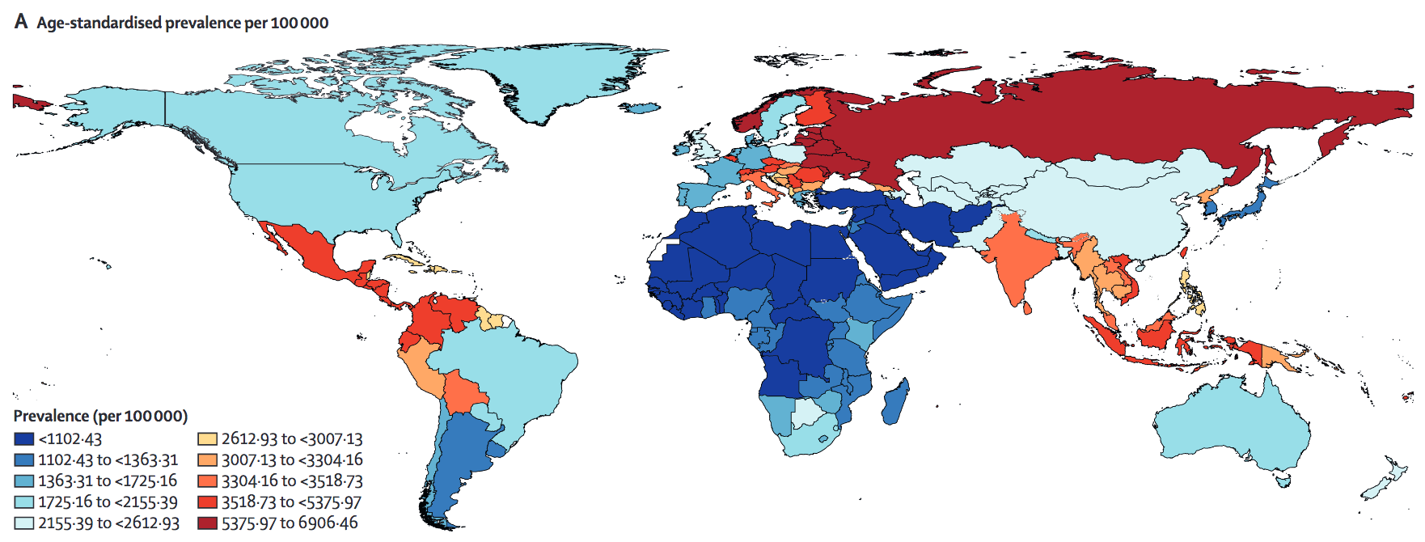
BPH Prevalence Worldwide
Lancet Healthy Longev. 3(11):e754-e776.
Notes:
GBD 2019 Benign Prostatic Hyperplasia Collaborators. The global, regional, and national burden of benign prostatic hyperplasia in 204 countries and territories from 2000 to 2019: a systematic analysis for the Global Burden of Disease Study 2019. Lancet Healthy Longev. 2022 Nov;3(11):e754-e776.

Slide 10
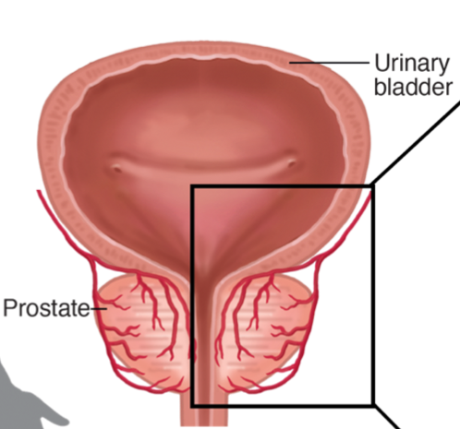
Hormones: Dihydrotestosterone (DHT) Increases BPH
Q: What foods cause high DHT?
A: Foods high in saturated fats such as red meat, seafood, shellfish, milk and milk products, poultry foods can increase levels of DHT in the body.
Q: What causes increased DHT production?
A: Increased production of cholesterol or high presence of cholesterol in the body through diet can increase the production of DHT in the body.
Q: How do certain foods reduce DHT production?
A: Certain foods such as avocado, spinach, berries and seeds inhibit the action of the enzyme 5-alpha reductase which is responsible for the conversion of testosterone to DHT.
Daily aerobic exercise can reduce DHT, particularly when combined with a low-fat, high-fiber diet consisting of whole grains, fruits, and vegetables.
Nishita Suratkal. (2022, September 26). Dietary Factors Responsible for Dihydrotestosterone (DHT) Production and Hair Loss - Frequently Asked Questions. Medindia. Retrieved on Jun 18, 2023 from https://www.medindia.net/dietandnutrition/dietary-factors-responsible-for-dihydrotestosterone-dht-production-and-hair-loss-faqs.htm.
Notes:
Nishita Suratkal. (2022, September 26). Dietary Factors Responsible for Dihydrotestosterone (DHT) Production and Hair Loss - Frequently Asked Questions. Medindia. Retrieved on Jun 18, 2023 from https://www.medindia.net/dietandnutrition/dietary-factors-responsible-for-dihydrotestosterone-dht-production-and-hair-loss-faqs.htm.
Barnard RJ, Aronson WJ. Benign prostatic hyperplasia: does lifestyle play a role? Phys Sportsmed. 2009 Dec;37(4):141-6.
Benign prostatic hyperplasia (BPH) is a very common condition in older men, affecting up to 80% of men aged >or= 80 years in the United States. It typically leads to lower urinary tract symptoms, which often require medical management. The exact cause of BPH is unknown, and the only 2 established factors associated with BPH are age and the presence of androgens. Although the presence of testosterone is required for the development of BPH, testosterone is not thought to be the underlying factor causing BPH because testosterone levels decrease in older men. Recent studies have reported that BPH is associated with elevations in plasma estradiol/testosterone ratio, insulin, and insulin-like growth factor-I. Daily aerobic exercise can reduce all of these plasma factors, particularly when combined with a low-fat, high-fiber diet consisting of whole grains, fruits, and vegetables. In cell culture studies, this type of lifestyle regimen has recently been shown to reduce the growth of serum-stimulated prostate epithelial cells and the growth of androgen-dependent prostate cancer cell lines.

Slide 11
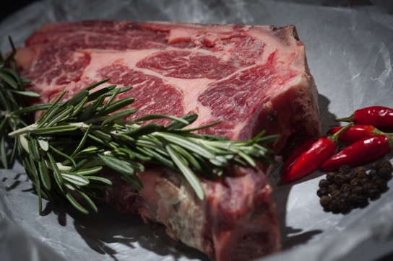
Red Meat Has Been Said To Be The New Tobacco.
Daily red meat consumption increases the risk of BPH by 38%.
Am J Epidemiol. 167(8):925-34.
Notes:
Kristal AR, Arnold KB, Schenk JM, Neuhouser ML, Goodman P, Penson DF, Thompson IM. Dietary patterns, supplement use, and the risk of symptomatic benign prostatic hyperplasia: results from the prostate cancer prevention trial. Am J Epidemiol. 2008 Apr 15;167(8):925-34.
This study examined dietary risk factors for incident benign prostatic hyperplasia (BPH) in 4,770 Prostate Cancer Prevention Trial (1994-2003) placebo-arm participants who were free of BPH at baseline. BPH was assessed over 7 years and was defined as medical or surgical treatment or repeated elevation (>14) on the International Prostate Symptom Score questionnaire. Diet, alcohol, and supplement use were assessed by use of a food frequency questionnaire. There were 876 incident BPH cases (33.6/1,000 person-years). The hazard ratios for the contrasts of the highest to lowest quintiles increased 31% for total fat and 27% for polyunsaturated fat and decreased 15% for protein (all p(trend) < 0.05). The risk was significantly lower in high consumers of alcoholic beverages (0 vs. > or =2/day: hazard ratio (HR) = 0.67) and vegetables (<1 vs. > or =4/day: HR = 0.68) and higher in daily (vs. <1/week) consumers of red meat (HR = 1.38). There were no associations of supplemental antioxidants with risk, and there was weak evidence for associations of lycopene, zinc, and supplemental vitamin D with reduced risk. A diet low in fat and red meat and high in protein and vegetables, as well as regular alcohol consumption, may reduce the risk of symptomatic BPH.

Slide 12

Which came first? The chicken or the egg?
Eating poultry and eggs can increase BPH by ~40%.
Urology. 67(1):73-9.
Notes:
Bravi F, Bosetti C, Dal Maso L, Talamini R, Montella M, Negri E, Ramazzotti V, Franceschi S, La Vecchia C. Food groups and risk of benign prostatic hyperplasia. Urology. 2006 Jan;67(1):73-9.
cereals (OR 1.55 for the greatest versus lowest quintile), bread (OR 1.69), eggs (OR 1.43), and poultry (OR 1.39). Inverse associations were observed for soups (OR 0.74), pulses (OR 0.74), cooked vegetables (OR 0.66), and citrus fruit (OR 0.82).

Slide 13
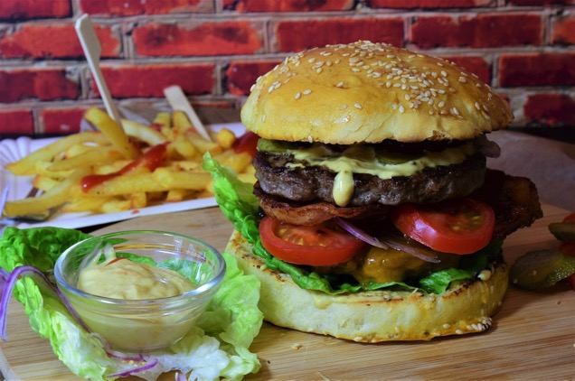
Fat and BPH
High fat diets increase prostate inflammation and BPH:
20% for vegetable fats/oils.
27% for polyunsaturated fat.
31% for total fat.
32% for fish oils (EPA, DHA).
Omega-3s found in vegetable sources like flaxseed lowers the risk of BPH.
Am J Epidemiol. 167(8):925-34.
Notes:
Kristal AR, Arnold KB, Schenk JM, Neuhouser ML, Goodman P, Penson DF, Thompson IM. Dietary patterns, supplement use, and the risk of symptomatic benign prostatic hyperplasia: results from the prostate cancer prevention trial. Am J Epidemiol. 2008 Apr 15;167(8):925-34.
This study examined dietary risk factors for incident benign prostatic hyperplasia (BPH) in 4,770 Prostate Cancer Prevention Trial (1994-2003) placebo-arm participants who were free of BPH at baseline. BPH was assessed over 7 years and was defined as medical or surgical treatment or repeated elevation (>14) on the International Prostate Symptom Score questionnaire. Diet, alcohol, and supplement use were assessed by use of a food frequency questionnaire. There were 876 incident BPH cases (33.6/1,000 person-years). The hazard ratios for the contrasts of the highest to lowest quintiles increased 31% for total fat and 27% for polyunsaturated fat and decreased 15% for protein (all p(trend) < 0.05). The risk was significantly lower in high consumers of alcoholic beverages (0 vs. > or =2/day: hazard ratio (HR) = 0.67) and vegetables (<1 vs. > or =4/day: HR = 0.68) and higher in daily (vs. <1/week) consumers of red meat (HR = 1.38). There were no associations of supplemental antioxidants with risk, and there was weak evidence for associations of lycopene, zinc, and supplemental vitamin D with reduced risk. A diet low in fat and red meat and high in protein and vegetables, as well as regular alcohol consumption, may reduce the risk of symptomatic BPH.
Suzuki S, Platz EA, Kawachi I, Willett WC, Giovannucci E. Intakes of energy and macronutrients and the risk of benign prostatic hyperplasia. Am J Clin Nutr. 2002 Apr;75(4):689-97.
Shankar E, Bhaskaran N, MacLennan GT, Liu G, Daneshgari F, Gupta S. Inflammatory Signaling Involved in High-Fat Diet Induced Prostate Diseases. J Urol Res. 2015 Jan 1;2(1):1018. Epub 2015 Jan 12.
High-Fat Diet (HFD) has emerged as an important risk factor not only for obesity and diabetes but also for urological disorders. Recent research provides ample evidence that HFD is a putative cause for prostatic diseases including prostate cancer. The mechanisms whereby these diseases develop in the prostate have not been fully elucidated. In this review we discuss signaling pathways intricately involved in HFD-induced prostate disease. We performed a search through PUBMED using key words "high fat diet" and "prostate". Our data and perspectives are included in this review along with research performed by various other groups. HFD is positively associated with an increased risk of benign prostatic hyperplasia (BPH) and prostate cancer. HFD induces oxidative stress and inflammation in the prostate gland, and these adverse influences transform it from a normal to a diseased state. Studies demonstrate that HFD accelerates the generation of reactive oxygen species by driving the NADPH oxidase system, exacerbating oxidative stress in the prostate. HFD also causes a significant increase in the levels of pro-inflammatory cytokines and gene products through activation of two important signaling pathways: the Signal Transducer and Activator of Transcription (STAT)-3 and Nuclear Factor-kappa B (NF-κB). Both these pathways function as transcription factors required for regulating genes involved in proliferation, survival, angiogenesis, invasion and inflammation. The crosstalk between these two pathways enhances their regulatory function. Through its influences on the NF-κB and Stat-3 signaling pathways, it appears likely that HFD increases the risk of development of BPH and prostate cancer.
Suzuki S, Platz EA, Kawachi I, Willett WC, Giovannucci E. Intakes of energy and macronutrients and the risk of benign prostatic hyperplasia. Am J Clin Nutr. 2002 Apr;75(4):689-97.
Lagiou P, Wuu J, Trichopoulou A, Hsieh CC, Adami HO, Trichopoulos D. Diet and benign prostatic hyperplasia: a study in Greece. Urology. 1999 Aug;54(2):284-90.

Slide 14

Gut Prostate Axis
A high-fat diet nurtures bacteria in the gut that elevate hormones responsible for prostate hyperplasia.
Front Cell Dev Biol. 2021 Jun 24;9:615928.
Notes:
Gu M, Liu C, Yang T, Zhan M, Cai Z, Chen Y, Chen Q, Wang Z. High-Fat Diet Induced Gut Microbiota Alterations Associating With Ghrelin/Jak2/Stat3 Up-Regulation to Promote Benign Prostatic Hyperplasia Development. Front Cell Dev Biol. 2021 Jun 24;9:615928.
Abstract
The role of high-fat diet (HFD) induced gut microbiota alteration and Ghrelin as well as their correlation in benign prostatic hyperplasia (BPH) were explored in our study. The gut microbiota was analyzed by 16s rRNA sequencing. Ghrelin levels in serum, along with Ghrelin and Ghrelin receptor in prostate tissue of mice and patients with BPH were measured. The effect of Ghrelin on cell proliferation, apoptosis, and induction of BPH in mice was explored. Our results indicated that BPH mice have the highest ratio of Firmicutes and Bacteroidetes induced by HFD, as well as Ghrelin level in serum and prostate tissue was significantly increased compared with control. Elevated Ghrelin content in the serum and prostate tissue of BPH patients was also observed. Ghrelin promotes cell proliferation while inhibiting cell apoptosis of prostate cells. The effect of Ghrelin on enlargement of the prostate was found almost equivalent to that of testosterone propionate (TP) which may be attenuated by Ghrelin receptor antagonist YIL-781. Ghrelin could up-regulate Jak2/pJak2/Stat3/pStat3 expression in vitro and in vivo. Our results suggested that Gut microbiota may associate with Ghrelin which plays an important role in activation of Jak2/Stat3 in BPH development. Gut microbiota and Ghrelin might be pathogenic factors for BPH and could be used as a target for mediation.

Slide 15
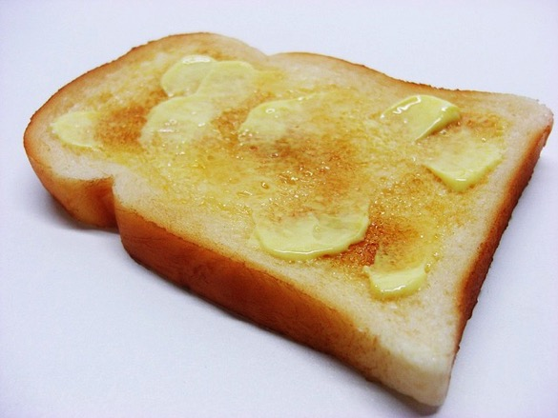
Of Butter, Margarine And Cooking Oils
All Instigators Of BPH.
Urology. 1999 Aug;54(2):284-90.
Notes:
Lagiou P, Wuu J, Trichopoulou A, Hsieh CC, Adami HO, Trichopoulos D. Diet and benign prostatic hyperplasia: a study in Greece. Urology. 1999 Aug;54(2):284-90.
Abstract
Objectives: To evaluate the nutritional etiology of benign prostatic hyperplasia (BPH) by conducting a case-control study in Athens, Greece. Despite the high morbidity and substantial human suffering produced by BPH, little research has been undertaken concerning the nutritional etiology of this disease.
Methods: The study sample consisted of 184 patients with histologically confirmed BPH and 246 control patients without clinical evidence of prostate disease. All patients and controls were permanent residents of the greater Athens area. The data were modeled through unconditional logistic regression.
Results: Among the food groups, fruits were inversely related to BPH risk, with a logistic regression-derived odds ratio of 0.79 per quintile increase and 95% confidence interval 0.67 to 0.93. Increased consumption of both butter and margarine was positively associated with BPH risk, and a marginally significant positive association was also evident for seed oils. No overall association was found with respect to consumption of olive oil. In analyses evaluating the role of nutrients rather than foods, zinc, an element selectively concentrated in the prostate gland, was significantly positively associated with BPH risk.
Conclusions: Our study provides evidence that, among added lipids, butter and margarine may increase the risk of BPH, and fruit intake may reduce this risk. Dietary zinc may play an important role in the etiology of BPH.

Slide 16

Animal Fat
Consumption of a diet rich in animal fat not only causes obesity, impaired glucose tolerance, and insulin resistance, but also act directly on the prostate to induce hyperplastic and neoplastic growth contributing to prostate cancer progression and BPH by creating a pro-inflammatory environment.
Nat Clin Pract Urol. 6:128–131.
Notes:
Consumption of a diet rich in animal fat not only causes obesity, impaired glucose tolerance, and insulin resistance, but also elevates ataxin levels in the adipose tissue, causing increased production of lysophosphatidic acid. This chemical in turn has been shown to act directly on the prostate to induce hyperplastic and neoplastic growth contributing to prostate cancer progression and BPH by creating a pro-inflammatory environment. Kulkarni P, Getzenberg RH. High-fat diet, obesity and prostate disease: the ATX-LPA axis? Nat Clin Pract Urol. 2009;6:128–131.
Ribeiro DL, Góes RM, Pinto-Fochi ME, Taboga SR, Abrahamsson PA, Dizeyi N. AKT and AMPK activation after high-fat and high-glucose in vitro treatment of prostate epithelial cells. Horm Metab Res. 2014 Jun;46(7):471-6.
Considering the increasing consumption of saturated fat and glucose in diets worldwide and its possible association to carcinogenesis, this investigation analysed the proliferation profile of nonmalignant human prostate epithelial cells after exposure to elevated levels of fat and glucose. PNT1A cells were cultured with palmitate (100 or 200 μM) and/or glucose (450 mg/dl) for 24 or 48 h. Treated cells were evaluated for viability test and cell proliferation (MTS assay). AKT and AMPK phosphorylation status were analysed by Western blotting. After 24 h of high-fat alone or associated with high-glucose treatment, there was an increase in AMPK and AKT activation associated to unchanged MTS-cell proliferation. Following 48 h of high-fat but not high-glucose alone, cells decreased AMPK activation and maintained elevated AKT levels. These data were associated to increased cell proliferation after further high-fat treatment. After longer high-fat exposure, MTS revealed that cells remained proliferating. High-glucose alone or associated to high-fat treatment was not able to increase cell proliferation and AKT activation. A high-fat medium containing 100 μM of palmitate stimulates proliferation in PNT1A cells by decreasing the activation of AMPK and increasing activation of AKT after longer exposure time. These findings improve the knowledge about the negative effect of high levels of this saturated fatty acid on proliferative disorders of prostate.

Slide 17

Fish Oil Increases BPH
BPH risk increases with intake of:
Eicosapentaenoic (EPA),
Docosahexaenoic (DHA),
Arachidonic acids.
Am J Clin Nutr. 75(4):689-97.
Notes:
Suzuki S, Platz EA, Kawachi I, Willett WC, Giovannucci E. Intakes of energy and macronutrients and the risk of benign prostatic hyperplasia. Am J Clin Nutr. 2002 Apr;75(4):689-97.
Background: Benign prostatic hyperplasia (BPH) is a common disease of older men. Although the etiology remains unclear, nutritional factors may have an effect on the disease.
Objective: Because the literature on the relations between macronutrient intakes and BPH risk is limited, we examined these relations among men in the Health Professionals Follow-up Study.
Design: We followed men aged 40-75 y from baseline in 1986 to 1994. Total BPH cases (n = 3523) comprised men who reported BPH surgery (n = 1589) or who did not undergo surgery but scored 15-35 points on the lower urinary tract symptom questionnaire of the American Urological Association (n = 1934); non-cases were men who scored < or = 7 points (n = 24388). Odds ratios (ORs) and 95% CIs were calculated by using multivariate logistic regression.
Results: The ORs rose with increasing total energy intake in a comparison of the highest and lowest quintiles for total BPH (OR: 1.29; 95% CI: 1.14, 1.45) and symptoms of BPH (1.43; 1.23, 1.66). Energy-adjusted total protein intake was positively associated with total BPH (1.18; 1.05, 1.33) and BPH surgery (1.26; 1.06, 1.49). Energy-adjusted total fat intake was not associated with risk of total BPH, but intakes of eicosapentaenoic, docosahexaenoic, and arachidonic acids were associated with a moderate increase in risk of total BPH.
Conclusions: We observed modest direct associations between BPH and intakes of total energy, protein, and specific long-chain polyunsaturated fatty acids. Because eicosapentaenoic, docosahexaenoic, and arachidonic acids are highly unsaturated fatty acids, our findings support a possible role of oxidative stress in the etiology of BPH.

Slide 18

Is your Cholesterol up?
So will be your risk of BPH!
Hyperlipidemia is associated with an increased risk of clinical BPH.
Prostate. 78(2):113-120.
Notes:
Shih HJ, Huang CJ, Lin JA, Kao MC, Fan YC, Tsai PS. Hyperlipidemia is associated with an increased risk of clinical benign prostatic hyperplasia. Prostate. 2018 Feb;78(2):113-120.
Abstract
Background: A high fat diet is associated with risk of benign prostatic hyperplasia (BPH). However, whether hyperlipidemia is associated with BPH remains unclear. This population-based cohort study elucidated whether hyperlipidemia is associated with an increased risk of BPH.
Methods: We used a new-exposure design and analyzed data retrieved from the Taiwan National Health Insurance Database between January 1, 2000 and December 31, 2013. The cohort of men with newly diagnosed hyperlipidemia and the age- and index-date-matched (1:3) nonhyperlipidemia cohort were tracked for incidence of BPH during a 1- to 14-year follow-up. Diagnosis of BPH using the International Classification of Diseases, Ninth Revision, Clinical Modification codes, and the occurrence of BPH diagnosis plus the use of alpha-blockers or 5-alpha reductase inhibitors or receipt of transurethral resection of the prostate were the primary and secondary endpoints, respectively. The confounders in this study were diabetes mellitus, hypertension, coronary heart disease, obesity, liver cirrhosis, nonsteroidal anti-inflammatory drugs, metformin, aspirin, and number of urologist visits. Hazard ratios (HRs) and 95% confidence intervals (CIs) were estimated using a multivariate Cox proportional hazards regression model adjusted for the propensity score.
Results: A total of 35 860 subjects (aged 40-99 years)-including the hyperlipidemia cohort (n = 8,965) and nonhyperlipidemia cohort (n = 26 895)-were identified. Our data revealed that the hyperlipidemia cohort had significantly higher incidences of developing BPH (24.6% vs 12.3%, P < 0.001) and treated BPH (13% vs 5.7%, P < 0.001) compared with the nonhyperlipidemia cohort. The risk of developing BPH in the hyperlipidemia cohort was significantly higher than that in the nonhyperlipidemia cohort (HR = 1.73, 95% CI = 1.63-1.83, P < 0.001) after adjustment for the propensity score.
Conclusions: Hyperlipidemia is associated with an increased risk of clinical BPH.
Erbay G, Ceyhun G. Association between hyperlipidemia and prostatic enlargement: A case-control study. Urologia. 2022 Feb;89(1):58-63.
Abstract
Objective: A high-fat diet is associated with the development of benign prostatic enlargement (BPE), but whether hyperlipidemia is associated with BPE remains unclear. This study aimed to evaluate whether hyperlipidemia is a risk factor for the development of BPE.
Material and methods: This study included 265 BPE patients with lower urinary tract symptoms (LUTS) and 248 age-matched healthy individuals without LUTS. The patient and control groups included in the study were compared in terms of fasting serum glucose, serum lipid values, prostate specific antigen (PSA), and prostate size measured by abdominal ultrasonography.
Results: The prostate sizes of the patient and healthy control group were 59.4 ± 12.6 and 41.8 ± 11.1 ml, respectively (p = 0.007). It was observed that the mean PSA value of the patient group (2.33 ± 1.69) was statistically higher than that of the control group (1.21 ± 1.05) (p = 0.002). Total cholesterol and LDL-cholesterol were significantly higher and HDL-cholesterol was significantly lower among the patients compared to the controls. Prostate size had a negative correlation with HDL-cholesterol and a positive correlation with LDL-cholesterol and total cholesterol. Additionally, LDL-cholesterol and total cholesterol were independent risk factors for prostate enlargement.
Conclusion: This study indicates that increased levels of LDL-cholesterol and total cholesterol are significantly associated with the enlargement of the prostate. Hyperlipidemia may be one of the risk factors in the processes of prostatic growth and progression.
Freeman MR, Solomon KR. Cholesterol and benign prostate disease. Differentiation. 2011 Nov-Dec;82(4-5):244-52.

Slide 19
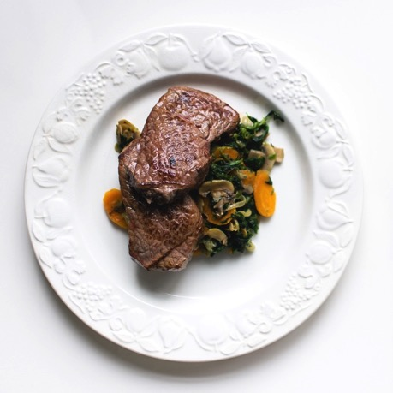
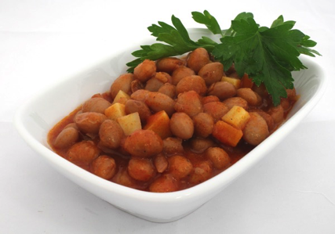
Beans or Beef?
Not all protein is created equal.
A diet rich in vegetable protein and low in animal protein helps control BPH.
Clin Nutr ESPEN. 33:5-11.
Notes:
Das K, Buchholz N. Benign prostate hyperplasia and nutrition. Clin Nutr ESPEN. 2019 Oct;33:5-11. doi: 10.1016/j.clnesp.2019.07.015.
Moderate exercise 4–6 times a week, a diet rich in vegetable protein and low in animal protein, zinc and Vitamin D, and supplements like Saw palmetto, Cemilton and Pygeum extracts may help in controlling BPH.

Slide 20
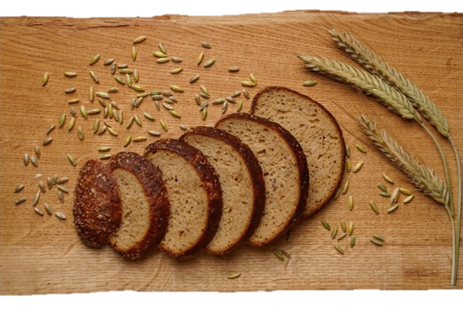
Grain-a-tarians, The meat avoidant diet
Over emphasis on gains and breads in the diet can increase BPH by up to 69%.
Eat your fruits and vegetables!
Urology. 67(1):73-9.
Notes:
Bravi F, Bosetti C, Dal Maso L, Talamini R, Montella M, Negri E, Ramazzotti V, Franceschi S, La Vecchia C. Food groups and risk of benign prostatic hyperplasia. Urology. 2006 Jan;67(1):73-9.

Slide 21

Inflammation and BPH
Fermented foods
Animal Products
Fried foods
Oils
Caffeine
Salt
Cold
Hot
Dehydration
Fresh food antioxidants
Sunshine
Exercise
Fresh air
Good hydration
Early bedtime with 7.5-8 hrs rest
Eur Urol. 2014 Oct;66(4):619-22.
Notes:
More chronic inflammation was associated with more BPH.
Zlotta AR, Egawa S, Pushkar D, Govorov A, Kimura T, Kido M, Takahashi H, Kuk C, Kovylina M, Aldaoud N, Fleshner N, Finelli A, Klotz L, Lockwood G, Sykes J, Kwast Tv. Prevalence of inflammation and benign prostatic hyperplasia on autopsy in Asian and Caucasian men. Eur Urol. 2014 Oct;66(4):619-22.

Slide 22

Milk and BPH
In one study there was a higher risk of BPH with increasing intake of high-fat dairy products.
Meta-analysis suggests that high intakes of dairy products may be associated with an increased risk of prostate cancer.
Br J Nutr. 2022 Aug 10:1-18.
Notes:
Zhao Z, Wu D, Gao S, Zhou D, Zeng X, Yao Y, Xu Y, Zeng G. The association between dairy products consumption and prostate cancer risk: a systematic review and meta-analysis. Br J Nutr. 2022 Aug 10:1-18.
In this study, we conducted a meta-analysis to estimate the relationship between the consumption of dairy products and the risk of prostate cancer. We searched PubMed, Embase and Cochrane databases for relevant articles and identified a total of thirty-three cohort studies between 1989 and 2020. The qualities of included studies were assessed using Newcastle-Ottawa scale. Pooled adjusted relative risks (RR) with 95 % CI were calculated. We performed subgroup analyses stratified by dairy type, prostate cancer type, follow-up years, treatment era, collection times, adjustment for confounders and geographic location. In the subgroup analysis stratified by prostate cancer type, the pooled RR were 0·98 (95 % CI 0·94, 1·03) in the advanced group, 1·10 (95 % CI 0·98, 1·24) in the non-advanced group and 0·92 (95 % CI 0·84, 1·00) in the fatal group. In the dose-response analysis, a positive association for the risk of prostate cancer was observed for total dairy products 400 g/d (RR: 1·02; 95 % CI 1·00, 1·03), total milk 200 g/d (RR: 1·02; 95 % CI 1·01, 1·03), cheese 40 g/d (RR: 1·01; 95 % CI 1·00, 1·03) and butter 50 g/d (RR: 1·03; 95 % CI 1·01, 1·05). A decreased risk was observed for the intake of whole milk 100 g/d (RR: 0·97; 95 % CI 0·96, 0·99). Our meta-analysis suggests that high intakes of dairy products may be associated with an increased risk of prostate cancer; however, since many of the studies were affected by prostate-specific antigen (PSA) screening bias, additional studies with an adjustment of PSA screening are needed.
Ambrosini GL, de Klerk NH, Mackerras D, Leavy J, Fritschi L. Dietary patterns and surgically treated benign prostatic hyperplasia: a case control study in Western Australia. BJU Int. 2008 Apr;101(7):853-60.

Slide 23

Overeating and Prostate Cancer
Overeating increases the risk of BPH and prostate cancer.
Nutr Cancer. 29(2):120-6.
Notes:
Meyer F, Bairati I, Fradet Y, Moore L. Dietary energy and nutrients in relation to preclinical prostate cancer. Nutr Cancer. 1997;29(2):120-6.
Previous studies of diet and prostate cancer have focused on advanced disease and have suggested a positive association with saturated fat intake. We report a study assessing the relationship between diet and preclinical prostate cancer. A total of 215 men with preclinical prostate cancer and 593 controls with no evidence of cancer participated in a case-control study conducted in Quebec City between October 1990 and May 1993. The study population comprised two groups: men treated surgically for benign prostatic hypertrophy and participants in a prostate cancer screening program. Trained nutritionists interviewed the participants on their usual diet using a diet history questionnaire. Odds ratios for prostate cancer associated with quartiles of dietary intake and P values for trend were estimated by logistic regression while controlling for age, education, group, and family history of prostate cancer. A positive association was observed between total energy intake and preclinical prostate cancer (p = 0.004). The odds ratios for prostate cancer increased with each quartile of energy intake: 1.00, 1.77, 1.90, and 2.67. After adjustment for energy, nutrients were not associated with prostate cancer. This study provides some evidence that total energy intake is related to preclinical prostate cancer and suggests that diet could be involved earlier than thought in the occurrence of prostate cancer.
Safarinejad MR. Prevalence of benign prostatic hyperplasia in a population-based study in Iranian men 40 years old or older. Int Urol Nephrol. 2008;40(4):921-31.
Epidemiology of benign prostatic hyperplasia (BPH) is incompletely understood. The following study was done to estimate the prevalence of BPH according to obstructive and irritative symptoms of prostate obstruction determined by uroflowmetry and prostate size. In a cross-sectional study a total of 8,466 men aged 40 or older were interviewed by 74 general practitioners and answered the International Prostate Symptom Score (I-PSS) questionnaire. The subjects were randomly identified from 30 counties of Iran. They were invited to have a digital rectal examination (DRE), serum total prostate-specific antigen (tPSA) assay, abdominal ultrasonography to measure prostate size and measurement of maximum urinary flow rate (Qmax). Data on medical history, toxic habits, and current use of medications were obtained. Of the men interviewed, the prevalence of BPH, defined as I-PSS greater than 7, maximum flow less than 15 ml/s and prostate size greater than 30 gm, was 23.8%. The prevalence increased with age, from 1.2% in men 40-49 to 36% in those >70 years (tested for trend, P = 0.001). A positive association was found between BPH and body mass index (BMI) (P = 0.04), height (P = 0.03), diabetes mellitus (P = 0.04), increased total energy intake (P = 0.02), age-adjusted levels of total PSA (P = 0.02), heart disease (P = 0.03), and marital status (P = 0.01). The prevalence of BPH is relatively high in Iran. The provided bothersome due to BPH did not correlate to symptom severity and should be considered independently in clinical decision-making.

Slide 24

Obesity and BPH
High waist circumference, BMI, and sedentary behavior all independently increase BPH.
Obesity induces an androgenic to estrogenic switch in the prostate gland, which is associated with BPH.
J Transl Med. 20(1):495.
Notes:
Wang YB, Yang L, Deng YQ, Yan SY, Luo LS, Chen P, Zeng XT. Causal relationship between obesity, lifestyle factors and risk of benign prostatic hyperplasia: a univariable and multivariable Mendelian randomization study. J Transl Med. 2022 Oct 29;20(1):495.
This study supports independent causal roles of high waist circumference, BMI and sedentary behavior in BPH.
Xue B, Wu S, Sharkey C, Tabatabaei S, Wu CL, Tao Z, Cheng Z, Strand D, Olumi AF, Wang Z. Obesity-associated inflammation induces androgenic to estrogenic switch in the pros
Abstract
Background and objective: Our patient cohort revealed that obesity is strongly associated with steroid-5α reductase type 2 (SRD5A2) promoter methylation and reduced protein expression. The underlying mechanism of prostatic growth in this population is poorly understood. Here we addressed the question of how obesity, inflammation, and steroid hormones affect the development of benign prostatic hyperplasia (BPH).
Material and methods: We used preadipocytes, macrophages, primary human prostatic stromal cells, prostate tissues from high-fat diet-induced obese mice, and 35 prostate specimens that were collected from patients who underwent transurethral resection of the prostate (TURP). RNA was isolated and quantified with RT-PCR. Genome DNA was extracted and SRD5A2 promoter methylation was determined. Sex hormones were determined by high-performance liquid chromatography-tandem mass spectrometry. Protein was extracted and determined by ELISA test.
Results: In prostatic tissues with obesity, the levels of inflammatory mediators were elevated. SRD5A2 promoter methylation was promoted, but SRD5A2 expression was inhibited. Inflammatory mediators and saturated fatty acid synergistically regulated aromatase activity. Obesity promoted an androgenic to estrogenic switch in the prostate.
Conclusions: Our findings suggest that obesity-associated inflammation induces androgenic to estrogenic switch in the prostate gland, which may serve as an effective strategy for alternative therapies for management of lower urinary tract symptoms associated with BPH in select individuals.
tate gland. Prostate Cancer Prostatic Dis. 2020 Sep;23(3):465-474. doi: 10.1038/s41391-020-0208-4.

Slide 25
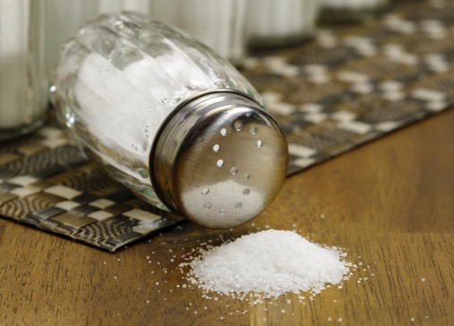
Sodium and the Prostate
Adding Two-thirds of a teaspoon of salt (1500mg) per day more than doubles the risk of BPH.
Eur Urol. 55(5):1179-89.
Notes:
Maserejian NN, Giovannucci EL, McKinlay JB. Dietary macronutrients, cholesterol, and sodium and lower urinary tract symptoms in men. Eur Urol. 2009 May;55(5):1179-89.
Sodium intake had a significant positive association with LUTS (ptrend = 0.007) and the
continuous symptom score (ptrend = 0.02). Men in the highest quintile of sodium intake were
more than twice as likely to report LUTS as men in the lowest quintile (OR = 2.25; 95% CI,
1.26–4.03; p = 0.006; sensitivity analyses: OR = 2.11; 95% CI, 1.15–3.84; p = 0.02). The
difference between the highest and lowest quintiles, which was on average approximately 1500
Maserejian et al. Page 4
Eur Urol. Author manuscript; available in PMC 2010 May 1.
NIH-PA Author Manuscript NIH-PA Author Manuscript NIH-PA Author Manuscript
mg of sodium (approximately two-thirds of a teaspoon of salt), was associated with an increase
in symptom score of 1.1 points (p = 0.03). The linear trend was particularly strong for storage
symptoms (ptrend = 0.004). No consistent association emerged between sodium intake and
voiding symptoms

Slide 26

Mono Sodium Glutamate (MSG)
BPH is a known side effect of MSG in your foods.
MSG causes prostate and testicular damage affecting male fertility.
Environ Sci Pollut Res Int. 28(23):29629-29642.
Notes:
Helal AM, Abdel-Latif MS, Abomughaid MM, Ghareeb DA, El-Sayed MM. Potential therapeutic effects of Ulva lactuca water fraction on monosodium glutamate-induced testicular and prostatic tissue damage in rats. Environ Sci Pollut Res Int. 2021 Jun;28(23):29629-29642.
Male infertility is considered one of the most critical health problems that are expected to expand worldwide. Ulva lactuca is a species of green seaweeds which is known to be a rich source of many important nutrients. Accordingly, this study is designated to investigate the therapeutic role of Ulva lactuca water fraction (UL) against monosodium glutamate (MSG)-induced male reproductive system disorders in male rats. Ulva lactuca methanolic crude extract was prepared firstly, and then water-dissolved compounds of this crude methanolic extract were separated. Ulva lactuca water fraction active phenolic compounds were determined using high-performance liquid chromatography (HPLC). Thirty-two male rats were divided equally into four groups; male infertility was induced in sixteen experimental animals by MSG at dose of 15 mg/Kg for 45 days. Eight infertile animals were treated with 100 mg/Kg of Ulva lactuca water fraction for 30 days. The rest of the animals were divided into two control groups; one control group (eight animals) was used to study the effect of UL on healthy rats at dose of 100 mg/Kg for 30 days and healthy control group (eight animals). Semen quality parameters (concentration and motility ratio), serum testosterone, prostate-specific antigen (PSA), and phosphatases were estimated by using standard protocols. Moreover, prooxidants and endogenous antioxidant enzymes were measured in prostate and testis homogenates. In addition, relative expression of pro-inflammatory genes (inducible nitric oxide synthase (i-NOS), cyclooxygenase-2 (COX-2), tumor necrosis factor-α alpha (TNF-α), and tumor protein (P53)) were assessed in testicular and prostatic tissues. Finally, histological alterations were measured by hematoxylin and eosin (H&E) stain. Results revealed that Ulva lactuca water fraction contains active phenolic constituents responsible for its antioxidant bioactivity. Oral administration of MSG significantly induced histological alterations. Oxidative stress was observed with elevated levels of nitric oxide (NO), thiobarbituric acid reactive substances (TBARS), and xanthine oxidase (XO) activity in both testis and prostate tissues. MSG adversely affected prostate function via elevation of PSA, prostatic acid phosphatases (PAPs), and total acid phosphatases (TAPs). In addition, it upregulated pro-inflammatory genes in testis and prostate tissues. Meanwhile, MSG reduced serum testosterone, semen quality, and antioxidant enzyme activities (glutathione peroxidase (GPx), glutathione-s-transferase (GST), and superoxide dismutase (SOD)). Treatment with UL notably ameliorated the state of oxidative stress and downregulated the expression of pro-inflammatory gene markers. This study highlighted the potential efficacy of Ulva lactuca water fraction on MSG-induced male infertility in rats. Therapeutic effect of UL on oxidative stress and inflammation induced by MSG in testicular and prostatic tissues.
Kolva, AC "Potential MSG Side Effects Including BPH Symptom Outbreaks." 7 Oct. 2010 EzineArticles.com. 18 Jun. 2023
Olowofolahan AO, Adeosun OA, Olorunsogo OO. Monosodium Glutamate Induces Cytotoxicity in Rat Liver via Mitochondrial Permeability Transition Pore Opening. Cell Biochem Biophys. 2020 Dec;78(4):429-437.
Monosodium glutamate (MSG) is a major food additive used as a flavor enhancer. A lot of controversies have been generated over the use of MSG. The present study therefore investigated whether MSG would induce cytotoxicity via the induction of mitochondrial permeability transition (mPT) pore opening. 36 male albino rats were used for this study. The rats were equally divided into six groups: group I is the control while group II, III, IV, V, and VI were orally treated with MSG (25, 50, 100, 200, and 400 mg/kg) daily for 28 days. The opening of the pore, cytochrome c release, mitochondrial ATPase activity, mitochondrial lipid peroxidation and hepatic DNA fragmentation were determined spectrophotometrically. Histological assessment of prostate and brain was carried out. The results show that MSG at concentrations ≤30 µg/ml did not induce mPT pore opening while higher concentrations caused significant induction of pore opening. Also, at lower doses (25 and 50 mg/kg), MSG did not cause any significant induction of mPT pore opening while at higher doses, there were significant induction of pore opening. Similar trend of results was recorded for cytochrome c release, mitochondrial ATPase activity and lipid peroxidation. The histological results show that at low doses (25 and 50 mg/kg), no significant lesion was observed while higher doses caused benign prostatic hyperplasia (BPH) in the prostate and necrotic damage in the brain. MSG administration at low dose is tolerable while high doses induce cytotoxicity via mPT pore opening.

Slide 27
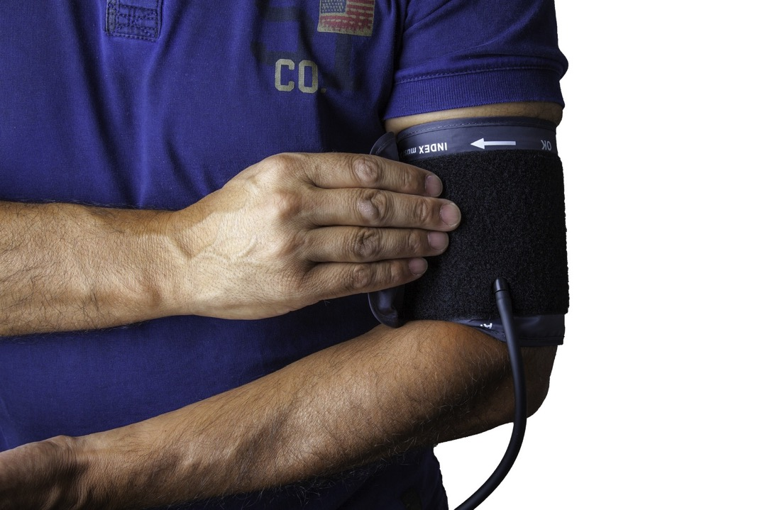
High blood pressure is associated with increased incidence of BPH.
Arch Esp Urol. 56(4):355-8.
Notes:
Arch Esp Urol
. 2003 May;56(4):355-8.
[Relation between hypertension and clinical cases of benign prostatic hyperplasia]
[Article in Spanish]
José Antonio Nicolás Torralba 1 , Jesús Tornero Ruiz, Vicente Bañón Pérez, Gerardo Server Pastor, Pedro López Cubillana, Mariano Pérez Albacete
Affiliations
PMID: 12830607
Abstract
Objectives: To confirm the relationship between hypertension and lower urinary tract symptoms (LUTS) in our environment, and to evaluate the association between hypertension and LUTS secondary to benign prostatic hypertrophy (BPH).
Methods: We prospectively studied during 3 months all male patients older than 50 years (163 patients) analysing previous medical history, IPSS, digital rectal examination, urine sediment, basic biochemical profile, PSA, uroflowmetry, and urinary tract ultrasound. Patients with neurological diseases, previous pelvic trauma, diabetes mellitus, suspicious digital rectal examination, abnormal PSA, or under treatment with alpha blockers, antidepressants, finasteride or antipsychotic drugs were excluded.
Results: From a total of 163 patients 113 were classified as suffering clinical BPH (LUTS, prostate greater than 30 gm, and uroflowmetry < 15 ml/sec), and 75 as hypertensive. Among 75 hypertensive patients 31 presented IPSS greater than 7 (41.3%) in comparison to 20 out of 88 non hypertensive patients (22.7%), being the difference statistically significant.
Conclusions: Our study confirms what has been previously reported by other authors, that there is a statistically significant relationship between hypertension and LUTS secondary to BPH.

Slide 28
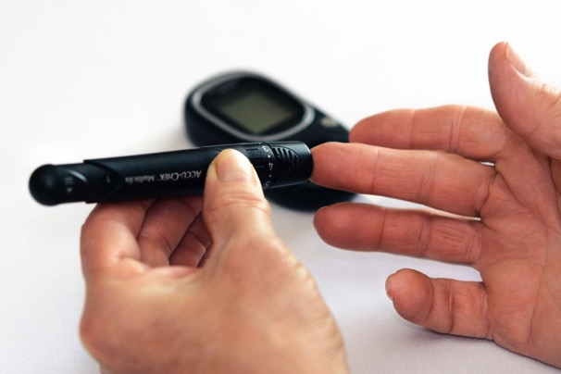
Diabetes increases the risk of BPH
A high fasting blood sugar level increases BPH.
High blood insulin levels cause unnatural over growth of the prostate.
Aging Male. 18(1):34-7.
Notes:
Zhao MJ, Huang Q, Wang XH, Ren XY, Jin YH, Zeng XT. Comparing clinical parameters of abnormal and normal fasting blood glucose in benign prostatic hyperplasia patients. Aging Male. 2020 Dec;23(5):655-662.
Abstract
Objective: To investigate the correlation of clinical measurements on normal and abnormal fasting blood glucose (FBG) with benign prostatic hyperplasia (BPH).
Methods: From September 2016 to January 2018, 771 BPH patients were enrolled for further selection. The eligible patients were divided into normal FBG, impaired fasting glucose (IFG), and high risk of type 2 diabetes mellitus (HR-T2DM) groups. Then, relevant parameters were compared among these three groups using Pearson's correlation coefficient.
Results: Finally including 443 patients with normal FBG, 113 with IFG and 56 with HR-T2DM. Height, weight, body mass index, smoking status, hemoglobin, serum Na+, serum Cl-, and serum Ca2+ were significantly different between normal and abnormal FBG groups. In IFG/HR-T2DM group, obviously connections were demonstrated for weight with prostate volume (PV), for serum Na+, PV, and serum Cl- with total prostate-specific antigen (t-PSA), for FBG with international prostate symptom score (IPSS). In normal FBG group, significant correlations of age, weight, body mass index, hemoglobin, and serum Ca2+ with PV, of age, systolic blood pressure, PV, and serum Cl- with t-PSA; and of FBG, hemoglobin, and serum Na+ with IPSS were also observed.
Conclusions: Our study suggests that FBG level probably plays an important role in BPH.
Heo JE, Kim DG, Yoo JW, Lee KS. Metabolic syndrome-related factors as possible targets for lower urinary tract symptoms in Korean males. Aging Male. 2023 Dec;26(1):6-12.
Abstract
Introduction: A positive association between benign prostate hyperplasia (BPH)/lower urinary tract symptoms (LUTS) and metabolic syndrome (MetS) was reported in several studies, but studies from Asia often showed conflicting results.
Materials and methods: Medical records were obtained from a health promotion center database between 2021 and 2022. Men without a history of treatment for LUTS were evaluated using the International Prostate Symptom Score (IPSS), Overactive Bladder Symptom Score (OABSS), transrectal ultrasonography.
Results: Of 1345 individuals, 603 (44.8%) had MetS. Older age, higher IPSS values, higher prevalence rates of BPH and overactive bladder, higher triiodothyronine, and lower testosterone and sex-hormone binding globulin were observed in individuals with MetS than in individuals without MetS. The severity of LUTS significantly increased in the individuals with MetS (p = .002). In individuals with MetS, age, HbA1c, and cerebrovascular disease (CVD) were associated with IPSS. For OABSS, age, HbA1c, thyroid-stimulating hormone (TSH), coronary artery occlusive disease, and CVD were identified as predictors.
Conclusions: We confirmed the positive correlation between MetS and BPH/LUTS in Korean. Factors including TSH and atherosclerosis affected LUTS in individuals with MetS. These findings suggested a potential role of thyroid hormones and atherosclerosis in the etiology and treatment of BPH/LUTS in patients with MetS.
Ferreira FT, Daltoé L, Succi G, Cunha F, Ferreira JM, Lorenzetti F, Dambros M. Relation between glycemic levels and low tract urinary symptoms in elderly. Aging Male. 2015 Mar;18(1):34-7.
Abstract
Introduction: Due the low mortality attributed to BPH, the evaluation of the impacts of LUTS on quality of life of the patients has great importance, especially on the concern of therapeutic choices, except on cases of formal surgery indication. This increase is directly related with difficulties to perform ordinary tasks and a normal living in community.
Objectives: Determinate an association among Diabetes mellitus II and BPH symptoms in a group of elder men.
Methodology: This is an observational clinic trial, comparative. About 62 male subjects, 60 years old or more have been active interviewed. They were divided in two similarly groups. First was composed by men without diabetes and the second with diabetic men. For the evaluation of prostatic symptoms, it was utilized the IPSS.
Results: Mean age on Group I was 67.6 years old, while on Group II was 68.7 years old (p = 0.1521). After questionnaire, 51.5% of participants on Group I and 54.2% on Group II presented Systemic Arterial Hypertension (p = 0.099). IPSS was higher on group II (p < 0.0005).
Discussion: Diabetes mellitus was positively associated with the increasing of the LUTS, especially NOCTÚRIA. Patients on group I had a media of 14.2 points on IPSS questionnaire, while those on group II reached the media of 7 points. This pattern was the same even after the age, corporal mass and social/economic adjustment.
Conclusion: There is a statistically association between DM and LUTS on Elder men, evaluated through a specific questionnaire.
Vikram A, Jena G, Ramarao P. Insulin-resistance and benign prostatic hyperplasia: the connection. Eur J Pharmacol. 2010 Sep 1;641(2-3):75-81.

Slide 29

BPH In A Cup
Caffeine culprit!
Int J Exp Pathol.93(6):429-37.
Notes:
Sarobo C, Lacorte LM, Martins M, Rinaldi JC, Moroz A, Scarano WR, Delella FK, Felisbino SL. Chronic caffeine intake increases androgenic stimuli, epithelial cell proliferation and hyperplasia in rat ventral prostate. Int J Exp Pathol. 2012 Dec;93(6):429-37.

Slide 30

Alcohol
Laboratory animals given alcohol demonstrate changes in their prostates consistent with BPH and early cancer.
Cell Biol Int. 31(5):459-72.
Notes:
Cândido EM, Carvalho CA, Martinez FE, Cagnon VH. Experimental alcoholism and pathogenesis of prostatic diseases in UChB rats. Cell Biol Int. 2007 May;31(5):459-72.
Previous studies have shown that long-term alcohol treatment has negative effects on prostatic stromal-epithelial interaction. Thus, the aim of the present study was to analyze the histochemical, immunohistochemical and ultrastructural alterations that occur in the prostatic stroma and epithelium of rats submitted to chronic alcohol ingestion and alcohol abstinence, as well as to establish the relationship between these changes and prostatic diseases. Thirty male rats (10 Wistar and 20 UChB rats) were divided into three experimental groups: the control group received tap water, the alcoholic group received ethanol diluted to 10 degrees G.L. for 150 days, and the abstinent group received the same liquid diet as the alcoholic group up to 120 days of treatment and only tap water for 30 days thereafter. At the end of treatment, all animals were sacrificed and the ventral lobe of the prostate was removed and processed for histochemical, immunohistochemical and ultrastructural analyses. In addition, plasma testosterone levels were measured. The results showed prostatic intraepithelial neoplasia, infolding of the epithelium towards the stroma, stromal hypertrophy and the presence of inflammatory cells in alcoholic animals. In the abstinent group, alterations were noted mainly in the stromal area. In conclusion, ethanol triggers alterations in prostatic epithelial and stromal compartments, affecting the stromal microenvironment and predisposing the organ to pathological processes.

Slide 31
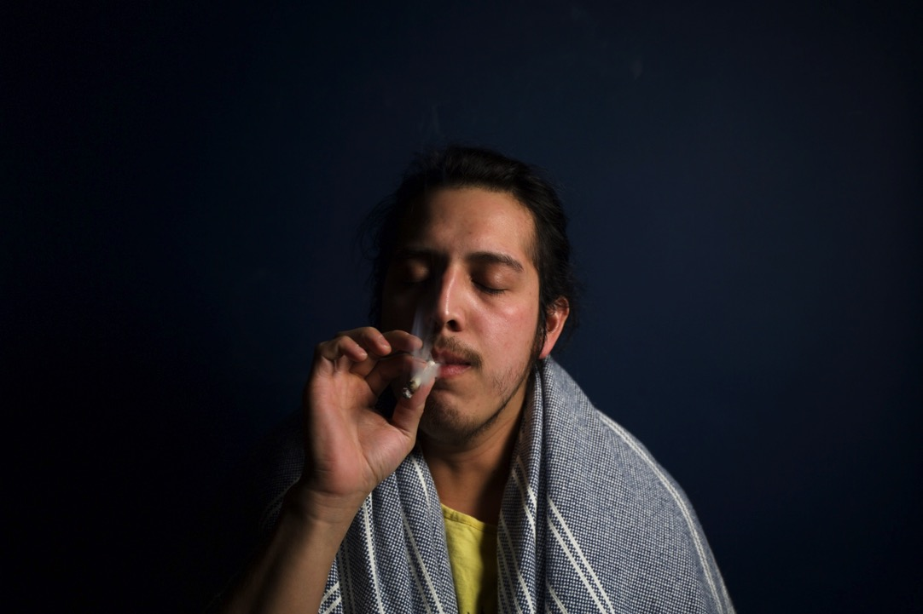
Marijuana BPH Association
Men with depression and MJ usage were more likely to be treated for BPH.
Can J Urol. 29(4):11249-11254.
Notes:
Lloyd GL, Makedon AM, Marks JM, Wiesen B, Carmichael H. The relationship of depression, alcohol and marijuana with treatment for LUTS/BPH. Can J Urol. 2022 Aug;29(4):11249-11254.
Men with depression and MJ usage were more likely to be treated for LUTS/BPH

Slide 32

Avoid Sexual Stimulation
Avoid sexual stimulation without a natural conclusion (ejaculation and orgasm).
Continued stimulation leads to a prolonged engorgement. This is not good for the prostate.
Keep you mind where it belongs. Do not look as anything hinting of a pornographical nature.
Avoid everything that is sexually stimulating.
Natural Remedies Encyclopedia

Slide 33
Perfect health Depends On Perfect Circulation

Slide 34

If you sit on it all the time.....
Sedentary lifestyle increased the risk of BPH by 72%.
Int Neurourol J. 18(3):155-62.
Notes:
Lee HW, Kim SA, Nam JW, Kim MK, Choi BY, Moon HS. The study about physical activity for subjects with prevention of benign prostate hyperplasia. Int Neurourol J. 2014 Sep;18(3):155-62.
Abstract
Purpose: The number of benign prostatic hyperplasia (BPH) subjects has been increasing worldwide, and many studies have been conducted to determine the treatment that can delay drug therapy or surgery. Subsequently, most of these studies involved physical activity (PA) and associated factors. Therefore, we aimed to determine factors associated with BPH prevalence based on a review of past and present studies and to investigate the effect of a healthy lifestyle as a protective factor of BPH occurrence.
Methods: We selected 582 subjects aged ≥40 years from an initial 779 subjects recruited from Gyeonggi, Yangpyeong, South Korea, during August 2009 to August 2011. Trained investigators surveyed International Prostate Symptom Score and demographic information, including PA and lifestyle questionnaire during face-to-face interviews; further, they performed digital rectal examination, rectal ultrasonography, and measured prostate-specific antigen levels. The statistical association between PA and BPH was analyzed by logistic regression analysis using multivariable regression models which use categorical variables by the Cochran-Mantel-Haenszel test and continuous variables by the general linear model.
Results: Seven statistically significant variables for PA were selected. Regular exercise, frequency of exercise, sedentary time, nonsedentary time, leisure time PA (metabolic equivalent, hr/wk) were not statistically associated with prostate volume but sedentary time (hr/day) was the only factor that showed a significant association in the multivariable model, including a linear effect relationship. Subjects with lower levels of sedentary time (4.5-7.0 hr/day) had a significantly lower risk of BPH (odds ratio [OR], 0.93; 95% confidence interval [CI], 0.52-1.67) than those with a higher sedentary time (>7 hr/day) (OR, 1.72; 95% CI, 0.96-3.09) (P for trend=0.05).
Conclusions: Our study showed that reducing sedentary time could have a protective effect and reduce the prevalence of BPH. Further prospective studies with a larger sample size are needed to assess the impact of reducing sedentary time on BPH risk.

Slide 35

Cold exposure
Cold exposure alters prostate blood flow and increases prostate problems
Scand J Urol Nephrol. 41(5):430-5.
Notes:
Hedelin H, Jonsson K. Chronic abacterial prostatitis and cold exposure: an explorative study. Scand J Urol Nephrol. 2007;41(5):430-5.
Abstract
Objective: Chronic abacterial prostatitis/pelvic pain syndrome (CP/CPPS) is characterized by pain, voiding and sexual dysfunction persisting fo r> 3 months. The symptoms tend to occur in relapses of varying length. To evaluate what causes a relapse and what precautions patients with CP/CPPS undertake to avoid a relapse and/or aggravation of symptoms, individual semi-structured interviews were performed.
Material and methods: Information was obtained from semi-structured in-depth interviews with 10 selected men with CP/CPPS (mean age 44 years; 30-62 years). The interviews were transcribed and analysed according to Girorgi's phenomenological method as modified by Malterud.
Results: CP/CPPS tended to start in connection with a specific event involving cold exposure, suggesting cold as an initiating stimulus for CP/CPPS. The informants also reported that cold exposure caused aggravation of symptoms and provoked their relapse. Sitting on cold objects, spending time in cold, damp or windy surroundings and walking on a cold floor were provocative and thus were avoided. The exposure did not have to be either prolonged or intense. Heat applied to the perineum, as well as spending time in a warmer climate, gave relief from symptoms.
Conclusions: It appears that cold is one of the factors that can trigger a process resulting in CP/CPPS. The fact that cold also causes aggravation of symptoms and can initiate a relapse was evident, as was the fact that symptoms could be relieved by heat. The connection between cold and symptom aggravation is well known among clinicians but has not previously been studied in a systematic way. The fact that cold, in a susceptible man, can initiate a process resulting in CP/CPSS has not been reported before. Studies aimed at elucidating the mechanisms behind this phenomenon are warranted. Reflex vasoconstriction in a susceptible individual is a possible cause.
Hedelin H, Jonsson K. Chronic prostatitis/chronic pelvic pain syndrome: symptoms are aggravated by cold and become less distressing with age and time. Scand J Urol Nephrol. 2007;41(6):516-20.
Abstract
Objectives: To evaluate how age and the duration of the condition influence the distress caused by the chronic prostatitis/chronic pelvic pain syndrome (CP/CPPS) and to study how heat and cold influence the symptoms associated with CP/ CPPS as reported by patients afflicted with the condition.
Material and methods: Forty-eight men (median age 50 years; age range 27-70 years) who had suffered from CP/CPPS for a duration ranging from 18 months to 40 years were included in the study. The evaluation included determination of the serum prostate-specific antigen level, the National Institutes of Health's Chronic Prostatitis Symptom Index (NIH-CPSI) and the International Prostate Symptom Score (IPSS).
Results: The mean NIH-CPSI score was 23.0 +/- 4.8. The mean IPSS was 14.3 +/- 7.2. Dysuria was reported by 30 men (63%) and ejaculatory pain by 22 (48%). Men with dysuria had painful ejaculations more often (60%) than men without (22%) (p <0.01). There was a strong negative correlation between age and the NIH-CPSI quality of life (QOL) score (correlation coefficient 0.646; p < 0.001). Independent of age, the duration of the disease also correlated with the NIH-CPSI QOL score (correlation coefficient -0.48; p < 0.02). The total NIH-CPSI score did not correlate with either age or the duration of the disease. Nearly every other man stated that the disease had started in association with a specific event, which for 15 men (31%) included exposure to cold. Forty men (83%) reported that cold caused symptom aggravation and/or induced a relapse. Thirty men (63%) stated that taking a hot bath and 22 (46%) reported that spending time in a hot climate decreased the symptoms.
Conclusions: Age, as well as the duration of the condition, influenced the distress induced by CP/CPPS, suggesting an improved coping ability with time as well as age. The ambient temperature appears to play a role as cold was frequently reported as causing symptom aggravation and heat was often reported to be ameliorating. The mechanisms behind this association between CP/CPPS and temperature as well as the correlation between ejaculatory pain and dysuria require further study.
Mehik A, Hellström P, Lukkarinen O, Sarpola A, Järvelin M. Epidemiology of prostatitis in Finnish men: a population-based cross-sectional study. BJU Int. 2000 Sep;86(4):443-8.
Abstract
Objective: To study the lifetime occurrence of prostatitis in Finnish men and their exposure to the disease. Subjects and methods A population-based cross-sectional survey was conducted in the two most northerly provinces of Finland (Oulu and Lapland). Altogether, 2500 male residents aged 20-59 years were chosen at random to complete a questionnaire on prostatitis. The data were collected between June 1996 and October 1997. Replies were received from 1832 men, giving a response rate of 75%.
Results: The overall lifetime prevalence of prostatitis was 14.2%. The risk of having or having had prostatitis increased with age, being 1.7 times greater in men aged 40-49 years than in those aged 20-39 years, and 3.1 times greater in those aged 50-59 years. The overall incidence was 37.8/10 000 person years. More than a quarter of the 261 men who had or had had prostatitis symptoms (27%) suffered from them at least once a year, while 16% suffered from persistent symptoms; 63% of the men with prostatitis had their worst symptoms during the winter (November-March). Neither education nor profession had much influence on the occurrence of prostatitis, but divorced and single men had a lower risk than married men. Most patients felt they had not received enough information about the disease at their first visit to a general practitioner.
Conclusions: The results of this survey showed that the occurrence of prostatitis symptoms in men living in northern Finland is higher than that reported in other parts of the world. This could be partly caused by the cold climate.

Slide 36

Warm ankles/legs: clothing
Sci Rep. 2014 Jan 22;4:3822.
Notes:
Saito M, Tsounapi P, Oikawa R, Shimizu S, Honda M, Sejima T, Kinoshita Y, Tomita S. Prostatic ischemia induces ventral prostatic hyperplasia in the SHR; possible mechanism of development of BPH. Sci Rep. 2014 Jan 22;4:3822. doi: 10.1038/srep03822.
In the light of increasing evidence that benign prostatic hyperplasia is associated with cardiovascular disease, we have investigated the relationship between prostatic blood flow and prostatic hyperplasia in the spontaneously-hypertensive-rat (SHR). Twelve-week-old male SHRs were treated with nicorandil for six weeks. Wistar-Kyoto rats were used as controls. Six weeks after nicorandil treatment, blood pressure and the prostatic blood flow were estimated, and tissue levels of malondialdehyde, HIF-1α, TGF-β1, bFGF, dihydrotestosterone, and α-SMA were measured. SHRs showed significant increases in blood pressure, tissue levels of malondialdehyde, HIF-1α, TGF-β1, bFGF, α-SMA and a significant decrease in the prostatic blood flow. Although treatment with nicorandil failed to alter the blood-pressure and α-SMA, it significantly ameliorated the increased levels of malondialdehyde, HIF-1α, TGF-β1, and bFGF. There were no significant differences in tissue levels of dihydrotestosterone among any groups. These data indicate that development of prostatic hyperplasia may be associated with prostatic hypoxia, which nicorandil prevents via its effect to increase the blood flow.

Slide 37

Calcium Stones in Your Prostate?
For some men, calcium stones in their prostates can cause outlet obstruction.
Stones occur from increased inflammation in the presence of Magnesium/Calcium imbalance.
A diet sufficient of Magnesium helps reduce calcium stones.
Foods high in magnesium include: pumpkin seeds, sesame seeds, almonds, hazelnuts, wheat germ, buckwheat, spinach, tofu, and kelp.
Med Sci Monit. 24:9196-9203.
Notes:
Stone dissolve tea might be helpful. http://healingherbs.biz/products/herbal_teas.html#stonedissolve
Sun C, Xie G, Huang F, Liu X. Effects of Calcium Oxalate on Expression of Clusterin and Lower Urinary Tract Symptoms in Prostatitis and Benign Prostatic Hyperplasia Patients with Calculi. Med Sci Monit. 2018 Dec 18;24:9196-9203.
Riley JM, Kim H, Averch TD, Kim HJ. Effect of magnesium on calcium and oxalate ion binding. J Endourol. 2013 Dec;27(12):1487-92.
Abstract
Background and purpose: Magnesium (Mg(2+)) has been shown to be a kidney stone inhibitor; however, the exact mechanism of its effect is unknown. Using theoretical models, the interactions of calcium and oxalate were examined in the presence of Mg(2+).
Methods: Molecular dynamics simulations were performed with NAMD and CHARMM27 force field. The interaction between calcium (Ca(2+)) and oxalate (Ox(2-)) ions was examined with and without magnesium. Concentrations of calcium and oxalate were 0.1 M and 0.03 M, respectively, and placed in a cubic box of length ~115 Angstrom. Na(+) and Cl(-) ions were inserted to meet system electroneutrality. Mg(2+) was then placed into the box at physiologic concentrations and the interaction between calcium and oxalate was observed. In addition, the effect of citrate and pH were examined in regard to the effect of Mg(2+) inhibition. Each system was allowed to run until a stable crystalline structure was formed.
Results: The presence of Mg(2+) reduces the average size of the calcium oxalate and calcium phosphate aggregates. This effect is found to be Mg(2+) concentration-dependent. It is also found that Mg(2+) inhibition is synergistic with citrate and continues to be effective at acidic pH levels.
Conclusion: The presence of magnesium ions tends to destabilize calcium oxalate ion pairs and reduce the size of their aggregates. Mg(2+) inhibitory effect is synergistic with citrate and remains effective in acidic environments. Further studies are needed to see if this can be applied to in vivo models as well as extending this to other stone inhibitors and promoters.

Slide 38

Fruits and Vegetables For BPH!
Adequate consumption of fruits and vegetables, especially dark green leafy vegetables reduced BPH by 34%.
Medicine (Baltimore). 2016 Jan;95(4):e2557.
Notes:
Wong SY. Fruit and Vegetable Intake in Relation to Lower Urinary Tract Symptoms and Erectile Dysfunction Among Southern Chinese Elderly Men: A 4-Year Prospective Study of Mr OS Hong Kong. Medicine (Baltimore). 2016 Jan;95(4):e2557.
The role of fruit and vegetable (FV) intake in relation to prostate health remains inconclusive. This 4-year longitudinal study aims to explore the association of FV intake and the development of lower urinary tract symptoms (LUTS, a cluster of chronic urinary symptoms occurring in bladder, prostate and urethra), incidence of symptomatic benign prostatic hyperplasia (BPH) and erectile dysfunction (ED) in Chinese elderly men. Data were obtained from a 4 years longitudinal study (Mr OS Hong Kong, the largest prospective study on bone health in Chinese elderly). Two thousand Chinese men aged 65 years and older were recruited from the local community, of whom 1998 (99.9%) at baseline and 1564 (78.2%) at 4-year follow-up reported data on LUTS, which were evaluated by a validated International Prostate Symptoms Scale (IPSS). Erectile function was evaluated by the International Index of Erectile Dysfunction-5 (IIEF-5) questionnaires at 2- (n = 386) and 4-year (n = 475) follow-ups. Dietary intake was assessed using a validated food frequency questionnaire at baseline. Analysis was conducted using multivariate linear and logistic regression. For total FV and most of their subclasses, moderate consumption had the lowest mean changes of LUTS; we thus applied the moderate levels as the reference in the regression models. The high levels of total FV intake (>350 g/1000 kcal/day) were significantly associated with reduced IPSS by scores of -1.174 ± 0.459 (or -17.3% of basal IPSS, P = 0.011) relative to the moderate groups (250-350 g/1000 kcal/day). FV consumption had no significant association with the score change of ED or the odds of sexual activities at 4-year (all P > 0.05). High intake of dark and leafy vegetables (>50 g/1000 kcal/day) significantly reduced the risk of LUTS progression by 37.2% [odds ratio (OR) (95% confidence interval, 95% CI): 0.628 (0.466∼0.848), P = 0.002] or risk of symptomatic BPH by 34.3% [OR (95% CI): 0.657 (0.442-0.976), P = 0.038] after 4 years compared with the moderate group (25-50 g/1000 kcal/day). Adequate FV intakes, especially dark and leafy vegetables, were associated with improved LUTS among Chinese elderly men, but lack an association with ED and sexuality.

Slide 39
Cranberry For The Prostate!
Cranberry consumption produces significant decrease in:
Prostate weight (by 33%).
Dihydrotestosterone (DHT) levels (by 18% in serum and 28% in prostate).
and reduces unwanted prostate histological changes.
J Med Food. 23(12):1296-1302.
Notes:
An YJ, Lee JY, Kim Y, Jun W, Lee YH. Cranberry Powder Attenuates Benign Prostatic Hyperplasia in Rats. J Med Food. 2020 Dec;23(12):1296-1302.
Cranberry powder (CR) is reported to be effective against lower urinary tract symptoms (LUTS) and recurrent urinary tract infections. Benign prostatic hyperplasia (BPH) in men older than 50 years is a common cause of LUTS. Here, we attempted to evaluate if CR is also effective for treating BPH using a BPH-induced rat model, which was orally administered CR. Male Sprague-Dawley rats weighing 200-250 g were randomly divided into the following six groups (n = 9): noncastration group; castration group; BPH group; BPH and cranberry for 8-week (CR8W) group; BPH and cranberry for 4-week (CR4W) group; and BPH and saw palmetto group (saw palmetto). Compared with the BPH group, the CR8W group showed a significant decrease in prostate weight (by 33%), dihydrotestosterone (DHT) levels (by 18% in serum and 28% in prostate), 5-alpha reductase levels (18% reduction of type 1 and 35% of type 2), and histological changes. These results indicate that CR could attenuate BPH by inhibiting 5-alpha reductase and by reducing other biomarkers such as prostate weight and DHT levels. Thus, CR may be an effective candidate for the development of a functional food for BPH treatment. IACUC (USW-IACUC-R-2015-004).
Vidlar A, Vostalova J, Ulrichova J, Student V, Stejskal D, Reichenbach R, Vrbkova J, Ruzicka F, Simanek V. The effectiveness of dried cranberries ( Vaccinium macrocarpon) in men with lower urinary tract symptoms. Br J Nutr. 2010 Oct;104(8):1181-9.
Lower urinary tract symptoms (LUTS) are a common condition in older men. The objective of the present study was to evaluate the efficacy and tolerability of cranberry (Vaccinium macrocarpon) powder in men at risk of prostate disease with LUTS, elevated prostate-specific antigen (PSA), negative prostate biopsy and clinically confirmed chronic non-bacterial prostatitis. Forty-two participants received either 1500 mg of the dried powdered cranberries per d for 6 months (cranberry group; n 21) or no cranberry treatment (control group; n 21). Physical examination, International Prostate Symptom Score, quality of life (QoL), five-item version of the International Index of Erectile Function (IIEF-5), basic clinical chemistry parameters, haematology, Se, testosterone, PSA (free and total), C-reactive protein (CRP), antioxidant status, transrectal ultrasound prostate volume, urinary flow rate, ultrasound-estimated post-void residual urine volume at baseline, and at 3 and 6 months, and urine ex vivo anti-adherence activity were determined in all subjects. In contrast to the control group, patients in the cranberry group had statistically significant improvement in International Prostate Symptom Score, QoL, urination parameters including voiding parameters (rate of urine flow, average flow, total volume and post-void residual urine volume), and lower total PSA level on day 180 of the study. There was no influence on blood testosterone or serum CRP levels. There was no statistically significant improvement in the control group. The results of the present trial are the first firm evidence that cranberries may ameliorate LUTS, independent of benign prostatic hyperplasia or C-reactive protein level.

Slide 40


Tomatoes and Lycopene
Consumption of 64g of tomato products per day can reduce the risk of prostate cancer by as much as 28% according to the Adventist Health Study.
Tomato products and lycopene have been shown to improve symptoms of BPH and lower PSA.
Cancer Causes Control. 31(4):341-351. AHS-2
Notes:
Fraser GE, Jacobsen BK, Knutsen SF, Mashchak A, Lloren JI. Tomato consumption and intake of lycopene as predictors of the incidence of prostate cancer: the Adventist Health Study-2. Cancer Causes Control. 2020 Apr;31(4):341-351.
Abstract
Purpose: Studies have controversially suggested that prostate cancer, the most common cancer among Western men, is less common among those with a high intake of tomato products and lycopene. We examine multivariable associations between the intake of tomatoes and lycopene, and risk of prostate cancer.
Methods: In a prospective study of 27,934 Adventist men without prevalent cancer, Cox proportional hazard regression analyses were used to address the objectives. Dietary measurement error was partially corrected with regression calibration.
Results: 1226 incident cases of prostate cancer, 355 of them aggressive, were identified during 7.9 years of follow-up. Consumption of canned and cooked tomatoes more than four times a week was associated with a HR = 0.72 (95% CI 0.55, 0.94, P = 0.02) comparing to risk in those never consuming this food. Treating this as a continuous variable, adjusting for confounders, produces a similar result, HR = 0.86 (95% CI 0.75, 0.99), comparing 64 g/day with zero intakes (questionnaire data). Regression calibration, although less precise, suggests a yet stronger and statistically significant inverse relationship, comparing a 24-h dietary recall intake of 71 g/day canned and cooked tomato product, with zero intake. Uncalibrated multivariable-adjusted competing risk analyses do not find differences in tomato associations between aggressive and non-aggressive prostate cancers although power for aggressive cancers is limited.
Conclusion: Consumption of canned and cooked tomatoes may reduce the risk of prostate cancer. These products contain more available lycopene. However, an observational study cannot exclude confounding by some unidentified, prostate cancer preventive factor. Clinical Trial Registry: ClinicalTrials.gov Identifier: NCT03615599
Chen J, Song Y, Zhang L. Lycopene/tomato consumption and the risk of prostate cancer: a systematic review and meta-analysis of prospective studies. J Nutr Sci Vitaminol (Tokyo). 2013;59(3):213-23.
Compared with consumers of lower raw tomato intake, the odds ratio (OR) of incidence of prostate cancer among consumers of higher raw tomato intake was 0.81
150. Cormio, L.; Calò, B.; Falagario, U.; Iezzi, M.; Lamolinara, A.; Vitaglione, P.; Silecchia, G.; Carrieri, G.; Fogliano, V.;
Iacobelli, S.; et al. Improvement of urinary tract symptoms and quality of life in benign prostate hyperplasia patients associ-
ated with consumption of a newly developed whole tomato-based food supplement: A phase II prospective, randomized
double-blinded, placebo-controlled st. J. Transl. Med. 2021, 19, 24. [CrossRef]
151. Edinger, M.S.; Koff, W.J. Effect of the consumption of tomato paste on plasma prostate-specific antigen levels in patients with
benign prostate hyperplasia. Braz. J. Med. Biol. Res. 2006, 39, 1115–1119. [CrossRef]
152. Schwarz, S.; Obermüller-Jevic, U.C.; Hellmis, E.; Koch, W.; Jacobi, G.; Biesalski, H.K. Lycopene inhibits disease progression in
patients with benign prostate hyperplasia. J. Nutr. 2008, 138, 49–53. [CrossRef] [PubMed]

Slide 41
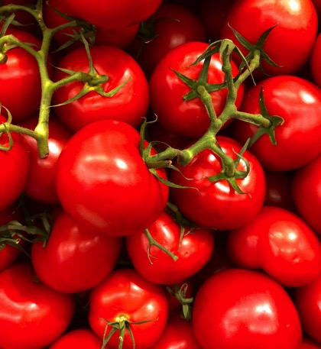
Lycopene
Tomatoes, with their lycopene have been shown to reduce urinary tract symptoms in BPH.
It is well-established that the beneficial properties of single phytonutrients can be better attained when they are taken with the complex of the molecules present in their natural milieu.
Tomato, the fruit providing the most comprehensive complex of prostate-health-preserving micronutrients, has been shown to be superior to its single-nutrient counterparts in decreasing the incidence of age-related prostate diseases.
Int J Mol Sci. 24(6):5795.
Notes:
Natali PG, Piantelli M, Minacori M, Eufemi M, Imberti L. Improving Whole Tomato Transformation for Prostate Health: Benign Prostate Hypertrophy as an Exploratory Model. Int J Mol Sci. 2023 Mar 17;24(6):5795.
It is well-established that the beneficial properties of single phytonutrients can be better attained when they are taken with the complex of the molecules present in their natural milieu. Tomato, the fruit providing the most comprehensive complex of prostate-health-preserving micronutrients, has been shown to be superior to its single-nutrient counterparts in decreasing the incidence of age-related prostate diseases. Herein, we describe a novel tomato food supplement enriched with olive polyphenols, containing cis-lycopene concentrations far exceeding those present in industry-produced tomato commodities. The supplement, endowed with antioxidant activity comparable to that of N-acetylcysteine, significantly reduced, in experimental animals, the blood levels of prostate-cancer-promoting cytokines. In prospective, randomized, double-blinded, placebo-controlled studies performed on patients affected by benign prostatic hyperplasia, its uptake significantly improved urinary symptoms and quality of life. Therefore, this supplement can complement and, in some cases, be an alternative to current benign prostatic hyperplasia management. Furthermore, the product suppressed carcinogenesis in the TRAMP mouse model of human prostate cancer and interfered with prostate cancer molecular signaling. Thus, it may offer a step forward in exploring the potential of tomato consumption to delay or prevent the onset of age-related prostate diseases in high-risk individuals.

Slide 42

Broccoli for Prostate Health!
Broccoli and cruciferous vegetables help BPH by decreasing oxidative stress and bladder dysfunction caused by bladder outlet obstruction.
Cruciferous Vegetables contain an phytochemical which slows down the metabolism in hyperplastic prostate cells helping to protect against BPH.
Oxid Med Cell Longev. 2016:7598294.
Notes:
Liu C, Xu H, Fu S, Chen Y, Chen Q, Cai Z, Zhou J, Wang Z. Sulforaphane Ameliorates Bladder Dysfunction through Activation of the Nrf2-ARE Pathway in a Rat Model of Partial Bladder Outlet Obstruction. Oxid Med Cell Longev. 2016;2016:7598294.
Purpose. We evaluated the effect of sulforaphane (SFN) treatment on the function and changes of expression of Nrf2-ARE pathway in the bladder of rats with bladder outlet obstruction (BOO). Materials and Methods. A total of 18 male Sprague-Dawley rats at age of 8 weeks were divided into 3 groups (6 of each): the sham operated group, the BOO group, and the BOO+SFN group. We examined histological alterations and the changes of oxidative stress markers and the protein expression of the Nrf2-ARE pathway. Results. We found that SFN treatment could prolong micturition interval and increase bladder capacity and bladder compliance. However, the peak voiding pressure was lower than BOO group. SFN treatment can ameliorate the increase of collagen fibers induced by obstruction. SFN treatment also increased the activity of SOD, GSH-Px, and CAT compared to the other groups. The level of bladder cell apoptosis was decreased in BOO rats with SFN treatment. Moreover, SFN could reduce the ratio of Bax/Bcl-2 expression. Furthermore, SFN could activate the Nrf2 expression with elevation of its target antioxidant proteins. Conclusions. The sulforaphane-mediated decrease of oxidative stress and activation of the Nrf2-ARE pathway may ameliorate bladder dysfunction caused by bladder outlet obstruction.
Sulforaphane (SFN) is a naturally occurring isothiocyanate that is present in cruciferous vegetables such as broccoli.
Clarke JD, Hsu A, Yu Z, Dashwood RH, Ho E. Differential effects of sulforaphane on histone deacetylases, cell cycle arrest and apoptosis in normal prostate cells versus hyperplastic and cancerous prostate cells. Mol Nutr Food Res. 2011 Jul;55(7):999-1009.
Myzak MC, Hardin K, Wang R, Dashwood RH, Ho E. Sulforaphane inhibits histone deacetylase activity in BPH-1, LnCaP and PC-3 prostate epithelial cells. Carcinogenesis. 2006 Apr;27(4):811-9.

Slide 43
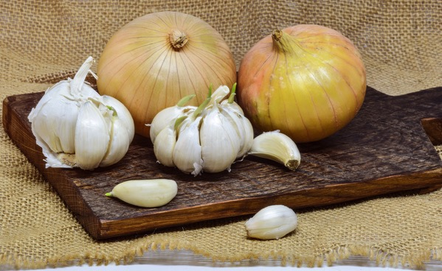
Garlic and Onions
High consumption of garlic reduces the risk of BPH by 35%.
High consumption of onions reduces the risk of BPH by 60%.
Urology. 70(4):672-6.
Notes:
Galeone C, Pelucchi C, Talamini R, Negri E, Dal Maso L, Montella M, Ramazzotti V, Franceschi S, La Vecchia C. Onion and garlic intake and the odds of benign prostatic hyperplasia. Urology. 2007 Oct;70(4):672-6.
Objective: To analyze the relationship between onion and garlic intake and benign prostatic hyperplasia (BPH), using data from a multicenter case-control study conducted in Italy.
Methods: A multicenter case-control study of 1369 patients with BPH and 1451 controls, admitted to the same hospitals for a wide spectrum of acute, non-neoplastic conditions, was conducted in Italy between 1991 and 2002. Information was collected by trained interviewers using a validated and reproducible food frequency questionnaire. Multivariate odds ratios (ORs) and 95% confidence intervals (CIs) were obtained after allowance for recognized confounding factors and energy intake.
Results: Compared with nonusers, the multivariate ORs for the highest category of onion and garlic intake were 0.41 (95% CI 0.24 to 0.72) and 0.72 (95% CI 0.57 to 0.91), respectively. The combined OR for frequent users versus nonusers of both onion and garlic was 0.65 (95% CI 0.49 to 0.86). The inverse relationships were consistent across age strata.
Conclusions: This uniquely large data set from European populations showed an inverse association between allium vegetable consumption and BPH.

Slide 44
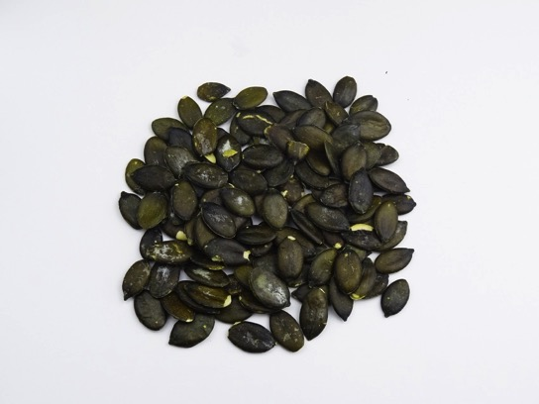
Pumpkin Seed Helps Prostate BPH
Pumpkin seed products are popular prostate remedies which have been helpful for some people would be worth looking into.
Pumpkin seeds are a source of zinc, a protective element against BPH.
Zinc rich foods include nuts, pumpkin seeds, sunflower seeds, wheat bran, wheat germ, onions, molasses, peas, beans, and lentils. It is almost nonexistent in refined, processed foods.
J. Pak. Med. Assoc. 64, 683–685.
Notes:
61. Schiebel-Schlosser, G.; Friederich, M. Phytotherapy of BPH with pumpkin seeds-a multicenter clinical trial. Z. Phytother. 1998, 19, 71–76.
62. Vahlensieck, W.; Theurer, C.; Pfitzer, E.; Patz, B.; Banik, N.; Engelmann, U. Effects of pumpkin seed in men with lower urinary
tract symptoms due to benign prostatic hyperplasia in the one-year, randomized, placebo-controlled GRANU study. Urol. Int.
2015, 94, 286–295. [CrossRef]
63. Coulson, S.; Rao, A.; Beck, S.L.; Steels, E.; Gramotnev, H.; Vitetta, L. A phase II randomised double-blind placebo-controlled
clinical trial investigating the efficacy and safety of ProstateEZE Max: A herbal medicine preparation for the management of
symptoms of benign prostatic hypertrophy. Complement. Ther. Med. 2013, 21, 172–179. [CrossRef]
64. Leibbrand, M.; Siefer, S.; Schön, C.; Perrinjaquet-Moccetti, T.; Kompek, A.; Csernich, A.; Bucar, F.; Kreuter, M.H. Effects of an
oil-free hydroethanolic pumpkin seed extract on symptom frequency and severity in men with benign prostatic hyperplasia: A
pilot study in humans. J. Med. Food 2019, 22, 551–559. [CrossRef]
65. Shirvan, M.K.; Mahboob, M.R.; Masuminia, M.; Mohammadi, S. Pumpkin seed oil (prostafit) or prazosin? Which one is better in
the treatment of symptomatic benign prostatic hyperplasia. J. Pak. Med. Assoc. 2014, 64, 683–685.
66. Hong, H.; Kim, C.S.; Maeng, S. Effects of pumpkin seed oil and saw palmetto oil in Korean men with symptomatic benign
prostatic hyperplasia. Nutr. Res. Pract. 2009, 4, 323–327. [CrossRef]
67. Friederich, M.; Theurer, C.; Schiebel-Schlosser, G. Prosta Fink Forte capsules in the treatment of benign prostatic hyperplasia.
Multicentric surveillance study in 2245 patients. Forsch Komplementarmed Klass Naturheilkd 2000, 7, 200–204.
Cicero, A. F., Allkanjari, O., Busetto, G. M., Cai, T., Larganà, G., Magri, V., Perletti, G., Robustelli Della Cuna, F. S., Russo, G. I., Stamatiou, K., Trinchieri, A., & Vitalone, A. (2019). Nutraceutical treatment and prevention of benign prostatic hyperplasia and prostate cancer. Archivio Italiano Di Urologia E Andrologia, 91(3).
zinc are a protective factor for benign prostatic hyperplasia

Slide 45
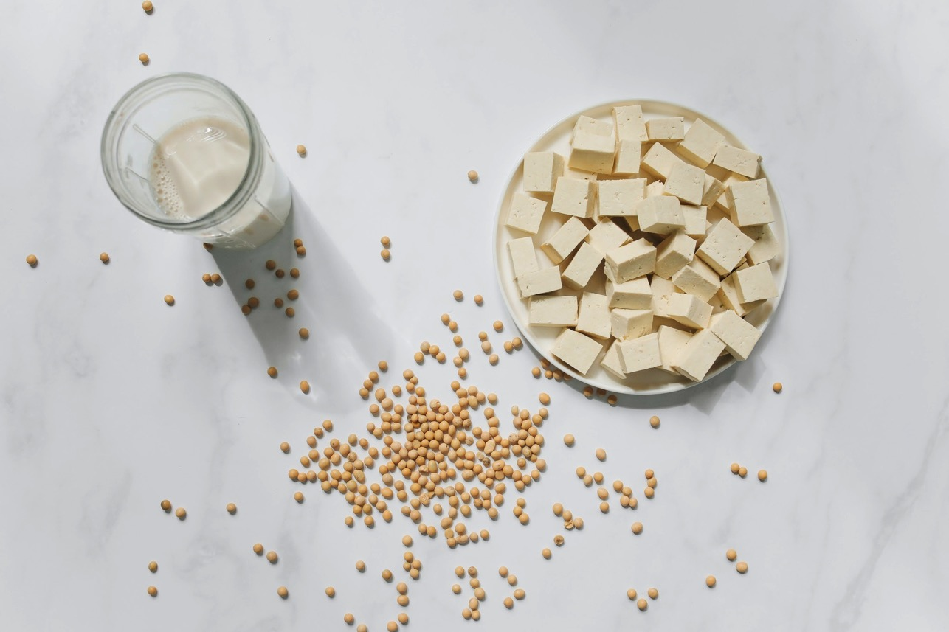
Soy!
Soy consumption reduces BPH and improves voiding symptoms.
Soy significantly decreased serum levels of free testosterone and dihydrotestosterone (DHT)!
Nutrients. 2022 Nov 22;14(23):4943.
Notes:
Huang R, Liu Y, Hu S, Tamalunas A, Waidelich R, Strittmatter F, Stief CG, Hennenberg M. Inhibition of α₁-Adrenergic, Non-Adrenergic and Neurogenic Human Prostate Smooth Muscle Contraction and of Stromal Cell Growth by the Isoflavones Genistein and Daidzein. Nutrients. 2022 Nov 22;14(23):4943.
Soy consumption correlates negatively with benign prostatic hyperplasia (BPH) and voiding symptoms.
Tanaka M, Fujimoto K, Chihara Y, Torimoto K, Yoneda T, Tanaka N, Hirayama A, Miyanaga N, Akaza H, Hirao Y. Isoflavone supplements stimulated the production of serum equol and decreased the serum dihydrotestosterone levels in healthy male volunteers. Prostate Cancer Prostatic Dis. 2009;12(3):247-52.

Slide 46
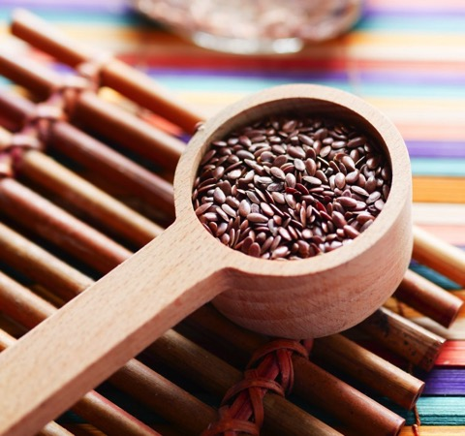
Flaxseed
Flaxseed suppresses prostatic epithelial proliferation, reducing BPH.
The Omega-3s in flax help reduce inflammation.
J Toxicol Environ Health A. 2015;78(7):453-65.
Notes:
Said MM, Hassan NS, Schlicht MJ, Bosland MC. Flaxseed suppressed prostatic epithelial proliferation in a rat model of benign prostatic hyperplasia. J Toxicol Environ Health A. 2015;78(7):453-65.
Benign prostatic hyperplasia (BPH), a disease occurring frequently among elderly males, is a slow progressive enlargement of the fibromuscular and epithelial structures of the prostate gland. Dietary factors may influence the prostate and exert an influence on prostatic growth and disease. The current study was undertaken to investigate the protective effect of dietary flaxseed supplementation against testosterone-induced prostatic hyperplasia in male rats. Forty male Wistar rats were divided into 5 groups: (1) untreated control; (2) treatment with testosterone propionate (TP) to induce prostate enlargement; (3) TP-treated group fed a diet containing 5% milled flaxseed; (4) TP-treated group fed a diet containing 10% milled flaxseed; and (5) TP-treated group fed a diet containing 20 ppm finasteride. Treatment with TP significantly increased the absolute and relative weights of different prostatic lobes, serum testosterone (T), and testosterone/estradiol ratio, as well as prostatic vascular endothelial growth factor (VEGF) expression, RNA synthesis per cell, and epithelial cell proliferation, detected as Ki67 labeling. Histopathological examination did not reveal marked differences in acinar morphology in ventral prostate, whereas morphometric analysis showed significantly increased epithelial cell height. Co-administration of flaxseed or finasteride with TP significantly reduced prostatic VEFG, epithelial cell proliferation, and RNA/DNA ratio, along with a significant increase in serum T and testosterone/estradiol ratio compared with TP-only-treated rats. Our results indicate that flaxseed, similar to the 5α-reductase inhibitor finasteride, blocked TP-induced prostate enlargement in a rat model of BPH, likely through suppression of prostatic VEFG and cellular proliferation.

Slide 47
Selenium
Selenium is very beneficial to the BPH, it is both protective and curative, although the protective effects were more pronounced.
Folia Morphol (Warsz). 81(4):942-955.
Notes:
Elfakharany WA, Safwat MM, Essawy AS. Possible protective and curative effects of selenium nanoparticles on testosterone-induced benign prostatic hyperplasia rat model. Folia Morphol (Warsz). 2022;81(4):942-955.

Slide 48

Saw Palmetto
In one study, Saw Palmetto had the same effect in treating BPH compared with common prostate medications after at least 6-month treatment cycle.
Am. J. Men’s Health 1557988320905407.
Notes:
111. Gravas, S.; Samarinas, M.; Zacharouli, K.; Karatzas, A.; Tzortzis, V.; Koukoulis, G.; Melekos, M. The effect of hexanic extract of
Serenoa repens on prostatic inflammation: Results from a randomized biopsy study. World J. Urol. 2019, 37, 539–544. [CrossRef]
112. Ishii, I.; Wada, T.; Takara, T. Effects of saw palmetto fruit extract intake on improving urination issues in Japanese men: A
randomized, double-blind, parallel-group, placebo-controlled study. Food Sci. Nutr. 2020, 8, 4017–4026. [CrossRef]
Cai, T.; Cui, Y.; Yu, S.; Li, Q.; Zhou, Z.; Gao, Z. Comparison of Serenoa repens with Tamsulosin in the Treatment of Benign Prostatic
Hyperplasia: A Systematic Review and Meta-Analysis. Am. J. Men’s Health 2020, 14, 1557988320905407.

Slide 49
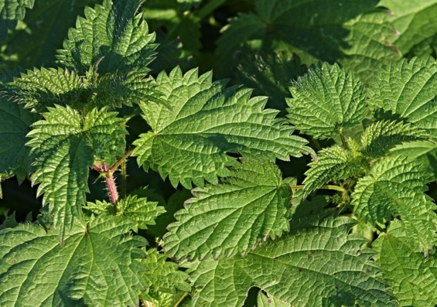
Stinging Nettle Treatment for Milder BPH
Urtica dioica L.
stinging nettle,
common nettle
Ortiga.
The root extract has been used traditionally for the treatment of symptomatic BPH, and shows efficacy in clinical trials.
J Herb Pharmacother. 5(4):1-11.
Notes:
251. Vontobel, H.; Herzog, R.; Rutishauser, G.; Kreis, H. Results of a double-blind study on the effectiveness of ERU (extractum radicis
Urticae) capsules in conservative treatment of benign prostatic hyperplasia. Urologe A 1985, 24, 49–51. [PubMed]
252. Koch, E.; Biber, A. Pharmakologische Wirkungen von Sabal- und Urtikaextrakten als Grundlage für eine rationale medikamentöse
Therapie der benignen Prostatahyperplasie. Urologe B 1994, 34, 95–100.
253. Stahl, H.P. Die Therapie Prostatischer Nykturie. Z. Für Algemeine Med. 1984, 60, 128–132.
254. Friesen, A. Statistiche Analyse einer Multizenter-Langzeitstudie mit ERD. Beninge Prostata hyperplasie II. J. Klin. Exp. UraZ.
1988, 19, 121–130.
255. Dhouibi, R.; Affes, H.; Ben Salem, M.; Hammami, S.; Sahnoun, Z.; Zeghal, K.M.; Ksouda, K. Screening of pharmacological uses of
Urtica dioica and others benefits. Prog. Biophys. Mol Biol. 2020, 150, 67–77. [CrossRef]
256. Safarinejad, M.R. Urtica dioica for treatment of benign prostatic hyperplasia: A prospective, randomized, double-blind, placebo-
controlled, crossover study. J. Herb. Pharmacother. 2005, 5, 1–11. [CrossRef]
257. Lopatkin, N.; Sivkov, A.; Schläfke, S.; Funk, P.; Medvedev, A.; Engelmann, U. Efficacy and safety of a combination of Sabal and
Urtica extract in lower urinary tract symptoms—Long-term follow-up of a placebo-controlled, double-blind, multicenter trial. Int.
Urol. Nephrol. 2007, 39, 1137–1146. [CrossRef]
258. Mahboubi, M. Urtica dioica in the Management of Benign Prostate Hyperplasia (BPH). Nat. Prod. J. 2020, 10, 535–542.

Slide 50
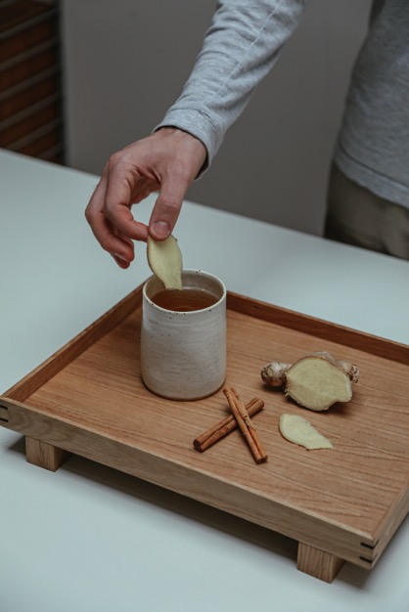
Ginger
Ginger has a number of phytochemicals responsible for its positive effects on BPH. Have you ever tried fresh ginger tea?
J Microsc Ultrastruct. 9(4):164-169.
Notes:
Ahmed AS, Soliman MG. Protective Role of 4-(4-Hydroxy-3-methoxyphenyl)-2-Butanone on Prostatic Cells Hyperplasia of Rats and Human, 5α-reductase Inhibition Pathway. J Microsc Ultrastruct. 2021 May 24;9(4):164-169.
Chukwu-Eze U.S., Mairiga J.P., Ijeomah A.U., Enemali, M.O., Ukeagbu, M.C., Maiva E.P., Kasar, S., Iwuozor, C.R. Comparative Analysis of Anti-Proliferative Effect of Zingiber Officinale (Ginger) and Solanum Lycopersicum (Tomatoes) on Testosterone-Induced Benign Prostatic Hyperplasia in Male Albino Rats. International Journal of Research and Innovation in Applied Science (IJRIAS) |Volume VII, Issue VIII, August 2022|ISSN 2454-6194.
Su Joung Kim, Jeong Yoon Lee, Jeong-Sun Ju, and Yoo-Hyun Lee. Inhibitory Effects of Ginger (Zingiber officinale Roscoe) Ethanol Extract on Benign Prostatic Hyperplasia. Journal of the Korean Society of Food Science and Nutrition 2020; 49(5): 425-432.
Basma G. Eid, Hala Mosli, Atif Hasan, Hany M. El-Bassossy, "Ginger Ingredients Alleviate Diabetic Prostatic Complications: Effect on Oxidative Stress and Fibrosis", Evidence-Based Complementary and Alternative Medicine, vol. 2017, Article ID 6090269, 12 pages, 2017.

Slide 51
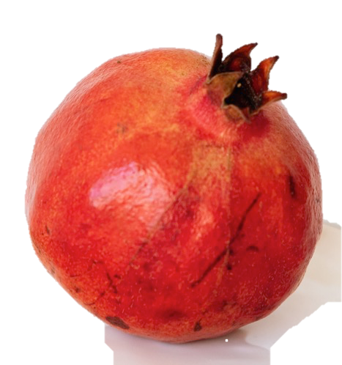
Pomegranate
Antioxidant and Antiangiogenic Activity.
Counters testosterone-induced BPH in rat’s Prostate.
Int J Mol Sci. 24(13):10719.
Notes:
Ammar AE, Esmat A, Hassona MD, Tadros MG, Abdel-Naim AB, Guns ES. The effect of pomegranate fruit extract on testosterone-induced BPH in rats. Prostate. 2015 May;75(7):679-92.
Consoli V, Burò I, Gulisano M, Castellano A, D'Amico AG, D'Agata V, Vanella L, Sorrenti V. Evaluation of the Antioxidant and Antiangiogenic Activity of a Pomegranate Extract in BPH-1 Prostate Epithelial Cells. Int J Mol Sci. 2023 Jun 27;24(13):10719.

Slide 52
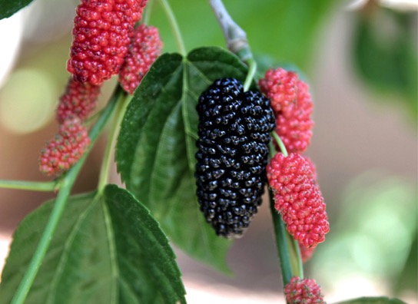
Black Mulberries Make a Difference
Mulberries have been shown to make a difference in BPH and the ill effects of excess testosterone in prostate tissues and reduces urinary tract symptoms of BPH.
Rev Int Androl. 19(1):53-61.
Notes:
Farshid MA, Fazeli M, Shomali T, Nazifi S, Namazi F. Protective effect of black mulberry (Morus nigra L.) fruit hydroalcoholic extract against testosterone-induced benign prostatic hyperplasia in rats. Rev Int Androl. 2021 Jan-Mar;19(1):53-61.
Fenner A. BPH: Go with the Flowens(™)--cranberry powder improves male LUTS in double-blind, placebo-controlled trial. Nat Rev Urol. 2015 Jul;12(7):364.
Vidlar A, Student V Jr, Vostalova J, Fromentin E, Roller M, Simanek V, Student V. Cranberry fruit powder (Flowens™) improves lower urinary tract symptoms in men: a double-blind, randomized, placebo-controlled study. World J Urol. 2016 Mar;34(3):419-24.

Slide 53

French Maritime Pine Bark
BPH symptoms like: emptying, frequency,
intermittency, urgency, weak flow, straining,
nocturia are all significantly improved with Pycnogenol® (P<0.05).
Minerva Med. 109(4):280-284.
Notes:
Ledda A, Belcaro G, Feragalli B, Cornelli U, Dugall M, Corsi M, Cesarone MR. Benign prostatic hypertrophy: Pycnogenol® supplementation improves prostate symptoms and residual bladder volume. Minerva Med. 2018 Aug;109(4):280-284.

Slide 54

Walking for Prostate Health
Regular exercise helps reduce the risk of BPH by 19%.
Men who walk 2 to 3 h/wk have a 25% lower risk of total BPH.
Arch Intern Med. 158(21):2349-56.
Notes:
Platz EA, Kawachi I, Rimm EB, Colditz GA, Stampfer MJ, Willett WC, Giovannucci E. Physical activity and benign prostatic hyperplasia. Arch Intern Med. 1998 Nov 23;158(21):2349-56.
Abstract
Background: Benign prostatic hyperplasia (BPH) leading to prostatic enlargement and lower urinary tract symptoms is highly prevalent among older men. Sympathetic nervous system activity, which is decreased by physical activity, is associated with increased prostatic smooth-muscle tone and prostatic symptoms. Therefore, we assessed whether physical activity leads to fewer lower urinary tract symptoms in the Health Professionals Follow-up Study.
Methods: We observed men who were aged 40 to 75 years at baseline in 1986 for subsequent incidence of surgery for BPH. The men were free of diagnosed cancer, including prostate cancer at baseline and during follow-up, had not had a radical prostatectomy, and provided data on physical activity. Cases were men who under-went BPH surgery between 1986 and 1994 (n = 1890) or, among those who did not have surgery, who scored 15 or more points of 35 (n = 1853) on 7 questions about lower urinary tract symptoms modified from the American Urological Association Symptom Index. Noncases were men who scored 7 points or less (n = 21745). Odds ratios (ORs) and 95% confidence intervals (CIs) were calculated from multiple logistic regression models.
Results: After controlling for age, race or ethnicity, alcohol consumption, and smoking, physical activity was inversely related with total BPH (extreme quintiles: OR, 0.75; 95% CI, 0.67-0.85; P for trend, <.001), surgery for BPH (OR, 0.76; 95% CI, 0.64-0.90; P for trend, <.001), and symptomatic BPH (OR, 0.75; 95% CI, 0.64-0.87; P for trend, <.001). Walking, the most prevalent activity, was inversely related to BPH risk; men who walked 2 to 3 h/wk had a 25% lower risk of total BPH.
Conclusion: Our results indicate that more physically active men have a lower frequency of lower urinary tract symptoms.
Foster SA, Shortridge EF, DiBonaventura M, Viktrup L. Predictors of self-reported benign prostatic hyperplasia in European men: analysis of the European National Health and Wellness Survey. World J Urol. 2015 May;33(5):639-47.
Abstract
Purpose: This study aimed to identify predictors of European men who self-reported being diagnosed with benign prostatic hyperplasia (DxBPH) compared to men with moderate-to-severe lower urinary tract symptoms [American Urological Association Symptom Index (AUA-SI) score ≥8] who did not self-report a BPH diagnosis (non-DxBPH).
Methods: Data were taken from the 2010 European National Health and Wellness Survey; a cross-sectional, self-administered, Internet-based questionnaire. This analysis included males ≥40 years with DxBPH or without DxBPH, but with AUA-SI ≥8. Chi-square tests were used for categorical variables and independent samples t tests were used for continuous variables. Logistic regressions were conducted among all men ≥40 years to predict being DxBPH.
Results: About 1,638 DxBPH and 3,676 non-DxBPH men were included. The estimated prevalence of DxBPH and non-DxBPH was 8.53 and 19.13 %. Men with DxBPH were older than non-DxBPH males (mean age 66.1 and 58.3, P < 0.001). The mean AUA-SI score was 11.3 for DxBPH and 13.2 for non-DxBPH. Being older (OR = 1.077), having a university education (OR = 1.252), having private health insurance (OR = 1.186), and specific health behaviors/attitudes [regular exercise (OR = 1.191), visiting a doctor within the previous 6 months (OR = 2.398), consulting with a medical professional when not feeling well (OR = 1.097), reporting having an attentive doctor (OR = 1.112)], and higher voiding symptoms (OR = 1.032) were significant predictors of DxBPH.
Conclusions: Older men with higher education and access to care and more engagement in their healthcare were more likely to self-report being diagnosed.

Slide 55

Sunshine
Men with vitamin D sufficiency have significantly less prostate enlargement.
Urol Ann. 2017 Apr-Jun;9(2):170-173.
Notes:
Elshazly MA, Sultan MF, Aboutaleb HA, Salem SM, Aziz MS, Abd Elbaky TM, Elsherif EA, Gawish MM, Alajrawi FT, Elgadi FAA, Thaher AH, Shebl MA, Allam AM, Kehinde E. Vitamin D deficiency and lower urinary tract symptoms in males above 50 years of age. Urol Ann. 2017 Apr-Jun;9(2):170-173.
Abstract
Context: Lower urinary tract symptoms (LUTSs) in elderly males are usually related to benign prostatic hyperplasia (BPH) in the majority of cases. It is estimated that BPH affects half of men above the age of 50 years. Recently, a relationship between Vitamin D deficiency and LUTS in elderly males has been reported.
Aims: The aim of this study was to analyze Vitamin D levels in males aged above 50 years presenting with LUTS.
Settings and design: This is a prospective case-control study.
Patients and methods: This was a case-control study in which males above 50 years of age who presented with LUTS (Group A) were compared with a control group (Group B) without LUTS. Both groups were investigated regarding Vitamin D level, prostate-specific antigen (PSA), International Prostatic Symptoms Score (IPSS), prostate size, flow rate, serum calcium levels, and abdominal ultrasonography.
Statistical analysis used: Statistical software package (SPSS Inc., Chicago, IL, USA) was used for the statistical analyses, performing t-test for quantitative data to compare between the two groups. Pearson's correlation coefficient "r" test was calculated between two quantitative, continuous variables in Group A. P <0.05 was considered statistically significant.
Results: A total of 150 patients were studied. There were 70 and 80 patients in Groups A and B, respectively. The mean age of Group A patients was 60.32 ± 11.93 years versus 58.12 ± 10.55 years for Group B patients (P > 0.05). The mean value of Vitamin D level was 40.82 ± 29.46 nmol/L in Group A and 70.25 ± 22.42 nmol/L in Group B (P < 0.001). The mean value of prostate size was 50.12 ± 23.24 g in Group A and 30.68 ± 4.90 g in Group B (P < 0.001). The mean serum calcium level was 2.4 ± 0.14 mmol/L and 2.50 ± 0.15 mmol/L in Groups A and B, respectively (P < 0.001). The mean value of PSA in Group A was 2.24 ± 1.95 ng/ml versus 2.11 ± 0.45 ng/ml in Group B (P < 0.001). The mean value of IPSS in Group A was 13.38 ± 5.32 ml/s versus 3.41 ± 2.42 ml/s in Group B. The mean value of Q max in uroflowmetry in Group A was 11.5 ± 2 ml/s versus 15.4 ± 1 ml/s in Group B.
Conclusions: Men older than 50 years of age with LUTS have lower levels of Vitamin D compared to men without LUTS.

Slide 56

Resting Your Prostate
Make sleep a habit. Adequate sleep duration is protective for BPH.
J Gerontol A Biol Sci Med Sci. 2023 Aug 1:glad187.
Notes:
Jia F, Wei Z, Kong X, Mao Y, Yang Y. Causal associations between lifestyle habits and risk of benign prostatic hyperplasia: a two-sample Mendelian randomization study. J Gerontol A Biol Sci Med Sci. 2023 Aug 1:glad187.

Slide 57

Prostate massage
Prostate massage has be shown to be effective at reduction in size of enlarged prostates.
Andrologia. 12(1):30-3.
Notes:
Paz GF, Fainman N, Homonnai ZT, Kraicer PF. The effect of massage treatment of prostatic congestion on the prostatic size and secretion of citric acid. Andrologia. 1980 Jan-Feb;12(1):30-3.
In this study, 25 men, referred to our clinic for diagnosis and therapy of infertility were included. All had enlarged prostates. They were given 10 sessions of prostatic massage during 3--4 weeks and the fluid expressed was analysed for citric acid. The hypertrophy was seen to recede in almost all cases. Citric acid concentrations fell in only 6/25 cases analysed. In all the others, values did not fall and remained relatively stable. There was no apparent relationship between reduction of prostatic volume and the pattern of citric acid secretion.

Slide 58
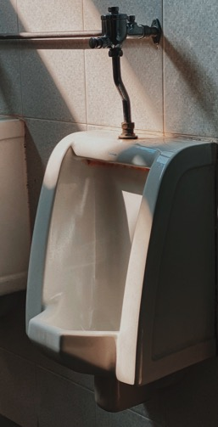
Standing vs Sitting to Urinate
For men with urinary tract issues due to BPH, sitting to urinate can help improve symptoms.
PLoS One. 2014 Jul 22;9(7):e101320.
Notes:
de Jong Y, Pinckaers JH, ten Brinck RM, Lycklama à Nijeholt AA, Dekkers OM. Urinating standing versus sitting: position is of influence in men with prostate enlargement. A systematic review and meta-analysis. PLoS One. 2014 Jul 22;9(7):e101320.

Slide 59
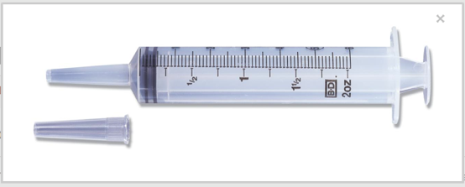
Charcoal suppository
¼ cup water
1/8 cup charcoal powder
½ teaspoon psyllium powder
Mix in a bowl
or
1 cup water
3 tablespoons ground flax
3 tablespoons charcoal
Bring to a boil and let cool
Place in a catheter tip syringe. Inject into rectum and hold over night. Pass with feces at next bowel movement.

Slide 60
Sitz
Three minutes hot.
One minute cold.
Alternate 5 X.
End with cold.
“Natural means, used in accordance with God's will, bring about supernatural results. We ask for a miracle, and the Lord directs the mind to some simple remedy.” {2SM 346.4}
Notes:
Park SU, Lee SH, Chung YG, Park KK, Mah SY, Hong SJ, Chung BH. Warm sitz bath: are there benefits after transurethral resection of the prostate? Korean J Urol. 2010 Nov;51(11):763-6.
https://prostatecancer911.com/4-natural-home-remedies-for-bph/
A sitz bath is an old-fashioned method that really works when it comes to shrinking the prostate naturally. The hot bath relaxes the pelvic muscles and promotes healing. The cold bath eases pain and reduces prostate swelling.
For this method, you just need to fill the bathtub with warm water and then add ½ cup of Epsom salt to it. And, in another bathtub (or large container), you fill with cold water and add several drops of lavender essential oil to the bathtub.
Now, you sit in the bathtub containing hot water (105 degrees F to 115 degrees F) for about 3 minutes. Then, move to the one with cold water for 1 minute (55 degrees F to 85 degrees F).
You should repeat these steps about 3 times and end the procedure with a cold bath.
This is a natural way to shrink the prostate and soothe it. Hydrotherapy is commonly used as a method of prostate enlargement treatment, especially for relieving symptoms. A sitz bath increases blood circulation in the pelvic area and eases the constriction of the urethra.

Slide 61


Kegel's
For men with benign prostatic hyperplasia (BPH) or enlarged prostate, pelvic muscle exercises known as Kegel exercises can relieve symptoms by strengthening the muscles around your bladder and penis.
https://www.mintstl.com/blog/kegel-exercises-to-improve-enlarged-prostate-symptoms
Notes:
https://www.mintstl.com/blog/kegel-exercises-to-improve-enlarged-prostate-symptoms

Slide 62
How to do Kegel exercises for men
To get started:
Find the right muscles. To identify your pelvic floor muscles, stop urination in midstream or tighten the muscles that keep you from passing gas. These maneuvers use your pelvic floor muscles. Once you've identified your pelvic floor muscles, you can do the exercises in any position, although you might find it easiest to do them lying down at first.
Perfect your technique. Tighten your pelvic floor muscles, hold the contraction for three seconds, and then relax for three seconds. Try it a few times in a row. When your muscles get stronger, try doing Kegel exercises while sitting, standing or walking.
Maintain your focus. For best results, focus on tightening only your pelvic floor muscles. Be careful not to flex the muscles in your abdomen, thighs or buttocks. Avoid holding your breath. Instead, breathe freely during the exercises.
Repeat 3 times a day. Aim for at least three sets of 10 repetitions a day.
https://www.mayoclinic.org/healthy-lifestyle/mens-health/in-depth/kegel-exercises-for-men/art-20045074

Slide 63
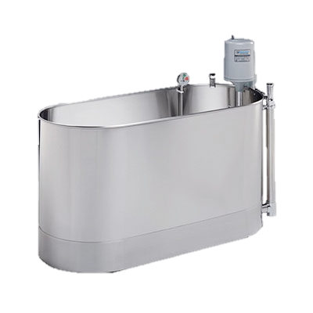
Fever?
Notes:
BPH or Cancer

Slide 64
Summary!
BPH is the result of poor blood circulation and poor oxygenation, increased inflammation, increased hormones and dehydration.
Good dietary choices and lifestyle habits reduce inflammation and hormones; increase circulation, oxygenation and hydration.
Eat more fresh fruit and vegetables.
Drink more water.
Exercise more out in the fresh air and sunshine.
Try some herbs, charcoal, hydrotherapy and massage.
Ask God to bless His simple natural remedies with supernatural success.

