Slide 1
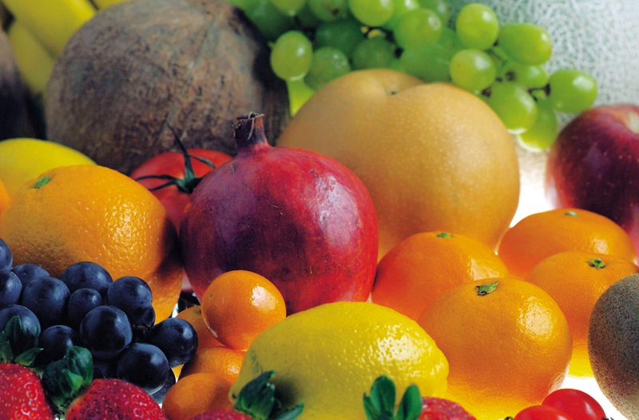
Notes:
Psa_103:3 Who forgiveth all thine iniquities; who healeth all thy diseases;

Slide 2

Progressing to Heaven
Eden Lost to Eden Regained!
Notes:
Bible Study, not sermon, get out your note pads, and like the noble Bereans review the teachings.

Slide 3

God Planted Man in a Garden!
What diet did God Give Man?
Notes:
Dress and keep it!

Slide 4
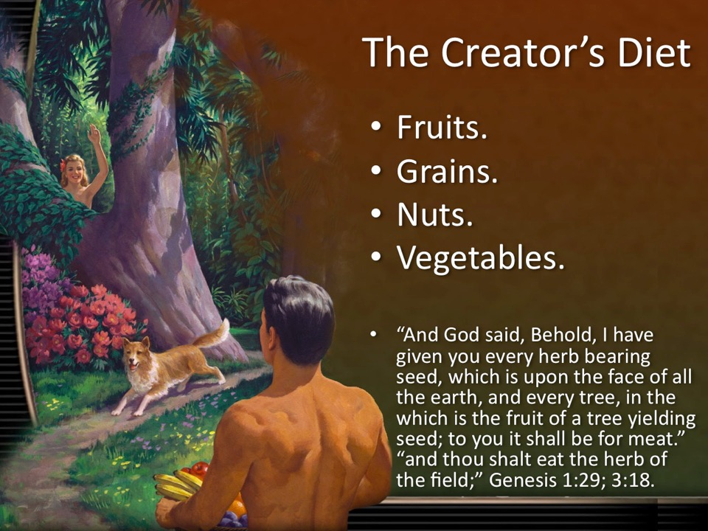
NIV

Slide 5
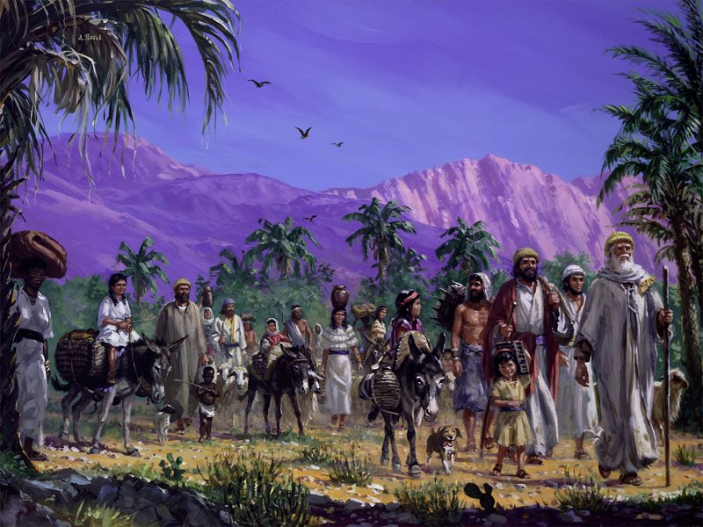
Why did God feed Israel with manna in the wilderness during the Exodus?

Slide 6
“As a general thing, the Lord did not provide His people with flesh meat in the desert, because He knew that the use of this diet would create disease and insubordination.” CD 375.
“We may have to remain here in this world because of insubordination many more years, as did the children of Israel; but for Christ’s sake, His people should not add sin to sin by charging God with the consequence of their own wrong course of action.” Ev 696.

Slide 7
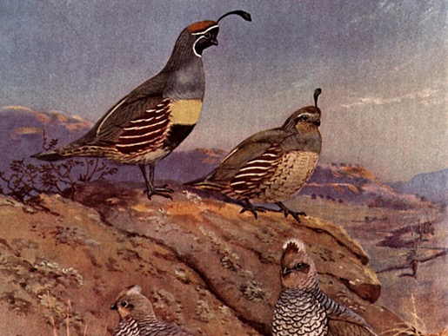
What word does God use to describe Israels desire for the flesh pots of Egypt?
“And the mixt multitude that was among them fell a lusting: and the children of Israel also wept again, and said, Who shall give us flesh to eat?” Numbers 11:4.

Slide 8
What other word does God call this lust?
“30 They were not estranged from their lust. But while their meat was yet in their mouths, 31. The wrath of God came upon them, and slew the fattest of them, and smote down the chosen men of Israel. 32. For all this they sinned still, and believed not for his wondrous works.” Psalms 78:30-32

Slide 9


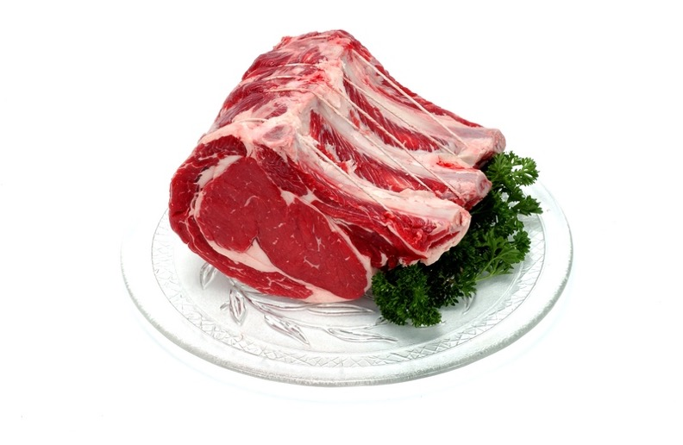
How does Satan Overthrow Man?

Slide 10
“But with many of them God was not well pleased: for they were overthrown in the wilderness.
Now these things were our examples, to the intent we should not lust after evil things, as they also lusted.”
“Now all these things happened unto them for ensamples: and they are written for our admonition, upon whom the ends of the world are come.” 1 Corinthians 10:5,6,11.
Notes:
When God led the children of Israel out of Egypt, it was His purpose to establish them in the land of Canaan a pure, happy, healthy as well as righteous, people. Let us look at the means by which He would accomplish this. He subjected them to a course of discipline, which, had it been cheerfully followed, would have resulted in good, both to themselves and to their posterity. He removed flesh food from them in a great measure. He had granted them flesh in answer to their clamors, just before reaching Sinai, but it was furnished for only one day. God might have provided flesh as easily as manna, but a restriction was placed upon the people for their good. It was His purpose to supply them with food better suited to their wants than the feverish diet to which many of them had been accustomed in Egypt. The perverted appetite was to be brought into a more healthy state, that they might enjoy the food given to Adam and Eve in Eden. Ms59-1890.2
Had they been willing to deny appetite in obedience to His restrictions, feebleness and disease would have been unknown among them. Their descendants would have possessed physical and mental strength. They would have had clear perceptions of truth and duty, keen discrimination, and sound judgment. But they were unwilling to submit to God’s requirements, and they failed to reach the standard He had set for them and to receive the blessings that might have been theirs. They murmured at God’s restrictions, and lusted after the flesh-pots of Egypt. God let them have flesh, but it proved a curse to them. “With many of them God was not well pleased, for they were overthrown in the wilderness.” 1 Corinthians 10:5. Ms59-1890.3

Slide 11

What does science tell us about the effect of meat on critical brain function?
(J Nutr. 2016 Jan 6.) (J Child Psychol Psychiatry. 2014 Sep;55(9):1017-24.)

Slide 12
The western diet, (red meat, potatoes with rich gravy, and butter), significantly limit the function of your God given brain.
(J Nutr. 2016 Jan 6.) (J Child Psychol Psychiatry. 2014 Sep;55(9):1017-24.)

Slide 13

How does a meat diet affect teenagers?
(Prev Med. 2009 Aug;49(1):39-44.)
Notes:
Adolescent behavior is significantly better on a fresh fruit and vegetable diet than on a meat diet.

Slide 14

Does eating meat ruin your spiritual life?
“But lusted exceedingly in the wilderness, and tempted God in the desert. And he gave them their request;
“but sent leanness into their soul.” Psalms 106:14,15.
Notes:
I’m not making this up, and this is the Bible!
malnourished emaciated soul

Slide 15

How does meat eating affect ones psychological mood and mental outlook?
(Nutr J. 2010 Jun 1;9:26.)
(Nutr J. 2012 Feb 14;11:9.)
Notes:
Vegetarians experience healthier mood states and have less negative emotions compared to omnivores.
Restricting meat, fish, and poultry significantly improves ones mood and mental outlook.

Slide 16
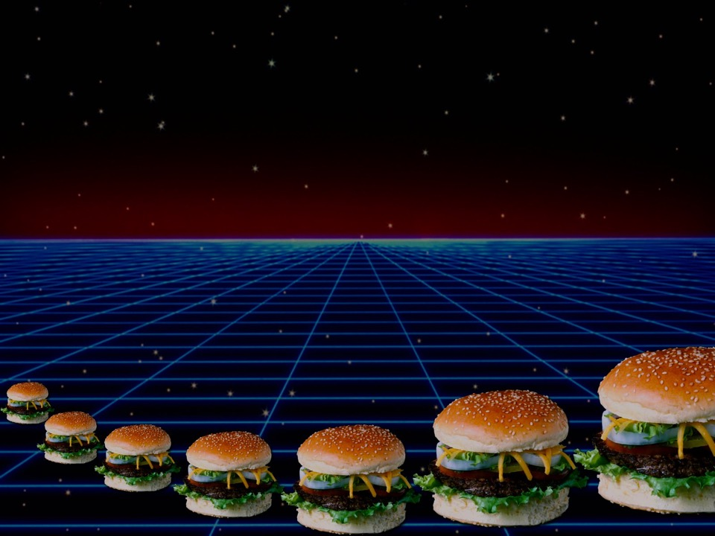
Is meat eating a salvational issue?
“To day if ye will hear his voice, Harden not your heart, as in the provocation, and as in the day of temptation in the wilderness: When your fathers tempted me, proved me,” “Unto whom I sware in my wrath that they should not enter into my rest.” Psalms 95:7-11, see Heb 3:8-19.
“And they sinned yet more against him by provoking the most High in the wilderness. And they tempted God in their heart by asking meat for their lust.
“Because they believed not in God, and trusted not in his salvation:” Psalms 78:17-31.
Notes:
In other words, you could be lost if you eat meat. What says the scriptures????

Slide 17

What happens when vegetarian animals are fed meat?
Notes:
Dr Marrow, Dr. Marrow, the rabbits are biting me, look at my finger.

Slide 18

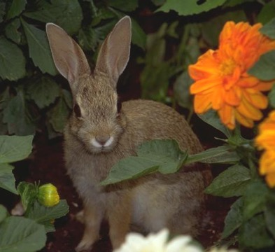
Aggression
Dr. Robert E. Morrow, MD’s experiment with rabbits and hamburger:
The rabbits took a long time to get used to a meat diet.
They became addicted and refused rabbit chow in preference for meat.
They even waited for hamburger even when vegetables were served.
They became vicious: even prone to kill and eat their own babies.
They would fight to the death.
If they died, others rabbits became cannibalistic.
They even bit their caretaker.
The caretaker became a vegetarian.
(Spangler, J R; “Editorial: Hamburgers or angel’s Food” Ministry: International Journal for Pastors; Silver Spring MD; September 1989 Archives; https://www.ministrymagazine.org/archive/1989/09/hamburgers-or-angels-food ).

Slide 19

Aggression
The same results occur in people. Meat makes a fighter:
Tough,
Mean,
Aggressive.
Dr. Robert E. Morrow, M. D., testified personally to the difference in himself when on a vegetarian diet as opposed to a meat diet.
He felt much more aggressive on a flesh diet.
He concluded that to strengthen those characteristics that are associated with a higher level of spirituality, a vegetarian diet would be helpful.
(Spangler, J R; “Editorial: Hamburgers or angel’s Food” Ministry: International Journal for Pastors; Silver Spring MD; September 1989 Archives; https://www.ministrymagazine.org/archive/1989/09/hamburgers-or-angels-food ).

Slide 20
Do any worldly thought leaders understand this?

Slide 21
“As long as there are slaughter houses there will always be battlefields.”― Leo Tolstoy, What I Believe
Notes:
https://www.goodreads.com/quotes/42064-as-long-as-there-are-slaughter-houses-there-will-always

Slide 22
I have been instructed that flesh food has a tendency to animalize the nature, to rob men and women of that love and sympathy which they should feel for everyone, and to give the lower passions control over the higher powers of the being. If meat eating was ever healthful, it is not safe now. {CG 382.1}

Slide 23
Cancers, tumors, and all inflammatory diseases are largely caused by meat eating. {CD 388.1}
From the light God has given me, the prevalence of cancer and tumors is largely due to gross living on dead flesh. {CD 388.2}

Slide 24
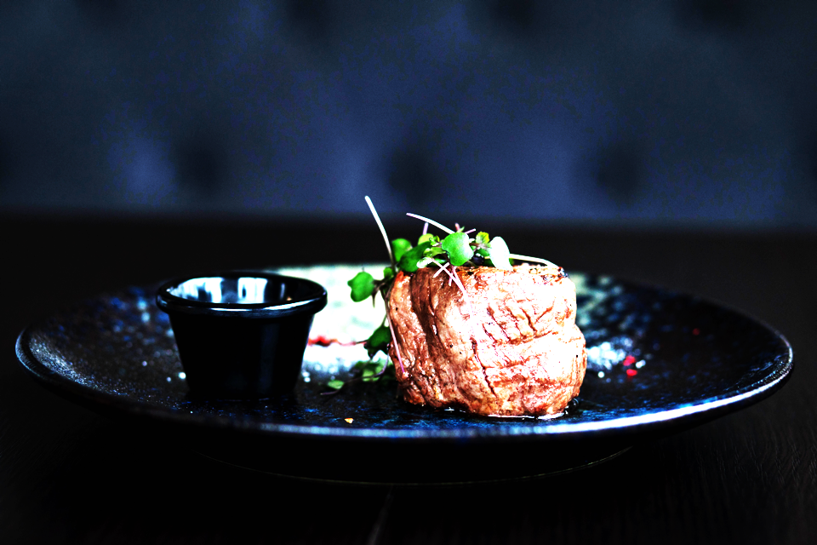
Meat increase cancer risk through:
Hormones.
Species crossing viruses.
Toxins.
Animal Fat.
Animal Protein.
Notes:
https://www.pexels.com/photo/plate-of-beef-with-herbs-1639563/

Slide 25
The disease upon animals is becoming more and more common, and our only safety now is in leaving meat entirely alone. {CD 412.1}
The meat diet is the serious question. Shall human beings live on the flesh of dead animals? The answer, from the light that God has given is, No, decidedly No. {CD 388.3} .

Slide 26
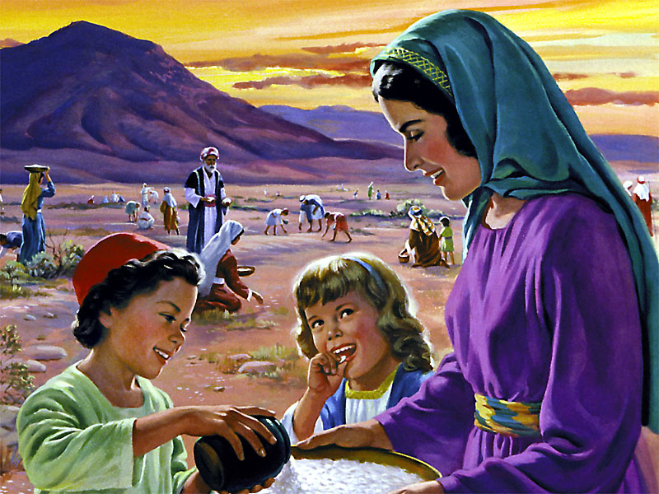
What does manna represent?

Slide 27
“I am the living bread which came down from heaven: if any man eat of this bread, he shall live for ever: and the bread that I will give is my flesh, which I will give for the life of the world.” John 6:51.
Notes:
If manna represented Jesus Christ, what does the meat they lusted after represent?

Slide 28
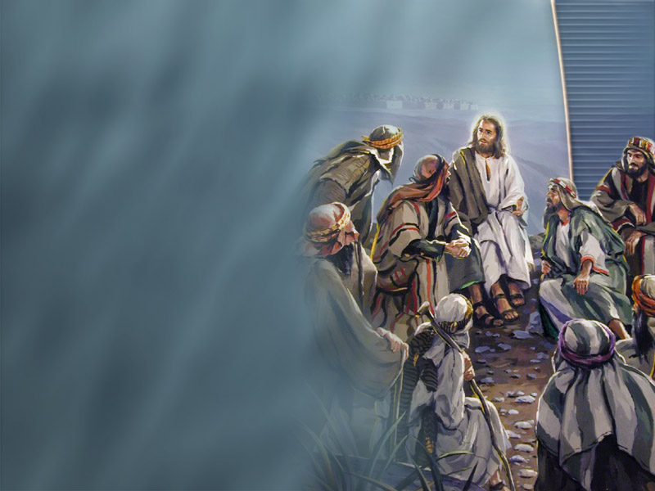
What Fast Was Jesus Talking About?
“And they said unto him, Why do the disciples of John fast often, and make prayers, and likewise the disciples of the Pharisees; but thine eat and drink?
“And he said unto them, Can ye make the children of the bridechamber fast, while the bridegroom is with them?
“But the days will come, when the bridegroom shall be taken away from them, and then shall they fast in those days.” Luke 5:33-35.

Slide 29

Josephus
Every year, 255,000 Passover animals slaughtered.
Notes:
Herdsmen meat eaters

Slide 30
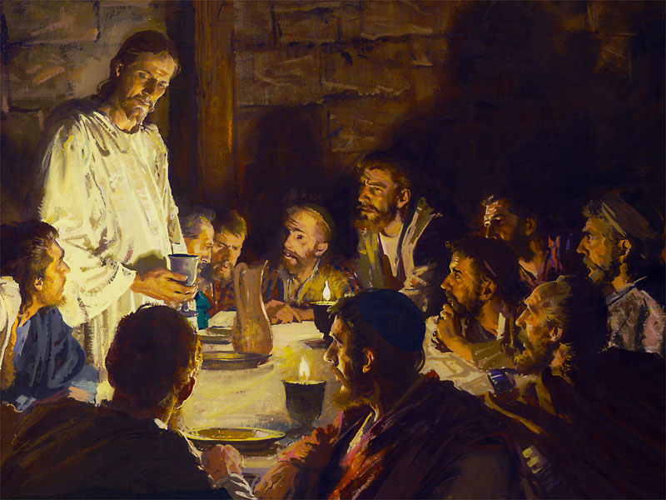
What diet did Jesus eat in the upper room?
With desire I have desired to eat this passover with you before I suffer:
For I say unto you, I will not any more eat thereof, until it be fulfilled in the kingdom of God.
... And he took the cup, and gave thanks,
... And he took bread, and gave thanks, Luke 22:13-20.
Celebration of the Lord’s supper included bread and wine, not mutton.
Notes:
For as often as ye eat this bread, and drink this cup, ye do shew the Lord's death till he come. 1 Corinthians 11:26.
Christ is still at the table on which the paschal supper has been spread. The unleavened cakes used at the Passover season are before Him. The Passover wine, untouched by fermentation, is on the table. These emblems Christ employs to represent His own unblemished sacrifice. Nothing corrupted by fermentation, the symbol of sin and death, could represent the "Lamb without blemish and without spot." 1 Peter 1:19. {DA 653.2}

Slide 31
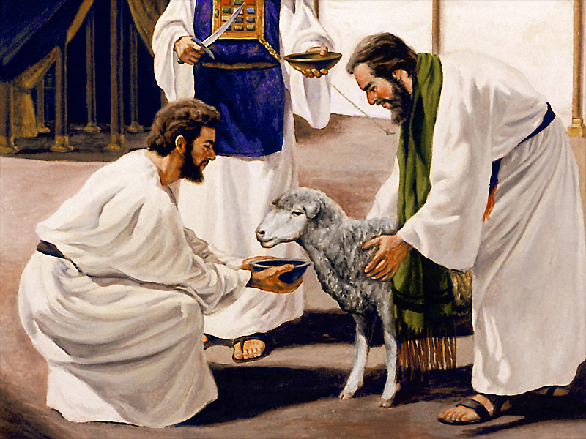
When did the sacrificial system end?
“And he shall confirm the covenant with many for one week: and in the midst of the week he shall cause the sacrifice and the oblation to cease,” Daniel 9:27.

Slide 32
What Fast Was Jesus Talking About?
“How could the children of the bridechamber fast when the bridegroom was yet with them?
“But when he should go back to Heaven, leaving his disciples to meet alone the unbelief and darkness of the world, then it would be fitting for the church to fast and mourn, until her absent Lord should return the second time.” {2SP 192.2}.

Slide 33

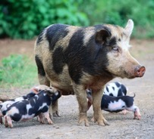
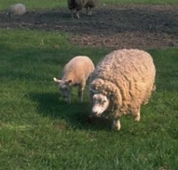
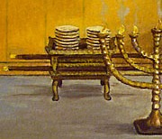
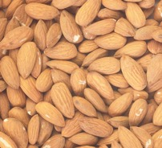




Gentiles
Jews
Christian
Remnant
Grains
Grapes
Olive oil
Manna
Almonds
Unclean
Clean

Slide 34

When Should we fast?
“On the tenth day of this seventh month there shall be a day of atonement: it shall be an holy convocation unto you; and ye shall afflict your souls,” Levi 23:26-32.
“I humbled (afflicted) my soul with fasting; and my prayer returned into mine own bosom.” Psalms 35:13.
“Every man was to afflict his soul while the work of atonement was going forward. All business was laid aside, and the whole congregation of Israel spent the day in solemn humiliation before God, with prayer, fasting, and deep searching of heart.” PP 355.

Slide 35
What happens if we do not fast, especially from meat during the antitypical day of atonement?
“For whatsoever soul it be that shall not be afflicted in that same day, he shall be cut off from among his people.” Leviticus 23:29
“And in that day did the Lord GOD of hosts call to weeping, and to mourning, and to baldness, and to girding with sackcloth:
“And behold joy and gladness, slaying oxen, and killing sheep, eating flesh, and drinking wine: let us eat and drink; for to morrow we shall die.
“And it was revealed in mine ears by the LORD of hosts, Surely this iniquity shall not be purged from you till ye die, saith the Lord GOD of hosts.” Isaiah 22:12-14.

Slide 36
"He who has become a partaker of the divine nature knows that his citizenship is above. He catches the inspiration from the Spirit of Christ. His soul is hid with Christ in God. Such a man Satan can no longer employ as his instrumentality to insinuate himself into the very sanctuary of God, to defile the temple of God. He gains victories at every step. He is filled with ennobling thoughts. He regards every human being as precious, because Christ has died for every soul." {PC 418.3}

Slide 37

How will meat eating affect ones ability to survive the time of trouble?

Slide 38
“Greater reforms should be seen among the people who claim to be looking for the soon appearing of Christ.
“There are those who ought to be awake to the danger of meat eating, who are still eating the flesh of animals, thus endangering the physical, mental, and spiritual health.
“Many who are now only half converted on the question of meat eating will go from God’s people, to walk no more with them.” { CH 575.2}

Slide 39
What is the spiritual benefit of fasting?
“It is your privilege to receive more of the Spirit of God, as you engage in fasting and earnest prayer.” {RH 13 January, 1910}
“Howbeit this kind goeth not out but by prayer and fasting.” Matt 17:21.
Notes:
Or an abstemious diet?

Slide 40
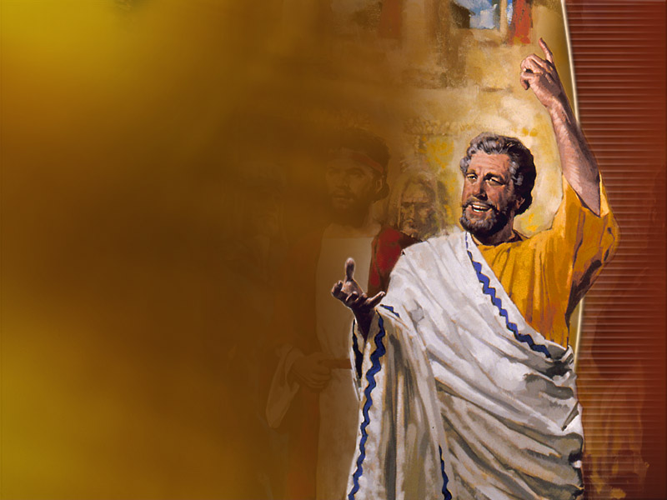
Do heathen people ever fast?
“So the people of Nineveh believed God, and proclaimed a fast, and put on sackcloth, from the greatest of them even to the least of them.” Jonah 3:5.

Slide 41
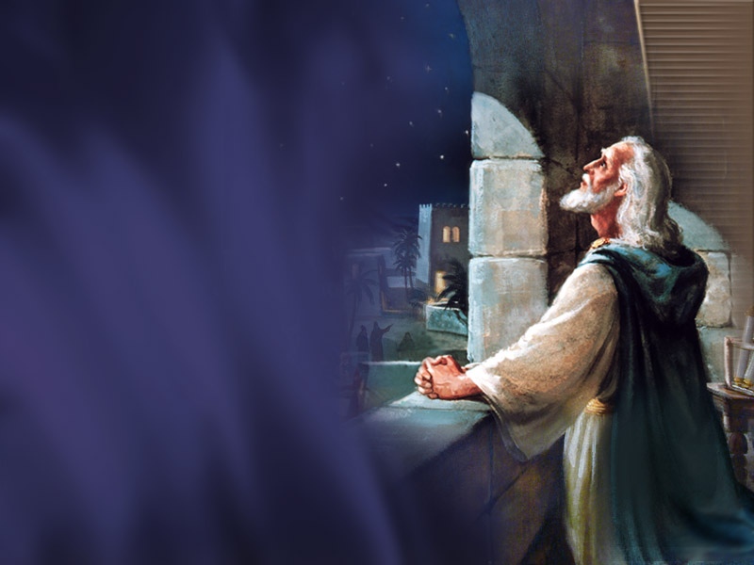
What was Daniel’s fast like?
“I ate no pleasant bread, neither came flesh nor wine in my mouth, neither did I anoint myself at all, till three whole weeks were fulfilled.” Daniel 10:3.
“The true fasting which should be recommended to all, is abstinence from every stimulating kind of food, and the proper use of wholesome, simple food, which God has provided in abundance.” {CD 188.3}

Slide 42
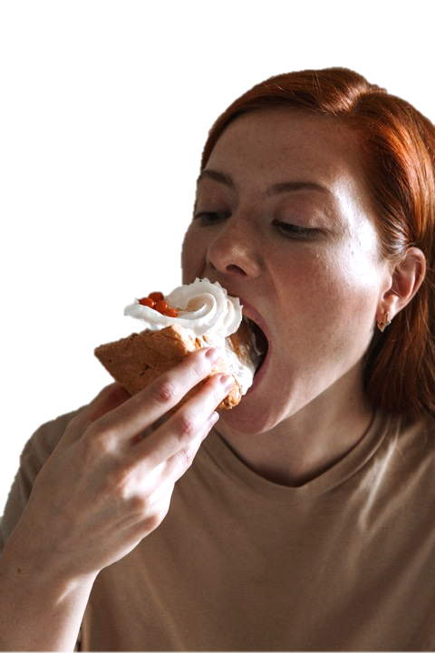
Why do we eat?
“Blessed art thou, O land, when thy king is the son of nobles, and thy princes eat in due season, for strength, and not for drunkenness!” Ecclesiastes 10:17

Slide 43
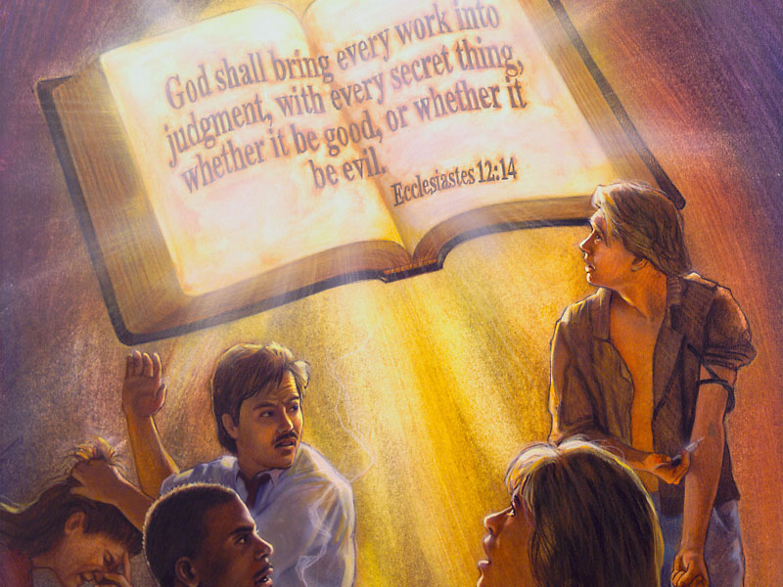
Is Meat Addictive?
(Curr Pharm Des. 2003;9(16):1331-44.)
Notes:
Are You An Addict?
Ever wonder why people have a hard time giving up meat?
One reason meat is so addictive lies in its ability to stimulate the same receptors in your brain activated by heroin.
That’s right, heroin addicts experience the same challenge giving up their habit as carnivores do theirs.
(Curr Pharm Des. 2003;9(16):1331-44.)

Slide 44

Is meat a
gateway Drug?
Notes:
Gateway drug, meat

Slide 45
“It was thought that flesh meat would give me vitality, and this was, therefore, my principal article of diet. But instead of gaining strength, I grew weaker and weaker.
“Light came to me, showing me the injury men and women were doing to the mental, moral, and physical faculties by the use of flesh meat.
“I was shown that the whole human structure is affected by this diet, that by it man strengthens the animal propensities and the appetite for liquor.” {CD 487.1}
Notes:
Rat study, SAD=>alcohol

Slide 46
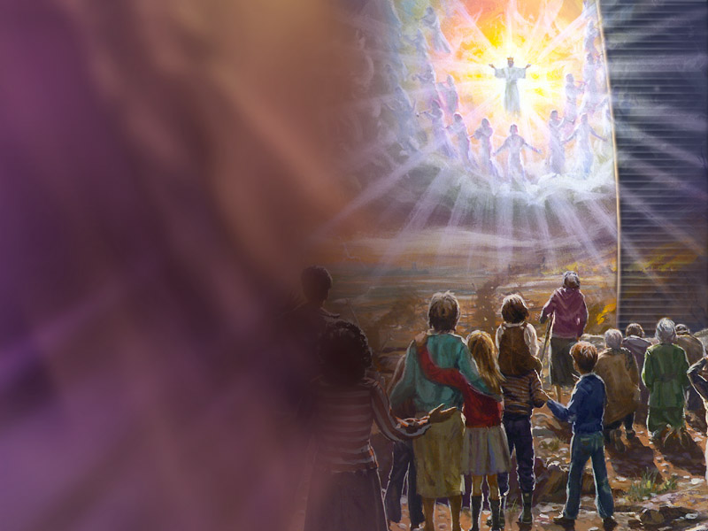
How Can I Prepare For Translation?
“Grains and fruits prepared free from grease, and in as natural a condition as possible, should be the food for the tables of all who claim to be preparing for translation to heaven.” {2T 352.1}

Slide 47

Is Your Body Ready For Heaven?
“And the very God of peace sanctify you wholly; and I pray God your whole spirit and soul and body be preserved blameless unto the coming of our Lord Jesus Christ.” 1 Thessalonians 5:23,24.

Slide 48
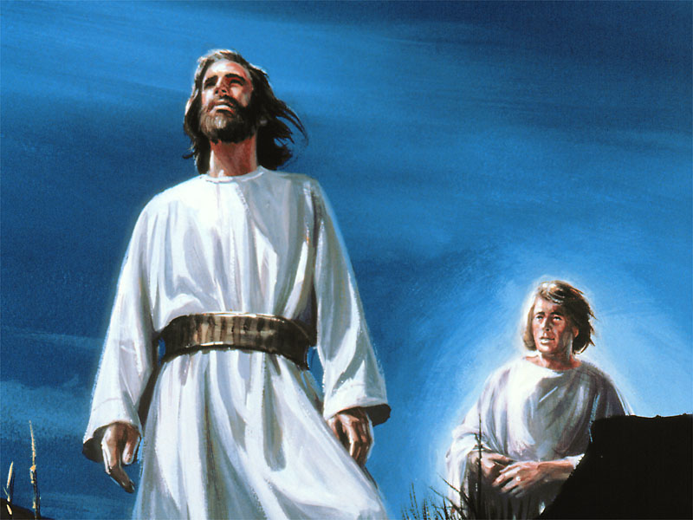
Did Jesus eat meat during the wilderness battle with Satan?
Notes:
Meat was not a part of the Lord’s preparation when He went to meet the devil in the wilderness.
“And Jesus being full of the Holy Ghost returned from Jordan, and was led by the Spirit into the wilderness, Being forty days tempted of the devil. And in those days he did eat nothing: and when they were ended, he afterward hungered.” Luke 4:1

Slide 49
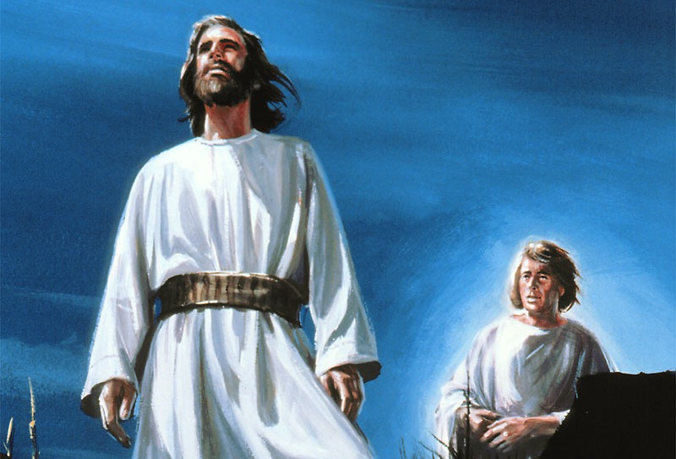
Are We Following Jesus?
Fasting is a preparation for our final conflict.
The 144,000 are those who “follow the lamb where ever He goeth”.
They do what He does; they follow Him in His abstemious diet in preparation for the final showdown.

Slide 50
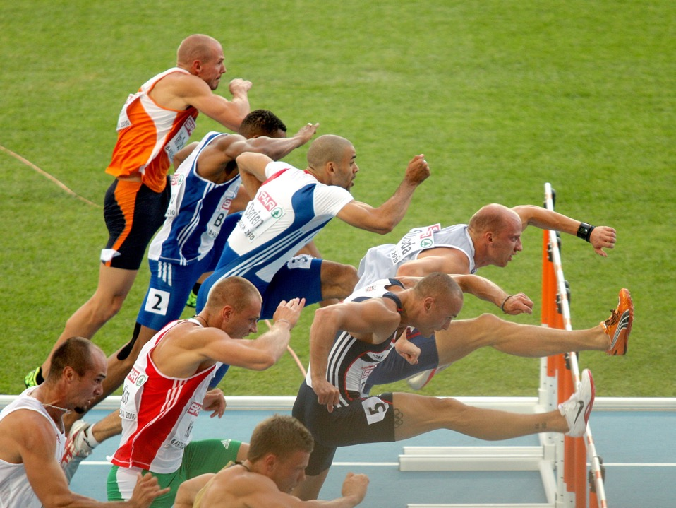
Are we striving to overcome in all things?
“And every man that striveth for the mastery is temperate in all things. Now they do it to obtain a corruptible crown; but we an incorruptible.” 1 Corinthians 9:25.
If we are to be among Jesus’ faithful, end time people, we will need to pay special attention to diet.
Notes:
Vegetarian athletes outperform omnivors.

Slide 51
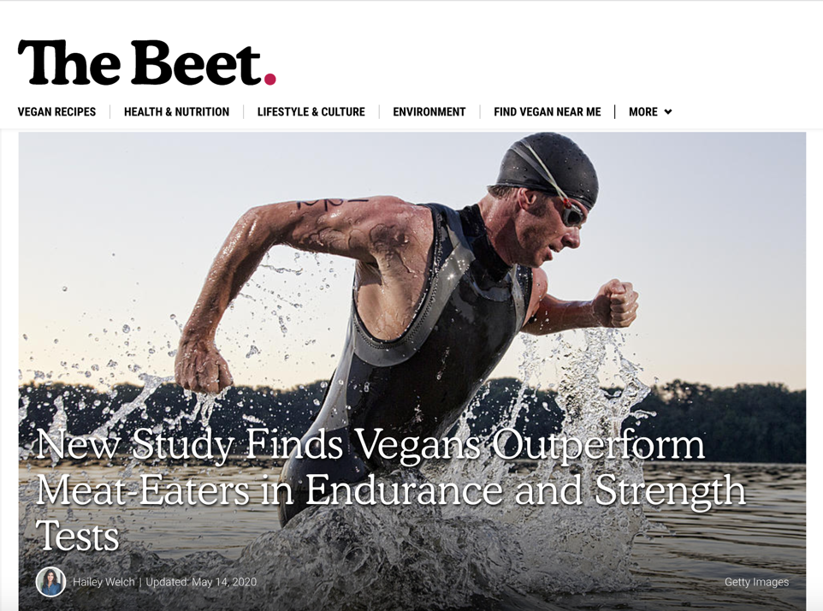
Eur J Clin Nutr. 74(11):1550-1555.
Notes:
https://thebeet.com/shocking-new-study-vegans-outperform-omnivores-in-endurance-tests/
https://www.nature.com/articles/s41430-020-0639-y.epdf?sharing_token=D9SBYN1HizoIVSfkunG7hNRgN0jAjWel9jnR3ZoTv0PzfXFnOmSoB5kzvAVZ_kajSh9SqZVuxkda6aKQvgx3AufxdPmjB0OnPqjOA3Xdadxkd7Wa9Znfd-ok9Ss69awvGTwTIAbYa3oS0o5iUSdpsfiIMPZREfAnEo1tt3nS508%3D
Boutros GH, Landry-Duval MA, Garzon M, Karelis AD. Is a vegan diet detrimental to endurance and muscle strength? Eur J Clin Nutr. 2020 Nov;74(11):1550-1555. doi: 10.1038/s41430-020-0639-y. Epub 2020 Apr 24. PMID: 32332862.

Slide 52

Can We Retake The Garden?
“The reason why many of us will fall in the time of trouble is because of laxity in temperance and indulgence of appetite.”
“Adam and Eve lost Eden through the indulgence of appetite, and we can only regain it by the denial of the same." {RH, October 21, 1884}

Slide 53
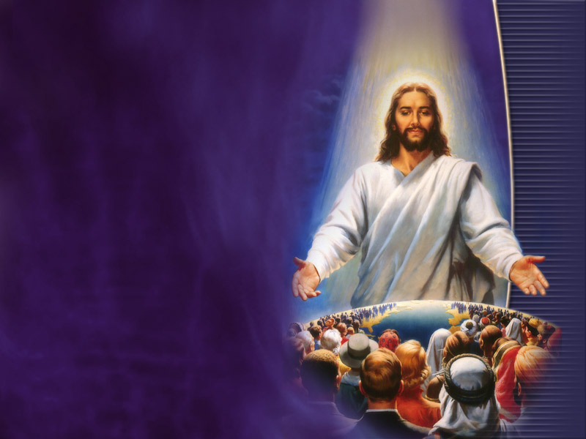
Why did God Give Us The Health Message?
“The light God has given on health reform is for our salvation and the salvation of the world.” CD 461.1

Slide 54

A Time To Fast
If our appetites clamor for the flesh of dead animals, it is a necessity to fast and pray for the Lord to give His grace to deny fleshly lusts which war against the soul. { MM 283.1}

Slide 55
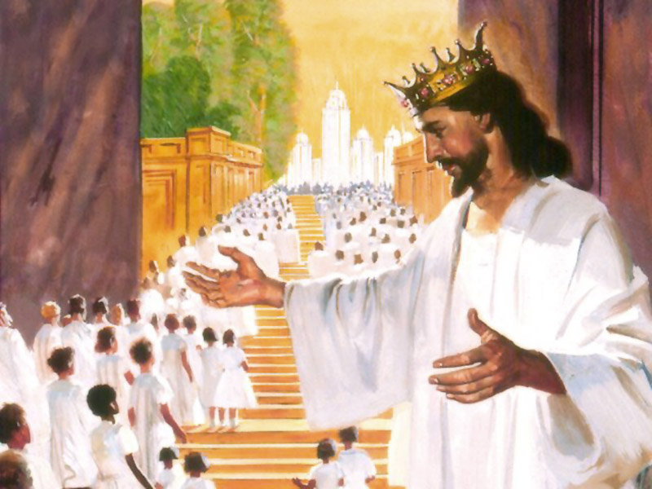
Are You hungry for Heaven’s Menu?
In heaven Jesus will again eat with us the menu of the Lord’s Supper.
Jesus was instituting a new dietary era for His new Testament church.
Jesus ended the sacrificial system and instituted a simple fasting diet, free from meat, to prepare us for heaven.

Slide 56
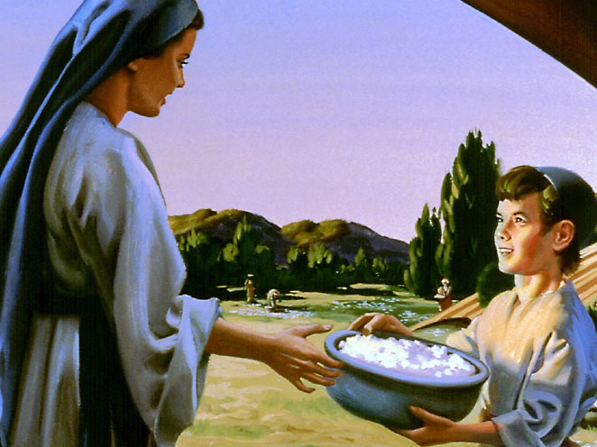
Wilderness Diet
Preparing to enter the Promised Land

Slide 57
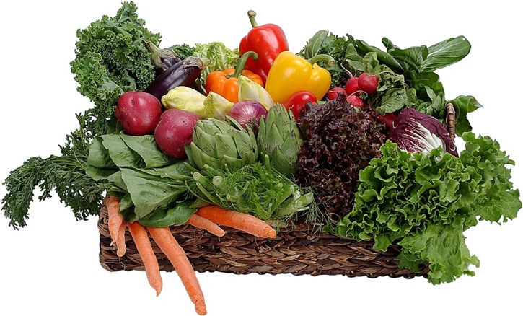
People on a 6 month fresh fruit and vegetable diet, lost weight and normalize their blood pressure:
Surprise finding:
“Eighty percent of those who smoked or drank alcohol abstained spontaneously.” UCLA, South Med J. 78(7):841-4.
Notes:
South Med J. 1985 Jul;78(7):841-4.
Effects of a raw food diet on hypertension and obesity.
Douglass JM, Rasgon IM, Fleiss PM, Schmidt RD, Peters SN, Abelmann EA.
Abstract
We examined responses to cooked and uncooked food in 32 outpatients with essential hypertension; 28 were also overweight. By varying cooked and uncooked food percentages and salt intake, patients acted as their own control subjects in this unblinded study. After a mean duration of 6.7 months, average intake of uncooked food comprised 62% of calories ingested. Mean weight loss was 3.8 kg and mean diastolic pressure reduction 17.8 mm Hg, both statistically significant (P less than .00001). Eighty percent of those who smoked or drank alcohol abstained spontaneously.
PMID: 4012382 [PubMed - indexed for MEDLINE]

Slide 58
Can Diet Help Me Gain Heaven At Last?
“Let the diet reform be progressive.
“By precept and example make it plain that the food which God gave Adam in his sinless state is the best for man's use as he seeks to regain that sinless state.”
{7T 135.1,2}
Notes:
Eating the flesh of dead animals has an injurious effect upon spirituality. When meat is made the staple article of food, the higher faculties are overborne by the lower passions. These things are an offense to God and are the cause of a decline in spiritual life.--Lt 69, 1896. {2MCP 407.3}

Slide 59

Conclusion
God wants to return us to the pre-sin Eden diet.
Jesus was guiding the church to this end by abolishing animal sacrifice and instituting the Lord’s supper, based on plant foods.
Let’s prepare today for heaven’s diet and the marriage supper of the Lamb.
Notes:
How many want to be honored guests at the marriage supper of the Lamb?
How many want to be faithfully preparing now to enjoy Heaven’s menu?

