Slide 1
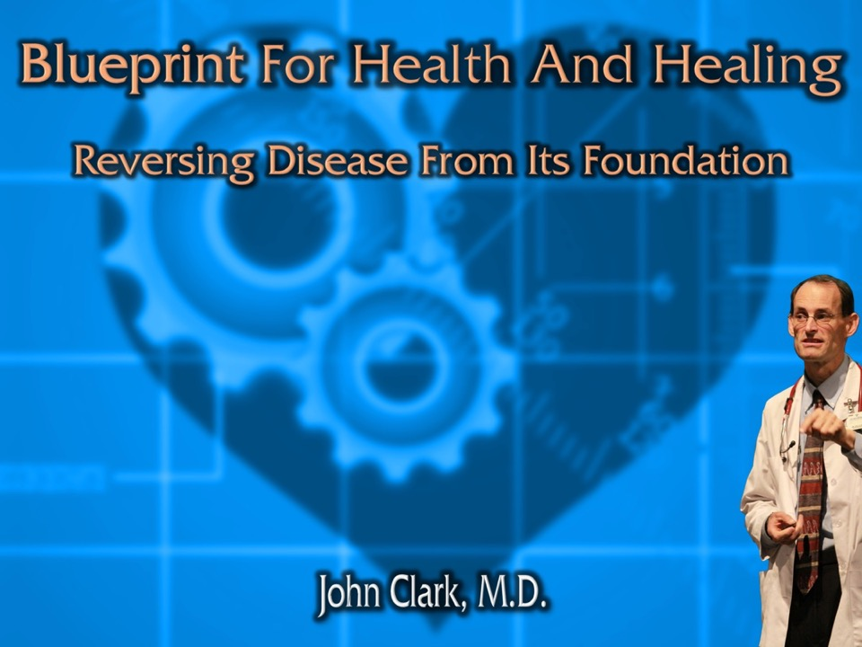
Winning Over Parkinson's
Notes:
Welcome to Blueprint for Health and Healing,
Reversing Disease From Its Foundation
Hi, I’m Dr. John Clark
Today's topic is, “Winning Over Parkinson’s”

Slide 2


What is Parkinson’s Disease?
Common symptoms:
Tremor of the hands, arms, legs or jaw.
Rigidity or stiffness of the limbs and trunk.
Slowness of movement.
Postural instability or impaired balance and coordination.
Dementia, psychosis, anxiety, insomnia, autonomic dysfunction, and mood disturbances.
Depressive symptoms occur in approximately half of patients.
Biol Psychiatry. 2003 Aug 1;54(3):363-75.

Slide 3


What is Parkinson’s Disease?
Over a million individuals in the US have Parkinson's.
Second most common neurodegenerative disease next to Alzheimer's disease.
Peak age at onset is 55 to 66 years.
Biol Psychiatry. 2003 Aug 1;54(3):363-75.

Slide 4

What is Parkinson’s Disease?
Parkinson’s Disease is the result of the loss of function of dopaminergic neurons in the brain.
Free radicals increase brain inflammation and cause damage to the dopaminergic neurons.
Antioxidants are protective against oxidative damage.
J Neurosci. 2003 Feb 15;23(4):1228-36.

Slide 5

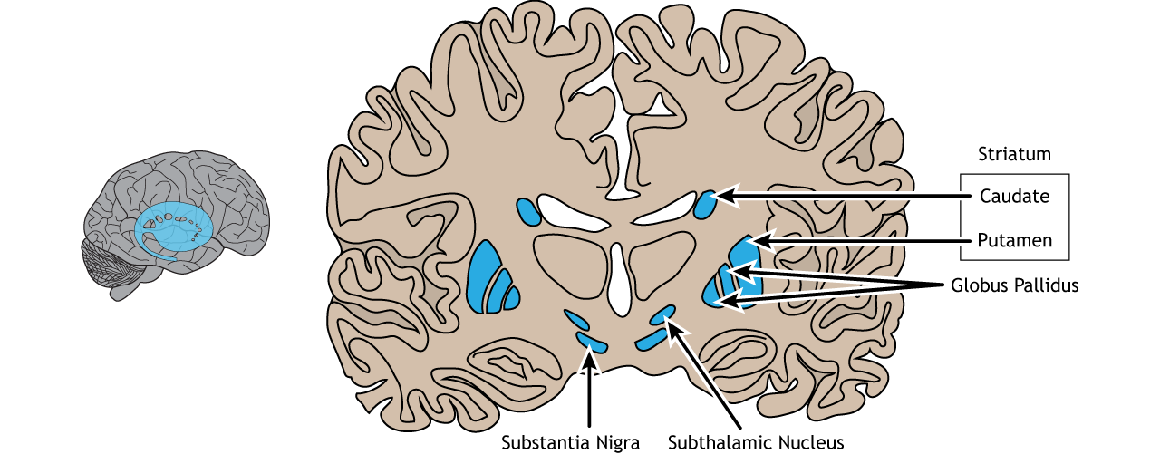

Slide 6

Real Risks For Parkinson’s
Increasing Risk with:
Smoking 81%
Drinking 58%
Diabetes. 52%
Depression 38%
Stroke 33%
Heart Disease 11%
Hypertension 6%
Asian J Surg. 46(10):4413-4415.
Notes:
Min X, Zhou W, Fan X. Risk factors for Parkinson's disease in aging population. Asian J Surg. 2023 Oct;46(10):4413-4415.

Slide 7

Smoking Increases Parkinson’s Risk
Parkinson’s risk rises with the number of years tobacco is smoked.
J Neurol Sci. 2004 Feb 15;217(2):169-74.
Notes:
J Neurol Sci. 2004 Feb 15;217(2):169-74.
Multiple risk factors for Parkinson's disease.
Gorell JM, Peterson EL, Rybicki BA, Johnson CC.
Department of Neurology, Henry Ford Health Sciences Center, Henry Ford Health System, Detroit, MI, USA. gorell@neuro.hfh.edu
OBJECTIVE: To determine the relative contribution of various risk factors to the development of Parkinson's disease (PD). METHODS: Ten variables that were independently associated with PD in a health system population-based case-control study of epidemiological risk factors for the disease were jointly assessed. Stepwise logistic regression, adjusted for sex, race and age was used to develop a multiple variate model that best predicted the presence of PD. The population attributable risk was estimated for each variable in the final model, as well as for all factors together. RESULTS: The 10 initial variables included >20 years occupational exposure to manganese or to copper, individually; >20 years joint occupational exposure to either lead and copper, copper and iron, or lead and iron; a positive family history of PD in first- or second-degree relatives; occupational exposure to insecticides or herbicides; occupational exposure to farming; and smoking. Logistic regression resulted in a final model that included >20 years joint occupational exposure to lead and copper (p=0.009; population attributable risk [PAR]=3.9%), occupational exposure to insecticides (p=0.002; PAR=8.1%), a positive family history of PD in first- and second-degree relatives (p=0.001; PAR=12.4%), and smoking </=30 pack-years or not smoking (p=0.005; PAR=41.4%). All four variables combined had a PAR=54.1%. CONCLUSIONS: Our final model of PD risk suggests that occupational, environmental lifestyle and, likely, genetic factors, individually and collectively, play a significant role in the etiology of the disease. Clearly, additional risk factors remain to be determined through future research.
PMID: 14706220 [PubMed - indexed for MEDLINE]

Slide 8

Alcohol Use Disorder
Alcohol Use Disorder is associated with a 42% higher risk of Parkinson’s.
Alzheimers Dement (Amst). ;14(1):e12370.
Notes:
Zhang P, Edenberg HJ, Nurnberger J, Lai D, Cheng F, Liu Y. Alcohol use disorder is associated with higher risks of Alzheimer's and Parkinson's diseases: A study of US insurance claims data. Alzheimers Dement (Amst). 2022 Nov 21;14(1):e12370.

Slide 9

Anxiety and Parkinson’s Disease?
A high level of anxiety increases the risk of Parkinson’s by 50%.
Taking anxiety pills further increases the risk another 10%!
Mov Disord. 2003 Jun;18(6):646-51.
Notes:
Mov Disord. 2003 Jun;18(6):646-51.
Prospective study of phobic anxiety and risk of Parkinson's disease.
Weisskopf MG, Chen H, Schwarzschild MA, Kawachi I, Ascherio A.
Department of Nutrition, Harvard School of Public Health, Boston, Massachusetts 02115, USA. mweissko@hsph.harvard.edu
Anxiety disorders are common in Parkinson's disease (PD). However, the risk of PD among people with anxiety has not been examined in a prospective cohort study. We examined this relation prospectively within the Health Professionals Follow-Up Study, a cohort of US male health professionals. In 1988, anxiety was assessed using the Crown-Crisp phobic anxiety index in 35,815 men without PD, stroke, or cancer at baseline. There were 189 incident cases of PD during 12 years of follow-up. After adjusting for age, smoking, and caffeine intake, the relative risk of PD among men with the highest level of anxiety (Crown-Crisp index scores of 4 and above) was 1.5 (95% CI = 1.0-2.1; P-trend = 0.01) compared to men with the lowest level of anxiety. This positive association persisted after excluding cases of PD with onset in the first 2 years of follow-up. Use of anxiolytic medication was also associated with an elevated risk of PD (RR= 1.6; 95% CI = 0.9-3.1), but adjusting for this potential confounder did not materially affect the association between anxiety and risk of PD. Our results suggest that anxiety is a risk factor for PD. Whether this association is causal or the result of shared underlying biology remains a question. Copyright 2003 Movement Disorder Society
PMID: 12784267 [PubMed - indexed for MEDLINE]

Slide 10

Mental Stress
Psychological stress leads to neuroinflammation and progressive neurodegeneration increasing the risk of Parkinson’s.
Exp Neurol. 285(Pt A):61-71.
Notes:
Lin XM, Pan MH, Sun J, Wang M, Huang ZH, Wang G, Wang R, Gong HB, Huang RT, Huang F, Sun WY, Liu HZ, Kurihara H, Li YF, Duan WJ, He RR. Membrane phospholipid peroxidation promotes loss of dopaminergic neurons in psychological stress-induced Parkinson's disease susceptibility. Aging Cell. 2023 Aug 25:e13970.
Sieurin J, Andel R, Tillander A, Valdes EG, Pedersen NL, Wirdefeldt K. Occupational stress and risk for Parkinson's disease: A nationwide cohort study. Mov Disord. 2018 Sep;33(9):1456-1464.
Wu Q, Yang X, Zhang Y, Zhang L, Feng L. Chronic mild stress accelerates the progression of Parkinson's disease in A53T α-synuclein transgenic mice. Exp Neurol. 2016 Nov;285(Pt A):61-71.
Hemmerle AM, Herman JP, Seroogy KB. Stress, depression and Parkinson's disease. Exp Neurol. 2012 Jan;233(1):79-86. doi: 10.1016/j.expneurol.2011.09.035.

Slide 11
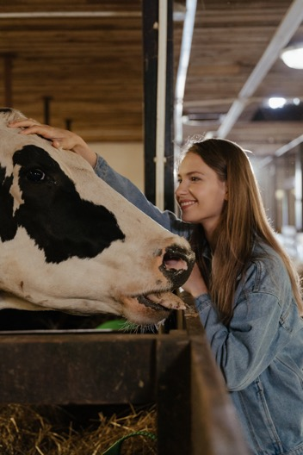
Of Cows, Chickens, & Pigs
Eating cows, chickens, and pigs increases gut α-synuclein, which travels up the nerves to the brain like prions to cause Parkinson’s.
NPJ Parkinsons Dis. 2017 Nov 24;3:33.
Notes:
Killinger BA, Labrie V. Vertebrate food products as a potential source of prion-like α-synuclein. NPJ Parkinsons Dis. 2017 Nov 24;3:33.
The aberrant aggregation of the protein α-synuclein is thought to be involved in Parkinson's disease (PD). However, the factors that lead to initiation and propagation of α-synuclein aggregation are not clearly understood. Recently, the hypothesis that α-synuclein aggregation spreads via a prion-like mechanism originating in the gut has gained much scientific attention. If α-synuclein spreads via a prion-like mechanism, then an important question becomes, what are the origins of this prion-like species? Here we review the possibility that α-synuclein aggregation could be seeded via the ingestion of a prion-like α-synuclein species contained within food products originating from vertebrates. To do this, we highlight current evidence for the gut-to-brain hypothesis of PD, and put this in context of available routes of α-synuclein prion infectivity via the gastrointestinal (GI) tract. We then discuss meat as a ready exogenous source of α-synuclein and how certain risk factors, including inflammation, may allow for dietary α-synuclein to pass from the GI lumen into the host to induce pathology. Lastly, we review epidemiological evidence that dietary factors may be involved in PD. Overall, research to date has yet to directly test the contribution of dietary α-synuclein to the mechanism of initiation and progression of the disease. However, numerous experimental findings, including the potent seeding and spreading behavior of α-synuclein fibrils, seem to support, at least in part, the feasibility of an infection with a prion α-synuclein particle via the GI tract. Further studies are required to determine whether dietary α-synuclein contributes to seeding pathology in the gut.

Slide 12

Dairy
Consumption of dairy products and especially milk has been linked to an 80% increased risk for PD in men that consumed > 2.9 servings of dairy products per day compared to those consuming< 1 serving per day.
J Neural Transm (Vienna). 129(9):1235-1245.
Notes:
Reichmann H, Csoti I, Koschel J, Lorenzl S, Schrader C, Winkler J, Wüllner U. Life style and Parkinson's disease. J Neural Transm (Vienna). 2022 Sep;129(9):1235-1245.

Slide 13

Fats, Oils, Margarines
Eliminate all refined oils, from bottles, margarine, butter, read labels. Avoid Peanut butter, and fried foods.
Acta Biochim Biophys Sin (Shanghai). 51(9):969-971.
Notes:
Morris JK, Bomhoff GL, Stanford JA, Geiger PC. Neurodegeneration in an animal model of Parkinson's disease is exacerbated by a high-fat diet. Am J Physiol Regul Integr Comp Physiol. 2010 Oct;299(4):R1082-90. doi: 10.1152/ajpregu.00449.2010.
Wu H, Xie B, Ke M, Deng Y. High-fat diet causes increased endogenous neurotoxins and phenotype of Parkinson's disease in mice. Acta Biochim Biophys Sin (Shanghai). 2019 Sep 6;51(9):969-971.

Slide 14

Parkinson’s And Oil
The risk of Parkinson’s disease increases:
20% for each additional serving of vegetable oil per day.
50% for each additional serving of olive oil.
125% for each serving of mayonnaise.
Nutr Neurosci. 27(8):849-856.
Notes:
Kheirouri S, Alizadeh M, Keramati M. High use of non-hydrogenated plant source oils and mayonnaise sauce increase the risk of Parkinson disease. Nutr Neurosci. 2024 Aug;27(8):849-856.

Slide 15

The Shakes
Vinegar promotes trembling of the nerves.
CD 434.1
Notes:
Some are never really drunk, but are always under the influence of cider or fermented wine. They are feverish, unbalanced in mind, not really delirious, but in fully as bad a condition; for all the noble powers of the mind are perverted. A tendency to disease of various kinds, as dropsy, liver complaint, trembling nerves, and a determination of blood to the head, results from the habitual use of sour cider. By its use many bring upon themselves permanent disease. Some die of consumption or fall under the power of apoplexy from this cause alone. Some suffer from dyspepsia. Every vital function is deadened and the physicians tell them that they have liver complaint, when if they would break open the cider barrel, and never replace it, their abused life forces would recover their vigor. CD 434.1

Slide 16
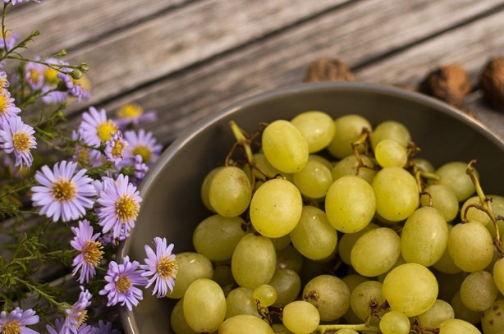
Fungicides
Fungicide exposure is a risk factor for the development of Parkinson’s.
Crit Rev Toxicol. 54(1):35-54.
Notes:
Lini RS, Scanferla DTP, de Oliveira NG, Aguera RG, Santos TDS, Teixeira JJV, Kaneshima AMS, Mossini SAG. Fungicides as a risk factor for the development of neurological diseases and disorders in humans: a systematic review. Crit Rev Toxicol. 2024 Jan;54(1):35-54.
Although studies show that pesticides, especially insecticides, may be toxic to humans, publications on the neurological effects of fungicides are scarce. As fungicides are used widely in Brazil, it is necessary to gather evidence to support actions aimed at safely using of these chemicals. We investigated through a systematic review of publications on the use of fungicides and consequences of exposure related to nervous system diseases or neurological disorders in humans. The protocol review was registered on PROSPERO and followed the guidelines of the PRISMA-Statement. As far as it is known, there is no apparent systematic review in the literature on this topic. The search was comprised of the following databases: PubMed; Web of Science; Scopus and EMBASE, using groups of Mesh terms and strategies specific to each database. Thirteen articles were selected for this review. Regarding the substances analyzed in the studies, some reported the use of fungicides in general, without separating them by type, while others summarized the categories of all pesticides by their function (insecticides, herbicides, fungicides, etc.) or chemical class (dithiocarbamate, dicarboximide, inorganic, etc.). However, most of the articles referred to fungicides that contain the metal manganese (Mn) in their composition. As for neurological disorders, articles addressed Parkinson's disease (PD), neurodevelopmental outcomes, extrapyramidal syndrome resembling PD, cognitive disorders, depression, neural tube defects, motor neurone disease, and amyotrophic lateral sclerosis. Most investigations pointed to exposure to fungicides, mainly maneb and mancozeb, leading to the development of at least one neurological disease, which suggests the need for further multicentric clinical trials and prospective studies for greater clarity of the research problem.

Slide 17

Antibiotics Increase Parkinson’s
Penicillins, tetracyclines, sulfonamides & trimethoprim, macrolides & lincosamides fluoroquinolones, antifungals, increase the risk of Parkinson’s by as much as 44%.
Mov Disord. 35(3):431-442.
Notes:
Mertsalmi TH, Pekkonen E, Scheperjans F. Antibiotic exposure and risk of Parkinson's disease in Finland: A nationwide case-control study. Mov Disord. 2020 Mar;35(3):431-442.
Abstract
Background: Gut microbiota alterations have been found in prodromal and established Parkinson's disease (PD). Antibiotic exposure can have long-term effects on the composition of human intestinal microbiota, but a potential connection between antibiotic exposure and risk of PD has not been studied previously.
Objective: To evaluate the impact of antibiotic exposure on the risk of PD in a nationwide, register-based, case-control study.
Methods: We identified all patients who were diagnosed with PD in Finland during the years 1998 to 2014. Information was obtained on individual purchases of orally administered antibiotics during the years 1993 to 2014. We assessed the association between prior antibiotic exposure and PD using conditional logistic regression.
Results: The study population consisted of 13,976 PD cases and 40,697 controls. The strongest connection with PD risk was found for oral exposure to macrolides and lincosamides (adjusted odds ratio up to 1.416; 95% confidence interval, 1.053-1.904). After correction for multiple comparisons, exposure to antianaerobics and tetracyclines 10 to 15 years before the index date, sulfonamides and trimethoprim 1 to 5 years before the index date, and antifungal medications 1 to 5 years before the index date were positively associated with PD risk. In post hoc analyses, further positive associations were found for broad-spectrum antibiotics.
Conclusions: Exposure to certain types of oral antibiotics seems to be associated with an elevated risk of PD with a delay that is consistent with the proposed duration of a prodromal period. The pattern of associations supports the hypothesis that effects on gut microbiota could link antibiotics to PD, but further studies are needed to confirm this. © 2019 International Parkinson and Movement Disorder Society.

Slide 18

The making of a Parkinson’s Patient
Parkinson’s Patient tend to eat a Lower-quality diet with higher intakes of carbohydrates, total and added sugars, and trans fats and lower intakes of fiber, folate, unsaturated fatty acids, protein, and fat.
Parkinsonism Relat Disord. 115:105816.
Notes:
Kwon D, Folle AD, Del Rosario I, Zhang K, Paul KC, Keener AM, Bronstein JM, Ritz B. Diet quality and Parkinson's disease: Potential strategies for non-motor symptom management. Parkinsonism Relat Disord. 2023 Aug 19;115:105816.
Introduction: Parkinson's disease (PD) is now considered a systemic disease, and some phenotypes may be modifiable by diet. We will compare the diet quality and intake of specific nutrients and food groups of PD patients with household and community controls to examine how diet may influence PD clinical features.
Methods: We conducted a case-control study of 98 PD patients and 83 controls (household = 53; community = 30) in central California, assessing dietary habits over the past month and calculating the Healthy Eating Index (HEI)-2015. We employed multivariate logistic and linear regression analyses to assess associations between diet and PD status, PD symptom profiles, and medication, adjusting for relevant confounders.
Results: PD patients had a lower HEI score than controls, with an OR of 0.65 (95% CI: 0.45, 0.94) per 10-points increase in HEI. Lower-quality diet was characterized by higher intakes of carbohydrates, total and added sugars, and trans fats and lower intakes of fiber, folate, unsaturated fatty acids, protein, and fat. PD patients with chronic constipation had a 4.84 point lower HEI score than those without (β per 10-point in HEI: -0.48; 95% CI: -0.97, -0.00). Furthermore, patients on high dopamine agonist doses consumed more sugar than those on lower doses.
Conclusion: PD patients consume a lower-quality diet compared to household and community controls. Dietary modifications may alleviate non-motor symptoms like constipation, and promoting a healthy diet should become a part of routine care and disease management for PD patients, with special attention on agonist-treated and hyposmic patients.

Slide 19
Monosodium Glutamate
Eliminate intake of large doses of the dietary amino acids aspartate and glutamate, which act as excitatory neurotransmitters.
High levels of aspartate and/or glutamate in the brain are associated with modified brain function and neuronal damage.
In people with Parkinson's disease, there may be enhanced uptake of these amino acids when consumed in large doses.
Avoid aspartate, which is found in NutraSweet ® and diet sodas, and glutamate, found in seasonings that contain monosodium glutamate (MSG).
MSG is hidden in many foods under other names.

Slide 20

Should I Live Near A Swamp?
Living in wet conditions near a body of water can increase the risk of Parkinson’s by 7.5 times.
Ann Indian Acad Neurol. 26(2):174-181.
Notes:
Roy A, Choudhury S, Banerjee R, Basu P, Mondal B, Sarkar S, Anand SS, Dey S, Kumar H. Dietary and Environmental Risk Factors in Parkinson's and Alzheimer's Disease: A Semi-Quantitative Pilot Study. Ann Indian Acad Neurol. 2023 Mar-Apr;26(2):174-181.

Slide 21

Microorganisms and Parkinson's
Environmental agents increasing Parkinson’s include:
Fungi.
Bacteria.
Viruses.
Notes:
Fernández-Espejo E. Microorganisms that are related with increased risk for Parkinson's disease. Neurologia (Engl Ed). 2020 Nov 4:S0213-4853(20)30301-7.
Fernández-Espejo E. Microorganisms associated with increased risk of Parkinson's disease. Neurologia (Engl Ed). 2023 Sep;38(7):495-503.
Leta V, Urso D, Batzu L, Lau YH, Mathew D, Boura I, Raeder V, Falup-Pecurariu C, van Wamelen D, Ray Chaudhuri K. Viruses, parkinsonism and Parkinson's disease: the past, present and future. J Neural Transm (Vienna). 2022 Sep;129(9):1119-1132.

Slide 22

Out of the Cities
The prevalence of Parkinson’s in urban areas studied, were twice as high as those in rural area studied.
Neuroepidemiology. 33(4):350-7.
Notes:
Chen CC, Chen TF, Hwang YC, Wen YR, Chiu YH, Wu CY, Chen RC, Tai JJ, Chen TH, Liou HH. Different prevalence rates of Parkinson's disease in urban and rural areas: a population-based study in Taiwan. Neuroepidemiology. 2009;33(4):350-7.
Abstract
Background: Rural living has long been debated as a risk factor for idiopathic Parkinson's disease (IPD). But few community-based studies compared this difference between urban and rural areas.
Methods: Population-based surveys by neurologists using a standardized diagnostic protocol were conducted in the urban areas of Keelung City and compared the prevalence rates of IPD with those we had previously determined in the rural area of Ilan County, Taiwan. Subjects were diagnosed with IPD when at least 2 of the 4 cardinal signs of parkinsonism were present and by exclusion of secondary parkinsonism. Gender-specific age-standardized prevalence rates of IPD by using the 1970 and 2000 US censuses were calculated for comparison.
Results: The participation rate was 84.9%. The crude prevalence rate of IPD in persons aged 40 years and over was 706 (95% CI: 551-864) per 100,000 population. The age-adjusted prevalence rates by using the 1970 US census were 633 (95% CI: 620-646) for people aged 40 and over and 230 (95% CI: 227-234) for all ages. Our results were similar to those obtained in Sicily, Rotterdam, and 3 communities in China. Moreover, the prevalence rates of IPD in Keelung, the urban area studied, were twice as high as those in Ilan, the rural area studied (p < 0.001).
Conclusions: Our results suggest that urban living is more important as a risk factor for IPD development than rural living in Taiwan.

Slide 23

Pesticides, Heavy Metals And Solvents
Modern environmental exposures put our brains at risk.
Front Cell Neurosci. 9:124.
Notes:
Chin-Chan M, Navarro-Yepes J, Quintanilla-Vega B. Environmental pollutants as risk factors for neurodegenerative disorders: Alzheimer and Parkinson diseases. Front Cell Neurosci. 2015 Apr 10;9:124.
Neurodegenerative diseases including Alzheimer (AD) and Parkinson (PD) have attracted attention in last decades due to their high incidence worldwide. The etiology of these diseases is still unclear; however the role of the environment as a putative risk factor has gained importance. More worryingly is the evidence that pre- and post-natal exposures to environmental factors predispose to the onset of neurodegenerative diseases in later life. Neurotoxic metals such as lead, mercury, aluminum, cadmium and arsenic, as well as some pesticides and metal-based nanoparticles have been involved in AD due to their ability to increase beta-amyloid (Aβ) peptide and the phosphorylation of Tau protein (P-Tau), causing senile/amyloid plaques and neurofibrillary tangles (NFTs) characteristic of AD. The exposure to lead, manganese, solvents and some pesticides has been related to hallmarks of PD such as mitochondrial dysfunction, alterations in metal homeostasis and aggregation of proteins such as α-synuclein (α-syn), which is a key constituent of Lewy bodies (LB), a crucial factor in PD pathogenesis. Common mechanisms of environmental pollutants to increase Aβ, P-Tau, α-syn and neuronal death have been reported, including the oxidative stress mainly involved in the increase of Aβ and α-syn, and the reduced activity/protein levels of Aβ degrading enzyme (IDE)s such as neprilysin or insulin IDE. In addition, epigenetic mechanisms by maternal nutrient supplementation and exposure to heavy metals and pesticides have been proposed to lead phenotypic diversity and susceptibility to neurodegenerative diseases. This review discusses data from epidemiological and experimental studies about the role of environmental factors in the development of idiopathic AD and PD, and their mechanisms of action.
Tanner CM, Ross GW, Jewell SA, Hauser RA, Jankovic J, Factor SA, Bressman S, Deligtisch A, Marras C, Lyons KE, Bhudhikanok GS, Roucoux DF, Meng C, Abbott RD, Langston JW. Occupation and risk of parkinsonism: a multicenter case-control study. Arch Neurol. 2009 Sep;66(9):1106-13.
Wan F, Yu T, Hu J, Yin S, Li Y, Kou L, Chi X, Wu J, Sun Y, Zhou Q, Zou W, Zhang Z, Wang T. The pyrethroids metabolite 3-phenoxybenzoic acid induces dopaminergic degeneration. Sci Total Environ. 2022 Sep 10;838(Pt 2):156027.
Exposure to pyrethroids, a significant class of the most widely used agricultural chemicals, has been associated with an increased risk of Parkinson's disease (PD). However, although many different pyrethroids induce roughly the same symptoms of Parkinsonism, the underlying mechanisms remain unknown. To find the shared key features among these mechanisms, we focused on 3-phenoxybenzoic acid (3-PBA), a common and prominent metabolite of most pyrethroids produced via hydrolysis by CEs in mammals. To determine the contribution of 3-PBA to the initiation and progression of PD, we performed in vivo and in vitro experiments, respectively, and found that 3-PBA not only accumulates in murine brain tissues over time but also further induces PD-like pathologies (increased α-syn and phospho-S129, decreased TH) to the same or even greater extent than the precursor pyrethroid. A before-after study of PET-DAT in the same mice revealed that low concentrations of 3-PBA (0.5 mg/kg) could paradoxically cause DAT to increase (22.46% higher than pre-drug test). The intervention of DAT inhibitors and activators respectively alleviated and enhanced the dopaminergic toxicity of 3-PBA, indicating that 3-PBA interacts with DAT. In particular, low concentrations of 3-PBA increase the DAT, which in turn induces 3-PBA to enter the dopaminergic neurons to exert toxic effects. Finally, we described a mechanism underlying this potential role of 3-PBA in the pathological aggregation of α-syn. Specifically, 3-PBA was found to dysregulate C/EBP β levels and further anomalously activate AEP in vivo and in vitro, accompanied by increased accumulation of pathologically cleaved α-syn (N103 fragments) and accelerated α-syn aggregation. All these results suggest that 3-PBA exposure could mimic the pathological and pathogenetic features of PD, showing that this metabolite is a key pathogenic compound in pyrethroid-related pathological effects and a possible dopamine neurotoxin. Additionally, our findings provide a crucial reference for the primary prevention of PD.

Slide 24

Round-Up Ready Parkinson’s
Glyphosate [Round-Up, N-phosphono-methylglycine] is the most used herbicide worldwide and it has been reported very recently that Glyphosate is very harmful and can produce lots of diseases such as Alzheimer and Parkinson's disease, depression, cancer, infertility including genotoxic effects.
J Hazard Mater. 339:54-62.
Notes:
J Hazard Mater. 2017 Oct 5;339:54-62. doi: 10.1016/j.jhazmat.2017.06.014. Epub 2017 Jun 9.
PVP capped silver nanocubes assisted removal of glyphosate from water-A photoluminescence study.
Sarkar S1, Das R2.
Author information
Abstract
Glyphosate [N-phosphono-methylglycine (PMG)] is the most used herbicide worldwide and it has been reported very recently that Glyphosate is very harmful and can produce lots of diseases such as alzheimer and parkinson's disease, depression, cancer, infertility including genotoxic effects. As it is mostly present in stable water body and ground water system, its detection and removal is very important. Here, we have shown a fluorescence technique for the removal of glyphosate from water using chemically synthesized polyvinylpyrrolidone (PVP) silver nanocrystals. Transmission Electron Microscopy (TEM) study shows the average size of silver nanocrystals of 100nm approximately with a morphology of cubic shape. Glyphosate does not show absorption in the visible region. But both glyphosate and silver nanocrystals show strong fluorescence in the visible region. So, photoluminescence study has been successfully utilized to detect the glyphosate in water samples and on treating the glyphosate contaminated water sample with silver nanocrystals, the sample shows no emission peak of glyphosate at 458nm. Thus, this approach is a promising and very rapid method for the detection and removal of glyphosate from water samples on treatment with silver nanocubes. NMR spectra further confirms that the silver nanocrystals treated contaminated water samples are glyphosate free.

Slide 25


Electromagnetic Fields (EMF)
RF-EMF leads to an increase in reactive oxygen species, which was shown to be involved in the development of neurodegenerative diseases such as Parkinson's disease.
Toxicol In Vitro. 61:104609.
Notes:
von Niederhäusern N, Ducray A, Zielinski J, Murbach M, Mevissen M. Effects of radiofrequency electromagnetic field exposure on neuronal differentiation and mitochondrial function in SH-SY5Y cells. Toxicol In Vitro. 2019 Dec;61:104609.
Exposure to radiofrequency electromagnetic fields (RF-EMF) has
dramatically increased in the last decades with expanding use of mobile
phones telecommunication worldwide. The International Agency of
Research on Cancer (IARC) has classified RF-EMF as a possible carcinogen.
A large number of in vitro and in vivo studies provided evidence
that RF-EMF leads to an increase in reactive oxygen species (ROS)
production in cells after RF-EMF exposure (Friedman et al., 2007; Xu
et al., 2010; Consales et al., 2012; Wang and Zhang, 2017). ROS
generation was found in SH-SY5Y cells after short-term RF-EMF exposure
at a specific absorption rate (SAR) of 5 W/kg at 872 MHz for 1 h
(Luukkonen et al., 2009). Ertilav et al. reported an elevation in ROS
production in hippocampal and dorsal root ganglion neurons of female
Wistar rats after long-term RF-EMF exposure to 900 and 1800 MHz for
1 year, 1 h per day at 0.1 W/kg (Ertilav et al., 2018). The fact that
various studies reported an increased production of ROS after RF-EMF
exposure, mitochondrial impairment might be a target of RF-EMF
(Gupta et al., 2018).
Besides cancer, ROS was shown to be involved in the development
of neurodegenerative diseases such as Parkinson's disease (PD) (Dias
et al., 2013; Cacabelos, 2017). In PD patients, a progressive loss of
dopaminergic neurons in the substantia nigra pars compacta was demonstrated
(Cacabelos, 2017; Martinez et al., 2018). Most of the cases
are idiopathic but interactions with α-synuclein, oxidative stress and
mitochondrial dysfunction have been suspected (Xie et al., 2010;
Perfeito et al., 2014; Roberts and Brown, 2015; Roberts et al., 2016).

Slide 26

Traumatic Brain Injury
Traumatic Brain Injury with loss of consciousness, such as in contact sports, significantly increases the risk for Parkinson’s.
JAMA Neurol. 73(9):1062-9.
Notes:
Crane PK, Gibbons LE, Dams-O'Connor K, Trittschuh E, Leverenz JB, Keene CD, Sonnen J, Montine TJ, Bennett DA, Leurgans S, Schneider JA, Larson EB. Association of Traumatic Brain Injury With Late-Life Neurodegenerative Conditions and Neuropathologic Findings. JAMA Neurol. 2016 Sep 1;73(9):1062-9.
Abstract
Importance: The late effects of traumatic brain injury (TBI) are of great interest, but studies characterizing these effects are limited.
Objective: To determine whether TBI with loss of consciousness (LOC) is associated with an increased risk for clinical and neuropathologic findings of Alzheimer disease (AD), Parkinson disease (PD), and other dementias.
Design, setting, and participants: This study analyzed data from the Religious Orders Study (ROS), Memory and Aging Project (MAP), and Adult Changes in Thought study (ACT). All ROS and MAP participants and a subset of ACT participants consent to autopsy. Studies performed annual (ROS and MAP) or biennial (ACT) cognitive and clinical testing to identify incident cases of dementia and AD. The 7130 participants included members of a Seattle-area health care delivery system (ACT), priests and nuns living in orders across the United States (ROS), and Chicago-area adults in retirement communities (MAP). Of these, 1589 underwent autopsy. Primary hypothesis was that TBI with LOC would be associated with increased risk for AD and neurofibrillary tangles. Data were accrued from 1994 to April 1, 2014.
Exposures: Self-reported TBI when the participant was free of dementia, categorized as no more than 1 vs more than 1 hour of LOC.
Main outcomes and measures: Clinical outcomes included incident all-cause dementia, AD, and PD in all studies and incident mild cognitive impairment and progression of parkinsonian signs in ROS and MAP. Neuropathologic outcomes included neurofibrillary tangles, neuritic plaques, microinfarcts, cystic infarcts, Lewy bodies, and hippocampal sclerosis in all studies.
Results: Of 7130 participants (2879 [40.4%] men; overall mean [SD] age, 79.9 [6.9] years), 865 reported a history of TBI with LOC. In 45 190 person-years of follow-up, 1537 incident cases of dementia and 117 of PD were identified. No association was found between TBI with LOC and incident dementia (ACT: HR for TBI with LOC ≤1 hour, 1.03; 95% CI, 0.83-1.27; HR for TBI with LOC >1 hour, 1.18; 95% CI, 0.77-1.78; ROS and MAP: HR for TBI with LOC ≤1 hour, 0.87; 95% CI, 0.58-1.29; HR for TBI with LOC >1 hour, 0.84; 95% CI, 0.44-1.57) or AD (findings similar to those for dementia). Associations were found for TBI with LOC and incident PD in ACT (HR for TBI with LOC >1 hour, 3.56; 95% CI, 1.52-8.28) and progression of parkinsonian signs in ROS and MAP (odds ratio [OR] for TBI with LOC ≤1 hour, 1.65; 95% CI, 1.23-2.21; OR for TBI with LOC >1 hour, 2.23; 95% CI, 1.16-4.29). Traumatic brain injury with LOC was associated with Lewy bodies (any Lewy body in ACT: RR for TBI with LOC >1 hour, 2.64; 95% CI, 1.40-4.99; Lewy bodies in substantia nigra and/or locus ceruleus in ACT: RR for TBI with LOC >1 hour, 3.30; 95% CI, 1.71-6.38; Lewy bodies in frontal or temporal cortex in ACT: RR for TBI with LOC >1 hour, 5.73; 95% CI, 2.18-15.0; ROS and MAP: RR for TBI with LOC ≤1 hour, 1.64; 95% CI, 1.00-2.70; pooled RR for TBI with LOC ≤1 hour, 1.59; 95% CI, 1.06-2.39) and microinfarcts (any cortical microinfarct in ROS and MAP: RR for TBI with LOC >1 hour, 2.12; 95% CI, 1.12-4.01; pooled RR for TBI with LOC >1 hour, 1.58; 95% CI, 1.06-2.35).
Conclusions and relevance: Pooled clinical and neuropathologic data from 3 prospective cohort studies indicate that TBI with LOC is associated with risk for Lewy body accumulation, progression of parkinsonism, and PD, but not dementia, AD, neuritic plaques, or neurofibrillary tangles.

Slide 27
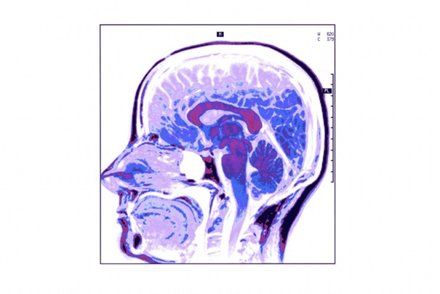
Preventing Parkinson’s
Dietary lowering of the risk of Parkinson’s:
  Eat a nutritionally-balanced diet that contains adequate amounts of fruits and vegetables.
Choose foods high in:
  Vitamin C, B6, B12.
  Folate.
  S-adenosyl-L-methionine.
Int J Mol Med. 2004 Mar;13(3):343-53.

Slide 28

Preventing Parkinson’s
Reduces Parkinson’s
Increases Parkinson’s
Fresh vegetables.
Fresh fruit.
Nuts. (walnuts).
Seeds.
Fresh herbs
Spices (turmeric, ginger, pepper, cloves).
High Vitamin A&E foods.
Ginkgo biloba.
Cheese.
Yogurt.
Ice cream.
Beef, pork, chicken.
Fried foods.
Sodas: diet > non-diet.
Canned fruits and vegetables.
Oxid Med Cell Longev. 2017;2017:6405278.
Notes:
Mischley LK, Lau RC, Bennett RD. Role of Diet and Nutritional Supplements in Parkinson's Disease Progression. Oxid Med Cell Longev. 2017;2017:6405278.
Abstract
Objectives: The goal of this study is to describe modifiable lifestyle variables associated with reduced rate of Parkinson's disease (PD) progression.
Methods: The patient-reported outcomes in PD (PRO-PD) were used as the primary outcome measure, and a food frequency questionnaire (FFQ) was used to assess dietary intake. In this cross-sectional analysis, regression analysis was performed on baseline data to identify the nutritional and pharmacological interventions associated with the rate of PD progression. All analyses were adjusted for age, gender, and years since diagnosis.
Results: 1053 individuals with self-reported idiopathic PD were available for analysis. Foods associated with the reduced rate of PD progression included fresh vegetables, fresh fruit, nuts and seeds, nonfried fish, olive oil, wine, coconut oil, fresh herbs, and spices (P < 0.05). Foods associated with more rapid PD progression include canned fruits and vegetables, diet and nondiet soda, fried foods, beef, ice cream, yogurt, and cheese (P < 0.05). Nutritional supplements coenzyme Q10 and fish oil were associated with reduced PD progression (P = 0.026 and P = 0.019, resp.), and iron supplementation was associated with faster progression (P = 0.022).
Discussion: These are the first data to provide evidence that targeted nutrition is associated with the rate of PD progression.
Miyake Y, Fukushima W, Tanaka K, Sasaki S, Kiyohara C, Tsuboi Y, Yamada T, Oeda T, Miki T, Kawamura N, Sakae N, Fukuyama H, Hirota Y, Nagai M; Fukuoka Kinki Parkinson's Disease Study Group. Dietary intake of antioxidant vitamins and risk of Parkinson's disease: a case-control study in Japan. Eur J Neurol. 2011 Jan;18(1):106-13.
higher intake of vitamin E and β-carotene may be associated with a decreased risk of PD.
Rehman MU, Wali AF, Ahmad A, Shakeel S, Rasool S, Ali R, Rashid SM, Madkhali H, Ganaie MA, Khan R. Neuroprotective Strategies for Neurological Disorders by Natural Products: An update. Curr Neuropharmacol. 2019;17(3):247-267.
Different spices including turmeric, ginger, pepper, cloves have been found to possess neuroprotective effects against PD
Rojas P, Ruiz-Sánchez E, Rojas C, Ogren SO. Ginkgo biloba extract (EGb 761) modulates the expression of dopamine-related genes in 1-methyl-4-phenyl-1,2,3,6-tetrahydropyridine-induced Parkinsonism in mice. Neuroscience. 2012 Oct 25;223:246-57.
Essa MM, Subash S, Dhanalakshmi C, Manivasagam T, Al-Adawi S, Guillemin GJ, Justin Thenmozhi A. Dietary Supplementation of Walnut Partially Reverses 1-Methyl-4-phenyl-1,2,3,6-tetrahydropyridine Induced Neurodegeneration in a Mouse Model of Parkinson's Disease. Neurochem Res. 2015 Jun;40(6):1283-93.
Choi JG, Park G, Kim HG, Oh DS, Kim H, Oh MS. In Vitro and in Vivo Neuroprotective Effects of Walnut (Juglandis Semen) in Models of Parkinson's Disease. Int J Mol Sci. 2016 Jan 15;17(1):108.

Slide 29
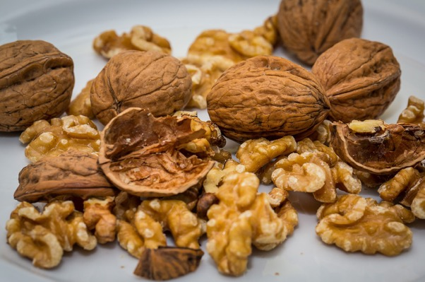
Walnuts
Walnuts have neuroprotective effects and may have potential for Parkinson’s Disease prevention or treatment.
Int J Mol Sci. 2016 Jan 15;17(1):108.
Notes:
Choi JG, Park G, Kim HG, Oh DS, Kim H, Oh MS. In Vitro and in Vivo Neuroprotective Effects of Walnut (Juglandis Semen) in Models of Parkinson's Disease. Int J Mol Sci. 2016 Jan 15;17(1):108.

Slide 30
Velvet Beans
Phytochemicals in Velvet beans enhance Neuroplastic recovery of motor function lost in Parkinson's disease.
Mol Cell Neurosci. 126:103883.
Notes:
Denne T, Winfrey LC, Moore C, Whitner C, D'Silva T, Soumyanath A, Shinto L, Hiller A, Meshul CK. Recovery of motor function is associated with rescue of glutamate biomarkers in the striatum and motor cortex following treatment with Mucuna pruriens in a murine model of Parkinsons disease. Mol Cell Neurosci. 2023 Sep;126:103883.
There is growing interest in the use of natural products for the treatment of Parkinson's disease (PD). Mucuna pruriens has been used in the treatment of humans with PD. The goal of this study was to determine if daily oral treatment with an extract of Mucuna pruriens, starting after the MPTP-induced loss of nigrostriatal dopamine in male mice, would result in recovery/restoration of motor function, tyrosine hydroxylase (TH) protein expression in the nigrostriatal pathway, or glutamate biomarkers in both the striatum and motor cortex. Following MPTP administration, resulting in an 80 % loss of striatal TH, treatment with Mucuna pruriens failed to rescue either striatal TH or the dopamine transporter back to the control levels, but there was restoration of gait/motor function. There was an MPTP-induced loss of TH-labeled neurons in the substantia nigra pars compacta and in the number of striatal dendritic spines, both of which failed to be recovered following treatment with Mucuna pruriens. This Mucuna pruriens-induced locomotor recovery following MPTP was associated with restoration of two striatal glutamate transporter proteins, GLAST (EAAT1) and EAAC1 (EAAT3), and the vesicular glutamate transporter 2 (Vglut2) within the motor cortex. Post-MPTP treatment with Mucuna pruriens, results in locomotor improvement that is associated with recovery of striatal and motor cortex glutamate transporters but is independent of nigrostriatal TH restoration.

Slide 31
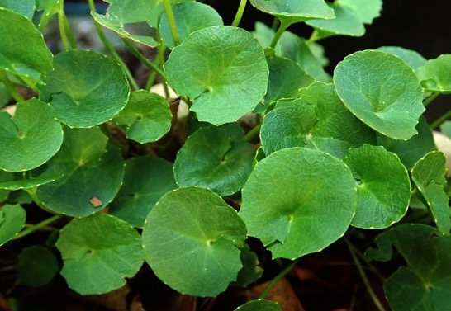
Gotu Kola
Goto Kola has neuro protective effects in Parkinson’s disease that help prevent progression of motor disturbances.
Biol Trace Elem Res. 200(12):5115-5126.
Notes:
Firdaus Z, Kumar D, Singh SK, Singh TD. Centella asiatica Alleviates AlCl₃-induced Cognitive Impairment, Oxidative Stress, and Neurodegeneration by Modulating Cholinergic Activity and Oxidative Burden in Rat Brain. Biol Trace Elem Res. 2022 Dec;200(12):5115-5126.
Bhatnagar M, Goel I, Roy T, Shukla SD, Khurana S. Complete Comparison Display (CCD) evaluation of ethanol extracts of Centella asiatica and Withania somnifera shows that they can non-synergistically ameliorate biochemical and behavioural damages in MPTP induced Parkinson's model of mice. PLoS One. 2017 May 16;12(5):e0177254.
Xu CL, Qu R, Zhang J, Li LF, Ma SP. Neuroprotective effects of madecassoside in early stage of Parkinson's disease induced by MPTP in rats. Fitoterapia. 2013 Oct;90:112-8.

Slide 32
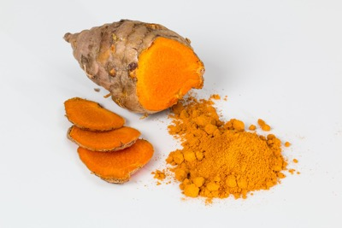
Turmeric
Curcumin is a neuroprotective agent with antioxidant, anti-inflammatory, free radical scavenging, mitochondrial protecting, and iron-chelating properties, which enhance dopamine levels in the brain for Parkinson’s patients.
Int J Mol Sci. 22(20):11248.
Notes:
Nebrisi EE. Neuroprotective Activities of Curcumin in Parkinson's Disease: A Review of the Literature. Int J Mol Sci. 2021 Oct 18;22(20):11248.
Saleem U, Khalid S, Chauhdary Z, Anwar F, Shah MA, Alsharif I, Babalghith AO, Khayat RO, Albalawi AE, Baokbah TAS, Farrukh M, Vargas-De-La-Cruz C, Panichayupakaranant P. The curative and mechanistic acumen of curcuminoids formulations against haloperidol induced Parkinson's disease animal model. Metab Brain Dis. 2023 Mar;38(3):1051-1066.

Slide 33
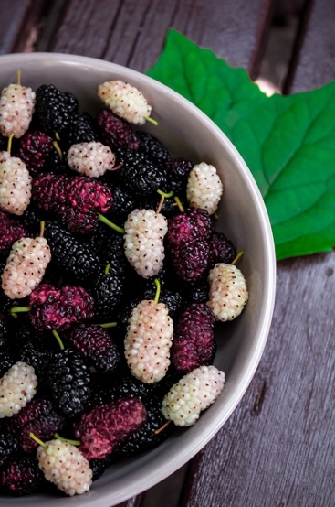
Fruits: Blackberry, Citrus, Mulberry
Fruit to the rescue, high in phytochemicals, antioxidants and vitamins.
J Exp Pharmacol. 10:29-35.
Notes:
Fahimi Z, Jahromy MH. Effects of blackberry (Morus nigra) fruit juice on levodopa-induced dyskinesia in a mice model of Parkinson's disease. J Exp Pharmacol. 2018 Jul 4;10:29-35.
Abstract
Background and objective: Levodopa-induced dyskinesia (LID) is a movement disorder that occurs due to levodopa consumption for a long period to attenuate Parkinsonism. Plants have been the basis for medical treatments in human history and still widely practiced. Blackberry (Morus nigra) is one of the fruits rich in anthocyanin. The present study examined the effect of blackberry fruit juice on LID in 1-methyl-4-phenyl-1,2,3,6-tetrahydropyridine (MPTP)-induced Parkinson's disease in mice.
Materials and methods: In this study, 42 male mice were used, which were divided into six groups equally: one control group and five groups receiving MPTP injection. After confirmation of Parkinsonism in MPTP groups, one group was preserved without treatment and four other groups were treated with levodopa (50 mg/kg ip). After the onset of LID (2 weeks), one group was kept without additional treatment and three other groups were treated with three different doses of blackberry fruit juice (5, 10, and 15 mL/kg) with levodopa orally for 7 days. Abnormal involuntary movement scale (AIMS) and cylinder behavioral test were carried out according to the schedule. The collected data were analyzed using the SPSS software with the significant level of P<0.05.
Results: Parkinson's disease was confirmed with AIMS test on the fourth day after MPTP injection. The onset of LID was observed after 2 weeks of levodopa treatment using both behavioral tests. The result of administration of M. nigra fruit juice for 1 week showed that this addition is useful in hindering LID. These effects were more pronounced at doses 10 and 15 mL/kg with nearly the same results on attenuating AIMS. Low dose of the fruit juice does not seem to affect LID significantly.
Conclusion: M. nigra fruit juice is effective to attenuate LID in an MPTP-induced Parkinson mice model.
Braidy N, Behzad S, Habtemariam S, Ahmed T, Daglia M, Nabavi SM, Sobarzo-Sanchez E, Nabavi SF. Neuroprotective Effects of Citrus Fruit-Derived Flavonoids, Nobiletin and Tangeretin in Alzheimer's and Parkinson's Disease. CNS Neurol Disord Drug Targets. 2017;16(4):387-397.
Neurodegenerative diseases, namely Alzheimer's disease and Parkinson's disease represent a deleterious impact worldwide. Despite extensive preclinical and clinical research in neurodegenerative disorders, therapeutic strategies aimed at the prevention and chronic treatment of neurodegenerative conditions have not been successfully translated to the clinic. Therefore, the identification of novel pharmacological intervention derived from natural products is warranted. Nobiletin and tangeretin are important citrus flavonoids derived from the peel and other parts of Citrus L. genus, and have been shown to exhibit neuroprotective effects in several in vitro and in vivo studies. Apart from there antioxidant and anti-inflammatory effects, nobiletin and tangeretin have been shown to attenuate cholinergic deficits, reduce the abnormal accumulation of neurotoxic amyloid-beta peptides, reverse N-methyl- D-aspartate (NMDA) receptor hypofunction, ameliorate ischemic injury, inhibit hyperphosphorylation of tau protein, enhance neprilysin levels, modulate several signaling cascades, and protect against 1-methyl-4-phenylpyridinium (MPP(+)) and 1-methyl-4-phenyl-1,2,3,6-tetrahydropyridine (MPTP) toxicity. Taken together, these naturally occurring phytochemicals may represent beneficial drug candidates for the treatment and prevention of Alzheimer's and Parkinson's disease.
Gu PS, Moon M, Choi JG, Oh MS. Mulberry fruit ameliorates Parkinson's-disease-related pathology by reducing α-synuclein and ubiquitin levels in a 1-methyl-4-phenyl-1,2,3,6-tetrahydropyridine/probenecid model. J Nutr Biochem. 2017 Jan;39:15-21.
Mulberry fruit, which has been long used in traditional oriental medicine, was reported to ameliorate motor dysfunction and dopaminergic neuronal degeneration via antioxidant and antiapoptotic effects in an animal model of Parkinson's disease (PD). More than 95% of PD patients exhibit nonmotor problems such as olfactory dysfunction and gastrointestinal constipation, which are generally considered to be early symptoms of PD. However, few studies have actually examined potential drugs to treat early PD symptoms. The present study examined the protective effects of mulberry fruit extract (ME) against neurotoxicity in a 1-methyl-4-phenyl 1,2,3,6-tetrahydropyridine/probenecid (MPTP/p) model of early PD. MPTP/p model was developed by systemic administration with MPTP (25 mg/kg) and probenecid (250 mg/kg) over 5 weeks. The behavioral studies showed that treatment of mice with ME significantly improved PD-related nonmotor symptoms as well as motor impairment, demonstrated by utilizing the olfactory, pole, rotarod and open field tests. In addition, immunohistochemical analysis indicated that ME exhibits the protective effects against dopaminergic neuronal damage induced by MPTP/p in the substantia nigra and striatum. Moreover, by using Western blot analysis, we found that treatment with ME inhibited the up-regulation of α-synuclein and ubiquitin, well known as composition of Lewy bodies in the substantia nigra and striatum of the MPTP/p mice. Taken together, these data suggest that ME may have therapeutic potential for preventing PD.
Kim HG, Ju MS, Shim JS, Kim MC, Lee SH, Huh Y, Kim SY, Oh MS. Mulberry fruit protects dopaminergic neurons in toxin-induced Parkinson's disease models. Br J Nutr. 2010 Jul;104(1):8-16.
Parkinson's disease (PD), one of the most common neurodegenerative disorders, is characterised by the loss of dopaminergic neurons in the substantia nigra pars compacta (SNpc) to the striatum (ST), and involves oxidative stress. Mulberry fruit from Morus alba L. (Moraceae) is commonly eaten, and has long been used in traditional oriental medicine. It contains well-known antioxidant agents such as anthocyanins. The present study examined the protective effects of 70 % ethanol extract of mulberry fruit (ME) against neurotoxicity in in vitro and in vivo PD models. In SH-SY5Y cells stressed with 6-hydroxydopamine (6-OHDA), ME significantly protected the cells from neurotoxicity in a dose-dependent manner. Other assays demonstrated that the protective effect of ME was mediated by its antioxidant and anti-apoptotic effects, regulating reactive oxygen species and NO generation, Bcl-2 and Bax proteins, mitochondrial membrane depolarisation and caspase-3 activation. In mesencephalic primary cells stressed with 6-OHDA or 1-methyl-4-phenylpyridinium (MPP+), pre-treatment with ME also protected dopamine neurons, showing a wide range of effective concentrations in MPP+-induced toxicity. In the sub-acute mouse PD model induced by 1-methyl-4-phenyl-1,2,3,6-tetrahydropyridine (MPTP), ME showed a preventative effect against PD-like symptoms (bradykinesia) in the behavioural test and prevented MPTP-induced dopaminergic neuronal damage in an immunocytochemical analysis of the SNpc and ST. These results indicate that ME has neuroprotective effects in in vitro and in vivo PD models, and that it may be useful in preventing or treating PD.

Slide 34
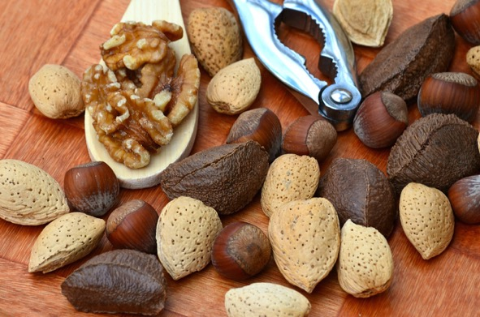
Vegetables and Nuts
Higher intakes of vegetables and nuts are associated with a lower risk of PD.
Vegetables 28% lower.
Nuts 31% lower.
Mov Disord. 38(11):1994-2004.
Notes:
Tresserra-Rimbau A, Thompson AS, Bondonno N, Jennings A, Kühn T, Cassidy A. Plant-Based Dietary Patterns and Parkinson's Disease: A Prospective Analysis of the UK Biobank. Mov Disord. 2023 Nov;38(11):1994-2004.
Abstract
Background: Plant-based diets have been associated with a lower risk of several chronic diseases, but the relationship with PD is unknown.
Objectives: We examined the association of three different plant-based diets with PD incidence in the UK Biobank cohort.
Methods: We conducted a prospective study among 126,283 participants from the UK Biobank cohort. Three plant-based diet indices (overall plant-based diet index, PDI; healthful plant-based diet index, hPDI; and unhealthful plant-based diet index, uPDI) were derived from 24-hour dietary recalls based on 17 food groups. Multivariable Cox regression models were used to estimate the risk of PD across quartiles of the PDIs and for each of the food groups that constituted the score. Further analyses were carried out to assess potential heterogeneity in associations between hPDI and PD across strata of some hypothesized effect modifiers.
Results: During 11.8 years of follow-up (1,490,139 person-years), 577 cases of PD incidence were reported. After multivariable adjustment, participants in the highest hPDI and overall PDI quartile had lower risk of PD (22% and 18%, respectively), whereas a higher uPDI was associated with a 38% higher PD risk. In food-based analyses, higher intakes of vegetables, nuts, and tea were associated with a lower risk of PD (28%, 31% and 25%, respectively). Stratifying by Polygenic Risk Score (PRS), results were significant only for those with a lower PRS for PD.
Conclusions: Following a healthful plant-based diet and in particular the inclusion of readily achievable intakes of vegetables, nuts and tea in the habitual diet are associated with a lower risk of PD. © 2023 The Authors. Movement Disorders published by Wiley Periodicals LLC on behalf of International Parkinson and Movement Disorder Society.

Slide 35

Parkinson’s & α-synuclein
Eating a vegetarian diet helps eliminate α-synuclein.
Nutr Neurosci. 2023 Apr;26(4):332-344.
Notes:
Lerner A. The intestinal luminal sources of α-synuclein: a gastroenterologist perspective. Nutr Rev. 2022 Jan 10;80(2):282-293.

Slide 36
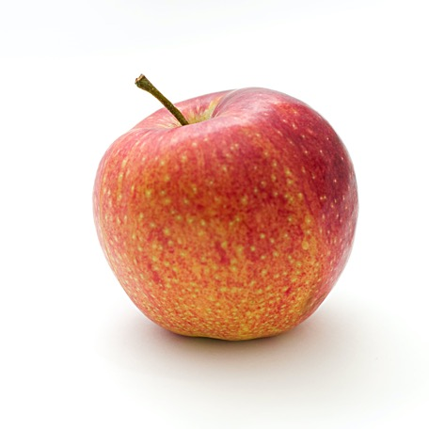
An Apple a Day & Parkinson’s
Production of α-synuclein is down regulated by apple products.
Olive also show promise.
Nutr Neurosci. 2023 Apr;26(4):332-344.
Notes:
Alawadi AA, Benedito VA, Skinner RC, Warren DC, Showman C, Tou JC. RNA-sequencing revealed apple pomace ameliorates expression of genes in the hypothalamus associated with neurodegeneration in female rats fed a Western diet during adolescence to adulthood. Nutr Neurosci. 2023 Apr;26(4):332-344.
Abstract
Objectives: Apple pomace, a waste byproduct of apple processing, is rich in nutrients (e.g. polyphenols and soluble fiber) with the potential to be neuroprotective. The aim of this study was to employ RNA-sequencing (RNASeq) technology to investigate diet-gene interactions in the hypothalamus of rats after feeding a Western diet calorically substituted with apple pomace.
Methods: Adolescent (age 21-29 days) female Sprague-Dawley rats were randomly assigned (n = 8 rats/group) to consume either a purified standard diet, Western (WE) diet, or Western diet calorically substituted with 10% apple pomace (WE/AP) for 8 weeks. RNA-seq was performed (n = 5 rats/group) to determine global differentially expressed genes in the hypothalamus.
Results: RNA-seq results comparing rats fed WE to WE/AP revealed 15 differentially expressed genes in the hypothalamus. Caloric substitution of WE diet with 10% apple pomace downregulated (q < 0.06) five genes implicated in brain aging and neurodegenerative disorders: synuclein alpha, phospholipase D family member 5, NADH dehydrogenase Fe-S protein 6, choline O-acetyltransferase, and frizzled class receptor 6.
Discussion: Altered gene expression of these five genes suggests that apple pomace ameliorated synthesis of the neurotransmitter, acetylcholine, in rats fed a WE diet. Apple pomace, a rich source of antioxidant polyphenols and soluble fiber, has been shown to reverse nonalcoholic fatty liver disease (NAFLD). Diet-induced NAFLD decreases hepatic de novo synthesis of choline, a precursor to acetylcholine. Based on preclinical evidence, apple pomace has the potential to be a sustainable functional food for maintaining brain function and for reducing the risk of neurodegeneration.
Pogačnik L, Pirc K, Palmela I, Skrt M, Kim KS, Brites D, Brito MA, Ulrih NP, Silva RF. Potential for brain accessibility and analysis of stability of selected flavonoids in relation to neuroprotection in vitro. Brain Res. 2016 Nov 15;1651:17-26.
Natural food sources constitute a promising source of new compounds with neuroprotective properties, once they have the ability to reach the brain. Our aim was to evaluate the brain accessibility of quercetin, epigallocatechin gallate (EGCG) and cyanidin-3-glucoside (C3G) in relation to their neuroprotective capability. Primary cortical neuron cultures were exposed to oxidative insult in the absence and presence of the selected compounds, and neuroprotection was assessed through evaluation of apoptotic-like and necrotic-like cell death. The brain accessibility of selected compounds was assessed using an optimised human blood-brain barrier model. The blood-brain barrier model was crossed rapidly by EGCG and more slowly by C3G, but not by quercetin. EGCG protected against oxidation-induced neuronal necrotic-like cell death by ~40%, and apoptosis by ~30%. Both quercetin and C3G were less effective, since only the lowest quercetin concentration was protective, and C3G only prevented necrosis by ~37%. Quercetin, EGCG and C3G effectively inhibited α-synuclein fibrillation over the relevant timescale applied here. Overall, EGCG seems to be the most promising neuroprotective compound. Thus, inclusion of this polyphenol in the diet might provide an affordable means to reduce the impact of neurodegenerative diseases.
Mohammad-Beigi H, Aliakbari F, Sahin C, Lomax C, Tawfike A, Schafer NP, Amiri-Nowdijeh A, Eskandari H, Møller IM, Hosseini-Mazinani M, Christiansen G, Ward JL, Morshedi D, Otzen DE. Oleuropein derivatives from olive fruit extracts reduce α-synuclein fibrillation and oligomer toxicity. J Biol Chem. 2019 Mar 15;294(11):4215-4232.
Aggregation of α-synuclein (αSN) is implicated in neuronal degeneration in Parkinson's disease and has prompted searches for natural compounds inhibiting αSN aggregation and reducing its tendency to form toxic oligomers. Oil from the olive tree (Olea europaea L.) represents the main source of fat in the Mediterranean diet and contains variable levels of phenolic compounds, many structurally related to the compound oleuropein. Here, using αSN aggregation, fibrillation, size-exclusion chromatography-multiangle light scattering (SEC-MALS)-based assays, and toxicity assays, we systematically screened the fruit extracts of 15 different olive varieties to identify compounds that can inhibit αSN aggregation and oligomer toxicity and also have antioxidant activity. Polyphenol composition differed markedly among varieties. The variety with the most effective antioxidant and aggregation activities, Koroneiki, combined strong inhibition of αSN fibril nucleation and elongation with strong disaggregation activity on preformed fibrils and prevented the formation of toxic αSN oligomers. Fractionation of the Koroneiki extract identified oleuropein aglycone, hydroxyl oleuropein aglycone, and oleuropein as key compounds responsible for the differences in inhibition across the extracts. These phenolic compounds inhibited αSN amyloidogenesis by directing αSN monomers into small αSN oligomers with lower toxicity, thereby suppressing the subsequent fibril growth phase. Our results highlight the molecular consequences of differences in the level of effective phenolic compounds in different olive varieties, insights that have implications for long-term human health.

Slide 37

Onions & Parkinson’s
Onions with their quercetin and n-acetylcysteine (NAC) help decrease levels of α-synuclein.
PLoS One. 2010 Aug 23;5(8):e12333.
Notes:
Clark J, Clore EL, Zheng K, Adame A, Masliah E, Simon DK. Oral N-acetyl-cysteine attenuates loss of dopaminergic terminals in alpha-synuclein overexpressing mice. PLoS One. 2010 Aug 23;5(8):e12333.
Levels of glutathione are lower in the substantia nigra (SN) early in Parkinson's disease (PD) and this may contribute to mitochondrial dysfunction and oxidative stress. Oxidative stress may increase the accumulation of toxic forms of alpha-synuclein (SNCA). We hypothesized that supplementation with (NAC), a source of cysteine--the limiting amino acid in glutathione synthesis, would protect against alpha-synuclein toxicity. Transgenic mice overexpressing wild-type human alpha-synuclein drank water supplemented with NAC or control water supplemented with alanine from ages 6 weeks to 1 year. NAC increased SN levels of glutathione within 5-7 weeks of treatment; however, this increase was not sustained at 1 year. Despite the transient nature of the impact of NAC on brain glutathione, the loss of dopaminergic terminals at 1 year associated with SNCA overexpression was significantly attenuated by NAC supplementation, as measured by immunoreactivity for tyrosine hydroxylase in the striatum (p = 0.007; unpaired, two-tailed t-test), with a similar but nonsignificant trend for dopamine transporter (DAT) immunoreactivity. NAC significantly decreased the levels of human SNCA in the brains of PDGFb-SNCA transgenic mice compared to alanine treated transgenics. This was associated with a decrease in nuclear NFkappaB localization and an increase in cytoplasmic localization of NFkappaB in the NAC-treated transgenics. Overall, these results indicate that oral NAC supplementation decreases SNCA levels in brain and partially protects against loss of dopaminergic terminals associated with overexpression of alpha-synuclein in this model.
afiq H, Farhan M, Rafi H, Rehman S, Arshad M, Shakeel S. Inhibition of drug induced Parkinsonism by chronic supplementation of quercetin in haloperidol-treated wistars. Pak J Pharm Sci. 2022 Nov;35(6):1655-1662.
Haloperidol is a neuroleptic medication that is used to treat a wide range of neuropsychiatric conditions. It has been shown to produce medicinal effects against hyperactivity, agitation and mania, as well as schizophrenia. Long-term usage of haloperidol raises the risk of acquiring a neurological condition like Parkinson's disease. Haloperidol causes drug-induced Parkinsonism (DIP) by blocking central dopamine receptors and causing extrapyramidal symptoms during long-term treatment. Quercetin has been shown to reduce the loss of striatal neurons, which may enhance motor capabilities and protect against agents that cause the production of reactive oxygen species (ROS). As a result, present study intended to evaluate the efficacy of quercetin on haloperidol-related motor abnormalities. To develop behavioral impairments, rats (n=24) randomly divided to control and haloperidol group for four weeks. The animals were split into four groups after four weeks: Control, quercetin, haloperidol and haloperidol + quercetin. Animals were administered haloperidol i.p injections of 5mg/kg and quercetin (100mg/kg) orally for 21 days. The treatment of haloperidol-treated rats with quercetin was successful in reversing the haloperidol alterations. It decreased animal food intake and alleviated anxiogenic behavior. The chronic treatment of quercetin further reduced the movement abnormalities in animal model of drug induced pseudo-Parkinson.

Slide 38
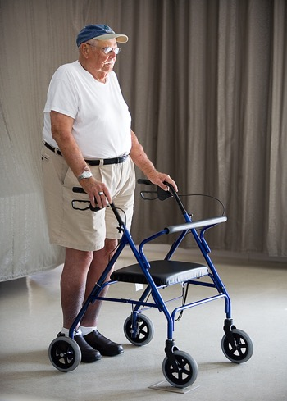
The Will To Live
In Parkinson’s there is an inability to put the decision to start moving into action.
People with poor will power--who are inhibited, depressed, emotional, and have lots of somatic complaints; And are not achievement oriented, suffer significantly higher Parkinson’s rates.
J Neurol Neurosurg Psychiatry. 1998 Feb;64(2):262-6.
Notes:
J Neurol Neurosurg Psychiatry. 1998 Feb;64(2):262-6.
Personality, depression, and premorbid lifestyle in twin pairs discordant for Parkinson's disease.
Heberlein I, Ludin HP, Scholz J, Vieregge P.
Department of Neurology, Medical University of Lubeck, Germany.
Present personality traits (Freiburg personality inventory, FPI-R), depression (von Zerssen's depression scale), and self assessed state of health were evaluated in 15 twin pairs (six monozygotic and nine dizygotic; mean age 62.5 years) discordant for idiopathic Parkinson's disease and in 17 unrelated healthy control subjects. The twins had additional questionnaire based interviews on premorbid lifestyle. For disability, twins with Parkinson's disease scored lower on FPI-R than controls in "achievement orientation" and "extraversion", higher in "inhibitedness", "somatic complaints", and "emotionality". They scored higher for depression and for state of health than unaffected twins and controls. For zygosity, monozygotic twins scored lower than dizygotic twins in "achievement orientation", "aggressiveness", and "strain". Monozygotic twins had less "achievement orientation" and "extraversion" and more "somatic complaints" than controls. Monozygotic twins had a lower within pair difference than dizygotic twins in "social orientation". During premorbid times the affected twin with later Parkinson's disease was estimated to have been "less often the leader" in the twin pair. Although small in sample size, this twin study indicates a genetic impact for some personality features beyond the Parkinson's disease motor syndrome.
PMID: 9489545 [PubMed - indexed for MEDLINE]PMCID: PMC2169972

Slide 39

The Schedule & Parkinson’s
Regularity in schedule is associated with:
  Less Parkinson’s.
  Better sleep.
  Less motor disturbances.
  Less depression.
Chronobiol Int. 2005;22(5):917-24.
Notes:
Chronobiol Int. 2005;22(5):917-24.Click here to read Links
Lifestyle regularity measured by the social rhythm metric in Parkinson's disease.
Câmara Magalhães S, Vitorino Souza C, Rocha Dias T, Felipe Carvalhedo de Bruin P, de Bruin VM.
Department of Medicine, Universidade Federal do Ceará, Ceará, Brazil.
Parkinson's disease (PD) is a chronic progressive motor disorder that may present with a spectrum of symptoms and disease severity. Therapy is frequently associated with motor fluctuations and dyskinesias; therefore, monitoring of motor fluctuations and daily abilities is important for adequate management. The Social Rhythm Metric (SRM) is a diary-like questionnaire that quantifies the extent to which a person's life is regular vs. irregular on a daily basis with respect to event timing. Lifestyle regularity has been assessed by the SRM in other clinical situations. The aim of this study was to evaluate lifestyle regularity in a population with PD using the SRM and its relationship to clinical and therapeutic factors. Twenty-eight consecutive patients with PD and 14 control subjects were studied. Severity of motor dysfunction was evaluated with the Unified Parkinson's Disease Rating Scale (UPDRS). Depressive symptoms were assessed with the Montgomery Asberg Depressive Rating Scale (MADRS), sleep quality with the Pittsburgh Sleep Quality Index (PSQI), and subjective daytime sleepiness with the Epworth sleepiness scale. Daily lifestyle regularity was assessed by the SRM for 2 weeks. Patients with PD had lower SRM scores than controls, and those with motor fluctuations had even lower scores (p=0.04). Patients with motor fluctuations showed more clinical disability (p=0.01), a worse quality of sleep (p=0.02), and more depressive symptoms (p=0.02). SRM results were correlated with PSQI values (p=0.016). Our findings show that the regularity of daily activities as measured by the SRM is disorganized in patients with PD and that this irregularity is related to sleep quality.
PMID: 16298776 [PubMed - indexed for MEDLINE]

Slide 40

Does a Vegan Diet Reduce Risk for Parkinson's Disease?
Diets high in animal fat or cholesterol are associated with a substantial increase in risk for Parkinson's disease.
Groups whose diets tend to be vegan or quasi-vegan; Sub-Saharan black Africans, rural Chinese, and Japanese, enjoy substantially lower rates of Parkinson's.
Med Hypotheses. 2001 Sep;57(3):318-23.

Slide 41

Caloric Restriction and Parkinson's Disease?
Caloric restriction has recently been shown to protect the central dopaminergic neurons of mice from neurotoxins.
Med Hypotheses. 2001 Sep;57(3):318-23.

Slide 42

Of Water And Constipation
Parkinson’s patients tend not to feel thirsty.
Not drinking enough water and as a result being constipated are HUGE risk factors for developing Parkinson’s later in life.
J Neurol. 2004 Oct;251 Suppl 7:vII18-23.
Notes:
J Neurol. 2004 Oct;251 Suppl 7:vII18-23.
Life style risks of Parkinson's disease: association between decreased water intake and constipation.
Ueki A, Otsuka M.
Department of Neurology, Jichi Medical School Omiya Medical Center, 1-847 Amanuma-cho, Omiya-ku, Saitama-City, Saitama 330-8503, Japan. uekia@omiya.jichi.ac.jp
Gastrointestinal dysfunction, especially constipation, is one of the major problems in the daily life of patients with Parkinson's disease (PD). About 60 to 80% of PD patients suffer from constipation. Several studies have proven that constipation appears about 10 to 20 years prior to motor symptoms. More recently, Abbott et al. have found from a large scale prospective study that lower frequency bowel movements predict the future risk of PD. Furthermore, Braak et al. have found that Lewy neuritis and Lewy bodies, the hallmarks of PD pathology, appear in the dorsal nucleus of vagus in the earliest stage of the disease and then extend upward through the brain stem to reach the substantia nigra in the third stage. They also hypothesize that some yet undefined toxins break through the mucosal barrier of the intestine and are incorporated into the axon terminal of the vagus nerve and transported in a retrograde manner to the vagus nucleus. In this study, we assessed bowel movements and nutritional status in Japanese patients with PD. We found that intake of water was significantly decreased in PD patients from early life and associated with their constipation. Ninety four patients with PD (M 50, F 44) were enrolled. Nutritional status was assessed using the Self-administered Diet History Questionnaire (DHQ). Total water intake was calculated from the consumption of coffee, green tea, and tea. We also questioned the behavior of water drinking from the early stage of life. The questionnaire for bowel movements concerned the frequency of defecation, age of onset of constipation, and age of onset of motor dysfunction. Less than one bowel movement in 3 days was defined as constipation. The nutritional status of PD patients did not differ significantly from those of controls though several studies have shown excess intake of animal fats or reduced consumption of coffee are risks in PD. In contrast, water intake was significantly lower in PD patients than controls (604.0+/-377.2 ml/d vs 909.5+/-531.6 ml/d; P<0.0001). Interestingly, PD patients tended not to feel thirsty and thus they had no desire to drink water throughout their life. Seventy four patients out of 94 (78.7 %) complained of constipation. Mean bowel frequency was once per 3.3+/-1.1 days and 71.1% of patients were defined as having constipation. Women suffered from constipation more frequently than men (82.4% vs 61.9 %). In 33 patients out of 74 (44.6 %), onset of constipation preceded motor disturbance by an average time of 18.1+/-18.8 years. Furthermore, the amount of water intake correlated inversely with the severity of constipation and the depletion of water intake preceded constipation in most cases.The present results support previous findings that constipation precedes the onset of motor dysfunction in PD. To our knowledge, this is the first report to point out latent water depletion in PD patients. It is not certain at present whether coffee or caffeine themselves are the protective factor for PD or alternatively the amount of water in coffee drinking is more essential. Prospective studies on a large scale are necessary to elucidate the real meaning of water depletion in PD.

Slide 43
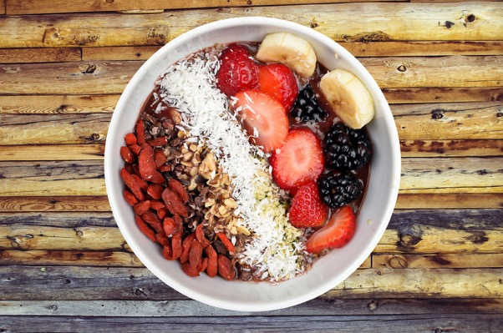
Fiber, Microbiome and Parkinson’s
Low fiber diets favor pathogenic bacteria increasing liability for Parkinson’s.
Eat more Fiber!
Cell Rep. 42(9):113071.
Notes:
Schmit KJ, Garcia P, Sciortino A, Aho VTE, Pardo Rodriguez B, Thomas MH, Gérardy JJ, Bastero Acha I, Halder R, Cialini C, Heurtaux T, Ostahi I, Busi SB, Grandmougin L, Lowndes T, Singh Y, Martens EC, Mittelbronn M, Buttini M, Wilmes P. Fiber deprivation and microbiome-borne curli shift gut bacterial populations and accelerate disease in a mouse model of Parkinson's disease. Cell Rep. 2023 Sep 26;42(9):113071.
Parkinson's disease (PD) is a neurological disorder characterized by motor dysfunction, dopaminergic neuron loss, and alpha-synuclein (αSyn) inclusions. Many PD risk factors are known, but those affecting disease progression are not. Lifestyle and microbial dysbiosis are candidates in this context. Diet-driven gut dysbiosis and reduced barrier function may increase exposure of enteric neurons to toxins. Here, we study whether fiber deprivation and exposure to bacterial curli, a protein cross-seeding with αSyn, individually or together, exacerbate disease in the enteric and central nervous systems of a transgenic PD mouse model. We analyze the gut microbiome, motor behavior, and gastrointestinal and brain pathologies. We find that diet and bacterial curli alter the microbiome and exacerbate motor performance, as well as intestinal and brain pathologies, but to different extents. Our results shed important insights on how diet and microbiome-borne insults modulate PD progression via the gut-brain axis and have implications for lifestyle management of PD.

Slide 44
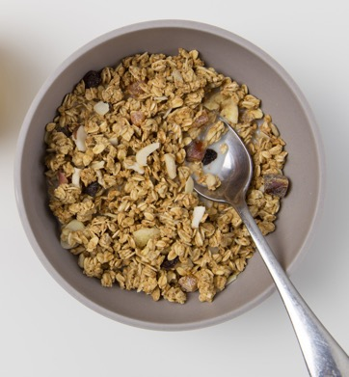
Fiber Prebiotic and Parkinson’s
Dietary Fiber is extremely important for Parkinson’s patients and a healthy microbiome—gut brain axis.
Parkinson’s patients eat too little fruit and fiber.
Ann Indian Acad Neurol. 26(2):174-181.
Notes:
Martens EC, Mittelbronn M, Buttini M, Wilmes P. Fiber deprivation and microbiome-borne curli shift gut bacterial populations and accelerate disease in a mouse model of Parkinson's disease. Cell Rep. 2023 Sep 26;42(9):113071.
Cantu-Jungles TM, Rasmussen HE, Hamaker BR. Potential of Prebiotic Butyrogenic Fibers in Parkinson's Disease. Front Neurol. 2019 Jun 20;10:663.
Roy A, Choudhury S, Banerjee R, Basu P, Mondal B, Sarkar S, Anand SS, Dey S, Kumar H. Dietary and Environmental Risk Factors in Parkinson's and Alzheimer's Disease: A Semi-Quantitative Pilot Study. Ann Indian Acad Neurol. 2023 Mar-Apr;26(2):174-181.
Hall DA, Voigt RM, Cantu-Jungles TM, Hamaker B, Engen PA, Shaikh M, Raeisi S, Green SJ, Naqib A, Forsyth CB, Chen T, Manfready R, Ouyang B, Rasmussen HE, Sedghi S, Goetz CG, Keshavarzian A. An open label, non-randomized study assessing a prebiotic fiber intervention in a small cohort of Parkinson's disease participants. Nat Commun. 2023 Feb 18;14(1):926.
Abdel-Haq R, Schlachetzki JCM, Boktor JC, Cantu-Jungles TM, Thron T, Zhang M, Bostick JW, Khazaei T, Chilakala S, Morais LH, Humphrey G, Keshavarzian A, Katz JE, Thomson M, Knight R, Gradinaru V, Hamaker BR, Glass CK, Mazmanian SK. A prebiotic diet modulates microglial states and motor deficits in α-synuclein overexpressing mice. Elife. 2022 Nov 8;11:e81453.
Becker A, Schmartz GP, Gröger L, Grammes N, Galata V, Philippeit H, Weiland J, Ludwig N, Meese E, Tierling S, Walter J, Schwiertz A, Spiegel J, Wagenpfeil G, Faßbender K, Keller A, Unger MM. Effects of Resistant Starch on Symptoms, Fecal Markers, and Gut Microbiota in Parkinson's Disease - The RESISTA-PD Trial. Genomics Proteomics Bioinformatics. 2022 Apr;20(2):274-287.
Alfonsetti M, Castelli V, d'Angelo M. Are We What We Eat? Impact of Diet on the Gut-Brain Axis in Parkinson's Disease. Nutrients. 2022 Jan 17;14(2):380.

Slide 45

Fresh Air And Natural Green Environment
Get close to nature, preserve your brain.
Green surroundings are associated with decreased risk of PD.
Environ Res. 197:111170.
Notes:
Yu Z, Wei F, Zhang X, Wu M, Lin H, Shui L, Jin M, Wang J, Tang M, Chen K. Air pollution, surrounding green, road proximity and Parkinson's disease: A prospective cohort study. Environ Res. 2021 Jun;197:111170.
Abstract
Background: Though growing evidence has linked air pollution to Parkinson's disease (PD), the results remain inconsistent. Less is known about the relevance of road proximity and surrounding green. We aimed to investigate the individual and joint associations of air pollution, road proximity and surrounding green with the incidence of PD in a prospective cohort study.
Methods: We used data from a prospective cohort of 47,516 participants recruited from July 2015 to January 2018 in Ningbo, China. Long-term exposure to particulate matter with aerodynamic diameter ≤2.5 μm (PM_{2.5}) and ≤10 μm (PM₁₀) and nitrogen dioxide (NO₂) estimated by land-use regression models, road proximity and surrounding green assessed by Normalized Difference Vegetation Index (NDVI) were calculated based on the residential address for each participant. Cox proportional hazard models were used to analyze the individual and joint effects of air pollution, road proximity, and surrounding green on PD.
Results: In single-exposure models, PM_{2.5}, PM₁₀, NO₂ and road proximity was associated with increased risk of PD (e.g. Hazard Ratio (HR) = 1.51, 95%CI:1.02, 2.24 per interquartile range (IQR) increase for PM_{2.5}) while surrounding green was associated with decreased risk of PD (e.g. HR = 0.80, 95%CI:0.65, 0.98 per IQR increase for NDVI in 300 m buffer). In two-exposure models, the associations of PM_{2.5} and surrounding green persisted while the associations of NO₂ and road proximity attenuated towards unity.
Conclusions: We found that PM_{2.5} were associated with increased risk of incident PD while surrounding green was associated with decreased risk of PD. Future studies about PD etiology may benefit from including multiple environmental exposures to address potential joint associations.
Zhu Z, Yang Z, Yu L, Xu L, Wu Y, Zhang X, Shen P, Lin H, Shui L, Tang M, Jin M, Wang J, Chen K. Residential greenness, air pollution and incident neurodegenerative disease: A cohort study in China. Sci Total Environ. 2023 Jun 20;878:163173.

Slide 46

Sunshine
Regular sun exposure reduces the risk of Parkinson’s by 98%!
Vitamin D supplements resulted in no significant benefits in improving motor function for patients with Parkinson's disease.
Med Sci Monit. 25:666-674.
Notes:
Zhou Z, Zhou R, Zhang Z, Li K. The Association Between Vitamin D Status, Vitamin D Supplementation, Sunlight Exposure, and Parkinson's Disease: A Systematic Review and Meta-Analysis. Med Sci Monit. 2019 Jan 23;25:666-674.
BACKGROUND This literature review and meta-analysis aimed to determine the association between deficiency of vitamin D, or 25-hydroxyvitamin D, and Parkinson's disease, and whether vitamin D from supplements and sunlight improves the symptoms of Parkinson's disease. MATERIAL AND METHODS A literature review and meta-analysis were performed according to the Preferred Reporting Items for Systematic Reviews and Meta-Analyses (PRISMA) statement. Systematic literature review was performed using databases that included the Web of Science, PubMed, the Cochrane Library, and Embase. The Jadad scale (the Oxford quality scoring system) and the Newcastle-Ottawa scale (NOS) were used to evaluate the quality of the studies. RESULTS Eight studies were included in the meta-analysis. Both 25-hydroxyvitamin D insufficiency (<30 ng/mL) (OR, 1.77; 95% CI, 1.29-2.43; P<0.001) and deficiency (<20 ng/mL) (OR, 2.55; 95% CI, 1.98-3.27; P<0.001) were significantly associated with an increased risk of Parkinson's disease when compared with normal controls Sunlight exposure (³15 min/week) was significantly associated with a reduced risk of Parkinson's disease (OR, 0.02; 95% CI, 0.00-0.10; P<0.001). The use of vitamin D supplements was effective in increasing 25-hydroxyvitamin D levels (SMD, 1.79; 95% CI, 1.40-2.18; P<0.001), but had no significant effect on motor function (MD, -1.82; 95% CI, -5.10-1.45; P=0.275) in patients with Parkinson's disease. CONCLUSIONS Insufficiency and deficiency of 25-hydroxyvitamin D and reduced exposure to sunlight were significantly associated with an increased risk of Parkinson's disease. However, vitamin D supplements resulted in no significant benefits in improving motor function for patients with Parkinson's disease.

Slide 47

Exercise
People who exercise more reduce their risk of Parkinson’s by 53%.
Neuropsychiatr Dis Treat. 11:695-700.
Notes:
Zou YM, Tan JP, Li N, Yang JS, Yu BC, Yu JM, Zhao YM, Wang LN. Do physical exercise and reading reduce the risk of Parkinson's disease? a cross-sectional study on factors associated with Parkinson's disease in elderly Chinese veterans. Neuropsychiatr Dis Treat. 2015 Mar 16;11:695-700.
Abstract
Background: The purpose of this study was to investigate risk factors for and factors protecting against Parkinson's disease (PD) in elderly Chinese veterans.
Methods: Using a database containing detailed information on the health status of the nervous system in elderly Chinese veterans, univariate and multivariate analyses of factors that may be associated with PD were performed. Univariate analysis of qualitative data was done using the Pearson Chi-square and Fisher's exact tests, and the Mann-Whitney U nonparametric test was used for univariate analysis of quantitative data. Multivariate logistic regression analysis was used to identify independent risk factors for and factors protecting against PD in elderly Chinese veterans.
Results: A total of 9,676 elderly Chinese veterans were enrolled, including 228 cases with PD and 183 cases with Parkinson's syndrome, with 9,265 non-PD subjects serving as controls. Age (odds ratio [OR] 1.343, 95% confidence interval [CI] 1.028-1.755) and medical history of essential tremor (OR 1.228, 95% CI 1.081-1.396) were identified as independent risk factors for PD, with age being the most important risk factor. Physical exercise (OR 0.478, 95% CI 0.355-0.643) and reading (OR 0.513, 95% CI 0.357-0.735) were identified as independent factors protecting against PD, and physical exercise showed better protection against PD relative to reading. Smoking, alcohol use, anemia, cerebral trauma, education level, and electromagnetic field exposure showed no association with PD.
Conclusion: Physical exercise and reading may be independent factors that protect against PD among elderly Chinese veterans, while advancing age and medical history of essential tremor may be independent risk factors for PD. This study was cross-sectional, so further research is needed to confirm its results.
Martín-Núñez J, Calvache-Mateo A, López-López L, Heredia-Ciuró A, Cabrera-Martos I, Rodríguez-Torres J, Valenza MC. Effects of Exercise-Based Interventions on Physical Activity Levels in Persons With Parkinson's Disease: A Systematic Review With Meta-analysis. J Geriatr Phys Ther. 2023 Oct-Dec 01;46(4):207-213.
Abstract
Background and purpose: Parkinson's disease (PD) is the most common neurodegenerative movement disorder. Symptom severity leads to devastating consequences such as falls, immobility, impaired quality of life, and reduced general activity. Adopting a sedentary lifestyle creates a vicious circle, as physical inactivity can negatively affect the clinical domains of PD. Despite the recognition of the disease-modifying potential of physical activity (PA), achieving adequate exercise levels can be challenging for individuals with PD. This study aimed to investigate the repercussions of exercise-based interventions to improve PA levels in persons with PD through a systematic review with meta-analysis.
Methods: A search was conducted from database inception to February 2021 across 3 databases: PubMed, Web of Science, and Scopus. Randomized controlled trials were included if they involved persons with PD, outcome measures associated with PA levels, and an exercise-based intervention. Two reviewers performed independent data extraction and methodologic quality assessment of the studies using the Downs and Black quality checklist.
Results: A total of 6 studies were included in the study (1251 persons with PD). Four intervention types were identified: balance, strength, aerobic, and multimodal exercise (combination of several types of exercise programs). The meta-analysis showed that exercise interventions have a positive effect on PA (standard mean difference = 0.50, 95% CI =-0.02, 1.00; P = .06). The risk of bias was generally low.
Conclusions: The findings support the use of exercise-based interventions (aerobic exercise, balance exercise, strength exercise, and/or multimodal exercise) to improve PA levels. However, the limited number of studies and the heterogeneity of the interventions do not allow us to draw a definitive conclusion.

Slide 48
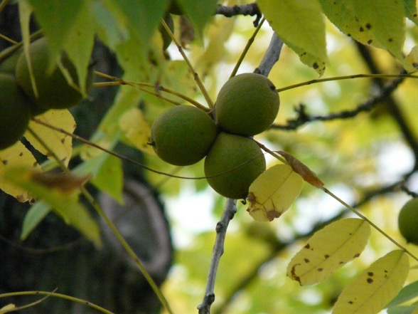
Tryptophan
Increase intake of the essential amino acid, tryptophan. The following foods are good sources of tryptophan: tofu, soybeans, pumpkin seeds, gluten, sesame seeds, nuts, almonds, black walnuts, legumes, back-eyed peas, lima beans.
Not good (because they compete for adsorption with tryptophan) are fish, milk, meat, (rice is questionable).

Slide 49
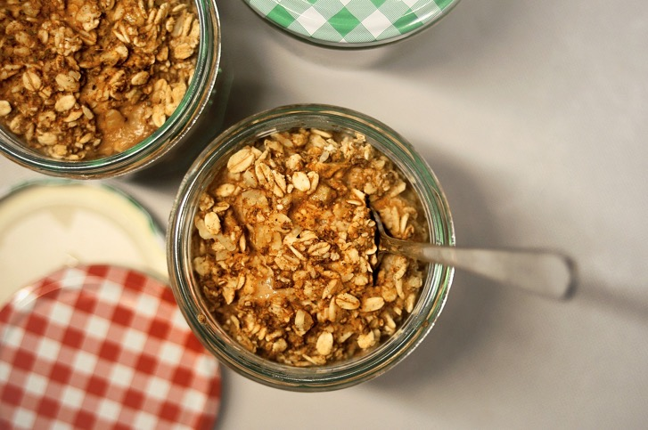
Melatonin
Melatonin high in oats, tomatoes and corn. Increases by fasting especially in evening hours.
Foods high in B6 – sweet bell peppers, sunflower seeds, sesame seeds.

Slide 50

Ashwagandha and St. John’s Wort
Ashwagandha: raises dopamine levels and improves motor function.
St. John’s Wort: blocks the enzymes that break down dopamine, thus increasing its levels in the brain.
Notes:
Ashwagandha
Ashwagandha, or Withania somnifera, is a perennial shrub native to Asia, Africa and Europe. Indian Ayurvedic healers use the roots as a general anti-aging tonic, and the plant also has antibiotic, anti-inflammatory and antitumor actions. A study published in the September 2009 issue of the “Journal of Ethnopharmacology” found that ashwagandha root extract raised dopamine levels and improved motor function in test animals who had their dopamine levels reduced by chemical antagonists to mimic Parkinson’s disease. This research suggests that ashwagandha may improve mobility in patients with dopamine deficiency disorders like Parkinson’s. Do not use this herb during pregnancy.
St. John’s Wort
St. John’s wort, or Hypericum perforatum, is a European shrub with clusters of tiny yellow flowers. It has a long history as a remedy for wounds, burns and pain, and contemporary herbalists also use it to treat mild depression. The main ingredients are hypericin and hyperforin, which affect the central nervous system. In their 2009 book, “Medicinal Plants of the World,” botanist Ben-Erik van Wyk and biologist Michael Wink state that St. John’s wort extract blocks the enzymes that break down dopamine, thus increasing its levels in the brain and making it a useful treatment for depression. Do not combine this herb with other antidepressants.

Slide 51
Hot and cold treatments to the head.
Start with a hot pack over the forehead and a cold pack over the upper neck and lower skull, keep them in place for 3 minutes,
then switch them to cold in front and hot in back for three minutes. Keep switching every three minutes, keeping the hot packs hot and the cold packs cold, switch about 7 or 8 times and then set the hot aside and finish with a cold pack on the last side you had hot for one minute.
Then have the patient lay down for about 20 minutes.
Notes:
Head hydrotherapy

Slide 52
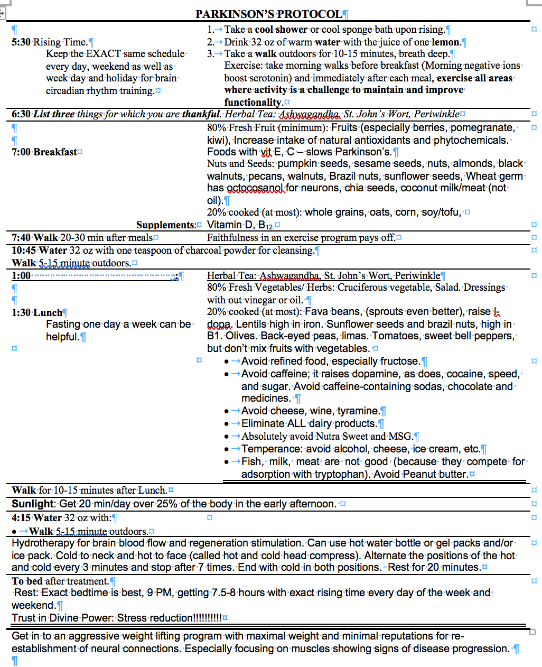
Notes:
PARKINSON’S PROTOCOL
5:30 Rising Time.
Keep the EXACT same schedule every day, weekend as well as week day and holiday for brain circadian rhythm training.
1. Take a cool shower or cool sponge bath upon rising.
2. Drink 32 oz of warm water with the juice of one lemon.
3. Take a walk outdoors for 10-15 minutes, breath deep. Exercise: take morning walks before breakfast (Morning negative ions boost serotonin) and immediately after each meal, exercise all areas where activity is a challenge to maintain and improve functionality.
6:30 List three things for which you are thankful. Herbal Tea: Ashwagandha, St. John’s Wort, Periwinkle
7:00 Breakfast
80% Fresh Fruit (minimum): Fruits (especially berries, pomegranate, kiwi), Increase intake of natural antioxidants and phytochemicals. Foods with vit E, C – slows Parkinson’s.
Nuts and Seeds: pumpkin seeds, sesame seeds, nuts, almonds, black walnuts, pecans, walnuts, Brazil nuts, sunflower seeds, Wheat germ has octocosanol for neurons, chia seeds, coconut milk/meat (not oil).
20% cooked (at most): whole grains, oats, corn, soy/tofu,
Supplements: Vitamin D, B_{12,} as indicated
7:40 Walk 20-30 min after meals. Faithfulness in an exercise program pays off.
10:45 Water 32 oz with one teaspoon of charcoal powder for cleansing.
Walk 5-15 minute outdoors.
1:00 Herbal Tea: Ashwagandha, St. John’s Wort, Periwinkle
1:30 Lunch (Fasting one day a week can be helpful.)
80% Fresh Vegetables/ Herbs: Cruciferous vegetable, Salad. Dressings without vinegar or oil.
20% cooked (at most): Fava beans, (sprouts even better), raise l-dopa. Lentils high in iron. Sunflower seeds and brazil nuts, high in B1. Olives. Back-eyed peas, limas. Tomatoes, sweet bell peppers, but don’t mix fruits with vegetables.
Avoid refined food, especially fructose.
Avoid caffeine; it raises dopamine, as does, cocaine, speed, and sugar. Avoid caffeine-containing sodas, chocolate and medicines.
Avoid cheese, wine, tyramine.
Eliminate ALL dairy products.
Absolutely avoid Nutra Sweet and MSG.
Temperance: avoid alcohol, cheese, ice cream, etc.
Fish, milk, meat are not good (because they compete for adsorption with tryptophan). Avoid Peanut butter.
Walk for 10-15 minutes after Lunch.
Sunlight: Get 20 min/day over 25% of the body in the early afternoon, especially the head.
4:15 Water 32 oz with:
Walk 5-15 minute outdoors.
Hot and cold treatments to the head. Start with a hot pack over the forehead and a cold pack over the upper neck and lower skull, keep them in place for 3 minutes, then switch them to cold in front and hot in back for three minutes. I find it easiest to have the patient lay down with the back of their head on one pack while the other is place over the forehead. Keep switching every three minutes, keeping the hot pack hot and the cold pack cold. Switch about 7 or 8 times and then set the hot aside and finish with a cold pack on the last side you had applied the hot pack. Then have the patient lay down for about 20 minutes.
To bed after treatment.
Rest: Exact bedtime is best, 9 PM, getting 7.5-8 hours with exact rising time every day of the week and weekend.
Trust in Divine Power: Stress reduction!!!!!!!!!!

Slide 54

The Spiritual Advantage
Compared with participants who considered religion very important in their lives, participants who considered religion “not at all important” in their lives had a tenfold higher risk of developing Parkinson’s.
J Relig Health. 62(6):4192-4208.
Notes:
Otaiku AI. Religiosity and Risk of Parkinson's Disease in England and the USA. J Relig Health. 2023 Dec;62(6):4192-4208.

Slide 55

Summary:
Whole plant food diet, eat your protection.
Detox, pesticides, heavy metals, solvents.
Exercise out in the sun and fresh air, strengthen your areas of challenge.
Explore some natural remedies.
Destress, rest in God.

Slide 56

NorthernLightsHealthEducation.com

Slide 57
Winning Over Parkinson's
Notes:
Howard’s knuckles turned white as he held tightly onto his walker. With a bit of a tremor he rocked forward and back trying desperately to initiate a step to start walking. I could feel his predicament and finely walked over, and gently helped him left his leg and take that first step. In the presentation “Winning over Parkinson’s” we deal with the increasing tremors, decreasing ability for self-care and independent living. Have you seen your medication doses go up and experienced increasing side effects? We’ll be talking about natural remedies, stress management. We’ll help you maximize your diet to preserve brain function in your fight to get the victory over Parkinson’s. Listen to this program, put its principles into practice, and start winning over Parkinson’s today.
Howard held tightly onto his walker,
rocking forward and back, trying desperately initiate a step and get walking.
“Winning over Parkinson’s” is a
Benefit/problem solved
Increasing tremors
decreasing ability for self care and independent living
Increasing medication dosing with increasing side effects
Bullet points
Managing stress
Maximizing a brain protective diet
Natural remedies
Inspire
Satisfaction of doing something personally to contribute to your own good brain health.
Call to action
tune into this this program, put its principles into practice, start winning over Parkinson’s today!

