Slide 1

Osteoporosis:
Nothing to Crack Up About
Notes:
Welcome to Blueprint for Health and Healing,
Reversing Disease From Its Foundation
Hi, I’m Dr. John Clark
Today's topic is, “Osteoporosis: Nothing to Crack Up About”
When Sarah’s osteoporosis scan results came back, she was shocked. Osteoporosis? Immediately she came to see me. There is always the risk of multiple fractures with osteoporosis, the bones can be painful and you’re always afraid you’re going to fall down and break something. We worked up a program for Sarah based on the principles in this presentation, Over the next year Sarah practiced these principles faithfully. At her next scan, her bone density had picked dramatically. Don’t miss this presentation, apply its well-researched advice, and feel confident about the strength of your bones.

Slide 2
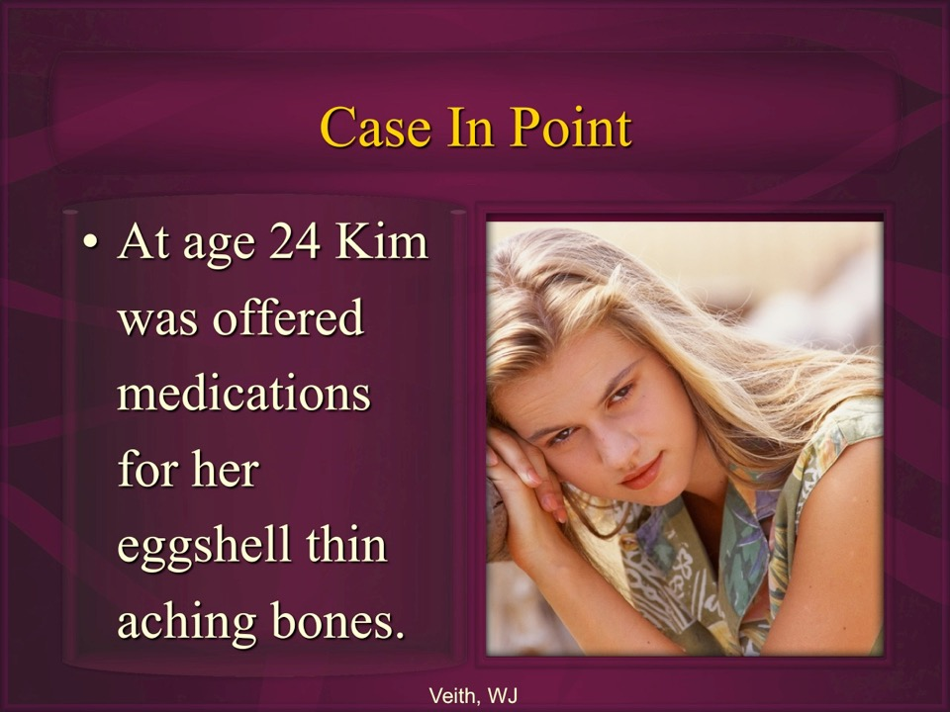

Slide 3

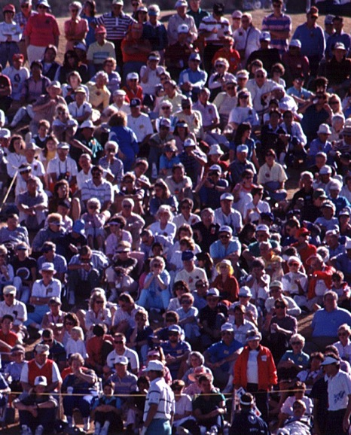
Epidemiology of Osteoporosis
Prevalence:
  10 million Americans have osteoporosis.
    80% Women.
    20% Men .
  43 million Americans are at significant risk with osteopenia.
NCHS Data Brief. 2021 Mar;(405):1-8.
Notes:
Sarafrazi N, Wambogo EA, Shepherd JA. Osteoporosis or Low Bone Mass in Older Adults: United States, 2017- 2018. NCHS Data Brief. 2021 Mar;(405):1-8.
St. Joseph's Mercy Health Center, 1635 Higdon Ferry Rd., Suite H, Hot Springs, AR 71913, USA. kamel@pol.net
Abstract
OBJECTIVE: To describe the etiology, diagnosis, and nonprescription interventions for the prevention and treatment of postmenopausal osteoporosis.
BACKGROUND: Osteoporosis affects more than 20 million individuals in North America and is responsible for more than 1.5 million fractures in the United States. About 50% of white women in the United States will have an osteoporotic fracture during their lifetime.
SUMMARY: Postmenopausal osteoporosis is the result of estrogen deficiency, which results in up-regulation of several cytokines and excessive bone resorption. Various bone mineral density (BMD) testing methods are available, but the World Health Organization based the diagnosis of postmenopausal osteoporosis on the presence of a BMD T-score that is 2.5 standard deviations or greater below the mean for young women as assessed by dual-energy X-ray absorptiometry (DXA) at the hip, spine, and mid-radius. Ensuring adequate calcium and vitamin D intake is the cornerstone of any regimen aimed at preventing or treating postmenopausal osteoporosis. Other nonpharmacologic measures address modifiable risk factors for the disease and include exercise, smoking cessation, reducing consumption of caffeine and alcohol, and avoiding medications known to decrease bone mass.
CONCLUSIONS: Postmenopausal osteoporosis is the result of estrogen deficiency and excessive bone resorption. Ensuring intake combined with lifestyle changes to address modifiable risk factors for the disease may help in the prevention and treatment of this condition.
PMID: 17269852 [PubMed - indexed for MEDLINE]

Slide 4

Notes:
INTRO: Hi, I’m Dr. John Clark, I specialize in Lifestyle medicine. Lifestyle medicine maximizes your health above the probability of disease.
I have now spent over 14 years now researching and teaching people how to overcome high blood pressure and other lifestyle diseases.

Slide 5

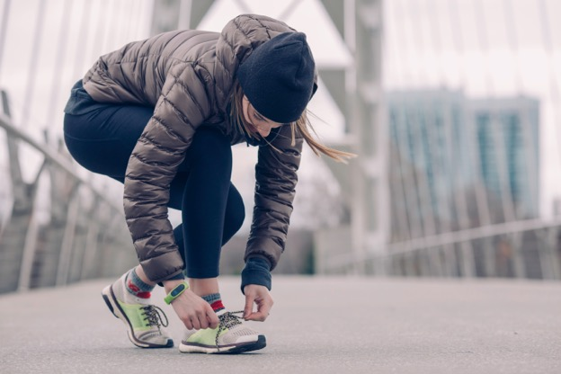

Osteoporosis is a lifestyle disease treated effectively by simple lifestyle changes.

Slide 6
Overview:
Bone fractures you CAN avoid.
Preventing osteoporosis by understanding its causes.
Calcium and protein in bone strength.
Benefits of exercise, sunlight and vitamin D.

Slide 7
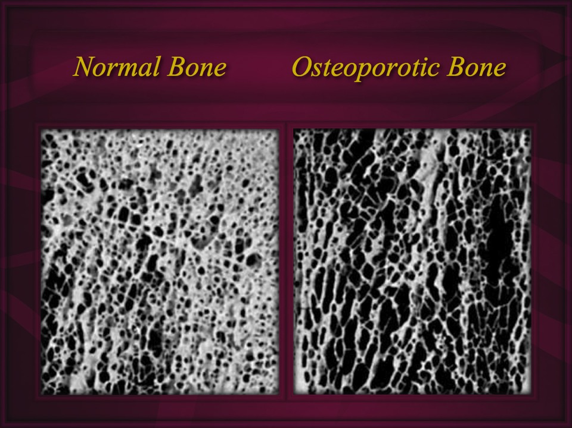

Slide 8
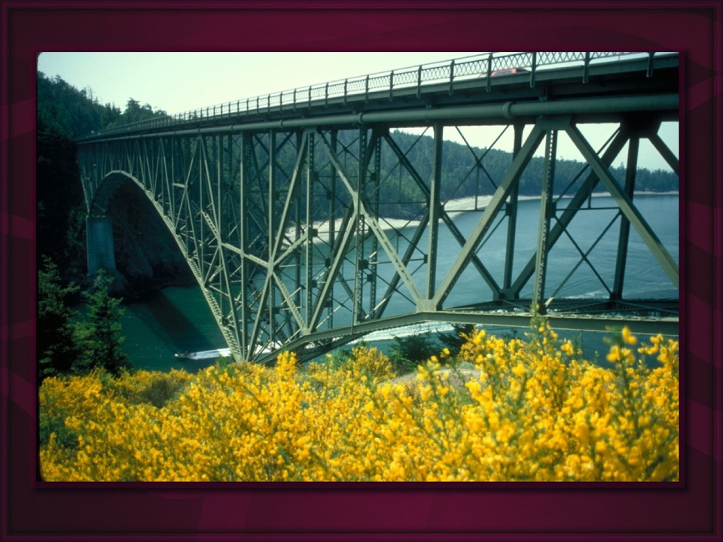

Slide 9
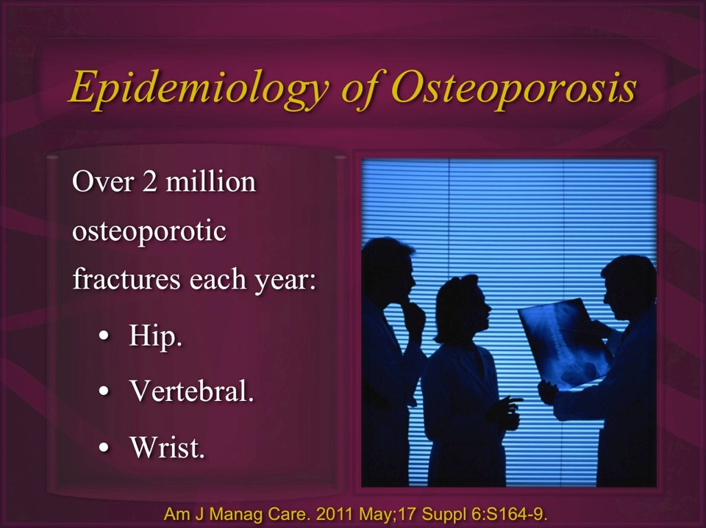

Slide 10

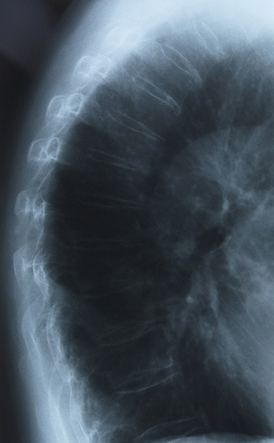
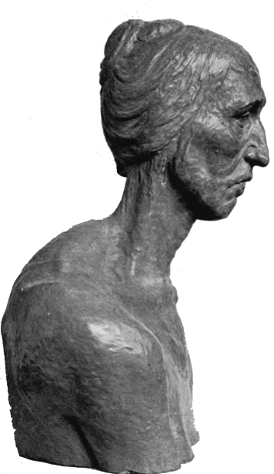
Spine Fractures

Slide 11
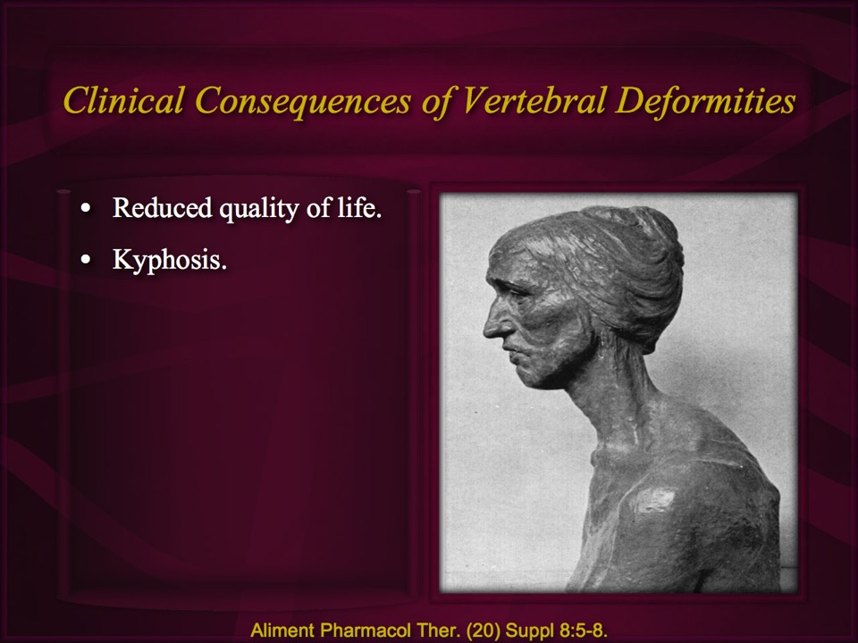

Slide 12
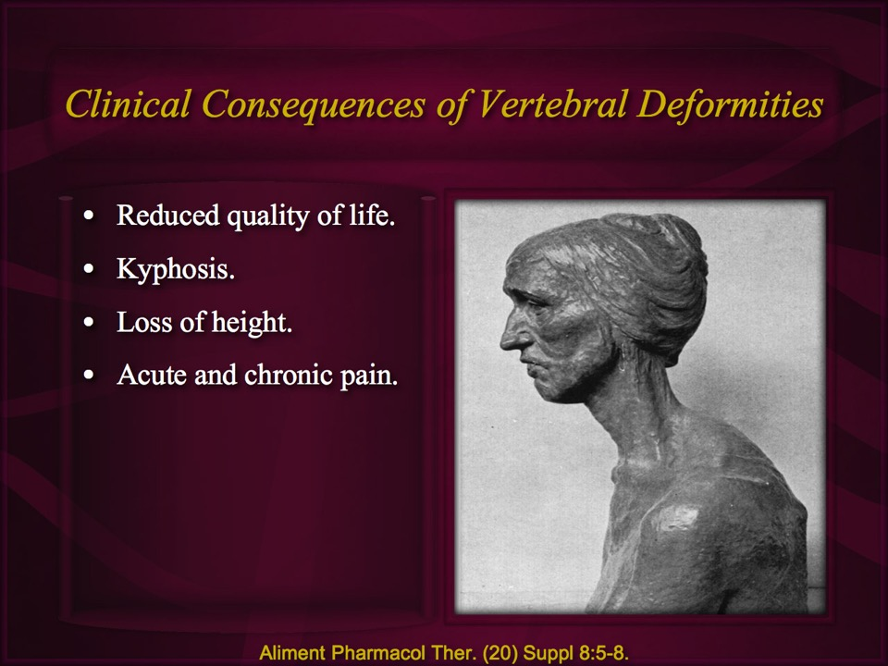

Slide 13
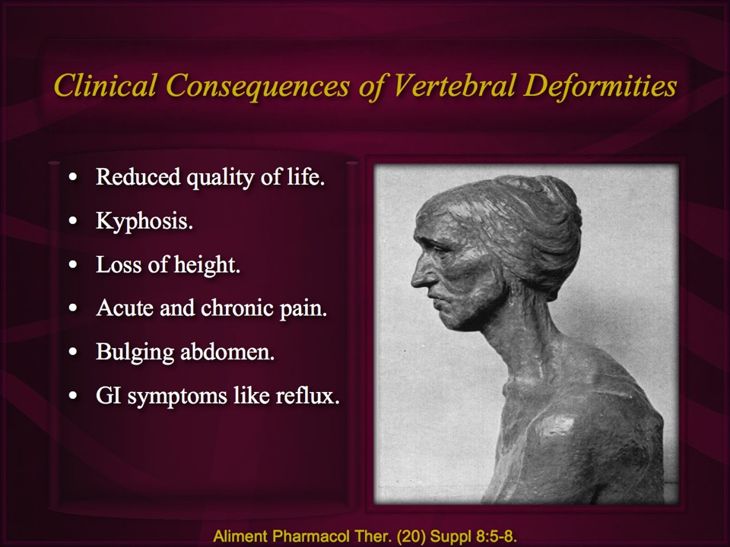

Slide 14
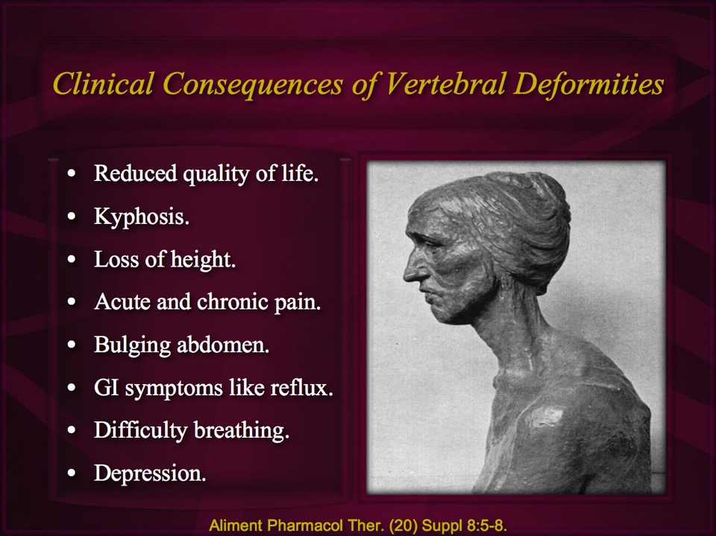

Slide 15


Hip Fracture Due To Osteoporosis
35% of post-menopausal white women have osteoporosis of the hip, spine or wrist.
By 2025, 50% of Americans over age 50 will have osteo-porosis of the hip.
National Osteoporosis Foundation

Slide 16
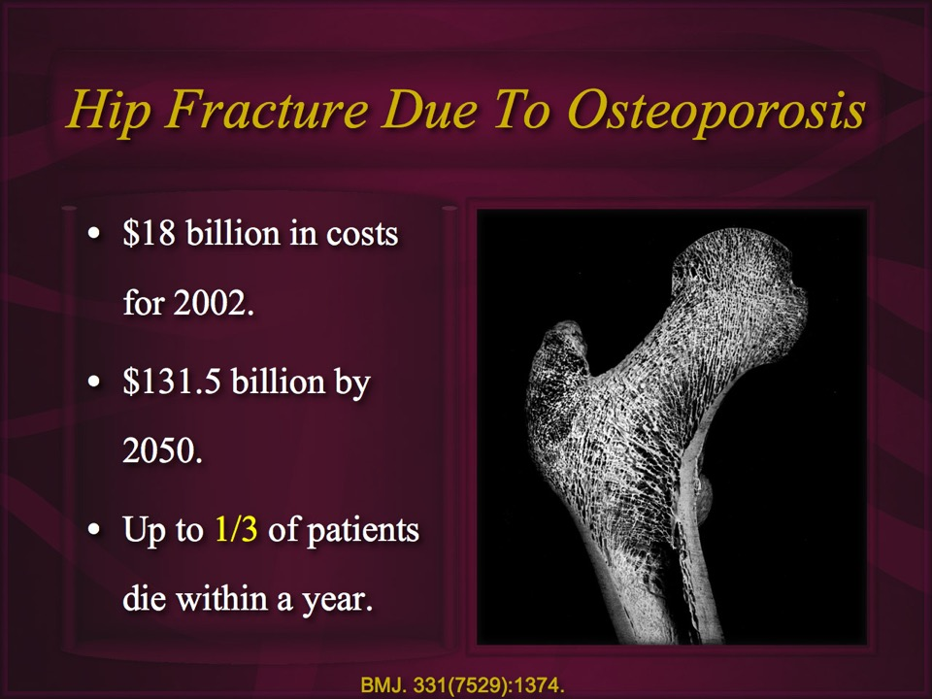

Slide 17

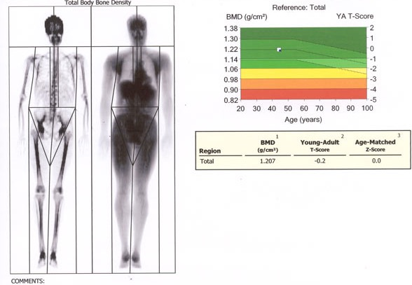
For each standard deviation of bone loss there is a 40% increase in mortality from hip fracture.
DEXA
Osteopenia T score of -1 to -2.5
Osteoporosis T score of <= -2.5
Calcif Tissue Int. 1998 Sep;63(3):190-6.
Notes:
Calcif Tissue Int. 1998 Sep;63(3):190-6. Links
Bone mineral density is a predictor of survival.Johansson C, Black D, Johnell O, Oden A, Mellstrom D.
Department of Geriatric Medicine, Vasa Hospital, University of Goteborg, S-411 33 Goteborg, Sweden.
The purpose of this study was to examine the relationship between bone mineral density (BMD) and survival in both sexes and to compare BMD with other established risk factors such as blood pressure and cholesterol. A population-based prospective study of 1924 individuals (850 men, 1074 women) was performed in Goteborg from 1980 to 1983. Measurements of BMD were obtained in 1468 (76%) of the participants (653 men, 815 women). This selection of individuals generated 10,965 person years, and death was registered for 289 men and 197 women in the 7-year period (2661 days) after bone mineral measurement. Later information on date of death was obtained from the official population register. This information covers 7 years from the time of survey of the last examined participant (in Dec. 1983). At the beginning of the study, BMD was measured in the calcaneus by dual photon absorptiometry (DPA), and blood pressure, serum cholesterol, serum triglycerides, and body mass index (BMI) were also recorded. The study was coordinated with the National Register of Causes of Death and the National Cancer Register. A modified version of the Cox proportional hazards model was used to calculate and determine the age-adjusted relations between nontrauma mortality and BMD. When the various quartiles of BMD were compared prospectively from 70, 75, and 79 years of age with survival figures during the 2661-day follow-up period, the first and the second quartiles with the lowest BMD at entry showed the lowest survival rate in both men (P = 0.01) and women (P = 0.01). A decrease of 1 SD of BMD in a univariate analysis was associated with a 1.39-fold increase in mortality in both men (95% confidence interval 1.25-1.56, P < 0.001) and women (95% confidence interval 1.22-1.58, P < 0.001), and a multivariate analysis demonstrated a relative risk of 1.23 (95% confidence interval 1.10-1.41, P < 0.001) in men and 1.19 (95% confidence interval 1.02 to 1.39, P = 0.019) in women. All relations were adjusted for sex, age, and follow-up. This study indicates that BMD is a predictor of survival, especially for subjects over 70. Bone mineral density was found to be a better predictor of death than blood pressure and cholesterol. This study indicates that, after adjustments have been made for diseases, low bone mass is an independent predictor of mortality and might be a marker of general health or functional aging. Its measurement might therefore be a valuable tool in general health investigations.
PMID: 9701621 [PubMed - indexed for MEDLINE]
Bone mineral density at the hip predicts mortality in elderly men.
Osteoporos Int. 2001;12(4):259-65. Related Articles, Links
Trivedi DP, Khaw KT.
Clinical Gerontology Unit, University of Cambridge, UK. dpt21@medschl.cam.ac.uk
Low bone density as assessed by calcaneal ultrasound has been associated with mortality in elderly men and women. We examined the relationship between bone density measured at the hip and all cause and cardiovascular mortality in elderly men. Men aged 65-76 years from the general community were recruited from general practices in Cambridge between 1991 and 1995. At baseline survey, data collection included health questionnaires, measures of anthropometry and cardiovascular risk factors, as well as bone mineral density (BMD) measured using dual energy X-ray absorptiometry. All men have been followed up for vital status up to December 1999. BMD was significantly inversely related to mortality from all causes and cardiovascular disease, with decreasing rates with increasing bone density quartile, and an approximate halving of risk between the bottom and top quartile (p < 0.002, test for trend all causes and p < 0.025, test for trend for cardiovascular deaths). In multivariate analyses using the Cox proportional hazards model, an increase of 1 standard deviation (0.144 g/cm2) in total hip bone density was significantly associated with an age-adjusted 0.77 relative risk (95% CI 0.66-0.91) for all-cause mortality and 0.76 relative risk (95% CI 0.62-0.93) for cardiovascular disease mortality. The association remained significant after adjusting for age, body mass index, cigarette smoking status, serum cholesterol, systolic blood pressure, past history of heart attack, stroke or cancer and other lifestyle factors which included use of alcohol, physical activity and general health status. Low bone density at the hip is thus a strong and independent predictor of all-cause and cardiovascular mortality in older men.
Publication Types:
Multicenter Study
PMID: 11420774 [PubMed - indexed for MEDLINE]

Slide 18
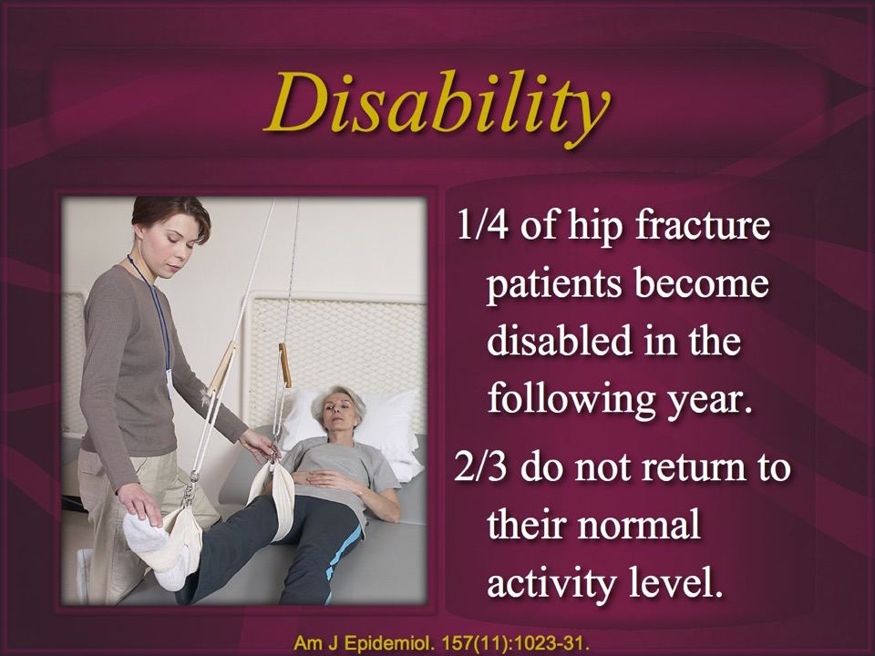

Slide 19
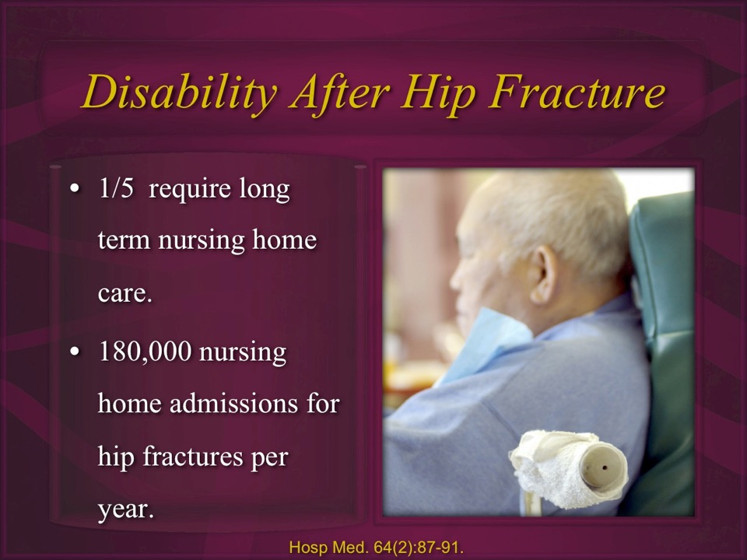

Slide 20
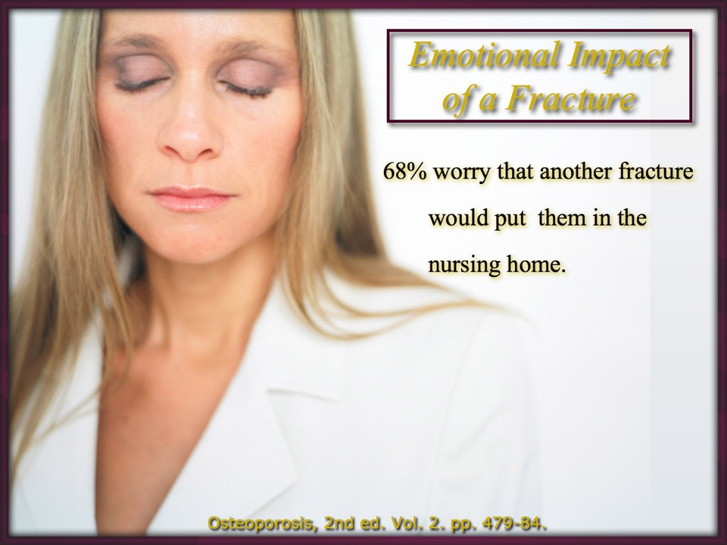

Slide 21
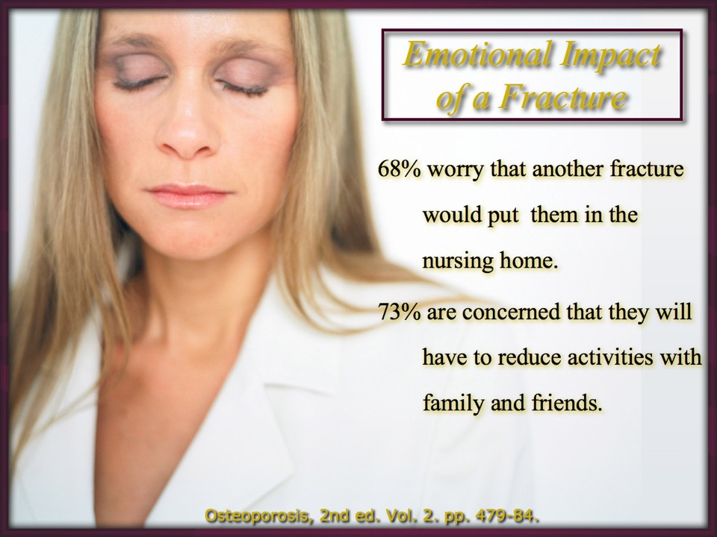

Slide 22
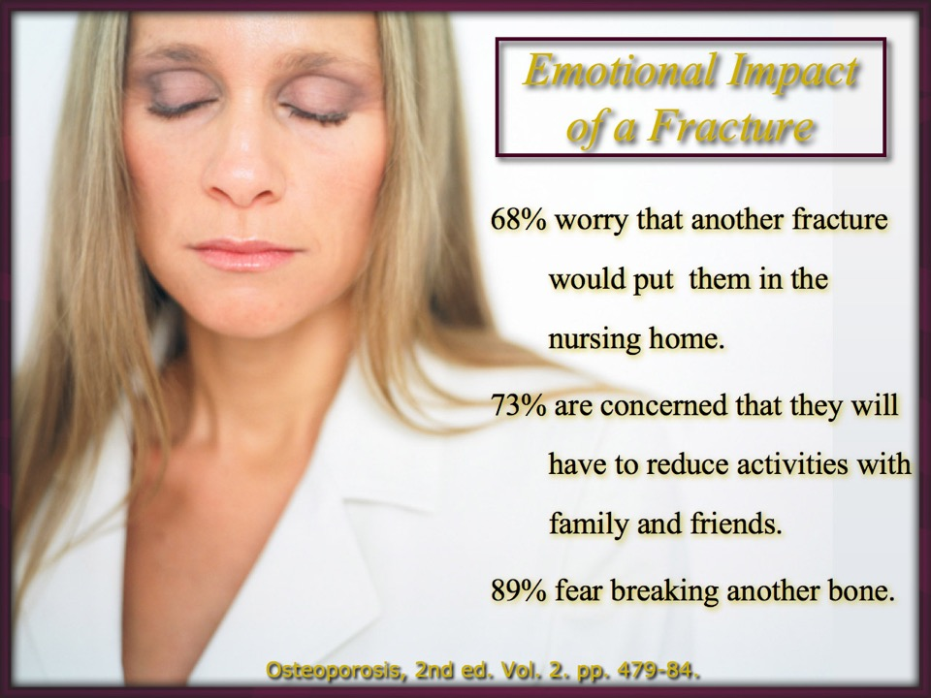

Slide 23
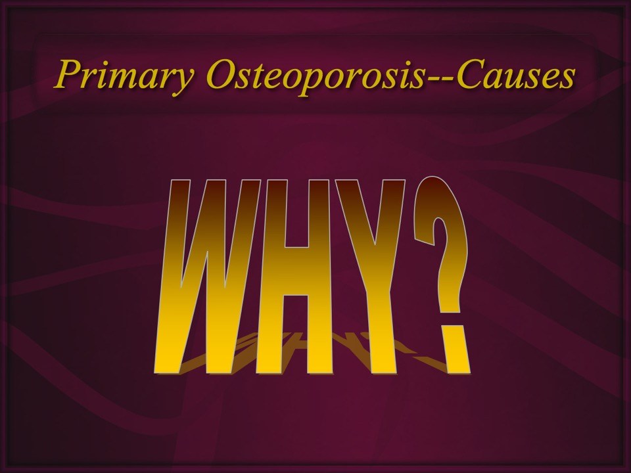

Slide 24
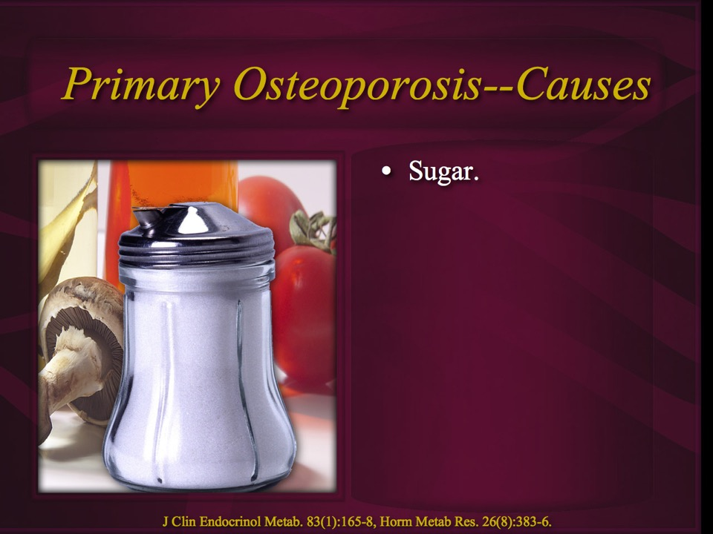


Slide 25
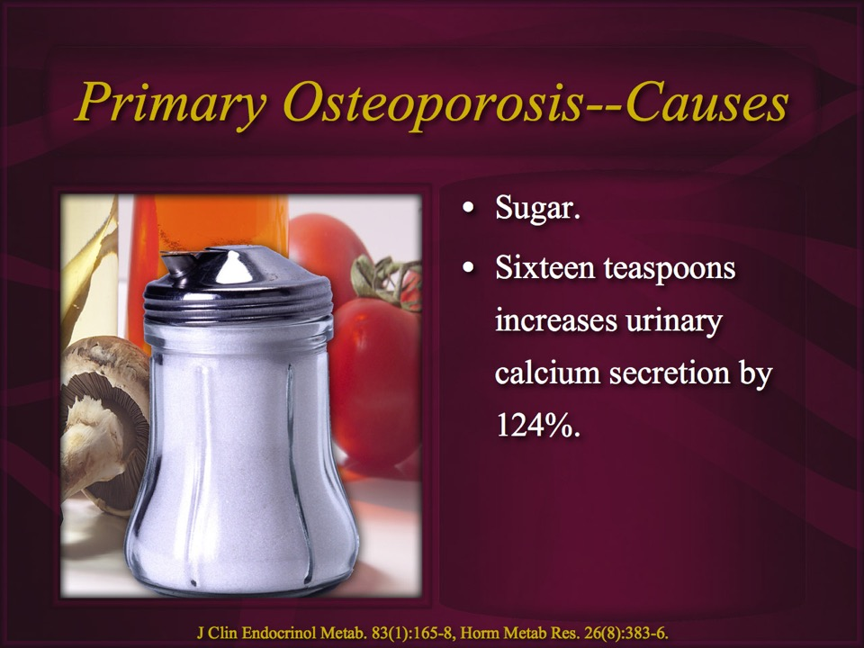

Slide 26
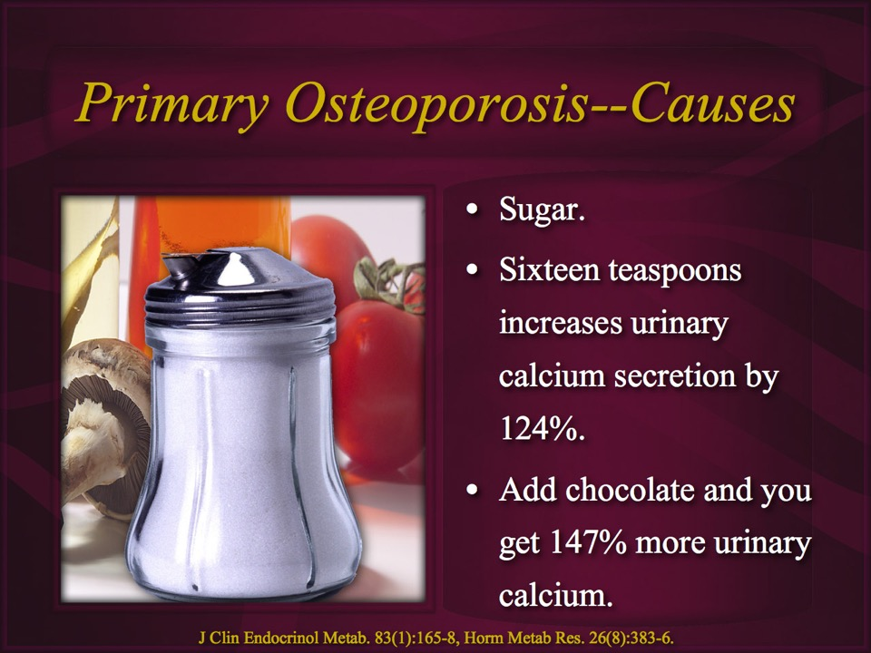

Slide 27
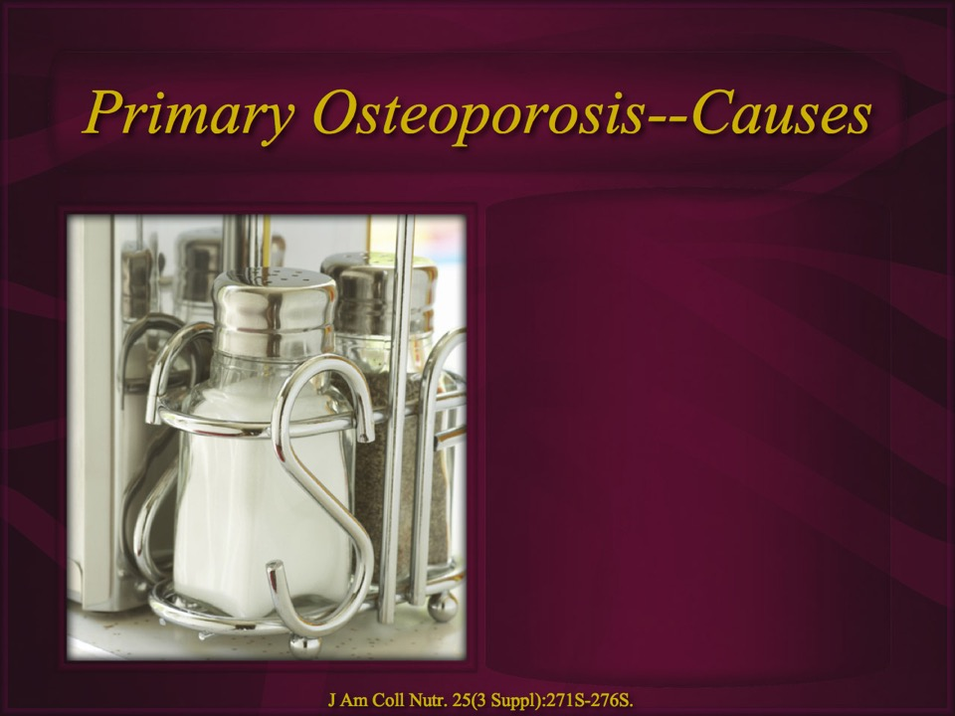

Slide 28
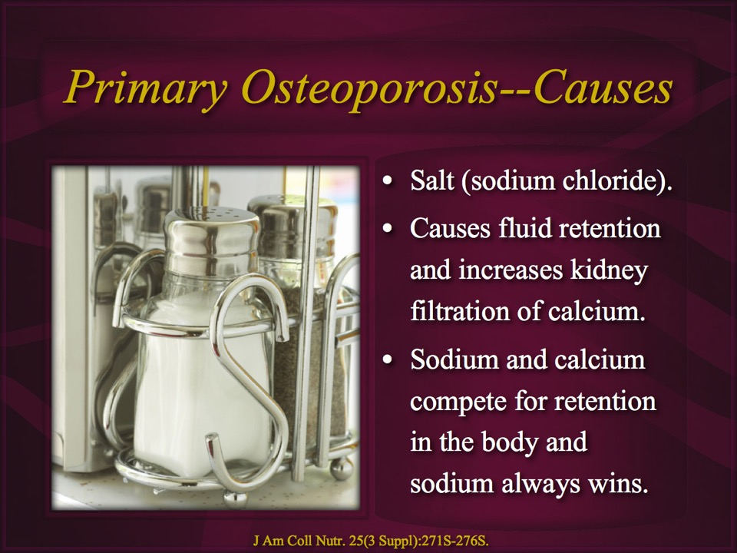

Slide 29
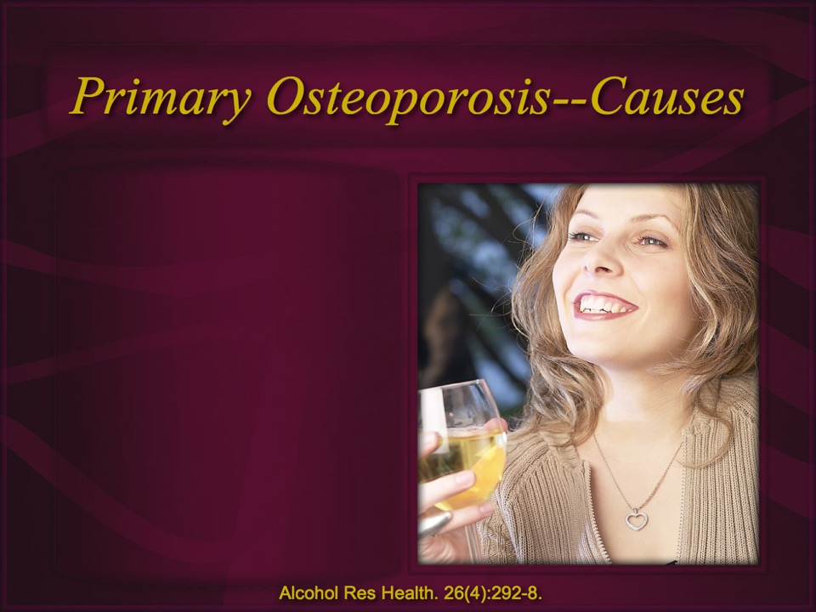
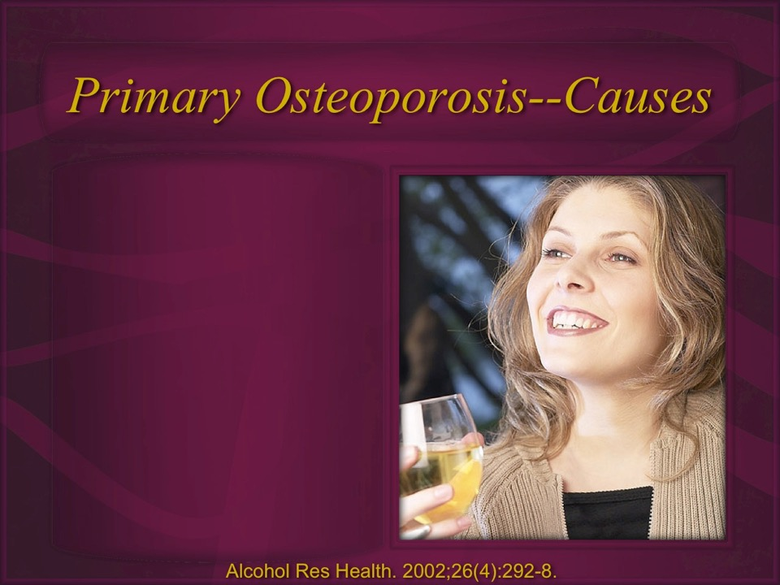

Slide 30
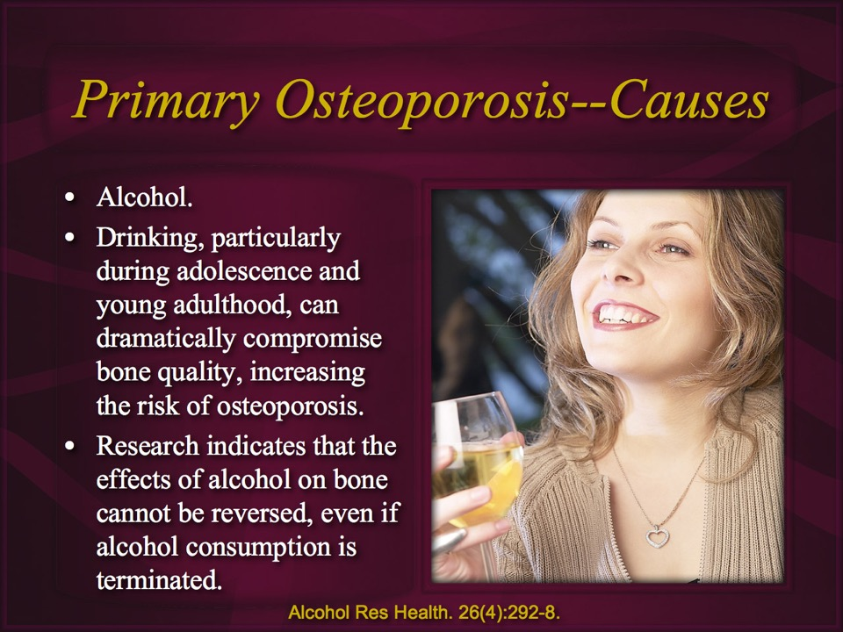


Slide 31
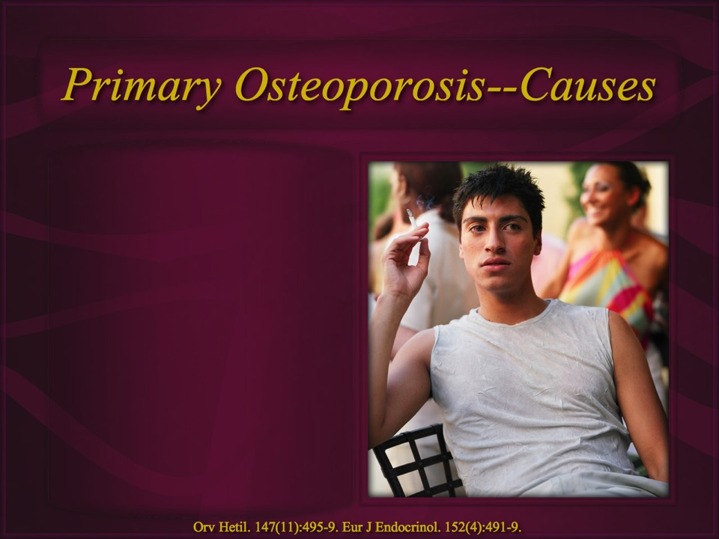

Slide 32
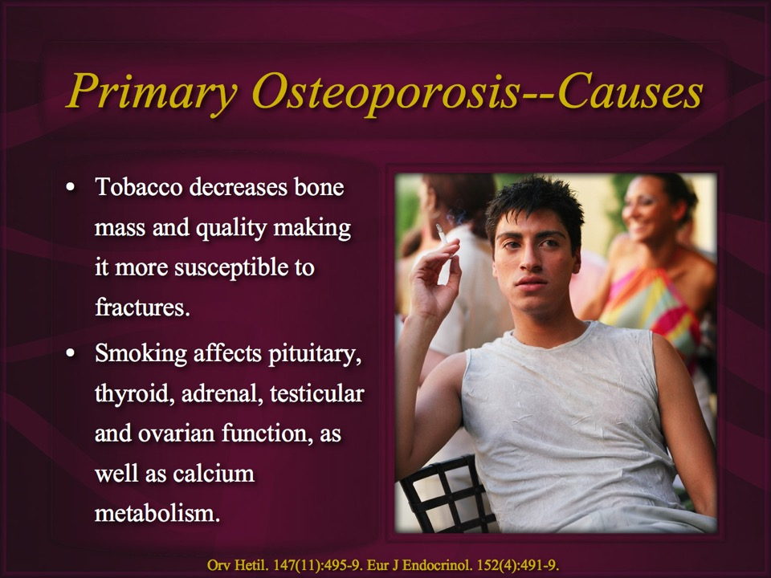

Slide 33
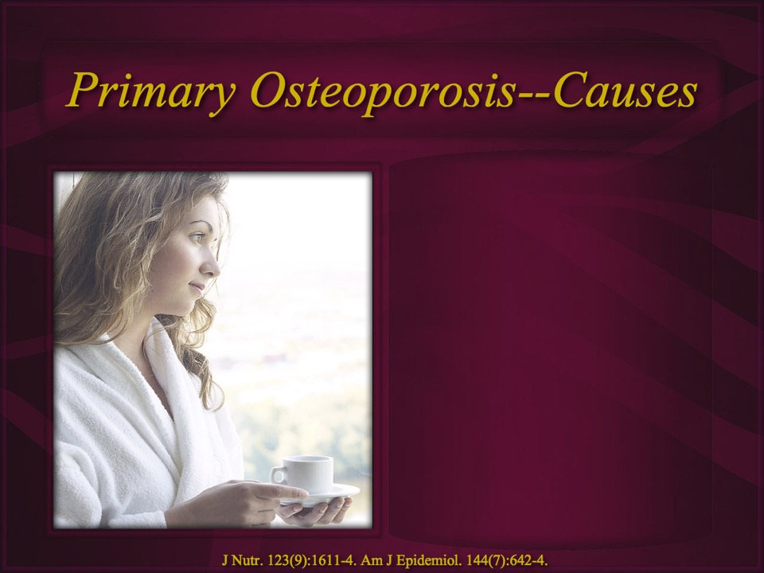

Slide 34
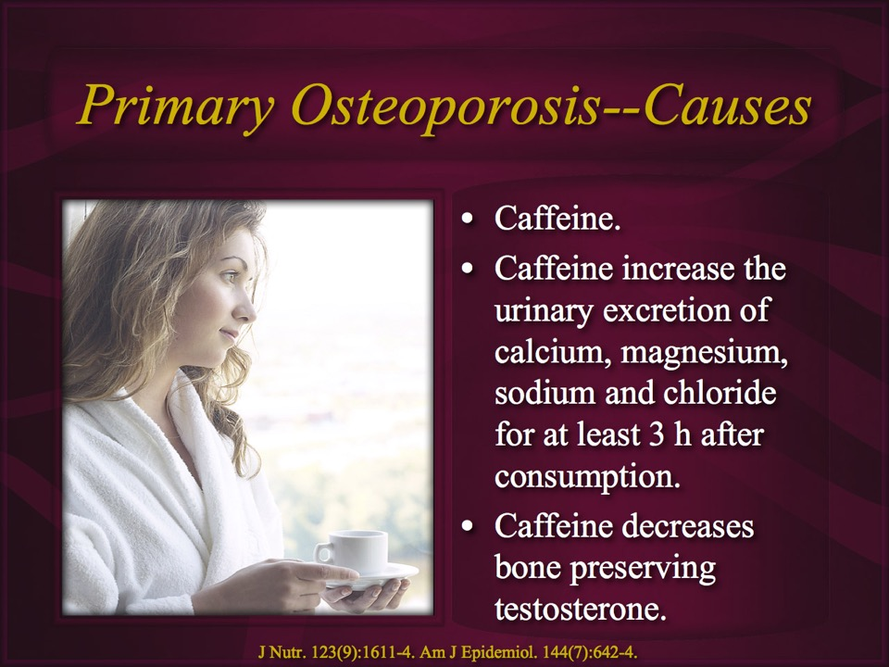

Slide 35
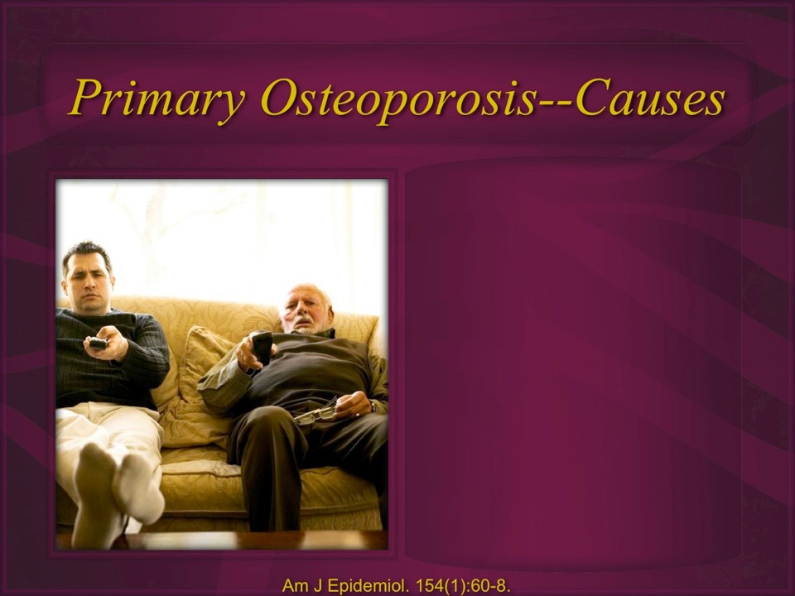

Slide 36
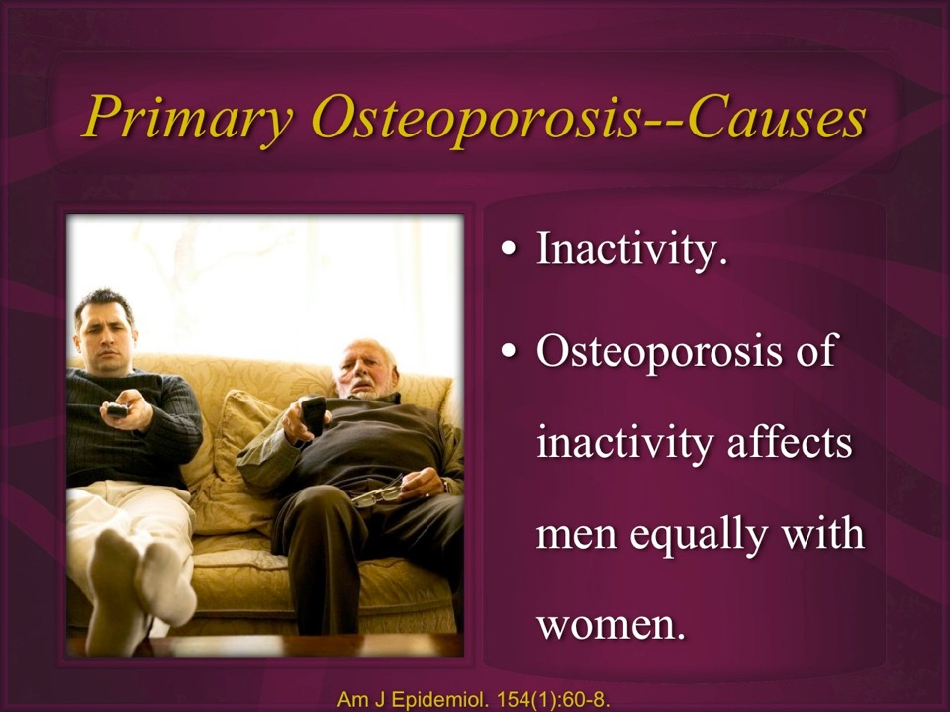

Slide 37
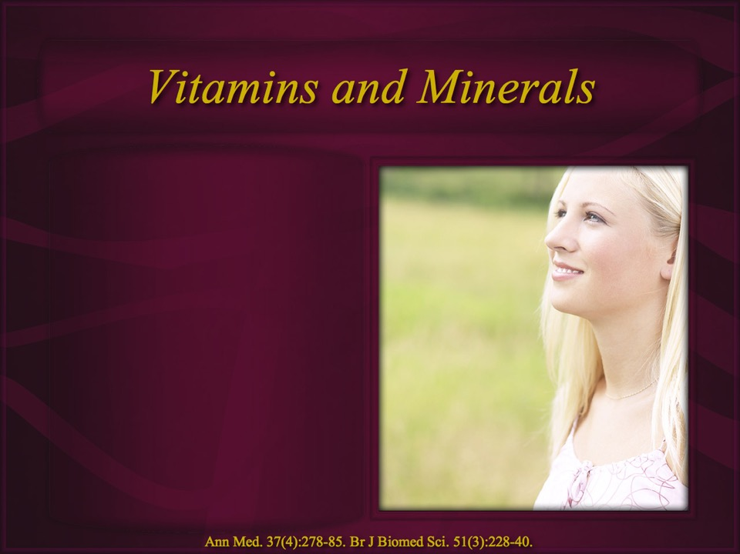

Slide 38

Primary Osteoporosis--Causes
Deficiencies of vitamins D, K, B12, B6 and folate, and minerals magnesium, copper, and boron pre-dispose to osteoporosis.
Ann Med. 2005;37(4):278-85. Br J Biomed Sci. 1994 Sep;51(3):228-40.
Notes:
Ann Med. 2005;37(4):278-85. Related Articles, Links
The role of vitamin D in the prevention of osteoporosis.
Comment in:
Ann Med. 2005;37(4):276-7.
Vieth R.
Department of Nutritional Sciences, Laboratory Medicine and Pathology, University of Toronto, Ontario, Canada. rvieth@mtsinai.on.ca
The need for vitamin D to prevent rickets was the drive for selection of lighter skin color in temperate climates. Anthropologists also know that as human populations developed more sedentary lifestyles, this coincided with a decline in bone quantity, quality, and fracture resistance. Since osteoporosis occurs after the reproductive years, there is no way that natural selection could have adapted our biology to prevent it. However, osteoporosis can be largely prevented by optimizing physical activity, and the vitamin D-related factors of environment, and nutrition. The role of vitamin D3 in osteoporosis is conclusively established from a very simple meta-analysis of the four randomized, placebo-controlled clinical trials into the effect of 20 microg (800 IU) per day. These have all demonstrated that this dose prevents approximately 30% of hip or non-vertebral fractures compared to placebo, in adults older than 65 years. Intakes less than this have never been found effective. The lowest average serum 25-hydroxyvitamin D concentration in any study demonstrating fracture reduction was 74 nmol/L. Thus, 25-hydroxyvitamin D levels in older adults should exceed this amount. The role of vitamin D supplementation is to provide humans with the nutrient in an amount closer to our species' biological norm. This amount of vitamin D results in the optimal function of many aspects of health, including balance and muscle strength that lessen the risk of fracture beyond what is possible via the quality and quantity of bone itself.
Publication Types:
Review
PMID: 16019727 [PubMed - indexed for MEDLINE]
Br J Biomed Sci. 1994 Sep;51(3):228-40. Related Articles, Links
The role of nutrition in osteoporosis.
Bunker VW.
School of Pharmacy and Biomedical Sciences, University of Portsmouth, England, UK.
Osteoporosis-related bone fractures are a significant cause of mortality and morbidity, with women being particularly affected. Osteoporosis is a condition of bone fragility resulting from micro-architectural deterioration and decreased bone mass; adult bone mass depends upon the peak attained and the rate of subsequent loss; each depends on the interaction of genetic, hormonal, environmental and nutritional factors. An adequate supply of calcium is essential to attain maximum bone mass, and adult intakes below about 500 mg/day may predispose to low bone mass. Supplementation with calcium may conserve bone at some skeletal sites, but whether this translates into reduced fracture rates is not clear. Chronically low intakes of vitamin D--and possibly magnesium, boron, fluoride and vitamins K, B12, B6 and folic acid (particularly if co-existing)--may pre-dispose to osteoporosis. Similarly, chronically high intakes of protein, sodium chloride, alcohol and caffeine may also adversely affect bone health. The typical Western diet (high in protein, salt and refined, processed foods) combined with an increasing sedentary lifestyle may contribute to the increasing incidence of osteoporosis in the elderly.
Publication Types:
Review
PMID: 7881322 [PubMed - indexed for MEDLINE]
J Trace Elem Med Biol. 2002;16(3):149-54.
Meat diets and fragile bones: inferences about osteoporosis.
Klevay LM, Wildman RE.
USDA, ARS, Grand Forks Human Nutrition Research Center, ND 58202-9034, USA. lklevay@gfhnrc.ars.usda.gov
Because women supplemented with copper have improved bone density and femurs of rats deficient in copper have decreased mechanical strength, the hypothesis that mice fed meat would have fragile bones was tested. Mice fed sirloin are hypercholesterolemic in comparison to mice fed meat and beef liver because of a relative deficiency of copper compared to zinc. Male, albino, Swiss mice were fed trimmed sirloin or sirloin supplemented with beef liver (3/1 by weight). After 62 days, when hypercholesterolemia was detected, mice were killed and femurs were removed, cleaned and dried. Breaking strength was measured carefully at room temperature. The meat diet produced femurs 23% weaker (8.8 +/- 0.70 N/mg.100 vs 11.4 +/- 0.92, mean +/- SE, p < 0.04) in comparison to meat plus liver. Calcium, copper and phosphorus concentrations were unaffected but zinc was mildly elevated in the weak bones (426 +/- 17.5 pg/g vs 355 +/- 9.23, p < 0.002). These elements generally are unaltered in osteoporotic bones. Because copper deficiency produces osteoporosis in animals and people and because the Western diet often is low in copper, further tests of the hypothesis that diets low in copper contribute to osteoporosis are warranted.
Publication Types:
Research Support, Non-U.S. Gov't
Research Support, U.S. Gov't, Non-P.H.S.
PMID: 12437150 [PubMed - indexed for MEDLINE]

Slide 39


Schedule
Int J Mol Sci. 14(5):10063-74.
Notes:
Int J Mol Sci. 2013 May 10;14(5):10063-74. doi: 10.3390/ijms140510063.
Melatonin effects on hard tissues: bone and tooth.
Liu J¹, Huang F, He HW.
Author information
1Guanghua School of Stomatology, Hospital of Stomatology, Sun Yat-sen University, Guangzhou 510055, China. gzhfang@yahoo.com.cn.
Abstract
Melatonin is an endogenous hormone rhythmically produced in the pineal gland under the control of the suprachiasmatic nucleus (SCN) and the light/dark cycle. This indole plays an important role in many physiological processes including circadian entrainment, blood pressure regulation, seasonal reproduction, ovarian physiology, immune function, etc. Recently, the investigation and applications of melatonin in the hard tissues bone and tooth have received great attention. Melatonin has been investigated relative to boneremolding, osteoporosis, osseointegration of dental implants and dentine formation. In the present review, we discuss the large body of published evidence and review data of melatonin effects on hard tissues, specifically, bone and tooth.
PMID: 23665905

Slide 40
Schedule and Melatonin
Meal times.
Bed time.
Int J Mol Sci. 14(5):10063-74.
Notes:
Int J Mol Sci. 2013 May 10;14(5):10063-74. doi: 10.3390/ijms140510063.
Melatonin effects on hard tissues: bone and tooth.
Liu J¹, Huang F, He HW.
Author information
1Guanghua School of Stomatology, Hospital of Stomatology, Sun Yat-sen University, Guangzhou 510055, China. gzhfang@yahoo.com.cn.
Abstract
Melatonin is an endogenous hormone rhythmically produced in the pineal gland under the control of the suprachiasmatic nucleus (SCN) and the light/dark cycle. This indole plays an important role in many physiological processes including circadian entrainment, blood pressure regulation, seasonal reproduction, ovarian physiology, immune function, etc. Recently, the investigation and applications of melatonin in the hard tissues bone and tooth have received great attention. Melatonin has been investigated relative to boneremolding, osteoporosis, osseointegration of dental implants and dentine formation. In the present review, we discuss the large body of published evidence and review data of melatonin effects on hard tissues, specifically, bone and tooth.
PMID: 23665905

Slide 41
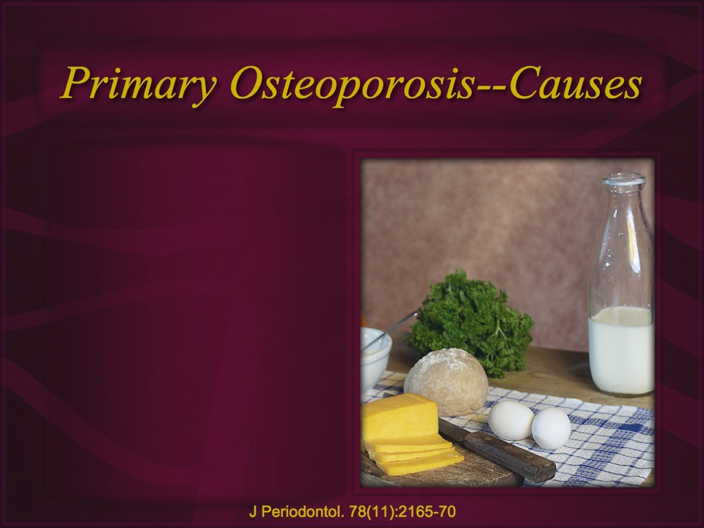

Slide 42
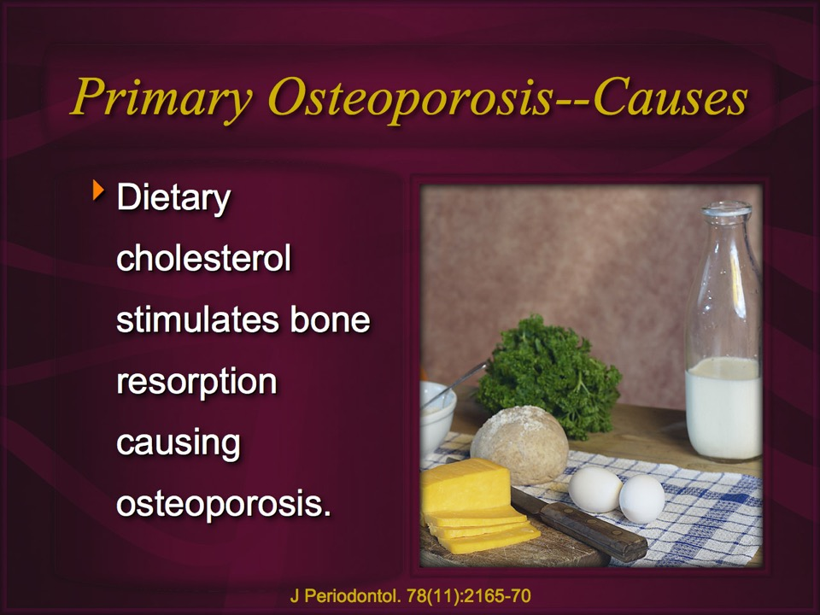

Slide 43
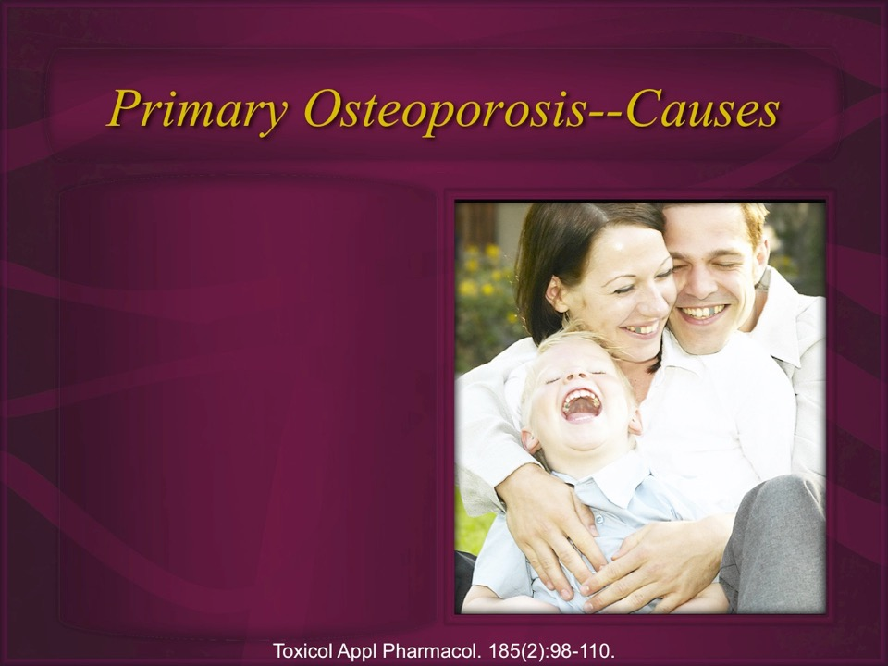
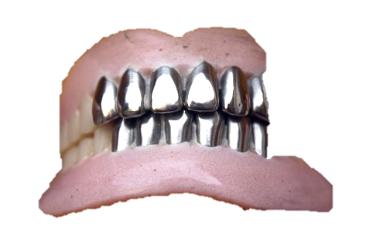

Slide 44
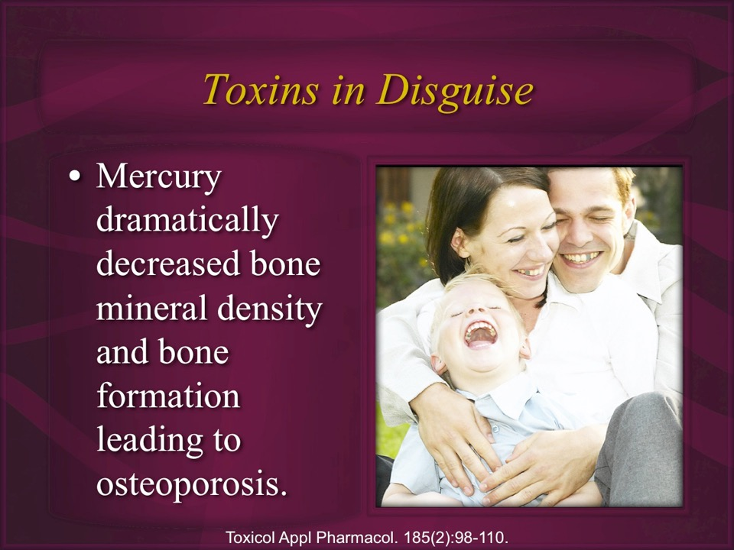

Slide 45
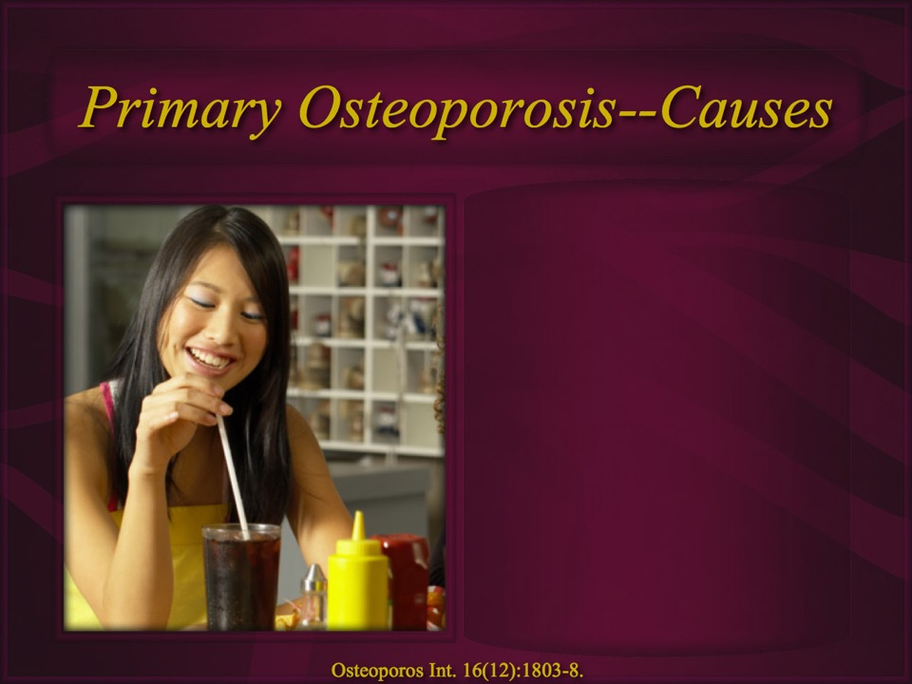

Slide 46
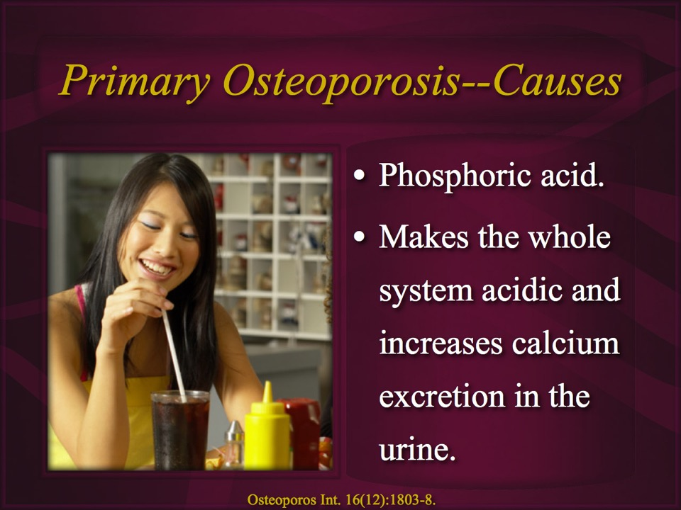

Slide 47
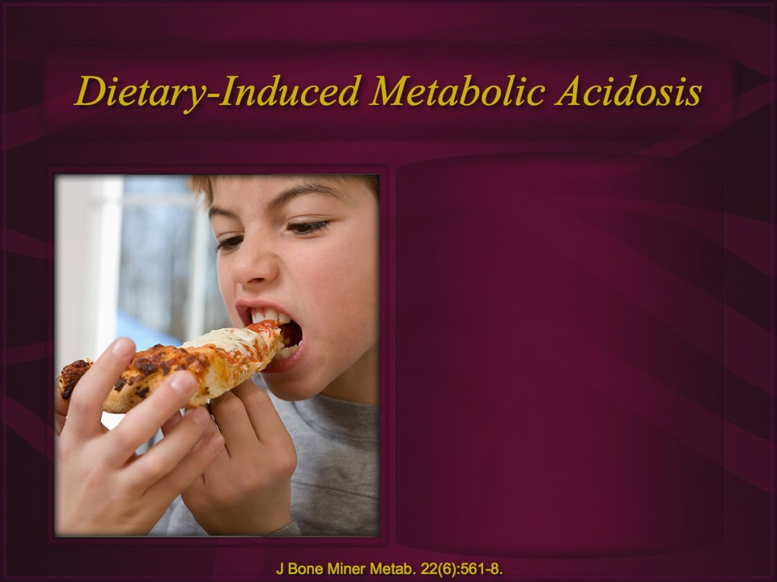

Slide 48
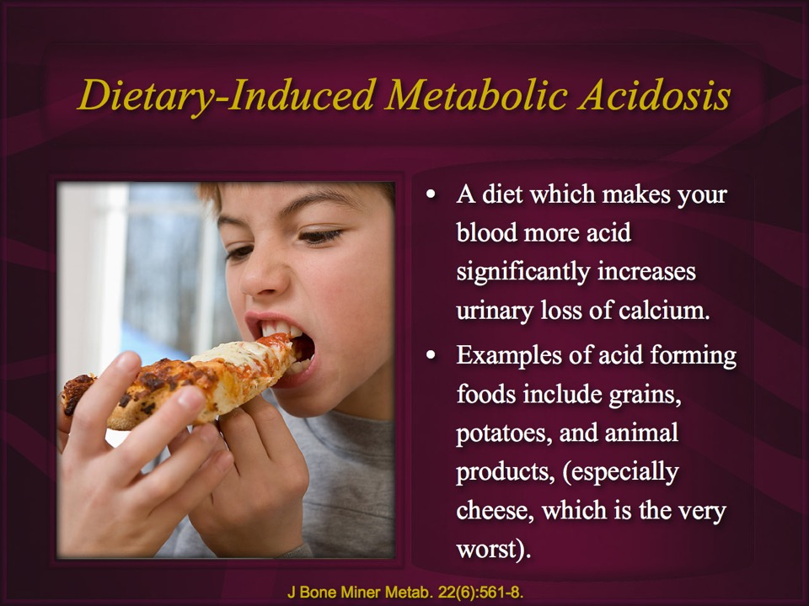

Slide 49
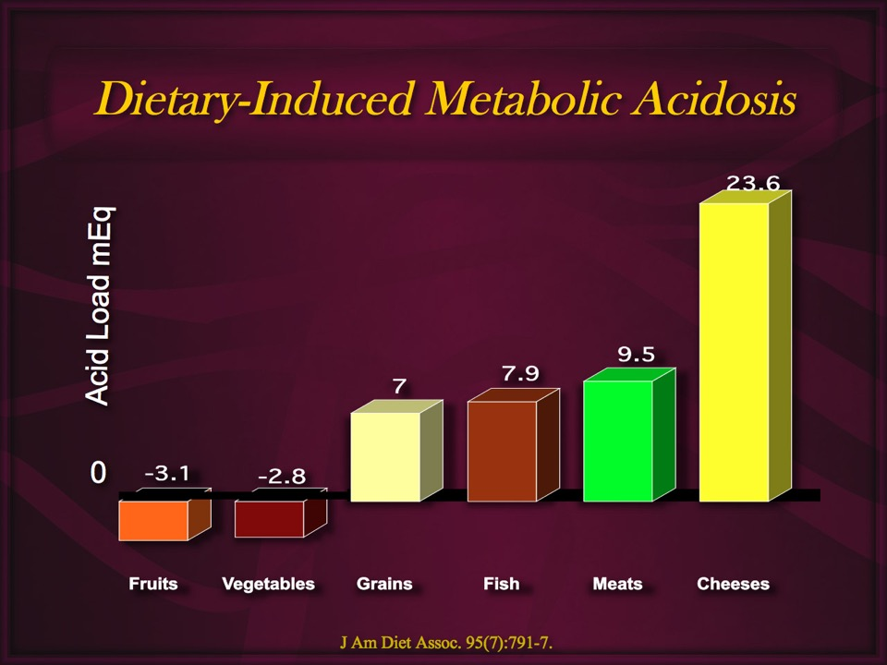
Notes:
Remer T, Manz F. Potential renal acid load of foods and its influence on urine pH. J Am Diet Assoc. 1995 Jul;95(7):791-7.
The purpose of this study was to calculate the potential renal acid load (PRAL) of selected, frequently consumed foods. A physiologically based calculation model was recently validated to yield an appropriate estimate of renal net acid excretion (NAE); the model depends primarily on nutrient intake data. When nutrient data from actual food composition tables were used, the calculation model yielded PRAL values that ranged from an average maximum of 23.6 mEq/100 g for certain hard cheeses over 0 mEq/100 g for fats and oils to an average minimum of approximately -3 mEq/100 g for fruits and fruit juices and vegetables. By means of these PRAL data (summed according to the amounts of foods and beverages consumed daily and by an estimate of excretion of organic acids [based on body size]), the daily NAE can be calculated. This calculation methodology, primarily based on PRAL, allows an appropriate prediction of the effects of diet on the acidity of urine. For practical applicability in dietetic prevention of recurrent urolithiasis or in other fields of dietetics, the additionally determined correlation (r = .83; P < .001) between NAE and urine pH can be used to ascertain NAE target values for a desired urine pH modification.

Slide 50
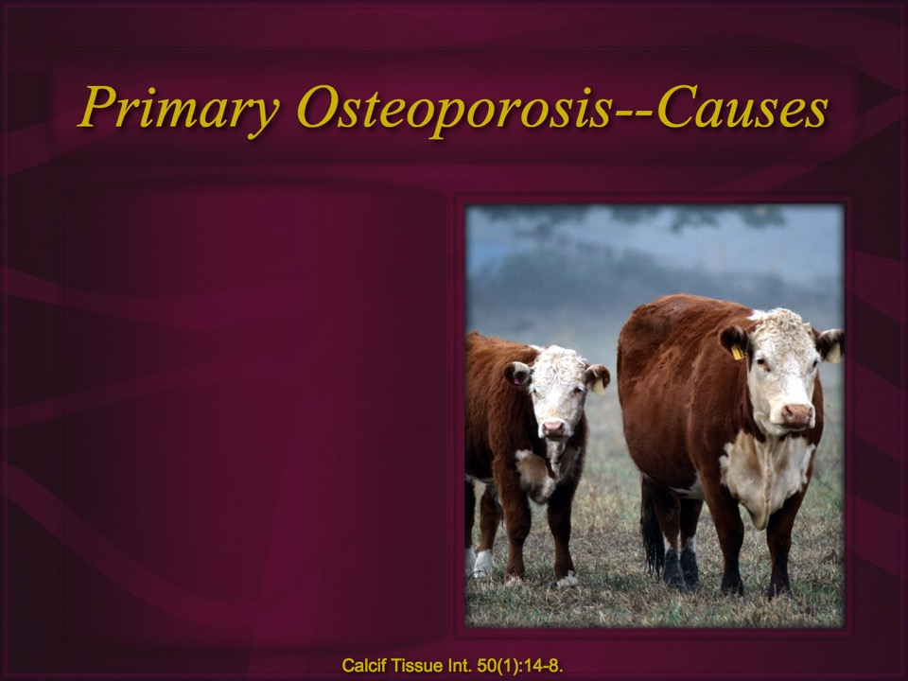

Slide 51
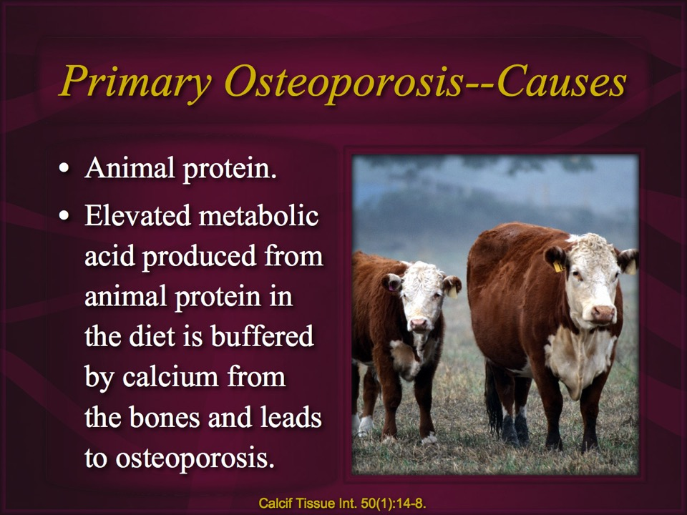

Slide 52
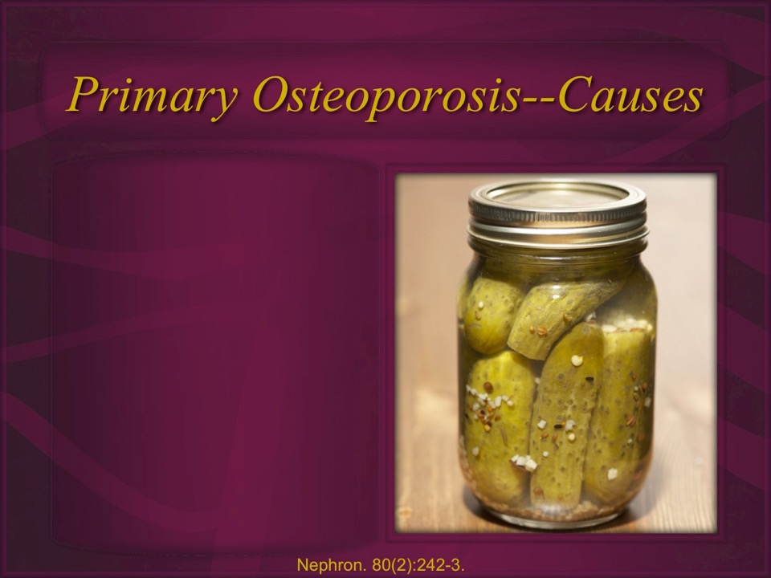

Slide 53
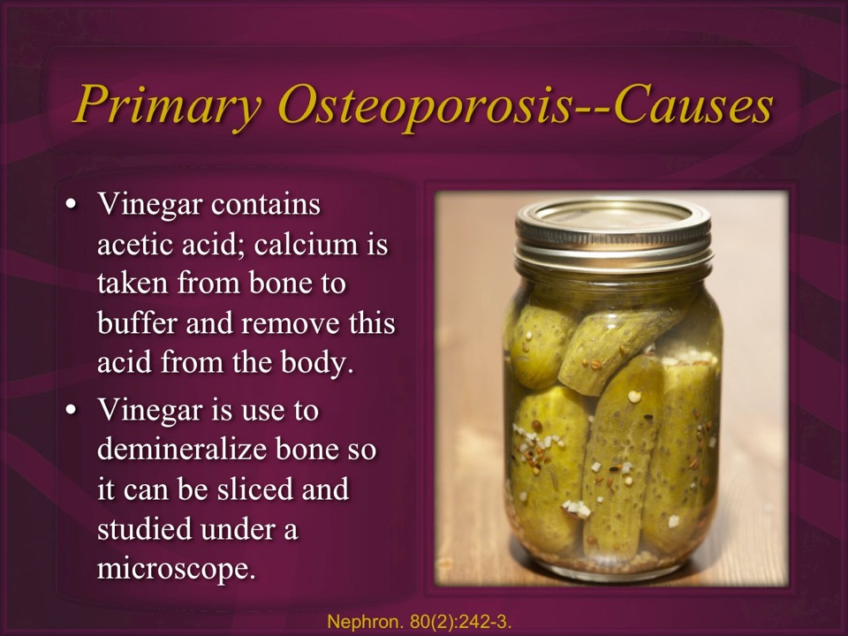

Slide 54
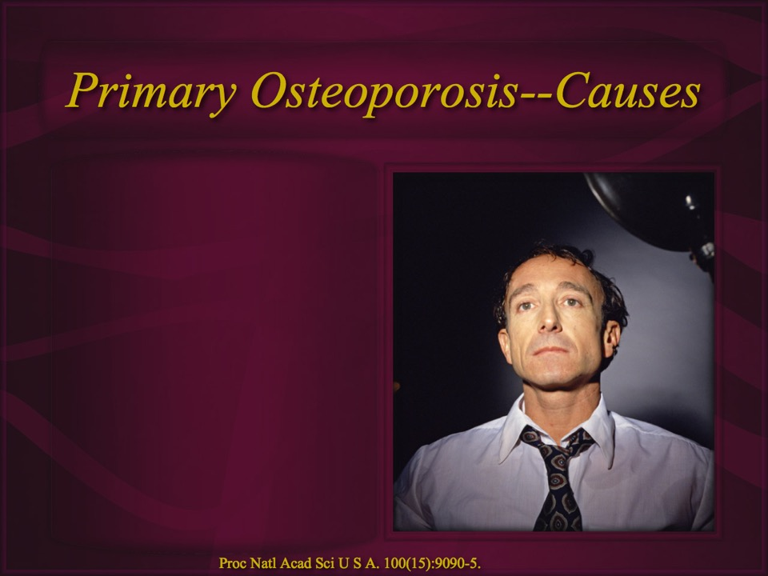

Slide 55


Slide 56


Slide 57


Slide 58


Slide 59


Slide 60


Slide 61


Slide 62



Slide 63


Slide 64


Slide 65


Slide 66


Slide 67


Slide 68


Slide 69


Slide 70


Slide 71


Slide 72


Slide 73


Slide 74


Slide 75


Slide 76


Slide 77


Slide 78


Slide 79


Slide 80


Slide 81


Slide 82


Slide 83


Slide 84


Slide 85


Slide 86


Slide 87


Slide 88


Slide 89


Slide 90


Slide 91


Slide 92


Slide 93


Eskimos: Osteoporosis, Calcium & Protein
High levels of physical activity.
2000 mg to 2500 mg of calcium a day.
Worst osteoporosis in the world.
Daily protein intake 250-400 gm.
Am J Clin Nutr. 1974 Sep;27(9):916-25.
Notes:
Bone mineral content of North Alaskan Eskimos.
Mazess RB, Mather W.
Am J Clin Nutr. 1974 Sep;27(9):916-25. Links
PMID: 4412233 [PubMed - indexed for MEDLINE]
Hum Biol. 1975 Feb;47(1):44-63.
Bone mineral content in Canadian Eskimos.
Mazess RB, Mather WE.
PMID: 1126702 [PubMed - indexed for MEDLINE]

Slide 94



Slide 95


Slide 96


Slide 97


Slide 98


Slide 99


Slide 100


Slide 101


Slide 102


Slide 103

l

Slide 104





Slide 105




Protein! Beef, Broccoli or Tomatoes?

Slide 106




Protein! Beef, Broccoli or Tomatoes?
Notes:
https://tools.myfooddata.com/nutrition-comparison/170379-170457-170693/200cals-200cals-200cals/1-1-1/1#

Slide 107

Protein! Beef, Broccoli or Tomatoes?
16.6x4=66.4 or 33.2%
9.8x4=39.2 or 19.6%
11.1X4=44.4cal or 22.2%
Notes:
https://tools.myfooddata.com/nutrition-comparison/170379-170457-170693/200cals-200cals-200cals/1-1-1/1#
.1

Slide 108

Calcium! Beef, Broccoli or Tomatoes?

Slide 109




Slide 110


Slide 111


Slide 112


Slide 113


Slide 114


Horsetail Tea (Equisetum Arvense)
Use of horsetail tea, with its silica:
Increases bone formation, cortical bone thickness and trabecula width.
Decreases bone resorption.
Green beans also helpful.
Caspian J Intern Med. 10(2):176-182.
Notes:
Arbabzadegan N, Moghadamnia AA, Kazemi S, Nozari F, Moudi E, Haghanifar S. Effect of equisetum arvense extract on bone mineral density in Wistar rats via digital radiography. Caspian J Intern Med. 2019 Spring;10(2):176-182.
A diet containing 120 mg/kg equisetum arvense extract resulted in increased mandibular bone mineral density.
Menghini L, Ferrante C, Leporini L, Recinella L, Chiavaroli A, Leone S, Pintore G, Vacca M, Orlando G, Brunetti L. A natural formula containing lactoferrin, Equisetum arvensis, soy isoflavones and vitamin D3 modulates bone remodeling and inflammatory markers in young and aged rats. J Biol Regul Homeost Agents. 2016 Oct-Dec;30(4):985-996.
In conclusion, our findings corroborate the rational use of natural formula in the prevention and management of osteoporotic disease.
Kotwal SD, Badole SR. Anabolic therapy with Equisetum arvense along with bone mineralising nutrients in ovariectomized rat model of osteoporosis. Indian J Pharmacol. 2016 May-Jun;48(3):312-5.
We report a significant change in formation and resorption markers of bone as well as in cortical bone thickness and trabecular width
Price CT, Koval KJ, Langford JR. Silicon: a review of its potential role in the prevention and treatment of postmenopausal osteoporosis. Int J Endocrinol. 2013;2013:316783. doi: 10.1155/2013/316783. Epub 2013 May 15.
Physicians are aware of the benefits of calcium and vitamin D supplementation. However, additional nutritional components may also be important for bone health. There is a growing body of the scientific literature which recognizes that silicon plays an essential role in bone formation and maintenance. Silicon improves bone matrix quality and facilitates bone mineralization. Increased intake of bioavailable silicon has been associated with increased bone mineral density. Silicon supplementation in animals and humans has been shown to increase bone mineral density and improve bone strength. Dietary sources of bioavailable silicon include whole grains, cereals, beer, and some vegetables such as green beans. Silicon in the form of silica, or silicon dioxide (SiO2), is a common food additive but has limited intestinal absorption. More attention to this important mineral by the academic community may lead to improved nutrition, dietary supplements, and better understanding of the role of silicon in the management of postmenopausal osteoporosis.

Slide 115

Watering Your Bone Garden
Good hydration is significantly predictive of strong bones.
Dehydration increases risk of bone loss by as much as 5 fold.
Eur Rev Aging Phys Act. 2021 May 31;18(1):7.
Notes:
Kopiczko A, Adamczyk JG, Gryko K, Popowczak M. Bone mineral density in elite masters athletes: the effect of body composition and long-term exercise. Eur Rev Aging Phys Act. 2021 May 31;18(1):7.
Abstract
Background: The purpose of the study was to examine how bone mineral density (BMD) is related to body composition depending on the practiced sport (endurance, speed-power, throwing sports) in participants of the World Masters Athletics Championship.
Methods: Dual-energy X-ray absorptiometry (DXA) was used to determine BMD and bone mass (BMC). Body composition was analyzed by means of the JAWON Medical X-scan analyzer using bioelectrical impedance methods. Percentage body fat (%BF), body fat mass (BFM), lean body mass (LBM), total body water (TBW), soft lean mass (SLM), intracellular water (ICW), and extracellular water (ECW) were evaluated.
Results: Among men, the most important variables affecting the BMD norm were LBM (OR = 32.578; p = 0.023), ECW (OR = 0.003; p = 0.016) and ICW (OR = 0.011; p = 0.031), in the distal part and SLM (OR = 5.008; p = 0.020) and ICW (0.354, p = 0.008) in the proximal part. In women, the most important predictors of normal BMD were ICW (OR = 10.174; p = 0.003) and LBM (OR = 0.470; p = 0.020) in the distal part and ICW (OR = 5.254; p = 0.038) in the proximal part.
Conclusion: The representatives of strength based events had the most advantageous BMD levels. The condition of bone tissue evaluated by BMC and BMD of the forearm in masters athletes was strongly determined by the level of lean body components and the type of sports training associated with the track and field event. In the most important predictors of the BMD norm were also hydration components ECW and ICW. However, this relationship requires more research on the nature and mechanisms of these interactions.

Slide 116


Slide 117


Slide 118


Slide 119


Slide 120


Slide 121


Slide 122

Banking on Your Bones
Weight bearing exercise.
Reduce protein and grain consumption.
Choose to abandon the calcium thieves.
20 minutes of daily sun on 25% of your body.
Eat a plant based diet rich in naturally occurring calcium.

Slide 123


Slide 124


Slide 125


Slide 127


Slide 128


Slide 129

NorthernLightsHealthEducation.com

Slide 130
Osteoporosis:
Nothing to Crack Up About
Notes:
When Sarah’s osteoporosis scan results came back, she was shocked. Osteoporosis? Immediately she came to see me. There is always the risk of multiple fractures with osteoporosis, the bones can be painful and you’re always afraid you’re going to fall down and break something. We worked up a program for Sarah based on the principles in this upcoming presentation, “Osteoporosis: Nothing to Crack Up About” Over the next year Sarah practiced these principles faithfully. At her next scan, her bone density had picked dramatically. Don’t miss this presentation, apply its well-researched advice, and feel confident about the strength of your bones.
Story: Sarah (skau)
Story
Benefit/problem solved
multiplying fractures
Painful bones
Fear of falling
Bullet points
Choosing the right foods
Making the sun your friend
Inspire
^3% one year
Call to action
Take in his presentation, apply its well researched advice and cease
worrying yourself sick over osteoporosis.

