Slide 1
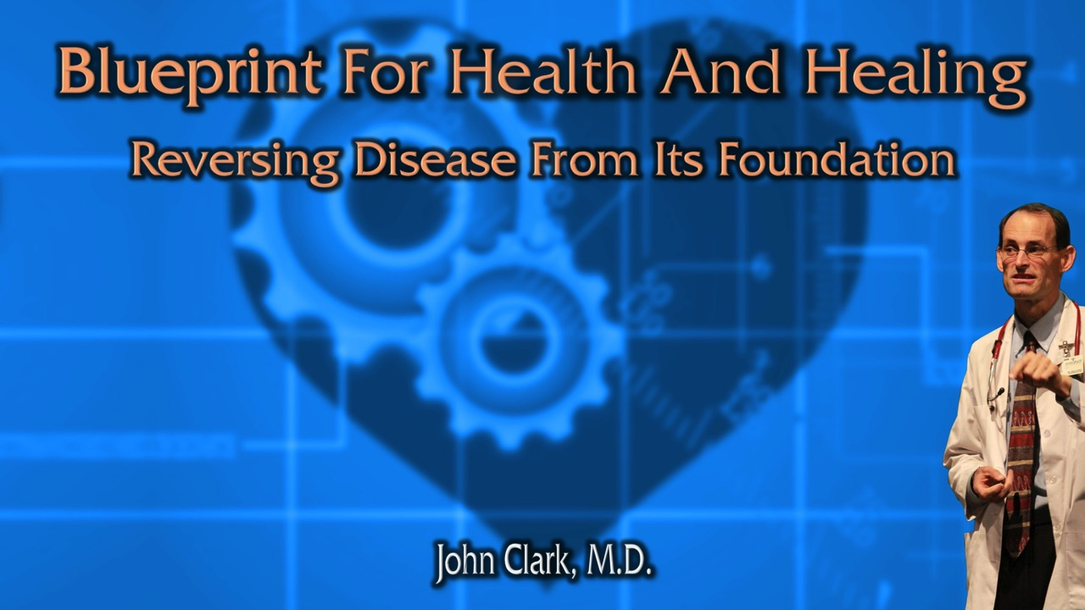
If We Would Be But More Grateful
The Power and Science Of Gratitude

Slide 2
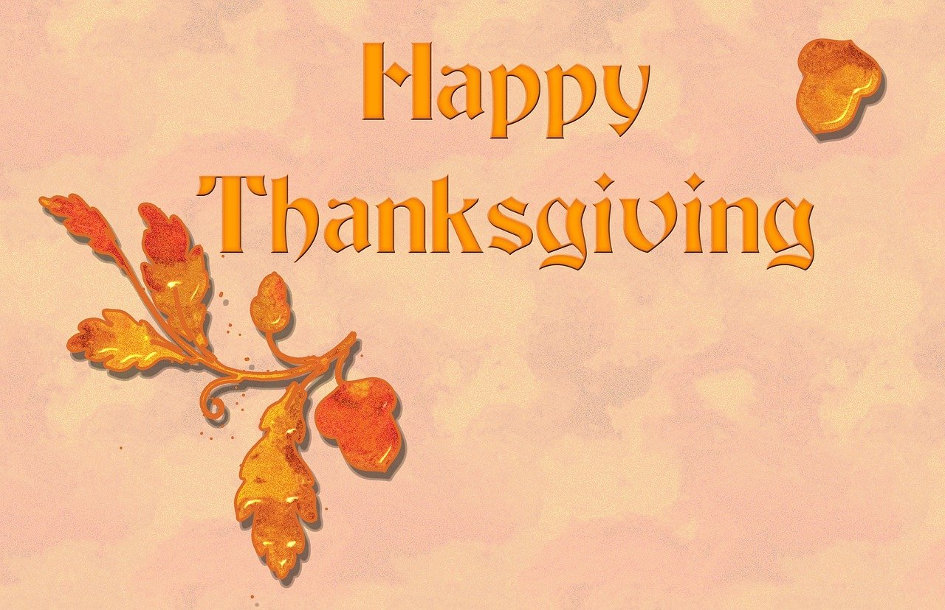
New Year
If We Would Be But More Grateful

Slide 3

THE COVETOUS MAN IS ALWAYS POOR
TRUE PROSPERITY IS TO BE GRATEFUL FOR WHAT YOU HAVE
Notes:
TP: What is Gratitude? What does the Dictionary say?

Slide 4
Webster’s
GRATITUDE, n. [L. gratitudo, from gratus, pleasing. See Grace.]
An emotion of the heart, excited by a favor or benefit received; a sentiment of kindness or good will towards a benefactor; thankfulness.
Notes:
1828
Gratitude is an agreeable emotion, consisting in or accompanied with good will to a benefactor, and a disposition to make a suitable return of benefits or services, or when no return can be made, with a desire to see the benefactor prosperous and happy.
Gratitude is a virtue of the highest excellence, as it implies a feeling and generous heart, and a proper sense of duty.
The love of God is the sublimest gratitude.
TP: what other words describe gratefulness? What does the Thesaurus say?

Slide 5
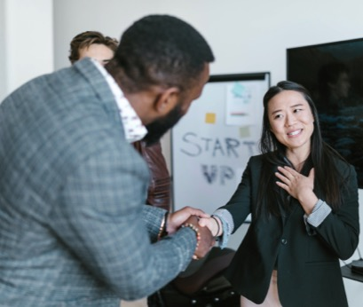
Thesaurus
Acknowledgment
Obligation
Recognition
Thanks
Appreciativeness
Grace
Gratefulness
Honor
Indebtedness
Praise
Requital
Response
Responsiveness
Thankfulness
Thanksgiving
Sense Of Obligation
Notes:
We will use these words interchangeably.
TP: Ultimately, to whom is our gratefulness directed?

Slide 6
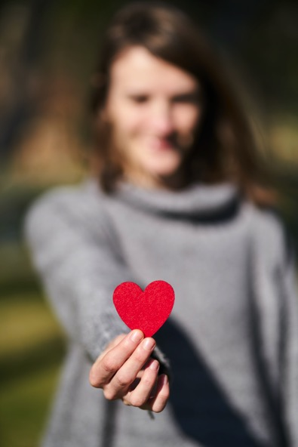
Gratitude Improves Your Health
“‘A merry [rejoicing] heart doeth good like a medicine.’ Proverbs 17:22.
“Gratitude, rejoicing, benevolence, trust in God’s love and care—these are health’s greatest safeguard.” {MH 281.3}

Slide 7

A Grateful Outlook—Recognizing And Appreciating The Positives In Our Lives can:
Decrease psychological stress and harmful stress hormones.
Psychoneuroendocrinology. 88:144-152.
Notes:
Salzmann S, Euteneuer F, Strahler J, Laferton JAC, Nater UM, Rief W. Optimizing expectations and distraction leads to lower cortisol levels after acute stress. Psychoneuroendocrinology. 2018 Feb;88:144-152. doi: 10.1016/j.psyneuen.2017.12.011. Epub 2017 Dec 21. PMID: 29278839.

Slide 8
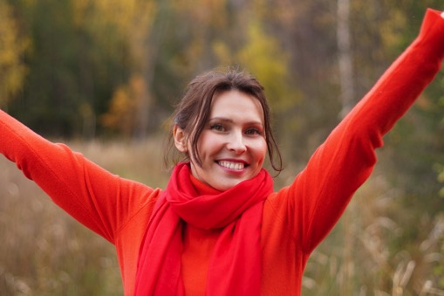
A Grateful Outlook—Recognizing And Appreciating The Positives In Our Lives can:
Make us more optimistic.
Optimism, in turn, makes us happier, improves our health, and has been shown to increase lifespan by several years.
Optimism has been shown to decrease depression, anxiety, PTSD and suicides.
J Psychiatr Res. 149:168-176.
Notes:
McGuire AP, Fagan JG, Tsai J, Merians AN, Nichter B, Norman SB, Southwick SM, Pietrzak RH. Dispositional gratitude predicts the development of psychopathology and suicidal behaviors: Results from a 7-year population-based study of U.S. military veterans. J Psychiatr Res. 2022 May;149:168-176. doi: 10.1016/j.jpsychires.2022.02.028. Epub 2022 Mar 2. PMID: 35278781; PMCID: PMC9017955.
Tomczyk J, Nezlek JB, Krejtz I. Gratitude Can Help Women At-Risk for Depression Accept Their Depressive Symptoms, Which Leads to Improved Mental Health. Front Psychol. 2022 Apr 7;13:878819. doi: 10.3389/fpsyg.2022.878819. PMID: 35465539; PMCID: PMC9022718.

Slide 9
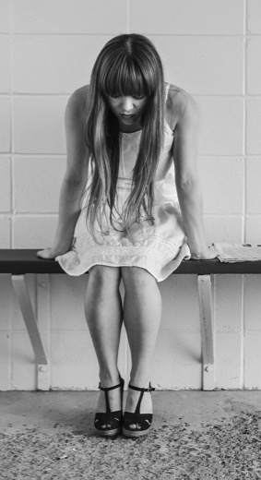
A Grateful Outlook—Recognizing And Appreciating The Positives In Our Lives can:
Showing gratitude to others decreases the likelihood of them being suicidal.
Cien Saude Colet. 20(6):1731-40.
Notes:
Gutierrez DM, Sousa AB, Grubits S. Suicidal ideation and attempted suicide in elderly people - subjective experiences. Cien Saude Colet. 2015 Jun;20(6):1731-40. English, Portuguese. doi: 10.1590/1413-81232015206.02242015. PMID: 26060951.

Slide 10
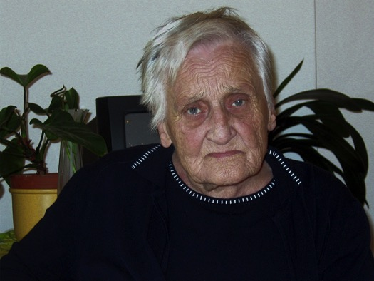
A Grateful Outlook—Recognizing And Appreciating The Positives In Our Lives can:
Decelerate the effects of neurodegeneration, helping to stave off Alzheimer’s and other dementias.
Arch Gerontol Geriatr. 100:104645.
Notes:
Tani Y, Koyama Y, Doi S, Sugihara G, Machida M, Amagasa S, Murayama H, Inoue S, Fujiwara T, Shobugawa Y. Association between gratitude, the brain and cognitive function in older adults: Results from the NEIGE study. Arch Gerontol Geriatr. 2022 May-Jun;100:104645. doi: 10.1016/j.archger.2022.104645. Epub 2022 Jan 30. PMID: 35123174.

Slide 11
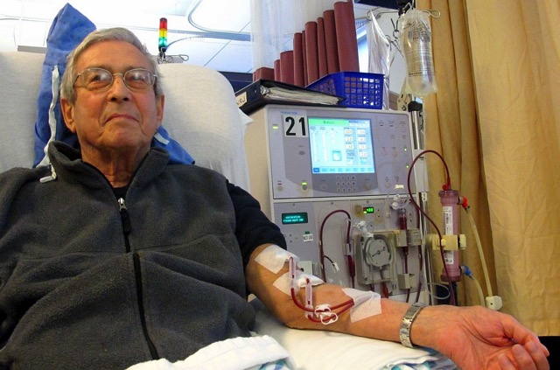
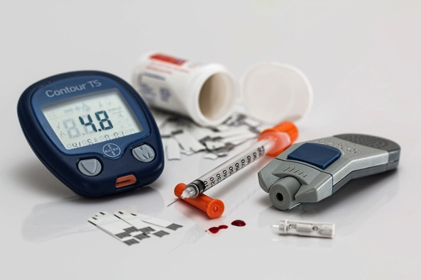
A Grateful Outlook—Recognizing And Appreciating The Positives In Our Lives can:
Lower blood sugar and HbA1c levels.
Elevated HbA1c levels have been associated with chronic kidney disease, cancer, and diabetes.
J Occup Environ Med. 61(5):357-372.
Notes:
Lord D, Deem A, Pitchford P, Bray-Richardson E, Drennon M. A 6-Week Worksite Positivity Program Leads to Greater Life Satisfaction, Decreased Inflammation, and a Greater Number of Employees With A1C Levels in Range. J Occup Environ Med. 2019 May;61(5):357-372. doi: 10.1097/JOM.0000000000001527. PMID: 30614897.

Slide 12
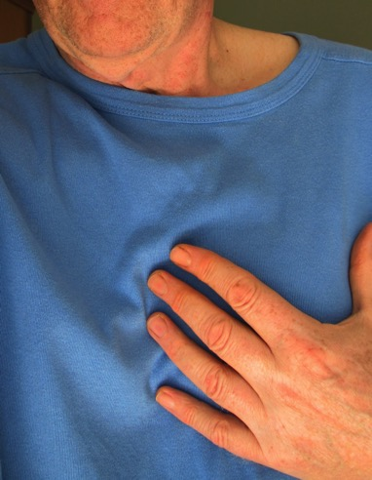
A Grateful Outlook—Recognizing And Appreciating The Positives In Our Lives can:
Makes heart failure patients less fatigued, less depressed and more optimistic about controlling their symptoms.
Spiritual Clin Pract (Wash D C ). 2(1):5-17.
Notes:
Mills PJ, Redwine L, Wilson K, Pung MA, Chinh K, Greenberg BH, Lunde O, Maisel A, Raisinghani A, Wood A, Chopra D. The Role of Gratitude in Spiritual Well-being in Asymptomatic Heart Failure Patients. Spiritual Clin Pract (Wash D C ). 2015 Mar;2(1):5-17. doi: 10.1037/scp0000050. PMID: 26203459; PMCID: PMC4507265.

Slide 13
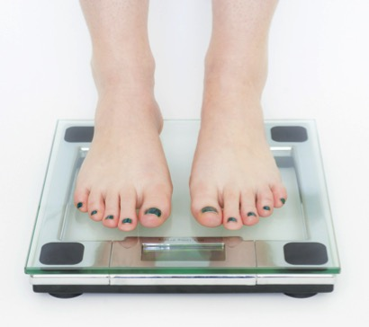
A Grateful Outlook—Recognizing And Appreciating The Positives In Our Lives can:
Reduce the amount of fatty comfort foods you eat, thus helping to combat obesity.
Notes:
Wolfe WL, Patterson K. Comparison of a gratitude-based and cognitive restructuring intervention for body dissatisfaction and dysfunctional eating behavior in college women. Eat Disord. 2017 Jul-Sep;25(4):330-344. doi: 10.1080/10640266.2017.1279908. Epub 2017 Jan 31. PMID: 28139177.

Slide 14
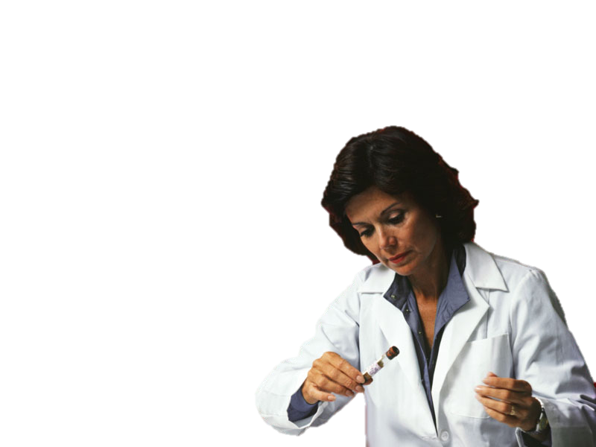
A Grateful Outlook—Recognizing And Appreciating The Positives In Our Lives can:
Lowers triglycerides making heart attacks less likely.
Sci Rep. 2022 Apr 11;12(1):6034.
Notes:
Hartanto A, Majeed NM, Lua VYQ, Wong J, Chen NRY. Dispositional gratitude, health-related factors, and lipid profiles in midlife: a biomarker study. Sci Rep. 2022 Apr 11;12(1):6034. doi: 10.1038/s41598-022-09960-w. PMID: 35410991; PMCID: PMC9001645.

Slide 15
A Grateful Heart Is A Healthy Heart
Appreciation Gratitude
Perceiving Blessings
Verses
Blaming Others
Decreased Risk of Another Heart Attack
Increased Risk of Another Heart Attack
Notes:
“Glen Affleck a researcher at the University of Connecticut asked patients to rate the degree to which various factors were seen as responsible for their heart attacks, and also asked whether or not they had seen any possible benefits, gains, or advantages from their illness. Cardiac patients who blamed their heart attack on others were more likely to suffer yet another heart attack within the next eight years. On the other hand, perceiving benefits and gains from an initial heart attack, including becoming more appreciative of life, was related to a reduced risk for subsequent attack.”
From the book Thanks! How Practicing Gratitude Can Make You Happier by Robert A. Emmons, PhD
Ronaldson A, Molloy GJ, Wikman A, Poole L, Kaski JC, Steptoe A. Optimism and recovery after acute coronary syndrome: a clinical cohort study. Psychosom Med. 2015 Apr;77(3):311-8. doi: 10.1097/PSY.0000000000000155. PMID: 25738438; PMCID: PMC4396437.

Slide 16
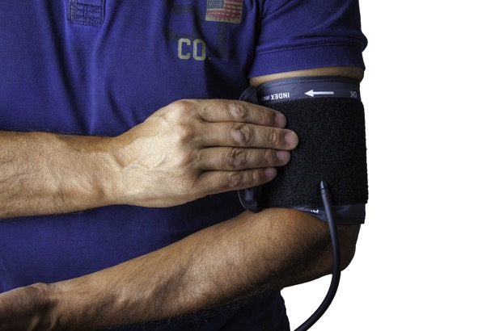
A Grateful Outlook—Recognizing And Appreciating The Positives In Our Lives can:
Lower dangerously high blood pressure.
Emotion. 21(7):1357-1365.
Notes:
Newman DB, Gordon AM, Mendes WB. Comparing daily physiological and psychological benefits of gratitude and optimism using a digital platform. Emotion. 2021 Oct;21(7):1357-1365. doi: 10.1037/emo0001025. Epub 2021 Nov 15. PMID: 34780238; PMCID: PMC9070006.

Slide 17
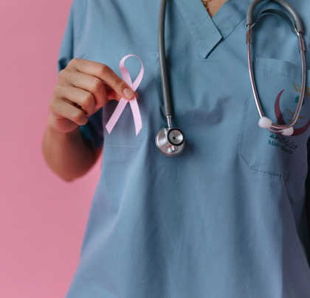
A Grateful Outlook—Recognizing And Appreciating The Positives In Our Lives can:
Improve long term survival in cancer patients.
Cancer Nurs. 16(5):354-61.
Notes:
Carter BJ. Long-term survivors of breast cancer. A qualitative descriptive study. Cancer Nurs. 1993 Oct;16(5):354-61.

Slide 18
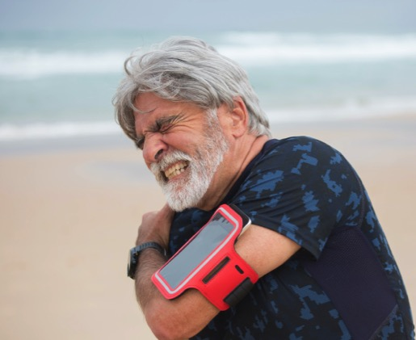
A Grateful Outlook—Recognizing And Appreciating The Positives In Our Lives can:
Gratitude reduces whole body inflammation:
TNF-𝛂 and IL-6 decrease as gratitude increases.
Brain Behav Immun. 2021 Jul;95:444-453.
Notes:
TP: I am happy gratitude improves our health. Did you know gratitude improves our lives too?
Hazlett LI, Moieni M, Irwin MR, Haltom KEB, Jevtic I, Meyer ML, Breen EC, Cole SW, Eisenberger NI. Exploring neural mechanisms of the health benefits of gratitude in women: A randomized controlled trial. Brain Behav Immun. 2021 Jul;95:444-453. doi: 10.1016/j.bbi.2021.04.019. Epub 2021 Apr 28. PMID: 33932527.

Slide 19
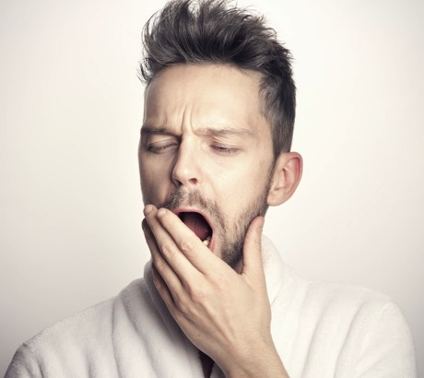
A Grateful Outlook—Recognizing And Appreciating The Positives In Our Lives can:
Help alleviate insomnia, giving better sleep quality.
Behav Sleep Med. 17(1):41-48.
Notes:
Alkozei A, Smith R, Kotzin MD, Waugaman DL, Killgore WDS. The Association Between Trait Gratitude and Self-Reported Sleep Quality Is Mediated by Depressive Mood State. Behav Sleep Med. 2019 Jan-Feb;17(1):41-48. doi: 10.1080/15402002.2016.1276017. Epub 2017 Jan 27. PMID: 28128978.
Wood AM, Joseph S, Lloyd J, Atkins S. Gratitude influences sleep through the mechanism of pre-sleep cognitions. J Psychosom Res. 2009 Jan;66(1):43-8. doi: 10.1016/j.jpsychores.2008.09.002. Epub 2008 Nov 22. PMID: 19073292.

Slide 20
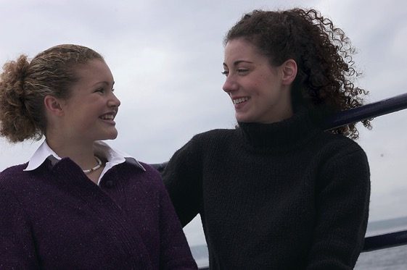
Health Tonic
“Nothing tends more to promote health of body and of soul than does a spirit of gratitude and praise…If we would give more expression to our faith, rejoice more in the blessings that we know we have,--the great mercy and love of God,--we should have more faith and greater joy.” MH 251

Slide 21
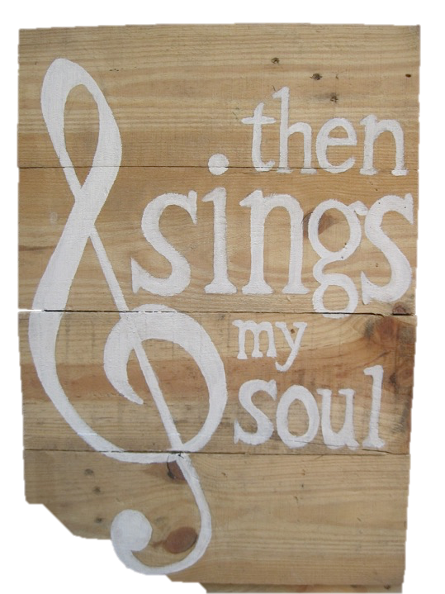
"Whoso offereth praise," says the Creator, "glorifieth Me." Psalm 50:23.
All the inhabitants of heaven unite in praising God. Let us learn the song of the angels now, that we may sing it when we join their shining ranks. {PP 289.3}
“While I live will I praise the Lord: I will sing praises unto my God while I have any being.” Psalms 146:2
Notes:
It is the great circle of beneficence!
TP: are all grateful?

Slide 22

The wicked are characterized as unthankful.
“This know also, that in the last days perilous times shall come. For men shall be lovers of their own selves, covetous, boasters, proud, blasphemers, disobedient to parents, unthankful,” 2 Timothy 3:1-2.
“Because that, when they knew God, they glorified him not as God, neither were thankful; but became vain in their imaginations, and their foolish heart was darkened.” Romans 1:21.
Notes:
TP: Why be grateful? What are the benefits?

Slide 23
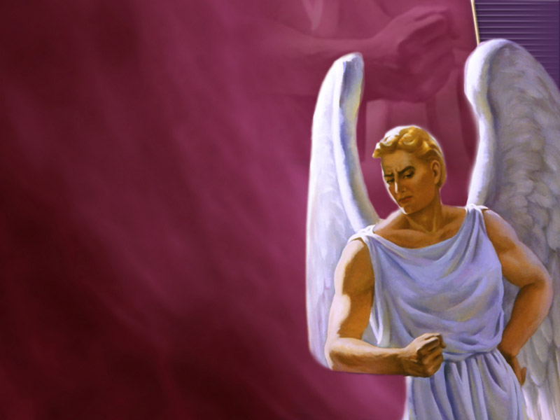
“He had been highly exalted; but this did not call forth from him gratitude and praise to his Creator. He aspired to the height of God himself.” {1SP 18.1}

Slide 24
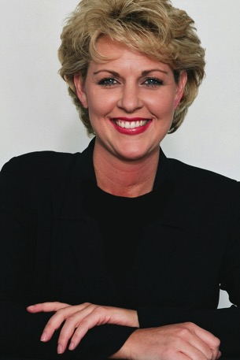
Gratitude Improves Our Life.

Slide 25

Gratitude generates good feelings.
Surprise, surprise: gratitude actually feels good.
Gratitude is just happiness that we recognize after-the-fact to have been caused by the kindness of others.
Gratitude doesn't just make us happier, it is happiness in and of itself!
“The soul may ascend nearer heaven on the wings of grateful praise.” {SC 104.1}
Front Psychol. 13:849412.
Notes:
“The soul may ascend nearer heaven on the wings of praise. God is worshiped with song and music in the courts above, and as we express our gratitude we are approximating to the worship of the heavenly hosts.” {SC 104.1}
Garg N, Mahipalan M, Poulose S, Burgess J. Does Gratitude Ensure Workplace Happiness Among University Teachers? Examining the Role of Social and Psychological Capital and Spiritual Climate. Front Psychol. 2022 Apr 22;13:849412. doi: 10.3389/fpsyg.2022.849412. PMID: 35529571; PMCID: PMC9072633.

Slide 26

Gratitude Strengthens Our Positive Emotions.
Gratitude helps us:
Bounce back quicker from stress,
Lets us experience more good feelings.
As we are grateful, God gives us more to be grateful for. OHC 10.3
Appl Psychol Health Well Being. 14(2):347-361.
Notes:
“God loves the thankful heart, trusting implicitly in His words of promise, gathering comfort and hope and peace from them; and He will reveal to us still greater depths of His love.” OHC 10.3
Datu JAD, Valdez JPM, McInerney DM, Cayubit RF. The effects of gratitude and kindness on life satisfaction, positive emotions, negative emotions, and COVID-19 anxiety: An online pilot experimental study. Appl Psychol Health Well Being. 2022 May;14(2):347-361. doi: 10.1111/aphw.12306. Epub 2021 Oct 20. PMID: 34668323; PMCID: PMC8652666.

Slide 27
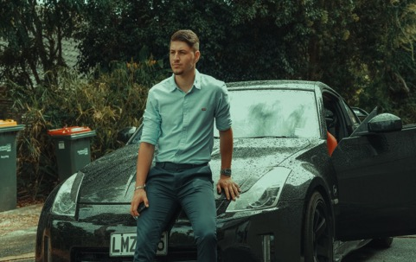
Gratitude reduces materialism.
Materialism reduces the sense of well-being and increases rates of mental disorders.
The problem with materialism is that it:
  Makes you feel less competent,
  Reduces feelings of relatedness and gratitude,
  Reduces you ability to appreciate and enjoy the good in life,
  Generates negative emotions,
  Makes you more self-centered.
How does gratitude reduce materialism?
  Gratitude helps by reducing our tendency to compare ourselves to those with a higher social status.
  Those who cultivate an attitude of gratitude are more likely to perceive benevolence, which in turn causes their brains to assume they are in an environment full of social support, which in turn kills insecurity and materialism.
Notes:
Jiang D, Liu S, Lee JC, Li LMW. Do People Become More or Less Materialistic during Disasters? The Mediating Roles of Mortality Salience and Gratitude. Int J Environ Res Public Health. 2021 Aug 13;18(16):8566. doi: 10.3390/ijerph18168566. PMID: 34444313; PMCID: PMC8392249.
Unanue J, Oriol X, Oyanedel JC, Rubio A, Unanue W. Gratitude at Work Prospectively Predicts Lower Workplace Materialism: A Three-Wave Longitudinal Study in Chile. Int J Environ Res Public Health. 2021 Apr 5;18(7):3787. doi: 10.3390/ijerph18073787. PMID: 33916410; PMCID: PMC8038617.
Bernardo ABI, Tan-Mansukhani R, Daganzo MAA. Associations Between Materialism, Gratitude, and Well-Being in Children of Overseas Filipino Workers. Eur J Psychol. 2018 Aug 31;14(3):581-598. doi: 10.5964/ejop.v14i3.1555. PMID: 30263072; PMCID: PMC6143983.

Slide 28
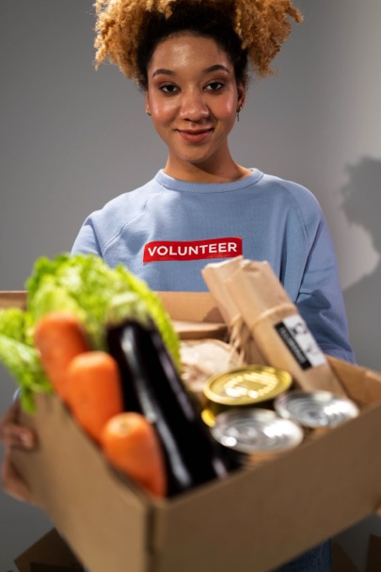
Gratitude Makes Us Less Self-centered
The very nature of gratitude is to focus on others (on their acts of benevolence).
“Looking upon the crucified Redeemer, we more fully comprehend the magnitude and meaning of the sacrifice made by the Majesty of heaven.
“The plan of salvation is glorified before us, and the thought of Calvary awakens living and sacred emotions in our hearts.
“Praise to God and the Lamb will be in our hearts and on our lips; for pride and self-worship cannot flourish in the soul that keeps fresh in memory the scenes of Calvary.” { DA 661.2}
Front Hum Neurosci. 11:599.
Notes:
As every blessing we enjoy is brought to us through the condescension, humiliation, and sacrifice of Jesus Christ, we should render to him our best gifts, above all not withholding ourselves. The infinite sacrifice which Christ has made to free us from the guilt and woe of sin, should work in every heart a spirit of gratitude and self-denial which is not manifested by the world. God's gift of Christ to man filled all Heaven with amazement, and inspired at his birth the angelic song, "Glory to God in the highest, and on earth peace, good will toward men." {RH, December 11, 1879 par. 5}
Karns CM, Moore WE 3rd, Mayr U. The Cultivation of Pure Altruism via Gratitude: A Functional MRI Study of Change with Gratitude Practice. Front Hum Neurosci. 2017 Dec 12;11:599. doi: 10.3389/fnhum.2017.00599. PMID: 29375336; PMCID: PMC5770643.

Slide 29
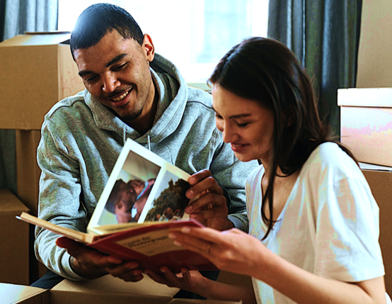
Gratitude Makes Our Memories Happier
Cultivating a grateful spirit helps us to remember the past in a more positive light.
It can actually transform some of our neutral or even negative memories into positive ones.
Curr Psychol 23, 52–67.
Notes:
Gratitude in the present makes us more likely to remember positive memories in a positive light.
Cultivating a grateful spirit helps us to remember the past in a more positive light.
There are dozens of ways our memories get changed over time – we remember things as being worse than they actually were, as being longer or shorter, people as being kinder or crueler, as being more or less interesting, and so on.
Watkins, P.C., Grimm, D.L. & Kolts, R. Counting your blessings: Positive memories among grateful persons. Curr Psychol 23, 52–67 (2004).

Slide 30
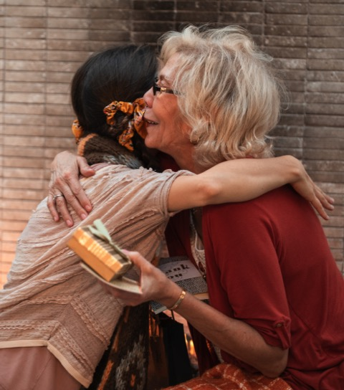
Gratitude Reduces Feelings Of Envy
The Bible speaks of love as charity and says, “charity envieth not;” 1 Corinthians 13:4.
Showing gratitude to others must then be an expression of love.
One way of loving your neighbour would be to show, or express to him, something about him for which you are grateful.
Notes:
A humble mind and a grateful heart will elevate us above petty trials and real difficulties. 4T 610.2
Xiang Y, Chao X, Ye Y. Effect of Gratitude on Benign and Malicious Envy: The Mediating Role of Social Support. Front Psychiatry. 2018 May 7;9:139. doi: 10.3389/fpsyt.2018.00139. PMID: 29867595; PMCID: PMC5949559.
https://www.happierhuman.com/benefits-of-gratitude/

Slide 31
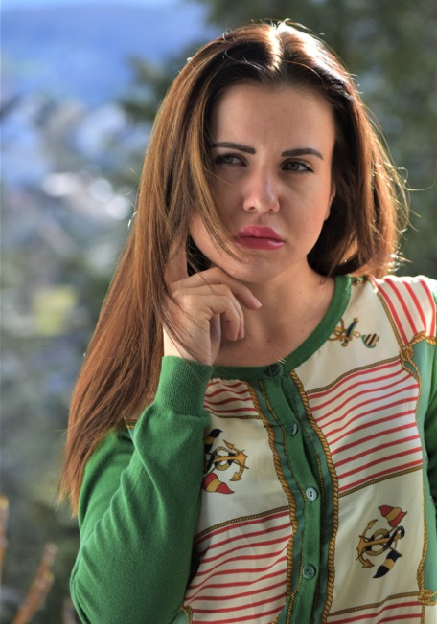
Gratitude Reduces Feelings Of Envy
Envy produces feelings of inadequacy, insecurity, materialism, inferiority, distrust, and unhappiness.
Just like it is impossible to feel optimistic and pessimistic at the same time, gratitude is the act of perceiving benevolence, while envy and jealousy is the act of perceiving inadequacy. Benevolence and inadequacy cannot be completely perceived at the same time.
“A humble mind and a grateful heart will elevate us above petty trials and real difficulties.” 4T 610.2
Front Psychiatry. 9:139.
Notes:
A humble mind and a grateful heart will elevate us above petty trials and real difficulties. 4T 610.2
Xiang Y, Chao X, Ye Y. Effect of Gratitude on Benign and Malicious Envy: The Mediating Role of Social Support. Front Psychiatry. 2018 May 7;9:139. doi: 10.3389/fpsyt.2018.00139. PMID: 29867595; PMCID: PMC5949559.
https://www.happierhuman.com/benefits-of-gratitude/

Slide 32
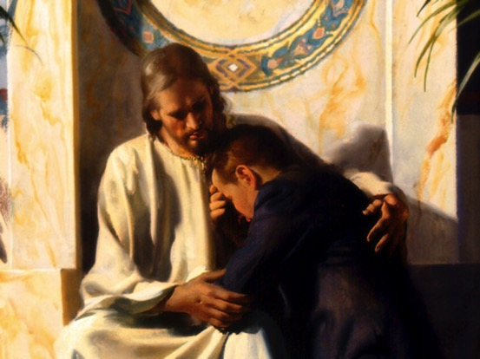
Gratitude Increases Spirituality
Gratitude awakens our spiritual nature, helping us feel closer to God.
“O give thanks unto the LORD; for he is good: for his mercy endureth for ever.” Psalms 118:29.
Psychiatr Danub. 33(Suppl 4):827-832.
Notes:
Gratitude spontaneously gives rise to spiritual attribution, helping one feel closer to God.
Ferenczi A, Tanyi Z, Mirnics Z, Kovács D, Mészáros V, Hübner A, Kövi Z. Gratitude, Religiousness and Well-Being. Psychiatr Danub. 2021 Spring-Summer;33(Suppl 4):827-832. PMID: 35026809.

Slide 33
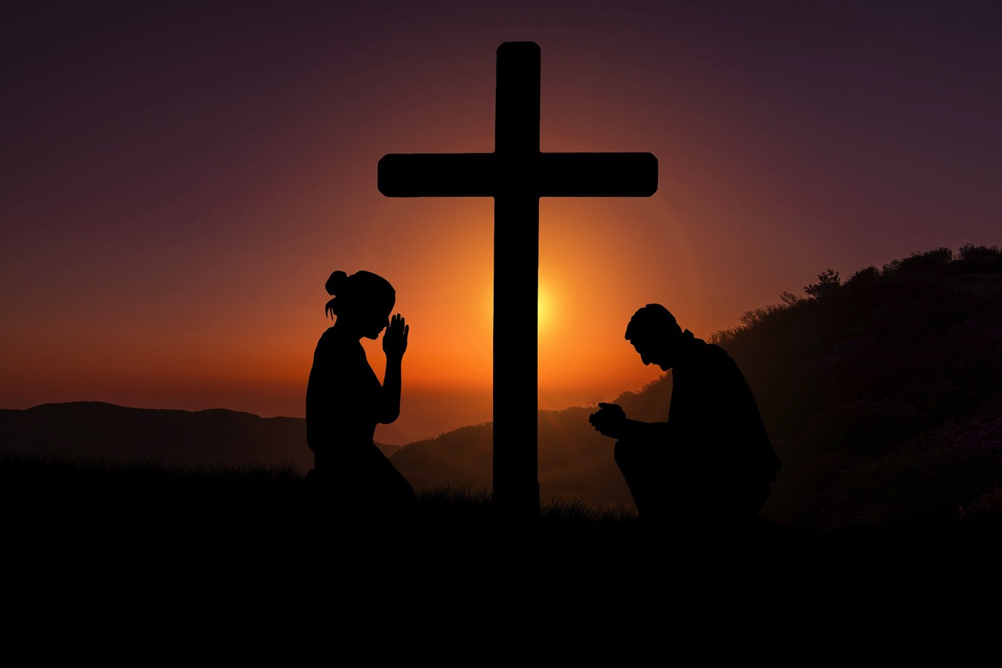
Inconceivable Blessing
“No tongue can express, no finite mind can conceive, the blessing that results from appreciating the goodness and love of God.” {MH 251.4}

Slide 34
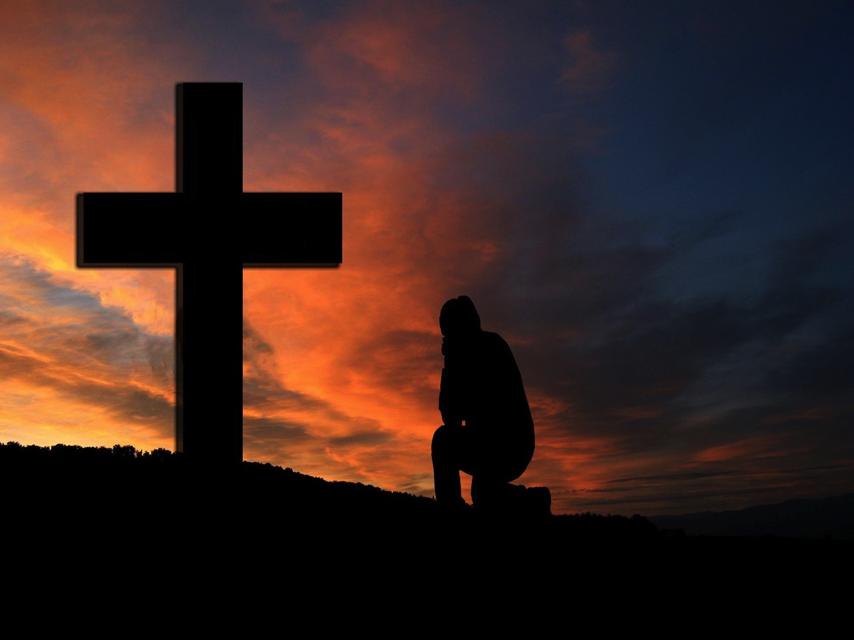
Christianity is all about Gratitude
“In this was manifested the love of God toward us, because that God sent his only begotten Son into the world, that we might live through him. Herein is love, not that we loved God, but that he loved us, and sent his Son to be the propitiation for our sins. Beloved, if God so loved us, we ought also to love one another."1 John 4:9-11.

Slide 35
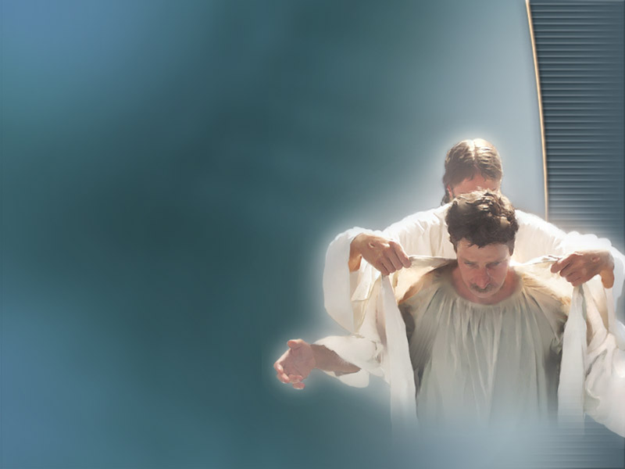
Robe of Righteousness
“I will greatly rejoice in the LORD, my soul shall be joyful in my God; for he hath clothed me with the garments of salvation, he hath covered me with the robe of righteousness,” Isaiah 61:10.
“To appoint unto them that mourn in Zion, to give unto them beauty for ashes, the oil of joy for mourning, the garment of praise for the spirit of heaviness;” Isaiah 61:3.

Slide 36

Gratitude Stimulates & Increases Frontal Lobe Activity
For example, gift exchange enhances cognitive function particularly of the frontal lobes.
Front Psychol. 6:1491
Notes:
Fox GR, Kaplan J, Damasio H, Damasio A. Neural correlates of gratitude. Front Psychol. 2015 Sep 30;6:1491.
Balconi M, Fronda G, Vanutelli ME. A gift for gratitude and cooperative behavior: brain and cognitive effects. Soc Cogn Affect Neurosci. 2019 Dec 30;14(12):1317-1327.

Slide 37
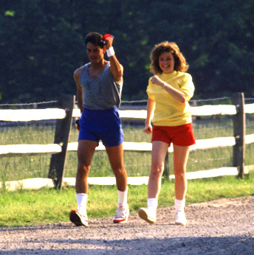
Gratitude Makes You More Likely To Exercise
In one study, those who kept a weekly gratitude journal exercised 40 minutes more per week.
J Pers Soc Psychol. 84(2):377-89.
Notes:
Emmons RA, McCullough ME. Counting blessings versus burdens: an experimental investigation of gratitude and subjective well-being in daily life. J Pers Soc Psychol. 2003 Feb;84(2):377-89. doi: 10.1037//0022-3514.84.2.377. PMID: 12585811.

Slide 38
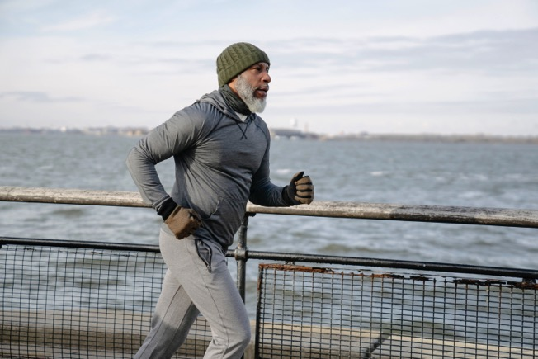
Gratitude increases your energy levels.
Gratitude and vitality are strongly correlated – the grateful are much more likely to report physical and mental vigor.
“Gratitude deepens as we give it expression, and the joy it brings is life to soul and body.” {CS 80.2}
Notes:
Tang PM, Ilies R, Aw SSY, Lin KJ, Lee R, Trombini C. How and when service beneficiaries' gratitude enriches employees' daily lives. J Appl Psychol. 2022 Jun;107(6):987-1008. doi: 10.1037/apl0000975. Epub 2021 Dec 23. PMID: 34941289.

Slide 39
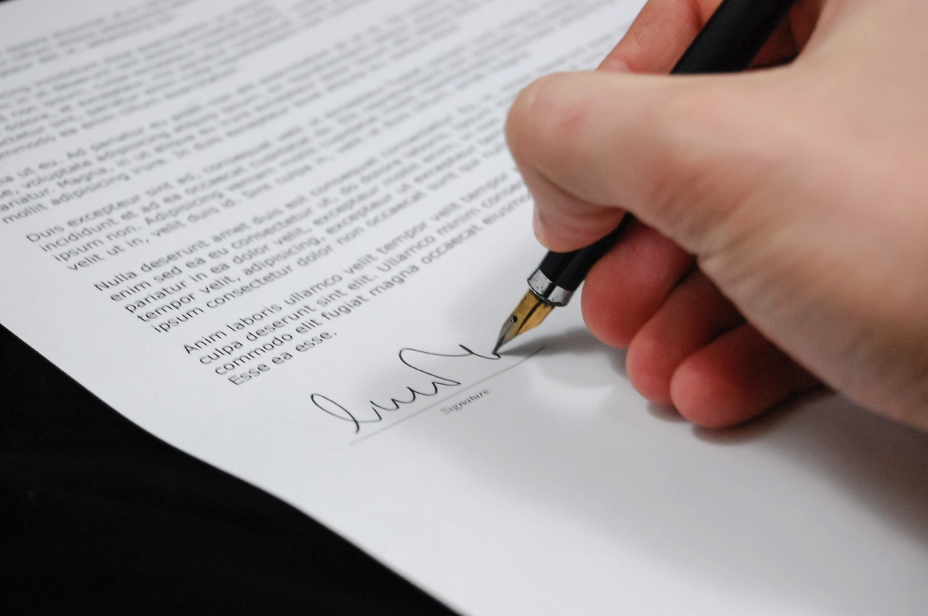
Gratitude Improves Mental Health!
Writing letters of gratitude to others significantly improved mental health and positive emotions.
Psychother Res. 28(2):192-202.
Notes:
Wong YJ, Owen J, Gabana NT, Brown JW, McInnis S, Toth P, Gilman L. Does gratitude writing improve the mental health of psychotherapy clients? Evidence from a randomized controlled trial. Psychother Res. 2018 Mar;28(2):192-202.
Although the past decade has witnessed growing research interest in positive psychological interventions (PPIs), their potential as adjunctive interventions for psychotherapy remains relatively unexplored. Therefore, this article expands the frontiers of PPI research by reporting the first randomized controlled trial to test a gratitude writing adjunctive intervention for psychotherapy clients. Participants were 293 adults seeking university-based psychotherapy services. Participants were randomly assigned to one of three conditions: (a) control (psychotherapy only), (b) a psychotherapy plus expressive writing, and (c) a psychotherapy plus gratitude writing. Participants in the gratitude condition wrote letters expressing gratitude to others, whereas those in the expressive writing condition wrote about their deepest thoughts and feelings about stressful experiences. About 4 weeks as well as 12 weeks after the conclusion of the writing intervention, participants in the gratitude condition reported significantly better mental health than those in the expressive and control conditions, whereas those in the expressive and control conditions did not differ significantly. Moreover, lower proportions of negative emotion words in participants' writing mediated the positive effect of condition (gratitude versus expressive writing) on mental health. These findings are discussed in light of the use of gratitude interventions as adjunctive interventions for psychotherapy clients.

Slide 40
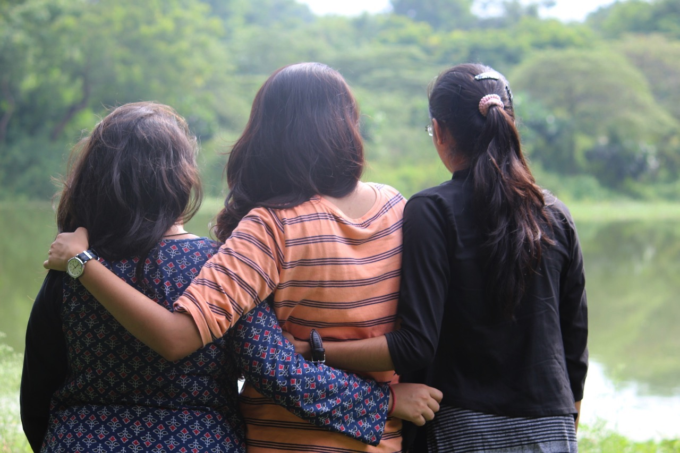
Gratitude Helps You Network
Notes:
Maheux AJ, Nesi J, Galla BM, Roberts SR, Choukas-Bradley S. #Grateful: Longitudinal Associations Between Adolescents' Social Media Use and Gratitude During the COVID-19 Pandemic. J Res Adolesc. 2021 Sep;31(3):734-747. doi: 10.1111/jora.12650. PMID: 34448294; PMCID: PMC8456851.

Slide 41
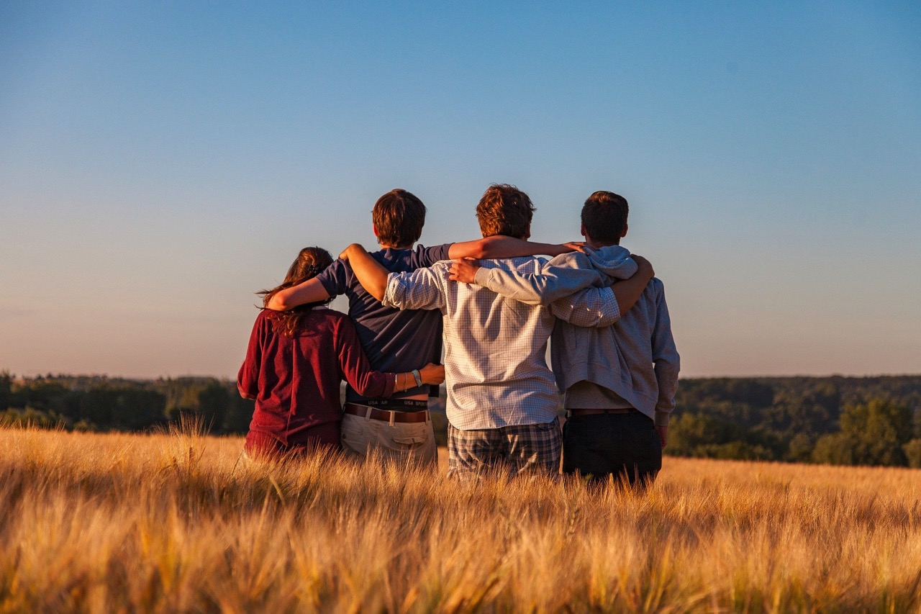
Gratitude Helps You Make Friends
One effective way to start a conversation or move a relationship forward is an expression of gratitude.
Psychol Bull. 143(6):601-635.
Notes:
Ma LK, Tunney RJ, Ferguson E. Does gratitude enhance prosociality?: A meta-analytic review. Psychol Bull. 2017 Jun;143(6):601-635. doi: 10.1037/bul0000103. Epub 2017 Apr 13. PMID: 28406659.

Slide 42

Gratitude Improves Your Decision Making
Notes:
Park G, vanOyen-Witvliet C, Barraza JA, Marsh BU. The Benefit of Gratitude: Trait Gratitude Is Associated With Effective Economic Decision-Making in the Ultimatum Game. Front Psychol. 2021 Apr 20;12:590132. doi: 10.3389/fpsyg.2021.590132. PMID: 33959062; PMCID: PMC8093863.

Slide 43

Gratitude helps us relax
Gratitude and positive emotions, in general, are among the strongest relaxants known to man.
“I will both lay me down in peace, and sleep: for thou, LORD, only makest me dwell in safety.” Psalms 4:8.
Behav Res Ther. 119:103415.
Notes:
Heckendorf H, Lehr D, Ebert DD, Freund H. Efficacy of an internet and app-based gratitude intervention in reducing repetitive negative thinking and mechanisms of change in the intervention's effect on anxiety and depression: Results from a randomized controlled trial. Behav Res Ther. 2019 Aug;119:103415. doi: 10.1016/j.brat.2019.103415. Epub 2019 Jun 8. PMID: 31202003.

Slide 44
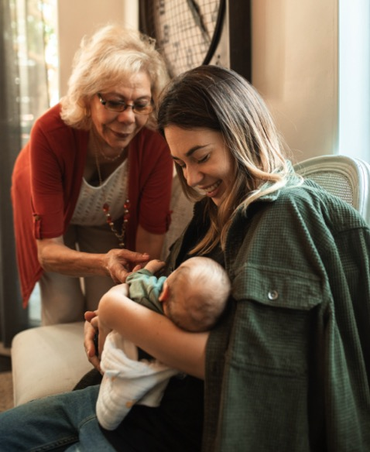
Gratitude Helps Us Bounce Back
People who express gratitude are more resilient--negative emotional swings don’t last as long.
Those that have more gratitude are less likely to develop PTSD, and are more likely to grow in times of stress.
“In every thing give thanks: for this is the will of God in Christ Jesus concerning you.” 1 Thessalonians 5:18.
“And we know that all things work together for good to them that love God, to them who are the called according to his purpose.” Romans 8:28.
Death Stud. 41(7):436-446.
Notes:
Greene N, McGovern K. Gratitude, psychological well-being, and perceptions of posttraumatic growth in adults who lost a parent in childhood. Death Stud. 2017 Aug;41(7):436-446. doi: 10.1080/07481187.2017.1296505. Epub 2017 Feb 17. PMID: 28346066.
Genesis 50:20 But as for you, ye thought evil against me; but God meant it unto good, to bring to pass, as it is this day, to save much people alive.

Slide 45
Gratitude Helps Your Marriage
The Losada ratio, divides the total number of positive expressions (support, encouragement, and appreciation) made during a typical interaction by the number of negative expressions (disapproval, sarcasm, and cynicism).
When the ratio was below .9, that is there were 11% more negative expressions than positive expressions, marriages tend to plummet towards divorce or languishment.
Those marriages that lasted and were found satisfying were those with a positivity ratio above 5.1 (five positive expressions to each negative).
Notes:
https://www.happierhuman.com/losada-ratio/

Slide 46
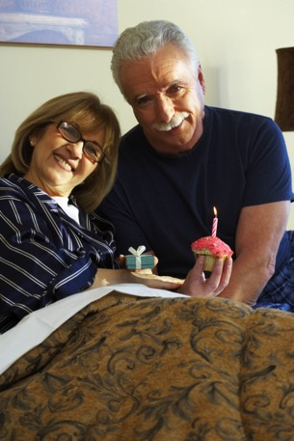
Becoming More Grateful

Slide 47
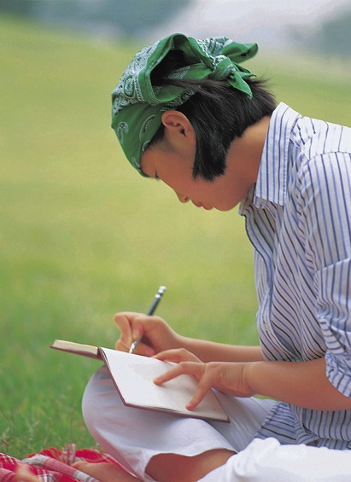
Keep a Gratitude Journal.
Take time daily to remind yourself of the gifts, grace, benefits, and good things you enjoy.
Recall moments of gratitude associated with ordinary events, your personal attributes, or valued people in your life.
“Then they that feared the LORD spake often one to another: and the LORD hearkened, and heard it, and a book of remembrance was written before him for them that feared the LORD, and that thought upon his name.” Malachi 3:16.
Notes:
Kathryn C. Adair, Lindsay A. Kennedy & J. Bryan Sexton (2020) Three Good Tools: Positively reflecting backwards and forwards is associated with robust improvements in well-being across three distinct interventions, The Journal of Positive Psychology, 15:5, 613-622,

Slide 48
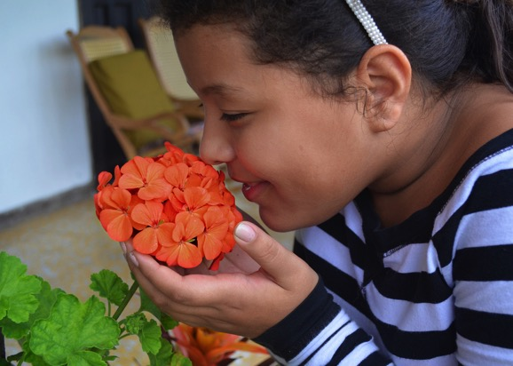
Come to Your Senses.
Through our senses— the ability to touch, see, smell, taste, and hear— we gain an appreciation of what it means to be human and of what an incredible miracle it is to be alive. Seen through the lens of gratitude, the human body is not only a miraculous construction, but also a gift.
Front Psychol. 12:738770.
Notes:
“That which was from the beginning, which we have heard, which we have seen with our eyes, which we have looked upon, and our hands have handled, of the Word of life; …That which we have seen and heard declare we unto you, that ye also may have fellowship with us: and truly our fellowship is with the Father, and with his Son Jesus Christ.” 1 John 1:1-3.
Büssing A. Wondering Awe as a Perceptive Aspect of Spirituality and Its Relation to Indicators of Wellbeing: Frequency of Perception and Underlying Triggers. Front Psychol. 2021 Sep 30;12:738770. doi: 10.3389/fpsyg.2021.738770. PMID: 34659054; PMCID: PMC8515136.
https://www.longtonexchange.co.uk/gratitude-how-to-happify-your-mind/

Slide 49
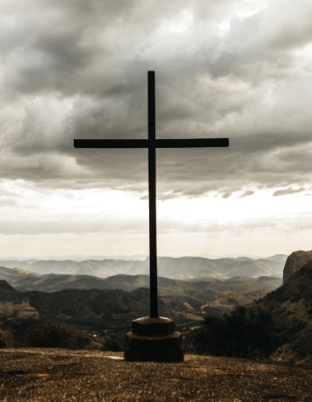
Use Visual Reminders.
Because the two primary obstacles to gratefulness are forgetfulness and a lack of mindful awareness, visual reminders can serve as cues to trigger thoughts of gratitude. Often times, the best visual reminders are other people.
The Rainbow. Genesis 9:12-16.
Jesus’ parables.
Notes:
Kreitzer MJ, Telke S, Hanson L, Leininger B, Evans R. Outcomes of a Gratitude Practice in an Online Community of Caring. J Altern Complement Med. 2019 Apr;25(4):385-391. doi: 10.1089/acm.2018.0460. Epub 2019 Feb 20. PMID: 30785803.

Slide 50
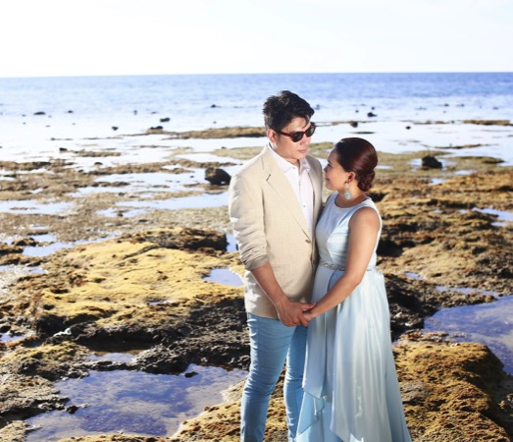
Make a Vow to Practice Gratitude
Research shows that making an oath to perform a behavior increases the likelihood that the action will be executed. Therefore, write your own gratitude vow, which could be as simple as “I vow to count my blessings each day,” and post it somewhere where you will be reminded of it every day.
Notes:
“My praise shall be of thee in the great congregation: I will pay my vows before them that fear him.” Psalms 22:25.

Slide 51
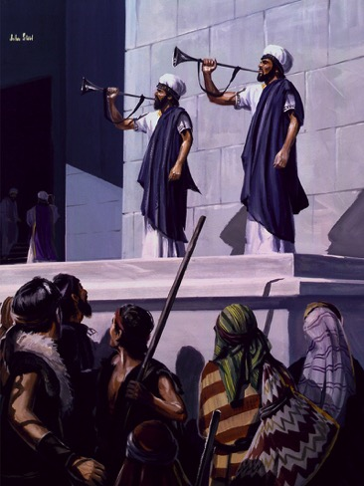
Rituals Of Gratitude
When rituals of gratitude are a normal part of both your routine and your special events, you connect with those around you in a way that benefits everyone.
The experience you share with your partner and/or your children becomes a meaningful time of bonding. So say thank you, say it often, and say it together.
For example, the feast of tabernacles was a joyous commemoration of the blessings of God to us as a people {RH, November 17, 1885}
Notes:
Rituals of Gratitude - The Gottman Institute
https://www.gottman.com › blog › rituals-of-gratitude
“Well would it be for us to have a feast of tabernacles, a joyous commemoration of the blessings of God to us as a people. As the children of Israel celebrated the deliverance that God wrought for their fathers, and his miraculous preservation of them during their journeyings from Egypt to the promised land, so should the people of God at the present time gratefully call to mind the various ways he has devised to bring them out from the world, out from the darkness of error, into the precious light of truth.” {RH, November 17, 1885 par. 14}
Pawlina W, Hammer RR, Strauss JD, Heath SG, Zhao KD, Sahota S, Regnier TD, Freshwater DR, Feeley MA. The hand that gives the rose. Mayo Clin Proc. 2011 Feb;86(2):139-44. doi: 10.4065/mcp.2010.0625. PMID: 21282487; PMCID: PMC3031438.

Slide 52
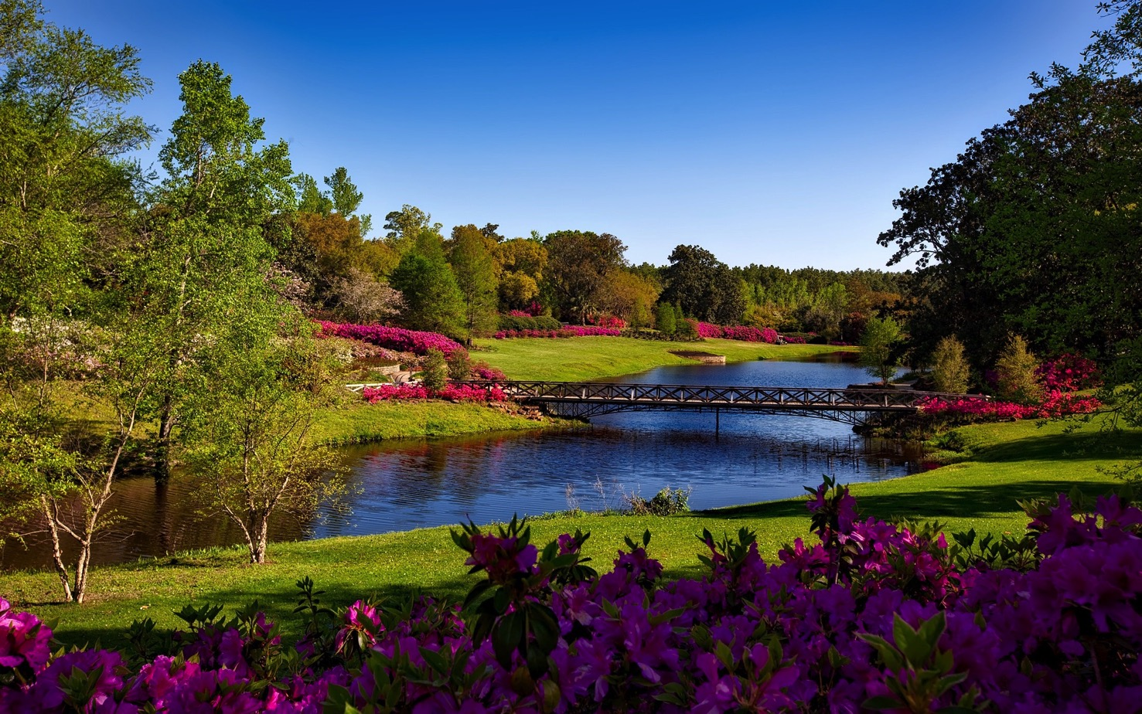
A Day For Gratitude
“A Psalm or Song for the sabbath day. It is a good thing to give thanks unto the LORD, and to sing praises unto thy name, O most High:” Psalms 92:1.

Slide 53
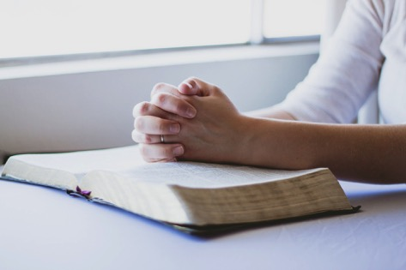
Prayers of Gratitude.
Prayers of gratitude are most powerful form of prayer, because through these prayers people recognize the ultimate source of all they are and all they will ever be.
“Begin every day with earnest prayer, not omitting to offer praise and thanksgiving.” {TDG 42.4}
Notes:
“O give thanks unto the LORD; for he is good; for his mercy endureth for ever. And say ye, Save us, O God of our salvation, and gather us together, and deliver us from the heathen, that we may give thanks to thy holy name, and glory in thy praise. Blessed be the LORD God of Israel for ever and ever. And all the people said, Amen, and praised the LORD.” 1 Chronicles 16:34-36.

Slide 54
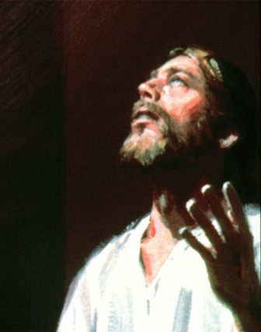
Prayers of Gratitude.
Philippians 4:6. “Be careful for nothing; but in every thing by prayer and supplication with thanksgiving let your requests be made known unto God.”
“We do not pray any too much, but we are too sparing of giving thanks. If the loving-kindness of God called forth more thanksgiving and praise, we would have far more power in prayer.
“You who complain that God does not hear your prayers, change your present order and mingle praise with your petitions. When you consider His goodness and mercies you will find that He will consider your wants.” {5T 317.1}

Slide 55
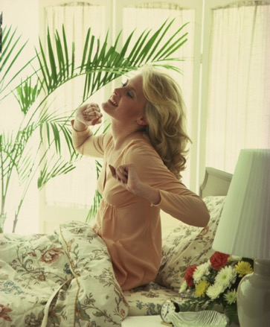
“When you open your eyes in the morning, thank God that He has kept you through the night. Thank Him for His peace in your heart. Morning, noon, and night, let gratitude as a sweet perfume ascend to heaven.” {MH 253.2}

Slide 56
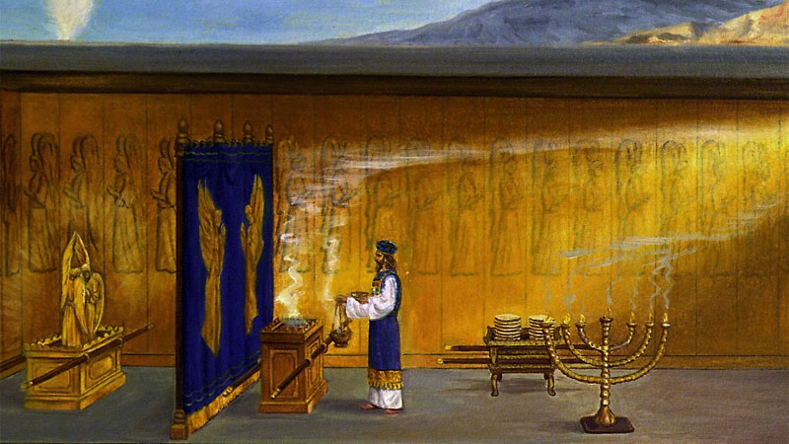
Like Incense
“Let words of penitence and grateful praise come up before God as sweet incense in His heavenly sanctuary.” {2SM 272.3}

Slide 57
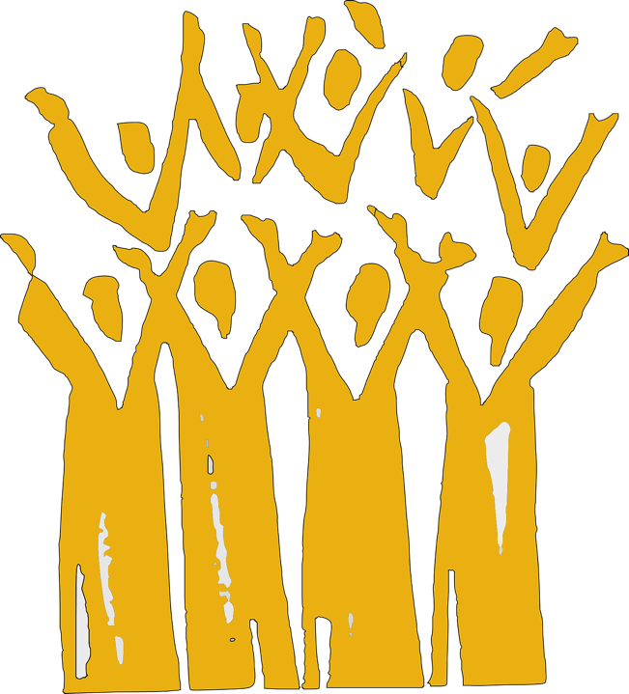
“But thou art holy, O thou that inhabitest the praises of Israel.” Psalms 22:3

Slide 58
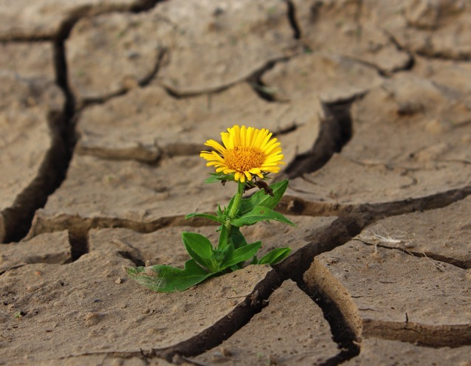
Can you always be grateful?
“Although the fig tree shall not blossom, neither shall fruit be in the vines; the labour of the olive shall fail, and the fields shall yield no meat; the flock shall be cut off from the fold, and there shall be no herd in the stalls: Yet I will rejoice in the LORD, I will joy in the God of my salvation.” Habakkuk 3:17-18.
Notes:
Individualize this like Ann did “Though my marriage tree may not bud and though my crop of children may fail and my work produce little yield, though there is no money in the bank and no dream left in the heart, though others may choose different ways to live their one life, till my least heaving breath, I will fight to the death for this: “I will take joy”. One Thousand Gifts page 176

Slide 59
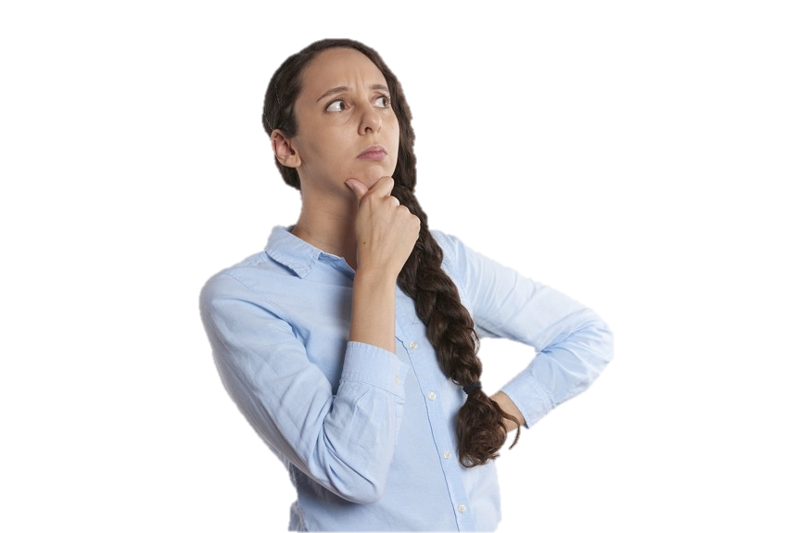
Remember the Bad.
To be grateful in your current state, it is helpful to remember the hard times that you once experienced. When you remember how difficult life used to be and how far you have come, this contrast is fertile ground for gratefulness.
“Then shall ye remember your own evil ways, and your doings that were not good...” Ezekiel 36:31-33.
“Alleluia! heaven is cheap enough.” {LS 67.2}
Notes:
“We all went under the tree, and sat down to look at the glory of the place, …We tried to call up our greatest trials, but they looked so small compared with the far more exceeding and eternal weight of glory that surrounded us, that we could not speak them out, and we all cried out, ‘Alleluia! heaven is cheap enough!’ and we touched our glorious harps and made heaven's arches ring.” {LS 67.2}

Slide 60
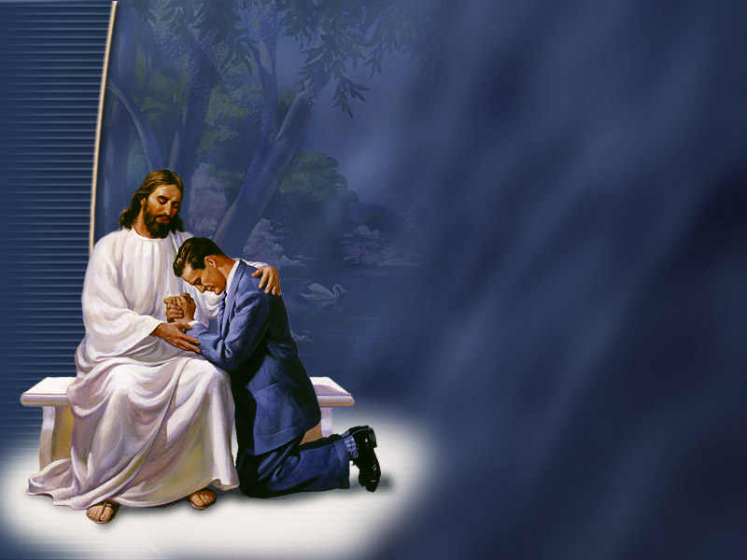
“The degree of our love for God depends upon the clearness and fullness of our conviction of sin. "By the law is the knowledge of sin." The more we see of the perils to which we have been exposed by sin, the more grateful we shall be for deliverance.” {RH, September 25, 1900 par. 13}

Slide 61

Gratitude Diet
“The gratitude we offer to God for His blessings is greatly affected by the food placed in the stomach. Indulgence of appetite is the cause of dissension, strife, discord, and many other evils.” {2MCP 391.5}

Slide 62

Gratitude Diet
“Remove far from me vanity and lies: give me neither poverty nor riches; feed me with food convenient for me: Lest I be full, and deny thee, and say, Who is the LORD? or lest I be poor, and steal, and take the name of my God in vain.” Proverbs 30:8-9.
“But Jeshurun waxed fat, and kicked: thou art waxen fat, thou art grown thick, thou art covered with fatness; then he forsook God which made him, and lightly esteemed the Rock of his salvation.” Deuteronomy 32:15.

Slide 63


“The gift of Christ to the world was beyond computation, and no power could compete with God by giving a gift that would bear any comparison to the value of heaven's best treasure.
“The greatness of this gift was to furnish men with a theme of thanksgiving and praise that would last through time and through eternity.” {YI December 13, 1894}

Slide 64


What Does God Really Long For, What Is The Inner Desire Of His Heart?
“The Lord desires us to appreciate the great plan of redemption, to realize our high privilege as the children of God, and to walk before Him in obedience, with grateful thanksgiving. He desires us to serve Him in newness of life, with gladness every day. He longs to see gratitude welling up in our hearts because our names are written in the Lamb's book of life, because we may cast all our care upon Him who cares for us. He bids us rejoice because we are the heritage of the Lord, because the righteousness of Christ is the white robe of His saints, because we have the blessed hope of the soon coming of our Saviour.” {COL 299.2}

Slide 65

“Our hearts are to be so filled with the love of Christ that our words of thanksgiving shall warm other hearts.” {8T 18.1}

Slide 66

“I saw many of the saints go into the houses, take off their glittering crowns and lay them on the shelf, then go out into the field by the houses to do something with the beautiful flowers and trees growing spontaneously everywhere. A glorious light shone above their heads, and they were continually offering praises to God.” {LS80 216.1}

Slide 67


In Summary
A spirit of gratitude yields physical, mental, social and spiritual health benefits.

Slide 68
In Summary
Make it a practice to remember what your are grateful for.

Slide 69
In Summary
Spread gratitude by expressing it to others in words and acts.

Slide 70
In Summary
Our greatest gratitude goes to God to whom we owe everything in life.

Slide 71



Slide 72

NorthernLightsHealthEducation.com

Slide 73
If We Would Be But More Grateful
The Power and Science Of Gratitude
Notes:
Bob looked at life like a long dark tunnel with a light at the end of the tunnel seemed to be vanishing. That was until he came to our lecture entitled, “If We Would Be But More Grateful: The Power and Science Of Gratitude”. He found himself becoming more cheerful, more optimistic in his outlook, what’s more his health improved and he actually started looking forward to a longer healthier happier life. Don’t miss this presentation, put its proven advice into practice, and you too can start living healthier and happier beginning today.
Story: Bob, dark tunnel, Light at end fading
Benefit/problem solved
more cheerful optimistic outlook
Better health
Longer happier life
Bullet points
Simple practices in the privacy of your own home.
Inspire
If We Would Be But More Grateful: The Power and Science Of Gratitude
Call to action
Don’t miss this presentation, put its proven advice into practice, and start living healthier and happier beginning today.

