Slide 1
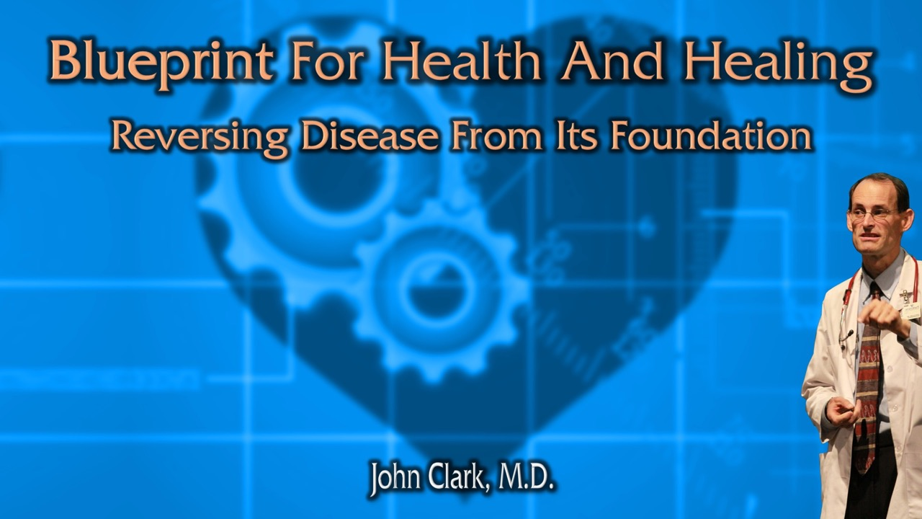
Natural Kidney Health

Slide 2

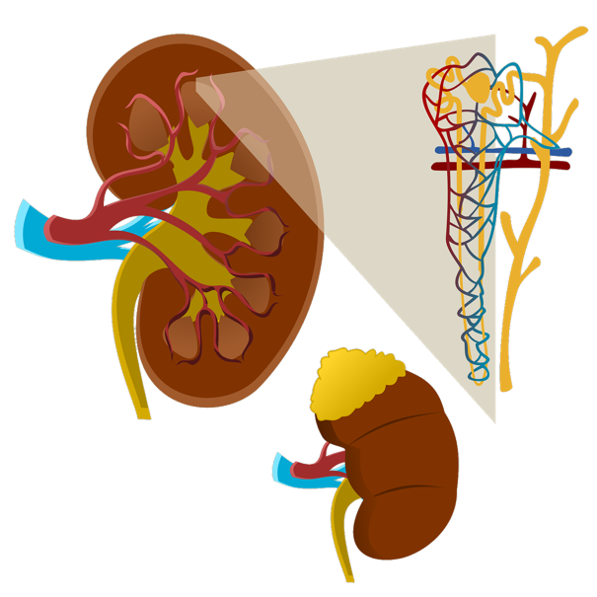
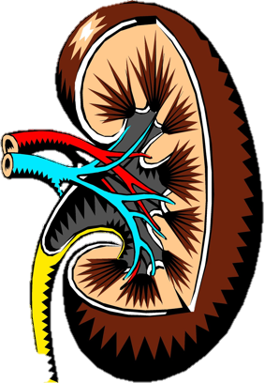
Natural Kidney Health

Slide 3
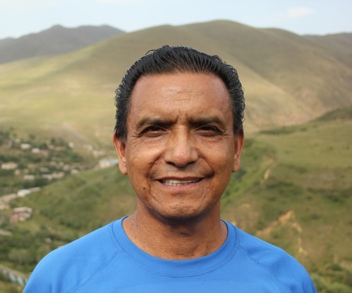
“I would like to share with you the great blessing the Lord has done in my brothers health with regard to his kidneys. I thank God for answered prayers. Dr. Clark the Lord blessed the diet regime you so kindly recommended for my brother. He has been following the diet faithfully and that in itself is a miracle. They did another test of his blood and this time also the urine. The results that came back last week said “I have good news for you!”. The creatinine had been 3.31 and kidney function 20% the first time, which you might recall. Well, the second results showed a creatinine level of 1.12 and kidney function at 54% and another result showed 74%! A miracle of God! Dr. Clark I want to thank you so much for your help which is always given with faith in the Lord.”

Slide 4

By the end of this presentation you will better understand the causes, preventative measures and natural remedies for kidney disease.

Slide 5
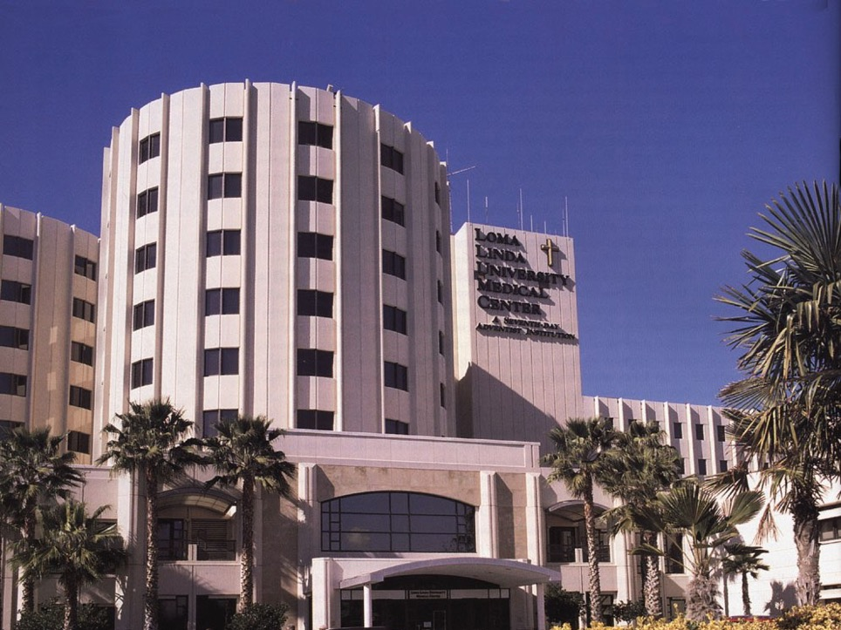

Slide 6
Your kidneys are delicate organs that respond well to temperate measures.

Slide 7

We will cover:
Dietary considerations.
Lifestyle kidney effects.
Simple natural remedies.

Slide 8
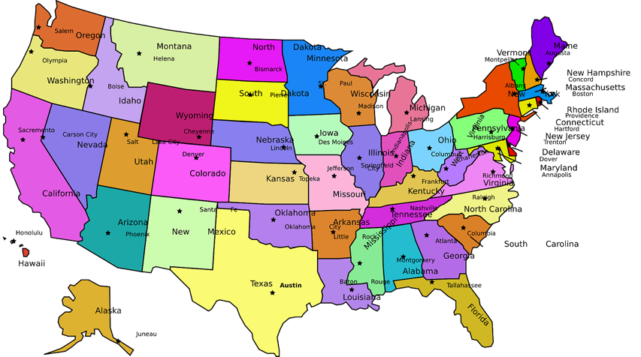
About 15% of US adults suffer chronic kidney disease, 554,038 patients undergo dialysis several times a week.
Am J Kidney Dis. 2021 Apr;77(4 Suppl 1):A7-A8.
Notes:
Johansen KL, Chertow GM, Foley RN, Gilbertson DT, Herzog CA, Ishani A, Israni AK, Ku E, Kurella Tamura M, Li S, Li S, Liu J, Obrador GT, O'Hare AM, Peng Y, Powe NR, Roetker NS, St Peter WL, Abbott KC, Chan KE, Schulman IH, Snyder J, Solid C, Weinhandl ED, Winkelmayer WC, Wetmore JB. US Renal Data System 2020 Annual Data Report: Epidemiology of Kidney Disease in the United States. Am J Kidney Dis. 2021 Apr;77(4 Suppl 1):A7-A8. doi: 10.1053/j.ajkd.2021.01.002. PMID: 33752804.
CKD among adults in the United States has been relatively stable at just under 15% for the last 15 years.
2018, there were 554,038 patients undergoing dialysis

Slide 9

Chronic kidney disease is loss of kidney function.
The most common causes are:
Poor lifestyle choices leading to:
  High blood pressure.
  Chronic glomerulonephritis (kidney damage).
  High blood sugar (diabetes).
Drug side effects.
Polycystic kidney disease.
Blocked urinary tract.
Kidney infection.
https://www.urologyhealth.org/urology-a-z/k/kidney-(renal)-failure

Slide 10
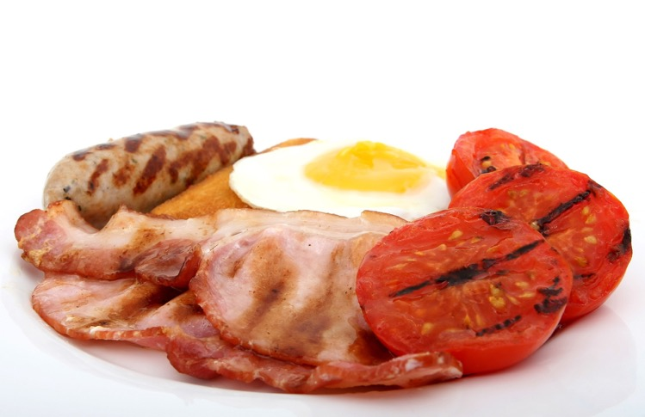
Avoid all animal products! (milk, eggs, cream, yogurt, flesh of fowl or beast).
Consumption of animal protein reduces your kidney function 40% almost immediately and causes progressively permanent deterioration of their function over time.
J Am Coll Nutr. 27(5):528-37.
Notes:
Lew QJ, Jafar TH, Koh HW, Jin A, Chow KY, Yuan JM, Koh WP. Red Meat Intake and Risk of ESRD. J Am Soc Nephrol. 2016 Jul 14.
Almeida JC, Zelmanovitz T, Vaz JS, Steemburgo T, Perassolo MS, Gross JL, Azevedo MJ. Sources of protein and polyunsaturated fatty acids of the diet and microalbuminuria in type 2 diabetes mellitus. J Am Coll Nutr. 2008 Oct;27(5):528-37.

Slide 11
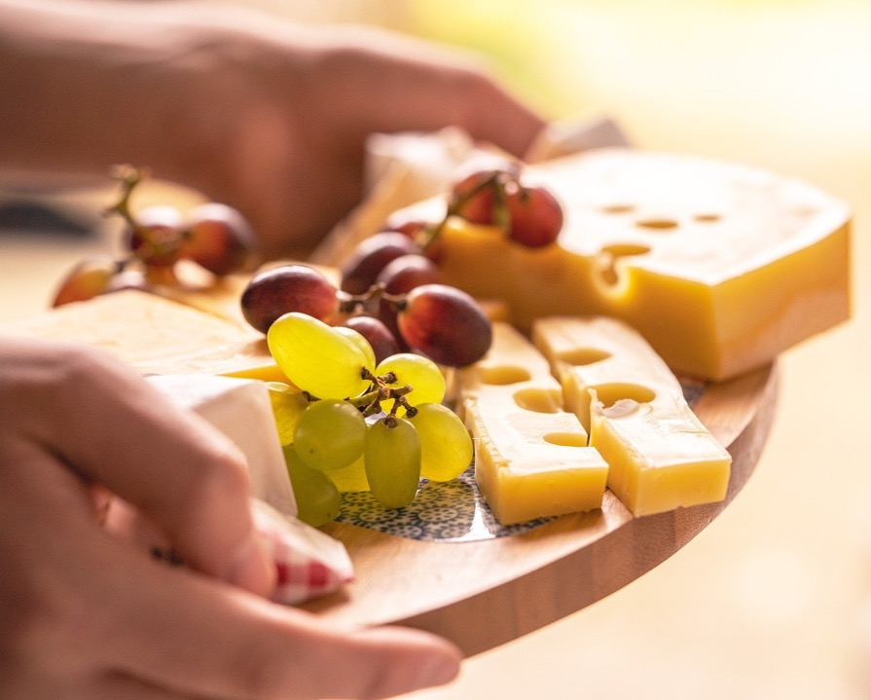

Animal protein, especially cheese, increases the acid load that your kidneys must process, this increases damage to your kidneys.
J Nephrol. 24(1):11-7.
Notes:
Remer T, Manz F. Potential renal acid load of foods and its influence on urine pH. J Am Diet Assoc. 1995 Jul;95(7):791-7.
van den Berg E, Hospers FA, Navis G, Engberink MF, Brink EJ, Geleijnse JM, van Baak MA, Gans RO, Bakker SJ. Dietary acid load and rapid progression to end-stage renal disease of diabetic nephropathy in Westernized South Asian people. J Nephrol. 2011 Jan-Feb;24(1):11-7.

Slide 12

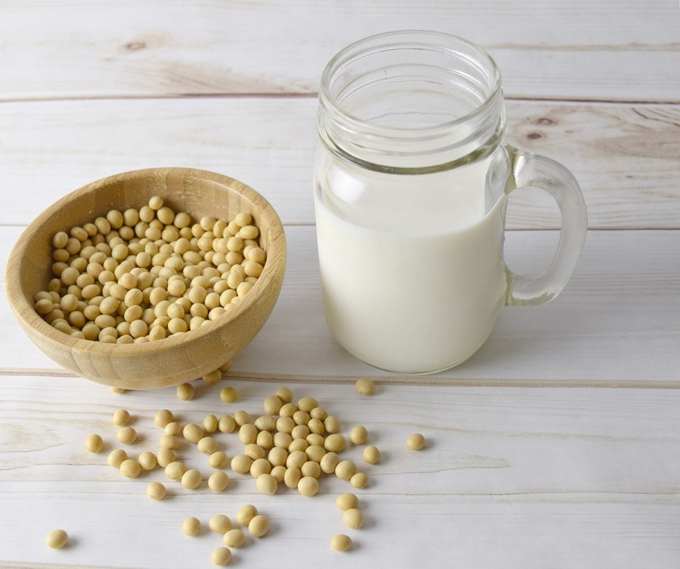
Vegetable protein sources, like soy, can be beneficial to your kidneys.
Lancet. 339(8802):1131-4.
Notes:
D'Amico G, Gentile MG, Manna G, Fellin G, Ciceri R, Cofano F, Petrini C, Lavarda F, Perolini S, Porrini M. Effect of vegetarian soy diet on hyperlipidaemia in nephrotic syndrome. Lancet. 1992 May 9;339(8802):1131-4.

Slide 13
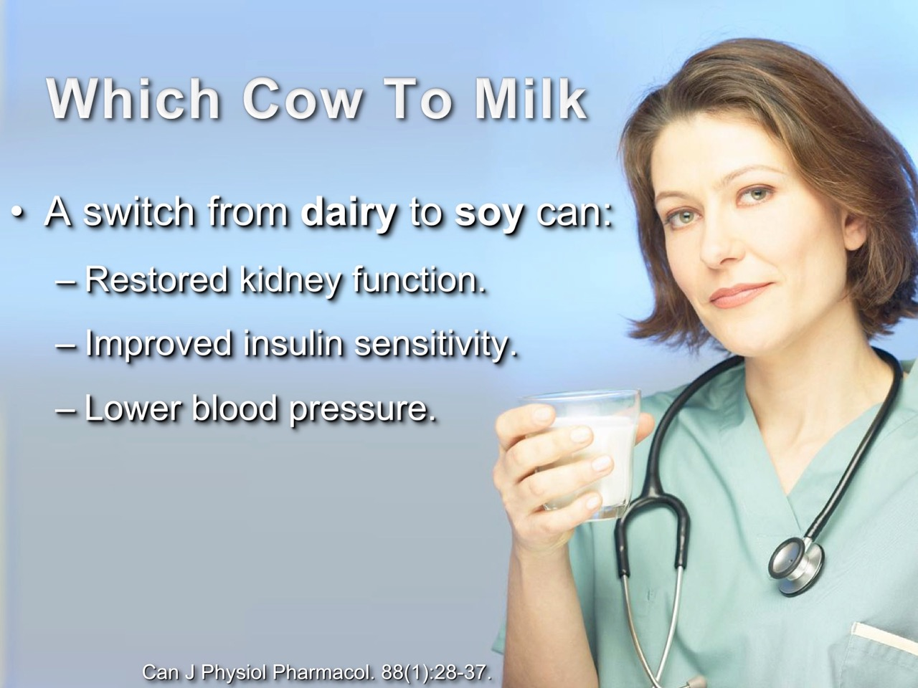

Slide 14
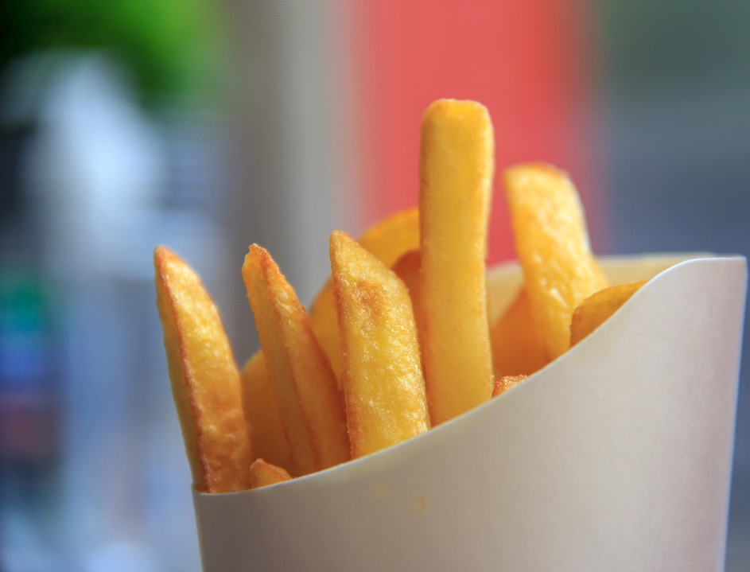

Fried foods harm your kidneys.
Refined oils, such as cooking oil, lard, butter and margarine damage your kidneys.
Pediatr Res. 2016 Mar;79(3):416-24.
Notes:
Gutiérrez OM, Muntner P, Rizk DV, McClellan WM, Warnock DG, Newby PK, Judd SE. Dietary patterns and risk of death and progression to ESRD in individuals with CKD: a cohort study. Am J Kidney Dis. 2014 Aug;64(2):204-13.
Xu H, Sjögren P, Ärnlöv J, Banerjee T, Cederholm T, Risérus U, Lindholm B, Lind L, Carrero J. A proinflammatory diet is associated with systemic inflammation and reduced kidney function in elderly adults. J Nutr. 2015 Apr;145(4):729-35.
Morrow WJ, Homsy J, Swanson CA, Ohashi Y, Estes J, Levy JA. Dietary fat influences the expression of autoimmune disease in MRL/lpr/lpr mice. Immunology. 1986 Nov;59(3):439-43.
Aliou Y, Liao MC, Zhao XP, Chang SY, Chenier I, Ingelfinger JR, Zhang SL. Post-weaning high-fat diet accelerates kidney injury, but not hypertension programmed by maternal diabetes. Pediatr Res. 2016 Mar;79(3):416-24.
Koshiba K1, Kumano K, Watanabe T, Takashima Y, Cynshi O. Effects of high fat diet and a novel antioxidant (BO653) on ischemia reperfusion injury of rat kidney. Nihon Jinzo Gakkai Shi. 1997 Jul;39(5):455-63.

Slide 15
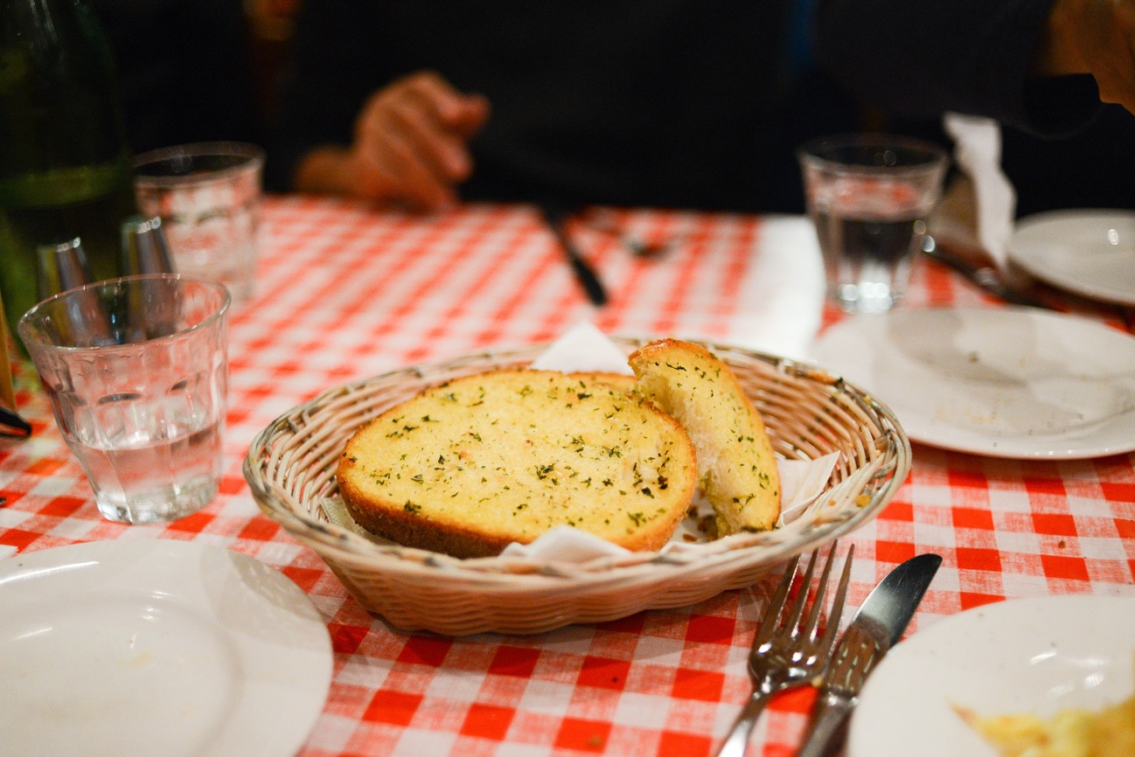
All oils, butters, margarines or oil-based dressings, only thicken your blood and decrease it’s ability to carry oxygen to your kidneys.
Clin Nutr. 2013 Aug;32(4):606-12.
Notes:
Swank RL, Nakamura H. Oxygen availability in brain tissues after lipid meals. Am J Physiol. 1960 Jan;198:217-20.
Díaz-López A, Bulló M, Basora J, Martínez-González MÁ, Guasch-Ferré M, Estruch R, Wärnberg J, Serra-Majem L, Arós F, Lapetra J, Ros E, Pintó X, Covas MI, Salas-Salvadó J. Cross-sectional associations between macronutrient intake and chronic kidney disease in a population at high cardiovascular risk. Clin Nutr. 2013 Aug;32(4):606-12.

Slide 16
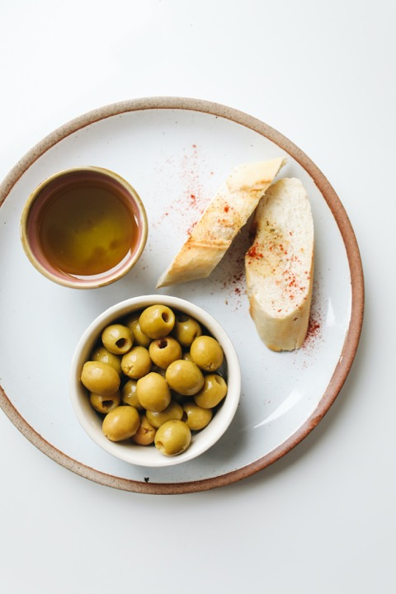
Whole ripe olives provide nutrients that are most beneficial to your kidneys, but olive oil is not so beneficial.
J Agric Food Chem. 2009 Jul 22;57(14):6298-304.
Notes:
3,4-Dihydroxyphenylglycol (DHPG): an important phenolic compound present in natural table olives. Rodríguez G1, Lama A, Jaramillo S, Fuentes-Alventosa JM, Guillén R, Jiménez-Araujo A, Rodríguez-Arcos R, Fernández-Bolaños J. J Agric Food Chem. 2009 Jul 22;57(14):6298-304.
Kountouri AM1, Mylona A, Kaliora AC, Andrikopoulos NK. Bioavailability of the phenolic compounds of the fruits (drupes) of Olea europaea (olives): impact on plasma antioxidant status in humans. Phytomedicine. 2007 Oct;14(10):659-67.

Slide 17
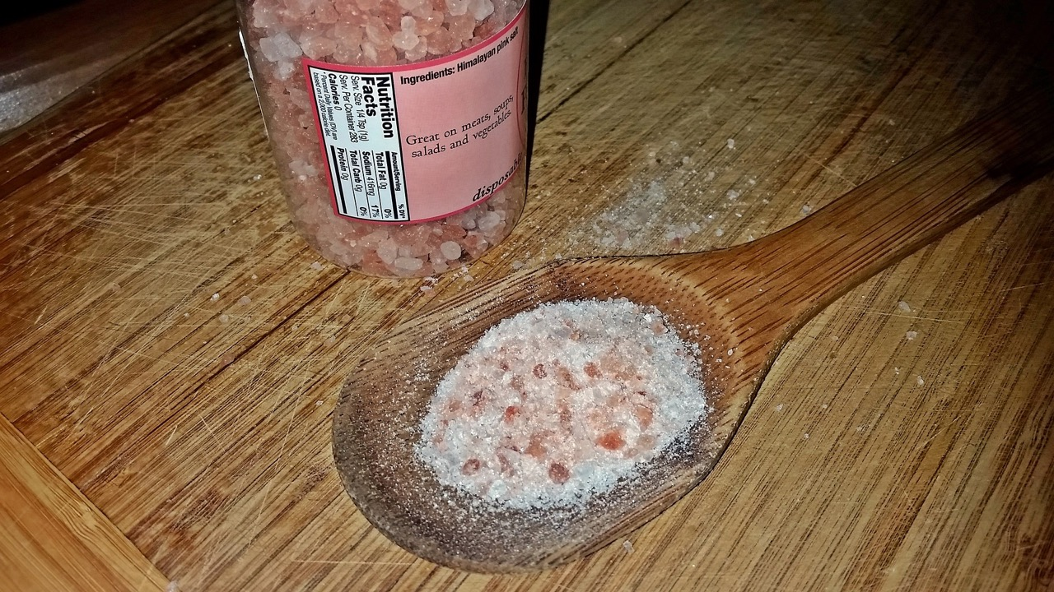
Your kidneys will recover better on a low salt diet.
Am J Physiol Renal Physiol. 2014 Jul 1;307(1):F33-40.
Notes:
Fellner RC, Cook AK, O'Connor PM, Zhang S, Pollock DM, Inscho EW. High-salt diet blunts renal autoregulation by a reactive oxygen species-dependent mechanism. Am J Physiol Renal Physiol. 2014 Jul 1;307(1):F33-40.

Slide 18
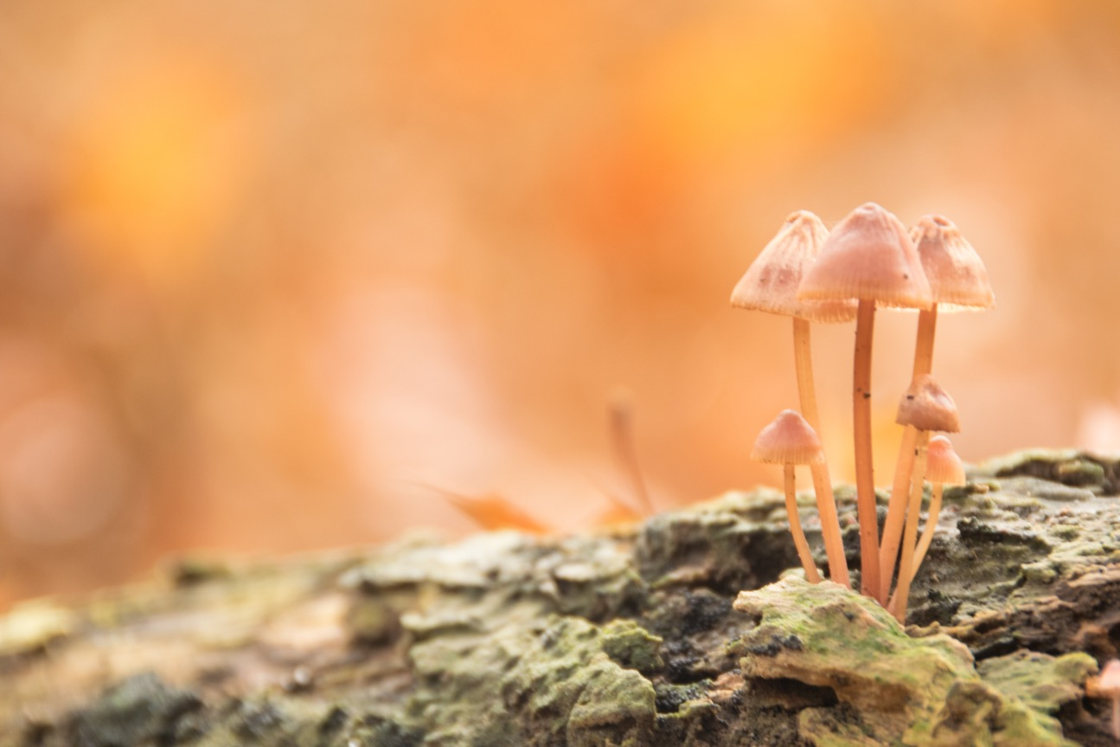
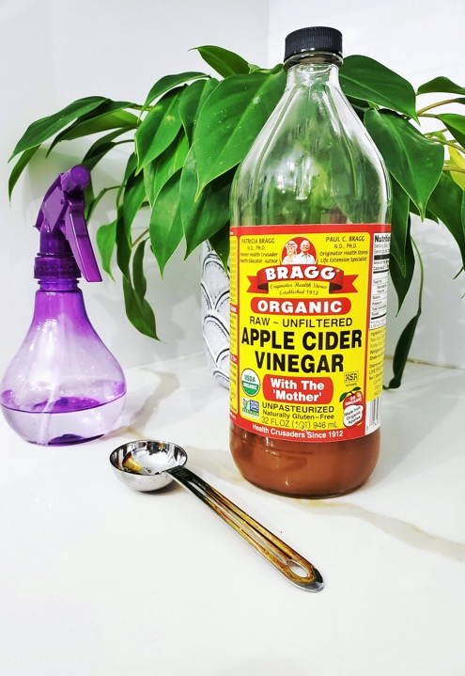
To preserve you kidneys function never eat inflammatory foods.
Inflammatory foods include any food created by fermenting, rotting, spoiling, aging, processing, refining or frying.
Examples include, but are not limited to:
Vinegar, cheese, soy sauce, chocolate, vanilla, tempe, meso, yogurt, sour cream, sauerkraut, pickles and mushrooms.
No vinegar whatsoever! It harms your kidneys.
Kidney Int. 38(6):1109-17.
Notes:
Nath KA, Paller MS. Dietary deficiency of antioxidants exacerbates ischemic injury in the rat kidney. Kidney Int. 1990 Dec;38(6):1109-17.
Nadkarni GN, Rao V, Ismail-Beigi F, Fonseca VA, Shah SV, Simonson MS, Cantley L, Devarajan P, Parikh CR, Coca SG. Association of Urinary Biomarkers of Inflammation, Injury, and Fibrosis with Renal Function Decline: The ACCORD Trial. Clin J Am Soc Nephrol. 2016 May 17.

Slide 19
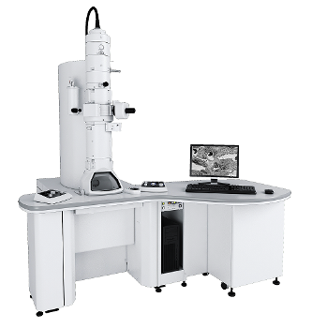
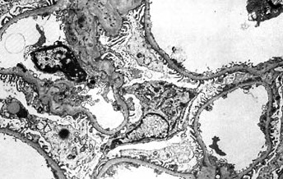
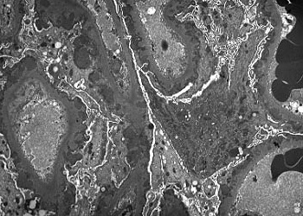
Normal kidney
blood vessel wall.
Thickened
inflamed
membrane.

Slide 20
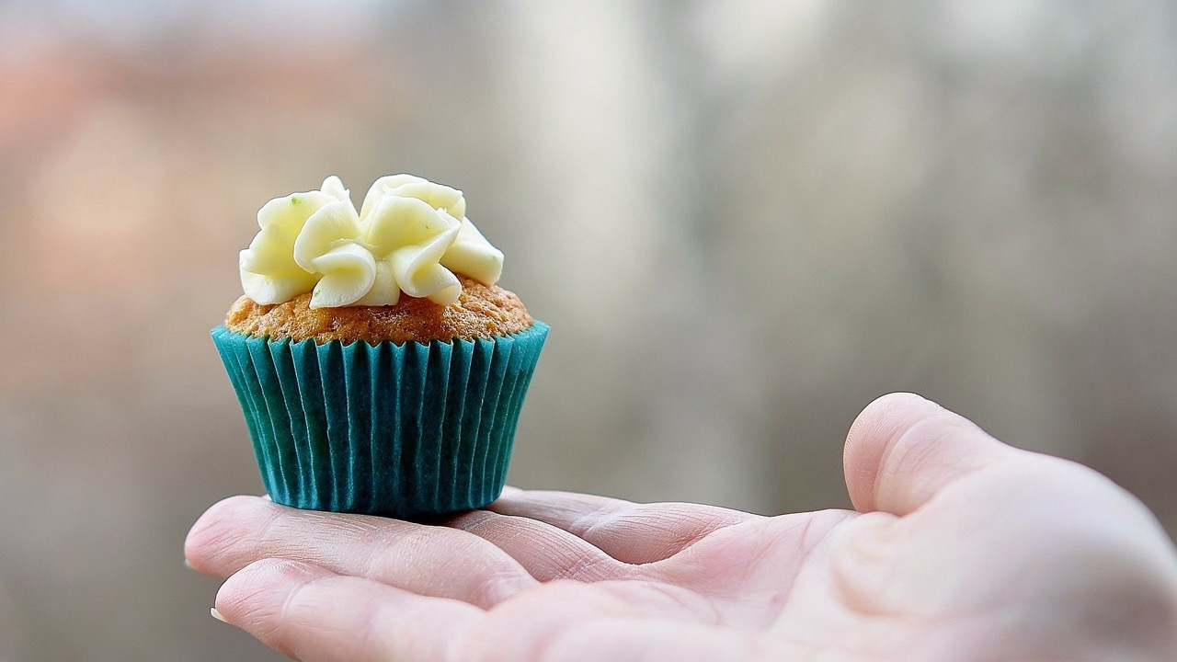
Refined sugar/sweets inflame your kidneys and compromise their function.
It is imperative that you learn to read the ingredients on food labels.
Adv Chronic Kidney Dis. 2013 Mar;20(2):157-64.
Notes:
Karalius VP, Shoham DA. Dietary sugar and artificial sweetener intake and chronic kidney disease: a review. Adv Chronic Kidney Dis. 2013 Mar;20(2):157-64. doi: 10.1053/j.ackd.2012.12.005. PMID: 23439375.

Slide 21
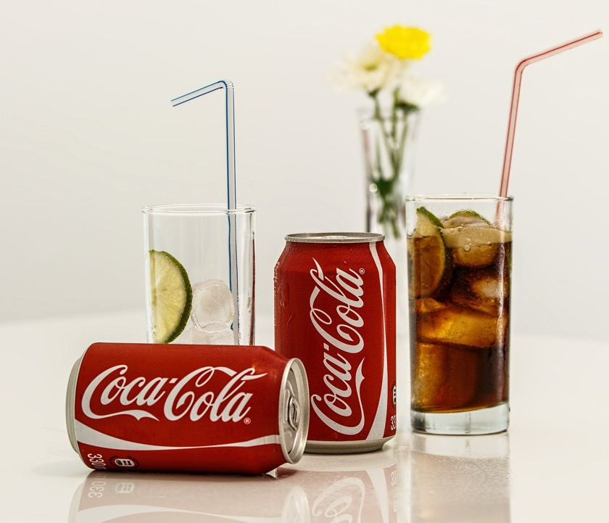

No sodas, or refined fructose containing products what so ever, even Agave is dangerous to your kidneys.
J Agric Food Chem. 57(21):10205-10.
Notes:
Shoham DA, Durazo-Arvizu R, Kramer H, Luke A, Vupputuri S, Kshirsagar A, Cooper RS. Sugary soda consumption and albuminuria: results from the National Health and Nutrition Examination Survey, 1999-2004. PLoS One. 2008;3(10):e3431.
Lin J1, Curhan GC. Associations of sugar and artificially sweetened soda with albuminuria and kidney function decline in women. Clin J Am Soc Nephrol. 2011 Jan;6(1):160-6.
Pokrywczynska M, Flisinski M, Jundzill A, Krzyzanowska S, Brymora A, Deptula A, Bodnar M, Kloskowski T, Stefanska A, Marszalek A, Manitius J, Drewa T. Impact of fructose diet and renal failure on the function of pancreatic islets. Pancreas. 2014 Jul;43(5):801-8.
Nakayama T, Kosugi T, Gersch M, Connor T, Sanchez-Lozada LG, Lanaspa MA, Roncal C, Perez-Pozo SE, Johnson RJ, Nakagawa T. Dietary fructose causes tubulointerstitial injury in the normal rat kidney. Am J Physiol Renal Physiol. 2010 Mar;298(3):F712-20.
García-Aguirre M, Sáenz-Alvaro VA, Rodríguez-Soto MA, Vicente-Magueyal FJ, Botello-Alvarez E, Jimenez-Islas H, Cárdenas-Manríquez M, Rico-Martínez R, Navarrete-Bolaños JL. Strategy for biotechnological process design applied to the enzymatic hydrolysis of agave fructo-oligosaccharides to obtain fructose-rich syrups. J Agric Food Chem. 2009 Nov 11;57(21):10205-10.
Chapman CL, Johnson BD, Sackett JR, Parker MD, Schlader ZJ. Soft drink consumption during and following exercise in the heat elevates biomarkers of acute kidney injury. Am J Physiol Regul Integr Comp Physiol. 2019 Mar 1;316(3):R189-R198. doi: 10.1152/ajpregu.00351.2018. Epub 2019 Jan 2. PMID: 30601706.

Slide 22
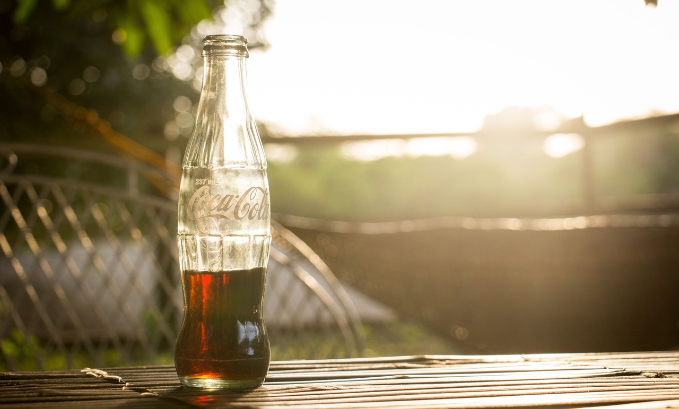
Caffeine No Help
Ren Fail. 2007;29(7):891-902.

Slide 23

Drink 2+ alcoholic beverages per day and your risk of kidney failure increases 4 fold.
Am J Epidemiol. 1999 Dec 15;150(12):1275-81.
Am J Epidemiol. 1999 Dec 15;150(12):1275-81.
Notes:
Perneger TV, Whelton PK, Puddey IB, Klag MJ. Risk of end-stage renal disease associated with alcohol consumption. Am J Epidemiol. 1999 Dec 15;150(12):1275-81. doi: 10.1093/oxfordjournals.aje.a009958. PMID: 10604769.

Slide 24
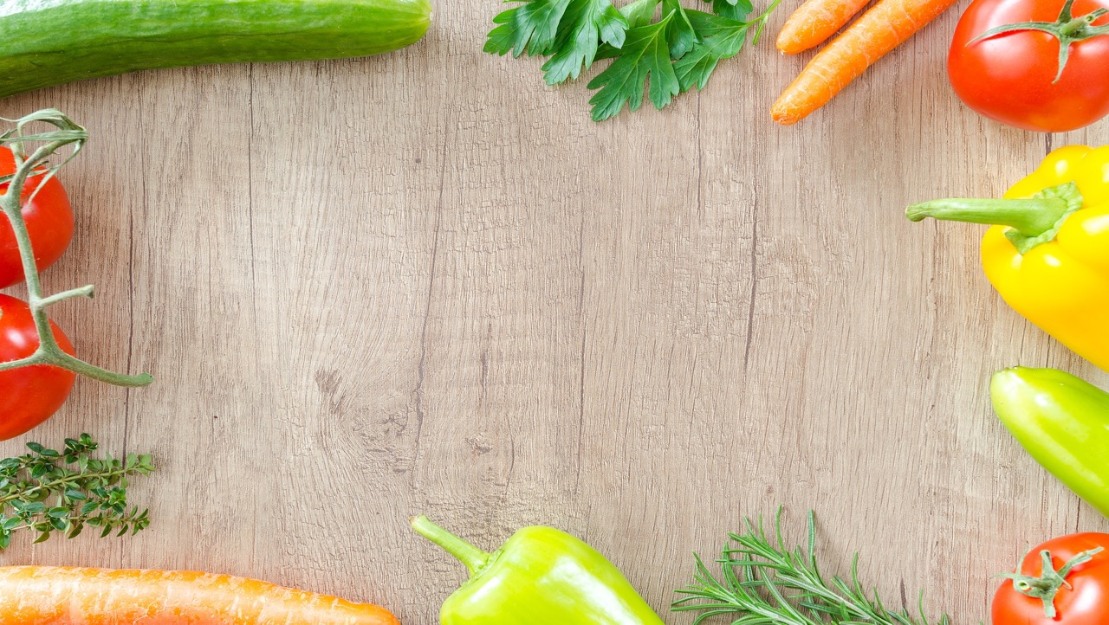
The best diet for the health of your kidneys consists of fruits, grains, nuts, and vegetables.
I recommend that around 80% of your diet be taken as fresh fruit or fresh vegetables (fresh, not cooked food) for the restoration of your kidneys.
Curr Hypertens Rep. 2015 Mar;17(3):16.
Notes:
Wiwanitkit V. Renal function parameters of Thai vegans compared with non-vegans. Ren Fail. 2007;29(2):219-20.
Hariharan D, Vellanki K, Kramer H. The Western Diet and Chronic Kidney Disease. Curr Hypertens Rep. 2015 Mar;17(3):16.
Gaisbauer M, Langosch A. Raw food and immunity Fortschr Med. 1990 Jun 10;108(17):338-40.

Slide 25
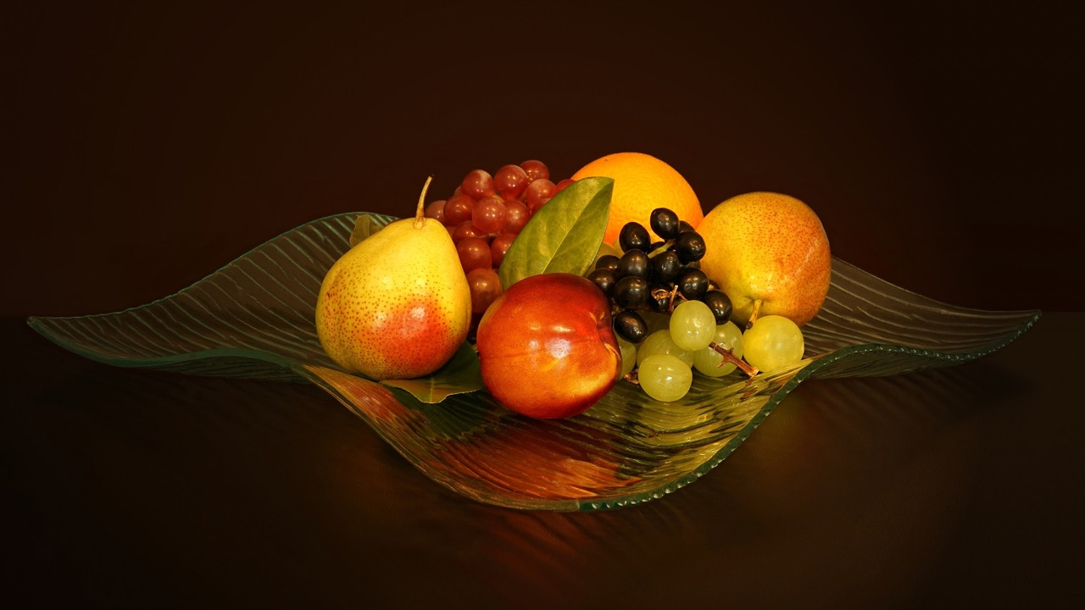
Foods that help your kidneys produce more urine include:
Artichoke, celery, eggplant, cauliflower, asparagus, green beans, apples, peaches, cantaloupe, pears, watermelon, grapes, onions, chives and leeks.

Slide 26

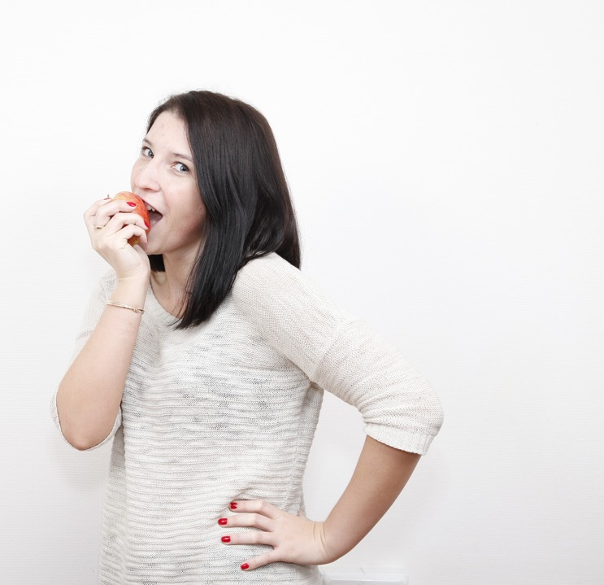
Also helpful for kidney disease are squash, chestnuts, dates, potatoes and sweet corn (non GMO).
All in all, eating a diet consisting of 80% fresh fruit or vegetables is best for the restoration of your kidneys.
Pamplona-Roger GD. Encyclopedia of foods and their healing power : a guide to food science and diet therapy. Madrid : Editorial Safeliz, 2011.

Slide 27
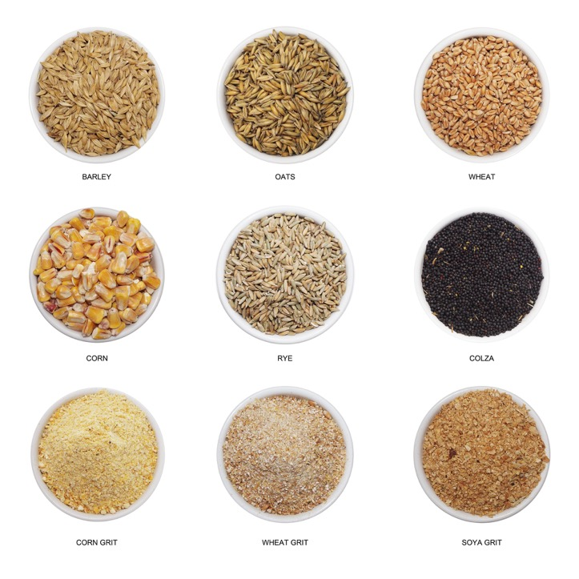
Fiber, especially soluble fiber, as found in oat and barley bran are extremely helpful.
It is recommended that if you desire to improve the health of your kidneys take at least ½ cup of oat bran or similar fiber each day.
It can be cooked, added to another food or eaten raw, for example, with soymilk or oatmeal etc.
Eur J Clin Nutr. 2015 Jul;69(7):761-8.
Notes:
Chiavaroli L, Mirrahimi A, Sievenpiper JL, Jenkins DJ, Darling PB. Dietary fiber effects in chronic kidney disease: a systematic review and meta-analysis of controlled feeding trials. Eur J Clin Nutr. 2015 Jul;69(7):761-8.
Salmean YA, Segal MS, Langkamp-Henken B, Canales MT, Zello GA, Dahl WJ. Foods with added fiber lower serum creatinine levels in patients with chronic kidney disease J Ren Nutr. 2013 Mar;23(2):e29-32.
Sirich TL. Dietary protein and fiber in end stage renal disease. Semin Dial. 2015 Jan-Feb;28(1):75-80.

Slide 28
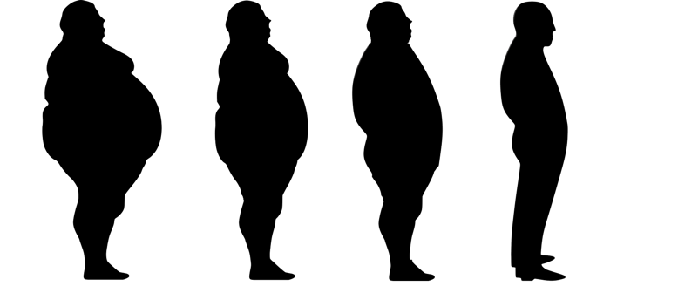
Being over weight increases the damage to your kidneys.
Weight loss decreases dangerous visceral fat lipid peroxidation.
Weight loss improves your kidney’s function even if you are obese.
Eating less food (i.e., fewer calories, fasting one day a week, two meals a day) and losing weight are indispensable to your kidney’s preservation and health.
PLoS One. 10(12):e0144442.
Nephrol Dial Transplant. 28 Suppl 4:iv82-98.
Notes:
Xu XM, Cai GY, Bu R, Wang WJ, Bai XY, Sun XF, Chen XM. Beneficial Effects of Caloric Restriction on Chronic Kidney Disease in Rodent Models: A Meta-Analysis and Systematic Review. PLoS One. 2015 Dec 22;10(12):e0144442.
Bernieh B, Al Hakim MR, Boobes Y, Abu Zidan FM. Fasting Ramadan in chronic kidney disease patients: clinical and biochemical effects. Saudi J Kidney Dis Transpl. 2010 Sep;21(5):898-902.
Gelber RP, Kurth T, Kausz AT, Manson JE, Buring JE, Levey AS, Gaziano JM. Association between body mass index and CKD in apparently healthy men. Am J Kidney Dis. 2005 Nov;46(5):871-80.
Kawamoto R, Kohara K, Tabara Y, Miki T, Ohtsuka N, Kusunoki T, Yorimitsu N. An association between body mass index and estimated glomerular filtration rate. Hypertens Res. 2008 Aug;31(8):1559-64.
Othman M, Kawar B, El Nahas AM. Influence of obesity on progression of non-diabetic chronic kidney disease: a retrospective cohort study. Nephron Clin Pract. 2009;113(1):c16-23.
Drechsler C, de Mutsert R, Grootendorst DC, Boeschoten EW, Krediet RT, le Cessie S, Wanner C, Dekker FW; NECOSAD Study Group. Association of body mass index with decline in residual kidney function after initiation of dialysis. Am J Kidney Dis. 2009 Jun;53(6):1014-23.
Dandona P, Mohanty P, Ghanim H, Aljada A, Browne R, Hamouda W, Prabhala A, Afzal A, Garg R. The suppressive effect of dietary restriction and weight loss in the obese on the generation of reactive oxygen species by leukocytes, lipid peroxidation, and protein carbonylation. J Clin Endocrinol Metab. 2001 Jan;86(1):355-62.
Mohn A, Catino M, Capanna R, Giannini C, Marcovecchio M, Chiarelli F. Increased oxidative stress in prepubertal severely obese children: effect of a dietary restriction-weight loss program. J Clin Endocrinol Metab. 2005 May;90(5):2653-8.
Kanda E, Muneyuki T, Suwa K, Nakajima K. Effects of Weight Loss Speed on Kidney Function Differ Depending on Body Mass Index in Nondiabetic Healthy People: A Prospective Cohort. PLoS One. 2015 Nov 23;10(11):e0143434.
Bolignano D, Zoccali C. Effects of weight loss on renal function in obese CKD patients: a systematic review. Nephrol Dial Transplant. 2013 Nov;28 Suppl 4:iv82-98.

Slide 29

MSG (Mono Sodium Glutamate) causes damage to your kidneys from major oxidative stress.
Exp Toxicol Pathol. 69(7):547-556.
Notes:
Contini MDC, Fabro A, Millen N, Benmelej A, Mahieu S. Adverse effects in kidney function, antioxidant systems and histopathology in rats receiving monosodium glutamate diet. Exp Toxicol Pathol. 2017 Sep 5;69(7):547-556. doi: 10.1016/j.etp.2017.03.003. Epub 2017 May 16. PMID: 28522248.
We investigated the effects of adding of monosodium glutamate (MSG) to a standard diet on oxidative stress in kidney, nitric oxide excretion, renal ions handling and blood pressure. We examined the association of these changes with the effects on renal histology. The study was performed on male Wistar rats (5 weeks old) divided into 3 groups: 1) MSG group were fed a diet supplemented with 3g of MSG/kg b.w./day, five days a week, and spontaneous ingestion of a 1% MSG solution during 16 weeks; 2) NaCl group were fed a diet with NaCl (1g/kg b.w./day) and 0.35% NaCl solution permanently alone at the same frequency and time; 3) control group were fed the normal chow and tap water. Sodium, potassium, calcium, phosphorus, creatinine, protein and nitric oxide excretion were analyzed in urine. We utilized clearance techniques to examine glomerular filtration rate and cortical renal plasma flow. We determined the oxidative state and the histopathological changes of renal tissue. Following MSG treatment, absolute and fractional sodium and potassium excretion decreased although there was hyperfiltration. The MSG group showed similar increase in blood pressure than the NaCl group, but nitric oxide excretion was significantly reduced. Although no increase in lipid peroxidation was verified, its observed alteration in the reduced glutathione/oxidized cycle and their enzymes GPx and GR. These changes were accompanied by alterations histological both glomerular as well as tubular level and by interstitial fibrosis with mononuclear cells accumulation. These results indicate that the addition of MSG in the diet decreases the excretion of Na, K and water with hyperfiltration. NaCl retention that leads to hypertension was accompanied by renal pathologic changes, intrarenal oxidative stress and reduction of nitric oxide excretion.
Elbassuoni EA, Ragy MM, Ahmed SM. Evidence of the protective effect of l-arginine and vitamin D against monosodium glutamate-induced liver and kidney dysfunction in rats. Biomed Pharmacother. 2018 Dec;108:799-808. doi: 10.1016/j.biopha.2018.09.093. Epub 2018 Sep 22. PMID: 30253372.
Monosodium glutamate (MSG) is frequently consumed as a flavor enhancer or food additive. Possible MSG-induced injurious effects on some organs have been stated in experimental animal models. Thus, in this study we tried to clarify effect and possible mechanism of action of MSG on liver and kidney, and if this results affected by the addition of l-Arginine or vitamin D to it. Animals divided into; Control, MSG treated, MSG + vitamin D treated, MSG + L-arginine treated group. Serum separated to determine liver and kidney function parameters. Kidneys and livers dissected out for histological examination and for assay of oxidative stress markers. RESULTS: MSG increased body weight and produced liver and kidney dysfunctions. The MSG-induced oxidative liver and kidney damage was proved. Vitamin D and l- Arginine have been shown to protect and restore the liver and the kidney capabilities in MSG models injury via inhibiting oxidative damage, vitamin D or l- Arginine suppresses the increased food intake and body weight gain induced by MSG. CONCLUSIONS: due to injurious effect of MSG, it should be avoided especially in liver or kidney disorders, foods containing excess MSG can be fortified with vitamin D or l- Arginine to overcome its adverse effects.

Slide 30
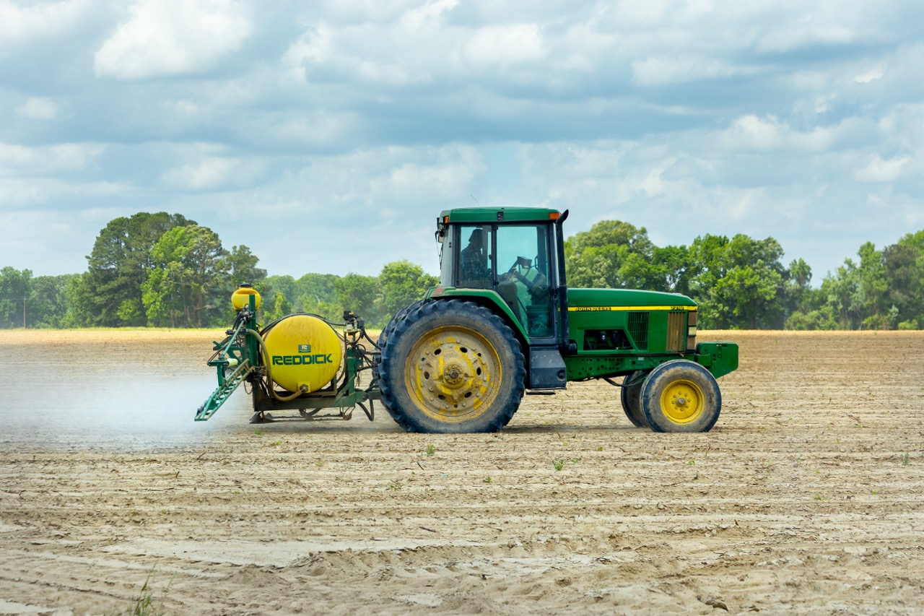
Exposure to glyphosate herbicide (Roundup), has been found to cause kidney failure.
Toxicol Lett. 258:1-10.
Notes:
Toxicol Lett. 2016 Jun 7;258:1-10. Mechanism-specific injury biomarkers predict nephrotoxicity early following glyphosate surfactant herbicide (GPSH) poisoning. Mohamed F, Endre ZH, Pickering JW, Jayamanne S, Palangasinghe C, Shahmy S, Chathuranga U, Wijerathna T, Shihana F, Gawarammana I, Buckley NA.

Slide 31
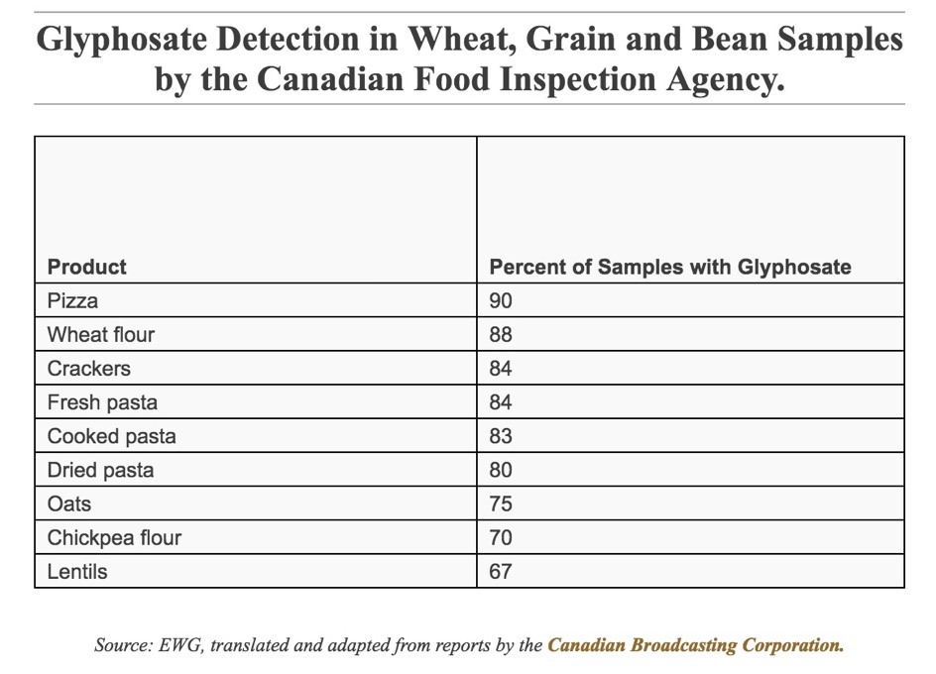
https://www.ewg.org/news-and-analysis/2019/02/glyphosate-contamination-food-goes-far-beyond-oat-products
Notes:
https://www.ewg.org/news-and-analysis/2019/02/glyphosate-contamination-food-goes-far-beyond-oat-products

Slide 32
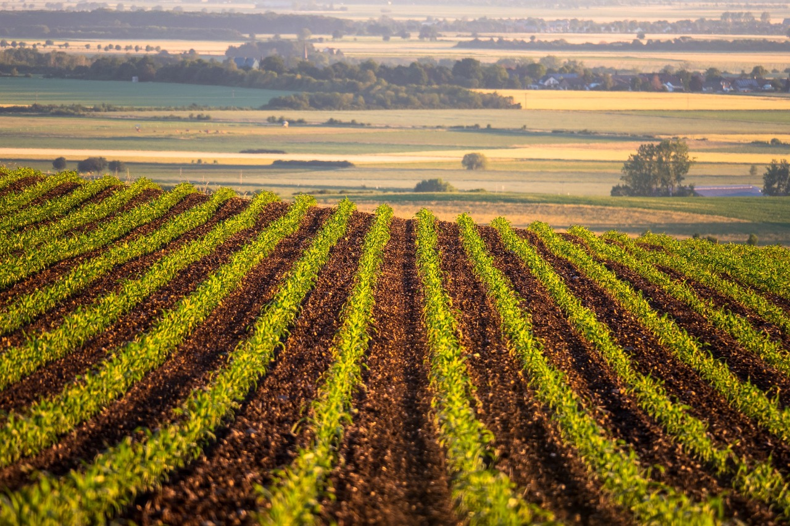
Genetically modified foods (GMO) are a detriment to your kidneys’ health.
Food Chem. Toxicol. 50, 4221–4231.
Notes:
Séralini, G.-E.; Clair, E.; Mesnage, R.; Gress, S.; Defarge, N.; Malatesta, M.; Hennequin, D.; Spiroux de Vendˆomois, J. Long term toxicity of a Roundup herbicide and a Roundup-tolerant genetically modified maize. Food Chem. Toxicol. 2012, 50, 4221–4231.

Slide 33
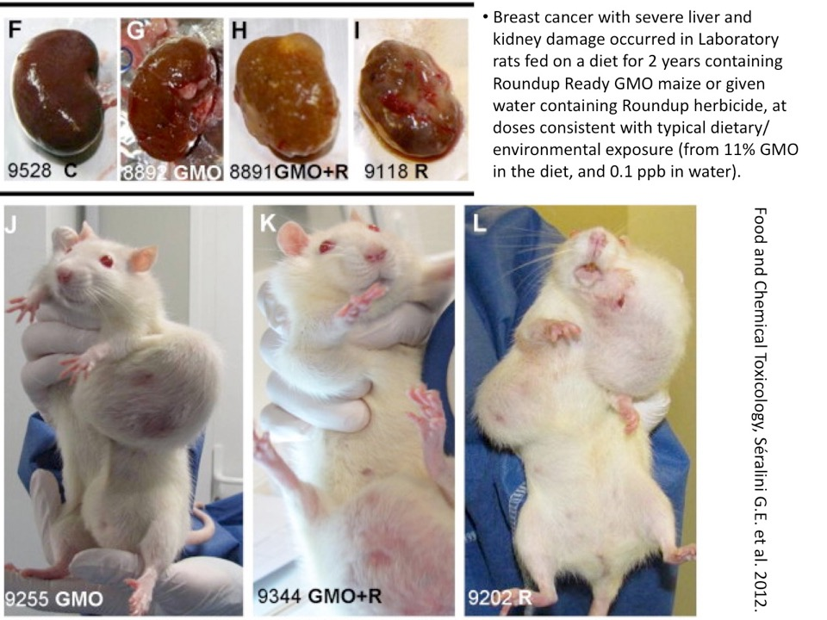

Slide 40

Avoid exposure to diesel fumes.
Cell Physiol Biochem. 38(5):1703-13.
Notes:
Nemmar A, Karaca T, Beegam S, Yuvaraju P, Yasin J, Hamadi NK, Ali BH. Prolonged Pulmonary Exposure to Diesel Exhaust Particles Exacerbates Renal Oxidative Stress, Inflammation and DNA Damage in Mice with Adenine-Induced Chronic Renal Failure. Cell Physiol Biochem. 2016;38(5):1703-13.

Slide 41
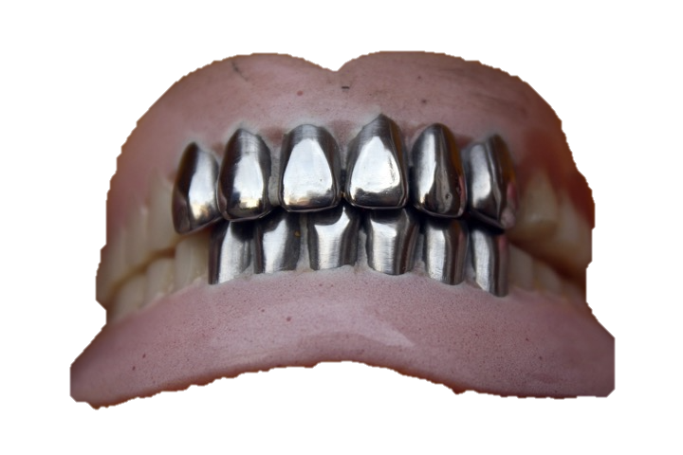
Heavy metals, industrial chemicals, elevated ambient temperatures, and infections.
Adv Chronic Kidney Dis. 17(3):254-64.
Notes:
Soderland P, Lovekar S, Weiner DE, Brooks DR, Kaufman JS. Chronic kidney disease associated with environmental toxins and exposures. Adv Chronic Kidney Dis. 2010 May;17(3):254-64.

Slide 42

Mold/mildew exposure can cause your kidneys to go into failure.
ScientificWorldJournal. 3:1058-64.
Notes:
Anyanwu E, Campbell AW, Vojdani A, Ehiri JE, Akpan AI. Biochemical changes in the serum of patients with chronic toxigenic mold exposures: a risk factor for multiple renal dysfunctions. ScientificWorldJournal. 2003 Nov 3;3:1058-64.
Mikkola R, Andersson MA, Hautaniemi M, Salkinoja-Salonen MS. Toxic indole alkaloids avrainvillamide and stephacidin B produced by a biocide tolerant indoor mold Aspergillus westerdijkiae. Toxicon. 2015 Jun 1;99:58-67.
Eren A, Kuştimur S, Kalkanci A, Unverdi S, Aktaş F, Sucak GT. Investigation of the effect of constructions in hospital environment on the crucial units for immunocompromised patients and the development of opportunistic mold infections. Mikrobiyol Bul. 2008 Jan;42(1):83-93.

Slide 43
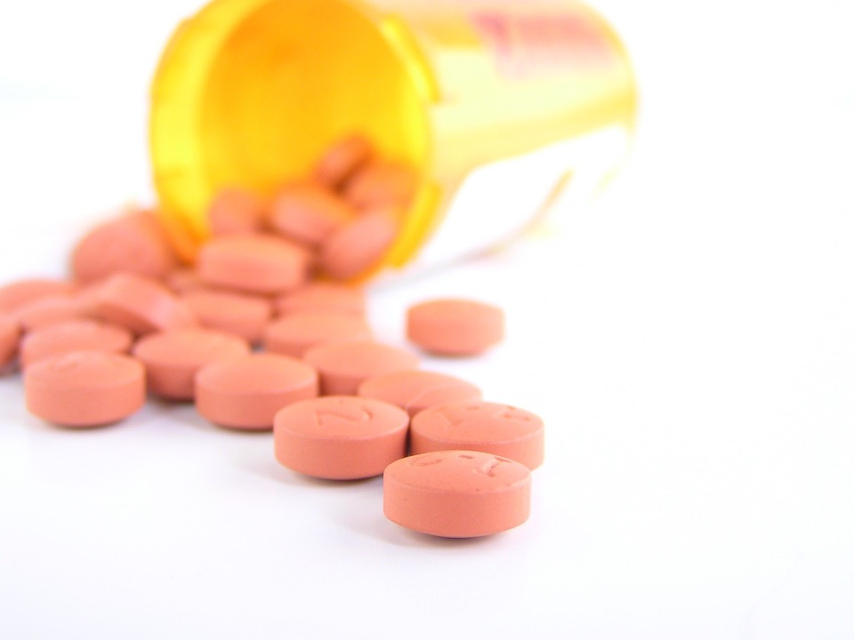
Drugs and Toxins
Anti-inflammatory pills, (Motrin, Naprosyn, aspirin, etc.) or acetaminophen, (Tylenol/Panadol) destroy your kidney’s function, even a baby aspirin can be hazardous.
Prev Chronic Dis. 11:E220.
Notes:
Jang SM, Cerulli J, Grabe DW, Fox C, Vassalotti JA, Prokopienko AJ, Pai AB. NSAID-avoidance education in community pharmacies for patients at high risk for acute kidney injury, upstate New York, 2011. Prev Chronic Dis. 2014 Dec 18;11:E220.
Henry D, Page J, Whyte I, Nanra R, Hall C. Consumption of non-steroidal anti-inflammatory drugs and the development of functional renal impairment in elderly subjects. Results of a case-control study. Br J Clin Pharmacol. 1997 Jul;44(1):85-90.
Perneger TV, Whelton PK, Klag MJ. Risk of kidney failure associated with the use of acetaminophen, aspirin, and nonsteroidal antiinflammatory drugs. N Engl J Med. 1994 Dec 22;331(25):1675-9.
Curhan GC, Knight EL, Rosner B, Hankinson SE, Stampfer MJ. Lifetime nonnarcotic analgesic use and decline in renal function in women. Arch Intern Med. 2004 Jul 26;164(14):1519-24.
Segal R, Lubart E, Leibovitz A, Iaina A, Caspi D. Renal effects of low dose aspirin in elderly patients. Isr Med Assoc J. 2006 Oct;8(10):679-82.

Slide 44
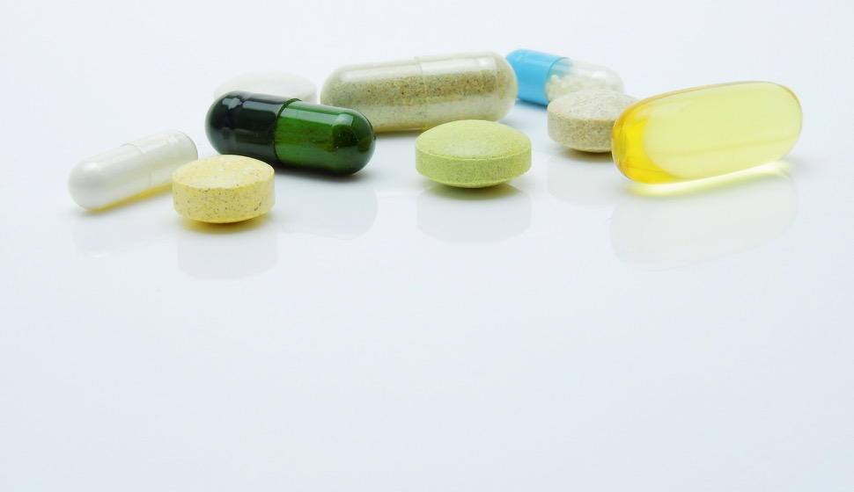
Ever notice a change in the color of your urine after taking supplement pills?
Most supplements, especially vitamins, are unhelpful because they only put an extra burden on your kidneys.
Nephrology (Carlton). 2015 Jun 4.
Notes:
Tangkiatkumjai M, Boardman H, Praditpornsilpa K, Walker DM. Association of herbal and dietary supplements with progression and complications of chronic kidney disease: a prospective cohort study. Nephrology (Carlton). 2015 Jun 4.

Slide 45
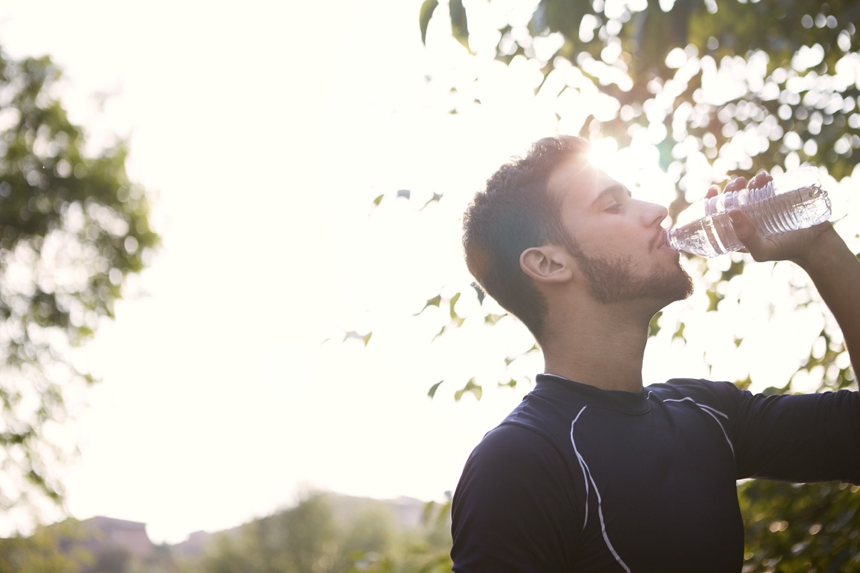
Water is a safe natural diuretic.
Water, not mud (other ingredients).
Meals as liquid, smoothies, soups and juices are harmful.
Liquid with meals burdens your kidneys.
Best taken 30 minutes before meals and 2+ hours after.
Schedule your water for success.
Nutrients.;8(4):204.

Slide 46
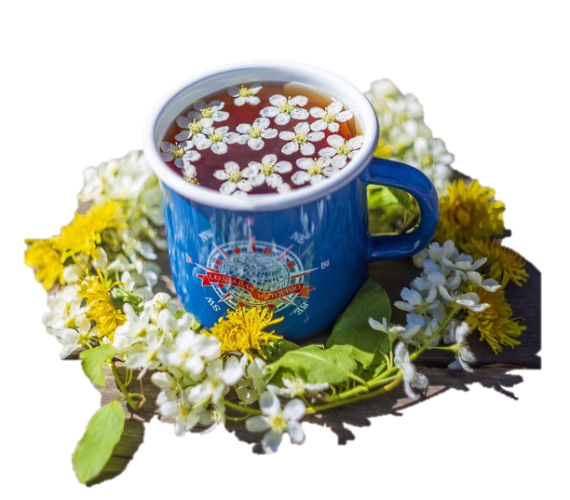
Certain herbal teas can be beneficial.
Dandelion tea, for example, helps you with urine production and reduces inflammation.
A good plan is to drink one cup of Dandelion tea one-half hour before you eat breakfast and lunch.
Ren Fail. 39(1):1-6.
Notes:
Clare BA, Conroy RS, Spelman K. The diuretic effect in human subjects of an extract of Taraxacum officinale folium over a single day. J Altern Complement Med. 2009 Aug;15(8):929-34.
Karakuş A, Değer Y, Yıldırım S. Protective effect of Silybum marianum and Taraxacum officinale extracts against oxidative kidney injuries induced by carbon tetrachloride in rats. Ren Fail. 2017 Nov;39(1):1-6.

Slide 47

Kidneys of sedentary people shut down whereas activity stimulates your kidney’s function.
Circ J. 79(6):1372-80.
Notes:
Reinhart GA, Lohmeier TE. Role of the renin-angiotensin system in mediating the effects of posture on renal function. Am J Physiol. 1996 Jul;271(1 Pt 2):R282-8.
Guo VY, Brage S, Ekelund U, Griffin SJ, Simmons RK; ADDITION-Plus study team. Objectively measured sedentary time, physical activity and kidney function in people with recently diagnosed Type 2 diabetes: a prospective cohort analysis. Diabet Med. 2015 Aug 18.
Silva SD Jr, Zampieri TT, Ruggeri A, Ceroni A, Aragão DS, Fernandes FB, Casarini DE, Michelini LC. Downregulation of the vascular renin-angiotensin system by aerobic training - focus on the balance between vasoconstrictor and vasodilator axes - . Circ J. 2015;79(6):1372-80.
Somineni HK, Boivin GP, Elased KM. Daily exercise training protects against albuminuria and angiotensin converting enzyme 2 shedding in db/db diabetic mice. J Endocrinol. 2014 Apr 22;221(2):235-51.

Slide 48

Get active exercise, in the open air, involving all your limbs.
Get fresh air, even when indoors, open windows for ventilation, especially at night.
Walking after every meal for 10-15 minutes improves your circulation.
Gardening is a most excellent exercise for your health.
Geriatr Gerontol Int. 2017 May;17(5):730-736.
Notes:
Lee S, Shimada H, Lee S, Makizako H, Doi T, Harada K, Bae S, Harada K, Hotta R, Tsutsumimoto K, Yoshida D, Nakakubo S, Anan Y, Park H, Suzuki T. Association between sedentary time and kidney function in community-dwelling elderly Japanese people. Geriatr Gerontol Int. 2017 May;17(5):730-736. doi: 10.1111/ggi.12779. Epub 2016 Jun 14. PMID: 27295943.
Lin J, Curhan GC. Kidney function decline and physical function in women. Nephrol Dial Transplant. 2008 Sep;23(9):2827-33.

Slide 49
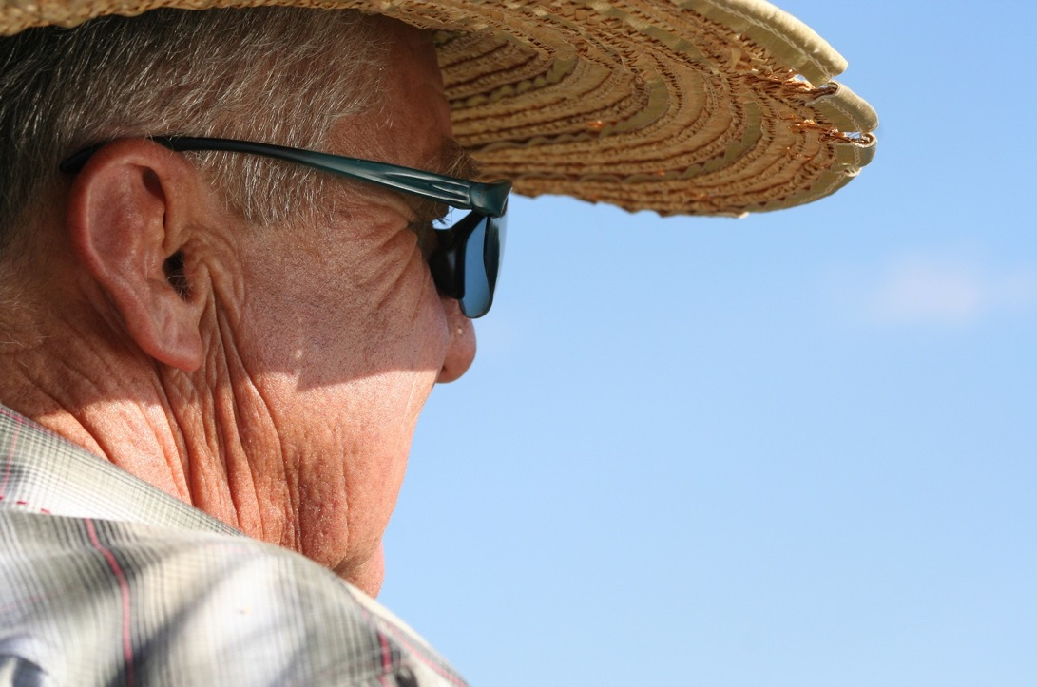
Sun for Life
Sunlight helps reduce mortality in kidney failure patients on dialysis.
Sunlight lowers their blood pressure.
Sci Rep. 9(1):2230.
Notes:
Yoon UA, Kim YC, Lee H, Kwon S, An JN, Kim DK, Kim YS, Lim CS, Lee JP, Kim H. The impact of sunlight exposure on mortality of patients with end stage renal disease. Sci Rep. 2019 Feb 18;9(1):2230.
Recent data suggest that reduced sunlight exposure is associated with increased mortality in the general population. To date, the association between sunlight exposure and mortality in dialysis patients has not been examined. Among 134,478 dialysis patients in the Korean end-stage renal disease (ESRD) cohort from 2001 to 2014, 31,291 patients were enrolled from seven metropolitan cities, and data were analyzed using bi-directional case-crossover design. We examined the association between short-term sunlight exposure and mortality in ESRD patients. We adjusted for temperature, humidity, and daily concentrations of nitrogen dioxide (NO2), sulfur dioxide (SO2), ozone (O3), carbon monoxide (CO), and particle matter (PM10) as confounders. The characteristics of the study population included age (65.6 ± 12.26 (mean ± standard deviation [SD]) years), sex (male, 59.96%; female, 41.04%), comorbidity (diabetes, 53.58%; hypertension, 40.5%), and kidney dialysis type (hemodialysis, 73.02%; peritoneal dialysis, 26.98%). The mean ± SD follow-up time was 4.68 ± 4.37 years. The daily sunlight exposure was significantly decreased in the case group compared with the control group (P = 0.004). Sunlight exposure was associated with all-cause death overall (ORs [95% CI]: 0.99 [0.98-0.99], P = 0.042) in a fully adjusted model. Patients with diabetes (ORs [95% CI]: 0.98 [0.97-0.99], P = 0.016) or aged higher than 75 years (ORs [95% CI]; 0.97 [0.96-0.99], P = 0.020) had higher risks of mortality than patients without diabetes or aged below 75 years, respectively. These findings suggest that sunlight exposure is inversely correlated with all-cause mortality in dialysis patients.
Weller RB, Wang Y, He J, Maddux FW, Usvyat L, Zhang H, Feelisch M, Kotanko P. Does Incident Solar Ultraviolet Radiation Lower Blood Pressure? J Am Heart Assoc. 2020 Mar 3;9(5):e013837.
Background Hypertension remains a leading global cause for premature death and disease. Most treatment guidelines emphasize the importance of risk factors, but not all are known, modifiable, or easily avoided. Population blood pressure correlates with latitude and is lower in summer than winter. Seasonal variations in sunlight exposure account for these differences, with temperature believed to be the main contributor. Recent research indicates that UV light enhances nitric oxide availability by mobilizing storage forms in the skin, suggesting incident solar UV radiation may lower blood pressure. We tested this hypothesis by exploring the association between environmental UV exposure and systolic blood pressure (SBP) in a large cohort of chronic hemodialysis patients in whom SBP is determined regularly. Methods and Results We studied 342 457 patients (36% black, 64% white) at 2178 US dialysis centers over 3 years. Incident UV radiation and temperature data for each clinic location were retrieved from the National Oceanic and Atmospheric Administration database. Linear mixed effects models with adjustment for ambient temperature, sex/age, body mass index, serum Na⁺/K⁺ and other covariates were fitted to each location and combined estimates of associations calculated using the DerSimonian and Laird procedure. Pre-dialysis SBP varied by season and was ≈4 mm Hg higher in black patients. Temperature, UVA and UVB were all linearly and inversely associated with SBP. This relationship remained statistically significant after correcting for temperature. Conclusions In hemodialysis patients, in addition to environmental temperature, incident solar UV radiation is associated with lower SBP. This raises the possibility that insufficient sunlight is a new risk factor for hypertension, perhaps even in the general population.

Slide 50

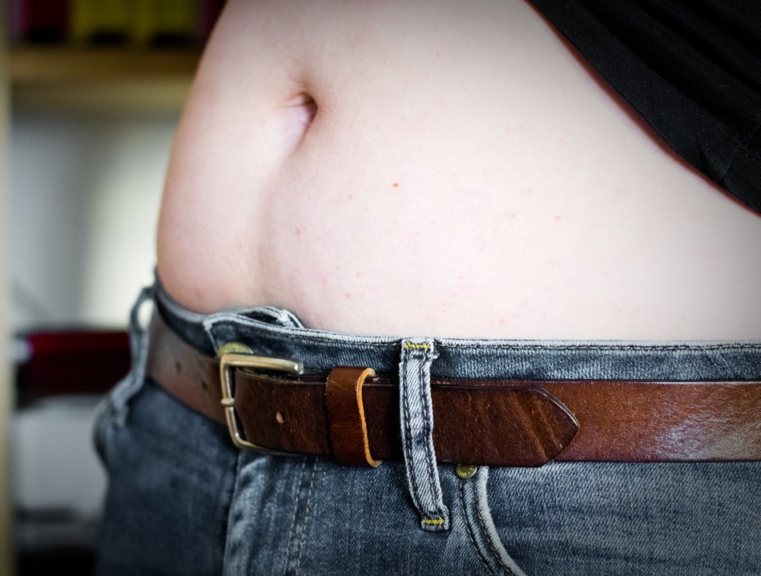
Avoid tight bands around your abdomen, (elastics and belts) as these affect circulation to your intestines and kidneys.
Perfect health depends on perfect circulation.
J Occup Environ Med. 38(9):925-7.
Notes:
Rafacz W, McGill SM. Wearing an abdominal belt increases diastolic blood pressure. J Occup Environ Med. 1996 Sep;38(9):925-7.
Hiramatsu K, Yamada T, Katakura M. Acute effects of cold on blood pressure, renin-angiotensinaldosterone
system, catecholamines and adrenal steroids in man. Clin Exp Pharmacol Physiol. 1984 Mar-
Apr;11(2):171-9.

Slide 51

Clothe all parts of your body (head, arms, ankles, and especially legs, etc.) evenly and adequately especially in cold weather.
Arctic Med Res. 50 Suppl 6:115-21
Notes:
Arctic Med Res. 1991; 50 Suppl 6:115-21

Slide 52


Sunshine and Vitamin D are beneficial to your kidney’s function and slow their decline in kidney failure.
J Clin Endocrinol Metab.;104(6):2267-2276.
Notes:
Lunyera J, Davenport CA, Pendergast J, Musani SK, Bhavsar NA, Sims M, Mwasongwe S, Wolf M, Diamantidis CJ, Boulware LE, Scialla JJ. Modifiers of Plasma 25-Hydroxyvitamin D and Chronic Kidney Disease Outcomes in Black Americans: The Jackson Heart Study. J Clin Endocrinol Metab. 2019 Jun 1;104(6):2267-2276. doi: 10.1210/jc.2018-01747. PMID: 30668751; PMCID: PMC6489693.

Slide 53

Inadequate sleep increases your risk of kidney failure by 80%.
Melatonin is also critical to your kidney’s health.
J Am Soc Nephrol. 2020 Dec;31(12):2937-2947.
Notes:
Park S, Lee S, Kim Y, Lee Y, Kang MW, Kim K, Kim YC, Han SS, Lee H, Lee JP, Joo KW, Lim CS, Kim YS, Kim DK. Short or Long Sleep Duration and CKD: A Mendelian Randomization Study. J Am Soc Nephrol. 2020 Dec;31(12):2937-2947. doi: 10.1681/ASN.2020050666. Epub 2020 Oct 1. PMID: 33004418; PMCID: PMC7790216.
Abstract
Background: Studies have found sleeping behaviors, such as sleep duration, to be associated with kidney function and cardiovascular disease risk. However, whether short or long sleep duration is a causative factor for kidney function impairment has been rarely studied.
Methods: We studied data from participants aged 40-69 years in the UK Biobank prospective cohort, including 25,605 self-reporting short-duration sleep (<6 hours per 24 hours), 404,550 reporting intermediate-duration sleep (6-8 hours), and 35,659 reporting long-duration sleep (≥9 hours) in the clinical analysis. Using logistic regression analysis, we investigated the observational association between the sleep duration group and prevalent CKD stages 3-5, analyzed by logistic regression analysis. We performed Mendelian randomization (MR) analysis involving 321,260 White British individuals using genetic instruments (genetic variants linked with short- or long-duration sleep behavior as instrumental variables). We performed genetic risk score analysis as a one-sample MR and extended the finding with a two-sample MR analysis with CKD outcome information from the independent CKDGen Consortium genome-wide association study meta-analysis.
Results: Short or long sleep duration clinically associated with higher prevalence of CKD compared with intermediate duration. The genetic risk score for short (but not long) sleep was significantly related to CKD (per unit reflecting a two-fold increase in the odds of the phenotype; adjusted odds ratio, 1.80; 95% confidence interval, 1.25 to 2.60). Two-sample MR analysis demonstrated causal effects of short sleep duration on CKD by the inverse variance weighted method, supported by causal estimates from MR-Egger regression.
Conclusions: These findings support an adverse effect of a short sleep duration on kidneyfunction. Clinicians may encourage patients to avoid short-duration sleeping behavior to reduce CKD risk.
Hrenak J, Paulis L, Repova K, Aziriova S, Nagtegaal EJ, Reiter RJ, Simko F. Melatonin and renal protection: novel perspectives from animal experiments and human studies (review). Curr Pharm Des. 2015;21(7):936-49. doi: 10.2174/1381612820666140929092929. PMID: 25269563.
Chronic kidney disease (CKD) is a serious public health problem. Current therapies are designed to slow down progression of the disease and avoid the necessity of dialysis or kidney transplantation. CKD is characterized by chronic inflammation and progressive cell death resulting in fibrotic rebuilding of renal tissue. Melatonin, the primary product of the pineal gland, has been shown to have pluripotent protective effects in many organs and tissues. It exerts anti-hypertensive, anti-inflammatory, anti-apoptotic, and antiremodelling actions. A principal mechanism of these numerous melatonin benefits resides in its extraordinary high efficacy as an antioxidant and scavenger protecting cells both extracellularly and in all subcellular structures. In addition to these receptor-independent actions, the effects of melatonin via specific MT-receptors may be beneficial. In several animal models of CKD, involving experimental hypertension, diabetes mellitus and various models of nephrotoxicity, melatonin reduced the oxidative burden, attenuated the chronic inflammation and limited apoptosis. These effects were associated with the reduction of proteinuria, damage of parenchymal cells and fibrosis. In humans, melatonin's chronobiological action attenuates sleep disturbances in hemodialyzed patients suffering from a relative melatonin deficiency. Moreover, melatonin reduces the oxidative burden and improves iron metabolism in hemodialyzed patients. In conclusion, the pleiotropic physiological actions of melatonin induce beneficial effects at numerous pathophysiological levels related to CKD both under experimental and clinical conditions. It is hoped that this review will prompt a large clinical trial to determine the efficacy of this nontoxic indoleamine as a potential treatment for this debilitating disease.

Slide 54
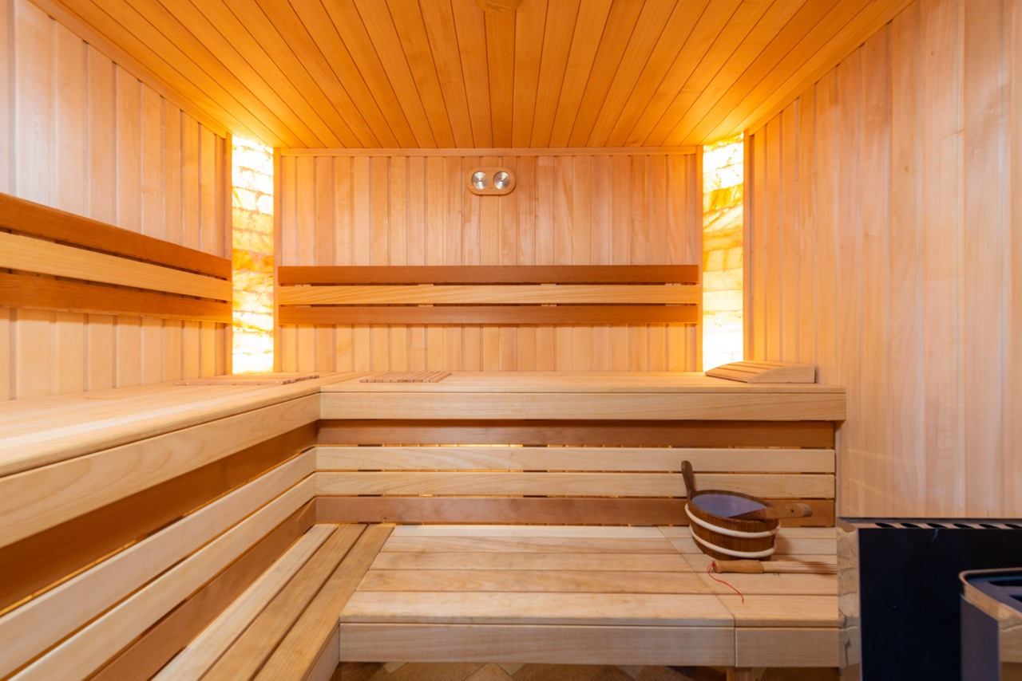
Sweating is helpful to remove toxins from your body otherwise dependent upon good kidney function for removal. For this reason saunas can be very helpful.
Bathe regularly and do thorough skin scrubbing to open up the pores of your skin.
Ren Fail. 36(1):126-30.
Notes:
Cecchini M, LoPresti V. Drug residues store in the body following cessation of use: impacts on neuroendocrine balance and behavior--use of the Hubbard sauna regimen to remove toxins and restore health. Med Hypotheses. 2007;68(4):868-79.
Ye T, Tu W, Xu G. Hot bath for the treatment of chronic renal failure. Ren Fail. 2014 Feb;36(1):126-30.
Ye T, Tu W, Xu G. Hot bath for the treatment of chronic renal failure. Ren Fail. 2014 Feb;36(1):126-30. doi: 10.3109/0886022X.2013.832318. Epub 2013 Sep 24. PMID: 24060101.

Slide 55

A bath will sooth your nerves. It promotes general perspiration, quickens your circulation, overcomes obstructions in your system, and acts beneficially on your kidneys and urinary organs.
In scientific studies a bath led to a significant increase of urine flow.
Zentralbl Gynakol. 111(13):864-70.
Notes:
Schnizer W, Mesrogli M, Seichert N, Schöps P, Knorr H, Schneider J, Wassmann M. Die "ausschwemmende" Wirkung des Bades. Untersuchung an gesunden Schwangeren und Patienten mit Odemen bzw. Gestose [The diuretic effect of a bath. Study in healthy pregnant females and patients with edema and gestosis]. Zentralbl Gynakol. 1989;111(13):864-70. German. PMID: 2800772.
The effect of a 40 minute thermoneutral bath on diuretic function and blood volume in a total of 27 pregnant women (13 healthy and 14 pregnant women with edema rsep. EPH-gestosis) was investigated. In both groups water immersion led to a significant increase of urine flow, natriuresis, kaliuresis, osmotic and free water clearance. Plasma volume increased about 8-9%. The patients with gestosis showed a higher creatinine clearance. The same group also showed a higher osmotic clearance and relatively more sodium excretion. Regarding the flushing effect of bath, two mechanism of water immersion that originated in hydrostatic pressure have to be discussed-activation of renal functions and mobilisation of interstitial fluid.
O'Hare JP, Heywood A, Summerhayes C, Lunn G, Evans JM, Walters G, Corrall RJ, Dieppe PA. Observations on the effect of immersion in Bath spa water. Br Med J (Clin Res Ed). 1985 Dec 21-28;291(6511):1747-51. doi: 10.1136/bmj.291.6511.1747. PMID: 3936569; PMCID: PMC1419186.
Immersion in water in spas has been practised for centuries and has many proponents. Despite fierce debate about its efficacy there has been little scientific evaluation of the effect of immersion in mineral waters. Eight normal subjects were immersed in Bath spa water for two hours and the renal, haematological, and cardiovascular responses were compared with those in the control periods before and after immersion. Significant, twofold diuresis and natriuresis, 5% haemodilution, and a 50% increase in cardiac index were observed in subjects immersed, sitting, in Bath spa water at 35 degrees C. These changes may constitute part of the scientific rationale for spa treatment in many states of disease.

Slide 56

Hydrotherapy
Hydrotherapy is beneficial at restoring your circulation.
Twice a day you can apply the following: We like to use hot water bottles and ice packs. Fill two hot water bottles with hot water and apply the hot water bottles to the kidneys on the mid back for 3 minutes. Then remove the hot water bottles and apply ice packs for 1 minute to the same area.
Repeat this process 7 times and end with cold, then lay down and rest for 20 minutes to finish the treatment.
This stimulates your kidney’s function.
J Back Musculoskelet Rehabil. 4(4):255-64.
Notes:
Becker BE. The biologic aspects of hydrotherapy. J Back Musculoskelet Rehabil. 1994 Jan 1;4(4):255-64.

Slide 57

Charcoal reduces the burden upon your kidneys by adsorbing substances otherwise dependent upon them for removal from your body.
One teaspoon of activated charcoal powder can be mixed in one cup of water and drank. This can be repeated two to three times a day.
Nephrology (Carlton). 2012 Sep;17(7):616-20.
Notes:
Wang Z, Cui M, Tang L, Li W, Wei Y, Zhu Z, Jia X, Kong X, Xu D. Oral activated charcoal suppresses hyperphosphataemia in haemodialysis patients. Nephrology (Carlton). 2012 Sep;17(7):616-20.
Musso CG, Michelangelo H, Reynaldi J, Martinez B, Vidal F, Quevedo M, Parot M, Waisman G, Algranati L. Combination of oral activated charcoal plus low protein diet as a new alternative for handling in the old end-stage renal disease patients. Saudi J Kidney Dis Transpl. 2010 Jan;21(1):102-4.
Yamamoto S, Zuo Y, Ma J, Yancey PG, Hunley TE, Motojima M, Fogo AB, Linton MF, Fazio S, Ichikawa I, Kon V. Oral activated charcoal adsorbent (AST-120) ameliorates extent and instability of atherosclerosis accelerated by kidney disease in apolipoprotein E-deficient mice. Nephrol Dial Transplant. 2011 Aug;26(8):2491-7. Epub 2011 Jan 18.

Slide 58
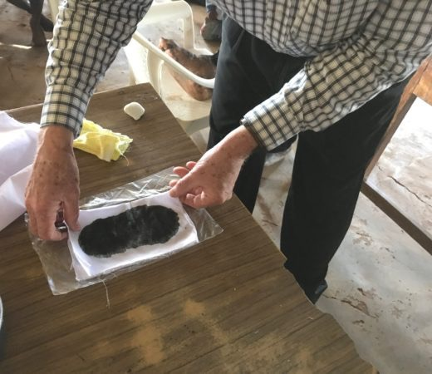
We recommend charcoal poultices over the kidneys at night for toxin removal while you are seeking to restore kidney function.
Our procedure is to take one cup of water and put it into a sauce pan on the stove. Add 3 tablespoons of activated charcoal powder and 3 tablespoons of ground flax seeds and bring to a boil. Stir well. Turn off the heat and let cool.
This can be applied one fourth inch thick over your kidneys and surrounding back area. Cover with a plastic wrap for overnight treatment.
Leave this on all night and remove it in the morning. The next night, turn the poultices over and use the other side. You can even make a supply of these ahead of time and store them in your freezer for future use.
(http://www.buyactivatedcharcoal.com/product/activated_charcoal_powder/hardwood/sn20)

Slide 59
Kidney Health
Eat natural foods as grown.
Avoid animal protein, fats, alcohol, caffeine, fermented and/or refined foods.
Avoid drugs and supplements.
Drink plenty of water, not liquid meals.
Exercise in the open air and sunshine.
Get plenty of sleep.
Let God be your healer!

Slide 60
Kidney Health
Avoid animal protein, fats, alcohol, caffeine, fermented and/or refined foods.
Avoid drugs and supplements.
Drink plenty of water, not liquid meals.
Exercise in the open air and sunshine.
Get plenty of sleep.
Let God be your healer!

Slide 61
Kidney Health
Avoid drugs and supplements.
Drink plenty of water, not liquid meals.
Exercise in the open air and sunshine.
Get plenty of sleep.
Let God be your healer!

Slide 62
Kidney Health
Drink plenty of water, not liquid meals.
Exercise in the open air and sunshine.
Get plenty of sleep.
Let God be your healer!

Slide 63
Kidney Health
Exercise in the open air and sunshine.
Get plenty of sleep.
Let God be your healer!

Slide 64
Kidney Health
Get plenty of sleep.
Let God be your healer!

Slide 65
Kidney Health
Let God be your Healer!

Slide 66
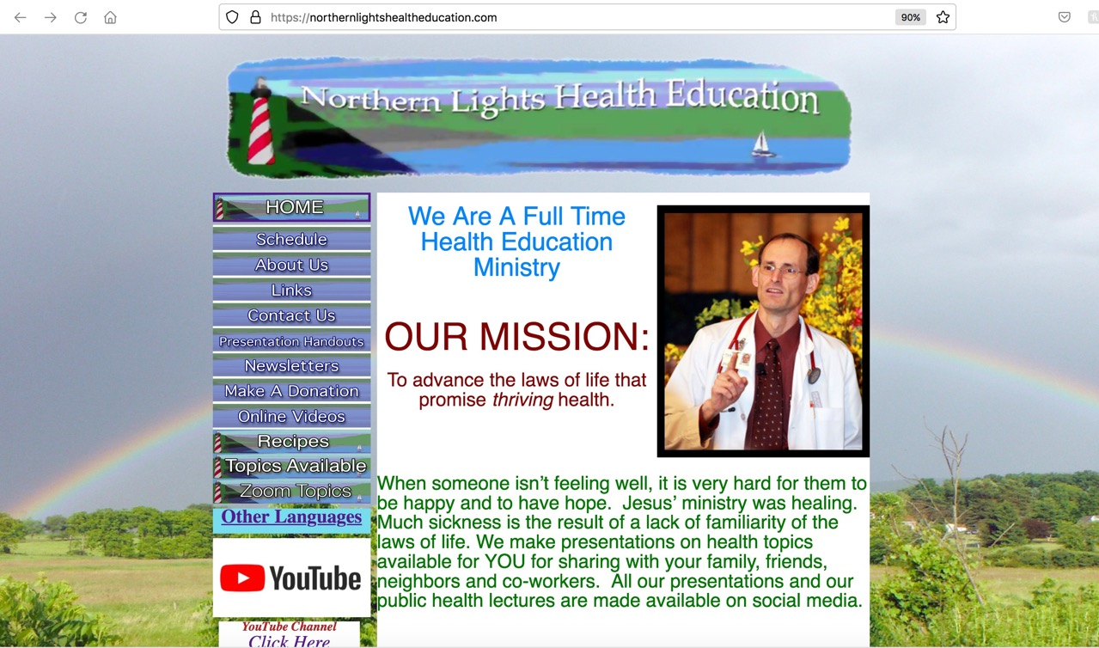
NorthernLightsHealthEducation.com

Slide 67
Natural Kidney Health
Notes:
His kidney function had fallen below 20%, doctors were warming up the dialysis machine, Hosea was scared. Alcoholism, poor dietary choices and sedentary lifestyle had taken their toll. His kidney function continued to decline, his blood pressure was going up, and now the threat of dialysis. Then he came to see me. I immediately helped him to apply principles from my talk, “Natural Kidney Health”, and his kidney function rose to 74%. Don’t miss this presentation, practice its principles, and your kidneys are going to love you.
Story: His kidney function had fallen below 20%, doctors were warming up the dialysis machine, Hosea was scared.
alcoholism, poor diet and sedentary lifestye had taken its toll.
Benefit/problem solved
Declining kidney function
High blood pressure
Avoid dialysis
from this talk
Simple food choices
Better lifestyle practices
Inspire
Hosea totally avoided dialysis as his kidney function went to 74%
Call to action
Don’t miss this presentation, practices its principles, and your kidneys will love you.

Slide 68
Drink water, not liquid foods.
Avoid animal protein, caffeine, oils, refined foods, fermented foods, sweets, fried foods, excess salt, overeating.
Avoid drugs, supplements.
Avoid diesel odors, Roundup, mercury, mold, and GMO foods.
Eat foods as grown.
Olives are good for kidney health.
Fiber is healthful.
Get plenty of outdoor exercise in the fresh air and sunlight.

