Slide 1

The Jab
Is vaccination an issue of conscience?
Notes:
Why God’s Children Don’t Take Vaccinations
Eternal Father Strong To Save
Vaccinated With Complications
Freedom of informed conscience!
TP: Plea for help!
Our physicians should be wise educators, warning all against self-indulgence, and showing that abstinence from the things that God has prohibited is the only way to prevent ruin of body and mind.--Testimonies, vol. 9, p. 161. (1909) {Ev 526.5}

Slide 2

Dear Dr Clark,
I am a Seventh Day Adventist from Australia. I commenced my physical therapy job today at an aged care facility. I was previously told in an email that I wouldn’t be allowed to enter the building unless I provided evidence of a recent influenza vaccination. After much prayer, I decided to turn up to my placement anyway. Thankfully, they allowed me to start my placement today, but I was told that I must provide a letter by tomorrow morning (written by someone in health) saying that I didn’t receive the vaccination due to religious reasons. Are you able to help me out in any way or know anyone that could? Thank you for your time.
            Regards,
            Joseph
Notes:
What would you do if you were give a 24hr vaccine mandate?
TP: Bill Gates bunkers, The Vaccine is the World’s bunker against fearful disease.

Slide 3
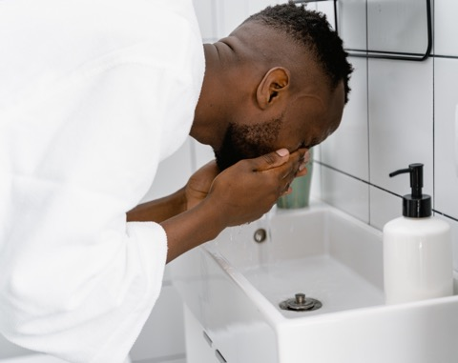
We Are Asked To Take Care Of Our Bodies Intelligently
“That every one of you should know how to possess his vessel in sanctification and honour;” 1 Thessalonians 4:4.

Slide 4
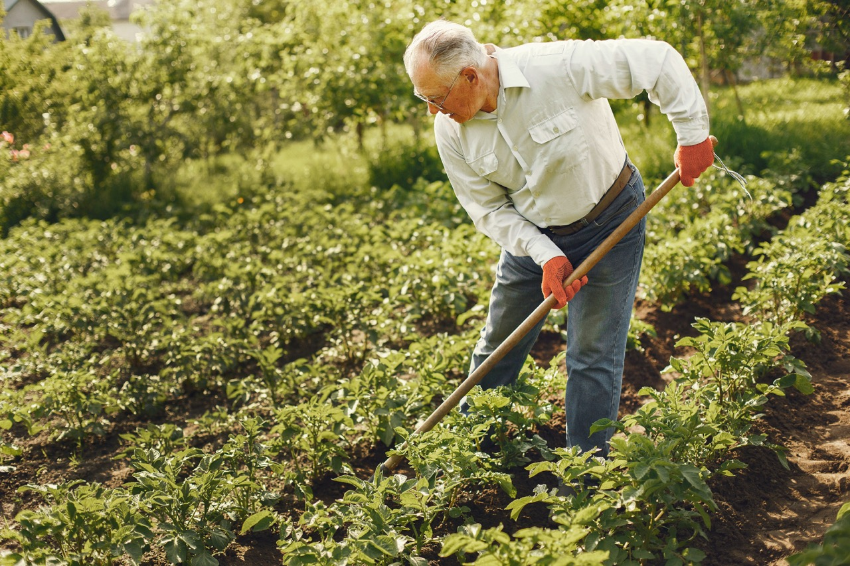
We Are Accountable For Our Care Of Our Body
“For we must all appear before the judgment seat of Christ; that every one may receive the things done in his body, according to that he hath done, whether it be good or bad.” 2 Corinthians 5:10.

Slide 5

Notes:
TP: FEMA, Adventist administrator, Obey the higher powers, ROMANS 13.

Slide 6
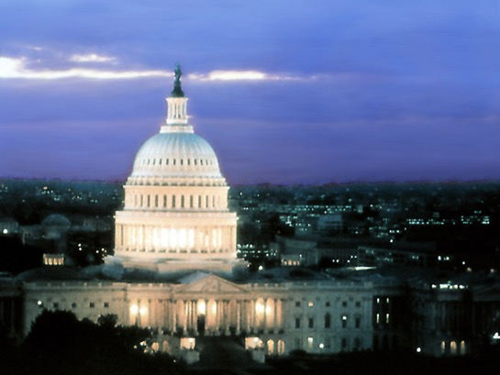
What if they mandate vaccinations, aren’t Governments ordained of God?
Romans 13:1-3
1. Let every soul be subject unto the higher powers. For there is no power but of God: the powers that be are ordained of God.
Notes:
TP: What if the laws of the government clash with the law of God?

Slide 7
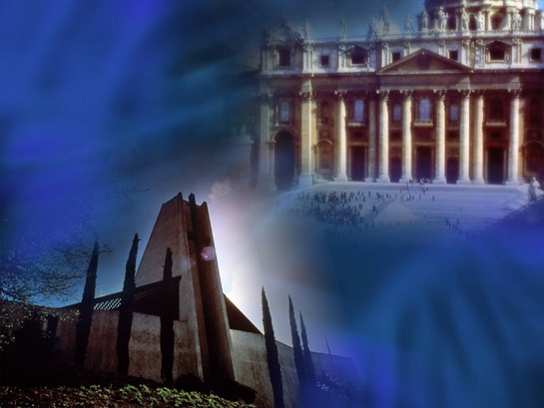
Is the government supposed to have jurisdiction over the things of God?
“And Jesus answering said unto them, Render to Caesar the things that are Caesar's, and to God the things that are God's.” Mark 12:17.
Notes:
TP: A case of massive identity theft.

Slide 8
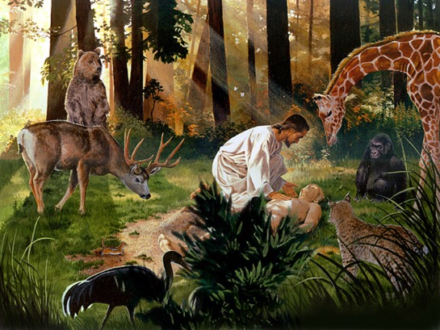
To whom does our body belong, the government or God? And Why?
“But now thus saith the LORD that created thee, O Jacob, and he that formed thee, O Israel, Fear not: for I have redeemed thee, I have called thee by thy name; thou art mine.” (Isaiah 43:1,2).
“For by him were all things created, …and by him all things consist.” Colossians 1:16-17.
“For ye are bought with a price: therefore glorify God in your body, and in your spirit, which are God's.” (1 Corinthians 6:19,20).
Notes:
Romans 6:16,19 Know ye not, that to whom ye yield yourselves servants to obey, his servants ye are to whom ye obey; whether of sin unto death, or of obedience unto righteousness? 19, I speak after the manner of men because of the infirmity of your flesh: for as ye have yielded your members servants to uncleanness and to iniquity unto iniquity; even so now yield your members servants to righteousness unto holiness.
TP: if the pandemic had you spinning, look what’s coming next!

Slide 9
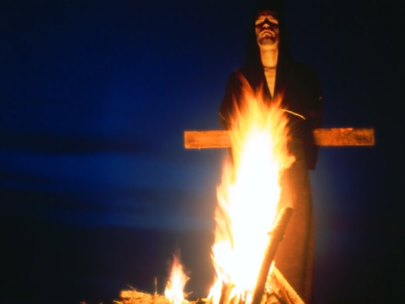
What does God tell us will follow on the heels of pestilence?
Matthew 24:7-10
7. For nation shall rise against nation, and kingdom against kingdom: and there shall be famines, and pestilences, and earthquakes, in divers places….
9. Then shall they deliver you up to be afflicted, and shall kill you: and ye shall be hated of all nations for my name's sake.
10. And then shall many be offended, and shall betray one another, and shall hate one another.
Notes:
TP: they are following a script, Have we seen this script before?

Slide 10
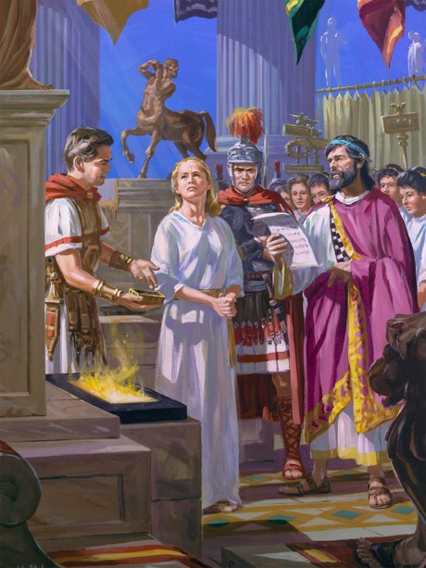
Déjà vu
“So hast thou also them that hold the doctrine of the Nicolaitans, which thing I hate.” Revelation 2:15.
The Nicolaitans were a group who taught a radical dualism between the body and the soul. They believed that what is done with the body cannot in any way defile the soul.
The city of Smyrna was the center of emperor worship in the Roman Empire. Once a year Roman citizens were required to burn incense in honor of the godhood the emperor and they were issued a certificate indicating that they had complied. To refuse to do so entailed certain death.
Notes:
TP: The authorities tell you that you have 18 days to come into compliance on vaccination, What’s you next move going to be?
Rev 2:6 But this you have, that you hate the deeds of the Nicolaitans, which I also hate.
The Nicolaitans were a group who taught a radical dualism between the body and the soul. They believed that what is done with the body cannot in any way defile the soul.
6 (Jude 4). The Sin of the Nicolaitans—Is it [our sin] the sin of the Nicolaitans, turning the grace of God into lasciviousness (The Review and Herald, June 7, 1887)? 7BC 957.5
(Romans 3:31.) Doctrine of the Nicolaitans—The doctrine is now largely taught that the gospel of Christ has made the law of God of no effect; that by “believing” we are released from the necessity of being doers of the Word. But this is the doctrine of the Nicolaitans, which Christ so unsparingly condemned (The Signs of the Times, January 2, 1912). 7BC 957.6
The city of Smyrna was the center of emperor worship in the Roman Empire. Once a year Roman citizens were required to burn incense in honor of the godhood the emperor and they were issued a certificate indicating that they had complied. To refuse to do so entailed certain death. Ignatius, bishop of Antioch, was thrown to the lions in the amphitheater in Smyrna (AD 107) and Polycarp, who was born in Smyrna in AD 69, was burned at the stake (AD 156).

Slide 11
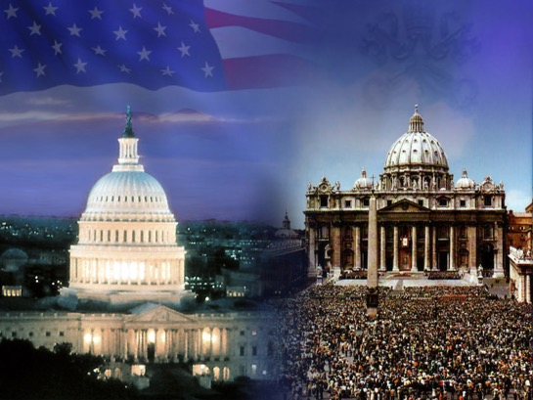
Is the government supposed to make anti-Biblical laws that are a terror to good people who do good works?
“For rulers are not a terror to good works, but to the evil. Wilt thou then not be afraid of the power? do that which is good, and thou shalt have praise of the same:” Romans 13:3.
Notes:
TP: What liberties does God offer you?

Slide 12


Liberty Of Conscience
“Let every man be fully persuaded in his own mind.” Romans 14:5.
“Choose you this day whom ye will serve;” Joshua 24:15.
“Be not deceived; God is not mocked: for whatsoever a man soweth, that shall he also reap. For he that soweth to his flesh shall of the flesh reap corruption; but he that soweth to the Spirit shall of the Spirit reap life everlasting.” Galatians 6:7-8.
“See, I have set before thee this day life and good, and death and evil;” Deuteronomy 30:15
Notes:
TP: What disputes topics arise to the level of matters of conscience?

Slide 13
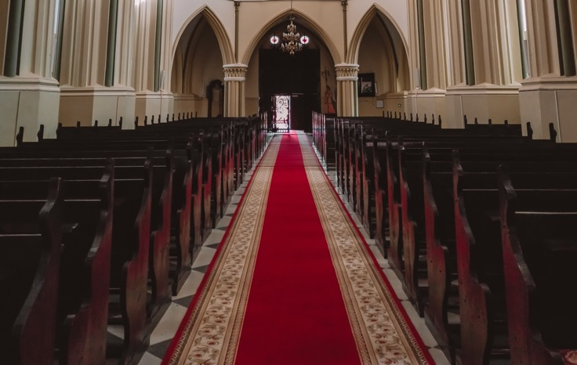
Is the color of the carpet at church an issue of conscience?
Notes:
TP: What would be a real issue? Preference vs conviction....

Slide 14
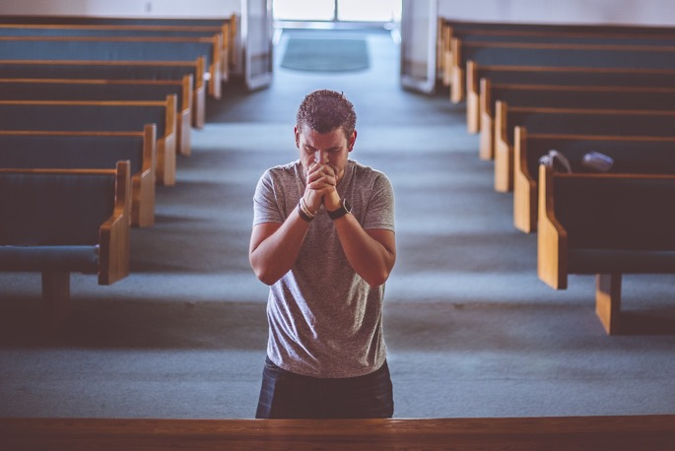
Is freedom to worship on Sabbath as issue of conscience?
Notes:
TP: Whose conscience do we go by?

Slide 15

Are All Consciences Dependable?
“Speaking lies in hypocrisy; having their conscience seared with a hot iron;” 1 Timothy 4:1-2.
“A conscience once violated is greatly weakened. It needs the strength of constant watchfulness and unceasing prayer.” 2T 90, 91.
Notes:
The conscience can be overscrupulous (1 Cor. 10:25) or “seared” by abuse (1 Tim. 4:2). It can be enlightened by further knowledge of truth (1 Cor. 8:7), and it acts according to the light it has.
TP: Can a conscience go hay wire?

Slide 16
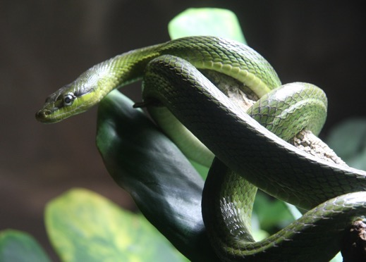
Liberty of Conscience Gone Hay Wire
“For, brethren, ye have been called unto liberty; only use not liberty for an occasion to the flesh, but by love serve one another.” Galatians 5:13.
“turning the grace of our God into lasciviousness, and denying the only Lord God, and our Lord Jesus Christ.” Jude 1:4.
Notes:
TP: What makes a conscience dependable?

Slide 17

A Trained Conscience
“He [the faulty student] will not allow his conscience and his heart to be educated, disciplined, and trained—worked as the husbandman works the earth, and as the architect constructs the building.” {YRP 38.2}
Notes:
TP: Educated in what?

Slide 18
“It is not enough that man follows the dictates of conscience. The mind must be enlightened as to what is God's will, and then an enlightened conscience will be an enlightened, intelligent will.” {17MR 168.3}

Slide 19
“Good angels wept to hear the words of Satan, and his exulting boasts. God declared that the rebellious should remain in Heaven no longer. Their high and happy state had been held upon condition of obedience to the law which God had given to govern the high order of intelligences.
“Satan grew bold in his rebellion, and expressed his contempt of the Creator's law. This Satan could not bear. He claimed that angels needed no law; but should be left free to follow their own will, which would ever guide them right; that law was a restriction of their liberty, and that to abolish law was one great object of his standing as he did.” {1SP 22.3}

Slide 20
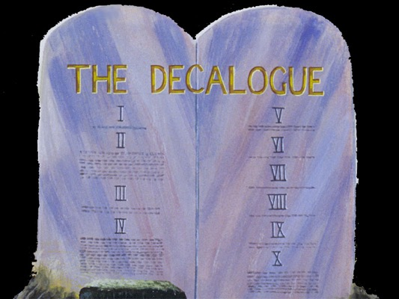
What defines liberty?
“But whoso looketh into the perfect law of liberty, and continueth therein, he being not a forgetful hearer, but a doer of the work, this man shall be blessed in his deed.” James 1:25
“So speak ye, and so do, as they that shall be judged by the law of liberty.” James 2:12
Notes:
TP: What are the predicted challenges in the last days?

Slide 21

Matthew 24:7 makes an apocalyptic statement:
“For nation shall rise against nation, and kingdom against kingdom: and there shall be famines, and pestilences, and earthquakes, in divers places.”
Accordingly, just before Jesus returns, pestilences will be prevalent.

Slide 22
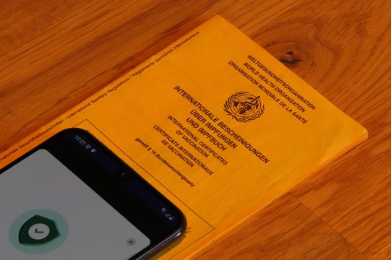
With pestilences now impacting the majority of people on earth, and governments opting for vaccination and vaccine passports as their preventative measure of choice, it seems wise, from a Christian, Biblical standpoint to have a ready Bible based answer concerning vaccinations.

Slide 23
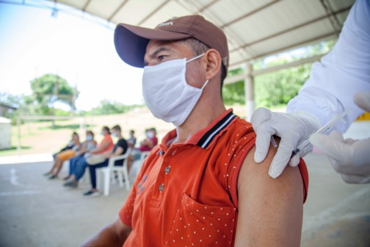
What is Vaccination? Let’s check wickipedia:
“Vaccination is the administration of a vaccine to help the immune system develop immunity from a disease. Vaccines contain a microorganism or virus in a weakened, live or killed state, or proteins or toxins from the organism. In stimulating the body's adaptive immunity, they help prevent sickness from an infectious disease.”
Vaccination is taking some identifiable part of a disease and injecting it via needle into the body, stimulating the body to prepare its immune system for future encounters with this disease.
https://en.wikipedia.org/wiki/Vaccination

Slide 24

We are the Remnant! Revelation 12:17.
Would God predict end-time pestilences without recommending any remedies for these end-time diseases?
And, as God’s end-time people, do we know what His solution is?

Slide 25
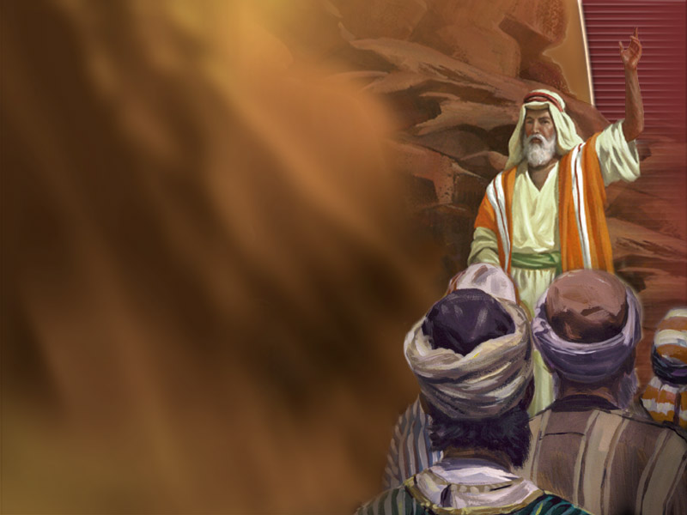
Is there any increased significance in the last days for the laws God gave through Moses?
“Remember ye the law of Moses my servant, which I commanded unto him in Horeb for all Israel, with the statutes and judgments. Behold, I will send you Elijah the prophet before the coming of the great and dreadful day of the LORD:” Malachi 4:4-5.
Notes:
Thus, Moses health laws are in force at the time of the destruction of the wicked.
TP: What happens to this earth when Jesus returns?

Slide 26
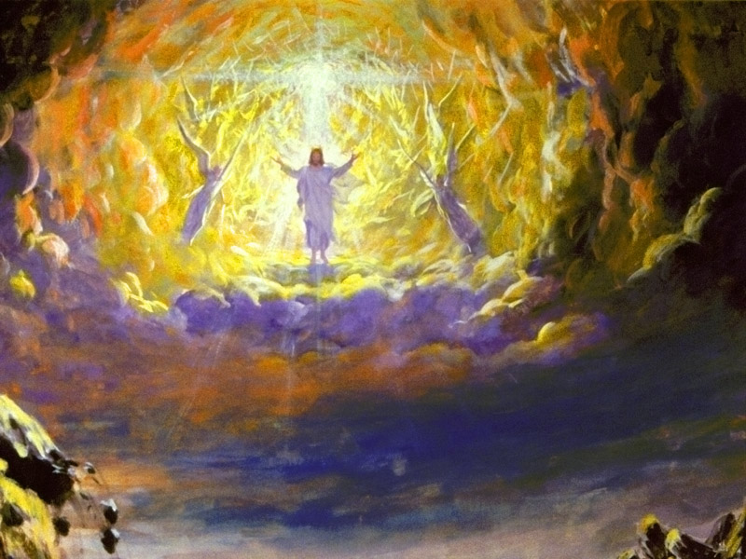
All The Elements Will Melt With Fervent Heat
“But the day of the Lord will come as a thief in the night; in the which the heavens shall pass away with a great noise, and the elements shall melt with fervent heat, the earth also and the works that are therein shall be burned up.” 2 Peter 3:10.
Notes:
What happens to the wicked?

Slide 27
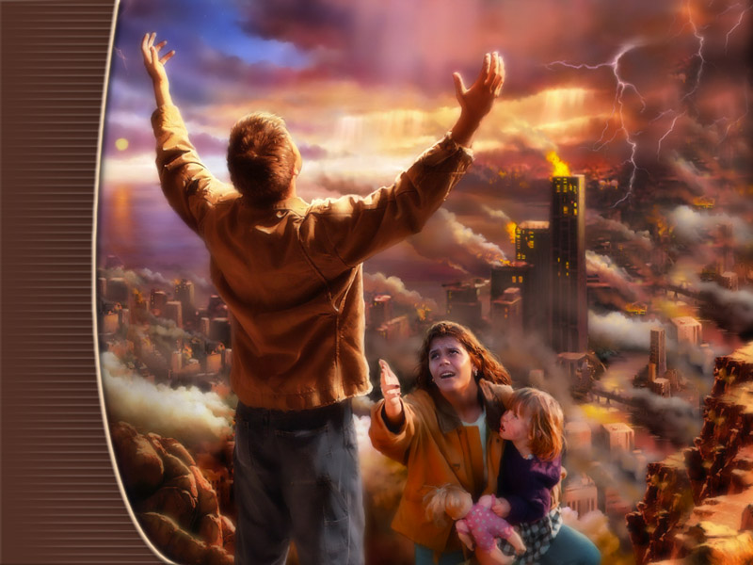
At that time those who are in violation of the health laws of Moses will receive their reward by fire, to be consumed with the wicked.
Notes:
TP: Give me a text.

Slide 28

“For, behold, the LORD will come with fire, …and the slain of the LORD shall be many…. They that … eat swine's flesh, and the abomination, and the mouse, shall be consumed together, saith the LORD.” Isaiah 66:15-17
“And the swine, though he divide the hoof, and be clovenfooted, yet he cheweth not the cud; he is unclean to you. Of their flesh shall ye not eat, and their carcase shall ye not touch; they are unclean to you.” Leviticus 11:7-8.
Nailed to cross?
Notes:
2 Peter 3:10-12.
John 5:46 For had ye believed Moses, ye would have believed me: for he wrote of me.
Luke 16:31 And he said unto him, If they hear not Moses and the prophets, neither will they be persuaded, though one rose from the dead.
Acts 15:20 But that we write unto them, that they abstain from pollutions of idols, and from fornication, and from things strangled, and from blood.
Acts 15:29 That ye abstain from meats offered to idols, and from blood, and from things strangled, and from fornication: from which if ye keep yourselves, ye shall do well. Fare ye well.
TP: Even your own church members, “you’re wasting time on the health message when we need to be preaching the love of Jesus? Or the three angel’s message.”

Slide 29

COVID came as a surprise to many people. But, Small Pox has long been feared, and predicted to make a future comeback. In fact, trade documents tell of the US government buying up Small Pox Vaccinations in mass in preparation for such an occurrence. (https://www.fiercepharma.com/deals/u-s-government-orders-additional-133m-of-bavarian-nordic-s-smallpox-vaccine)

Slide 30
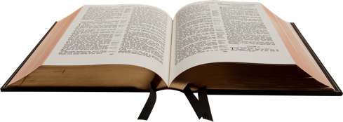
Biblical approach to disease
If we were to look in the Bible for a reference to Small Pox, or a Small Pox like disease, where could we find such a reference? In my humble estimation it would be in Leviticus 15, because Small Pox goes through a phase where it is a weeping sore.
Leviticus 15:1-2
1. And the LORD spake unto Moses and to Aaron, saying,
2. Speak unto the children of Israel, and say unto them, When any man hath a running issue out of his flesh, because of his issue he is unclean.

Slide 31
What does Leviticus 15 tell us about such a disease process and God’s rules regarding its management.
3 And this shall be his uncleanness in his issue: whether his flesh run with his issue, or his flesh be stopped from his issue, it is his uncleanness.
4 Every bed, whereon he lieth that hath the issue, is unclean: and every thing, whereon he sitteth, shall be unclean.
5 And whosoever toucheth his bed shall wash his clothes, and bathe himself in water, and be unclean until the even.
6 And he that sitteth on any thing whereon he sat that hath the issue shall wash his clothes, and bathe himself in water, and be unclean until the even.
7 And he that toucheth the flesh of him that hath the issue shall wash his clothes, and bathe himself in water, and be unclean until the even.

Slide 32
Defilement
The Bible declares this Small Pox like disease unclean—that you better not touch the diseased’s bed or chair, or you become unclean.
What happens if you come in contact with any of his body fluids?
Leviticus 15:8
8. And if he that hath the issue spit upon him that is clean; then he shall wash his clothes, and bathe himself in water, and be unclean until the even.
You certainly don’t even want to let a Small Pox patient spit on you! So, I believe God is being very clear that any imaginable form of contact with disease is unacceptable and defiling.
Notes:
TP: It’s unclean, but is it really a sin?

Slide 33
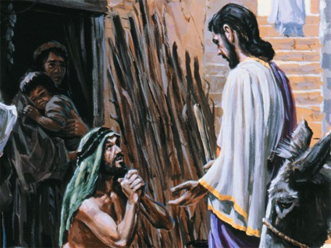
If I become unclean through contact with this Small Pox patient, what does God say is the consequence, what is my recourse? Leviticus 5 describes such an occurrence.
Leviticus 5:2-6
2. Or if a soul touch any unclean thing, whether it be a carcase of an unclean beast, or a carcase of unclean cattle, or the carcase of unclean creeping things, and if it be hidden from him; he also shall be unclean, and guilty.
3. Or if he touch the uncleanness of man, whatsoever uncleanness it be that a man shall be defiled withal, and it be hid from him; when he knoweth of it, then he shall be guilty.
5. And it shall be, when he shall be guilty in one of these things, that he shall confess that he hath sinned in that thing:
6. And he shall bring his trespass offering unto the LORD for his sin which he hath sinned, a female from the flock, a lamb or a kid of the goats, for a sin offering; and the priest shall make an atonement for him concerning his sin.
Notes:
TP: if defilement is a sin, what does that make vaccination?

Slide 34
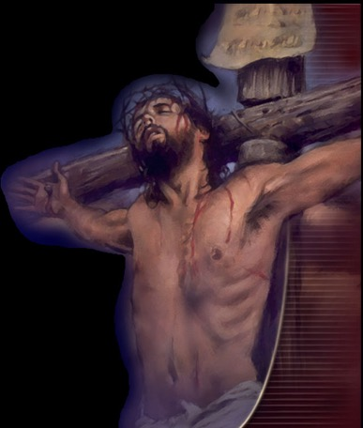
Salvational Issue
Contamination with disease is classified as an iniquity, a sin, requiring a blood atonement, and that is even if the uncleanness happened unintentionally, not purposefully or presumptuously.
Psalms 19:13. “Keep back thy servant also from presumptuous sins; let them not have dominion over me: then shall I be upright, and I shall be innocent from the great transgression.”

Slide 35
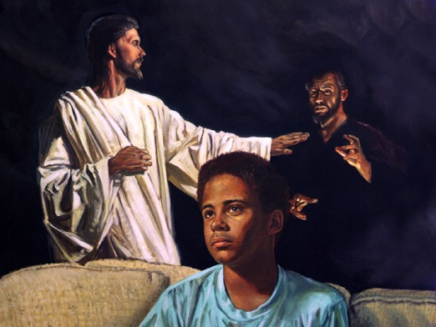
What if I fail to avail myself of the necessary cleansing for this sin of contact with unclean disease, what then?
“But the man that shall be unclean, and shall not purify himself, that soul shall be cut off from among the congregation, because he hath defiled the sanctuary of the LORD:” Numbers 19:20.
Being cut off has a very ominous sound to it. It seems to be a step above, but most likely includes, being disfellowshipped, or losing one’s membership in the congregation. Today we might call this a “test of fellowship”.

Slide 36
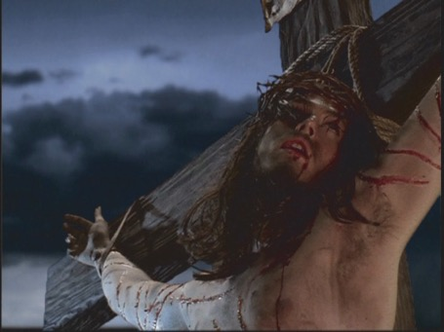
What if instead of spitting on me, the Small Pox patient spits into a syringe and injects me with the unclean disease? God is quick to have a solution to sin, but presumptuous sins war against the soul. So really, according to God (not the AMA or CDC) vaccination is engaging in sin for which a blood atonement is required. Is sin a salvational issue?

Slide 37
What does Paul say about this sort of contamination?
1 Thessalonians 4:7 For God hath not called us unto uncleanness, but unto holiness.
2 Corinthians 6:17-18 Wherefore come out from among them, and be ye separate, saith the Lord, and touch not the unclean thing; and I will receive you,
18. And will be a Father unto you, and ye shall be my sons and daughters, saith the Lord Almighty.
Did we see something earlier about the hearts of the children being turned to the father in the Elijah message?

Slide 38
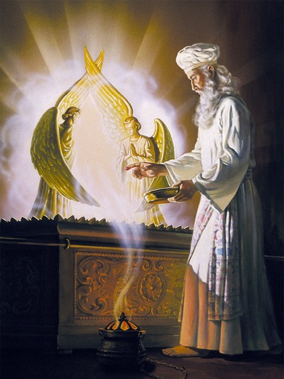
What does Paul say is the outcome of being defiled with uncleanness?
1 Corinthians 3:16-20 Know ye not that ye are the temple of God, and that the Spirit of God dwelleth in you? 17. If any man defile the temple of God, him shall God destroy; for the temple of God is holy, which temple ye are. 18. Let no man deceive himself. If any man among you seemeth to be wise in this world, let him become a fool, that he may be wise.
19. For the wisdom of this world is foolishness with God. For it is written, He taketh the wise in their own craftiness. 20. And again, The Lord knoweth the thoughts of the wise, that they are vain.
SALVATIONAL ISSUE?!

Slide 39
How does God view this manipulating of his natural creation and disease, the result of sin, by modern science for the supposed betterment of mankind?
“Who can bring a clean thing out of an unclean? not one.” Job 14:4.

Slide 40
So how did we, as Christians, get led down this garden pathway to vaccination?
Jeremiah 10:2. “Thus saith the LORD,
Learn not the way of the heathen,
and be not dismayed at the signs of heaven;
for the heathen are dismayed at them.”
Psalms 106:34-36 They did not destroy the nations, concerning whom the LORD commanded them: 35, But were mingled among the heathen, and learned their works. 36, And they served their idols: which were a snare unto them.

Slide 41

The Jab
Vaccination is deliberate defilement of your body with disease in flagrant violation of God’s health statutes.
Isaiah 8:20 “To the law and to the testimony: if they speak not according to this word, it is because there is no light in them.”

Slide 42

We have learned the way of the heathen, and loved it. Maybe God does not know what He is talking about? Did God need modern science to improve His health understanding?
“But God will have a people upon the earth to maintain the Bible, and the Bible only, as the standard of all doctrines and the basis of all reforms.
The opinions of learned men, the deductions of science, the creeds or decisions of ecclesiastical councils, as numerous and discordant as are the churches which they represent, the voice of the majority—not one nor all of these should be regarded as evidence for or against any point of religious faith.
Before accepting any doctrine or precept, we should demand a plain ‘Thus saith the Lord’ in its support.” GC 595.1

Slide 43

Matthew 4:4 But he answered and said, It is written, Man shall not live by bread alone, but by every word that proceedeth out of the mouth of God.
Not by:
Bread alone! or
Medical science alone! or
Government mandates alone! or
Opinions of friends and trusted relatives alone!
News hype alone....

Slide 44
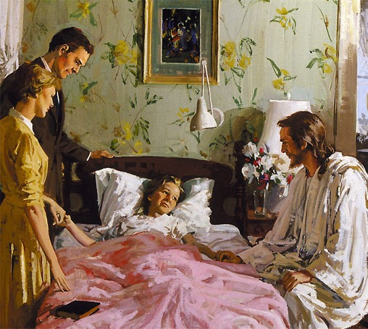
How do we prevent catching the pestilence?
“And said, If thou wilt diligently hearken to the voice of the LORD thy God, and wilt do that which is right in his sight, and wilt give ear to his commandments, and keep all his statutes, I will put none of these diseases upon thee, which I have brought upon the Egyptians: for I am the LORD that healeth thee.” Exodus 15:26.

Slide 45
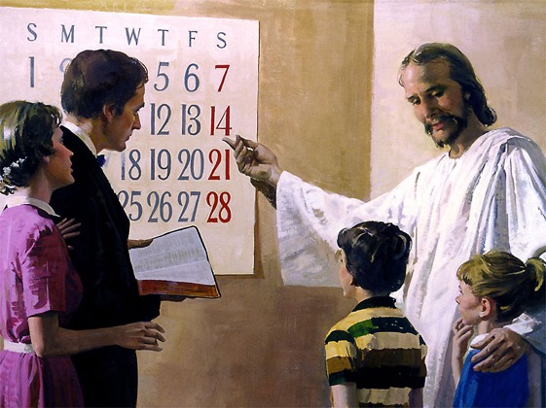
When does the word of God ask us to assemble?
“Six days shall work be done: but the seventh day is the sabbath of rest, an holy convocation (something called out, that is, a public meeting [the act, the persons, or the place]; also a rehearsal: - assembly, calling, convocation, reading.);” Leviticus 23:3.
Notes:
Did Jesus, our example, do this?

Slide 46
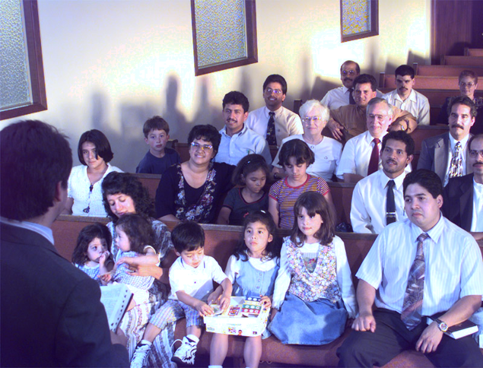
Not Forsaking the Assembling
“Not forsaking the assembling of ourselves together, as the manner of some is; but exhorting one another: and so much the more, as ye see the day approaching.” Hebrews 10:25.
Notes:
What happens if we don’t? Read on.

Slide 47
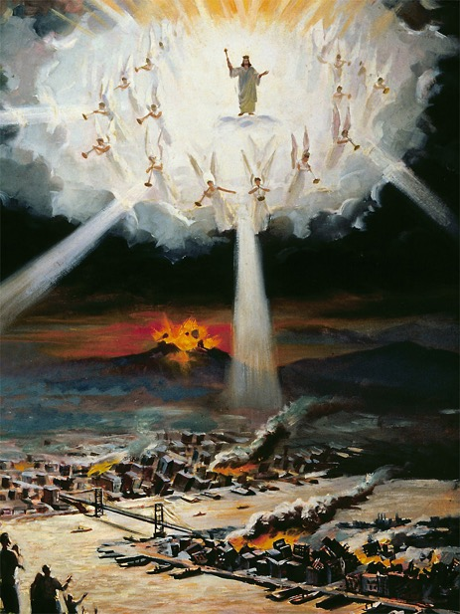
How do we know that day is approaching?
“For nation shall rise against nation, and kingdom against kingdom: and there shall be famines, and pestilences, and earthquakes, in divers places.” Matthew 24:7.

Slide 48
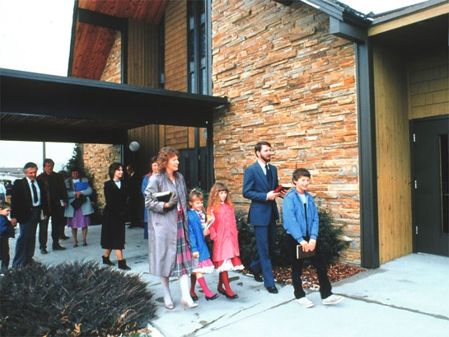
Where does the Bible command us to assemble?
“Not forsaking the assembling of ourselves together (episunagōgē, at or near the synagogue or church.)” Hebrews 10:25.
Notes:
Can I just watch TV, HOPE, 3ABN, AD…

Slide 49

For relief from pestilence: Pray at church.
“If there be pestilence,… Then what prayer or what supplication soever shall be made of any man,… and shall spread forth his hands in this house: Then hear thou from heaven thy dwelling place, and forgive, and render unto every man according unto all his ways, whose heart thou knowest;” 2 Chronicles 6:28-31
Notes:
2 Chronicles 6:28-31 If there be dearth in the land, if there be pestilence, if there be blasting, or mildew, locusts, or caterpillers; if their enemies besiege them in the cities of their land; whatsoever sore or whatsoever sickness there be: 29. Then what prayer or what supplication soever shall be made of any man, or of all thy people Israel, when every one shall know his own sore and his own grief, and shall spread forth his hands in this house: 30. Then hear thou from heaven thy dwelling place, and forgive, and render unto every man according unto all his ways, whose heart thou knowest; (for thou only knowest the hearts of the children of men:) 31. That they may fear thee, to walk in thy ways, so long as they live in the land which thou gavest unto our fathers.

Slide 50
For relief from pestilence: Confess and Pray
“If I shut up heaven that there be no rain, or if I command the locusts to devour the land, or if I send pestilence among my people; 14. If my people, which are called by my name, shall humble themselves, and pray, and seek my face, and turn from their wicked ways; then will I hear from heaven, and will forgive their sin, and will heal their land.” 2 Chronicles 7:13-14.
Notes:
2 Chronicles 6:28-31 If there be dearth in the land, if there be pestilence, if there be blasting, or mildew, locusts, or caterpillers; if their enemies besiege them in the cities of their land; whatsoever sore or whatsoever sickness there be: 29. Then what prayer or what supplication soever shall be made of any man, or of all thy people Israel, when every one shall know his own sore and his own grief, and shall spread forth his hands in this house: 30. Then hear thou from heaven thy dwelling place, and forgive, and render unto every man according unto all his ways, whose heart thou knowest; (for thou only knowest the hearts of the children of men:) 31. That they may fear thee, to walk in thy ways, so long as they live in the land which thou gavest unto our fathers.

Slide 51
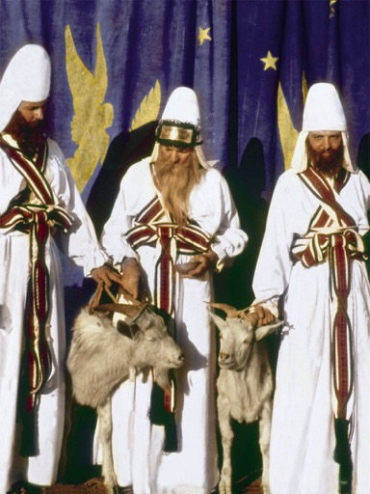
Prepare By Consecrating The Tabernacle Worshipers
“And I have given the Levites as a gift to Aaron and to his sons from among the children of Israel, to do the service of the children of Israel in the tabernacle of the congregation, and to make an atonement for the children of Israel: that there be no plague among the children of Israel, when the children of Israel come nigh unto the sanctuary.” Numbers 8:19.

Slide 52
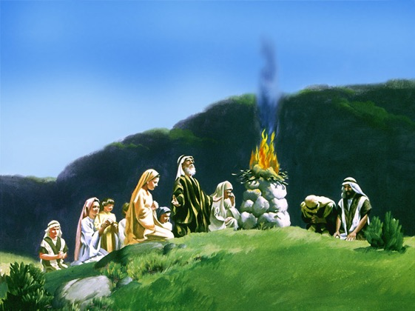
What if we neglect to assemble?
“And they said, The God of the Hebrews hath met with us: let us go, we pray thee, three days' journey into the desert, and sacrifice unto the LORD our God; lest he fall upon us with pestilence, or with the sword.” Exodus 5:3.

Slide 53
Notice, prevention is contingent upon adherence to God’s statues of health. The statutes of health outlaw contact with disease. The mandates of the government demand purposeful exposure to defiling disease. Who’s side are you on?
Acts 5:29 Then Peter and the other apostles answered and said, We ought to obey God rather than men.
Matthew 15:8-9 This people draweth nigh unto me with their mouth, and honoureth me with their lips; but their heart is far from me. 9. But in vain they do worship me, teaching for doctrines the commandments of men.
We claim we love God, but not enough to keep His health reform laws.

Slide 54
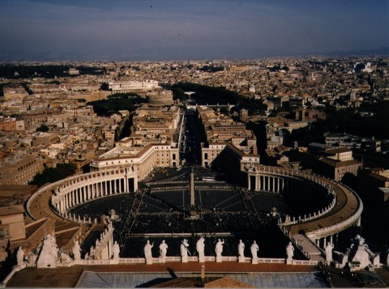
Who falsely claims jurisdiction over the bodies and souls of people?
Revelation 18:11-13
11. And the merchants of the earth shall weep and mourn over her; for no man buyeth their merchandise any more:
13. And cinnamon, and odours, and ointments, and frankincense, and wine, and oil, and fine flour, and wheat, and beasts, and sheep, and horses, and chariots, and slaves (bodies), and souls of men.
Notes:
TP: Who is the big guy who wants you vaccinated?

Slide 55
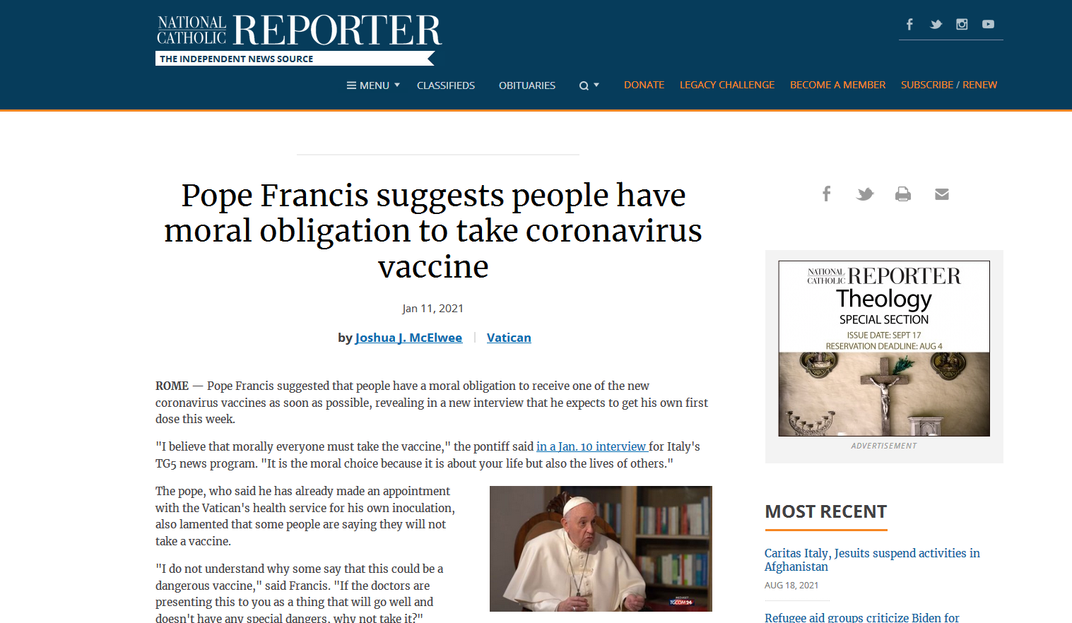
Notes:
TP: What is the Bibles name for a government that enforces such mandates?
https://www.ncronline.org/news/vatican/pope-francis-suggests-people-have-moral-obligation-take-coronavirus-vaccine

Slide 56
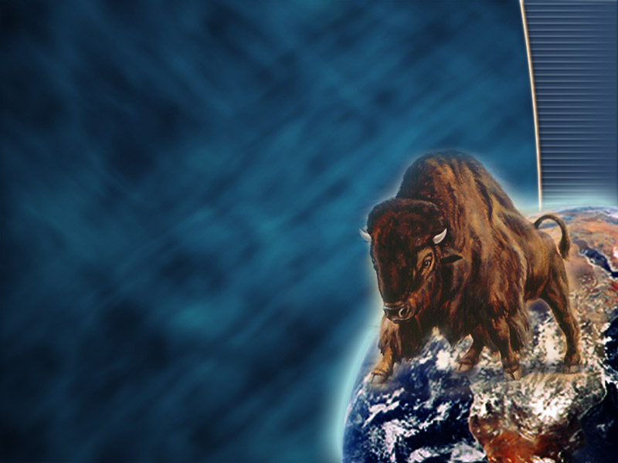
What symbolism doe the Bible use for a government which presumes to enforce an anti-Biblical laws?
Revelation 13:14-15
14. And deceiveth them that dwell on the earth by the means of those miracles which he had power to do in the sight of the beast; saying to them that dwell on the earth, that they should make an image to the beast, which had the wound by a sword, and did live.
15. And he had power to give life unto the image of the beast, that the image of the beast should both speak, and cause that as many as would not worship the image of the beast should be killed.
Notes:
TP: How do you spell fire?

Slide 57
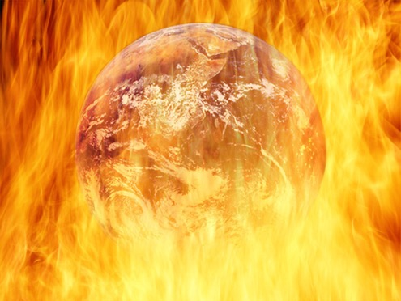
What happens to us if we worship the image of the beast by bowing to the governments enforcement of anti-Biblical laws?
“And the third angel followed them, saying with a loud voice, If any man worship the beast and his image, and receive his mark in his forehead, or in his hand, The same shall drink of the wine of the wrath of God, which is poured out without mixture into the cup of his indignation; and he shall be tormented with fire and brimstone in the presence of the holy angels, and in the presence of the Lamb: And the smoke of their torment ascendeth up for ever and ever: and they have no rest day nor night, who worship the beast and his image, and whosoever receiveth the mark of his name.” Revelation 14:9-11.
Notes:
TP: So your church just threw you under the bus on vaccination mandates! You asked for a religious exemption and they said follow the government mandates:

Slide 58
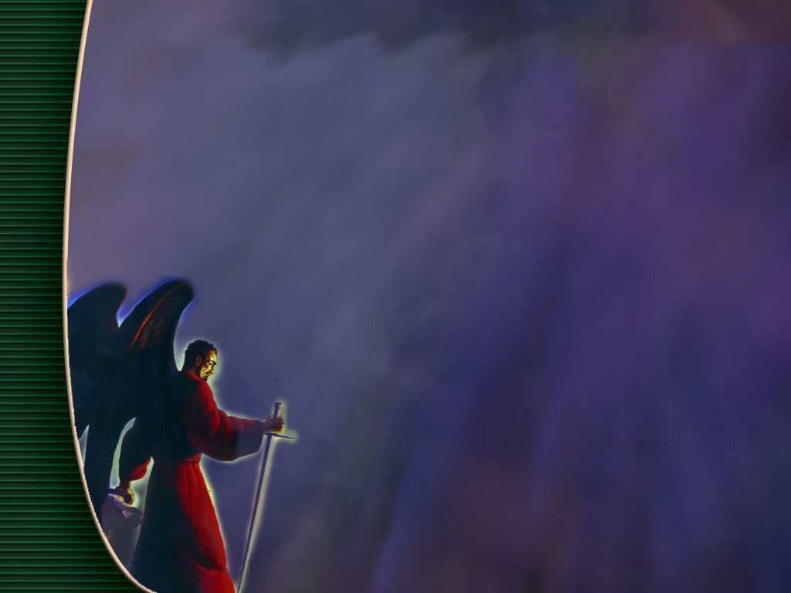
Kill Destroy
“The thief cometh not, but for to steal, and to kill, and to destroy:”
John 10:10.
“For we wrestle not against flesh and blood, but against principalities, against powers, against the rulers of the darkness of this world, against spiritual wickedness in high places.” Ephesians 6:12.
Notes:
Satan’s agents know why they are injecting you! Are you aware of that?

Slide 59
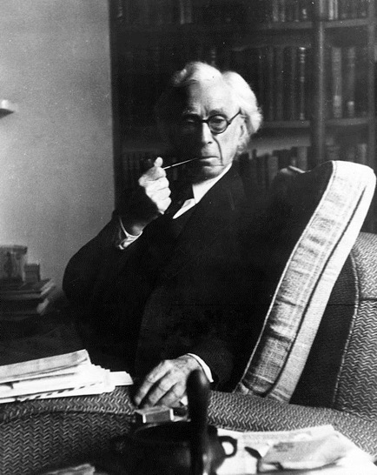
"It is to be expected that advances in physiology and psychology will give governments much more control over individual mentality than they now have even in totalitarian countries.
Fichte laid it down that education should aim at destroying free will, so that, after pupils have left school, they shall be incapable, throughout the rest of their lives, of thinking or acting otherwise than as their schoolmasters would have wished.
Diet, injections, and injunctions will combine, from a very early age, to produce the sort of character and the sort of beliefs that the authorities consider desirable, and any serious criticism of the powers that be will become psychologically impossible. . . .”
-Bertrand Russell, The Impact of Science on Society, 1952, p. 61-62
Notes:
TP: They will butter you up, spin a positive motive for your choice:

Slide 60

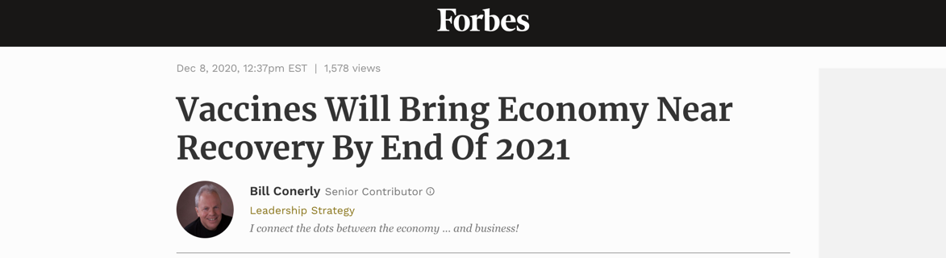
World Sees Vaccine As Solution
Revelation 18:23 “And the light of a candle shall shine no more at all in thee; and the voice of the bridegroom and of the bride shall be heard no more at all in thee: for thy merchants were the great men of the earth; for by thy sorceries [pharmakeia] were all nations deceived.”
Notes:
TP: what is the worlds reaction going to be when you say no to their vaccine saviour?

Slide 61
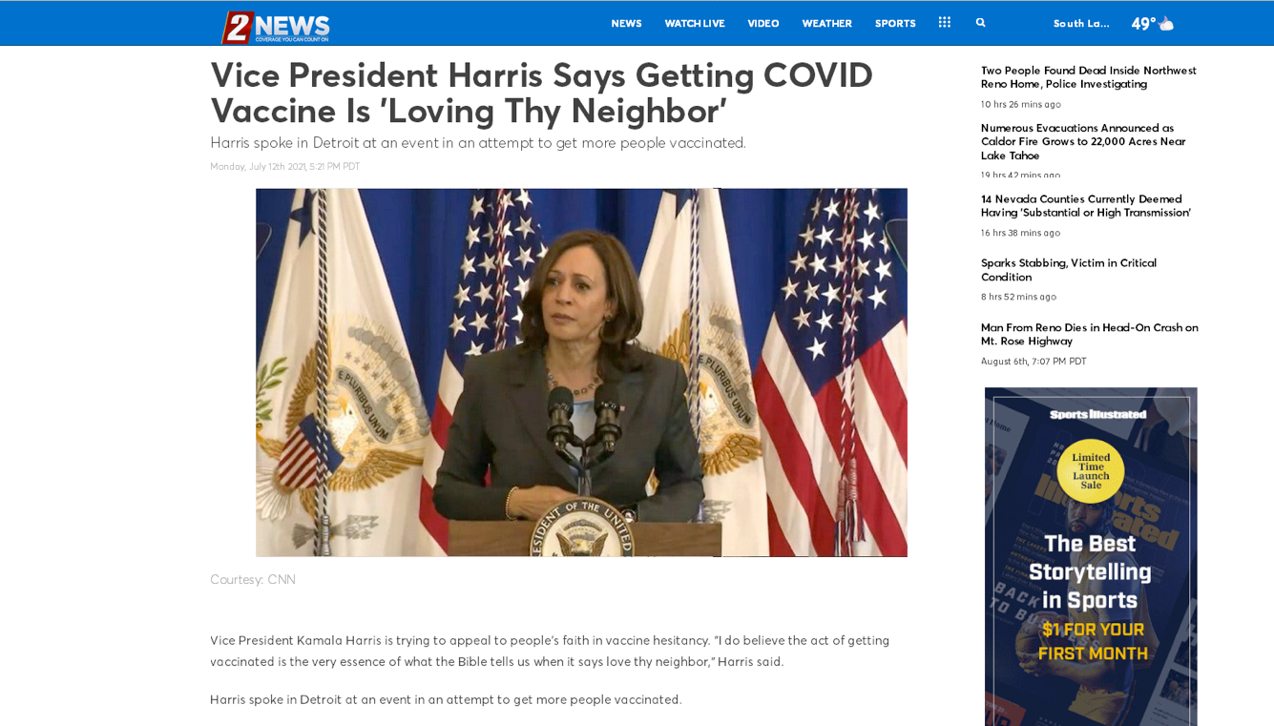
Notes:
TP: For the better good: So you can see your…, minister to…, save the planet….
https://www.ktvn.com/story/44289362/vice-president-harris-says-getting-covid-vaccine-is-loving-thy-neighbor

Slide 62
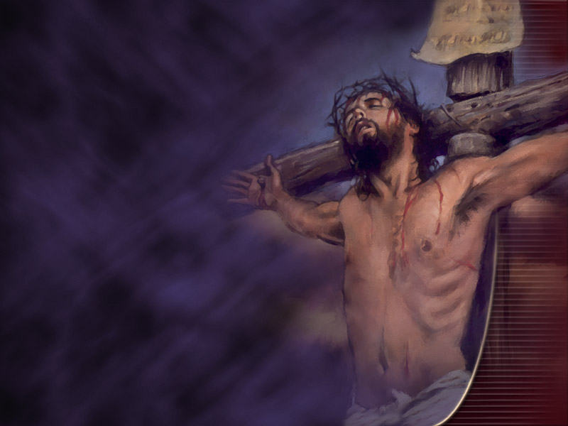
The Better Good
“And one of them, named Caiaphas, being the high priest that same year, said unto them, Ye know nothing at all, Nor consider that it is expedient for us, that one man should die for the people, and that the whole nation perish not.” John 11:49-50.
Notes:
TP: Satan says, “We have results on our side”! What if you refuse the vaccine, get sick, and die!

Slide 63
Dear Dr John Clark,
Thank you so much for taking the time to write this letter. Words cannot express my gratitude! This letter has been the biggest answer to prayer and a significant faith-building experience. After trying to contact multiple people and getting rejected, I left the situation in God's hands when I went to sleep last night. I woke this morning to see your email...this is truly a miracle! This has helped me to learn to trust God no matter the situation and that His plan and timing is always best. I praise God for your ministry and pray that he continues to bless you and your family.
            Sincerely,
            Joseph
Notes:
TP: Does God need our help running the universe? Fighting disease down here on earth?

Slide 64
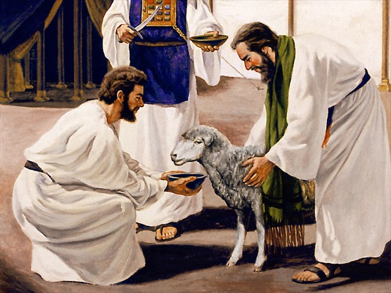
True Believers
“I beseech you therefore, brethren, by the mercies of God, that ye present your bodies a living sacrifice, holy, acceptable unto God, which is your reasonable service (Spiritual Worship NRV).
“And be not conformed to this world: but be ye transformed by the renewing of your mind, that ye may prove what is that good, and acceptable, and perfect, will of God.” Romans 12:1-2.
Notes:
TP: What letter did God lead me to write?

Slide 65
To Whom It May Concern:
I am writing on behalf of Joseph.
Joseph’s competency and exceptional value as an honorable employ stem from the impact his implicit faith in the Word of God has had on him as a person.
As a Bible based Christian, he knows of God’s investment in him, both by creating him, and by saving him from sin. “What? know ye not that your body is the temple of the Holy Ghost which is in you, which ye have of God, and ye are not your own? For ye are bought with a price: therefore glorify God in your body, and in your spirit, which are God's.” 1 Corinthians 6:19-20. Joseph wants to truly glorify God in his body.
As a Christian who bases his faith on verifiable Bible doctrine, he knows that introducing anything defiling into his body would compromise his ability to render the performance on the job for which he is valued. The Word of God says, “Know ye not that ye are the temple of God, and that the Spirit of God dwelleth in you? If any man defile the temple of God, him shall God destroy; for the temple of God is holy, which temple ye are.” (1 Corinthians 3:16-17). Joseph chooses not to defile his body with injections of disease samples (Leviticus 15:3-12). He knows that, not only does God require him to maintain the body He has given him in good health, but He will also hold him accountable for any damage he does to it. “For we must all appear before the judgment seat of Christ; that every one may receive the things done in his body, according to that he hath done, whether it be good or bad.” 2 Corinthians 5:10.
God tells each Christian that they need to have a personal knowledge of how to preserve the health of their bodies: “That every one of you should know how to possess his vessel (body) in sanctification and honour;” (1 Thessalonians 4:4). God has given Joseph definite instruction on how to avoid disease: “And said, If thou wilt diligently hearken to the voice of the LORD thy God, and wilt do that which is right in his sight, and wilt give ear to his commandments, and keep all his statutes, I will put none of these diseases upon thee, which I have brought upon the Egyptians: for I am the LORD that healeth thee.” Exodus 15:26. Joseph wants God to be his protector from disease and, if he is sick, Joseph appeals to God to be his healer. He knows that God expects him to follow all the Biblical health laws, and if he does this he can commit the keeping of his health to Him. If Joseph breaks any of the health laws, he realizes that God cannot protect him, or anyone else , from disease. (Deuteronomy 7:9-15). Joseph’s conscience constrains him to commit himself entirely to God’s healing power exercised in his behalf as he follows God’s health laws and plan for disease prevention.
It is my hope that Joseph’s employer will exempt him from participation in any vaccination program based on his religious convictions.
          Sincerely,
          John Clark, M.D.
          Medical Doctor
Notes:
TP: Ok, Ok, but the chruchies say EGW was pro vaccine! Was She?
Can you endure a little sound doctrine as I go though this?

Slide 66
“Her priests have violated my law, and have profaned mine holy things: they have put no difference between the holy and profane, neither have they shewed difference between the unclean and the clean,” Ezekiel 22:26.
Wise laws….
Granted, a lot of nationally prominent evangelical leaders are trying to talk sense to their parishioners. Rick Warren is telling his people to get vaccinated: “God revealed a lot of his will when he gave you that brain. And he expects you to use it.”
Notes:
https://www.penncapital-star.com/commentary/some-evangelical-christians-have-forgotten-their-moral-duty-to-get-vaccinated-dick-polman/
TP: How would you expect these lords many and gods many to treat Godly purity?

Slide 67
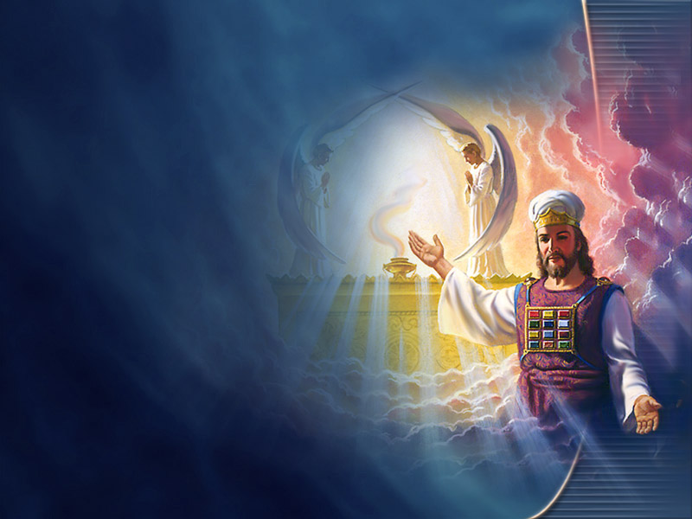
Separate Clean From Unclean
“And I heard another voice from heaven, saying, Come out of her, my people, that ye be not partakers of her sins, and that ye receive not of her plagues.” Revelation 18:4.
Notes:
TP: Is the vaccine a passport to heaven?

Slide 68
Dear Dr. John Clark,
God is so good! The facility allowed me to continue the placement after I gave them your letter. It is uncommon for aged care facilities in Australia to consider religious exemptions so this has been a huge answer to prayer. Furthermore, this experience helped open up a positive religious conversation with my placement supervisor who was very interested in my faith. Thank you so much again for taking the time to write the letter and for your help with this situation. I am truly grateful.
          God bless,
          Joseph

Slide 69
“Who can bring a clean thing out of an unclean? not one.” (Job 14:4).
“If any man defile the temple of God, him shall God destroy;” 1 Corinthians 3:16-17.
“Wherefore come out from among them, and be ye separate, saith the Lord, and touch not the unclean thing; and I will receive you,” 2 Corinthians 6:16-17.
Notes:
Hesikiah

Slide 70
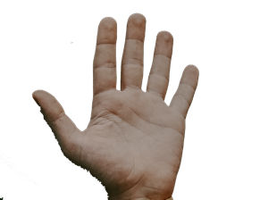
Your Creator God sustains your life and watches over you every moment.
God’s goal is a pure and holy human family who will be comfortable in His glorious presence.
Satan desires to steal, kill and destroy. He wants you to be abominably unclean, defiled and destroyed by God eternal glory.
The 8 natural remedies are a summery of God’s health plan.
Satan’s counterfeit health plan involves taking disease, which is unclean in God’s presence, and injecting your body with it.
“Every man that hath this hope in him purifieth himself, even as he is pure.” 1 John 3:3.
How many want to be God’s pure and Holy People ready for His return?

