Slide 1


Blueprint For Health And Healing
Reversing Disease From Its Foundation
Ideal Weight:
Achieve It Naturally
John Clark, M.D.
Notes:
Welcome to Blueprint for Health and Healing,
Reversing Disease From Its Foundation
Hello, I’m Dr. John Clark
Today's topic is Ideal Weight: Achieve It Naturally

Slide 2

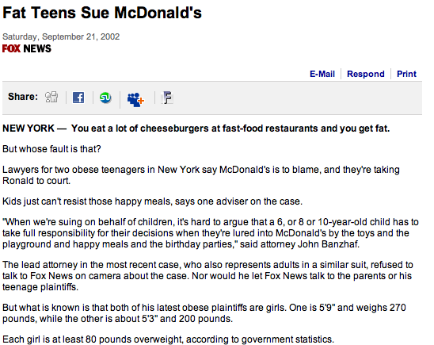

Slide 3
Stats
An estimated 74% of adults in the United States are considered to be overweight,
Approximately 42% are obese.
Obesity is highest among Black adults (50%) and Hispanic adults (46%), followed by White adults (41%),
Approximately 32% of children and adolescents in the United States are considered to be overweight, and about 20% are obese.
Notes:
Centers for Disease Control and Prevention. Overweight & Obesity: Data & Statistics. Available at https://www.cdc.gov/obesity/data/index.html. Last accessed July 14, 2024.

Slide 6


Are You A Sign Of The End Of The World?
“But as the days of Noe were, so shall also the coming of the Son of man be. For as in the days that were before the flood they were eating and drinking, marrying and giving in marriage, until the day that Noe entered into the ark, And knew not until the flood came, and took them all away; so shall also the coming of the Son of man be.” Matthew 24:37-39.

Slide 7

Obesity can be reversed with simple lifestyle changes.

Slide 8
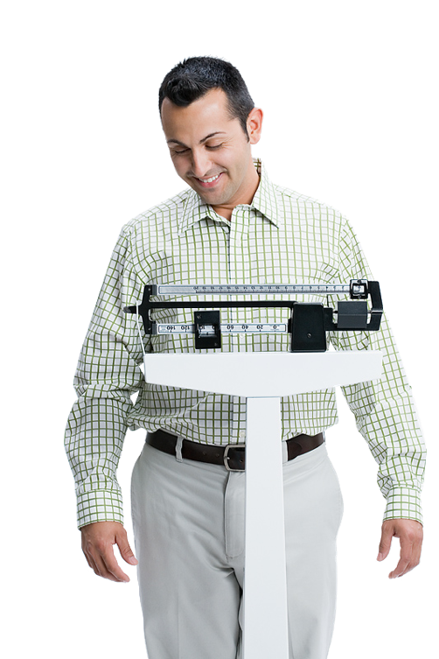
What You Will Learn In This Presentation
Causes of Obesity.
Tips on Diet.
Physical Activity Benefits.
Science of will power and success.

Slide 9
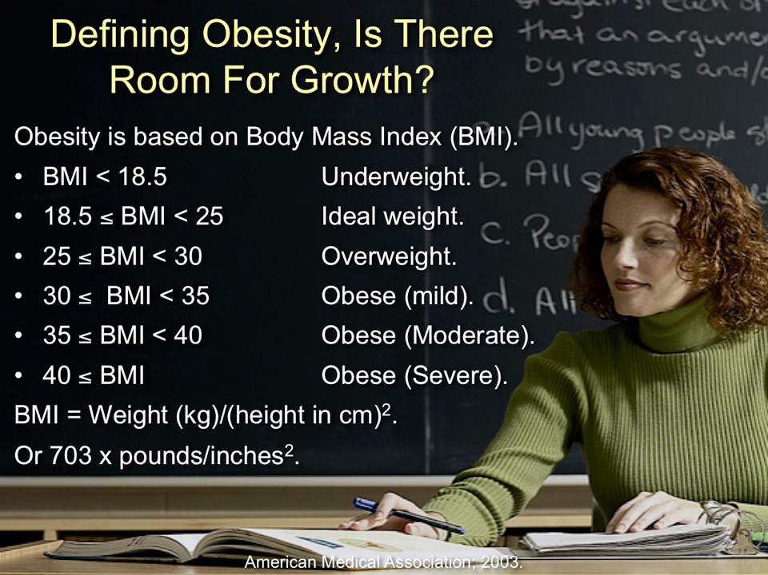
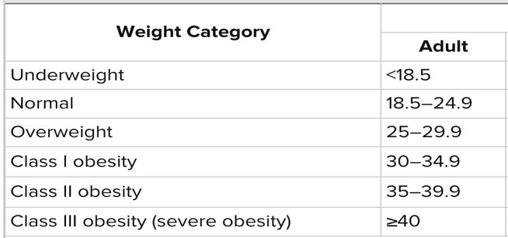

Slide 10
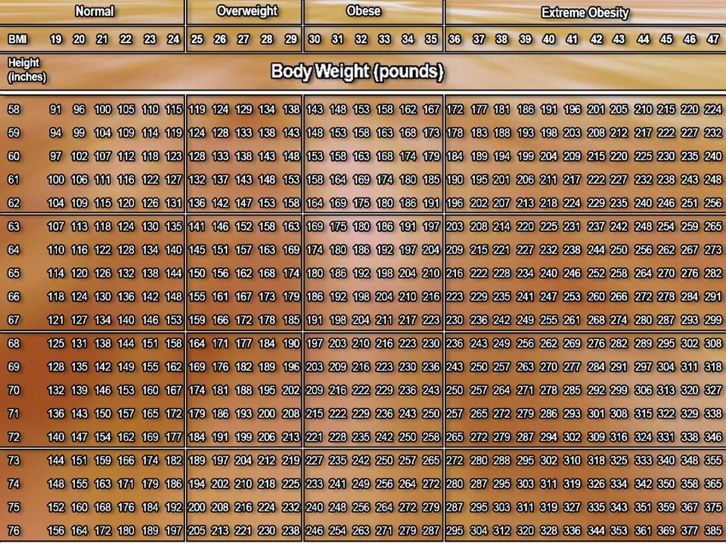

Slide 11

Hidden Cost of Abundant Fat
Percent Increased Risk
Due To Obesity
Notes:
INCONTINENCE
Diabetes Care. 2007 Oct;30(10):2536-41. Epub 2007 Jul 9.
Pelvic floor disorders, diabetes, and obesity in women: findings from the Kaiser Permanente Continence Associated Risk Epidemiology Study.
Lawrence JM, Lukacz ES, Liu IL, Nager CW, Luber KM.
Department of Research and Evaluation, Kaiser Permanente Southern California, 100 S. Los Robles, 2nd Floor, Pasadena CA 91101, USA. jean.m.lawrence@kp.org
OBJECTIVE: We examined associations between obesity and diabetes and female pelvic floor disorders (PFDs), stress urinary incontinence (SUI), overactive bladder (OAB), and anal incontinence (AI) in community-dwelling women. RESEARCH DESIGN AND METHODS: Women were screened for PFD using a validated mailed survey. Diabetes status, glycemic control, and diabetes treatment were extracted from clinical databases, while other risk factors for PFDs were obtained through self-report. Women were categorized hierarchically as nonobese/nondiabetic (reference), nonobese/diabetic, obese/nondiabetic, and obese/diabetic. RESULTS: Of 3,962 women, 393 (10%) had diabetes. In unadjusted analyses, women with diabetes and women who were obese had greater odds of having PFDs. Among women with diabetes, being obese was associated with SUI and OAB. After adjusting for confounders, we found that obese/diabetic women were at the highest likelihood of having SUI (odds ratio 3.67 [95% CI 2.48-5.43]) and AI (2.09 [1.48-2.97]). The odds of having OAB among obese women was the same for obese/diabetic women (2.97 [2.08-4.36]) and obese/nondiabetic women (2.93 [2.33-3.68]). Nonobese/diabetic women had higher odds of SUI (1.90 [1.15-3.11]) but did not differ significantly in their OAB (1.45 [0.88-2.38]) and AI (1.33 [0.89-2.00]) prevalence from nonobese/nondiabetic women. CONCLUSIONS: Given the impaired quality of life experienced by women with PFDs, health care providers should counsel women that obesity and diabetes may be independent modifiable risk factors for PFDs.
Publication Types:
Research Support, N.I.H., Extramural
Research Support, Non-U.S. Gov't
PMID: 17620443 [PubMed - indexed for MEDLINE]
SLEEP APNEA
Laryngoscope. 2005 Aug;115(8):1493-8.Related Articles, Links
Body fat composition: a predictive factor for obstructive sleep apnea.
Oğretmenoğlu O, Süslü AE, Yücel OT, Onerci TM, Sahin A.
Department of Otorhinolaryngology, Head and Neck Surgery, Hacettepe University Faculty of Medicine, 06100 Hacettepe, Ankara, Turkey.
OBJECTIVE: To investigate body fat composition, measured by bioelectrical impedance assay (BIA), for predicting the presence and severity of obstructive sleep apnea-hypopnea syndrome (OSAHS). Body fat composition was also compared with other well-known OSAHS predictors such as body mass index (BMI), neck circumference, and abdominal visceral fat. STUDY DESIGN: A prospective study was designed. Fifty-one patients (41 male, 10 female), who were referred to Hacettepe University Faculty of Medicine, Department of Otorhinolaryngology, Head and Neck Surgery with suspected OSAHS, between April 2003 and June 2004, were included in the study. METHODS: All patients underwent polysomnography (PSG) and were classified according to their apnea-hypopnea index (AHI) into four groups. The cross-sectional area of abdominal visceral fat was measured by computed tomography (CT) scanning in 33 of the patients. Neck circumference and BMI was measured for all patients. BIA was performed to determine body fat composition. The groups were compared, and correlation of the variables with AHI was investigated. RESULTS: Of the variables, BMI and percentage of body fat (determined by BIA) were found to be significantly correlated with AHI (r = 0.782, r = 0.647). CT of cross-sectional area of abdominal visceral fat provided 100% sensitivity and specificity (P < .001) in differentiating simple snorers from OSAHS patients. By combining percentage of body fat and body fat mass, higher levels of sensitivity (95%) and specificity (100%) were achieved for diagnosis of OSAHS. CONCLUSION: It was concluded that the BIA could be an inexpensive and practical alternative to prePSG screening tests and should be included in the evaluation of OSAHS patients.
Publication Types:
Comparative Study
PMID: 16094131 [PubMed - indexed for MEDLINE]
Arq Bras Endocrinol Metabol. 2006 Feb;50(1):74-81. Epub 2006 Apr 17.Related Articles, Links
[Obstructive sleep apnea and hypopnea syndrome (OSAHS): association with obesity, gender and age]
[Article in Portuguese]
Daltro CH, Fontes FH, Santos-Jesus R, Gregorio PB, Araújo LM.
Universidade Federal da Bahia, Real Sociedade de Beneficência Portuguesa, Hospital Português, Salvador, BA. carlahcd@terra.com.br
Obstructive sleep apnea and hypopnea syndrome (OSAHS) has been the focus of extensive research because of its association with neurocognitive and cardiovascular complications. The aim of this study was to evaluate the frequency and association between OSAHS and the class of obesity, gender and age in outpatients referred to a sleep laboratory. We selected 1,595 patients, 71.7% male. Mean +/- SD age was 46.7 +/- 11.7 years, BMI was 28.1 +/- 5.1 kg/m2 and AIH was 13.9 +/- 15.5 events/ hour of sleep. The patients were considered apneic when the apnea-hypopnea index (AHI) was > 5 events/hour of sleep; OSAHS was present in: (1) 71.1% of men and 50.3% of women (p < 0.001); (2) in 45.3% of patients with normal BMI, in 64.3% of those overweighed and in 80% of obese (p < 0.001). According to age, 61.2% with age < 55 were apneic, as well as 78% of those with age > 55 years old (p < 0.001). We concluded that OSAHS was directly and strongly associated to the male gender, obesity class and to aging.
Publication Types:
English Abstract
PMID: 16628278 [PubMed - indexed for MEDLINE]
in 45.3% of patients with normal BMI, in 64.3% of those overweighed and in 80% of obese (p < 0.001).
Obes Surg. 2007 Jan;17(1):95-9.Related Articles, Links
Obesity and obstructive sleep apnea-hypopnea syndrome: the impact of bariatric surgery.
Fritscher LG, Mottin CC, Canani S, Chatkin JM.
Serviço de Pneumologia da PUCRS, Porto Alegre, RS, Brazil.
Obstructive sleep apnea-hypopnea syndrome (OSAHS) is characterized by successive episodes of cessation or decrease in respiratory airflow, in which obesity is an important risk factor. The prevalence of the disease in morbidly obese patients is approximately 70%. Treatment is based on the use of continuous positive airway pressure (CPAP) and weight loss in obese patients. Weight loss by dieting often produces unsatisfactory results, and the use of CPAP does not show good adherence because of being long-term and uncomfortable. Bariatric surgery has emerged as the treatment for morbid obesity and various associated co-morbidities. This article reviews the principal studies that evaluate the modifications in obstructive sleep apnea after bariatric surgery, showing that surgery is an effective treatment for the management of OSAHS in morbidly obese patients.
Publication Types:
Review
PMID: 17355775 [PubMed - indexed for MEDLINE]
ASTHMA
Respir Med. 2004 Jan;98(1):29-37.Related Articles, Links
Body mass index and the risk of asthma in adults.
Luder E, Ehrlich RI, Lou WY, Melnik TA, Kattan M.
Department of Pediatrics, Mount Sinai School of Medicine, One Gustave L. Levy Place, Box 1202B, New York, NY 10029, USA. elisabeth.luder@mssm.edu
Asthma and obesity are both chronic conditions and their prevalences have risen in affluent societies. A positive association between asthma and being overweight or obese has been reported in children and women, but associations in men are less clearly described. The objective of this study was to explore the association between body mass index (BMI) and asthma in men and women of diverse ethnic and socioeconomic background living in New York State, USA. In this study, we analyzed cross-sectional data on 5524 subjects aged 18 years and older who were interviewed by telephone in the 1996 and 1997 New York State Behavioral Risk Factor Surveillance System. Asthma (doctor-diagnosed), and weight and height were self-reported. BMI (kg/m2) was used as a measure of adiposity. Weighted logistic regression analysis, with stratification by gender and age, was used to examine the relationship between asthma prevalence and BMI, adjusting for race/ethnicity, education, health insurance, time since last physical examination, physical activity and smoking status. The results showed that the prevalence of asthma was 4.6% (CI: 3.6-5.5%) among men and 8.1% (CI: 7.1-9.1%) among women. In women, the prevalence of asthma was significantly increased in those with a BMI 25 kg/m2 or higher (BMI 25-27.5: OR = 1.76, 95% CI: 1.06-2.94; BMI 27.5-29.9: OR = 2.45, 95% CI: 1.41-4.25; BMI > or = 30: OR = 2.67, 95% CI: 1.66-4.29) when compared to the reference category (BMI: 22-24.9 kg/m2). In men, the prevalence of asthma was increased in the lowest weight category, BMI < 22 kg/m2 (OR = 3.05, 95% CI: 1.37-6.78) and in the highest category, BMI > or = 30 kg/m2 (OR = 2.92, 95% CI: 1.39-6.14). This U-shaped association persisted when restricting the analysis to men who had never smoked and was more pronounced for those between 18 and 49 years of age. In conclusion, this cross-sectional study showed that men and women differ significantly in the association between BMI and asthma prevalence only with respect to the lowest weight category. While women had a monotonic association, men showed a U-shaped relationship, indicating that both extremes of weight are associated with a higher prevalence of asthma.
Publication Types:
Research Support, U.S. Gov't, Non-P.H.S.
PMID: 14959811 [PubMed - indexed for MEDLINE]
Thorax. 2008 Jan;63(1):14-20.Related Articles, Links
Body mass index and asthma severity in the National Asthma Survey.
Taylor B, Mannino D, Brown C, Crocker D, Twum-Baah N, Holguin F.
Emory University, Atlanta, Georgia, USA.
BACKGROUND: The association between obesity and asthma severity remains controversial and limited to small studies. METHODS: We determined the association of body mass index (BMI) and asthma severity in the National Asthma Survey. We included adults (age > or = 18 years) who self-reported symptoms of asthma in the past 5 years. A total of 3095 patients were divided into the following BMI categories: 1080 (35%) non-overweight (BMI < 25), 993 (32%) overweight (BMI > or = 25 and < 30) and 1022 (33%) obese (BMI > or = 30). Asthma severity measures included respiratory symptoms, healthcare utilisation, medication use, missed work days and the Global Initiative for Asthma (GINA) severity classification. Models were adjusted for: gender, race, age, education, income, employment status, smoking status, family history of asthma, state of residence and residence in a metropolitan statistical area. RESULTS: Compared with non-overweight subjects, obese subjects with asthma were more likely to report continuous symptoms (OR 1.66, 95% CI 1.09 to 2.54), miss more work days (OR 1.35, 95% CI 1.01 to 1.81), use short acting beta agonists (OR 1.36, 95% CI 1.06 to 1.75), use inhaled corticosteroids (OR 1.34, 95% CI 1.01 to 1.79) and use any controller medication according to GINA guidelines (OR 1.37, 95% CI 1.01 to 1.85). Also, obese respondents were less likely to be in asthma remission (OR 0.56, 95% CI 0.38 to 0.82) and were more likely to have severe persistent asthma (GINA IV) (OR 1.42, 95% CI 1.05 to 1.90). CONCLUSIONS: In a large, diverse sample of adults with asthma, obesity was associated with measures of asthma severity after adjusting for potential confounders.
Publication Types:
Research Support, N.I.H., Extramural
Research Support, Non-U.S. Gov't
Research Support, U.S. Gov't, P.H.S.
PMID: 18156567 [PubMed - in process]
GALLSTONES
Eur J Gastroenterol Hepatol. 2000 Dec;12(12):1347-52.Related Articles, Links
Gallstones in obesity and weight loss.
Erlinger S.
Service d'Hépatologie and INSERM U-481, H pital Beaujon, France. serge.erlinger@bjn.ap-hop-paris
The prevalence of cholesterol gallstones is increased in obese persons. The risk is especially high in those with the highest body mass index (relative risk 5-6). Weight loss further increases the risk of gallstones: the prevalence of new gallstones reaches 10-12% after 8-16 weeks of low-calorie diet and more than 30% within 12-18 months after gastric by-pass surgery. About one-third of the stones are symptomatic. The increased prevalence of stones is mostly due to supersaturation of bile with cholesterol, because of an increased synthesis by the liver and secretion into bile. Saturation is further increased during weight loss. It returns toward normal after weight stabilization at a lower level, allowing spontaneous stone dissolution in some cases. Identified risk factors for gallstones during weight loss are a relative loss of weight greater than 24% of initial body weight, a rate of weight loss greater than 1.5 kg per week, a very low calorie diet with no fat, a long overnight fast period and a high serum triglyceride level. Ursodeoxycholic acid decreases cholesterol saturation of bile and gallstone incidence during weight loss. Other preventive measures include a control of weight loss rate, a reduction of the length of overnight fast, and maintenance of a small amount of fat in the diet.
Publication Types:
Review
PMID: 11192327 [PubMed - indexed for MEDLINE]
REFLUX
Ann Intern Med. 2005 Aug 2;143(3):199-211.Related Articles, Links
Meta-analysis: obesity and the risk for gastroesophageal reflux disease and its complications.
Hampel H, Abraham NS, El-Serag HB.
Michael E. DeBakey Veterans Affairs Medical Center, Baylor College of Medicine, Houston, Texas 77030, USA.
BACKGROUND: The association of body mass index and gastroesophageal reflux disease (GERD), including its complications (esophagitis, Barrett esophagus, and esophageal adenocarcinoma), is unclear. PURPOSE: To conduct a systematic review and meta-analysis to estimate the magnitude and determinants of an association between obesity and GERD symptoms, erosive esophagitis, Barrett esophagus, and adenocarcinoma of the esophagus and of the gastric cardia. DATA SOURCES: MEDLINE search between 1966 and October 2004 for published full studies. STUDY SELECTION: Studies that provided risk estimates and met criteria on defining exposure and reporting outcomes and sample size. DATA EXTRACTION: Two investigators independently performed standardized search and data abstraction. Unadjusted and adjusted odds ratios for individual outcomes were obtained or calculated for each study and were pooled by using a random-effects model. DATA SYNTHESIS: Nine studies examined the association of body mass index (BMI) with GERD symptoms. Six of these studies found statistically significant associations. Six of 7 studies found significant associations of BMI with erosive esophagitis, 6 of 7 found significant associations with esophageal adenocarcinoma, and 4 of 6 found significant associations with gastric cardia adenocarcinoma. In data from 8 studies, there was a trend toward a dose-response relationship with an increase in the pooled adjusted odds ratios for GERD symptoms of 1.43 (95% CI, 1.158 to 1.774) for BMI of 25 kg/m2 to 30 kg/m2 and 1.94 (CI, 1.468 to 2.566) for BMI greater than 30 kg/m2. Similarly, the pooled adjusted odds ratios for esophageal adenocarcinoma for BMI of 25 kg/m2 to 30 kg/m2 and BMI greater than 30 kg/m2 were 1.52 (CI, 1.147 to 2.009) and 2.78 (CI, 1.850 to 4.164), respectively. LIMITATIONS: Heterogeneity in the findings was present, although it was mostly in the magnitude of statistically significant positive associations. No studies in this review examined the association between Barrett esophagus and obesity. CONCLUSION: Obesity is associated with a statistically significant increase in the risk for GERD symptoms, erosive esophagitis, and esophageal adenocarcinoma. The risk for these disorders seems to progressively increase with increasing weight.
Publication Types:
Meta-Analysis
Research Support, U.S. Gov't, Non-P.H.S.
Dis Esophagus. 2006;19(5):321-8.Related Articles, Links
Obesity and lifestyle risk factors for gastroesophageal reflux disease, Barrett esophagus and esophageal adenocarcinoma.
Veugelers PJ, Porter GA, Guernsey DL, Casson AG.
Dalhousie University, Halifax, Nova Scotia, Canada.
The aim of this study was to examine the association of obesity with esophageal adenocarcinoma, and with the precursor lesions Barrett esophagus and gastroesophageal reflux disease (GERD). This case-control study included cases with GERD (n = 142), Barrett esophagus (n = 130), and esophageal adenocarcinoma (n = 57). Controls comprised 102 asymptomatic individuals. Using logistic regression methods, we compared obesity rates between cases and controls adjusting for differences in age, gender, and lifestyle risk factors. Relative to normal weight, obese individuals were at increased risk for esophageal adenocarcinoma (Odds Ratio [OR] 4.67, 95% Confidence Interval [CI] 1.27-17.9). Diets high in vitamin C were associated with a lower risk for GERD (OR 0.40, 95% CI 0.19-0.87), Barrett esophagus (OR 0.44, 95% CI 0.20-0.98), and esophageal adenocarcinoma (OR 0.21, 95% CI 0.06-0.77). For the more established risk factors, we confirmed that smoking was a significant risk factor for esophageal adenocarcinoma, and that increased liquor consumption was associated with GERD and Barrett esophagus. In light of the current obesity epidemic, esophageal adenocarcinoma incidence rates are expected to continue to increase. Successful promotion of healthy body weight and diets high in vitamin C may substantially reduce the incidence of this disease.
Publication Types:
Research Support, Non-U.S. Gov't
PMID: 16984526 [PubMed - indexed for MEDLINE]
N Engl J Med. 2006 Jun 1;354(22):2340-8.Related Articles, Links
Comment in:
N Engl J Med. 2006 Aug 24;355(8):848-9; author reply 849-50.
N Engl J Med. 2006 Aug 24;355(8):848; author reply 849-50.
N Engl J Med. 2006 Aug 24;355(8):848; author reply 849-50.
Body-mass index and symptoms of gastroesophageal reflux in women.
Jacobson BC, Somers SC, Fuchs CS, Kelly CP, Camargo CA Jr.
Boston University School of Medicine and Boston Medical Center, Boston, USA. brian.jacobson@bmc.org
BACKGROUND: Overweight and obese persons are at increased risk for gastroesophageal reflux disease. An association between body-mass index (BMI)--the weight in kilograms divided by the square of the height in meters - and symptoms of gastroesophageal reflux disease in persons of normal weight has not been demonstrated. METHODS: In 2000, we used a supplemental questionnaire to determine the frequency, severity, and duration of symptoms of gastroesophageal reflux disease among randomly selected participants in the Nurses' Health Study. After categorizing women according to BMI as measured in 1998, we used logistic-regression models to study the association between BMI and symptoms of gastroesophageal reflux disease. RESULTS: Of 10,545 women who completed the questionnaire (response rate, 86 percent), 2310 (22 percent) reported having symptoms at least once a week, and 3419 (55 percent of those who had any symptoms) described their symptoms as moderate in severity. We observed a dose-dependent relationship between increasing BMI and frequent reflux symptoms (multivariate P for trend <0.001). As compared with women who had a BMI of 20.0 to 22.4, the multivariate odds ratios for frequent symptoms were 0.67 (95 percent confidence interval, 0.48 to 0.93) for a BMI of less than 20.0, 1.38 (95 percent confidence interval, 1.13 to 1.67) for a BMI of 22.5 to 24.9, 2.20 (95 percent confidence interval, 1.81 to 2.66) for a BMI of 25.0 to 27.4, 2.43 (95 percent confidence interval, 1.96 to 3.01) for a BMI of 27.5 to 29.9, 2.92 (95 percent confidence interval, 2.35 to 3.62) for a BMI of 30.0 to 34.9, and 2.93 (95 percent confidence interval, 2.24 to 3.85) for a BMI of 35.0 or more. Even in women with a normal baseline BMI, an increase in BMI of more than 3.5, as compared with no weight changes, was associated with an increased risk of frequent symptoms of reflux (odds ratio, 2.80; 95 percent confidence interval, 1.63 to 4.82). CONCLUSIONS: BMI is associated with symptoms of gastroesophageal reflux disease in both normal-weight and overweight women. Even moderate weight gain among persons of normal weight may cause or exacerbate symptoms of reflux. Copyright 2006 Massachusetts Medical Society.
Publication Types:
Research Support, N.I.H., Extramural
Research Support, Non-U.S. Gov't
PMID: 16738270 [PubMed - indexed for MEDLINE]
DVT
Arch Intern Med. 2000 Dec 11-25;160(22):3415-20.Related Articles, Links
An epidemiologic study of risk factors for deep vein thrombosis in medical outpatients: the Sirius study.
Samama MM.
Hôtel Dieu, Département d'Hématologie Biologique, 1, Place du Parvis Notre Dame, 75181 Paris Cedex 04, France.
BACKGROUND: Little information is available concerning risk factors for venous thromboembolism (VTE) in nonhospitalized patients. PARTICIPANTS AND METHODS: An epidemiologic case-control study of deep vein thrombosis (DVT) risk factors was conducted in 1272 outpatients by general practitioners. The case population (636 patients presenting with DVT) was paired with the control population (636 patients presenting with influenzal or rhinopharyngeal syndrome) according to sex and age. Deep vein thrombosis was to be documented by at least 1 objective test. Risk factors were classified into "intrinsic" ("permanent") and "triggering" ("transient") factors and were evidenced using univariate analysis. RESULTS: In the medical population, defined as patients who had not undergone surgery or application of a plaster cast to the lower extremities within the 3 weeks preceding inclusion (494 cases and 494 controls), intrinsic factors such as history of VTE, venous insufficiency, chronic heart failure, obesity, immobile standing position, history of more than 3 pregnancies, and triggering factors such as pregnancy, violent effort, or muscular trauma, deterioration of general condition, immobilization, long-distance travel, and infectious disease were significantly more frequent in the case patients than in the controls (odds ratio, >1; P<.05). In the overall population, additional risk factors were cancer, blood group A, plaster cast of the lower extremities, and surgery. In both populations, the number of risk factors per patient was greater in the case patients than in the controls. CONCLUSION: Several risk factors for DVT were identified in medical outpatients presenting with DVT, and their comprehension may improve appropriateness and efficiency of the different methods available for thromboprophylaxis. Arch Intern Med. 2000;160:3415-3420.
Publication Types:
Research Support, Non-U.S. Gov't
PMID: 11112234 [PubMed - indexed for MEDLINE]
CHD
Arch Intern Med. 2007 Sep 10;167(16):1720-8. Links
Association of overweight with increased risk of coronary heart disease partly independent of blood pressure and cholesterol levels: a meta-analysis of 21 cohort studies including more than 300 000 persons.Bogers RP, Bemelmans WJ, Hoogenveen RT, Boshuizen HC, Woodward M, Knekt P, van Dam RM, Hu FB, Visscher TL, Menotti A, Thorpe RJ Jr, Jamrozik K, Calling S, Strand BH, Shipley MJ; for the BMI-CHD Collaboration Investigators.
Centre for Prevention and Health Services Research, National Institute for Public Health and the Environment, PO Box 1, 3720 BA Bilthoven, The Netherlands. rik.bogers@rivm.nl
BACKGROUND: The extent to which moderate overweight (body mass index [BMI], 25.0-29.9 [calculated as weight in kilograms divided by height in meters squared]) and obesity (BMI, >/= 30.0) are associated with increased risk of coronary heart disease (CHD) through adverse effects on blood pressure and cholesterol levels is unclear, as is the risk of CHD that remains after these mediating effects are considered. METHODS: Relative risks (RRs) of CHD associated with moderate overweight and obesity with and without adjustment for blood pressure and cholesterol concentrations were calculated by the members of a collaboration of prospective cohort studies of healthy, mainly white persons and pooled by means of random-effects models (RRs for categories of BMI in 14 cohorts and for continuous BMI in 21 cohorts; total N = 302 296). RESULTS: A total of 18 000 CHD events occurred during follow-up. The age-, sex-, physical activity-, and smoking-adjusted RRs (95% confidence intervals) for moderate overweight and obesity compared with normal weight were 1.32 (1.24-1.40) and 1.81 (1.56-2.10), respectively. Additional adjustment for blood pressure and cholesterol levels reduced the RR to 1.17 (1.11-1.23) for moderate overweight and to 1.49 (1.32-1.67) for obesity. The RR associated with a 5-unit BMI increment was 1.29 (1.22-1.35) before and 1.16 (1.11-1.21) after adjustment for blood pressure and cholesterol levels. CONCLUSIONS: Adverse effects of overweight on blood pressure and cholesterol levels could account for about 45% of the increased risk of CHD. Even for moderate overweight, there is a significant increased risk of CHD independent of these traditional risk factors, although confounding (eg, by dietary factors) cannot be completely ruled out.
PMID: 17846390 [PubMed - indexed for MEDLINE]
DEPRESSION
Psychological correlates of obesity in women.
van der Merwe MT.
Int J Obes (Lond). 2007 Nov;31 Suppl 2:S14-8; discussion S31-2.Click here to read
Department of Endocrinology and Molecular and Metabolic Research Unit, University of Pretoria, Pretoria, Republic of South Africa. tessavdm@iafrica.com
Psychological comorbidity is high in patients with obesity and is associated with a variety of medical and dietary problems as well as demographic, social and cognitive risk factors. Young overweight and obese women are at particular risk for developing sustained depressive mood, which is an important gateway symptom for major depressive disorder. Increased knowledge of behavioural risk factors has enabled patients with obesity to be classified on a psychological basis and this needs to be considered as part of a patient's clinical assessment and treatment strategy. Increased awareness of abnormal eating behaviour, together with profiling of personality traits, could improve treatment selection for obese women and improve the outcome of weight-loss programmes. Individualised antiobesity drug therapy may be required depending on the patient's psychological characteristics.
PMID: 17968432 [PubMed - in process]
Gen Hosp Psychiatry. 2008 Jan-Feb;30(1):32-9.Related Articles, Links
Association between obesity and depression in middle-aged women.
Simon GE, Ludman EJ, Linde JA, Operskalski BH, Ichikawa L, Rohde P, Finch EA, Jeffery RW.
Center for Health Studies, Group Health Cooperative, Seattle, WA 98101, USA.
OBJECTIVE: Evaluate the association between obesity and depression among middle-aged women. METHODS: A total of 4641 female health plan enrollees aged 40-65 years completed a structured telephone interview including self-reported height and weight, the Patient Health Questionnaire (PHQ) assessment of depression; a brief measure of rate was 62%. RESULTS: Prevalence of moderate or severe depression increased from 6.5% among those with body mass index (BMI) under 25 to 25.9% among those with BMI over 35. Prevalence of obesity increased from 25.4% among those with no depressive symptoms to 57.8% among those with moderate to severe depression. Independent of obesity, depression was associated with significant reductions in frequency of moderate (4.6 vs. 5.4 times per week) or vigorous (2.8 vs. 3.7 times per week) physical activity. Depression was associated with significantly higher daily caloric intake (1831 vs. 1543) among those with BMI over 30. CONCLUSIONS: Among middle-aged women, depression is strongly and consistently associated with obesity, lower physical activity and (among the obese) higher caloric intake. Public health approaches to reducing the burden of obesity or depression must consider the strong association between these two common conditions.
PMID: 18164938 [PubMed - in process]
--------------------------------------------------------------------------------
2: Am J Epidemiol. 2003 Dec 15;158(12):1139-47.Related Articles, Links
Is obesity associated with major depression? Results from the Third National Health and Nutrition Examination Survey.
Onyike CU, Crum RM, Lee HB, Lyketsos CG, Eaton WW.
Department of Psychiatry and Behavioral Sciences, School of Medicine, Johns Hopkins University, Baltimore, MD 21287, USA. conyike1@jhem.jhmi.edu
Data from the Third National Health and Nutrition Examination Survey (1988-1994) were used to examine the relation between obesity and depression. Past-month depression was defined using criteria from the Diagnostic and Statistical Manual of Mental Disorders, Third Edition, and was measured with the Diagnostic Interview Schedule. Obesity was defined as a body mass index (weight (kg)/height (m)2) of 30 or higher. The authors compared risks of depression in obese and normal-weight (body mass index 18.5-24.9) persons. Obesity was associated with past-month depression in women (odds ratio (OR)=1.82, 95% confidence interval (CI): 1.01, 3.3) but was not significantly associated in men (OR=1.73, 95% CI: 0.56, 5.37). When obesity was stratified by severity, heterogeneity in the association with depression was observed. Class 3 (severe) obesity (body mass index > or =40) was associated with past-month depression in unadjusted analyses (OR=4.98, 95% CI: 2.07, 11.99); the association remained strong after results were controlled for age, education, marital status, physician's health rating, dieting for medical reasons, use of psychiatric medicines, cigarette smoking, and use of alcohol, marijuana, and cocaine. These findings suggest that obesity is associated with depression mainly among persons with severe obesity. Prospective studies will be necessary to clarify the obesity-depression relation but await the identification of potential risk factors for depression in the obese.
Publication Types:
Research Support, U.S. Gov't, P.H.S.
PMID: 14652298 [PubMed - indexed for MEDLINE]
GOUT
Arch Intern Med. 2005 Apr 11;165(7):742-8.Related Articles, Links
Obesity, weight change, hypertension, diuretic use, and risk of gout in men: the health professionals follow-up study.
Choi HK, Atkinson K, Karlson EW, Curhan G.
Rheumatology Unit, Department of Medicine, Massachusetts General Hospital, MA 02114, USA. hchoi@partners.org
BACKGROUND: Limited prospective information exists on the relation between obesity and weight change and the risk of gout. Similarly, both hypertension and diuretic use have been considered risk factors for gout; however, their independent contributions have not been established prospectively. METHODS: We prospectively examined over a 12-year period (1986-1998) the relation between adiposity, weight change, hypertension, and diuretic use and incident gout in 47,150 male participants with no history of gout at baseline. We used a supplementary questionnaire to ascertain the American College of Rheumatology criteria for gout. RESULTS: During 12 years we documented 730 confirmed incident cases of gout. Compared with men with a body mass index (BMI) of 21 to 22.9, the multivariate relative risks (RRs) of gout were 1.95 (95% confidence interval [CI], 1.44-2.65) for men with a BMI of 25 to 29.9, 2.33 (95% CI, 1.62-3.36) for men with a BMI of 30 to 34.9, and 2.97 (95% CI, 1.73-5.10) for men with a BMI of 35 or greater (P for trend <.001). Compared with men who had maintained their weight (+/-4 lb) since age 21 years, the multivariate RR of gout for men who had gained 30 lb or more since age 21 years was 1.99 (95% CI, 1.49-2.66). In contrast, the multivariate RR for men who had lost 10 lb or more since the study baseline was 0.61 (95% CI, 0.40-0.92). The multivariate RRs of gout were 2.31 (95% CI, 1.96-2.72) for the presence of hypertension and 1.77 (95% CI, 1.42-2.20) for diuretic use. CONCLUSIONS: Higher adiposity and weight gain are strong risk factors for gout in men, while weight loss is protective. Hypertension and diuretic use are also important independent risk factors for gout.
Publication Types:
Research Support, Non-U.S. Gov't
Research Support, U.S. Gov't, P.H.S.
PMID: 15824292 [PubMed - indexed for MEDLINE]
Clin Dermatol. 2006 Nov-Dec;24(6):498-508.Related Articles, Links
Metabolic diseases: gout.
Falasca GF.
Division of Rheumatology, Cooper University Hospital, Robert Wood Johnson Medical School at Camden, University of Medicine and Dentistry of New Jersey, Camden, NJ 08103, USA. falasca-gerald@cooperhealth.edu
Gout is a disease of antiquity but is increasing once again in prevalence despite availability of reasonably effective treatments. This may be related to a combination of factors, including diet, obesity, and diuretic use. Allergic reactions, noncompliance, drug interactions, and sometimes inefficacy all limit the effective use of current hypouricemic agents. There are new treatments for gout on the horizon, including febuxostat, a nonpurine inhibitor of xanthine oxidase with a potentially better combination of efficacy and side effects than allopurinol. Diagnostic progress is being made in that ultrasound may offer a noninvasive means of diagnosing tophaceous deposits in and around joints. The increasing prevalence of gout means that dermatologists will see more cutaneous manifestations of gout, including tophi, draining sinus tracts, panniculitis, and dystrophic calcifications.
Publication Types:
Review
PMID: 17113968 [PubMed - indexed for MEDLINE]
--------------------------------------------------------------------------------
2: Curr Pharm Des. 2005;11(32):4133-8.Related Articles, Links
Dietary factors and hyperuricaemia.
Schlesinger N.
Department of Medicine, UMDNJ-Robert Wood Johnson Medical School, New Brunswick, NJ 08903-0019, USA. schlesna@umdnj.edu
The connection of gout and hyperuricaemia with gluttony, overindulgence in food and alcohol and obesity dates from ancient times. Studies from different parts of the world suggest that the incidence and severity of hyperuricaemia and gout may be increasing. Uric acid (urate) is the end product of purine degradation. Although most uric acid is derived from the metabolism of endogenous purine, eating foods rich in purines contributes to the total pool of uric acid. Sustained hyperuricaemia is a risk factor for acute gouty arthritis, chronic tophaceous gout, renal stones and possibly cardiovascular events and mortality. Before starting lifelong urate-lowering drug therapy, it is important to identify and treat underlying disorders that may be contributing to hyperuricaemia. It is relevant to recognize the strong association of the insulin resistance syndrome (IRS) (abdominal obesity, dyslipidaemia, hypertension, raised serum insulin levels and glucose intolerance) with hyperuricaemia. Consumption of meat, seafood and alcoholic beverages in moderation and attention to food portion size is important. Moderation in the consumption of not only beer but also other forms of alcohol is essential. In the obese, controlled weight management has the potential to lower serum urate in a quantitatively similar way to relatively unpalatable "low purine" diets. Non-fat milk and low-fat yogurt have a variety of health benefits and dairy products may have clinically meaningful antihyperuricaemic effects. In addition, fruits, such as cherries and high intakes of vegetable protein diet may reduce serum urate levels.
Publication Types:
Review
PMID: 16375734 [PubMed - indexed for MEDLINE]
J Am Acad Dermatol. 2007 Jun;56(6):901-16; quiz 917-20.Related Articles, Links
Comment in:
J Am Acad Dermatol. 2007 Oct;57(4):730; author reply 730-1.
Obesity and the skin: skin physiology and skin manifestations of obesity.
Yosipovitch G, DeVore A, Dawn A.
Departments of Dermatology, Regenerative Medicine, Wake Forest University School of Medicine, Winston-Salem, NC 27157, USA. gyosipov@wfubmc.edu
Obesity is widely recognized as an epidemic in the Western world; however, the impact of obesity on the skin has received minimal attention. The purpose of this article is to highlight the association between obesity and dermatologic conditions. We review the impact of obesity on the skin, including skin physiology, skin manifestations of obesity, and dermatologic diseases aggravated by obesity. Obesity is responsible for changes in skin barrier function, sebaceous glands and sebum production, sweat glands, lymphatics, collagen structure and function, wound healing, microcirculation and macrocirculation, and subcutaneous fat. Moreover, obesity is implicated in a wide spectrum of dermatologic diseases, including acanthosis nigricans, acrochordons, keratosis pilaris, hyperandrogenism and hirsutism, striae distensae, adiposis dolorosa, and fat redistribution, lymphedema, chronic venous insufficiency, plantar hyperkeratosis, cellulitis, skin infections, hidradenitis suppurativa, psoriasis, insulin resistance syndrome, and tophaceous gout. We review the clinical features, evidence for association with obesity, and management of these various dermatoses and highlight the profound impact of obesity in clinical dermatology. LEARNING OBJECTIVE: After completing this learning activity, participants should be aware of obesity-associated changes in skin physiology, skin manifestations of obesity, and dermatologic diseases aggravated by obesity, and be able to formulate a pathophysiology-based treatment strategy for obesity-associated dermatoses.
Publication Types:
Review
PMID: 17504714 [PubMed - indexed for MEDLINE]
INFERTILITY
Impact of Obesity on female reproductive health: British Fertility Society, Policy and Practice Guidelines.
Balen AH, Anderson RA.
Hum Fertil (Camb). 2007 Dec;10(4):195-206.
Reproductive Medicine & Surgery, Leeds Teaching Hospitals, Leeds, UK.
Obesity has a significant adverse impact on reproductive outcome. It influences not only the chance of conception but also the response to fertility treatment, and increases the risk of miscarriage, congenital anomalies and pregnancy complications in addition to potential adverse effects on long term health of both mother and infant. Women should aim for a normal BMI before starting any form of fertility treatment. Treatment should be deferred until the BMI is less than 35 kg/m(2), although in those with more time (e.g., less than 37 years; normal serum FSH concentration) a weight reduction to a BMI of less than 30 kg/m(2) is preferable. Clinicians should consider deferring treatment to women outside these guidelines. Women should be provided with assistance to lose weight, including psychological support, dietary advice, exercise classes and where appropriate, weight reducing agents or bariatric surgery. Even a moderate weight loss of 5 - 10% of body weight can be sufficient to restore fertility and improve metabolic markers.
PMID: 18049955 [PubMed - in process]
Fertil Steril. 2008 Jan 4 [Epub ahead of print]Related Articles, Links
Male obesity and alteration in sperm parameters.
Hammoud AO, Wilde N, Gibson M, Parks A, Carrell DT, Meikle AW.
Division of Reproductive Endocrinology and Infertility, Department of Obstetrics and Gynecology, University of Utah, School of Medicine, Salt Lake City, Utah.
OBJECTIVE: To study the effect of male obesity on sperm parameters and erectile dysfunction. DESIGN: Retrospective analysis. SETTING: Referral fertility center. PATIENT(S): Couples presenting for infertility treatment. INTERVENTION(S): On presentation, all men reported their weight and height and filled out an intake form that includes questions regarding factors that affect male infertility, including presence of erectile dysfunction. Body mass index (BMI) was divided into three groups: normal (BMI <25 kg/m(2)), overweight (25 kg/m(2) </= BMI < 30 kg/m(2)), and obese (BMI >/=30 kg/m(2)). Sperm parameters reviewed included sperm concentration and progressively motile sperm count. MAIN OUTCOME MEASURE(S): Oligozoospermia, low progressively motile sperm count, and self-reported erectile dysfunction. RESULT(S): The mean age of the study population was 32.8 +/- 0.3 years. Among the 526 patients, 10.2% (54 of 526) were excluded because of the presence of a male factor known to affect fertility. The incidence of oligozoospermia increased with increasing BMI: normal weight = 5.32%, overweight = 9.52%, and obese = 15.62%. The prevalence of a low progressively motile sperm count was also greater with increasing BMI: normal weight = 4.52%, overweight = 8.93%, and obese = 13.28%. The incidence of erectile dysfunction did not vary across BMI categories when corrected for potential contributing factors. CONCLUSION(S): Male obesity is associated with increased incidence of low sperm concentration and low progressively motile sperm count.
PMID: 18178190 [PubMed - as supplied by publisher]
Obes Res. 2002 Jun;10(6):551-4.Related Articles, Links
Obesity increases the risk of spontaneous abortion during infertility treatment.
Wang JX, Davies MJ, Norman RJ.
Reproductive Medicine Unit, Department of Obstetrics and Gynaecology, University of Adelaide, The Queen Elizabeth Hospital, Woodville, Australia. jim.wang@adelaide.edu.au
OBJECTIVE: This study examines the relationship between body mass and the risk of spontaneous abortion in a large cohort of patients who received infertility treatment. RESEARCH METHODS AND PROCEDURES: This is a retrospective study using data on pregnancies (n = 2349) achieved after treatment in a tertiary medical center from 1987 to 1999. One pregnancy per subject was included, and the subjects were stratified into five body mass groups based on body mass index (BMI): underweight, <18.5 kg/m(2); normal, 18.5 to 24.9 kg/m(2); overweight, 25 to 29.9 kg/m(2); obese, 30 to 34.9 kg/m(2); and very obese, > or =35 kg/m(2). Logistical regression analysis was used. RESULTS: The overall incidence of spontaneous abortion was 20% (476 of 2349). The effect of BMI on the risk of spontaneous abortion was significant after adjusting for several independent risk factors. Compared with the reference group (BMI 18.5 to 24.9 kg/m(2)), underweight women had a similar risk of spontaneous abortion, whereas there was progressive increase of risk in overweight, obese, and very obese groups (p < 0.05, p < 0.01, and p < 0.001, respectively). DISCUSSION: Of all known risk factors for spontaneous abortion, the control of obesity has great significance because it is noninvasive, potentially modifiable, possibly amenable to low cost, and self-manageable by patients. This study established a positive relationship between BMI and the risk of spontaneous abortion in women who became pregnant after assisted reproductive technology treatment.
Publication Types:
Research Support, Non-U.S. Gov't
PMID: 12055331 [PubMed - indexed for MEDLINE]
Body mass index*
18.5 kg/m2 0.94
18.5–24.9 kg/m2 1
25–29.9 kg/m2 1.29
30–34.9 kg/m2 1.71
35 kg/m2 2.19
Epidemiology. 1994 Mar;5(2):247-50.Related Articles, Links
Body mass index and ovulatory infertility.
Grodstein F, Goldman MB, Cramer DW.
Department of Epidemiology, Harvard School of Public Health, Boston, MA 02115.
Several studies have examined the association between body mass index and infertility. We compared body mass index in 597 women diagnosed with ovulatory infertility at seven infertility clinics in the United States and Canada with 1,695 primiparous controls who recently gave birth. The obese women (body mass index > or = 27) had a relative risk of ovulatory infertility of 3.1 [95% confidence interval (CI) = 2.2-4.4], compared with women of lower body weight (body mass index 20-24.9). We found a small effect in women with a body mass index of 25-26.9 or less than 17 [relative risk (RR) = 1.2, 95% CI = 0.8-1.9; and RR = 1.6, 95% CI = 0.7-3.9, respectively). We conclude that the risk of ovulatory infertility is highest in obese women but is also slightly increased in moderately overweight and underweight women.
Publication Types:
Research Support, Non-U.S. Gov't
Research Support, U.S. Gov't, P.H.S.
PMID: 8173001 [PubMed - indexed for MEDLINE]
PMS
J Psychosom Obstet Gynaecol. 2005 Mar;26(1):33-9.Related Articles, Links
Obesity as a risk factor for premenstrual syndrome.
Masho SW, Adera T, South-Paul J.
Department of Preventive Medicine and Community Health, Virginia Commonwealth University, Richmond 23298-0212, USA. swmasho@vcu.edu
PURPOSE: To determine the association between obesity and Premenstrual Syndrome (PMS). METHODS: A cross-sectional study was conducted using a random-digit dialing method. The sampling frame consisted of all possible area codes, exchanges, and 4-digit suffixes in Virginia. A total of 874 women between the ages of 18-44 residing in the state of Virginia between August 1 and September 15, 1994 were interviewed. Cases were defined as women who reported severe or extreme PMS symptom changes using the Shortened Premenstrual Assessment Form. The main exposure variable was obesity as measured by Body Mass Index. RESULTS: The prevalence of PMS in Virginia was 10.3 percent. Obese women (BMI > or = 30) had nearly a three-fold increased risk for PMS than non-obese women OR = 2.8 (95% CI = 1.1, 7.2). PMS was more prevalent among whites, younger women, and smokers. CONCLUSION: This data provided evidence that obesity is strongly associated with PMS. Since obesity is a modifiable risk factor, PMS management strategies should not only consider factors such as, high stress, and smoking but also obesity.
Publication Types:
Research Support, U.S. Gov't, Non-P.H.S.
PMID: 15962720 [PubMed - indexed for MEDLINE]
MORTALITY
JAMA. 2007 Dec 5;298(21):2507-16. Links
Cardiorespiratory fitness and adiposity as mortality predictors in older adults.
Sui X, LaMonte MJ, Laditka JN, Hardin JW, Chase N, Hooker SP, Blair SN.
Department of Exercise Science, Arnold School of Public Health, University of South Carolina, Columbia, SC 29208, USA. msui@gwm.sc.edu
CONTEXT: Although levels of physical activity and aerobic capacity decline with age and the prevalence of obesity tends to increase with age, the independent and joint associations among fitness, adiposity, and mortality in older adults have not been adequately examined. OBJECTIVE: To determine the association among cardiorespiratory fitness ("fitness"), adiposity, and mortality in older adults. DESIGN, SETTING, AND PATIENTS: Cohort of 2603 adults aged 60 years or older (mean age, 64.4 [SD, 4.8] years; 19.8% women) enrolled in the Aerobics Center Longitudinal Study who completed a baseline health examination during 1979-2001. Fitness was assessed by a maximal exercise test, and adiposity was assessed by body mass index (BMI), waist circumference, and percent body fat. Low fitness was defined as the lowest fifth of the sex-specific distribution of maximal treadmill exercise test duration. The distributions of BMI, waist circumference, and percent body fat were grouped for analysis according to clinical guidelines. MAIN OUTCOME MEASURE: All-cause mortality through December 31, 2003. RESULTS: There were 450 deaths during a mean follow-up of 12 years and 31 236 person-years of exposure. Death rates per 1000 person-years, adjusted for age, sex, and examination year were 13.9, 13.3, 18.3, and 31.8 across BMI groups of 18.5-24.9, 25.0-29.9, 30.0-34.9, and > or =35.0, respectively (P = .01 for trend); 13.3 and 18.2 for normal and high waist circumference (> or =88 cm in women; > or =102 cm in men) (P = .004); 13.7 and 14.6 for normal and high percent body fat (> or =30% in women; > or =25% in men) (P = .51); and 32.6, 16.6, 12.8, 12.3, and 8.1 across incremental fifths of fitness (P < .001 for trend). The association between waist circumference and mortality persisted after further adjustment for smoking, baseline health status, and BMI (P = .02) but not after additional adjustment for fitness (P = .86). Fitness predicted mortality risk after further adjustment for smoking, baseline health, and either BMI, waist circumference, or percent body fat (P < .001 for trend). CONCLUSIONS: In this study population, fitness was a significant mortality predictor in older adults, independent of overall or abdominal adiposity. Clinicians should consider the importance of preserving functional capacity by recommending regular physical activity for older individuals, normal-weight and overweight alike.
PMID: 18056904 [PubMed - indexed for MEDLINE]
WT. BMI Deaths/1000
Normal 18.5-24.9 13.9
Overweight 25.0-29.9 13.3
Obese 30.0-34.9 18.3
Very Obese > or =35.0 31.8
Being very obese can increase the risk of dying by 140%.
Cardiovascular fitness can reduce the risk of dying from obesity by 75%
32.6, 16.6, 12.8, 12.3, and 8.1 across incremental fifths of fitness (P < .001 for trend).
Being cardiovascularly fit can reduce mortality risk by 75%
DIABETES
Diabetes Care. 2007 Jun;30(6):1562-6. Epub 2007 Mar 19.Related Articles, Links
Effect of BMI on lifetime risk for diabetes in the U.S.
Narayan KM, Boyle JP, Thompson TJ, Gregg EW, Williamson DF.
Division of Diabetes Translation, National Center for Chronic Disease Prevention and Health Promotion, Centers for Disease Control and Prevention, Atlanta, Georgia 30322, USA. kmvnarayan@sph.emory.edu
OBJECTIVE: At birth, the lifetime risk of developing diabetes is one in three, but lifetime risks across BMI categories are unknown. We estimated BMI-specific lifetime diabetes risk in the U.S. for age-, sex-, and ethnicity-specific subgroups. RESEARCH DESIGN AND METHODS: National Health Interview Survey data (n = 780,694, 1997-2004) were used to estimate age-, race-, sex-, and BMI-specific prevalence and incidence of diabetes in 2004. U.S. Census Bureau age-, race-, and sex-specific population and mortality rate estimates for 2004 were combined with two previous studies of mortality to estimate diabetes- and BMI-specific mortality rates. These estimates were used in a Markov model to project lifetime risk of diagnosed diabetes by baseline age, race, sex, and BMI. RESULTS: Lifetime diabetes risk at 18 years of age increased from 7.6 to 70.3% between underweight and very obese men and from 12.2 to 74.4% for women. The lifetime risk difference was lower at older ages. At 65 years of age, compared with normal-weight male subjects, lifetime risk differences (percent) increased from 3.7 to 23.9 percentage points between overweight and very obese men and from 8.7 to 26.7 percentage points for women. The impact of BMI on diabetes duration also decreased with age. CONCLUSIONS: Overweight and especially obesity, particularly at younger ages, substantially increases lifetime risk of diagnosed diabetes, while their impact on diabetes risk, life expectancy, and diabetes duration diminishes with age.
PMID: 17372155 [PubMed - indexed for MEDLINE]
JAMA. 2003 Jan 1;289(1):76-9.
Prevalence of obesity, diabetes, and obesity-related health risk factors, 2001.Mokdad AH, Ford ES, Bowman BA, Dietz WH, Vinicor F, Bales VS, Marks JS.
Division of Adult and Community Health, 4770 National Center for Chronic Disease Prevention and Health Promotion, Centers for Disease Control and Prevention, Atlanta, GA 30341-3717, USA. ahm1@cdc.gov
CONTEXT: Obesity and diabetes are increasing in the United States. OBJECTIVE: To estimate the prevalence of obesity and diabetes among US adults in 2001. DESIGN, SETTING, AND PARTICIPANTS: Random-digit telephone survey of 195 005 adults aged 18 years or older residing in all states participating in the Behavioral Risk Factor Surveillance System in 2001. MAIN OUTCOME MEASURES: Body mass index, based on self-reported weight and height and self-reported diabetes. RESULTS: In 2001 the prevalence of obesity (BMI > or =30) was 20.9% vs 19.8% in 2000, an increase of 5.6%. The prevalence of diabetes increased to 7.9% vs 7.3% in 2000, an increase of 8.2%. The prevalence of BMI of 40 or higher in 2001 was 2.3%. Overweight and obesity were significantly associated with diabetes, high blood pressure, high cholesterol, asthma, arthritis, and poor health status. Compared with adults with normal weight, adults with a BMI of 40 or higher had an odds ratio (OR) of 7.37 (95% confidence interval [CI], 6.39-8.50) for diagnosed diabetes, 6.38 (95% CI, 5.67-7.17) for high blood pressure, 1.88 (95% CI,1.67-2.13) for high cholesterol levels, 2.72 (95% CI, 2.38-3.12) for asthma, 4.41 (95% CI, 3.91-4.97) for arthritis, and 4.19 (95% CI, 3.68-4.76) for fair or poor health. CONCLUSIONS: Increases in obesity and diabetes among US adults continue in both sexes, all ages, all races, all educational levels, and all smoking levels. Obesity is strongly associated with several major health risk factors.
PMID: 12503980 [PubMed - indexed for MEDLINE]
Diabetes Care. 2007 Jun;30(6):1418-24. Epub 2007 Mar 10.Related Articles, Links
Short-term weight change and the incidence of diabetes in midlife: results from the Australian Longitudinal Study on Women's Health.
Mishra GD, Carrigan G, Brown WJ, Barnett AG, Dobson AJ.
School of Population Health, University of Queensland, Herston, Queensland, Australia. g.mishra@uq.edu.au
OBJECTIVE: Although there is consensus that excess adiposity is strongly associated with type 2 diabetes, its relationship with weight change is less clear. This study investigates the relative impact of BMI at baseline and short-term (2- or 3-year) weight changes on the incidence of diabetes. RESEARCH DESIGN AND METHODS: Prospective data were collected from a population-based cohort of middle-aged women participating in the Australian Longitudinal Study on Women's Health (n = 7,239 for this report). To date, participants have completed four mailed surveys (S1, 1996; S2, 1998; S3, 2001; and S4, 2004). Generalized estimating equations were used to model binary repeated-measures data to assess the impact of BMI at S1 and weight change (S1 to S2; S2 to S3) on 3-year incidence of diabetes at S3 and S4, respectively, adjusting for sociodemographic and lifestyle factors. RESULTS: BMI at S1 was strongly associated with the development of diabetes by S3 or S4. Compared with women who had a BMI <25 kg/m2, those with BMI > or =25 kg/m2 had higher incidence of diabetes (P < 0.0001), with odd ratios reaching 12.1 (95% CI 7.6-19.3) for women in the very obese group (BMI > or =35 kg/m2). There was no association between shorter-term weight gain or weight loss on first-reported diagnosis of diabetes (P = 0.08). CONCLUSIONS: Because women's risk of developing type 2 diabetes in midlife is more closely related to their initial BMI (when aged 45-50 years) than to subsequent short-term weight change, public health initiatives should target the prevention of weight gain before and during early adulthood.
Publication Types:
Research Support, Non-U.S. Gov't
PMID: 17351279 [PubMed - indexed for MEDLINE]
STROKE
Curr Atheroscler Rep. 2001 Jul;3(4):321-7.
Related Articles, Links
Prevention of strokes.
Jeerakathil TJ, Wolf PA.
Department of Neurology, Boston University School of Medicine, 715 Albany Street, B 608, Boston, MA 02118-2526, USA. thjeerak@hotmail.com
Stroke is a major cause of morbidity and mortality. Risk factors for stroke have been determined through prospective epidemiologic study. Control of risk factors has been demonstrated to reduce stroke incidence, either through controlled trials or inferred from observational studies. In the past few years, new approaches to the treatment of established risk factors have been discovered. These include aggressive control of hypertension in diabetes patients, prevention of type 2 diabetes through lifestyle modification, carotid endarterectomy for moderate symptomatic carotid stenosis, encouragement of a high level of physical activity, and control of abdominal obesity and elevated body mass index. In addition, new strategies for stroke prevention have been identified, including encouragement of a diet high in fruits, vegetables, whole grains, and omega-3 fatty acids, the use of vitamins B12, B6, and folic acid in hyperhomocysteinemia, and moderate alcohol consumption. Clinical trial data support the use of hydroxy-methyl-coenzyme A inhibitors in patients with coronary artery disease, and ramipril in high-risk patients with coronary artery disease and diabetes, for the primary prevention of stroke. New risk factors for stroke are being investigated, including the role of chronic inflammation and infection, and these may provide future strategies for stroke prevention.
Publication Types:
* Research Support, Non-U.S. Gov't
* Research Support, U.S. Gov't, P.H.S.
* Review
PMID: 11389798 [PubMed - indexed for MEDLINE]
Arch Intern Med. 2007 Jul 9;167(13):1420-7.Related Articles, Links
Body mass index, waist circumference, and waist-hip ratio on the risk of total and type-specific stroke.
Hu G, Tuomilehto J, Silventoinen K, Sarti C, Männistö S, Jousilahti P.
Department of Health Promotion and Chronic Diseases Prevention, National Public Health Institute, Mannerheimintie 166, FIN-00300 Helsinki, Finland. hu.gang@ktl.fi
BACKGROUND: Adiposity is an established risk factor for cardiovascular disease, but the relationship of adiposity with the risk of cerebrovascular disease is still to some extent unclear. METHODS: We prospectively investigated the association of different indicators of adiposity (body mass index [BMI] [calculated as weight in kilograms divided by height in meters squared], waist circumference, and waist-hip ratio) with total and type-specific stroke incidence among 49 996 Finnish participants who were aged 25 to 74 years and free of coronary heart disease and stroke at baseline. RESULTS: During a 19.5-year follow-up, 3228 people developed an incident stroke event (674 hemorrhagic and 2554 ischemic). Compared with normal-weight men (BMI, 18.5-24.9), the multivariate-adjusted (age, study year, smoking, physical activity, educational level, family history of stroke, and alcohol drinking) hazard ratios among lean (BMI, < 18.5), overweight (BMI, 25.0-29.9), and obese (BMI, > or = 30.0) men were 0.74 (95% confidence interval [CI], 0.18-2.96), 1.23 (95% CI, 1.10-1.37), and 1.59 (95% CI, 1.37-1.83) for total stroke, and 0.49 (95% CI, 0.07-3.50), 1.27 (95% CI, 1.12-1.44), and 1.70 (95% CI, 1.45-2.00) for ischemic stroke, respectively. Among women, the corresponding hazard ratios were 1.87 (95% CI, 1.12-3.14), 1.08 (95% CI, 0.95-1.22), and 1.30 (95% CI, 1.14-1.50) for total stroke, and 1.81 (95% CI, 0.97-3.41), 1.11 (95% CI, 0.96-1.28), and 1.41 (95% CI, 1.21-1.64) for ischemic stroke. Abdominal adiposity, defined as the highest quartile of waist circumference or waist-hip ratio, was associated with a greater risk of total and ischemic stroke in men but not in women. CONCLUSIONS: Body mass index was a risk factor for total and ischemic stroke in men and women. Abdominal adiposity was a risk factor for total and ischemic stroke only in men.
Publication Types:
Research Support, Non-U.S. Gov't
PMID: 17620537 [PubMed - indexed for MEDLINE]
J Intern Med. 2006 Nov;260(5):442-50.Related Articles, Links
Prospective study of body size and risk for stroke amongst women below age 60.
Lu M, Ye W, Adami HO, Weiderpass E.
Department of Medical Epidemiology and Biostatistics, Karolinska Institutet, Stockholm, Sweden. ming.lu@meb.ki.se
The relation between obesity, particularly abdominal obesity, and risk of stroke amongst women remains unclear. In 1991-1992, a prospective study was initiated in Sweden amongst women who returned a self-administered questionnaire. Through linkage with nation-wide registries, 45,449 women, free of stroke at entry, were followed up until diagnosis of first incident stroke, death, or the end of follow-up in 2002. We estimated multivariate relative risks (RRs) with 95% confidence intervals (CIs) from Cox proportional hazards regression models. A total of 170 incident stroke cases occurred during an average of 11 years of follow-up. The RR of stroke amongst women in the highest compared with the lowest quintile was 2.4 (95% CI 1.3-4.2; P for trend 0.04) for waist-to-hip ratio, 2.5 (95% CI 1.5-4.3; P for trend 0.01) for waist-to-height ratio and 2.3 (95% CI 1.2-4.3; P for trend 0.02) for waist circumference. Adjustment for hypertension and diabetes attenuated these risk estimates. In contrast, birth weight, body mass index (BMI) at age 18, BMI at entry, weight change in adulthood and adult height were not significantly associated with risk of stroke. This study provides evidence that, in contrast to BMI, several different measures of abdominal obesity are strong predictors of stroke in women.
Publication Types:
Research Support, Non-U.S. Gov't
PMID: 17040250 [PubMed - indexed for MEDLINE]
CIRRHOSIS
Clin Gastroenterol Hepatol. 2005 Jan;3(1):67-74.Related Articles, Links
Is central obesity associated with cirrhosis-related death or hospitalization? A population-based, cohort study.
Ioannou GN, Weiss NS, Boyko EJ, Kowdley KV, Kahn SE, Carithers RL, Tsai EC, Dominitz JA.
Health Services Research and Development and Northwest Hepatitis C Resource Centers, Veterans Affairs Puget Sound System, Seattle, Washington, USA. georgei@medicine.washington.edu
BACKGROUND & AIMS: We aimed to determine the interaction between body fat distribution (central versus peripheral) and increased body mass index (BMI) with regards to the risk of cirrhosis-related death or hospitalization. METHODS: Participants included 11,434 persons aged 25-74 years without evidence of cirrhosis at entry into the study or during the first 5 years of follow-up who were subsequently followed for a mean of 12.9 years as part of the first National Health and Nutrition Examination Survey. Participants were categorized into "normal-weight" (BMI < 25 kg/m 2 , N = 5750), "overweight" (BMI 25 to < 30 kg/m 2 , N = 3770), and "obese" (BMI > or = 30 kg/m 2 , N = 1914). The subscapular to triceps skinfold thickness ratio (SFR) was used to categorize body fat distribution into central (SFR > 1, N = 5211) and peripheral (SFR < or = 1, N = 6223). RESULTS: Cirrhosis resulted in death or hospitalization of 88 participants during 149,888 person-years of follow-up (59/100,000 person-years). Among persons with a central body fat distribution, cirrhosis-related deaths or hospitalizations were more common in obese persons (115/100,000 person-years, adjusted hazard ratio 2.2, 95% confidence interval [CI] 1.1-4.6) and in overweight persons (94/100,000 person-years, adjusted hazard ratio 1.5, 95% CI 0.8-3.0) compared to normal-weight persons (59/100,000 person-years). However, among persons with a peripheral fat distribution, there was no association between obesity (adjusted hazard ratio 0.7, 95% CI 0.3-1.6) or overweight (adjusted hazard ratio 0.8, 95% CI 0.2-2.8) and cirrhosis-related death or hospitalization. CONCLUSIONS: The risk of cirrhosis-related death or hospitalization appears to be increased in the presence of cirrhosis, but only among persons with a central fat distribution. The excess risk associated with central obesity might be related to insulin resistance and hepatic steatosis.
Publication Types:
Research Support, Non-U.S. Gov't
Research Support, U.S. Gov't, P.H.S.
PMID: 15645407 [PubMed - indexed for MEDLINE]
Schweiz Rundsch Med Prax. 2007 Nov 21;96(47):1857-60.Related Articles, Links
[Non-alcoholic steatohepatitis--a new epidemic]
[Article in German]
Maier KP.
Leberzentrum Klinikum Esslingen, Akademisches Lehrkrankenhaus der Universität Tübingen, Hirschlandstrasse 97 D-73730 Esslingen. kp.maier@kliniken-es.de
Non-alcoholic steatohepatitis (NASH), the metabolic syndrome of the liver, characterised by the consequences of obesity (insulin resistance, production of free radicals, chronic inflammation) has become a new epidemic in the United States as in Europe. Diagnosis is suspected in patients with obesity, denying alcohol abuse, having typical co-morbitities (Hypertension, Diabetes mellitus, Hyperlipidemia). Liver histology confirms the diagnosis of NASH. Fatty liver without inflammation bears a good prognosis. Liver fibrosis, however, in NASH patients signalizes progression to liver cirrhosis and even HCC. Treatment modalities are limited. Reduction of body weight, physical activity, treatment of co-morbitities, specially Hypertension and Diabetes are of paramount importance. At the moment it remains unclear whether glitazone treatment could be introduced in the therapeutic armentarium.
Publication Types:
English Abstract
PMID: 18062158 [PubMed - indexed for MEDLINE]
--------------------------------------------------------------------------------
2: Nutr Clin Pract. 2007 Feb;22(1):1-10.Related Articles, Links
Nonalcoholic Fatty liver disease and obesity.
Saadeh S.
Division of Hepatology, 4 Roberts, Baylor University Medical Center, Dallas, TX 75246, USA. sherifs@BaylorHealth.edu
Nonalcoholic fatty liver disease (NAFLD) is an increasingly recognized medical condition that may progress to hepatic cirrhosis with liver failure. The pathologic picture resembles that of alcohol-induced liver injury, but it occurs in patients who do not abuse alcohol. NAFLD is more common among patients with evidence of insulin resistance. NAFLD refers to a wide spectrum of liver damage, ranging from simple steatosis to steatohepatitis, fibrosis, and cirrhosis. The clinical implications of NAFLD are derived mostly from its common occurrence in the general population, specifically in obese individuals, and its potential to progress to cirrhosis and liver failure. It is difficult to propose a treatment strategy for NAFLD because its pathogenesis is poorly understood; however, the most commonly associated clinical features of obesity, diabetes mellitus, lipid disorders, and hypertension deserve therapeutic interventions independent of NAFLD. It is also not known if and how treatment of these other conditions affects the natural history of NAFLD, particularly in the long term.
Publication Types:
Review
PMID: 17242448 [PubMed - indexed for MEDLINE]

Slide 12


Slide 13
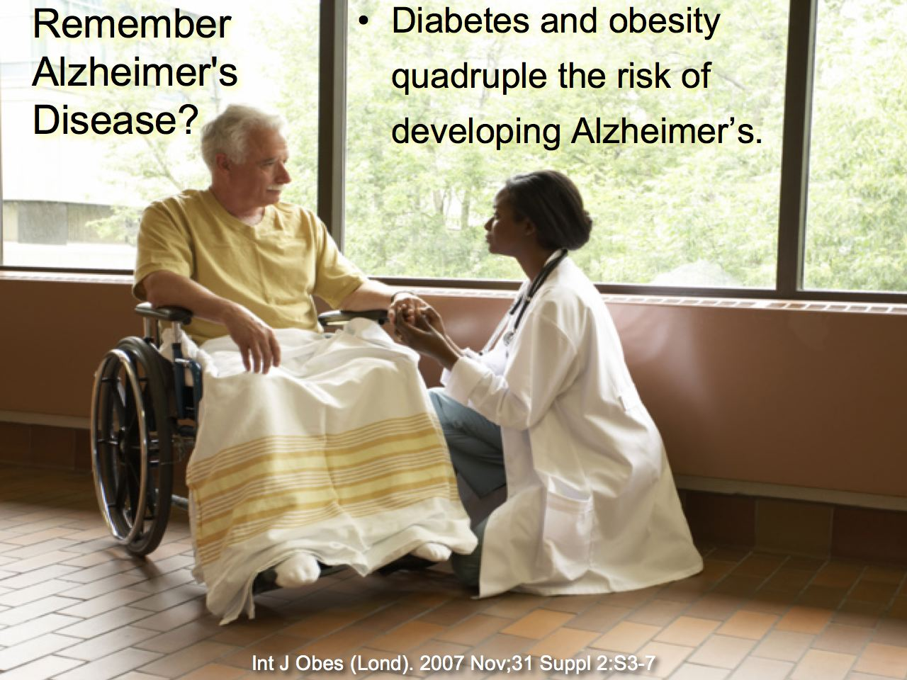

Slide 14
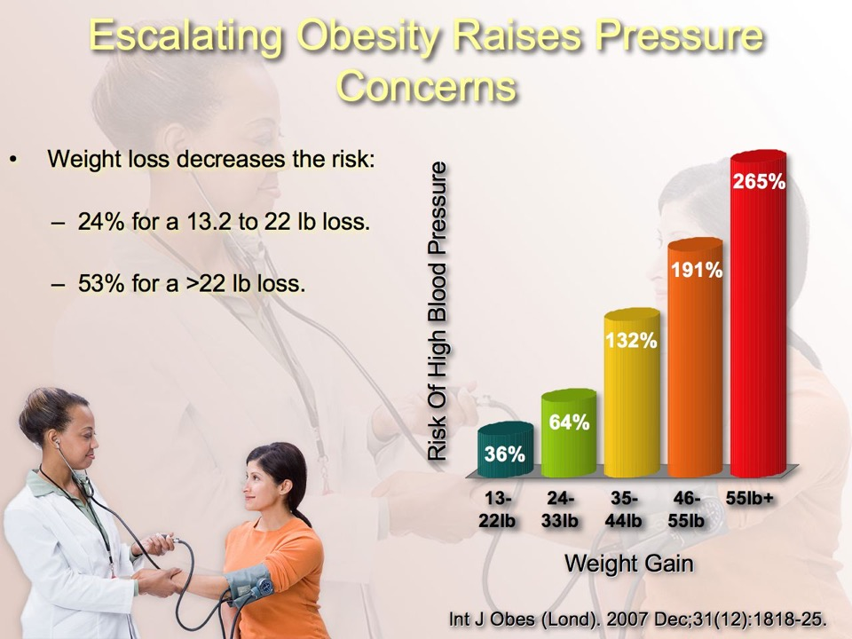

Slide 15
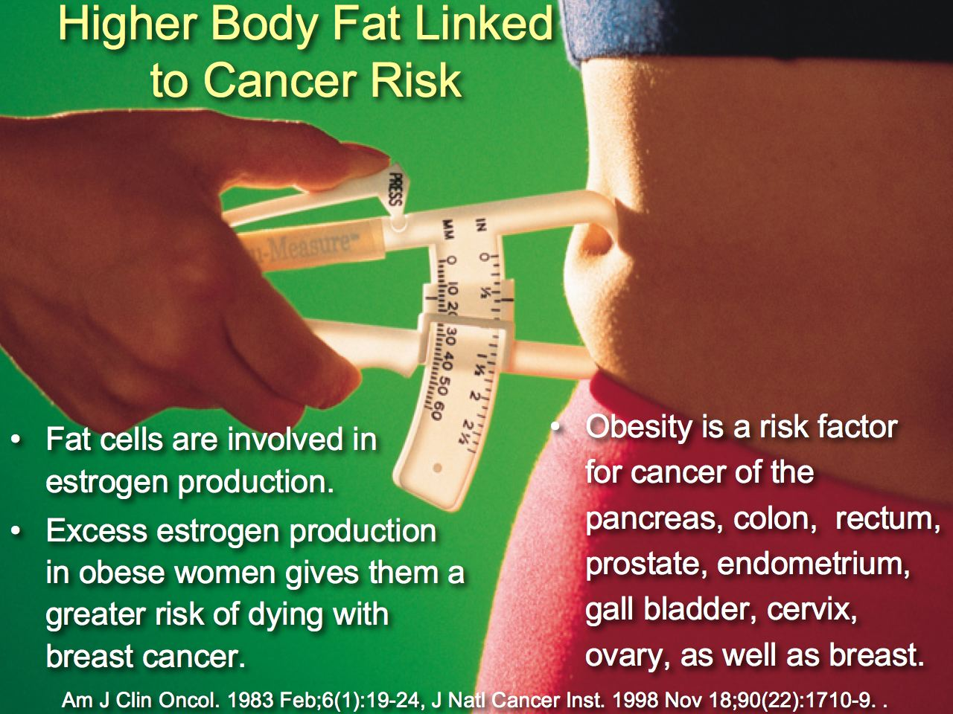

Slide 16


Slide 17
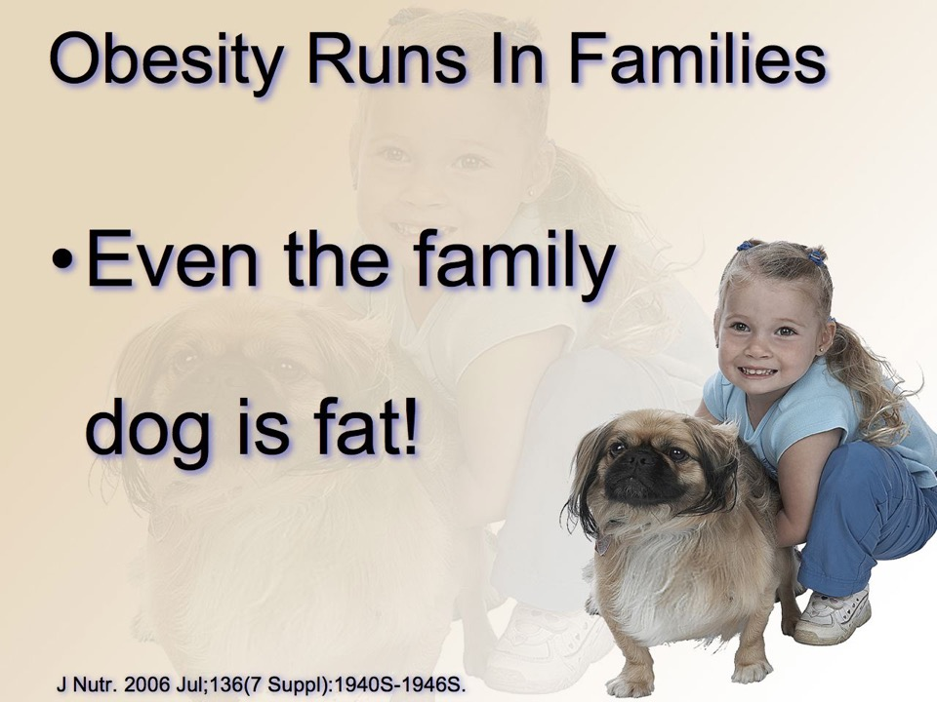

Slide 18

Genetics Loads The Gun
Lifestyle pulls the trigger.

Slide 19
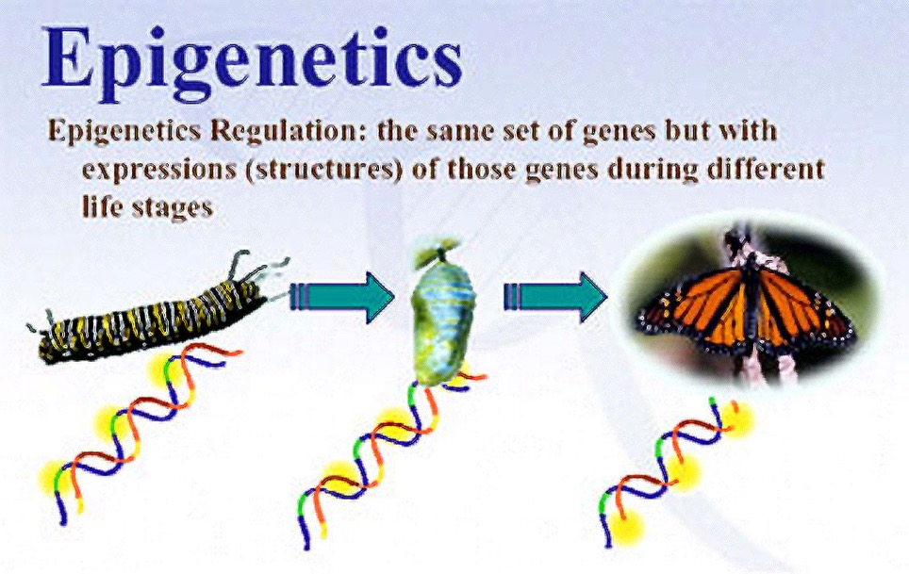

Slide 20


Slide 21
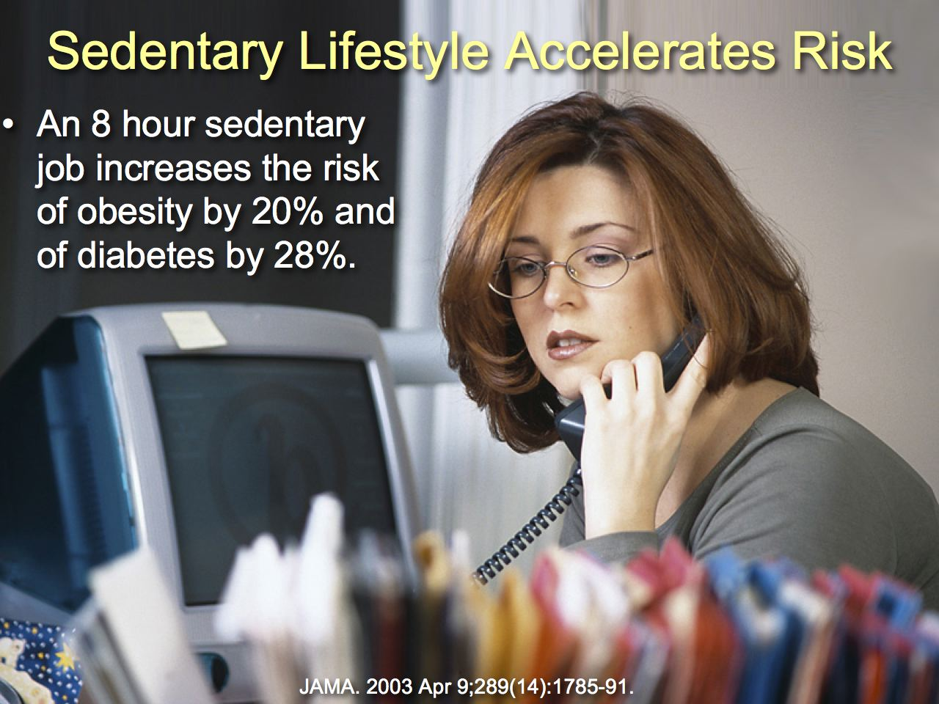

Slide 22
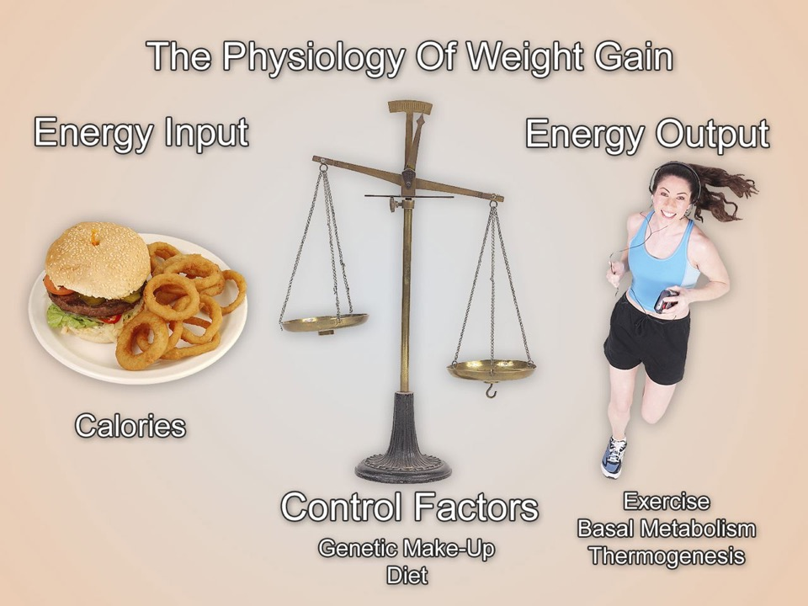
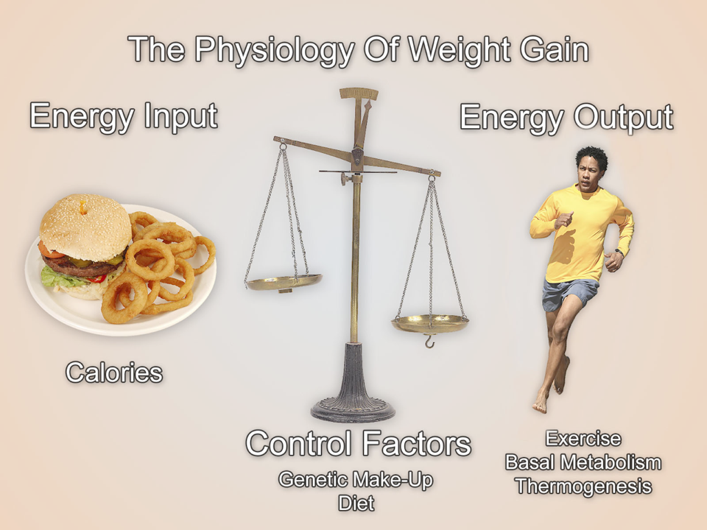

Slide 23


Slide 24


Slide 25


Slide 26


Slide 27
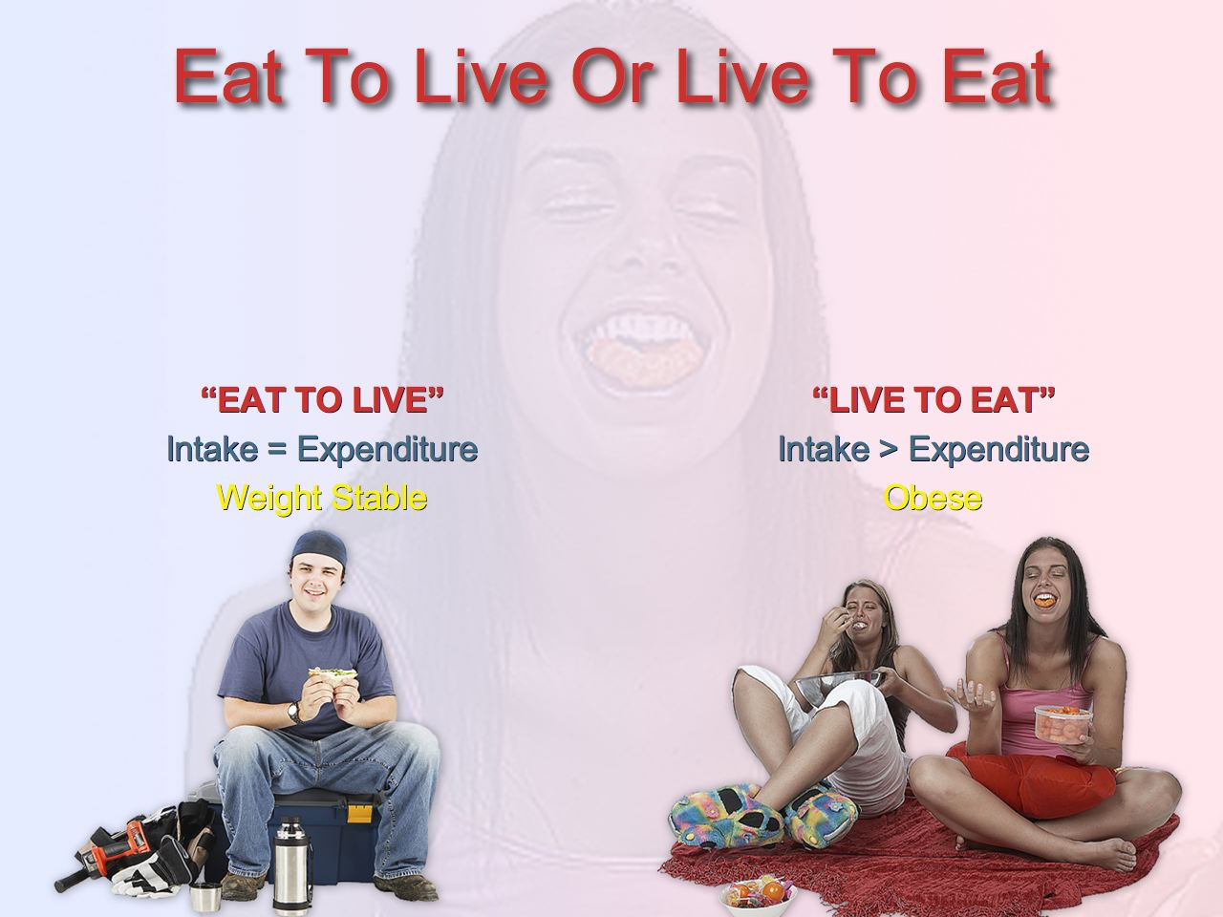

Slide 28


Slide 29

Notes:
29

Slide 30
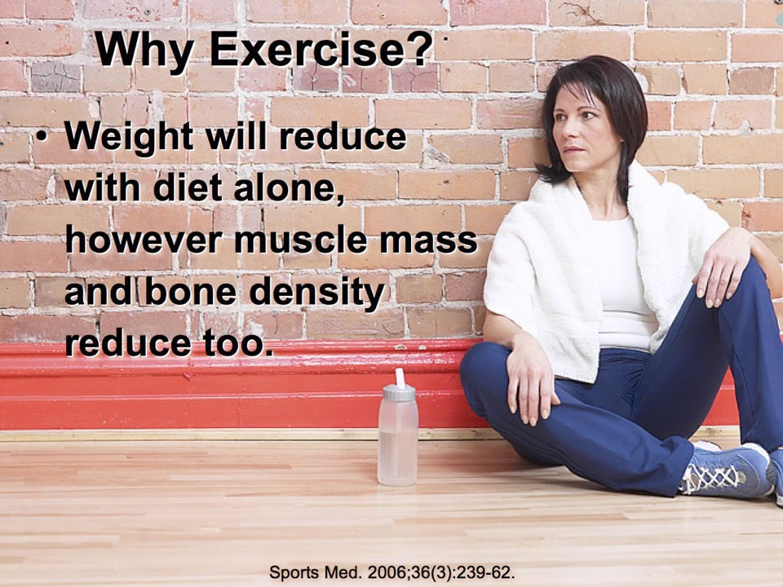
Notes:
30

Slide 31
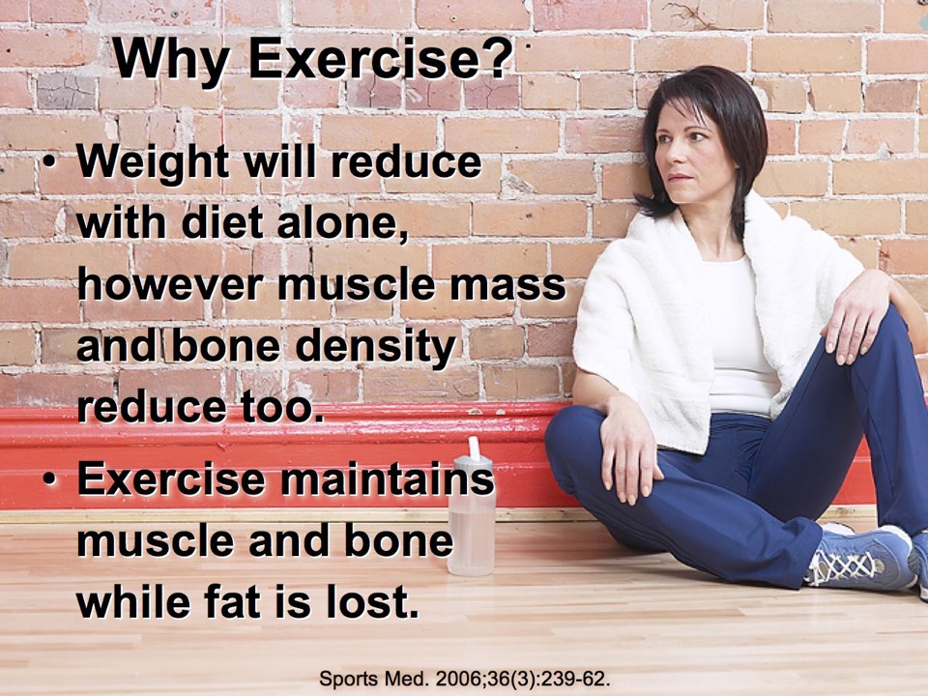
Notes:
31

Slide 32
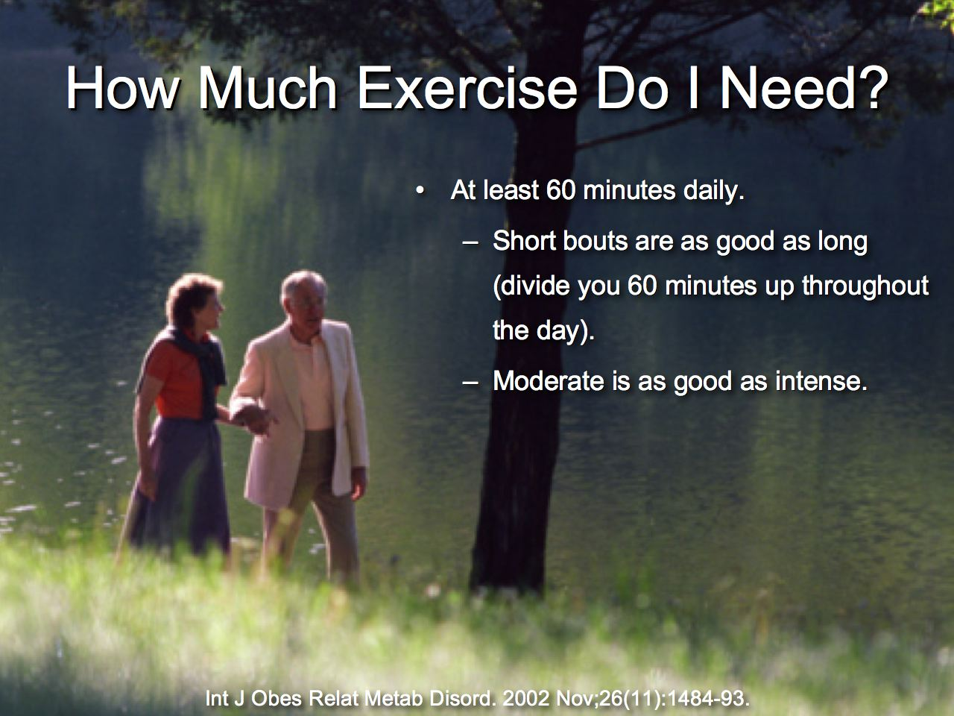
Notes:
32

Slide 33
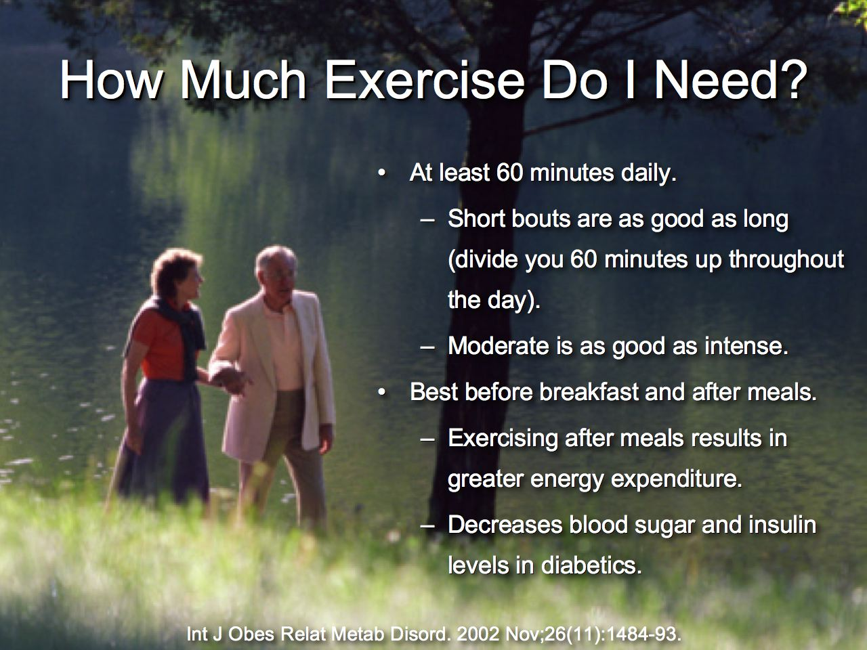
Notes:
33

Slide 34
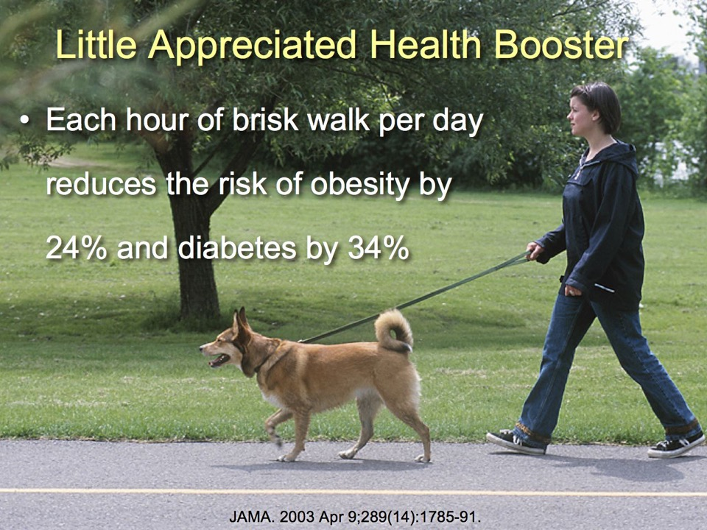
Notes:
34

Slide 35
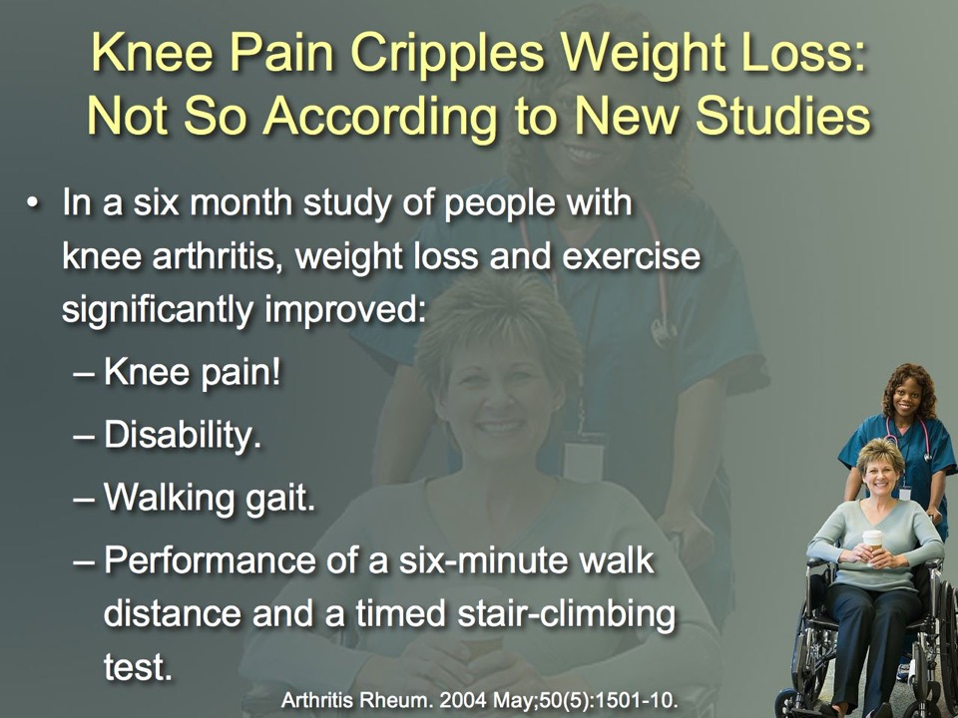
Notes:
35

Slide 36
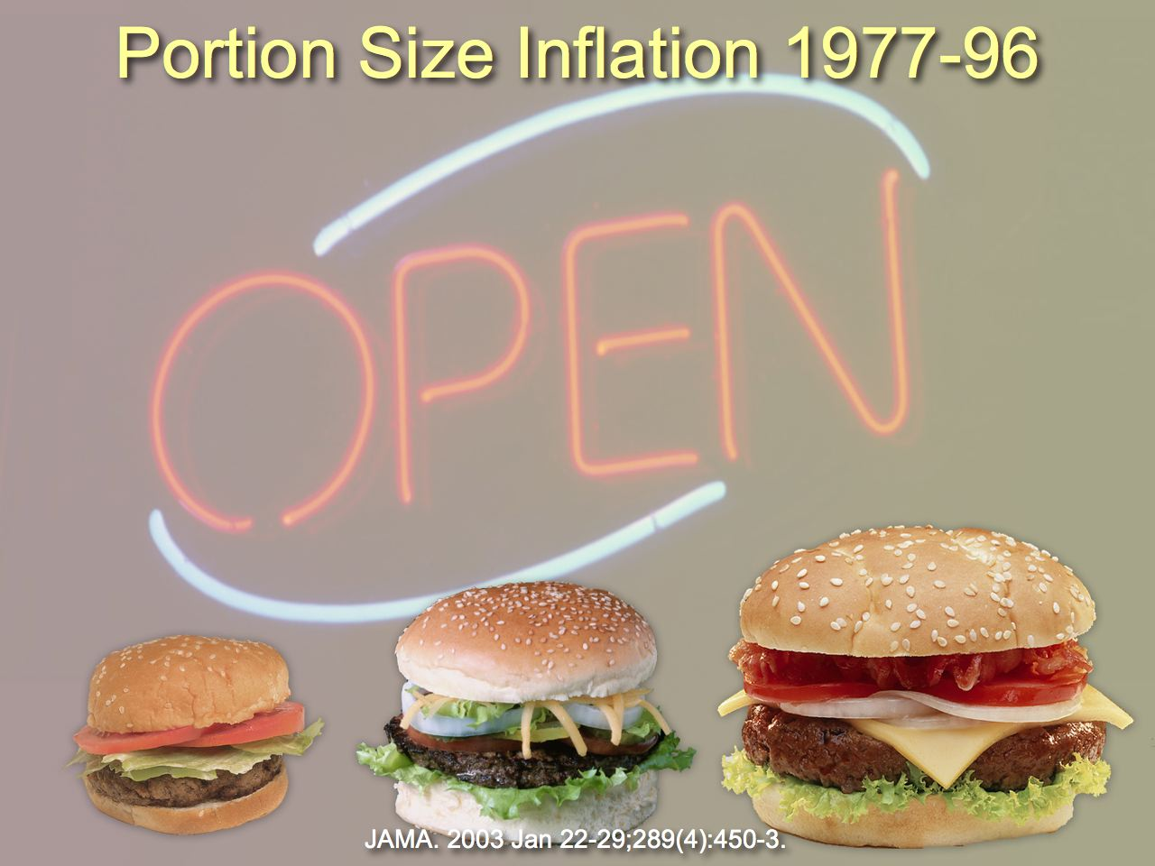
Notes:
36

Slide 37
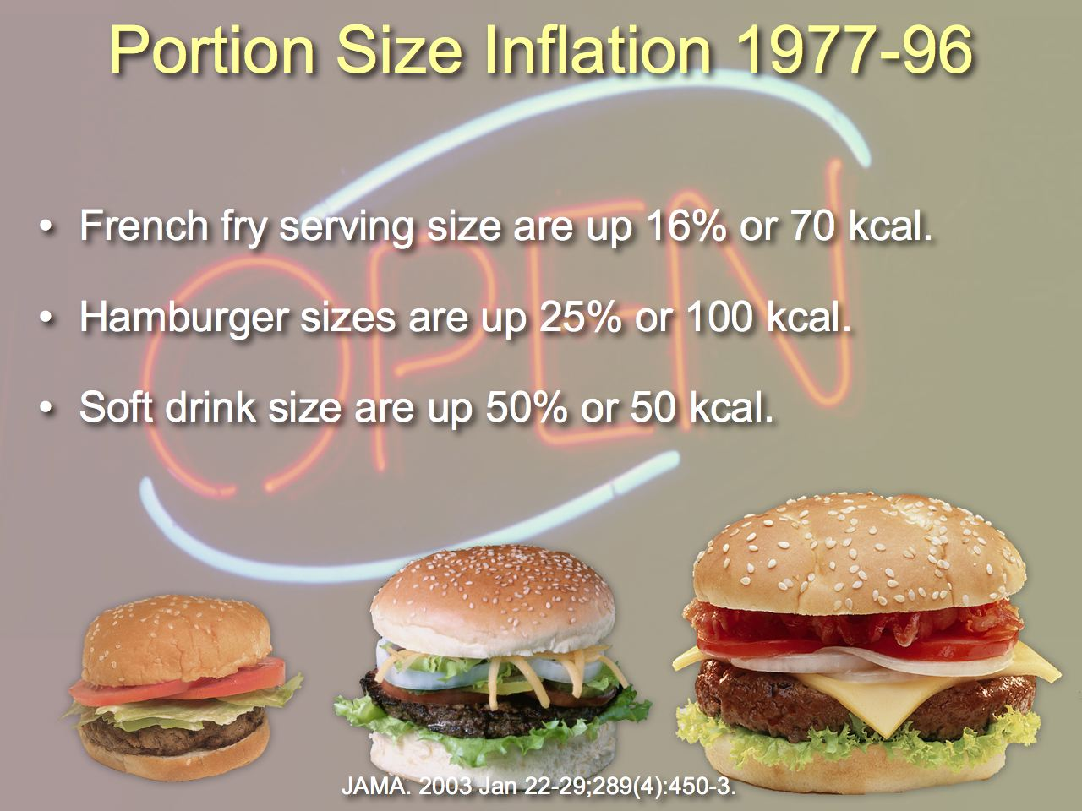
Notes:
37

Slide 38
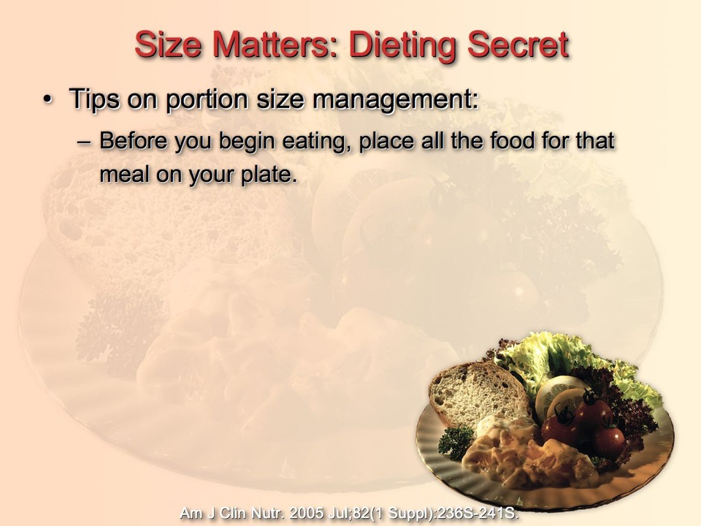
Notes:
38

Slide 39
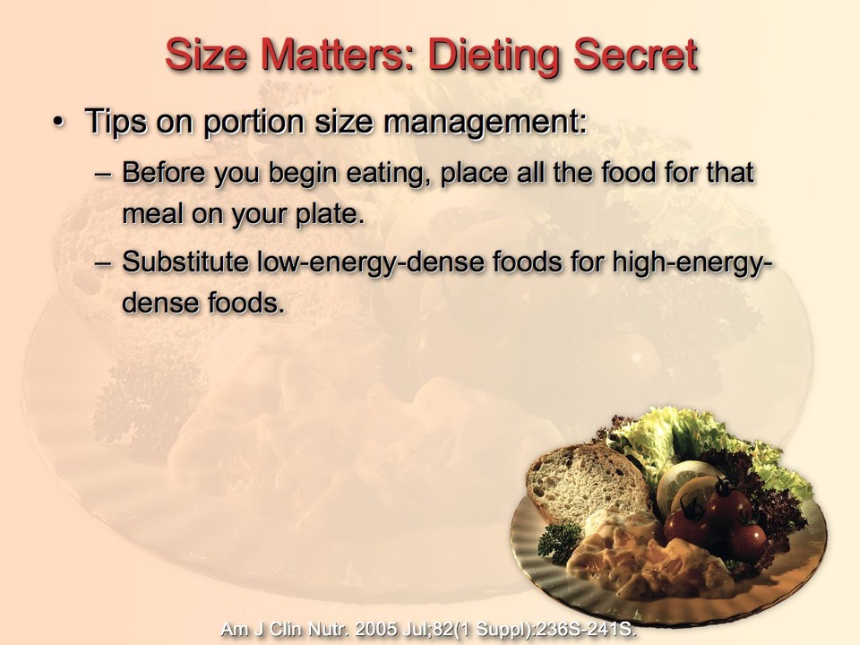
Notes:
39

Slide 40
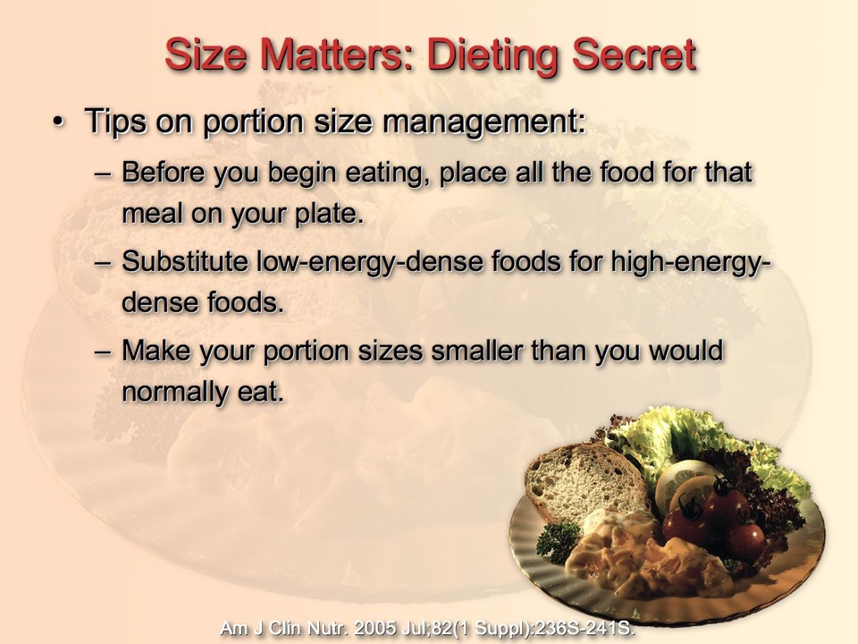
Notes:
40

Slide 41
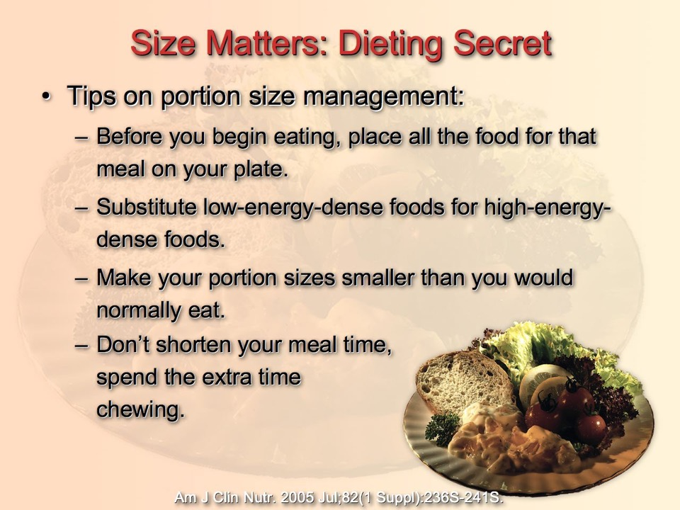
Notes:
41

Slide 42
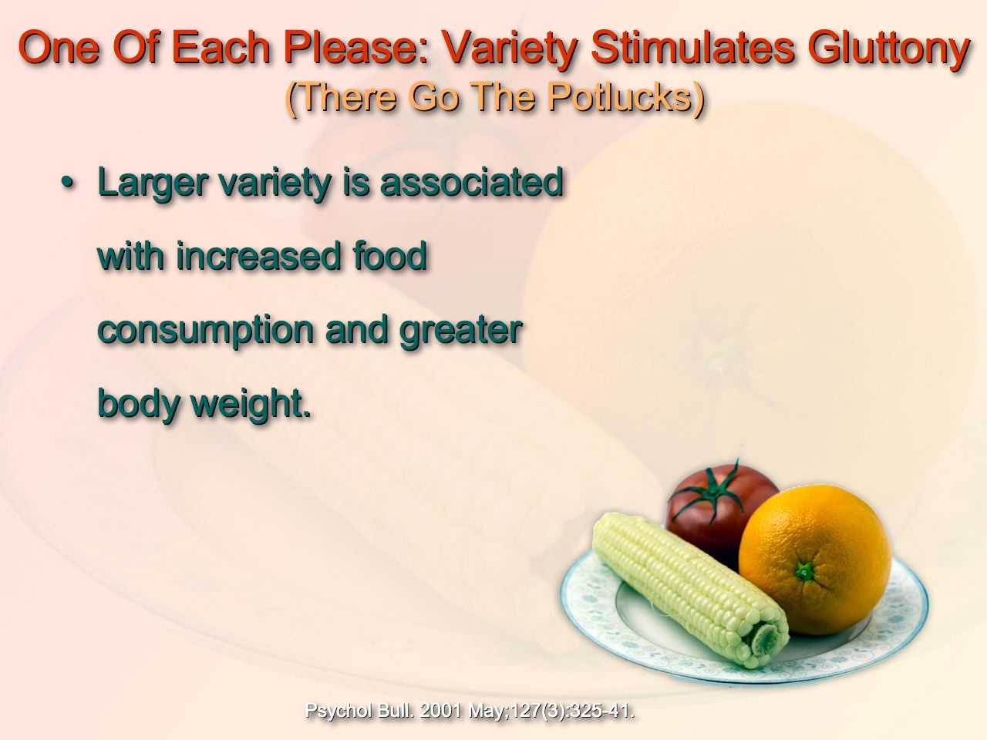
Notes:
42

Slide 43
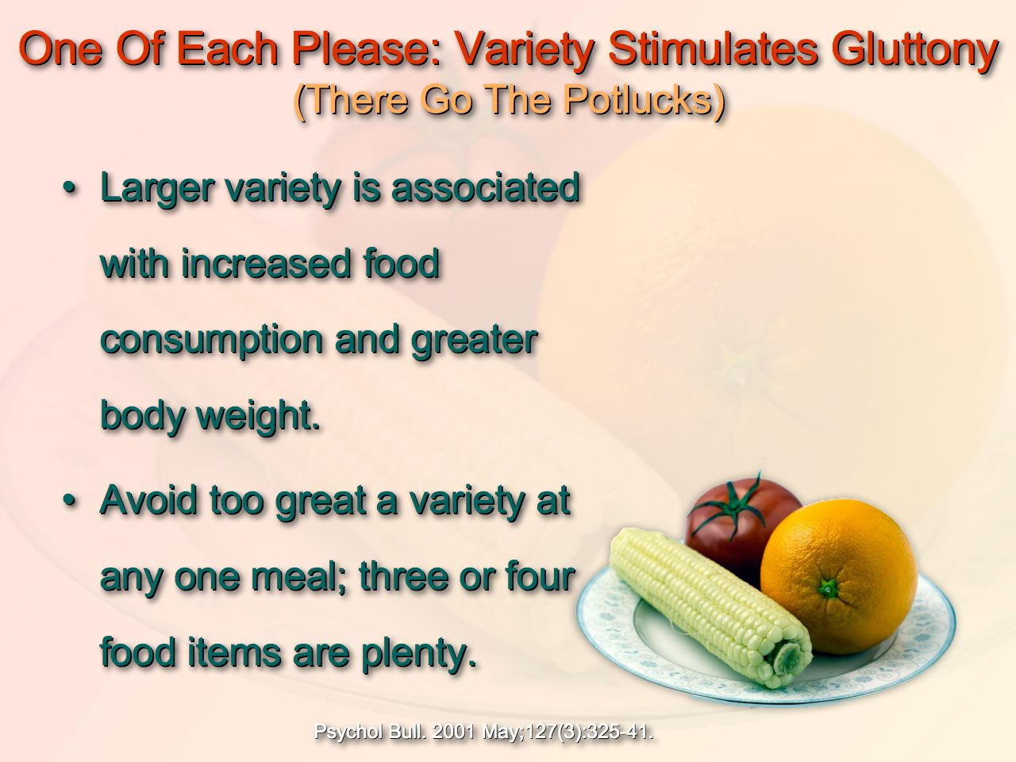
Notes:
43

Slide 44

Notes:
44

Slide 45
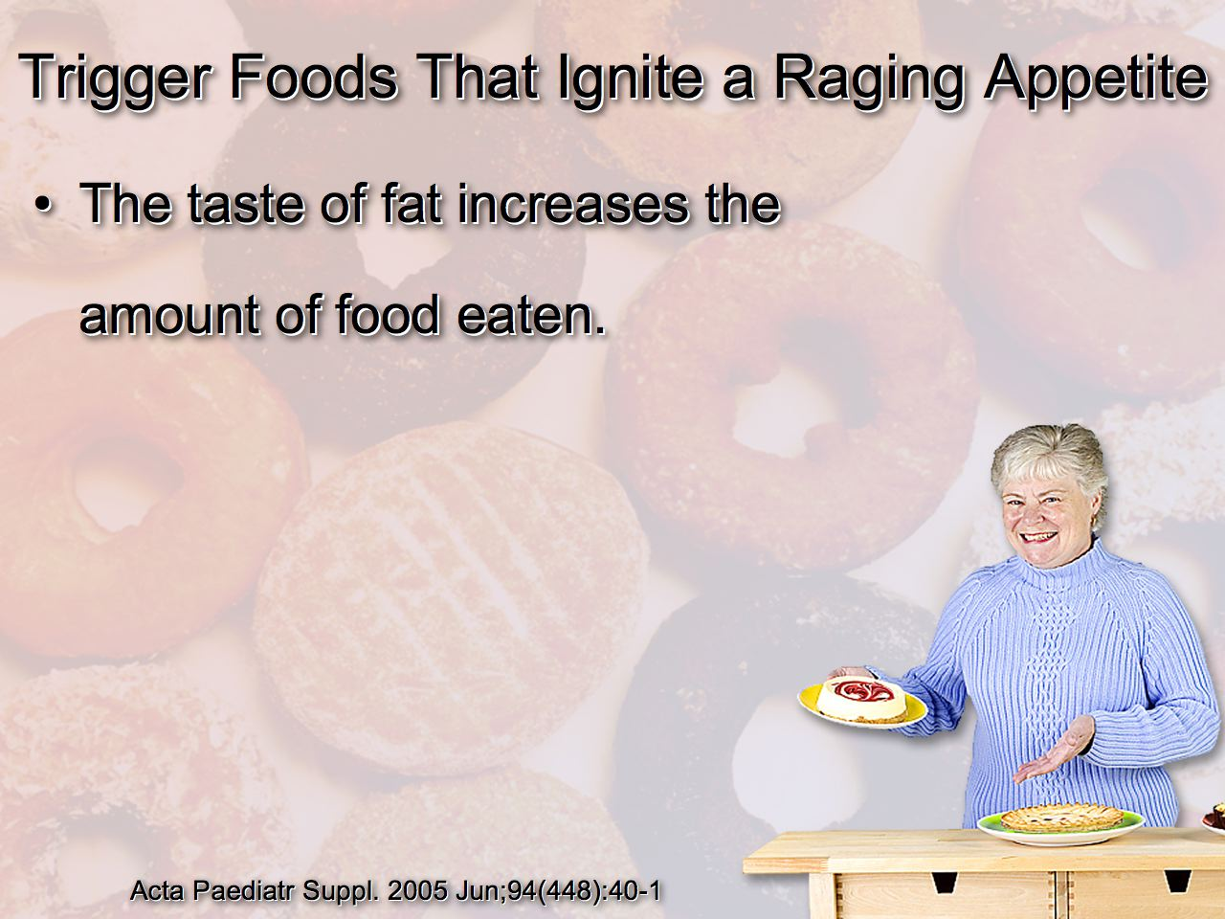
Notes:
45

Slide 46
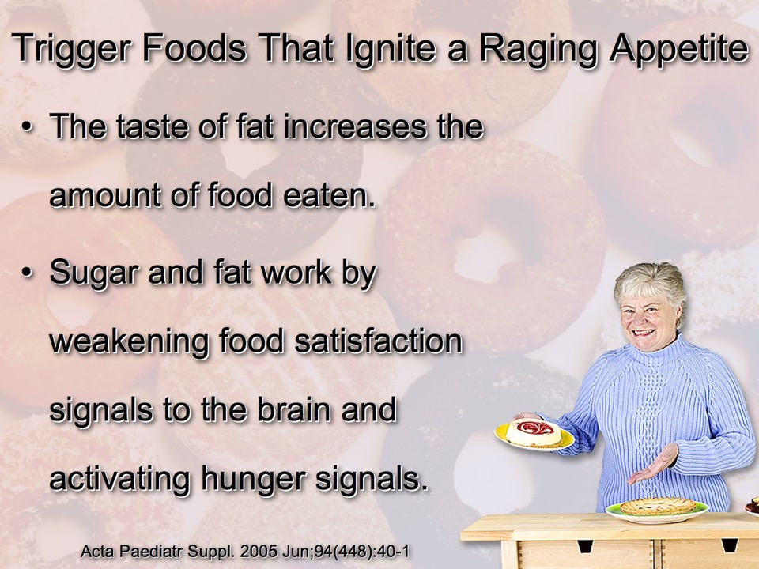
Notes:
46

Slide 47
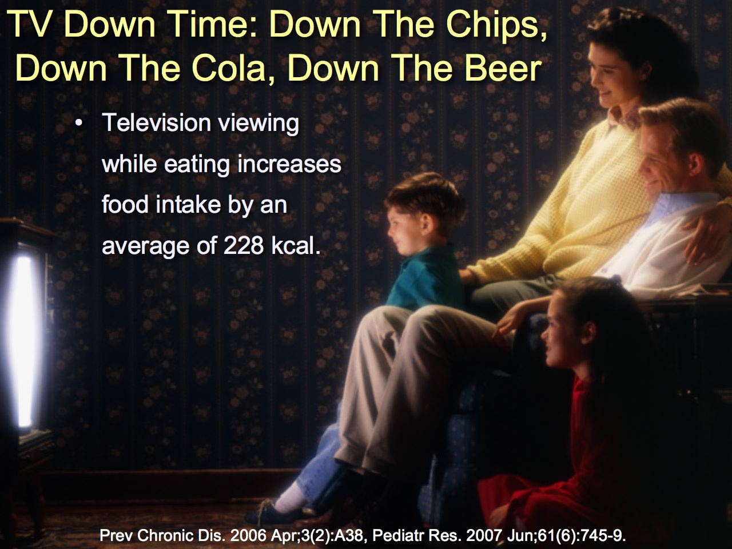
Notes:
47

Slide 48
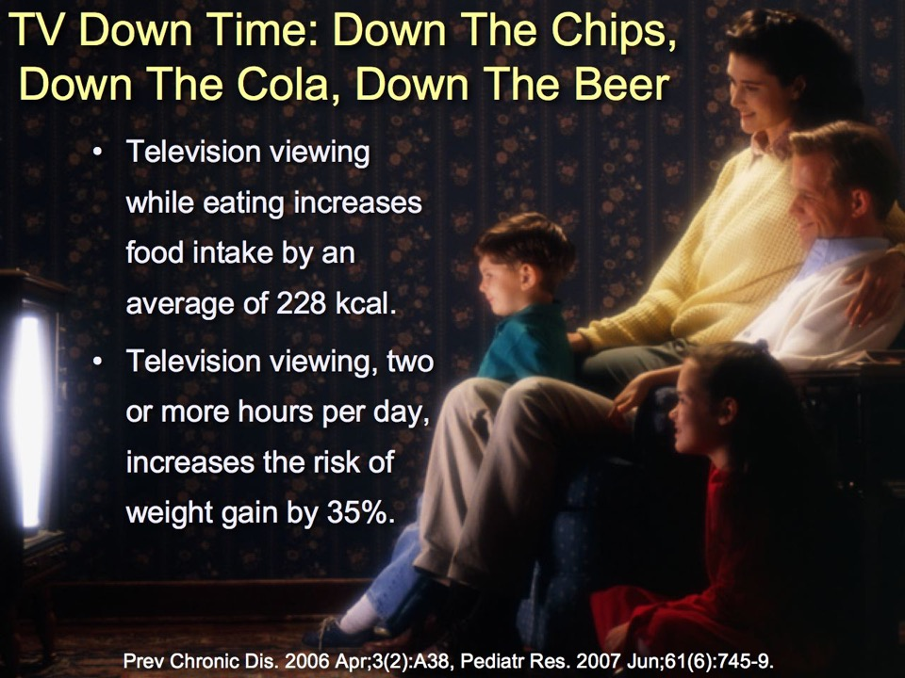
Notes:
48

Slide 49

Notes:
49

Slide 50

Notes:
50

Slide 51

Notes:
51

Slide 52
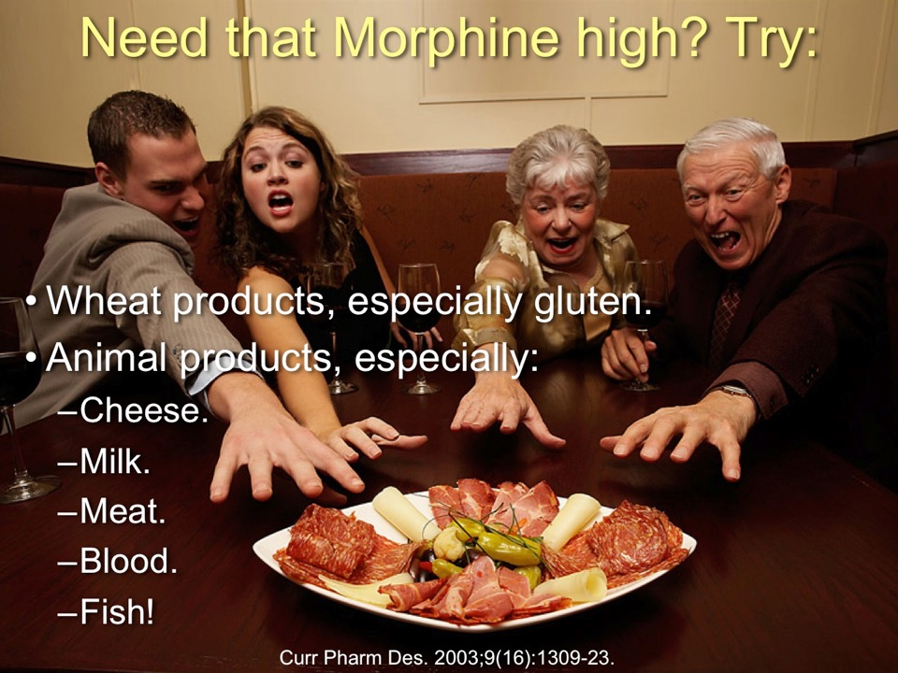

Slide 53
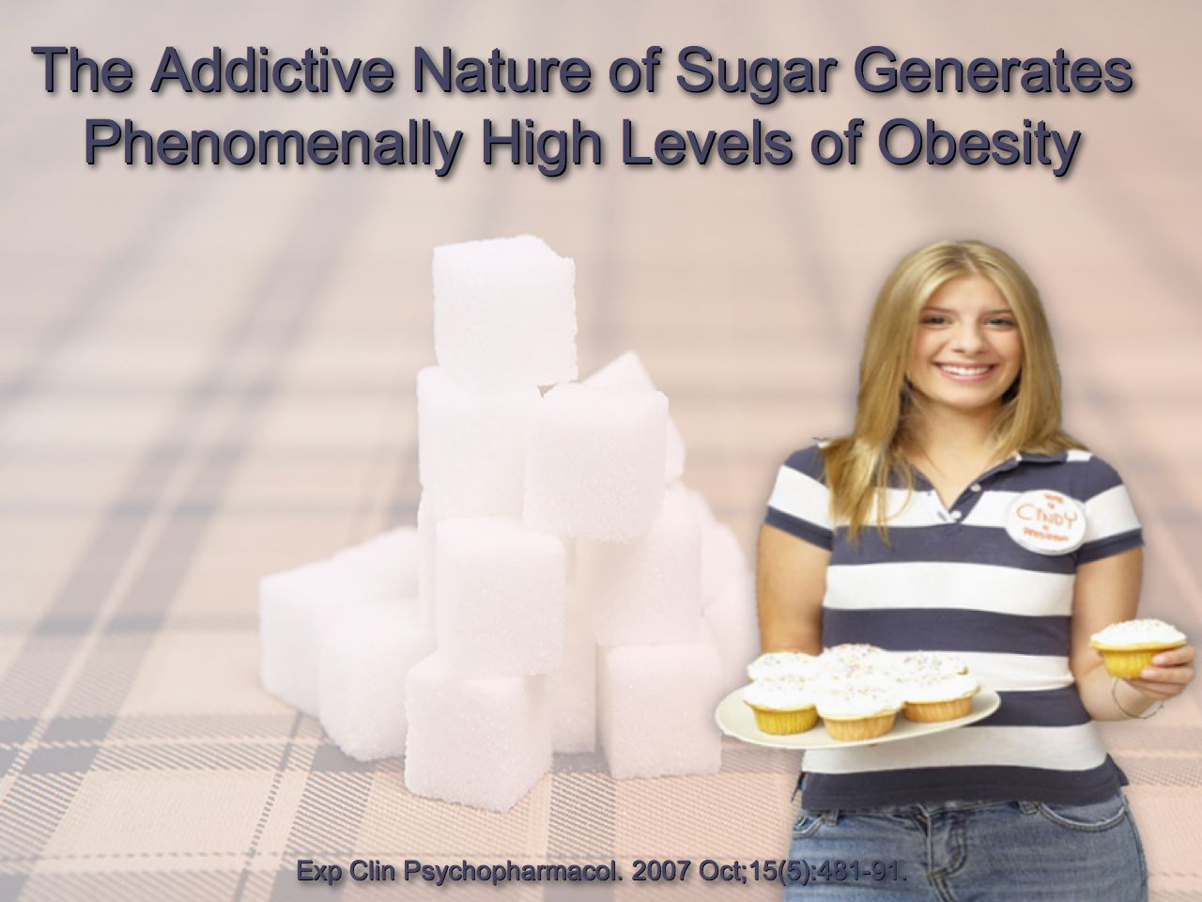
Notes:
53

Slide 54
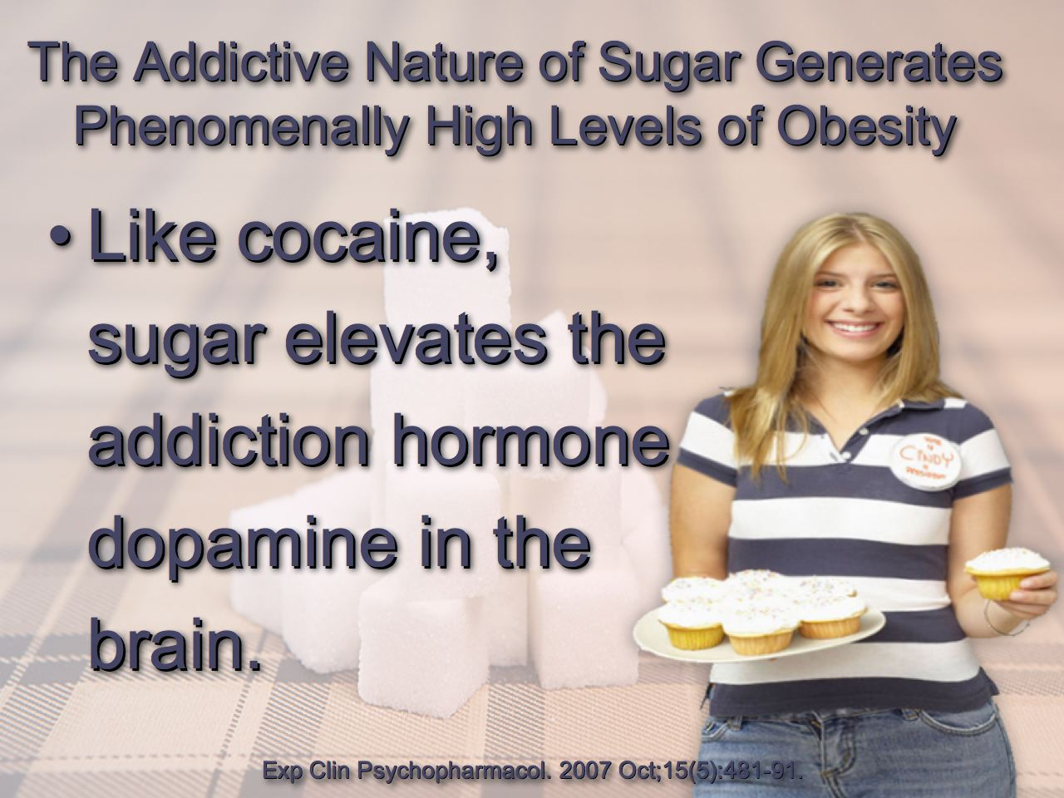
Notes:
54

Slide 55
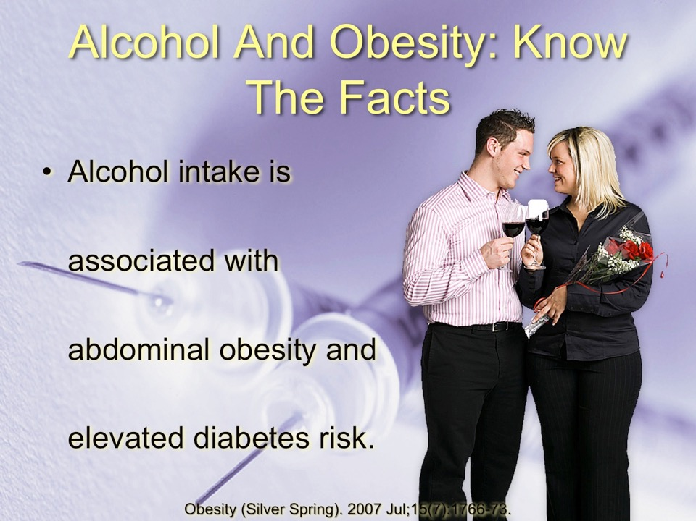

Slide 56

Notes:
56

Slide 57
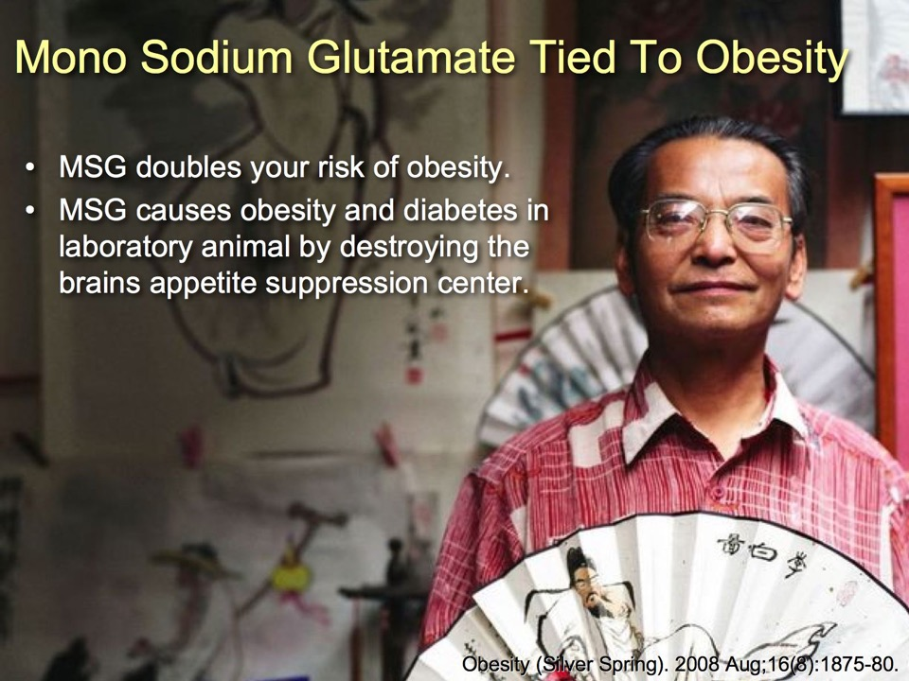
Notes:
57

Slide 58


Slide 59
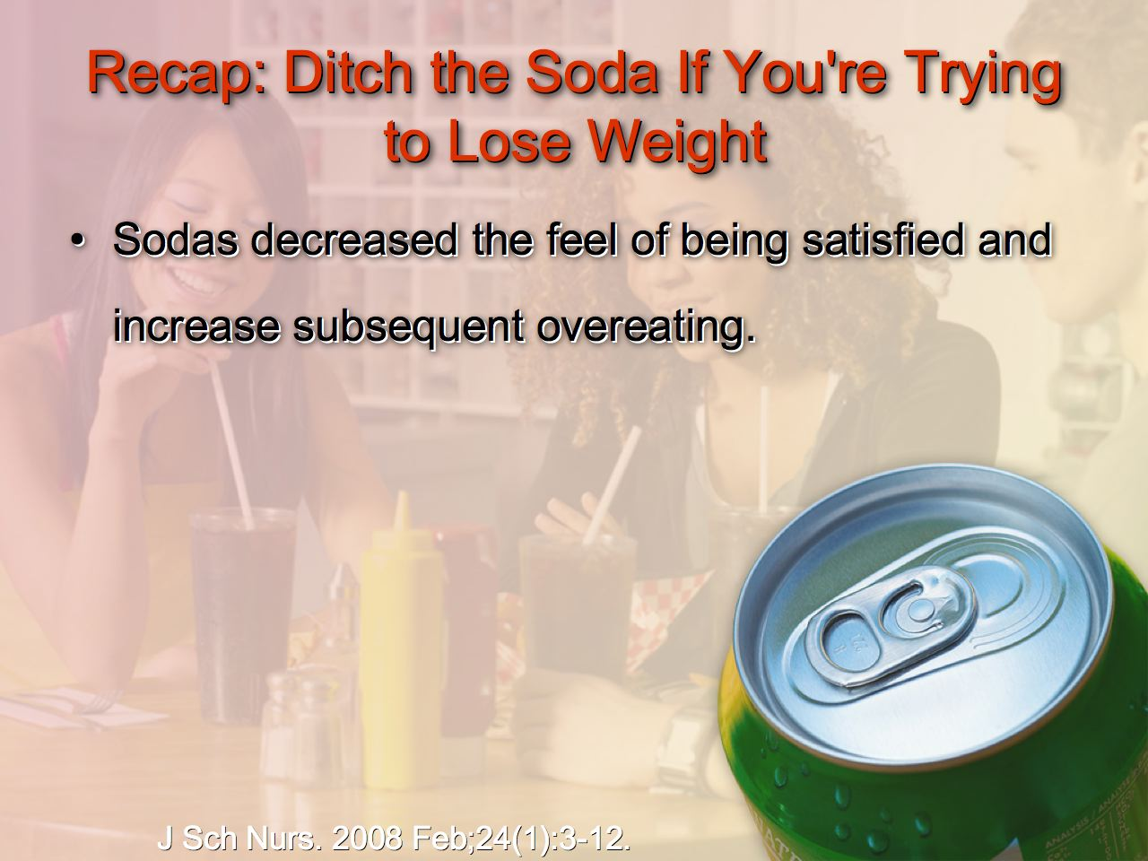
Notes:
59

Slide 60
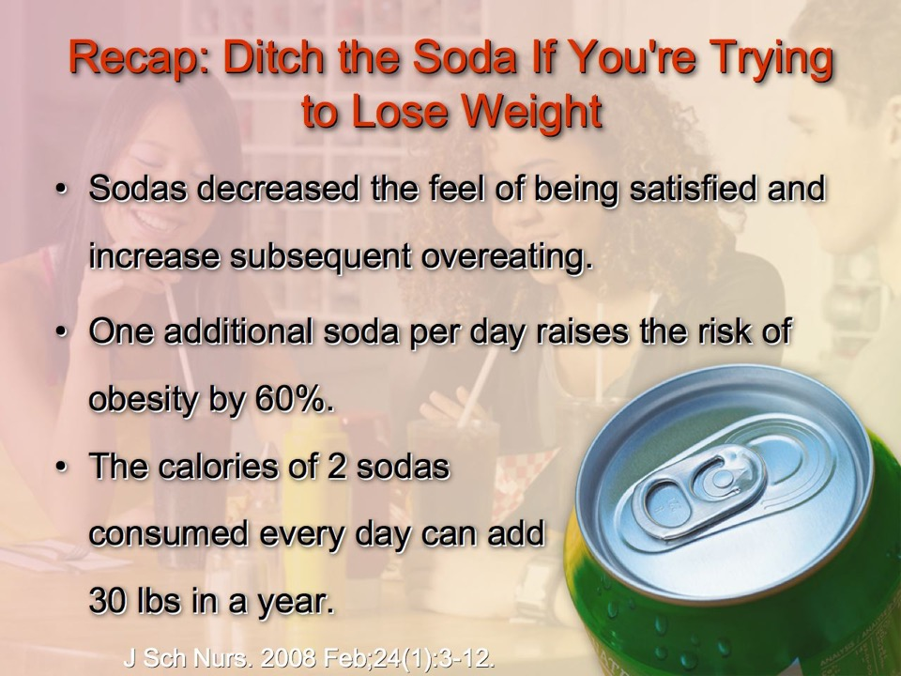
Notes:
60

Slide 61

Notes:
61

Slide 62

Notes:
62

Slide 63
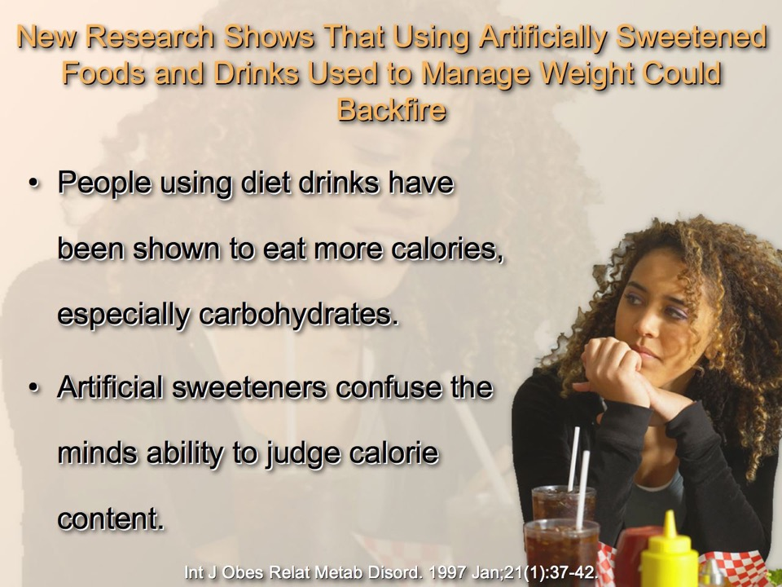
Notes:
63

Slide 64


Slide 65
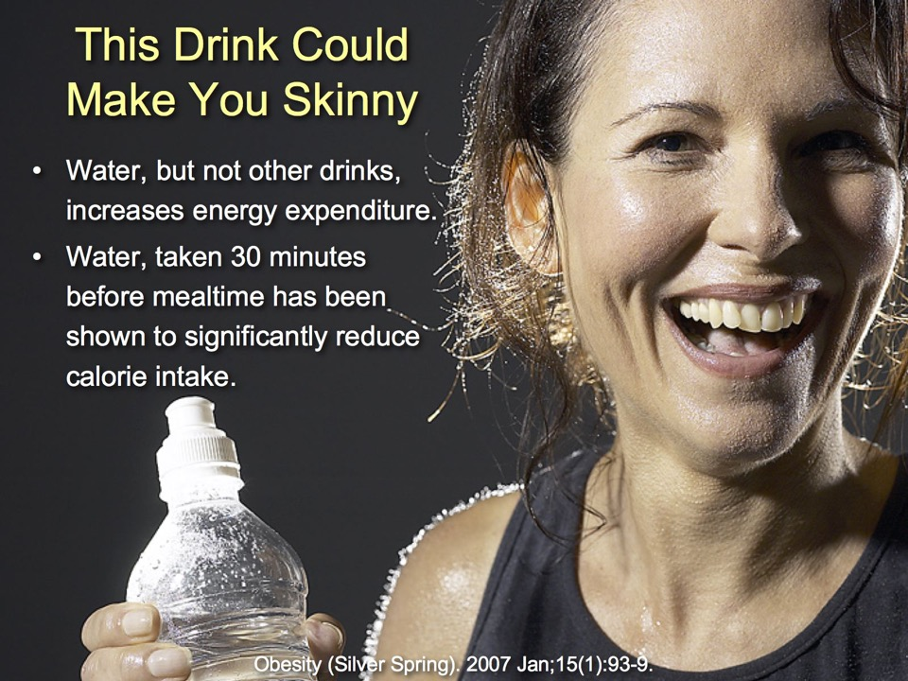

Slide 66


Notes:
66

Slide 67
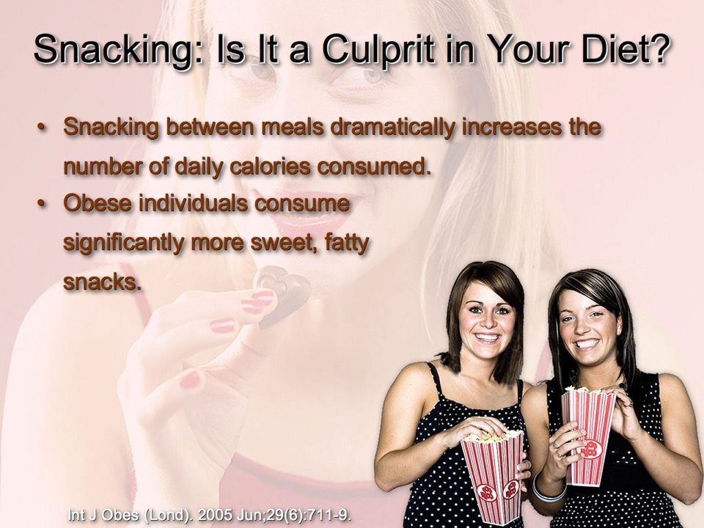

Notes:
67

Slide 68
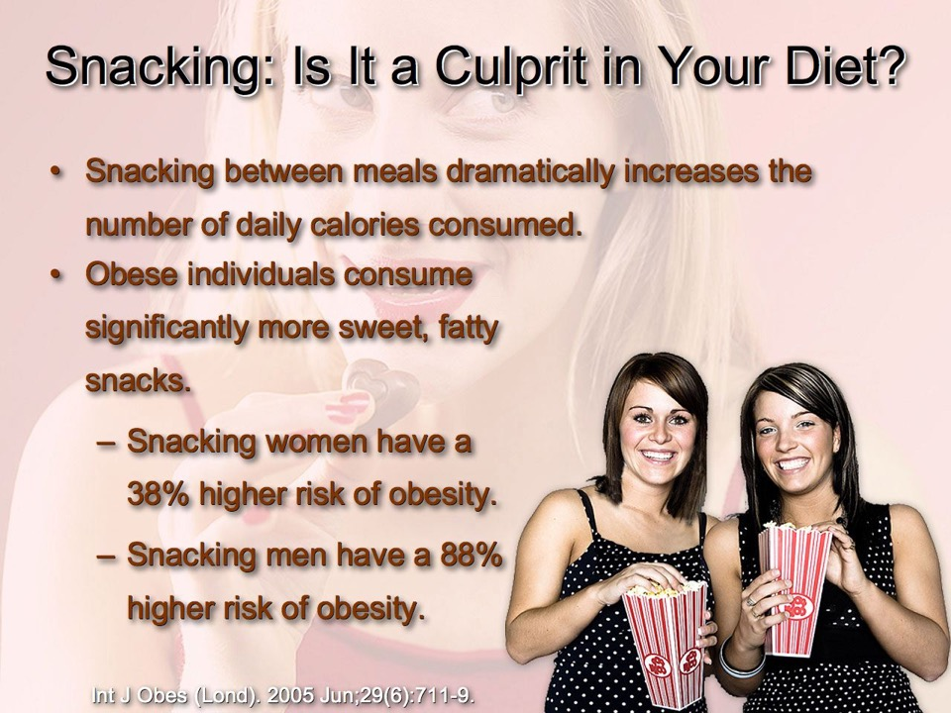
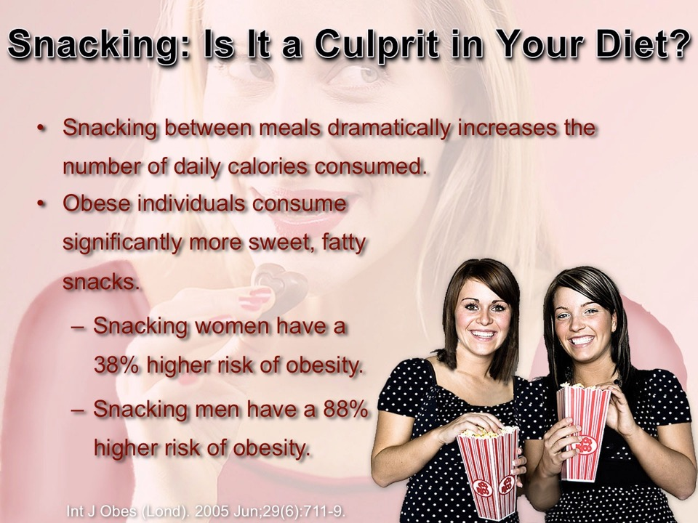
Notes:
68

Slide 69

Notes:
69

Slide 70

Notes:
70

Slide 71

Notes:
71

Slide 72
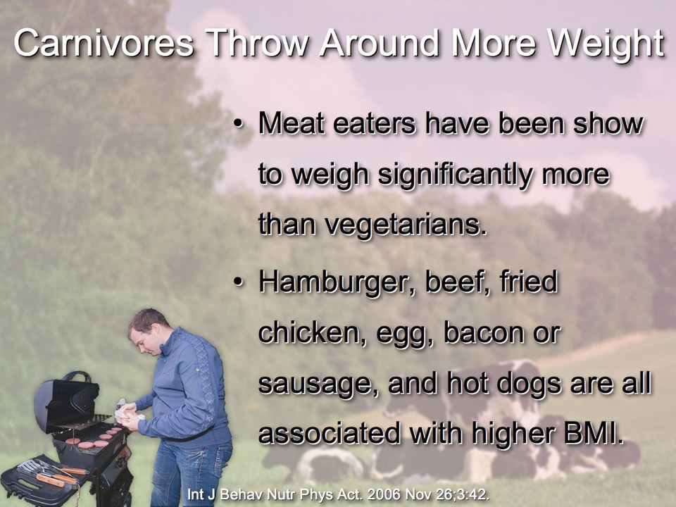
Notes:
72

Slide 73

Notes:
73

Slide 74
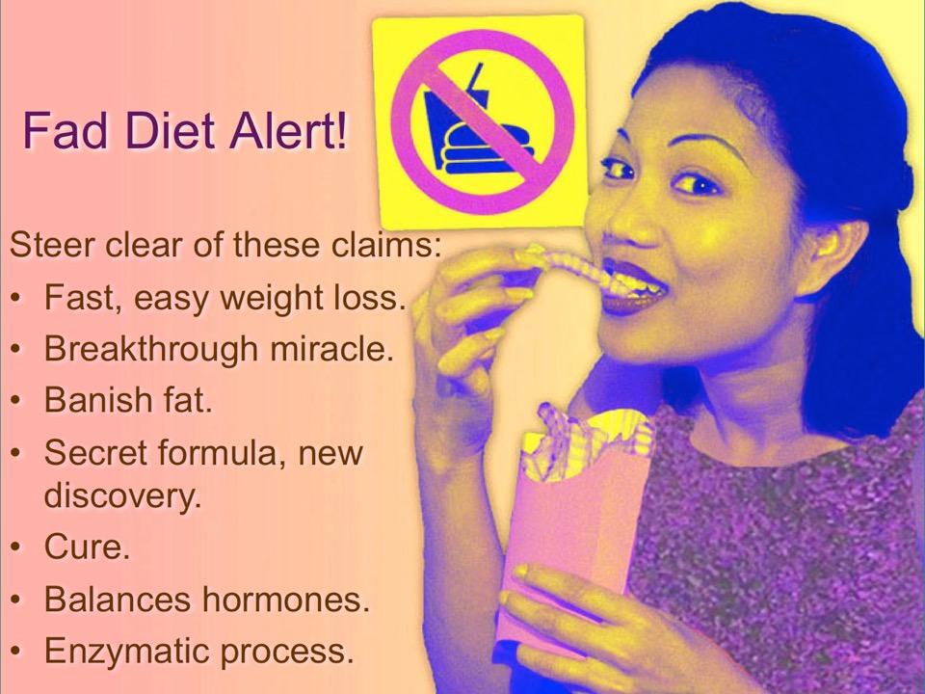

Slide 75
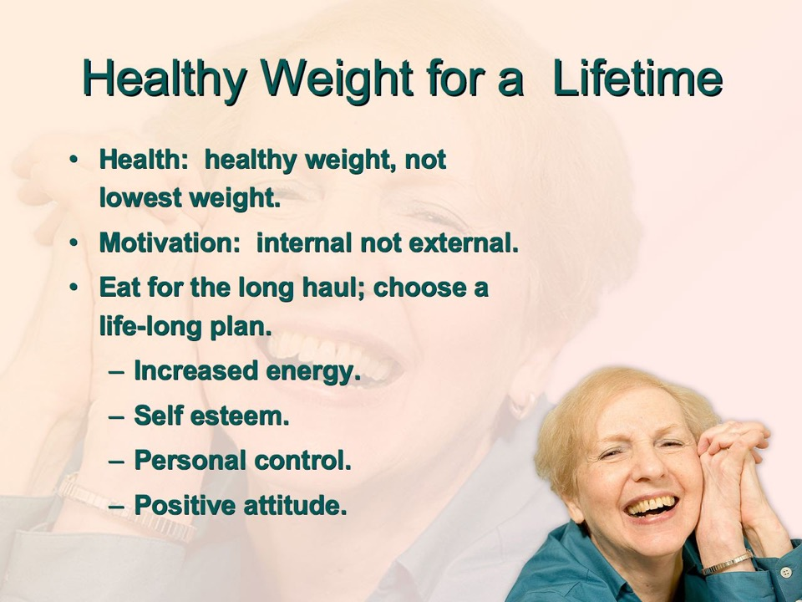

Slide 76


Slide 77


Slide 78


Slide 79
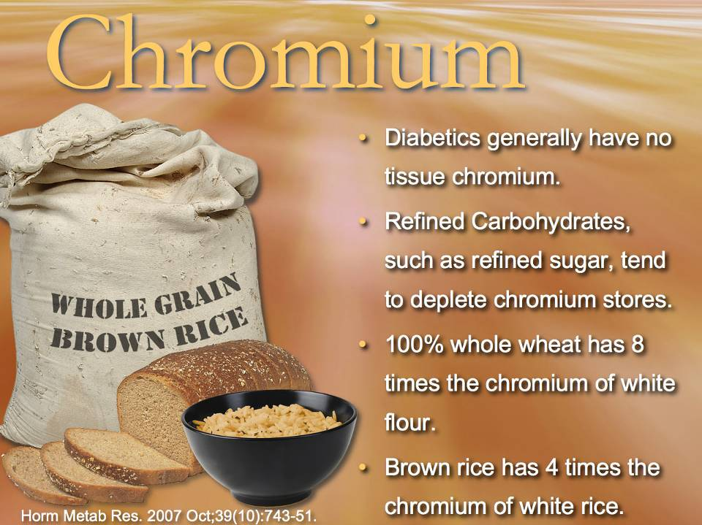
Notes:
79

Slide 80
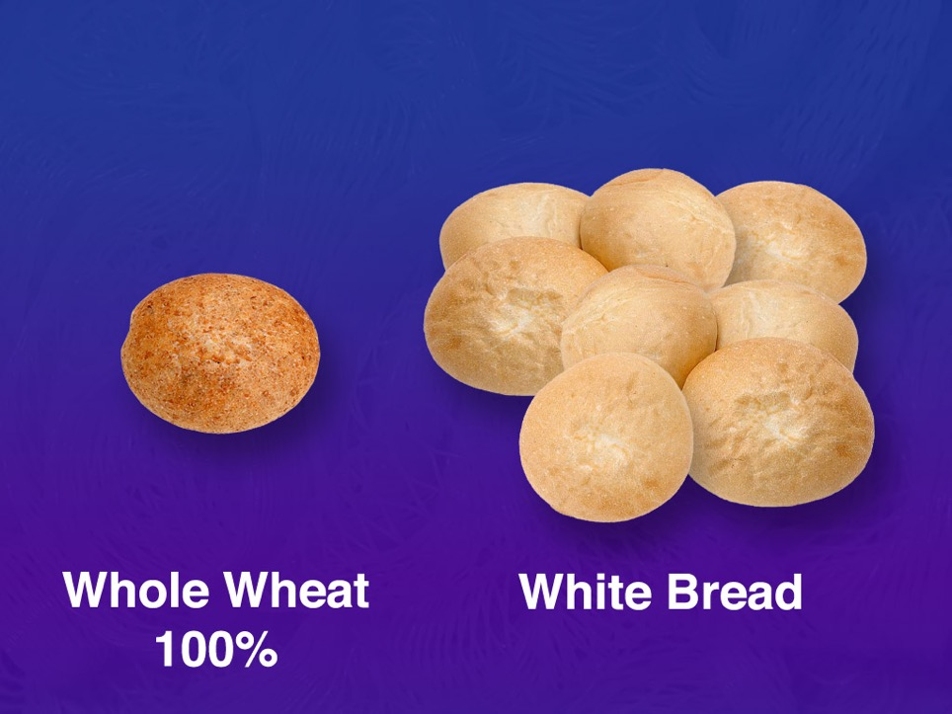
How Many Servings?
1:8
Some people’s bodies are constantly crying out for missing nutrients.
What food makes your body the happiest?
Notes:
1:8
Some people’s bodies are constantly crying out for missing nutrients.
What food makes your body the happiest?

Slide 81



Slide 82



Slide 83



Slide 84
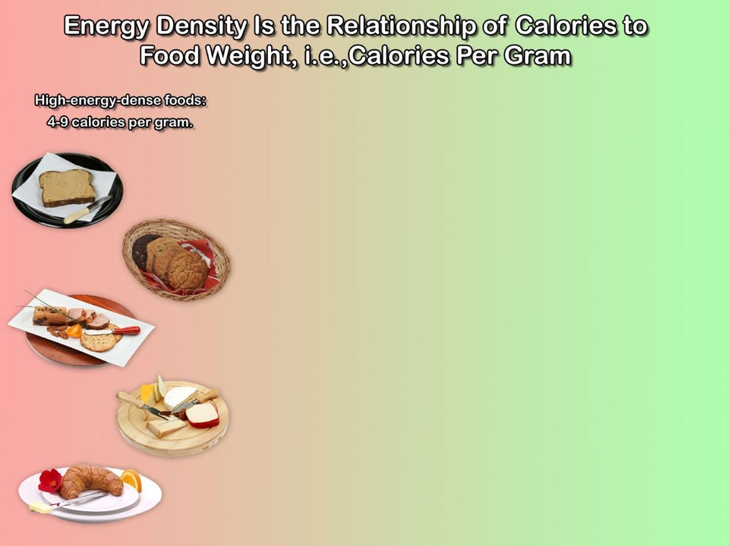

Slide 85


Slide 86


Slide 87


Slide 88


Slide 89


Slide 90


Slide 91


Slide 92


Slide 93


Slide 94


Slide 95


Slide 96


Slide 97



Slide 98



Slide 99


Slide 100


Slide 101


Slide 102


Slide 103


Slide 104


Slide 105


Slide 106


Slide 107


Slide 108


Slide 109


Slide 110


Slide 111

Notes:
111

Slide 112

Notes:
112

Slide 113

Notes:
113

Slide 114

Notes:
114

Slide 115

Notes:
115

Slide 116

Notes:
116

Slide 117

Notes:
117

Slide 118



Slide 119



Slide 120

Summing It All Up
Plan your meals; eat modest portions of low energy dense/high nutritionally dense whole plant foods. Keep the menu simple.
Put all the food you are going to eat on your plate at the start of the meal and keep written records of what you eat, etc.

Slide 121
Summing It All Up
Plan your meals; eat modest portions of low energy dense/high nutritionally dense whole plant foods. Keep the menu simple.
Put all the food you are going to eat on your plate at the start of the meal and keep written records of what you eat, etc.
Eat breakfast everyday and keep a strict schedule, skip dinner if you must skip a meal. Fasting a day a week can be helpful.

Slide 122
Summing It All Up
Put all the food you are going to eat on your plate at the start of the meal and keep written records of what you eat, etc.
Eat breakfast everyday and keep a strict schedule, skip dinner if you must skip a meal. Fasting a day a week can be helpful.
Eat only natural food that does not feed addiction or overpower rational decision-making. Eat for “strength and not for drunkenness.

Slide 123
Summing It All Up
Eat breakfast everyday and keep a strict schedule, skip dinner if you must skip a meal. Fasting a day a week can be helpful.
Eat only natural food that does not feed addiction or overpower rational decision-making. Eat for “strength and not for drunkenness.
Chew your food well—choose food that requires chewing.

Slide 124
Summing It All Up
Eat only natural food that does not feed addiction or overpower rational decision-making. Eat for “strength and not for drunkenness.
Chew your food well—choose food that requires chewing.
Drink plenty of water between meals: 30 min prior or 2 hrs after.

Slide 125
Summing It All Up
Chew your food well—choose food that requires chewing.
Drink plenty of water between meals: 30 min prior or 2 hrs after.
Exercise regularly: walk outdoors in the fresh air and sunshine, engage in some resistance exercises or activities.

Slide 126
Summing It All Up
Drink plenty of water between meals: 30 min prior or 2 hrs after.
Exercise regularly: walk outdoors in the fresh air and sunshine, engage in some resistance exercises or activities.
Take regular time for adequate sleep.

Slide 127
Summing It All Up
Exercise regularly: walk outdoors in the fresh air and sunshine, engage in some resistance exercises or activities.
Take regular time for adequate sleep.
Establish a plan for your known weaknesses and with God’s help make them your strengths.

Slide 128
Summing It All Up
Take regular time for adequate sleep.
Establish a plan for your known weaknesses and with God’s help make them your strengths.

Slide 129

NorthernLightsHealthEducation.com

Slide 130
Blueprint For Health And Healing
Reversing Disease From Its Foundation
Ideal Weight:
Achieve It Naturally
John Clark, M.D.
Notes:
Story: Mikey (Michael) “This excellent lifestyle program has made even skipping a meal or two now and then easy, I don’t even get hunger” Michael had asked me to put him on a weight loss program. With middle age spread catching up with him, falling metabolism, and creeping weight gain, he had felt the need to reform. And now, with this new program, he had discovered that he could even fast a day or two a week and not feel gnawing hunger pains, he had plenty of energy, lots of vitality, and, most importantly, a steady loss of unwanted weight. So what we are talking about here is how to be healthy and happy while achieving our ideal weight. Listen to this program, put its principles into practice, and you too can find weight management a delight.
None programs he had tried seemed to make any satisfying difference.
Benefit/problem solved
Falling metabolism
Middle age spread
Creeping weight gain
fasting without gnawing hunger
plenty of energy and vitality
steady weight loss
Bullet points
Eating satisfaction without weight concerns
No yo-yo fad dieting
Healthy and fit
no starvation diet.
Inspire
Call to action

