Slide 1


Notes:
302 Deeper Yet
582 Working Oh Christ With Thee
328 Must Jesus Bear the Cross Alone
191 Love Divine, Wesley
Never venture to enter the pulpit until you have wrestled with God in prayer, and come forth as seeing Him who is invisible, with your faces lighted up with beams from the Sun of Righteousness. You will then have no tame words to offer. The divine truths which glow in your own breast will kindle the hearts of others. {GW92 467.2}

Slide 2

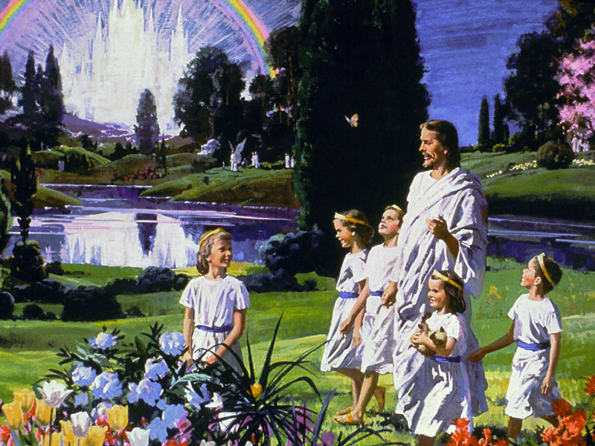

Notes:
TP: Heaven is a beautiful place full of beautiful happy people. But was it always that way?
Never venture to enter the pulpit until you have wrestled with God in prayer, and come forth as seeing Him who is invisible, with your faces lighted up with beams from the Sun of Righteousness. You will then have no tame words to offer. The divine truths which glow in your own breast will kindle the hearts of others. {GW92 467.2}

Slide 3
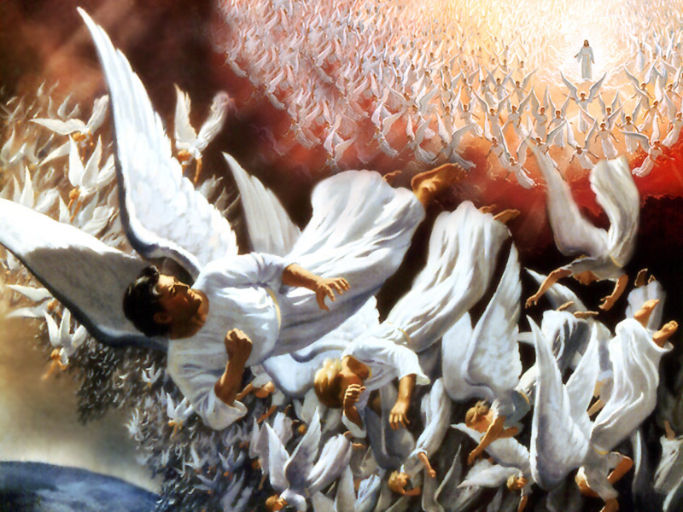
Notes:
Something went terribly wrong
War broke out, Satan was cast out, And the history of God’s universe was tarnished!
Preventative strategies must be put in place to protect the universe against a reoccurrence.
TP: Affliction shall not rise up a second time, but how?

Slide 4

“Angels in Heaven mourned the fate of those who had been their companions in happiness and bliss. Their loss was felt in Heaven.
“The Father consulted Jesus in regard to at once carrying out their purpose to make man to inhabit the earth.
“He would place man upon probation to test his loyalty, before he could be rendered eternally secure." (SR 19).
Notes:
Where’s Celestine? She went with Lucifer….
Thus the Two Trees
TP: So what was the object in their being granted free choice?
Why did God give Adam and Eve free choice? Liberty of conscience?

Slide 5

The Object of Free Choice
“God might have created them without the power to transgress His requirements,
“but in that case there could have been no development of character; their service would not have been voluntary, but forced.” (Ed 23).
Notes:
TP: What was Adam’s Mission before the fall, if he chose to accept it?

Slide 6

“It was possible for Adam, before the fall, to form a righteous character by obedience to God's law.” (SC 62).
Notes:
TP: Why did God give us a second probation? to do what?
Big theological concept.
This solves the original sin, the nature of Christ, righteousness by faith, health reform, the whole bit!

Slide 7
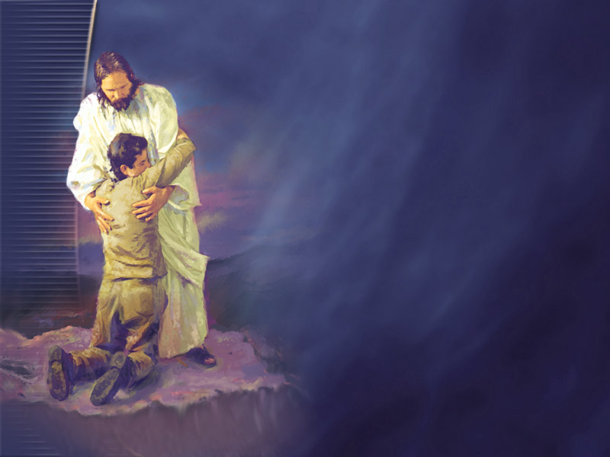
Second Chance
“When death was proclaimed as the penalty of sin, he offered to give his life for the life of the world, in order that man might have a second probation,...
“and receive power to form a character after the divine image.” (ST, Feb 13, 1896).
Notes:
TP: Was Adam put in a hospital or a boot camp after the fall? Wouldn’t Eden be a nicer place to develop character?

Slide 8

School Of Hard Knocks
“No longer were they to dwell in Eden, for in its perfection it could not teach them the lessons which it was now essential for them to learn.” (Ed 25).
Notes:
You cannot develop character in a vacuum,
Polishing takes some grit, some grinding powder.
TP: Is this character development thing a salvational issue?

Slide 9
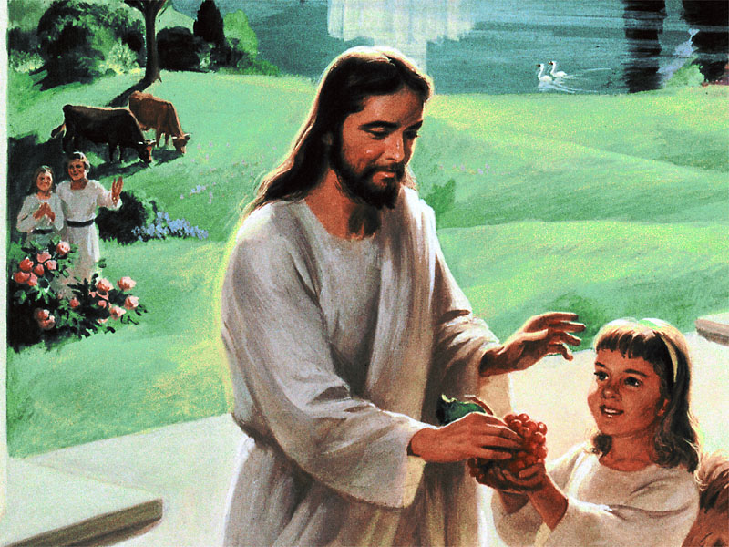
Eternal Life/Character
“You have not a sound mind; and unless there is a great change in you, you will not be able to so perfect Christian character as to obtain eternal life.” PH159 95.2
“All are lost unless they are transformed in character.” {ST, January 15, 1894 par. 4}
Notes:
“We should never forget that we are placed on trial in this world, to determine our fitness for the future life. None can enter heaven whose characters are defiled by the foul blot of selfishness. Therefore, God tests us here, by committing to us temporal possessions, that our use of these may show whether we can be entrusted with eternal riches.” {CS 22.1}
TP: But I thought that all I had to do was to just claim the blood of Jesus over my sins and I walk a way free!? Yes and No.

Slide 10
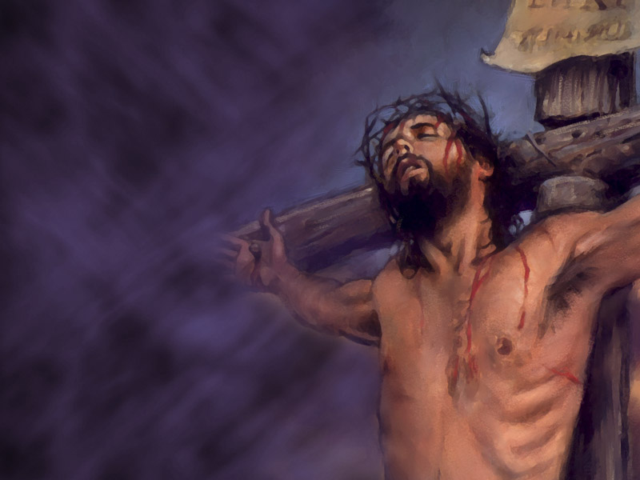
“At the very outset of the Christian life every believer should be taught its foundation principles.
“He should be taught that he is not merely to be saved by Christ's sacrifice,
“but that he is to make the life of Christ his life and the character of Christ his character.” (COL 57).
Notes:
TP: Why and How are we saved by Jesus life not just His death?

Slide 11
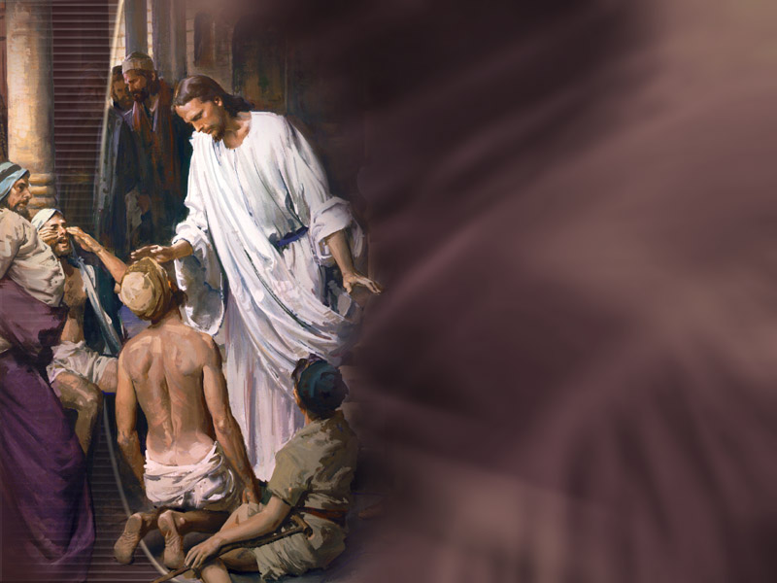
“For if, when we were enemies, we were reconciled to God by the death of his Son, much more, being reconciled, we shall be saved by his life.” Romans 5:10.
“We are reconciled to God by His death, and we shall be saved by His life, as it is wrought out in our character.” Ms158-1902.27
Notes:
TP: If you don’t aim, will you hit the target?

Slide 12

Intentional Christianity,
Intentional Character Sanctification.
“Characters formed by circumstance are changeable and discordant—a mass of contraries. Their possessors have no high aim or purpose in life. They have no ennobling influence upon the characters of others. They are purposeless and powerless.” 4T 657.2
“Those who are waiting to behold a magical change in their characters without determined effort on their part to overcome sin, will be disappointed. Mar 227.2
Notes:
TP: But Character is so hard to change, is this really necessary?
As the leaven, when mingled with the meal, works from within outward, so it is by the renewing of the heart that the grace of God works to transform the life. No mere external change is sufficient to bring us into harmony with God. There are many who try to reform by correcting this bad habit or that bad habit, and they hope in this way to become Christians, but they are beginning in the wrong place. Our first work is with the heart. RH July 7, 1904, par. 7
“Those who in their life fulfill God's purpose must put forth painstaking effort, applying themselves closely and earnestly to the accomplishment of whatever He gives them to do.”--YI, August 20, 1903.

Slide 13
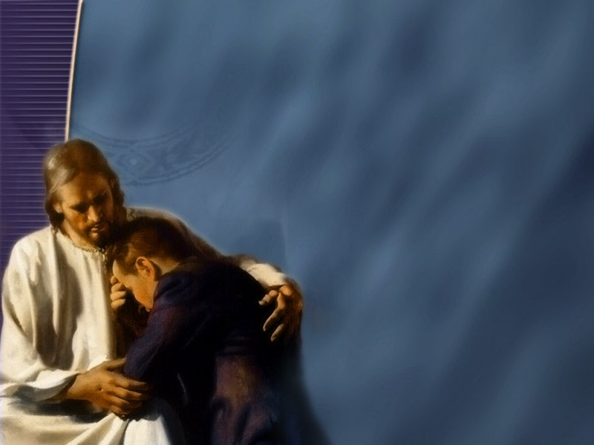
“Let no one say, ‘I cannot overcome my defects of character’; for if this is your decision, then you cannot have eternal life.
“When there is a determined purpose born in your heart to overcome, you will have a disposition to overcome, and will cultivate those traits of character that are desirable, and will engage in the conflict with steady, persevering effort.”
“You will exercise a ceaseless watchfulness over your defects of character, and will cultivate right practices in little things.” (SD 115).
Notes:
If you believe you cannot be perfect, you will not be perfect.
Sponceller
TP: Why do some people find it hard to perfect character?

Slide 14
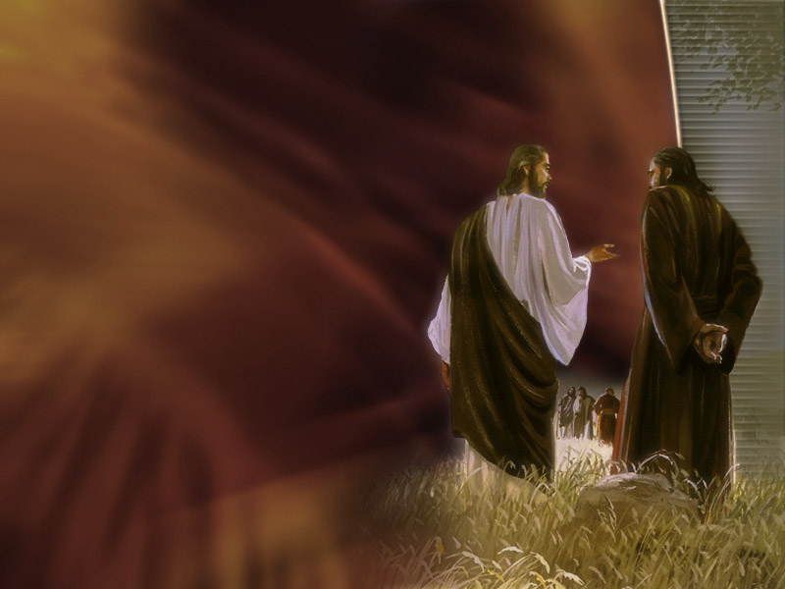
Warring Against the Flesh
“Christ has given us no assurance that to attain perfection of character is an easy matter.
“A noble, all-round character is not inherited.
“It does not come to us by accident.
“A noble character is earned by individual effort through the merits and grace of Christ.
“God gives the talents, the powers of the mind; we form the character.
“It is formed by hard, stern battles with self. Conflict after conflict must be waged against hereditary tendencies.
“We shall have to criticize ourselves closely, and allow not one unfavorable trait to remain uncorrected.” (COL 331).
Notes:
3. You don’t win it in a lottery.
4. Can you do it on your own?
Can you do it without Christ?
Will He do it without 100% of your effort?
TP: Eve blew it on appetite. Is she the only one?

Slide 15

Appetite
“The controlling power of appetite will prove the ruin of thousands, when, if they had conquered on this point, they would have had moral power to gain the victory over every other temptation of Satan.
“But those who are slaves to appetite will fail in perfecting Christian character.” (CD 59).
Notes:
TP: Need help developing a Christian Character? Looking for some serious aid?

Slide 16

“He who cherishes the light which God has given him upon health reform has an important aid in the work of becoming sanctified through the truth, and fitted for immortality.
“But if he disregards that light and lives in violation of natural law, he must pay the penalty; his spiritual powers are benumbed, and how can he perfect holiness in the fear of God?” CH 22.2
Notes:
TP: What is the sweet / dessert character interaction?

Slide 17

“Sugar is not good for the stomach. It causes fermentation, and this clouds the brain and brings peevishness into the disposition.” CD 327.1
Notes:
TP: do you or some one you know, get up in the morning like a growling bear or lion?

Slide 18
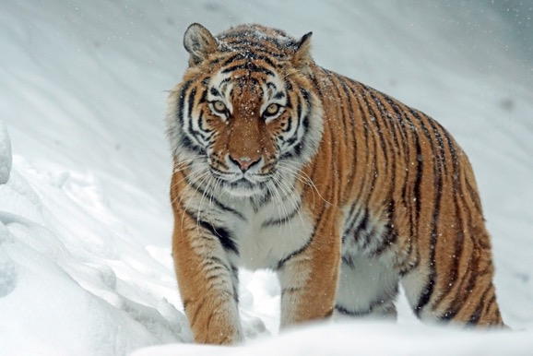
“I was instructed that the use of flesh meat has a tendency to animalize the nature, and to rob men and women of the love and sympathy which they should feel for everyone.
“We are built up from that which we eat, and those whose diet is largely composed of animal food are brought into a condition where they allow the lower passions to assume control of the higher powers of the being.
“There are many kinds of wholesome food. But we do say that flesh meat is not the right food for God's people. It animalizes human beings.
“In a country such as this, where there are fruits, grains, and nuts in abundance, how can one think that he must eat the flesh of dead animals?” {5MR 408.1}
Animalize
Notes:
TP: Do you have a hot pepper personality?

Slide 19

“Food prepared with condiments and spices inflames the stomach, corrupts the blood, and paves the way to stronger stimulants. It induces nervous debility, impatience, and lack of self-control. Tobacco and the wine cup follow.” {Te 57.3}
“The child was proverbial for her nervousness and irritability of temper, and these fiery condiments were well calculated to produce such a condition.” {CD 242.3}
Notes:
TP: Have you wondered if you would ever overcome your irritable disposition? Where could it be coming from?

Slide 20
“The abuses of the stomach by the gratification of appetite are the fruitful source of most church trials.
“An intemperate man cannot be a patient man.
“The sin of intemperate eating, eating too frequently, too much, and of rich, unwholesome food, destroys the healthy action of the digestive organs, affects the brain, and perverts the judgment, preventing rational, calm, healthy thinking and acting.
“And this is a fruitful source of church trials. {1T 618.3}
Notes:
TP: Ever feel like you are climbing a ladder?

Slide 21
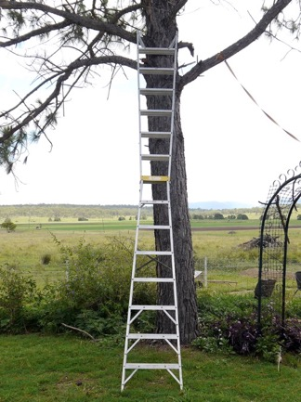
Every Round Goes Higher Higher
"And to temperance, patience." The need of becoming temperate is made manifest as we try to take this step. It is next to an impossibility for an intemperate person to be patient.
“No impatient man or woman will ever enter into the courts of heaven.
“We must not allow the natural feelings to control our judgment. Many are quickly irritated, and their words are sharp and bitter.” {RH, February 21, 1888 par. 10}
Notes:
TP: Any clues or hacks for character development?

Slide 22

Eating Between Meals
“In order to keep their restless children still, they have given them cake, or candies, almost any hour of the day, and their stomachs are crowded with hurtful things at irregular periods.
“The digestive organs are constantly taxed, and are not allowed periods of rest. The liver becomes inactive, the blood impure, and the children are sickly, and irritable, because they are real sufferers by intemperance, and it is impossible for them to exercise patience. 2SM 434.3

Slide 23
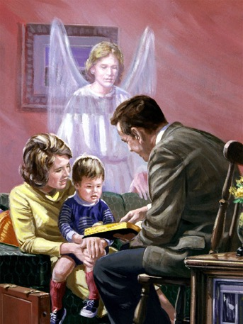
Christian homes, established and conducted in accordance with God's plan, are among His most effective agencies for the formation of Christian character and for the advancement of His work. {Mar 102.5}
Notes:
TP: when can I sit back satisfied that I have arrived in the Character building project?

Slide 24

Work Of A Lifetime
“Sanctification of character is the work of a lifetime.
“Our lives are to be hewed, and squared, and polished until they reflect the likeness of Christ.” (RH, Jul 8, 1909).
“Who will render to every man according to his deeds: To them who by patient continuance in well doing seek for glory and honour and immortality, eternal life:” Romans 2:6-7.
Notes:
What is sanctified?
TP: What if I did not get started early on the cleaning growing process?
“by the grace of God to form characters in harmony with the principles of His holy law. This is Bible sanctification.” {Mar 231.3}

Slide 25

“Brother F, you are naturally an impatient, fretful, exacting man at home; and after a short acquaintance you show this out in new places. You frequently talk in an impatient, overbearing manner.
“What time have you set to gain the victory over your perverse will and the defects in your character? With the advancement you now make, your probation may close before you have made the determined efforts essential to give you the victory over self. {4T 341.3}
“So teach us to number our days, that we may apply our hearts unto wisdom.” Psalms 90:10,12.
“Every day that passes makes one less left us to complete our work of perfecting character.” YI August 25, 1886, par. 3.
“See then that ye walk circumspectly, not as fools, but as wise, Redeeming the time, because the days are evil.” Ephesians 5:15-16.
Notes:
TP: What is character? And how do you modify it?

Slide 26

What is Character?
Thoughts, Feelings, Habits
“If the thoughts are wrong the feelings will be wrong, and the thoughts and feelings combined make up the moral character.” {5T 310.1}
“Thus actions repeated form habits, habits form character, and by the character our destiny for time and for eternity is decided.” COL 356.2
Notes:
“Strength of character consists of two things--power of will and power of self-control.” {Mar 223.4}
TP: If this is character, how do I make it grow? Like growing potatoes, what’s the process?

Slide 27

How do we sanctify the thoughts?
Study Bible Truths
“And there is nothing more calculated to energize the mind, and strengthen the intellect, than the study of the word of God.
“No other book is so potent to elevate the thoughts, to give vigor to the faculties, as the broad, ennobling truths of the Bible.
“If God's word were studied as it should be, men would have a breadth of mind, a nobility of character, and a stability of purpose, that is rarely seen in these times.” {CE 118.2}

Slide 28
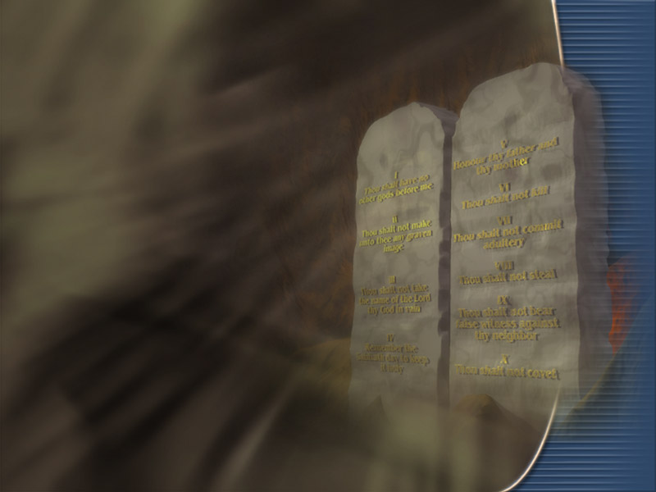
The Law
“God has given His holy law to man as His measure of character. By this law you may see and overcome every defect in your character. You may sever yourself from every idol, and link yourself to the throne of God by the golden chain of grace and truth.” {Mar 48.4}
Notes:
What will develop a the excellent character?
“The Saviour's life of obedience maintained the claims of the law, and showed the excellence of character that obedience would develop.” (ST, Mar 29, 1910).

Slide 29
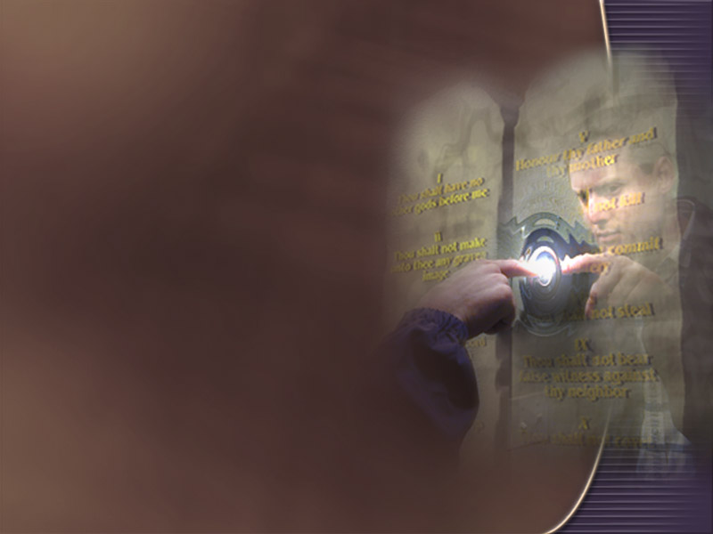
“Let us, as Christ's followers, search our hearts as with a lighted candle to see what manner of spirit we are of.
“For our present and eternal good, let us criticize our actions, to see how they stand in the light of the law of God.
“For this law is our standard. Let every soul search his own heart.” (OHC 162).
“Let us earnestly examine ourselves by the light of God's Word, seeking to discover every defect of character, that we may wash our robes and make them white in the blood of the Lamb.” (OHC 305.5).
Notes:
TP: What is my most effective part in the process?

Slide 30
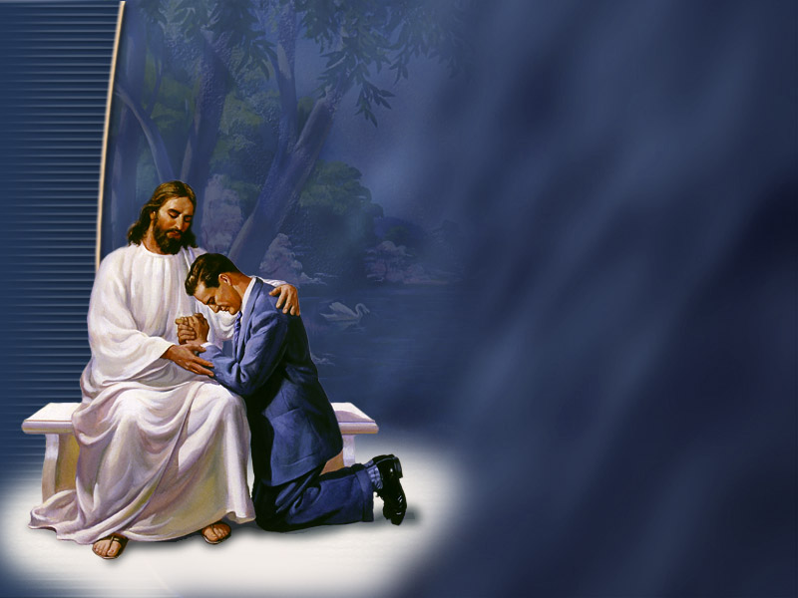
Prayer and Promises
“Prayer is heaven's ordained means of success in the conflict with sin and the development of Christian character." (AA 564).
Notes:
TP: Feeling! They get me every time! How do I manage feelings?

Slide 31

How do we sanctify the feelings?
Behold the Man of Calvary
“By beholding we become changed into the same image. Carnal thoughts, carnal feelings, will be no longer entertained. You will no longer be frivolous, cheap in talk, and unholy in life. Then you will reach, through the grace of Christ, the highest standard of purity and elevation of character.” {TSB 67.1}
Notes:
TP: is there a short cut, or a simplified concept that develops character?

Slide 32
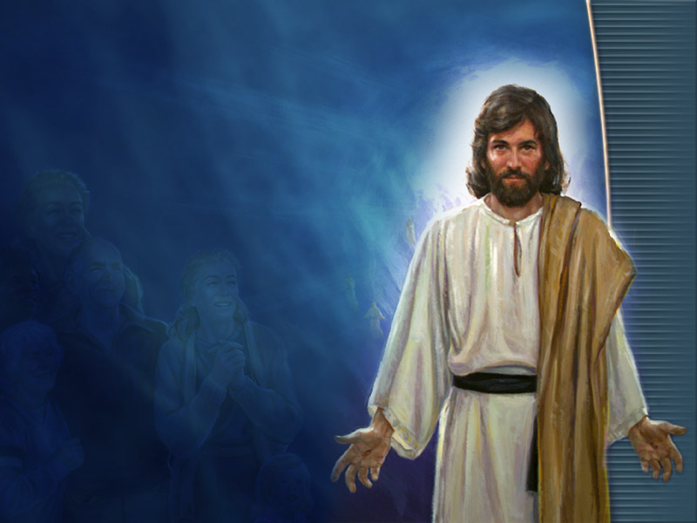
Behold Christ
“In knowing Christ through the grace that he has shed forth abundantly, we become changed, and the character is sanctified through belief of the truth. (AG 240).
“When this is accomplished, we reflect, as in a mirror, the glory of the Lord.
“That is, the character of the one who thus beholds Christ is so like his, that one looking at his sees Christ's own character shining out as from a mirror.” (RH, Apr 28, 1891).
Notes:
TP: So I grow the good, how do I get rid of the bad?

Slide 33

How do we sanctify the habits?
Make it a Habit to Imitate Jesus Christ the Perfect Pattern
“It is not by looking away from Him that we imitate the life of Jesus, but by talking of Him, by dwelling upon His perfections, by seeking to refine the taste and elevate the character, by trying—through faith and love, and by earnest, persevering effort—to approach the perfect Pattern. By having a knowledge of Christ—His words, His habits, and His lessons of instruction—we borrow the virtues of the character we have so closely studied, and become imbued with the spirit we have so much admired. Jesus becomes to us ‘the chiefest among ten thousand,’ the One ‘altogether lovely’” 6BC 1098.7
Notes:
TP: Is there a school where they teach this?

Slide 34

True Education
“True education does not ignore the value of scientific knowledge or literary acquirements; but above information it values power; above power, goodness; above intellectual acquirements, character.” (Ed 225).
Notes:
TP: Is there any way to know if your character is making progress? What is the ultimate goal?

Slide 35
Character Complete
“The completeness of Christian character is attained when the impulse to help and bless others springs constantly from within--when the sunshine of heaven fills the heart and is revealed in the countenance.” (COL 384).
Notes:
TP: How can I devote time to personal character development is I am so busy helping others with there problems?

Slide 36
Character Complete
“He permits us to come in contact with suffering and calamity in order to call us out of our selfishness; He seeks to develop in us the attributes of His character—compassion, tenderness, and love.
“By accepting this work of ministry we place ourselves in His school, to be fitted for the courts of God. By rejecting it, we reject His instruction, and choose eternal separation from His presence.” COL 388.3
Notes:
TP: What was the 5 foolish virgins problem?

Slide 37
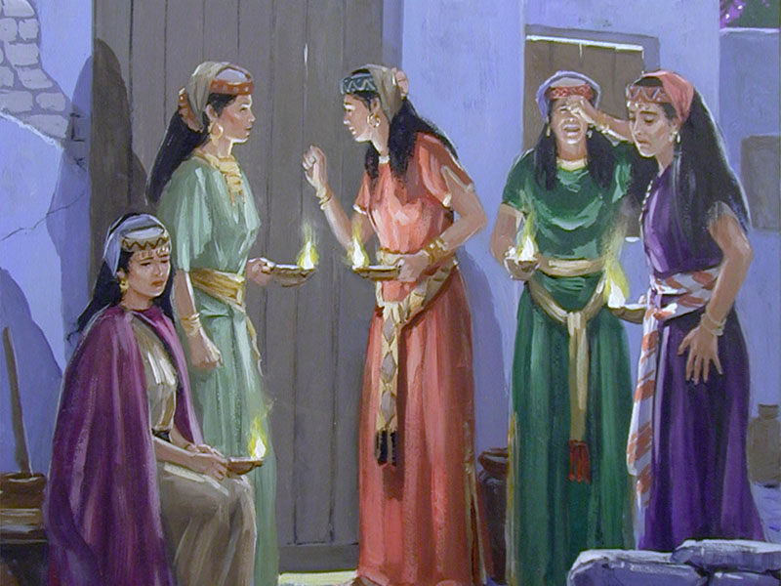
Oil Crisis
“In the parable, the foolish virgins are represented as begging for oil, and failing to receive it at their request. This is symbolic of those who have not prepared themselves by developing a character to stand in a time of crisis.
“It is as if they should go to their neighbors and say, Give me your character, or I shall be lost. Those that were wise could not impart their oil to the flickering lamps of the foolish virgins. Character is not transferable. It is not to be bought or sold; it is to be acquired." {YI, January 16, 1896 par. 2}
Notes:
TP: Why all the emphasis on character? Isn’t heaven cheap enough?

Slide 38
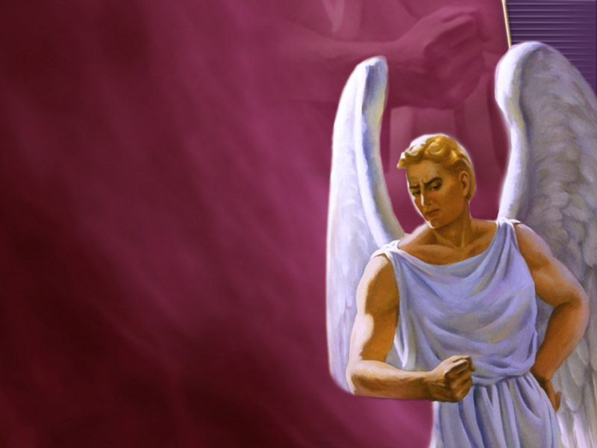
Pulling Another Lucifer
“We are all to be tested here in this life to prove whether, if admitted to heaven, we shall repeat the same course that Satan pursued there.”
“But if the character which we develop during our probation is according to the divine Pattern, it qualifies us to receive the welcome, ‘Well done, thou good and faithful servant:’” (Matt 25:21) (1MR 201).
Notes:
TP: What role does character development play in the final sealing?

Slide 39

“…sealed in their foreheads--it is not any seal or mark that can be seen, but a settling into the truth, both intellectually and spiritually, so they cannot be moved…”(MAR 200).
“The seal of the living God will be placed upon those only who bear a likeness to Christ in character.” (CG 182).
Notes:
TP: Give me a discount card, I want to reach heaven with out all this character stuff. I think I can make it is heaven all right.

Slide 40
Pulling Another Lucifer
“Were justice extinct, and were it possible for divine mercy to open the gates to the whole race, irrespective of character, there would be a worse condition of disaffection and rebellion in heaven than before Satan was expelled. The peace, happiness, and harmony of heaven would be broken.” {RH December 13, 1892.}
Notes:
TP: Why Can’t I just be “Twinkled” into heaven?

Slide 41
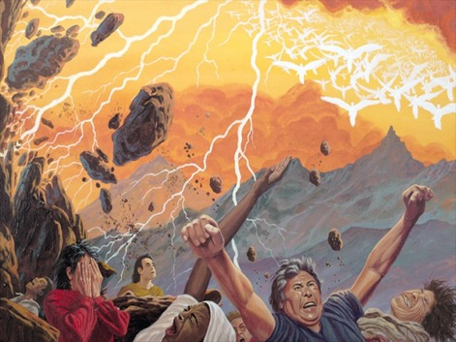
“Could those whose lives have been spent in rebellion against God be suddenly transported to heaven,… Could they endure the glory of God and the Lamb?
“No, no; years of probation were granted them, that they might form characters for heaven; but they have never trained the mind to love purity; they have never learned the language of heaven, and now it is too late.
“The destiny of the wicked is fixed by their own choice. Their exclusion from heaven is voluntary with themselves, and just and merciful on the part of God." {GC 542.2}
Notes:
TP: As we near the second coming we are to give the Elijah message. What’s the Elijah message all about?

Slide 42
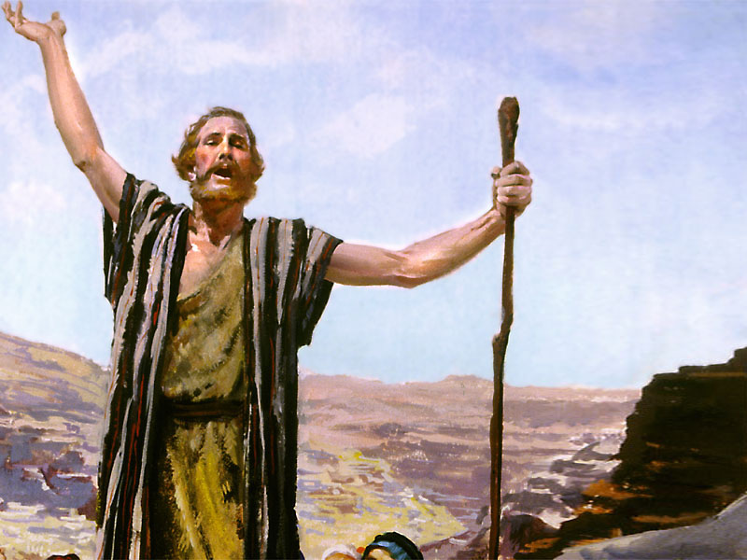
The Elijah Message
“John declared to the Jews that their standing before God was to be decided by their character and life. Profession was worthless.
“If their life and character were not in harmony with God's law, they were not His people.” {DA 107.1}
Notes:
Someone is going to chop this guys head off.
TP: What is the most important thing I can do to be prepared to be delivered during the time of trouble?

Slide 43

“The time of trouble is the crucible that is to bring out Christ-like characters. It is designed to lead the people of God to renounce Satan and his temptations.
“Let none be discouraged in view of the severe trials to be met in the time of Jacob's trouble, which is yet before them. They are to work earnestly, anxiously, not for that time, but for today.
“In these precious closing hours of probation, we have a deep and living experience to gain. We shall thus form characters that will insure our deliverance in the time of trouble. “ {RH, August 12, 1884}
Notes:
TP: I’m going to heaven, what can I take with me?

Slide 44
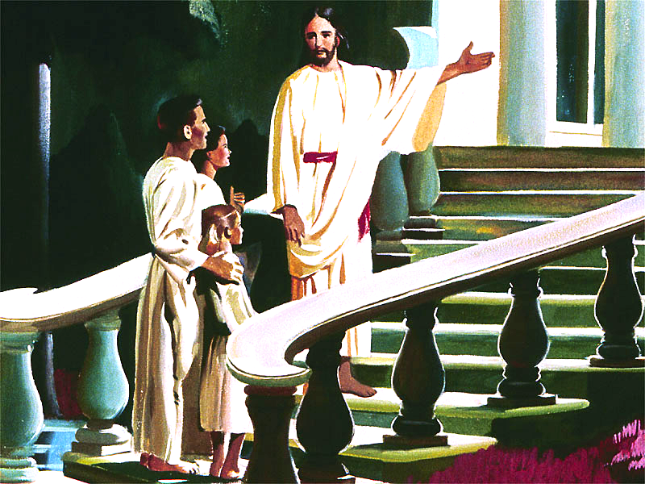
Character is the only thing you can take to heaven!
“A character formed according to the divine likeness is the only treasure that we can take from this world to the next. …How important, then, is the development of character in this life.” {COL 332.3}
Notes:
TP: What vested interest does God have in my character personally?

Slide 45
To Honor God or Not
“The honor of God, the honor of Jesus Christ, is involved in the perfection of your character… Your character is His glory revealed in you.” {SW, October 25, 1898 par. 2}
Notes:
Revelation 18
TP: When will Jesus return to take us all home?
If He just magically changed something about your character and took you to heaven, wouldn’t that be like Him taking someone else to heaven in your body? That is like a brain transplant, which is real a donor body, or body transplant.

Slide 46
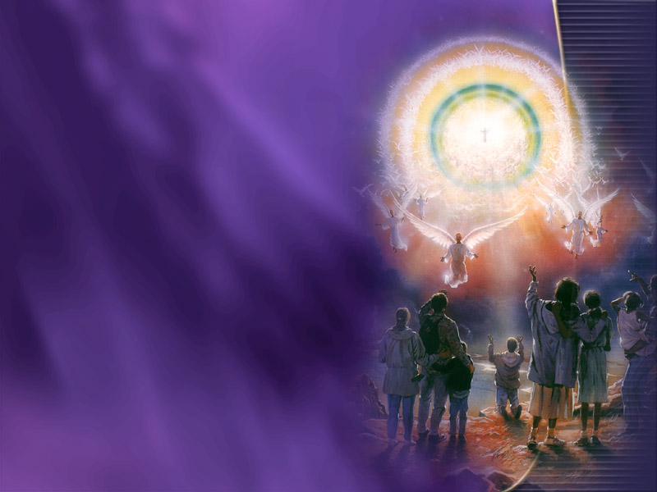
True Ticket To Heaven
“Christ is waiting with longing desire for the manifestation of Himself in His church.
“When the character of Christ shall be perfectly reproduced in His people, then He will come to claim them as His own.” (COL 69).
Notes:
Then and only then will you be admitted to heaven.
It is not 6 Hail Marys or a quick confession of the mouth that will get you to heaven, but a character that will not reintroduce sin into the universe.
Roma 10:9 (KJS) That if thou shalt confess with thy mouth the Lord Jesus, and shalt believe in thine heart that God hath raised him from the dead, thou shalt be saved.
TP: Why didn’t Jesus just return in 1844?

Slide 47
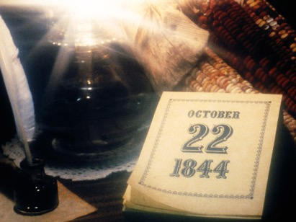
1844 and Beyond
“If the message had been of as short duration as many of us supposed (great disappointment of 1844), there would have been no time for them to develop character. Many moved from feeling, not from principle and faith, and this solemn, fearful message stirred them. It wrought upon their feelings, and excited their fears, but did not accomplish the work which God designed that it should.” 1T 186.2
Notes:
TP: the disciples were always worried about which one of them would be the greatest in the kingdom of heaven. How is greatness in the kingdom of heaven determined?

Slide 48
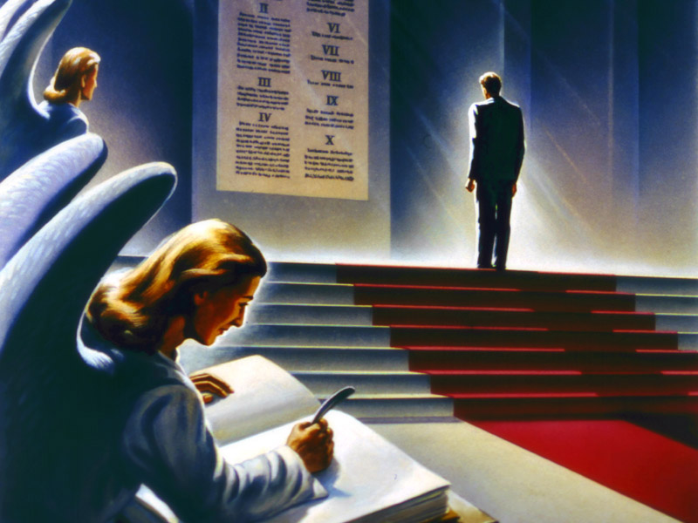
Who is the Greatest?
“In the kingdom of God, position is not gained through favoritism.
“It is not earned, nor is it received through an arbitrary bestowal.
“It is the result of character.
“The crown and the throne are the tokens of a condition attained--tokens of self-conquest through the grace of our Lord Jesus Christ.” (AA 543).
Notes:
That’s why Jesus takes first place, he has the best character!
TP: What position in heaven will your character earn you if you get there?

Slide 49
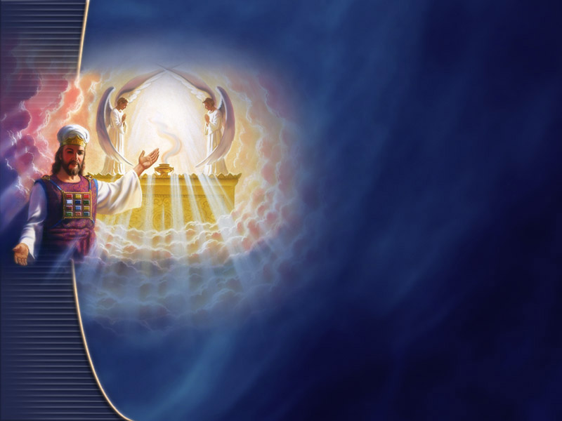
Kings And Priests
“To him that overcometh will I grant to sit with me in my throne, even as I also overcame, and am set down with my Father in his throne.” Revelation 3:21.
“The overcomers, who upon the earth were partakers of the divine nature, He makes kings and priests unto God.” (UL 313).
Notes:
TP: How does God know sin will not enter the universe again? What is His assurance?

Slide 50
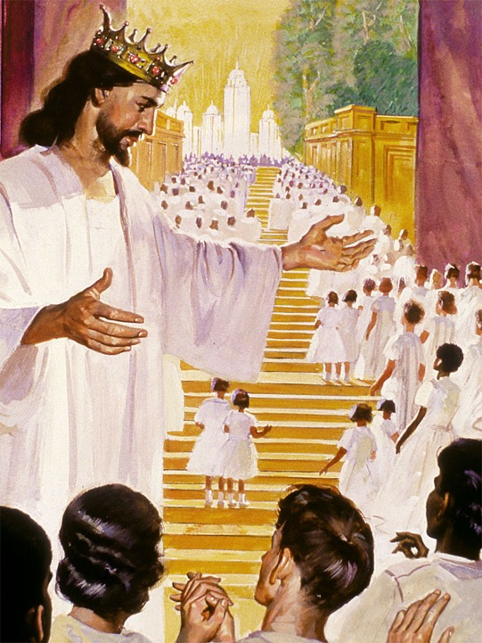
He Has To Have Faith In You!
“And, behold, I come quickly; and my reward is with me, to give every man according as his work shall be.”
Revelation 22:12.

Slide 51

Summary
Adam failed to develop a sinless character in Eden.
Jesus secured us a second probation so we can develop a sinless character like His, sealed for heaven.
Character is developed in a world of hard knocks by beholding Christ in His word and especially in His law and conforming our life to His.
True education and sanctification is developing a character for eternity where we will be priests and kings.
God is interested in your character development and is underwriting the whole process.
Your Eternal Life And The Security Of The Universe Depend On It!

Slide 52
The apostles and prophets and holy men of old did not perfect their characters by miracles, by some wonderful and unusual demonstration; but they used the ability given them by God, trusting alone in the righteousness of Christ. And all who will use the same means may secure the same result.—The General Conference Bulletin, July 1, 1900. YRP 327.4

Slide 53
Ten Virgins Lamp
"Thy word is a lamp unto my feet, and a light unto my path." - Psalm 119:105.
"For the commandment is a lamp; and the law is light; and reproofs of instruction are the way of life:" - Proverbs 6:23.
"We have also a more sure word of prophecy; whereunto ye do well that ye take heed, as unto a light that shineth in a dark place, until the day dawn, and the day star arise in your hearts:" - 2 Peter 1:19.

Slide 54
Oil of Spirit
"They that were foolish took their lamps, and took no oil with them: But the wise took oil in their vessels with their lamps." - Matthew 25:3-4 KJV
"And the angel that talked with me came again, and waked me, as a man that is wakened out of his sleep, And said unto me, What seest thou? And I said, I have looked, and behold a candlestick all of gold, with a bowl upon the top of it, and his seven lamps thereon, and seven pipes to the seven lamps, which are upon the top thereof: And two olive trees by it, one upon the right side of the bowl, and the other upon the left side thereof. So I answered and spake to the angel that talked with me, saying, What are these, my lord? Then the angel that talked with me answered and said unto me, Knowest thou not what these be? And I said, No, my lord. Then he answered and spake unto me, saying, This is the word of the LORD unto Zerubbabel, saying, Not by might, nor by power, but by my spirit, saith the LORD of hosts." - Zechariah 4:1-6 KJV

Slide 55
Fire and Spirit
"John answered, saying unto them all, I indeed baptize you with water; but one mightier than I cometh, the latchet of whose shoes I am not worthy to unloose: he shall baptize you with the Holy Ghost and with fire:" - Luke 3:16 KJV

Slide 56
"Of how much sorer punishment, suppose ye, shall he be thought worthy, who hath trodden under foot the Son of God, and hath counted the blood of the covenant, wherewith he was sanctified, an unholy thing, and hath done despite unto the Spirit of grace?" - Hebrews 10:29 KJV
"And when they had prayed, the place was shaken where they were assembled together; and they were all filled with the Holy Ghost, and they spake the word of God with boldness. ... And with great power gave the apostles witness of the resurrection of the Lord Jesus: and great grace was upon them all." - Acts 4:31, 33 KJV

Slide 57
"That as sin hath reigned unto death, even so might grace reign through righteousness unto eternal life by Jesus Christ our Lord." - Romans 5:21 KJV
"And now, brethren, I commend you to God, and to the word of his grace, which is able to build you up, and to give you an inheritance among all them which are sanctified." - Acts 20:32 KJV

