Slide 1

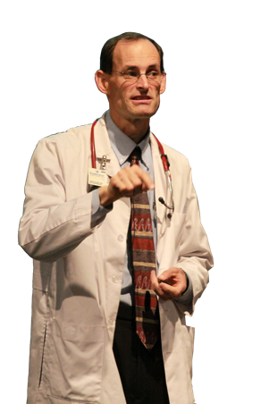
Blueprint For Health And Healing
Reversing Disease From Its Foundation
Vigorous Healthy Natural Blood Pressure
John Clark, M.D.
Notes:
Welcome to Blueprint for Health and Healing,
Reversing Disease From Its Foundation
Hi, I’m Dr. John Clark
Today's topic is Vigorous Healthy Natural Blood Pressure

Slide 2
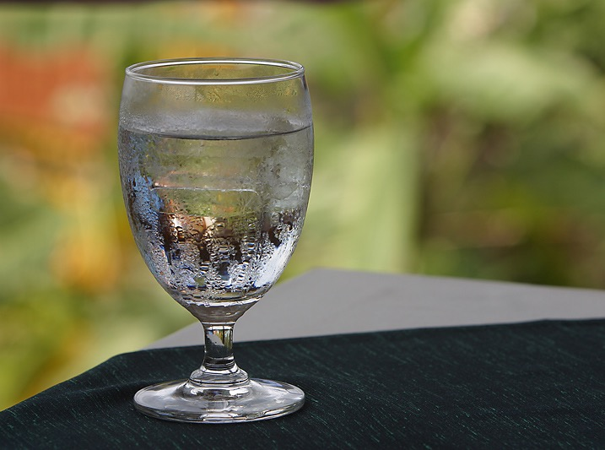

Notes:
Hook Nancy! My Blood Pressure is180/140, what shall I do, should I call an ambulance, should I go the the emergency room?
Transition: High blood pressure can be treated with simple Natural remedies.

Slide 3
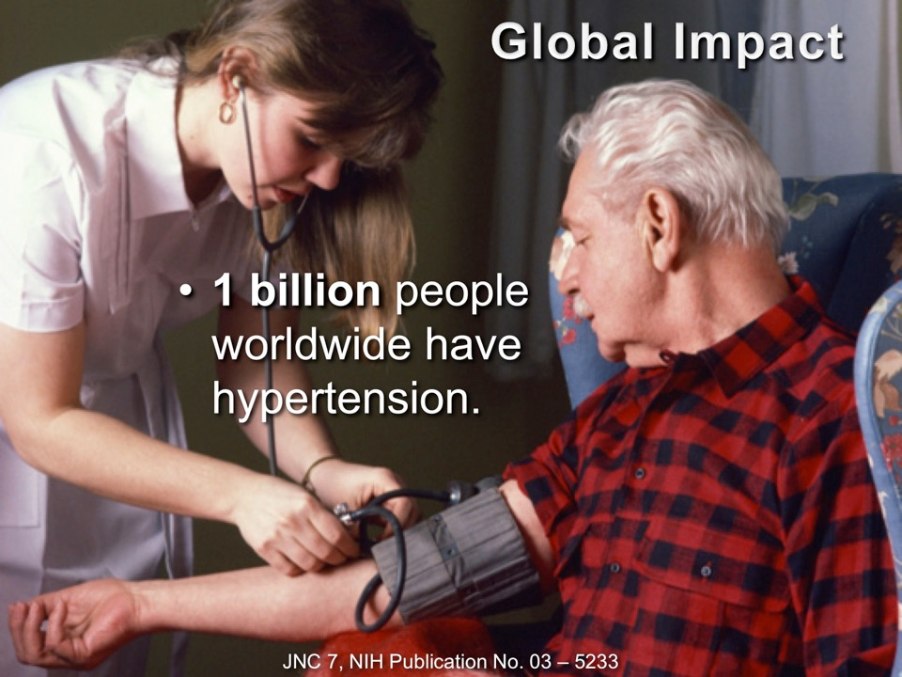
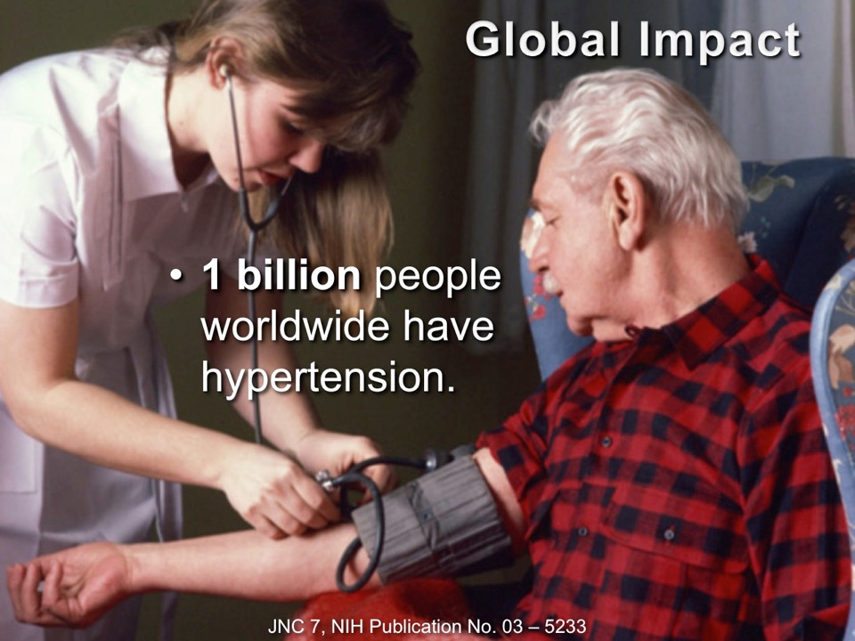
Notes:
Why do you need to know about high blood pressure?

Slide 4

Natural Blood Pressure Control
Notes:
with natural blood pressure control,
Good food, pure water, vigorous exercise
you will feel good and have
real joy, energy and self-esteem

Slide 5

Notes:
INTRO: Hi, I’m Dr. John Clark, I specialize in Lifestyle medicine. Lifestyle medicine maximizes your health above the probability of disease.
I have now spent over 14 years now researching and teaching people how to overcome high blood pressure and other lifestyle diseases.

Slide 6
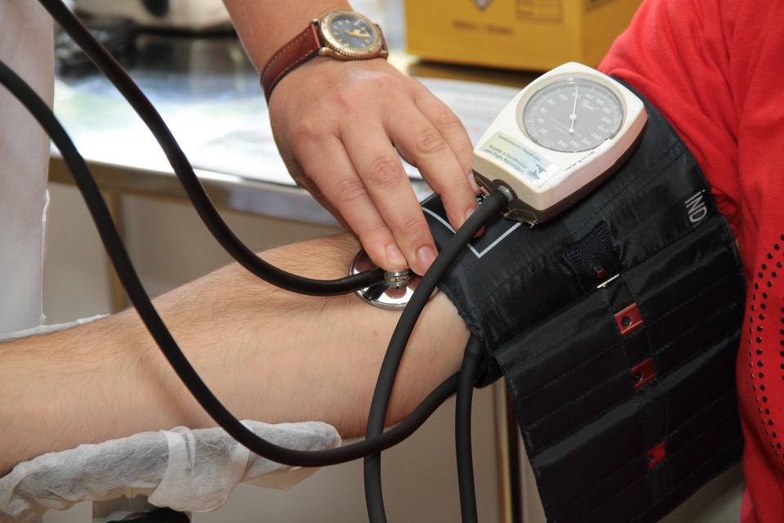
Notes:
PREVIEW: Today we are going to talk about optimal lifestyle practices that produce a healthy blood pressure.
High blood pressure normally results from uninformed choices.
Positive choices can bring you normal healthy blood pressure.
BENEFIT: By the end of this talk you will know why people have high blood pressure, and a list of natural remedies that can bring blood pressure to a healthy normal.

Slide 7
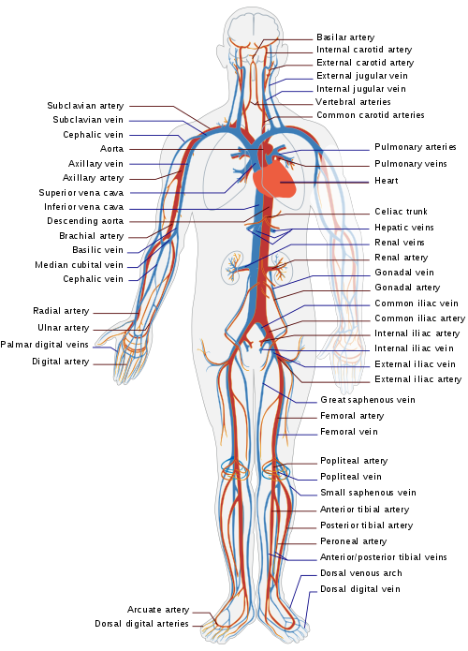
The life of the flesh is in the blood: Leviticus 17:11
Tissue Oxygenation.
Freedom of Blood Flow.
Psychological state.
LadyofHats, Mariana Ruiz Villarreal [Public domain], via Wikimedia Commons
Notes:
Oxygen energized the tissues.
Pulse—relax—pulse
Peace and Happiness relax blood vessels, calms the heart, and improves tissue oxygenation.

Slide 8

Overview
Lifestyle habits.
Dietary choices.
Psychological well being.

Slide 9
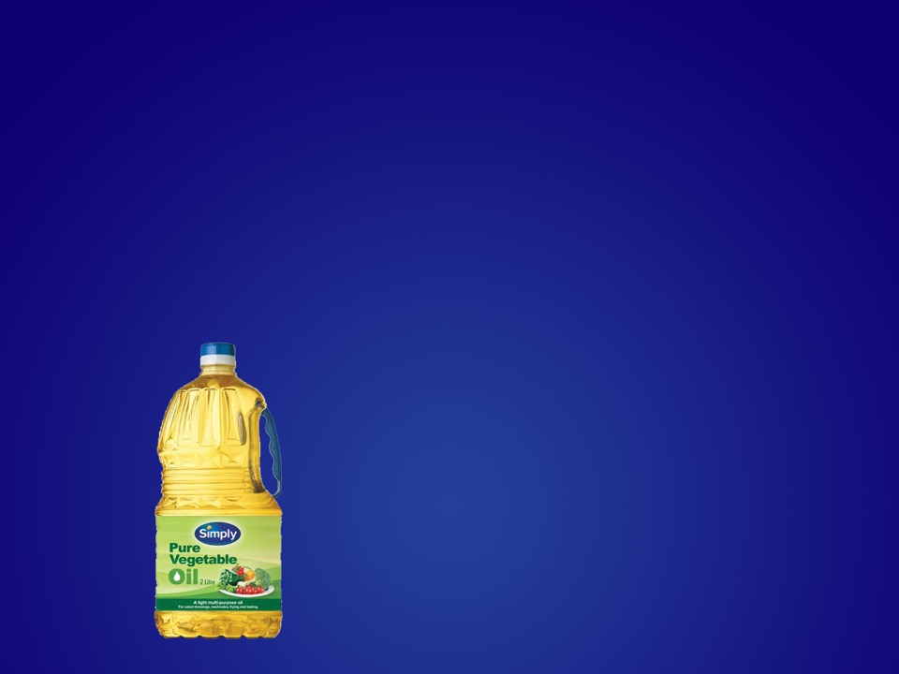
Unfavorable Diet
Fats
Notes:
Reduce oxygen carrying capacity
Thickened blood slows circulation, over works the heart, raises the blood pressure
Raise inflammation in the body and cause high blood pressure
Refined oils increase the risk of stroke at an earlier age.

Slide 10
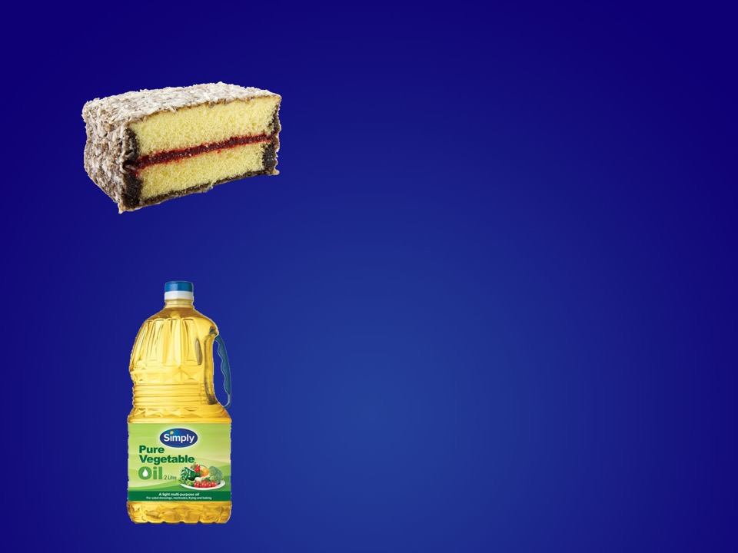
Unfavorable Diet
Sugars
Notes:
Compromise kidney function, cause sodium retention, increase salt sensitivity,
Increase inflammation, insulin resistance, and obesity
increase heart rate and myocardial oxygen demand

Slide 11
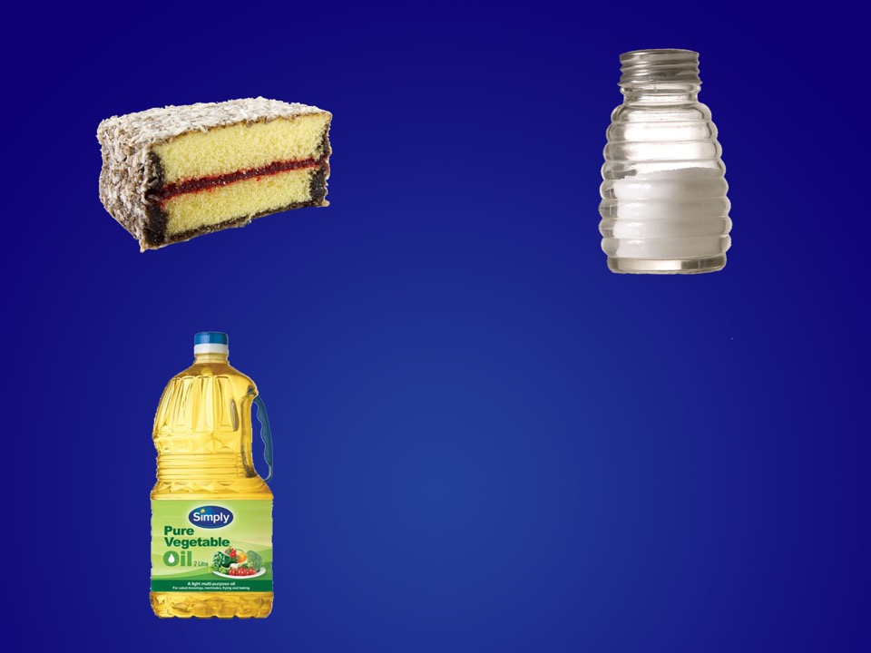
Unfavorable Diet
Salt
Notes:
Hardens arteries,
Increases vascular inflammation
Causes fluid retention

Slide 12
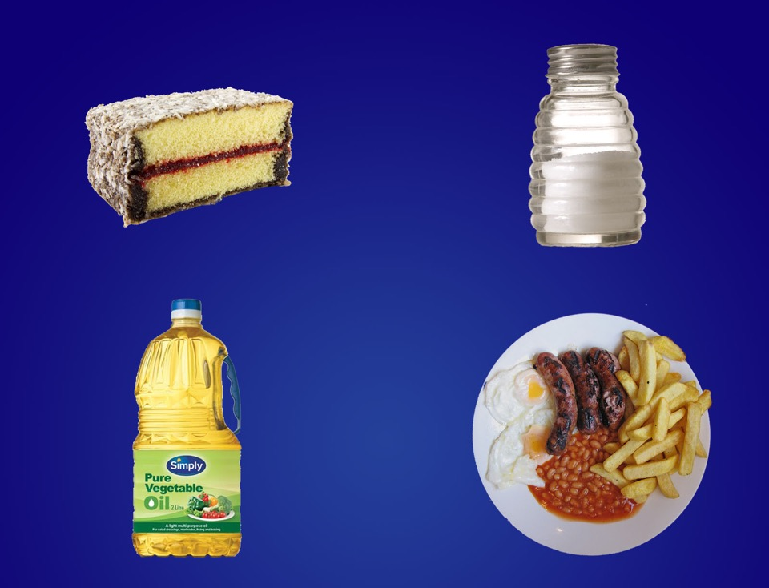
Unfavorable Diet
Meats
Notes:
If you eat animal products (meat, eggs and dairy) you are 6 times more likely to get high blood pressure.

Slide 13

Fruits And Vegetables Relax Blood Vessels
Atherosclerosis. 158(1):247-51.
Notes:
Those who eat largely of fruits and vegetables have a 77% lower risk of hypertension.
Make Blood vessels more responsive to NO relaxation signals.

Slide 14

Choosing A Dietary Lifestyle
AHS-2 Results
Relative Risk
Diet
Am J Clin Nutr. 89(5):1607S-1612S.

Slide 15
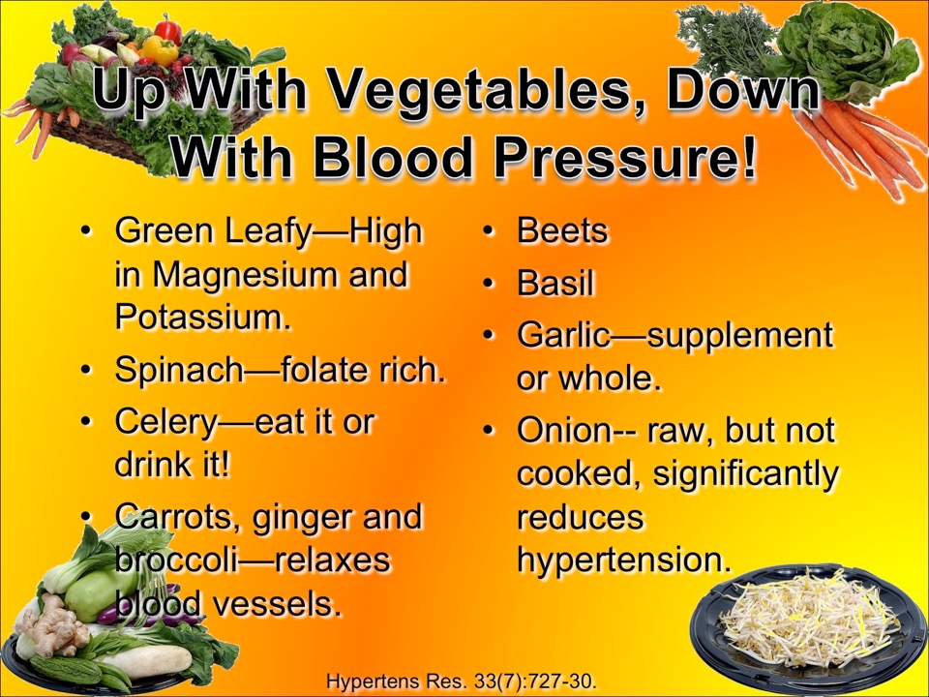

Slide 16
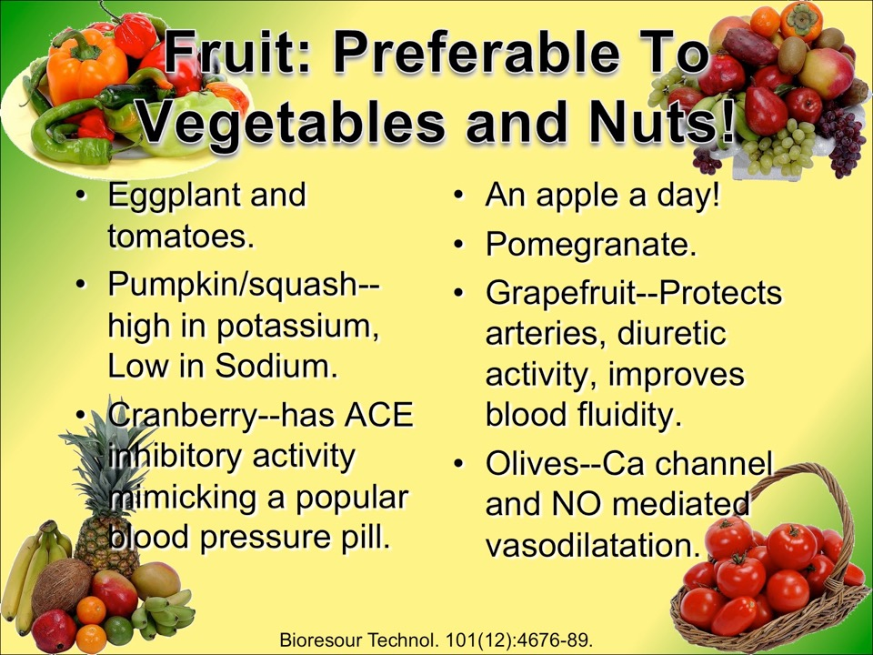

Slide 17

Grains
Refined 69%
92% Total
Risk
Whole 23%
Am J Clin Nutr. 86(2):472-9.

Slide 18
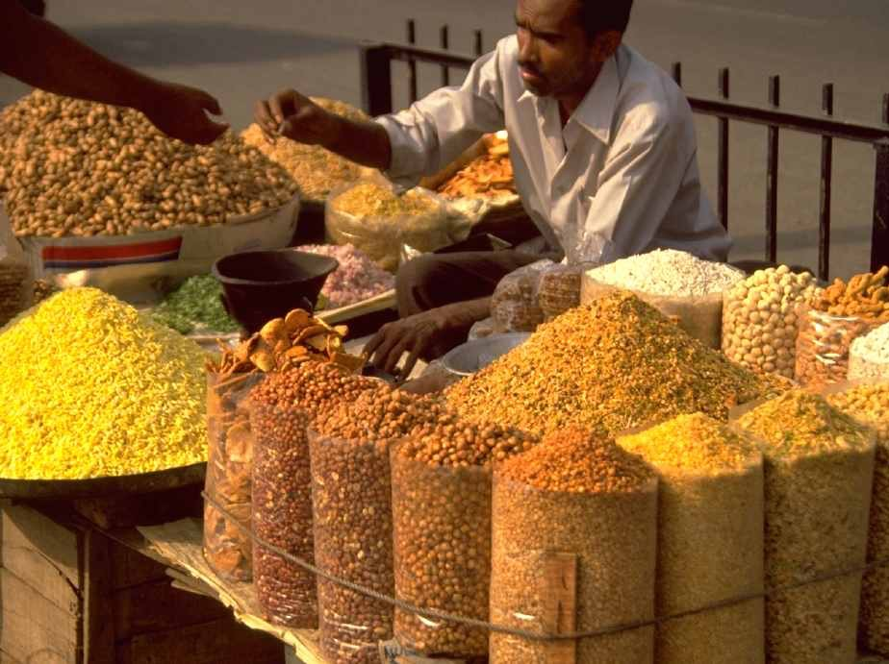
J Hypertens. 17(6):749-56.
Notes:
In rural populations still practicing their traditional lifestyle hypertension is unheard of and there is no age related rise in blood pressure.

Slide 19
Increased weight means increased blood pressure.
Risk Of High Blood Pressure
Weight Gain
Int J Obes. 31(12):1818-25.
Notes:
19

Slide 20
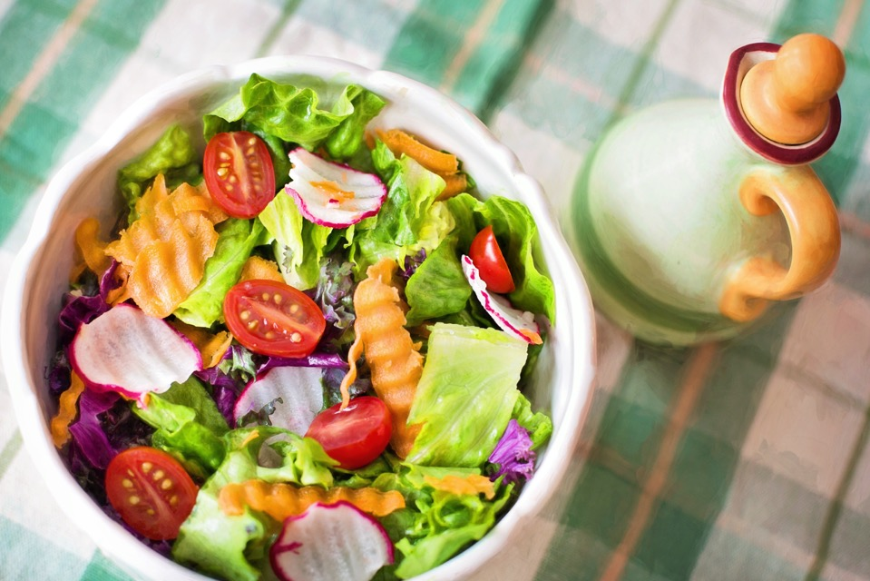
Notes:
Eat For Strength
No Fear of starvation
Atonement sufficient

Slide 21

Fasting one day a week may be more effective than pills.
J Altern Complement Med. 8(5):643-50.

Slide 22
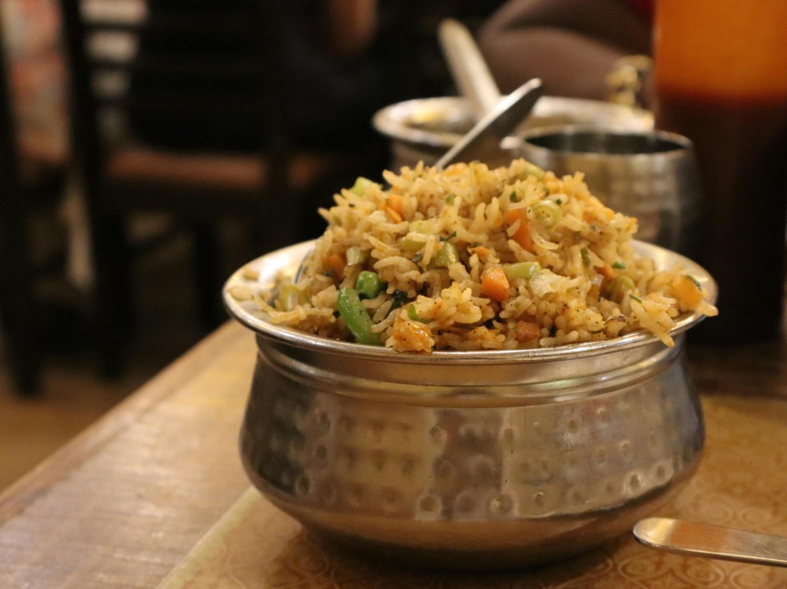
Suffering for Supper
Skipping supper improves blood pressure and other cardiac risk factors.
Cell Metab. 27(6):1212-1221.e3.
Notes:
Sutton EF, Beyl R, Early KS, Cefalu WT, Ravussin E, Peterson CM. Early Time-Restricted Feeding Improves Insulin Sensitivity, Blood Pressure, and Oxidative Stress Even without Weight Loss in Men with Prediabetes. Cell Metab. 2018 Jun 5;27(6):1212-1221.e3.
Intermittent fasting (IF) improves cardiometabolic health; however, it is unknown whether these effects are due solely to weight loss. We conducted the first supervised controlled feeding trial to test whether IF has benefits independent of weight loss by feeding participants enough food to maintain their weight. Our proof-of-concept study also constitutes the first trial of early time-restricted feeding (eTRF), a form of IF that involves eating early in the day to be in alignment with circadian rhythms in metabolism. Men with prediabetes were randomized to eTRF (6-hr feeding period, with dinner before 3 p.m.) or a control schedule (12-hr feeding period) for 5 weeks and later crossed over to the other schedule. eTRF improved insulin sensitivity, β cell responsiveness, blood pressure, oxidative stress, and appetite. We demonstrate for the first time in humans that eTRF improves some aspects of cardiometabolic health and that IF's effects are not solely due to weight loss.

Slide 23

A 6 month fresh fruit and vegetable diet produced an 8 pound weight loss and a 18mm Hg blood pressure decrease.
Serendipitously, 80% of those in this study who smoked or drank alcohol abstained spontaneously.
South Med J. 78(7):841-4.

Slide 24

“Thou openest thine hand, and satisfiest the desire of every living thing.” Psalms 145:16.
Notes:
https://www.redwallpapers.com/wallpaper/selective-focus-photography-orange-tabby-cat-looking-up-free-stock-photo-image-wallpaper

Slide 25

The Bible Diet
“Then God said, "I give you every seed-bearing plant on the face of the whole earth and every tree that has fruit with seed in it. They will be yours for food.” “and you will eat the plants of the field.” Genesis 1:29; 3:18 (NIV).

Slide 26

Notes:
Diet of heaven
Not hurt nor destroy
Wipe a way all tears
Tree of life: fruit
Lion lay down with the lamb

Slide 27

Your lifestyle habits also Impact your blood pressure.

Slide 28



High blood pressure effects your whole body.
Macular
Degeneration
Stroke and
Alzheimer’s
Heart disease
Kidney Disease
Lancet. (9349):1903-13.

Slide 29

Caffeine raises blood pressure with stress hormones and by stiffening the arteries.
Pharmacol Ther. 121(2):185-91.

Slide 30
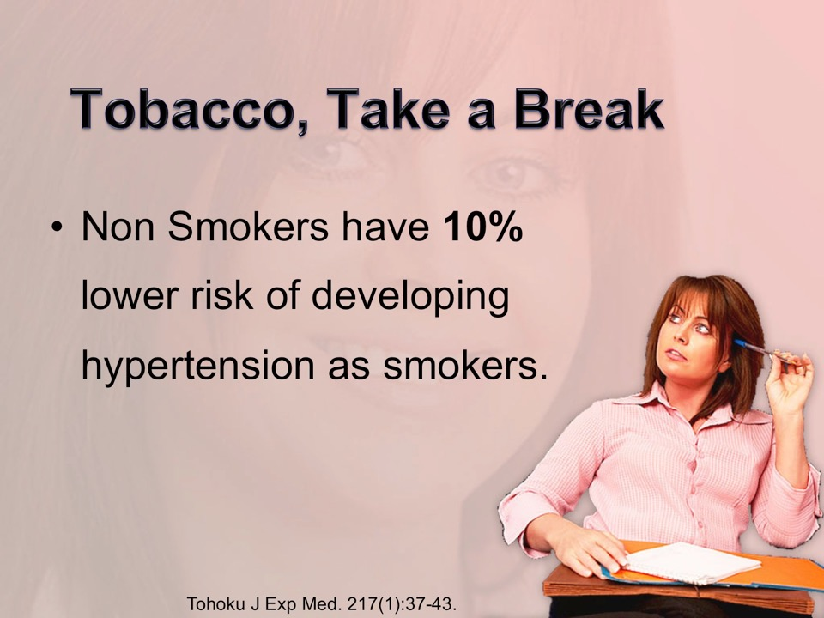

Slide 31

Blood Pressure increases linearly with alcohol consumption.
Blood Pressure
Alcohol
Addiction. 104(12):1981-90.

Slide 32

People who drink plenty of water have lower blood pressures.
Physiol Behav. 100(1):15-21.

Slide 33
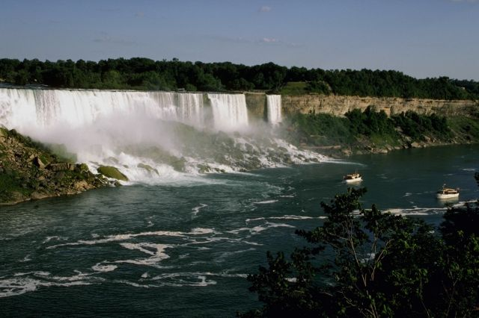


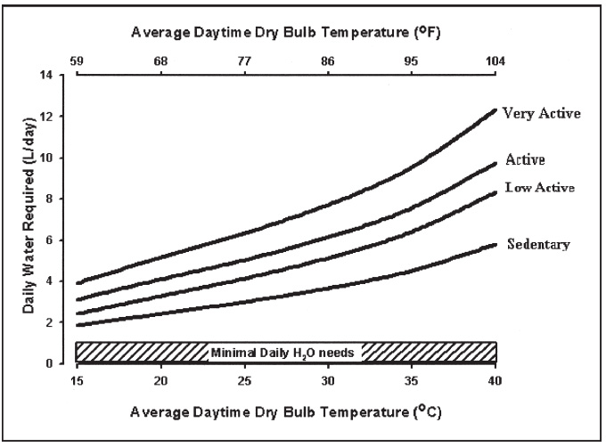
How Much Water?
3.7 L
2.7 L
Nutr Rev. 2005 Jun;63(6 Pt 2):S30-9.

Slide 34
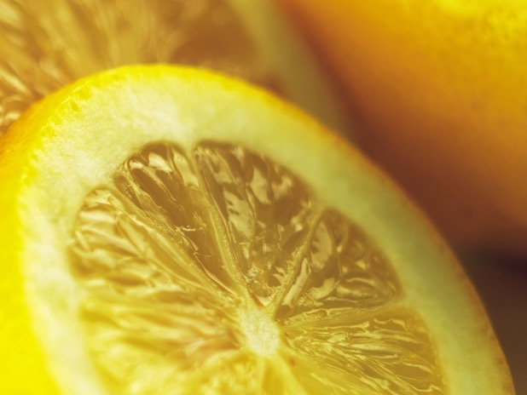
Lemon water lowers blood pressure; start each day with one quart/litre.
Food Sci. Technol. Int. Tokyo, 4 (1), 29-32

Slide 35
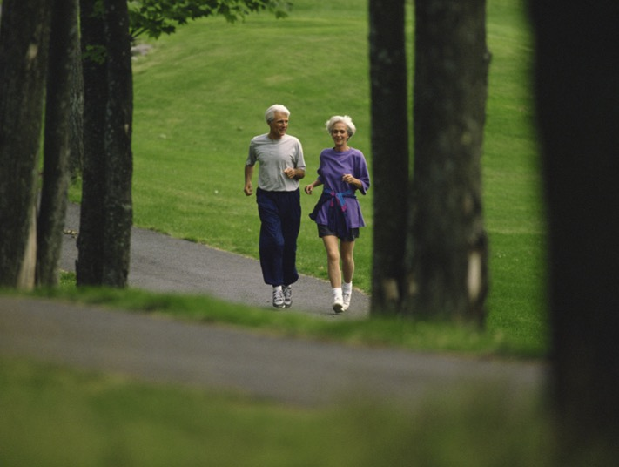
Wakeup with a cool sponge bath and a outdoor walk.

Slide 36

Cold Extremities
J Auton Nerv Syst. 61(2):109-15.

Slide 37
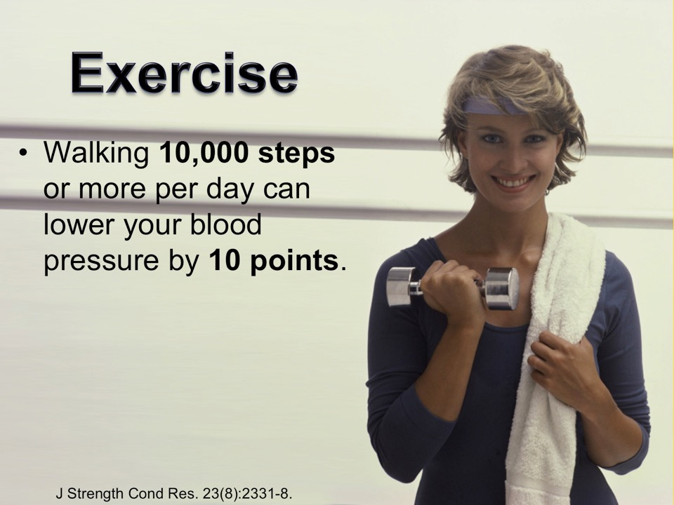

Slide 38
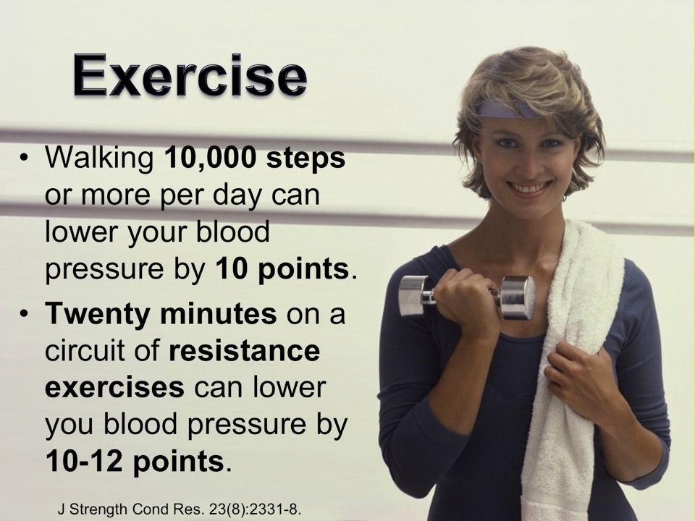

Slide 39
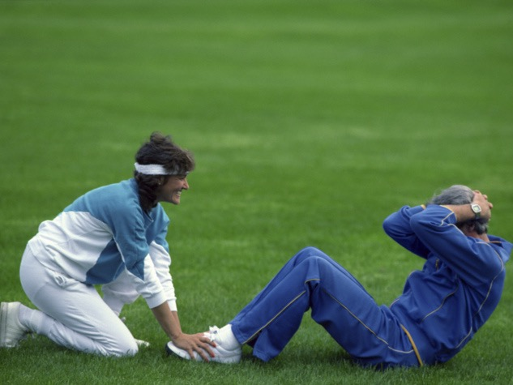

Am J Physiol Heart Circ Physiol. 293(5):H3159-64.
Notes:
Inactivity stiffens blood vessels and inhibits blood flow to muscles.
Regular use of your muscles keeps them supple, improves their blood supply and lowers your blood pressure.

Slide 40

Circ Res. 105(10):1031-40.
Notes:
Sunshine lowers blood pressure by relaxing blood vessels and raising vitamin D levels.
Johnson RS, Titze J, Weller R. Cutaneous control of blood pressure. Curr Opin Nephrol Hypertens. 2016;25(1):11-15.
Abstract
Purpose of review: Textbook theory holds that blood pressure (BP) is regulated by the brain, by blood vessels, or by the kidney. Recent evidence suggests that BP could be regulated in the skin.
Recent findings: The skin holds a complex capillary counter current system, which controls body temperature, skin perfusion, and apparently systemic BP. Epidemiological data suggest that sunlight exposure plays a role in controlling BP. Ultraviolet A radiation produces vasodilation and a fall in BP. Keratinocytes and immune cells control blood flow in the extensive countercurrent loop system of the skin by producing nitric oxide, a key regulator of vascular tone. The balance between hypoxia-inducible factor-1α and hypoxia-inducible factor-2α activity in keratinocytes controls skin perfusion, systemic thermoregulation, and systemic BP by nitric oxide-dependent mechanisms. Furthermore, the skin accumulates Na which generates a barrier to promote immunological host defense. Immune cells control skin Na metabolism and the clearance of Na via the lymphatic system. Reduced lymphatic clearance increases BP.
Summary: Apart from the well-known role of the brain, blood vessels, and the kidney, the skin is important for systemic BP control in humans and in experimental animals.
Opländer C, Volkmar CM, Paunel-Görgülü A, van Faassen EE, Heiss C, Kelm M, Halmer D, Mürtz M, Pallua N, Suschek CV. Whole body UVA irradiation lowers systemic blood pressure by release of nitric oxide from intracutaneous photolabile nitric oxide derivates. Circ Res. 2009 Nov 6;105(10):1031-40.
Abstract
Rationale: Human skin contains photolabile nitric oxide derivates like nitrite and S-nitroso thiols, which after UVA irradiation, decompose and lead to the formation of vasoactive NO.
Objective: Here, we investigated whether whole body UVA irradiation influences the blood pressure of healthy volunteers because of cutaneous nonenzymatic NO formation.
Methods and results: As detected by chemoluminescence detection or by electron paramagnetic resonance spectroscopy in vitro with human skin specimens, UVA illumination (25 J/cm(2)) significantly increased the intradermal levels of free NO. In addition, UVA enhanced dermal S-nitrosothiols 2.3-fold, and the subfraction of dermal S-nitrosoalbumin 2.9-fold. In vivo, in healthy volunteers creamed with a skin cream containing isotopically labeled (15)N-nitrite, whole body UVA irradiation (20 J/cm(2)) induced significant levels of (15)N-labeled S-nitrosothiols in the blood plasma of light exposed subjects, as detected by cavity leak out spectroscopy. Furthermore, whole body UVA irradiation caused a rapid, significant decrease, lasting up to 60 minutes, in systolic and diastolic blood pressure of healthy volunteers by 11+/-2% at 30 minutes after UVA exposure. The decrease in blood pressure strongly correlated (R(2)=0.74) with enhanced plasma concentration of nitrosated species, as detected by a chemiluminescence assay, with increased forearm blood flow (+26+/-7%), with increased flow mediated vasodilation of the brachial artery (+68+/-22%), and with decreased forearm vascular resistance (-28+/-7%).
Conclusions: UVA irradiation of human skin caused a significant drop in blood pressure even at moderate UVA doses. The effects were attributed to UVA induced release of NO from cutaneous photolabile NO derivates.

Slide 41

J Hypertens. 28(3):446-51.
Notes:
Melatonin reduces blood pressure.
Regular hours for sleeping increases melatonin.
Late evening artificial lighting reduces melatonin production.

Slide 42

J Occup Environ Med. 38(9):925-7.
Notes:
Loose clothing that hangs from your shoulders and does not compression your waist aids in lowering blood pressure.

Slide 43

Deep abdominal breathing lowers blood pressure.
Fresh, pure air, with negative ions lowers blood pressure.
J Altern Complement Med. 16(10):1039-45.

Slide 44

And this brings us to our final section: the impact of Mind on Body.

Slide 45
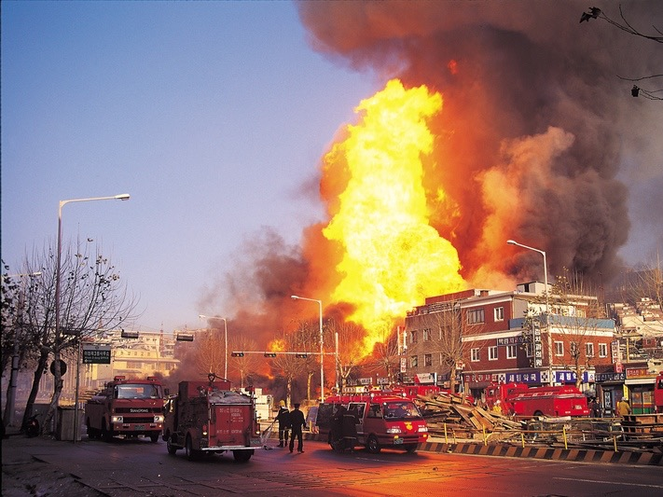
Earthquakes and other stress raising natural disasters increase the incidence of hypertension in their wake.
“For nation shall rise against nation, and kingdom against kingdom: and there shall be earthquakes in divers places, and there shall be famines and troubles: these are the beginnings of sorrows.” Mark 13:8
Curr Hypertens Rep. 3(3):249-54.

Slide 46

"So do not start worrying: 'Where will my food come from? or my drink? or my clothes?' (These are the things the pagans are always concerned about.) Your Father in heaven knows that you need all these things.
Instead, be concerned above everything else with the Kingdom of God and with what he requires of you, and he will provide you with all these other things.
So do not worry about tomorrow; it will have enough worries of its own. There is no need to add to the troubles each day brings. Matthew 6:31-34 GNB.
Notes:
Ultimate Stress Management

Slide 47

A spirit of forgiveness has been shown to bring blood pressure down. J Behav Med. 33(4):293-304.
“…forgiving one another, even as God for Christ's sake hath forgiven you.” Ephesians 4:32.
Notes:
J Behav Med. 2010 Aug;33(4):293-304.
The influence of forgiveness and apology on cardiovascular reactivity and recovery in response to mental stress.
Whited MC, Wheat AL, Larkin KT.
Department of Preventive and Behavioral Medicine, University of Massachusetts Medical Center, 55 Lake Avenue N., Worcester, MA 01605, USA. matthew.whited@umassmed.edu
Abstract
To investigate the relation between forgiveness and apology as they relate to cardiovascular reactivity and recovery, 29 men and 50 women were exposed to an interpersonal transgression (i.e., verbal harassment) while performing a serial subtraction task. Participants were categorized into high and low forgiveness groups based on scores on the forgiving personality scale. Following the task, approximately half of the participants received an apology from the experimenter for his/her comments during the task. Although no group differences in cardiovascular reactivity were observed during the serial subtraction task, persons high in forgiveness displayed more rapid diastolic and mean arterial blood pressure recovery than persons low in forgiveness. In response to the apology, participants displayed greater high frequency heart rate variability recovery compared to those who did not receive an apology. A significant apology x sex interaction was observed for diastolic blood pressure and mean arterial blood pressure. Women who received an apology exhibited faster recovery from the transgression than women who did not receive an apology. In contrast, men who received an apology exhibited delayed recovery from the transgression compared to men who did not receive an apology. These results indicate that there are potentially healthful benefits to forgiveness and apology, but the relation is influenced by situation and by sex.
PMID: 20364307 [PubMed - indexed for MEDLINE]
Related citations
Publication Types, MeSH Terms
2.
Int J Psychophysiol. 2008 Apr;68(1):51-8. Epub 2008 Jan 17.
Forgiveness, physiological reactivity and health: the role of anger.
Lawler-Row KA, Karremans JC, Scott C, Edlis-Matityahou M, Edwards L.
Department of Psychology, East Carolina University, Greenville, NC 27858, USA. rowk@ecu.edu
Abstract
Research has revealed that forgiveness may have beneficial effects for the forgiver's health. The present research explored whether reductions in anger underlie such effects, or whether forgiveness has beneficial health effects above and beyond the effects of decreasing anger. State and trait forgiveness were examined, along with styles of anger expression, for their relationship to physiological responses during recalled betrayal, and to self-reported health indices. State and trait forgiveness were negatively associated with anger-out; however, with one exception, no other styles of anger expression were linked with forgiveness. Both forgiveness and anger-out were associated with systolic blood pressure, heart rate and rate-pressure product. Partial correlations revealed that trait forgiveness accounted for significant variance in mean systolic blood pressure and rate-pressure product, and state forgiveness predicted mean heart rate, even after gender and anger-out had been controlled. On the other hand, anger-out fully mediated the trait forgiveness-heart rate and state forgiveness-rate pressure product effects. Trait forgiveness was significantly associated with fewer medications and less alcohol use, lower blood pressure and rate pressure product; state forgiveness was significantly associated with lower heart rate and fewer physical symptoms. Neither of these sets of findings were the result of decreased levels of anger-out being associated with forgiveness. These findings have important theoretical implications regarding the forgiveness-health link, suggesting that the benefits of forgiveness extend beyond the dissipation of anger.
PMID: 18262673 [PubMed - indexed for MEDLINE]
Related citations
MeSH Terms
3.
Int J Psychophysiol. 2007 Aug;65(2):87-94. Epub 2007 Mar 14.
The impact of forgiveness on cardiovascular reactivity and recovery.
Friedberg JP, Suchday S, Shelov DV.
Research and Development, Veterans Affairs NY Harbor Healthcare System, New York Campus, 423 East 23rd St. Room 13051-C, New York, NY 10010, United States. jennifer.friedberg@va.gov
Abstract
The current study investigated the relationship between trait forgiveness and cardiovascular reactivity (CVR) and recovery in 99 normotensive participants (mean age=33.8). Cardiovascular parameters were obtained at 2-minute intervals during a 10-minute baseline period and a 20-minute recovery period, and at 1-minute intervals during a 4-minute anger recall task and a 4-minute serial subtraction task without harassment. Participants filled out a self-report measure of forgiveness prior to the laboratory procedure. Although forgiveness was not related to CVR, higher levels of trait forgiveness were predictive of lower diastolic blood pressure (DBP) at baseline (p<.02) and faster DBP recovery (p<.003). Findings suggest that forgiveness may be related to overall reductions in blood pressure levels and may aid in cardiovascular recovery from stress. The results also provide preliminary evidence that forgiveness may impact cardiovascular health not through a myocardial or vascular pathway, but through another mechanism.
PMID: 17466400 [PubMed - indexed for MEDLINE]
Related citations
MeSH Terms
4.
J Pastoral Care Counsel. 2006 Spring-Summer;60(1-2):27-34.
Hypertension reduction through forgiveness training.
Tibbits D, Ellis G, Piramelli C, Luskin F, Lukman R.
Florida Hospital, 601 E Rollins Street, Orlando, FL 32803, USA.
Abstract
The objective of this study was to determine if patients with diagnosed stage-1 hypertension could benefit by a forgiveness training program to achieve measurable reductions in anger expression and blood pressure. Twenty-five participants were randomly divided into wait-listed control and intervention groups. The control group monitored blood pressure while the intervention group participated in an 8-week forgiveness training program. At the end of eight weeks, the wait listed group became an intervention group. Those who received forgiveness training achieved significant reductions in anger expression when compared to the control group. While reductions in blood pressure were not achieved by all the participants, those participants who entered the program with elevated anger expression scores did achieve significant reductions in blood pressure. It is suggested that forgiveness training may be an effective clinical intervention for some hypertensive patients with elevated levels of anger.
PMID: 16733947 [PubMed - indexed for MEDLINE]
Related citations
MeSH Terms
5.
J Behav Med. 2005 Apr;28(2):157-67.
The unique effects of forgiveness on health: an exploration of pathways.
Lawler KA, Younger JW, Piferi RL, Jobe RL, Edmondson KA, Jones WH.
Department of Psychology, University of Tennessee, Knoxville, Tennessee, USA.
Abstract
The relationship of forgiveness, both state and trait, to health was assessed. Eighty-one community adults completed a packet of questionnaires and participated in a laboratory interview about a time of hurt or betrayal. Heart rate and blood pressure were recorded during a 10 min baseline, the interview and during a recovery period; interviews were structured around a framework of questions and videotaped. Four measures of forgiveness were all statistically associated with five measures of health (physical symptoms, medications used, sleep quality, fatigue, and somatic complaints). Trait forgiveness was associated with decreased reactivity (rate-pressure product) to the interview, but sympathetic reactivity did not account for the trait forgiveness-health association. Four mechanisms or pathways by which forgiveness could lead to fewer physical symptoms were examined: spirituality, social skills, reduction in negative affect, and reduction in stress. All factors either partially or fully mediated the effect of forgiveness on health; however, the strongest mediator for both state and trait forgiveness was reduction in negative affect. For state forgiveness, the second strongest mediator was reduction in stress; for trait forgiveness, both conflict management and reduction in stress were strong contributors.
PMID: 15957571 [PubMed - indexed for MEDLINE]
Related citations
Publication Types, MeSH Terms
6.
J Behav Med. 2003 Oct;26(5):373-93.
A change of heart: cardiovascular correlates of forgiveness in response to interpersonal conflict.
Lawler KA, Younger JW, Piferi RL, Billington E, Jobe R, Edmondson K, Jones WH.
Department of Psychology, University of Tennessee, Knoxville, Tennessee 37996-0900, USA. klawler@utk.edu
Abstract
This study sought to examine the psychophysiological correlates of forgiveness in response to interpersonal conflict. One hundred eight college students (44 males and 64 females) participated in two interviews about times of interpersonal betrayal, one about a parent and one about a friend/partner. Measures of forgiving personality and state forgiveness were collected, as well as stress, hostility, empathy, and self-reported illness symptoms. During baseline, interviews and recovery periods, repeated measures were taken of blood pressure, heart rate, frontalis EMG, and skin conductance. Trait forgiveness was associated with lower levels of blood pressure. State forgiveness was associated with lower blood pressure levels, heart rate, and rate pressure product. Acute, stress-induced reactivity was also linked to forgiveness: state forgiveness was associated with diastolic and mean arterial pressure and rate pressure product reactivity during the parent interview. Increased blood pressure recovery after stress was also linked to trait forgiveness. Forgiveness may produce beneficial effects directly by reducing allostatic load associated with betrayal and conflict, and indirectly through reductions in perceived stress.
PMID: 14593849 [PubMed - indexed for MEDLINE]
Related citations
Publication Types, MeSH Terms
7.
Psychol Sci. 2001 Mar;12(2):117-23.
Granting forgiveness or harboring grudges: implications for emotion, physiology, and health.
vanOyen Witvliet C, Ludwig TE, Vander Laan KL.
Psychology Department, Hope College, Holland, MI 49422-9000, USA. witvliet@hope.edu
Abstract
Interpersonal offenses frequently mar relationships. Theorists have argued that the responses victims adopt toward their offenders have ramifications not only for their cognition, but also for their emotion, physiology, and health. This study examined the immediate emotional and physiological effects that occurred when participants (35 females, 36 males) rehearsed hurtful memories and nursed grudges (i.e., were unforgiving) compared with when they cultivated empathic perspective taking and imagined granting forgiveness (i.e., were forgiving) toward real-life offenders. Unforgiving thoughts prompted more aversive emotion, and significantly higher corrugator (brow) electromyogram (EMG), skin conductance, heart rate, and blood pressure changes from baseline. The EMG, skin conductance, and heart rate effects persisted after imagery into the recovery periods. Forgiving thoughts prompted greater perceived control and comparatively lower physiological stress responses. The results dovetail with the psychophysiology literature and suggest possible mechanisms through which chronic unforgiving responses may erode health whereas forgiving responses may enhance it.
PMID: 11340919 [PubMed - indexed for MEDLINE]
Soc Sci Med. 2009 Jan;68(2):314-22. Epub 2008 Nov 18.
An examination of the relationship between multiple dimensions of religiosity, blood pressure, and hypertension.
Buck AC, Williams DR, Musick MA, Sternthal MJ.
Georgetown University, Washington, DC, USA. acb75@georgetown.edu
Abstract
Researchers have established the role of heredity and lifestyle in the occurrence of hypertension, but the potential role of psychosocial factors, especially religiosity, is less understood. This paper analyzes the relationship between multiple dimensions of religiosity and systolic blood pressure, diastolic blood pressure, and hypertension using data taken from the Chicago Community Adult Health Study, a probability sample of adults (N=3105) aged 18 and over living in the city of Chicago, USA. Of the primary religiosity variables examined here, attendance and public participation were not significantly related to the outcomes. Prayer was associated with an increased likelihood of hypertension, and spirituality was associated with increased diastolic blood pressure. The addition of several other religiosity variables to the models did not appear to affect these findings. However, variables for meaning and forgiveness were associated with lower diastolic blood pressure and a decreased likelihood of hypertension outcomes. These findings emphasize the importance of analyzing religiosity as a multidimensional phenomenon. This study should be regarded as a first step toward systematically analyzing a complex relationship.
PMID: 19019516 [PubMed - indexed for MEDLINE]

Slide 48

Freedom From Resentment and Guilt Lower Blood Pressure. Psychosom Med. 55(2):203-11.
“And herein do I exercise myself, to have always a conscience void of offence toward God, and toward men.” Acts 24:16.

Slide 49

Faith In After Life
Older adults who experience the death of a loved one and who believe in a good afterlife are less likely to develop hypertension.
J Gerontol B Psychol Sci Soc Sci. 57(2):S96-S107.
“Marvel not at this: for the hour is coming, in the which all that are in the graves shall hear his voice, And shall come forth;
they that have done good, unto the resurrection of life;
and they that have done evil, unto the resurrection of damnation.” John 5:28,29.

Slide 50

Moving to the city?
Expect a 23 point rise in your blood pressure!
Int J Epidemiol. 33(4):769-76.

Slide 51

Walking Outdoors amongst trees, flowers, and other wonders of God’s great nature, lower blood pressure and stress.
“And the LORD God planted a garden eastward in Eden; and there he put the man whom he had formed.” Genesis 2:8.
J Environ Psychol 23:109-123.
Notes:
MAN’s Ecological Niche

Slide 52

Notes:
Jesus often went out into the Garden to pray.

Slide 53

Notes:
The experience of Awe Has been found to promote physical and mental health.

Slide 54

Awe
“And as we behold the beautiful and grand in nature, our affections go out after God. While the spirit is awed, the soul is invigorated by coming in contact with the Infinite through His works.” {DA 70.4}
Notes:
Looking at something bigger and grander than your self brings humility.
https://www.canr.msu.edu/news/the_influence_of_awe

Slide 55

Notes:
People who take the time to experience the awe are found to have better health, and healthier blood pressures.

Slide 56

Notes:
Whether it’s big things like the sky, mountains, or sea

Slide 57

Notes:
Or small things like intricate beautiful flowers.

Slide 58

Notes:
The beauties of God’s great creation are there for our health and appreciation.
Also the contemplation of the grandest themes,

Slide 59


Greater love hath no man than this, that a man lay down his life for his friends. John 15:13.
Notes:
As salvation and the unselfish generosity of Jesus on the cross, the awe, drawing us away from our selfish selves leads us to more vigorous health.

Slide 60

“Eye hath not seen, nor ear heard, neither have entered into the heart of man, the things which God hath prepared for them that love him.”
1 Corinthians 2:9.
Notes:
And think of the awe to be experience in the heaven, that Jesus has gone to prepare for us, where every tear will be wiped away and all that we have experienced here will be explained.
click
Can we help but trust the God that has done so much for us.

Slide 61

Letting Hypertension Go
Avoid excess salt, meat, and processed sugar and fat.
Eat a delicious whole plant based diet, high in fiber, minerals, vitamins and antioxidants.
Make weight control a habit.
Avoid the pitfalls of tobacco, caffeine and alcohol.
Keep well hydrated with pure vitalizing water; add a little lemon too.
Take regular time for enjoyable exercise in the awe of the great outdoors, far from traffic, pollution, stressful crowds.
Get plenty of warm sunshine and fresh invigorating air.
Guard your sleep and evaluate its quality for effectiveness.
Contemplate the bliss of heaven and the marvels of redeeming grace.
Let God know you need Him to release you from stress, guilt, fear and hypertension.
Rely on Him for guidance as you come more into line with His original plan for diet and lifestyle.

Slide 62
Letting Hypertension Go
Avoid excess salt, meat, and processed sugar and fat.
Eat a delicious whole plant based diet, high in fiber, minerals, vitamins and antioxidants.
Make weight control a habit.
Avoid the pitfalls of tobacco, caffeine and alcohol.
Keep well hydrated with pure vitalizing water; add a little lemon too.
Take regular time for enjoyable exercise in the awe of the great outdoors, far from traffic, pollution, stressful crowds.
Get plenty of warm sunshine and fresh invigorating air.
Guard your sleep and evaluate its quality for effectiveness.
Contemplate the bliss of heaven and the marvels of redeeming grace.
Let God know you need Him to release you from stress, guilt, fear and hypertension.
Rely on Him for guidance as you come more into line with His original plan for diet and lifestyle.

Slide 63
Letting Hypertension Go
Eat a delicious whole plant based diet, high in fiber, minerals, vitamins and antioxidants.
Make weight control a habit.
Avoid the pitfalls of tobacco, caffeine and alcohol.
Keep well hydrated with pure vitalizing water; add a little lemon too.
Take regular time for enjoyable exercise in the awe of the great outdoors, far from traffic, pollution, stressful crowds.
Get plenty of warm sunshine and fresh invigorating air.
Guard your sleep and evaluate its quality for effectiveness.
Contemplate the bliss of heaven and the marvels of redeeming grace.
Let God know you need Him to release you from stress, guilt, fear and hypertension.
Rely on Him for guidance as you come more into line with His original plan for diet and lifestyle.

Slide 64
Letting Hypertension Go
Make weight control a habit.
Avoid the pitfalls of tobacco, caffeine and alcohol.
Keep well hydrated with pure vitalizing water; add a little lemon too.
Take regular time for enjoyable exercise in the awe of the great outdoors, far from traffic, pollution, stressful crowds.
Get plenty of warm sunshine and fresh invigorating air.
Guard your sleep and evaluate its quality for effectiveness.
Contemplate the bliss of heaven and the marvels of redeeming grace.
Let God know you need Him to release you from stress, guilt, fear and hypertension.
Rely on Him for guidance as you come more into line with His original plan for diet and lifestyle.

Slide 65
Letting Hypertension Go
Avoid the pitfalls of tobacco, caffeine and alcohol.
Keep well hydrated with pure vitalizing water; add a little lemon too.
Take regular time for enjoyable exercise in the awe of the great outdoors, far from traffic, pollution, stressful crowds.
Get plenty of warm sunshine and fresh invigorating air.
Guard your sleep and evaluate its quality for effectiveness.
Contemplate the bliss of heaven and the marvels of redeeming grace.
Let God know you need Him to release you from stress, guilt, fear and hypertension.
Rely on Him for guidance as you come more into line with His original plan for diet and lifestyle.

Slide 66
Letting Hypertension Go
Keep well hydrated with pure vitalizing water; add a little lemon too.
Take regular time for enjoyable exercise in the awe of the great outdoors, far from traffic, pollution, stressful crowds.
Get plenty of warm sunshine and fresh invigorating air.
Guard your sleep and evaluate its quality for effectiveness.
Contemplate the bliss of heaven and the marvels of redeeming grace.
Let God know you need Him to release you from stress, guilt, fear and hypertension.
Rely on Him for guidance as you come more into line with His original plan for diet and lifestyle.

Slide 67
Letting Hypertension Go
Take regular time for enjoyable exercise in the awe of the great outdoors, far from traffic, pollution, stressful crowds.
Get plenty of warm sunshine and fresh invigorating air.
Guard your sleep and evaluate its quality for effectiveness.
Contemplate the bliss of heaven and the marvels of redeeming grace.
Let God know you need Him to release you from stress, guilt, fear and hypertension.
Rely on Him for guidance as you come more into line with His original plan for diet and lifestyle.

Slide 68
Letting Hypertension Go
Get plenty of warm sunshine and fresh invigorating air.
Guard your sleep and evaluate its quality for effectiveness.
Contemplate the bliss of heaven and the marvels of redeeming grace.
Let God know you need Him to release you from stress, guilt, fear and hypertension.
Rely on Him for guidance as you come more into line with His original plan for diet and lifestyle.

Slide 69
Letting Hypertension Go
Guard your sleep and evaluate its quality for effectiveness.
Contemplate the bliss of heaven and the marvels of redeeming grace.
Let God know you need Him to release you from stress, guilt, fear and hypertension.
Rely on Him for guidance as you come more into line with His original plan for diet and lifestyle.

Slide 70
Letting Hypertension Go
Contemplate the bliss of heaven and the marvels of redeeming grace.
Let God know you need Him to release you from stress, guilt, fear and hypertension.
Rely on Him for guidance as you come more into line with His original plan for diet and lifestyle.

Slide 71
Letting Hypertension Go
Let God know you need Him to release you from stress, guilt, fear and hypertension.
Rely on Him for guidance as you come more into line with His original plan for diet and lifestyle.

Slide 72


In Summary
As you adopt a healthy diet your blood pressure will respond positively.
Good lifestyle habit will ensure good circulation.
Psychological rest and peace will be reflected in a calm pulse, steady heart beat and a healthy blood pressure.

Slide 73
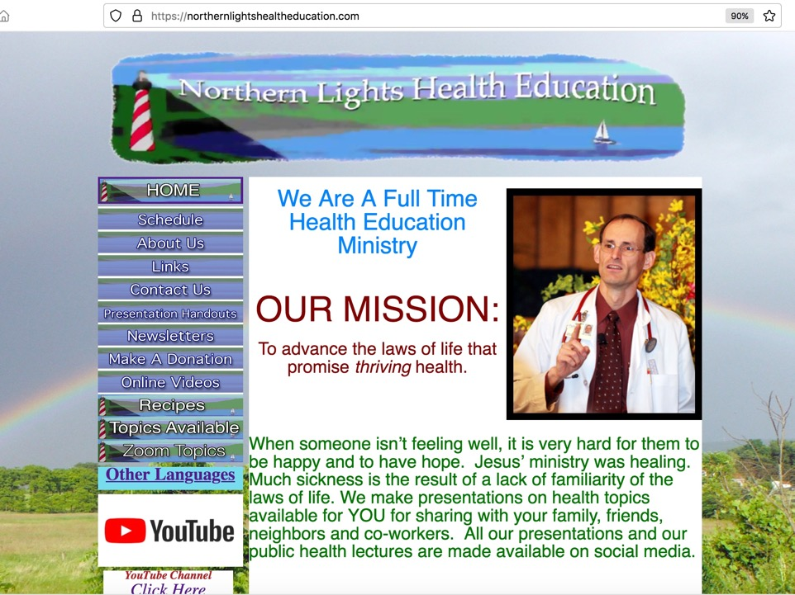
NorthernLightsHealthEducation.com

Slide 74
Blueprint For Health And Healing
Reversing Disease From Its Foundation
Vigorous Healthy Natural Blood Pressure
John Clark, M.D.
Notes:
Story: Marge (Norman’s mother) “Son, come quickly, my blood pressure is 180/140 an I am afraid if I don’t get to the emergency room soon I could have a stroke.” Marge had seen her blood pressure rise ominously with time. She was now on three blood pressure medications, all of which had undesirable side effects, and nothing seemed to be working. Her doctor’s had repeatedly warned her that she was at high risk for a stroke. Six weeks into this blood pressure program, Marge was off all medications and had normal blood pressure. With the information in the presentation, you too can experience “vigorous healthy natural blood pressure” that can last for a lifetime.
This presentation isYou too can have Bullet points
1billion world wide
Benefit/problem solved
creeping blood pressure
risk of stroke and kidney failure
No more medication side effects
vigorous healthy natural blood pressure for a lifetime
Inspire
Call to action

