Slide 1


Slide 2


Slide 3

Health and Spirituality

Slide 4
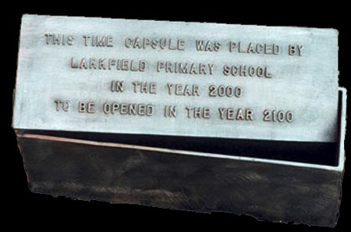
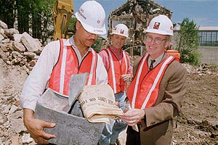
TIME CAPSULES

Slide 5

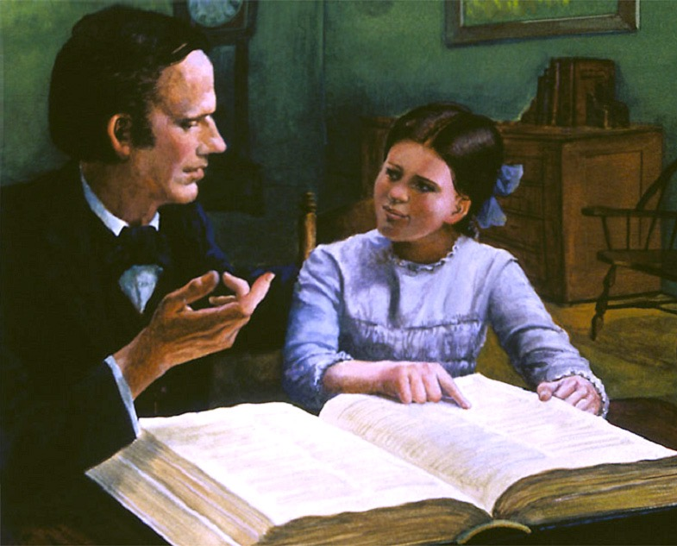

Slide 6
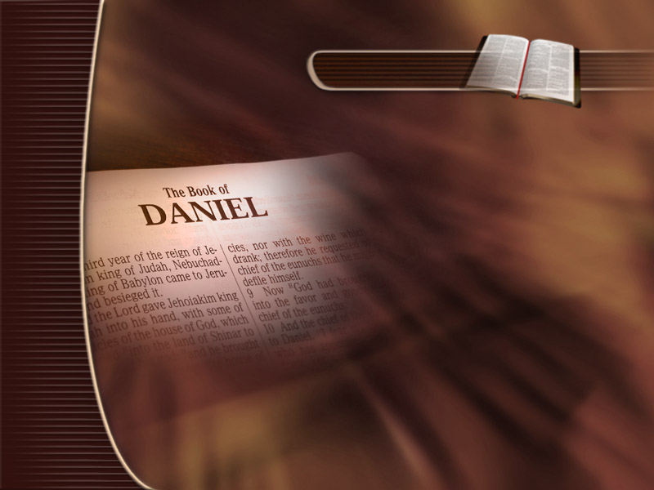
Daniel 12:4
“But thou, O Daniel, shut up the words, and seal the book, even to the time of the end: many shall run to and fro, and knowledge shall be increased.”

Slide 7



Slide 8
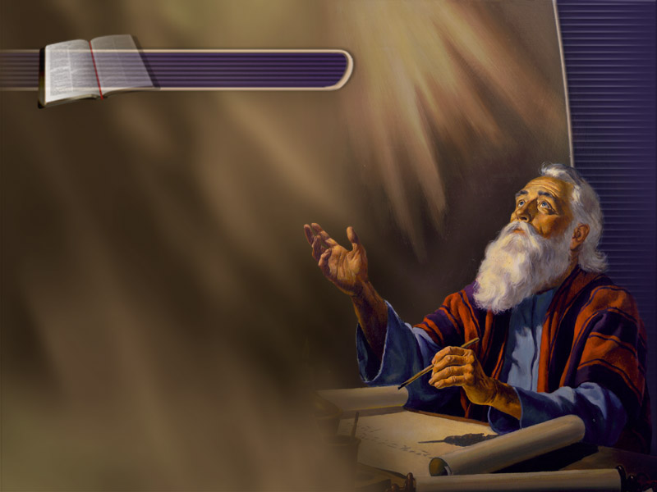
Daniel 12:8,9
“And I heard, but I understood not: then said I, O my Lord, what shall be the end of these things? And he said, Go thy way, Daniel: for the words are closed up and sealed till the time of the end.”

Slide 9
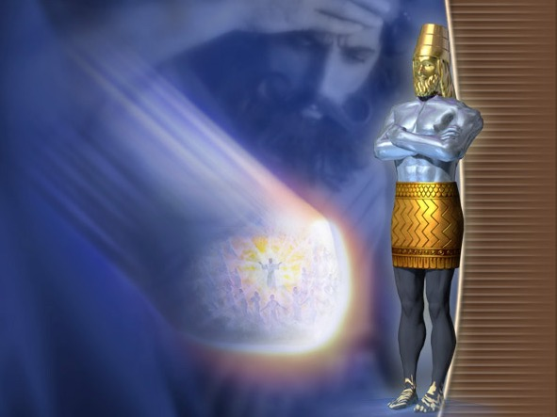
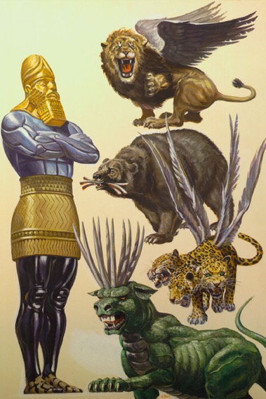
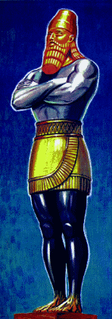
Daniel 2
Daniel 7
Daniel 8
Daniel 11
Lion with
eagle’s wings
Babylon
Head of gold
History
History
“And in the days of these kings shall the God of heaven set up a kingdom, which shall never be destroyed:” (Daniel 2:44).
Breast of silver
Bear with 3
ribs in mouth
Ram with
2 horns
Darius the Mede
Medo-Persia
He goat with
1 great horn
with 4 sprouts
Mighty king
stands up
in Grecia
Belly of brass
Leopard with
4 heads
Greece
Rome
Legs of iron
Dreadful and
terrible beast
One of the 4
sprouting horns
King of North
Modern
Babylon
Little horn
speaks great
things
Toes of
Iron and clay
Horn magnifies
himself
King of north
exalts himself
Restoration
Kingdom
King
Sanctuary
People

Slide 11
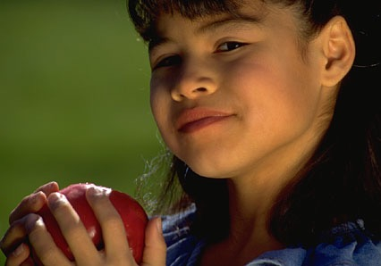

Slide 12
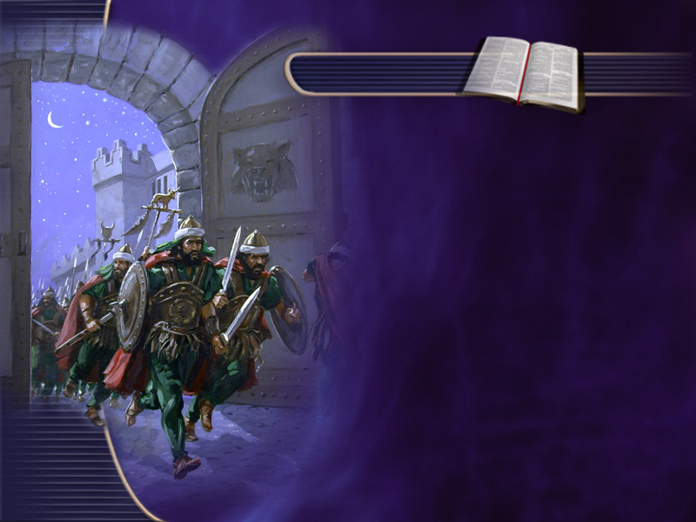
Daniel 1:1-4
“King Nebuchadnezzar of Babylonia attacked Jerusalem and surrounded the city. The Lord let him capture King Jehoiakim … The king ordered Ashpenaz, his chief official, to select from among the Israelite exiles some young men of the royal family and of the noble families...”

Slide 13
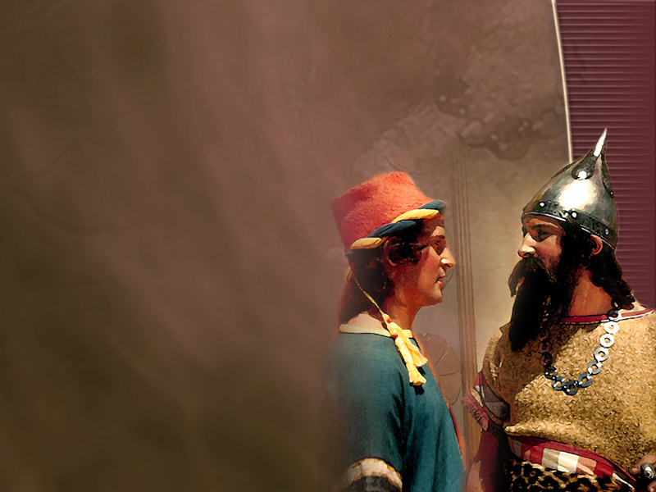
Brain Washing Begins
“…whom they might teach the learning and the tongue of the Chaldeans.” Daniel 1:4.
Trained and acculturated to become Babylonians.

Slide 14
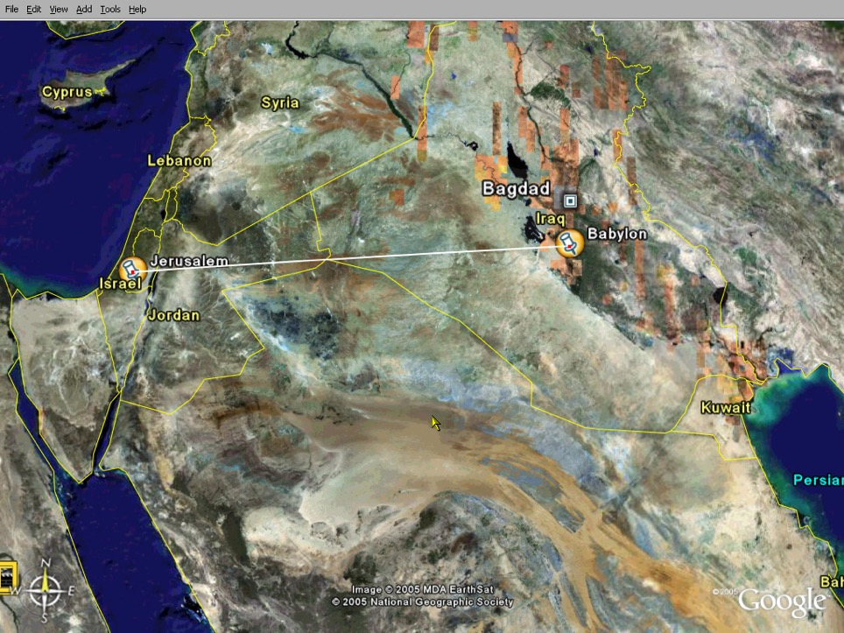
How Far Is It From Jerusalem To Babylon?
554 Mi.

Slide 15

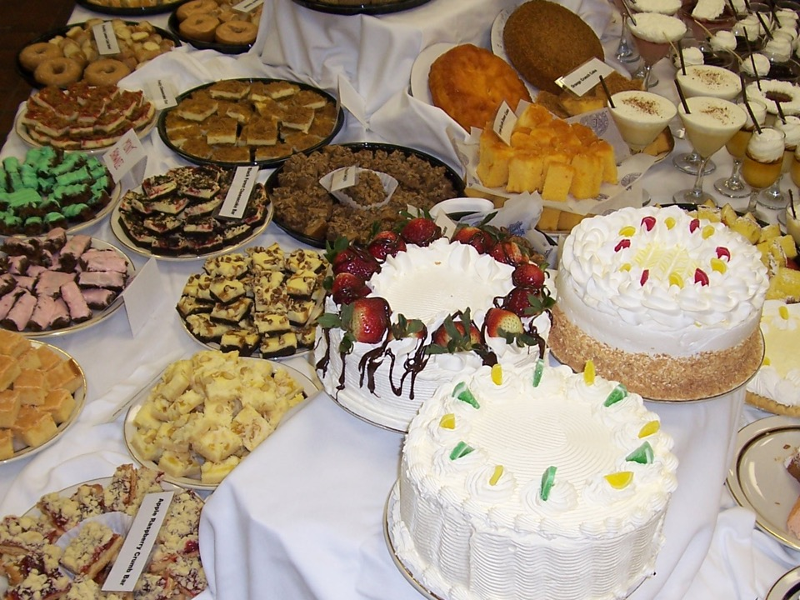

Slide 16
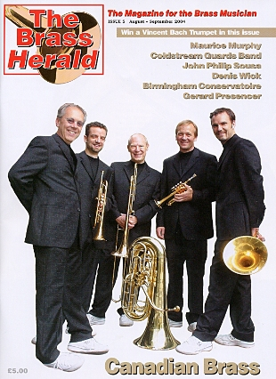

Slide 17
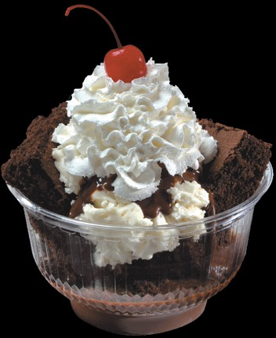
Sugar and the Brain
“And from the light given me, sugar, when largely used, is more injurious than meat.”
“Sugar is not good for the stomach. It causes fermentation, and this clouds the brain and brings peevishness into the disposition.”
Notes:
{CD 328.2}
{CD 327.1}

Slide 18
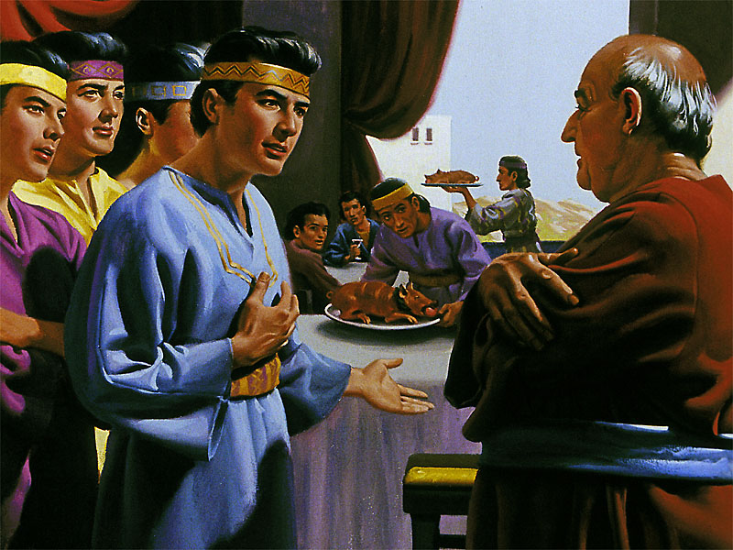
“But Daniel purposed in his heart that he would not defile himself with the portion of the king's meat, nor with the wine which he drank:” Daniel 1:8.

Slide 19
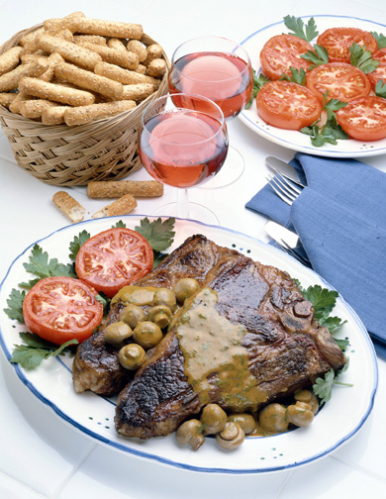

Slide 20

Proverbs 31:4
“It is not for kings to drink wine; nor for princes strong drink: Lest they drink, and forget the law, and pervert the judgment of any of the afflicted.”

Slide 21
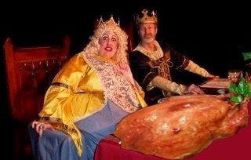
Meat and Intelligence
“…Eating much flesh will diminish intellectual activity. Students would accomplish much more in their studies if they never tasted meat. When the animal part of the human nature is strengthened by meat-eating, the intellectual power diminishes proportionately.”
Notes:
CD 389

Slide 22
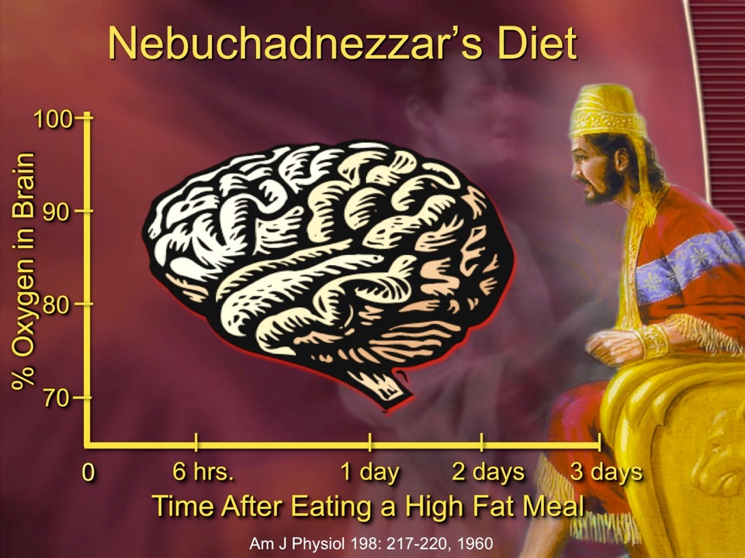

Slide 23
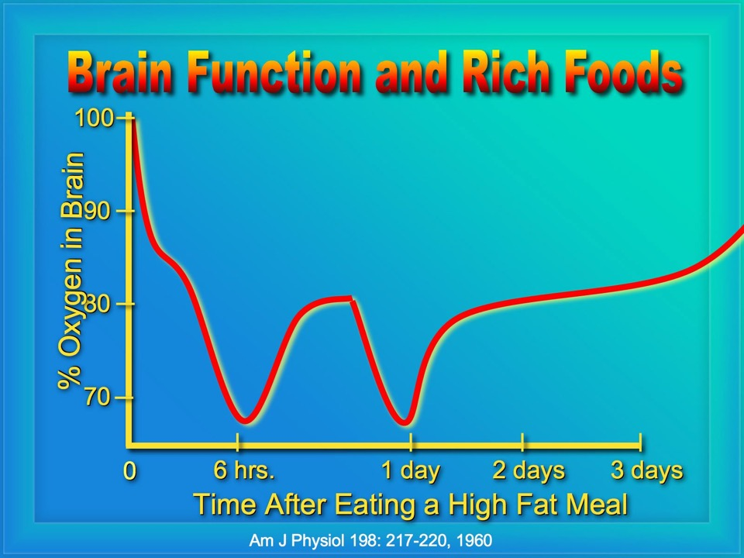
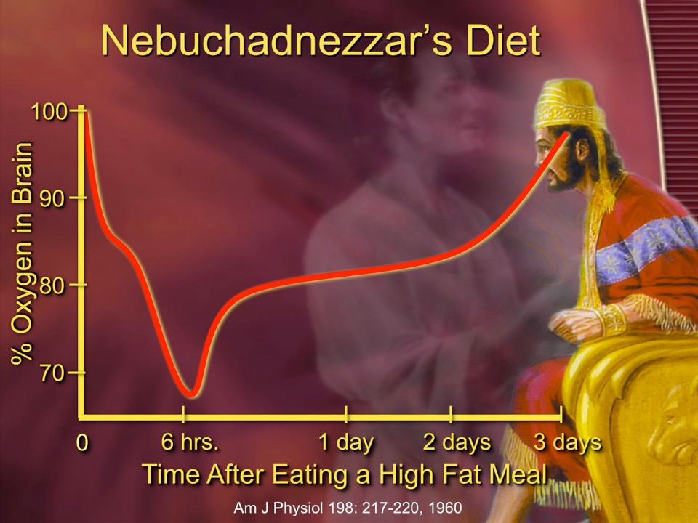

Slide 24
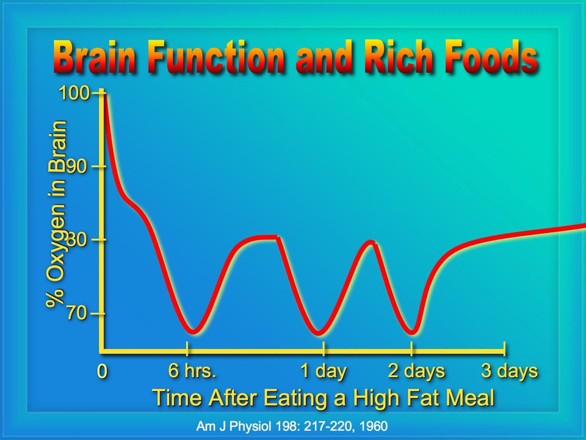
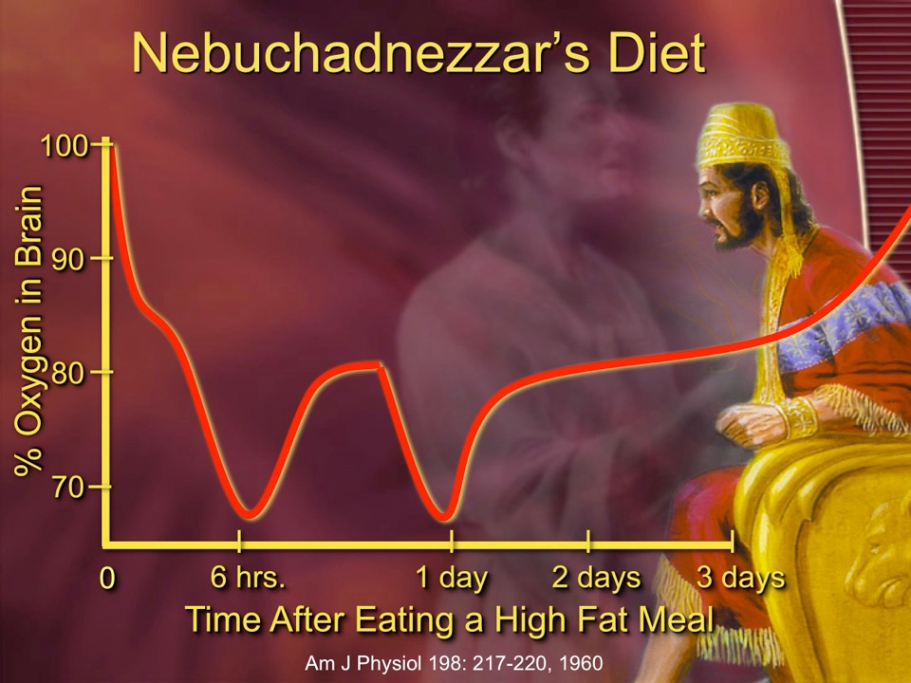

Slide 25
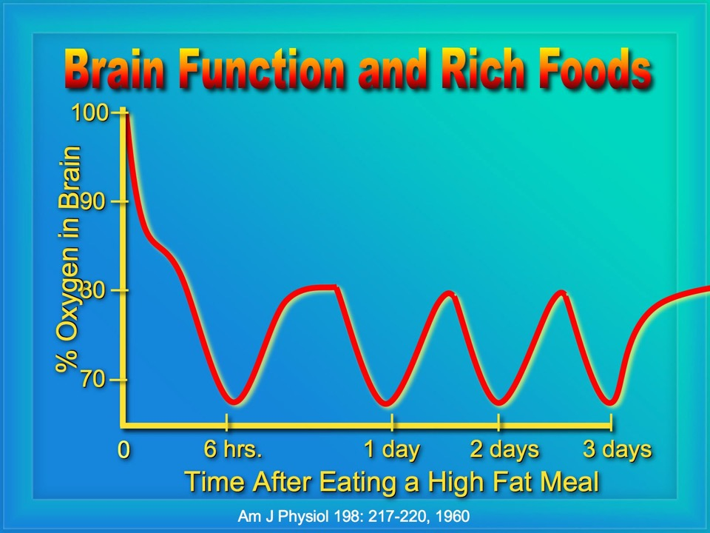
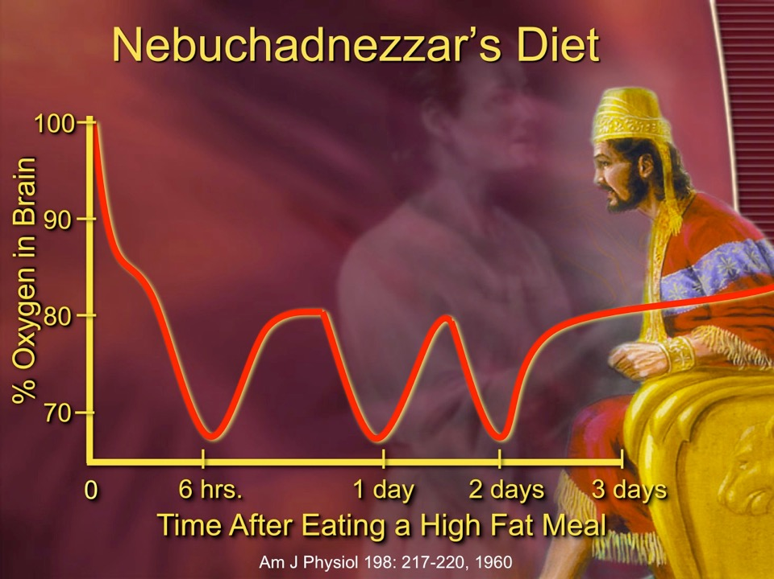

Slide 26
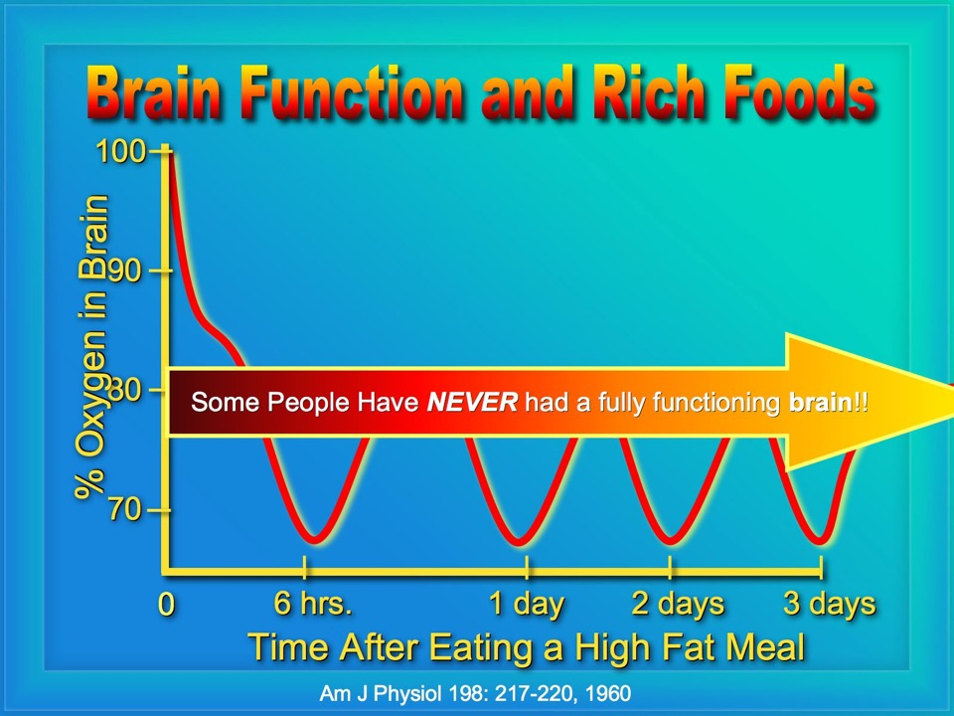
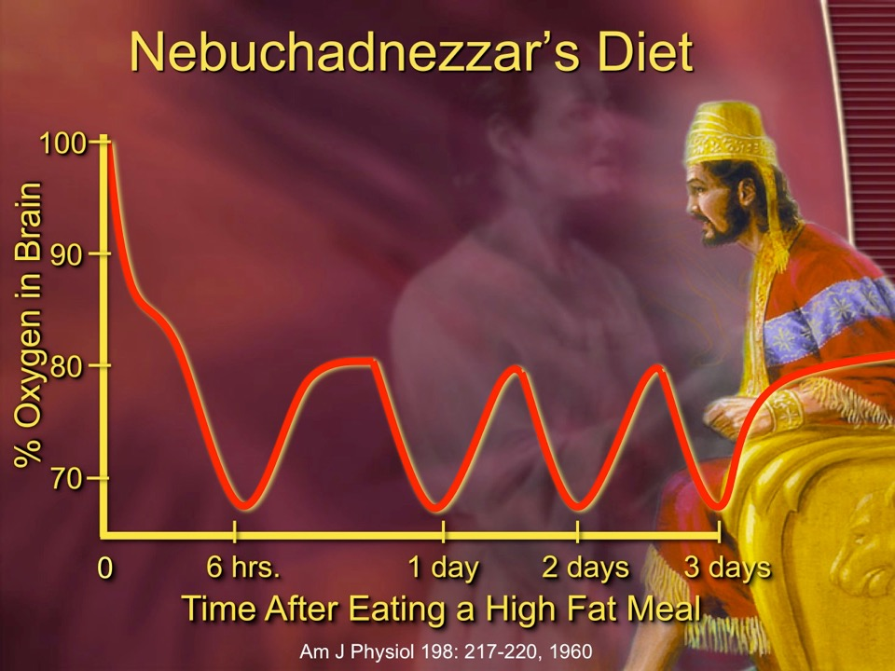

Slide 27
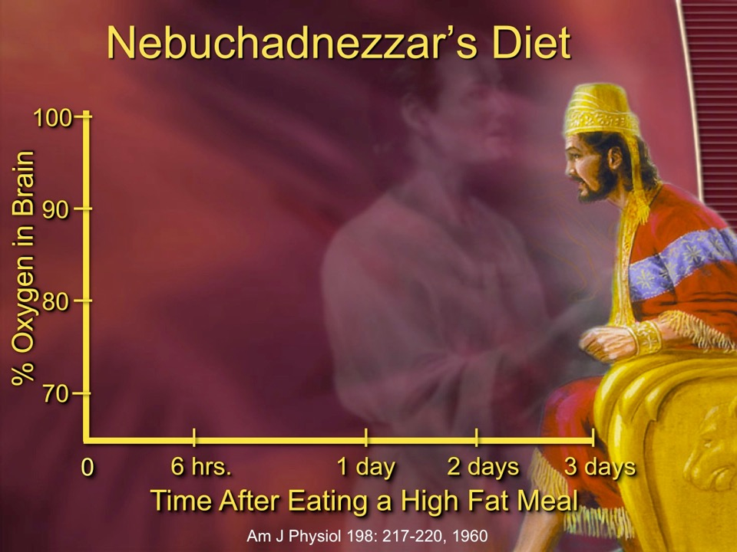
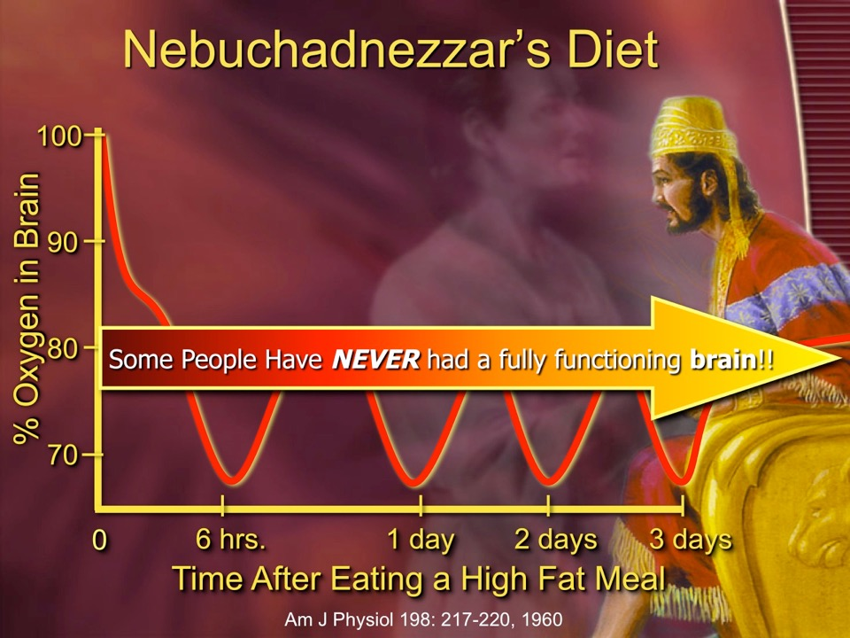

Slide 28
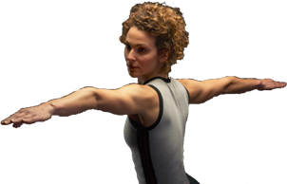
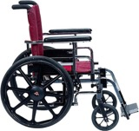
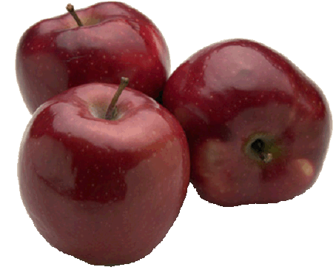
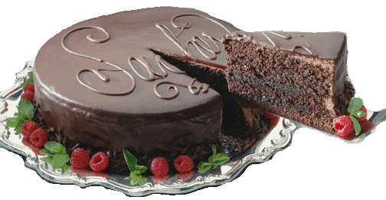
Health versus disability scale.
Increase Health
Increase Indulgence
Increase Strength
Increase Disability

Slide 29
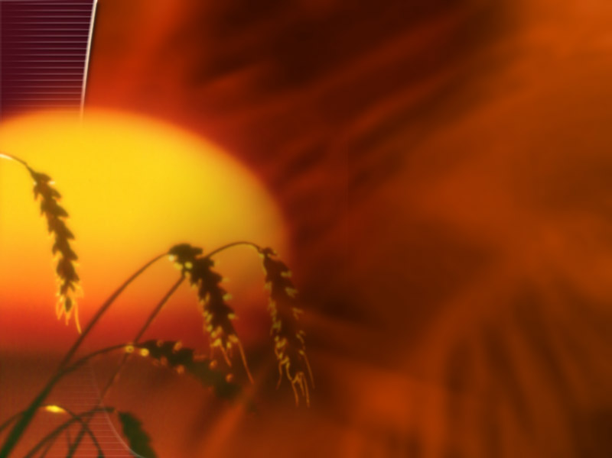
“Be not deceived; God is not mocked: for whatsoever a man soweth, that shall he also reap.”
Galations 6:7

Slide 30
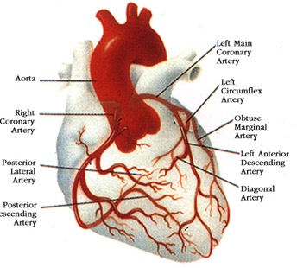
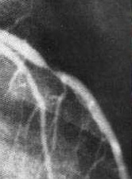
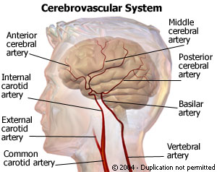
Mental function changes can be detected for blockages of <20%.
We can only detect heart problems at >70% blockage.
Brain
Heart
70%
20%
Notes:
That’s me!

Slide 31
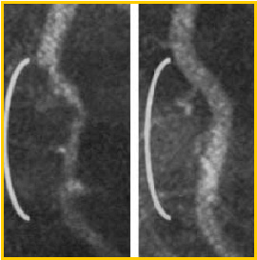
Plaque Reducing Diet
Caldwell Esselstyn, Jr., MD, of the Cleveland Clinic has shown on angiography that blockages in coronary arteries can be reversed by changes in diet.

Slide 32
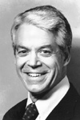
Plaque Reducing Diet
“The optimal diet consists of grains, legumes, vegetables, and fruit, with <10%-15% of its calories coming from fat.”
Caldwell Esselstyn, Jr., MD

Slide 33
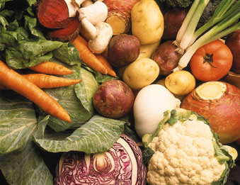
Plaque Reducing Diet
He goes on to say that, “This diet minimizes the likelihood of stroke, obesity, hypertension, type 2 diabetes, and cancers of the breast, prostate, colon, rectum, uterus, and ovary.”

Slide 34
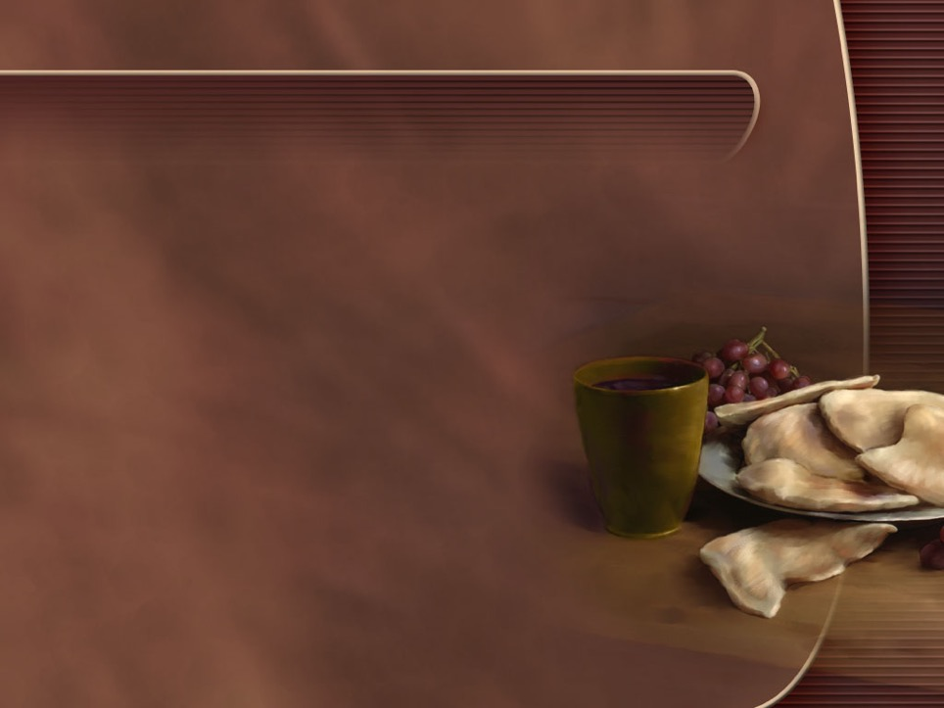
Daniel 1:11-14 (KJS)
“Then said Daniel to Melzar, Prove thy servants, I beseech thee, ten days; and let them give us pulse to eat, and water to drink. Then let our countenances be looked upon before thee, and the countenance of the children that eat of the portion of the king's meat: and as thou seest, deal with thy servants.”

Slide 35

Ten Day Diet Challange
What would 10 days on your diet and lifestyle do for someone with diabetes, heart disease or high blood pressure?

Slide 36
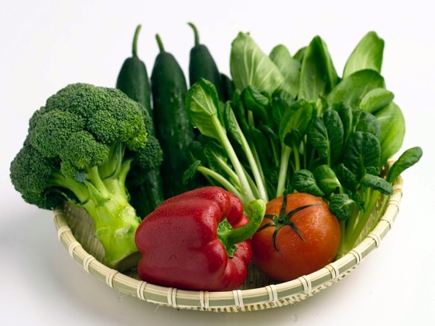
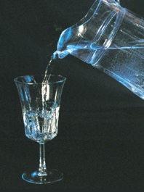
What kind of diet was Daniel asking for?
"Please test your servants for ten days, and let them give us vegetables to eat and water to drink.” Daniel 1:12 (NKJV).

Slide 37
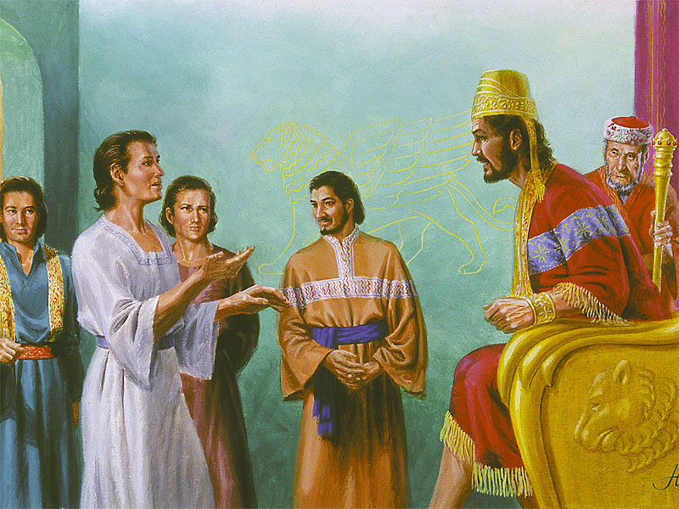

Slide 38
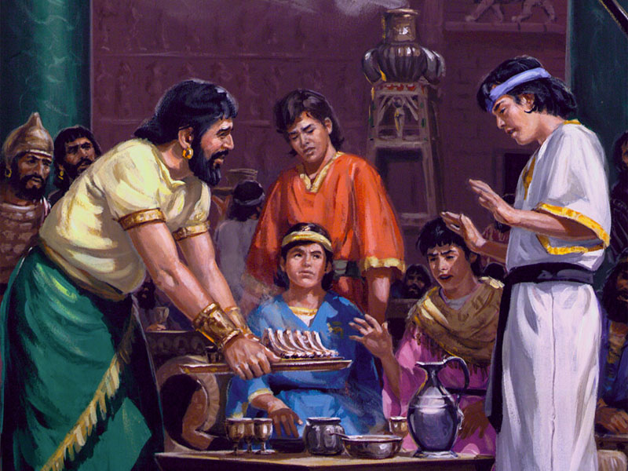

Slide 39
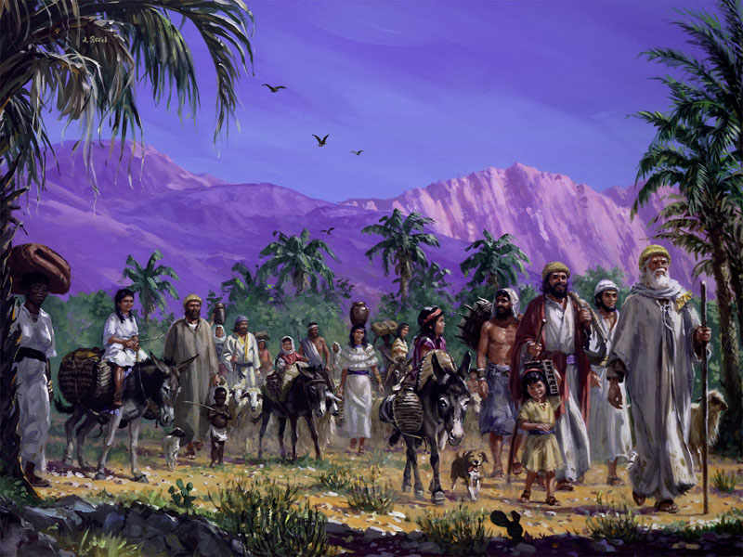
“As a general thing, the Lord did not provide His people with flesh meat in the desert, because He knew that the use of this diet would create disease and insubordination. {CD 375}
Notes:
CD 375.

Slide 40

Fresh Food Diet Cures Intemperance
On a 6 month fresh fruit and vegetable diet, people lost weight and normalize their blood pressure.
“Eighty percent of those who smoked or drank alcohol abstained spontaneously.” UCLA, South Med J. 78(7):841-4.
Notes:
South Med J. 1985 Jul;78(7):841-4.
Effects of a raw food diet on hypertension and obesity.
Douglass JM, Rasgon IM, Fleiss PM, Schmidt RD, Peters SN, Abelmann EA.
Abstract
We examined responses to cooked and uncooked food in 32 outpatients with essential hypertension; 28 were also overweight. By varying cooked and uncooked food percentages and salt intake, patients acted as their own control subjects in this unblinded study. After a mean duration of 6.7 months, average intake of uncooked food comprised 62% of calories ingested. Mean weight loss was 3.8 kg and mean diastolic pressure reduction 17.8 mm Hg, both statistically significant (P less than .00001). Eighty percent of those who smoked or drank alcohol abstained spontaneously.
PMID: 4012382 [PubMed - indexed for MEDLINE]

Slide 41
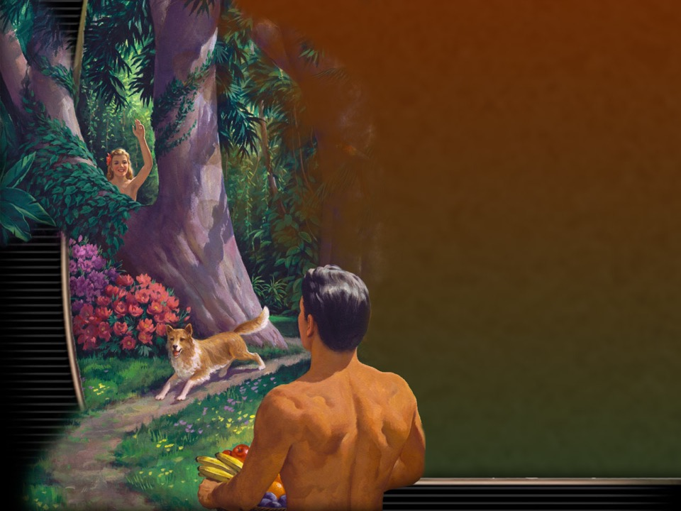
Retaking The Garden
“It would be well for us to do less cooking and eat more fruit in its natural state.
“We are coming to the time when recipes for cooking will not be needed, for God's people will learn that the food God gave Adam in his sinless state is the best for keeping the body in a sinless state.” 21MR 286.

Slide 42
Retaking The Garden
“It would be well for us to do less cooking and to eat more fruit in its natural state.
“Concerning flesh meat, we should educate the people to let it alone. Its use is contrary to the best development of the physical, mental, and moral powers.
“By precept and example make it plain that the food which God gave Adam in his sinless state is the best for man's use as he seeks to regain that sinless state.” {7T 134-5}
Notes:
{7T 134-5}

Slide 43

By Beholding…
“…we see through a glass, darkly…” 1 Corinthians 13:12.
The light of healthful living helps clear the lens a bit!

Slide 44
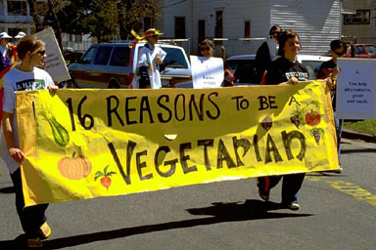
Has Daniel been unsealed to the general public?
French Politition: Alexandre Ledru-Rollin:
“There go the people. I must follow them for I am their leader.”

Slide 45
Spirituality
Health

Slide 46
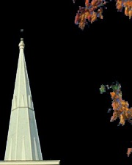
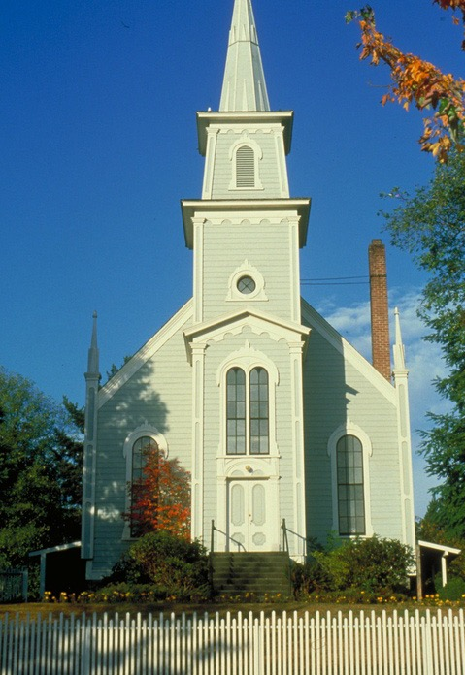
Spirituality and health statistics.
Spirituality and health statistics.
People who do not attend religious services have an 87% higher risk of dying from all causes according to one study.

Slide 47



Slide 48

Forgiveness and Health
“Look upon mine affliction and my pain; and forgive all my sins.” Psalm 25:18
“And the inhabitant shall not say, I am sick: the people that dwell therein shall be forgiven their iniquity.” Isaiah 33:24

Slide 49

How they live longer:
Don’t smoke.
Put family first.
Active every day.
Keep socially engaged.
Eat fruits, vegetables, and whole grains.
Eat nuts and beans.
Observe the Sabbath.
Have faith.

Slide 50

Seventh-day Adventists
National Geographic: November 2005
“Adventists also observe Sabbath on Saturday, socializing with other church members and enjoying a sanctuary in time that helps relieve stress.”

Slide 51

Death After Surgery
Elderly patients were 14 times less likely to die after heart surgery if they found comfort in their religious faith and were socially active.
Those who did not find any strength or comfort from religion were three times more likely to die after surgery.

Slide 52

James 1:27
What is the true religion that gives one a long and happy life?
“Pure religion and undefiled before God and the Father is this, To visit the fatherless and widows in their affliction, and to keep himself unspotted from the world.”

Slide 53


Live to Give
Mortality was significantly reduced for individuals who provided support to friends, relatives, neighbors, and their spouse.
Receiving support had no effect on mortality.
        Brown SL, Nesse RM, Vinokur AD, Smith DM. Psychol Sci. 2003 Jul;14(4):320-7.

Slide 54

Acts 20:35
“It is more blessed to give than to receive.”
Depression, bipolar, anxiety?
Multiple sclerosis, neuropathy, tremors?
Heart disease, heart failure, stroke?
“The pleasure of doing good to others imparts a glow to the feelings which flashes through the nerves, quickens the circulation of the blood, and induces mental and physical health.” 4T 56

Slide 55

What else is Daniel Known For?

Slide 56

Daniel 12:1
“And there shall be a time of trouble, such as never was since there was a nation even to that same time:”

Slide 57

“Those who have had the light upon the subjects of eating and dressing with simplicity, in obedience to physical and moral laws, and who turn from the light which points out their duty, will shun duty in other things.
If they blunt their consciences to avoid the cross which they will have to take up to be in harmony with natural law, they will, in order to shun reproach, violate the ten commandments.”
Notes:
CH p.105

Slide 58


“The controlling power of appetite will prove the ruin of thousands, when, if they had conquered on this point, they would have had moral power to gain the victory over every other temptation of Satan.
“But those who are slaves to appetite will fail in perfecting Christian character.” CD 59.
Notes:
CD 59.

Slide 59

Is Daniel’s diet another burden or blessing?

Slide 60

Summary
Daniel is a prophetic book sealed until our time.
Why does this prophetic book, sealed for our time, commence with a cute little story about a dietary experiment?
God wants us to have clear minds to understand the prophecies and remain faithful to our Savior during the times just upon of us.
Notes:
The diet clears the mind to understand the prophecies
The diet is a proving ground for loyalty
The diet is part of the preparation for what we will face so we will remain loyal to our savior Jesus Christ.

Slide 61


Blueprint For Health And Healing
Reversing Disease From Its Foundation
Health and Spirituality
The Mind Body Connection
John Clark, M.D.
Notes:
She knew she could not handle any more pain, tiredness or irritability, but what was the real cause? She kept trying new diets, natural remedies and exercise programs, but to no avail. Then Kathy discovered answers to important questions in the presentation, “Health and Spirituality: The Mind Body Connection” What role does the peace that comes from a healthy spirituality play in recovery from physical ailments? What is the relationship between what I eat and how well I think? Are your physical issues a result of something you are doing or the way you are thinking? Don’t miss this presentation, you too may discover keys to your most difficult health issues.
Story: Kathy (Karla)
Benefit/problem solved
What role does the peace that comes from a healthy spirituality play in recovery from physical ailments?
What is the relationship between what I eat and how well I think?
Are your physical issues a result of something you are doing or thinking?
Bullet points
Inspire
Call to action

