Slide 1

Glorify God In Your Body
Notes:
fixed

Slide 2

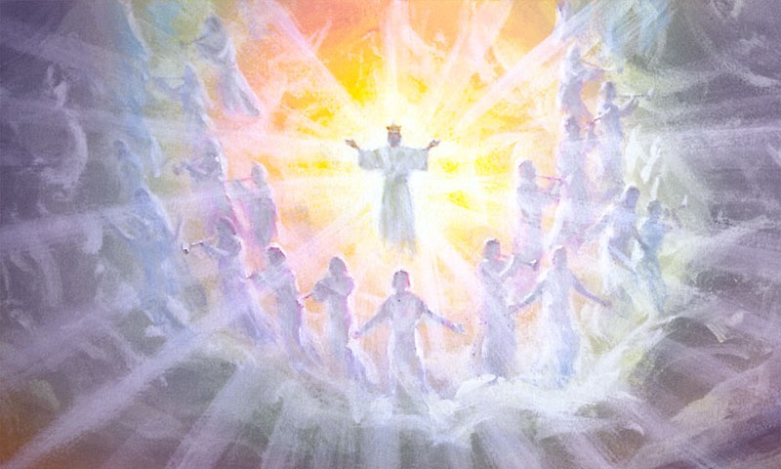
Glorify God!
“… glorify God in your body, and in your spirit, which are God's.” 1 Corinthians 6:20

Slide 3

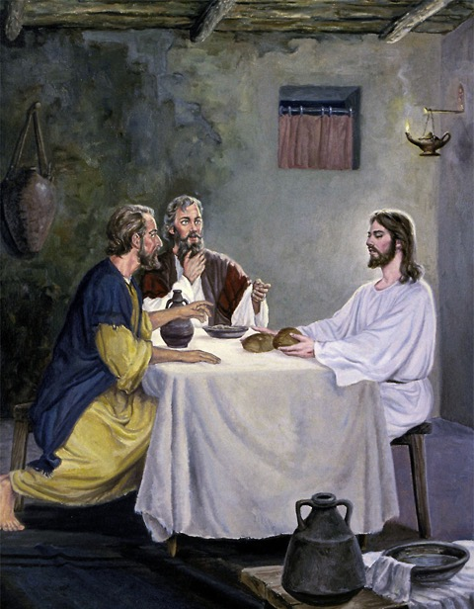
1Corinthinas 10:31
“Whether therefore ye eat, or drink, or whatsoever ye do, do all to the glory of God.”

Slide 4

Broken Down?

Slide 5

Specimens of Life
“I will praise thee; for I am fearfully and wonderfully made:”
Psalms 139:14.

Slide 6

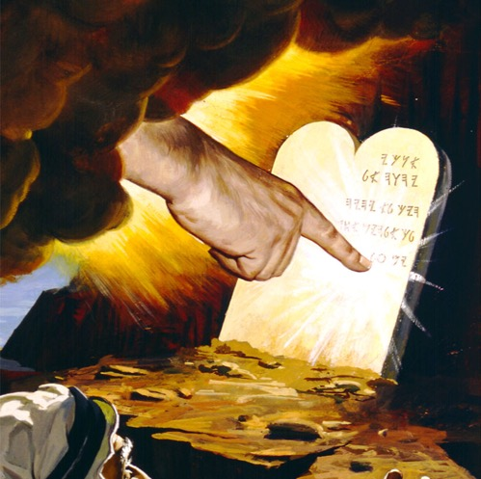
Law of God is the Law of Life
“If thou wilt diligently hearken to the voice of the LORD thy God, and wilt do that which is right in his sight, and wilt give ear to his commandments, and keep all his statutes,
“I will put none of these diseases upon thee, which I have brought upon the Egyptians: for I am the LORD that healeth thee.”
Exodus 15:26.

Slide 7

Sanctification
“And the very God of peace sanctify you wholly; and I pray God your whole spirit and soul and body be preserved blameless unto the coming of our Lord Jesus Christ.” 1Thessalonians 5:23,24.
Notes:
7

Slide 8
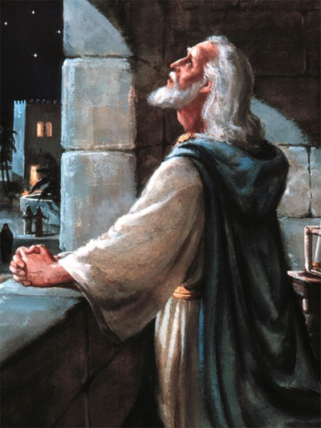
The Work Of A Full Lifetime
“Who will render to every man according to his deeds: To them who by patient continuance in well doing seek for glory and honour and immortality, eternal life:” Romans 2:6,7.

Slide 9

Redeem The Time!
“See then that ye walk circumspectly, not as fools, but as wise, Redeeming the time, because the days are evil.

Slide 10
Redeem The Time!
“See then that ye walk circumspectly, not as fools, but as wise, Redeeming the time, because the days are evil. Wherefore be ye not unwise, but understanding what the will of the Lord is.” Ephesians 5:15-18.

Slide 11

“…therefore glorify God in your body...” 1Corinthians 6:19.
How do we honor or glorify God with our bodies?
Bodies like Arnold?
Walking in Jesus’ footsteps of service.
We must be fit for service.
Notes:
11

Slide 12

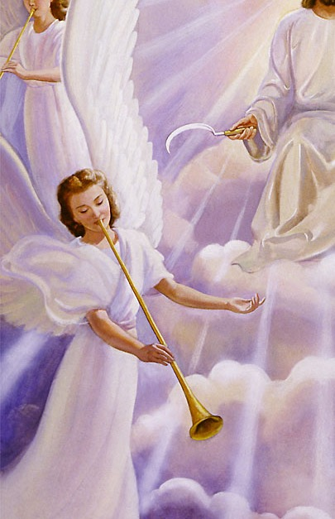
Mystery of God
“But in the days of the voice of the seventh angel, when he shall begin to sound, the mystery of God should be finished, as he hath declared to his servants the prophets.” Rev 10:7.

Slide 13
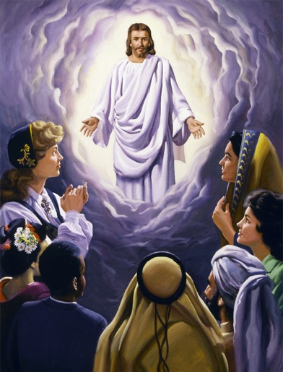
Colossians 1:25-27
“God would make known what is the riches of the glory of this mystery among the Gentiles;

Slide 14
Colossians 1:25-27
“God would make known what is the riches of the glory of this mystery among the Gentiles; which is Christ in you, the hope of glory:”

Slide 15
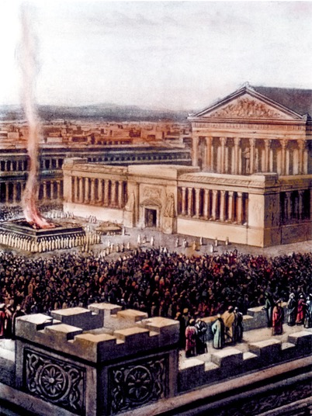
Body Temple
"Ye are the temple of the living God; as God hath said, I will dwell in them, and walk in them; and I will be their God, and they shall be My people." 2Corinthians 6:16
Notes:
15

Slide 16
Body Temple
“What? know ye not that your body is the temple of the Holy Ghost which is in you, … therefore glorify God in your body, and in your spirit, which are God's.” 1Corinthians 6:19.

Slide 17
1Corinthians 3:16,17
“Know ye not that ye are the temple of God, and that the Spirit of God dwelleth in you?

Slide 18
1Corinthians 3:16,17
“Know ye not that ye are the temple of God, and that the Spirit of God dwelleth in you? If any man defile the temple of God, him shall God destroy; for the temple of God is holy, which temple ye are.”
Notes:
18

Slide 19
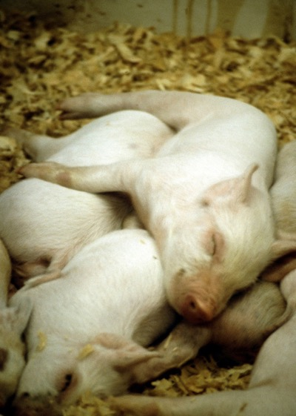
Neurophysiology
Biblically Clean meats cause a significant slowing of brain function.
Biblically unclean meats cause a seven fold decrease in brain function.
Baldwin, BE. Ed. Health & Healing

Slide 20

Cholesterol Above 150 Increases Risk of Death from Heart Disease
18
16
14
12
Death Rate per 1,000 Men
10
8
6
4
2
140
160
180
200
220
240
260
280
300
Serum Cholesterol
JAMA 1986 Nov 28;56(20):2823-8
Notes:
20

Slide 21

Seventh-Day Adventist Diet and Heart Attack Deaths
Risk of Heart Disease Death
Men age 35 or Older
Am J Clin Nutr 1978 Oct;31(10 Suppl):S191-S198.
Notes:
21

Slide 22
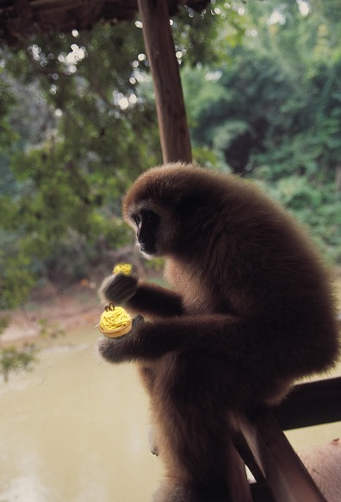
What Can Cause Defilement?
Within 24 hours of eating oxidized cholesterol, animals develop arterial lesions just like those that lead to heart attacks in people.
Dietary Fats and Health, 1983 p. 919-33
Notes:
22

Slide 23

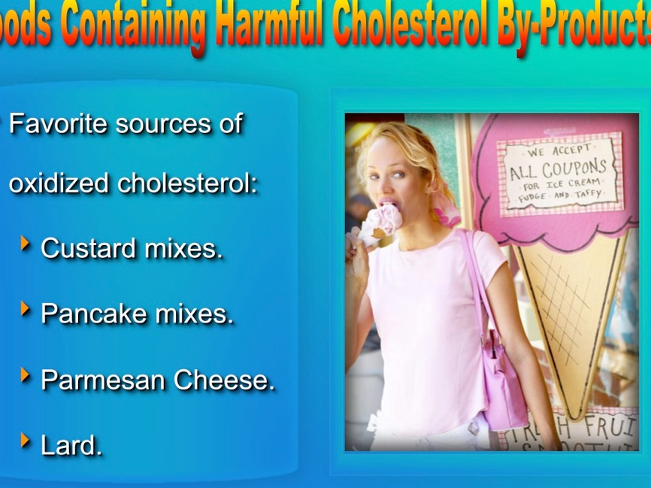

Foods Containing Harmful Cholesterol By-Products
Common sources of oxidized cholesterol include:
  Animal Products.
  Custard mixes.
  Pancake mixes.
  Cheese.
Dietary Fats and Health, 1983 p. 919-33
Notes:
23

Slide 24

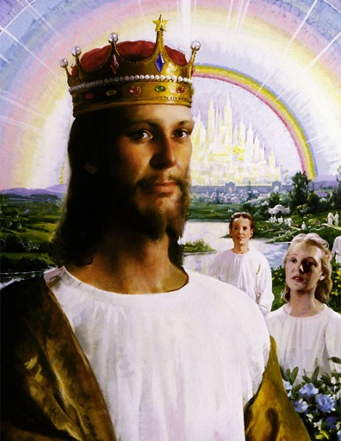
Revelation 21:23,26,27
“And the city had no need of the sun, neither of the moon, to shine in it: for the glory of God did lighten it, … And there shall in no wise enter into it any thing that defileth,”
Notes:
24

Slide 25
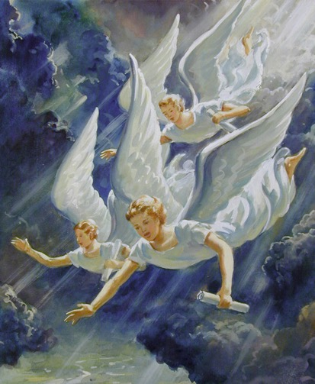
Revelation 14:6,7
“And I saw another angel fly in the midst of heaven…, Saying with a loud voice, Fear God, and give glory to him; for the hour of his judgment is come:”
Notes:
25

Slide 26
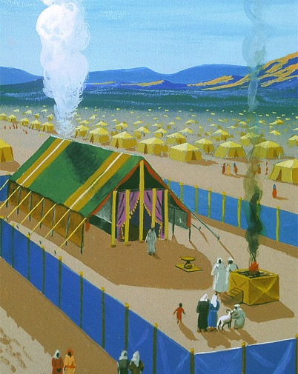
Day of Atonement
The cleansing of the Sanctuary on the day of atonement was a time of judgment for Israel, symbolizing the final judgment.
Notes:
26

Slide 27

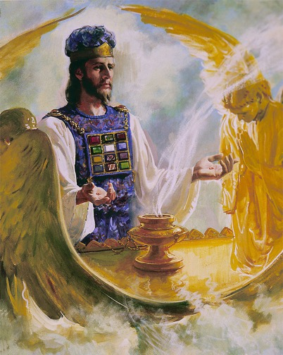
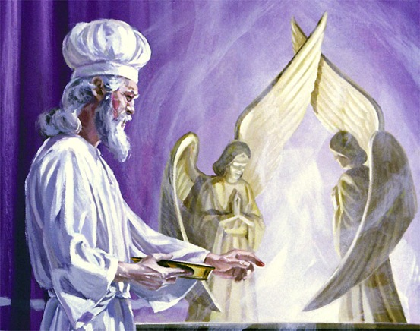
Sanctuary Health:
Day of Atonement
Leviticus 16:29-30 And this shall be a statute for ever unto you: that in the seventh month, on the tenth day of the month, ye shall afflict your souls, and do no work at all, whether it be one of your own country, or a stranger that sojourneth among you: 30. For on that day shall the priest make an atonement for you, to cleanse you, that ye may be clean from all your sins before the LORD.
Psalms 35:13 But as for me, when they were sick, my clothing was sackcloth: I humbled my soul with fasting; and my prayer returned into mine own bosom.
Notes:
27
Humble = afflict

Slide 28

Isaiah 22:12-14
“And in that day did the Lord GOD of hosts call to weeping, and to mourning, and to baldness, and to girding with sackcloth:
“And behold joy and gladness, slaying oxen, and killing sheep, eating flesh, and drinking wine: let us eat and drink; for to morrow we shall die.”
“Surely this iniquity shall not be purged from you till ye die, saith the Lord GOD of hosts.”
Notes:
28

Slide 29
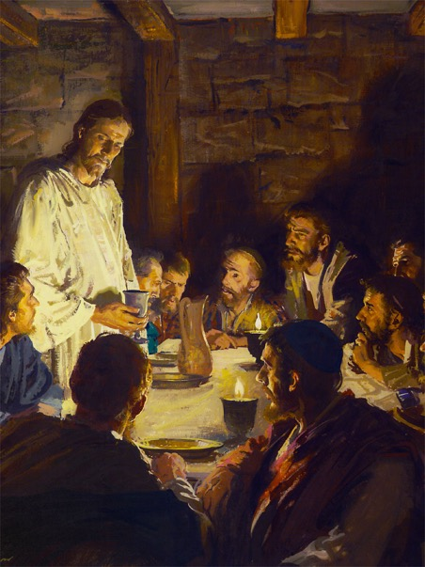
Health Examination
“But let a man examine himself, and so let him eat of that bread, and drink of that cup.
“For he that eateth and drinketh unworthily, eateth and drinketh damnation to himself, not discerning the Lord's body.
“For this cause many are weak and sickly among you, and many sleep.”
1Cor 11:28-30.

Slide 30
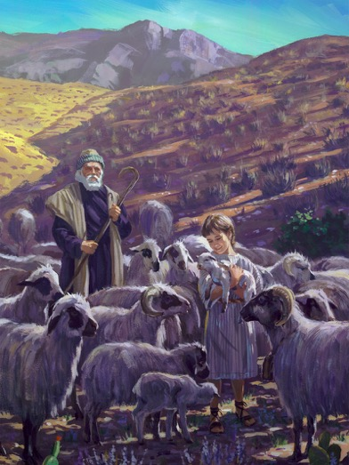
Exodus 12:5
“Your lamb shall be without blemish, a male of the first year: ye shall take it out from the sheep, or from the goats:”

Slide 31
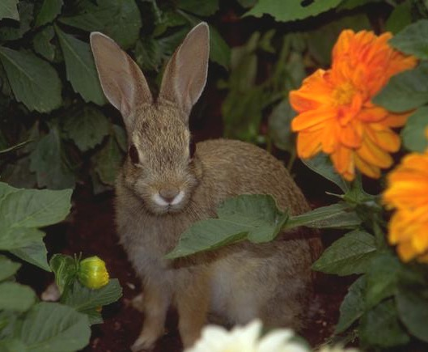
Alzheimer’s and Cholesterol
High cholesterol is a risk factor for Alzheimer's disease.
Rabbits fed cholesterol in their diet develop Alzheimer’s type changes in their brains.
Neurosci Lett. 2004 Oct 14;369(2):87-92. J Mol Neurosci. 2004;24(1):97-104.
Notes:
31

Slide 32
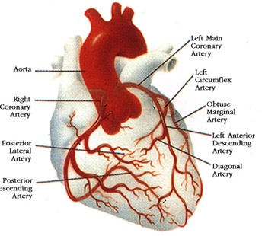
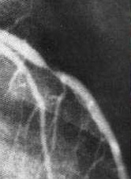
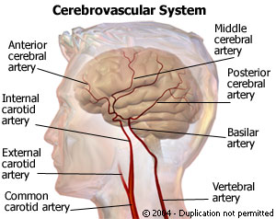
Mental function changes can be detected for blockages of <20%.
We can only detect heart problems at >70% blockage.
Brain
Heart
70%
20%

Slide 33
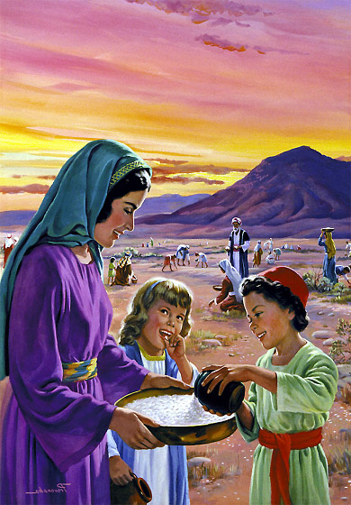
Manna Represents Jesus
“I am the living bread which came down from heaven: if any man eat of this bread, he shall live for ever:” John 6:51.

Slide 34
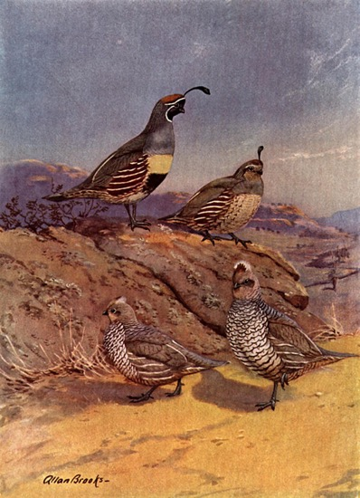
Soul and Body
“And he gave them their request; but sent leanness into their soul.” Psalm 106:14,15.
Notes:
34

Slide 35

Soul and Body
“Beloved, I wish above all things that thou mayest prosper and be in health, even as thy soul prospereth.” 3John 1:2.

Slide 36
How Do I Prosper?
“Believe in the LORD your God, so shall ye be established;
believe his prophets, so shall ye prosper.” 2 Chronicles 20:20.
Notes:
36

Slide 37
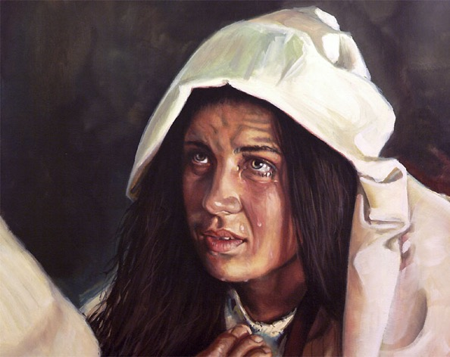
Sozo = Save or Heal
“For the Son of man is come to save that which was lost.” Matthew 18:11.
“And he said unto her, Daughter, thy faith hath made thee whole;” Mark 5:34.

Slide 38

Does Diet Really Have Anything To Do With Salvation?
Yea, hath God said, appetite is a salvational issue?
Ye shall not surely be lost.

Slide 39
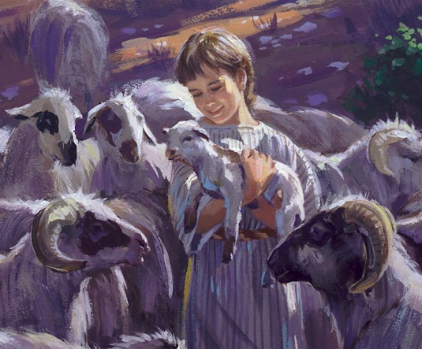
Living Sacrifices, Holy, Acceptable
“I beseech you therefore, brethren, by the mercies of God, that ye present your bodies a living sacrifice, holy, acceptable unto God, which is your reasonable service [Gr. worship].” Romans 12:1.

Slide 40
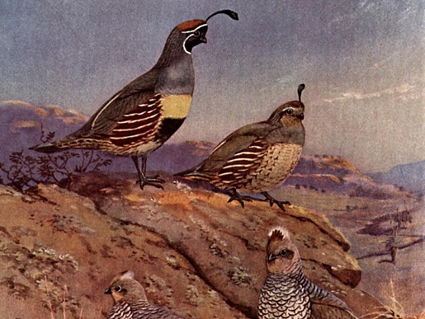
What word does God use to describe Israel's desire for the flesh pots of Egypt?
“And the mixt multitude that was among them fell a lusting: and the children of Israel also wept again, and said, Who shall give us flesh to eat?” Numbers 11:4.

Slide 41

Does Eating Meat Ruin Your Spiritual Life?
“But lusted exceedingly in the wilderness, and tempted God in the desert. And he gave them their request;
“but sent leanness into their soul.” Psalms 106:14,15.
South Med J. 78(7):841-4. UCLA
Notes:
41
Douglass JM, Rasgon IM, Fleiss PM, Schmidt RD, Peters SN, Abelmann EA. Effects of a raw food diet on hypertension and obesity. South Med J. 1985 Jul;78(7):841-4.
Abstract
We examined responses to cooked and uncooked food in 32 outpatients with essential hypertension; 28 were also overweight. By varying cooked and uncooked food percentages and salt intake, patients acted as their own control subjects in this unblinded study. After a mean duration of 6.7 months, average intake of uncooked food comprised 62% of calories ingested. Mean weight loss was 3.8 kg and mean diastolic pressure reduction 17.8 mm Hg, both statistically significant (P less than .00001). Eighty percent of those who smoked or drank alcohol abstained spontaneously.
PMID: 4012382 [PubMed - indexed for MEDLINE]

Slide 42
What other word does God call this lust?
“30 They were not estranged from their lust. But while their meat was yet in their mouths, 31. The wrath of God came upon them, and slew the fattest of them, and smote down the chosen men of Israel. 32. For all this they sinned still, and believed not for his wondrous works.” Psalms 78:30-32

Slide 43
Fresh Fruit and Vegetables
The Natural Plant Based Diet
A 6 month fresh fruit and vegetable diet produced an 8 pound weight loss and a 18 mm Hg blood pressure decrease.
Serendipitously, 80% of those in this study who smoked or drank alcohol abstained spontaneously.
South Med J. 78(7):841-4. UCLA
Notes:
43
Douglass JM, Rasgon IM, Fleiss PM, Schmidt RD, Peters SN, Abelmann EA. Effects of a raw food diet on hypertension and obesity. South Med J. 1985 Jul;78(7):841-4.
Abstract
We examined responses to cooked and uncooked food in 32 outpatients with essential hypertension; 28 were also overweight. By varying cooked and uncooked food percentages and salt intake, patients acted as their own control subjects in this unblinded study. After a mean duration of 6.7 months, average intake of uncooked food comprised 62% of calories ingested. Mean weight loss was 3.8 kg and mean diastolic pressure reduction 17.8 mm Hg, both statistically significant (P less than .00001). Eighty percent of those who smoked or drank alcohol abstained spontaneously.
PMID: 4012382 [PubMed - indexed for MEDLINE]

Slide 44

Philippians 3:18,19
“For many walk, of whom I have told you often,
Notes:
44

Slide 45
Philippians 3:18,19
“For many walk, of whom I have told you often, and now tell you even weeping,
Notes:
45

Slide 46
Philippians 3:18,19
“For many walk, of whom I have told you often, and now tell you even weeping, that they are the enemies of the cross of Christ:
Notes:
46

Slide 47
Philippians 3:18,19
“For many walk, of whom I have told you often, and now tell you even weeping, that they are the enemies of the cross of Christ: Whose end is destruction,
Notes:
47

Slide 48
Philippians 3:18,19
“For many walk, of whom I have told you often, and now tell you even weeping, that they are the enemies of the cross of Christ: Whose end is destruction, whose God is their belly, and whose glory is in their shame, who mind earthly things.”
Notes:
48

Slide 49
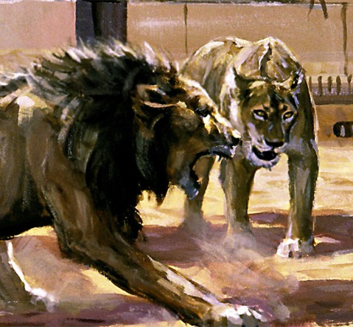
The Lions Head
“Be sober (Be temperate, clear headed), be vigilant; because your adversary the devil, as a roaring lion, walketh about, seeking whom he may devour:” 1Peter 5:8.

Slide 50

Heads or Tails
“And I will put enmity between thee and the woman, and between thy seed and her seed; it shall bruise thy head, and thou shalt bruise his heel.” Genesis 3:15.

Slide 51
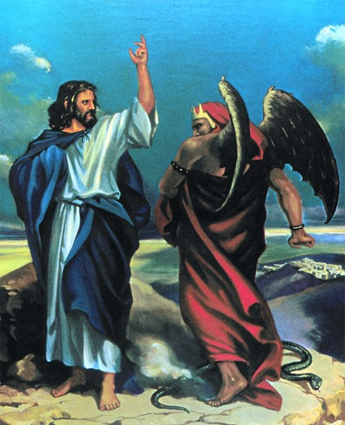
Bruising the Head
“But he answered and said, ‘It is written, Man shall not live by bread alone, but by every word that proceedeth out of the mouth of God.’” Matthew 4:4.

Slide 52
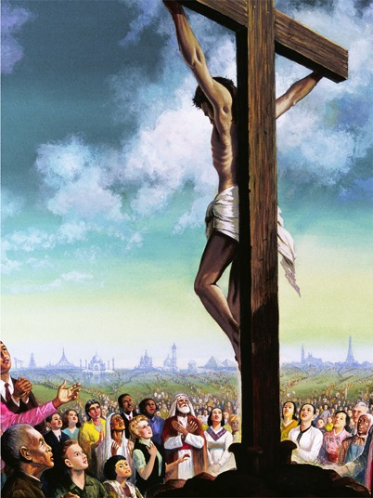
Bruised For Our Iniquities
“But he was wounded for our transgressions, he was bruised for our iniquities: the chastisement of our peace was upon him; and with his stripes we are healed.” Isaiah 53:5.

Slide 53
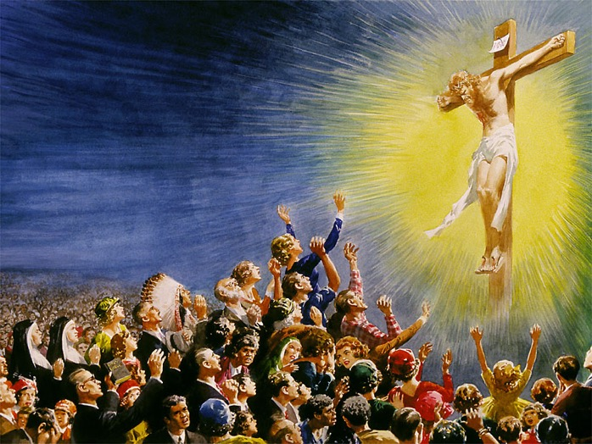
How Did Jesus Bruise Satan’s Head?
“Now is the judgment of this world: now shall the prince of this world be cast out. And I, if I be lifted up from the earth, will draw all men unto me.” John 12:31,32.

Slide 54
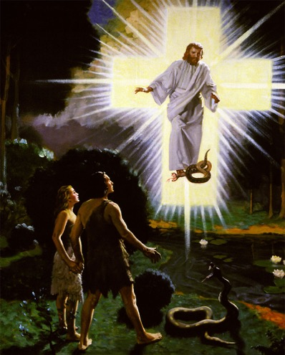
Follow In Jesus Footsteps?
“And the God of peace shall bruise Satan under your feet shortly.” Romans 16:20.

Slide 55
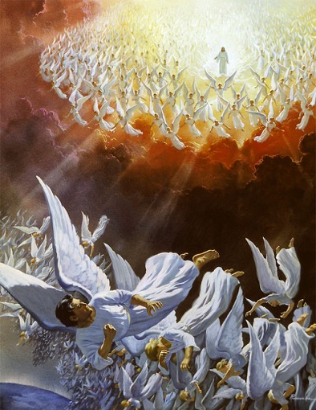
Walk On Satan
“And he said unto them, I beheld Satan as lightning fall from heaven.
“Behold, I give unto you power to tread on serpents and scorpions, and over all the power of the enemy: and nothing shall by any means hurt you.” Luke 10:18-19.

Slide 56
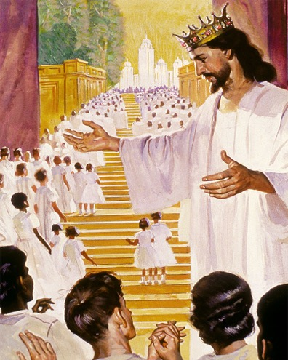
The Overcomers
“And they overcame him by the blood of the Lamb, and by the word of their testimony; and they loved not their lives unto the death.” Revelation 12:11.

Slide 57
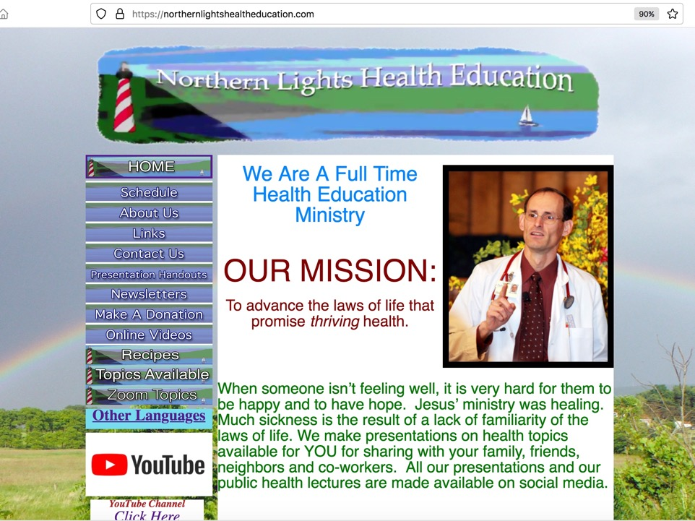
NorthernLightsHealthEducation.com

Slide 58
Glorify God In Your Body
Notes:
In 1Corinthians 6:19 The Bible asks us to glorify God in our body.
Does the current physical state of your body Glorify God?
1 Thessalonians 5:23, tells us that our whole spirit and soul and body are to be sanctified unto the coming of our Lord Jesus Christ.
Have you sanctified your body? set it apart for holy purposes?
Romans 12:1 RSV tells us that part of our spiritual worship is having a body which would make a reasonable sacrifice.
Is your body free of any defiling blemishes?
These are questions we seek to answer in our presentation, Glorify God In Your Body, you won’t want to miss this presentation.
Story/intro:
Benefit/problem solved
Sanctify Soul Body Spirit
Bullet points
Glorify God in your Body
Finish mystery of God
Inspire
Call to action

