Slide 1


Slide 2
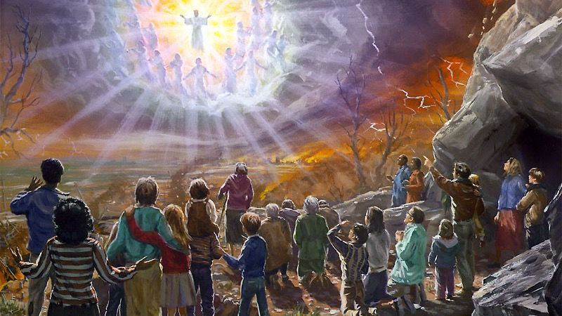
Final Generation
Am I Among The Remnant?
Notes:
Never venture to enter the pulpit until you have wrestled with God in prayer, and come forth as seeing Him who is invisible, with your faces lighted up with beams from the Sun of Righteousness. You will then have no tame words to offer. The divine truths which glow in your own breast will kindle the hearts of others. {GW92 467.2}

Slide 3


Notes:
Reinder Bruinsma’s In All Humility published by Oak and Acorn; George Knight's End-Time Events and the Last Generation and God’s Character and the Last Generation edited by Jiří Moskala and John C. Peckham with contributions from faculty at the Seventh-day Adventist Theological Seminary on the campus of Andrews University, both published by Pacific Press, and Salvation: Contours of Adventist Soteriology, edited by Martin Hanna, Darius W. Jankiewicz and John W. Reeve, and published by Andrews University Press.

Slide 4

What limits your progress?
“Man will rise no higher than his conceptions of truth, purity, and holiness.” {PP 91.2}
Psalms 135:18 They that make them are like unto them: so is every one that trusteth in them.
Notes:
“Higher than the highest human thought can reach is God's ideal for His children.” {Ed 18.3}
Psalms 135:18 They that make them are like unto them: so is every one that trusteth in them.

Slide 5

Who Shall Stand?
“Many will be laid away to sleep before the fiery ordeal of the time of trouble shall come upon our world.” {CH 375.2}.
Notes:
*** Warwick lady, Chris Kemp, I want to be laid to rest before t of t
Do you think any wicked will be laid to rest to escape the tribulation?
“There hath no temptation taken you but such as is common to man: but God is faithful, who will not suffer you to be tempted above that ye are able; but will with the temptation also make a way to escape, that ye may be able to bear it.” 1 Corinthians 10:13.
Gideon's army?

Slide 6

Bible Complete Just for Us
“The Bible has accumulated and bound up together its treasures for this last generation.
“There the whole accumulated truths are presented in force to us that we may profit by their teachings.” {3SM 339.1}
Notes:
Satan seeks to counterwork the work of God, and he is constantly urging men to accept his principles. He represents the chosen people of God as a deluded people. He is an accuser of the brethren, and his accusing power is employed against those who work righteousness. The Lord desires through His people to answer Satan’s charges by showing the results of obedience to right principles. { COL 296.4}
Will any body but the last generation fulfill this?
“The honor of God, the honor of Jesus Christ, is involved in the perfection of your character… Your character is His glory revealed in you.” {SW, October 25, 1898 par. 2}

Slide 7
Will any body but the last generation fulfill this?
“Satan seeks to counterwork the work of God, and he is constantly urging men to accept his principles. He represents the chosen people of God as a deluded people. He is an accuser of the brethren, and his accusing power is employed against those who work righteousness. The Lord desires through His people to answer Satan’s charges by showing the results of obedience to right principles.” {COL 296.4}
“The honor of God, the honor of Jesus Christ, is involved in the perfection of your character… Your character is His glory revealed in you.” {SW, October 25, 1898 par. 2}

Slide 8
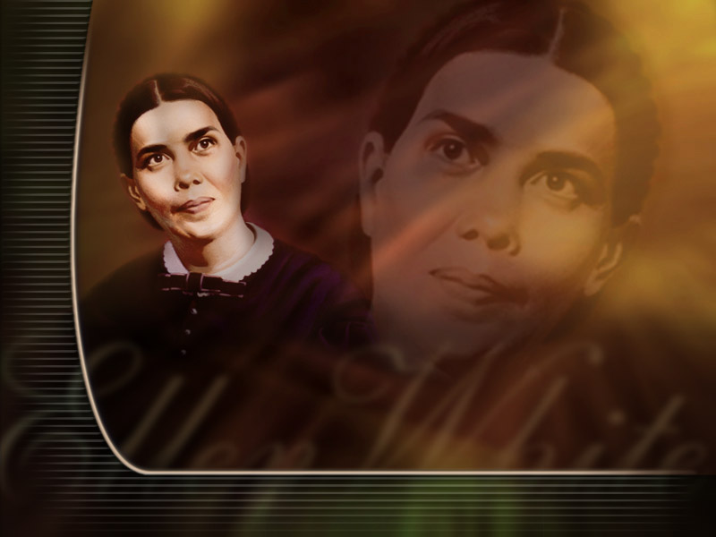
Testimonies Just For Us
“And the dragon was wroth with the woman, and went to make war with the remnant of her seed, which keep the commandments of God, and have the testimony of Jesus Christ.” Revelation 12:17
“In ancient times God spoke to men by the mouth of prophets and apostles. In these days He speaks to them by the testimonies of His Spirit.
“There was never a time when God instructed His people more earnestly than He instructs them now concerning His will and the course that He would have them pursue.” (4T 147).
Notes:
The work of Elder Haskell and others who have labored in Oakland and the nearby places might have been a much greater blessing, had they not been obliged to meet wrong influences in opposition to the counsels that God has given to build up and prepare a people for the final conflict that is before us. {LLM 466.2}
To make plain natural law, and urge the obedience of it, is the work that accompanies the third angel's message, to prepare a people for the coming of the Lord. {PH138 2.1}

Slide 9

The Greatest Wealth Of Truth Ever Entrusted To Mortals
“What advantage then hath the Jew? ... Much every way: chiefly, because that unto them were committed the oracles of God.” Romans 3:1-2
“Seventh-day Adventists have been chosen by God as a peculiar people, separate from the world…. The greatest wealth of truth ever entrusted to mortals, the most solemn and fearful warnings ever sent by God to man, have been committed to them to be given to the world.” {7T 138.2}
Notes:
Of those who boast of their light, and yet fail to walk in it, Christ says, "But I say unto you, It shall be more tolerable for Tyre and Sidon at the day of judgment, than for you. And thou, Capernaum [Seventh-day Adventists, who have had great light], which art exalted unto heaven [in point of privilege], shalt be brought down to hell: for if the mighty works, which have been done in thee, had been done in Sodom, it would have remained until this day. But I say unto you, That it shall be more tolerable for the land of Sodom in the day of judgment, than for thee." At that time Jesus answered and said, "I thank thee, O Father, Lord of heaven and earth, because thou hast hid these things from the wise and prudent [in their own estimation], and hast revealed them unto babes." {RH, August 1, 1893 par. 5}
The remnant people of God, who keep His commandments, will understand the word spoken by Daniel, "Many shall be purified, and made white, and tried; but the wicked shall do wickedly: and none of the wicked shall understand; but the wise shall understand" (Dan. 12:10). {TDG 84.1}

Slide 10
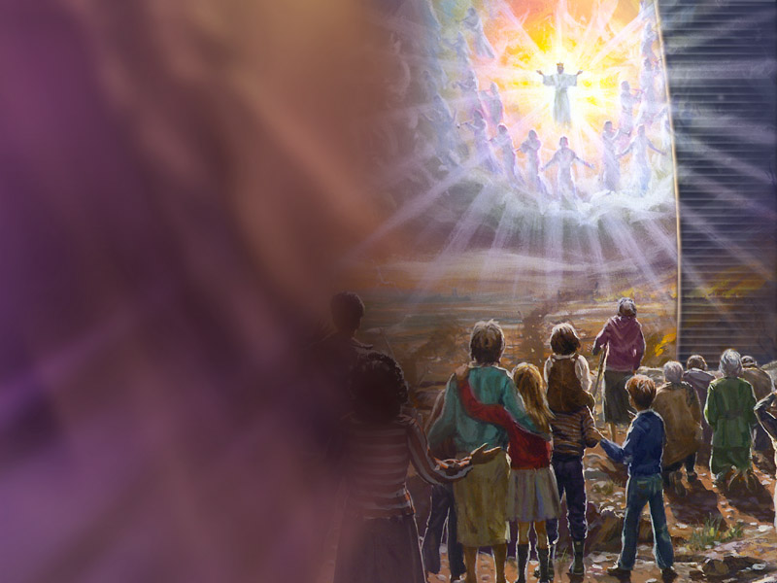
Upon Whom The Ends Of The World Are Come
“Now all these things happened unto them for ensamples: and they are written for our admonition, upon whom the ends of the world are come.” 1 Corinthians 10:11
“I am instructed to say to our churches, Study the Testimonies. They are written for our admonition and encouragement, upon whom the ends of the world are come.” 3SM 358.2

Slide 11
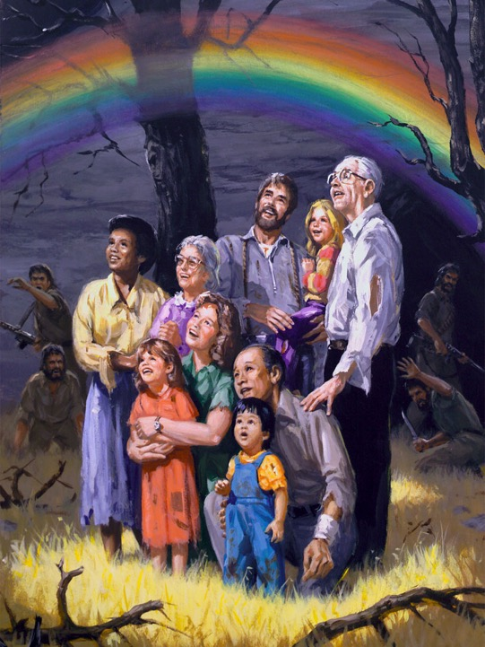
That They Without Us Should Not Be Made Perfect
“And these all, having obtained a good report through faith, received not the promise: 40. God having provided some better thing for us, that they without us should not be made perfect.” Hebrews 11:39-40
“God has a much higher standard for his people to reach than they have reached in the past.” {RH, November 24, 1910 par. 1}
Notes:
Enoch, the seventh from Adam, was ever prophesying the coming of the Lord. This great event had been revealed to him in vision. Abel, though dead, is ever speaking of the blood of Christ which alone can make our offerings and gifts perfect. The Bible has accumulated and bound up together its treasures for this last generation. All the great events and solemn transactions of Old Testament history have been, and are, repeating themselves in the church in these last days. There is Moses still speaking, teaching self-renunciation by wishing himself blotted from the Book of Life for his fellow men, that they might be saved. David is leading the intercession of the church for the salvation of souls to the ends of the earth. The prophets are still testifying of the sufferings of Christ and the glory that should follow. There the whole accumulated truths are presented in force to us that we may profit by their teachings. We are under the influence of the whole. What manner of persons ought we to be to whom all this rich light of inheritance has been given. Concentrating all the influence of the past with new and increased light of the present, accrued power is given to all who will follow the light. Their faith will increase, and be brought into exercise at the present time, awakening an energy and an intensely increased earnestness, and through dependence upon God for His power to replenish the world and send the light of the Sun of Righteousness to the ends of the earth. {3SM 339.1}
Satan seeks to counterwork the work of God, and he is constantly urging men to accept his principles. He represents the chosen people of God as a deluded people. He is an accuser of the brethren, and his accusing power is employed against those who work righteousness. The Lord desires through His people to answer Satan’s charges by showing the results of obedience to right principles. { COL 296.4}
Will any body but the last generation fulfill this? Satan seeks to counterwork the work of God, and he is constantly urging men to accept his principles. He represents the chosen people of God as a deluded people. He is an accuser of the brethren, and his accusing power is employed against those who work righteousness. The Lord desires through His people to answer Satan’s charges by showing the results of obedience to right principles. { COL 296.4}

Slide 12

The sealing.
“The seal of God will never be placed upon the forehead of an impure man or woman.” {5T 216.2}
“Nevertheless the foundation of God standeth sure, having this seal, The Lord knoweth them that are his. And, Let every one that nameth the name of Christ depart from iniquity.” 2 Timothy 2:19
Notes:
The class who do not feel grieved over their own spiritual declension, nor mourn over the sins of others, will be left without the seal of God. The Lord commissions His messengers, the men with slaughtering weapons in their hands: "Go ye after him through the city, and smite: let not your eye spare, neither have ye pity: slay utterly old and young, both maids, and little children, and women: but come not near any man upon whom is the mark; and begin at My sanctuary. Then they began at the ancient men which were before the house." {5T 211.1}
Not one of us will ever receive the seal of God while our characters have one spot or stain upon them. It is left with us to remedy the defects in our characters, to cleanse the soul temple of every defilement. Then the latter rain will fall upon us as the early rain fell upon the disciples on the Day of Pentecost. {5T 214.2}
We are too easily satisfied with our attainments. We feel rich and increased with goods and know not that we are "wretched, and miserable, and poor, and blind, and naked." Now is the time to heed the admonition of the True Witness: "I counsel thee to buy of Me gold tried in the fire, that thou mayest be rich; and white raiment, that thou mayest be clothed, and that the shame of thy nakedness do not appear; and anoint thine eyes with eyesalve, that thou mayest see." {5T 214.3}
Now is the time to prepare. The seal of God will never be placed upon the forehead of an impure man or woman. It will never be placed upon the forehead of the ambitious, world-loving man or woman. It will never be placed upon the forehead of men or women of false tongues or deceitful hearts. All who receive the seal must be without spot before God--candidates for heaven. Go forward, my brethren and sisters. I can only write briefly upon these points at this time, merely calling your attention to the necessity of preparation. Search the Scriptures for yourselves, that you may understand the fearful solemnity of the present hour. {5T 216.2}
2 Timothy 2:19 Nevertheless the foundation of God standeth sure, having this seal, The Lord knoweth them that are his. And, Let every one that nameth the name of Christ depart from iniquity.
Revelation 9:4 And it was commanded them that they should not hurt the grass of the earth, neither any green thing, neither any tree; but only those men which have not the seal of God in their foreheads.

Slide 13
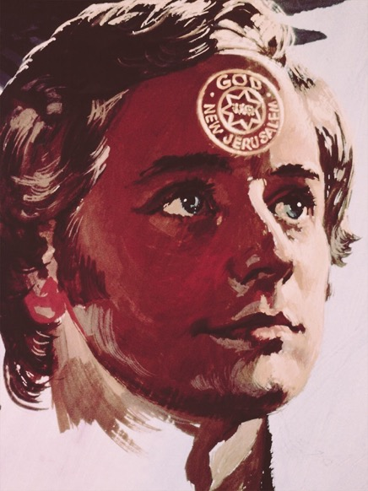
“Upon those who keep the Sabbath of the Lord is laid the responsibility of doing a work of mercy and benevolence.
“Medical missionary work is to be bound up with the message, and sealed with the seal of God.” {WM 121.3}

Slide 14

Pass through shaking Unscathed
“The shaking must soon take place to purify the church.” {2SG 284.1}
“Only those who live by faith in this probationary life, will be able to stand in the day of test, when everything that can be shaken will be shaken, but they shall dwell in safety and be unmoved.” {OHC 354.5}

Slide 15
“If the work of temperance were carried forward by us...there would be a shaking among the people.” {6T 111.1}

Slide 16

Time Of Trouble Such As Never Was
“The ‘time of trouble, such as never was,’ is soon to open upon us; and we shall need an experience which we do not now possess and which many are too indolent to obtain.
“It is often the case that trouble is greater in anticipation than in reality; but this is not true of the crisis before us.” { GC 622.4}
“Now, while our great High Priest is making the atonement for us, we should seek to become perfect in Christ. Not even by a thought could our Saviour be brought to yield to the power of temptation.
“This is the condition in which those must be found who shall stand in the time of trouble.” { GC 623.1}

Slide 17

Why We May Fail
“The reason why many of us will fall in the time of trouble is because of laxity in temperance and indulgence of appetite.” {Te 150.2}

Slide 18

Receive the Latter rain
“Be patient therefore, brethren, unto the coming of the Lord. Behold, the husbandman waiteth for the precious fruit of the earth, and hath long patience for it, until he receive the early and latter rain.” James 5:7
“At that time the ‘latter rain,’ or refreshing from the presence of the Lord, will come, to give power to the loud voice of the third angel, and prepare the saints to stand in the period when the seven last plagues shall be poured out.” { EW 85.3}
Notes:
I saw that many were neglecting the preparation so needful and were looking to the time of “refreshing” and the “latter rain” to fit them to stand in the day of the Lord and to live in His sight. Oh, how many I saw in the time of trouble without a shelter! They had neglected the needful preparation; therefore they could not receive the refreshing that all must have to fit them to live in the sight of a holy God. Those who refuse to be hewed by the prophets and fail to purify their souls in obeying the whole truth, and who are willing to believe that their condition is far better than it really is, will come up to the time of the falling of the plagues, and then see that they needed to be hewed and squared for the building. But there will be no time then to do it and no Mediator to plead their cause before the Father. Before this time the awfully solemn declaration has gone forth, “He that is unjust, let him be unjust still: and he which is filthy, let him be filthy still: and he that is righteous, let him be righteous still: and he that is holy, let him be holy still.” I saw that none could share the “refreshing” unless they obtain the victory over every besetment, over pride, selfishness, love of the world, and over every wrong word and action. We should, therefore, be drawing nearer and nearer to the Lord and be earnestly seeking that preparation necessary to enable us to stand in the battle in the day of the Lord. Let all remember that God is holy and that none but holy beings can ever dwell in His presence. { EW 71.2}
The third angel’s message is swelling into a loud cry, and you must not feel at liberty to neglect the present duty, and still entertain the idea that at some future time you will be the recipients of great blessing, when without any effort on your part a wonderful revival will take place. Today you are to give yourselves to God, that he may make of you vessels unto honor, and meet for his service. Today you are to give yourself to God, that you may be emptied of self, emptied of envy, jealousy, evil-surmising, strife, everything that shall be dishonoring to God. Today you are to have your vessel purified that it may be ready for the heavenly dew, ready for the showers of the latter rain; for the latter rain will come, and the blessing of God will fill every soul that is purified from every defilement. It is our work today to yield our souls to Christ, that we may be fitted for the time of refreshing from the presence of the Lord—fitted for the baptism of the Holy Spirit. { RH March 22, 1892, par. 13 }

Slide 19

Ripened First Fruits
“The harvest is the end of the world; and the reapers are the angels.” Matthew 13:39
“But when the fruit is ripe (margin), immediately he putteth in the sickle, because the harvest is come.” Mark 4:29
“And another angel came out of the temple, crying with a loud voice to him that sat on the cloud, Thrust in thy sickle, and reap: for the time is come for thee to reap; for the harvest of the earth is ripe.” Revelation 14:15

Slide 20
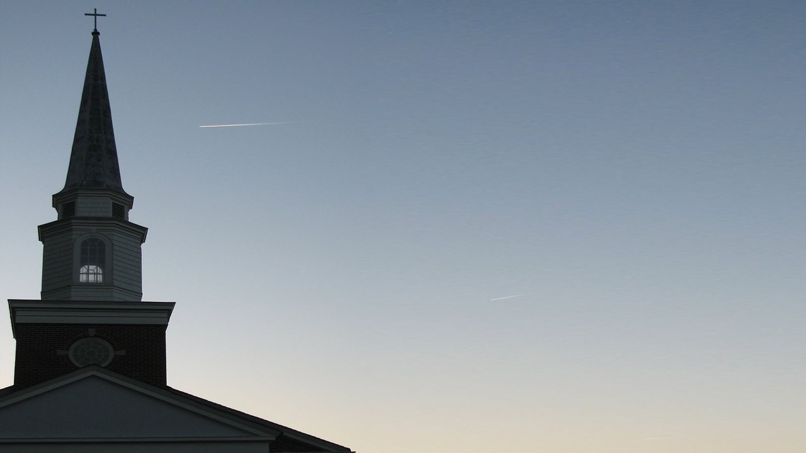
United Church
Ephesians 4:13 “Till we all come in the unity of the faith, and of the knowledge of the Son of God, unto a perfect man, unto the measure of the stature of the fulness of Christ:”
“The 144,000 were all sealed and perfectly united.” { EW 15.1}
Notes:
“When we are united in the unity for which Christ prayed, this long controversy that has been kept up through satanic agency will end, and we shall not see men framing plans after the order of the world because they have not spiritual eyesight to discern spiritual things. They now see men as trees walking, and they need the divine touch, that they may see as God sees, and work as Christ worked. Then will Zion’s watchmen unitedly sound the trumpet in clearer, louder notes; for they will see the sword coming, and realize the danger in which the people of God are placed. { LS 327.1}
The 144,000 were all sealed and perfectly united. On their foreheads was written, God, New Jerusalem, and a glorious star containing Jesus’ new name. At our happy, holy state the wicked were enraged, and would rush violently up to lay hands on us to thrust us into prison, when we would stretch forth the hand in the name of the Lord, and they would fall helpless to the ground. Then it was that the synagogue of Satan knew that God had loved us who could wash one another’s feet and salute the brethren with a holy kiss, and they worshiped at our feet. { EW 15.1}
The time has come when everything that can be shaken will be shaken. We are in the shaking time. Be assured that only those who live the prayer of Christ for unity among His disciples, working it out in practical life, will stand the test. { RH June 18, 1901, par. 1 }
When the Holy Spirit controls the minds of our church members, there will be seen in our churches a much higher standard in speech, in ministry, in spirituality, than is now seen. The church members will be refreshed by the water of life, and the laborers, working under one Head, even Christ, will reveal their Master in spirit, in word, in deed, and will encourage one another to press forward in the grand, closing work in which we are engaged. There will be a healthy increase of unity and love, which will bear testimony to the world that God sent His Son to die for the redemption of sinners. Divine truth will be exalted; and as it shines forth as a lamp that burneth, we shall understand it more and still more clearly. { 8T 211.2}

Slide 21

Overcomers
“Everyone who by faith obeys God's commandments will reach the condition of sinlessness in which Adam lived before his transgression.” {HP 146.5}
“By precept and example make it plain that the food which God gave Adam in his sinless state is the best for man's use as he seeks to regain that sinless state.” {7T 135.2}
Notes:
adam

Slide 22

The Ruin Of Thousands
“The controlling power of appetite will prove the ruin of thousands, when, if they had conquered on this point, they would have had moral power to gain the victory over every other temptation of Satan.
“And as we near the close of time, Satan's temptation to indulge appetite will be more powerful and more difficult to overcome.” {CH 574.2}

Slide 23

Bruise Satan completely
Romans 16:20 “And the God of peace shall bruise Satan under your feet shortly. The grace of our Lord Jesus Christ be with you. Amen.”
“The church will yet see troublous times.
“But although she must meet heresies and persecutions, although she must battle with the infidel and the apostate, yet by the help of God she is bruising the head of Satan.” {4T 594.3}

Slide 24
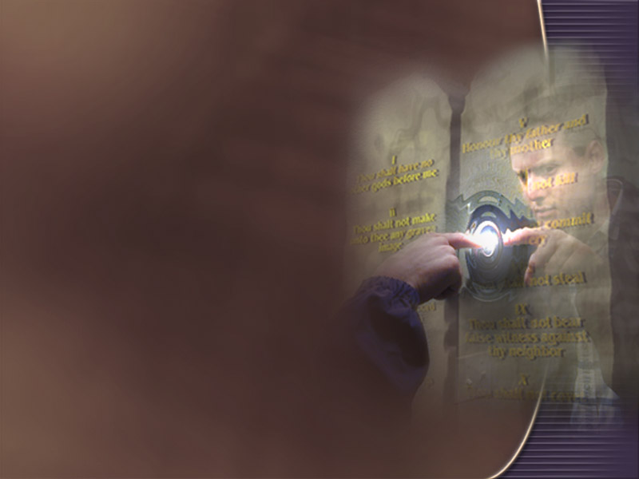
Keep Commandments as Jesus Did
“Here is the patience of the saints: here are they that keep the commandments of God, and the faith of Jesus.” Revelation 14:12
“He who has not sufficient faith in Christ, to believe that he can keep him from sinning, has not the faith that will give him an entrance to the kingdom of God.” {3SM 360}

Slide 25
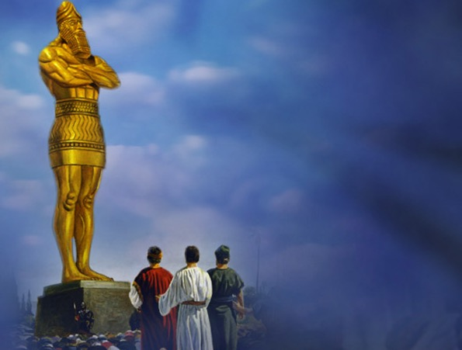

“Those who have had the light upon the subjects of eating and dressing with simplicity, in obedience to physical and moral laws, and who turn from the light which points out their duty, will shun duty in other things.
“If they blunt their consciences to avoid the cross which they will have to take up to be in harmony with natural law, they will, in order to shun reproach, violate the ten commandments.” CH p.105.
Notes:
CH p.105

Slide 26
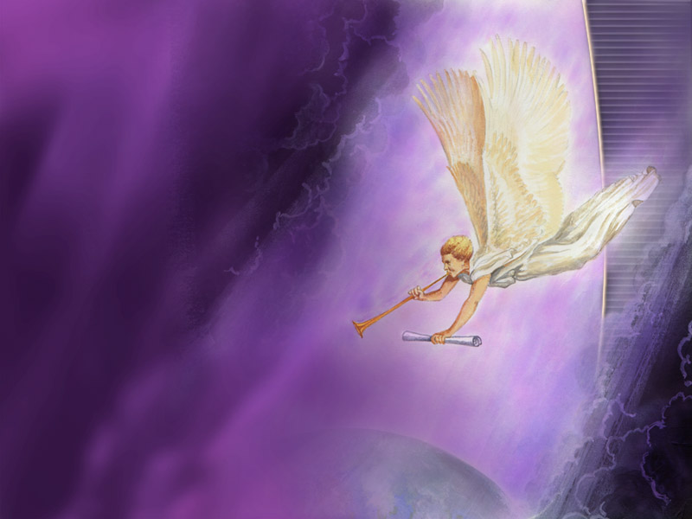
The mystery of God finished
“But in the days of the voice of the seventh angel, when he shall begin to sound, the mystery of God should be finished, as he hath declared to his servants the prophets.” Revelation 10:7.
“To whom God would make known what is the riches of the glory of this mystery among the Gentiles; which is Christ in you, the hope of glory:” Colossians 1:27.
What? know ye not that your body is the temple of the Holy Ghost which is in you, which ye have of God, and ye are not your own? For ye are bought with a price: therefore glorify God in your body, and in your spirit, which are God's. 1 Corinthians 6:19-20.

Slide 27
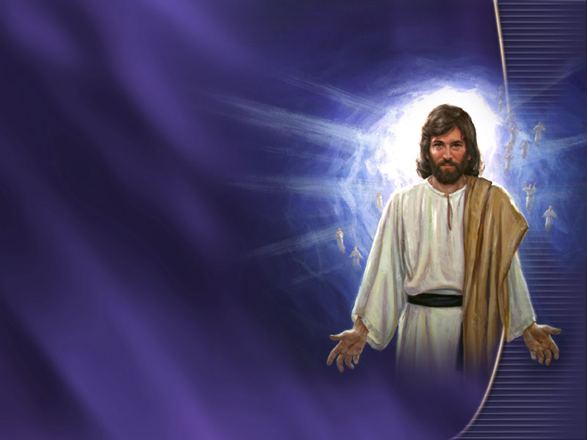
Come To Claim Them As His Own
“Herein is our love made perfect, that we may have boldness in the day of judgment: because as he is, so are we in this world.” 1 John 4:17
“When the fruit is brought forth, immediately he putteth in the sickle, because the harvest is come.” Christ is waiting with longing desire for the manifestation of Himself in His church. When the character of Christ shall be perfectly reproduced in His people, then He will come to claim them as His own.” { COL 69.1}

Slide 28

144,000
“And I looked, and, lo, a Lamb stood on the mount Sion, and with him an hundred forty and four thousand, having his Father's name written in their foreheads.” Revelation 14:1
“Let us strive with all the power that God has given us to be among the hundred and forty-four thousand.” {Mar 241.9}
Notes:
Soon we heard the voice of God like many waters, which gave us the day and hour of Jesus' coming. The living saints, 144,000 in number, knew and understood the voice, while the wicked thought it was thunder and an earthquake. When God spake the time, He poured upon us the Holy Spirit, and our faces began to light up and shine with the glory of God, as Moses' did when he came down from Mount Sinai. {1T 59.1}
The 144,000 were all sealed and perfectly united. On their foreheads were the words God, New Jerusalem, and a glorious star containing Jesus' new name. At our happy, holy state the wicked were enraged, and would rush violently up to lay hands on us to thrust us into prison, when we would stretch forth the hand in the name of the Lord, and they would fall helpless to the ground. Then it was that the synagogue of Satan knew that God had loved us, who could wash one another's feet, and salute the brethren with a holy kiss, and they worshiped at our feet. {1T 59.2}

Slide 29
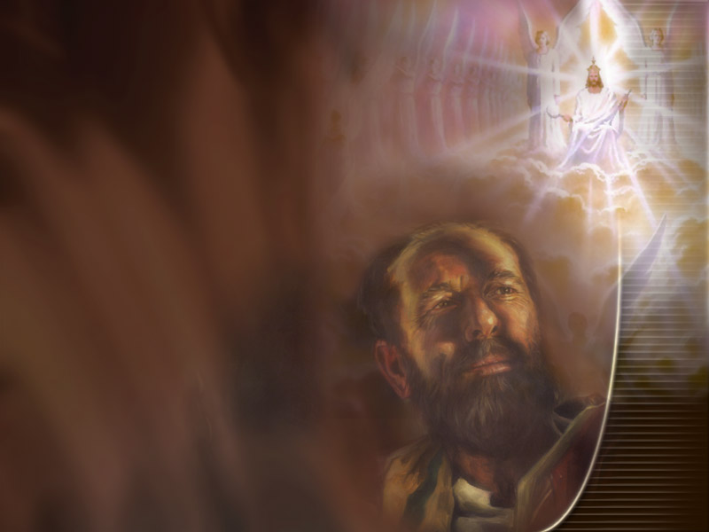
Preparing to be translated.
“Then we which are alive and remain shall be caught up together with them in the clouds, to meet the Lord in the air: and so shall we ever be with the Lord.” 1 Thessalonians 4:17
“God's people will separate themselves from the unrighteous practices of those around them, and will seek for purity of thought, and holy conformity to his will, until his divine image will be reflected in them. Like Enoch they will be fitting for translation to Heaven.” {3SG 59.1}
Notes:
Among those who are waiting for the coming of the Lord, meat eating will eventually be done away; flesh will cease to form a part of their diet. We should ever keep this end in view, and endeavor to work steadily toward it. I cannot think that in the practice of flesh eating we are in harmony with the light which God has been pleased to give us. All who are connected with our health institutions especially should be educating themselves to subsist on fruits, grains, and vegetables. If we move from principle in these things, if we as Christian reformers educate our own taste, and bring our diet to God's plan, then we may exert an influence upon others in this matter, which will be pleasing to God. {CD 380.4}
God is leading out a people who are peculiar. He will cleanse and purify them, and fit them for translation. Every carnal thing will be separated from God's peculiar treasures until they shall be like gold seven times purified. {1T 430.2}
If ever there was a time when the diet should be of the most simple kind, it is now. Meat should not be placed before our children. Its influence is to excite and strengthen the lower passions, and has a tendency to deaden the moral powers. Grains and fruits prepared free from grease, and in as natural a condition as possible, should be the food for the tables of all who claim to be preparing for translation to heaven. The less feverish the diet, the more easily can the passions be controlled. Gratification of taste should not be consulted irrespective of physical, intellectual, or moral health. {CD 63.3}
Those who come up to every point, and stand every test, and overcome, be the price what it may, have heeded the counsel of the True Witness, and they will receive the latter rain, and thus be fitted for translation. {1T 187.1}
God proves His people in this world. This is the fitting-up place to appear in His presence. Here, in this world, in these last days, persons will show what power affects their hearts and controls their actions. If it is the power of divine truth, it will lead to good works. It will elevate the receiver, and make him noblehearted and generous, like his divine Lord. But if evil angels control the heart, it will be seen in various ways. The fruit will be selfishness, covetousness, pride, and evil passions. {1T 188.1}
God's people will separate themselves from the unrighteous practices of those around them, and will seek for purity of thought, and holy conformity to his will, until his divine image will be reflected in them. Like Enoch they will be fitting for translation to Heaven. While they endeavor to instruct and warn the world, they will not conform to the spirit and customs of unbelievers, but will condemn them by their holy conversation and godly example. Enoch's translation to Heaven just before the destruction of the world by a flood, represents the translation of all the living righteous from the earth previous to its destruction by fire. The saints will be glorified in the presence of those who have hated them for their loyal obedience to God's righteous commandments. {3SG 59.1}
In order to be fitted for translation, the people of God must know themselves. They must understand in regard to their own physical frames that they may be able with the psalmist to exclaim: "I will praise Thee; for I am fearfully and wonderfully made." They should ever have the appetite in subjection to the moral and intellectual organs. The body should be servant to the mind, and not the mind to the body. {1T 486.3}
But the Lord reproves and corrects the people who profess to keep His law. He points out their sins and lays open their iniquity because He wishes to separate all sin and wickedness from them, that they may perfect holiness in His fear and be prepared to die in the Lord or to be translated to heaven. God rebukes, reproves, and corrects them, that they may be refined, sanctified, elevated, and finally exalted to His own throne. {2T 452.2}
Those who have trained the mind to delight in spiritual exercises are the ones who can be translated and not be overwhelmed with the purity and transcendent glory of heaven. You may have a good knowledge of the arts, you may have an acquaintance with the sciences, you may excel in music and in penmanship, your manners may please your associates, but what have these things to do with a preparation for heaven? What have they to do to prepare you to stand before the tribunal of God? {2T 267.1}
Be not deceived. God is not mocked. Nothing but holiness will prepare you for heaven. It is sincere, experimental piety alone that can give you a pure, elevated character and enable you to enter into the presence of God, who dwelleth in light unapproachable. The heavenly character must be acquired on earth, or it can never be acquired at all. Then begin at once. Flatter not yourself that a time will come when you can make an earnest effort easier than now. Every day increases your distance from God. Prepare for eternity with such zeal as you have not yet manifested. Educate your mind to love the Bible, to love the prayer meeting, to love the hour of meditation, and, above all, the hour when the soul communes with God. Become heavenly-minded if you would unite with the heavenly choir in the mansions above. {2T 267.2}
Oh, there is a great work to be done for the people of God, ere they are prepared for translation to heaven! The heat of the furnace upon some must be severe to reveal the dross. Self will have to be crucified. When each believer is to the very extent of his knowledge obeying the Lord, and yet seeking to give no just occasion to his fellow men to oppress him, he should not fear the results, even though it be imprisonment and death.... {OHC 323.3}
The Christian life is constantly an onward march. Jesus sits as a refiner and purifier of His people; and when His image is perfectly reflected in them, they are perfect and holy, and prepared for translation. A great work is required of the Christian. We are exhorted to cleanse ourselves from all filthiness of the flesh and spirit, perfecting holiness in the fear of God. Here we see where the great labor rests. There is a constant work for the Christian. Every branch in the parent vine must derive life and strength from that vine, in order to yield fruit. {1T 340.4}

Slide 30

Give the Loud Cry
“And after these things I saw another angel come down from heaven, having great power; and the earth was lightened with his glory.” Revelation 18:1-4
“The health reform, I was shown, is a part of the third angel’s message and is just as closely connected with it as are the arm and hand with the human body.
“God’s people are not prepared for the loud cry of the third angel.
“Having therefore these promises, dearly beloved, let us cleanse ourselves from all filthiness of the flesh and spirit, perfecting holiness in the fear of God.”
“Gluttony is the prevailing sin of this age. Lustful appetite makes slaves of men and women, and beclouds their intellects and stupefies their moral sensibilities to such a degree that the sacred, elevated truths of God’s word are not appreciated.” { 1T 486.2}
Notes:
I was shown that if God's people make no efforts on their part, but wait for the refreshing to come upon them and remove their wrongs and correct their errors; if they depend upon that to cleanse them from filthiness of the flesh and spirit, and fit them to engage in the loud cry of the third angel, they will be found wanting. The refreshing or power of God comes only on those who have prepared themselves for it by doing the work which God bids them, namely, cleansing themselves from all filthiness of the flesh and spirit, perfecting holiness in the fear of God. {1T 619.1}
And in this last generation the parable of the mustard seed is to reach a signal and triumphant fulfillment. The little seed will become a tree. The last message of warning and mercy is to go to "every nation and kindred and tongue" (Rev. 14:6-14), "to take out of them a people for His name" (Acts 15:14; Rev. 18:1). And the earth shall be lightened with His glory. {COL 79.3}

Slide 31
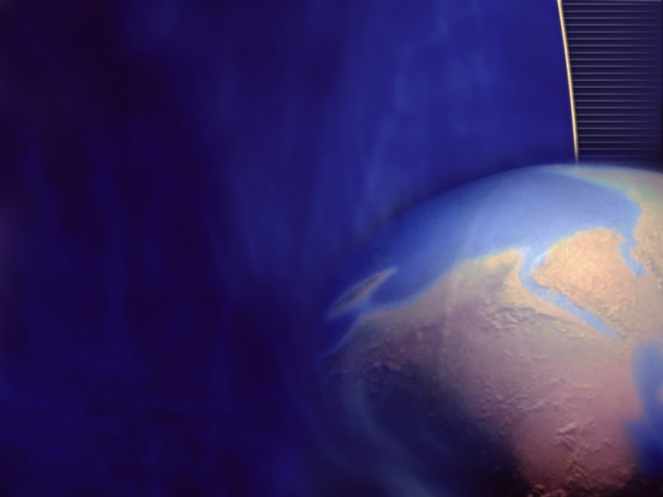
This gospel of the kingdom to all the world.
“And this gospel of the kingdom shall be preached in all the world for a witness unto all nations; and then shall the end come.” Matthew 24:14
“The work which the church has failed to do in a time of peace and prosperity she will have to do in a terrible crisis under most discouraging, forbidding circumstances.
“The warnings that worldly conformity has silenced or withheld must be given under the fiercest opposition from enemies of the faith.” {5T 463.2}
“I wish to tell you that soon there will be no work done in ministerial lines but medical missionary work.” {CH 533.1}
Notes:
The agencies of Satan are having their last chance to develop before the world, before angels and men, the true principles of their attributes. The people of God are now to stand as representatives of the attributes of the Father and the Son. "Watch therefore: for ye know not what hour your Lord doth come." {RH, April 14, 1896 par. 9}
The work which the church has failed to do in a time of peace and prosperity she will have to do in a terrible crisis under most discouraging, forbidding circumstances. The warnings that worldly conformity has silenced or withheld must be given under the fiercest opposition from enemies of the faith. And at that time the superficial, conservative class, whose influence has steadily retarded the progress of the work, will renounce the faith and take their stand with its avowed enemies, toward whom their sympathies have long been tending. These apostates will then manifest the most bitter enmity, doing all in their power to oppress and malign their former brethren and to excite indignation against them. This day is just before us. The members of the church will individually be tested and proved. They will be placed in circumstances where they will be forced to bear witness for the truth. Many will be called to speak before councils and in courts of justice, perhaps separately and alone. The experience which would have helped them in this emergency they have neglected to obtain, and their souls are burdened with remorse for wasted opportunities and neglected privileges. {5T 463.2}
In the prophecy of Jerusalem's destruction Christ said, "Because iniquity shall abound, the love of many shall wax cold. But he that shall endure unto the end, the same shall be saved. And this gospel of the kingdom shall be preached in all the world for a witness unto all nations; and then shall the end come." This prophecy will again be fulfilled. The abounding iniquity of that day finds its counterpart in this generation. So with the prediction in regard to the preaching of the gospel. Before the fall of Jerusalem, Paul, writing by the Holy Spirit, declared that the gospel was preached to "every creature which is under heaven." Col. 1:23. So now, before the coming of the Son of man, the everlasting gospel is to be preached "to every nation, and kindred, and tongue, and people." Rev. 14:6, 14. God "hath appointed a day, in the which He will judge the world." Acts 17:31. Christ tells us when that day shall be ushered in. He does not say that all the world will be converted, but that "this gospel of the kingdom shall be preached in all the world for a witness unto all nations; and then shall the end come." By giving the gospel to the world it is in our power to hasten our Lord's return. We are not only to look for but to hasten the coming of the day of God. 2 Peter 3:12, margin. Had the church of Christ done her appointed work as the Lord ordained, the whole world would before this have been warned, and the Lord Jesus would have come to our earth in power and great glory. {DA 633.3}

Slide 32
Why Did This Generation Get a Health Message?
“And the very God of peace sanctify you wholly; and I pray God your whole spirit and soul and body be preserved blameless unto the coming of our Lord Jesus Christ.” 1 Thessalonians 5:23.
“The health reform is closely connected with the work of the third message,…
“Its place is among those subjects which set forth the preparatory work to meet the events brought to view by the message; among these it is prominent.” {1T 559.2}

Slide 33

Health for End Times
“A reform in the habits of life is especially needed at this time, in order to fit a people for the coming of Christ.
“Hygienic reform is a subject that we need to understand in order to be prepared for the events that are close upon us.”
“For those who are looking for the coming of the Lord, for those who are called to be laborers in His vineyard—for all who are fitting themselves for a place in the everlasting kingdom—how important that the brain be clear and the body as free as possible from disease.” Ms59-1890.

Slide 34
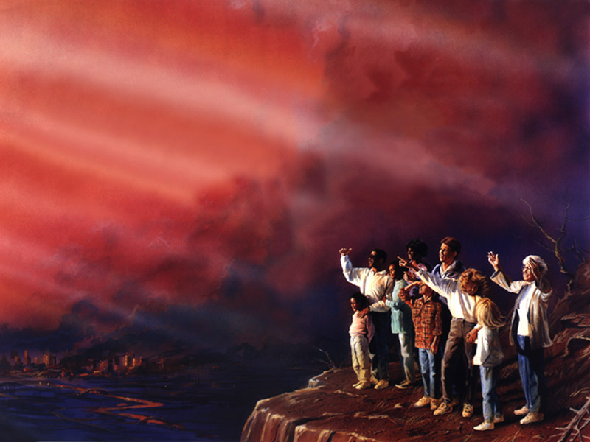
For Our Salvation And The Salvation Of The World
“I saw that our heavenly Father has bestowed upon us the great blessing of light upon the health reform that we may obey the claims which He has upon us and glorify Him in our bodies and spirits which are His and finally stand without fault before the throne of God.
“There are but few as yet who are aroused sufficiently to understand how much their habits of diet have to do with their health, their characters, their usefulness in this world, and their eternal destiny.”{1T 488}
“The light God has given on health reform is for our salvation and the salvation of the world.” {CD 461.1}
Notes:
DANIEL

Slide 35
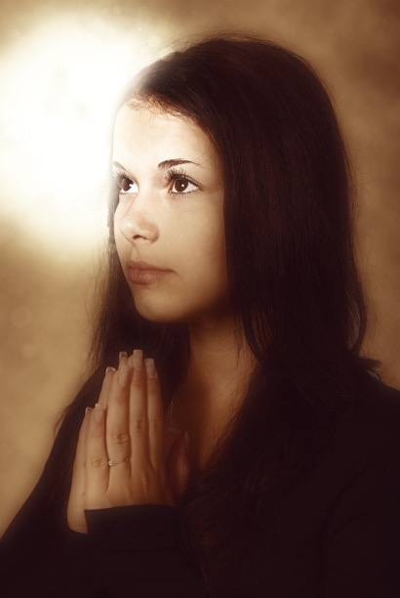
Important Aid
“Sinful indulgence defiles the body and unfits men for spiritual worship.
“He who cherishes the light which God has given him upon health reform has an important aid in the work of becoming sanctified through the truth, and fitted for immortality.
“But if he disregards that light and lives in violation of natural law, he must pay the penalty; his spiritual powers are benumbed, and how can he perfect holiness in the fear of God?” CH 22.2

Slide 36
Diet: Preparing to be translated.
Philippians 4:5 “Let your moderation be known unto all men. The Lord is at hand.”
“Among those who are waiting for the coming of the Lord, meat eating will eventually be done away; flesh will cease to form a part of their diet.” {CD 380.4}
“If ever there was a time when the diet should be of the most simple kind, it is now.
“Meat should not be placed before our children. Its influence is to excite and strengthen the lower passions, and has a tendency to deaden the moral powers.
“Grains and fruits prepared free from grease, and in as natural a condition as possible, should be the food for the tables of all who claim to be preparing for translation to heaven. The less feverish the diet, the more easily can the passions be controlled.” {CD 63.3}
Notes:
Among those who are waiting for the coming of the Lord, meat eating will eventually be done away; flesh will cease to form a part of their diet. We should ever keep this end in view, and endeavor to work steadily toward it. I cannot think that in the practice of flesh eating we are in harmony with the light which God has been pleased to give us. All who are connected with our health institutions especially should be educating themselves to subsist on fruits, grains, and vegetables. If we move from principle in these things, if we as Christian reformers educate our own taste, and bring our diet to God's plan, then we may exert an influence upon others in this matter, which will be pleasing to God. {CD 380.4}
If ever there was a time when the diet should be of the most simple kind, it is now. Meat should not be placed before our children. Its influence is to excite and strengthen the lower passions, and has a tendency to deaden the moral powers. Grains and fruits prepared free from grease, and in as natural a condition as possible, should be the food for the tables of all who claim to be preparing for translation to heaven. The less feverish the diet, the more easily can the passions be controlled. Gratification of taste should not be consulted irrespective of physical, intellectual, or moral health. {CD 63.3}
Those who come up to every point, and stand every test, and overcome, be the price what it may, have heeded the counsel of the True Witness, and they will receive the latter rain, and thus be fitted for translation. {1T 187.1}
God proves His people in this world. This is the fitting-up place to appear in His presence. Here, in this world, in these last days, persons will show what power affects their hearts and controls their actions. If it is the power of divine truth, it will lead to good works. It will elevate the receiver, and make him noblehearted and generous, like his divine Lord. But if evil angels control the heart, it will be seen in various ways. The fruit will be selfishness, covetousness, pride, and evil passions. {1T 188.1}
God's people will separate themselves from the unrighteous practices of those around them, and will seek for purity of thought, and holy conformity to his will, until his divine image will be reflected in them. Like Enoch they will be fitting for translation to Heaven. While they endeavor to instruct and warn the world, they will not conform to the spirit and customs of unbelievers, but will condemn them by their holy conversation and godly example. Enoch's translation to Heaven just before the destruction of the world by a flood, represents the translation of all the living righteous from the earth previous to its destruction by fire. The saints will be glorified in the presence of those who have hated them for their loyal obedience to God's righteous commandments. {3SG 59.1}
In order to be fitted for translation, the people of God must know themselves. They must understand in regard to their own physical frames that they may be able with the psalmist to exclaim: "I will praise Thee; for I am fearfully and wonderfully made." They should ever have the appetite in subjection to the moral and intellectual organs. The body should be servant to the mind, and not the mind to the body. {1T 486.3}
But the Lord reproves and corrects the people who profess to keep His law. He points out their sins and lays open their iniquity because He wishes to separate all sin and wickedness from them, that they may perfect holiness in His fear and be prepared to die in the Lord or to be translated to heaven. God rebukes, reproves, and corrects them, that they may be refined, sanctified, elevated, and finally exalted to His own throne. {2T 452.2}
Those who have trained the mind to delight in spiritual exercises are the ones who can be translated and not be overwhelmed with the purity and transcendent glory of heaven. You may have a good knowledge of the arts, you may have an acquaintance with the sciences, you may excel in music and in penmanship, your manners may please your associates, but what have these things to do with a preparation for heaven? What have they to do to prepare you to stand before the tribunal of God? {2T 267.1}
Be not deceived. God is not mocked. Nothing but holiness will prepare you for heaven. It is sincere, experimental piety alone that can give you a pure, elevated character and enable you to enter into the presence of God, who dwelleth in light unapproachable. The heavenly character must be acquired on earth, or it can never be acquired at all. Then begin at once. Flatter not yourself that a time will come when you can make an earnest effort easier than now. Every day increases your distance from God. Prepare for eternity with such zeal as you have not yet manifested. Educate your mind to love the Bible, to love the prayer meeting, to love the hour of meditation, and, above all, the hour when the soul communes with God. Become heavenly-minded if you would unite with the heavenly choir in the mansions above. {2T 267.2}

Slide 37

Walk No More
“Greater reforms should be seen among the people who claim to be looking for the soon appearing of Christ.
“There are those who ought to be awake to the danger of meat eating, who are still eating the flesh of animals, thus endangering the physical, mental, and spiritual health.
“Many who are now only half converted on the question of meat eating will go from God's people, to walk no more with them.” CH 575.2

Slide 38
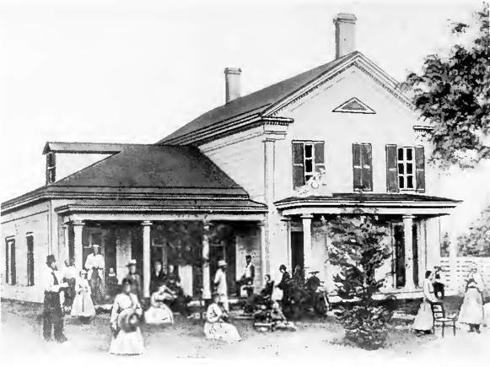
Gospel Includes Health Reform
“The Lord has given instruction that the gospel is to be carried forward, and the gospel includes health reform in all its phases.
“Our work is to enlighten the world, for it is blind to the movements which are taking place, preparing the way for the plagues which God will permit to come upon the world.” Ms172-1899.8

Slide 39
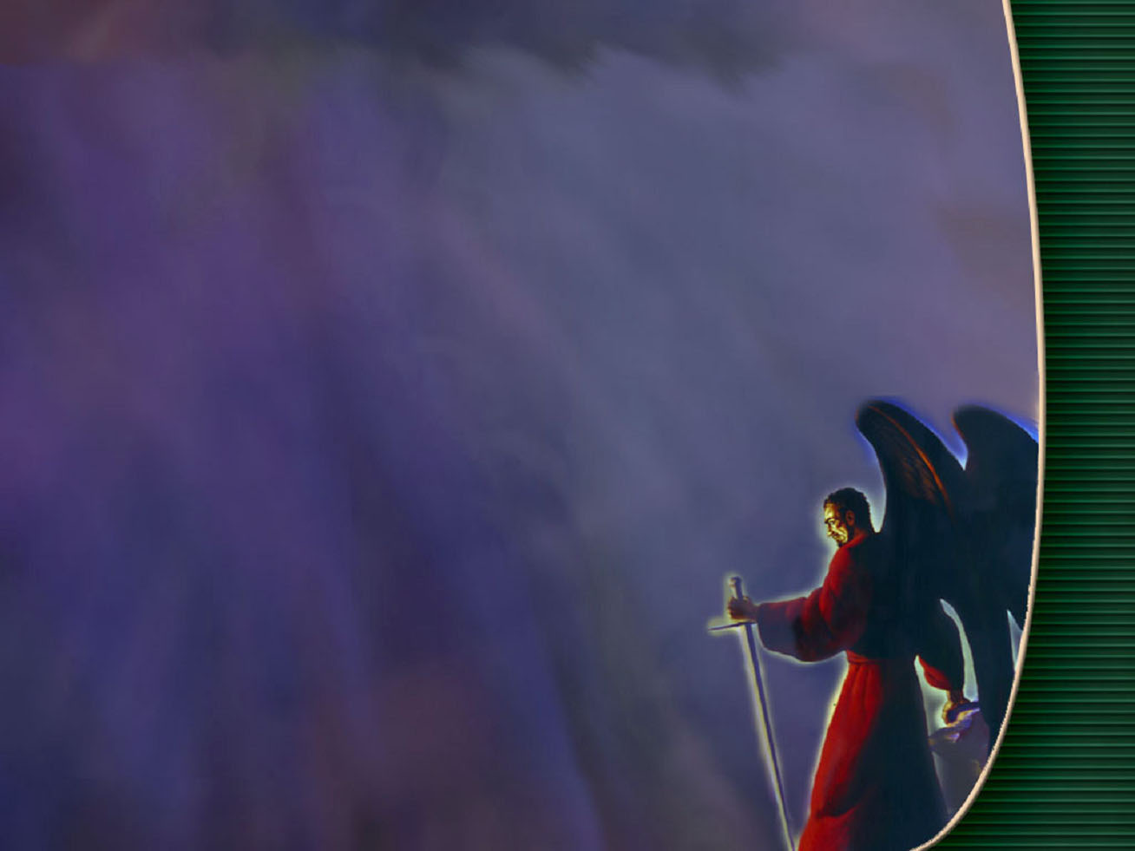
He Knoweth That He Hath But A Short Time
“Woe to the inhabiters of the earth and of the sea! for the devil is come down unto you, having great wrath, because he knoweth that he hath but a short time.” Revelation 12:12
“It is impossible to give any idea of the experience of the people of God who shall be alive upon the earth when celestial glory and a repetition of the persecutions of the past are blended.” {9T 16.1}
Notes:
Daniel 11:44 But tidings out of the east and out of the north shall trouble him: therefore he shall go forth with great fury to destroy, and utterly to make away many.
The great controversy between good and evil will increase in intensity to the very close of time. In all ages the wrath of Satan has been manifested against the church of Christ; and God has bestowed His grace and Spirit upon His people to strengthen them to stand against the power of the evil one. When the apostles of Christ were to bear His gospel to the world and to record it for all future ages, they were especially endowed with the enlightenment of the Spirit. But as the church approaches her final deliverance, Satan is to work with greater power. He comes down "having great wrath, because he knoweth that he hath but a short time." Revelation 12:12. He will work "with all power and signs and lying wonders." 2 Thessalonians 2:9. For six thousand years that mastermind that once was highest among the angels of God has been wholly bent to the work of deception and ruin. And all the depths of satanic skill and subtlety acquired, all the cruelty developed, during these struggles of the ages, will be brought to bear against God's people in the final conflict. And in this time of peril the followers of Christ are to bear to the world the warning of the Lord's second advent; and a people are to be prepared to stand before Him at His coming, "without spot, and blameless." 2 Peter 3:14. At this time the special endowment of divine grace and power is not less needful to the church than in apostolic days. {GC ix.4}
Satan is a diligent Bible student. He knows that his time is short, and he seeks at every point to counterwork the work of the Lord upon this earth. It is impossible to give any idea of the experience of the people of God who shall be alive upon the earth when celestial glory and a repetition of the persecutions of the past are blended. They will walk in the light proceeding from the throne of God. By means of the angels there will be constant communication between heaven and earth. And Satan, surrounded by evil angels, and claiming to be God, will work miracles of all kinds, to deceive, if possible, the very elect. God's people will not find their safety in working miracles, for Satan will counterfeit the miracles that will be wrought. God's tried and tested people will find their power in the sign spoken of in Exodus 31:12-18. They are to take their stand on the living word: "It is written." This is the only foundation upon which they can stand securely. Those who have broken their covenant with God will in that day be without God and without hope. {9T 16.1}
The apostle John in vision heard a loud voice in Heaven exclaiming, "Woe to the inhabiters of the earth and of the sea! for the devil is come down unto you, having great wrath, because he knoweth that he hath but a short time." [REV. 12:12.] Fearful are the scenes which call forth this exclamation from the heavenly voice. The wrath of Satan increases as his time grows short, and his work of deceit and destruction reaches its culmination in the time of trouble. God's long-suffering has ended. The world has rejected his mercy, despised his love, and trampled upon his law. The wicked have passed the boundary of their probation, and the Lord withdraws his protection, and leaves them to the mercy of the leader they have chosen. Satan will have power over those who have yielded themselves to his control, and he will plunge the inhabitants of the earth into one great, final trouble. As the angels of God cease to hold in check the fierce winds of human passion, all the elements of strife will be let loose. The whole world will be involved in ruin more terrible than that which came upon Jerusalem of old. {4SP 440.3}

Slide 40

Probations Close
“ He that is unjust, let him be unjust still: and he which is filthy, let him be filthy still: and he that is righteous, let him be righteous still: and he that is holy, let him be holy still.” Revelation 22:11
“When the Lord comes, those who are holy will be holy still. Those who have preserved their bodies and spirits in holiness, in sanctification and honor, will then receive the finishing touch of immortality.” { 2T 355.1}

Slide 41
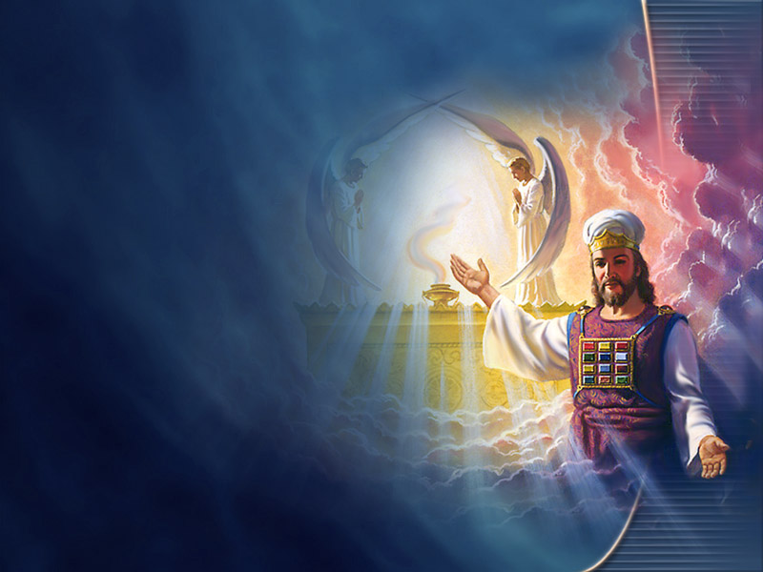
With out an intercessor
“And at that time shall Michael stand up, the great prince which standeth for the children of thy people: and there shall be a time of trouble, such as never was since there was a nation even to that same time: and at that time thy people shall be delivered, every one that shall be found written in the book.” Daniel 12:1
“As Jesus moved out of the most holy place, I heard the tinkling of the bells upon His garment; and as He left, a cloud of darkness covered the inhabitants of the earth. There was then no mediator between guilty man and an offended God.
“In that fearful time, after the close of Jesus’ mediation, the saints were living in the sight of a holy God without an intercessor.” { EW 280.2}

Slide 42
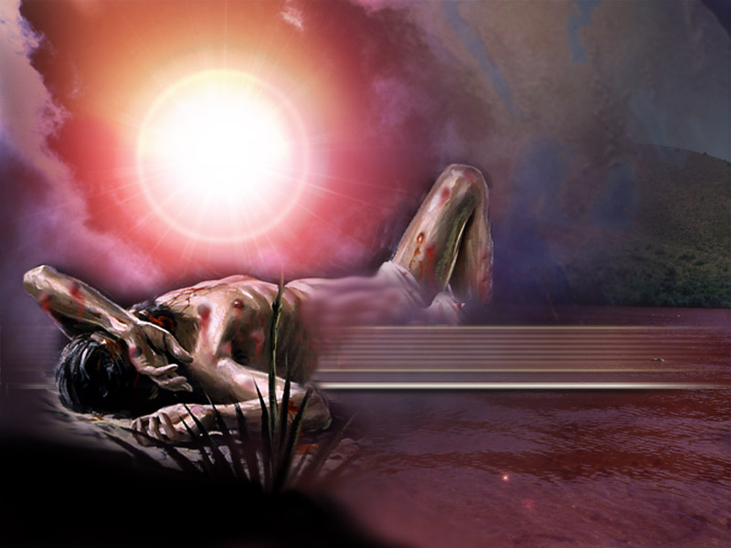
Seven Last Plagues
“Those who refuse to be hewed by the prophets and fail to purify their souls in obeying the whole truth, and who are willing to believe that their condition is far better than it really is, will come up to the time of the falling of the plagues, and then see that they needed to be hewed and squared for the building. But there will be no time then to do it and no Mediator to plead their cause before the Father.” {EW 71.2}
Notes:
Neither of you have seen the necessity of health reform, but when the plagues of God shall be all around you, you will then see the principles of health reform and strict temperance in all things,--that temperance alone is the foundation of all the graces that come from God, the foundation of all victories to be gained. {Te 201.4}

Slide 43
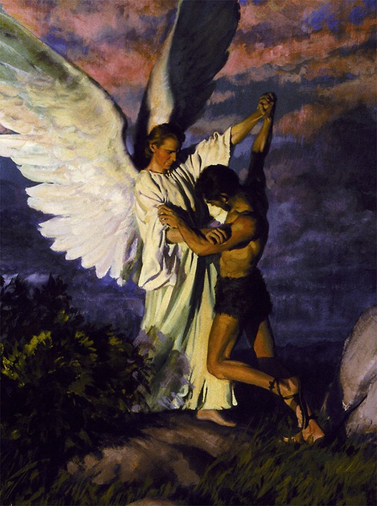
Time Of Jacobs Trouble
“Alas! for that day is great, so that none is like it: it is even the time of Jacob's trouble; but he shall be saved out of it.” Jeremiah 30:7
“These plagues enraged the wicked against the righteous; they thought that we had brought the judgments of God upon them, and that if they could rid the earth of us, the plagues would then be stayed.
“A decree went forth to slay the saints, which caused them to cry day and night for deliverance. This was the time of Jacob's trouble. Then all the saints cried out with anguish of spirit, and were delivered by the voice of God.” {EW 36.2}
Notes:
I saw that the four angels would hold the four winds until Jesus' work was done in the sanctuary, and then will come the seven last plagues. These plagues enraged the wicked against the righteous; they thought that we had brought the judgments of God upon them, and that if they could rid the earth of us, the plagues would then be stayed. A decree went forth to slay the saints, which caused them to cry day and night for deliverance. This was the time of Jacob's trouble. Then all the saints cried out with anguish of spirit, and were delivered by the voice of God. The 144,000 triumphed. Their faces were lighted up with the glory of God. Then I was shown a company who were howling in agony. On their garments was written in large characters, "Thou art weighed in the balance, and found wanting." I asked who this company were. The angel said, "These are they who have once kept the Sabbath and have given it up." I heard them cry with a loud voice, "We have believed in Thy coming, and taught it with energy." And while they were speaking, their eyes would fall upon their garments and see the writing, and then they would wail aloud. I saw that they had drunk of the deep waters, and fouled the residue with their feet--trodden the Sabbath underfoot-- and that was why they were weighed in the balance and found wanting. {EW 36.2}
It was an hour of fearful, terrible agony to the saints. Day and night they cried unto God for deliverance. To outward appearance, there was no possibility of their escape. The wicked had already begun to triumph, crying out, "Why doesn't your God deliver you out of our hands? Why don't you go up and save your lives?" But the saints heeded them not, Like Jacob, they were wrestling with God. The angels longed to deliver them, but they must wait a little longer; the people of God must drink of the cup and be baptized with the baptism. The angels, faithful to their trust, continued their watch. God would not suffer His name to be reproached among the heathen. The time had nearly come when He was to manifest His mighty power and gloriously deliver His saints. For His name's glory He would deliver every one of those who had patiently waited for Him and whose names were written in the book. {EW 283.2}
Had not Jacob previously repented of his sin in obtaining the birthright by fraud, God would not have heard his prayer and mercifully preserved his life. So, in the time of trouble, if the people of God had unconfessed sins to appear before them while tortured with fear and anguish, they would be overwhelmed; despair would cut off their faith, and they could not have confidence to plead with God for deliverance. But while they have a deep sense of their unworthiness, they have no concealed wrongs to reveal. Their sins have gone beforehand to judgment and have been blotted out, and they cannot bring them to remembrance. {GC 620.1}
As the approach of the Roman armies was a sign to the disciples of the impending destruction of Jerusalem, so may this apostasy be a sign to us that the limit of God's forbearance is reached, that the measure of our nation's iniquity is full, and that the angel of mercy is about to take her flight, never to return. The people of God will then be plunged into those scenes of affliction and distress which prophets have described as the time of Jacob's trouble. The cries of the faithful, persecuted ones ascend to heaven. And as the blood of Abel cried from the ground, there are voices also crying to God from martyrs' graves, from the sepulchers of the sea, from mountain caverns, from convent vaults: "How long, O Lord, holy and true, dost Thou not judge and avenge our blood on them that dwell on the earth?" {5T 451.2}
In these days of peril those who have been unfaithful in their duties in life, and whose mistakes and sins of neglect are registered against them in the book in Heaven, unrepented of and unforgiven, will be overcome by Satan. Every one is to be tested and severely tried. Satan will exert all his energies, and call to his aid his evil host, who will exercise all their experience, artifice, and cunning, to deceive souls and wrest them from the hands of Jesus Christ. He makes them believe they may be unfaithful in the minor duties of life, and God will not see, God will not notice; but that Being who numbers the hairs of our head, and marks the fall of the little sparrow, notices every deviation from truth, every departure from honor and integrity in both secular and religious things. These errors and sins corrupt the man, and disqualify him for the society of heavenly angels. By his defiled character he has placed himself under the flag of Satan. The arch deceiver has power over this class. The more exalted their profession, the more honorable the position they have held, the more grievous their course in the sight of God, the more sure the triumph of Satan. These will have no shelter in the time of Jacob’s trouble. Their sins will then appear of such magnitude that they will have no confidence to pray, no heart to wrestle as did Jacob. On the other hand, those who have been of like passion, erring and sinful in their lives, but who have repented of their sins, and in genuine sorrow confessed them, will have pardon written against their names in the heavenly records. They will be hid ‘in the day of the Lord’s anger. Satan will attack this class, but like Jacob they have taken hold of the strength of God, and true to his character he is at peace with them, and sends angels to comfort and bless and sustain them in their time of peril. The time of Jacob’s trouble will test every one, and distinguish the genuine Christian from the one who is so only in name. { ST November 27, 1879, par. 6 }
Thou hast proved mine heart; thou hast visited me in the night; thou hast tried me, and shalt find nothing; I am purposed that my mouth shall not transgress. Psalms 17:3.

Slide 44
Insure Deliverance In The Time Of Trouble
“Let none be discouraged in view of the severe trials to be met in the time of Jacob’s trouble, which is yet before them. They are to work earnestly, anxiously, not for that time, but for today. What we want is to have a knowledge of the truth as it is in Christ now, and a personal experience now. In these precious closing hours of probation, we have a deep and living experience to gain. We shall thus form characters that will insure our deliverance in the time of trouble.” { RH August 12, 1884, par. 10 }
Notes:
I saw that the four angels would hold the four winds until Jesus' work was done in the sanctuary, and then will come the seven last plagues. These plagues enraged the wicked against the righteous; they thought that we had brought the judgments of God upon them, and that if they could rid the earth of us, the plagues would then be stayed. A decree went forth to slay the saints, which caused them to cry day and night for deliverance. This was the time of Jacob's trouble. Then all the saints cried out with anguish of spirit, and were delivered by the voice of God. The 144,000 triumphed. Their faces were lighted up with the glory of God. Then I was shown a company who were howling in agony. On their garments was written in large characters, "Thou art weighed in the balance, and found wanting." I asked who this company were. The angel said, "These are they who have once kept the Sabbath and have given it up." I heard them cry with a loud voice, "We have believed in Thy coming, and taught it with energy." And while they were speaking, their eyes would fall upon their garments and see the writing, and then they would wail aloud. I saw that they had drunk of the deep waters, and fouled the residue with their feet--trodden the Sabbath underfoot-- and that was why they were weighed in the balance and found wanting. {EW 36.2}
It was an hour of fearful, terrible agony to the saints. Day and night they cried unto God for deliverance. To outward appearance, there was no possibility of their escape. The wicked had already begun to triumph, crying out, "Why doesn't your God deliver you out of our hands? Why don't you go up and save your lives?" But the saints heeded them not, Like Jacob, they were wrestling with God. The angels longed to deliver them, but they must wait a little longer; the people of God must drink of the cup and be baptized with the baptism. The angels, faithful to their trust, continued their watch. God would not suffer His name to be reproached among the heathen. The time had nearly come when He was to manifest His mighty power and gloriously deliver His saints. For His name's glory He would deliver every one of those who had patiently waited for Him and whose names were written in the book. {EW 283.2}
Had not Jacob previously repented of his sin in obtaining the birthright by fraud, God would not have heard his prayer and mercifully preserved his life. So, in the time of trouble, if the people of God had unconfessed sins to appear before them while tortured with fear and anguish, they would be overwhelmed; despair would cut off their faith, and they could not have confidence to plead with God for deliverance. But while they have a deep sense of their unworthiness, they have no concealed wrongs to reveal. Their sins have gone beforehand to judgment and have been blotted out, and they cannot bring them to remembrance. {GC 620.1}
As the approach of the Roman armies was a sign to the disciples of the impending destruction of Jerusalem, so may this apostasy be a sign to us that the limit of God's forbearance is reached, that the measure of our nation's iniquity is full, and that the angel of mercy is about to take her flight, never to return. The people of God will then be plunged into those scenes of affliction and distress which prophets have described as the time of Jacob's trouble. The cries of the faithful, persecuted ones ascend to heaven. And as the blood of Abel cried from the ground, there are voices also crying to God from martyrs' graves, from the sepulchers of the sea, from mountain caverns, from convent vaults: "How long, O Lord, holy and true, dost Thou not judge and avenge our blood on them that dwell on the earth?" {5T 451.2}
In these days of peril those who have been unfaithful in their duties in life, and whose mistakes and sins of neglect are registered against them in the book in Heaven, unrepented of and unforgiven, will be overcome by Satan. Every one is to be tested and severely tried. Satan will exert all his energies, and call to his aid his evil host, who will exercise all their experience, artifice, and cunning, to deceive souls and wrest them from the hands of Jesus Christ. He makes them believe they may be unfaithful in the minor duties of life, and God will not see, God will not notice; but that Being who numbers the hairs of our head, and marks the fall of the little sparrow, notices every deviation from truth, every departure from honor and integrity in both secular and religious things. These errors and sins corrupt the man, and disqualify him for the society of heavenly angels. By his defiled character he has placed himself under the flag of Satan. The arch deceiver has power over this class. The more exalted their profession, the more honorable the position they have held, the more grievous their course in the sight of God, the more sure the triumph of Satan. These will have no shelter in the time of Jacob’s trouble. Their sins will then appear of such magnitude that they will have no confidence to pray, no heart to wrestle as did Jacob. On the other hand, those who have been of like passion, erring and sinful in their lives, but who have repented of their sins, and in genuine sorrow confessed them, will have pardon written against their names in the heavenly records. They will be hid ‘in the day of the Lord’s anger. Satan will attack this class, but like Jacob they have taken hold of the strength of God, and true to his character he is at peace with them, and sends angels to comfort and bless and sustain them in their time of peril. The time of Jacob’s trouble will test every one, and distinguish the genuine Christian from the one who is so only in name. { ST November 27, 1879, par. 6 }
Thou hast proved mine heart; thou hast visited me in the night; thou hast tried me, and shalt find nothing; I am purposed that my mouth shall not transgress. Psalms 17:3.

Slide 45
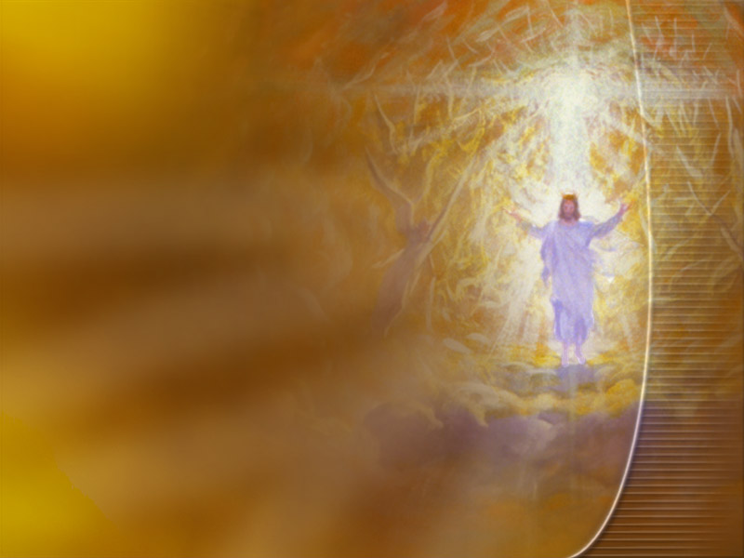
Who may abide the day of his coming?
“Soon our eyes were drawn to the east, for a small black cloud had appeared, about half as large as a man's hand, which we all knew was the sign of the Son of man.
“Upon His head were many crowns. His feet had the appearance of fire; in His right hand was a sharp sickle; in His left, a silver trumpet. His eyes were as a flame of fire, which searched His children through and through.
“Then all faces gathered paleness, and those that God had rejected gathered blackness. Then we all cried out, "Who shall be able to stand? Is my robe spotless?" Then the angels ceased to sing, and there was some time of awful silence,
“when Jesus spoke: "Those who have clean hands and pure hearts shall be able to stand; My grace is sufficient for you." At this our faces lighted up, and joy filled every heart. And the angels struck a note higher and sang again, while the cloud drew still nearer the earth.” {EW 15.2}

Slide 46
Summary, God Has A Special Generation Who:
Will not be laid to rest before the time of trouble.
Have been given a special health message to prepare for the second coming.
Are not shaken out.
Receive the seal of God.
Receive the latter rain.
Ripen as first fruits unto God.
Form a united church.
Overcome sin and Satan.
Keep the Commandments as Jesus did.
Sing a special song.
Finish the mystery of God on earth.
Develop a character like Christ’s.
Give the loud cry.
Fulfill the Gospel commission.
Endure the wrath of Satan, Time of trouble, close of probation, seven last plagues.
Can stand in God’s presence unashamed.
Have the Testimony of Jesus.
Are translated without seeing death.

