Slide 1

Notes:
Psa_103:3 Who forgiveth all thine iniquities; who healeth all thy diseases;
Good better best
This talk could get me.....
If at Church, I’d get....

Slide 2
Disclaimer:
God has put you in charge of your health. You are your own best doctor. The following is not a substitute for your personal responsibility in caring for your God given body. As always, if you have any further questions or concerns about your health you should consult your chosen and trusted health information source, and common sense. By watching this presentation your are agreeing to the terms of service, including not making any judgment prior to hearing the entire topic.

Slide 3

Drug Medications:
Let The Fourth Angel Sound!
“And I heard another voice from heaven, saying, Come out of her, my people, that ye be not partakers of her sins, and that ye receive not of her plagues.” Revelation 18:4.

Slide 4


Slide 5
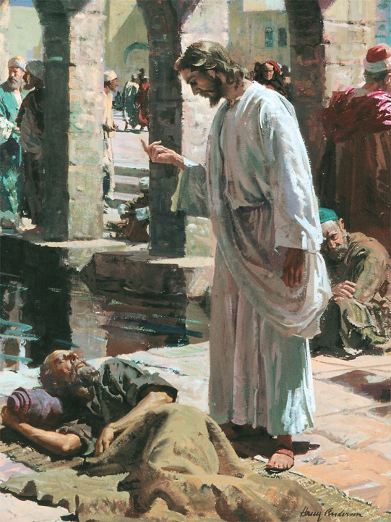
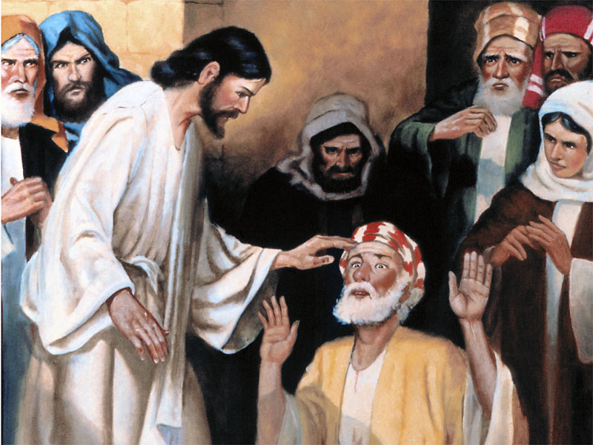
Notes:
Pleased to be here, can share with out prejudice.
Jesus spent more time healing than preaching.
God wants to be your healer!
Clay on congenitally blind man's eyes.
Free of filthy lucre.

Slide 6
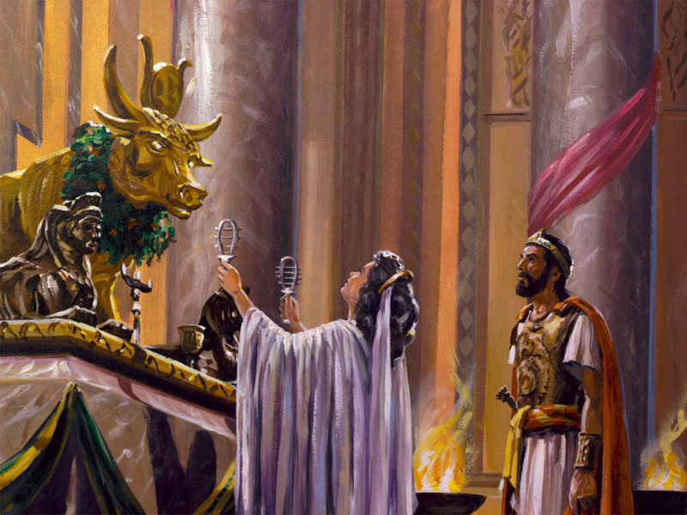
Ekron: A New Image For A New World
"Ahaziah fell down through a lattice in his upper chamber that was in Samaria, and was sick: and he sent messengers, and said unto them, Go, inquire of Baal-zebub the god of Ekron whether I shall recover of this disease.
“But the angel of the Lord said to Elijah the Tishbite, Arise, go up to meet the messengers of the king of Samaria, and say unto them, Is it not because there is not a God in Israel, that ye go to inquire of Baal-zebub the god of Ekron? Now therefore thus saith the Lord, Thou shalt not come down from that bed on which thou art gone up, but shalt surely die." {5T 191.2}

Slide 7
Ekron: A New Image For A New World
“During the father's reign, Ahaziah had witnessed the wondrous works of the Most High.
“Instead of humbling his heart before the Lord, he had followed after Baal, and at last he had ventured upon this, his most daring act of impiety.
“Rebellious, and unwilling to repent, Ahaziah died, "according to the word of the Lord which Elijah had spoken." {PK 209.2}
Notes:
God wants to be your healer!

Slide 8

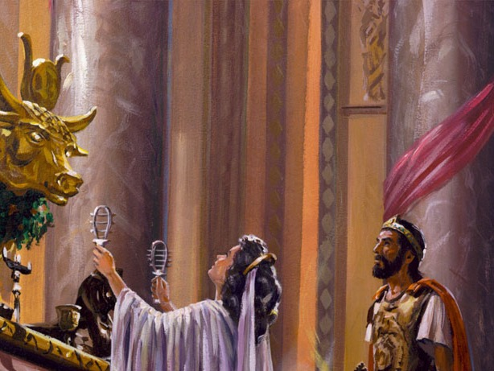
WHO GETS THE WORSHIP?
Many, “When sickness is the result of their transgression of natural law, they do not seek to correct their errors and then ask the blessing of God, but they resort to the physicians.
“If they recover health they give to drugs and doctors all the honor.
“They are ever ready to idolize human power and wisdom, seeming to know no other God than the creature--dust and ashes.” {5T 194.1}
Notes:
How are God and Doctors different?

Slide 9
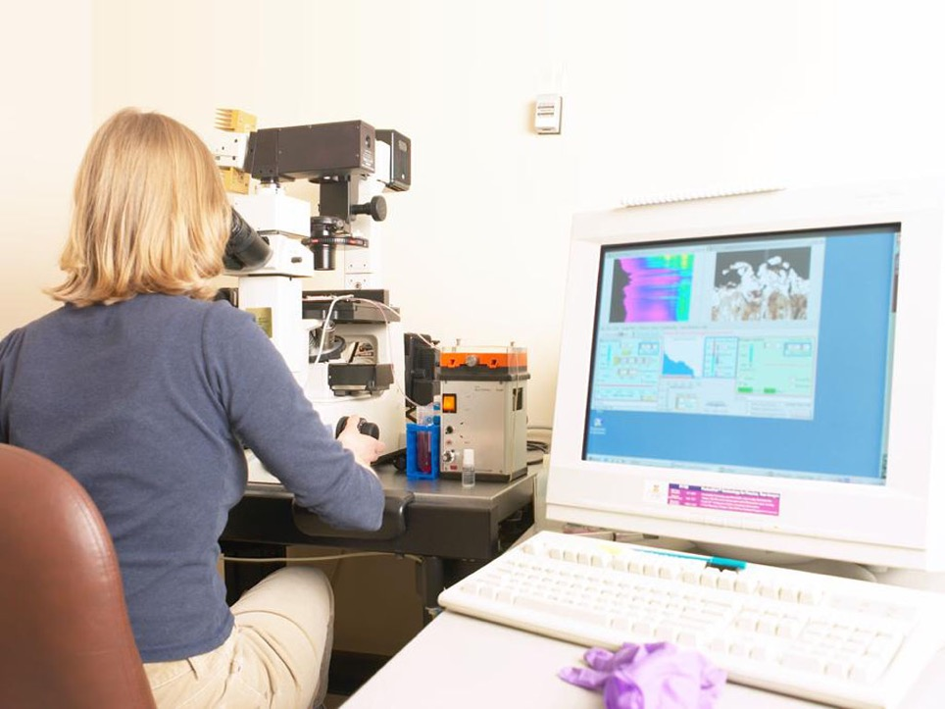
Ekron: A New Image For A New World
“Though we do not pay homage to heathen gods, yet thousands are worshiping at Satan's shrine as verily as did the king of Israel.
“The very spirit of heathen idolatry is rife today, though under the influence of science and education it has assumed a more refined and attractive form.” {5T 192.3}

Slide 10
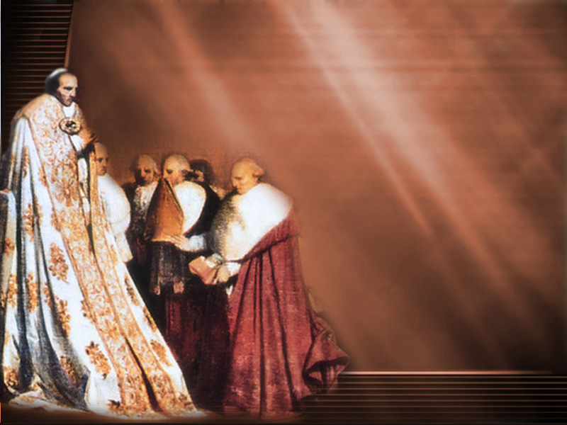
“My Doctor…”
Many trust “their bodies to the doctor, and their souls to the minister,” But, “To become acquainted with the wonderful mechanism of the human frame, to understand the dependence of one organ upon another, for the healthful action of all, is a work in which”, they, have “no interest.” {FE 59.2}

Slide 11
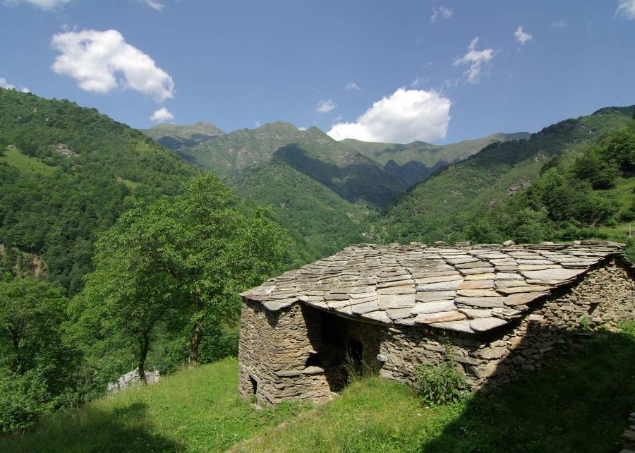
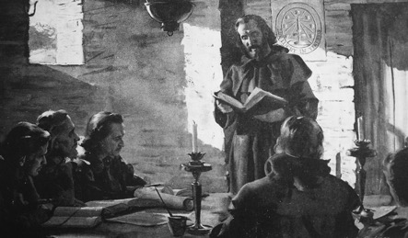
Waldensian Missionary School
Notes:
Jesus gave the commission to His church “heal the sick” (Luke 9:2) in the self-denying spirit of Christ.
Apostasy in the Church lead to healing shrines, prayers to the saints, confessionals, and penances paid to abolish sins on one’s deathbed, a great windfall for the Church.
In the late twelfth century A.D. Waldenses and Albigenses challenged the apostasy and began turning the practice of Christ centered healing back to its roots.
They practiced physical healing, some specializing in wound healing, others in surgery and quickly became known as the “best of doctors.” This greatly challenged the Catholic medical/financial system.

Slide 12
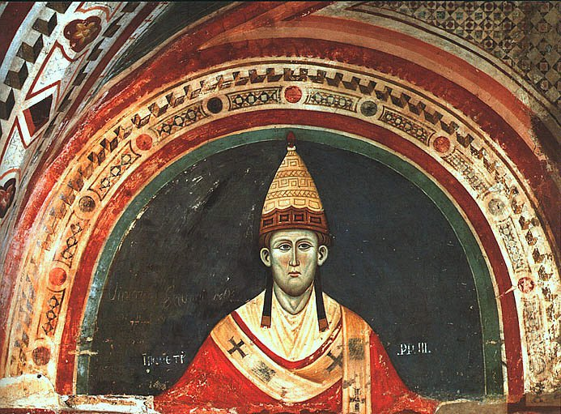
Notes:
In response to this growing threat to its dominance in all matters concerning humanity, the Romish Church, at the directive of Pope Innocent III, carried out a massive assault on the Albigenses and Waldenses.

Slide 13
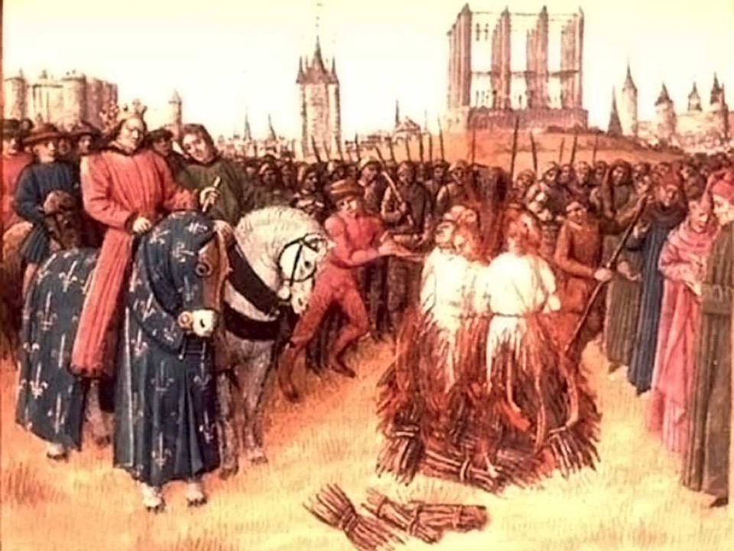
Notes:
As a result 20,000 Albigenses were murdered and along with them the hopes of a large scale change for the better in the medical establishment.
Unbeknownst to most people, this retaliation in healthcare practice was what directly led to the setting up of the Roman Catholic Inquisition (2) and the loss of millions upon millions of human lives.

Slide 14
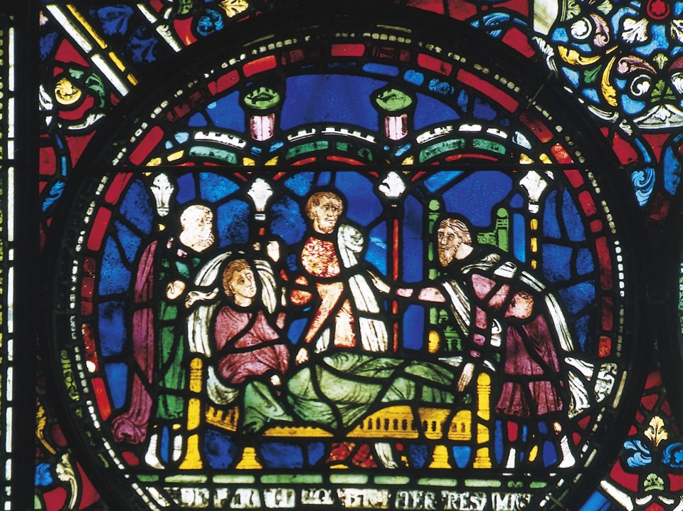
"The truth for this time, the third angel's message, is to be proclaimed with a loud voice as we approach the great final test. This test must come to the churches in connection with true medical missionary work."
We are told that in time of trouble "there will be sick ones, plenty of them, that will need help" so because of the need, but also "for their own sake, they should, while they have opportunity, become intelligent in regard to disease, its causes, prevention and cure, and those who will do this will find a field of labor anywhere." C. H. 506. {PH144 29.2}
Notes:
With the quelling of this “heretical movement,” Pope Innocent III initiated what has now become the modern day hospital system in Europe.
Also, in his Lateran Council of 1215, the Papal See saw to it that only doctors approved by the church could practice medicine.

Slide 15

Is Your Physician a Christian?
“The Lord will hear and answer the prayers of the Christian physician.”
“In treating the sick, the physician will seek God for wisdom; then, instead of placing his dependence upon drugs and expecting that medicine will bring health to his patients, he will use nature's restoratives, and employ natural means whereby the sick may be aided to recover.” {HL 247.4}.

Slide 16
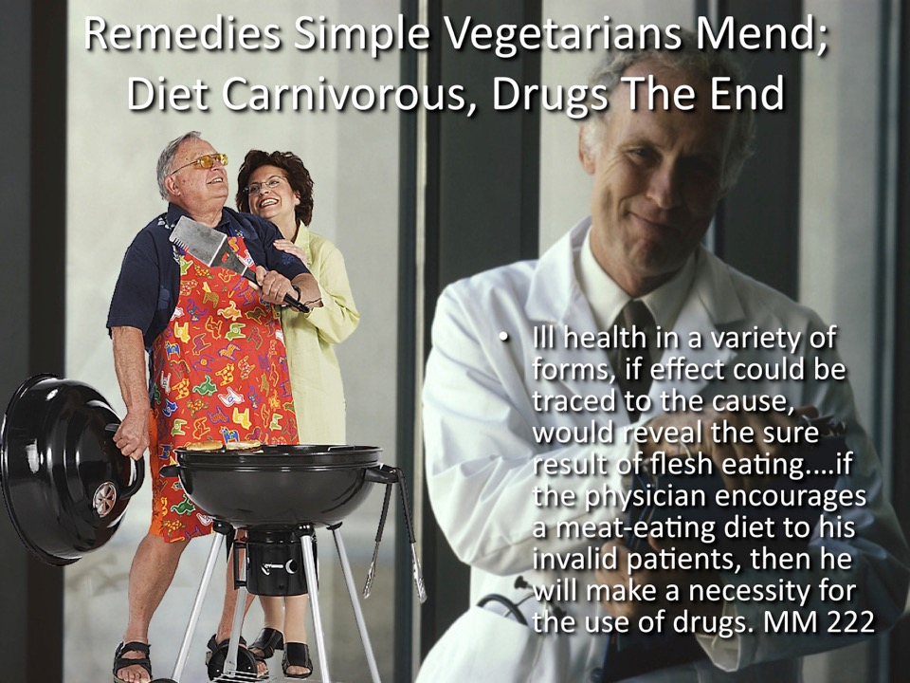

Slide 17
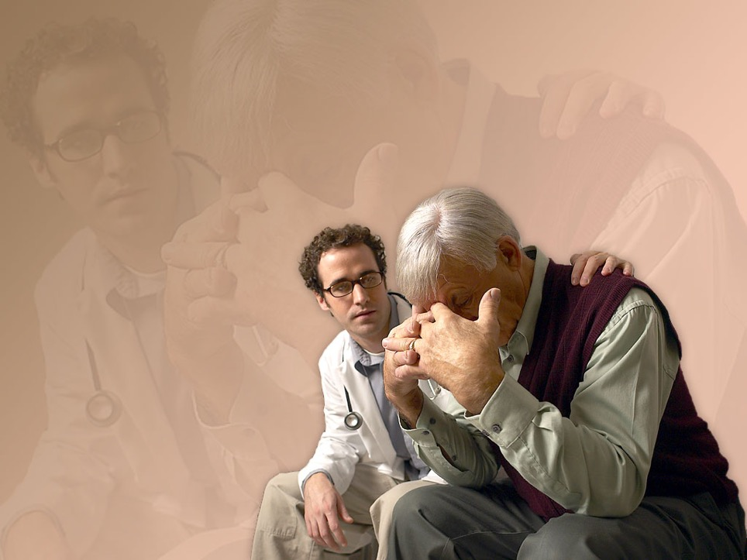
When Human Help Fails
“When human help fails, God will be the helper of His people.
“Our Lord has given us definite instruction through the apostle James as to our duty in case of sickness.
"Is any sick among you? let him call for the elders of the church; and let them pray over him, anointing him with oil in the name of the Lord: and the prayer of faith shall save the sick, and the Lord shall raise him up.” {5T 196.2}
Notes:
God wants to be your healer!

Slide 18
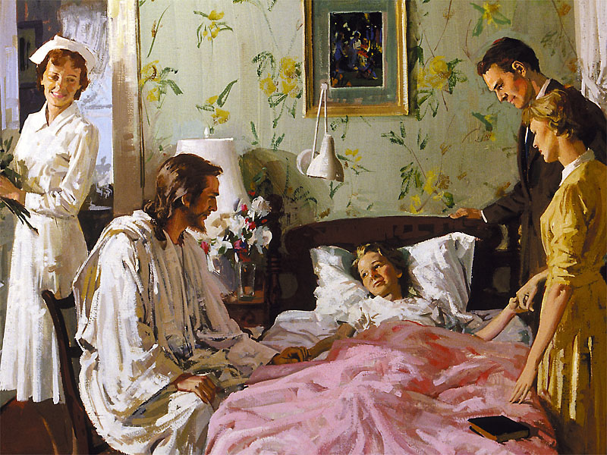
Blessed of God
“The Lord has given me light that when the Israel of today humble themselves before Him, and cleanse the soul-temple from all defilement, He will hear their prayers in behalf of the sick and will bless in the use of His remedies for disease.
“When in faith the human agent does all he can to combat disease, using the simple methods of treatment that God has provided, his efforts will be blessed of God.” {9T 164.1}.

Slide 19
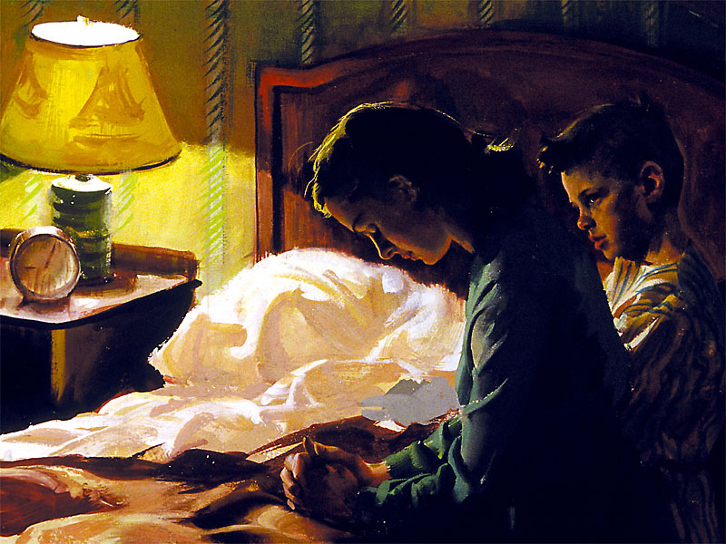
Neither Will The Lord Hear Your Prayers
“To those who desire prayer for their restoration to health, it should be made plain that the violation of God's law, either natural or spiritual, is sin, and that in order for them to receive His blessing, sin must be confessed and forsaken.” {MH 228.1}
T

Slide 20

Faith or Transgression?
“for whatsoever is not of faith is sin.” Romans 14:23.
“That which we lack in faith we make up by the use of drugs.
“Let us give up the drugs, believing that Jesus does not desire us to be sick, and that if we live according to the principles of health reform, He will keep us well.” {19MR 51.2}
Notes:
The Lord would have our physicians cooperate with Him in their treatment of the sick, showing more faith and using fewer drugs. Let us rely upon God. Our faith is feeble, and our hearts remain unchanged. God would have a change take place. He says, "A new heart also will I give you." When this promise is fulfilled to the people of God, the condition of things will be very different from what it now is.--MS. 14, 1904. {MM 40.3}

Slide 21
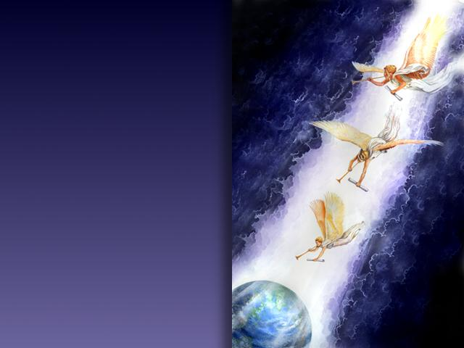
3rd Angel!
“If the principles of health reform are carried out, the work will indeed be as closely allied to that of the third angel's message as the hand is to the body.”
“Every effort made for the physical and moral health of the people should be based on moral principles.”
“They should know how to eat properly, to work intelligently, to dress healthfully, and should be taught to bring all their habits into harmony with the laws of life and health, and to discard drugs.” {13MR 177.3}
Notes:
When is the third angel’s message relevant?
There for when is the discarding of drugs relevant?

Slide 22
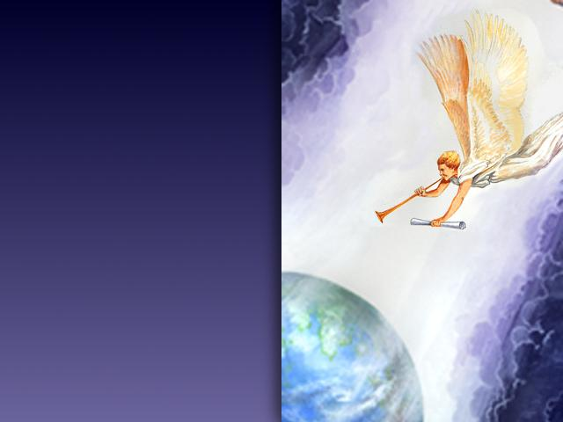
Third Angel Swells Into Loud Cry Of Fourth Angel: Come Out!
“The health reform, I was shown, is a part of the third angel's message and is just as closely connected with it as are the arm and hand with the human body…. God's people are not prepared for the loud cry of the third angel.” {1T 486.2}

Slide 23

Medications: A False Gospel
Saved In Your Sins Or From Your Sins?
If God Won’t Heal You, Try Pills?
“For thirty years the light on health reform has been coming to the people of God, but many have made it a subject of jest.
“They make flesh meat a part of their diet. Disease comes upon them. Sick and suffering as a result of their own wrong course, they ask for the prayers of the servants of God.
“They have continued to use tea, coffee, spices, and flesh meat. Their bodies are full of disease. How can we, I ask, present such ones to the Lord for healing?”
“But how can the Lord work in their behalf when they are not willing to do His will, when they refuse to heed His instruction in regard to health reform?{CD 400}.
Notes:
Look Mate, I’ve got Penicillin!
God wants to be your healer!

Slide 24
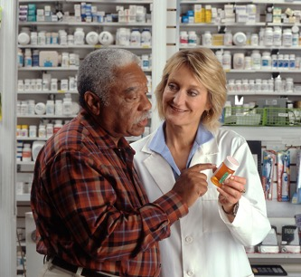
Advent of a New Class of Drugs: God’s Answer to Disease?
“The endless variety of medicines in the market, the numerous advertisements of new drugs and mixtures, all of which, they say, result in wonderful cures, kill hundreds where they benefit one. Those who are sick are not patient. They will take the various medicines, some of which are very powerful, although they know nothing of the nature of the mixtures. All the medicines they take only make their recovery more hopeless.” RH September 12, 1899, Art. B, par. 4

Slide 25

Except The LORD Build…
“Except the LORD build the house, they labour in vain that build it: except the LORD keep the city, the watchman waketh but in vain.” Psalms 127:1.
“Who forgiveth all thine iniquities; who healeth all thy diseases;” Psalms 103:3.
Except The LORD Heal…
Notes:
God Wants to be your healer!

Slide 26
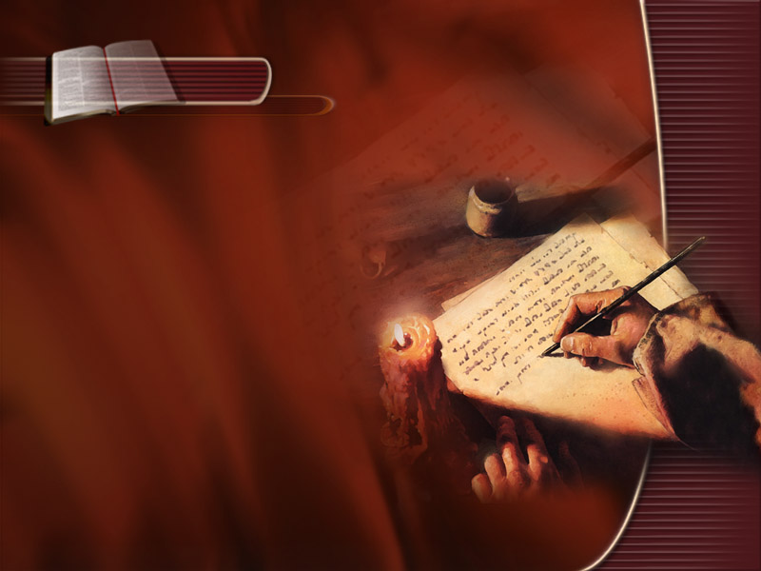
Isaiah 38:1-3
“In those days was Hezekiah sick unto death.
“And Isaiah the prophet the son of Amoz came unto him, and said unto him, Thus saith the LORD, Set thine house in order: for thou shalt die, and not live.
“Then Hezekiah turned his face toward the wall, and prayed unto the LORD,… And Hezekiah wept sore.”

Slide 27
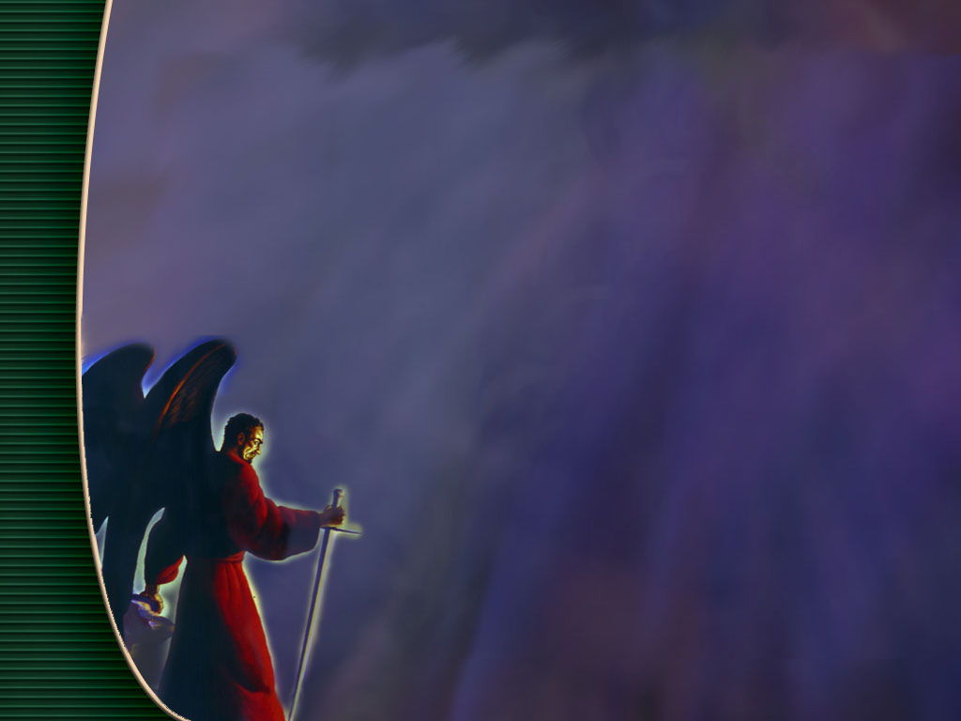
Healed By Satan, Under Satan’s Power
“The mother, watching by the sickbed of her child, exclaims: ‘I can do no more. Is there no physician who has power to restore my child?’
“She is told of the wonderful cures performed by some clairvoyant or magnetic healer (e.g. Chiropractor), and she trusts her dear one to his charge, placing it as verily in the hands of Satan as if he were standing by her side.
“In many instances the future life of the child is controlled by a satanic power which it seems impossible to break.” {5T 193.5}

Slide 28

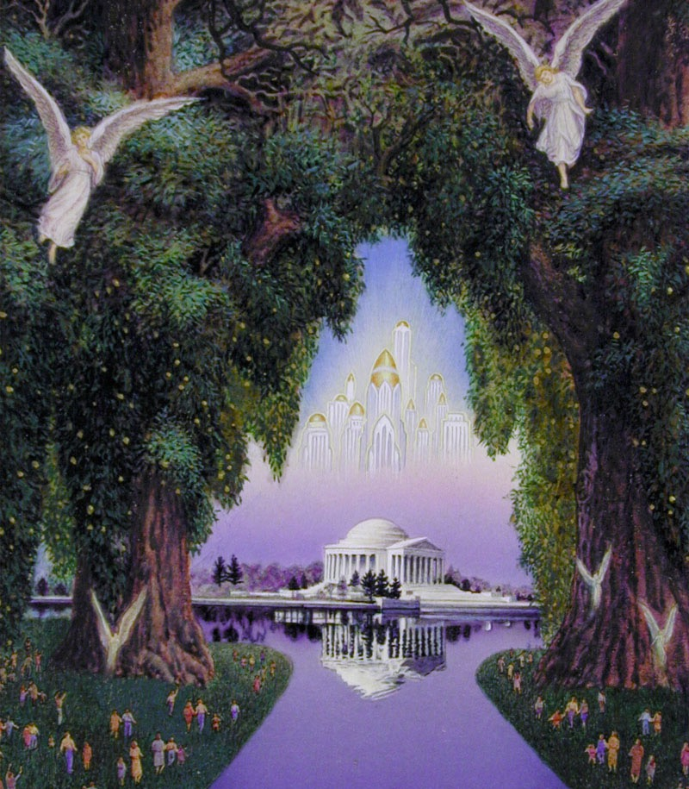
Where Is Your Tree Of Life?
“To a large extent Satan has carried out his plans…From the beginning to the end the crime of tobacco-using, of opium and drug medication, has its origin in perverted knowledge.
“It is through plucking and eating of poisonous fruit, through the intricacies of names that the common people do not understand, that thousands and ten thousands of lives are lost.
“This great knowledge, supposed by man to be so wonderful, God did not mean that man should have.
“They are using the poisonous productions that Satan himself has planted to take the place of the tree of life, whose leaves are for the healing of the nations.” {SpM 140.4}
There are 225,000 deaths annually from medical errors including 106,000 deaths due to "nonerror adverse events of medications" JAMA, Volume 284, No. 4, July 26, 2000.
Notes:
Christ never planted the seeds of death in the system. Satan planted these seeds when he tempted Adam to eat of the tree of knowledge, which meant disobedience to God. Not one noxious plant was placed in the Lord's great garden, but after Adam and Eve sinned, poisonous herbs sprang up. In the parable of the sower the question was asked the master, "Didst not thou sow good seed in thy field? From whence then hath it tares?" The master answered, "An enemy hath done this." [Matt. 13:27, 28.] All tares are sown by the evil one. Every noxious herb is of his sowing, and by his ingenious methods of amalgamation he has corrupted the earth with tares. {16MR 247.2}
Then shall physicians continue to resort to drugs which leave a deadly evil in the system, destroying that life which Christ came to restore? Christ's remedies cleanse the system. But Satan has tempted man to introduce into the system that which weakens the human machinery, clogging and destroying the fine, beautiful arrangements of God. The drugs administered to the sick do not restore, but destroy. Drugs never cure. Instead, they place in the system seeds which bear a very bitter harvest. {16MR 247.3}
Starfield B. Is US health really the best in the world? JAMA. 2000 Jul 26;284(4):483-5.

Slide 29
Healed By Satanic Agencies
“God's Word declares that Satan will work miracles. He will make people sick, and then will suddenly remove from them his satanic power. They will then be regarded as healed.
“These works of apparent healing will bring Seventh-day Adventists to the test.
“Many who have had great light will fail to walk in the light, because they have not become one with Christ.” {Mar 209.1}
Notes:
Can this appear in scientific journals?
Deception of evidence based medicine.

Slide 30
Healed By Satanic Agencies
“Those who give themselves up to the sorcery of Satan, may boast of great benefit received; but does this prove their course to be wise or safe? What if life should be prolonged? What if temporal gain should be secured? Will it pay in the end to have disregarded the will of God? All such apparent gain will prove at last an irrecoverable loss. We cannot with impunity break down a single barrier which God has erected to guard His people from Satan's power." {PK 212.1}

Slide 31
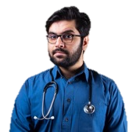
“Learn not the way of the heathen.” Jeremiah 10:2.
“Trust not to poisonous drugs that will interfere with nature's work and leave their cruel trail behind. Work away from drugs, and never, never advise one under your influence to go to Ann Arbor or any other place to obtain the education supposed to be essential for the perfection of the medical practitioner.” {21MR 41.4}
“Health reform, I have stated, needs reforming. The grand finishing touch that Ann Arbor has been supposed to give the students is educating away from the lessons that God has given in regard to drug medication.” Lt106-1895.40
“They did not destroy the nations, concerning whom the LORD commanded them: But were mingled among the heathen, and learned their works. And they served their idols: which were a snare unto them.” Psalms 106:34-36.
“When sickness is the result of their transgression of natural law, they do not seek to correct their errors and then ask the blessing of God, but they resort to the physicians. If they recover health they give to drugs and doctors all the honor. They are ever ready to idolize human power and wisdom, seeming to know no other God than the creature--dust and ashes.” {5T 194.1}

Slide 32

Compare and Contrast
Now the works of the flesh are manifest, which are these; Adultery, fornication, uncleanness, lasciviousness, Idolatry, witchcraft (Pharmakeia: sorcery, witchcraft. 1. the use or the administering of drugs 2. poisoning.), hatred…
But the fruit of the Spirit is love, joy, peace, longsuffering, gentleness, goodness, faith, Meekness, temperance: against such there is no law. And they that are Christ's have crucified the flesh with the affections and lusts. Gala 5:19-24.
Notes:
Pizza Hut

Slide 33

To Be Only Partially Healed,
Is Not To Be Healed At All
“They have healed also the hurt of the daughter of my people slightly,…” Jeremiah 6:14
Notes:
God wants to be your healer!

Slide 34
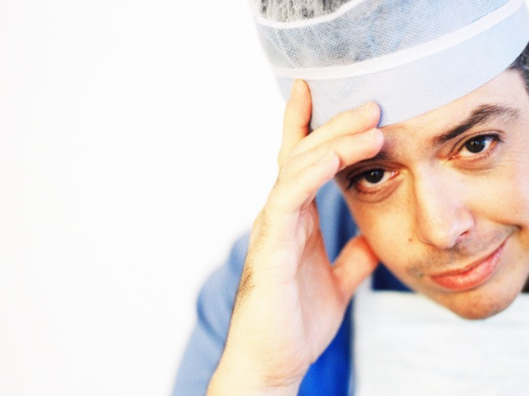
Just Give Me A Pill So I Can Continue My Chosen Lifestyle
Fast Food Medicine
“Many persons bring disease upon themselves by their self-indulgence. They have not lived in accordance with natural law or the principles of strict purity.
“Others have disregarded the laws of health in their habits of eating and drinking, dressing, or working. Often some form of vice is the cause of feebleness of mind or body.
“Should these persons gain the blessing of health, many of them would continue to pursue the same course of heedless transgression of God's natural and spiritual laws,...” {MH 227.3}

Slide 35

Drugs Never Cure Disease
“Drugs never cure disease. They only change the form and location.
“Nature alone is the effectual restorer, and how much better could she perform her task if left to herself. But this privilege is seldom allowed her.
“If crippled nature bears up under the load, and finally accomplishes in a great measure her double task, and the patient lives, the credit is given to the physician.
“But if nature fails in her effort to expel the poison from the system, and the patient dies, it is called a wonderful dispensation of Providence.
“If the patient had taken a course to relieve overburdened nature in season, and understandingly used pure soft water, this dispensation of drug-mortality might have been wholly averted.
“The use of water can accomplish but little, if the patient does not feel the necessity of also strictly attending to his diet.” {2SM 451.1}
Notes:
Hungarian CEO
Drugs never cure disease. They only change the form and location. Nature alone is the effectual restorer, and how much better could she perform her task if left to herself. But this privilege is seldom allowed her. If crippled nature bears up under the load, and finally accomplishes in a great measure her double task, and the patient lives, the credit is given to the physician. But if nature fails in her effort to expel the poison from the system, and the patient dies, it is called a wonderful dispensation of Providence. If the patient had taken a course to relieve overburdened nature in season, and understandingly used pure soft water, this dispensation of drug-mortality might have been wholly averted. The use of water can accomplish but little, if the patient does not feel the necessity of also strictly attending to his diet. {2SM 451.1}

Slide 36

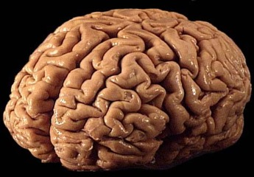
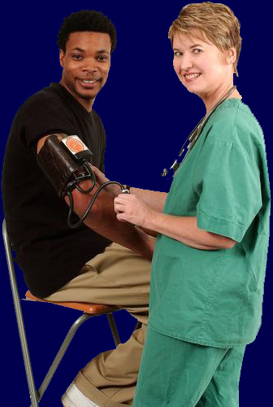
“People need to be taught that drugs do not cure disease. It is true that they sometimes afford present relief, and the patient appears to recover as the result of their use; … But in most cases the drug only changes the form and location of the disease.” {MH 126}.
Notes:
–Ministry of Healing p. 126

Slide 37

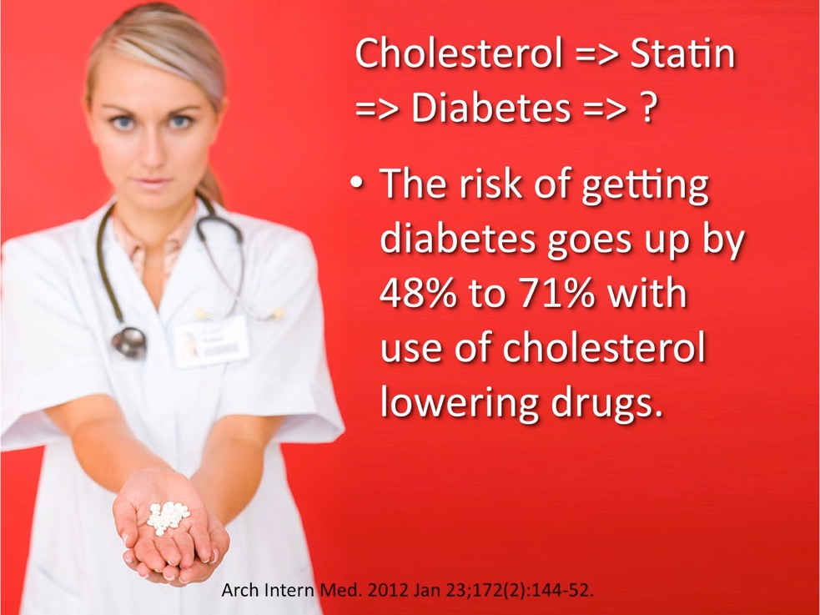

Slide 38
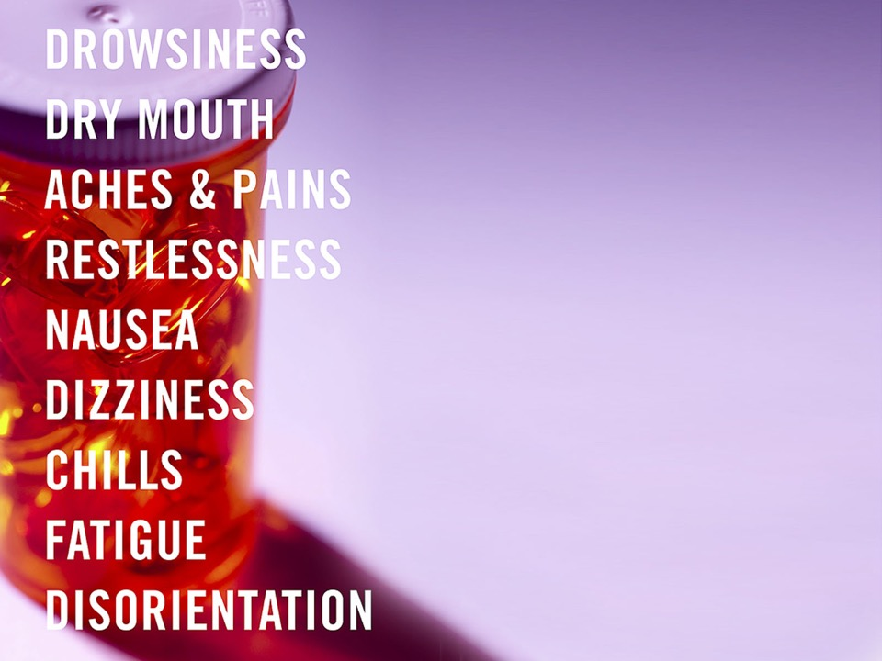
Statins and Cancer, Its A Wash
“In some randomized trials, notwithstanding their short duration, statins have been found to increase cancer incidence especially in the elderly and women. In these situations, the decrease in cardiovascular mortality can be matched by an equal increase in cancer mortality, leaving all-cause mortality unchanged.”
Recenti Prog Med. 2009 Jan;100(1):33-9.
Notes:
Recenti Prog Med. 2009 Jan;100(1):33-9.
[Immunomodulatory properties of statins and cancer risk]
[Article in Italian]
Mascitelli L, Goldstein MR, Pezzetta F.
Servizio Sanitario, Comando Brigata Alpina Julia, Udine. lumasci@libero.it
Statins are cholesterol-lowering drugs widely prescribed for cardiovascular prevention. They are also immunomodulatory and increase peripheral regulatory T cell numbers and function, in vivo. This may be beneficial by decreasing inflammatory response within the atheroma and stabilizing atherosclerotic plaque, however this novel pleiotropic effect might impair host tumor-specific effector T cell responses. Indeed, in some randomized trials, notwithstanding their short duration, statins have been found to increase cancer incidence especially in the elderly and women. In these situations, the decrease in cardiovascular mortality can be matched by an equal increase in cancer mortality, leaving all-cause mortality unchanged. Furthermore, statins have been shown to interfere with cancer immunotherapy. Preventive pharmacological treatment can sometimes be justified because of reduced cardiovascular events even if total mortality does not change, but if it leads to an increase in cancer incidence, it might be not easily accepted. Physicians need to weigh the global risks and benefits when prescribing statins.
PMID: 19445281 [PubMed - in process]
38

Slide 39
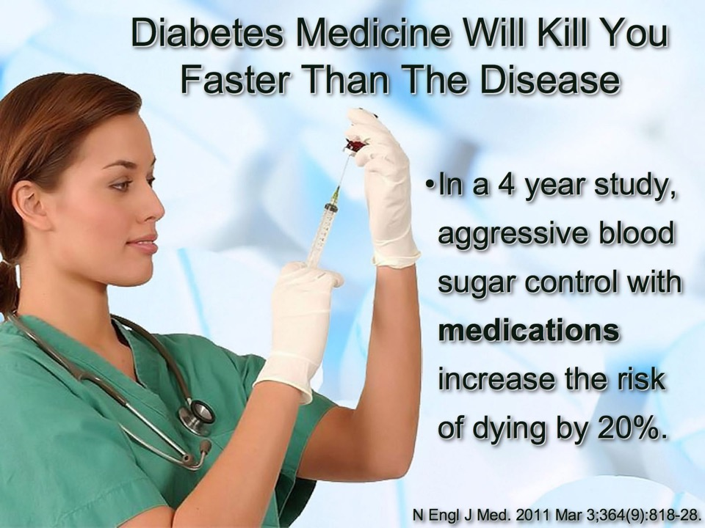

Slide 40
Fungalbionics
Penicillin
Tumorigenesis
Notes:
Park SJ, Kim M, Jeong S, Park YJ, Choi S, Chang J, Oh YH, Cho SW, Park YJ, Park SM. Association Between Antibiotic Exposure and Thyroid Cancer: A Nationwide Cohort Study in South Korea. Thyroid. 2024 Jan;34(1):112-122.

Slide 41
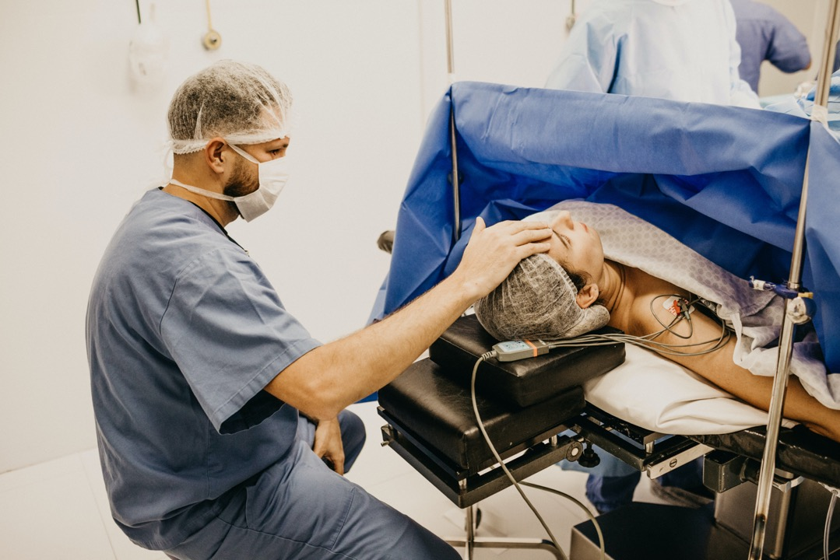
Notes:
General anesthesia

Slide 42
Pharmaceutical Drug Medications and Vaccinations
In 1900 cancer affected 5% of the population. Under the influence of vaccinations containing many viruses and drug medications that suppress the immune system one-third of women (33%) and half of men (50%) will now develop cancer in their lifetime.
Clin Transl Med. 2020 Dec;10(8):e215.
Notes:
Khatami M. Deceptology in cancer and vaccine sciences: Seeds of immune destruction-mini electric shocks in mitochondria: Neuroplasticity-electrobiology of response profiles and increased induced diseases in four generations - A hypothesis. Clin Transl Med. 2020 Dec;10(8):e215. doi: 10.1002/ctm2.215. PMID: 33377661; PMCID: PMC7749544.

Slide 43
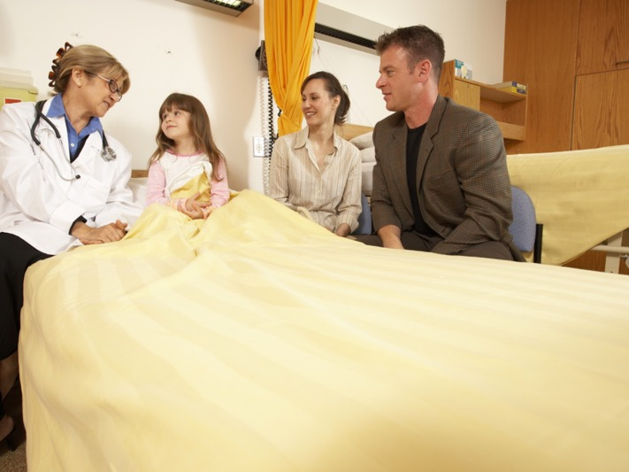
Symptomatologists
“The diseased have ye not strengthened, neither have ye healed that which was sick, neither have ye bound up that which was broken, neither have ye brought again that which was driven away, neither have ye sought that which was lost;…” Ezekiel 34:4

Slide 44

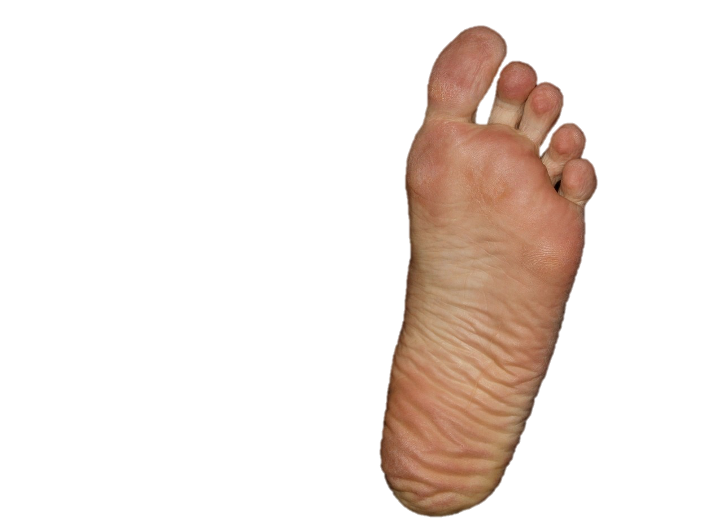
“And Asa in the thirty and ninth year of his reign was diseased in his feet, until his disease was exceeding great: yet in his disease he sought not to the LORD, but to the physicians.” 2Chronicles 16:12.

Slide 45
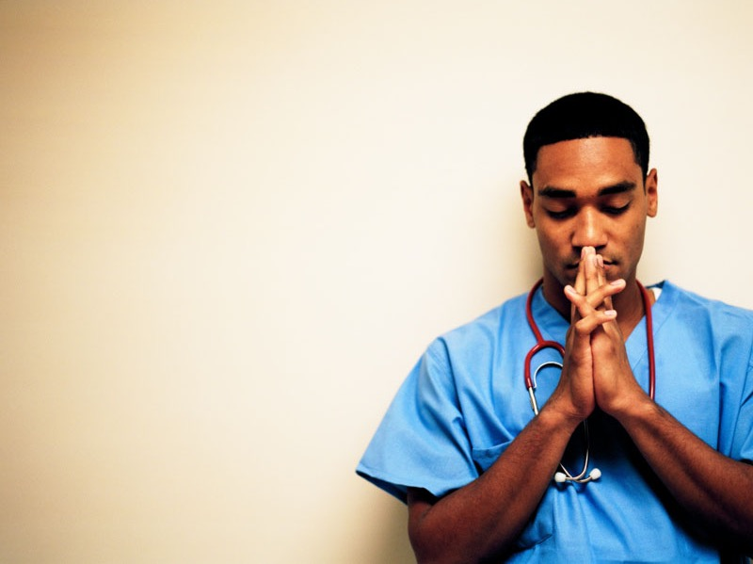
Is it not because there is not a God…
“Natural means, used in accordance with God's will, bring about supernatural results. We ask for a miracle, and the Lord directs the mind to some simple remedy.

Slide 46
Is it not because there is not a God…
“Natural means, used in accordance with God's will, bring about supernatural results. We ask for a miracle, and the Lord directs the mind to some simple remedy.
We ask to be kept from the pestilence that walketh in darkness, that is stalking with such power through the world; we are then to cooperate with God, observing the laws of health and life.

Slide 47
Is it not because there is not a God…
“Natural means, used in accordance with God's will, bring about supernatural results. We ask for a miracle, and the Lord directs the mind to some simple remedy.
We ask to be kept from the pestilence that walketh in darkness, that is stalking with such power through the world; we are then to cooperate with God, observing the laws of health and life.
Having done all that we possibly can, we are to keep asking in faith for health and strength. We are to eat that food which will preserve the health of the body.” {2SM 346.4}
Notes:
God wants to be your healer!

Slide 48

Natural Remedies Heaven Approves
“Pure air, sunlight, abstemiousness, rest, exercise, proper diet, the use of water, trust in divine power--these are the true remedies.” {MH 127.2}

Slide 49
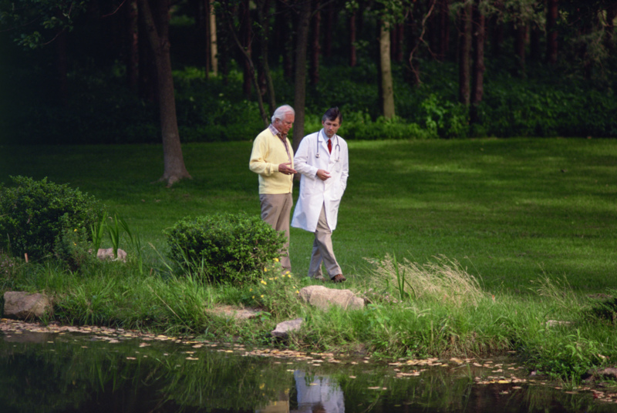
Rx: Biped Locomotion
“When the weather will permit, all who can possibly do so ought to walk in the open air every day, summer and winter.” “A walk, even in winter, would be more beneficial to the health than all the medicine the doctors may prescribe.” {2T 529.1}

Slide 50
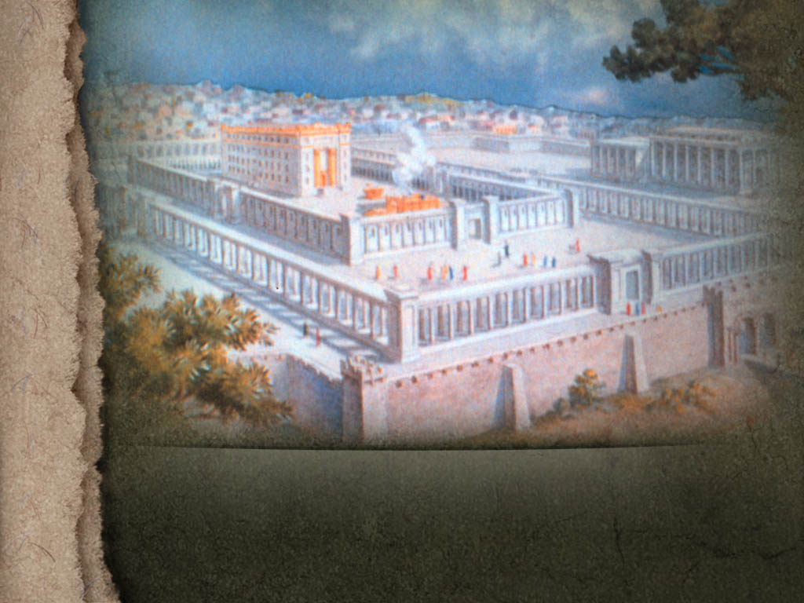
God's Design in Our Sanitariums
God's purpose for His institutions today may also be read in the purpose which He sought to accomplish through the Jewish nation.” {6T 221.2}
“God chose Israel to reveal His character to men. He desired them to be as wells of salvation in the world.” {AA 14.1}
Notes:
What Everybody?

Slide 51
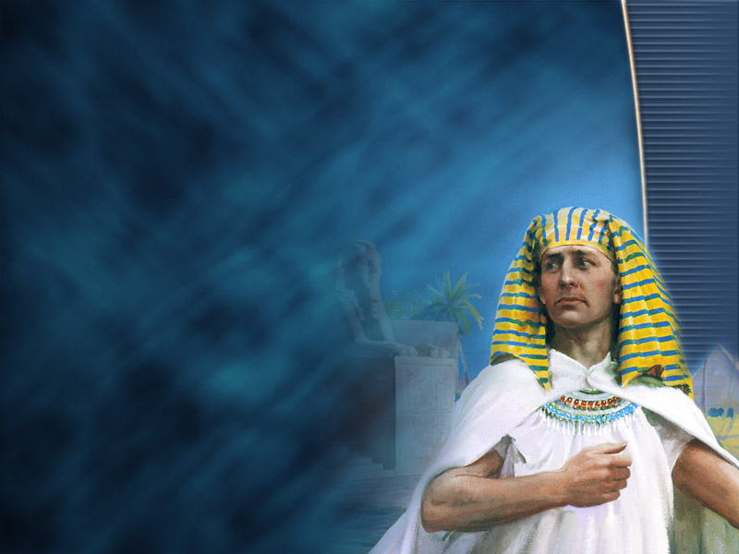
God's Design in Our Sanitariums
“Every institution established by Seventh-day Adventists is to be to the world what Joseph was in Egypt and what Daniel and his fellows were in Babylon.”{6T 219.1}

Slide 52

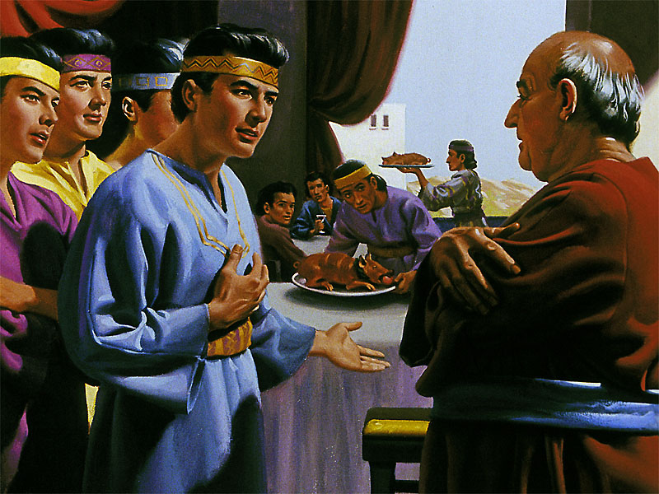
“But Daniel purposed in his heart that he would not defile himself with the portion of the king's meat, nor with the wine which he drank.” Daniel 1:8.

Slide 53
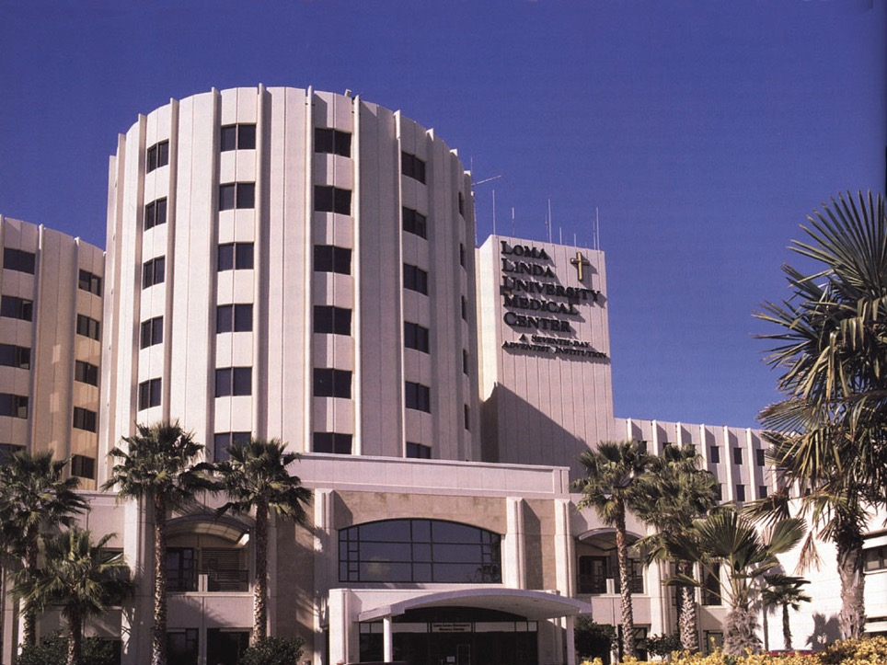
“Be careful not to do anything that would restrict the work at Loma Linda.
“It is in the order of God that this property has been secured, and He has given instruction that a school should be connected with the sanitarium.
“A special work is to be done there in qualifying young men and young women to be efficient medical missionary workers.
“They are to be taught how to treat the sick without the use of drugs.” {LLM 182.1}.
Notes:
Never, never build mammoth institutions. Let these institutions be small, and let there be more of them, that the work of winning souls to Christ may be accomplished. It may often be necessary to start sanitarium work in the city, but never build a sanitarium in a city. Rent a building, and keep looking for a suitable place out of the city. The sick are to be reached, not by massive buildings, but by the establishment of many small sanitariums, which are to be as lights shining in a dark place. Those who are engaged in this work are to reflect the sunlight of Christ's face. They are to be as salt that has not lost its savor. By sanitarium work, properly conducted, the influence of true, pure religion will be extended to many souls. {MM 323.4}
From our sanitariums trained workers are to go forth into places where the truth has never been proclaimed, and do missionary work for the Master.--Letter 17, 1905.

Slide 54
“We never proposed to establish sanitariums to have them run in nearly the same grooves as other institutions. If we do not have a sanitarium which is in many things decidedly contrary to other institutions, we can see nothing gained. Shall our appetites, habits, and practices be of that order that you will educate those who are connected with you to make excuses similar to those you have made for the indulgence of eating the flesh of animals?” SpM 45.2

Slide 55


Only Hope
“The only hope of better things is in the education of the people in right principles.
“Let physicians teach the people that restorative power is not in drugs, but in nature.
“Disease is an effort of nature to free the system from conditions that result from a violation of the laws of health.
“In case of sickness, the cause should be ascertained.
“Unhealthful conditions should be changed, wrong habits corrected.
“Then nature is to be assisted in her effort to expel impurities and to re-establish right conditions in the system.” {MH 127.1}

Slide 56
Drug medication historical context
Anciently In Israel before the Babylonian captivity
Hezekiah was being killed by the drugs given him till Isaiah applied a natural remedy. {Lt67-1899.6}
Jesus in His day
“While He did not give countenance to drug medication, He sanctioned the use of simple and natural remedies.” {DA 824.1}
Time of Kellogg
“The students in your institution are not to be educated to regard drugs as a necessity. They are to be educated to leave drugs alone.” Lt67-1899.5
For the final Remnant Church and the time of the end
“...the remnant church...sanitariums should be established, and that in them drug medication should be discarded,...” IR May 13, 1908, par. 6
In the Future, during the Sunday law and the mark of the beast of the third angel’s message
“...discard drugs... If the principles of health reform are carried out, the work will indeed be as closely allied to that of the third angel's message as the hand is to the body.” 13MR 177.3
Notes:
Never has been, Never will be!

Slide 57
Drug medication historical context
To the end of time:
The world is the field of our labor, and we are to strive to give the last message of mercy to the world.... You can serve the Lord in your position by working with new methods and discarding drugs. {MM 125.1}
A wonderful responsibility rests upon those connected with the sanitariums established in His name for the treatment of the sick. This is to be done without the use of poisonous drugs. Those who become workers in the sanitariums are to believe the words of Christ, "Lo, I am with you alway, even unto the end of the world." {LLM 198.4}
Forever! Abandon, not just until Moderna creates a new one....
You should avoid the use of drugs and carefully observe the laws of health.... drugging should be forever abandoned; for while it does not cure any malady, it enfeebles the system, making it more susceptible to disease. {5T 311.1}
No time in earth’s history for drugs:
“From beginning to end, the crime of tobacco using, of opium and drug medication, has its origin in perverted knowledge.... They are using the poisonous productions that Satan himself has planted to take the place of the tree of life, whose leaves are for the healing of the nations.” {Te 75.1}
Revelation 18:23 KJV - "for by thy sorceries [pharmakeia] were all nations deceived."
Notes:
Never has been, Never will be!

Slide 58
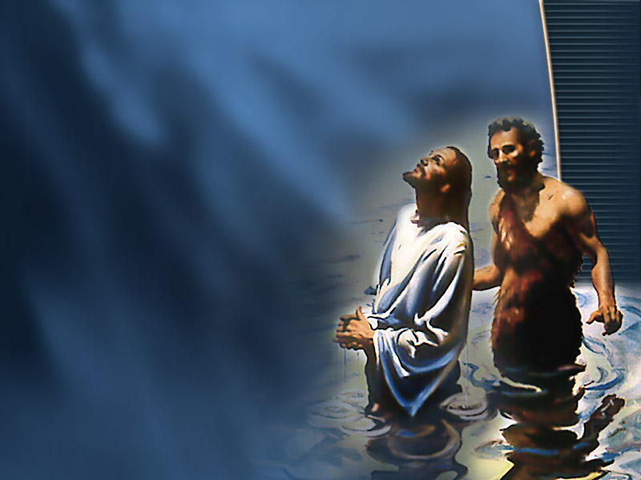
One Lord, One Faith, One Baptism, One Medical Practice
“There are many ways of practicing the healing art, but there is only one way that Heaven approves.
“God's remedies are the simple agencies of nature, that will not tax or debilitate the system through their powerful properties.
“…Fresh air, exercise, pure water, and clean, sweet premises, are within the reach of all with but little expense; but drugs are expensive, both in the outlay of means and the effect produced upon the system.” {CH 323.2}

Slide 59
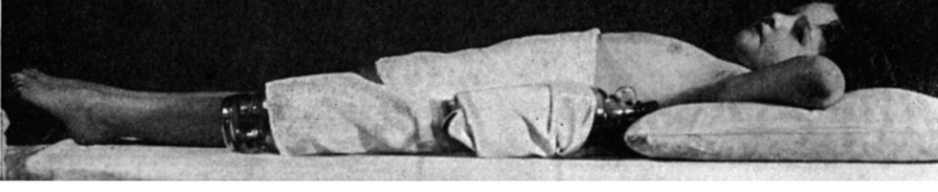
Repentance Needed
“Drug medication should never have been introduced into our institutions. There was no need of this being so, and for this very reason the Lord would have us establish an institution where He can come in and where His grace and power can be revealed. ‘I am the resurrection and the life,’ He declares.” {SpM 137.1}
Notes:
God wants to be your healer!

Slide 60

A Call For Medical Evangelists
“And I heard another voice from heaven, saying, Come out of her, my people, that ye be not partakers of her sins, and that ye receive not of her plagues.” Revelation 18:4.
“And the light of a candle shall shine no more at all in thee; and the voice of the bridegroom and of the bride shall be heard no more at all in thee: for thy merchants were the great men of the earth; for by thy sorceries (Pharmakeia: sorcery, witchcraft. 1. the use or the administering of drugs 2. poisoning.) were all nations deceived.” Revelation 18:23.

Slide 61
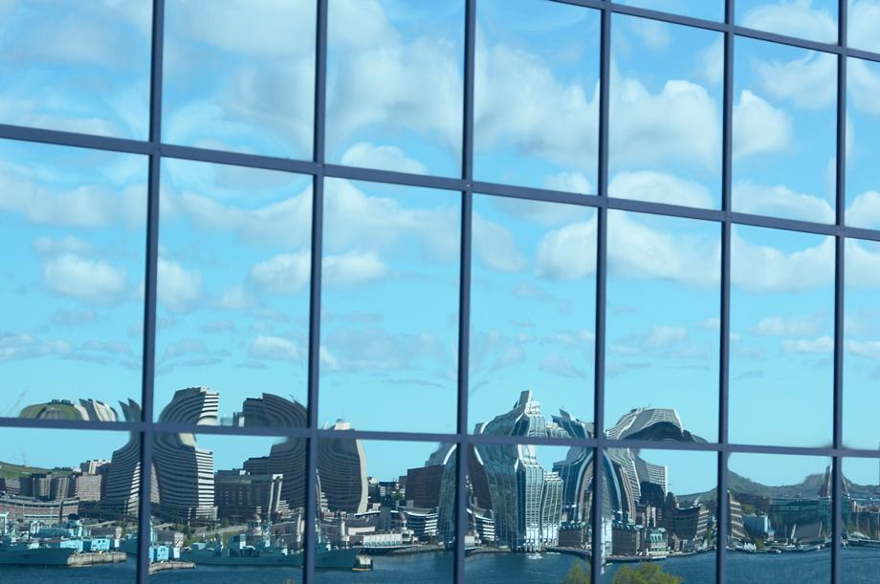
Come Out!
“In every health institution that has fallen into worldly practices, the Lord calls for a decided change. Let our workers now come out from the world, and be separate.” {16MR 14.1}

Slide 62
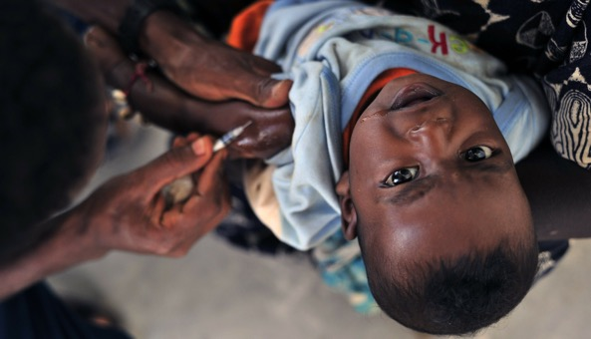
Mission Medications
“Woe unto you, scribes and Pharisees, hypocrites! for ye compass sea and land to make one proselyte, and when he is made, ye make him twofold more the child of hell than yourselves.” Matthew 23:15.
“The whole heathen world will rise up in judgment against those whom heaven has favored the most, but who have placed themselves on Satan's side, and worked in his lines to bring their soul-destroying narcotics to foreign lands, to pollute and destroy the heathen nations with their defiling and health-destroying drugs. For the sake of a revenue, a professedly Christian nation have forced their traffic upon the heathen nations at the point of the sword, and thus compelled them to accept their merchandise, which would in using degrade the people below the level of the brute creation.” 3MR 341.3

Slide 63

“I Don’t Take Medication, I Use Vitamins, Nutraceuticals And Supplements
“When attacked by disease, many will not take the trouble to search out the cause of their illness.
“Their chief anxiety is to rid themselves of pain and inconvenience.
“So they resort to patent nostrums, of whose real properties they know little, or they apply to a physician for some remedy to counteract the result of their misdoing, but with no thought of making a change in their unhealthful habits.
“If immediate benefit is not realized, another medicine is tried, and then another. Thus the evil continues.” {MH 126.2}
Notes:
Medication is not the answer, self control and God control is.

Slide 64
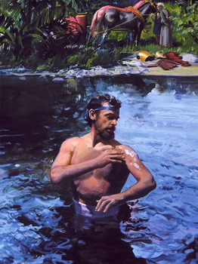
Naaman
“So Naaman came with his horses and with his chariot, and stood at the door of the house of Elisha. And Elisha sent a messenger unto him, saying, Go and wash in Jordan seven times, and thy flesh shall come again to thee, and thou shalt be clean.” 2 Kings 5:9-10.
7 dip cure.
Bottle it and sell it.
“Wherefore? Because they sought it not by faith, but as it were by the works of the law. For they stumbled at that stumblingstone;” Romans 9:32.

Slide 65
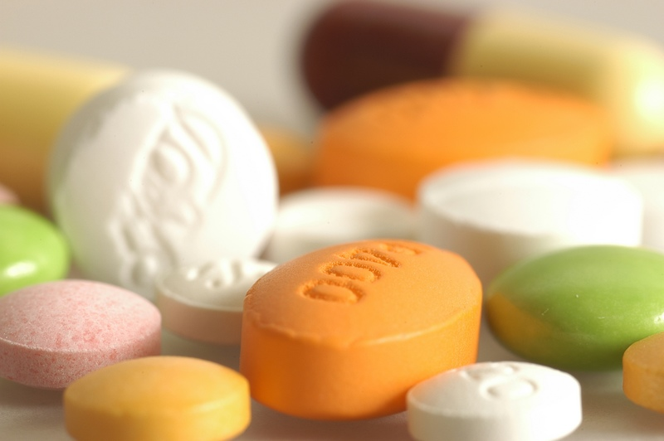
“But My Modern Pills Are Just Herbs…”
“The true method for healing the sick is to tell them of the herbs that grow for the benefit of man.
“Scientists have attached large names to these simplest preparations, but true education will lead us to teach the sick that they need not call in a doctor any more than they would call in a lawyer. They can themselves administer the simple herbs if necessary.
“To educate the human family that the doctor alone knows all the ills of infants and persons of every age, is false teaching, and the sooner we as a people stand on the principles of health reform, the greater will be the blessing that will come to those who would do true medical work.” {SpM 137.2}
“If any among us are sick, let us not dishonor God by applying to earthly physicians, but apply to the God of Israel.
“If we follow his directions (James 5:14, 15) the sick will be healed. God's promise cannot fail. Have faith in God, and trust wholly in him, that when Christ who is our life shall appear we may appear with him in glory.” --(Topsham, Jan. 31, 1849. {Broadside2, January 31, 1849 par. 13}).
Cannot Refuse

Slide 66
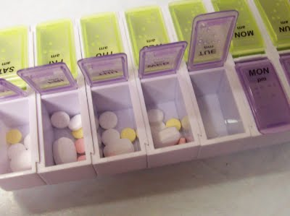
How many pill sorters should one prepare for fleeing to the mountains in the time of trouble?

Slide 67
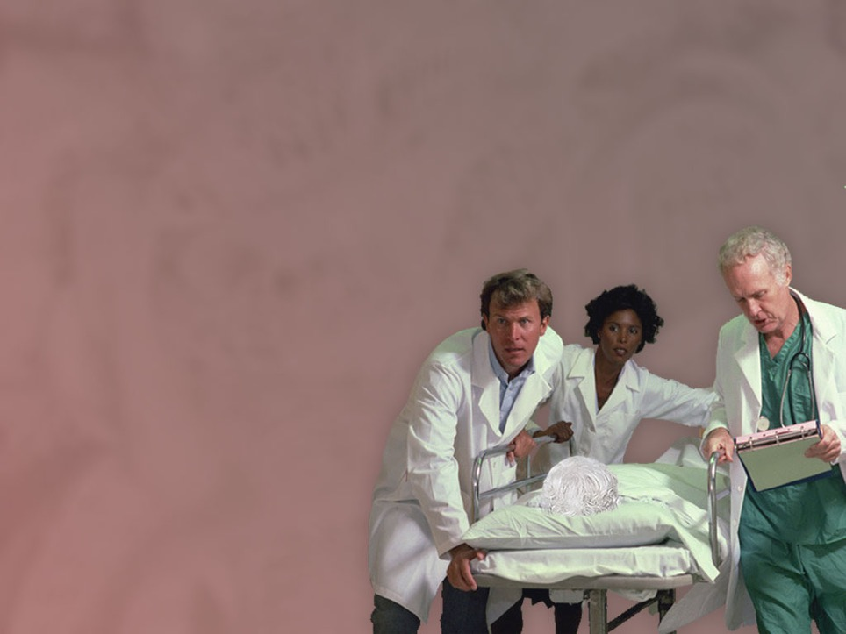
Biological Replacements
“There is one thing that has saved life--an infusion of blood from one person to another; but this would be difficult and perhaps impossible for you to do. I merely suggest it.” {MM 286.4}

Slide 68
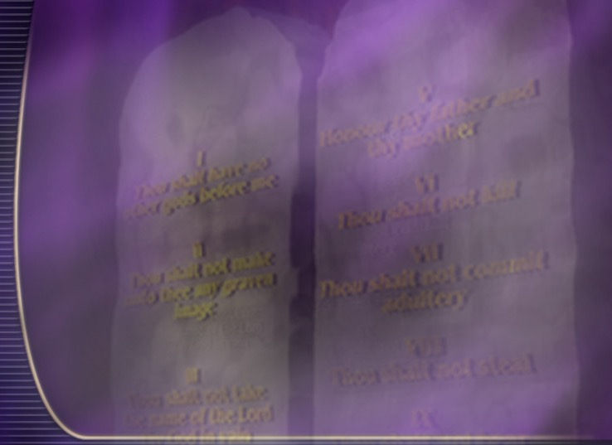
God wants to be your Healer, spiritually and physically.
  The Great Physician wants your worship and allegiance.
  He works through nature, the 8 laws of health, simple natural remedies, and answers prayer.
  God wants His medical missionaries and institutions to reveal His character to the world.
Satan wants your worship and allegiance.
  Satan wants to be your healer spiritually and physically.
  Satan works through mysticism, emotions, magic, deception and drugs.
  Satan wants God’s health care providers and facilities to deny God and represent Satan to the world.
God calls us to come out of Babylon to the glory of His healing grace, both spiritually and physically.
How many are willing to come out of Babylon and Worship God as the only True Healer?

Slide 69
Let The Fourth Angel Sound
“And I heard another voice from heaven, saying, Come out of her, my people, that ye be not partakers of her sins, and that ye receive not of her plagues… for by thy sorceries [medications] were all nations deceived.” Revelavtion 18:4,23.

Slide 70
Speakers Notes
Notes:
Only if I published it.
I am not the criterion
No one is allowed to edit my works
Presume to speak for God or the prophet
What if life should be prolonged
WwII drugs and disease
Abx cancer
General anesthetic

Slide 71
Drug Medication Historical Context
Anciently In Israel drugs were not acceptable treatment with God.
The medical fraternity, represented to me as Freemasonry, with their long, unintelligible names, which common people cannot understand, would call the Lord’s prescription for Hezekiah quackery. Death was pronounced upon the king, but he prayed for life, and his prayer was heard. Those who had the care of him were told to get a bunch of figs and put them on the sore, and the king was restored. This means was taken by God to teach them that all their preparations were only depriving the king of the power to rally and overcome disease while they pursued their course of treatment, his life could not be saved. The Lord diverted their minds from their wonderful mysteries to a simple remedy of nature. Lt67-1899.6
Jeremiah 46:11 KJV - "Go up into Gilead, and take balm, O virgin, the daughter of Egypt: in vain shalt thou use many medicines; for thou shalt not be cured."

Slide 72
In Jesus Day Drugs were not God’s choice
In the Saviour's manner of healing there were lessons for His disciples. On one occasion He anointed the eyes of a blind man with clay, and bade him, "Go, wash in the pool of Siloam. . . . He went his way therefore, and washed, and came seeing." John 9:7. The cure could be wrought only by the power of the Great Healer, yet Christ made use of the simple agencies of nature. While He did not give countenance to drug medication, He sanctioned the use of simple and natural remedies. {DA 824.1}.

Slide 73
In Kellogg’s day, he was not to use drugs
Dr. Kellogg, God has given you favor with the medical fraternity, and He would have you hold that favor. But in no case are you to stand as do the physicians of the world to exalt allopathy above every other practice, and call all other methods quackery and error; for from the beginning to the present time the results of allopathy have made a most objectionable showing. There has been loss of life in your sanitarium because drugs have been administered, and these give no chance for nature to do her work of restoration. Drug medication has broken up the power of the human machinery, and the patients have died. Others have carried the drugs away with them, making less effective the simple remedies nature uses to restore the system. The students in your institution are not to be educated to regard drugs as a necessity. They are to be educated to leave drugs alone. Lt67-1899.5

Slide 74
Ellen Whites Day they were to be avoided
"God's blessing will rest upon every effort made to awaken an interest in health reform; for it is needed everywhere. There must be a revival in regard to this matter; for God purposes to accomplish much through this agency. Present temperance, with all its advantages in reference to health. Educate people in regard to the laws of life, so that they may know how to preserve health. The efforts put forth at the present time are not meeting the mind of God. Drug medication, as it is generally practiced, is a curse. Educate away from drugs. Use them less and less, and depend more upon hygienic agencies, then nature will respond to God's physicians,--pure air, pure water, proper exercise, a clear conscience. Those who persist in the use of tea, coffee, and flesh meats will feel the need of drugs, but many might recover without one grain of medicine if they would obey the laws of health. Drugs need seldom to be used." {GCDB, January 30, 1893 par. 2}

Slide 75
For the Remnant Church and the time of the end drugs are not better or acceptable
“Our sanitariums are established to educate in regard to right habits of living. This education every member of the remnant church needs. The light given me was that sanitariums should be established, and that in them drug medication should be discarded, and simple, rational methods of treatment should be employed for healing of disease. In these institutions people were to be taught how to dress, breathe, and eat properly,—how to prevent sickness by proper habits of living.” IR May 13, 1908, par. 6

Slide 77
The education that meets the world's standard is to be less and less valued by those who are seeking for efficiency in carrying the medical missionary work in connection with the work of the third angel's message. They are to be educated from the standpoint of conscience, and, as they conscientiously and faithfully follow right methods in their treatment of the sick, these methods will come to be recognized as preferable to the methods to which many have become accustomed, which demand the use of poisonous drugs. 9T 175.2

Slide 78
In their practice, the physicians should seek more and more to lessen the use of drugs instead of increasing it. When Dr. Chamberlain came to the Health Retreat, she laid aside her knowledge and practice of hygiene and administered the little homeopathic <doses> for almost every ailment. <This was against the light God had given.> Thus our people, who had been taught to avoid drugs in almost every form, were receiving a different education. I was obliged to tell her that this practice of depending upon medicine whether in large or small doses, was not in accordance with the principles of health reform. The Lord had in His providence given light in regard to the establishment of sanitariums where the sick should be treated upon hygienic principles. The people must be taught to depend on the Lord’s natural remedies, pure air, pure water, <simple,> healthful foods. Lt26a-1889.9

Slide 79
Every poisonous preparation in the vegetable and mineral kingdoms, taken into the system, will leave its wretched influence, affecting the liver and lungs, and deranging the system generally. Nor does the evil end here. Diseased, feeble infants are brought into the world to share this misery, transmitted to them from their parents. {4aSG 140.1}

Slide 80
It is not by the use of poisonous drugs that this will be done, but by the use of simple remedies. We should seek to correct false habits and practices, and teach the lessons of self-denial. The indulgence of appetite is the greatest evil with which we have to contend. {MM 85.2}

Slide 81
Multitudes remain in inexcusable ignorance in regard to the laws of their being. They are wondering why our race is so feeble, and why so many die prematurely. Is there not a cause? Physicians who profess to understand the human organism, prescribe for their patients, and even for their own dear children, and their companions, slow poisons to break up disease, or to cure slight indisposition. Surely, they cannot realize the evil of these things as they were presented before me, or they could not do thus. The effects of the poison may not be immediately perceived, but it is doing its work surely in the system, undermining the constitution, and crippling nature in her efforts. They are seeking to correct an evil, but produce a far greater one, which is often incurable. Those who are thus dealt with are constantly sick, and constantly dosing. And yet, if you listen to their conversation, you will often hear them praising the drugs they have been using, and recommending their use to others, because they have been benefited by their use. It would seem that to such as can reason from cause to effect, the sallow countenance, the continual complaints of ailments and general prostration of those who claim to be benefited, would be sufficient proofs of the health-destroying influence of drugs. And yet many are so blinded they do not see that all the drugs they have taken have not cured them, but made them worse. The drug invalid numbers one in the world, but is generally peevish, irritable, always sick, lingering out a miserable existence, and seems to live only to call into constant exercise the patience of others. Poisonous drugs have not killed them outright, for nature is loth to give up her hold on life. She is unwilling to cease her struggles. Yet these drug-takers are never well. They are always taking cold, which causes extreme suffering, because of the poison all through their system. {4aSG 137.1}
Mercury, calomel, and quinine have brought their amount of wretchedness, which the day of God alone will fully reveal. Preparations of mercury and calomel taken into the system ever retain their poisonous strength as long as there is a particle of it left in the system. These poisonous preparations have destroyed their millions, and left sufferers upon the earth to linger out a miserable existence. All are better off without these dangerous mixtures. Miserable sufferers, with disease in almost every form, mis-shapen by suffering, with dreadful ulcers, and pains in the bones, loss of teeth, loss of memory, and impaired sight, are to be seen almost every where. They are victims of poisonous preparations, which have been, in many cases, administered to cure some slight indisposition, which after a day or two of fasting would have disappeared without medicine. But poisonous mixtures, administered by physicians, have proved their ruin. {4aSG 139.2}

Slide 82
Were I sick, I would just as soon call in a lawyer as a physician from among general practitioners. I would not touch their nostrums, to which they give Latin names. I am determined to know, in straight English, the name of everything that I introduce into my system. PC 14.7
Those who make a practice of taking drugs sin against their intelligence and endanger their whole after life. There are herbs that are harmless, the use of which will tide over many apparently serious difficulties. But if all would seek to become intelligent in regard to their bodily necessities, sickness would be rare instead of common. An ounce of prevention is worth a pound of cure. PC 15.1

Slide 83
To use drugs while continuing evil habits, is certainly inconsistent, and greatly dishonors God by dishonoring the body which He has made. Yet for all this, stimulants and drugs continue to be prescribed, and freely used by human beings, while the hurtful indulgences that produce the disease are not discarded.--Letter 19, 1892. {Te 84.2}

Slide 84
The physician should know how to pray. In many cases he must increase suffering in order to save life; and whether the patient is a Christian or not, he feels greater security if he knows that his physician fears God. Prayer will give the sick an abiding confidence; and many times if their cases are borne to the Great Physician in humble trust, it will do more for them than all the drugs that can be administered. {5T 443.3}

Slide 85
The minds of the suffering ones must be led to grasp the hope of deliverance from special peril. Speak to them hopeful words, words of courage. There are those patronizing our sanitariums whom the Lord will heal if they will abstain from the use of liquor and drugs and will use simple and safe remedies to counteract disease brought on through perverted appetite. If they will act their part to break the spell of the enemy by firmly resisting temptation, and will surrender themselves to the One who gave His life for sinful souls, they will become sons and daughters of God. {MM 263.5}

