Slide 1

Diabetes:
The Butter With The Sweet
Notes:
Welcome to Blueprint for Health and Healing,
Reversing Disease From Its Foundation
Hello, I’m Dr. John Clark
Today’s Topic is Diabetes: The Butter With The Sweet

Slide 2


Slide 3


Slide 4
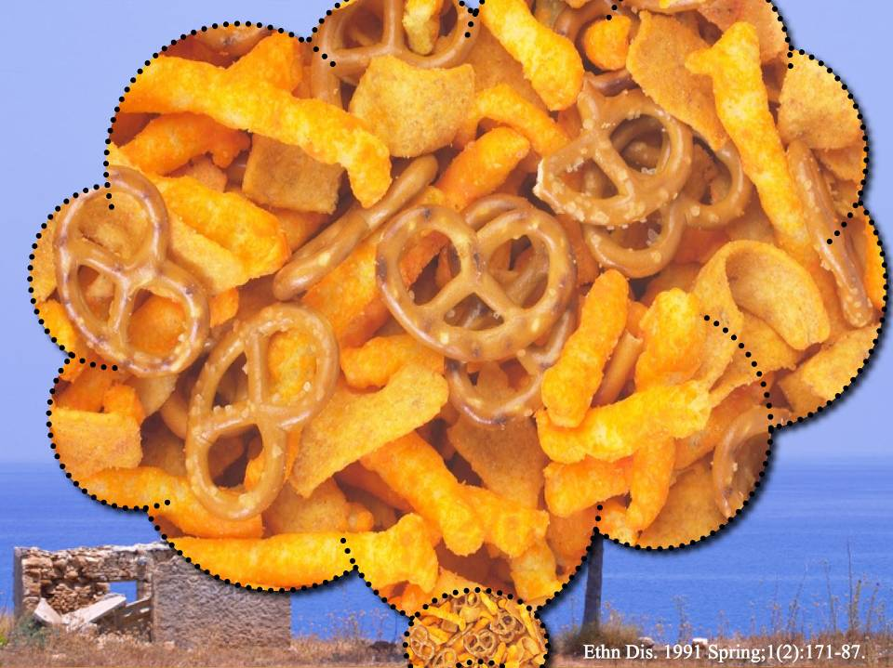

Slide 5
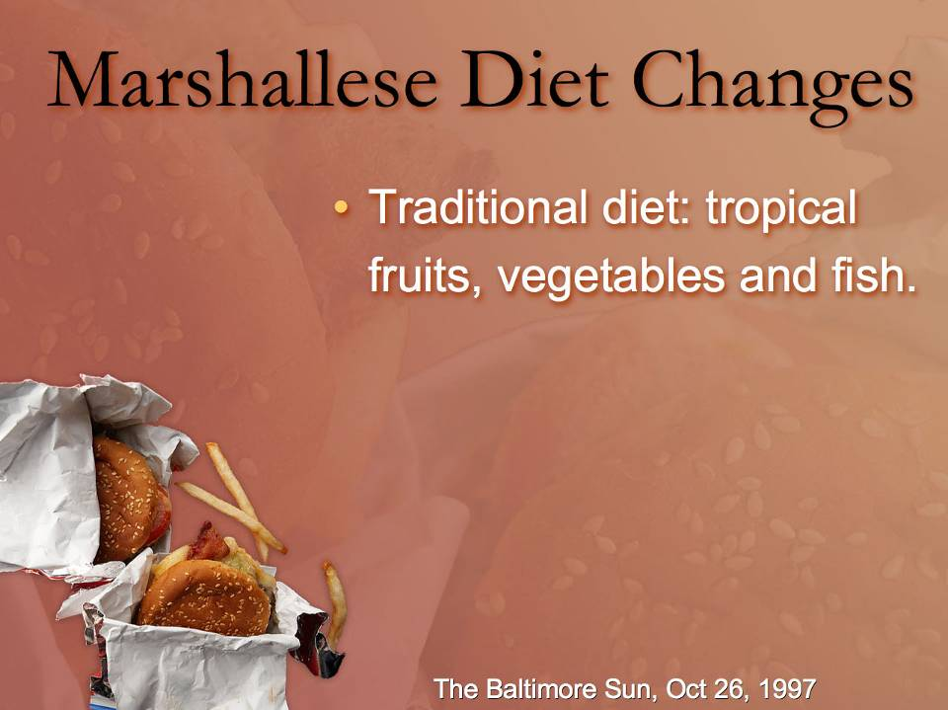

Slide 6
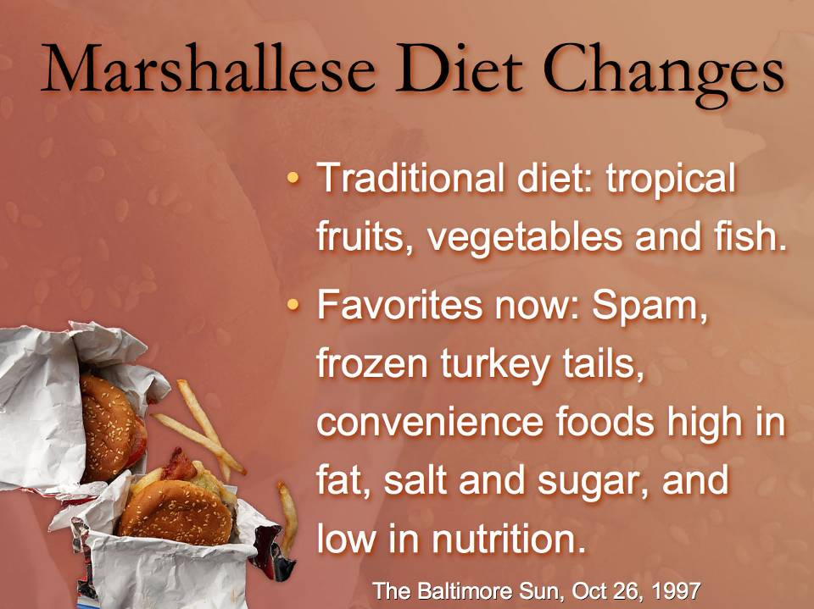

Slide 7
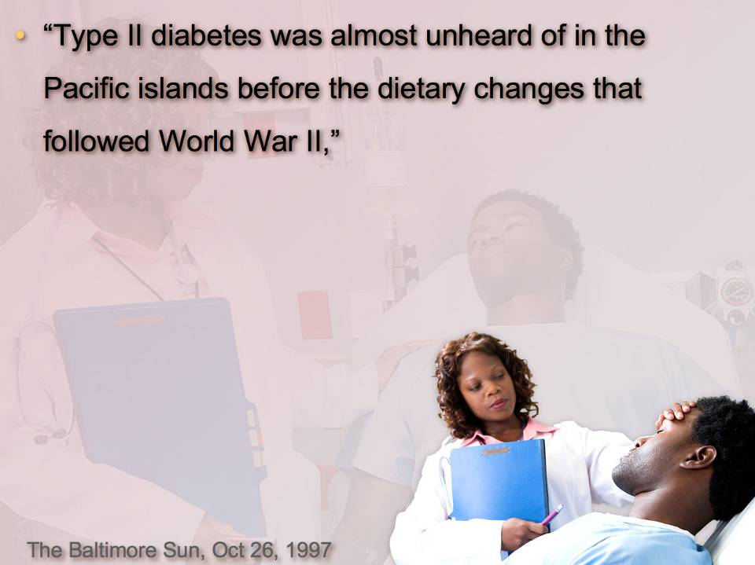

Slide 8
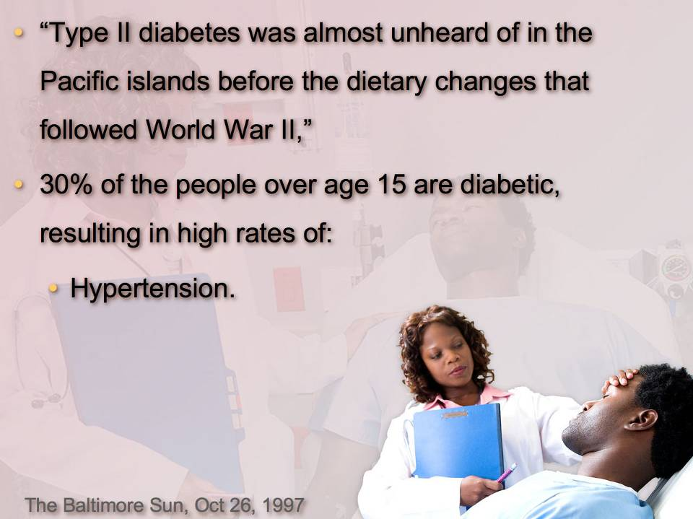

Slide 9
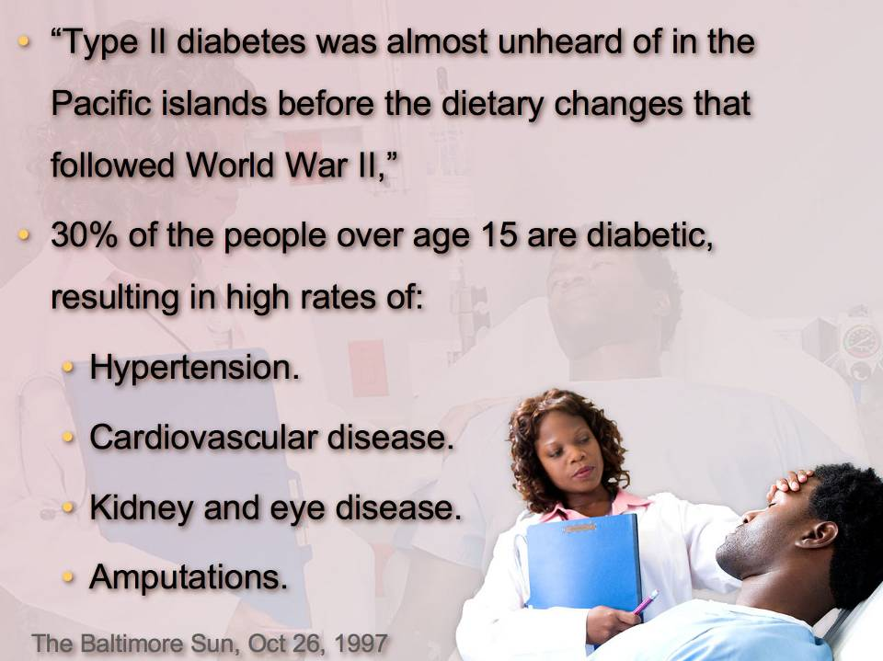

Slide 10
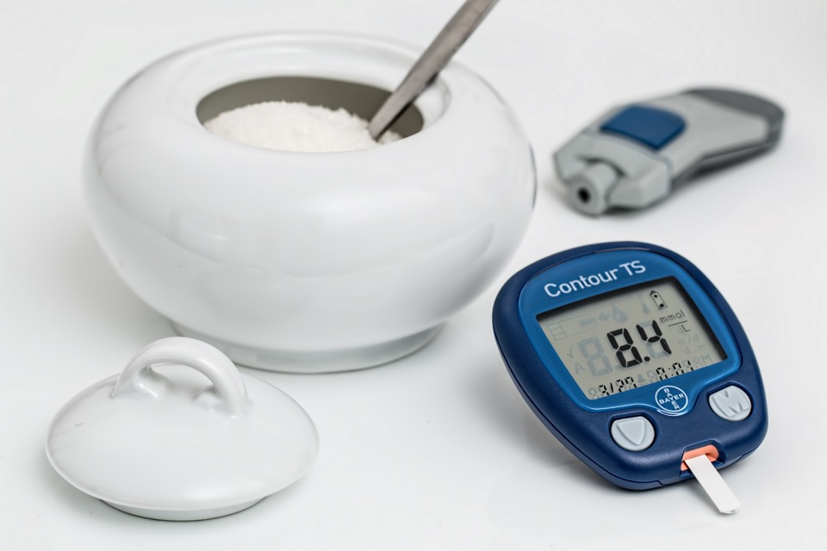
Natural Safe Blood Sugar Control

Slide 11

Notes:
INTRO: Hi, I’m Dr. John Clark, I specialize in Lifestyle medicine. Lifestyle medicine maximizes your health above the probability of disease.
I have now spent over 14 years now researching and teaching people how to overcome high blood pressure and other lifestyle diseases.

Slide 12
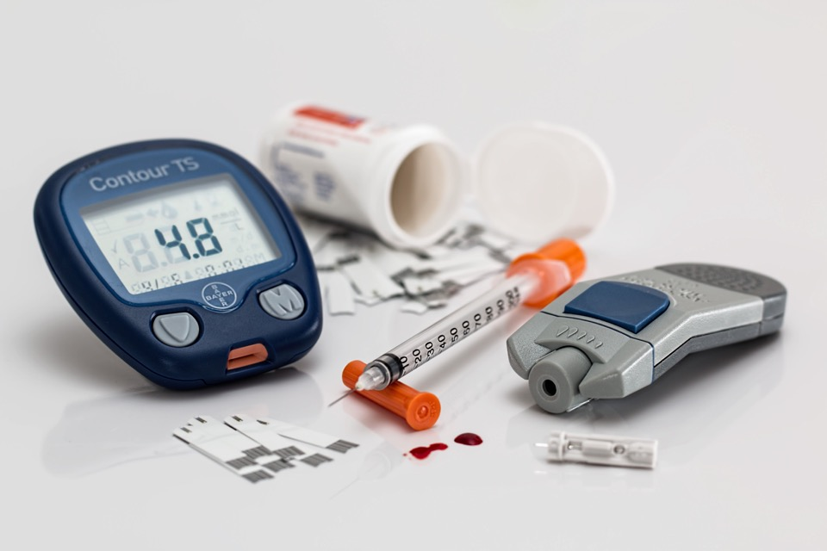
What lifestyle improvements would it take for you to avoid or reverse diabetes?

Slide 13

Outline:
Obesity and Fats.
Glycemic Index and Fiber.
Exercise and Water.

Slide 14
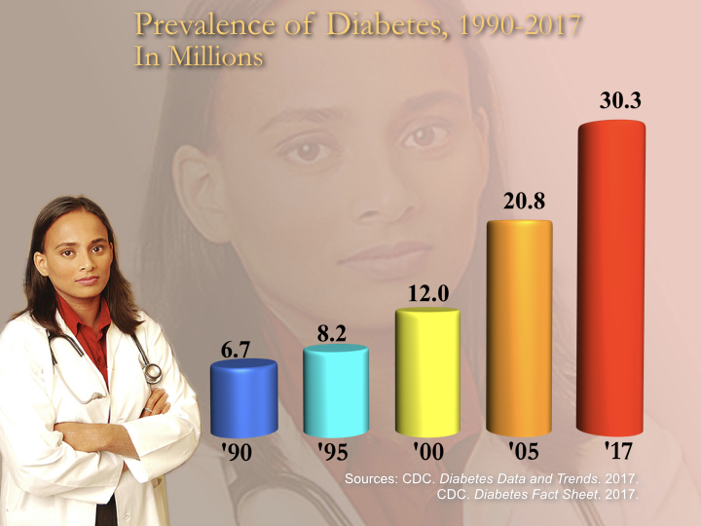

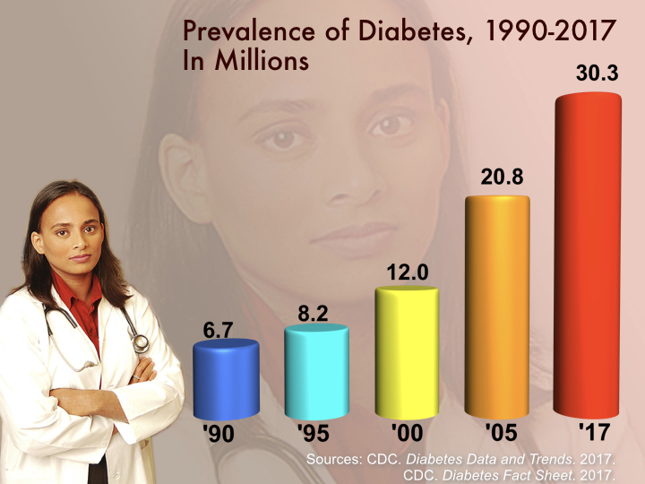


Australian Diabetes
1995 to 2007
Prevalence
Diabetes
http://www.abs.gov.au/AUSSTATS/abs@.nsf/DetailsPage/4820.0.55.0012007-08?OpenDocument

Slide 15

Notes:
Most people are concerned that they will come down with their parent’s diseases.
Our parent’s choice may have gotten them in trouble.
What lifestyle improvements would it take to avoid or reverse diabetes?

Slide 16
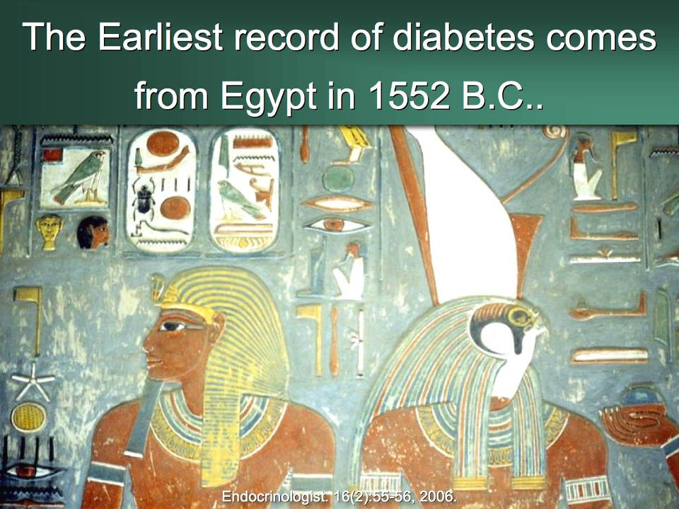

Slide 17

Notes:
Message: Apparently God had told them something, and if they would totally followed it, they could completely avoid diabetes.
What did He tell then, and can we also benefit from these instructions?

Slide 18
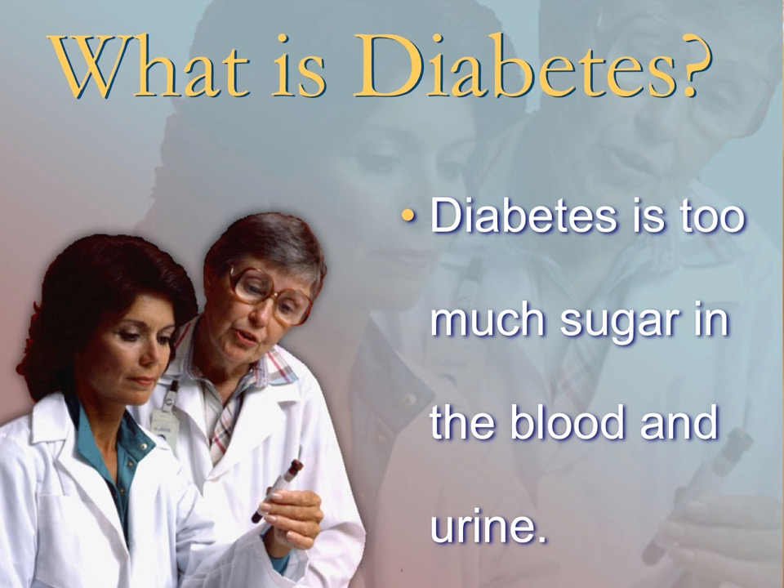

Slide 19
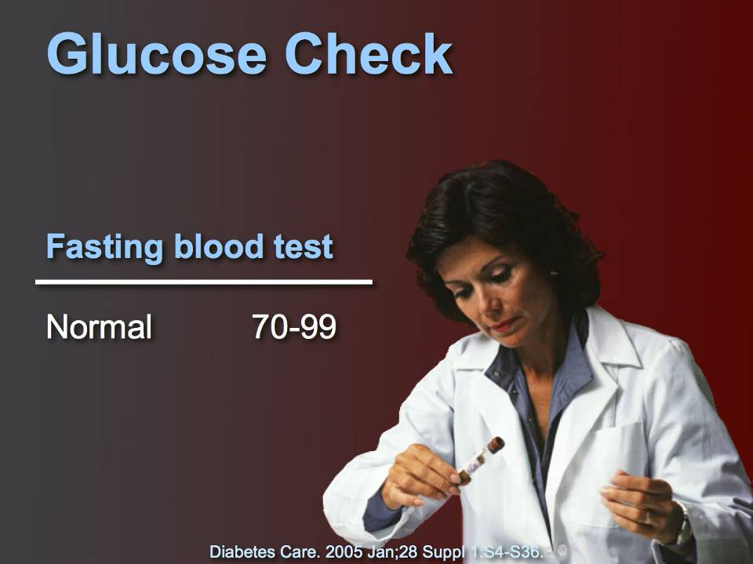
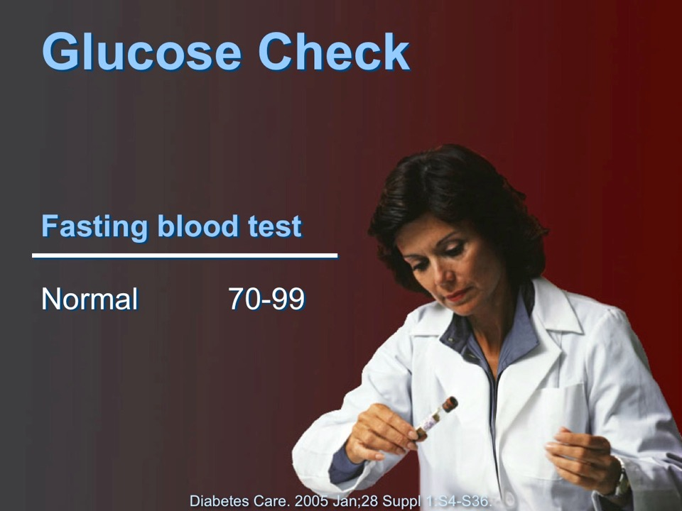
Notes:
In general:
A fasting blood sugar level below 100 milligrams per deciliter (mg/dL) — 5.6 millimoles per liter (mmol/L) — is considered normal.
A fasting blood sugar level from 100 to 125 mg/dL (5.6 to 7.0 mmol/L) is considered prediabetes. This result is sometimes called impaired fasting glucose.
A fasting blood sugar level of 126 mg/dL (7.0 mmol/L) or higher indicates type 2 diabetes.
In general:
An A1C level below 5.7% is considered normal
An A1C level between 5.7% and 6.4% is considered prediabetes
An A1C level of 6.5% or higher on two separate tests indicates type 2 diabetes
Certain conditions can make the A1C test inaccurate — such as if you're pregnant or have an uncommon form of hemoglobin.
https://www.mayoclinic.org/diseases-conditions/prediabetes/diagnosis-treatment/drc-20355284 accessed 8 Feb 2022 7:23pm.

Slide 20
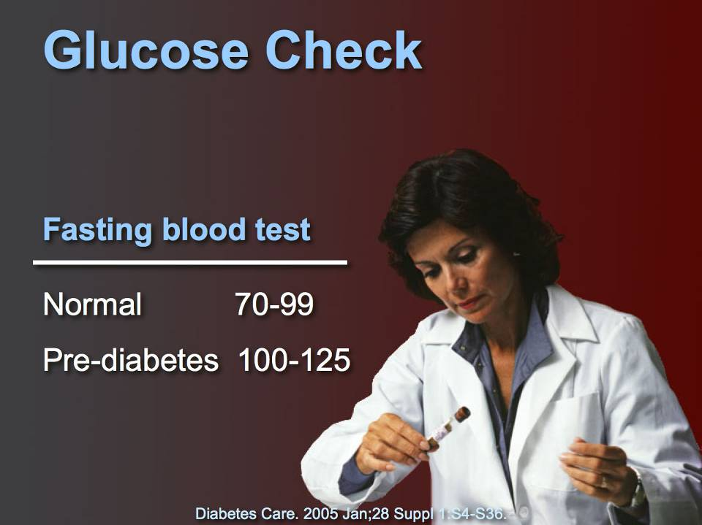
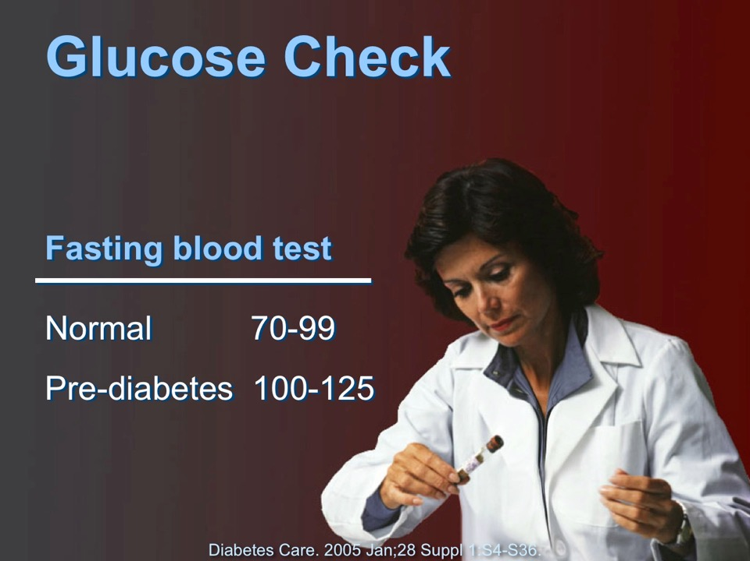

Slide 21

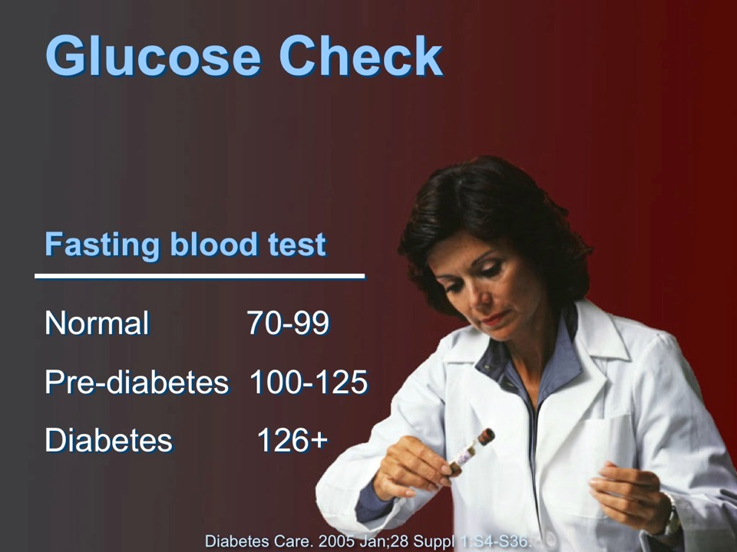
Notes:
In general:
A fasting blood sugar level below 100 milligrams per deciliter (mg/dL) — 5.6 millimoles per liter (mmol/L) — is considered normal.
A fasting blood sugar level from 100 to 125 mg/dL (5.6 to 7.0 mmol/L) is considered prediabetes. This result is sometimes called impaired fasting glucose.
A fasting blood sugar level of 126 mg/dL (7.0 mmol/L) or higher indicates type 2 diabetes.
In general:
An A1C level below 5.7% is considered normal
An A1C level between 5.7% and 6.4% is considered prediabetes
An A1C level of 6.5% or higher on two separate tests indicates type 2 diabetes
Certain conditions can make the A1C test inaccurate — such as if you're pregnant or have an uncommon form of hemoglobin.
https://www.mayoclinic.org/diseases-conditions/prediabetes/diagnosis-treatment/drc-20355284 accessed 8 Feb 2022 7:23pm.

Slide 22

Why You Do Not Want Diabetes
Notes:
That’s how we diagnose diabetes.
Now I want to share some reasons why you do not want to get or ignore diabetes.

Slide 23


Slide 24

Aunt Nancy
Notes:
Most people like their toes and want to keep them.
Trish: H&C, Charcoal poultices, principles from this lecture.
People making good choices enjoy better health with their families and friends.
What does it take to keep all your toes?

Slide 25
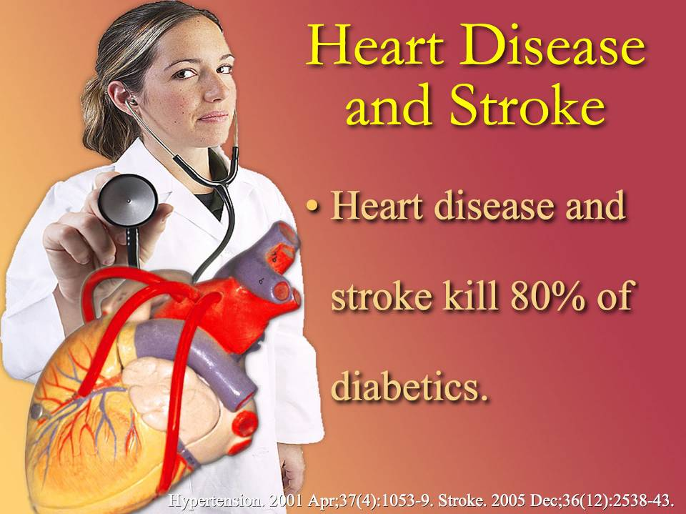

Slide 26
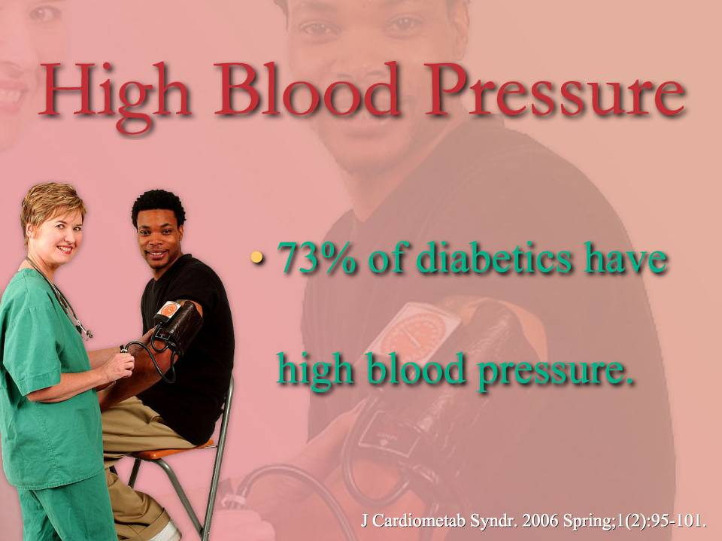

Slide 27


Slide 28
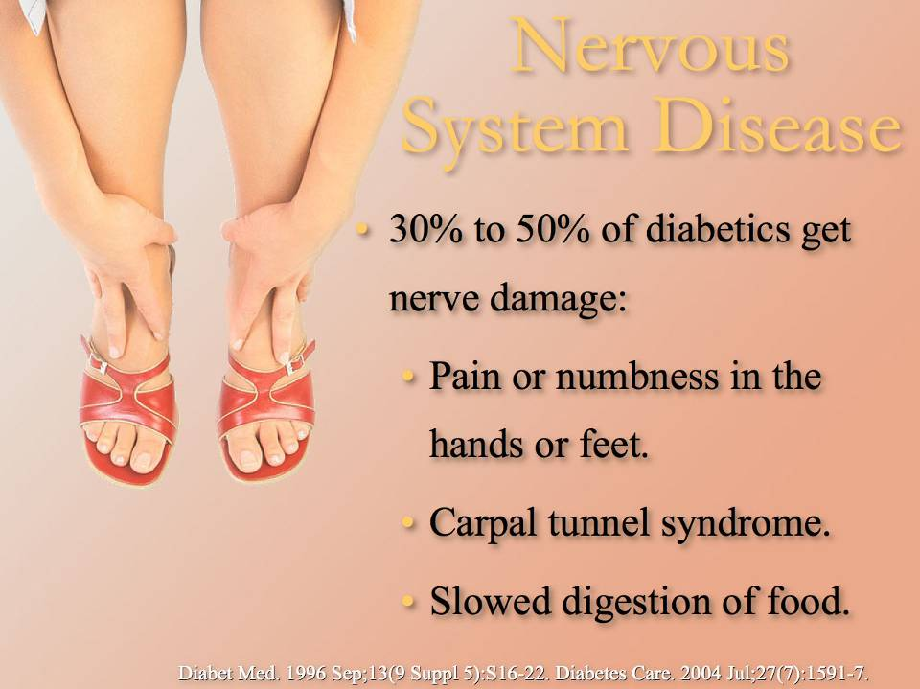

Slide 29
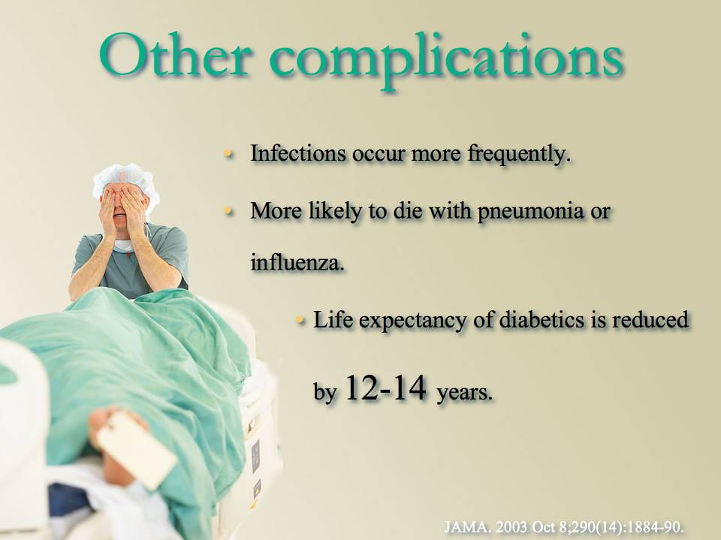

Slide 30
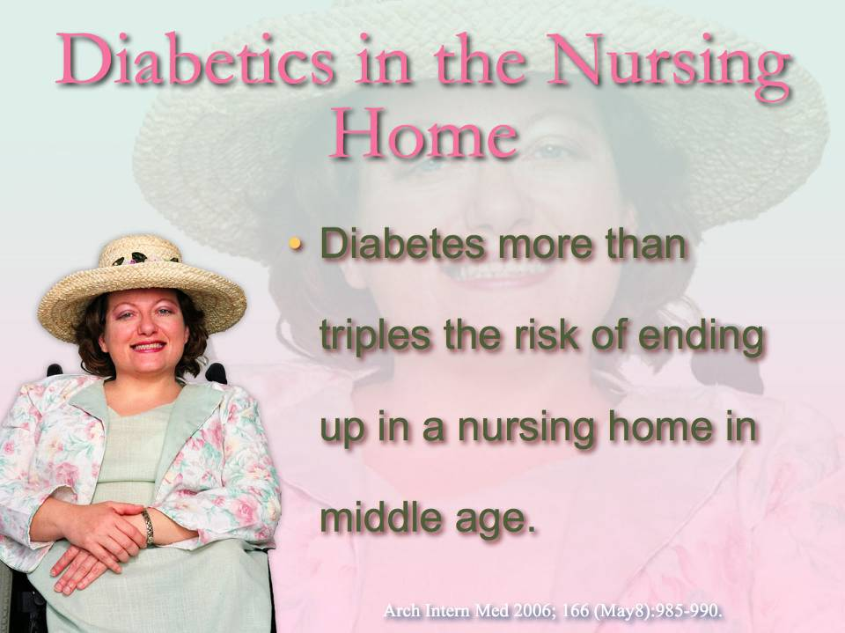

Slide 31
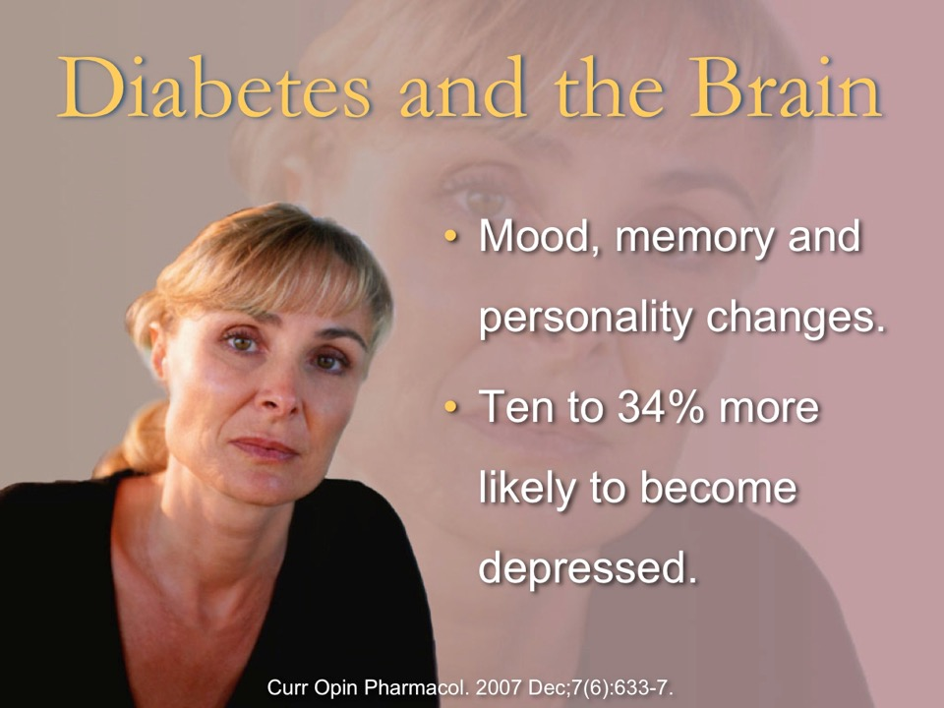

Slide 32


Herb and divorce.
Many people find relationships challenging. What would happen to your relationships if you followed a diabetes friendly lifestyle?
And what would that look like?
Notes:
Herb and divorce.
Many people find relationships challenging. What would happen to your relationships if you followed a diabetes friendly lifestyle?
And what would that look like?

Slide 33
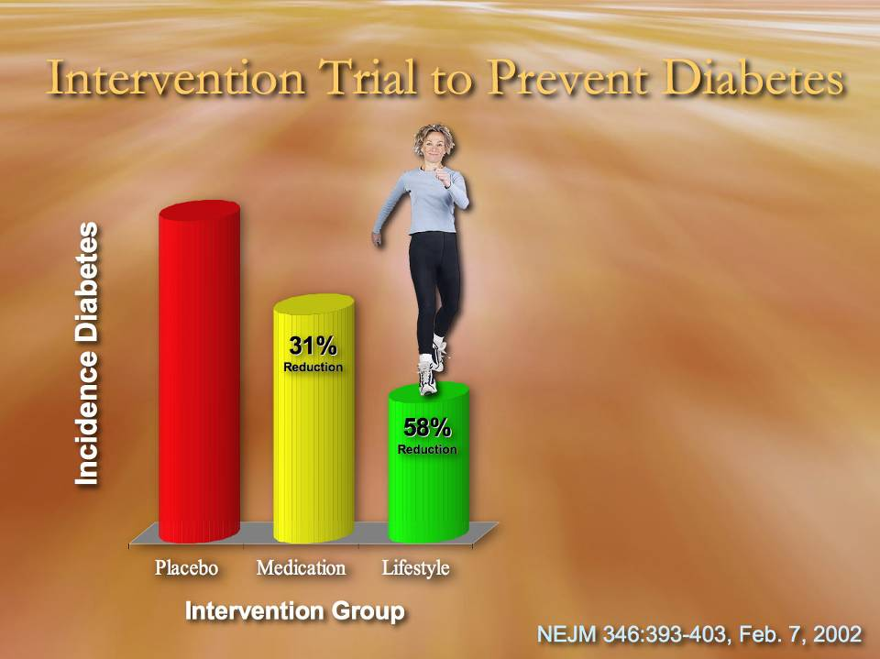
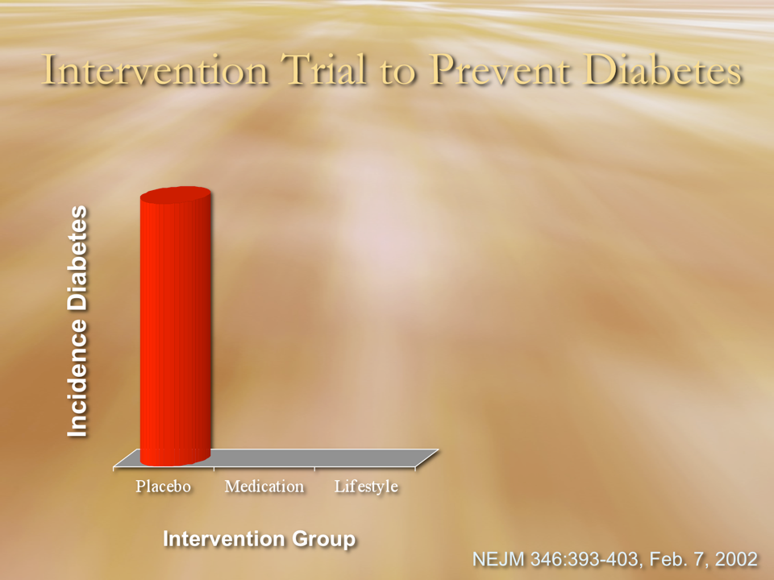

Slide 34
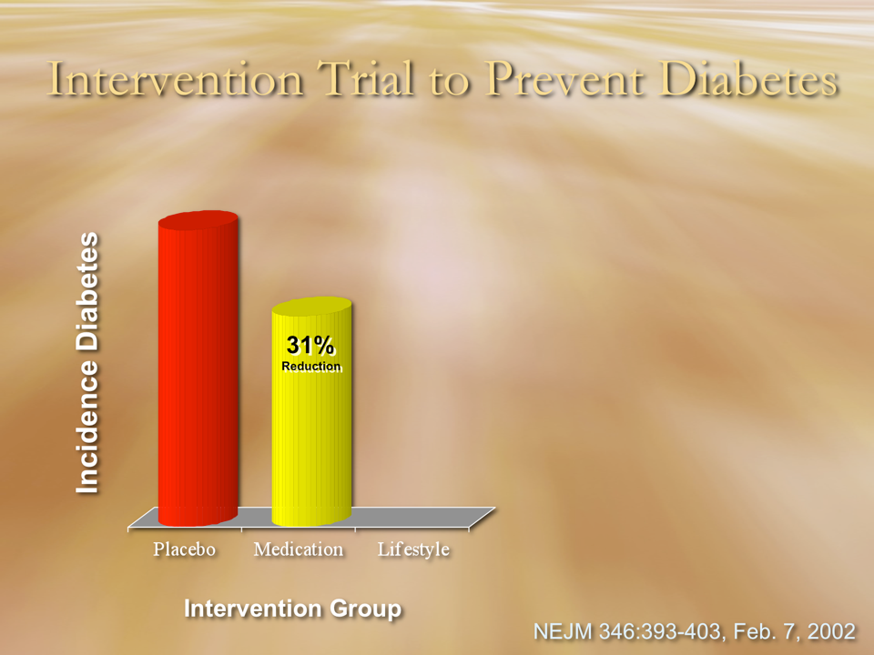

Slide 35
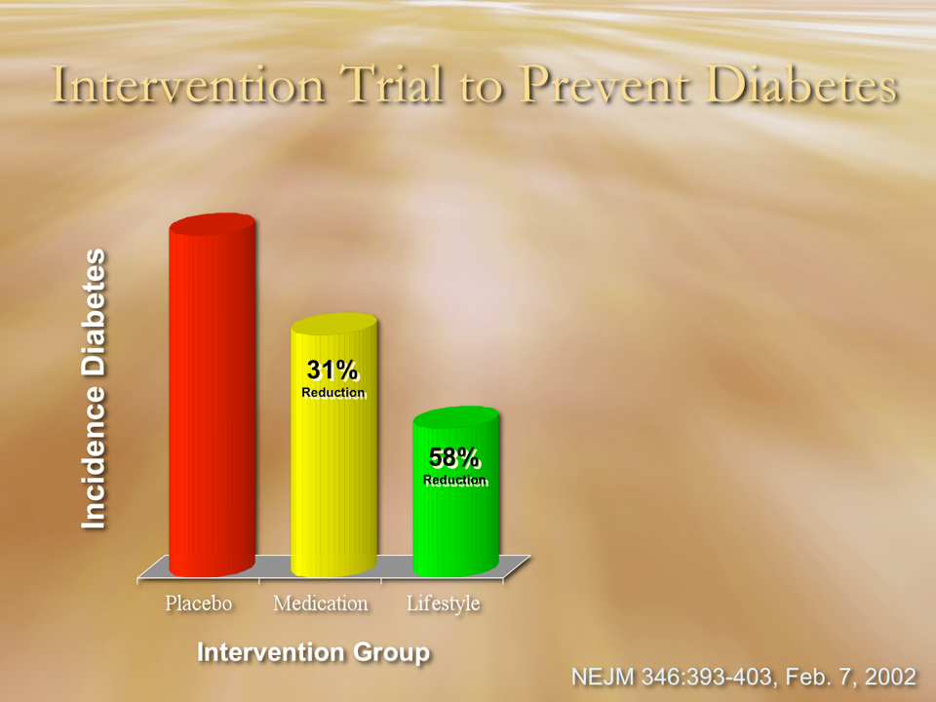

Slide 36
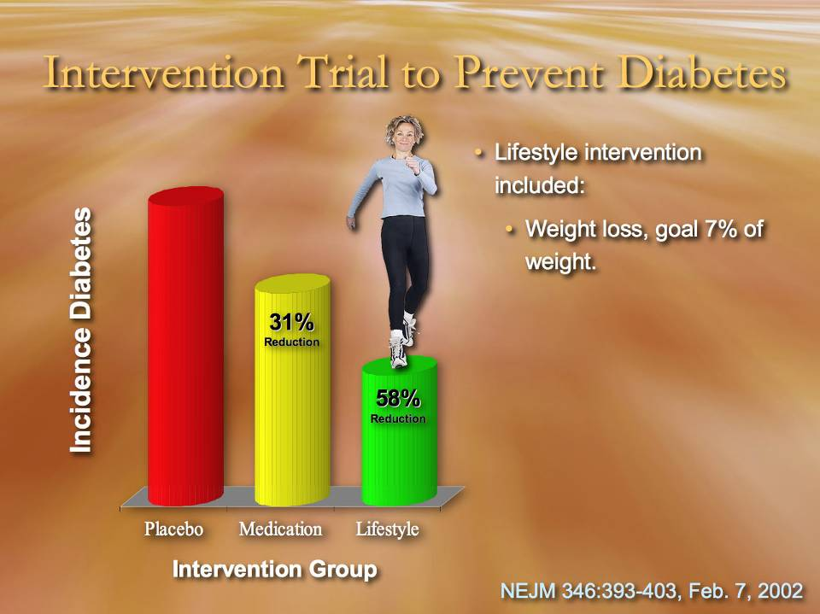
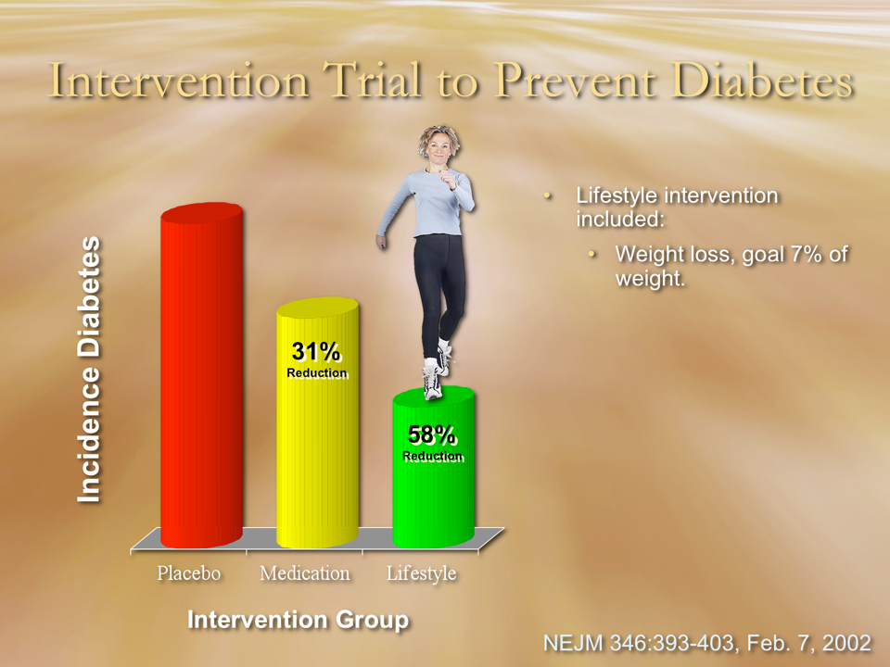
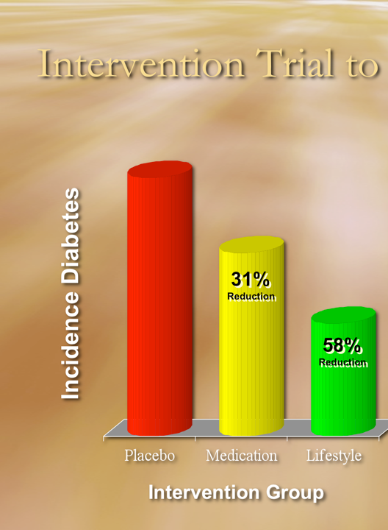

Slide 37
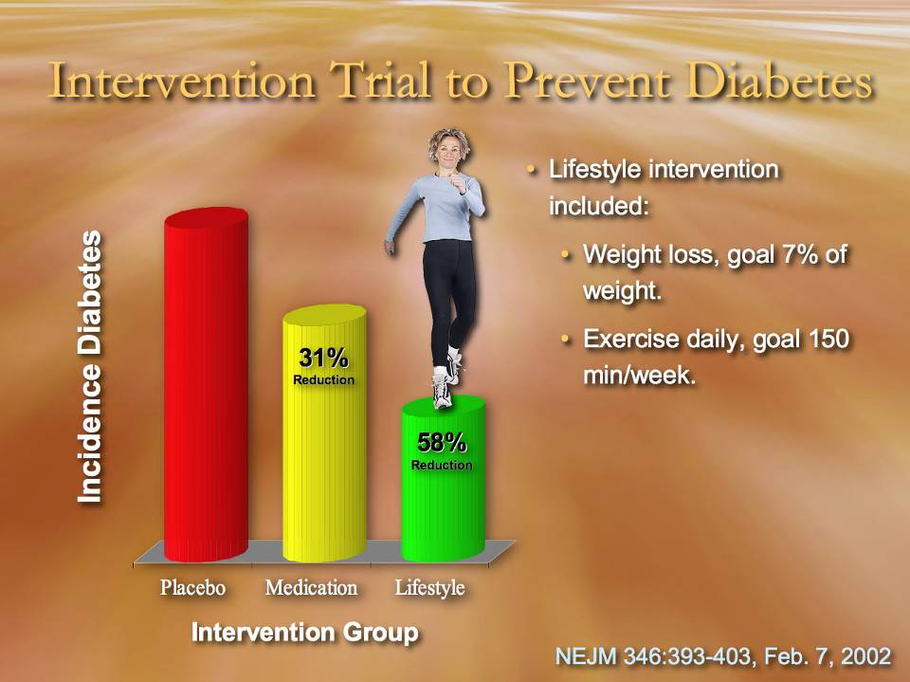


Slide 38
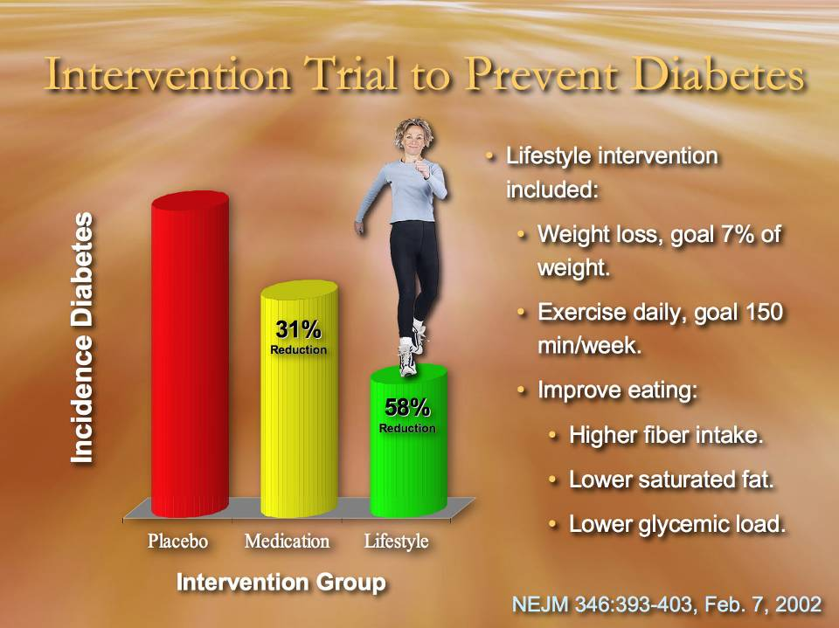
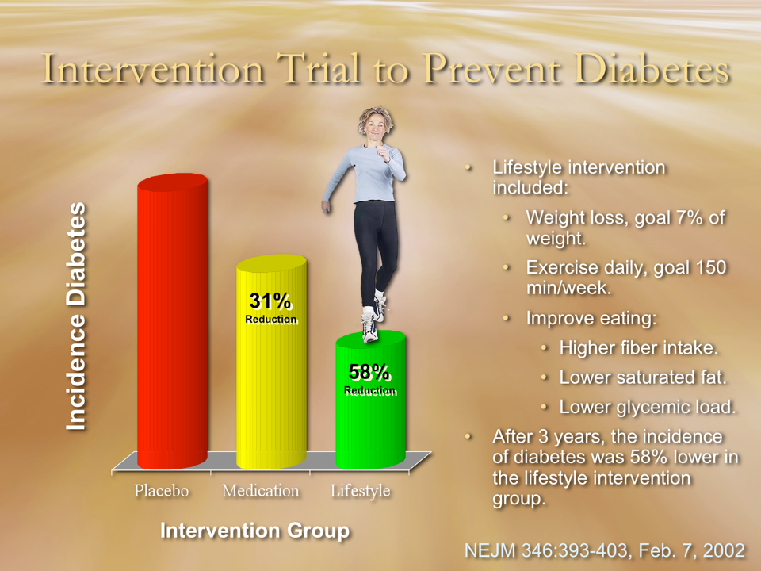

Slide 39

Much More Powerful Medical Intervention.
Notes:
When you have a choice between a get by solution and the very best solution for your health and the health of your family, which do you want?
Well, what about drugs and insulin, are they safe?

Slide 40
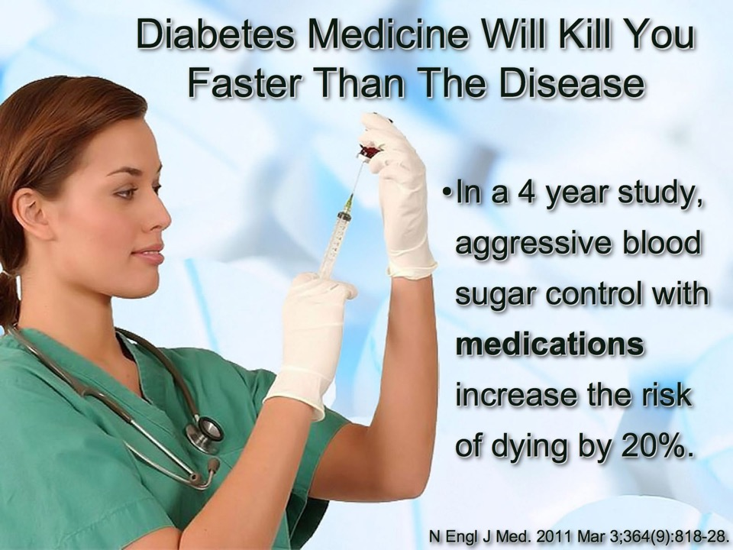

Slide 41

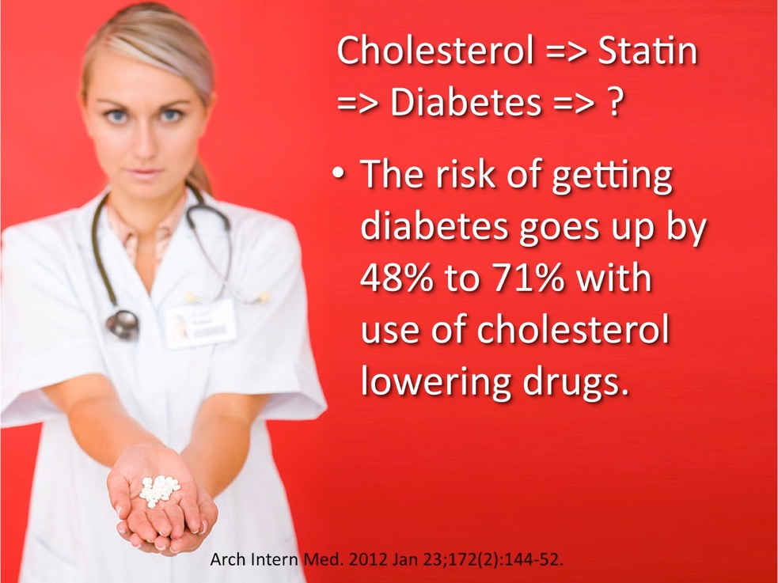

Slide 42


Drugs Don’t Cure Disease
Notes:
Healthy people don’t need drugs.
Most people like to be healthy.
What does it take to be healthy?

Slide 43
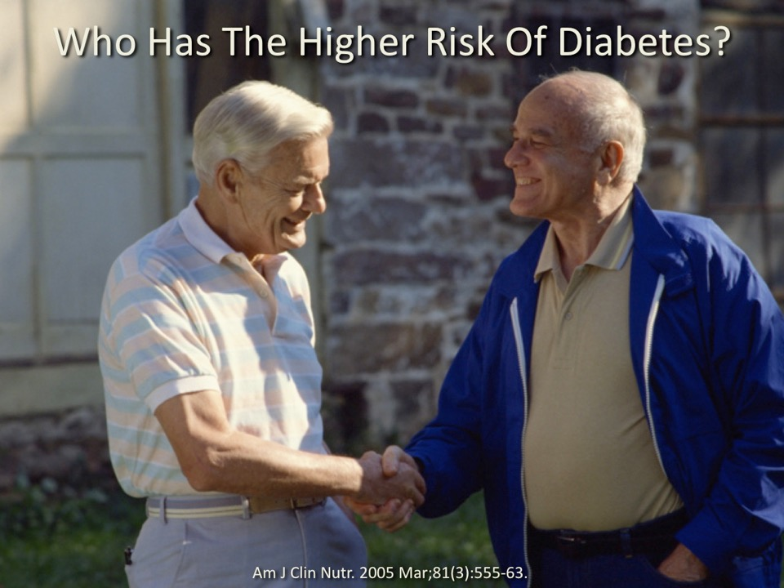
Notes:
Obesity and Diabetes

Slide 44

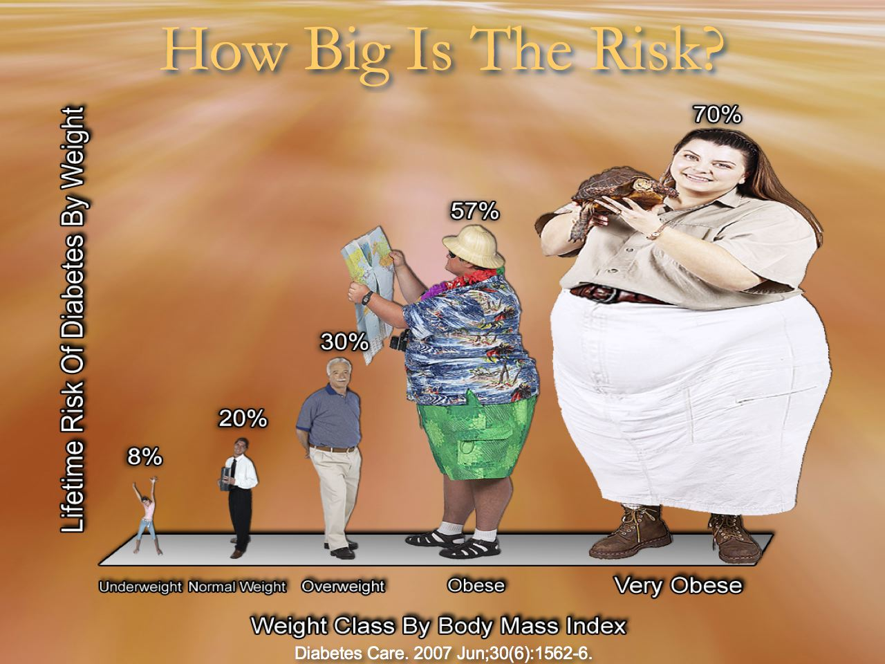
Notes:
44

Slide 45
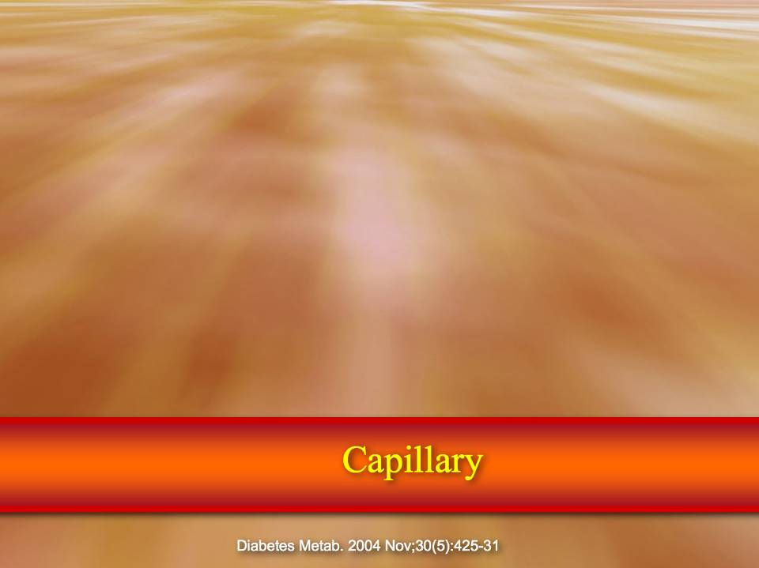
Notes:
45

Slide 46
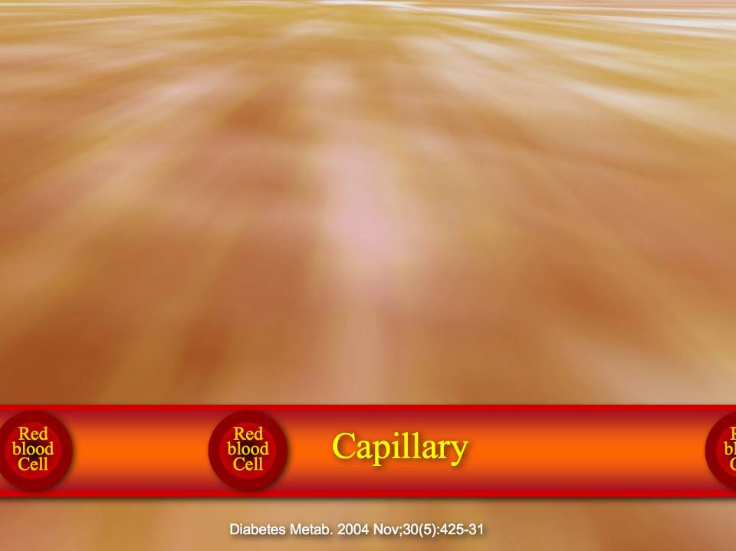
Notes:
46

Slide 47
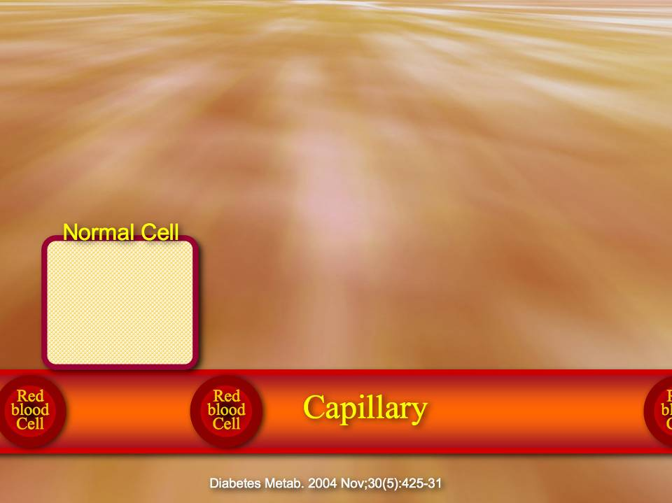
Notes:
47

Slide 48
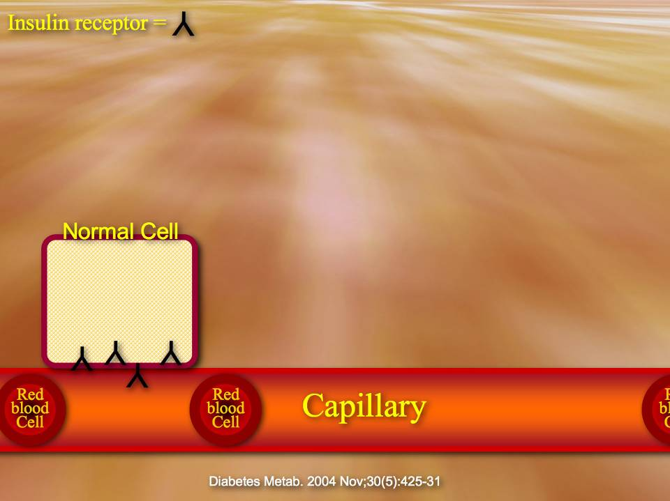
Notes:
48

Slide 49
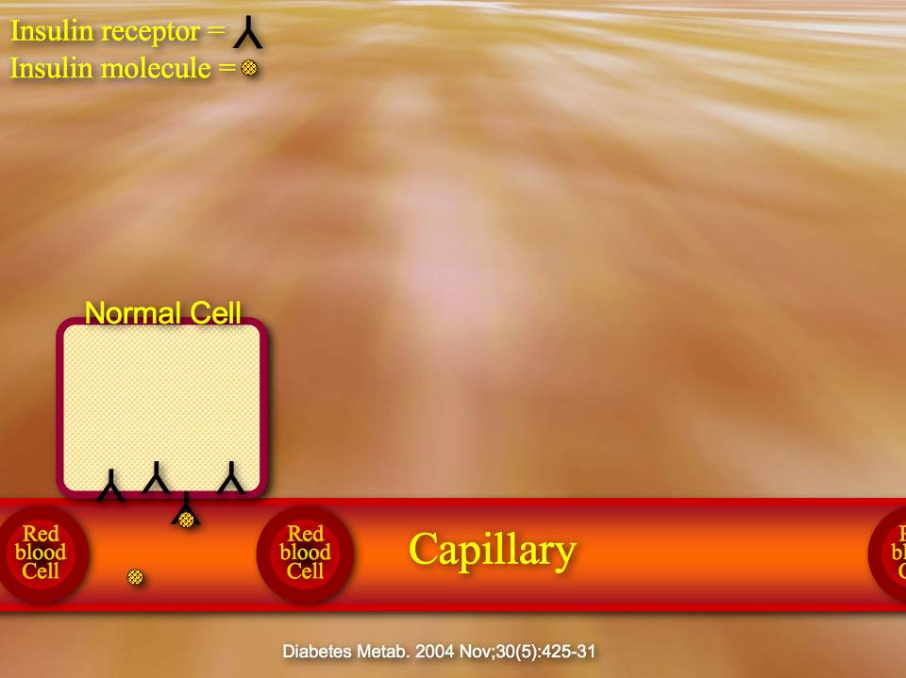
Notes:
49

Slide 50
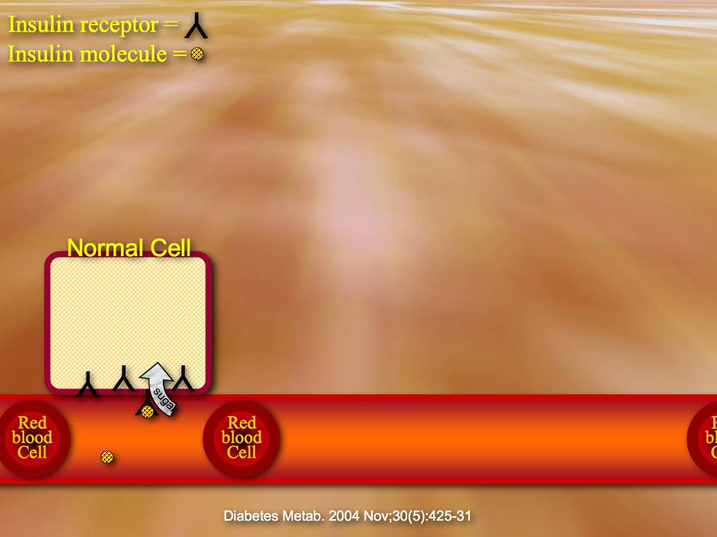
Notes:
50

Slide 51
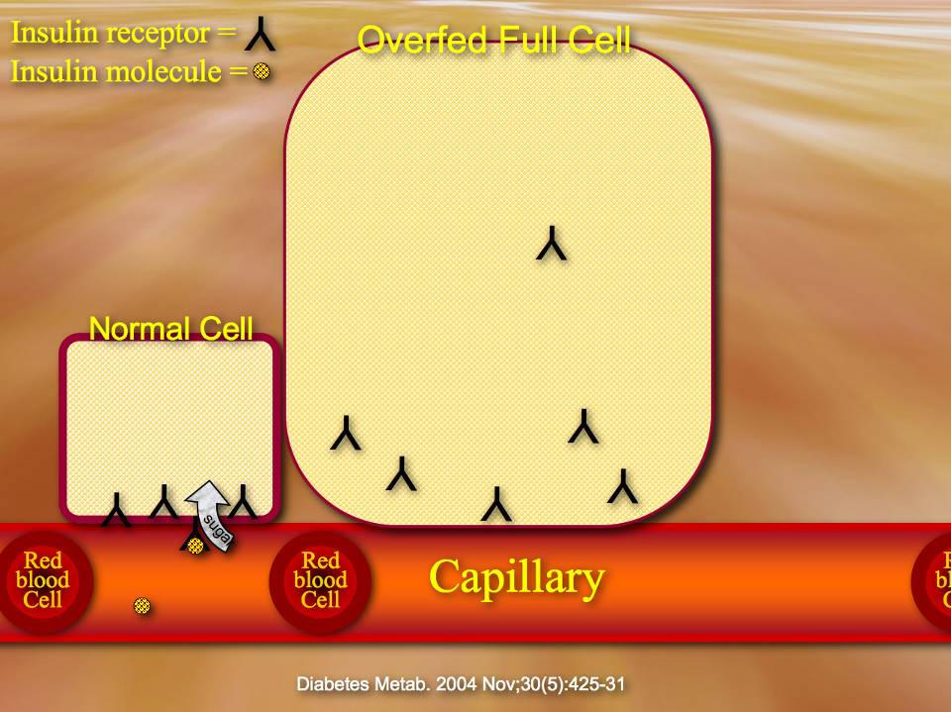
Notes:
51

Slide 52
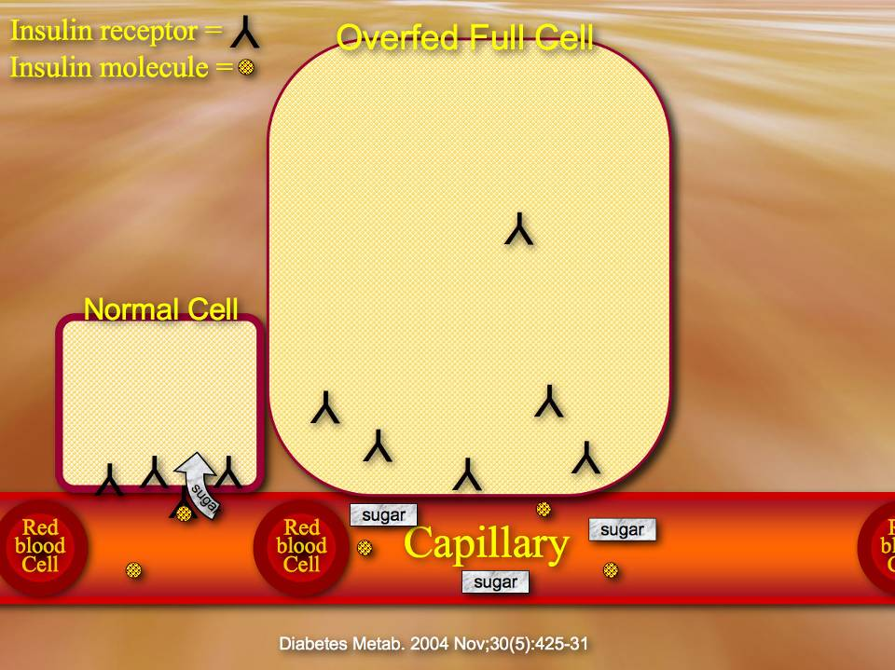
Sugar 1 gram = 4 Calories.
Fat 1 gram = 9 Calories.
Notes:
52

Slide 53
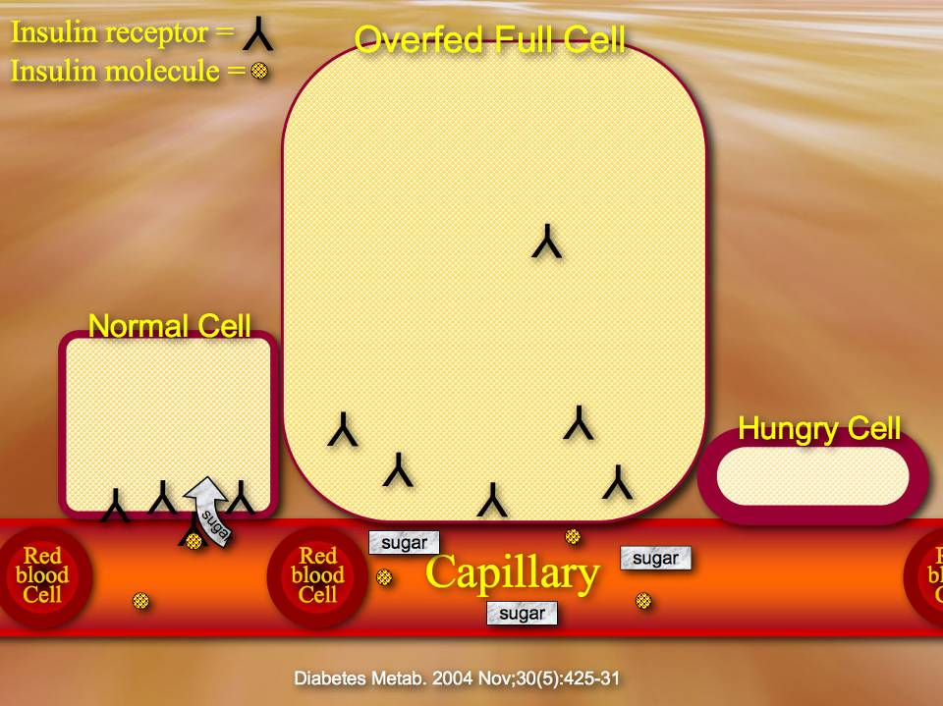
Sugar 1 gram = 4 Calories.
Fat 1 gram = 9 Calories.
Notes:
53

Slide 54
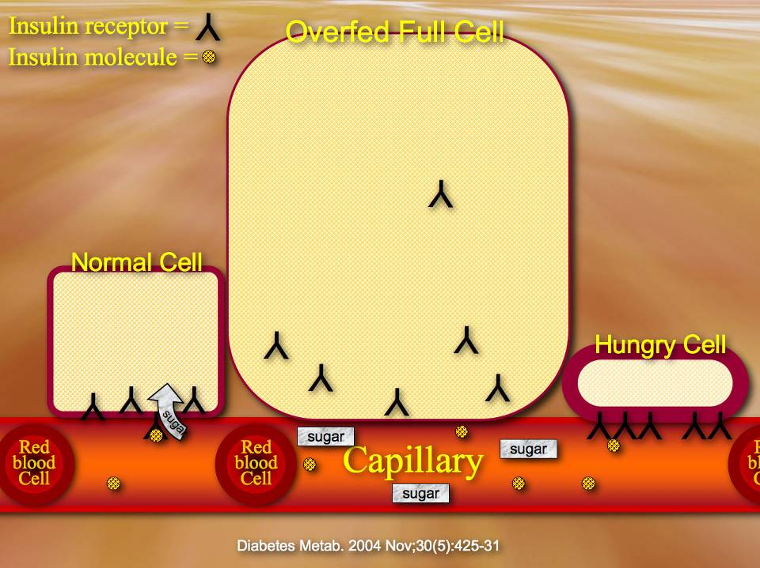
Sugar 1 gram = 4 Calories.
Fat 1 gram = 9 Calories.
Notes:
54

Slide 55
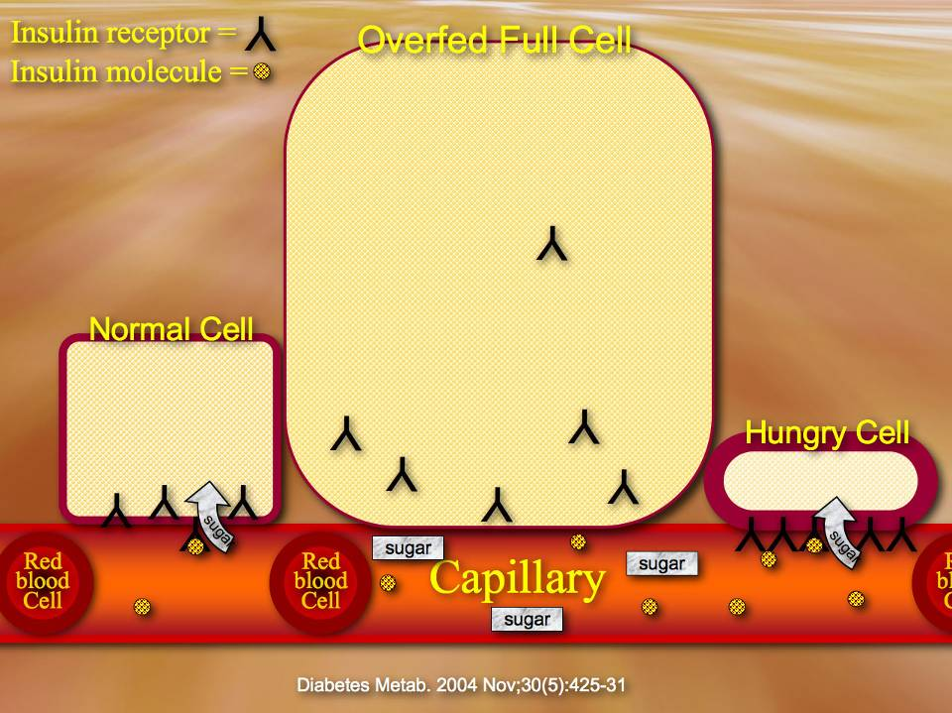
Sugar 1 gram = 4 Calories.
Fat 1 gram = 9 Calories.
Notes:
55

Slide 56
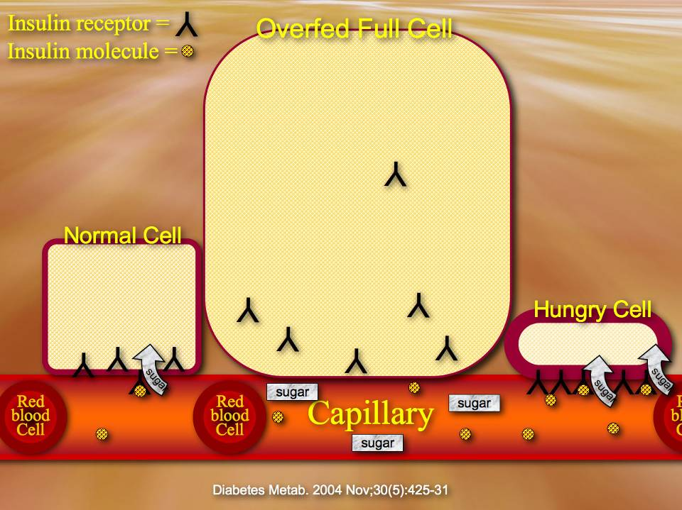
Sugar 1 gram = 4 Calories.
Fat 1 gram = 9 Calories.
Notes:
56

Slide 57
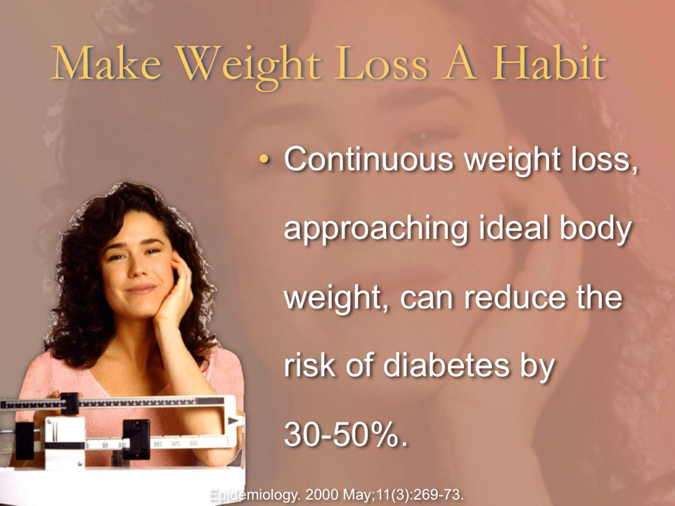

Slide 58

Pate
Glenn beat his diabetes naturally, what about you?
Notes:
Glenn beat his diabetes naturally, what about you?
Now we said that fat fills cells up the fastest, lets look more closely at the fats found in most Americans diets.

Slide 59


Slide 60


Slide 61


Slide 62


Slide 63

Notes:
Herb
No refined oils in diet, no diabetes. More years of life, more time with family on vacation.
What would happen to your health if you avoided all animal fats and refined plant oils?

Slide 64

News Item

Slide 65


Slide 66




Slide 67


Slide 68


Slide 69


Slide 70



Notes:
Can you put a nozzle on a hose while the water is still running?
Can you cure your diabetes if you keep feeding it?

Slide 71


Slide 72


Slide 73


Slide 74


Slide 75


Slide 76


Slide 77


Slide 78


Slide 79


Slide 80



Slide 81


Slide 82


Slide 83


Slide 84


Slide 85


Slide 86


Slide 87


Slide 88


Slide 89

Evening Meal Menace
Each 3-hour increase in nighttime fasting duration was associated with roughly a 20% reduced odds of elevated HbA1c.
Cancer Epidemiol Biomarkers Prev. 24(5):783-9.
Notes:
Marinac CR, Natarajan L, Sears DD, Gallo LC, Hartman SJ, Arredondo E, Patterson RE. Prolonged Nightly Fasting and Breast Cancer Risk: Findings from NHANES (2009-2010). Cancer Epidemiol Biomarkers Prev. 2015 May;24(5):783-9.

Slide 90


Slide 91


Slide 92


Slide 93


Slide 94

Notes:
People on a whole plant food don’t get hungry between meals.
What would it be like to not be tempted by snacks?

Slide 95




Slide 96




Slide 97


Slide 98


Slide 99



Slide 100




Slide 101


Slide 102



Slide 103



Slide 104


Slide 105

Whole Food/refined food
  Minerals/Glucose intolerance
    Fructose
Notes:
Whole plant foods keep you satisfied and control your blood sugars naturally.

Slide 106


Slide 107

Notes:
1:8

Slide 108

How Many Servings?
1:8
Some people’s bodies are constantly crying out for missing nutrients.
What food makes your body the happiest?
Notes:
Some people’s bodies are constantly crying out for missing nutrients.
What food makes your body the happiest?

Slide 109

Notes:
109

Slide 110

Notes:
110

Slide 111

Notes:
111
Fiber slows the rate at which sugar moves from the digestive organs to the blood stream.
The Body is better at controlling slow changes in blood sugar.
People who eat more fiber have an easier time controlling their blood sugars.
What would happen if you chose more fiber rich foods?

Slide 112

Notes:
Gestational Diabetes, Michelle
Fiber slows the rate at which sugar moves from the digestive organs to the blood stream.
The Body is better at controlling slow changes in blood sugar.
People who eat more fiber have an easier time controlling their blood sugars.
What would happen if you chose more fiber rich foods?

Slide 113

Notes:
113

Slide 114

Evid Based Complement Alternat Med. 2008 Sep;5(3):281-7.
Notes:
114
Evid Based Complement Alternat Med. 2008 Sep;5(3):281-7.
Red Cabbage (Brassica oleracea) Ameliorates Diabetic Nephropathy in Rats.Kataya HA, Hamza AA.
Department of Biology, Faculty of Science, UAE University, Al-Ain, PO Box: 17555, UAE.
The protective action against oxidative stress of red cabbage (Brassica oleracea) extract was investigated. Diabetes was induced in male Wistar rats using streptozotocin (60 mg/kg body weight). Throughout the experimental period (60 days), diabetic rats exhibited many symptoms including loss of body weight, hyperglycemia, polyuria, polydipsia, renal enlargement and renal dysfunction. Significant increase in malondialdehyde, a lipid peroxidation marker, was observed in diabetic kidney. This was accompanied by a significant increase in reduced glutathione and superoxide dismutase activity and a decrease in catalase activity and in the total antioxidant capacity of the kidneys. Daily oral ingestion (1 g/kg body weight) of B. oleracea extract for 60 days reversed the adverse effect of diabetes in rats. B. oleracea extract lowered blood glucose levels and restored renal function and body weight loss. In addition, B. oleracea extract attenuated the adverse effect of diabetes on malondialdehyde, glutathione and superoxide dismutase activity as well as catalase activity and total antioxidant capacity of diabetic kidneys. In conclusion, the antioxidant and antihyperglycemic properties of B. oleracea extract may offer a potential therapeutic source for the treatment of diabetes.
PMID: 18830445 [PubMed - in process]

Slide 115

Notes:
More people who eat cabbage regularly are more likely to get off of their insulin.
What about picking up a head of cabbage next time you are in the grocery store?

Slide 116

Herbs For Diabetes
Citrus leaves reduces insulin resistance.
Bladderwrack inhibits carbohydrate metabolism, stimulates insulin production and protects the pancreas,
Rosemary and Lemon Balm inhibit carbohydrate metabolism.
Astragalus: reduces beta cell inflammation.
Red ginseng and Jiaogulan stimulate beta cell insulin production.
Peppermint for better flavor.
Notes:
Diabetes herbal tea. To be taken, one half cup 30 minutes before each meal.
Psalms 104:14 KJV. He causeth the grass to grow for the cattle, and herb for the service of man: that he may bring forth food out of the earth;
"This is God's method. The herbs that grow for the benefit of man, and the little handful of herbs kept and steeped and used for sudden ailments, have served tenfold, yes, one hundred fold better purposes, than all the drugs hidden under mysterious names and dealt out to the sick. {PH144 12.2}
Tea for type 1 diabetes taken one half hour before meals. Recipe:
1 part Astragalus root powder.
1 part Jiaogulan leaves.
1 part thinly shaved Ginseng root slices.
2 parts fresh or 1 part dried Rosemary leaves.
2 parts fresh or 1 part dried Lemon Balm.
1-2 parts crushed citrus leaves (lemon, pomelo, grapefruit or orange).
2 parts fresh or 1 part dried Peppermint leaves.
1 part Bladderwrack
Mix dry ingredients. Bring one quart of water to a boil and add 1/4 cup of the tea mix. Let steep for at least 20 minutes. Make up in large batch and keep in the refrigerator.
Rationale:
Beta cell inflammation reduction:
Astragalus [1]
Beta cell stimulators of insulin production:
Jiaogulan (Gynostemma pentaphyllum) tea [2]
Red ginseng[3]
Carbohydrate metabolism inhibition:
Rosemary[4]
Lemon balm [4]
Reduction of insulin resistance:
Citrus grandis (L.) Osbeck (pomelo) leaves [5]
Bladderwrack [11] Carbohydrate metabolism inhibition, Insulin stimulation and pancreatic protection, Protective effects against diabetic nephropathy, Iodine source.
Tea flavor enhancement:
Peppermint [6]
Others that could be used:
Goldenseal root [7] Antioxidant, anti-inflammatory and hypoglycemic activities, which contribute to its efficacy in diabetes. One half part in tea if in tea mix.
Fenugreek [8] protect and rejuvinate pancreatic β-cells. One part seeds if used in tea mix.
Tarragon (Artemisia dracunculus L.) [9] enhances insulin release from primary β cells. One half part of dried herb if used in tea mix.
Moringa oleifera leaf [10] possesses potent hypoglycemic effects. One half part if used in tea mix.
Where to Buy
Astragalus: https://www.mountainroseherbs.com/products/astragalus-root/profile
Jiaogluan: http://a.co/1KTYMsW
Red ginseng: https://www.mountainroseherbs.com/products/ginseng-root-whole-red/profile
Rosemary: Your garden or a nursery or: https://www.mountainroseherbs.com/products/rosemary-leaf/profile
Lemon balm: https://www.mountainroseherbs.com/products/lemon-balm/profile
Citrus leaf: https://www.fast-growing-trees.com/Meyer-Lemon-Tree.htm
Peppermint: https://www.mountainroseherbs.com/products/peppermint-leaf/profile
Bladderwrack: https://www.mountainroseherbs.com/products/bladderwrack/profile
Others:
Goldenseal: https://www.mountainroseherbs.com/products/goldenseal-root/profile
Fenugreek seeds: Local supermarket, spice section or Indian section.
Tarragon: https://www.mountainroseherbs.com/products/tarragon/profile
Moringa oleifera Lam. http://a.co/2bZDNyM
References
[1] Li RJ, Qiu SD, Chen HX, Tian H, Liu GQ. Effect of Astragalus polysaccharide on pancreatic cell mass in type 1 diabetic mice. Zhongguo Zhong Yao Za Zhi. 2007 Oct;32(20):2169-73.
Kojo Agyemang, Lifeng Han, Erwei Liu, Yi Zhang, Tao Wang, and Xiumei Gao. Recent Advances in Astragalus membranaceus Anti-Diabetic Research: Pharmacological Effects of Its Phytochemical Constituents. Evidence-Based Complementary and Alternative Medicine Volume 2013 (2013), Article ID 654643, 9 pages http://dx.doi.org/10.1155/2013/654643
[2] Norberg A, Hoa NK, Liepinsh E, Van Phan D, Thuan ND, Jörnvall H, Sillard R, Ostenson CG. A novel insulin-releasing substance, phanoside, from the plant Gynostemma pentaphyllum. J Biol Chem. 2004 Oct 1;279(40):41361-7.
[3] Kim K, Kim HY. Korean red ginseng stimulates insulin release from isolated rat pancreatic islets. J Ethnopharmacol. 2008 Nov 20;120(2):190-5.
Hui H, Tang G, Go VL. Hypoglycemic herbs and their action mechanisms. Chin Med. 2009 Jun 12;4:11. doi: 10.1186/1749-8546-4-11.
[4] Melzig MF, Funke I. Inhibitors of alpha-amylase from plants--a possibility to treat diabetes mellitus type II by phytotherapy? Wien Med Wochenschr. 2007;157(13-14):320-4.
[5] Rao YK, Lee MJ, Chen K, Lee YC, Wu WS, Tzeng YM. Insulin-Mimetic Action of Rhoifolin and Cosmosiin Isolated from Citrus grandis (L.) Osbeck Leaves: Enhanced Adiponectin Secretion and Insulin Receptor Phosphorylation in 3T3-L1 Cells. Evid Based Complement Alternat Med. 2011;2011:624375. Mar 10.
[6] Barbalho SM, Damasceno DC, Spada AP, da Silva VS, Martuchi KA, Oshiiwa M, Machado FM, Mendes CG. Metabolic Profile of Offspring from Diabetic Wistar Rats Treated with Mentha piperita (Peppermint). Evid Based Complement Alternat Med. 2011;2011:430237.
[7] Li Z, Geng YN, Jiang JD, Kong WJ. Antioxidant and anti-inflammatory activities of berberine in the treatment of diabetes mellitus. Evid Based Complement Alternat Med. 2014;2014:289264.
[8] Gong J, Dong H, Jiang SJ, Wang DK, Fang K, Yang DS, Zou X, Xu LJ, Wang KF, Lu FE. Fenugreek lactone attenuates palmitate-induced apoptosis and dysfunction in pancreatic β-cells. World J Gastroenterol. 2015 Dec 28;21(48):13457-65.
[9] Aggarwal S, Shailendra G, Ribnicky DM, Burk D, Karki N, Qingxia Wang MS. An extract of Artemisia dracunculus L. stimulates insulin secretion from β cells, activates AMPK and suppresses inflammation. J Ethnopharmacol. 2015 Jul 21;170:98-105.
[10] Abd E, Latif A, El Bialy Bel S, Mahboub HD, Abd Eldaim MA. Moringa oleifera leaf extract ameliorates alloxan-induced diabetes in rats by regeneration of β cells and reduction of pyruvate carboxylase expression. Biochem Cell Biol. 2014 Oct;92(5):413-9.
[11] Kim KT, Rioux LE, Turgeon SL. Alpha-amylase and alpha-glucosidase inhibition is differentially modulated by fucoidan obtained from Fucus vesiculosus and Ascophyllum nodosum. Phytochemistry. 2014 Feb;98:27-33.
Jiang X, Yu J, Ma Z, Zhang H, Xie F. Effects of fucoidan on insulin stimulation and pancreatic protection via the cAMP signaling pathway in vivo and in vitro. Mol Med Rep. 2015 Sep;12(3):4501-7.
Wang Y, Nie M, Lu Y, Wang R, Li J, Yang B, Xia M, Zhang H, Li X. Fucoidan exerts protective effects against diabetic nephropathy related to spontaneous diabetes through the NF-κB signaling pathway in vivo and in vitro. Int J Mol Med. 2015 Apr;35(4):1067-73.

Slide 117


Slide 118


Slide 119

Notes:
119

Slide 120

Notes:
120

Slide 121


Slide 122


Slide 123

Sick
Active people live longer, stay independent longer, avoid more chronic diseases.
Activity is a priority on the schedules of healthy people.
What time of day do you have scheduled for exercise?
Notes:
Activity is a priority on the schedules of healthy people.
Active people live longer, stay independent longer, enjoy more free time with their friends and family, and avoid more chronic diseases.
What time of day have you scheduled for invigorating outdoor exercise?

Slide 124

Notes:
124

Slide 125

Schedule Some Good Health Today
Between meals snacking, evening eating, and late bedtimes increases insulin resistance, obesity and diabetes.
J Pediatr. 205:257-264.
Notes:
Metabolism. 2016 May;65(5):714-27. doi: 10.1016/j.metabol.2016.02.003. Epub 2016 Feb 9.
Short-term feeding at the wrong time is sufficient to desynchronize peripheral clocks and induce obesity with hyperphagia, physical inactivity and metabolic disorders in mice.
Yasumoto Y1, Hashimoto C2, Nakao R3, Yamazaki H4, Hiroyama H3, Nemoto T3, Yamamoto S3, Sakurai M5, Oike H6, Wada N7, Yoshida-Noro C8, Oishi K9.
Author information
Abstract
BACKGROUND:
The circadian clock regulates various physiological and behavioral rhythms such as feeding and locomotor activity. Feeding at unusual times of the day (inactive phase) is thought to be associated with obesity and metabolic disorders in experimental animals and in humans.
OBJECTIVE:
The present study aimed to determine the underlying mechanisms through which time-of-day-dependent feeding influences metabolic homeostasis.
METHODS:
We compared food consumption, wheel-running activity, core body temperature, hormonal and metabolic variables in blood, lipid accumulation in the liver, circadian expression of clock and metabolic genes in peripheral tissues, and body weight gain between mice fed only during the sleep phase (DF, daytime feeding) and those fed only during the active phase (NF, nighttime feeding). All mice were fed with the same high-fat high-sucrose diet throughout the experiment. To the best of our knowledge, this is the first study to examine the metabolic effects of time-imposed restricted feeding (RF) in mice with free access to a running wheel.
RESULTS:
After one week of RF, DF mice gained more weight and developed hyperphagia, higher feed efficiency and more adiposity than NF mice. The daily amount of running on the wheel was rapidly and obviously reduced by DF, which might have been the result of time-of-day-dependent hypothermia. The amount of daily food consumption and hypothalamic mRNA expression of orexigenic neuropeptide Y and agouti-related protein were significantly higher in DF, than in NF mice, although levels of plasma leptin that fluctuate in an RF-dependent circadian manner, were significantly higher in DF mice. These findings suggested that the DF induced leptin resistance. The circadian phases of plasma insulin and ghrelin were synchronized to RF, although the corticosterone phase was unaffected. Peak levels of plasma insulin were remarkably higher in DF mice, although HOMA-IR was identical between the two groups. Significantly more free fatty acids, triglycerides and cholesterol accumulated in the livers of DF, than NF mice, which resulted from the increased expression of lipogenic genes such as Scd1, Acaca, and Fasn. Temporal expression of circadian clock genes became synchronized to RF in the liver but not in skeletal muscle, suggesting that uncoupling metabolic rhythms between the liver and skeletal muscle also contribute to DF-induced adiposity.
CONCLUSION:
Feeding at an unusual time of day (inactive phase) desynchronizes peripheral clocks and causes obesity and metabolic disorders by inducing leptin resistance, hyperphagia, physical inactivity, hepatic fat accumulation and adiposity.
Copyright © 2016 Elsevier Inc. All rights reserved.
KEYWORDS:
Feeding rhythm; Leptin resistance; Lipogenesis; Peripheral clock
PMID: 27085778
J Pediatr. 2019 Feb;205:257-264.e1. doi: 10.1016/j.jpeds.2018.10.027. Epub 2018 Nov 26.
Too Late and Not Enough: School Year Sleep Duration, Timing, and Circadian Misalignment Are Associated with Reduced Insulin Sensitivity in Adolescents with Overweight/Obesity.
Simon SL1, Behn CD2, Cree-Green M3, Kaar JL4, Pyle L5, Hawkins SMM6, Rahat H4, Garcia-Reyes Y4, Wright KP Jr7, Nadeau KJ3.
Author information
Abstract
OBJECTIVES:
To examine the relationship between insulin resistance (IR) and sleep/circadian health in overweight/obese adolescents. We hypothesized that insufficient and delayed sleep would be associated with IR in this population.
STUDY DESIGN:
Thirty-one adolescents (mean age, 16.0 ± 1.4 years; 77% female) with body mass index ≥90th percentile for age/sex were recruited from outpatient clinics at a children's hospital. Participants underwent 1 week of objective home sleep monitoring with wrist actigraphy during the academic year. A 3-hour oral glucose tolerance test was conducted, followed by in-laboratory salivary dim-light melatonin sampling every 30-60 minutes from 5 p.m. to noon the next day. Regression analyses between sleep and circadian variables with IR were examined.
RESULTS:
Longer sleep time and time in bed on weekends and weekdays and earlier weekday bedtime were significantly associated with better insulin sensitivity. Participants who obtained less than the median duration of sleep per night (6.6 hours) had evidence of IR with compensatory insulin secretion compared with those obtaining ≥6.6 hours of sleep. A wider phase angle between bedtime and melatonin onset, indicating a later circadian timing of sleep onset, was significantly associated with IR.
CONCLUSIONS:
Short sleep duration, later weekday bedtime, and later circadian timing of sleep were associated with IR in a cohort of adolescents with overweight/obesity during the school year. Further research is needed to better understand the physiology underlying these observations and to evaluate the impact of improved sleep and circadian health on metabolic health in this at-risk population.
Copyright © 2018 Elsevier Inc. All rights reserved.
KEYWORDS:
circadian rhythm; insulin resistance; pediatrics; sleep restriction
PMID: 30497764

Slide 126


Meal Timing Regularity Decreases Diabetes
When meal timing is consistent the pancreas provides higher basil insulin levels before a meal and more positive insulin secretion responses to the meal.
Regular meal timing keeps the pancreas insulin secretion clock on schedule.
Meal Irregularity results in higher unopposed insulin levels when there is no meal, greater tissue insulin resistance, pancreatic beta-cell function disruption, greater irregularities in blood sugar levels and higher HgA1c levels, a marker for diabetes.
Am J Clin Nutr. S0002-9165(25)00243-6.
Notes:
Saini C, Petrenko V, Pulimeno P, Giovannoni L, Berney T, Hebrok M, Howald C, Dermitzakis ET, Dibner C. A functional circadian clock is required for proper insulin secretion by human pancreatic islet cells. Diabetes Obes Metab. 2016 Apr;18(4):355-65.
Abstract
Aim: To determine the impact of a functional human islet clock on insulin secretion and gene transcription.
Methods: Efficient circadian clock disruption was achieved in human pancreatic islet cells by small interfering RNA-mediated knockdown of CLOCK. Human islet secretory function was assessed in the presence or absence of a functional circadian clock by stimulated insulin secretion assays, and by continuous around-the-clock monitoring of basal insulin secretion. Large-scale transcription analysis was accomplished by RNA sequencing, followed by quantitative RT-PCR analysis of selected targets.
Results: Circadian clock disruption resulted in a significant decrease in both acute and chronic glucose-stimulated insulin secretion. Moreover, basal insulin secretion by human islet cells synchronized in vitro exhibited a circadian pattern, which was perturbed upon clock disruption. RNA sequencing analysis suggested alterations in 352 transcript levels upon circadian clock disruption. Among them, key regulators of the insulin secretion pathway (GNAQ, ATP1A1, ATP5G2, KCNJ11) and transcripts required for granule maturation and release (VAMP3, STX6, SLC30A8) were affected.
Conclusions: Using our newly developed experimental approach for efficient clock disruption in human pancreatic islet cells, we show for the first time that a functional β-cell clock is required for proper basal and stimulated insulin secretion. Moreover, clock disruption has a profound impact on the human islet transcriptome, in particular, on the genes involved in insulin secretion.
Rakshit K, Qian J, Colwell CS, Matveyenko AV. The islet circadian clock: entrainment mechanisms, function and role in glucose homeostasis. Diabetes Obes Metab. 2015 Sep;17 Suppl 1(0 1):115-22.
Circadian regulation of glucose homeostasis and insulin secretion has long been appreciated as an important feature of metabolic control in humans. Circadian disruption is becoming increasingly prevalent in today's society and is likely responsible in part for the considerable rise in type 2 diabetes (T2DM) and metabolic syndrome worldwide. Thus, understanding molecular mechanisms driving the inter-relationship between circadian disruption and T2DM is important in context of disease prevention and therapeutics. In this regard, the goal of this article is to highlight the role of the circadian system, and islet circadian clocks in particular, as potential regulators of β-cell function and survival. To date, studies have shown that islet clocks respond to changes in feeding patterns, and regulate a multitude of critical cellular processes in insulin secreting β-cells (e.g. insulin exocytosis, mitochondrial function and response to oxidative stress). Subsequently, either genetic or environmental disruption of normal islet clock performance compromises β-cell function and leads to loss of glycaemic control. Future work is warranted to further unravel the role of circadian clocks in human islet function in health and contributions to pathogenesis of T2DM.
Chen YE, Ku CW, Chong MF, Yap F, Chan JKY, Loy SL, Chen LW. Associations of >1-h compared with 1-h meal timing variability (eating jetlag) with plasma glycemic parameters and continuous glucose monitoring measures among pregnant females: a prospective cohort study. Am J Clin Nutr. 2025 Apr 26:S0002-9165(25)00243-6.
ales: a prospective cohort study
Yu-En Chen 1, Chee Wai Ku 2, Mary Ff Chong 3, Fabian Yap 4, Jerry Kok Yen Chan 2, See Ling Loy 2, Ling-Wei Chen 5
Affiliations expand
PMID: 40294750 DOI: 10.1016/j.ajcnut.2025.04.026
Abstract
Background: Eating jetlag (EJL), the difference in eating times between weekdays and weekends, disrupts circadian alignment and may affect metabolic health. However, its influence on glucose tolerance and continuous glucose monitoring (CGM) during pregnancy remains unknown.
Objectives: We aimed to investigate the associations between EJL and glycemic parameters during pregnancy.
Methods: This secondary analysis was conducted on a cohort of 248 healthy pregnant females from Singapore. EJL, derived from 4-d food diaries at 20-wk of gestation, was the absolute difference in average meal times between weekdays and weekends for the first (EJLfirst) and last (EJLlast) meals and categorized as ≤1-h (reference) or >1-h. Primary outcomes at 25-wk of gestation included results from the 75-g oral glucose tolerance test, fasting insulin, homeostasis model assessment of insulin resistance (HOMA2-IR), and β-cell function (HOMA2-%B). Secondary outcomes at 20-wk of gestation included glycemic control and variability measured over 10-d using CGM. Skewed glycemic variables were log-transformed for normality, and associations between EJL and glycemic outcomes were analyzed using multivariable regressions.
Results: After adjusting for baseline sociodemographic, lifestyle, and dietary factors, EJLlast >1-h was associated with higher fasting insulin [geometric mean ratio (95% confidence intervals): 1.21 (1.05, 1.39)], HOMA2-IR [1.21 (1.05, 1.39)], HOMA2-%B [1.11 (1.01, 1.22)], and CGM-based measures, including mean glucose [1.05 (1.00, 1.09)], J-index [1.11 (1.01, 1.22)], and glucose management indicator [1.03 (1.00, 1.06)]. EJLfirst >1-h was associated with higher CGM-based mean amplitude of glycemic excursions (MAGE) [1.09 (1.01, 1.19)]. For CGM-based glycemic variability outcomes (standard deviation, coefficient of variation [CV], MAGE), there were interactions between EJLfirst and 1) diet quality [adherence to Dietary Approaches to Stop Hypertension (DASH)] (P-interactions = 0.06-0.09), and 2) prepregnancy body mass index (BMI) (P-interaction=0.07 for CV). In females with a prepregnancy BMI ≥23 kg/m2 and low diet quality (DASH score ≤median), EJLfirst >1 h was associated with higher CGM-based glycemic variability.
Conclusions: EJL was associated with unfavorable glycemic parameters during pregnancy. Dietary interventions could promote consistent meal timing, especially in higher risk groups with suboptimal nutritional status. This trial was registered at clinicaltrials.gov as NCT03803345.
Keywords: circadian behavior; continuous glucose monitoring; eating jetlag; gestational diabetes mellitus; glycemic variability; meal irregularity.

Slide 127


Slide 128


Slide 129

Water
The benefit to the people who switched was remarkable, as a group they all shared the benefits of hardly any sick time, they had a lot more fun on their weekends and vacations with their friends and families because they were healthier, all because of this right here (drink water, show bottle).
This has been such a health saver of so many lives.
The people who drank the water, It saved them hundreds of hours of sick time, everyone of the people enjoyed their vacations with their family more,
What do you think would happen if you drank more water?
Notes:
The benefit to the people who drank water was remarkable, because they were healthier it saved them hundreds of hours of sick time, they had a lot more fun on their weekends and vacations with their friends and families, all because of this right here (drink water, show bottle).
What do you think would happen if you drank more water?

Slide 130

The Bible Diet
Fruit.
Grains.
Nuts.
Seeds.
Vegetables.
Genesis 1:29; 3:18.

Slide 131
Notes:
131

Slide 132

  Take advantage of everything God put in whole plant foods for you.
Eat an unrefined, whole plant food diet, high in nutrients: minerals, phytochemicals, fiber and vitamins.

Slide 133

Three Liters of water a day.
“…take the water of life freely.” Revelation 22:17.

Slide 134

Exercise:
Before breakfast.
After meals.

Slide 135

Lean toward your deal weight.

Slide 136


Slide 137

NorthernLightsHealthEducation.com

Slide 138
Diabetes:
The Butter With The Sweet
Notes:
“My morning blood sugars are the lowest they have been in 20 years!” Barbara was ecstatic. She had experienced what many diabetics experience: climbing blood sugars, more and more medications, visual problems, persistent foot ulcers, and declining kidney function. When I introduced her to the program that you are going to learn about in the presentation, “Diabetes: The Butter with the sweet” she was skeptical, “If I follow that program my blood sugars will go off the charts!” But as she engaged in the program, her blood sugars came down, her complications went away and in time she would learn that she didn’t even need pills or injections to control her blood sugars. Barbara put diabetes behind her, so can you. Don’t miss this helpful and informative presentation, learn to manage diabetes at home with natural remedies and simple lifestyle improvements.
Barbara from Martinsville VA
20yr diabetic,
best morning blood sugars in 20 years.
Benefit/problem solved:
climbing blood sugars
Diabetic complications of vision problems, foot ulcers that were slow to heal, declining kidney funcion.
Bullet points
Lifestyle habits that make a difference.
Inspire:
Barbara put diabetes behind her
Call to action
Don’t miss this helpful and informative presentation: “Diabetes: The Butter With The Sweet”

