Slide 1
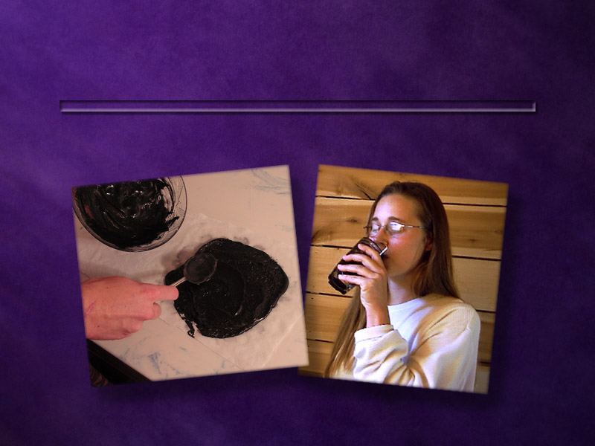
Charcoal
Nature’s Amazing Remedy
Notes:
Today we’ll learn more about charcoal—one of nature’s
amazing remedies.

Slide 2
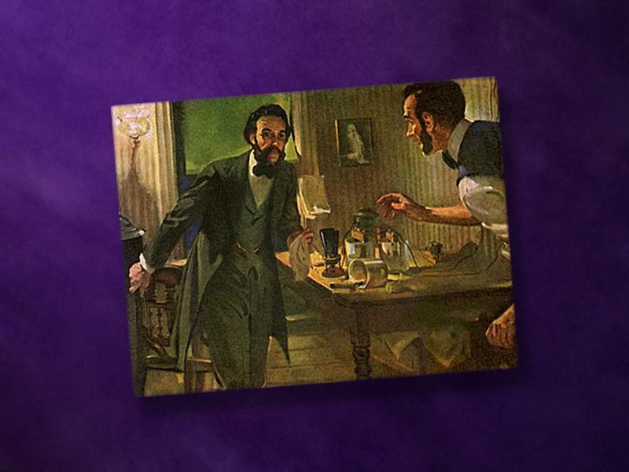
Notes:
In 1813, a well-known French chemist intentionally swallowed
a whole teaspoonful of arsenic. This was more than 150 times
the dose that would kill a person. However, he lived—and
without any ill effects! What was it that saved him? He had
mixed a liberal amount of charcoal with the poison.

Slide 3

What is charcoal?
Notes:
First of all, what is charcoal?

Slide 4
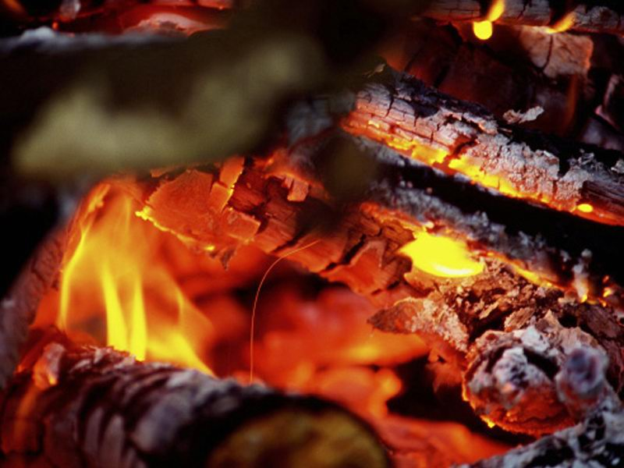
Notes:
Charcoal is a substance formed by burning either wood or
coconut shells in the absence of oxygen. What remains after
the burning process is pure black carbon.

Slide 5
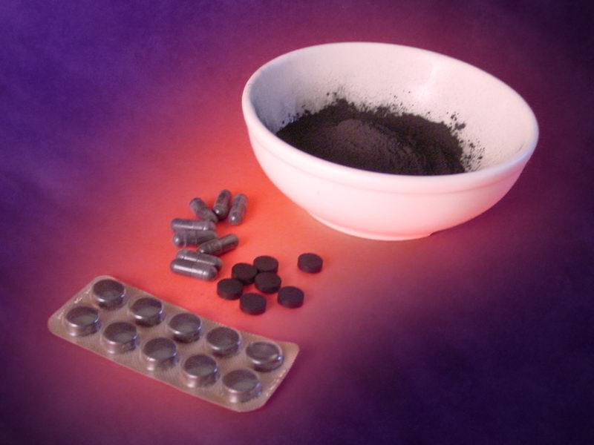
Notes:
Medicinal charcoal comes as a fluffy black powder that has no
odor or taste. It is also available in the form of tablets and
capsules. Charcoal is completely safe—with virtually no
potential of danger from overdosing.

Slide 6

How does charcoal work?
Notes:
How does it work?

Slide 7
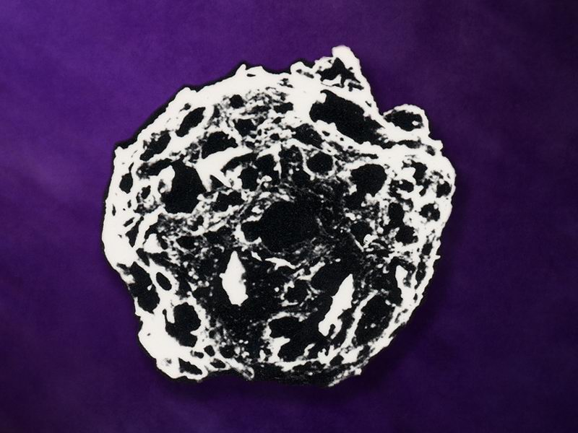
Notes:
When a small particle of charcoal is greatly magnified, it
resembles a sponge—containing many small holes and tunnellike
passages. Charcoal acts as an adsorbent by attracting and
binding toxins, poisons, gases, and even germs. Once entrapped
in the charcoal, these injurious substances become harmless to
the body.

Slide 8
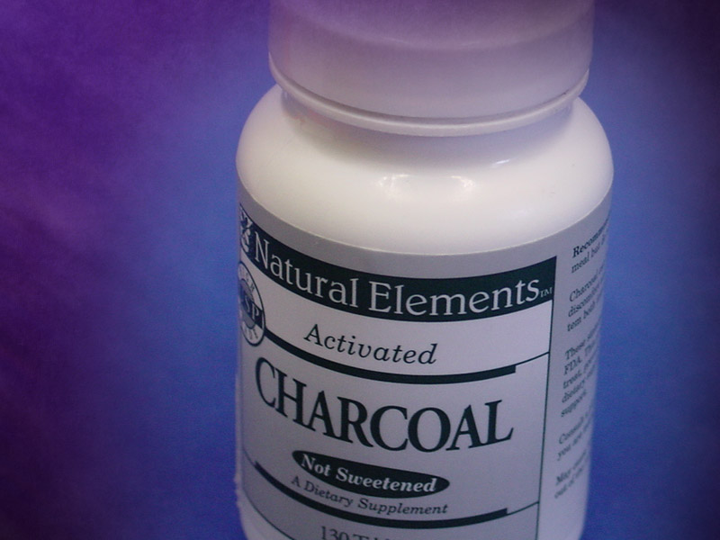
Activated
charcoal
Notes:
Charcoal comes in two varieties—regular and activated. Activated
charcoal is carbon that has been treated with high steam
temperatures to greatly enhance charcoal’s adsorbing capacity.

Slide 9
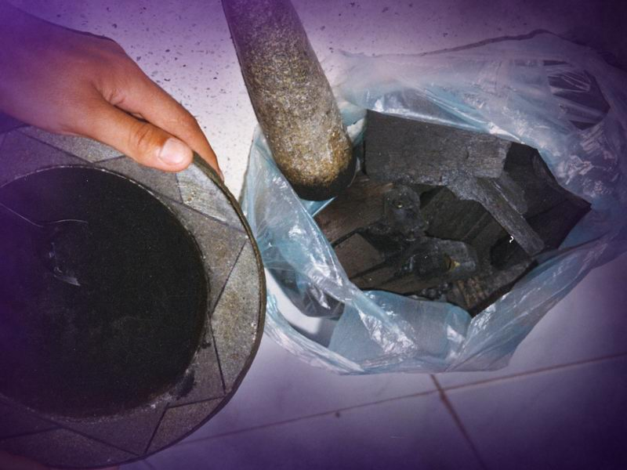
Notes:
Although this method was not developed until the early 20th
century, regular charcoal has been in use as an effective
healing agent for thousands of years.

Slide 10

The Charcoal Advantage
Readily available
Simple to use
Totally harmless
Highly effective
Notes:
Here are some of the features that have made charcoal such a
remarkable remedy:
➲ (It is) Readily available—and affordable.
➲ (It is) Simple to use—both internally and externally
➲ (It’s) Totally harmless
➲ (and it’s) Highly effective

Slide 11

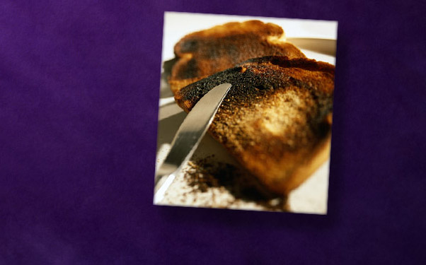
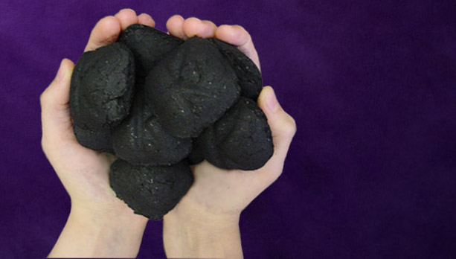
Do Not Use
Charcoal briquettes
Scorched food
Notes:
It’s important to note that the following items are not to be
used as medicinal charcoal:
➲ Charcoal briquettes for grilling food are not a safe source
of charcoal. They contain dangerous chemical agents that
ensure rapid igniting.
➲ Burnt toast and other scorched foods contain
unhealthful substances.

Slide 12

Internal Uses of Charcoal
Notes:
When taken internally, charcoal is a medicinal wonder-worker
for a wide variety of ailments.
Charcoal works best when mixed with a glass of plain water. It
is easy to drink when these simple directions are followed:

Slide 13
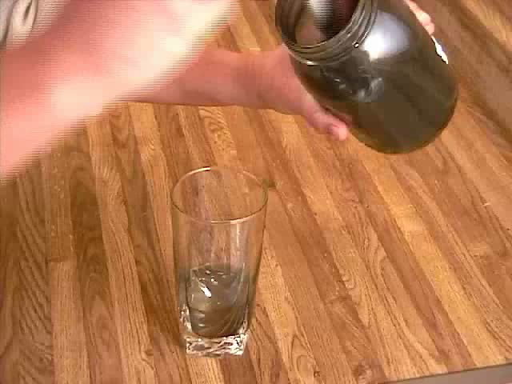
Notes:
Thoroughly mix 1 to 2 large tablespoonfuls of charcoal with
a small amount of water. Then fill the glass with additional
water—stirring frequently and making sure all the powder is
in solution.
● You may want to use a drinking straw when taking charcoal
—it is less messy.
● Follow the charcoal drink with some plain water.

Slide 14
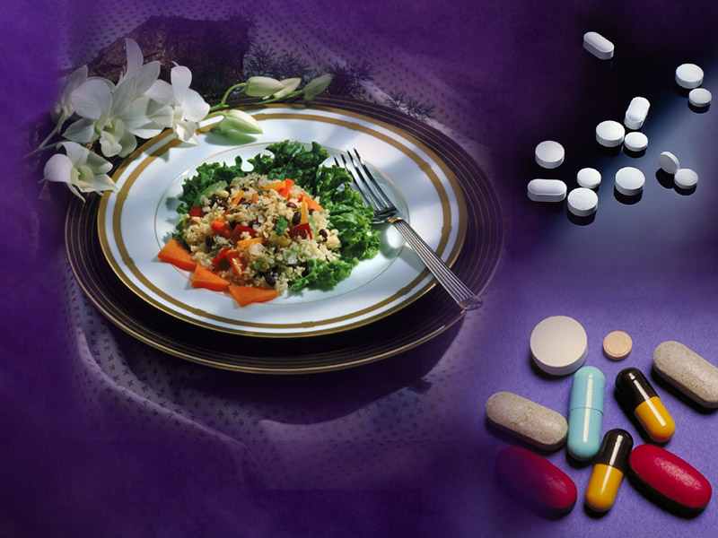
Between meals
2 hours after medications
Notes:
The best time to take charcoal is between meals and at least 2
hours after taking prescription medications—since charcoal
does adsorb many drugs.

Slide 15


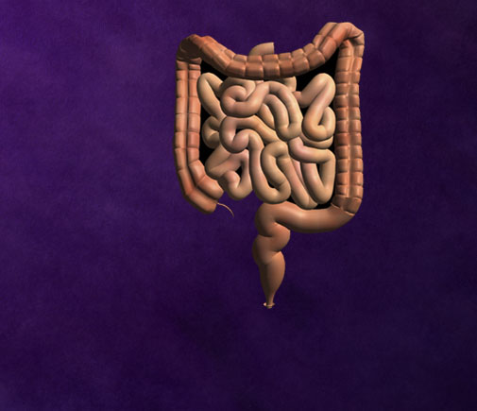


Internal Uses
Poisoning
Intestinal gas
Nausea and vomiting
Diarrhea
Notes:
Charcoal is often used with great success for the
following conditions:
➲ Poisoning
➲ Intestinal gas
➲ Nausea and vomiting
➲ Diarrhea

Slide 16

Poisoning
Notes:
Charcoal is the treatment of choice for poisoning in children,
as well as adults. It is most effective when taken within 30
minutes of a poisoning or drug overdose.
Here is what to do for poisoning:

Slide 17

Immediately
drink charcoal
solution
Notes:
Immediately drink 4 to 10 large spoonfuls of charcoal mixed
with a small amount of water.

Slide 18
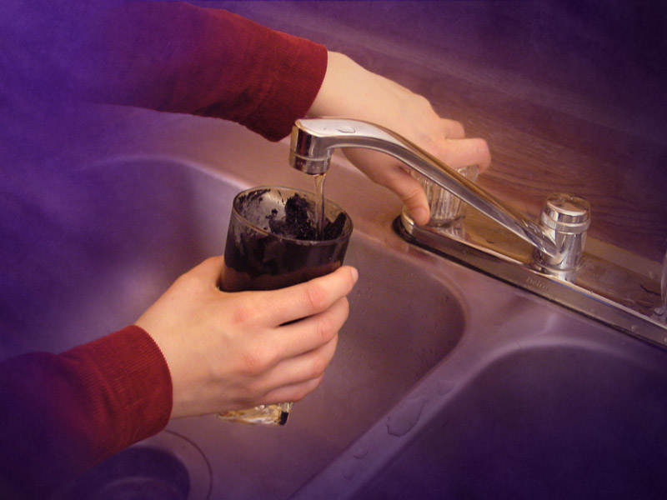
Refill the glass
and drink the
sediment
Notes:
Then refill the same glass with water and drink the contents
with the remaining charcoal sediment.
If a person has eaten within the past 2 hours, more charcoal
will be required.

Slide 19
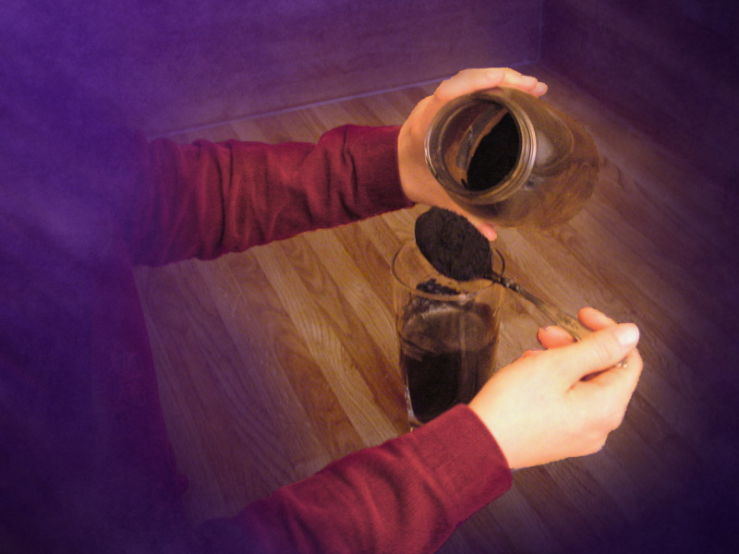
Repeat the
dosage in
10 minutes
Notes:
Repeat the charcoal dosage in 10 minutes, and any time
symptoms worsen.

Slide 20

Further treatment
and monitoring
Notes:
And of course, the patient should be taken to an emergency
room as quickly as possible for further treatment
and monitoring.

Slide 21

One half the dose
Notes:
As a general rule, treat children with one half
of the adult dose.

Slide 22
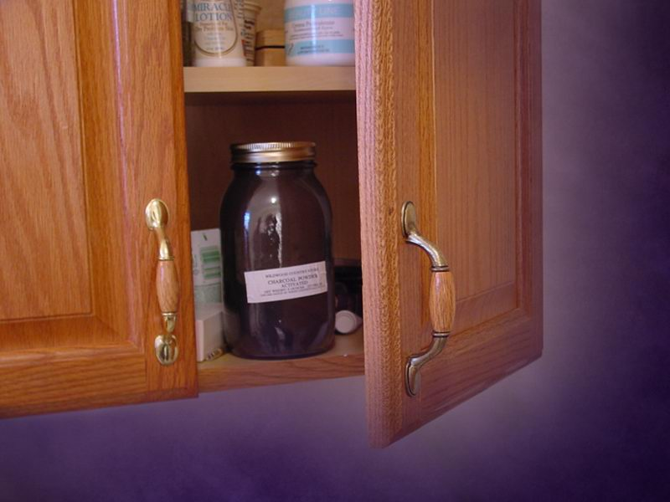
Notes:
Always keep a container of charcoal powder in your first aid
cabinet so that it will be readily available. When stored in a
dry, tightly covered container; charcoal powder will keep for
an indefinite period of time.

Slide 23

Notes:
A word of caution: Do not give charcoal by mouth to anyone
that is sleepy, unconscious, or otherwise unable to swallow. In
such cases, prompt medical attention is vital!

Slide 24



Nausea and Vomiting
Notes:
In the case of nausea and vomiting,
drink 1 to 2 large spoonfuls of powder in a little water after
each vomiting episode.
You may follow the charcoal water with a glass of plain water,
if tolerated. If the charcoal is vomited up, drink another glass
of charcoal water immediately.

Slide 25


Diarrhea
Notes:
For diarrhea, drink 1 to 2 large spoonfuls of charcoal powder
in a glass of water after each loose or watery stool.
Follow each glass of charcoal water with 1 or 2 glasses of
plain water.

Slide 26
Oral
Charcoal water
Tablets
Capsules
Notes:
Intestinal capillaries
Inflammatory bowel STORY
Bleeding
Diverticulitis
Ulcers
Animal nutrition
Prophylaxis
No vitamins lost
Psyllium for constipation
Capsule bezoar
Poisoning
Gas
Vomiting diarrhea
Cold flu
Heavy metals
Organic chemicals
cytokines

Slide 27

Notes:
Infants and small children with diarrhea are at greater risk for
dehydration, so be sure to give them plenty of water along
with other rehydration fluids.

Slide 28
Teeth
Poultice
Brushing
Notes:
Periodontal abscess STORY
Periodontal disease
Pocket recesses
Whitening

Slide 29



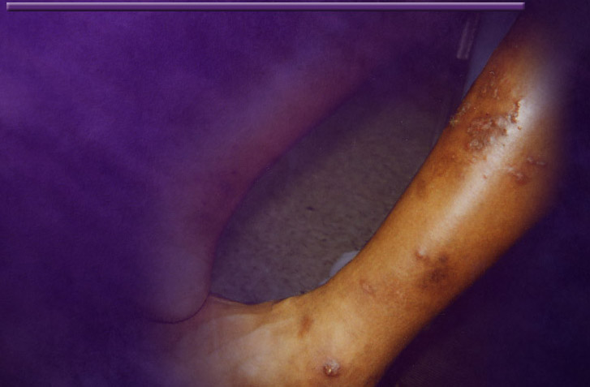
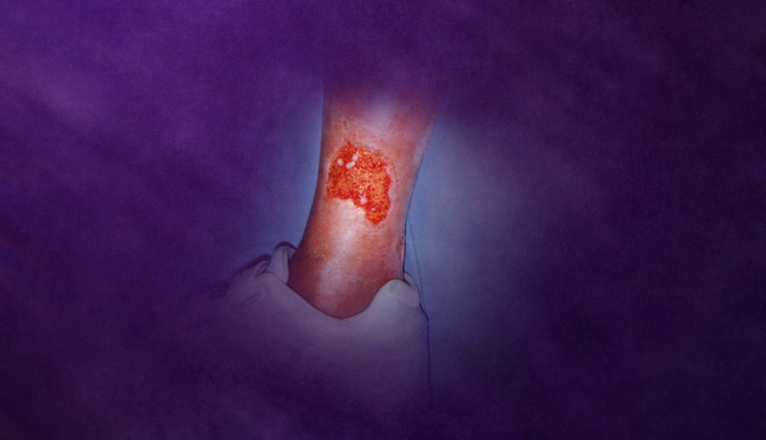

External Uses
Infection or inflammation
Eye and ear infections
Lesions
Bee stings
Spider and
snake bites
Notes:
Charcoal is also a very effective remedy when used externally.
When applied to body surfaces, charcoal adsorbs (draws out)
poisons and other harmful substances that have been excreted
through the pores of the skin.
Here are some of its external uses:
➲ Infection or inflammation of the skin and joints STORY arthritis STORY wound surgery, STORY Nail in foot
➲ Eye and ear infections
➲ Lesions from poisonous plants
➲ Bee stings and other insect bites
➲ Venomous spider and snake bites

Slide 30
Topical
Poultice
Fomentation
Salve/cream
Notes:
Preparation: Flax, Psyllium, culinary thickeners.
Cytokines
Poisonous bites, venomous bites
Stings
Eodema/swelling
Bacteria
Pain
Would healing
Organs: liver, kidneys, thyroid, Joints, Broken bones
Mix with: Comfrey, Ginger,

Slide 31
Cases
Trauma to knee

Slide 32
Skin
Poultice
Balm stick
Salve
Notes:
Poison Ivey
Tic bite
Infection
Would
Pain relief
Organs STORY kidney

Slide 33
Eyes
Grey water
  Allergies
  Infection
Fomentation
  Inflammation
  Pressure
Notes:
Pars planitis STORY
Glaucoma
Ocular rosacea
Julie Pink Eye STORY

Slide 34
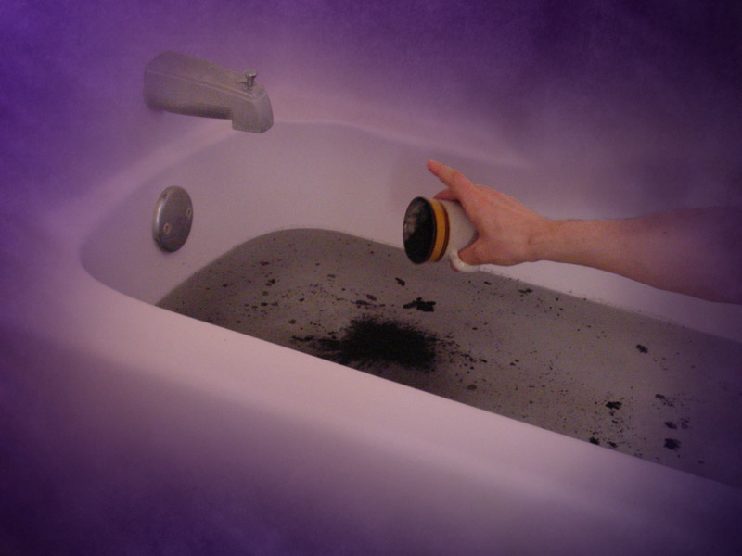
Charcoal bath
Notes:
For external conditions, charcoal can be used as a bath or
applied as a poultice.
The charcoal bath is useful for treating large body areas. It’s
quite simple; just add 2 cups of charcoal powder to a tub of
water. The entire body may be immersed in the charcoal water.

Slide 35
Bath
Skin lesions
Bites
Detox
Cancer
Notes:
Cancer, skin lesions/bites, detox. Story

Slide 36
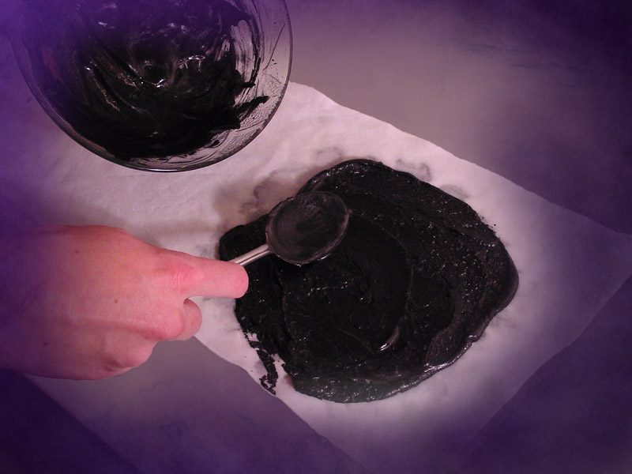
Charcoal Poultice
Notes:
The charcoal poultice is a moist compress applied to the skin,
and is useful for treating smaller or more localized body areas.
Here are directions for preparing and applying a poultice
at home:

Slide 37
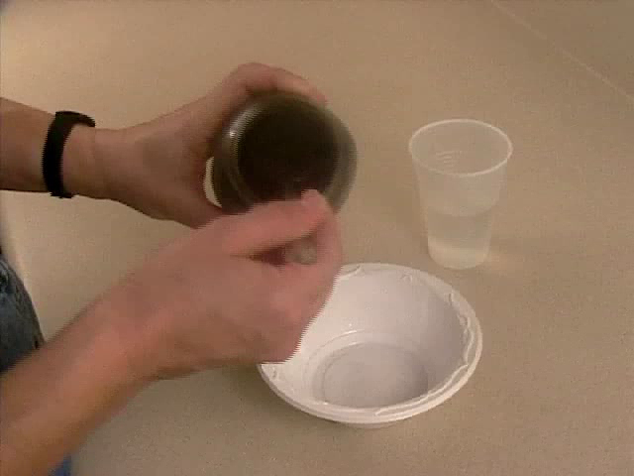
Notes:
● Mix charcoal with a little water to form a wet paste. Be sure it
has the right consistency.
● Spread the paste on one half of a folded paper towel—or
loosely woven cloth.
● Then cover the paste by folding over the other half of the
paper towel or cloth.
● Next place the charcoal poultice on the affected body part—
making sure it completely covers the area.
● Cover the poultice with plastic—to keep it from drying out.
(When available, plastic food wrap works fine.) If the
charcoal dries out, it will not be able to adsorb.
● Finish off by bandaging or taping the poultice
securely in place.

Slide 38
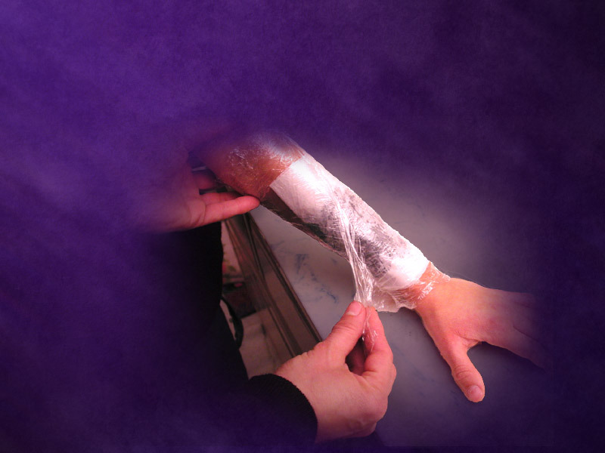
Treatment for Localized Conditions
Notes:
To treat localized infections or inflammation, poisonous plant
lesions, bee stings, and insect bites, do the following.

Slide 39
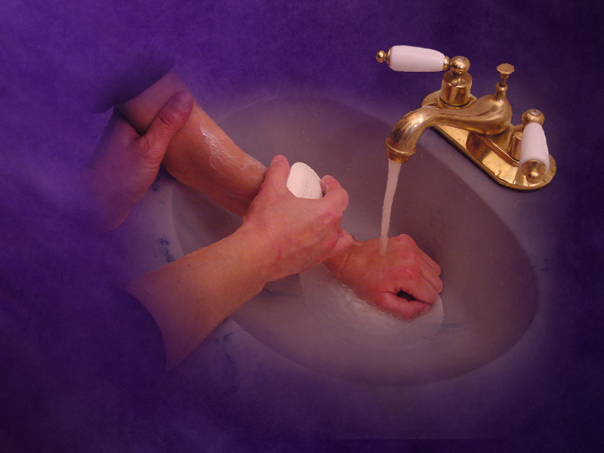
Wash the skin
Notes:
Wash the skin thoroughly with soap and water.

Slide 40
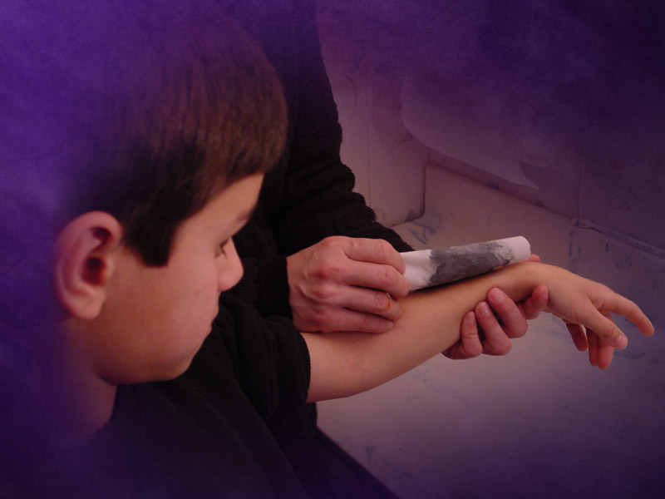
Apply the
poultice
Notes:
Apply the poultice and leave it on for several hours,
or better yet, overnight.

Slide 41
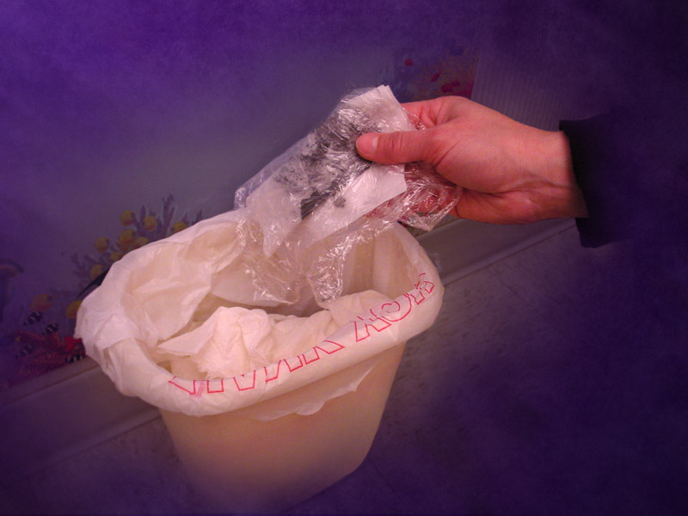
Remove
and discard
Notes:
Then remove and discard the poultice.

Slide 42
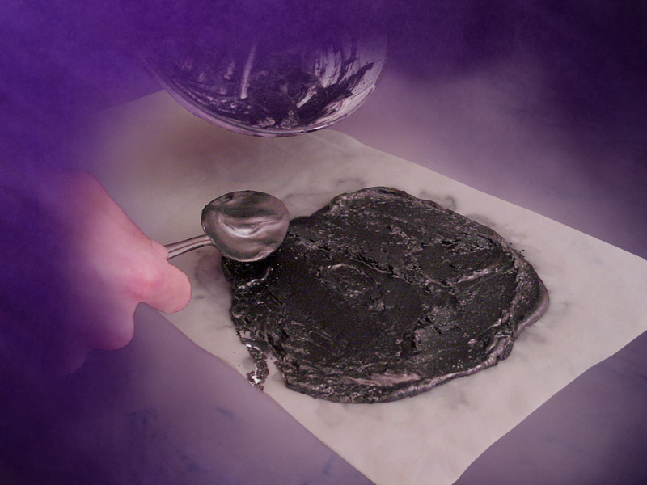
Prepare a
new poultice
Notes:
Prepare a new poultice each time another application is needed.

Slide 43

Treatment of multiple bee stings,
spider, and snake bites
Notes:
A word of caution: multiple bee stings, allergic reactions to
bee venom, as well as poisonous spider and snake bites, are all
medical emergencies that need immediate attention!

Slide 44

Notes:
Whether you’re in the great outdoors, the office, or on the
road, charcoal can be at hand when you need it, if you keep it
in your backpack, purse, or car. Be sure to keep charcoal
nearby at all times, especially if you are in an area that has
poisonous pests.

Slide 45

Treatment of Venomous
Bites and Stings
Notes:
Here are some directions for treating venomous bites and stings:

Slide 46
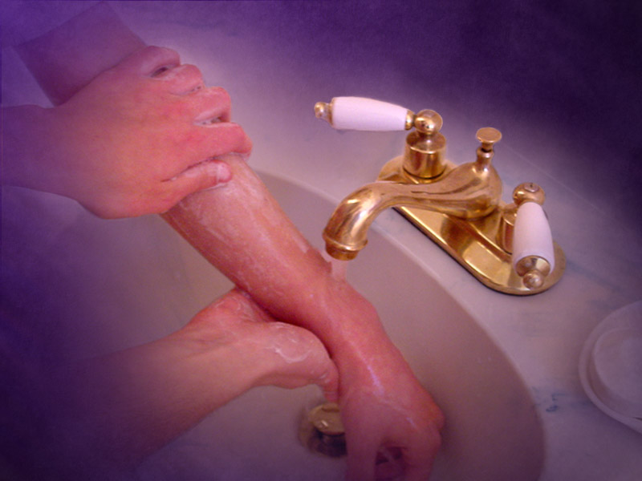
Wash the area
Notes:
Immediately wash the area thoroughly with soap and water

Slide 47

Submerge
in a cool
charcoal
bath
Notes:
Then submerge the affected body part in a cool charcoal bath
for 30 minutes to 1 hour—using . cup of charcoal to 8 liters
of water.

Slide 48
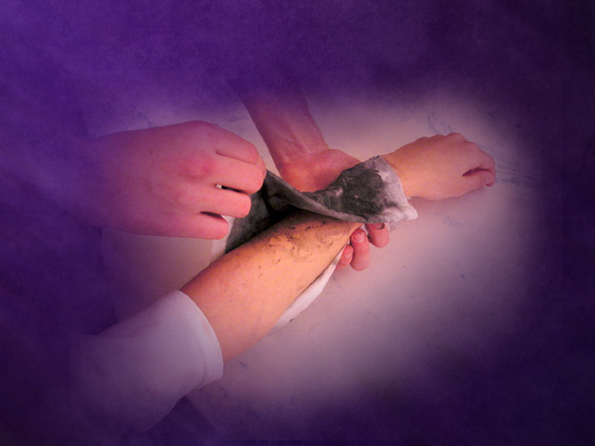
Apply a large poultice
Notes:
After the bath, apply a large charcoal poultice directly over
the bitten area, or even the entire extremity. Cover the poultice
with plastic—to keep it moist.

Slide 49
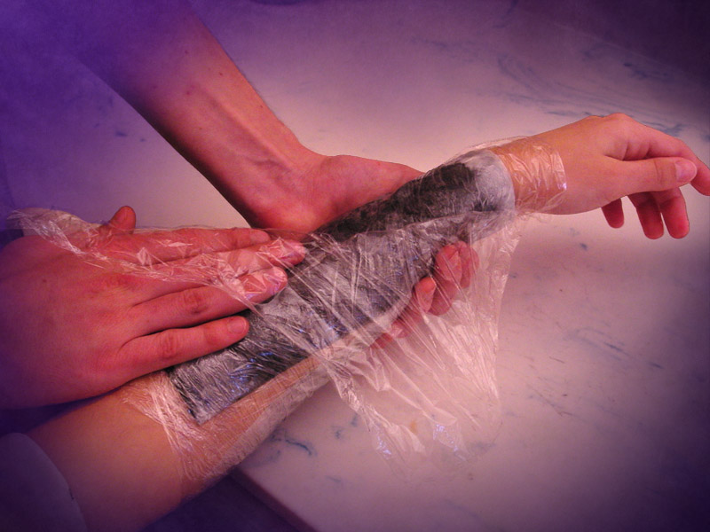
Change the poultice
Notes:
Change the poultice every 30 minutes—until pain and swelling
are gone.

Slide 50

Charcoal by mouth
Notes:
In addition, take charcoal by mouth—2 large spoonfuls of
charcoal in 1/2 glass of water every 2 hours for 3 doses. Each
charcoal dose should be followed by 2 glasses of water.
Charcoal works best when applied to any bite or sting as soon
as possible, before significant swelling occurs.

Slide 51
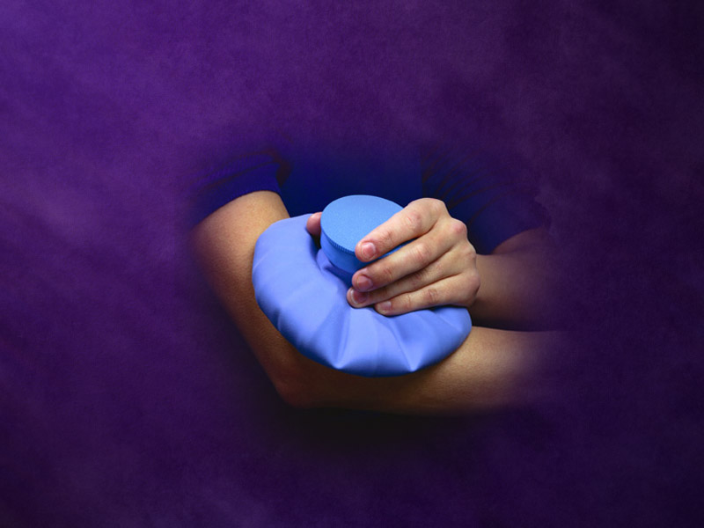
Add an ice pack
Notes:
Should pain and swelling progress, add ice packs to the area
and consider seeking further medical help.

Slide 52
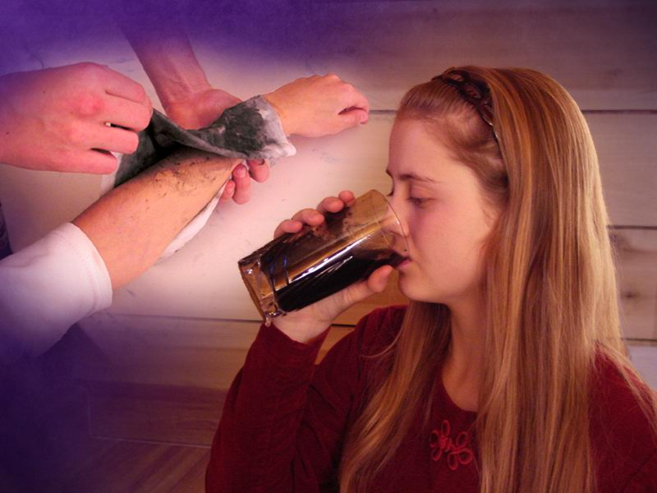
Notes:
Charcoal has saved many lives, especially in cases where
medical help was unavailable. Over and over again, charcoal
has proven itself to be a remedy of the highest value. In many
cases the simple remedies of nature, when used properly, are
far more effective than the high tech wonders
of modern medicine.

Slide 53
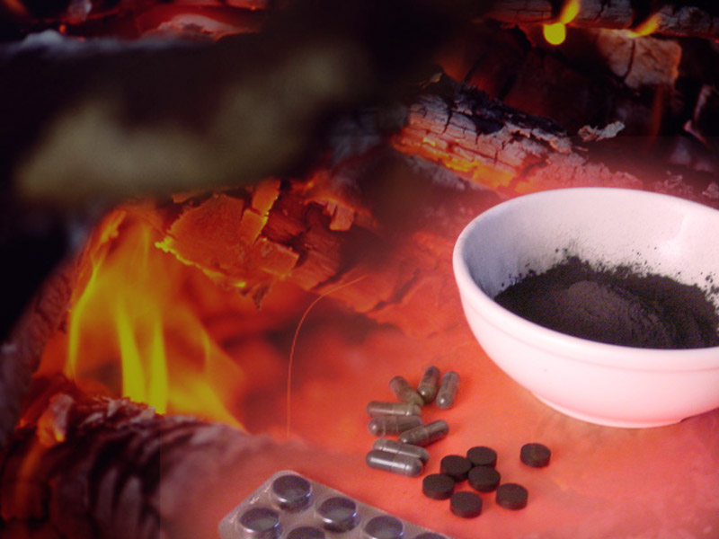
“God has chosen the foolish
things of the world to put to
shame the wise; and God
has chosen the weak
things of the world
to put to shame the
things which
are mighty.”
1 Corinthians 1:27
Notes:
The scriptures declare that “God has chosen the foolish things
of the world to put to shame the wise, and God has chosen the
weak things of the world to put to shame the things which are
mighty.” 1 Cor. 1:27 (NKJV)
May God bless you with abundant health as you seek to make
a wise use of the simple remedies He has provided.

