Slide 1

Cancer:
Is There Hope?
Notes:
fixed

Slide 2

Photo credit: Leslie Green-The Hungry Housewife

Slide 3
Cancer has surpassed heart disease as the number one cause of death for Westerners under the age of 85.
CA Cancer J Clin. 57(1):43-66.

Slide 4

Notes:
Current experience

Slide 5

Goal: To better understand the lifestyle factors That lead to cancer and how best to cancer proof yourself.

Slide 6

Cancer Overview
Diet
Toxins
Mind
lifestyle
Dietary factors.
Lifestyle factors.
Toxic contributors.
Psychological factors.

Slide 7

Red meat and dairy products double your risk of metastatic prostate cancer.
Study of 51,000 men.
Cancer Causes Control. 12(6):557-67.
Notes:
Cancer Causes Control. 2001 Aug;12(6):557-67. Related Articles, Links
A prospective study on intake of animal products and risk of prostate cancer.
Michaud DS, Augustsson K, Rimm EB, Stampfer MJ, Willet WC, Giovannucci E.
Department of Nutrition, Harvard School of Public Health, Boston, MA 02115, USA. michaudd@mail.nih.gov
OBJECTIVE: Association between animal products and prostate cancer have been observed in numerous observational studies, but it is not clear whether the high fat content of these foods or some other component accounts for these associations. We examine these associations among 51,529 men who contributed detailed dietary data. METHODS: Participants of the Health Professionals Follow-Up Study completed a semiquantitative food-frequency questionnaire in 1986, and subsequently in 1990 and 1994. Other data on potential risk factors were collected at baseline and in subsequent questionnaires during follow-up. Between 1986 and 1996, 1897 total cases of prostate cancer (excluding stage A1) and 249 metastatic cancers were identified. We used pooled logistic regression for analyses of diet and prostate cancer. RESULTS: Intakes of total meat, red meat, and dairy products were not associated with risk of total or advanced prostate cancer. An elevated risk for metastatic prostate cancer was observed with intake of red meat (relative risk (RR)= 1.6 for top vs. bottom quintile comparison, 95% confidence interval (CI) = 1.0-2.5); this association was slightly attenuated after controlling for saturated and alpha-linolenic fatty acids (RR = 1.5, 95% CI = 0.88-2.5). Processed meats, bacon and beef, pork or lamb as a main dish each contributed to an elevated risk of metastatic prostate cancer. Dairy product intake increased risk of metastatic prostate cancer (RR = 1.4, 95% CI = 0.91-2.2 for top vs. bottom quintile comparison), but no association remained after controlling for calcium and other fatty acids. A high intake in both red meat and dairy product was associated with a statistically significant two-fold elevation in risk of metastatic prostate cancer, compared to low intake of both products; however, most of the excess risk could be explained by known nutritional components of these foods. CONCLUSIONS: Intakes of red meat and dairy products appear to be related to increased risk of metastatic prostate cancer. While known nutrients, such as calcium and fatty acids, may explain most of the dairy association observed, it appears that a portion of the risk of metastatic prostate cancer associated with red meat intake remains unexplained.

Slide 8
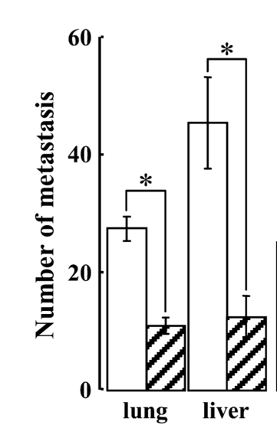
A high protein diet (25% ) increases your risk of tumor growth and spread (metastases).
50
40
30
25% Protein
Number Of Metastasis
5% Protein
20
10
0
Lung
Liver
Cancer
Cell Immunol. 231(1-2):96-102.
Notes:
Li C, Bai X, Wang S, Tomiyama-Miyaji C, et. al. Immunopotentiation of NKT cells by low-protein diet and the suppressive effect on tumor metastasis. Cell Immunol. 2004 Sep-Oct;231(1-2):96-102.
Department of Immunology, Niigata University School of Medicine, Niigata 951-8510, Japan.
Mice were fed with a 5% low-protein diet for two weeks, at which point tumor inoculation was conducted. Following this inoculation, the 5% low-protein diet was continued. On the other hand, control mice were fed with a normal diet (25% protein) and such diet was continued after tumor inoculation. In comparison with control mice, mice fed with the 5% low-protein diet showed a prominent prolongation of survival rate when injected with both EL4 and 3LL tumors. Interestingly, CD1d(-/-) mice, which primarily lack natural killer T (NKT) cells, did not show the prolongation of survival rate even when they received a 5% low-protein diet. The most striking phenomenon seen in tumor-bearing mice fed with the 5% low-protein diet was the suppression of tumor metastasis to the liver and lung. Such suppression was not seen in CD1d(-/-) mice who were fed with a 5% low-protein diet. Phenotypic study revealed that the proportion of NKT cells after tumor inoculation decreased in the mice fed with a normal diet. However, such decrease did not occur in mice fed with the 5% low-protein diet. Reflecting the activation of NKT cells by feeding, tumor cytotoxicity and cytokine production were also augmented by the 5% low-protein diet. These results suggest that a low-protein diet has the potential to augment the innate immunity against tumors, especially mediated by the activation of NKT cells.

Slide 9

Tomatoes protect you against cancers of the mouth, esophagus, stomach, colon, rectum and prostate.
Int J Cancer. 59(2):181-4. Cancer. 64(3):598-604.
International Journal of Cancer, 59:181-4(1994); Cancer, 64:598-604(1989).
Notes:
Int J Cancer. 1994 Oct 15;59(2):181-4.
Tomatoes and risk of digestive-tract cancers.
Franceschi S, Bidoli E, La Vecchia C, Talamini R, D'Avanzo B, Negri E.
Epidemiology Unit, Aviano Cancer Center, (PN), Italy.
In view of the persisting uncertainty concerning possible mechanisms by which high vegetable and fruit intake decreases cancer risk, foods with divergent values for potentially important micronutrients are a priority for investigation. Tomatoes are low in beta-carotene, but high in lycopene, an active antioxidative agent. In order to assess the effect of tomatoes on risk of cancers of the digestive tract, data were analyzed from an integrated series of case-control studies conducted between 1985 and 1991 in northern Italy, where tomato intake is high but, also, heterogeneous. The overall dataset included the following histologically confirmed cancer cases: oral cavity and pharynx, 314; esophagus, 85; stomach, 723; colon, 955; and rectum, 629; and a total of 2,879 controls admitted to hospital for acute non-neoplastic or non-digestive conditions, unrelated to long-term dietary modifications. Multivariate odds ratios (OR) and 95% confidence interval (CI) for subsequent quartiles of intake of raw tomatoes were derived, after allowance for age, sex, study center, education, smoking and drinking level, and tertile of total caloric intake. There was a consistent pattern of protection for all sites (OR in the upper quartile ranging between 0.4 and 0.7), most notably for gastrointestinal neoplasms. All trends in risk were highly significant. The beneficial effect of raw tomatoes in this population may be partly due to the fact that they constitute perhaps the most specific feature of the Mediterranean diet. However, if it is true that tomatoes protect against digestive-tract cancers, this is of interest from both a scientific and a public health viewpoint.
Publication Types:
Comparative Study
Research Support, Non-U.S. Gov't
PMID: 7927916 [PubMed - indexed for MEDLINE]
Cancer. 1989 Aug 1;64(3):598-604.
Cohort study of diet, lifestyle, and prostate cancer in Adventist men.
Mills PK, Beeson WL, Phillips RL, Fraser GE.
Department of Preventive Medicine, Loma Linda University School of Medicine, CA 92350.
Dietary and lifestyle characteristics were evaluated in relation to subsequent prostatic cancer risk in a cohort of approximately 14,000 Seventh-day Adventist men who completed a detailed lifestyle questionnaire in 1976 and who were monitored for cancer incidence until the end of 1982. During the 6-year follow-up period, 180 histologically confirmed prostatic cancers were detected among some 78,000 man-years of follow-up. Increasing educational attainment was associated with significantly decreased risk of prostate cancer in this study; age at first marriage was also inversely associated with risk, although this was not significant. There was no relationship between body mass index (as measured by Quetelet's Index) and risk. A history of prostate "trouble" was associated with a 60% increase in risk which was highly significant. Although there were suggestive relationships between increasing animal product consumption and increased risk, these results did not persist after accounting for the influence of fruit and vegetable consumption. Nor was exposure to the vegetarian lifestyle during the childhood years associated with alterations in subsequent risk. However, increasing consumption of beans, lentils and peas, tomatoes, raisin, dates, and other dried fruit were all associated with significantly decreased prostate cancer risk.
PMID: 2743254 [PubMed - indexed for MEDLINE]
Curr Opin Clin Nutr Metab Care. 2006 Nov;9(6):722-7.
Tomatoes, tomato products and lycopene in the prevention and treatment of prostate cancer: do we have the evidence from intervention studies?
Ellinger S, Ellinger J, Stehle P.
Department of Food and Nutrition Sciences-Nutrition Physiology, University of Bonn, Endenicher Allee 11-13, 53115 Bonn, Germany. ellinger@uni-bonn.de
PURPOSE OF REVIEW: Lycopene-rich foods such as fresh tomatoes and tomato products are discussed as potential effectors in the prevention and therapy of prostate cancer. This review provides an overview on the efficacy of supplementation with tomatoes, tomato products and lycopene on appropriate surrogate endpoint biomarkers such as DNA damage and metabolites of the insulin-like growth factor pathway in healthy individuals and prostate cancer patients. RECENT FINDINGS: Intervention studies show that the daily consumption of one serving of tomatoes or tomato products, but not supplementation with lycopene alone, increases the resistance of mononuclear leukocytes against DNA strand breaks induced by reactive oxygen species in healthy volunteers. Data from clinical trials with prostate cancer patients are scarce and contradictory. There is a paucity of reliable data on DNA damage in prostate tissue. SUMMARY: Increasing evidence suggests that a single serving of tomatoes or tomato products ingested daily may contribute to protect from DNA damage. As DNA damage seems to be involved in the pathogenesis of prostate cancer, the regular ingestion of tomatoes or tomato products might prevent the disease. Further well-designed studies are necessary to establish the role of tomatoes and tomato products in the prevention and therapy of prostate cancer.
PMID: 17053426 [PubMed - indexed for MEDLINE]

Slide 10
Fat increases your risk of dying of breast cancer.
25
Canada
U.S.A.
20
Malta
Australia
Sweden
W. Germany
Death Rate per 100,000
France
15
Finland
Portugal
Poland
10
Venezuela
Greece
Hong Kong
Japan
Mexico
5
Thailand
FEMALE
0
20
40
60
80
100
120
140
160
180
Total dietary fat intake (g/day)
Prog Biochem Pharmacol 10:308-53.
Notes:
Carroll KK, Khor HT. Dietary fat in relation to tumorigenesis. Prog Biochem Pharmacol. 1975;10:308-53.

Slide 11

Saturated fat triples your man’s risk of dying from prostate cancer.
Eur Urol. 35(5-6):388-91.
Notes:
Eur Urol. 1999;35(5-6):388-91.
Dietary fat and prostate cancer progression and survival.
Fradet Y, Meyer F, Bairati I, Shadmani R, Moore L.
Laval University, Quebec, Que., Canada. yves.fradet@crhdq.ulaval.ca
BACKGROUND: The association between dietary factors and the occurrence of prostate cancer has been studied extensively, but there is, as yet, no published study on the relationship between diet and disease progression among prostate cancer patients. We studied the association between dietary fat intake and prostate cancer survival. METHODS: We prospectively followed 384 men diagnosed with prostate cancer between 1990 and 1992 in the Quebec City area who participated in a case-control study of diet in relation to prostate cancer occurrence. Trained nutritionists interviewed the men on their usual diet using a diet history questionnaire. Deaths in the follow-up were documented through record linkage with the provincial mortality file and review of hospital records. The cause of death was taken as written on the death certificate. Cox proportional hazards models were used to estimate the relative risk of dying from prostate cancer associated with terciles of fat intake, expressed as percent of dietary energy, while controlling for prognostic factors and total energy. RESULTS: The median duration of follow-up was 5.2 years. During the follow-up period, 32 patients died of prostate cancer and 39 died of other causes. The 5-year disease-specific survival was 91%. After controlling for grade, clinical stage, initial treatment, age and total energy intake, we found that saturated fat consumption was significantly associated with disease-specific survival (p = 0.008). Compared to men in the lower tercile of saturated fat, those in the upper tercile had three times the risk of dying from prostate cancer (hazards ratio 3.13, 95% confidence interval 1.28-7.67). CONCLUSION: Our findings suggest that, if saturated fat is causally related to disease-specific survival, a moderate reduction of its intake below 10% of energy should reduce the risk of dying from prostate cancer. This dietary goal is already recommended for health promotion and primary prevention of heart disease and cancer.
Publication Types:
Review
PMID: 10325493 [PubMed - indexed for MEDLINE]

Slide 12

Processed vegetable oils quadruple your risk of breast and stomach cancer.
Asian Pac J Cancer Prev. 9(1):71-5.
Notes:
Asian Pac J Cancer Prev. 2008 Jan-Mar;9(1):71-5.
Lifestyle-related risk factors for stomach cancer in northeast Thailand.
Suwanrungruang K, Sriamporn S, Wiangnon S, Rangsrikajee D, Sookprasert A, Thipsuntornsak N, Satitvipawee P, Poomphakwaen K, Tokudome S.
Source
Faculty of Medicine, Cancer Unit, Srinagarind Hospital, Khon Kaen University, Khon Kaen, Thailand. krisuw@kku.ac.th
Abstract
BACKGROUND:
Stomach cancer is not common in Thailand but the life styles of the Thai population are changing to become more Western so that information for planning control programme of stomach cancer is necessary. The highest incidence rates of this neoplasm are found in Eastern Asia, ranging from age-standardized rates of 95.5/105 (men) and 40.1/105 (women) in Yamagata, Japan to 4.1/105 (men) and 2.1/105 (women) in Khon Kaen, Northeast of Thailand. In Thailand, the estimated age-standardized incidence rates in 1993, 1996 were 4.9/105, 4.1/105 in men and 3.0/105 , 2.6/105 in women. Risk factors for stomach cancer in Thai population are unclear, but possibly include low intake of vegetables and fruits, alcohol drinking, tobacco smoking and high intake of salt.
OBJECTIVE:
To investigate various aspects of dietary factors, smoking, and alcohol drinking in determining risk of stomach cancer in Thai population.
METHODS:
A case-control study was conducted in Khon Kaen, Thailand during 2002-2006, to study the role of these factors in stomach cancer. 101 stomach cancer cases and 202 matched controls (case : control = 1:2) by sex, age (? 3 years) and region were recruited from Srinagarind Hospital and Khon Kaen Regional Hospital, in Khon Kaen Province. All of cases were histologically confirmed. Controls had a variety of diseases, the main ones being disease of the eye. Information on dietary habits, alcohol drinking and smoking were collected by a structured questionnaire, blood samples were collected for further study.
RESULTS:
The distribution of the general characteristics by case-control status, the distribution of age and sex were similar in cases and controls. In the final analysis, the factors that found to be higher risk but not statistically significant were long-term filter cigarette smoking (OR=1.9, 95%CI: 0.85-4.50), long-term alcohol consumption (OR=1.2, 95%CI: 0.51-2.60) and low intake of vegetables and fruits (OR=1.2, 95%CI: 0.74-1.96). A high intake of vegetable oil (OR=4.5, 95%CI: 1.00.-20.17) was found to be associated with increased risk, and similar tendencies were noted for pork oil (OR=1.4, 95%CI: 0.63-3.01) and jeaw prik (mainly chilly with plara broth) (OR=1.2, 95%CI: 0 .76- 2.01).
CONCLUSION:
Our study confirmed protective effects of a high intake of fruits and vegetables against stomach cancer development and showed a high intake of sauces to increase risk of stomach cancer as in other countries in Asia.
PMID: 18439078 [PubMed - indexed for MEDLINE]
Nutr Cancer. 2005;53(2):152-9.
Nutrition, lifestyle, and breast cancer risk among Turkish women.
Ceber E, Sogukpinar N, Mermer G, Aydemir G.
Source
Ege University Izmir Ataturk School of Health, Izmir, Turkey. esin.ceber@ege.edu.t
Abstract
Breast cancer is the most common malignancy in women, with more than 1 million cases occurring worldwide annually. Cancer is one of the leading causes of mortality in Turkey; deaths due to breast cancer constitute 24.1% of all carcinoma cases reported among women. We conducted a case-control study of Turkish women with and without breast cancer to investigate the relationships of selected lifestyle and nutritional risk factors with breast cancer risk. Factors were chosen based upon published associations with breast cancer. Subjects were women in Izmir, Turkey. Cases were 123 women with breast cancer registered with the Department of Oncology, Ege University Hospital, in February through July 2004. The control group included 120 randomly selected women without a breast cancer diagnosis, registered with the Evka-4 Health Care Center and having similar sociodemographic characteristics. Inclusion criteria for participation consisted of 40 yr of age and over and willingness to participate. Chi2 tests and t-tests were used to determine statistical differences between cases and controls based on selected variables. Logistic regression was used to find the association between selected risk factors and breast cancer occurrence. Cases had smoked for more years, their age of first pregnancy was higher, and breast cancer occurrence was more common in first-degree relatives such as mothers and sisters of cases compared with controls. Cases were found to have consumed higher amounts of vegetable oil in contrast to controls. These findings are consistent with similar studies conducted in both developed and developing countries.
A significant association was found between frequency of consumption of vegetable oils (margarine) and breast cancer occurrence (OR = 4.92; 95% CI = 1.92–12.59).

Slide 13

Oral contraceptives increase your risk of breast cancer. Hormone-replacement therapy increases your risk of endometrial, ovarian and breast cancer.
Int J Cancer. 106(6):961-4. Lancet. 365(9470):1543-51.
Notes:
Int J Cancer. 2003 Oct 10;106(6):961-4. Related Articles, Links
Oral contraceptive use and risk of breast cancer by histologic type.
Newcomer LM, Newcomb PA, Trentham-Dietz A, Longnecker MP, Greenberg ER.
Fred Hutchinson Cancer Research Center, Seattle, WA 98109, USA. lnewcome@fhcrc.org
We examined the association between oral contraceptive use and risk of specific breast cancer histopathologies in a large, multi-center, population-based, case-control study. Women younger than age 75 with a new diagnosis of invasive breast cancer were identified from 4 statewide tumor registries. We compared women with lobular (n = 493) and ductal carcinoma (n = 5,510) to randomly selected controls (n = 9,311). Odds ratios (OR) and 95% confidence intervals (CI) for each histologic type were estimated using polytomous logistic regression, adjusted for other breast cancer risk factors. Current oral contraceptive use was associated with increased risk of lobular carcinoma (OR = 2.6, 95%CI = 1.0-7.1) and there was a significant trend (p = 0.017) of increased risk with more recent use. Oral contraceptive use was not clearly associated with ductal carcinoma (OR = 1.2, 95%CI = 0.8-1.9). These results suggest that the association between oral contraceptive use and risk of breast cancer may vary by histologic type. Copyright 2003 Wiley-Liss, Inc.
Publication Types:
Clinical Trial
Multicenter Study
Randomized Controlled Trial
PMID: 12918077 [PubMed - indexed for MEDLINE]
2: BMC Womens Health. 2002 Aug 5;2(1):9. Related Articles, Links
Oral contraceptive use before first birth and risk of breast cancer: a case control study.
Hemminki E, Luostarinen T, Pukkala E, Apter D, Hakulinen T.
National Research and Development Center for Welfare and Health, Health Services Research, Helsinki, Finland. elina.hemminki@stakes.fi
BACKGROUND: The aim of this study was first, to investigate whether women starting oral contraceptive (OC) use at a young age and before first birth have an increased risk for breast cancer and second, to report difficulties encountered in studying long-term health impacts of medical technologies. METHODS: Breast cancers occurring up until 1997 among 37153 Helsinki students born between 1946 and 1960 were identified by record linkage from the Finnish Cancer Registry; for each cancer case, five age-matched random controls were picked from the same student population. Those who had used the Helsinki Student Health Service (HSHS) at least three times (150 cases and 316 controls) form the final study subjects. Data on OC use and background characteristics were collected from patient records, and data on live births were derived from the population register. Odds ratios (OR) were adjusted for number of births, smoking and sports activity. RESULTS: Compared to the few non-users, OC users had a higher risk of breast cancer: the adjusted OR was 2.1 (95% confidence interval 1.1-4.2). Among OC users, no statistically significant differences in risk of breast cancer were found in regard to starting age or first birth, but small numbers made confidence intervals wide. Even though we had chosen students to be our study group, the population turned out to be unsuitable to answer our research question: most women had started their OC use old (at the age of 20 or later) and there were very few unexposed (almost all had used OC and before their first birth). CONCLUSIONS: Because adoption of the modern pattern of OC use was not common among students, it is unlikely that the impact of early and extended OC use can be studied before 2010, when women born in the 1960s are 40 to 50 years old.
PMID: 12160467 [PubMed - as supplied by publisher]
Lancet. 2005 Apr 30-May 6;365(9470):1543-51. Related Articles, Links
Endometrial cancer and hormone-replacement therapy in the Million Women Study.
Beral V, Bull D, Reeves G; Million Women Study Collaborators.
BACKGROUND: Postmenopausal women who use hormone-replacement therapy (HRT) containing oestrogen alone are at increased risk of endometrial cancer. To minimise this risk, many HRT users who have not had a hysterectomy use combined oestrogen-progestagen preparations or tibolone. Limited information is available on the incidence of endometrial cancer in users of these therapies. METHODS: 716,738 postmenopausal women in the UK without previous cancer or previous hysterectomy were recruited into the Million Women Study in 1996-2001, provided information about their use of HRT and other personal details, and were followed up for an average of 3.4 years, during which time 1320 incident endometrial cancers were diagnosed. FINDINGS: 320,953 women (45%) reported at recruitment that they had used HRT, among whom 69,577 (22%) last used continuous combined therapy (progestagen added daily to oestrogen), 145,486 (45%) last used cyclic combined therapy (progestagen added to oestrogen, usually for 10-14 days per month), 28,028 (9%) last used tibolone, and 14,204 (4%) last used oestrogen-only HRT. These HRT types had sharply contrasting effects on the overall risk of endometrial cancer (p<0.0001 for heterogeneity). Compared with never users of HRT, risk was: reduced with last use of continuous combined preparations (relative risk 0.71 [95% CI 0.56-0.90]; p=0.005); increased with last use of tibolone (1.79 [1.43-2.25]; p<0.0001) and oestrogen only (1.45 [1.02-2.06]; p=0.04); and not significantly altered with last use of cyclic combined preparations (1.05 [0.91-1.22]; p=0.5). A woman's body-mass index significantly affected these associations, such that the adverse effects of tibolone and oestrogen-only HRT were greatest in non-obese women, and the beneficial effects of combined HRT were greatest in obese women. INTERPRETATION: Oestrogens and tibolone increase the risk of endometrial cancer. Progestagens counteract the adverse effect of oestrogens on the endometrium, the effect being greater the more days every month that they are added to oestrogen and the more obese that women are. However, combined oestrogen-progestagen HRT causes a greater increase in breast cancer than the other therapies do. Thus, when endometrial and breast cancers are added together, there is a greater increase in total cancer incidence with use of combined HRT, both continuous and cyclic, than with use of the other therapies.
PMID: 15866308 [PubMed - indexed for MEDLINE]
J Natl Cancer Inst. 2005 Apr 20;97(8):595-602. Related Articles, Links
Plasma sex hormone concentrations and subsequent risk of breast cancer among women using postmenopausal hormones.
Tworoger SS, Missmer SA, Barbieri RL, Willett WC, Colditz GA, Hankinson SE.
Channing Laboratory, Department of Medicine, Brigham and Women's Hospital and Harvard Medical School, Boston, MA 02115, USA. nhsst@channing.harvard.edu
BACKGROUND: Sex hormone concentrations are associated with breast cancer risk among women not using postmenopausal hormones (PMH); however, whether a relationship exists among PMH users is unknown. Therefore, we conducted a prospective, nested case-control study within the Nurses' Health Study (NHS) cohort to examine the association between plasma sex hormone concentrations and postmenopausal breast cancer among women using PMH at blood collection. METHODS: Blood samples were collected from 1989 to 1990. During follow-up through May 31, 2000, 446 women developed breast cancer and were matched by age, date and time of day of blood collection, and fasting status to 459 control subjects (PMH users) who did not develop cancer. We used conditional logistic regression to estimate relative risks (RRs) and 95% confidence intervals (CIs). We compared hormone concentrations of the 459 control subjects with those of 363 postmenopausal NHS participants not taking PMH. All statistical tests were two-sided. RESULTS: PMH users had statistically significantly higher estradiol, free estradiol, sex hormone-binding globulin, and testosterone, and lower free testosterone concentrations than non-PMH users. Among PMH users, we found modest associations with breast cancer risk when comparing the highest versus lowest quartiles of free estradiol (RR = 1.7, 95% CI = 1.1 to 2.7; P(trend) = .06), free testosterone (RR = 1.6, 95% CI = 1.1 to 2.4; P(trend) = .03), and sex hormone-binding globulin (RR = 0.7, 95% CI = 0.5 to 1.1; P(trend) = .04), but not of estradiol or of testosterone. However, estradiol and free estradiol were statistically significantly positively associated with breast cancer risk among women older than 60 years (RR = 2.8, 95% CI = 1.5 to 5.0; P(trend) = .002 and 2.6, 95% CI = 1.4 to 4.7; P(trend) = .001, respectively) and among women with a body mass index of less than 25 kg/m2 (RR = 1.8, 95% CI = 1.1 to 3.1, P(trend) = .01 and 2.4, 95% CI = 1.4 to 4.0, P(trend) = .003, respectively). CONCLUSION: Although women using PMH have a different hormonal profile than those not using PMH, plasma sex hormone concentrations appear to be associated with breast cancer risk among PMH users.
PMID: 15840882 [PubMed - indexed for MEDLINE]

Slide 14

Obesity increases your risk for cancers of the breast, prostate, cervix, uterus, and ovary.
Am J Clin Oncol. 6(1):19-24.
Notes:
Am J Clin Oncol. 1983 Feb;6(1):19-24.
Obesity, estrogen production, and tumor estrogen receptors in women with carcinoma of the breast.
Donegan WL, Johnstone MF, Biedrzycki L.
The poor prognosis of obese women with carcinoma of the breast has yet to find a satisfactory explanation. It is suspected that the hormonal milieu of these patients may favor tumor growth. This investigation explored the relationship between obesity, urinary estrogen excretion, and tumor estrogen receptors (ER) in women treated with mastectomy for carcinoma of the breast. The ER levels determined from the primary cancers of 129 women treated with mastectomy were compared with the obesity index (O.I.) of these patients, i.e., weight in pounds/height in inches. In addition, 24-hour total urinary estrogen determinations were performed in 30 postmenopausal women and compared with their O.I. and ER. A weak direct correlation was found between ER and O.I. in postmenopausal women. The urinary estrogens of postmenopausal women were correlated directly with obesity index, but no relationship could be established between urinary estrogens and the ER content of breast cancers. It is concluded that the excess estrogen production of obese women may be responsible for their poor prognosis by promoting tumor growth. The high tumor ER concentrations associated with obesity suggest a high frequency of hormonally sensitive tumors.
PMID: 6837504 [PubMed - indexed for MEDLINE]
J Natl Cancer Inst. 1998 Nov 18;90(22):1710-9. Related Articles, Links
Dietary and nutritional factors and pancreatic cancer: a case-control study based on direct interviews.
Silverman DT, Swanson CA, Gridley G, Wacholder S, Greenberg RS, Brown LM, Hayes RB, Swanson GM, Schoenberg JB, Pottern LM, Schwartz AG, Fraumeni JF Jr, Hoover RN.
Division of Cancer Epidemiology and Genetics, National Cancer Institute, National Institutes of Health, Bethesda, MD 20892, USA. silvermd@EPNDCE.NCI.NIH.GOV
BACKGROUND: The relationship between diet and pancreatic cancer remains unclear. In this study, we assessed the role of diet and nutrition as risk factors for pancreatic cancer, using data obtained from direct interviews only, rather than data from less reliable interviews with next of kin. We evaluated whether dietary factors could explain the higher incidence of pancreatic cancer experienced by black Americans compared with white Americans. METHODS: We conducted a population-based case-control study of pancreatic cancer diagnosed in Atlanta (GA), Detroit (MI), and 10 New Jersey counties from August 1986 through April 1989. Reliable dietary histories were obtained for 436 patients and 2003 general-population control subjects aged 30-79 years. RESULTS: Obesity was associated with a statistically significant 50%-60% increased risk of pancreatic cancer that was consistent by sex and race. Although the magnitude of risk associated with obesity was identical in blacks and whites, a higher percentage of blacks were obese than were whites (women: 38% versus 16%; men: 27% versus 22%). A statistically significant positive trend in risk was observed with increasing caloric intake, with subjects in the highest quartile of caloric intake experiencing a 70% higher risk than those in the lowest quartile. A statistically significant interaction between body mass index (weight in kg/height in m2 for men and weight in kg/height in m1.5 for women) and total caloric intake was observed that was consistent by sex and race. Subjects in the highest quartile of both body mass index and caloric intake had a statistically significant 180% higher risk than those in the lowest quartile. CONCLUSIONS: Obesity is a risk factor for pancreatic cancer and appears to contribute to the higher risk of this disease among blacks than among whites in the United States, particularly among women. Furthermore, the interaction between body mass index and caloric intake suggests the importance of energy balance in pancreatic carcinogenesis.
PMID: 9827525 [PubMed - indexed for MEDLINE]
Jpn J Cancer Res. 1986 Mar;77(3):296-304.Links
Risk factors of multiple primary cancers in breast cancer patients.
Kato I, Miura S, Yoshida M, Tominaga S.
To clarify risk factors of multiple primary cancers in breast cancer patients, a case-control analysis based on data from medical records was conducted at the Aichi Cancer Center Hospital. For each of a total of 115 multiple primary cancer patients affected by one or two other primary cancers after or concurrently with breast cancer, two patients with unilateral breast cancer were selected as controls by matching age, time of the operation for breast cancer, and survival period. Multiple primary cancer patients were then divided into two groups, 61 cases of bilateral breast cancer and 56 cases of other multiple primary cancers. Conditional multiple logistic regression analysis indicated that relatively heavy smoking (more than 10 cigarettes per day) decreased the risk of multiple primary cancers taken overall (relative risk (RR) = 0.23); overweight status elevated the risk of bilateral breast cancer (RR = 3.01); and greater than average height (RR = 2.20), history of gallstone or cholecystitis (RR = 6.29), and late first birth or nulliparous status (RR = 6.85) elevated the risk of other multiple primary cancers. The effects of weight and height were predominant in the postmenopausal women. As to family history, we could not obtain clear results, though history of cancer among siblings tended to increase the risk of multiple primary cancers (P less than 0.10) and family history of breast cancer was more frequent in patients with bilateral breast cancer (not significant).
PMID: 3084420 [PubMed - indexed for MEDLINE]
Cancer. 2000 Jun 15;88(12):2751-7. Links
Android obesity at diagnosis and breast carcinoma survival: Evaluation of the effects of anthropometric variables at diagnosis, including body composition and body fat distribution and weight gain during life span,and survival from breast carcinoma.
Kumar NB, Cantor A, Allen K, Cox CE.
Department of Nutrition, H. Lee Moffitt Cancer Center and Research Institute, University of South Florida, Tampa 33612-9497, USA.
BACKGROUND: Although a large body of research exists concerning pathologic prognostic indicators of the rate of incidence and survival from breast carcinoma, to the authors' knowledge very few studies have examined the effects of anthropometric variables such as height, obesity, weight gain in adulthood, timing of weight gain, and body composition to survival, although these variables are related to the incidence rate. METHODS: The survival status of 166 patients diagnosed with primary breast carcinoma and followed for at least 10 years was obtained from the Cancer Center's registry, and significant anthropometric and other known prognostic indicators regarding survival after diagnosis were determined by Cox proportional hazards analysis. RESULTS: Eighty-three of 166 breast carcinoma patients (50%) with up to 10 years of follow-up died of disease. Android body fat distribution, as indicated by a higher suprailiac:thigh ratio, was a statistically significant (P < 0.0001) prognostic indicator for survival after controlling for stage of disease, with a hazards ratio of 2.6 (95% confidence interval [95% CI], 1.63-4.17). Adult weight gain, as indicated specifically by weight at age 30 years, was a statistically significant (P < 0.05) prognostic indicator for survival with a hazards ratio of 1.15 (95% CI, 1.0-1.28). In addition, the authors observed the Quatelet Index, a negatively significant (P < 0.01) prognostic indicator for survival with a hazards ratio of 0.92 (95% CI, 0.87-0.98). Other markers of general obesity such as weight at diagnosis, percent body fat, and body surface area were not significant markers influencing survival. Similarly, height; triceps, biceps; subscapular, suprailiac, abdominal, and thigh skinfolds; waist and hip circumferences; family history; and reproductive and hormonal variables at the time of diagnosis showed no apparent significant relation to survival. CONCLUSIONS: The results of the current study provide some evidence that android body fat distribution at diagnosis and increased weight at age 30 years increases a woman's risk of dying of breast carcinoma. Copyright 2000 American Cancer Society.
PMID: 10870057 [PubMed - indexed for MEDLINE]
Ann Intern Med. 1985 Dec;103(6 ( Pt 2)):1034-6.Links
Overweight and cancer.
Garfinkel L.
In a prospective study, mortality ratios were computed in relation to overweight, cancer, and other diseases. The study included 750 000 men and women followed for 12 years. Each person was given a weight index. Death rates for overweight and underweight persons were compared with rates for persons of average weight. Men who were 40% or more overweight had a mortality ratio for cancer of 1.33; women, 1.55. This ratio was much lower than that for coronary heart disease (men, 1.95; and women, 2.07); diabetes (5.19 and 7.90), and digestive diseases (3.99 and 2.29). Overweight men had significantly higher mortality ratios for colorectal and prostate cancer; overweight women had much higher rates for cancer of the endometrium, gall bladder, and cervix; and also significantly higher rates for ovary and breast cancer.
PMID: 4062120 [PubMed - indexed for MEDLINE]

Slide 15
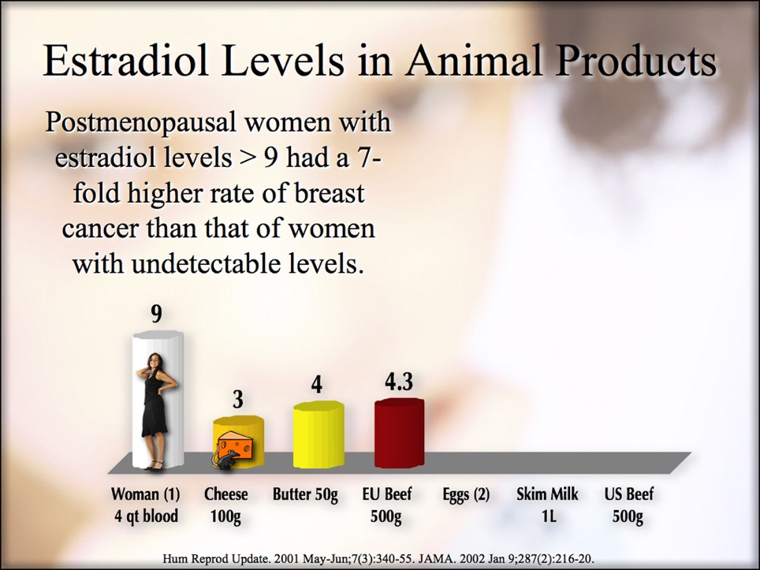

Slide 16
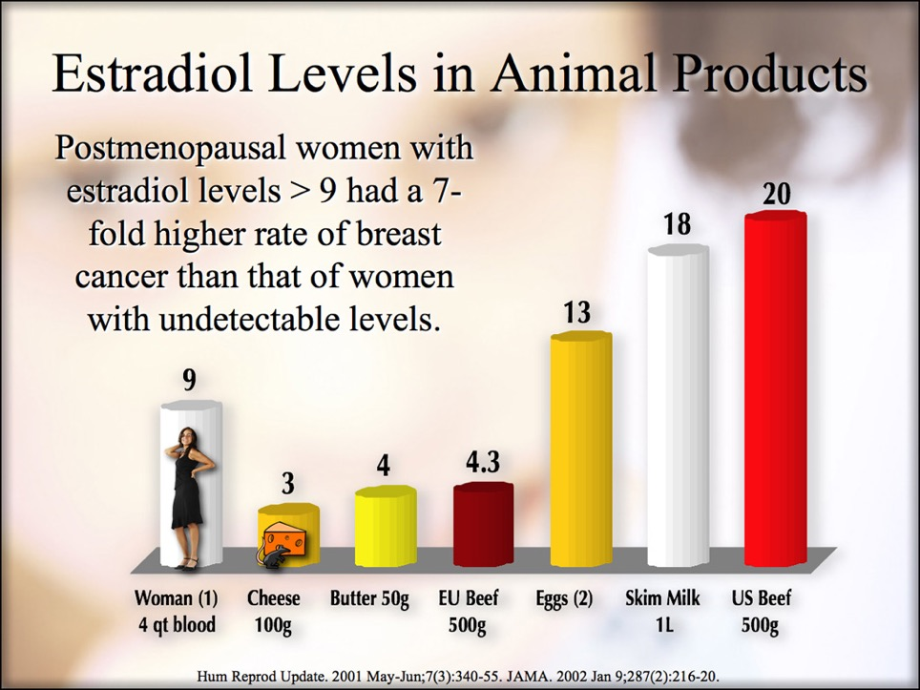

Slide 17
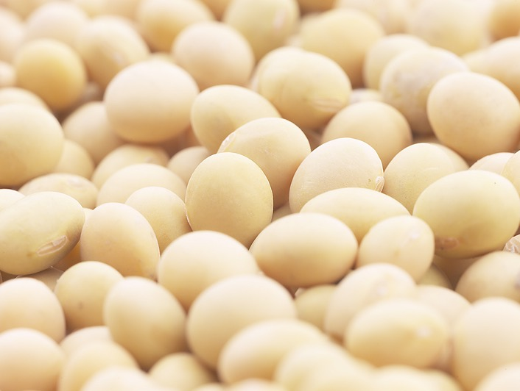
Phytoestrogens in soy, flax and turmeric counteract the growth stimulating effects of estradiol and environmental toxins reducing your risk of lung, prostate, breast and endometrial cancer.
Environ Health Perspect. 106(12):807-12.
Notes:
The inhibition of the estrogenic effects of pesticides and environmental chemicals by curcumin and isoflavonoids.
Environ Health Perspect. 1998 Dec;106(12):807-12.
Verma SP, Goldin BR, Lin PS.
Department of Family Medicine and Community Health, Tufts University School of Medicine, Boston, MA 02111 USA.
Many environmental chemicals and pesticides have been found to be estrogenic and have been shown to stimulate the growth of estrogen receptor-positive (ER-positive) human breast cancer cells. Since it is difficult to avoid human exposure to environmental estrogens, a potentially important area of research is the development of dietary strategies to prevent the stimulated growth of breast tumors by environmental estrogens. In this context, the inhibitory action of curcumin and a combination of curcumin and isoflavonoids were studied in ER-positive human breast cancer cells (MCF-7 and T47D) and ER-negative MDA-MB-231 cells induced by the pesticide o,p'-DDT and the environmental pollutants 4-nonylphenol and 4-octylphenol. The median inhibitory concentration (IC50) for curcumin in T47D cells was 10 microM when measured at either a 48-hr or a 6-day incubation time. The IC50 value for curcumin was within the 8-10 microM range for inhibiting the growth of T47D cells induced by a 10- microM concentration each of 4-nonylphenol, 4-octylphenol, and o, p'-DDT. The IC50 for curcumin in MCF-7 cells induced by 10 microM of either o,p'-DDT, 4-octylphenol, or 4-nonylphenol were 9, 39, and >50 microM, respectively. A combination of curcumin and isoflavonoids was able to inhibit the induced growth of ER-positive cells up to 95%. For MDA-MB-231 cells, the IC50 for curcumin was 17 microM, which was reduced to 11 microM in the presence of 25 microM genistein. Curcumin and genistein induce drastic changes in the morphological shape of both ER-positive and ER-negative cells. Data presented here indicate that a mixture of curcumin and isoflavonoids is the most potent inhibitor against the growth of human breast tumor cells. These data suggest that combinations of natural plant compounds may have preventive and therapeutic applications against the growth of breast tumors induced by environmental estrogens.
PMID: 9831541 [PubMed - indexed for MEDLINE]
Nutr Cancer. 1998;30(3):232-9.
Effect of soy-derived isoflavonoids on the induced growth of MCF-7 cells by estrogenic environmental chemicals.
Verma SP, Goldin BR.
Department of Family Medicine and Community Health, Tufts University School of Medicine, Boston, MA 02111, USA.
Isoflavonoids are natural plant compounds and possess antitumorigenic properties. Many environmental chemicals have been found to be estrogenic and can enhance tumor growth in estrogen receptor-positive cells. In the present study, the effects of genistein, daidzein, biochanin A, formononetin, and equol on the proliferation of estrogen receptor-positive MCF-7 cells induced by synthetic chemicals 1-(o-chlorophenyl)-1-(p-chlorophenyl)-2,2,2-trichloroethane (o,p'-DDT), 4-nonylphenol (4-NP), and 5-octylphenol (5-OP) found in the environment were investigated. Genistein, biochanin A, equol, and to some extent daidzein, but not formononetin, at < 10 microM can enhance the growth of MCF-7 cells in the absence of environmental chemicals. Formononetin was toxic to MCF-7 cells at the tested concentrations. The environmental chemicals 4-NP, 5-OP, and o,p'-DDT and the natural estrogen 17 beta-estradiol at 5, 5, and 10 microM and 5 nM, respectively, induced proliferation of MCF-7 cells. In the presence of isoflavonoids (> 25 microM), the environmental chemical-induced cell proliferation was inhibited. Individually, genistein (IC50 = 25-33 microM) was the most potent inhibitor against the induced proliferation of MCF-7 cells of the isoflavonoids needed for a 50% suppression of growth induced by 4-NP, 5-OP, and o,p'-DDT. A mixture of isoflavonoids was the most potent inhibitor against the induced proliferation. Estrogen receptor-dependent and -independent pathways could be involved in the inhibitory actions of isoflavonids. Because it is impossible to have a chemical-free environment, the in vitro data presented here are of practical importance to develop evolving dietary strategies and tactics against the adverse health effects of environmental chemicals.

Slide 18
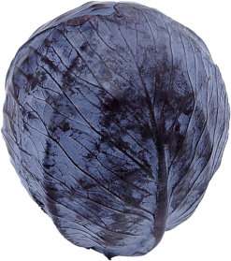
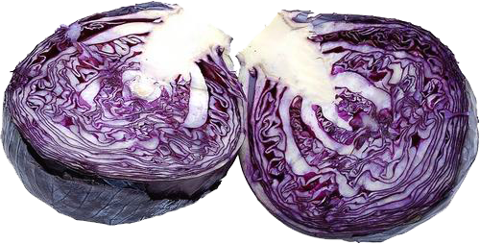
Phytochemicals in cruciferous vegetables (e.g., cabbage, broccoli, etc.), significantly increase the urinary excretion of estrogens.
Nutr Cancer. 16(1):59-66.

Slide 19

Exercise improves your cancer risks by reducing serum estradiol.
Cancer Res. 64(8):2923-8.
Notes:
Cancer Res. 2004 Apr 15;64(8):2923-8. Related Articles, Links
Effect of exercise on serum estrogens in postmenopausal women: a 12-month randomized clinical trial.
McTiernan A, Tworoger SS, Ulrich CM, Yasui Y, Irwin ML, Rajan KB, Sorensen B, Rudolph RE, Bowen D, Stanczyk FZ, Potter JD, Schwartz RS.
Cancer Prevention Research Program, The Fred Hutchinson Cancer Research Center, Seattle, Washington, USA.
Elevated circulating estrogens and a sedentary lifestyle increase risk for breast cancer. The effect of exercise on circulating estrogens in sedentary postmenopausal women is unknown. The objective of this study was to examine the effects of a 12-month moderate-intensity exercise intervention on serum estrogens. We randomly assigned 173 sedentary, overweight (body mass index > 24.0 kg/m(2), body fat > 33%), postmenopausal women, ages 50-75 years, not using hormone therapy, living in the Seattle, Washington, area for the next year, and willing to be randomly assigned to an exercise intervention or stretching control group. The exercise intervention included facility and home-based exercise (45 min, 5 days/week moderate intensity sports/recreational exercise). A total of 170 (98.3%) women completed the study with exercisers averaging 171 min/week of exercise. After 3 months, exercisers experienced declines in estrone, estradiol, and free estradiol of 3.8, 7.7, and 8.2%, respectively, versus no change or increased concentrations in controls (P = 0.03, 0.07, and 0.02, respectively). At 12 months, the direction of effect remained the same, although the differences were no longer statistically significant. The effect was limited to women who lost body fat: women whose percentage of body fat [by dual energy x-ray absortiometry (DEXA)] decreased by >/==" BORDER="0">2% had statistically significant (comparing exercisers versus controls) decreases at 12 months of 11.9, 13.7, and 16.7% for serum estrone, estradiol, and free estradiol, respectively. We concluded that a 12-month moderate-intensity exercise intervention in postmenopausal women resulted in significant decreases in serum estrogens. The association between increased physical activity and reduced risk for postmenopausal breast cancer may be partly explained by effects on serum estrogens.
Publication Types:
Clinical Trial
Randomized Controlled Trial
PMID: 15087413 [PubMed - indexed for MEDLINE]
Cancer Epidemiol Biomarkers Prev. 2003 Aug;12(8):721-7. Related Articles, Links
Effects of exercise training on fasting insulin, insulin resistance, insulin-like growth factors, and insulin-like growth factor binding proteins in postmenopausal breast cancer survivors: a randomized controlled trial.
Fairey AS, Courneya KS, Field CJ, Bell GJ, Jones LW, Mackey JR.
University of Alberta, Edmonton, Alberta, Canada T6G 2H9.
Insulin, insulin-like growth factors (IGFs) I and II, and IGF binding proteins (IGFBPs) 1 and 3 have been implicated in breast cancer outcomes. We conducted a randomized controlled trial to determine the physiological effects of exercise training on changes in these biological markers in postmenopausal breast cancer survivors. Fifty-three postmenopausal breast cancer survivors were randomly assigned to an exercise (n = 25) or control group (n = 28). The exercise group trained on cycle ergometers three times per week for 15 weeks. The control group did not train. End points included changes in fasting insulin, glucose, insulin resistance, IGF-I, IGF-II, IGFBP-1, IGFBP-3, and IGF-I:IGFBP-3 molar ratio between baseline and week 15. All of the statistical tests were two-sided (alpha = 0.05). Fifty-two participants completed the trial. The exercise group completed 44.3 of 45 (98.4%) prescribed exercise sessions. Baseline hormone concentrations did not differ between groups except that IGF-II was higher in the exercise group (P = 0.011). No significant differences between groups were observed for changes in fasting insulin (+6.3 pmol/liter; P = 0.941), glucose (+0.09 mmol/liter; P = 0.824), insulin resistance (+0.4; P = 0.247), IGF-II (-40.7 ng/ml; P = 0.101), or IGFBP-1 (+1.4 ng/ml; P = 0.774). However, significant differences between groups were observed for changes in IGF-I (-7.4 ng/ml; P = 0.045), IGFBP-3 (+180.5 ng/ml; P = 0.021), and IGF-I:IGFBP-3 molar ratio (-0.006; P = 0.017). Exercise training had significant physiological effects on IGF-I, IGFBP-3, and IGF-I:IGFBP-3 molar ratio in postmenopausal breast cancer survivors. The clinical implications of these findings remain to be defined.
Publication Types:
Clinical Trial
Randomized Controlled Trial
PMID: 12917202 [PubMed - indexed for MEDLINE]

Slide 20
If you are fit you have one-half the risk of dying of cancer.
Med Sci Sports Exerc. 34(5):735-9.
Cancer death rate
Fitness Level
Notes:
Lee CD, Blair SN. Cardiorespiratory fitness and smoking-related and total cancer mortality in men. Med Sci Sports Exerc. 2002 May;34(5):735-9.
Division of Epidemiology, University of Minnesota, Minneapolis, MN, USA.
PURPOSE: We investigated the association between cardiorespiratory fitness and smoking-related, nonsmoking-related, and total cancer mortality in men. METHODS: We followed 25,892 men, age 30-87 yr, who had a preventive medical evaluation, including a maximal exercise test and self-reported health habits. There were 335 cancer deaths (133 from smoking-related cancer, 202 from nonsmoking-related cancer) during an average of 10 yr of follow-up (259,124 man-yr). RESULTS: After adjustment for age, examination year, smoking habits, alcohol intake, body mass index, and diabetes mellitus, there was an inverse association between cardiorespiratory fitness levels and smoking-related (P < 0.001 for trend), nonsmoking-related (P = 0.001 for trend), and total cancer mortality (P < 0.001 for trend). Moderate and high levels of cardiorespiratory fitness were associated with lower risk of smoking-related and nonsmoking-related cancer mortality when compared with low fitness in men. We also observed that smoking-related mortality rates were progressively lower across low, moderate, and high fitness groups in former (P = 0.06 for trend) and current (P = 0.04 for trend) smokers. CONCLUSION: We conclude that cardiorespiratory fitness may provide protection against cancer mortality in men.
PMID: 11984287 [PubMed - indexed for MEDLINE]

Slide 21


Slide 22

Meatpacking plants workers are exposure to viruses which increase cancers of the lung, mouth and throat, colon, bladder, and kidney.
Am J Ind Med. 27(3):389-403.
Notes:
Johnson ES, Dalmas D, Noss J, et. al. Cancer mortality among workers in abattoirs and meatpacking plants: an update. Am J Ind Med. 1995 Mar;27(3):389-403.
Epidemiology Branch, National Institute of Environmental Health Sciences, Research Triangle Park, NC, USA.
Workers in abattoirs and meatpacking plants have potential for exposure to bovine leukemia virus (BLV) and bovine papilloma viruses (BPV), which are oncogenic in cattle. These workers also have increased exposure to human papilloma viruses (HPV) and certain chemical carcinogens. We investigated whether such a group showed increased risk of cancers. We report mortality results after an additional 9-year follow-up of a previously studied group of 5,522 workers in abattoirs and 4,589 workers in meatpacking plants. Excess risk of all cancers combined, cancers of the lung, buccal cavity and pharynx, esophagus, colon, bladder, kidney, and bone was observed. Since factors such as tobacco smoking, alcohol, and diet, which have known associations with some of these cancers, were not taken into account, the significance of these findings is not known, except for lung cancer, for which occupational factors are probably involved. Because some of these findings have been consistently reported before, studies that will control for confounding factors as well are now urgently needed.
PMID: 7747745 [PubMed - indexed for MEDLINE]

Slide 23


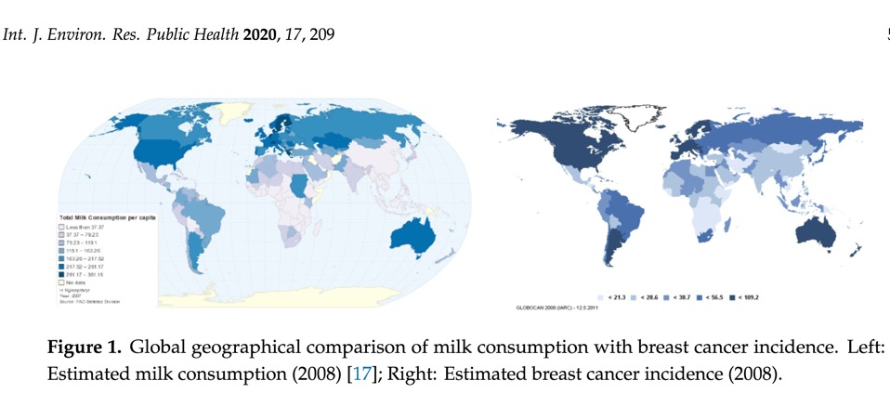
Women with breast cancer have 3 times the incidence of infection with Bovine Leukemia Virus, a virus common in dairy cattle and their milk.
Int J Environ Res Public Health. 2019 Dec 27;17(1):209.
Notes:
Symposium Abstract (2005)
We cannot hope to control breast cancer without knowing its cause. Breast cancer in mice is caused by a milk-transmitted virus, MMTV, and provides a model for a viral cause of human breast cancer. Since humans drink more cows milk than human milk, a bovine virus might be involed in human breast cancer. Bovine leukemia virus (BLV) causes widespread infection of cattle globally and in 1-5% of infected cattle leukemia/lymphoma may develop. Most infected cattle remain healthy, are retained in the herd, and are sources of beef and dairy products. Infectious virus may be present in bovine foodstuffs not adequately cooked or pasteurized. BLV infects white blood cells and breast cells of cattle. It can cross species naturally to infect goats and sheep, and can infect human cells in culture. Evidence is accumulating that some humans are infected with BLV. Antibodies to BLV were detected in 74% of human volunteers. BLV protein and DNA have been detected in human breast epithelium. The purpose of this case-control study was to determine whether BLV DNA is present more frequently in the breast tissue of women with a diagnosis of breast cancer than in women who have never had breast cancer. This is a first step in determining whether BLV in breast tissue is a risk factor for developing breast cancer. Breast tissues were obtained through the Cooperative Human Tissue Network from four catchment areas, Philadelphia, PA, Columbus, OH, Birmingham, AL, and the San Francisco East Bay area. Breast tissue sections were tested by in situ polymerase chain reaction (IS-PCR) for the presence of BLV DNA using primers from the BLV gene (tax) responsible for malignant transformation. This gene is not related to any region within the human genome. Results for 211 subjects completed to date indicate that the breast tissue of women with a diagnosis of breast cancer tested positive for BLV DNA significantly more frequently (62%) than breast tissue from women with no history of breast cancer (23%) (P<= .0001; age-adjusted odds ratio = 5.4, confidence interval = 2.42-11.9). In 55% of pairs of malignant and “uninvolved” breast tissues from the same breast cancer patient, BLV was present in the nonmalignant breast epithelium. This suggests that virus infection may have preceded malignant transformation, i.e. cancer may have been a rare, delayed event within a population of BLV-infected cells widespread in the breast tissue (field effect), rather than virus infection being selective for cells already malignant. If further studies support our data, and indicate how the virus is transmitted to humans, it may be possible to prevent some breast cancer cases by preventing or controlling human infection with BLV. This work was supported by funds from the California Breast Cancer Research Program of the University of California, Grant 6PB-0075 and the U.S. Army Medical Research and Materiel Command, grant DAMD17-02-1-0320.
Gertrude Buehring , Ph.D. Symposium Abstract (2005)California Breast Cancer Research Program of the University of California, Grant 6PB-0075
http://www.cbcrp.org/research/PageGrant.asp?grant_id=1815
Buehring GC, Sans HM. Breast Cancer Gone Viral? Review of Possible Role of Bovine Leukemia Virus in Breast Cancer, and Related Opportunities for Cancer Prevention. Int J Environ Res Public Health. 2019 Dec 27;17(1):209.
There are already multiple risk factors for developing human breast cancer, and bovine leukemia
virus (BLV) may be another one to add to the list. Six of the eight studies that examined breast cancer
tissues or DNA found BLV in breast tissues, which suggests strongly that BLV does infect humans, and
breasts can be targets of infection. Four of the five studies that were able to obtain normal breast tissue
from donors without breast cancer performed a comparative statistical analysis and found relatively
high odds ratios, ranging 2.73–5.59, with an average of 4.01

Slide 24

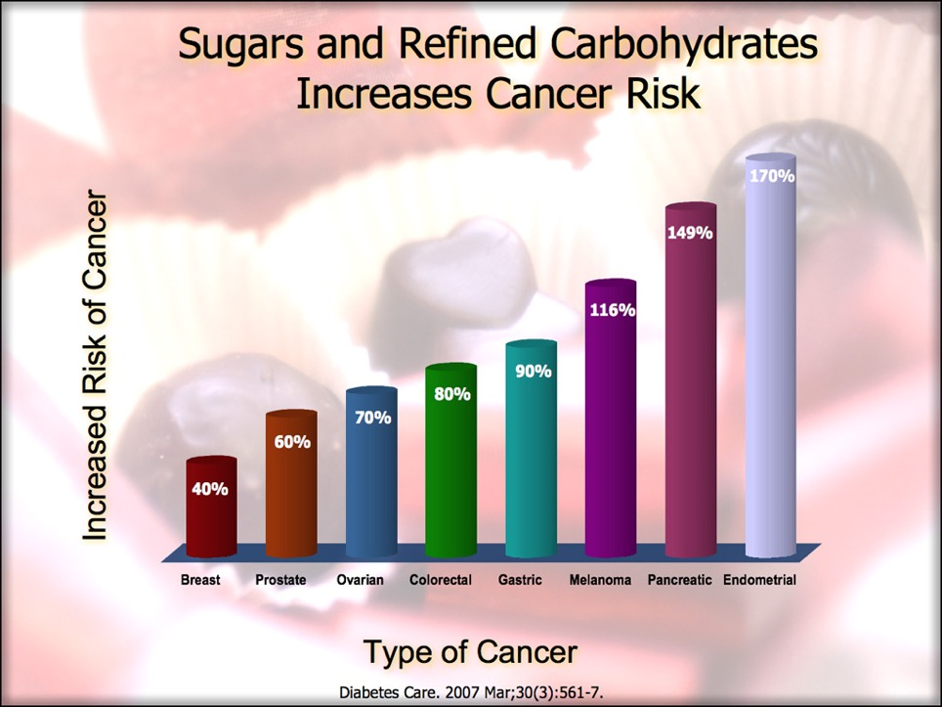

Does Sugar Feed Cancer?
Notes:
Sugar is readily metabolized by cancer cells to increase their growth and proliferation.
Cancer Res. 70(15):6368-76.

Slide 25
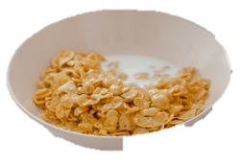

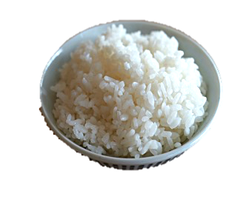


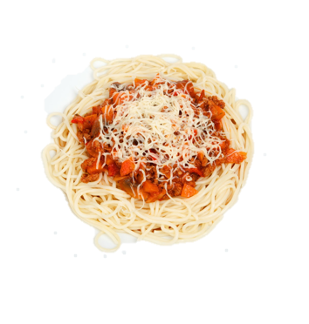
Consumption of refined cereals products doubles the risk of thyroid cancer and increases breast cancer by 30%.
Am J Clin Nutr. 70(6):1107-10.
Notes:
Chatenoud L, La Vecchia C, Franceschi S, Tavani A, Jacobs DR Jr, Parpinel MT, Soler M, Negri E. Refined-cereal intake and risk of selected cancers in italy. Am J Clin Nutr. 1999 Dec;70(6):1107-10.
Augustin LS, Dal Maso L, La Vecchia C, Parpinel M, Negri E, Vaccarella S, Kendall CW, Jenkins DJ, Francesch S. Dietary glycemic index and glycemic load, and breast cancer risk: a case-control study. Ann Oncol. 2001 Nov;12(11):1533-8.

Slide 26

Whole Grain Consumption Reduces Cancer!
Whole grain intake is associated with lower risk of total and site-specific cancer.
Especially colorectal, gastric, pancreatic, and esophageal cancers.
Each 30 g/day intake of whole grains was associated with a ~7% lower risk of cancer mortality.
Notes:
Gaesser GA. Whole Grains, Refined Grains, and Cancer Risk: A Systematic Review of Meta-Analyses of Observational Studies. Nutrients. 2020 Dec 7;12(12):3756.
whole grain intake is associated with lower risk of total and site-specific cancer, and support current dietary recommendations to increase whole grain consumption.
Meta-analyses consistently show that whole grain consumption is associated with lower risk of
total cancer mortality. Risk reductions for the highest intakes of whole grains ranged between 5%
and 12%. In dose-response analyses, each 30 g/day intake of whole grains was associated with a ~7%
lower risk of cancer mortality. For site-specific cancers, meta-analyses indicate that whole grain intake
is consistently associated with lower cancer risk, with the strongest evidence for colorectal, gastric,
pancreatic, and esophageal cancers. The only cancer for which whole grain intake was not associated
with lower risk was prostate cancer. Overall, these meta-analyses of cohort and case-control studies
support the recommendations for increased whole grain consumption [2,3].

Slide 27

I’ll Drink To That!?
Consumption of carbonated drinks or juice quadruples the risk of stomach cancer.
Asian Pac J Cancer Prev. 5(1):58-65.
Notes:
Khan MM, Goto R, Kobayashi K, Suzumura S, Nagata Y, Sonoda T, Sakauchi F, Washio M, Mori M. Dietary habits and cancer mortality among middle aged and older Japanese living in hokkaido, Japan by cancer site and sex. Asian Pac J Cancer Prev. 2004 Jan-Mar;5(1):58-65. PMID: 15075007.
carbonated drink/juice (RR=3.9)

Slide 28

Heterocyclic amines and N-nitroso compounds from meat cause DNA damage increasing colorectal cancer.
Cancer Rex. 66(3): 1859-65.

Slide 29
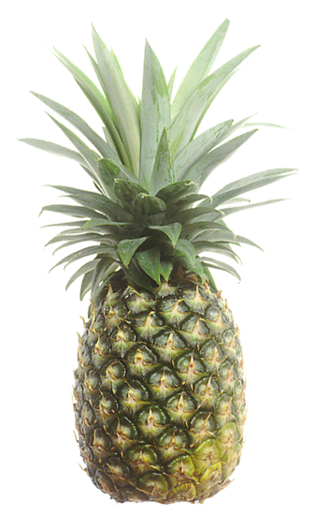
Pineapple prevents cancer in your stomach from meat by inhibiting the formation of N-nitroso compounds.
Carcinogenesis. 13(12):2277-80.

Slide 30
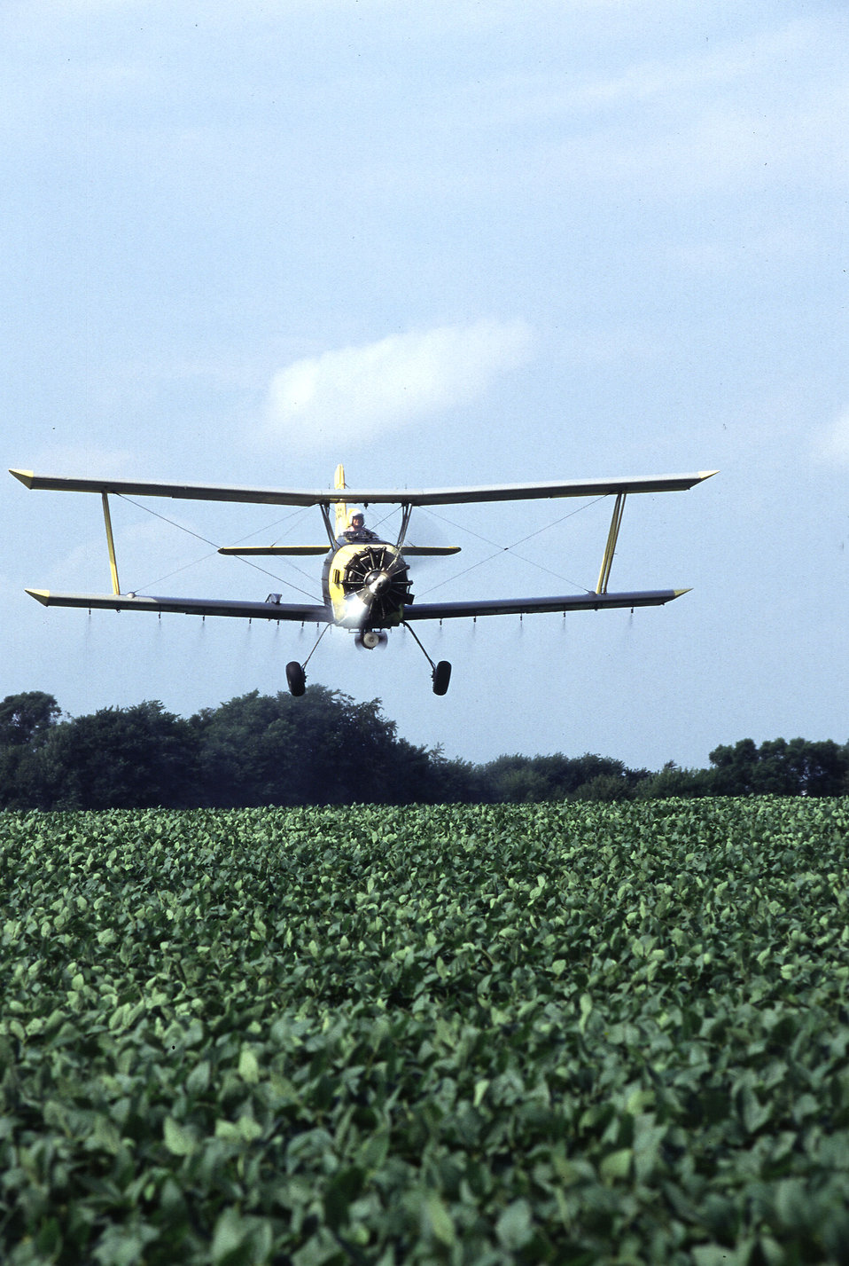
Pesticides, and herbicides.
Indian J Exp Biol. 36(4):395-8. Arch Environ Contam Toxicol. 35(1):140-7.
Notes:
Pesticides, and herbicides increase your risk of cancer by because they: increase oxidative stress, have hormonal activity, and suppress the immune system.
Indian J Exp Biol. 1998 Apr;36(4):395-8.Links
Organochlorine pesticide-induced oxidative stress and immune suppression in rats.
Koner BC, Banerjee BD, Ray A.
Department of Biochemistry and Pharmacology, University College of Medical Sciences and G.T.B. Hospital, University of Delhi, India.
Effects of subchronic DDT and lindane exposure were evaluated on lipid peroxidation, antioxidant mechanisms and humoral immune response in rats. Oral administration of DDT, (100 and 200 ppm) and lindane (40 and 80 ppm) dose dependently increased thiobarbituric acid reactive substance (TBARS) levels in serum after 8 wk of treatment. Superoxide dismutase (SOD) activity in red blood cells (RBC) was also dose dependently increased by these compounds. In addition, such DDT or lindane exposure markedly suppressed the humoral immune response as assessed by anti-sheep RBC antibody titres. Simultaneous treatment with ascorbic acid (100 mg/kg) markedly attenuated the effects of DDT and lindane on (a) lipid peroxidation, (b) SOD activity and (c) humoral immune suppression. These results indicate the possible involvement of free radicals in organochlorine-induced immunotoxicity.
PMID: 9717451 [PubMed - indexed for MEDLINE]
Arch Environ Contam Toxicol. 1998 Jul;35(1):140-7.
Chlororganic pesticides and polychlorinated biphenyls in breast tissue of women with benign and malignant breast disease.
Güttes S, Failing K, Neumann K, Kleinstein J, Georgii S, Brunn H.
Staatl. Medizinal-, Lebensmittel- und Veterinäruntersuchungsamt Mittelhessen, Marburger Str. 54, D-35396 Giessen, Germany.
Persistent chlorinated hydrocarbons assimilated through the diet may, as a result of their carcinogenic, immunotoxic, and, at least in regard to certain of these substances, estrogenic properties, play a role in the etiology of human breast cancer. As a consequence, increased concentrations of these ubiquitous environmental contaminants may be found in breast tissue of women suffering from malignant breast disease. To examine this possibility, surgically removed breast tissue samples from 65 women in Hesse, Germany were examined by capillary gas chromatography for p, p'-dichloro(diphenyl)trichloroethane (p,p'-DDT), p, p'-dichloro(diphenyl)-dichloroethane (p,p'-DDD), p, p'-dichloro(diphenyl)dichloroethene (p,p'-DDE), hexachlorobenzine (HCB), alpha-, beta-, and gamma-hexachlorocyclohexane (HCH) as well as the polychlorinated biphenyls (PCB) no. 28, 31, 49, 52, 101, 105, 118, 138, 153, 156, 170, and 180. Of the 65 patients, 45 were diagnosed with breast cancer. The control group of 20 women suffered from benign breast disease such as mastopathy. After statistical adjustment for age differences, higher concentrations of p,p'-DDT, p, p'-DDE, HCB as well as PCB-congeners no. 118, 138, 153, and 180 were detected in tissue from women with breast cancer than in tissue from control persons. These differences were weakly significant for p, p'-DDE (p = 0.017), for PCB 118 (p = 0.042) and for PCB no. 153 barely not significant (p = 0.083). On an average, a 62% higher concentration of p,p'-DDE was found in cancer tissue (cancer patients: 805 microg/kg fat; controls: 496 microg/kg fat) and 25% higher concentration of PCB no. 118 (81 microg/kg fat; 65 microg/kg fat). The concentrations of beta-HCH, PCB no. 156 and 170 were lower (not significant) in cancer tissue than in tissue from women with benign disease. PCB-congeners no. 105 and 149 as well as gamma-HCH could only be detected in individual tissue samples; congeners no. 28, 31, 49, 52, and 101 as well as alpha-HCH and p,p'-DDD were not detected in any of the samples. To rule out the possibility that the concentrations of chlorinated hydrocarbons measured were influenced by the surgical procedure, 20 samples of tissue that were at a distance (minimum 1 cm and maximum 3 cm) from the tumor, tissue that was in direct proximity to the tumor (no more than 5 mm from the tumor), and tumor tissue itself (center of tumor) were separately prepared and analyzed. The average concentrations of chlorinated hydrocarbons varied to differing degrees and only minimally in tumor and surrounding breast tissue, indicating that the surgical procedure did not influence the results.
Publication Types:
Comparative Study
PMID: 9601932 [PubMed - indexed for MEDLINE]
Environ Health Perspect. 1996 Oct;104(10):1084-9.
Identification of environmental chemicals with estrogenic activity using a combination of in vitro assays.
Klotz DM, Beckman BS, Hill SM, McLachlan JA, Walters MR, Arnold SF.
Tulane-Xavier Center for Bioenvironmental Research, Tulane University Medical Center, New Orleans, LA, USA.
Environmental chemicals that function as estrogens have been suggested to be associated with an increase in disease and dysfunctions in animals and humans. To characterize chemicals that may act as estrogens in humans, we have compared three in vitro assays which measure aspects of human estrogen receptor (hER)-mediated estrogenicity. Chemicals were first tested for estrogen-associated transcriptional activity in the yeast estrogen screen (YES). This was created by expressing hER and two estrogen response elements linked to the lacZ gene in yeast. Second, chemicals that were tested in YES were then assayed for direct interaction with hER in a competition binding assay. Third, chemicals were tested in the estrogen-responsive MCF-7 human breast cancer cell line transiently transfected with a plasmid containing two estrogen response elements linked to the luciferase gene. Together, these assays have identified two metabolites of DDT, o,p'-DDD and p,p'-DDD, that have estrogenic activity. Interestingly, previous studies had reported that the DDD metabolites were nonestrogenic in whole animal models. Alachlor, the most frequently used herbicide in the United States, cis-nonachlor, and trans-nonachlor displayed weak estrogenic activity in the combined assays. The antifungal agent benomyl had no estrogenic activity. We propose that a combination of in vitro assays can be used in conjunction with whole animal models for a more complete characterization of chemicals with estrogenic activity.
Publication Types:
Research Support, Non-U.S. Gov't
PMID: 8930550 [PubMed - indexed for MEDLINE]
Int Arch Occup Environ Health. 1994;65(6):351-8. Related Articles, Links
Parameters of immunological competence in subjects with high consumption of fish contaminated with persistent organochlorine compounds.
Svensson BG, Hallberg T, Nilsson A, Schütz A, Hagmar L.
Department of Occupational and Environmental Medicine, University of Lund, Sweden.
Consumption of fatty fish species, like salmon and herring, from the Baltic Sea is an important source of human exposure to persistent organochlorine compounds, e.g. polychlorinated dioxins (PCDDs), dibenzofurans (PCDFs) and biphenyls (PCBs). Many of these compounds show immunotoxic and hepatotoxic effects in animals. We have now studied immunological competence, including lymphocyte subsets, in 23 males with a high consumption of fish from the Baltic Sea and in a control group of 20 males with virtually no fish consumption. The high consumers had lower proportions and numbers of natural killer (NK) cells, identified by the CD 56 marker, in peripheral blood than the non-consumers. Weekly intake of fatty fish correlated negatively with proportions of NK cells (rs = -0.32, P = 0.04). There were also, in a subsample of 11 subjects, significant negative correlations between numbers of NK cells and blood levels of a toxic non-ortho-PCB congener (IUPAC 126; rs = -0.68, P = 0.02) and a mono-ortho congener (IUPAC 118; rs = -0.76, P = 0.01). A similar correlation, in 12 subjects, was seen for p,p'-DDT (rs = -0.76, P = 0.01). The corresponding negative correlation, in 13 subjects, with blood levels of PCDD/Fs was not significant (rs = -0.57, P = 0.07). No significant association was seen between organic mercury in erythrocytes and NK cells. Fish consumption was not associated with levels of any other lymphocyte subset. Neither were there any correlations with plasma immunoglobulins or liver enzyme activities. Our study indicates that accumulation of persistent organochlorine compounds in high consumers of fatty fish may adversely affect NK cell levels.
Publication Types:
Research Support, Non-U.S. Gov't
PMID: 8034358 [PubMed - indexed for MEDLINE]

Slide 31


Beef is the most dangerous food you can buy for herbicide contamination and is third in insecticide contamination.
http://globalcommunitywebnet.com/globalcommunity/cattleandbeef.htm
Notes:
http://globalcommunitywebnet.com/globalcommunity/cattleandbeef.htm
Accessed: Wednesday 10-9-2013

Slide 32

Cruciferous vegetables reduce damage to your DNA, stop toxins from binding to your DNA, and help cleanse toxins from your liver.
Carcinogenesis. 7(12):2025-31.
Notes:
Goeger DE, Shelton DW, Hendricks JD, Bailey GS. Mechanisms of anti-carcinogenesis by indole-3-carbinol: effect on the distribution and metabolism of aflatoxin B1 in rainbow trout. Carcinogenesis. 1986 Dec;7(12):2025-31.
Indole-3-carbinol (I3C), a component of cruciferous vegetables, was previously shown to inhibit aflatoxin B1 (AFB1) carcinogenesis in trout. The purpose of this study was to examine the effect of I3C on AFB1 metabolism and hepatic DNA adduct formation in vivo and in vitro. When fed at 0.2%, I3C produced a 70% reduction in average in vivo hepatic DNA binding of injected AFB1 over a 21-day period when compared to controls. A 24-h distribution study of injected tritiated AFB1 in I3C fish showed less total radioactivity in the blood and liver at all times examined, compared to controls. These reductions were due primarily to reduced levels of AFB1 bound to red blood cell DNA, reduced plasma levels of the primary metabolite aflatoxicol (AFL), and decreased levels of AFB1 and polar metabolites present in the liver of I3C fish. In contrast to blood, total radioactivity was significantly elevated in the bile of I3C fish resulting from a 7-fold increase in aflatoxicol-M1 glucuronide levels over controls. No difference was observed in concentration of AFL glucuronide, the primary conjugate present in control fish. There was no difference in total radioactivity remaining in the carcass of I3C or control fish. AFB1 metabolism in freshly isolated hepatocytes from I3C fish showed 20% less DNA binding in a 1-h assay, with a 2-fold increase in aflatoxin M1 production. Addition of I3C to control hepatocytes at levels of 1, 10 or 100 microM had no effect on AFB1 DNA binding. These findings indicate that I3C inhibition of AFB1 hepatocarcinogenesis in trout involves substantial changes in the pharmacokinetics of carcinogen distribution, metabolism and elimination, leading to significantly reduced initial hepatic-nuclear DNA damage in vivo.
PMID: 3096588 [PubMed - indexed for MEDLINE]

Slide 33

Summary
Meat increase cancer risk through:
Animal Protein.
Animal Fat.
Hormones.
Species crossing viruses.
Toxins.
Notes:
https://www.pexels.com/photo/plate-of-beef-with-herbs-1639563/

Slide 34

DNA Damage
Cancer Res. 65(1):349-57.
Notes:
Cancer Res. 2005 Jan 1;65(1):349-57. Related Articles, Links
Cell cycle checkpoints, DNA damage/repair, and lung cancer risk.
Wu X, Roth JA, Zhao H, Luo S, Zheng YL, Chiang S, Spitz MR.
Department of Epidemiology, University of Texas M.D. Anderson Cancer Center, Houston, TX 77030, USA. xwu@mdanderson.org
Given that defects in cell cycle control and DNA repair capacity may contribute to tumorigenesis, we hypothesized that patients with lung cancer would be more likely than healthy controls to exhibit deficiencies in cell cycle checkpoints and/or DNA repair capacity as gauged by cellular response to in vitro carcinogen exposure. In an ongoing case-control study of 155 patients with newly diagnosed lung cancer and 153 healthy controls, we used the comet assay to investigate the roles of cell cycle checkpoints and DNA damage/repair capability in lung tumorigenesis. The median gamma-radiation-induced and benzo(a)pyrene diol epoxide-induced Olive tail moments, the comet assay parameter for measuring DNA damage, were significantly higher in the case group (5.31 and 4.22, respectively) than in the control group (4.42 and 2.83, respectively; P < 0.001). Higher tail moments of gamma-radiation and benzo(a)pyrene diol epoxide-induced comets were significantly associated with 2.32- and 4.49-fold elevated risks, respectively, of lung cancer. The median gamma-radiation-induced increases of cells in the S and G(2) phases were significantly lower in cases (22.2% and 12.2%, respectively) than in controls (31.1% and 14.9%, respectively; P < 0.001). Shorter durations of the S and G(2) phases resulted in 4.54- and 1.85-fold increased risks, respectively, of lung cancer. Also observed were joint effects between gamma-radiation-induced increases of S and G(2) phase frequencies and mutagen-induced comets. In addition, we found that in controls, the S phase decreased as tail moment increased. This study is significant because it provides the first molecular epidemiologic evidence linking defects in cell cycle checkpoints and DNA damage/repair capacity to elevated lung cancer risk.
PMID: 15665313 [PubMed - indexed for MEDLINE]

Slide 35

Caffeine increases your cancer risk by stopping the DNA damage repair.
Especially cancers of the breast, colon, stomach, kidney, lung and ovaries.
Cancer Res.;59(17):4375-82. Int J Cancer. 28(6):691-3. Cancer.51(7):1249-53.
Notes:
Cancer Res. 1999 Sep 1;59(17):4375-82.
Inhibition of ATM and ATR kinase activities by the radiosensitizing agent, caffeine.
Sarkaria JN, Busby EC, Tibbetts RS, Roos P, Taya Y, Karnitz LM,Abraham RT.
Division of Oncology Research, Mayo Clinic, Rochester, Minnesota 55905, USA. sarkaria.jann@mayo.edu
Caffeine exposure sensitizes tumor cells to ionizing radiation and other genotoxic agents. The radiosensitizing effects of caffeine are associated with the disruption of multiple DNA damage-responsive cell cycle checkpoints. The similarity of these checkpoint defects to those seen in ataxia-telangiectasia (A-T) suggested that caffeine might inhibit one or more components in an A-T mutated (ATM)-dependent checkpoint pathway in DNA-damaged cells. We now show that caffeine inhibits the catalytic activity of both ATM and the related kinase, ATM and Rad3-related (ATR), at drug concentrations similar to those that induce radiosensitization. Moreover, like ATM-deficient cells, caffeine-treated A549 lung carcinoma cells irradiated in G2 fail to arrest progression into mitosis, and S-phase-irradiated cells exhibit radioresistant DNA synthesis. Similar concentrations of caffeine also inhibit gamma- and UV radiation-induced phosphorylation of p53 on Ser15, a modification that may be directly mediated by the ATM and ATR kinases. DNA-dependent protein kinase, another ATM-related protein involved in DNA damage repair, was resistant to the inhibitory effects of caffeine. Likewise, the catalytic activity of the G2 checkpoint kinase, hChk1, was only marginally suppressed by caffeine but was inhibited potently by the structurally distinct radiosensitizer, UCN-01. These data suggest that the radiosensitizing effects of caffeine are related to inhibition of the protein kinase activities of ATM and ATR and that both proteins are relevant targets for the development of novel anticancer agents.
PMID: 10485486 [PubMed - indexed for MEDLINE]
Food Chem Toxicol. 1987 Mar;25(3):247-51. Related Articles, Links
Evaluation of the genotoxicity of theobromine and caffeine.
Rosenkranz HS, Ennever FK.
Published data on the mutagenicity and genotoxicity of theobromine and caffeine were analysed by the Carcinogen Prediction and Battery Section (CPBS) method. In spite of some positive responses, these analyses did not predict for theobromine a potential for causing cancer by virtue of a genotoxic mechanism. Caffeine, on the other hand, clearly has potential for genotoxic carcinogenicity. The predictive performance of cost-effective batteries consisting of selected combinations of four assays was also evaluated. The predictions were similar to those derived when all the available test results were considered.
PMID: 3106176 [PubMed - indexed for MEDLINE]
Cancer. 1983 Apr 1;51(7):1249-53.
Caffeine and unsaturated fat diet significantly promotes DMBA-induced breast cancer in rats.
Minton JP, Abou-Issa H, Foecking MK, Sriram MG.
The following study was carried out to determine the possibility of caffeine being a promoter of breast cancer development in animals consuming vegetable fat. A controlled study, comparing the time of mammary tumor development and the number of tumors was carried out in Sprague-Dawley rats which had been given 20 mg of DMBA at seven weeks of age. This study evaluated the tumor promotional effects of caffeine alone, caffeine and unsaturated fat in combination, unsaturated fat alone, and a standard rat chow diet. The results show that the rats which consumed caffeine and unsaturated fat had the earliest development of tumor and the most multiple tumor occurrence. Average time to tumor development was 95 days. The fat or standard chow rats had an average time to tumor development of 134 and 140 days, respectively. The caffeine-alone rats had a mean time to tumor development of 188 days. The combination of an unsaturated fat diet and caffeine significantly shortened the time to tumor development when compared with the other three groups.
PMID: 6402286 [PubMed - indexed for MEDLINE]
Int J Cancer. 1981 Dec;28(6):691-3. Related Articles, Links
Coffee and ovarian cancer.
Trichopoulos D, Papapostolou M, Polychronopoulou A.
Ninety-two women with common epithelial tumors of the ovary and 105 comparison women admitted for various orthopedic conditions were interviewed regarding demographic, socio-economic and biomedical characteristics, including their use of coffee and tobacco. There was no association between tobacco smoking and ovarian cancer. However a statistically significant trend association was noted between coffee drinking and ovarian cancer (p approximately 0.03). The association could not be explained in terms of any other variable included in the present study. The relative risk for women drinking two or more cups of coffee per day was 2.2 with 95% confidence limits 1.0-4.8. Several descriptive epidemiologic data are compatible with a causal association between coffee and ovarian cancer.
PMID: 7333704 [PubMed - indexed for MEDLINE]

Slide 36
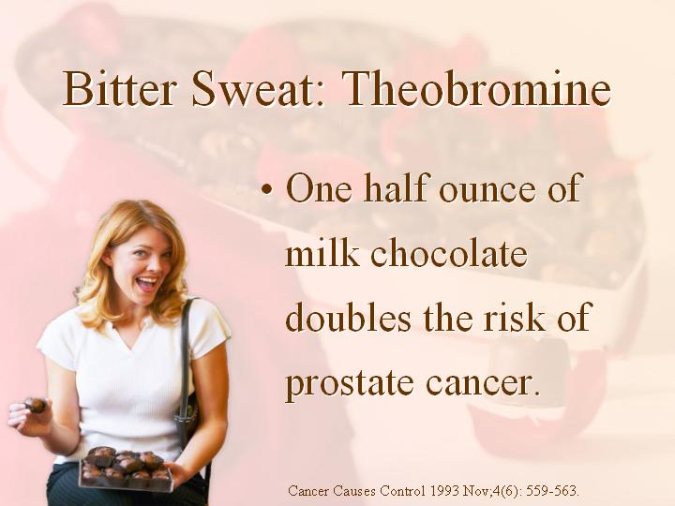

One half ounce of chocolate per day doubles the risk of prostate cancer.
Cancer Causes Control 4(6): 559-563.
Notes:
Slattery ML, West DW. Smoking, alcohol, coffee, tea, caffeine, and theobromine: risk of prostate cancer in Utah (United States). Cancer Causes Control 1993 Nov;4(6): 559-563.

Slide 37
Pharmaceutical Drug Medications and Vaccinations
In 1900 cancer affected 5% of the population. Under the influence of vaccinations containing many viruses and drug medications that suppress the immune system one-third of women (33%) and half of men (50%) will now develop cancer in their lifetime.
Clin Transl Med. 2020 Dec;10(8):e215.
Notes:
Khatami M. Deceptology in cancer and vaccine sciences: Seeds of immune destruction-mini electric shocks in mitochondria: Neuroplasticity-electrobiology of response profiles and increased induced diseases in four generations - A hypothesis. Clin Transl Med. 2020 Dec;10(8):e215. doi: 10.1002/ctm2.215. PMID: 33377661; PMCID: PMC7749544.

Slide 38
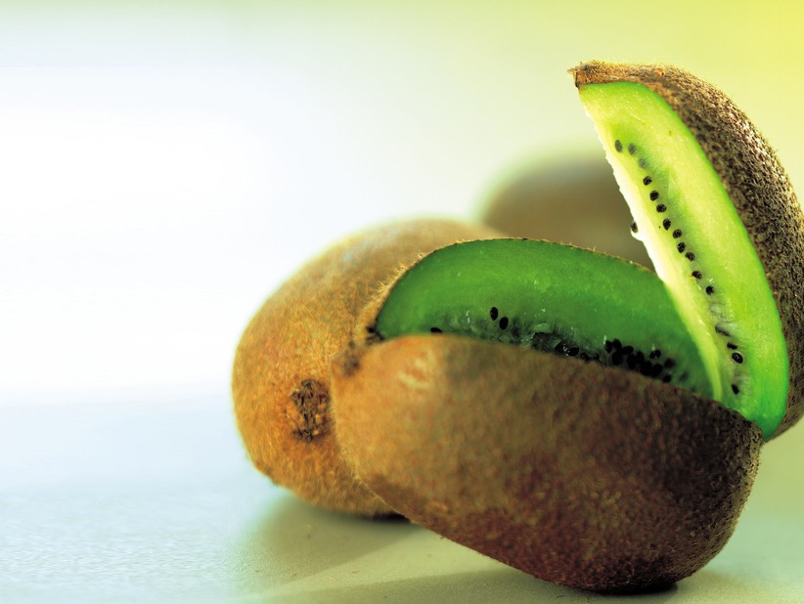
Kiwi stimulate DNA repair, and boost your antioxidant protection against DNA damage.
Carcinogenesis. 24(3):511-5.
Notes:
Collins AR, Harrington V, Drew J, Melvin R. Nutritional modulation of DNA repair in a human intervention study. Carcinogenesis. 2003 Mar;24(3):511-5.
Institute for Nutrition Research, University of Oslo, POB 1046 Blindern, N-0316 Oslo, Norway. a.r.collins@basalmed.uio.no
DNA oxidation is a potential cause of cancer in humans. It is well-known that fruits and vegetables protect against cancer, and this may be in part because they contain antioxidants, which decrease the level of oxidation of DNA. However, there are other possible mechanisms, such as an enhancement of cellular repair of this damage. A randomized cross-over study was carried out on healthy human subjects, who were given kiwifruit as a supplement to their normal diet, for 3-week periods at different 'doses', with 2-week washout periods between doses. Endogenous oxidation of bases in lymphocyte DNA, and the resistance of the DNA to oxidation ex vivo, were assessed using single cell gel electrophoresis (the 'comet assay'). The capacity to repair DNA base oxidation was measured with an in vitro test, and levels of expression of repair-related genes OGG1 and APE1 were assessed by semi-quantitative RT-PCR. Concentrations of dietary antioxidants were measured in plasma. The antioxidant status of plasma and of lymphocytes was increased by consumption of kiwifruit. Levels of endogenous oxidation of pyrimidines and purines in DNA were markedly decreased, and DNA repair measured on a substrate containing 8-oxo-7,8-dihydroguanine was substantially increased (without change in levels of OGG1 or APE1 mRNA). The magnitude of these effects was generally not related to the number of kiwifruits consumed per day. Kiwifruit provides a dual protection against oxidative DNA damage, enhancing antioxidant levels and stimulating DNA repair. It is probable that together these effects would decrease the risk of mutagenic changes leading to cancer.
Publication Types:
Clinical Trial
Randomized Controlled Trial
PMID: 12663512 [PubMed - indexed for MEDLINE]

Slide 39


Overeating doubles your risk of cancer.
Asian Pac J Cancer Prev. 14(2):841-8.
Notes:
Asian Pac J Cancer Prev. 2013;14(2):841-8.
Dietary and Lifestyle Factors and Risk of Non-Hodgkin's Lymphoma in Oman.
Ali A, Al-Belushi BS, Waly MI, Al-Moundhri M, Burney IA.
Source
Department of Food Science and Nutrition, College of Agricultural and Marine Sciences, Sultan Qaboos University, Sultanate of Oman E-mail : amanat@squ.edu.om.
Abstract
Background: The incidence of various types of cancers including the non-Hodgkin's lymphoma (NHL) has increased during the recent years. Diet and lifestyle factors have been reported to play an important role in the etiology of NHL. However, no such data are available from the Middle Eastern countries, including Oman. Materials and Methods: Forty-three histologically confirmed cases of non-Hodgkin's lymphoma (NHL) diagnosed at the Sultan Qaboos University Hospital (SQUH) and the Royal Hospital (RH), Muscat, Oman and forty-three age and gender matched controls were the subjects of this study. Frequency matching was used to select the control population. Information on social and demographic data as well as the dietary intake was collected by personal interviews, using a 117-items semi-quantitative food frequency questionnaire. Results: A non-significant increased risk of NHL was observed with higher body mass index (BMI) (OR=1.20, 95%CI: 0.45, 2.93), whereas a significantly decreased risk of NHL was associated with a higher educational level (OR=0.12, 95%CI: 0.03, 0.53). A significantly increased risk was observed for higher intake of energy (OR=2.67, 95%CI: 0.94, 7.57), protein (OR=1.49, 95%CI: 0.54, 4.10) and carbohydrates (OR=5.32, 95%CI: 1.78, 15.86). Higher consumption of daily servings from cereals (OR=3.25, 95%CI: 0.87, 12.09) and meat groups (OR=1.55, 95%CI: 0.58, 4.15) were also found to be associated with risk of NHL, whereas a significantly reduced risk was associated with higher consumption of vegetables (OR=0.24, 95%CI: 0.07, 0.82). The consumption of fruits, milk and dairy products however showed no significant association with the risk of developing NHL. Conclusion: The results suggest that obesity, high caloric intake, higher consumption of carbohydrate and protein are associated with increased risk of NHL, whereas a significantly reduced risk was observed with higher intake of vegetables.
PMID: 23621249 [PubMed - in process]

Slide 40

Caloric restriction enhances repair of your DNA and reduces DNA damage.
Mutat Res. 295(4-6):237-45.
Notes:
Mutat Res. 1993 Dec;295(4-6):237-45. Related Articles, Links
Effect of dietary restriction on DNA repair and DNA damage.
Haley-Zitlin V, Richardson A.
Geriatric Research, Education and Clinical Center, Audie L. Murphy Memorial Veterans Hospital, San Antonio, TX.
Dietary restriction is the only experimental manipulation known to extend lifespan and retard aging in mammals. Therefore, it is a powerful tool for identifying cellular processes that are involved in aging and senescence. Recently, several laboratories have begun to examine the effects of dietary restriction on the integrity of the genome and the ability of cells to repair DNA. In most studies, it was found that the repair of DNA damage, as measured by unscheduled DNA synthesis, was significantly higher in cells isolated from rodents fed calorie-restricted diets compared to cells isolated from rodents fed ad libitum. Dietary restriction also was observed to be associated with a reduction of the levels of certain types of DNA damage; however, preliminary experiments suggest that the effect of dietary restriction on the age-related accumulation of DNA damage depends on the type of DNA damage studied.
Publication Types:
Review
PMID: 7507560 [PubMed - indexed for MEDLINE]

Slide 41

Okinawans eat 40% fewer calories.
  80% fewer breast and prostate cancers.
  50% fewer ovarian and colon cancers.
Prev Med. 7(2):205-17.
Notes:
Kagawa Y. Impact of Westernization on the nutrition of Japanese: changes in physique, cancer, longevity and centenarians. Prev Med. 1978 Jun;7(2):205-17.
Department of Biochemistry, Jichi Medical School, Minamikawachi-machi, Tochigi-ken, Japan 329-04
Abstract
The traditional Japanese diet changed dramatically between 1950 and 1975: the intake of milk (15 fold), meat, poultry and eggs (7.5 fold) and fat (6 fold) has increased, while that of barley (1/40), potatoes (1/2) and rice (0.7) has decreased. This westernization is more pronounced in the younger generation, rich people, non-farmers and city dwellers. However, the quantities of western foods consumed in Japan are still much less than those in the U.S. or Europe. The quality of the nutrients is also very different: amylopectin, long chain polyunsaturated fatty acids and indigestible polysaccharides are abundant in the Japanese diet.
During this period, Japanese became taller and heavier. Breast, colon and lung cancers increased 2–3 fold, but those of the stomach (0.6) and uterus (0.3) decreased. As life expectancy has been extended (male 12, female 14 years), the number of patients in the same age group increased. Areas of longevity containing many centenarians (888 in 1977) were studied, in order to determine beneficial effects of westernization such as a decrease in apoplexia resulting from increased fat intake. More than the average amounts of animal proteins and vegetables were consumed in these areas. Among the Japanese, those in Okinawa were found to have the lowest total energy, sugar and salt, and the smallest physique, but had healthy longevity and the highest centenarian rate.

Slide 42


Slide 43
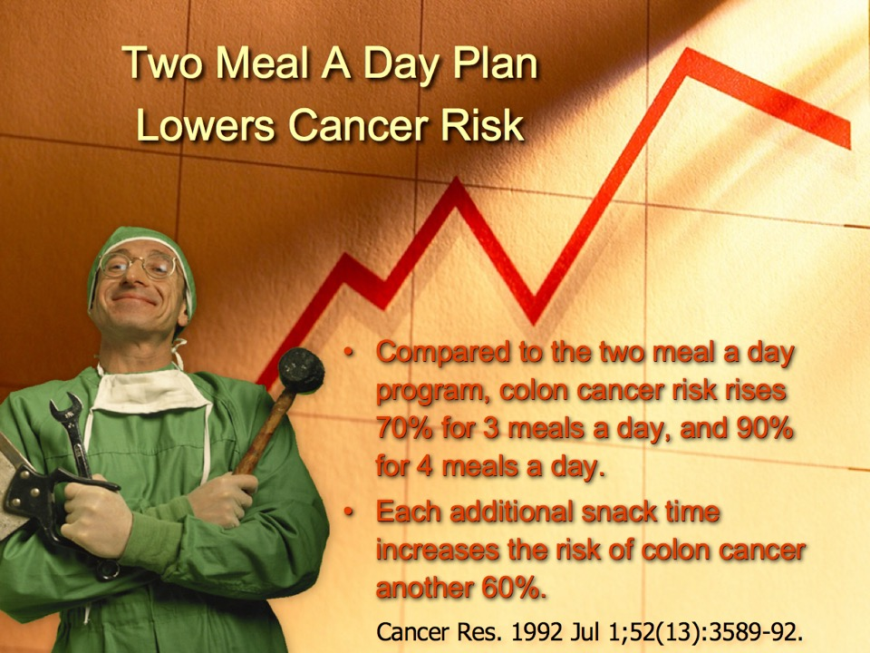

Slide 44

Fresh fruit and vegetables invigorate your immune system to fight cancer.
Fortschr Med. 108(17):338-40.
Notes:
Fortschr Med. 1990 Jun 10;108(17):338-40. Related Articles, Links
[Raw food and immunity]
[Article in German]
Gaisbauer M, Langosch A.
Klinik in der Stanggass, Berchtesgaden.
Uncooked food is an integral component of human nutrition, and is a necessary precondition for an intact immune system. Its therapeutic effect is complex, and a variety of influences of raw food and its constituents on the immune system have been documented. Such effects include antibiotic, anti-allergic, tumor-protective, immunomodulatory, and anti-inflammatory actions. In view of this, uncooked food can be seen as a useful adjunct to drugs in the treatment of allergic, rheumatic and infectious diseases.
Publication Types:
Review
PMID: 2198207 [PubMed - indexed for MEDLINE]
Am J Clin Nutr. 1994 May;59(5 Suppl):1162S-1165S.Links
Micronutrients and cancer risk.
Willett WC.
Department of Epidemiology, Harvard School of Public Health, Boston, MA 02115.
An abundance of epidemiologic evidence, based on numerous and remarkably consistent observations that persons who consume high intakes of fruits and vegetables have reduced risks of most human cancers, supports the concept that micronutrients may play important roles in the prevention of human cancers. Many studies suggest that carotenoid compounds in fruits and vegetables may be important in reducing risk of lung cancer. At least some forms of fiber may contribute to reduced risk of colon cancer, but recent analyses of colonic polyps suggest that folic acid may also play a protective role. Evidence for breast cancer is more limited but protective associations with vitamin A from both carotenoid and preformed sources have been seen in several studies. Although we cannot be certain which compounds are responsible, the evidence is overwhelming that an abundant intake of fruits and vegetables can play an important role in reducing cancer incidence.
PMID: 8172117 [PubMed - indexed for MEDLINE]

Slide 45

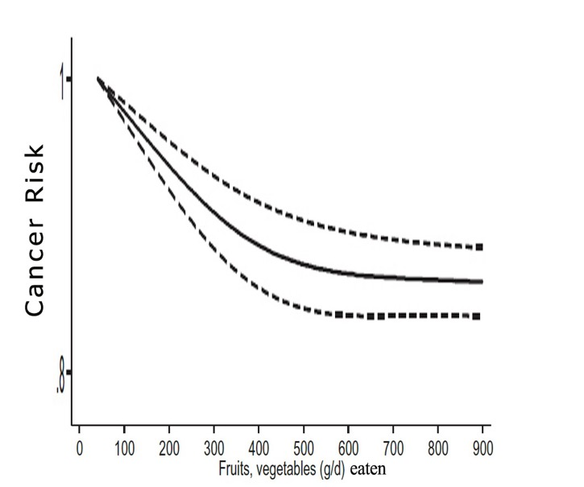
Int J Epidemiol. 2017 Jun 1;46(3):1029-1056.

Slide 46

“Then God said, "I give you every seed-bearing plant on the face of the whole earth and every tree that has fruit with seed in it. They will be yours for food.” “and you will eat the plants of the field.” Genesis 1:29; 3:18 (NIV).

Slide 47

Indoor rat’s cancers grow twice as fast and twice as large as rats living outdoors in fresh air and sunshine.
Environ Health Perspect. 2006 Oct;114(10):1558-66.

Slide 48
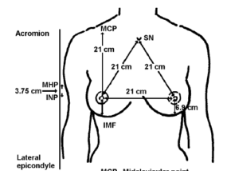

Perfect Health Depends On Perfect Circulation
Sweet spot
“Women who do not wear bras had half the risk of breast cancer compared with bra users."
Bras are for men, not women.
Eur J Cancer. 27(2):131-5.
Notes:
Corsets bound women for centuries, to the point of disease and death. Constriction is not a good thing for circulation. Nevertheless, this fashion of body shaping went on for centuries, despite its toll on women’s health.
Bras are really breast corsets. They shape the breasts, and this requires harmful pressure and compression of the delicate breast tissue.
Hsieh CC, Trichopoulos D. Breast size, handedness and breast cancer risk. Eur J Cancer. 1991;27(2):131-5.
Studies that Support the Bra/Cancer Link:
1991 Harvard study (CC Hsieh, D Trichopoulos (1991). Breast size, handedness and breast cancer risk. European Journal of Cancer and Clinical Oncology 27(2):131-135.). This study found that, “Premenopausal women who do not wear bras had half the risk of breast cancer compared with bra users…”
1991-93 U.S. Bra and Breast Cancer Study by Singer and Grismaijer, published in Dressed To Kill: The Link Between Breast Cancer and Bras (Avery/Penguin Putnam, 1995; ISCD Press, 2005). Found that bra-free women have about the same incidence of breast cancer as men. 24/7 bra wearing increases incidence over 100 times that of a bra-free woman.
Singer and Grismaijer did a follow-up study in Fiji, published in Get It Off! (ISCD Press, 2000). Found 24 case histories of breast cancer in a culture where half the women are bra-free. The women getting breast cancer were all wearing bras. Given women with the same genetics and diet and living in the same village, the ones getting breast disease were the ones wearing bras for work purposes.
A 2009 Chinese study (Zhang AQ, Xia JH, Wang Q, Li WP, Xu J, Chen ZY, Yang JM (2009). [Risk factors of breast cancer in women in Guangdong and the countermeasures]. In Chinese. Nan Fang Yi Ke Da Xue Xue Bao. 2009 Jul;29(7):1451-3.) found that NOT sleeping in a bra was protective against breast cancer, lowering the risk 60%.
2011 a study was published, in Spanish, confirming that bras are causing breast disease and cancer. http://www.portalesmedicos.com/publicaciones/articles/3691/1/Patologias-mamarias-generadas-por-el-uso-sostenido-y-seleccion-incorrecta-del-brassier-en-pacientes-que-acuden-a-la-consulta-de-mastologia- It found that underwired and push-up bras are the most harmful, but any bra that leaves red marks or indentations may cause disease.

Slide 49

Sunlight decreases your mortality from cancer.
Vitamin D is a potent inhibitor of cancer.
Countries with low sunlight incidence have greater bladder cancer, breast cancer, colon-rectum cancer, lung cancer, oesophagus cancer, oral cancer, ovary cancer, pancreas cancer, skin cancer and stomach cancer death rates when compared with sunny countries.
Anticancer Res. 26(4A):2515-24.
Notes:
Anticancer Res. 2006 Jul-Aug;26(4A):2515-24. Related Articles, Links
Vitamin D and cancer.
Spina CS, Tangpricha V, Uskokovic M, Adorinic L, Maehr H, Holick MF.
Vitamin D, Skin and Bone Research Laboratory, Division of Endocrinology, Diabetes and Nutrition, Department of Medicine, Boston University School of Medicine, Boston, MA 02118, USA.
The correlation between decreased morbidity and mortality of cancer and exposure to sunlight is known. The many biological functions of vitamin D that contribute to cancer prevention have only recently begun to be appreciated. Once activated 1,25-dihydroxyvitamin D [1,25(OH)2D3] functions as a potent inhibitor of normal and cancer cellular proliferation. Vitamin D deficiency in mice led to a 60% increase in colon tumor growth, compared to vitamin D-sufficient mice. The ligand binding domain of the Vitamin D receptor was shown to accommodate a class of 1,25(OH)2D3-analogs that possess an additional side-arm. These novel Gemini analogs were evaluated in vitro and in vivo. Select Gemini analogs were 100 times or more effective in inhibiting colon tumor growth in mice, compared to their parent compound. Correcting vitamin D deficiency may decrease the risk of developing colon cancer, while the novel Gemini 1,25(OH)2D3-analogs have the potential for therapeutic application in human colon cancer.
Publication Types:
Review
PMID: 16886659 [PubMed - indexed for MEDLINE]

Slide 50

Night light suppresses your anti-cancer hormone melatonin and increases colorectal and breast cancer.
J Natl Cancer Inst. 93(20):1563-8.
Notes:
Med Hypotheses. 2004;63(4):588-96.
Lighting for the human circadian clock: recent research indicates that lighting has become a public health issue.
Pauley SM.
spauley@cox-internet.com
The hypothesis that the suppression of melatonin (MLT) by exposure to light at night (LAN) may be one reason for the higher rates of breast and colorectal cancers in the developed world deserves more attention. The literature supports raising this subject for awareness as a growing public health issue. Evidence now exists that indirectly links exposures to LAN to human breast and colorectal cancers in shift workers. The hypothesis begs an even larger question: has medical science overlooked the suppression of MLT by LAN as a contributor to the overall incidence of cancer? The indirect linkage of breast cancer to LAN is further supported by laboratory rat experiments by David E. Blask and colleagues. Experiments involved the implanting of human MCF-7 breast cancer cell xenografts into the groins of rats and measurements were made of cancer cell growth rates, the uptake of linoleic acid (LA), and MLT levels. One group of implanted rats were placed in light-dark (12L:12D) and a second group in light-light (12L:12L) environments. Constant light suppressed MLT, increased cancer cell growth rates, and increased LA uptake into cancer cells. The opposite was seen in the light-dark group. The proposed mechanism is the suppression of nocturnal MLT by exposure to LAN and subsequent lack of protection by MLT on cancer cell receptor sites which allows the uptake of LA which in turn enhances the growth of cancer cells. MLT is a protective, oncostatic hormone and strong antioxidant having evolved in all plants and animals over the millennia. In vertebrates, MLT is normally produced by the pineal gland during the early morning hours of darkness, even in nocturnal animals, and is suppressed by exposure to LAN. Daily entrainment of the human circadian clock is important for good human health. These studies suggest that the proper use and color of indoor and outdoor lighting is important to the health of both humans and ecosystems. Lighting fixtures should be designed to minimize interference with normal circadian rhythms in plants and animals. New discoveries on blue-light-sensitive retinal ganglion cell light receptors that control the circadian clock and how those receptors relate to today's modern high intensity discharge (HID) lamps are discussed. There is a brief discussion of circadian rhythms and light pollution. With the precautionary principle in mind, practical suggestions are offered for better indoor and outdoor lighting practices designed to safeguard human health. Copyright 2004 Elsevier Ltd.
PMID: 15325001 [PubMed - indexed for MEDLINE]
J Natl Cancer Inst. 2001 Oct 17;93(20):1563-8. Related Articles, Links
Rotating night shifts and risk of breast cancer in women participating in the nurses' health study.
Schernhammer ES, Laden F, Speizer FE, Willett WC, Hunter DJ, Kawachi I, Colditz GA.
E. S. Schernhammer, Channing Laboratory, Department of Medicine, Brigham and Women's Hospital and Harvard Medical School, Boston, MA 02115, USA. eva.schernhammer@channing.harvard.edu
BACKGROUND: Melatonin shows potential oncostatic action, and light exposure during night suppresses melatonin production. There is little information, however, about the direct effect of night work on the risk of cancer. We investigated the effect of night work in breast cancer. METHODS: We examined the relationship between breast cancer and working on rotating night shifts during 10 years of follow-up in 78 562 women from the Nurses' Health Study. Information was ascertained in 1988 about the total number of years during which the nurses had worked rotating night shifts with at least three nights per month. From June 1988 through May 1998, we documented 2441 incident breast cancer cases. Logistic regression models were used to calculate relative risks (RRs) and 95% confidence intervals (CIs), adjusted for confounding variables and breast cancer risk factors. All statistical tests were two-sided. RESULTS: We observed a moderate increase in breast cancer risk among the women who worked 1-14 years or 15-29 years on rotating night shifts (multivariate adjusted RR = 1.08 [95% CI = 0.99 to 1.18] and RR = 1.08 [95% CI = 0.90 to 1.30], respectively). The risk was further increased among women who worked 30 or more years on the night shift (RR = 1.36; 95% CI = 1.04 to 1.78). The test for trend was statistically significant (P =.02). CONCLUSIONS: Women who work on rotating night shifts with at least three nights per month, in addition to days and evenings in that month, appear to have a moderately increased risk of breast cancer after extended periods of working rotating night shifts.
PMID: 11604480 [PubMed - indexed for MEDLINE]
J Natl Cancer Inst. 2005 Jul 20;97(14):1084-7. Related Articles, Links
Urinary melatonin levels and breast cancer risk.
Schernhammer ES, Hankinson SE.
Department of Medicine, Brigham and Women's Hospital, Harvard Medical School, Boston, MA, USA. eva.schernhammer@channing.harvard.edu
Exposure to light at night suppresses melatonin production, and night-shift work (a surrogate for such exposure) has been associated with an increased risk of breast cancer. However, the association between circulating melatonin levels and breast cancer risk is unclear. In a prospective case-control study nested within the Nurses' Health Study II cohort, we measured the concentration of the major melatonin metabolite, 6-sulphatoxymelatonin (aMT6s), in the first morning urine of 147 women with invasive breast cancer and 291 matched control subjects. In logistic regression models, the relative risk (reported as the odds ratio [OR]) of invasive breast cancer for women in the highest quartile of urinary aMT6s compared with those in the lowest was 0.59 (95% confidence interval [CI] = 0.36 to 0.97). This association was essentially unchanged after adjustment for breast cancer risk factors or plasma sex hormone levels but was slightly weakened when the analysis included 43 case patients with in situ breast cancer and their 85 matched control subjects (OR = 0.70, 95% CI = 0.47 to 1.06). The exclusion of women who had a history of night-shift work left our findings largely unchanged. These prospective data support the hypothesis that higher melatonin levels, as measured in first morning urine, are associated with a lower risk of breast cancer.
PMID: 16030307 [PubMed - indexed for MEDLINE]

Slide 51

Mold exposure in water-damaged buildings initiates inflammatory processes and reduces your cancer fighting natural killer cells.
J Environ Pub Health, Article ID 312836
Notes:
J Environ Public Health. 2012;2012:312836. doi: 10.1155/2012/312836. Epub 2011 Dec 15.
A water-damaged home and health of occupants: a case study.
Thrasher JD, Gray MR, Kilburn KH, Dennis DP, Yu A.
Arch Environ Health. 2003 Jul;58(7):410-20. Related Articles, Links
Mixed mold mycotoxicosis: immunological changes in humans following exposure in water-damaged buildings.
Gray MR, Thrasher JD, Crago R, Madison RA, Arnold L, Campbell AW, Vojdani A.
Progressive Healthcare Group, Benson, Arizona, USA. docmike007@aol.com
The study described was part of a larger multicenter investigation of patients with multiple health complaints attributable to confirmed exposure to mixed-molds infestation in water-damaged buildings. The authors present data on symptoms; clinical chemistries; abnormalities in pulmonary function; alterations in T, B, and natural killer (NK) cells; the presence of autoantibodies (i.e., antinuclear autoantibodies [ANA], autoantibodies against smooth muscle [ASM], and autoantibodies against central nervous system [CNS] and peripheral nervous system [PNS] myelins). A total of 209 adults, 42.7 +/- 16 yr of age (mean +/- standard deviation), were examined and tested with (a) self-administered weighted health history and symptom questionnaires; (b) standardized physical examinations; (c) complete blood counts and blood and urine chemistries; (d) urine and fecal cultures; (e) thyroid function tests (T4, free T3); (f) pulmonary function tests (forced vital capacity [FVC], forced expiratory volume in 1 sec [FEV1.0], and forced expiratory flow at 25%, 50%, 75%, and 25-75% of FVC [FEF25, FEF50, FEF75, and FEF2(25-75)]); (g) peripheral lymphocyte phenotypes (T, B, and NK cells) and mitogenesis determinations; and (h) a 13-item autoimmune panel. The molds-exposed patients reported a greater frequency and intensity of symptoms, particularly neurological and inflammatory symptoms, when compared with controls. The percentages of exposed individuals with increased lymphocyte phenotypes were: B cells (CD20+), 75.6%; CD5+CD25+, 68.9%; CD3+CD26+, 91.2%; CD8+HLR-DR+, 62%; and CD8+CD38+, 56.6%; whereas other phenotypes were decreased: CD8+CD11b+, 15.6% and CD3-CD16+CD56+, 38.5%. Mitogenesis to phytohemagglutinin was decreased in 26.2% of the exposed patients, but only 5.9% had decreased response to concanavalin A. Abnormally high levels of ANA, ASM, and CNS myelin (immunoglobulins [Ig]G, IgM, IgA) and PNS myelin (IgG, IgM, IgA) were found; odds ratios for each were significant at 95% confidence intervals, showing an increased risk for autoimmunity. The authors conclude that exposure to mixed molds and their associated mycotoxins in water-damaged buildings leads to multiple health problems involving the CNS and the immune system, in addition to pulmonary effects and allergies. Mold exposure also initiates inflammatory processes. The authors propose the term "mixed mold mycotoxicosis" for the multisystem illness observed in these patients.
Publication Types:
Clinical Trial
Controlled Clinical Trial
Multicenter Study
PMID: 15143854 [PubMed - indexed for MEDLINE]
Eur Respir J. 1996 Dec;9(12):2618-22. Related Articles, Links
Home dampness, moulds and their influence on respiratory infections and symptoms in adults in Finland.
Pirhonen I, Nevalainen A, Husman T, Pekkanen J.
Dept of Environmental Epidemiology, National Public Health Institute, Kuopio, Finland.
The aim of this study was to analyse the prevalence of mouldy homes and their association with respiratory symptoms and diseases in a subarctic climate. A questionnaire was mailed to a random sample of 2,000 males and females, aged 25-64 yrs, living in the county of Kuopio, Finland. A total of 1,521 (76%) responded and 1,460 were selected for the final analysis. The prevalence of homes with visible mould was 4%; with the odour of mould 5%; with damp spots, visible mould or the odour of mould 15%; and with moisture/ water damage, damp spots, visible mould or the odour of mould 23%. The number of reports of bronchitis, common cold, atopy, allergic rhinitis, rhinitis, fever and chills, hoarseness, fatigue, difficulties in concentration, lumbar backache and stomach ache were strongly associated with living in a damp home. Bronchitis, hoarseness and difficulties in concentration had the strongest associations, with adjusted odds ratios (95% confidence limits) of: 2.04 (1.49-2.78), 2.23 (1.37-3.63) and 2.17 (1.35-3.50), respectively. After controlling for a possible reporting bias by excluding those subjects reporting lumbar backache and recurrent stomach pain, eye irritation and tiredness remained significant. In conclusion, living in a home with mould problems may increase the risk of respiratory infections and symptoms in adults.
PMID: 8980978 [PubMed - indexed for MEDLINE]

Slide 52

Fermentation
Alcoholic beverages
Vinegar
Cheese
Sour cream
Yogurt
Soy sauce
Sauerkraut
Salami
Chocolate
Vanilla
Brown rice syrup
Nutritional yeast

Slide 53

Fermented Dinner Anyone?
Eating your food fermented increases Cancer risk by 58%.
Cancer Sci. 102(1):231-44.
Notes:
Kim J, Kang M, Lee JS, Inoue M, Sasazuki S, Tsugane S. Fermented and non-fermented soy food consumption and gastric cancer in Japanese and Korean populations: a meta-analysis of observational studies. Cancer Sci. 2011 Jan;102(1):231-44. doi: 10.1111/j.1349-7006.2010.01770.x. Epub 2010 Nov 10. PMID: 21070479.

Slide 54


Workers at plastic factories, making your food containers, have 5x the risk of pancreatic and liver cancer.
Environ Health Perspect. 17:167-70.
Notes:
Environ Health Perspect. 1976 Oct;17:167-70.
Mortality and cancer morbidity in a group of Swedish VCM and PCV production workers.
Byren D, Engholm G, Englund A, Westerholm P.
The cohort of workers employed in a Swedish vinyl chloride/poly(vinyl chloride) plant since its start in the early 1940's has been followed for mortality and cancer morbidity patterns. Only 21 of the 771 persons could not be traced. Difficulties in establishing exposure levels at different work areas in the past makes an evaluation of dose-effect relationships impossible. A four- to fivefold excess of pancreas/liver tumors was found, including two cases later classified as angiosarcomas of the liver. The number of brain tumors and suicide do not deviate significantly from expected. Cardiovascular and cerebrovascular diseases, on the other hand, differ significantly from the expected. The discrepancies between previous reports on VCM/PVC workers and this report are discussed. The possible etiology of the cardiovascular deaths is also discussed.
PMID: 1026402 [PubMed - indexed for MEDLINE]

Slide 55
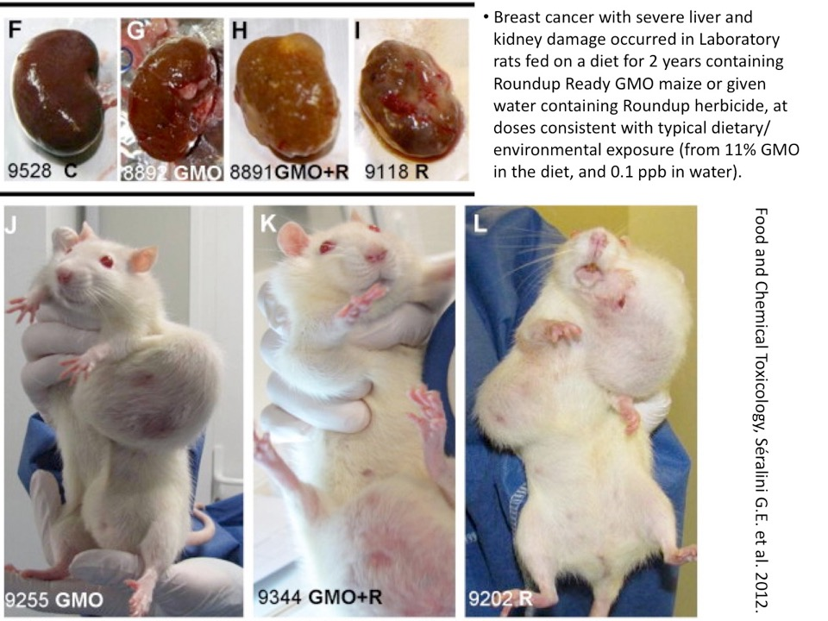

Slide 56

Drinking pure water, exercising, and taking saunas expels carcinogenic toxins from your body.
Med Hypotheses. 2006 Oct 11;
Notes:
Med Hypotheses. 2006 Oct 11; [Epub ahead of print] Related Articles, Links
Drug residues store in the body following cessation of use: Impacts on neuroendocrine balance and behavior - Use of the Hubbard sauna regimen to remove toxins and restore health.
Cecchini M, Lopresti V.
Foundation for Advancements in Science and Education, 4801 Wilshire Boulevard, Suite 215, Los Angeles, CA 90010, USA.
For decades, scientists have investigated the environmental and human health effects of synthetic chemicals. A growing body of research has illuminated the spectrum of consequences deriving from our reliance these substances and their proliferation in air, water, soil and the food chain. Of particular concern is the fact that residues of many man-made chemicals are now detectible in virtually every person. A key to a chemical's tendency to persist in tissues once it has entered the body is its lipophilicity. Substances that are poorly soluble in water and quite soluble in fat have relatively free access, via lipid-rich cellular membranes, to the cells of all organs including the ability to cross the blood-brain and placental barriers. Substantial data exist demonstrating that in addition to pollutants, drugs and their metabolites dispose to tissues high in fat content, including brain and adipose. While their characteristic lipophilicity permits drugs and medications to reach target tissues, thereby producing therapeutic effects in the present, current perceptions of risk may be ignoring the possibility that adipose accumulations of illicit drugs and pharmaceuticals may lead to future patterns of ill health similar to those associated with exposure to other categories of xenobiotic chemicals. Empirical data are beginning to characterize the myriad regulatory functions of adipose hormones, including roles in cravings, cognitive function, energy level, and inflammation as well as changes in adipose hormone levels associated with drug use. Included in this data are the observation that a rehabilitative treatment intervention introduced by L. Ron Hubbard in 1978 to aid in the broad elimination of chemicals from body stores improves symptoms common to both chemical exposure and drug addiction. The regimen, which includes exercise, sauna bathing, and vitamin and mineral supplementation, is utilized by nearly 70 drug rehabilitation and medical practices in over 20 countries. At present, much more is unknown than is known regarding long-term drug retention and effects. This subject deserves careful evaluation given its potential implications for health and chronic illnesses of poorly defined etiology (such as chronic fatigue syndrome), as well as drug abuse prevention, drug rehabilitation, forensic and legal areas.
PMID: 17045758 [PubMed - as supplied by publisher]

Slide 57

Cancers in your brain and ear can occur with radiation from your mobile phone.
5G
Int J Oncol. 22(2):399-407.
Notes:
5G is predicted to be particularly dangerous for each of four different reasons:
1. The extraordinarily high numbers of antennae that are planned.
2. The very high energy outputs which will be used to ensure penetration.
3. The extraordinarily high pulsation levels.
4. The apparent high level interactions of the 5G frequency on charged groups presumably including the voltage sensor charged groups.
Int J Oncol. 2003 Feb;22(2):399-407. Related Articles, Links
Further aspects on cellular and cordless telephones and brain tumours.
Hardell L, Mild KH, Carlberg M.
Department of Oncology, University Hospital, S-701 85 Orebro, Sweden. lennart.hardell@orebroll.se
We included in a case-control study on brain tumours and mobile and cordless telephones 1,617 patients aged 20-80 years of both sexes diagnosed during January 1, 1997 to June 30, 2000. They were alive at the study time and had histopathology verified brain tumour. One matched control to each case was selected from the Swedish Population Register. The study area was the Uppsala-Orebro, Stockholm, Linkoping and Goteborg medical regions of Sweden. Exposure was assessed by a questionnaire that was answered by 1,429 (88%) cases and 1,470 (91%) controls. In total use of analogue cellular telephones gave an increased risk with odds ratio (OR)=1.3, 95% confidence interval (CI)=1.04-1.6, whereas digital and cordless phones did not overall increase the risk significantly. Ipsilateral use of analogue phones gave OR=1.7, 95% CI=1.2-2.3, digital phones OR=1.3, 95% CI=1.02-1.8 and cordless phones OR=1.2, 95% CI=0.9-1.6. The risk for ipsilateral use was significantly increased for astrocytoma for all studied phone types, analogue phones OR=1.8,95% CI=1.1-3.2, digital phones OR=1.8, 95% CI=1.1-2.8, cordless phones OR=1.8, 95% CI=1.1-2.9. Use of a telephone on the opposite side of the brain was not associated with a significantly increased risk for brain tumours. Regarding anatomical area of the tumour and exposure to microwaves, the risk was increased for tumours located in the temporal area on the same side of the brain that was used during phone calls, significantly so for analogue cellular telephones OR=2.3, 95% CI=1.2-4.1. For acoustic neurinoma OR=4.4, 95% CI=2.1-9.2 was calculated among analogue cellular telephone users. When duration of use was analysed as a continuous variable in the total material, the risk increased per year for analogue phones with OR=1.04, 95% CI=1.01-1.08. For astrocytoma and ipsilateral use the trend was for analogue phones OR=1.10, 95% CI=1.02-1.19, digital phones OR=1.11, 95% CI=1.01-1.22, and cordless phones OR=1.09, 95% CI=1.01-1.19. There was a tendency of a shorter tumour induction period for ipsilateral exposure to microwaves than for contralateral, which may indicate a tumour promotor effect.
PMID: 12527940 [PubMed - indexed for MEDLINE]

Slide 58

Cancer risk increases 9% each hour per day you spend in front of the TV.
Circulation. 121(3):384-91.

Slide 59

Cancer death rates increase by 40% in people with stress from poor interpersonal skills.
“Peace of mind makes the body healthy, but jealousy is like a cancer.”
Proverbs 14:30 {TEV}.
Br J Med Psychol. 61 ( Pt 1):57-75.
Notes:
Br J Med Psychol. 1988 Mar;61 ( Pt 1):57-75. Related Articles, Links
Personality, stress and cancer: prediction and prophylaxis.
Eysenck HJ.
Institute of Psychiatry, University of London, Denmark Hill, UK.
This paper reports results from three prospective studies, in which probands were followed over periods of 10 years, before inquiring about death and cause of death. Personality inventories were administered at the beginning of the 10 year period, as were questions concerning smoking, drinking, medical diseases, etc. It was found that personality variables were much more predictive of death from cancer or cardiovascular disease than was smoking, and that different personality types were susceptible to either of these two diseases. Personality type was defined in terms of differential ways of dealing with interpersonal stress, and it was found that stress was a very potent cause of death, in the sense that stressed probands had a 40 per cent higher death rate than non-stressed probands.
Publication Types:
Review
PMID: 3282538 [PubMed - indexed for MEDLINE]
Am J Epidemiol. 2003 Mar 1;157(5):415-23. Related Articles, Links
Stressful life events and risk of breast cancer in 10,808 women: a cohort study.
Lillberg K, Verkasalo PK, Kaprio J, Teppo L, Helenius H, Koskenvuo M.
Department of Public Health, University of Helsinki, Helsinki, Finland. kirsi.lillberg@fimnet.fi
The authors prospectively investigated the relation between stressful life events and risk of breast cancer among 10,808 women from the Finnish Twin Cohort. Life events and breast cancer risk factors were assessed by self-administered questionnaire in 1981. A national modification of a standardized life event inventory was used, examining accumulation of life events and individual life events and placing emphasis on the 5 years preceding completion of the questionnaire. Through record linkage with the Finnish Cancer Registry, 180 incident cases of breast cancer were identified in the cohort between 1982 and 1996. The multivariable adjusted hazard ratio for breast cancer per one-event increase in the total number of life events was 1.07 (95% confidence interval (CI): 1.00, 1.15). This risk estimate rose to 1.35 (95% CI: 1.09, 1.67) when only major life events were taken into account. Independently of total life events, divorce/separation (hazard ratio (HR) = 2.26, 95% CI: 1.25, 4.07), death of a husband (HR = 2.00, 95% CI: 1.03, 3.88), and death of a close relative or friend (HR = 1.36, 95% CI: 1.00, 1.86) were all associated with increased risk of breast cancer. The findings suggest a role for life events in breast cancer etiology through hormonal or other mechanisms.
Publication Types:
Research Support, Non-U.S. Gov't
Twin Study
PMID: 12615606 [PubMed - indexed for MEDLINE]

Slide 60

Good spiritual health increases life expectancy, decreases anxiety and depression, and boosts your immune system to fight cancer.
Miller CA, Nursing for Wellness in Older Adults: Theory and Practice, 4th ed. P. 148.

Slide 61

Stress Release
Come unto me, all ye that labour and are heavy laden, and I will give you rest. Matthew 11:28

Slide 62


An attitude of gratitude significantly improves long term breast cancer survival.
Cancer Nurs. 16(5):354-61.
Notes:
Cancer Nurs. 1993 Oct;16(5):354-61.
Long-term survivors of breast cancer. A qualitative descriptive study.
Carter BJ.
University of California, San Francisco.
The purpose of this study was to explore the daily lived experience of women who have survived breast cancer beyond 5 years without recurrence. A qualitative descriptive approach was used to collect and analyze the stories of 25 women, 40-78 years of age, with 5-26 years of survival time. Informants participated in three interviews that were transcribed and analyzed. Informants described "going through" a survival process that involved movement through several phases. The phases included interpreting the diagnosis, confronting mortality, reprioritizing, coming to terms, moving on, and flashing back. Phases were interpreted within the context of informants' backgrounds, sources of meaning, and explanatory models of understanding illness. Many informants described the emergence of a more authentic self as a result of the cancer experience. Many informants emerged from the cancer experience with a clearer sense of self, gratitude for life, and strength and confidence in their ability to manage life crises. Findings suggest that care might best be provided by understanding the context of each person's life.
PMID: 8261383 [PubMed - indexed for MEDLINE]

Slide 63

Being helpful and supportive to your friends, neighbors, relatives and spouse significantly improves your survival odds.
Just receiving support adds no benefit.
“It is more blessed to give
than to receive.” Acts 20:35.
Psychol Sci. 14(4):320-7.

Slide 64

And I saw a new heaven and a new earth: for the first heaven and the first earth were passed away; and there was no more sea. And God shall wipe away all tears from their eyes; and there shall be no more death, neither sorrow, nor crying, neither shall there be any more pain: for the former things are passed away. Revelation 21:1,4

Slide 65

Doing It Well!
Take advantage of all the benefits in foods as grown.

Slide 66
Doing It Well!
Avoid animal products high in protein, fat, viruses, toxins and growth hormones.

Slide 67
Doing It Well!
Avoid foods and substances that damage DNA and suppress the immune system; like sugar, animal products, tobacco, alcohol, caffeine, heavy metals and pesticides.

Slide 68
Doing It Well!
Choose a lifestyle and diet which expels toxins from your body, invigorates your immune system and keeps you at peak physical, mental and spiritual performance.

Slide 69
Doing It Well!
Exercise in the open air and sunshine.

Slide 70
Doing It Well!
Drink plenty of pure water.

Slide 71
Doing It Well!
Rest in bed at night and in the love and providence of God.

Slide 72
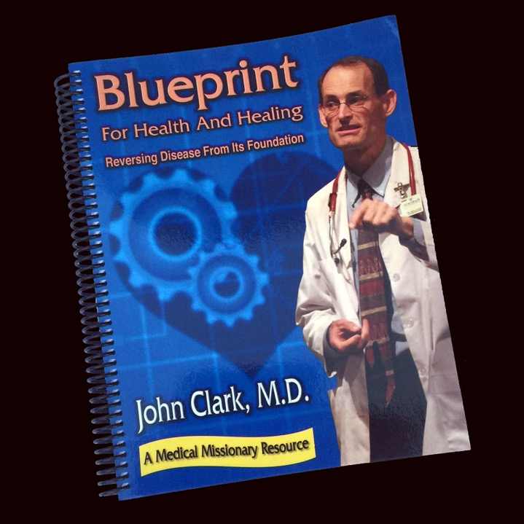
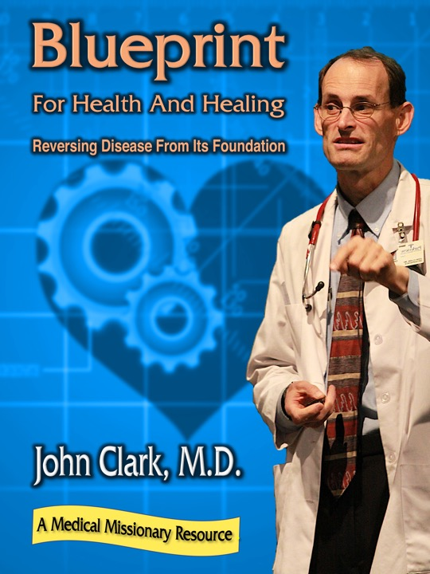

Slide 73

NorthernLightsHealthEducation.com

Slide 74
Cancer:
Is There Hope?
Notes:
Since the year 1900 cancer cases have skyrocketed anywhere from 6 to 10 times! How have we come so far? What has changed? We all know someone with cancer. Everyone fears the “big C” diagnosis. And nobody gets excited about the treatments, chemotherapy, radiation, and cancer surgery. In my presentation, “Cancer: Is There Hope?” you will learn the causes, prevention and some natural remedies for this dreaded disease. Start planning a bright cancer free future today.
Story: Since the year 1900 cancer rates have skyrocketed anywhere from 6 to 10 times!
How have we come so far.
We all know someone....
fear big C diagnosis
Benefit/problem solved
chemo, radiation, surgery
Bullet points
Ounce of prevention
Inspire
“Cancer: Is There Hope?”
Call to action
Come learn the the causes, prevention, and natural remedies of this dreaded disease. Start planning for a bright cancer free future starting today.

