Slide 1

Back and Neck Pain
Lifting the Burden
Notes:
fixed

Slide 2

Back and Neck Pain
Lifting the Burden
Notes:
Hi John
Just wanted to give you some feedback on my neighbour Jade who contacted you a week or so ago with help for her back pain. When she got your reply she texted me to tell me that she was going to start the "Bible diet" that very day, and follow your recommendations of walking, water and Vit C. I messaged her yesterday to see how she was going and this was her reply:
"I'm feeling so much better!!! I could feel an improvement after one day and have continued to get better each day. Hopefully after another week I should be all good."
I find it amazing that I have shared your details with a number of church members who have ongoing health problems and yet, to my knowledge, none of them have followed up. But here is a "Gentile" who embraced God's natural healing methods right from the start and has followed them diligently and has experienced His healing power. Truly the world is ready to hear this message of healing!!
Just praising God for His healing power and for raising up your ministry to help people physically and for using the health message as an entering wedge into the heart! I'm now praying for more opportunities to share the health message with Jade and eventually the 3 Angels Messages. As Jade and I were messaging each other last week, one of the things she said was: "I love that the Bible says to eat only plants!" She and her husband and 2 young children are already plant-based eaters so she was astounded to realise that this was the diet recommended by the Bible! Praise the Lord.
I know you'll keep this feedback to yourself as Jade may get back in touch with you to thank you. But I just wanted you to know so that you may be encouraged.
God bless you John and Julie and Connor also!
Jo

Slide 3
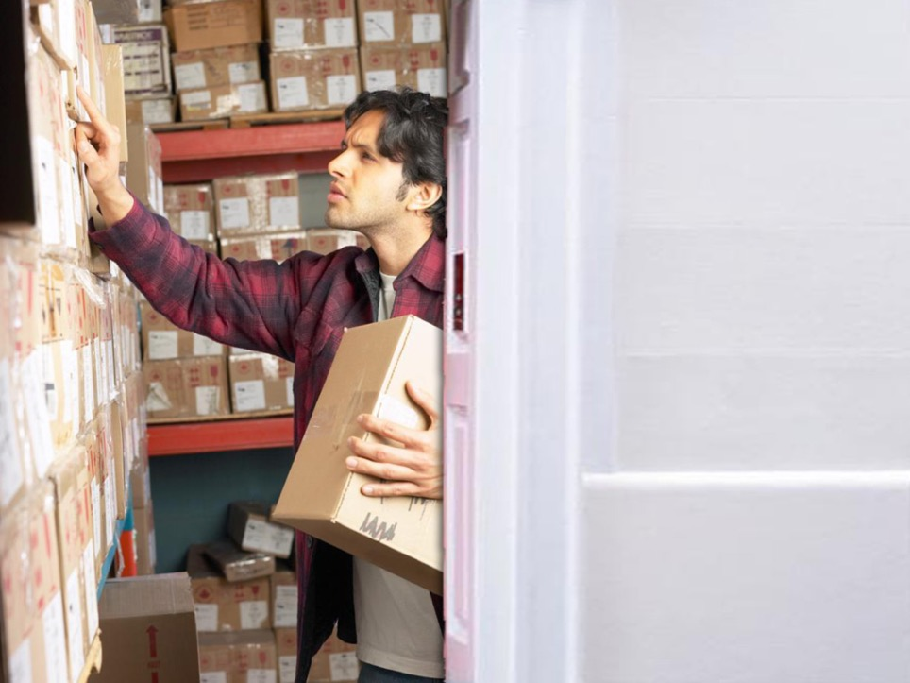
Notes:
George

Slide 4
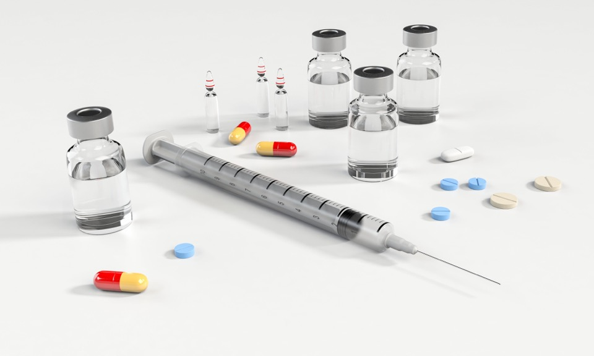
Back health without drugs, injections or surgery

Slide 5

Notes:
INTRO: Hi, I’m Dr. John Clark, I specialize in Lifestyle medicine. Lifestyle medicine maximizes your health above the probability of disease.
I have now spent over 14 years now researching and teaching people how to overcome high blood pressure and other lifestyle diseases.

Slide 6

Back pain responds best to simple lifestyle improvements.
Stories

Slide 7
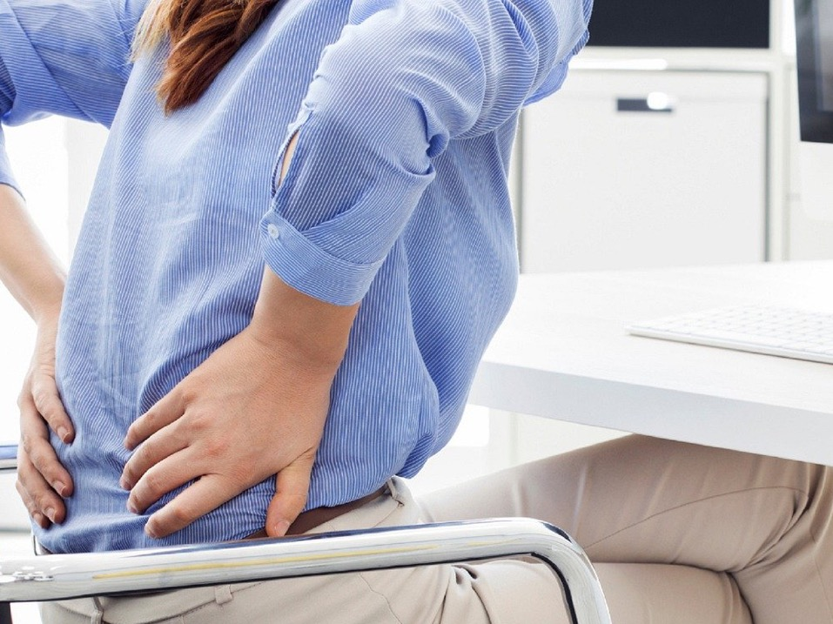
Overview:
Spine physiology.
Good hydration.
Impact of Obesity.
The food we eat.
Exercise and stretching.
Mind—body connection.

Slide 8
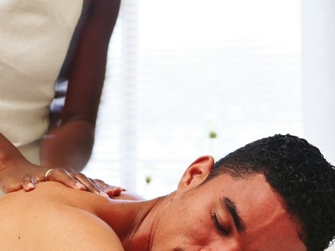
Epidemiology of Low Back Pain
29% of the US population report experiencing lower back 2019.
Worldwide, years lived with disability caused by LBP have increased by 54% between 1990 and 2015.
Notes:
5CDC
https://www.practicalpainmanagement.com/patient/conditions/low-back-pain/about-back-spine-neck-shoulder-pain-statistics

Slide 9

Low back pain is the leading cause of disability worldwide, affecting an estimated 540 million people at any one time.
60-80% of population will have lower back pain at some time in their lives.
15-20% will have back pain each year.
Notes:
https://www.sciencedaily.com/releases/2018/03/180321130901.htm

Slide 10

RISK FACTORS
Driving,
Sedentary occupation,
Vibration,
Smoking,
Previous full-term pregnancy,
Physical inactivity,
Increased body mass,
Tall stature.

Slide 11
Specific work-related factors that may predict chronicity
Job dissatisfaction
Conflict with supervisors or coworkers
High physical demands
Inability to modify work
High levels of job stress
Disputed or unresolved workers' compensation claim

Slide 12


Causes of Low Back Pain
Lumbar “strain” or “sprain” – 70%.
Degenerative changes – 10%.
Herniated disk – 4%.
Osteoporosis fractures – 4%.
Spinal stenosis – 3%.
Spondylolisthesis – 2%.

Slide 13
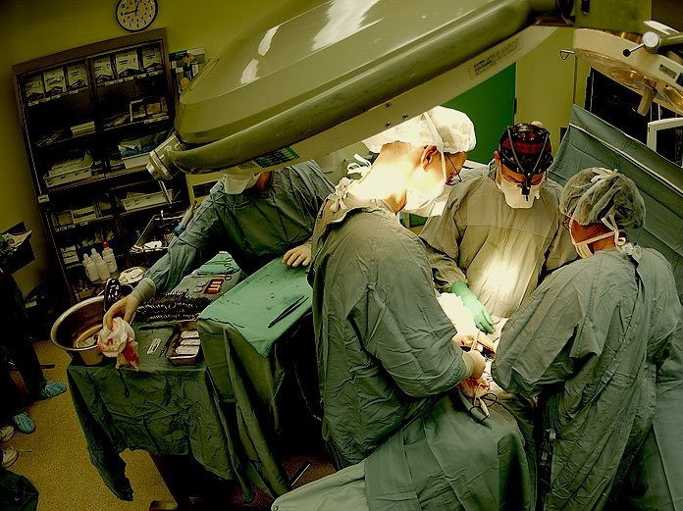
SURGICAL
Indications:
  Loss of bowel or bladder control.
  Progressive motor loss.
  Uncontrollable pain.

Slide 14
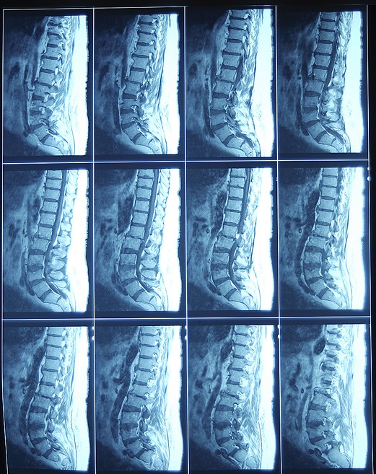
2 Years No Difference.

Slide 15
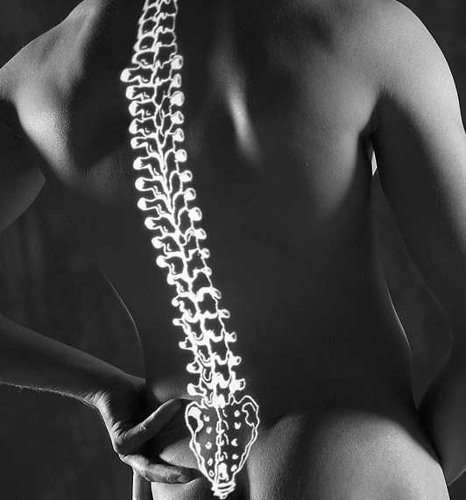
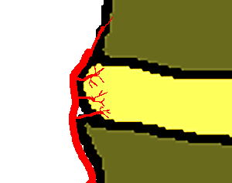
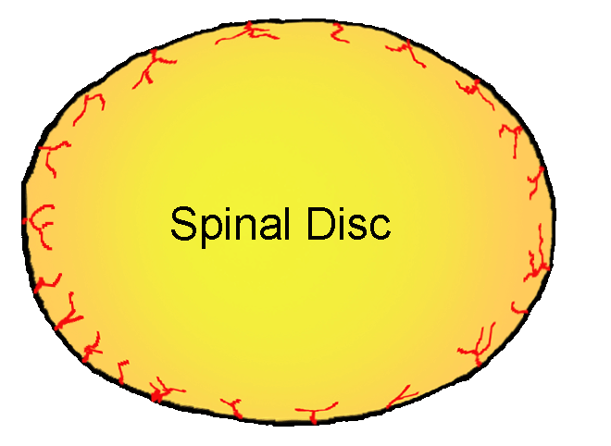
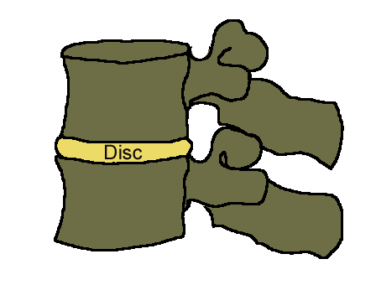
Why?
Back Physiology

Slide 16


Perfusion.
Elimination.

Slide 17
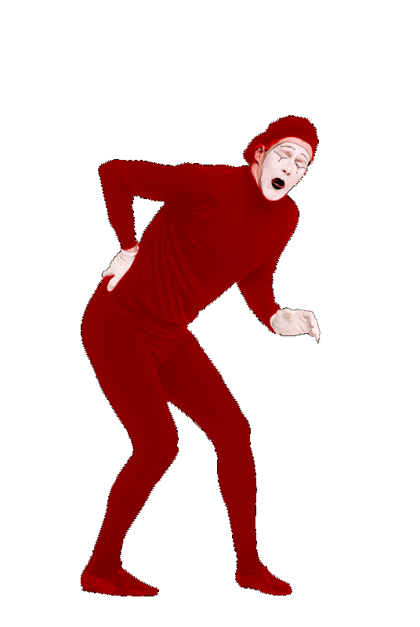
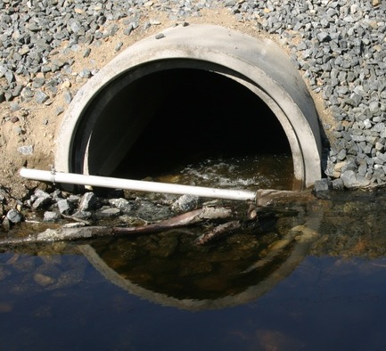
Plugged Pipes
Plaque.

Slide 18
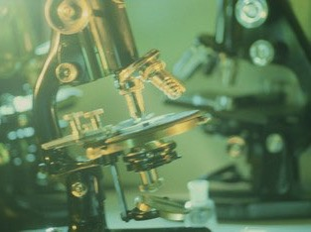
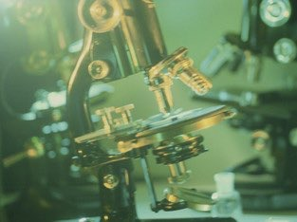
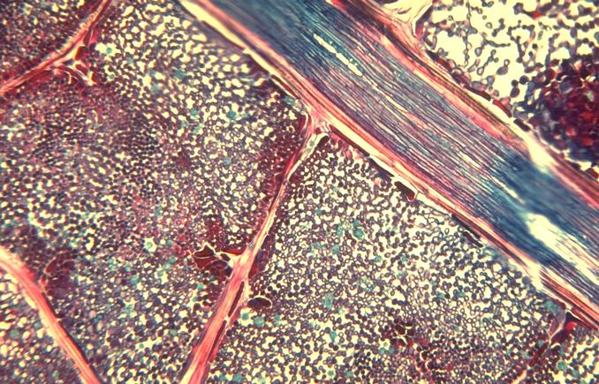
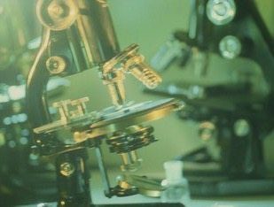
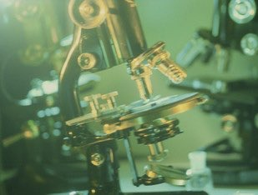
Plugged Pipes
Inflammation.

Slide 19

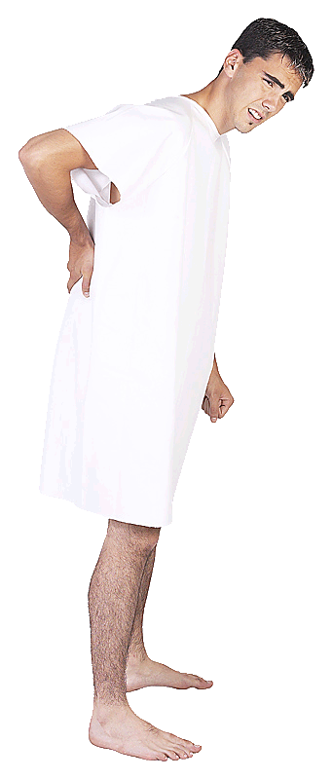
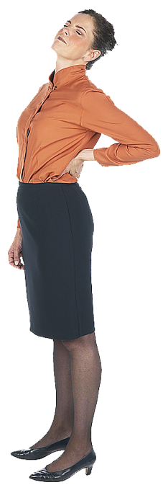
Waking up
  2 – 12 oz glasses of water upon rising.
Breakfast
  Oatmeal (no added oil or sugar), Fresh Fruit.
  Vitamin C 500 mg
Walk for 10 minutes after meal.
2 glasses of water mid morning.
Lunch
  Vegetables
  Raw preferred (no oil or excess salt)
  Vitamin C 500 mg
Walk for 10 minutes after meal.
2 glasses of water mid afternoon.
Supper
  Raw fruit
  At least 3 hour before bedtime
  Vitamin C 500 mg.
Walk for 10 minutes after meal.
2 glasses of water 2 hours after supper.
Bedtime
No coffee, tea, sodas, alcohol, tobacco, and no eating between meals.
Drink ice water for hunger between meals.
Low Back Pain Prescription
George

Slide 20

Nature of the Cure

Slide 21
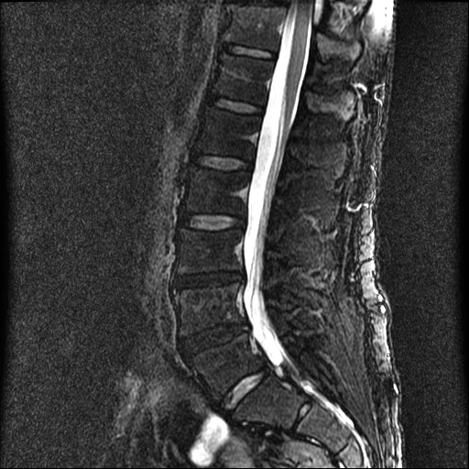
Dehydration
Normal Disc
Dry Discs

Slide 22
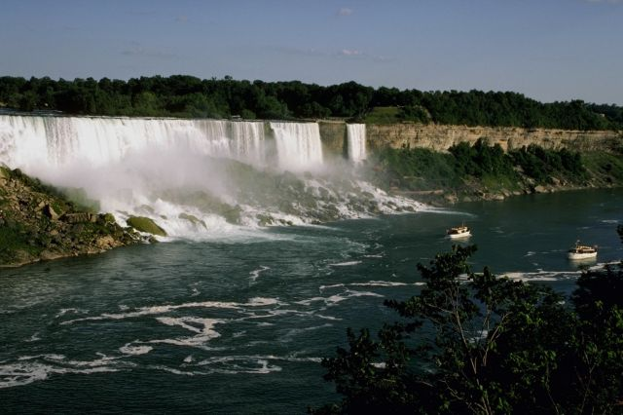


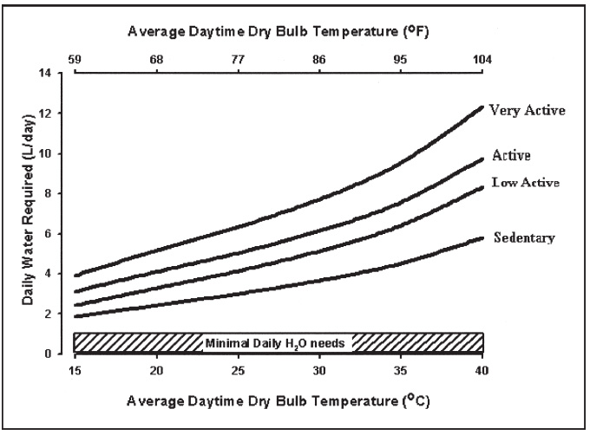
How Much Water?
3.7 L
2.7 L
Nutr Rev. 2005 Jun;63(6 Pt 2):S30-9.

Slide 23
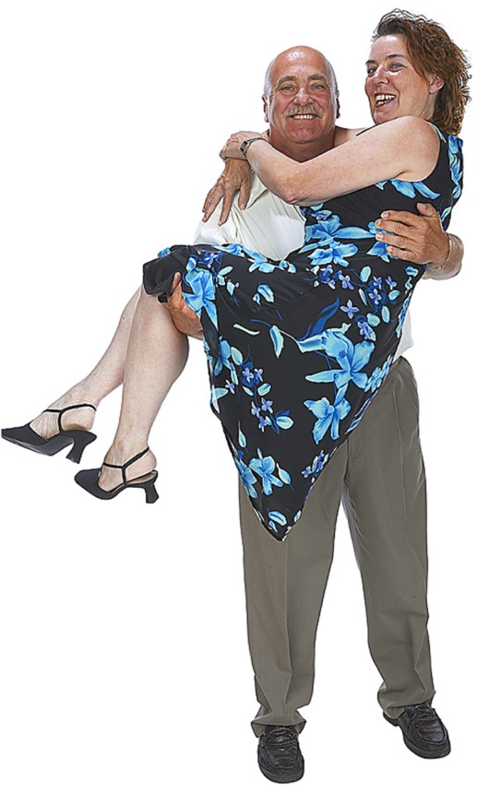
Obesity and Back Pain
Excess weight puts increased pressure on the discs, flattening them.
Overloaded, flattened discs take longer to rejuvenate.
Obese people have a higher incidence of back pain.
Clin Biomech (Bristol, Avon). 2005 Oct;20(8):799-805.
Notes:
Adipose tissue releases inflammatory mediators that contribute to the development of chronic, low-grade inflammation in obesity, which may accelerate the development of sciatica or cause sciatica symptoms to persist. Obesity may delay disk injury healing and lead to slower and less overall improvement in back-related disability, regardless of treatment modality. Obesity also increases the risk of recurrent disk herniation following lumbar surgical repair. Intervertebral disk nutrition may be disrupted by obesity, impairing the healing process. Long-term data have found BMI to be the strongest predictor of lumbar artery occlusion in patients with sciatica, suggesting impairment of nutrition as a pathway for the relationship between obesity and sciatica.
30. Rihn JA, Kurd M, Hilibrand AS, et al. The influence of obesity on the outcome of treatment of lumbar disc herniation: analysis of the Spine Patient Outcomes Research Trial (SPORT). J Bone Joint Surg Am. 2013;95(1):1-8.
31. Karppinen J, Kurunlahti M, Taimela S, Haapea M, Vanharanta H, Tervonen O. Determinants of lumbar artery occlusion among patients with sciatica: a three-year follow-up with magnetic resonance angiography. Eur Spine J. 2005;14(7):664-670.
32. Meredith DS, Huang RC, Nguyen J, Lyman S. Obesity increases the risk of recurrent herniated nucleus pulposus after lumbar microdiscectomy. Spine J. 2010;10(7):575-580.
Clin Biomech (Bristol, Avon). 2005 Oct;20(8):799-805. Related Articles, Links
Body mass as a factor in stature change.
Rodacki AL, Fowler NE, Provensi CL, Rodacki Cde L, Dezan VH.
Department of Physical Education, Parana Federal University, Rua Coracao de Maria, 92, Jardim Botanico, BR 116-Km 95 Curitiba, Parana, Brazil.
BACKGROUND. Back pain is a common condition which has been described as a serious public health problem. Spinal shrinkage has been used as an index of spinal loading in a range of tasks. Epidemiological evidence shows that body mass index (BMI: 30 kg/m(2)) is related to the development of low back pain however, no studies have described the stature change patterns of obese individuals. This study aimed to compare changes in stature after an exercise task in obese and non-obese individuals. METHODS. Twenty volunteers were divided into two equal groups; obese: BMI>30 kg/m(2), non-obese: BMI<25 kg/m(2). Stature was measured at 3 min intervals during a 30 min walking task and a 30 min standing recovery period. Tests were performed on two occasions, once with participants loaded during the walking task (10% body mass) and once unloaded. The influence of obesity and load condition on the magnitude and rate of stature change were compared by a two-way ANOVA. FINDINGS. In both groups the stature loss was greater in the loaded than unloaded condition (mean (SD)) (6.52 (1.45)mm and 3.55 (0.93)mm non-obese; 8.49 (1.75)mm and 7.02 (1.32)mm obese: P=0.016). The obese presented a greater reduction in stature in both task conditions. The obese group were unable to recover stature regardless of the task condition during the recovery period (loaded: 0.06 (0.3)mm; unloaded: 0.32 (0.6)mm; P=0.013). INTERPRETATION. It was concluded that the acute response of the spine to loading may represent a risk factor for low back pain in the obese, in addition to the chronic adaptations previously reported. A greater period of recovery may be necessary for obese individuals to re-establish intervertebral disc height. These findings may help to explain the high incidence of back disorders in obese individuals.
Publication Types:
Clinical Trial
Controlled Clinical Trial
PMID: 16005554 [PubMed - indexed for MEDLINE]
J Gerontol A Biol Sci Med Sci. 2002 Feb;57(2):M128-33. Related Articles, Links
The association of eating behavior with risk for morbidity in older women.
Hays NP, Bathalon GP, Roubenoff R, Lipman R, Roberts SB.
Jean Mayer USDA Human Nutrition Research Center on Aging, Tufts University, Boston, Massachusetts 02111, USA.
BACKGROUND: Although an influence of eating behavior on dietary intake and physiology has been documented in several studies, the extent to which eating behavior influences long-term health is uncertain. METHODS: Current dietary restraint, disinhibition, and hunger were assessed using the Eating Inventory in 1252 nonsmoking women aged 55 to 65 years. In addition, subjects reported the presence or absence of 22 specific morbidities, along with general demographic information. Logistic regression was used to examine associations between eating behavior scores and morbidity, adjusting for age, prior smoking status, hormone replacement therapy, education level, and body mass index (BMI). RESULTS: In adjusted models excluding BMI, higher disinhibition scores were associated with small increased risks for hypercholesterolemia (odds ratio [OR] 1.04, p =.045), leg cramps (OR 1.05, p =.044), indigestion (OR 1.06, p =.020), and cataract (OR 1.09, p =.036), and a decreased risk of eczema (OR 0.91, p =.008). In addition, higher hunger scores were associated with increased risk of eczema (OR 1.09, p =.026). However, after adjusting for confounding variables plus BMI, higher disinhibition scores were associated with increased risks for low back pain (OR 1.06, p =.031) and constipation (OR 1.10, p =.004), and associations of disinhibition and hunger with eczema were unchanged (OR 0.90, p =.008 and OR 1.09, p =.024, respectively). Dietary restraint was not associated with morbidity in any model. CONCLUSIONS: Higher disinhibition and hunger scores were associated with small alterations in reported morbidity risk in a large population of nonsmoking older women. Although our cross-sectional study design makes the directionality of these relationships unclear, our results suggest at most a relatively minor independent influence of eating behavior constructs on long-term health.
PMID: 11818433 [PubMed - indexed for MEDLINE]

Slide 24

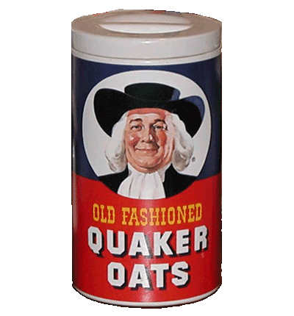
Nature of the Cure
Oatmeal.
  No Oils.
  No Sugars.

Slide 25
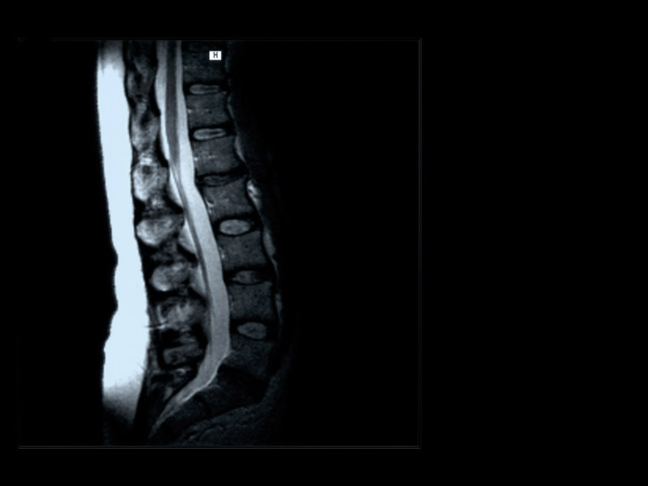
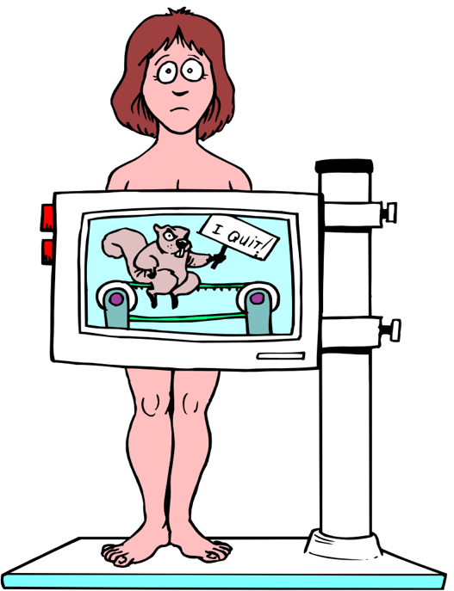
Clots / rouleauxed cells
Slow Transit.
Radiation.

Slide 26
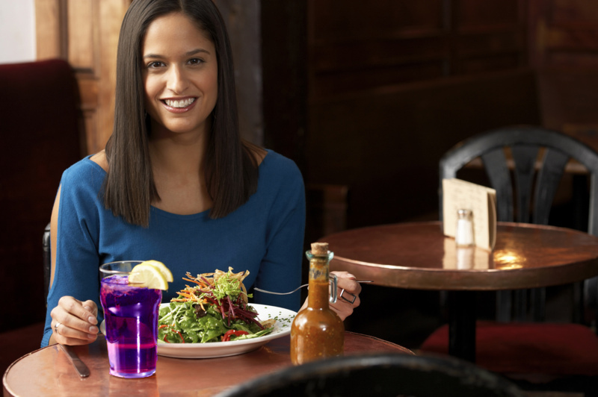

Fresh Fruit and Vegetables and Immunity
Fresh fruit and vegetables have been shown to be antibiotic, antiallergic, tumor-protective, anti-inflammatory and stimulating to the immune system.
Fortschr Med. 1990 Jun 10;108(17):338-40.
Notes:
Fortschr Med. 1990 Jun 10;108(17):338-40. Related Articles, Links
[Raw food and immunity]
[Article in German]
Gaisbauer M, Langosch A.
Klinik in der Stanggass, Berchtesgaden.
Uncooked food is an integral component of human nutrition, and is a necessary precondition for an intact immune system. Its therapeutic effect is complex, and a variety of influences of raw food and its constituents on the immune system have been documented. Such effects include antibiotic, antiallergic, tumor-protective, immunomodulatory, and anti-inflammatory actions. In view of this, uncooked food can be seen as a useful adjunct to drugs in the treatment of allergic, rheumatic and infectious diseases.
Publication Types:
Review
PMID: 2198207 [PubMed - indexed for MEDLINE]

Slide 27
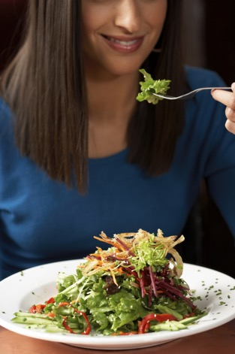
Plant Based Diet
Compared with omnivores, vegans had significantly higher blood concentrations of:
  Vitamin A.
  Vitamin C.
  Vitamin E.
Vegetarians’ natural killer cell activity is twice that of omnivores.
Am J Clin Nutr. 1995 Dec;62(6):1221-7. Nutr Cancer. 1989;12(3):271-8.
Notes:
Am J Clin Nutr. 1995 Dec;62(6):1221-7. Related Articles, Links
Antioxidant status in long-term adherents to a strict uncooked vegan diet.
Rauma AL, Torronen R, Hanninen O, Verhagen H, Mykkanen H.
Department of Clinical Nutrition, University of Kuopio, Finland.
Antioxidant status was investigated in 20 Finnish middle-aged female vegans and in one male vegan who were following a strict, uncooked vegan diet ("living food diet"), by means of a dietary survey and biochemical measurements (blood concentrations of vitamins C and E and beta-carotene, and the activities of the zinc/copper-dependent superoxide dismutase and selenium-dependent glutathione peroxidase). Values were compared with those of omnivores matched for sex, age, social status, and residence. Antioxidant supplementation was used by 4 of 20 female vegans and by 11 of 20 control subjects. Based on dietary records, the vegans had significantly higher intakes of beta-carotene, vitamin E, vitamin C, and copper, and a significantly lower intake of selenium than the omnivorous control subjects. The calculated dietary antioxidant intakes by the vegans, expressed as percentages of the US recommended dietary allowances, were as follows: 305% of vitamin C, 247% of vitamin A, 313% of vitamin E, 92% of zinc, 120% of copper, and 49% of selenium. Compared with the omnivores, the vegans had significantly higher blood concentrations of beta-carotene, vitamin C, and vitamin E, as well as higher erythrocyte superoxide dismutase activity. These differences were also seen in pairs who were using no antioxidant supplements. The present data indicate that the "living food diet" provides significantly more dietary antioxidants than does the cooked, omnivorous diet, and that the long-term adherents to this diet have a better antioxidant status than do omnivorous control subjects.
Nutr Cancer. 1989;12(3):271-8.
Natural killer cells, vitamins, and other blood components of vegetarian and omnivorous men.
Malter M, Schriever G, Eilber U.
Institute for Experimental Pathology, German Cancer Research Center, Heidelberg.
The study population consisted of male vegetarians (aged 28-50 years), who were recruited from the vegetarian cohort being followed by the Department of Epidemiology (German Cancer Research Center, Heidelberg, FRG), and the same number of age- and sex-matched controls from the personnel of the same center. Among the vitamins tested, only the level of carotene was significantly higher in vegetarians; the levels of vitamin A, K, and E were not elevated. Among the other blood parameters tested, only creatinine and glutamine-transferase levels were significantly lower in vegetarians. The natural cytotoxicity of peripheral blood lymphocytes was measured using a chromium-release test. Cytotoxic activity, which is expressed as lytic units, was significantly higher in vegetarians than in their omnivorous controls by a factor of 2. The total number of white blood cells, lymphocytes, and other subpopulations did not differ between vegetarians and nonvegetarians. The enhanced natural cytotoxicity may be one of the factors contributing to the lower cancer risk shown by vegetarians.

Slide 28
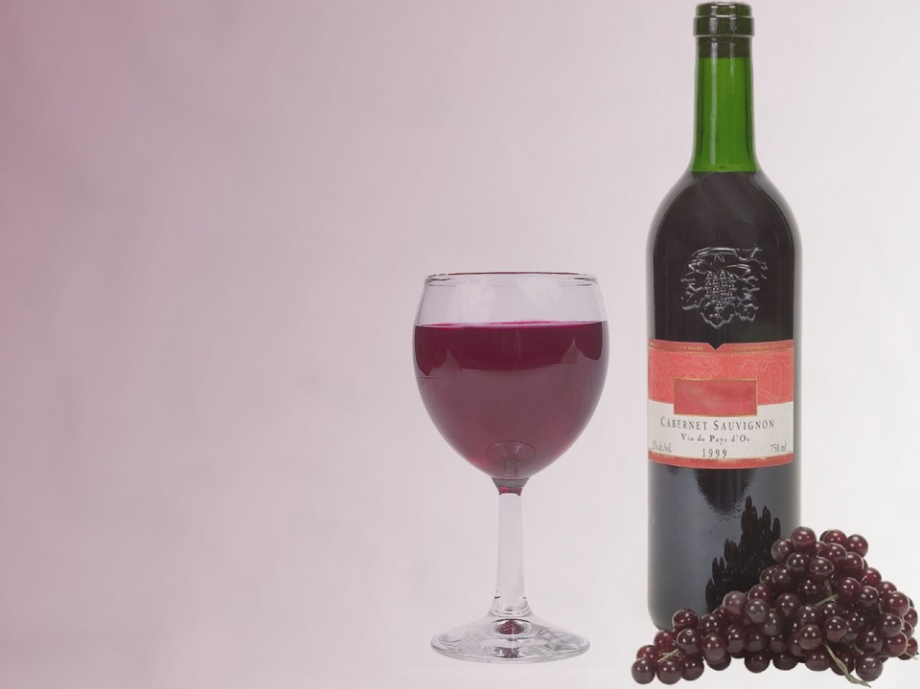
Fermentation Inflammation
Alcoholic beverages
Vinegar
Cheese
Sour cream
Yogurt
Soy sauce
Sauerkraut
Salami
Chocolate
Vanilla
Brown rice syrup
Nutritional yeast

Slide 29
Comfrey Salve Shows Efficacy
Comfrey Salve gave 2-1/2 times more pain relief than a placebo.
Br J Sports Med. 2010 Jul;44(9):637-41.
Notes:
Giannetti BM, Staiger C, Bulitta M, Predel HG. Efficacy and safety of comfrey root extract ointment in the treatment of acute upper or lower back pain: results of a double-blind, randomised, placebo controlled, multicentre trial. Br J Sports Med. 2010 Jul;44(9):637-41.
Abstract
Objective: The objective was to show the superiority of comfrey root extract ointment to placebo ointment in patients with acute upper or lower back pain.
Design: The study was conducted as a double-blind, multicentre, randomised clinical trial with parallel group design over a period of 5 days (SD 1). The patients (n = 120, mean age 36.9 years) were treated with verum or placebo ointment three times a day, 4 g ointment per application. The trial included four visits.
Main outcome measures: The primary efficacy variable was the area under the curve (AUC) of the visual analogue scale (VAS) on active standardised movement values at visits 1 to 4. The secondary efficacy variables were back pain at rest using assessment by the patient on VAS, pressure algometry (pain-time curve; AUC over 5 days), global assessment of efficacy by the patient and the investigator, consumption of analgesic medication and functional impairment measured using the Oswestry disability index.
Results: There was a significant treatment difference between comfrey extract and placebo regarding the primary variable. In the course of the trial the pain intensity on active standardised movement decreased on average (median) approximately 95.2% in the verum group and 37.8% in the placebo group.
Conclusions: The results of this clinical trial were clear-cut and consistent across all primary and secondary efficacy variables. Comfrey root extract showed a remarkably potent and clinically relevant effect in reducing acute back pain. For the first time a fast-acting effect of the ointment (1 h) was also witnessed.

Slide 30
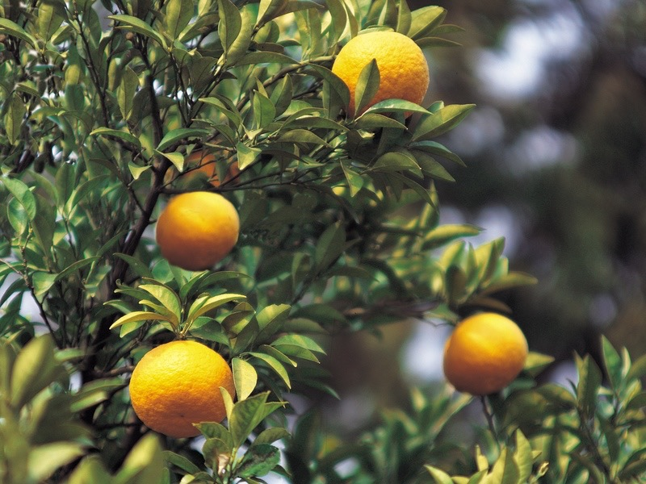
Nature of the Cure
Vitamin C.
Med Ann Dist Columbia. 1964 Jun;33:274-6.
Notes:
Med Ann Dist Columbia. 1964 Jun;33:274-6. Related Articles, Links
OPTIMUM VITAMIN C INTAKE AS A FACTOR IN THE PRESERVATION OF DISC INTEGRITY: PRELIMINARY REPORT.
GREENWOOD J Jr.
PMID: 14155607 [PubMed - OLDMEDLINE for Pre1966]

Slide 31

Nature of the Cure
Walk.
  Pumping
Eur Spine J. 2003; 12(2):166-72
Notes:
The effect of walking faster on people with acute low back pain.
Eur Spine J. 2003; 12(2):166-72 (ISSN: 0940-6719)
Taylor NF; Evans OM; Goldie PA
Faculty of Health Sciences, La Trobe University, Bundoora, Australia. N.Taylor@latrobe.edu.au
Little is known about self-selected speed and fast walking in people with acute low back pain. This study aimed to investigate (1) the strategies that people with acute low back pain use to change from self-selected speed to fast walking and (2) the effect of a period of treadmill walking on level of back pain. Eight participants with acute low back pain and eight matched control participants were evaluated during self-selected speed and fast walking on a treadmill. The eight participants with back pain were retested 6 weeks later when pain had resolved. Measurements were taken of (1) three-dimensional angular movements of the pelvis and lumbar spine using a videoanalysis system, (2) the timing and distance parameters of walking, and (3) pain levels as measured by a visual analogue scale. We found that to walk faster, those with acute low back pain increased stride length and the frontal plane movements of pelvic list and lumbar lateral flexion (pelvis) to a greater extent than when symptoms had resolved. We also found that 10 min of treadmill walking at self-selected speed led to a reduction in the level of back pain and that there was a high degree of negative correlation between level of back pain and stride length. An additional 5 min of fast walking did not lead to any further changes in level of back pain. These findings support clinical recommendations that the moderate physical activity of walking may be beneficial in the management of people with acute low back pain. To walk faster, people with acute low back pain may utilise strategies that had been limited at self-selected speed, without any increase in pain.
PreMedline Identifier: 12709854

Slide 32

Nature of the Cure
Walk.
  Oxygen.

Slide 33
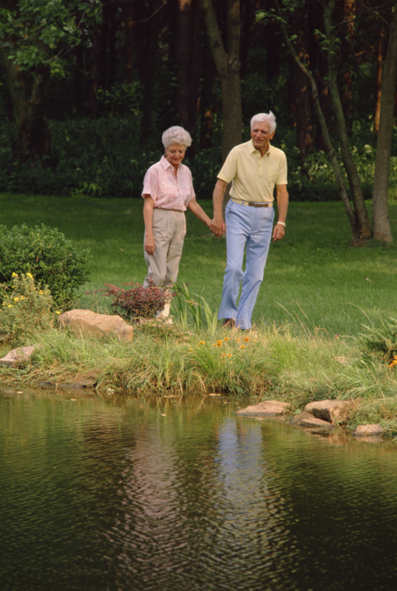
Nature of the Cure
Walk for Stress relief.

Slide 34

Schedule regularity.

Slide 35
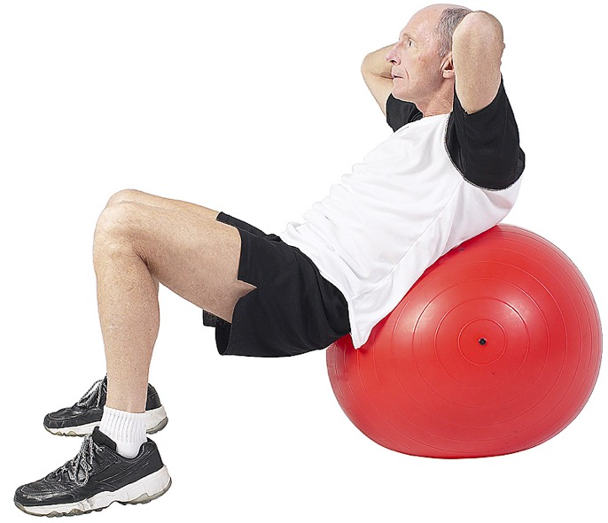
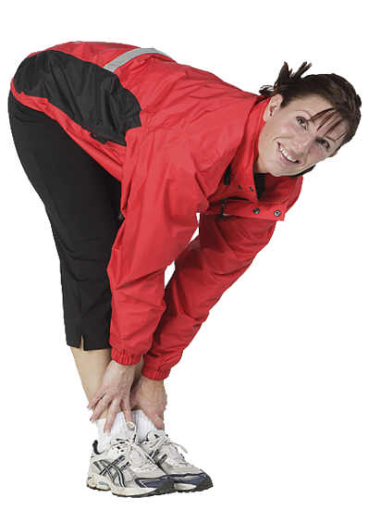
What About Exercises?

Slide 36
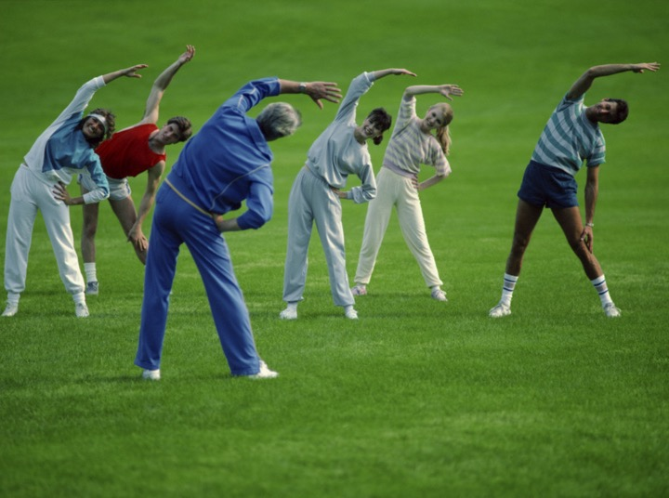
Stretching
The goal of stretching is to stretch and improve the flexibility of muscles and other soft tissues of the back.
This reduces stiffness and improve range of motion.

Slide 37

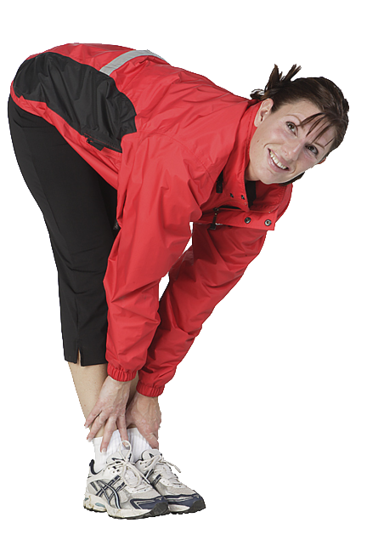
Flexion
Notes:
Forward Flexion Exercises:
Strengthen abdominal and buttock muscles reducing the load on the spine.
Stretch back and hip muscles.
Widen the spaces between vertebrae, thereby reducing pressure on the nerves.
Sudden twisting or vigorous forward flexion, such as aerobic dancing and rowing could raise pressure in the discs and may actually do more harm than good.

Slide 38
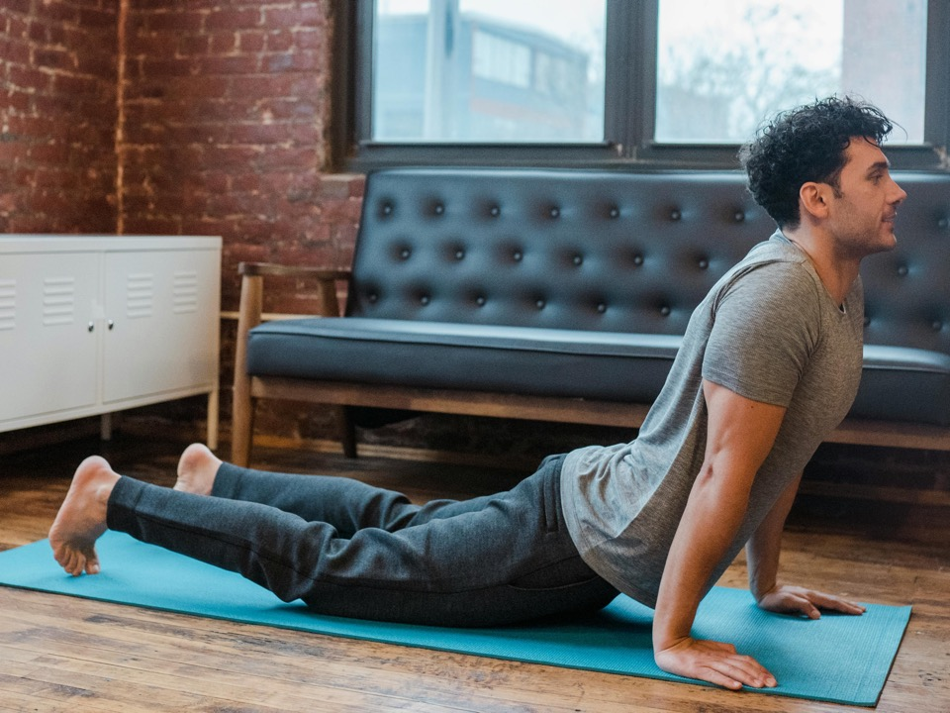
Extension
Notes:
These exercises open up the spinal canal and develop the muscles that support the spine.
Extension exercises may minimize pain that radiates from your back to other parts of your body.

Slide 39
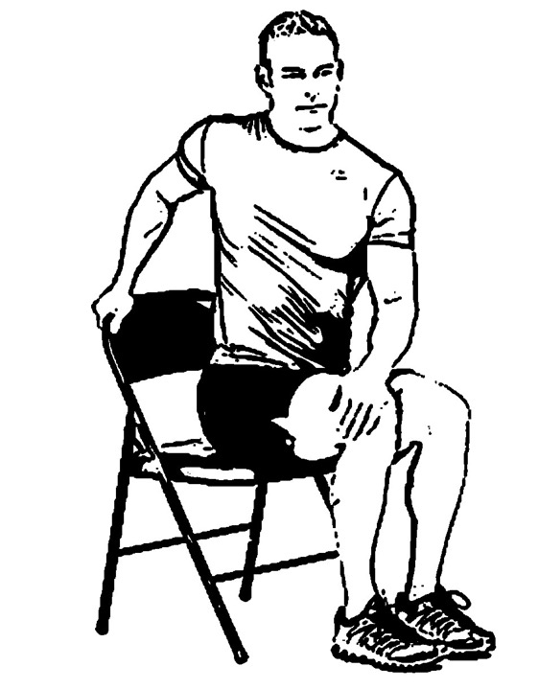
Twist

Slide 40
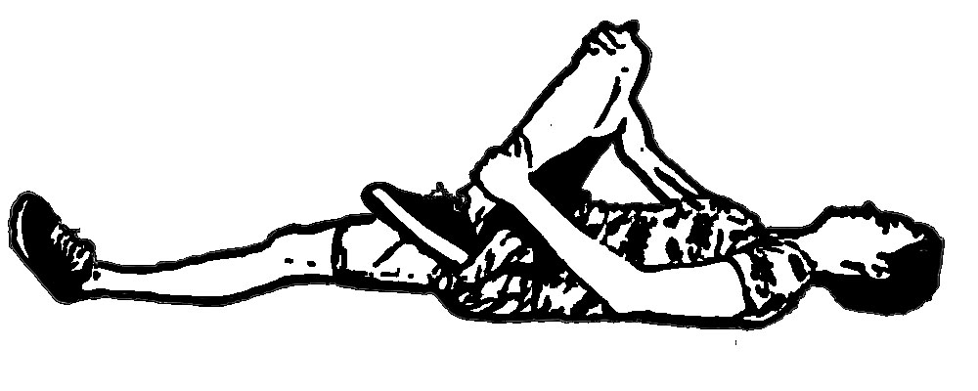
Piriformis

Slide 41

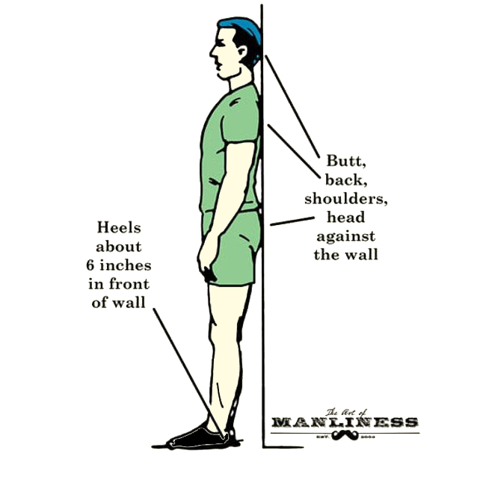
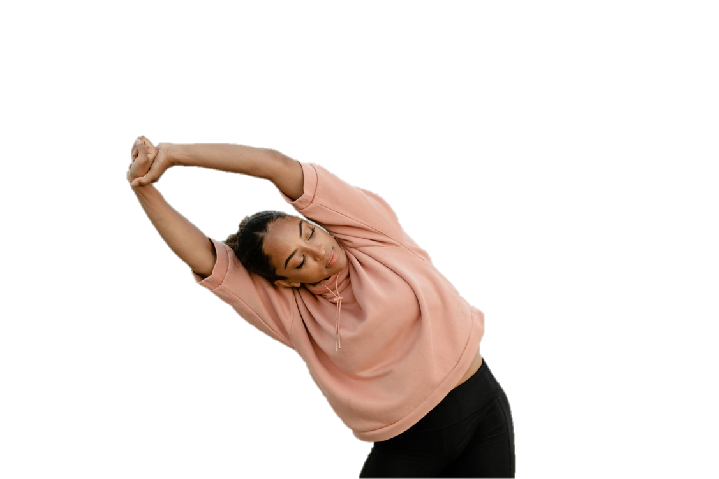
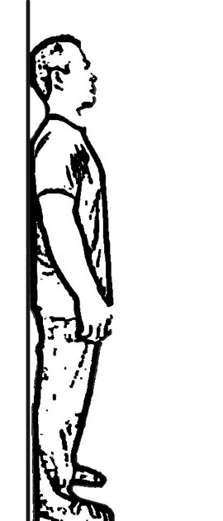

Side Flexion

Slide 42
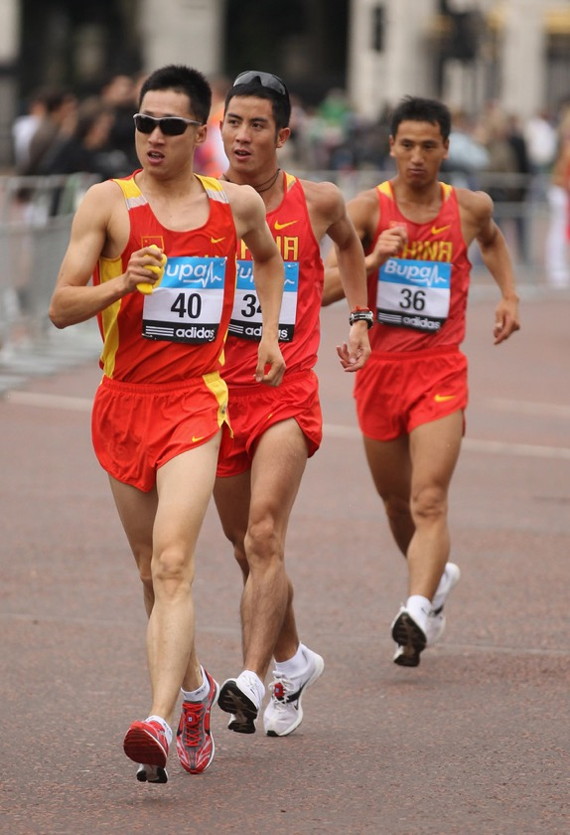
Walk

Slide 43
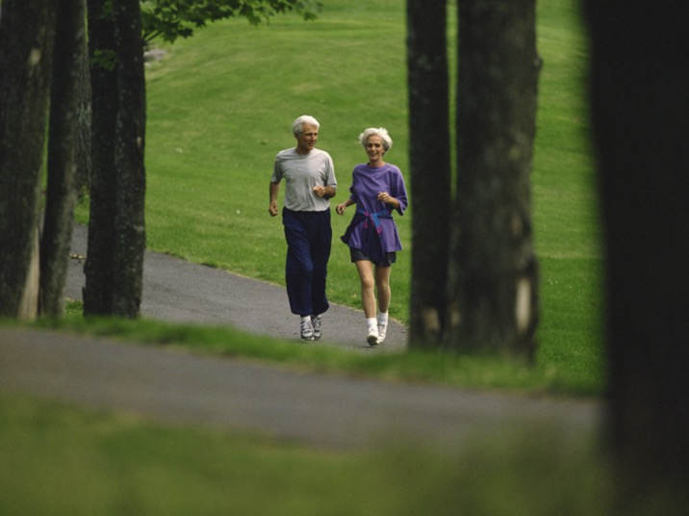
Aerobic
Notes:
Get at least 30 minutes of aerobic exercise three times a week.
Aerobic exercises include brisk walking, jogging, and swimming.
Aerobic exercise gets your heart pumping faster.
If you cannot do 30 minutes at a time, try three 10-minute sessions and work up.

Slide 44

Sunlight
Sunlight contributes to:
Pain reduction, function, lumbar flexion-extension ROM, and back extensor endurance.
Inflammation reducing Melatonin.
High sun derived vitamin D levels reduce the risk of back pain by 2.5 times.
Improved microcirculation.
Bone Joint Res. 12(3):199-201.
Notes:
Infrared
Ervolino F, Gazze R. Far infrared wavelength treatment for low back pain: Evaluation of a non-invasive device. Work. 2015;53(1):157-62.
Use of site-specific FIR therapy over a four-week period in the workplace was associated with significant clinical improvements in pain and quality of life for office workers with previously refractory low back pain.
Ansari NN, Naghdi S, Naseri N, Entezary E, Irani S, Jalaie S, Hasson S. Effect of therapeutic infra-red in patients with non-specific low back pain: a pilot study. J Bodyw Mov Ther. 2014 Jan;18(1):75-81.
The results of the ANOVA demonstrated a statistically significant main effect of IR on all outcomes of pain, function, lumbar flexion-extension ROM, and back extensor endurance.
Gale GD, Rothbart PJ, Li Y. Infrared therapy for chronic low back pain: a randomized, controlled trial. Pain Res Manag. 2006 Autumn;11(3):193-6.
The IR therapy unit used was demonstrated to be effective in reducing chronic low back pain, and no adverse effects were observed.
Melatonin
Brzeszczyńska J, Brzeszczyński F. Benefit of sunlight and melatonin on back pain and inflammation. Bone Joint Res. 2023 Mar 7;12(3):199-201.
The study by Bai et al14 is the first to highlight that NPCs derived from patient intervertebral discs express melatonin receptors and their activation decreases cellular pyroptosis, the inflammatory cell death process, induced by reactive oxygen species.
Sun driven blood flow
Li Z, Pollack GH. On the driver of blood circulation beyond the heart. PLoS One. 2023 Oct 19;18(10):e0289652.
The heart is widely acknowledged as the unique driver of blood circulation. Recently, we discovered a flow-driving mechanism that can operate without imposed pressure, using infrared (IR) energy to propel flow. We considered the possibility that, by exploiting this mechanism, blood vessels, themselves, could propel flow. We verified the existence of this driving mechanism by using a three-day-old chick-embryo model. When the heart was stopped, blood continued to flow for approximately 50 minutes, albeit at a lower velocity. When IR was introduced, the postmortem flow increased from ~41.1 ± 25.6 μm/s to ~153.0 ± 59.5 μm/s (n = 6). When IR energy was diminished under otherwise physiological conditions, blood failed to flow. Hence, this IR-dependent, vessel-based flow-driving mechanism may indeed operate in the circulatory system, complementing the action of the heart.
Blood flow
Kim J, Jung H, Yim J. Effects of Contrast Therapy Using Infrared and Cryotherapy as Compared with Contrast Bath Therapy on Blood Flow, Muscle Tone, and Pain Threshold in Young Healthy Adults. Med Sci Monit. 2020 Aug 3;26:e922544.
The results of this study suggest that (contrast therapy) CT using (infrared) IR and (cryotherapy) CR is more effective in improving blood flow than (contrast bath therapy) CBT and has the same effect on muscle tone and pain.
Vitamin D
Xu HW, Zhang SB, Yi YY, Chen H, Hu T, Wang SJ, Wu DS. Relationship between Vitamin D and Nonspecific Low Back Pain May Be Mediated by Inflammatory Markers. Pain Physician. 2021 Nov;24(7):E1015-E1023.
Patients with Ns-LBP had lower vitamin D and higher inflammatory marker levels. This association between hypovitaminosis D and Ns-CLBP may be mediated by IL-6.
Pishgahi A, Dolatkhah N, Shakouri SK, Hashemian M, Amiri A, Delkhosh Reihany M, Jahanjou F. Lower serum 25-hydroxyvitamin D3 concentration is associated with higher pain and disability in subjects with low back pain: a case-control study. BMC Res Notes. 2019 Nov 8;12(1):738.
There was a significant difference in serum concentration of 25 hydroxyvitamin D in patients with LBP in comparison to subjects without LBP. The serum concentration of 25 hydroxyvitamin D was significantly lower in patients with LBP and 42.85% and 22.22% of them had vitamin D deficiency and insufficiency, respectively. However, 14.54% and 27.27% of subjects without LBP showed vitamin D deficiency and insufficiency, respectively. According to the findings, subjects with lower serum 25 hydroxyvitamin D concentration (vitamin D deficiency or insufficiency) were 2.39 times more likely to exhibit LBP than subjects with normal vitamin D status.
Kim TH, Lee BH, Lee HM, Lee SH, Park JO, Kim HS, Kim SW, Moon SH. Prevalence of vitamin D deficiency in patients with lumbar spinal stenosis and its relationship with pain. Pain Physician. 2013 Mar-Apr;16(2):165-76.
Univariate logistic regression analysis showed a significantly higher prevalence of vitamin D deficiency in the following patients: 1) medical comorbidity; 2) urban residence rather than rural; 3) lower score for sunlight exposure; and 4) severe leg pain, or severe back and leg pain rather than mild to moderate pain. Pain category was significantly associated with lower sunlight exposure; however, the association between pain category and vitamin D deficiency remained significant even after adjustment for the sunlight exposure.
Supplements no good
Zadro JR, Shirley D, Ferreira M, Carvalho Silva AP, Lamb SE, Cooper C, Ferreira PH. Is Vitamin D Supplementation Effective for Low Back Pain? A Systematic Review and Meta-Analysis. Pain Physician. 2018 Mar;21(2):121-145.
Conclusions: Vitamin D supplementation is not more effective than placebo, no intervention, or other conservative/pharmacological interventions for LBP (based on very low quality evidence). These results are consistent, regardless of the type of LBP or vitamin D supplementation. Until well-designed and adequately powered clinical trials suggest otherwise, the prescription of vitamin D for LBP cannot be recommended. PROSPERO Registration No: CRD42016046874. www.crd.york.ac.uk/PROSPERO/display_record.asp?ID = CRD42016046874.

Slide 45
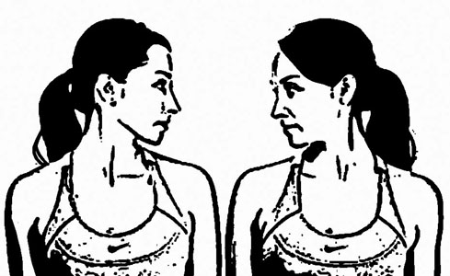
Neck Rotation

Slide 46
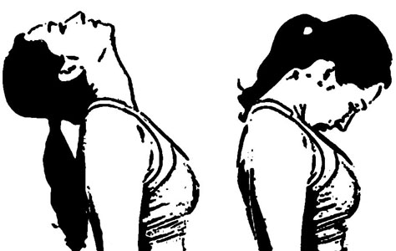
Neck Flexion, Extension

Slide 47
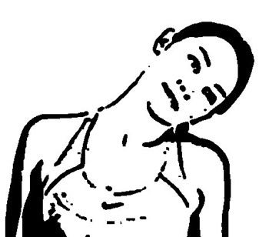
Neck Lateral Flexion

Slide 48
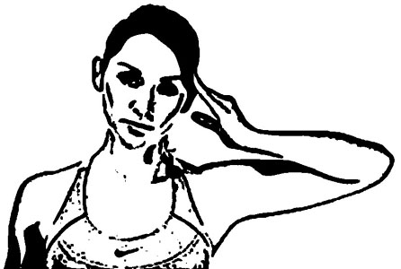
Resisted Lateral Flexion

Slide 49

Resisted Flexion, Extension

Slide 50

Nature of the Cure
Drink ice water for hunger between meals.

Slide 51
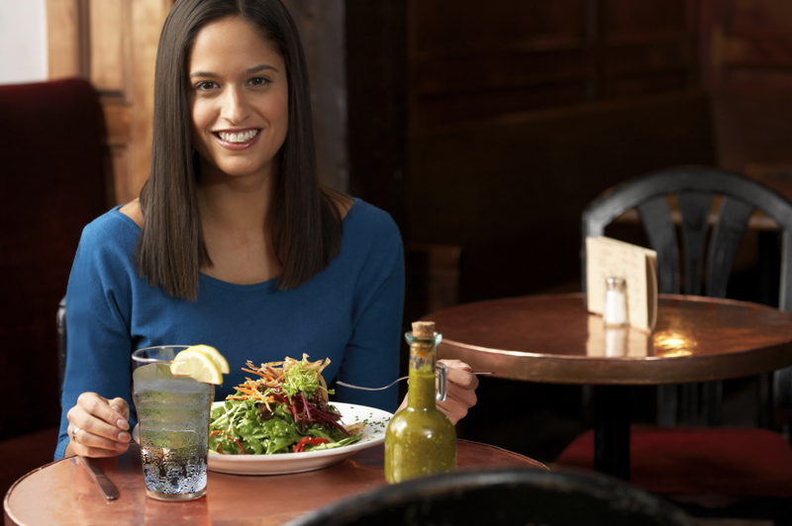
Nature of the Cure
Vegetables.
  Raw preferred.

Slide 52
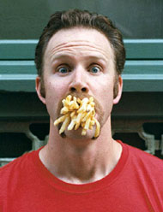
Nature of the Cure
Vegetables.
No oil or excess salt.

Slide 53
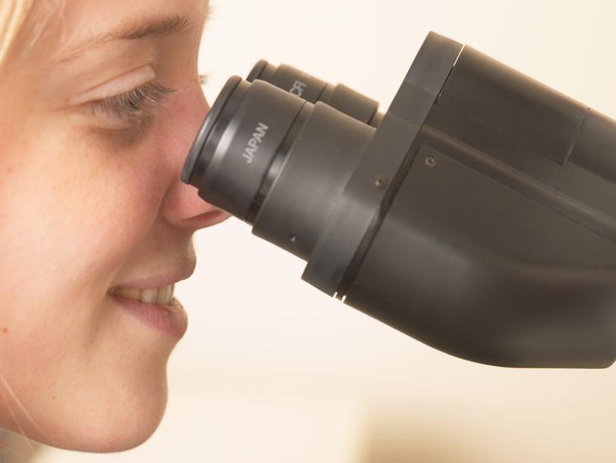

Clots / rouleauxed cells
Refined.

Slide 54

Nature of the Cure
Fruit.
  Raw preferred.

Slide 55

The Bible Diet
“Then God said, "I give you every seed-bearing plant on the face of the whole earth and every tree that has fruit with seed in it. They will be yours for food.” “and you will eat the plants of the field.” Genesis 1:29; 3:18 (NIV).

Slide 56


Nature of the Cure
Eat at least 3 hour before bedtime.

Slide 57

Nature of the Cure
No coffee, tea, sodas, alcohol, tobacco, and no eating between meals.

Slide 58

Shunting
Coffee.
Amines.

Slide 59

J Am Acad Orthop Surg, Vol 9, No 1, 2001, 9-17.
Notes:
J Am Acad Orthop Surg 2001;9:9-17
Abstract
Currently, there are more than 50 million smokers in this country, and approxi-
mately 800 billion cigarettes are smoked each year. Smoking is now the leading
avoidable cause of morbidity and mortality in the United States. According to
one report, over 500,000 deaths per year in the United States alone can be attrib-
uted to smoking. For years, orthopaedic surgeons have known about the rela-
tionships that putatively exist between smoking and an array of orthopaedic con-
ditions and complications. It has been shown to adversely affect bone mineral
density, lumbar disk disease, the rate of hip fractures, and the dynamics of bone
and wound healing. Although scientific and clinical information on smoking
and its consequences suggests differing degrees of correlation between smoking
and orthopaedic conditions, most available data do suggest a real and repro-
ducible relationship. In the past, there have been many individual reports that
deal with these relationships separately but very few published comprehensive
reviews. This summary of the current literature regarding the relationship
between smoking and musculoskeletal diseases and their treatment provides
information that can be used clinically by both the practitioner and the patient.
Disk Disease
Lumbar disk disease and herniation
has become a popular diagnosis
in cases of low back pain, in part
because a potential cure can be
sought with surgical intervention.58
Some authors believe that smoking
adversely affects the intervertebral
disks, predisposing patients to disk
disease and low back pain.45,53,60
Ernst45 believes that the intervertebral
disks are “malnourished” due
to many of the vascular and hematologic
changes that result from
long-term smoking. He postulates
that tissues such as the vertebrae
and vertebral disks have a tenuous
blood supply and are not able to
compensate for the decrease in
blood flow that occurs in the microvasculature
of chronic smokers.
Over time, the diffusion capacity for
the delivery of oxygen and nutrients
becomes insufficient, leaving the intervertebral
disks more vulnerable
to insults.45
Kelsey et al53 determined in
their epidemiologic study that cigarette
smoking in the year prior to a
patient’s presentation to a physi-
Musculoskeletal Effects of Smoking
12 Journal of the American Academy of Orthopaedic Surgeons
cian increased the risk of having a
prolapsed disk (odds ratio, 1.7).
Furthermore, they discerned a
weak dose response for smoking
and the subsequent risk of disk prolapse;
for every 10 cigarettes that
were smoked per day, the risk of
having a prolapsed disk increased
by 20%.
Hanley and Shapiro61 determined
that a smoking history
longer than 15 years was an important
factor in determining the postoperative
success of lumbar diskectomies
performed to treat severe
radiculopathies. They postulate
that the persistent back pain after
the procedure may be a manifestation
of the vascular effects of nicotine.
Furthermore, the metabolic
changes within the disk may render
it more susceptible to mechanical
problems.61
Battié et al57 examined differences
in magnetic resonance (MR)
imaging studies of the lumbar
spines of identical twins who were
highly discordant in their smoking
histories. They found no differences
in the reported rate of occurrence of
low back pain between the smoking
and nonsmoking groups but
did demonstrate a difference in the
disk degeneration scores (based on
MR imaging criteria) used to evaluate
the intervertebral regions of the
two groups.
Stronger evidence comes from
An et al.60 In their study, the rates
of smoking in a population of patients
with surgically confirmed cervical
or lumbar disk disease were
examined. The relative risk values
for lumbar and cervical disk disease
for smokers were 2.2 (P = 0.00029)
and 2.9 (P = 0.0025), respectively.
When the authors excluded those
patients who had recently quit
smoking from the “smokers” group,
the relative risks increased to 3.0
and 3.9, respectively. They demonstrated
that the association between
cigarette smoking and documented
disk disease, not just the subjective
complaint of low back pain, is quite
significant. Continued smoking in
light of these problems could actually
worsen the diskogenic or radicular
symptoms that accompany disk
disease.
So how does smoking exert these
changes in the intervertebral disks
that render them more susceptible
to disease? As stated earlier, Ernst45
believes that the macrovascular and
microvascular changes that occur in
smoking may affect the blood supply
around intervertebral disks.
The decreased blood flow renders
the disks susceptible to pathologic
changes.
The study by Battié et al57 supports
this notion. In that study, the
authors used MR imaging to evaluate
disk integrity in pairs of identical
twins discordant in their smoking
histories. Although there was
no difference in complaints of low
back pain, the mean score for lumbar
spine disk degeneration was
18% higher for the smokers (P =
0.015). Furthermore, because their
results demonstrated involvement
of the entire lumbar spine, the authors
postulated that the mechanism
of action must be systemic.
In a recent article, Newby et al3
showed that smoking has dramatic
adverse effects on the endogenous
fibrinolytic capacity of the vascular
endothelium of smokers, leading to
a systemic increase in the risk of
atherothrombotic disease or microvascular
occlusive disease. Jayson
and co-workers62-64 have performed
several studies demonstrating that
a decrease in fibrinolytic activity is
common in many chronic back pain
syndromes. It is feasible that this
mechanism is active in a large number
of patients who smoke and
have low back pain. It is also feasible
that this is a mechanism that
results in the local hypoperfusion of
the lumbar spine, as well as the
alterations in disk metabolism that
some authors believe occur in
smokers.3,45,60-64

Slide 60

Shunting
Stress Fight / Flight.
Rehabilitation (Stuttg). 2003; 42(4):195-203.
Notes:
[Chronic back pain: more than pain in the back. Findings of a regional survey among insurees of a workers pension insurance fund]
Rehabilitation (Stuttg). 2003; 42(4):195-203 (ISSN: 0034-3536)
Raspe A; Matthis C; Héon-Klin V; Raspe H
Institut für Sozialmedizin, Universitätsklinikum Schleswig-Holstein, Campus Lübeck. angelica.raspe@sozmed.mu-luebeck.de
BACKGROUND: Surveys with a main focus on back pain tend to isolate the complaint from possibly concomitant pains, other symptoms and disorders. Severe chronic back pain is assumed here to imply more than pain in the back. PARTICIPANTS AND METHODS: We report results from a two stage survey conducted in 1998 - 2000. The initial postal questionnaire addressed all 10,000 actively employed blue collar workers from a regional pension fund (Landesversicherungsanstalt Schleswig-Holstein) aged 40 - 54 and residing in or around Luebeck/Germany (68 % males). Subjects reporting severe and disabling back pain were invited to a socio-medical examination. The response and participation rates were 58 % and 65 % respectively. Non-response and non-participation seem to result in minor though opposite, effects. RESULTS: The prevalence of current back pain (back pain of any severity within the past 7 days) is high (68 %; including 16 % with severe, disabling back pain) despite the preponderance of males and a probable healthy worker effect. 82 % of subjects participating in the second round reported recurrent or persisting back pain on the day of examination, in the majority with a chronic fluctuating and overall deteriorating course pattern. 18 % reported no current back pain and hence gave prospective (and additionally retrospective) evidence of an episodic-intermittent course of the disorder. The former group showed significantly more pains, bodily complaints, dysfunctional cognitions, emotional distress and concomitant disorders. 35 % of them indicated back pain as their dominant health problem; 49 % identified back pain and another disorder as dominant, and 16 % reported other prominent health problems. More than 70 % of "other" disorders originated from the musculoskeletal system often involving the extremities. SUMMARY AND CONCLUSION: Back pain is very common among blue collar workers. Severe disabling back pain is usually associated with numerous other pains, bodily complaints, disorders, and indicators of psychological distress ("amplified back pain"). However, even amplified back pain is not always the sole or dominant health problem. Assessing the degree of "amplification" seems helpful in splitting a previously homogeneous group of severely affected back pain sufferers-with possible prognostic and therapeutic consequences.
PreMedline Identifier: 12938041

Slide 61

9/10ths

Slide 62
Psychosocial factors for developing chronicity
Negative belief that pain is harmful or potentially severely disabling
High levels of "fear avoidance" behaviors
Poor or maladaptive coping strategies
Expectation that passive, rather than active, treatment is beneficial
Excessive focus on pain
High emotional distress levels
Depressed mood, low morale, and social withdrawal
Resistance to change
Low self-efficacy
Family reinforcement of illness behavior
Concurrent social or financial problems
Troubled childhood (e.g., abuse, parental death, addiction)
Notes:
39. Stevans JM, Saper RB. Chronic low back pain. In: Rakel D (ed). Integrative Medicine. 3rd ed. Madison, WI: Elsevier Inc.; 2012: 260-269.
40. Chou R, Huffman LH. Medications for acute and chronic low back pain: a review of the evidence for an American Pain Society/American College of Physicians clinical practice guideline. Ann Intern Med. 2007;147(7):505-514.
41. University of Michigan Health System. Guidelines for Clinical Care: Acute Low Back Pain. Available at http://www.med.umich.edu/1info/FHP/practiceguides/back/back.pdf. Last accessed June 14, 2022.
42. Airaksinen O, Brox JI, Cedraschi C, et al. European guidelines for the management of chronic nonspecific low back pain. Eur Spine J. 2006;15(Suppl 1):S192-S300.

Slide 63


Jeremiah 15:17,18 (TEV)
“I stayed by myself and was filled with anger.
Why do I keep on suffering? Why are my wounds incurable? Why won't they heal?”

Slide 64

Psalms 129:2,3(RSV)
"Sorely have they afflicted me from my youth, yet they have not prevailed against me.
The plowers plowed upon my back; they made long their furrows."

Slide 65

Forgiveness and Back Pain
J Pain. 2005 Feb;6(2):84-91.
Notes:
Back pain patients who have learned by experience value of forgiveness have less pain, anger and psychological distress.
It has been found that the anger resulting from a lack of forgiveness has the greatest impact.
Patients who have the hardest time forgiving others are at the highest risk of back pain and psychological distress.
J Pain. 2005 Feb;6(2):84-91.
Forgiveness and chronic low back pain: a preliminary study examining the relationship of forgiveness to pain, anger, and psychological distress.
Carson JW, Keefe FJ, Goli V, Fras AM, Lynch TR, Thorp SR, Buechler JL.
Pain Prevention & Treatment Research Program, Department of Psychiatry and Behavioral Sciences, Duke University Medical Center, Durham, NC 27708, USA. jim.carson@duke.edu
Clinical observations suggest that many patients with chronic pain have difficulty forgiving persons they perceive as having unjustly offended them in some way. By using a sample of 61 patients with chronic low back pain, this study sought to determine the reliability and variability of forgiveness assessments in patients and to examine the relationship of forgiveness to pain, anger, and psychological distress. Standardized measures were used to assess patients' current levels of forgiveness, forgiveness self-efficacy, pain, anger, and psychological distress. Results showed that forgiveness-related constructs can be reliably assessed in patients with persistent pain, and that patients vary considerably along dimensions of forgiveness. Furthermore, correlational analyses showed that patients who had higher scores on forgiveness-related variables reported lower levels of pain, anger, and psychological distress. Additional analyses indicated that state anger largely mediated the association between forgiveness and psychological distress, as well as some of the associations between forgiveness and pain. These findings indicate that forgiveness can be reliably assessed in patients with persistent pain, and that a relationship appears to exist between forgiveness and important aspects of living with persistent pain. PERSPECTIVE: This preliminary study suggests there is a relationship between forgiveness and pain, anger, and psychological distress in patients with chronic low back pain. Patients who report an inability to forgive others might be experiencing higher pain and psychological distress that are mediated by relatively higher levels of state anger.
PMID: 15694874 [PubMed - indexed for MEDLINE]

Slide 66

Matthew 11:28-30
“Come unto me, all ye that labour and are heavy laden, and I will give you rest. Take my yoke upon you, and learn of me; for I am meek and lowly in heart: and ye shall find rest unto your souls. For my yoke is easy, and my burden is light.”

Slide 67

Outcome
George

Slide 68

Summary
Hydration.
Nutrition.
Exercise /Stretching.
Stress Management.
Notes:
Herbs
Cervical
Clothing
Volunteering

Slide 69

NorthernLightsHealthEducation.com

Slide 70
Back and Neck Pain
Lifting the Burden
Notes:
For fifty years Wilma suffered disabling back pain, ever since high school. A couple hours hard work in her garden would flair up her pain for the rest of the week. She’d have to take time off work. she was always stiff, she constantly feared lifting anything heavy. She had been offered multiple extensive back surgeries. That was when something happened that utterly changed Wilma’s life, she attended this presentation, “Back and Neck Pain: Lifting the Burden”. Within ten days, she could work four hours straight out in her garden and not be laid up in pain the rest of the week. No Pain! Don’t miss this presentation, find out how best to take care of your spine, put back pain worries in your past, you too can be a back-pain recovery success story.
Story: Wilma 50 years of back pain....
Benefit/problem solved
Stiff painful back
Lifting restrictions
avoid surgery
Bullet points
Inspire
Find freedom and joy in life never thought possible before
Call to action
Find out how best to take care of yourself, put back pain worries in your past, You too can be a back pain recovery success story.

Slide 71


Slide 72


Slide 75


Slide 76



