Slide 1

Autoimmune Inflammatory Diseases:
When Self is the Enemy
Notes:
fixed

Slide 2
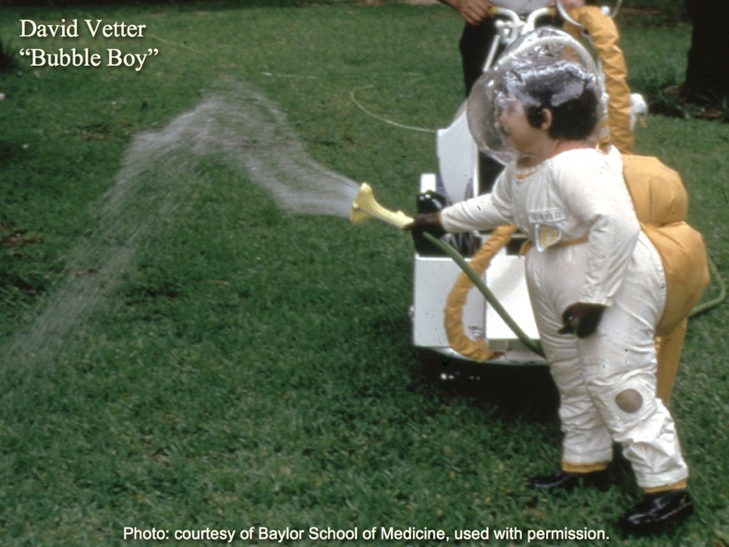

Slide 3
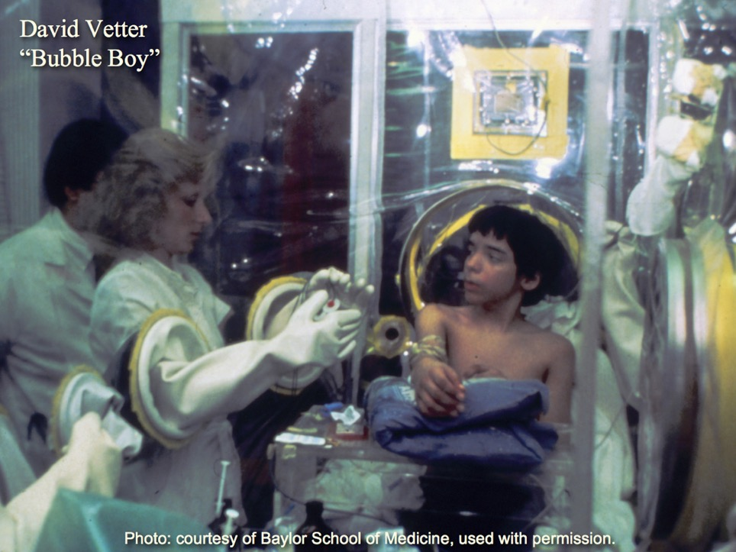

Slide 4
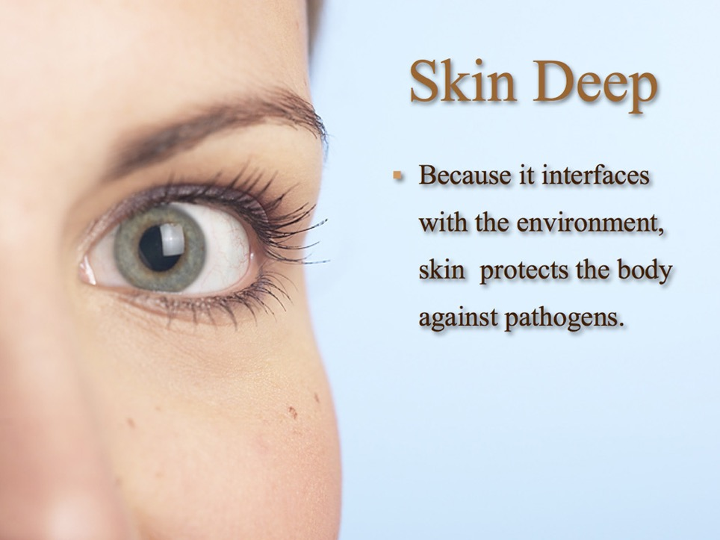

Slide 5
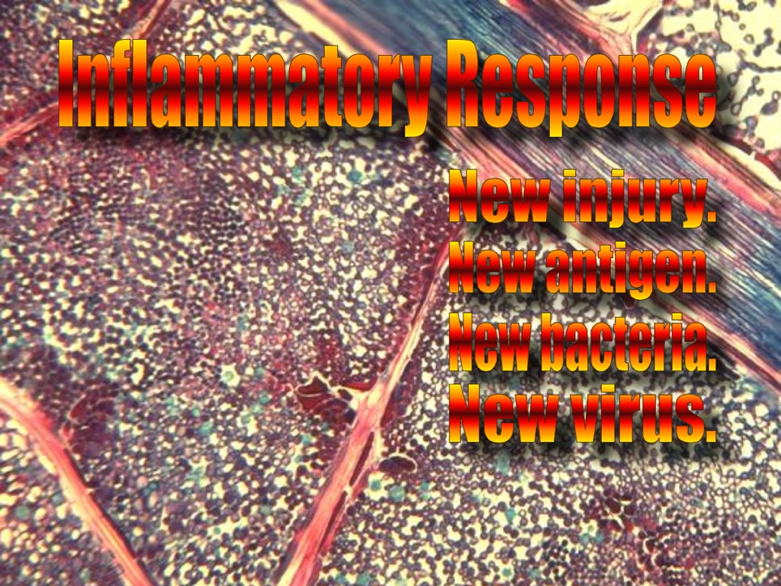

Slide 6
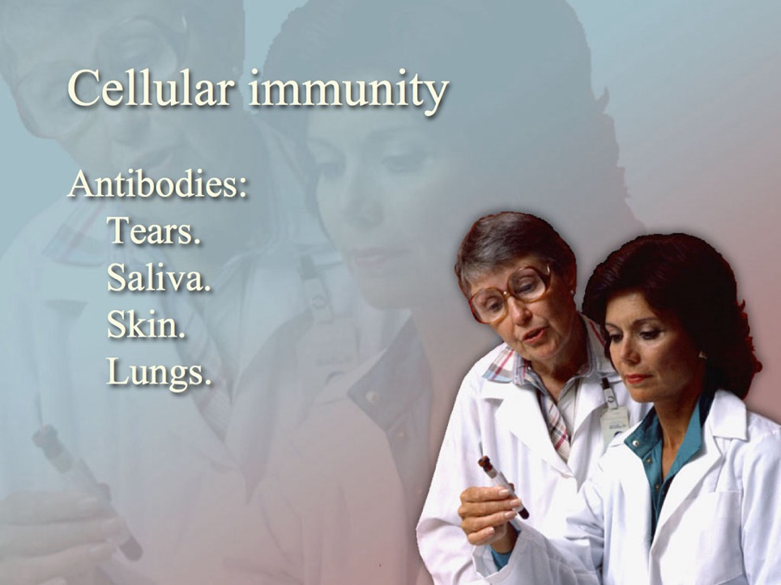


Slide 7

CELLULAR IMMUNITY
INFLAMMATION
Too Much Inflammation!
SKIN

Slide 8
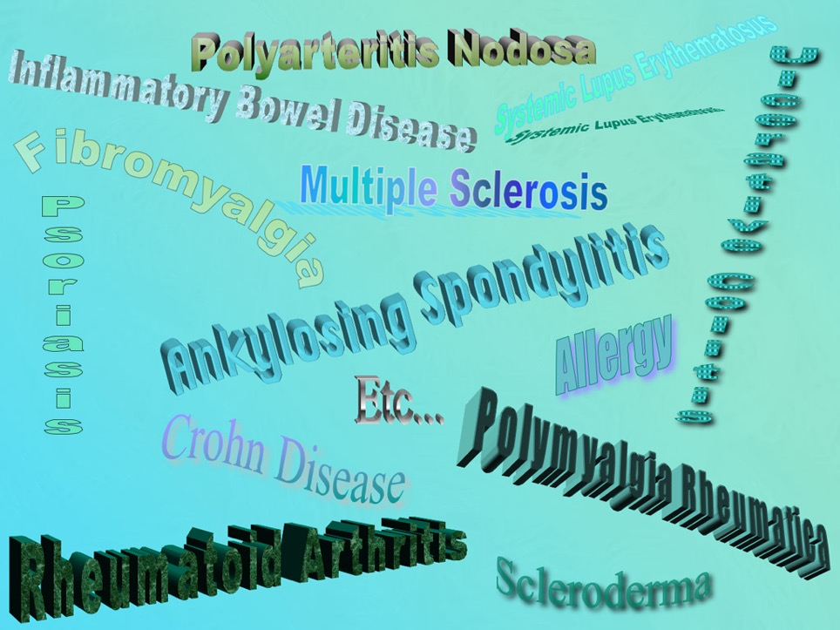
Asthma
Type I Diabetes

Slide 9
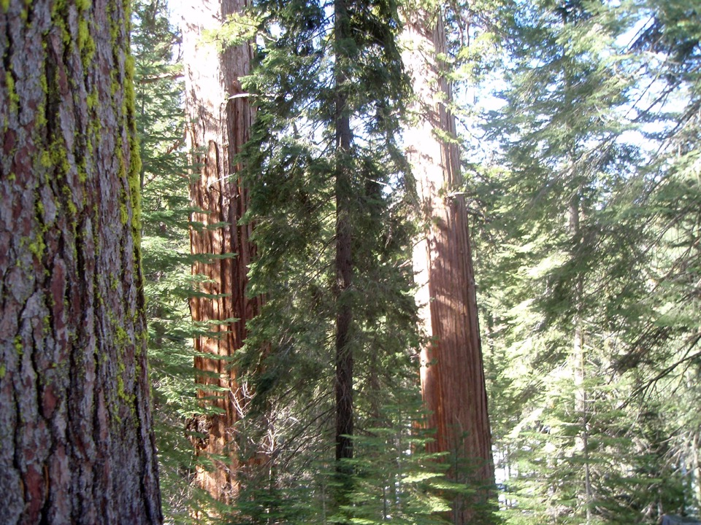
Notes:
Un-be-knows to you, your family, or your friends, or even you, may have been involved in lifestyle practices which have inadvertently set you up for one of these debilitating diseases.
Today I want to offer hope by dispelling some of the mystery that surrounds the acquiring of autoimmune disease and say that you are not doomed, you can avoid or even recover from autoimmune disease.
I will be sharing practical tips on overcoming these diseases naturally.
To begin, I want you to understand some of the dietary sources of inflammation for your body.

Slide 10
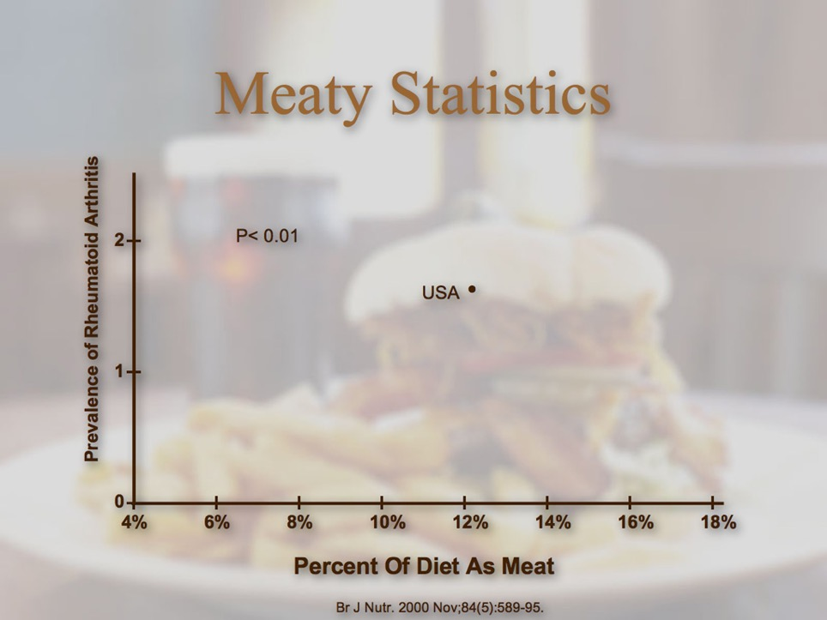

Slide 11
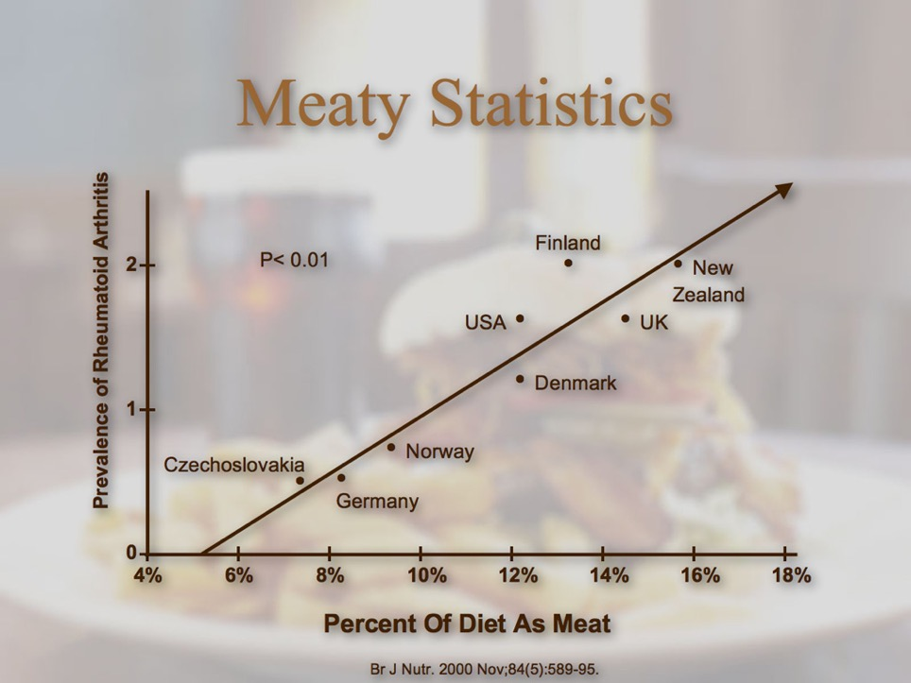

Slide 12
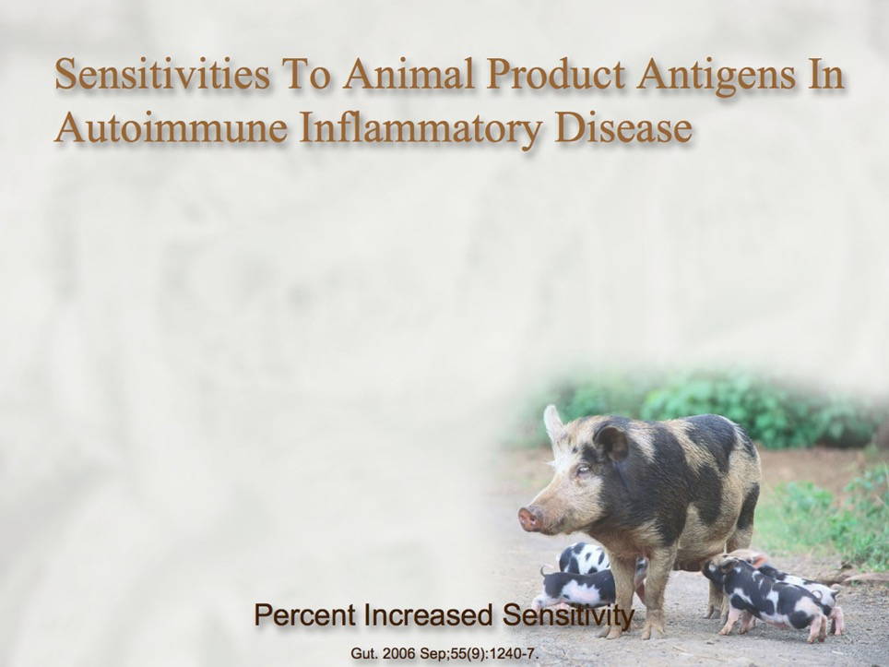

Slide 13
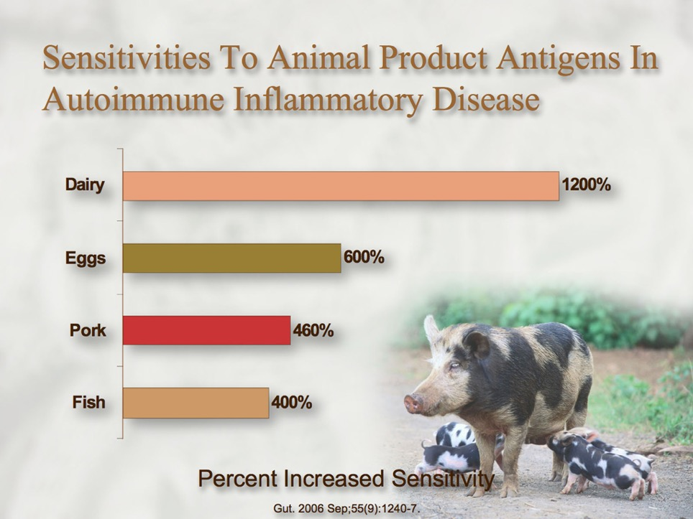

Slide 14
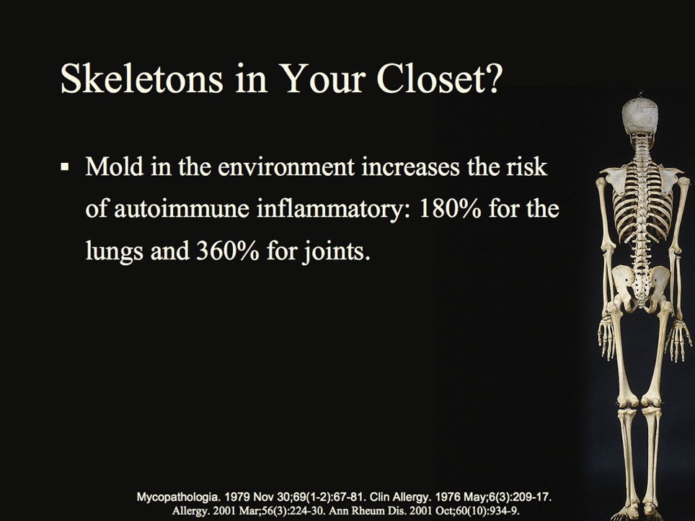

Slide 15
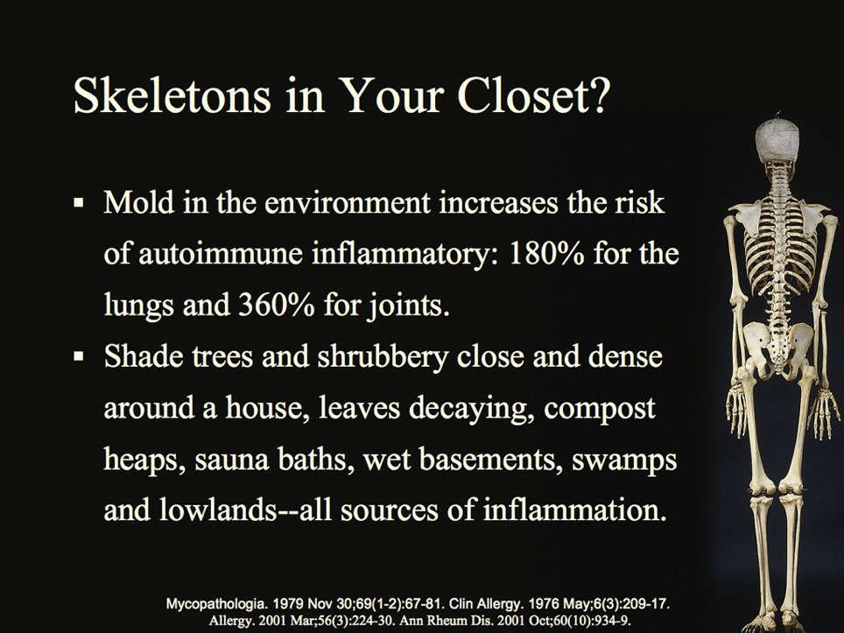

Slide 16
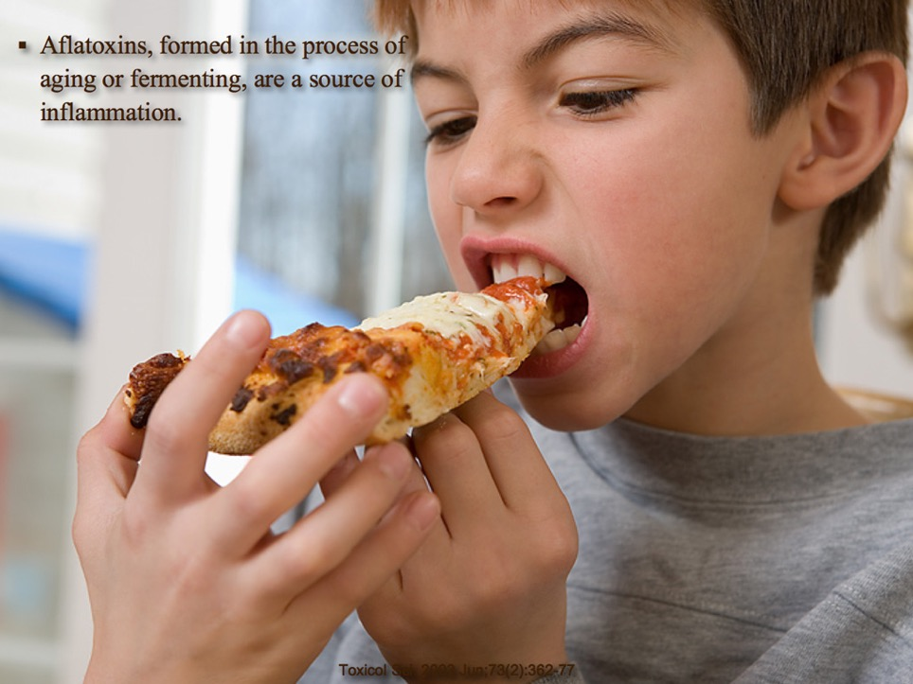

Slide 17
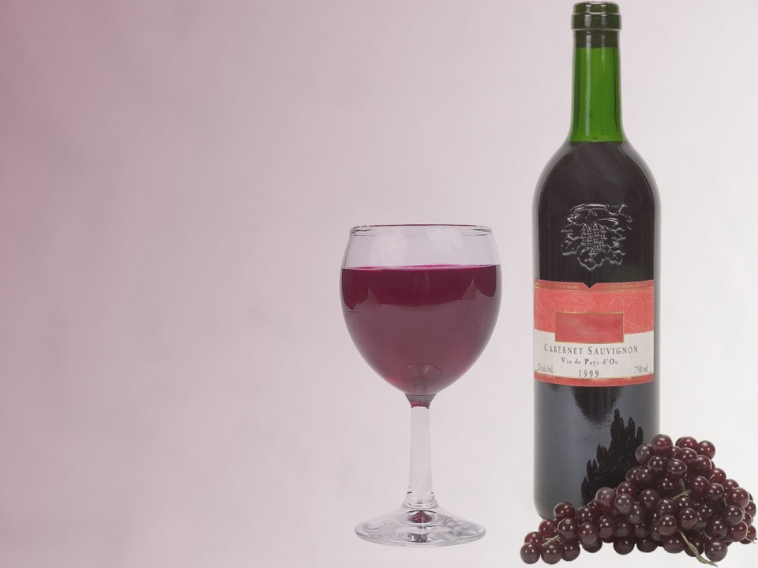
Fermentation Inflammation
Cheese
Alcoholic beverages
Vinegar
Soy sauce
Nutritional yeast
Salami
Chocolate
Vanilla
Mushrooms
Brown rice syrup
Sour cream
Yogurt
Sauerkraut

Slide 18
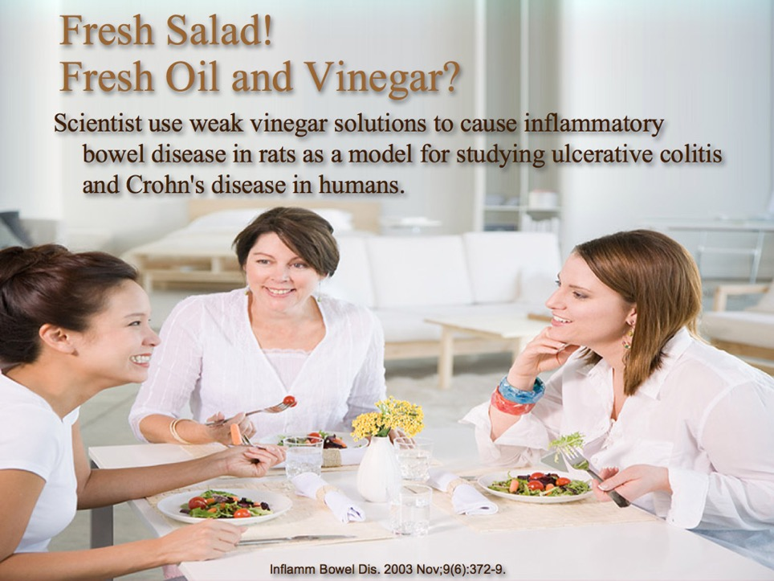


Slide 19
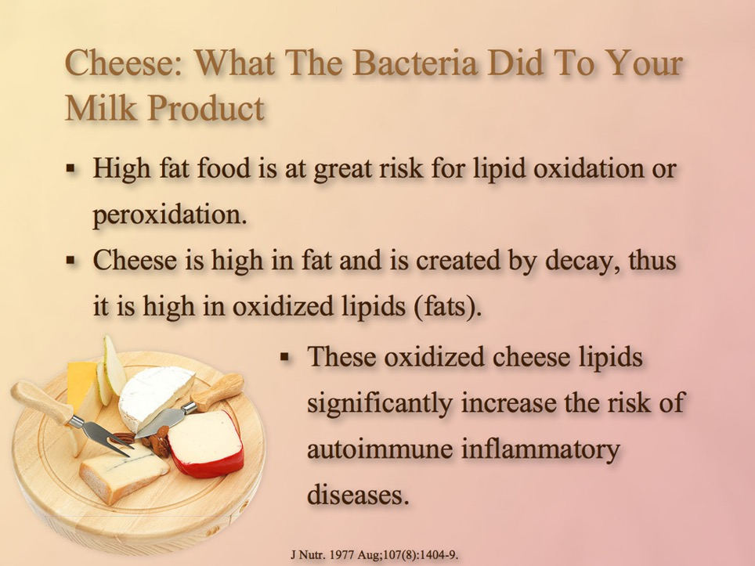
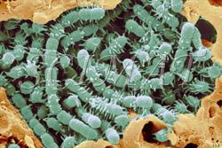

Slide 20
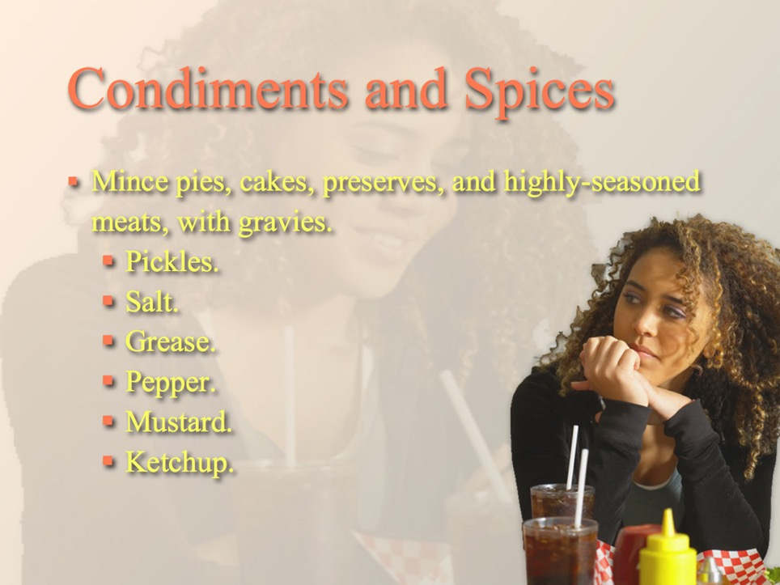

Slide 21
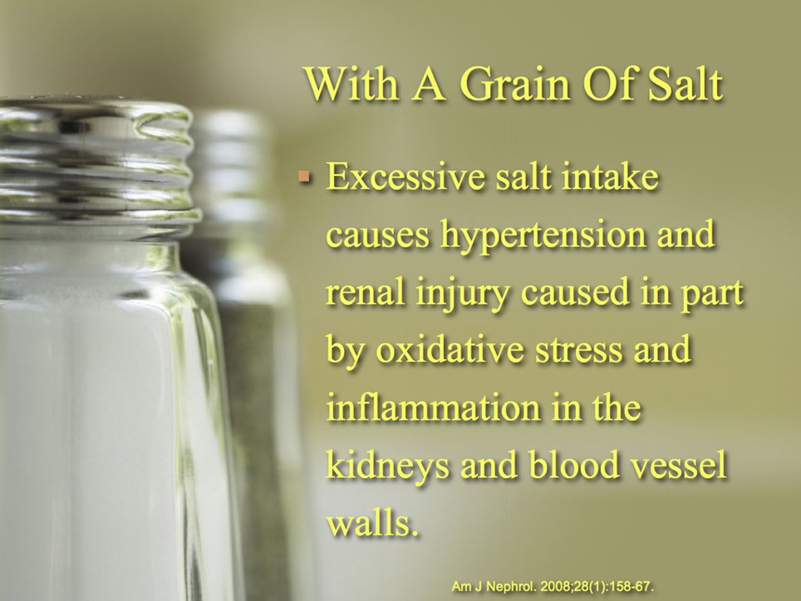

Slide 22
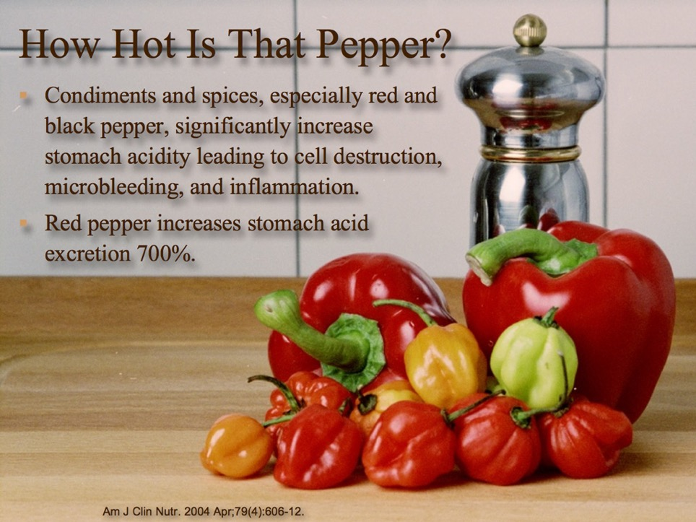

Slide 23
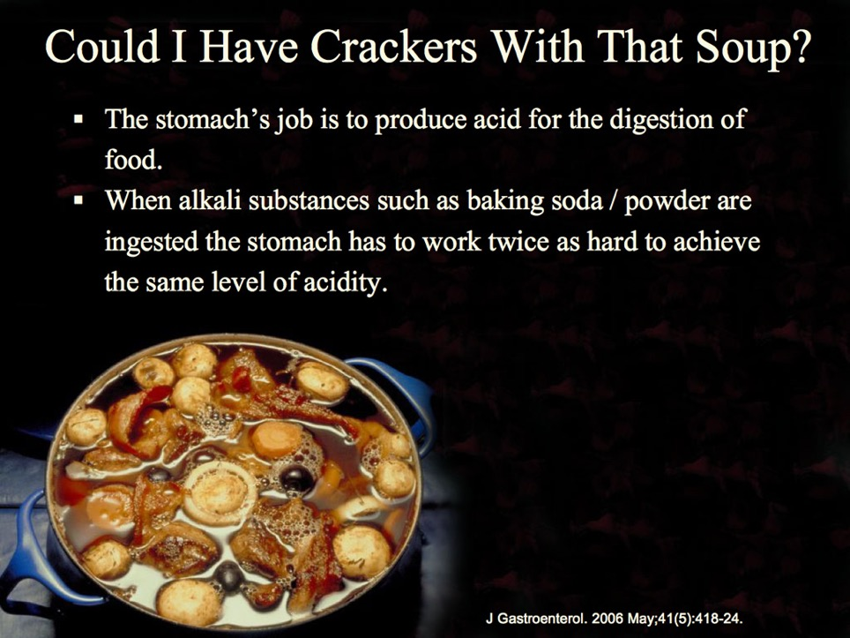

Slide 24
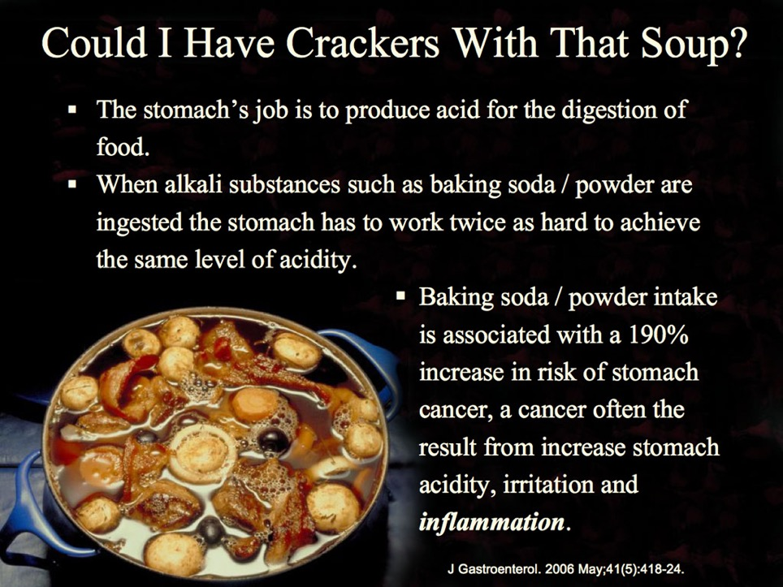

Slide 25
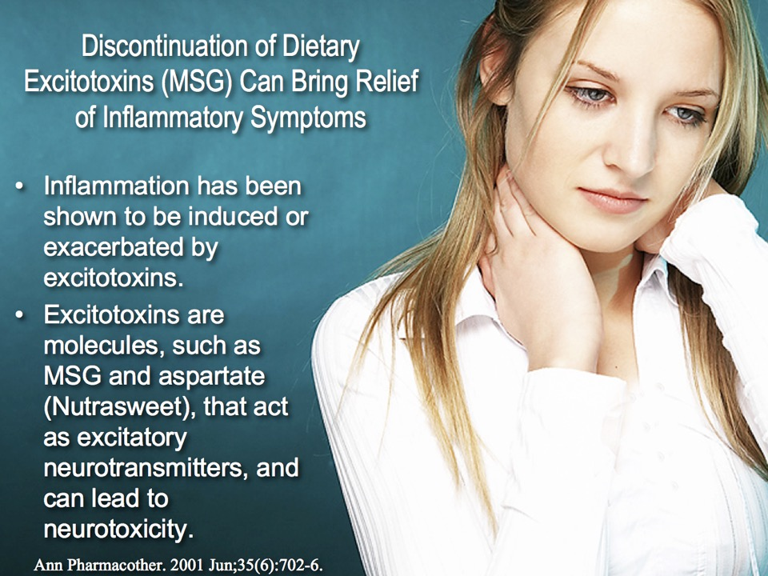

Slide 26
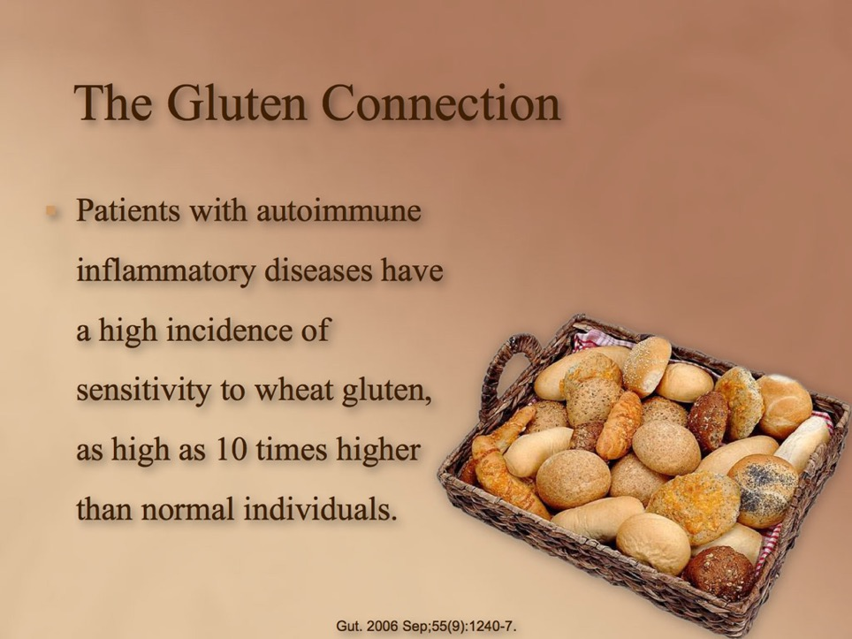

Slide 27
Notes:
Ever have a sticker in your sock, but it seemed impossible to find? All you could think of was relief…
Now you may have some insight into where the cocklebur of inflammation could be coming from.
Next I want to help you understand something called Oxidative Stress.
Oxidative stress is like a blow torch in the stubble, creating a prairie fire of pain and inflammation.

Slide 28
Oxydative Stress

Slide 29
Oxydative Stress
Oxygen

Slide 30
Oxydative Stress
Cholesterol
Oxygen

Slide 31
Oxydative Stress
Cholesterol
Oxygen
Oxidized Cholesterol
Free Radicals
Inflammation

Slide 32
Oxydative Stress
Cell
Cholesterol
Oxidized Cholesterol
Free Radicals
Inflammation

Slide 33
Oxydative Stress
Cell
Cholesterol
Ouch!
Oxidized Cholesterol
Free Radicals
Inflammation

Slide 34
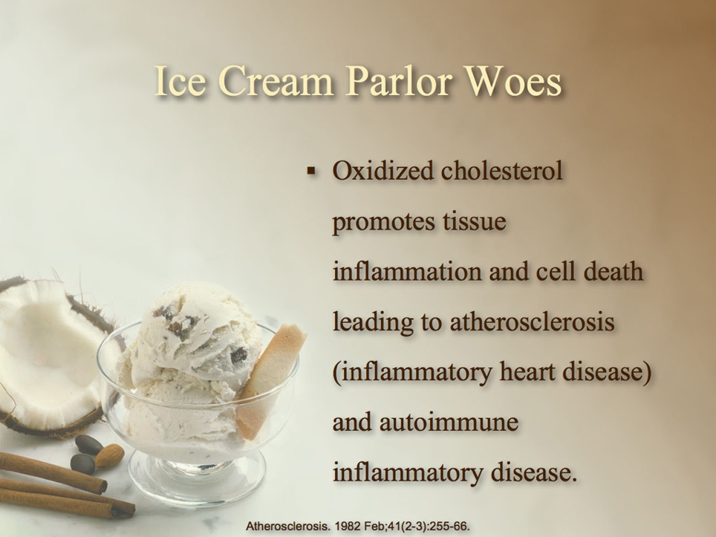

Slide 35
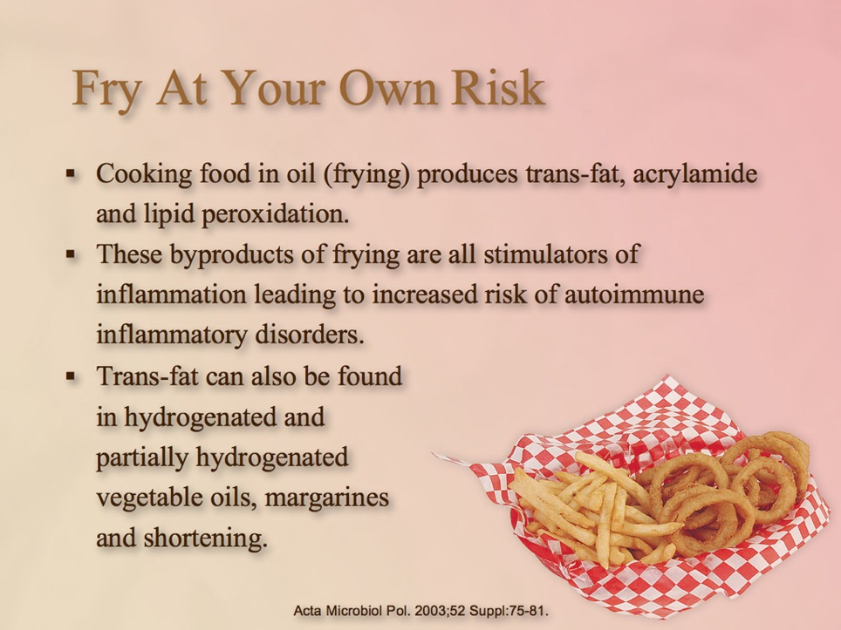

Slide 36
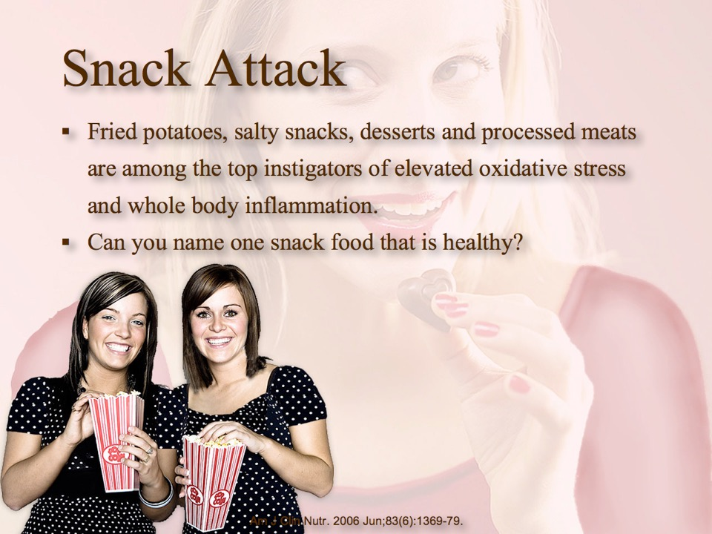

Slide 37
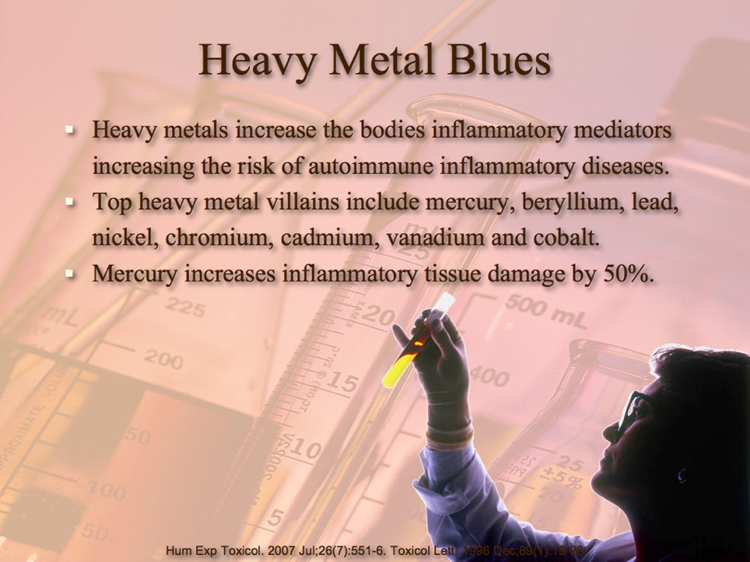


Slide 38
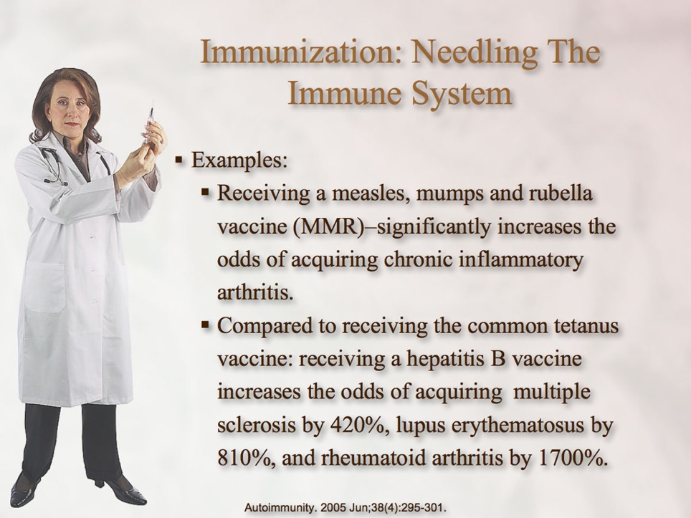

Slide 39
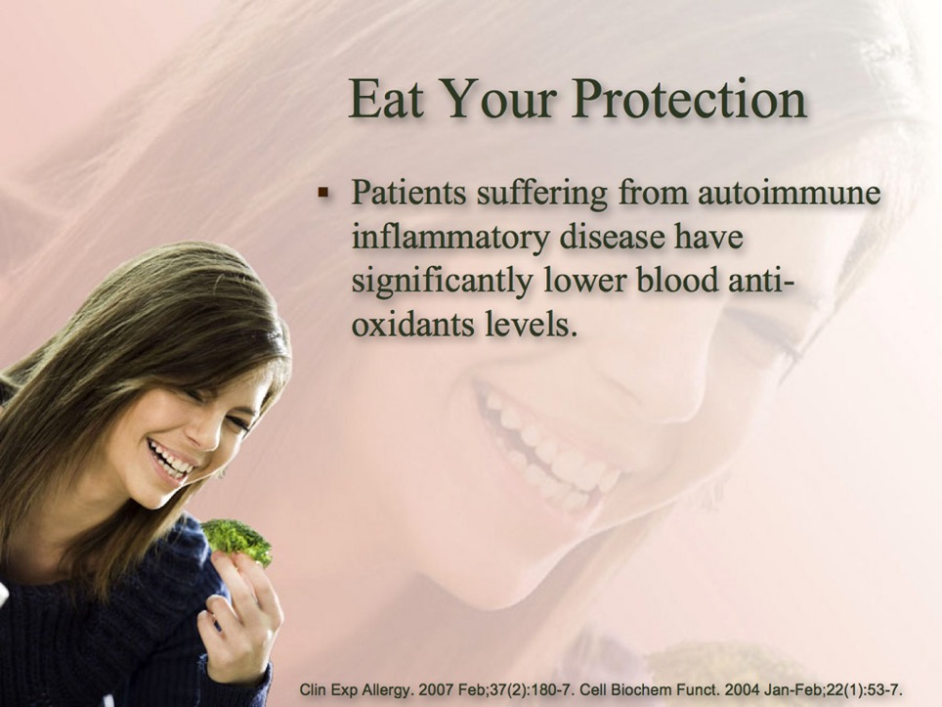

Slide 40
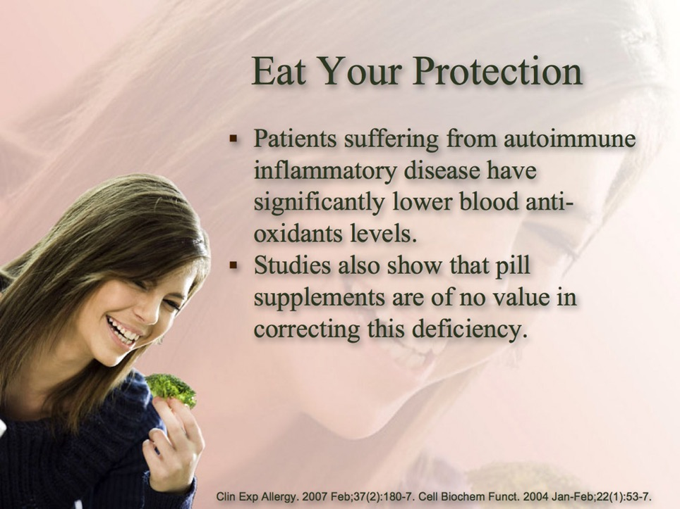

Slide 41
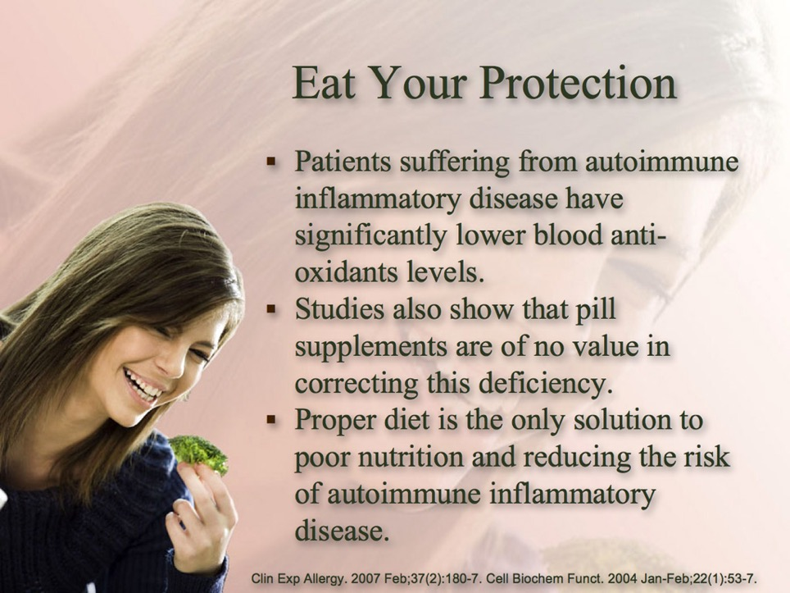

Slide 42
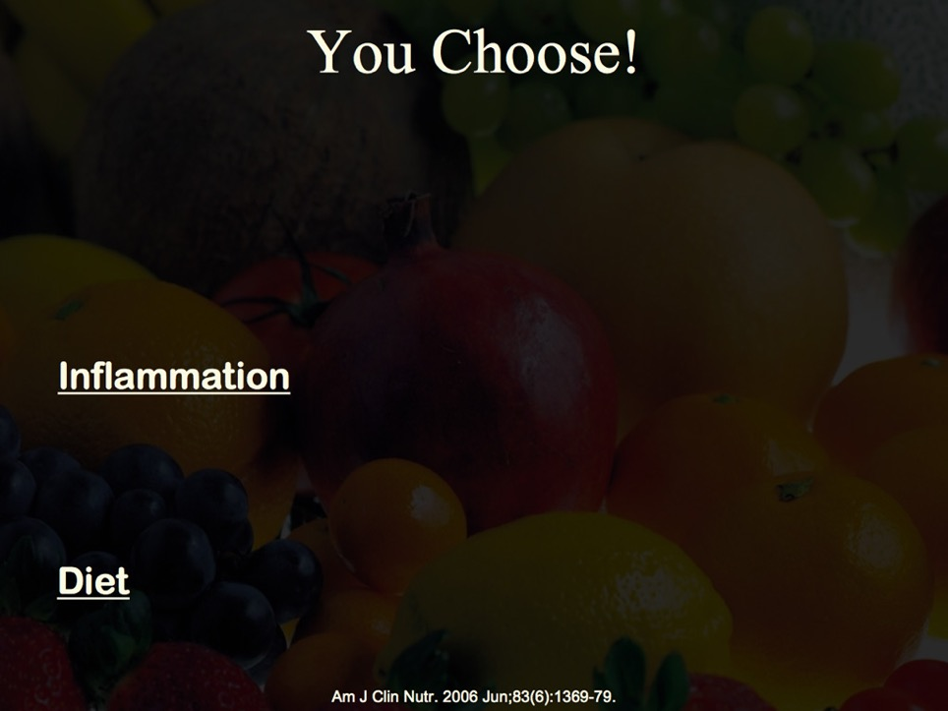

Slide 43
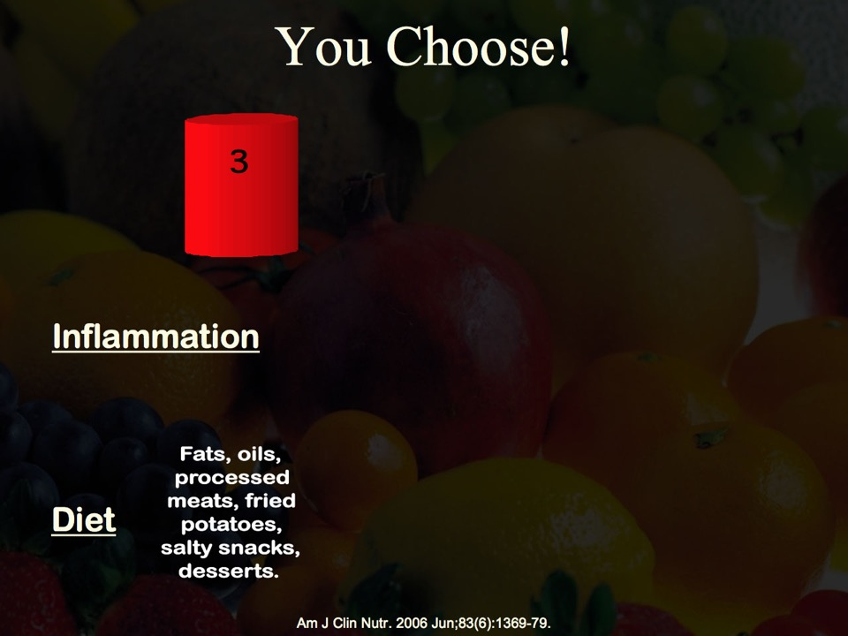

Slide 44
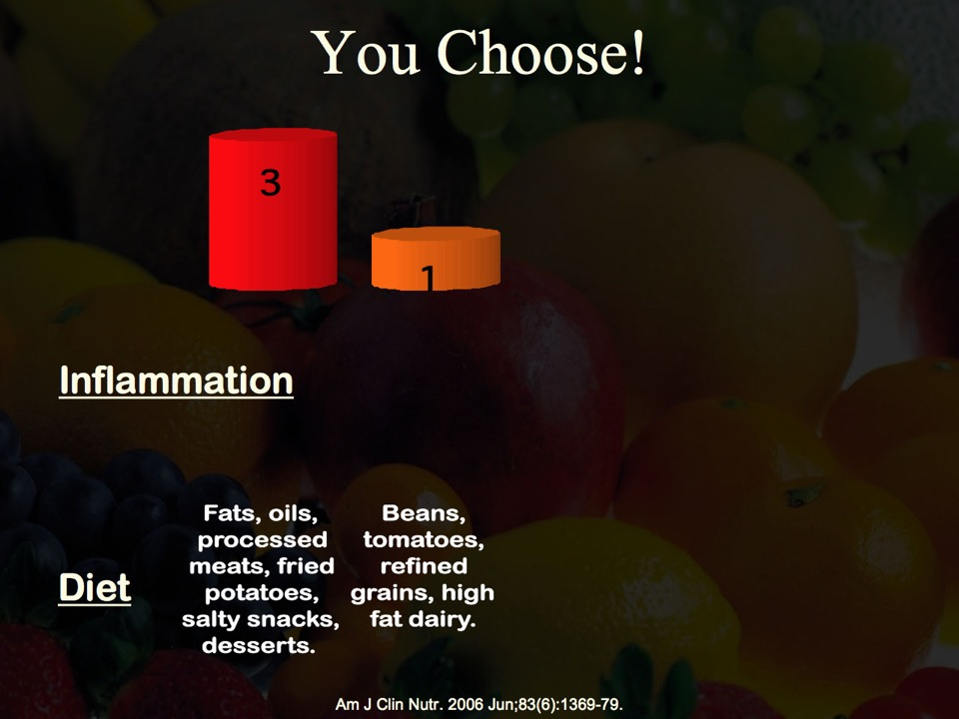

Slide 45
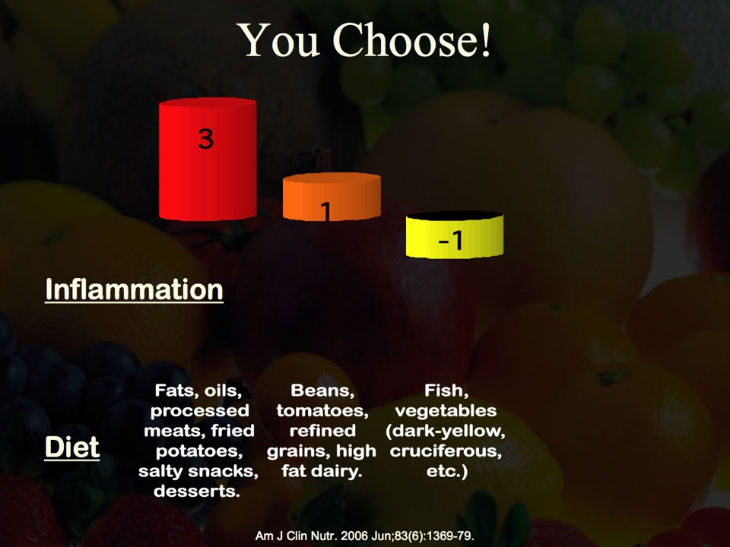

Slide 46
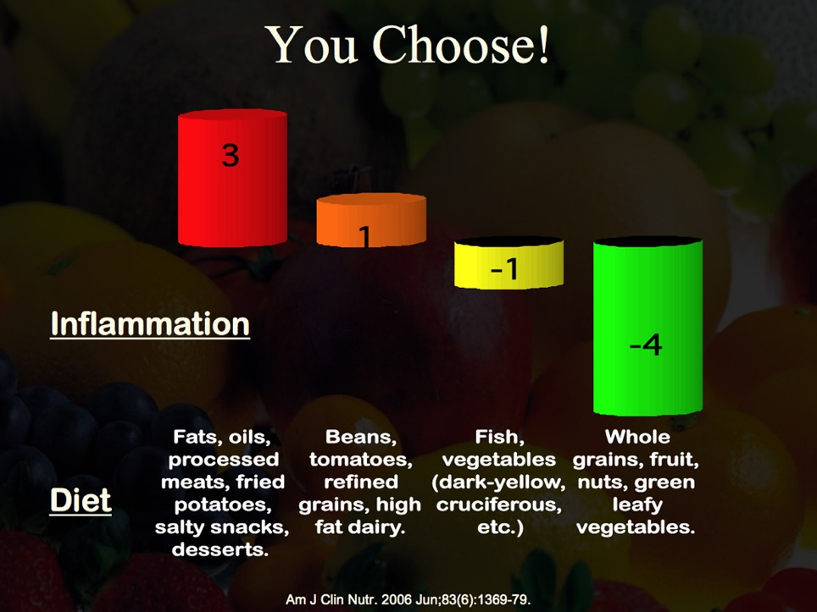

Slide 47
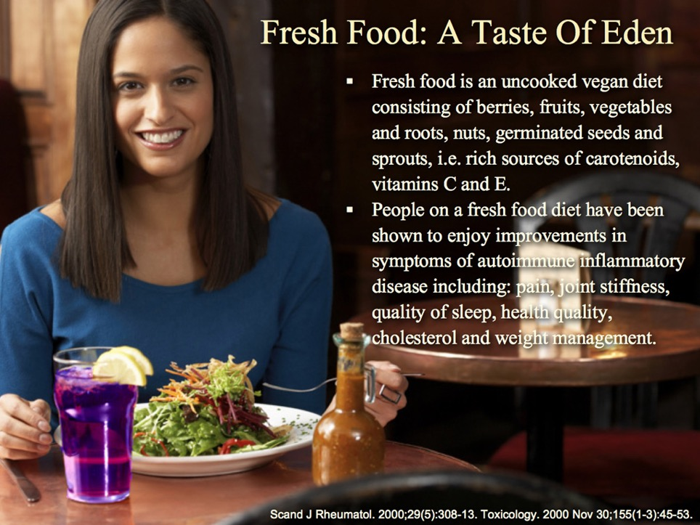

Slide 48
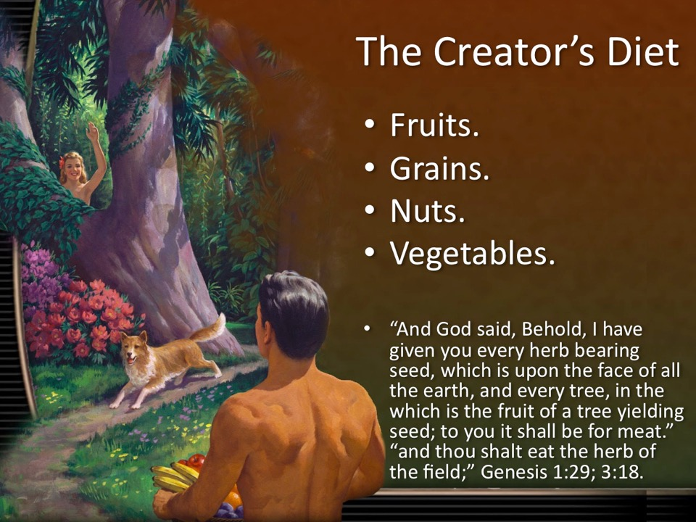

Slide 49
Notes:
Darlene: Allergies totally went away on one month fresh fruit and vegetable diet.
What would happen if you ate more fresh antioxidants?
Next I want to share with you the amazing blessings of charcoal.

Slide 50
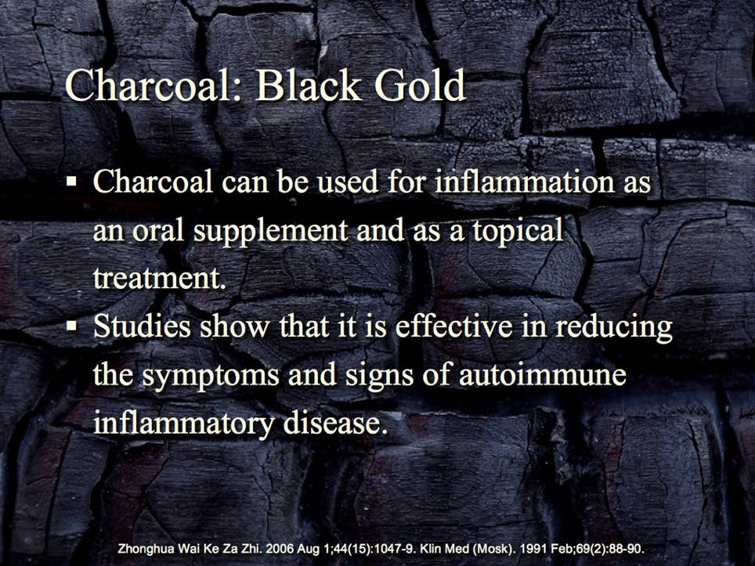

Slide 51
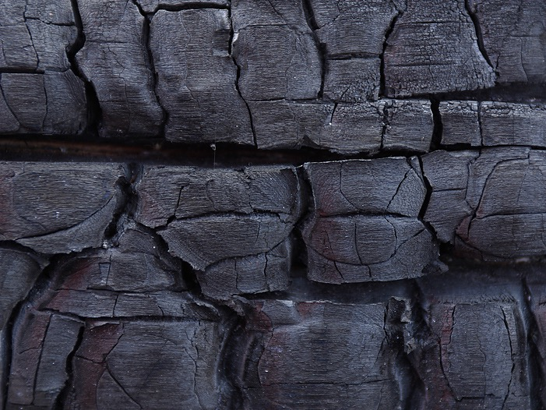
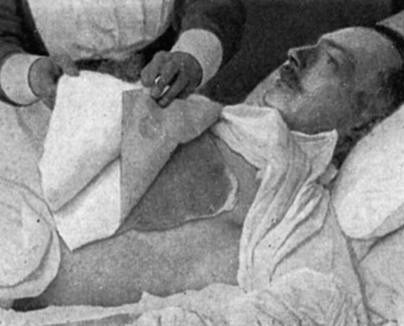
Charcoal: Black Gold
For inflammation and swelling a charcoal poultice is effective.
In a sauce pan mix:
  3 Tbs. activated charcoal powder.
  3 Tbs. whole flaxseed.
  1 cup water.
Bring to a boil and let sit till cool and slightly thickened.
Spread the mixture about 1/4 inch thick on a sturdy paper towel; cover with a second paper towel and place the poultice on the affected area.
Cooney DO. Activated Charcoal in Medical Applications. Mercel Dekker, inc. 1995.

Slide 52
Notes:
Amanda Consider charcoal as a means to lowering inflammation.
Poultices, ingested, fomentations.
Charcoal is a means of lowering inflammation as you search out and fix what was causing the autoimmune disease in the first place.
NEXT: I want to encourage you with the blessings to be found in water.
Reve 21:6 (KJS) And he said unto me, It is done. I am Alpha and Omega, the beginning and the end. I will give unto him that is athirst of the fountain of the water of life freely.

Slide 53
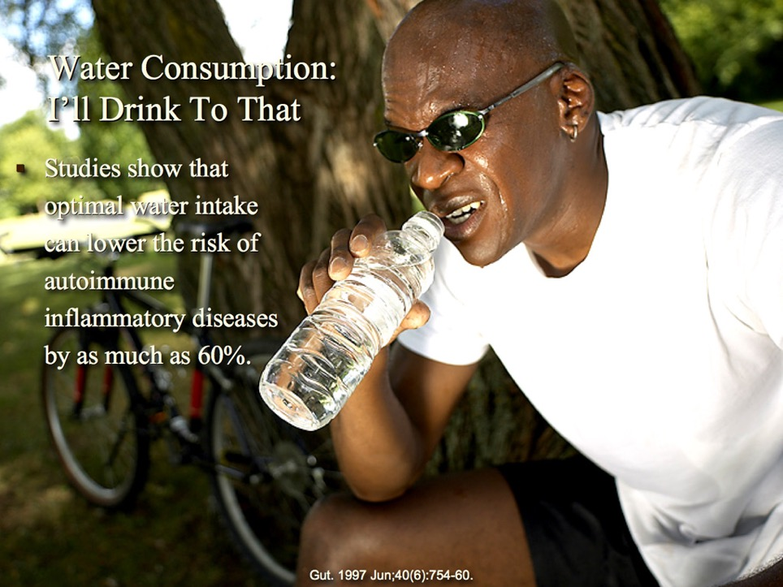
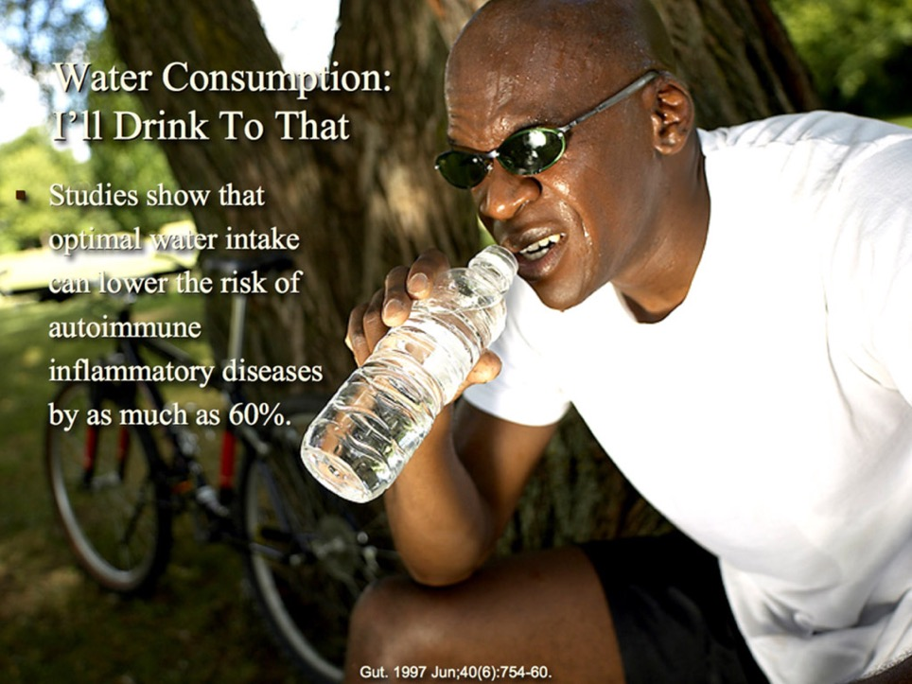

Slide 54
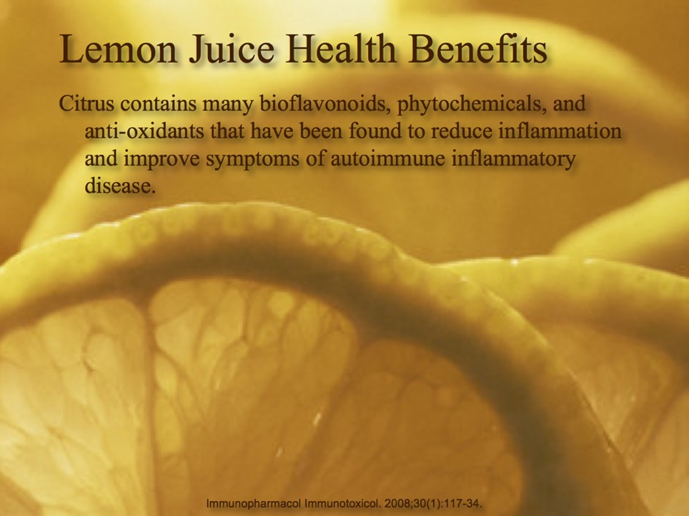

Slide 55
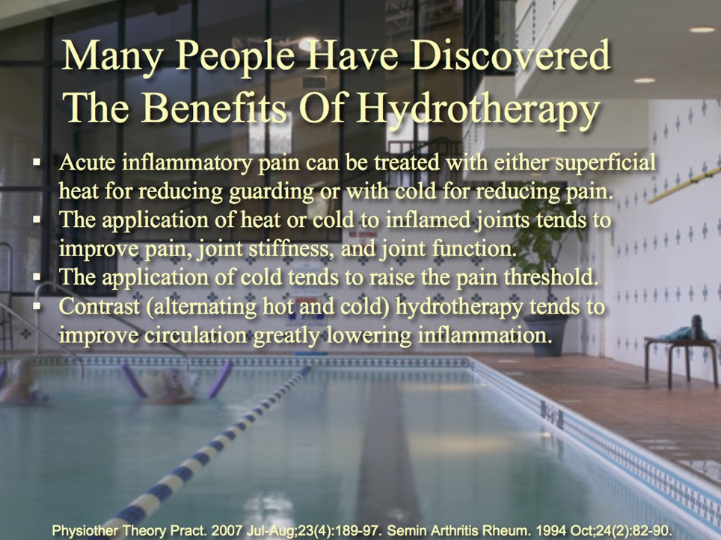

Slide 56
Notes:
Leukemia, back pain, arthritis knee pain: went into withdrawals when forgot morphine patch change.
She learned that if she followed God’s simple plan for lifestyle, drinking water , and eating good food, exercising outdoors, she could stop the mind altering drugs, be more alert and have better relationships with her family and friends.
What would happen if you drank more water?
Now I want to share with you the hazards of Intemperance in eating and drinking and its deleterious effects on recovery from autoimmune disease.

Slide 57
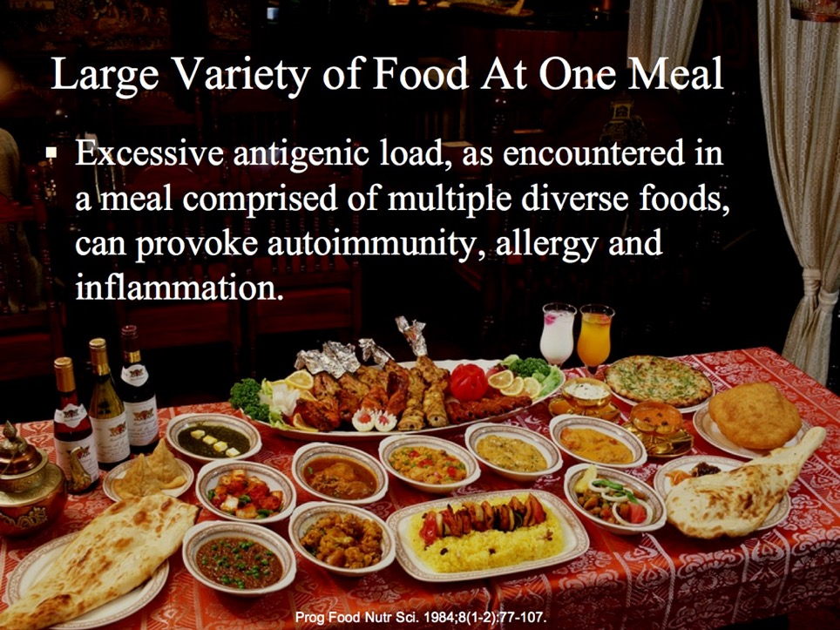
Notes:
The less that condiments and desserts are placed upon our tables, the better it will be for all who partake of the food. All mixed and complicated foods are injurious to the health of human beings. Dumb animals would never eat such a mixture as is often placed in the human stomach.... { CD 113.3}
The richness of food and complicated mixtures of food are health destroying.—Letter 72, 1896 { CD 113.4}
But that which is of the greatest importance is regularity and simplicity in your diet. Do not have a starvation diet, but do not take a variety at one meal. Get the very best things, if they cost you more, and eat not more than two or three articles at a meal. Two is better. Then there will not be so much quarrelling going on in your stomach. { KC 20.5 }
Here is a suggestion for all whose work is sedentary or chiefly mental; let those who have sufficient moral courage and self-control try it: At each meal take only two or three kinds of simple food, and eat no more than is required to satisfy hunger. Take active exercise every day, and see if you do not receive benefit. { MH 310.1}

Slide 58
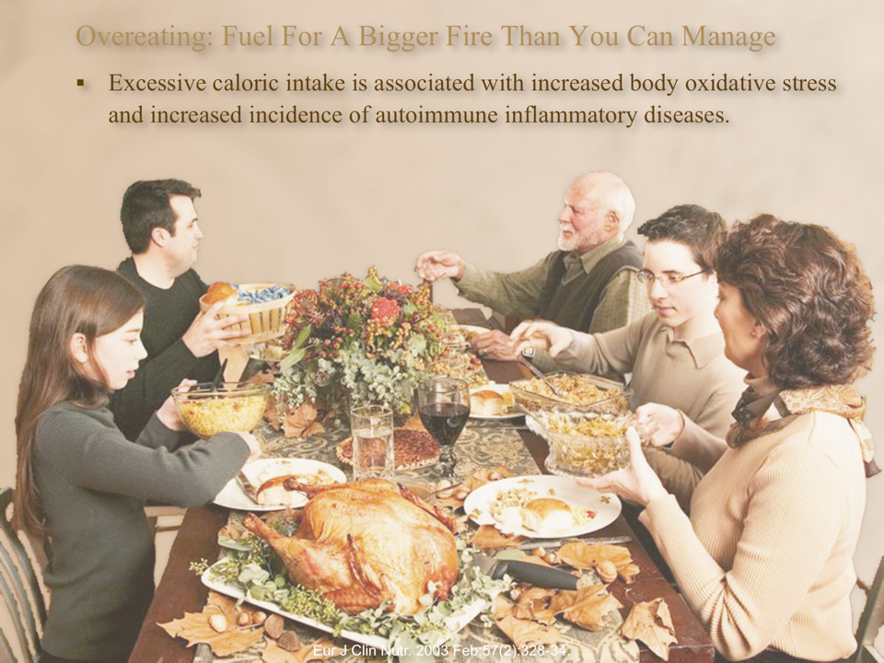

Slide 59


Slide 60

A Three Day Fast:
Resets the immune system.
Reduces inflammation.
Cell Stem Cell. 14(6):810-23.
Notes:
Cheng CW, Adams GB, Perin L, Wei M, Zhou X, Lam BS, Da Sacco S, Mirisola M, Quinn DI, Dorff TB, Kopchick JJ, Longo VD. Prolonged fasting reduces IGF-1/PKA to promote hematopoietic-stem-cell-based regeneration and reverse immunosuppression. Cell Stem Cell. 2014 Jun 5;14(6):810-23.
Author information
Erratum in
Cell Stem Cell. 2016 Feb 4;18(2):291-2.
Abstract
Immune system defects are at the center of aging and a range of diseases. Here, we show that prolonged fasting reduces circulating IGF-1 levels and PKA activity in various cell populations, leading to signal transduction changes in long-term hematopoietic stem cells (LT-HSCs) and niche cells that promote stress resistance, self-renewal, and lineage-balanced regeneration. Multiple cycles of fasting abated the immunosuppression and mortality caused by chemotherapy and reversed age-dependent myeloid-bias in mice, in agreement with preliminary data on the protection of lymphocytes from chemotoxicity in fasting patients. The proregenerative effects of fasting on stem cells were recapitulated by deficiencies in either IGF-1 or PKA and blunted by exogenous IGF-1. These findings link the reduced levels of IGF-1 caused by fasting to PKA signaling and establish their crucial role in regulating hematopoietic stem cell protection, self-renewal, and regeneration.
Copyright © 2014 Elsevier Inc. All rights reserved.
Comment in
Saying no to drugs: fasting protects hematopoietic stem cells from chemotherapy and aging. [Cell Stem Cell. 2014]
Prolonged fasting/refeeding promotes hematopoietic stem cell regeneration and rejuvenation. [Rejuvenation Res. 2014]
PMID: 24905167 PMCID: PMC4102383 DOI: 10.1016/j.stem.2014.04.014
[Indexed for MEDLINE] Free PMC Article
Similar articles
Icon for Elsevier ScienceIcon for PubMed CentralIcon for Loma Linda University Libraries
Publication type, MeSH terms, Substances, Grant support
Select item 20157582
Müller H, de Toledo FW, Resch KL. Fasting followed by vegetarian diet in patients with rheumatoid arthritis: a systematic review. Scand J Rheumatol. 2001;30(1):1-10.

Slide 61
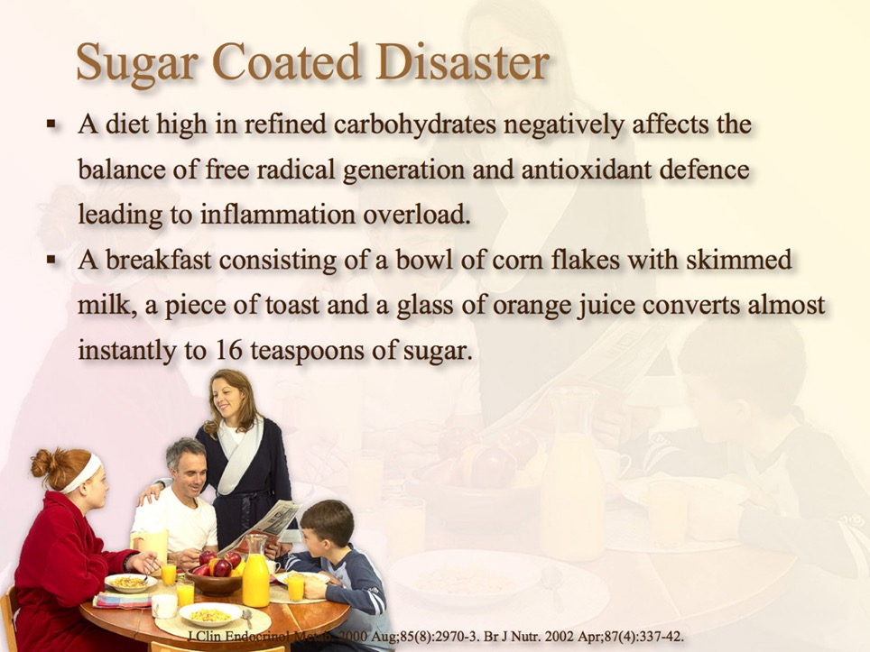

Slide 62


Slide 63


Slide 64



Slide 65



Slide 66



Slide 67



Slide 68



Slide 69



Slide 70


Slide 71


Slide 72


Slide 73
Notes:
Why do you keep beating your head against the wall? Because if feels so good when I stop.
At first I may throb and the body will withdrawal, but the cleansing is worth it and the result can improve health and well-being.
Next I want to help you understand the role of a healthy pulse to improved health.

Slide 74


Slide 75


Slide 76
Notes:
Glenn Pate: (“Roger”) 1 hour of activity interspersed through out the day.
What would happen to your health if you got more active and limited sitting and sleeping to just 23 hours a day?
And why did I send Roger out into the open air and sunshine?
Let me share with you the benefits of the outdoors over indoor living.

Slide 77


Slide 78



Slide 79


Slide 80
Notes:
How long can you hold your breath?
Researchers wanted to discover the spread of the flu one year. They identified the first major case of the year and how it became an epidemic.
One infected passenger boarded a plane flying from NY to CA. 73% of the passengers on that plane, who were forced to re-breath and re-breath the sick mans breath came down with the same influenza.
How many times have your re-breathed the air in you dwelling?
Next I want to talk about the benefits of a regular schedule for your and your loved ones who you do not want to suffer an autoimmune disease.
Being on time is like swinging a bat at an oncoming ball in baseball.

Slide 81


Slide 82


Slide 83

Inter mitochondrial Melatonin.

Slide 84


Slide 85


Slide 86


Slide 87


Slide 88


Slide 89


Slide 90
Notes:
As with hitting a home run in base ball, timing is crucial in overcoming an autoimmune inflammatory disease.
The AirPort.
Sierra SARRAH
Help your body hit a home run, practice you timing today.
Last but not lease, the mind can make you sick with an autoimmune inflammatory disease.

Slide 91


Slide 92


“Sickness of the mind prevails everywhere. Nine tenths of the diseases from which men suffer have their foundation here. Perhaps some living home trouble is, like a canker, eating to the very soul and weakening the life forces. Remorse for sin sometimes undermines the constitution and unbalances the mind.” Healthful Living p. 230

Slide 93


Slide 94

“And we know that all things work together for good to them that love God,” Romans 8:28.

Slide 95
Notes:
What would happen if you let God handle all the stressful situations that come along in your life?
Let’s summarize:

Slide 96

Take advantage of God’s wonderful provision for our wellness found in fresh fruits and vegetables, nuts, seeds, and grains with all their health promoting antioxidants, vitamins, minerals, phytochemicals and fiber.
Make wise use of charcoal as appropriate for your inflammatory condition.
Drink the water of life freely and regularly.
Make temperance your character strength. Practice moderation in those things that benefit health and totally avoid all things questionable or harmful.
Keep your pulse lively with invigorating exercise in the fresh, clean, pure outdoor air and sunshine.
Have a regular daily schedule keeping in sync with eating times, sleeping times and even exercising times.
Take it easy—let God be in charge, place your confidence His unfailing love and care.
Notes:
Eat your Protection!

Slide 97
Make wise use of charcoal as appropriate for your inflammatory condition.
Drink the water of life freely and regularly.
Make temperance your character strength.
Practice moderation in those things that benefit health and totally avoid all things questionable or harmful.
Keep your pulse lively with invigorating exercise in the fresh, clean, pure outdoor air and sunshine.
Have a regular daily schedule keeping in sync with eating times, sleeping times and even exercising times.
Take it easy—let God be in charge, place your confidence His unfailing love and care.
Notes:
Eat your Protection!

Slide 98
Drink the water of life freely and regularly.
Make temperance your character strength.
Practice moderation in those things that benefit health and totally avoid all things questionable or harmful.
Keep your pulse lively with invigorating exercise in the fresh, clean, pure outdoor air and sunshine.
Have a regular daily schedule keeping in sync with eating times, sleeping times and even exercising times.
Take it easy—let God be in charge, place your confidence His unfailing love and care.
Notes:
Eat your Protection!

Slide 99
Make temperance your character strength.
Practice moderation in those things that benefit health and totally avoid all things questionable or harmful.
Keep your pulse lively with invigorating exercise in the fresh, clean, pure outdoor air and sunshine.
Have a regular daily schedule keeping in sync with eating times, sleeping times and even exercising times.
Take it easy—let God be in charge, place your confidence His unfailing love and care.
Notes:
Eat your Protection!

Slide 100
Keep your pulse lively with invigorating exercise in the fresh, clean, pure outdoor air and sunshine.
Have a regular daily schedule keeping in sync with eating times, sleeping times and even exercising times.
Take it easy—let God be in charge, place your confidence His unfailing love and care.
Notes:
Eat your Protection!

Slide 101
Have a regular daily schedule keeping in sync with eating times, sleeping times and even exercising times.
Take it easy—let God be in charge, place your confidence His unfailing love and care.
Notes:
Eat your Protection!

Slide 102
Take it easy—let God be in charge, place your confidence His unfailing love and care.
Notes:
Eat your Protection!

Slide 103


Slide 104
Autoimmune Inflammatory Diseases:
When Self is the Enemy
Notes:
Naomi’s doctor became very quiet as she looked over the imaging studies of Naomi’s spine. She had just finished lecturing Naomi for not taking her autoimmune disease medications as prescribed. Naomi wondered what was taking so long. She knew she felt a lot better, no more pain, fatigue or drug side effects. She had been following the simple natural remedies and lifestyle suggestions found in my presentation, “Autoimmune Inflammatory Diseases: When Self is the Enemy”. Finally, the doctor turned around and said, Well, the radiologist says that compared to previous imaging studies, there is no longer any evidence of ankylosing spondylitis in your spine. Don’t miss this presentation, it could change your life forever too.
Story: Naomi (Canadian ankylosing spondylitis)
Benefit/problem solved
pain
fatigue
drug dependence
Bullet points
Autoimmune Inflammatory Diseases: When Self is the Enemy
Inspire
recover off meds, live to your fullest
Call to action
Don’t miss this lecture, it could change your life forever.

Slide 105


Slide 106


