Slide 1

Arthritis:
Don’t Let Joint Pain Slow Your Journey
Notes:
fixed

Slide 2
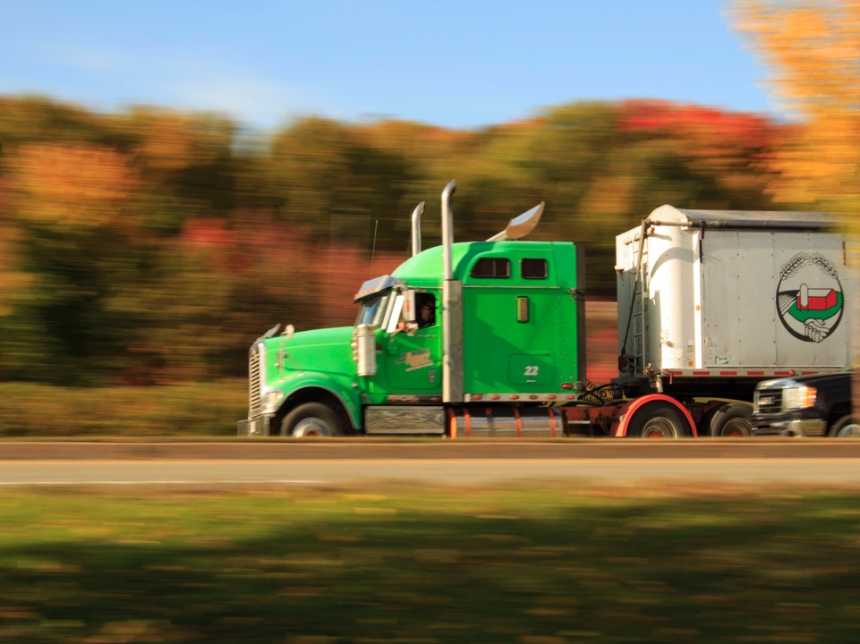
Story/opening
https://www.pexels.com
Notes:
Campmeeting truck driver
Denis and sugar

Slide 3
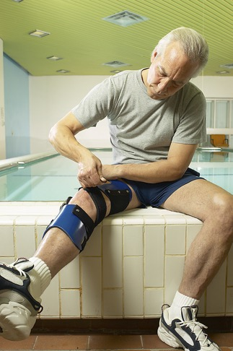
92 million adults, in the United States, with arthritis.
Arthritis Rheumatol. 70(2):185-192
Notes:
Jafarzadeh SR, Felson DT. Updated Estimates Suggest a Much Higher Prevalence of Arthritis in United States Adults Than Previous Ones. Arthritis Rheumatol. 2018 Feb;70(2):185-192. doi: 10.1002/art.40355. Epub 2018 Jan 3. PMID: 29178176; PMCID: PMC5788727.

Slide 4

Arthritis does not have to end your game.
https://www.pexels.com

Slide 5
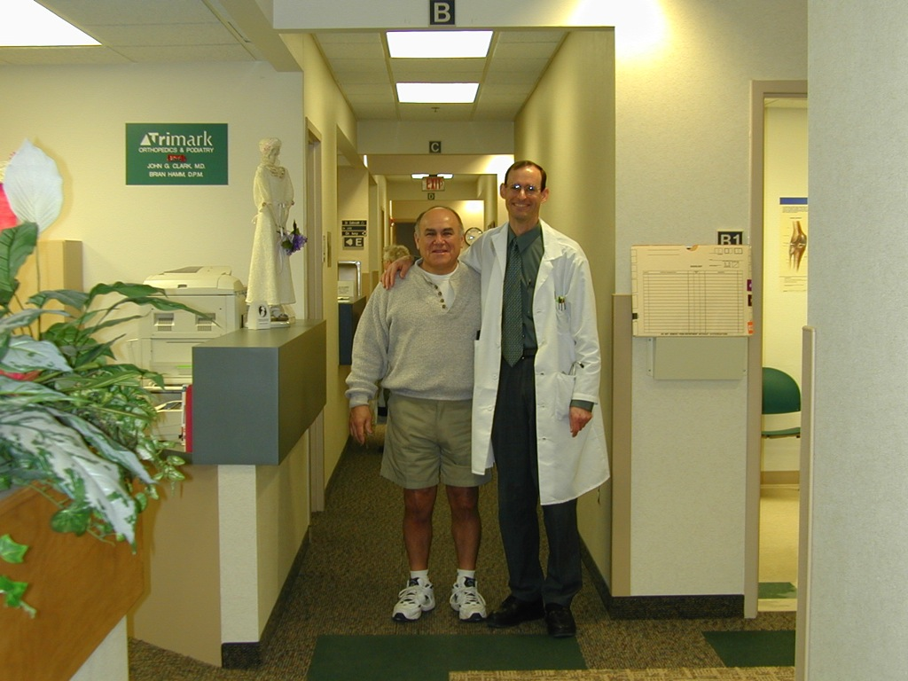

Slide 6
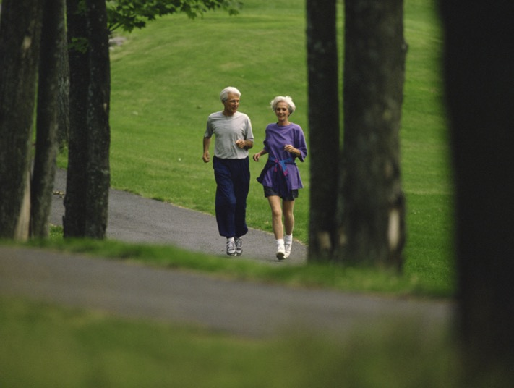
With simple lifestyle changes and natural remedies you can outrun arthritis.

Slide 7
Blood supply and oxygenation.
Exercise.
Natural Remedies.
Water and good hydration.
Diet and obesity.
Overview

Slide 8
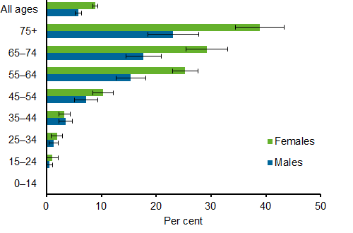
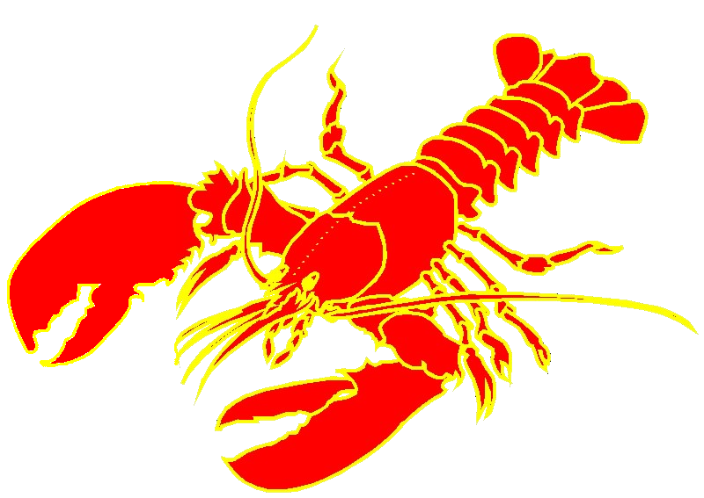
http://www.aihw.gov.au/uploadedImages/Subjects/Arthritis_and_musculoskeletal_conditions/Osteoarthritis/_Content/osteo-prevalence-age.png?n=3936
Prevalence of Osteoarthritis in Australia

Slide 9
“Disease is an effort of nature to free the system from conditions that result from a violation of the laws of health.” MH 127

Slide 10
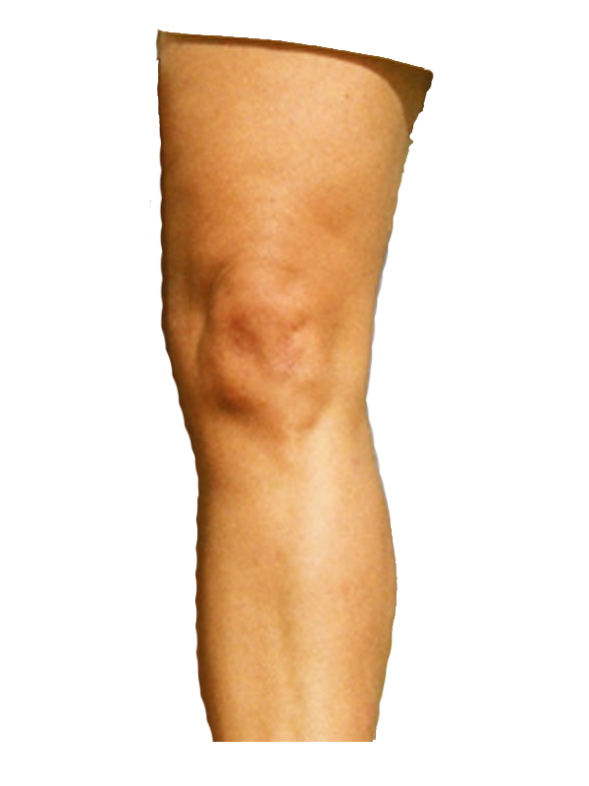

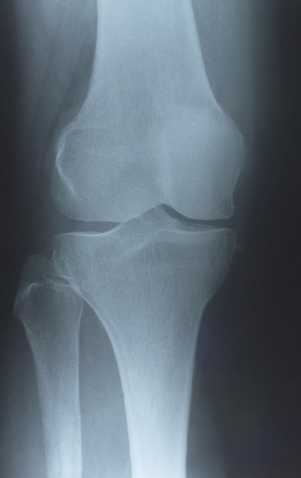

Blood cell
Cartilage has no blood supply.
FEMUR
Enlarged Capillary!
X ray of Knee
Knee Joint
Cartilage
TIBIA
Capsule.

Slide 11
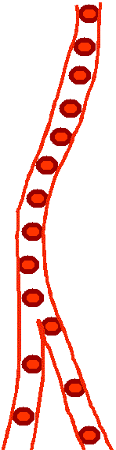
Blood must flow by the joint to maintain cartilage nutrition.

Slide 12
Fluid Must Flow To Cartilage.

Slide 13
Fluid must also flow away from cartilage.

Slide 14
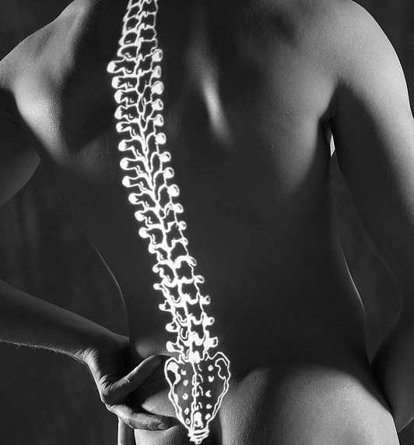
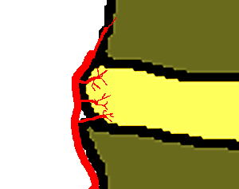
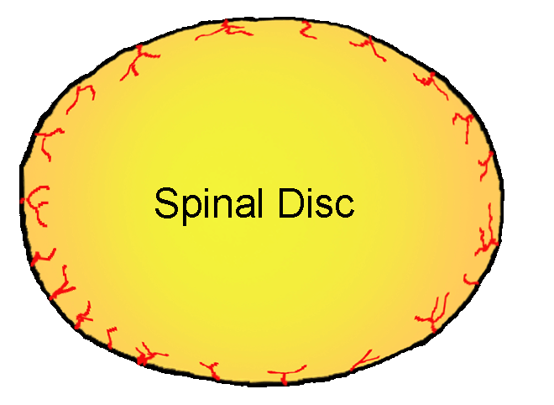
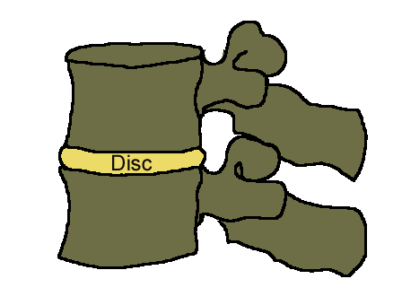
Why?

Slide 15
Anything that impedes fluid flow, to and from the cartilage, impedes cartilage nutrition.
Cartilage depends on its nutrition for health and repair.
Poor nutrition and failure of repair produce arthritis.

Slide 16

Cartilage and Water

Slide 17
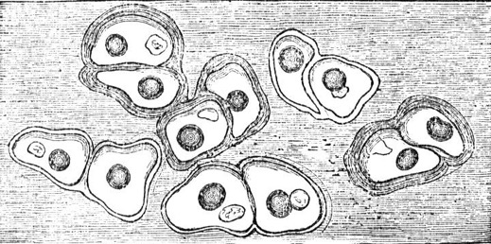
Healthy cartilage is 65%-80% water.

Slide 18
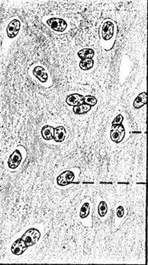
Water:
Shock absorber.
Lubricates.
Nourishes.

Slide 19
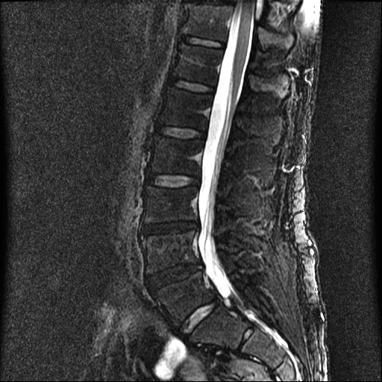
Dehydration
Normal Disc
Dry Discs

Slide 20
Dehydration.
No Water = No Fluid Flow.
Acid accumulates.
Cartilage cells starve and suffocate.

Slide 21
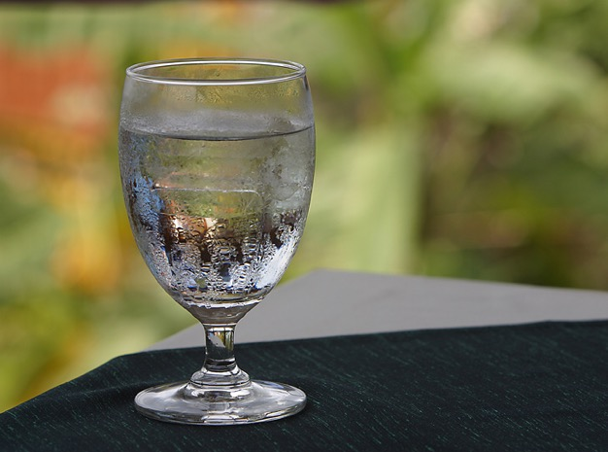
Cartilage Hydration
So! What should we drink?

Slide 22
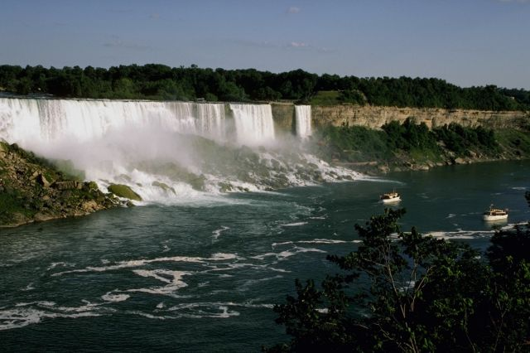


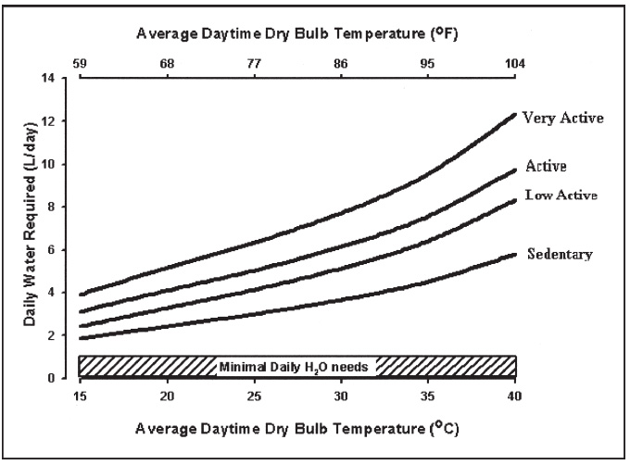
How Much Water?
3.7 L
2.7 L
Nutr Rev. 2005 Jun;63(6 Pt 2):S30-9.

Slide 23
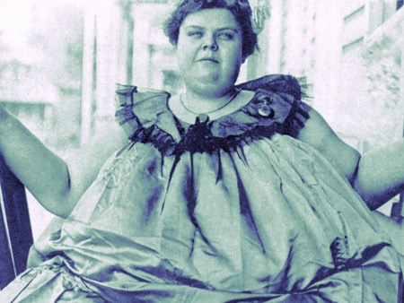
OBESITY

Slide 24
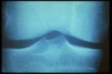
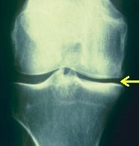
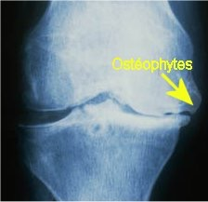
Joint Space Narrowing
Advanced Osteoarthritis
Normal Joint Space.
Loss of Joint Space.

Slide 25
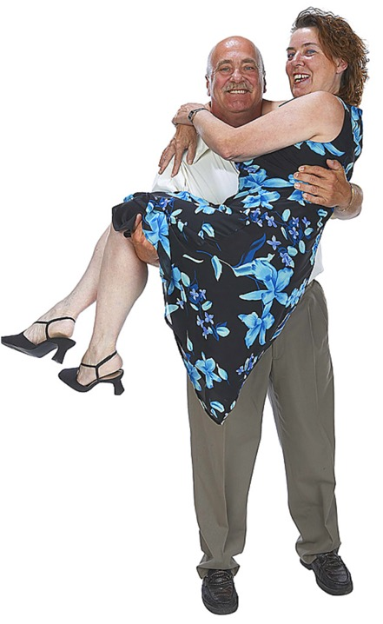
Obesity and Back Pain
Over weight people have higher rates of back pain.
Excess weight flattens discs.
Overloaded flattened discs take longer to recuperate.
Clin Biomech (Bristol, Avon). 2005 Oct;20(8):799-805.
Notes:
Clin Biomech (Bristol, Avon). 2005 Oct;20(8):799-805. Related Articles, Links
Body mass as a factor in stature change.
Rodacki AL, Fowler NE, Provensi CL, Rodacki Cde L, Dezan VH.
Department of Physical Education, Parana Federal University, Rua Coracao de Maria, 92, Jardim Botanico, BR 116-Km 95 Curitiba, Parana, Brazil.
BACKGROUND. Back pain is a common condition which has been described as a serious public health problem. Spinal shrinkage has been used as an index of spinal loading in a range of tasks. Epidemiological evidence shows that body mass index (BMI: 30 kg/m(2)) is related to the development of low back pain however, no studies have described the stature change patterns of obese individuals. This study aimed to compare changes in stature after an exercise task in obese and non-obese individuals. METHODS. Twenty volunteers were divided into two equal groups; obese: BMI>30 kg/m(2), non-obese: BMI<25 kg/m(2). Stature was measured at 3 min intervals during a 30 min walking task and a 30 min standing recovery period. Tests were performed on two occasions, once with participants loaded during the walking task (10% body mass) and once unloaded. The influence of obesity and load condition on the magnitude and rate of stature change were compared by a two-way ANOVA. FINDINGS. In both groups the stature loss was greater in the loaded than unloaded condition (mean (SD)) (6.52 (1.45)mm and 3.55 (0.93)mm non-obese; 8.49 (1.75)mm and 7.02 (1.32)mm obese: P=0.016). The obese presented a greater reduction in stature in both task conditions. The obese group were unable to recover stature regardless of the task condition during the recovery period (loaded: 0.06 (0.3)mm; unloaded: 0.32 (0.6)mm; P=0.013). INTERPRETATION. It was concluded that the acute response of the spine to loading may represent a risk factor for low back pain in the obese, in addition to the chronic adaptations previously reported. A greater period of recovery may be necessary for obese individuals to re-establish intervertebral disc height. These findings may help to explain the high incidence of back disorders in obese individuals.
Publication Types:
Clinical Trial
Controlled Clinical Trial
PMID: 16005554 [PubMed - indexed for MEDLINE]
J Gerontol A Biol Sci Med Sci. 2002 Feb;57(2):M128-33. Related Articles, Links
The association of eating behavior with risk for morbidity in older women.
Hays NP, Bathalon GP, Roubenoff R, Lipman R, Roberts SB.
Jean Mayer USDA Human Nutrition Research Center on Aging, Tufts University, Boston, Massachusetts 02111, USA.
BACKGROUND: Although an influence of eating behavior on dietary intake and physiology has been documented in several studies, the extent to which eating behavior influences long-term health is uncertain. METHODS: Current dietary restraint, disinhibition, and hunger were assessed using the Eating Inventory in 1252 nonsmoking women aged 55 to 65 years. In addition, subjects reported the presence or absence of 22 specific morbidities, along with general demographic information. Logistic regression was used to examine associations between eating behavior scores and morbidity, adjusting for age, prior smoking status, hormone replacement therapy, education level, and body mass index (BMI). RESULTS: In adjusted models excluding BMI, higher disinhibition scores were associated with small increased risks for hypercholesterolemia (odds ratio [OR] 1.04, p =.045), leg cramps (OR 1.05, p =.044), indigestion (OR 1.06, p =.020), and cataract (OR 1.09, p =.036), and a decreased risk of eczema (OR 0.91, p =.008). In addition, higher hunger scores were associated with increased risk of eczema (OR 1.09, p =.026). However, after adjusting for confounding variables plus BMI, higher disinhibition scores were associated with increased risks for low back pain (OR 1.06, p =.031) and constipation (OR 1.10, p =.004), and associations of disinhibition and hunger with eczema were unchanged (OR 0.90, p =.008 and OR 1.09, p =.024, respectively). Dietary restraint was not associated with morbidity in any model. CONCLUSIONS: Higher disinhibition and hunger scores were associated with small alterations in reported morbidity risk in a large population of nonsmoking older women. Although our cross-sectional study design makes the directionality of these relationships unclear, our results suggest at most a relatively minor independent influence of eating behavior constructs on long-term health.
PMID: 11818433 [PubMed - indexed for MEDLINE]

Slide 26
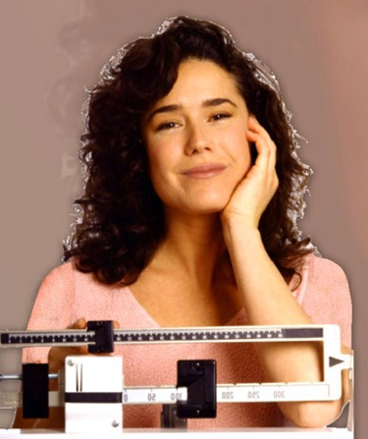
Weight Loss and Joint Health
A 10% weight reduction in patients with knee OA improved function by 28%.
Osteoarthritis Cartilage. 2005 Jan;13(1):20-7.

Slide 27
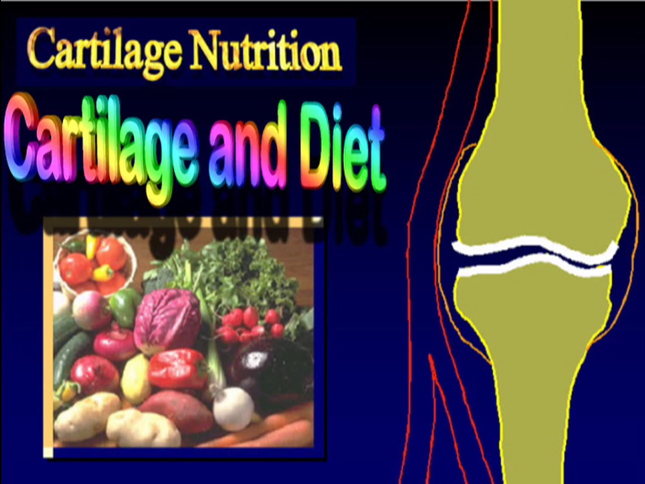

Slide 28

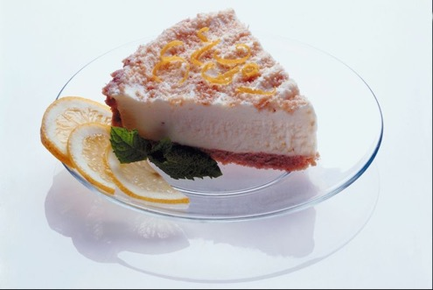
Refined Foods

Slide 29

Refined foods
create rouleaux.

Slide 30
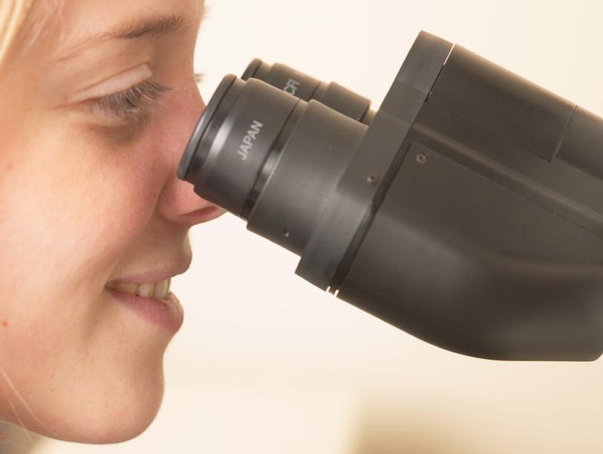
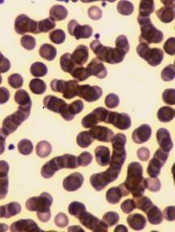
Clots / rouleauxed cells
Refined.

Slide 31
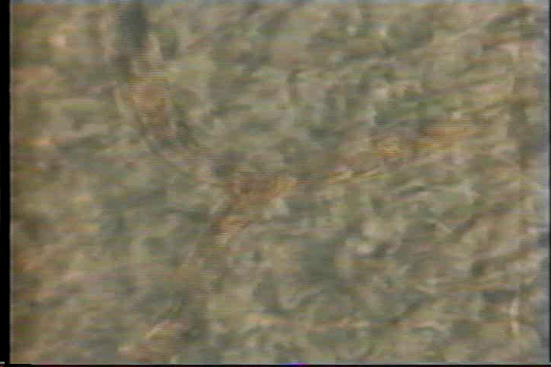
Refined foods create rouleaux.
Normal Blood Flow.

Slide 32
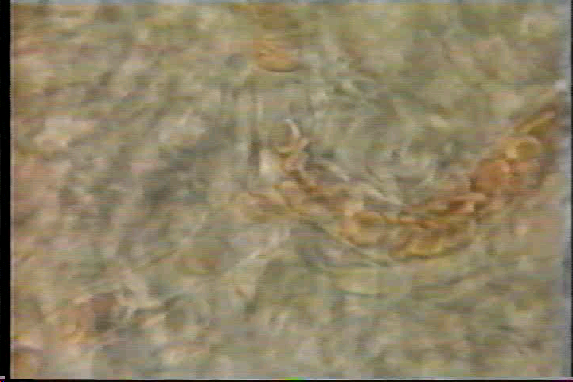
Refined foods create rouleaux
Rouleaux Blood Flow!

Slide 33

Refined foods that create rouleaux include:
Alcohol

Slide 34
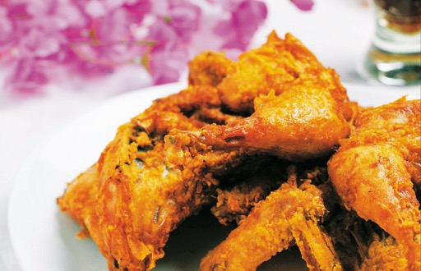
Refined foods that create rouleaux include:
Oil

Slide 35
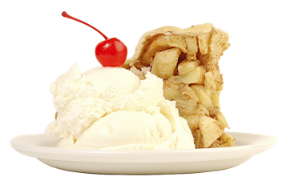
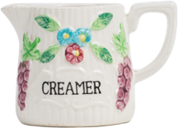
Refined foods that create rouleaux include:
Cream

Slide 36
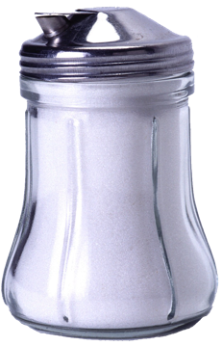
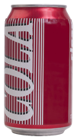
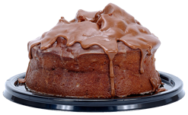
Refined foods that create rouleaux include:
Sugar

Slide 37
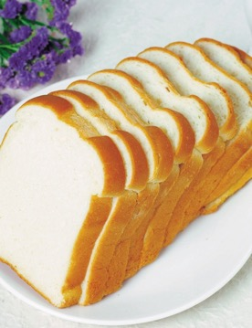
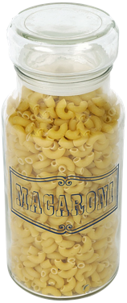
Refined foods that create rouleaux include:
Refined Starches

Slide 38
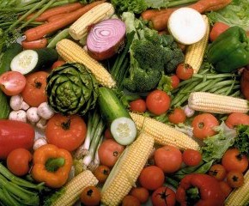
Blood Flow Promoting Diet
Fruits and Vegetables improve blood flow.

Slide 39
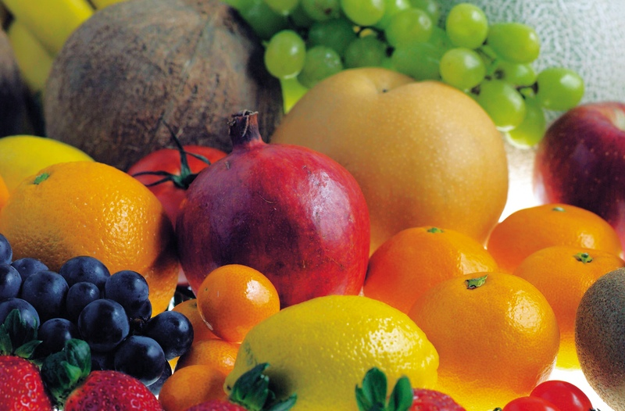
Omega-3 fatty acids in Fruits and vegetables, seeds and nuts promote blood flow.

Slide 40
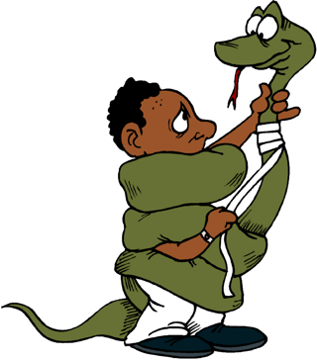
VASOACTIVE FOODS

Slide 41
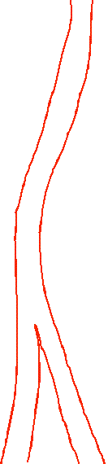
Vasoactive foods constrict free blood flow to the joint.

Slide 42

Vasoactive foods include:
Foods containing Caffeine.
Coffee
Notes:
Hasenfratz M; Battig K Action profiles of smoking and caffeine: Stroop
effect, EEG, and peripheral physiology. Pharmacol Biochem Behav 1992
May;42(1):155-61.

Slide 43

Vasoactive foods include:
Foods containing Caffeine.
Tea

Slide 44
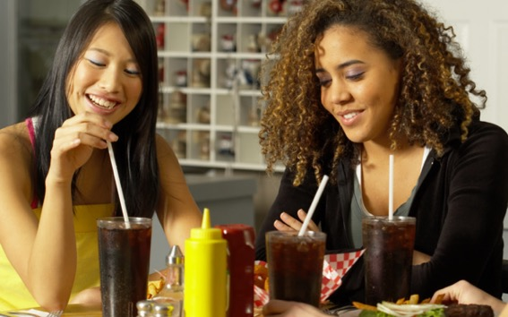
Vasoactive foods include:
Foods containing Caffeine.
Colas

Slide 45

Vasoactive substances include:
Nicotine

Slide 46

Insufficiently protecting the arms and legs from cold causes Vasoconstriction.

Slide 47
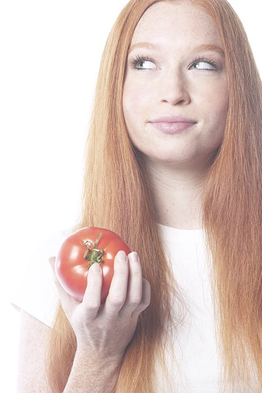
The Vaso-relaxing Diet
Improve vaso-relaxation:
  Vegetarian diet.
  Tomatoes.
  Unsaturated fats.
  Anti-oxidants.
  Zinc.
  Copper.

Slide 48
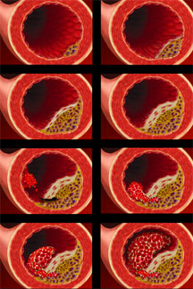
PLAQUE FORMING FOODS

Slide 49
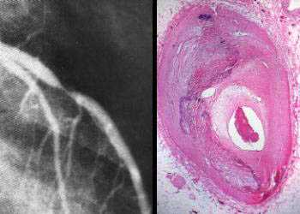
Plaque forming foods block blood flow to vital joint tissues.

Slide 50

Plaque forming foods include:
(2) foods high in fat:

Slide 51

Plaque forming foods include:
(2)foods especially high in saturated or trans-fats.

Slide 52
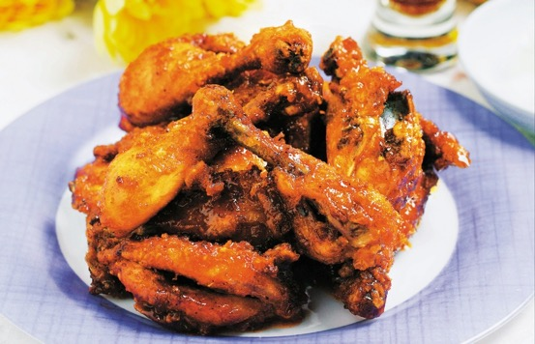
Plaque forming foods include:
(2)foods especially high in saturated or trans-fats.
Fried foods where the oils have been super heated.

Slide 53
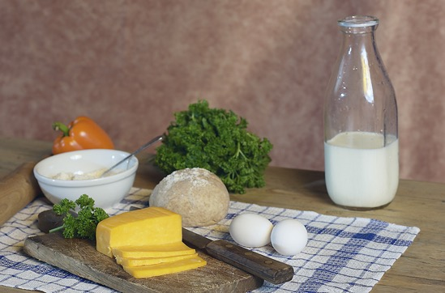
Plaque forming foods include:
(1) foods high in cholesterol.
Milk, Eggs, Cheese.

Slide 54

Plaque forming foods include:
foods especially high in oxidized cholesterol.
Ice cream

Slide 55

Plaque forming foods include:
foods especially high in oxidized cholesterol.
Pancake
mixes

Slide 56
Plaque Reducing Diet
Caldwell Esselstyn, Jr., MD, of the Cleveland Clinic has shown on angiography that blockages in coronary arteries can be reversed by changes in diet.
Before After

Slide 57
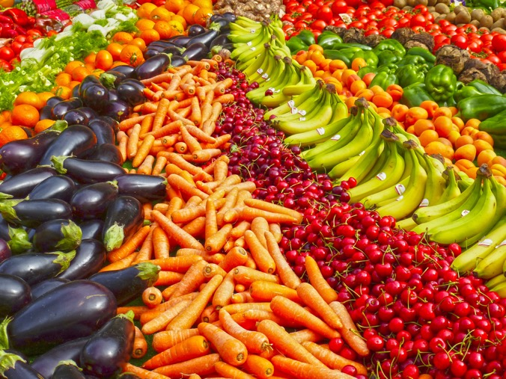
“The optimal diet consists of grains, legumes, vegetables, and fruit, with <10%-15% of its calories coming from fat.”
Caldwell Esselstyn, Jr., MD
https://www.pexels.com

Slide 58

Inflammatory Foods!

Slide 59
Inflammatory foods
thicken vessel walls.

Slide 60


Normal Kidney
Blood vessel Wall.
Thickened
inflamed
membrane.

Slide 61


Inflammatory foods include:
Meat

Slide 62



Inflammatory foods include:
Dairy

Slide 63

Inflammatory foods include:
Foods with aflatoxins.

Slide 64

Inflammatory foods include:
Foods with aflatoxins.
Some Peanut butter
Vinegar

Slide 65

https://www.doctorsandscience.com/uploads/1/3/5/8/135856265/health_fredom_summit_-_final_.pdf

Slide 66

Anti-inflammatory Diet
Fasting decreases inflammation especially when followed by a vegetarian diet.

Slide 67

Anti-inflammatory nutrients are found in fruits, vegetables, grains, bark, roots, stems, and flowers.

Slide 68

SLOW TRANSIT FOODS

Slide 69
Foods high in fat and low in fiber slow transit.

Slide 70

Bacterial overgrowth occurs and toxins increase.

Slide 71
Rouleaux.
Vasoconstriction.
Inflammation.

Slide 72

Slow Transit foods include:
Meat
High Fat
Low Fiber

Slide 73


Slow Transit foods include:
Fast Foods
High Fat
Low Fiber

Slide 74

Slow Transit foods include:
Pastries
High Fat
Low Fiber

Slide 75

Even meals digest more slowly fostering bacterial overgrowth.

Slide 76

The “Regular” Diet
Fiber.
Fiber.
Fiber.

Slide 77

Whole grains, dried fruit and fresh vegetables are good sources of dietary fiber.

Slide 78

Vegetarian Advantage
Higher consumption of fruits and vegetables decreases the risk of Osteoarthritis by 40%.
J Nutr Health Aging. 2017;21(7):750-758.
Notes:
Han HS, Chang CB, Lee DC, Lee JY. Relationship between Total Fruit and Vegetable Intake and Self-Reported Knee Pain in Older Adults. J Nutr Health Aging. 2017;21(7):750-758.
Abstract
Objectives: Knee pain is one of the most common symptoms of knee osteoarthritis (OA) that affects the quality of life in the older adults, and identifying the contributing factors of knee pain is important. We hypothesized that higher fruit and vegetable consumption might be associated with the severity of knee pain lower prevalence of severe knee pain by affecting pain perception in the knee joint. Therefore, we investigated the relationship between self-reported knee pain and the consumption of fruits vegetables, carotenoids and vitamin C and self-reported knee pain.
Design: Nationally representative cross sectional study.
Setting: 2010-2011 rounds of the Korean National Health and Nutrition Examination Survey.
Participants: A total of 6588 subjects aged ≥50 years were participated.
Methods: Severity of knee pain was estimated using a 10-point numeric rating scale (NRS). Daily intake of fruits, vegetables, and vitamins were estimated using data from 24-hour recalls and food frequency questionnaires.
Results: The NRS scores of knee pain decreased significantly with increasing fruit and vegetable intake quartiles. A multivariate logistic regression analysis showed that the fourth quartile of vegetable and fruit consumption was associated with decreased prevalence of severe knee pain (OR 0.59, 95% CI 0.48-0.73) compared with first quartile of vegetable and fruit consumption; however, carotenoids and vitamin C consumption was not associated with the severity of knee pain.
Conclusions: In conclusion, severe knee pain was independently associated with fruit and vegetable consumption. Our findings suggest that intake of whole fruits and vegetables may help improve knee pain in older adults.

Slide 79

Vitamins And Arthritis
People who are low on vitamin C and vitamin D have a threefold risk of progression of osteoarthritis.
Sunlight and rest improve arthritis.
Notes:
Vitamin C is an antioxidant and promotes collagen growth and can delay the onset of osteoarthritis.
McAlindon T, Felson DT. Nutrition: risk factors for osteoarthritis. Ann Rheum Dis. 1997 Jul;56(7):397-400.
On the other hand, for pro-
gression of radiographic knee OA, we found a threefold
reduction in risk for those in the middle and highest tertiles
of vitamin C intake (adjusted OR for highest v lowest ter-
tile=0.3; 95% confidence limits 0.1, 0.6). Those in the
highest tertile for vitamin C intake also had reduced risk of
developing knee pain during the course of the study
(aOR=0.3;0.1, 0.8). Reduction in risk of progression was
also seen for ‚ carotene (aOR=0.4;0.2, 0.9) and vitamin E
(aOR=0.7;0.3, 1.6) but was less consistent, in that the ‚
carotene association diminished substantially after
adjustment for vitamin C, and the vitamin E eVect was
seen only in men
STUDIES OF VITAMIN D IN HUMAN OA
We investigated the association of vitamin D status on the
incidence and progression of knee OA in the Framingham
OA Cohort Study. Participants had knee x rays taken at
examinations 18 (1983–5) and 22 (1992–3).62 We used two
measures of vitamin D status at exam 20; dietary intake,
estimated using a food frequency questionnaire, and serum
25 hydroxy-vitamin D. As with the antioxidant study, we
found no eVect of vitamin D status on the risk of incident
knee OA (for example, OR for lowest v highest tertile of
dietary vitamin D intake=1.02, 95% confidence limits=
0.45, 1.87). Risk of progression, however, increased three-
fold to fourfold for participants in the middle and lower
tertiles of both vitamin D intake (OR for lowest v highest
tertile=4.0, 95% confidence limits=1.4, 11.6) and serum
concentration (OR=2.9, 95% confidence limits=1.0, 8.2).
We concluded that low serum concentration, and low
intake, of vitamin D each seem to be associated with an
increase in the risk of knee OA progression.
Langstroth L. The Treatment of Chronic Arthritis by Diet and Sunlight. Cal West Med. 1935 Mar;42(3):145-9.

Slide 80

Pineapple
Contains bromelain which reduces arthritis pain.
Phytomedicine. 9(8):681-6.
Notes:
Walker AF, Bundy R, Hicks SM, Middleton RW. Bromelain reduces mild acute knee pain and improves well-being in a dose-dependent fashion in an open study of otherwise healthy adults. Phytomedicine. 2002 Dec;9(8):681-6.
There is preliminary clinical evidence to support the contention that the anti-inflammatory and analgesic properties of bromelain help to reduce symptoms of osteo- and rheumatoid arthritis. However, there have been no controlled studies of its effects on joint health in healthy subjects who lack such diagnosis. The current study investigated the effects of bromelain on mild acute knee pain of less than 3 months duration in otherwise healthy adults. The study was an open, dose-ranging postal study in volunteers who had been recruited through newspaper and magazine articles. Two validated questionnaires (WOMAC knee health Index and the Psychological Well-Being Index) were completed at baseline and after one month's intervention with bromelain, randomly allocated to volunteers as either 200 mg or 400 mg per day. Seventy seven subjects completed the study. In both treatment groups, all WOMAC symptom dimension scores were significantly reduced compared with baseline, with reductions in the final battery (total symptom score) of 41 and 59% (P = 0.0001 and <0.0001) in the low and high dose groups respectively. In addition, improvements in total symptom score (P = 0.036) and the stiffness (P = 0.026) and physical function (P = 0.021) dimensions were significantly greater in the high-dose (400 mg per day) compared with the low-dose group. Compared to baseline, overall psychological well-being was significantly improved in both groups after treatment (P = 0.015 and P = 0.0003 in the low and high dose groups respectively), and again, a significant dose-response relationship was observed. We conclude that bromelain may be effective in ameliorating physical symptoms and improving general well-being in otherwise healthy adults suffering from mild knee pain in a dose-dependant manner. Double blind, placebo-controlled studies are now warranted to confirm these results.

Slide 81

Gotu Kola (Centella Asiatica herb)
Gotu Kola herb reduces inflammation, balances antioxidants and reduces arthritis severity.
Biomed Environ Sci. 2014 Dec;27(12):926-38.
Notes:
Sharma S, Gupta R, Thakur SC. Attenuation of collagen induced arthritis by Centella asiatica methanol fraction via modulation of cytokines and oxidative stress. Biomed Environ Sci. 2014 Dec;27(12):926-38.
Abstract
Objective: To investigate the anti-inflammatory, antioxidant and anti-arthritic effects of Centella asiatica methanolfraction (CaME) on collagen-induced arthritis (CIA), an animal model of rheumatoid arthritis.
Methods: Arthritis was induced in female wistar rats by immunization with porcine type II collagen. The CIA rats were treated orally with CaME (50, 150, and 250 mg/kg/day) for 15 d (beginning on day 21 of the experimental period). The clinical, histological, biochemical, and immunological parameters were assessed.
Results: CaME treatment (150 and 250 mg/kg) significantly attenuated the severity of CIA and reduced the synovial inflammation, cartilage erosion, and bone erosion as evident from both histological and radiographic data. The escalated plasma levels of pro-inflammatory cytokines TNF-α, IL-1β, IL-6, and IL-12 alongwith nitric oxide in CIA rats decreased significantly on CaME treatment. The serum levels of type-II collagen antibody were significantly lower in rats of CaME (150 and 250 mg/kg) treated group than those in the arthritic group. Furthermore, by inhibiting the above mediators, CaME also contributed towards the reversal of the disturbed antioxidant levels and peroxidative damage.
Conclusion: Our results clearly indicate that oral administration of CaME suppresses joint inflammation, cytokine expression as well as antioxidant imbalance, thereby contributing to an amelioration of arthritis severity in CIA rats.

Slide 82

Turmeric
Turmeric is as anti-inflammatory as arthritis treatment medications.
commons.wikimedia.org/wiki/File:Curcuma_longa_roots.jpg
Clin Interv Aging. 20;9:451-8.
Notes:
Kuptniratsaikul V, Dajpratham P, Taechaarpornkul W, Buntragulpoontawee M, Lukkanapichonchut P, Chootip C, Saengsuwan J, Tantayakom K, Laongpech S. Efficacy and safety of Curcuma domestica extracts compared with ibuprofen in patients with knee osteoarthritis: a multicenter study. Clin Interv Aging. 2014 Mar 20;9:451-8.
Abstract
Objective: To determine the efficacy and safety of Curcuma domestica extracts in pain reduction and functional improvement.
Methods: 367 primary knee osteoarthritis patients with a pain score of 5 or higher were randomized to receive ibuprofen 1,200 mg/day or C. domestica extracts 1,500 mg/day for 4 weeks. The main outcomes were Western Ontario and McMaster Universities Osteoarthritis Index (WOMAC) total, WOMAC pain, WOMAC stiffness, and WOMAC function scores. Adverse events (AEs) were also recorded.
Results: 185 and 182 patients were randomly assigned into C. domestica extracts and ibuprofen groups, respectively. The baseline characteristics were no different between groups. The mean of all WOMAC scores at weeks 0, 2, and 4 showed significant improvement when compared with the baseline in both groups. After using the noninferiority test, the mean difference (95% confidence interval) of WOMAC total, WOMAC pain, and WOMAC function scores at week 4 adjusted by values at week 0 of C. domestica extracts were noninferior to those for the ibuprofen group (P=0.010, P=0.018, and P=0.010, respectively), except for the WOMAC stiffness subscale, which showed a trend toward significance (P=0.060). The number of patients who developed AEs was no different between groups. However, the number of events of abdominal pain/discomfort was significantly higher in the ibuprofen group than that in the C. domestica extracts group (P=0.046). Most subjects (96%-97%) were satisfied with the treatment, and two-thirds rated themselves as improved in a global assessment.
Conclusion: C. domestica extracts are as effective as ibuprofen for the treatment of knee osteoarthritis. The side effect profile was similar but with fewer gastrointestinal AE reports in the C. domestica extracts group.

Slide 83

The Bible Diet
Fruit.
Grains.
Nuts and seeds.
Vegetables.
“Then God said, "I give you every seed-bearing plant on the face of the whole earth and every tree that has fruit with seed in it. They will be yours for food.” “and you will eat the plants of the field.” Genesis 1:29; 3:18 (NIV).

Slide 84



Slide 85

Exercise
Cartilage has no blood supply. It depends on cyclic weight bearing to pump or squeeze nutrients in and out of its sponge like matrix.

Slide 86


Walk Daily
in the fresh air.
So! What should we do?

Slide 87

Knee Pain Cripples Weight Loss: Not So According to New Studies
In a study of people with knee arthritis, six month weight loss and exercise actually improved:
  Knee pain!
  Disability.
  Walking gait.
  Performance of:
    Six-minute walk distance.
    A timed stair-climbing test.
Arthritis Rheum. 2004 May;50(5):1501-10.
Notes:
J Am Geriatr Soc. 2000 Sep;48(9):1062-72.Related Articles, Links
Exercise and weight loss in obese older adults with knee osteoarthritis: a preliminary study.
Messier SP, Loeser RF, Mitchell MN, Valle G, Morgan TP, Rejeski WJ, Ettinger WH.
Department of Health and Exercise Science, Wake Forest University, Winston-Salem, North Carolina 27109, USA.
OBJECTIVE: The purposes of this pilot study were to determine if a combined dietary and exercise intervention would result in significant weight loss in older obese adults with knee osteoarthritis, and to compare the effects of exercise plus dietary therapy with exercise alone on gait, strength, knee pain, biomarkers of cartilage degradation, and physical function. DESIGN: Single-blind, two-arm, randomized clinical trial conducted for 24 weeks. SETTING: A university health and exercise science center. PARTICIPANTS: Twenty-four community-dwelling obese older adults aged > or = 60 years, body mass index > or = 28, knee pain, radiographic evidence of knee osteoarthritis, and self-reported physical disability. INTERVENTION: Randomization into two groups: exercise and diet (E&D) and exercise alone (E). Exercise consisted of a combined weight training and walking program for 1 hour three times per week. The dietary intervention included weekly sessions with a nutritionist utilizing cognitive-behavior modification to change dietary habits to reach a group goal of an average weight loss of 15 lb (6.8 kg) over 6 months. MEASUREMENTS: All measurements were conducted at baseline and 3 and 6 months, except for synovial fluid analysis, which was obtained only at baseline and 6 months. In addition, weight was measured weekly in the E&D group. Physical disability and knee pain were measured by self-report and physical performance was measured using the 6-minute walk and stair climb tasks. Biomechanical testing included kinetic and kinematic analysis of gait and isokinetic strength testing. Synovial fluid was analyzed for levels of total proteoglycan, keratan sulfate, and interleukin-1 beta. RESULTS: Twenty-one of the 24 participants completed the study, with one dropout in the E&D group and two in the E group. The E&D group lost a mean of 18.8 lb (8.5 kg) at 6 months compared with 4.0 lb (1.8 kg) in the E group (P = .01). Significant improvements were noted in both groups in self-reported disability and knee pain intensity and frequency as well as in physical performance measures. However, no statistical differences were found between the two groups at 6 months in knee pain scores or self-reported performance measures of physical function. There was no difference in knee strength between the groups, with both groups showing modest improvements from baseline to 6 months. At 6 months, the E&D group had a significantly greater loading rate (P = .03) and maximum braking force (P = .01) during gait. There were no significant between-group differences in the other biomechanical measures. Synovial fluid samples were obtainable at both baseline and 6 months in eight participants (four per group). The level of keratan sulfate decreased similarly in both groups from an average baseline of 96.8 +/- 37.1 to 71.5 +/- 23 ng/microg total proteoglycan. The level of IL-1 decreased from 25.3 +/- 9.8 at baseline to 8.3 +/- 6.1 pg/mL. The decrease in IL-1 correlated with the change in pain frequency (r = -0.77, P = .043). CONCLUSIONS: Weight loss can be achieved and sustained over a 6-month period in a cohort of older obese persons with osteoarthritis of the knee through a dietary and exercise intervention. Both exercise and combined weight loss and exercise regimens lead to improvements in pain, disability, and performance. Moreover, the trends in the biomechanical data suggest that exercise combined with diet may have an additional benefit in improved gait compared with exercise alone. A larger study is indicated to determine if weight loss provides additional benefits to exercise alone in this patient population.
Publication Types:
Clinical Trial
Comparative Study
Randomized Controlled Trial
Research Support, Non-U.S. Gov't
Research Support, U.S. Gov't, P.H.S.
PMID: 10983905 [PubMed - indexed for MEDLINE]
Arthritis Rheum. 2004 May;50(5):1501-10.Related Articles, Links
Comment in:
Arthritis Rheum. 2004 May;50(5):1366-9.
Exercise and dietary weight loss in overweight and obese older adults with knee osteoarthritis: the Arthritis, Diet, and Activity Promotion Trial.
Messier SP, Loeser RF, Miller GD, Morgan TM, Rejeski WJ, Sevick MA, Ettinger WH Jr, Pahor M, Williamson JD.
Claude D. Pepper Older Americans Independence Center, Wake Forest University, Winston-Salem, NC 27109, USA. messier@wfu.edu
OBJECTIVE: The Arthritis, Diet, and Activity Promotion Trial (ADAPT) was a randomized, single-blind clinical trial lasting 18 months that was designed to determine whether long-term exercise and dietary weight loss are more effective, either separately or in combination, than usual care in improving physical function, pain, and mobility in older overweight and obese adults with knee osteoarthritis (OA). METHODS: Three hundred sixteen community-dwelling overweight and obese adults ages 60 years and older, with a body mass index of > or =28 kg/m(2), knee pain, radiographic evidence of knee OA, and self-reported physical disability, were randomized into healthy lifestyle (control), diet only, exercise only, and diet plus exercise groups. The primary outcome was self-reported physical function as measured with the Western Ontario and McMaster Universities Osteoarthritis Index (WOMAC). Secondary outcomes included weight loss, 6-minute walk distance, stair-climb time, WOMAC pain and stiffness scores, and joint space width. RESULTS: Of the 316 randomized participants, 252 (80%) completed the study. Adherence was as follows: for healthy lifestyle, 73%; for diet only, 72%; for exercise only, 60%; and for diet plus exercise, 64%. In the diet plus exercise group, significant improvements in self-reported physical function (P < 0.05), 6-minute walk distance (P < 0.05), stair-climb time (P < 0.05), and knee pain (P < 0.05) relative to the healthy lifestyle group were observed. In the exercise group, a significant improvement in the 6-minute walk distance (P < 0.05) was observed. The diet-only group was not significantly different from the healthy lifestyle group for any of the functional or mobility measures. The weight-loss groups lost significantly (P < 0.05) more body weight (for diet, 4.9%; for diet plus exercise, 5.7%) than did the healthy lifestyle group (1.2%). Finally, changes in joint space width were not different between the groups. CONCLUSION: The combination of modest weight loss plus moderate exercise provides better overall improvements in self-reported measures of function and pain and in performance measures of mobility in older overweight and obese adults with knee OA compared with either intervention alone.
Publication Types:
Clinical Trial
Randomized Controlled Trial
Research Support, U.S. Gov't, P.H.S.
PMID: 15146420 [PubMed - indexed for MEDLINE]
J Clin Rheumatol. 2001 Aug;7(4):219-23.Related Articles, Links
Weight loss and exercise walking reduce pain and improve physical functioning in overweight postmenopausal women with knee osteoarthritis.
Martin K, Fontaine KR, Nicklas BJ, Dennis KE, Goldberg AP, Hochberg MC.
Division of Rheumatology and Clinical Immunology, Department of Medicine, University of Maryland School of Medicine, Baltimore, Maryland, USA.
We conducted an uncontrolled pilot study to determine the effects of a weight loss and walking program on knee pain and physical function in overweight and obese (body mass index; BMI [kg/m] 25-29.9 and BMI > or = 30, respectively) postmenopausal women with knee osteoarthritis (OA). Forty-eight such women completed self-report (Western Ontario and McMaster University Osteoarthritis Index (WOMAC)) and performance-based measures of physical function ("up and go" test, 6-min walk) and enrolled in a 6-month intervention that included weekly nutrition classes and an exercise-walking program. The intervention produced an average weight loss of 5.6 +/- 4.0 kg in the 30 women who completed the program. There also were significant improvements in the 6-min walk and on VO(2max). Improvements in the timed up and go test and on the WOMAC pain and function scores, however, were restricted only to women who were classified as obese at baseline. These findings suggest that a 6-month weight loss and walking program improves measures of physical functioning and pain in overweight and obese postmenopausal women with knee OA. Among obese women, functional improvement correlated with weight loss, encouraging continued emphasis on weight loss for managing knee OA.
PMID: 17039138 [PubMed]

Slide 88

Strength and Flexibility
Include strength and flexibility exercises two to three times per week:
  Protect against back pain and injuries.
  Maintain bone mineral content and bone strength.
  Prevent the loss of muscle mass.
  Improve your figure/physique.
  Prevent disability in older age.
Notes:
An important part of any fitness program is to include strengthening and stretching exercises. These exercises provide additional benefits to the ones you obtain from aerobic activity.
Source: Centers for Disease Control and Prevention and the American College of Sports Medicine, JAMA, Vol. 273, No. 5.

Slide 89

Joint Pain and Swelling: Hydrotherapy
3 minutes in a bucket of hot water.
1 minute in an bucket of ICE cold water.
Alternate 5 times.
End in the cold bucket.
Cover and rest for half an hour.
Notes:
Fokmare P, Phansopkar P. The Effect of Contrast Bath Therapy and Knee Pad Device on Pain, Range of Motion, and Functional Disability in Patients With Osteoarthritis Knee: A Randomized Control Trial. Cureus. 2023 Oct 24;15(10):e47586.

Slide 90

Why All The Hot And Cold Treatment?
Hot increases blood flow to the area.
Cold drives the blood deep.
Alternating pumps the edema out and wakes up the white cells.
The body warms the area up when you end in cold.
Notes:
Weerasekara RM, Tennakoon SU, Suraweera HJ. Contrast Therapy and Heat Therapy in Subacute Stage of Grade I and II Lateral Ankle Sprains. Foot Ankle Spec. 2016 Aug;9(4):307-23.

Slide 91

Where can this be used?
Fresh injuries where there is not excessive swelling or bruising.
Injured bones, joints, ligaments, tendons, or muscles.
Do not use on the head or genitals.

Slide 92


Making a charcoal poultice
1 cup water.
3 tablespoon flaxseed or psyllium husk.
3 tablespoon charcoal powder.
Notes:
92
Image - CharcoalRemedies.com

Slide 93

Notes:
93
Image - CharcoalRemedies.com

Slide 94

Notes:
94
Image - CharcoalRemedies.com

Slide 95

Notes:
95
Image - CharcoalRemedies.com

Slide 96

Notes:
96
Image - CharcoalRemedies.com

Slide 97

Notes:
97
Image - CharcoalRemedies.com

Slide 98

Notes:
98
Image - CharcoalRemedies.com

Slide 99

Anything that impedes fluid flow, to and from the cartilage, impedes cartilage nutrition.
Cartilage depends on its nutrition for health and repair.
Poor nutrition and failure of repair produce arthritis.

Slide 100

Arthritis:
Don’t Let Joint Pain Slow Your Journey
Can’t do what you always have wanted to do.
Pain, swelling, deformity, burden to others.
Disability, inactivity, isolation, early death.
Drink adequate water.
Exercise daily.
Choose a wholesome diet.

Slide 101
Arthritis:
Don’t Let Joint Pain Slow Your Journey
Pain, swelling, deformity, burden to others.
Disability, inactivity, isolation, early death.
Drink adequate water.
Exercise daily.
Choose a wholesome diet.

Slide 102
Arthritis:
Don’t Let Joint Pain Slow Your Journey
Disability, inactivity, isolation, early death.
Drink adequate water.
Exercise daily.
Choose a wholesome diet.

Slide 103
Arthritis:
Don’t Let Joint Pain Slow Your Journey
Drink adequate water.
Exercise daily.
Choose a wholesome diet.

Slide 104
Arthritis:
Don’t Let Joint Pain Slow Your Journey
Exercise daily.
Choose a wholesome diet.

Slide 105
Arthritis:
Don’t Let Joint Pain Slow Your Journey
Choose a wholesome diet.

Slide 106

NorthernLightsHealthEducation.com

Slide 107
Arthritis:
Don’t Let Joint Pain Slow Your Journey
Notes:
Stan’s lifelong truck driving career was coming quickly to an end as his knees developed painful arthritis. Doctors signed him up to have a total knee replaced. “Have you tried natural remedies?” asked his close caring friends. They helped him apply remedies from our presentation entitled, “Arthritis: Don’t Let Joint Pain Slow Your Journey” and it did the trick. Stan returned to his good old self again and canceled the surgery. Don’t miss this helpful presentation, start reversing your arthritis today.
Story: Stan the truck driver.
Benefit/problem solved
Avoid disability
maintain activity levels
Arthritis: Don’t Let Joint Pain Slow Your Journey
Bullet points
Learn natural home remedies
good diet benefits
practical Exercise advice
Inspire
Total avoid costly surgeries and declining activity levels.
Call to action
Don’t miss this helpful presentation, Start reversing arthritis today.

