Slide 1
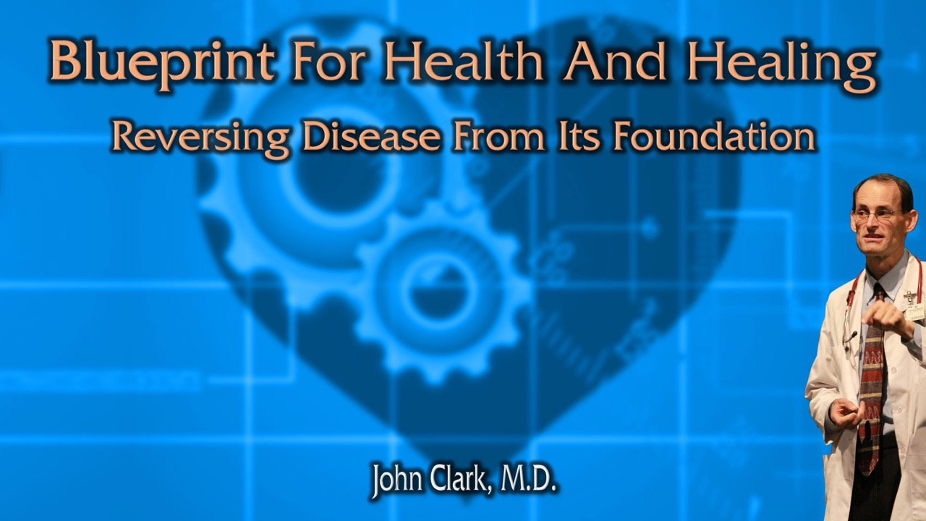
Anemia
How to Have Good Blood

Slide 2
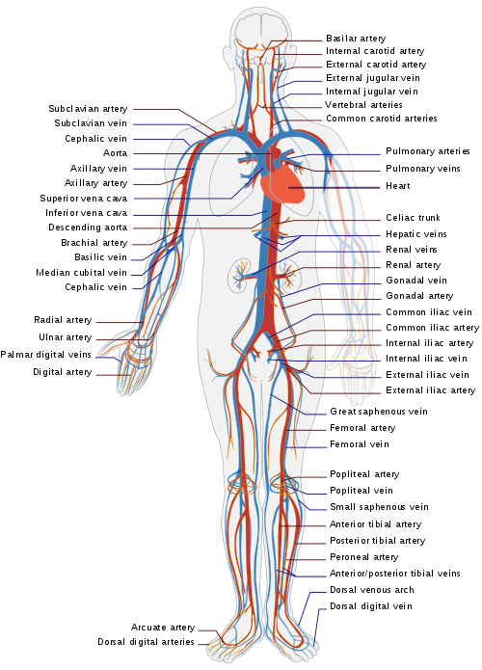
“Perfect health depends upon perfect circulation.”
Tissue oxygenation.
Nutrient distribution.
Temperature regulation.
External Pressure.
Posture.
Blood condition.
2T 531.2
Notes:
Little boys also are dressed so as to leave the lower limbs with far less protection than the upper part of the body. The limbs, being remote from the center of circulation, demand greater protection, instead of less. The veins which convey the blood to the extremities are large, providing for the flow of a sufficient quantity of blood to afford warmth and nutrition. But when the blood is chilled from these parts, the veins contract, and the circulation is retarded. Not only do the extremities suffer from cold, but through lack of nutrition the limbs do not attain their natural development. A good circulation purifies the blood, and secures health; while a poor circulation renders the blood impure, and induces congestion of the vital organs. {CTBH 91.2}
Perfect health depends upon perfect circulation. Special attention should be given to the extremities, that they may be as thoroughly clothed as the chest and the region over the heart, where is the greatest amount of heat. Parents who dress their children with the extremities naked, or nearly so, are sacrificing the health and lives of their children to fashion. If these parts are not so warm as the body, the circulation is not equalized. When the extremities, which are remote from the vital organs, are not properly clad, the blood is driven to the head, causing headache or nosebleed; or there is a sense of fullness about the chest, producing cough or palpitation of the heart, on account of too much blood in that locality; or the stomach has too much blood, causing indigestion. 2T 531.2

Slide 3
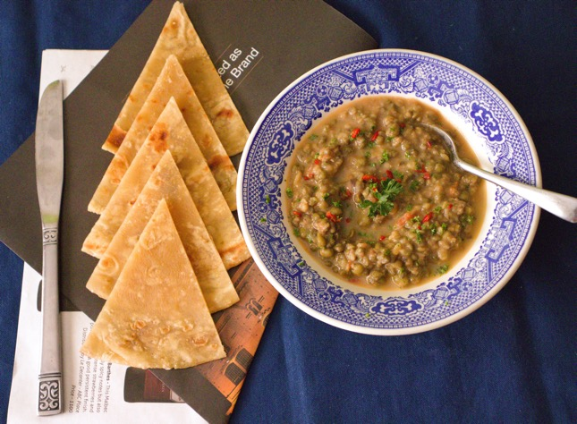
Nature Honors Those Who Render Obedience To Her Laws
Daniel an example.
“God always honors the right. The most promising youth of every land subdued by the great conqueror, had been gathered at Babylon, yet amid them all the Hebrew captives were without a rival. The erect form, the firm, elastic step, the fair countenance showing that the blood was uncorrupted, the undimmed senses, the untainted breath,--all were so many certificates of good habits,--insignia of the nobility with which nature honors those who render obedience to her laws.” {ST, March 2, 1882 par. 5}
ST, March 2, 1882 par. 5
Notes:
Nature Honors Those Who Render Obedience To Her Laws

Slide 4

Regularity Of Meal Times
“I should eat regularly of the most healthful food which will make the best quality of blood, and I should not work intemperately if it is in my power to avoid doing so. And when I violate the laws God has established in my being, I am to repent and reform, and place myself in the most favorable condition under the doctors God has provided--pure air, pure water, and the healing, precious sunlight.” {MM 230.2}
Notes:
Regularity Of Meal Times, Pure Air, Pure Water, And The Healing, Precious Sunlight
I should eat regularly of the most healthful food which will make the best quality of blood, and I should not work intemperately if it is in my power to avoid doing so. And when I violate the laws God has established in my being, I am to repent and reform, and place myself in the most favorable condition under the doctors God has provided--pure air, pure water, and the healing, precious sunlight. {MM 230.2}
Ashraf F, Nafees Uddin MM, Mustafa MS, Mughal ZUN, Atif Aleem S. Prevalence and factors influencing anemia in women of reproductive age visiting a tertiary care hospital (Jinnah Postgraduate Medical Center) in Karachi: A cross-sectional study. Womens Health (Lond). 2024 Jan-Dec;20:17455057241227364.
Abstract
Introduction: Anemia is a significant public health concern, primarily affecting young children, pregnant and postpartum women, and menstruating adolescent girls and women. This study aimed to evaluate the prevalence of anemia and associated factors in women of reproductive age visiting a tertiary care hospital in Karachi, Pakistan.
Objective: The primary objective was to determine the prevalence of anemia in women of reproductive age, while the secondary objective was to investigate potential causes of anemia within this demographic group.
Design: A prospective cross-sectional approach was employed, adhering to Strengthening the Reporting of Observational Studies in Epidemiology guidelines. A questionnaire-based method was used to assess anemia, and data were collected from women aged 14 to 40 years.
Method: The study was conducted at the Jinnah Postgraduate Medical Center from January to May 2023. The study was approved by the Institutional Review Board of Jinnah Sindh Medical University (Institutional Review Board reference number JSMU/IRB/2023/699). A sample of 397 women was included, and various demographic and lifestyle factors were assessed.
Results: In this study of 397 participants, 71.5% were found to have anemia, primarily microcytic anemia (48.2%). Anemia prevalence was highest among the 14-18 years age group (80.7%) and those from lower socioeconomic backgrounds (73.6%). Factors such as frequent tea consumption, irregular mealtimes, and pica consumption were associated with higher anemia rates. Pregnant women and those with more children were at a heightened risk of anemia.
Conclusion: The study reveals a notable prevalence of anemia among women of reproductive age with a surprising emphasis on younger individuals and lower socioeconomic groups. Dietary habits, lifestyle choices, and pregnancy status play significant roles in anemia development. Targeted interventions are essential, particularly for younger women, those from disadvantaged backgrounds, and pregnant individuals, to combat anemia effectively in this region.

Slide 5
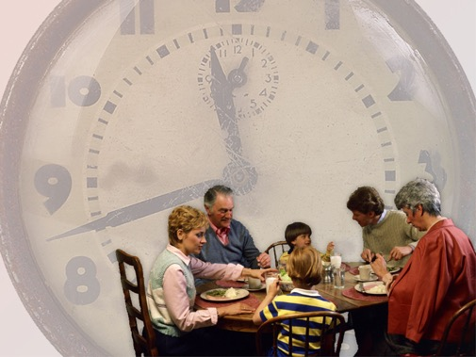
Strict Eating Schedule
“Irregularities in eating destroy the healthful tone of the digestive organs, to the detriment of health and cheerfulness.
“The food cannot be converted into good blood.
“If all would eat at regular periods, not tasting anything between meals, they would be ready for their meals and would find a pleasure in eating that would repay them for their effort. {CG 387}
"Indulging in eating too frequently, and in too large quantities, overtaxes the digestive organs, and produces a feverish state of the system. The blood becomes impure, and then diseases of various kinds occur.” {2SM 450.3
Notes:
Strict eating schedule
Irregularities in eating destroy the healthful tone of the digestive organs, to the detriment of health and cheerfulness. {CG 387.3}
In no case should the meals be irregular. If dinner is eaten an hour or two before the usual time, the stomach is unprepared for the new burden; for it has not yet disposed of the food eaten at the previous meal and has not vital force for the new work. Thus the system is overtaxed. {CG 387.4}
Neither should the meals be delayed one or two hours, to suit circumstances, or in order that a certain amount of work may be accomplished. The stomach calls for food at the time it is accustomed to receive it. If that time is delayed, the vitality of the system decreases and finally reaches so low an ebb that the appetite is entirely gone. If food is then taken, the stomach is unable to properly care for it. The food cannot be converted into good blood. If all would eat at regular periods, not tasting anything between meals, they would be ready for their meals and would find a pleasure in eating that would repay them for their effort. {CG 387.5}
Indulging in eating too frequently, and in too large quantities, overtaxes the digestive organs, and produces a feverish state of the system. The blood becomes impure, and then diseases of various kinds occur. {2SM 450.3}
Sciesielski LK, Felten M, Michalick L, Kirschner KM, Lattanzi G, Jacobi CLJ, Wallach T, Lang V, Landgraf D, Kramer A, Dame C. The circadian clock regulates rhythmic erythropoietin expression in the murine kidney. Kidney Int. 2021 Nov;100(5):1071-1080.

Slide 6

Pure Air
A multitude of women are nervous and careworn because they deprive themselves of the pure air that would make pure blood, and of the freedom of motion that would send the blood bounding through the veins, giving life, health, and energy. Many women have become confirmed invalids when they might have enjoyed health, and many have died of consumption and other diseases when they might have lived their allotted term of life had they dressed in accordance with health principles and exercised freely in the open air. {MH 293.2}
Notes:
Regularity Of Meal Times, Pure Air, Pure Water, And The Healing, Precious Sunlight
I should eat regularly of the most healthful food which will make the best quality of blood, and I should not work intemperately if it is in my power to avoid doing so. And when I violate the laws God has established in my being, I am to repent and reform, and place myself in the most favorable condition under the doctors God has provided--pure air, pure water, and the healing, precious sunlight. {MM 230.2}
Children who are accustomed to remain in close, heated rooms cannot have health. They are like hot-house plants. Parents should give especial attention to their children's dress. They should clothe their limbs comfortably, and then should have them spend some time in active, cheerful exercise in the open air each day, in winter as well as in summer. Little girls should not be deprived of the means of health because they are girls. There is just as much necessity for your girls to have constant and abundant supplies of fresh air, in order to have good blood and a sound constitution, as your boys. HR January 1, 1873, Art. B, par. 11
Every wrong habit which injures the health of the body reacts upon the mind. Many care-worn, nervous, anxious women are so because they have cheated themselves of the pure air that makes good blood, and the freedom of motion which sends the blood coursing through the veins, and gives live, health, and energy. Women, of all persons, need strength of mind and body to grapple with the ills and anxieties of life; but most of them are so weak and nerveless that they are conquered and crushed by them instead. Ms109-1909.16
Pure Air for Pure Blood
A multitude of women are nervous and careworn because they deprive themselves of the pure air that would make pure blood, and of the freedom of motion that would send the blood bounding through the veins, giving life, health, and energy. Many women have become confirmed invalids when they might have enjoyed health, and many have died of consumption and other diseases when they might have lived their allotted term of life had they dressed in accordance with health principles and exercised freely in the open air. {MH 293.2}
Especially do I commend Brother C to your care. Shall he die for want of air, the vitalizing air of heaven? The course he is pursuing is really shortening his life. Through his confinement indoors his blood is becoming foul and sluggish, the liver is deranged, the action of the heart is not right. Unless he works a change for himself, nature will take the work into her own hands. She will make a grand attempt to relieve the system by expelling the impurities from the blood. She will summon all the vital powers to work, and the whole organism will be deranged, and all this may end in paralysis or apoplexy. If he should ever recover from this crisis, his loss of time would be great; but the probabilities of recovery are very small. If Brother C cannot be aroused, I advise you, brethren, who have an interest in the cause of present truth, to take him, as Luther was taken by his friends, and carry him away from his work. {1T 520.1}
Ma L, Wang Y, Wang H, Ren L, Guo Y, Qin L, Gong Z, Li G, Sang N. Effects of PM_{2.5} exposure on hematopoiesis and coupled immune disorder in adult male mice. J Environ Sci (China). 2025 Sep;155:442-453.

Slide 7

Window Open At Night For Fresh Air
“In the cool of the evening it may be necessary to guard against chilliness by extra clothing; but there should be a free circulation of pure air through the room during sleeping hours. The free air of heaven, by day or night, is one of the richest blessings we can enjoy.”
“Fresh air will purify the blood, refresh the body, and help to make it strong and healthy. The invigoration produced will be reflected upon the mind, imparting to it tone and clearness, as well as a degree of composure and serenity.
“Living in close, ill-ventilated rooms, weakens the system, makes the mind gloomy, the skin sallow, and the circulation feeble; the blood moves sluggishly, digestion is retarded, and the system is rendered peculiarly sensitive to cold.” {CTBH 104}
Notes:
In the cool of the evening it may be necessary to guard against chilliness by extra clothing; but there should be a free circulation of pure air through the room during sleeping hours. The free air of heaven, by day or night, is one of the richest blessings we can enjoy. {CTBH 104.1}
Fresh air will purify the blood, refresh the body, and help to make it strong and healthy. The invigoration produced will be reflected upon the mind, imparting to it tone and clearness, as well as a degree of composure and serenity. It gives a healthful stimulus to the appetite, renders the digestion of food more perfect, and induces sound, sweet sleep. Living in close, ill-ventilated rooms, weakens the system, makes the mind gloomy, the skin sallow, and the circulation feeble; the blood moves sluggishly, digestion is retarded, and the system is rendered peculiarly sensitive to cold. One should so accustom himself to fresh, cool air that he will not be affected by slight changes of temperature. Of course he should be careful not to sit in a draft or in a cold room when weary, or when in a perspiration. {CTBH 104.2}

Slide 8

Exercise in open air with good deep breathing
“You have not had a liberal supply of air. Brother I has labored in his store, closely applying himself to his business and allowing himself but a limited amount of air and exercise.
“He breathes only from the top of his lungs. It is seldom that he exercises the abdominal muscles in the act of breathing.
“Stomach, liver, lungs, and brain are suffering for the want of deep, full inspirations of air, which would electrify the blood and impart to it a bright, lively color, and which alone can keep it pure and give tone and vigor to every part of the living machinery.” 2T 67.1
Notes:
Gratification of perverted appetite
Plain, simple diet, composed of unbolted wheat flour, vegetables and fruits prepared without spices or grease
Exercise in open air with good deep breathing
Hot drinks, cheese, white flour products not good
Overeating of too rich of food not good
Restaurant eating, for taste
The Lord has shown some things in regard to you which I feel it a duty to write. You were among the number who were presented before me as backward in health reform. Light has shone upon the pathway in which the people of God are traveling, yet all do not walk in the light and follow as fast as the providence of God marks out and opens the way before them. Until they do this, they will be in darkness. If God has spoken to His people, He designs that they shall hear and obey His voice. Last Sabbath, as I was speaking, your pale faces rose distinctly before me as I had been shown them. I saw your condition of health and the ailments you have suffered under so long. I was shown that you have not lived healthfully. Your appetites have been unhealthy, and you have gratified the taste at the expense of the stomach. You have taken into your stomachs articles which it is impossible to convert into good blood. This has laid a heavy tax on the liver, for the reason that the digestive organs are deranged. You both have diseased livers. The health reform would be a great benefit to you both if you would strictly carry it out. This you have failed to do. Your appetites are morbid, and because you do not relish a plain, simple diet, composed of unbolted wheat flour, vegetables and fruits prepared without spices or grease, you are continually transgressing the laws which God has established in your system. While you do this you must suffer the penalty, for to every transgression is affixed a penalty. Yet you wonder at your continued poor health. 2T 66.2
Be assured that God will not work a miracle to save you from the result of your own course of action. You have not had a liberal supply of air. Brother I has labored in his store, closely applying himself to his business and allowing himself but a limited amount of air and exercise. His circulation is depressed. He breathes only from the top of his lungs. It is seldom that he exercises the abdominal muscles in the act of breathing. Stomach, liver, lungs, and brain are suffering for the want of deep, full inspirations of air, which would electrify the blood and impart to it a bright, lively color, and which alone can keep it pure and give tone and vigor to every part of the living machinery. 2T 67.1
You, my dear brother and sister, can have a much better condition of health than you now enjoy, and can avoid very many ill turns, if you will simply exercise temperance in all things—temperance in labor, temperance in eating and drinking. Hot drinks are debilitating to the stomach. Cheese should never be introduced into the stomach. Fine-flour bread cannot impart to the system the nourishment that you will find in the unbolted wheat bread. The common use of bolted wheat bread cannot keep the system in a healthy condition. You both have inactive livers. The use of fine flour aggravates the difficulties under which you are laboring. 2T 68.1
There is no treatment which can relieve you of your present difficulties while you eat and drink as you do. You can do that for yourselves which the most experienced physician can never do. Regulate your diet. In order to gratify the taste, you frequently place a severe tax upon your digestive organs by receiving into the stomach food which is not the most healthful, and at times in immoderate quantities. This wearies the stomach and unfits it for the reception of even the most healthful food. You keep your stomachs constantly debilitated because of your wrong habits of eating. Your food is made too rich. It is not prepared in a simple, natural manner, but is totally unfitted for the stomach when you have prepared it to suit your taste. Nature is burdened, and endeavors to resist your efforts to cripple her. Chills and fevers are the result of those attempts to rid herself of the burden you lay upon her. You have to suffer the penalty of nature's violated laws. God has established laws in your system which you cannot violate without suffering the punishment. You have consulted taste without reference to health. You have made some changes, but have merely taken the first steps in reform diet. God requires of us temperance in all things. “Whether therefore ye eat, or drink, or whatsoever ye do, do all to the glory of God.” 2T 68.2
Nature bears abuse as long as she can without resisting, then she arouses and makes a mighty effort to rid herself of the encumbrances and evil treatment she has suffered. Then come headache, chills, fevers, nervousness, paralysis, and other evils too numerous to mention. A wrong course of eating or drinking destroys health, and with it the sweetness of life. Oh, how many times have you purchased what you called a good meal at the expense of a fevered system, loss of appetite, and loss of sleep! Inability to enjoy food, a sleepless night, hours of suffering—all for a meal in which taste was gratified! Thousands have indulged their perverted appetites, have eaten a good meal, as they called it, and as the result, have brought on a fever, or some other acute disease, and certain death. That was enjoyment purchased at immense cost. Yet many have done this, and these self-murderers have been eulogized by their friends and the minister, and carried directly to heaven at their death. What a thought! Gluttons in heaven! No, no; such will never enter the pearly gates of the golden city of God. Such will never be exalted to the right hand of Jesus the precious Saviour, the suffering Man of Calvary, whose life was one of constant self-denial and sacrifice. There is a place appointed for all such among the unworthy, who can have no part in the better life, the immortal inheritance. 2T 69.2

Slide 9

Indoor Life
Especially do I commend Brother C to your care. Shall he die for want of air, the vitalizing air of heaven? The course he is pursuing is really shortening his life. Through his confinement indoors his blood is becoming foul and sluggish, the liver is deranged, the action of the heart is not right.
Unless he works a change for himself, nature will take the work into her own hands. She will make a grand attempt to relieve the system by expelling the impurities from the blood. She will summon all the vital powers to work, and the whole organism will be deranged, and all this may end in paralysis or apoplexy. {1T 520.1}
Notes:
Brethren abroad, are you asleep to this matter? Must your hearts be made faint by the fall of another of God's workmen, whom you love? These men are the property of the church. Will you suffer them to die under the burdens? I appeal to you to advise a different order of things. I pray God that the bitter experience that has come upon us may never be allowed to come to any one of the brethren in the office. Especially do I commend Brother C to your care. Shall he die for want of air, the vitalizing air of heaven? The course he is pursuing is really shortening his life. Through his confinement indoors his blood is becoming foul and sluggish, the liver is deranged, the action of the heart is not right. Unless he works a change for himself, nature will take the work into her own hands. She will make a grand attempt to relieve the system by expelling the impurities from the blood. She will summon all the vital powers to work, and the whole organism will be deranged, and all this may end in paralysis or apoplexy. If he should ever recover from this crisis, his loss of time would be great; but the probabilities of recovery are very small. If Brother C cannot be aroused, I advise you, brethren, who have an interest in the cause of present truth, to take him, as Luther was taken by his friends, and carry him away from his work. {1T 520.1}

Slide 10

Ill-Ventilated Rooms
The effects produced by living in close, ill-ventilated rooms are these: The system becomes weak and unhealthy, the circulation is depressed, the blood moves sluggishly through the system because it is not purified and vitalized by the pure, invigorating air of heaven. The mind becomes depressed and gloomy, while the whole system is enervated; and fevers and other acute diseases are liable to be generated. Your careful exclusion of external air and fear of free ventilation leave you to breathe the corrupt, unwholesome air which is exhaled from the lungs of those staying in these rooms, and which is poisonous, unfit for the support of life. The body becomes relaxed, the skin becomes sallow, digestion is retarded, and the system is peculiarly sensitive to the influence of cold. {1T 702.3}

Slide 11

Proper breathing
“In order to have good blood, we must breathe well. Full, deep inspirations of pure air, which fill the lungs with oxygen, purify the blood. They impart to it a bright color and send it, a life-giving current, to every part of the body. A good respiration soothes the nerves; it stimulates the appetite and renders digestion more perfect; and it induces sound, refreshing sleep.” {MH 272.1}
Notes:
In order to have good blood, we must breathe well. Full, deep inspirations of pure air, which fill the lungs with oxygen, purify the blood. They impart to it a bright color and send it, a life-giving current, to every part of the body. A good respiration soothes the nerves; it stimulates the appetite and renders digestion more perfect; and it induces sound, refreshing sleep. {MH 272.1}
The lungs should be allowed the greatest freedom possible. Their capacity is developed by free action; it diminishes if they are cramped and compressed. Hence the ill effects of the practice so common, especially in sedentary pursuits, of stooping at one's work. In this position it is impossible to breathe deeply. Superficial breathing soon becomes a habit, and the lungs lose their power to expand. A similar effect is produced by tight lacing. Sufficient room is not given to the lower part of the chest; the abdominal muscles, which were designed to aid in breathing, do not have full play, and the lungs are restricted in their action. {MH 272.2}
Thus an insufficient supply of oxygen is received. The blood moves sluggishly. The waste, poisonous matter, which should be thrown off in the exhalations from the lungs, is retained, and the blood becomes impure. Not only the lungs, but the stomach, liver, and brain are affected. The skin becomes sallow, digestion is retarded; the heart is depressed; the brain is clouded; the thoughts are confused; gloom settles upon the spirits; the whole system becomes depressed and inactive, and peculiarly susceptible to disease. {MH 273.1}
The lungs are constantly throwing off impurities, and they need to be constantly supplied with fresh air. Impure air does not afford the necessary supply of oxygen, and the blood passes to the brain and other organs without being vitalized. Hence the necessity of thorough ventilation. To live in close, ill-ventilated rooms, where the air is dead and vitiated, weakens the entire system. It becomes peculiarly sensitive to the influence of cold, and a slight exposure induces disease. It is close confinement indoors that makes many women pale and feeble. They breathe the same air over and over until it becomes laden with poisonous matter thrown off through the lungs and pores, and impurities are thus conveyed back to the blood. {MH 274.1}

Slide 12

Stagnant Blood, Blood Stasis Inflammatory Syndrome
“A good circulation purifies the blood, and secures health; while a poor circulation renders the blood impure, and induces congestion of the vital organs.” {CTBH 91.2}
Notes:
Little boys also are dressed so as to leave the lower limbs with far less protection than the upper part of the body. The limbs, being remote from the center of circulation, demand greater protection, instead of less. The veins which convey the blood to the extremities are large, providing for the flow of a sufficient quantity of blood to afford warmth and nutrition. But when the blood is chilled from these parts, the veins contract, and the circulation is retarded. Not only do the extremities suffer from cold, but through lack of nutrition the limbs do not attain their natural development. A good circulation purifies the blood, and secures health; while a poor circulation renders the blood impure, and induces congestion of the vital organs. {CTBH 91.2}

Slide 13

The Healing, Precious Sunlight
“The building is so placed that it will get all the sunshine possible, not only in the sleeping rooms, but in the rooms where the patients sit. The sun is God's doctor, which brings health and strength, purifying and giving color to the blood, and we must have it.” AUCR July 26, 1899, Art. A, par. 4
Notes:
Regularity Of Meal Times, Pure Air, Pure Water, And The Healing, Precious Sunlight
The building is so placed that it will get all the sunshine possible, not only in the sleeping rooms, but in the rooms where the patients sit. The sun is God's doctor, which brings health and strength, purifying and giving color to the blood, and we must have it. It was objected that the building would be askew with the road. “Askew let it be,” I said; “that building must be where it will get the sunshine, in whatever position it is.” The building is just right as it now is. It will get the sunshine, and I am well pleased with it. AUCR July 26, 1899, Art. A, par. 4
I should eat regularly of the most healthful food which will make the best quality of blood, and I should not work intemperately if it is in my power to avoid doing so. And when I violate the laws God has established in my being, I am to repent and reform, and place myself in the most favorable condition under the doctors God has provided--pure air, pure water, and the healing, precious sunlight. {MM 230.2}
Indoors Away From Sun And Fresh Air, Clothes that constrict the lungs
Alcohol and tobacco pollute the blood of men, and thousands of lives are yearly sacrificed to these poisons. Confinement indoors, shut away from the glorious sunshine, and deprived of the invigorating air of heaven, improper eating, with wrong habits of dressing, corrupt the blood of women. The compression of the waist by tight-lacing prevents the waste matter from being thrown off through its natural channels. The most important of these is the lungs. In order for the lungs to do the work God designed, they must be left free, without the slightest compression. If the lungs are cramped they cannot develop; but their capacity will be diminished, making it impossible to take a sufficient inspiration of air. The abdominal muscles were designed to aid the lungs in their action. Where there is no compression of the lungs, the motion in full breathing will be observed to be mostly of the abdomen. When lacing prevents this, the breathing is restricted to the upper portion of the lungs. Women's dress should be arranged so loosely upon the person, about the waist, that she can breath without the least obstruction. Her arms should be left perfectly free, that she may raise them above her head with ease. {HR, November 1, 1871 par. 22}

Slide 14

Pure Water
“Pure water to drink and fresh air to breathe invigorate the vital organs, purify the blood, and help nature in her task of overcoming the bad conditions of the system.” HL 187.1
Notes:
Regularity Of Meal Times, Pure Air, Pure Water, And The Healing, Precious Sunlight
I should eat regularly of the most healthful food which will make the best quality of blood, and I should not work intemperately if it is in my power to avoid doing so. And when I violate the laws God has established in my being, I am to repent and reform, and place myself in the most favorable condition under the doctors God has provided--pure air, pure water, and the healing, precious sunlight. {MM 230.2}
In health and in sickness, pure water is one of heaven's choicest blessings. Its proper use promotes health. It is the beverage which God provided to quench the thirst of animals and man. Drunk freely, it helps to supply the necessities of the system and assists nature to resist disease. The external application of water is one of the easiest and most satisfactory ways of regulating the circulation of the blood. A cold or cool bath is an excellent tonic. Warm baths open the pores and thus aid in the elimination of impurities. Both warm and neutral baths soothe the nerves and equalize the circulation. MH 237.1

Slide 15

Bathing
“Persons in health should on no account neglect bathing. They should by all means bathe as often as twice a week. Those who are not in health have impurities of the blood, and the skin is not in a healthy condition. The multitude of pores, or little mouths, through which the body breathes become clogged and filled with waste matter. The skin needs to be carefully and thoroughly cleansed, that the pores may do their work in freeing the body from impurities; therefore feeble persons who are diseased surely need the advantages and blessings of bathing as often as twice a week, and frequently even more than this is positively necessary.
“Instead of increasing the liability to cold, a bath, properly taken, fortifies against cold because the circulation is improved and the uterine organs, which are more or less congested, are relieved; for the blood is brought to the surface, and a more easy and regular flow of the blood through all the blood vessels is obtained.” {3T 70.1}
Notes:
Persons in health should on no account neglect bathing. They should by all means bathe as often as twice a week. Those who are not in health have impurities of the blood, and the skin is not in a healthy condition. The multitude of pores, or little mouths, through which the body breathes become clogged and filled with waste matter. The skin needs to be carefully and thoroughly cleansed, that the pores may do their work in freeing the body from impurities; therefore feeble persons who are diseased surely need the advantages and blessings of bathing as often as twice a week, and frequently even more than this is positively necessary. Whether a person is sick or well, respiration is more free and easy if bathing is practiced. By it the muscles become more flexible, the mind and body are alike invigorated, the intellect is made brighter, and every faculty becomes livelier. The bath is a soother of the nerves. It promotes general perspiration, quickens the circulation, overcomes obstructions in the system, and acts beneficially on the kidneys and urinary organs. Bathing helps the bowels, stomach, and liver, giving energy and new life to each. It also promotes digestion, and instead of the system's being weakened it is strengthened. Instead of increasing the liability to cold, a bath, properly taken, fortifies against cold because the circulation is improved and the uterine organs, which are more or less congested, are relieved; for the blood is brought to the surface, and a more easy and regular flow of the blood through all the blood vessels is obtained. {3T 70.1}

Slide 16

Temperance in Work
Overwork not helpful.
“You work too hard. You work too many hours, and your blood-making organs are not in a healthy condition to make good blood.” {Lt8-1871}
Notes:
Regularity Of Meal Times, Pure Air, Pure Water, And The Healing, Precious Sunlight
I should eat regularly of the most healthful food which will make the best quality of blood, and I should not work intemperately if it is in my power to avoid doing so. And when I violate the laws God has established in my being, I am to repent and reform, and place myself in the most favorable condition under the doctors God has provided--pure air, pure water, and the healing, precious sunlight. {MM 230.2}
Overwork not helpful
I hope you will look at this matter candidly. You are becoming selfish. Our means is lent us of God, not that we should use it for ourselves needlessly or expend it upon you to use to your own advantage. My son, I fear you will always be in want unless you work upon a different principle than you have. You work too hard. You work too many hours, and your blood-making organs are not in a healthy condition to make good blood. Your face shows a diseased liver; fever may cut you down. I want you to take such a course that you will be happy, and will fill your position in this world and secure a home in the better world than this. {Lt8-1871}

Slide 17
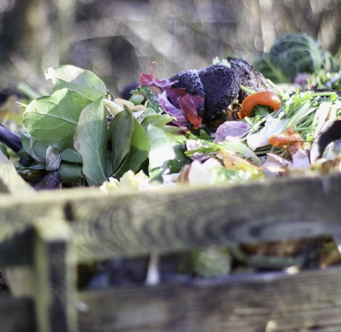
Sanitation
No sewer smells.
No Compost smells.
No dust mites.
“If every family realized the beneficial results of thorough cleanliness, they would make special efforts to remove every impurity from their persons and from their houses, and would extend their efforts to their premises. Many suffer decayed vegetable matter to remain about their premises. They are not awake to the influence of these things. There is constantly arising from these decaying substances an effluvium that is poisoning the air. By inhaling the impure air, the blood is poisoned, the lungs become affected, and the whole system is diseased. Disease of almost every description will be caused by inhaling the atmosphere affected by these decaying substances.” CH 62.1
Notes:
False maxims, evil customs, selfish gratifications, social influences of a pernicious character will need to be overcome by those who profess to believe the truth, if they would be followers of Jesus Christ and do their utmost to win souls to the truth. Our time to work is short, and the question is, Shall the means that you handle and pass into other hands be used in a manner that will secure to you the greatest liberty, or shall it pass from your hands, and your liberties be restricted, and you be subjected to inconvenient and unhealthful lodgings with water closets of such a character that they are pouring forth in your houses a polluted atmosphere, which is poisoning the blood? Shall there be plans to arrange humble lodgings, free from every extravagance, but where the sanitary conditions shall be especially arranged for health? Ms37-1886.33
If every family realized the beneficial results of thorough cleanliness, they would make special efforts to remove every impurity from their persons and from their houses, and would extend their efforts to their premises. Many suffer decayed vegetable matter to remain about their premises. They are not awake to the influence of these things. There is constantly arising from these decaying substances an effluvium that is poisoning the air. By inhaling the impure air, the blood is poisoned, the lungs become affected, and the whole system is diseased. Disease of almost every description will be caused by inhaling the atmosphere affected by these decaying substances. CH 62.1

Slide 18

Warm Clothing Of All Parts Of The Body
“The extremities are chilled, and the heart has thrown upon it double labor, in forcing the blood into these chilled extremities; and when the blood has performed its circuit through the body, and returned to the heart, it is not the same vigorous warm current that left it. It has been chilled in its passage through the limbs.
“The heart, weakened by too great labor, and poor circulation of poor blood, is then compelled to still greater exertion, in order to throw the blood to the extremities, which are never as healthfully warm as other parts of the body.
“The heart fails in its efforts, and the limbs become habitually cold; and the blood, which is chilled away from the extremities, is thrown back upon the lungs and brain, and inflammation and congestion of the lungs or of the brain is the result. RH January 9, 1900, Art. B, par. 2
Notes:
Warm clothing of all parts of the body
It is an error generally committed to make no difference in the life of a woman previous to the birth of her children. At this important period the labor of the mother should be lightened. Great changes are going on in her system. It requires a greater amount of blood, and therefore an increase of food of the most nourishing quality to convert into blood. Unless she has an abundant supply of nutritious food, she cannot retain her physical strength, and her offspring is robbed of vitality. Her clothing also demands attention. Care should be taken to protect the body from a sense of chilliness. She should not call vitality unnecessarily to the surface to supply the want of sufficient clothing. If the mother is deprived of an abundance of wholesome, nutritious food, she will lack in the quantity and quality of blood. Her circulation will be poor, and her child will lack in the very same things. There will be an inability in the offspring to appropriate food which it can convert into good blood to nourish the system. The prosperity of mother and child depends much upon good, warm clothing and a supply of nourishing food. The extra draft upon the vitality of the mother must be considered and provided for. 2T 381.3
The extremities are chilled, and the heart has thrown upon it double labor, in forcing the blood into these chilled extremities; and when the blood has performed its circuit through the body, and returned to the heart, it is not the same vigorous warm current that left it. It has been chilled in its passage through the limbs. The heart, weakened by too great labor, and poor circulation of poor blood, is then compelled to still greater exertion, in order to throw the blood to the extremities, which are never as healthfully warm as other parts of the body. The heart fails in its efforts, and the limbs become habitually cold; and the blood, which is chilled away from the extremities, is thrown back upon the lungs and brain, and inflammation and congestion of the lungs or of the brain is the result. RH January 9, 1900, Art. B, par. 2

Slide 19

Clothes that constrict the lungs
“If the lungs are cramped they cannot develop; but their capacity will be diminished, making it impossible to take a sufficient inspiration of air.” {HR, November 1, 1871 par. 22}
“It is essential to health that the chest have room to expand to its fullest extent in order that the lungs may be enabled to take full inspiration. When the lungs are restricted, the quantity of oxygen received into them is lessened. The blood is not properly vitalized, and the waste, poisonous matter which should be thrown off through the lungs is retained. In addition to this the circulation is hindered, and the internal organs are so cramped and crowded out of place that they cannot perform their work properly.” {MH 292.2}
Notes:
Indoors Away From Sun And Fresh Air, Clothes that constrict the lungs
Alcohol and tobacco pollute the blood of men, and thousands of lives are yearly sacrificed to these poisons. Confinement indoors, shut away from the glorious sunshine, and deprived of the invigorating air of heaven, improper eating, with wrong habits of dressing, corrupt the blood of women. The compression of the waist by tight-lacing prevents the waste matter from being thrown off through its natural channels. The most important of these is the lungs. In order for the lungs to do the work God designed, they must be left free, without the slightest compression. If the lungs are cramped they cannot develop; but their capacity will be diminished, making it impossible to take a sufficient inspiration of air. The abdominal muscles were designed to aid the lungs in their action. Where there is no compression of the lungs, the motion in full breathing will be observed to be mostly of the abdomen. When lacing prevents this, the breathing is restricted to the upper portion of the lungs. Women's dress should be arranged so loosely upon the person, about the waist, that she can breath without the least obstruction. Her arms should be left perfectly free, that she may raise them above her head with ease. {HR, November 1, 1871 par. 22}
Fresh air, warm loose clothing
In order to have good health, we must have good blood; for the blood is the current of life. It repairs waste and nourishes the body. When supplied with the proper food elements and when cleansed and vitalized by contact with pure air, it carries life and vigor to every part of the system. The more perfect the circulation, the better will this work be accomplished. MH 271.2
At every pulsation of the heart the blood should make its way quickly and easily to all parts of the body. Its circulation should not be hindered by tight clothing or bands, or by insufficient clothing of the extremities. Whatever hinders the circulation forces the blood back to the vital organs, producing congestion. Headache, cough, palpitation of the heart, or indigestion is often the result. MH 271.3
Lung health prerequisite to blood health: Breath correctly, No tight clothing over lungs, Correct posture, Full inspirations, Well ventilated rooms
In order to have good blood, we must breathe well. Full, deep inspirations of pure air, which fill the lungs with oxygen, purify the blood. They impart to it a bright color and send it, a life-giving current, to every part of the body. A good respiration soothes the nerves; it stimulates the appetite and renders digestion more perfect; and it induces sound, refreshing sleep. {MH 272.1}
The lungs should be allowed the greatest freedom possible. Their capacity is developed by free action; it diminishes if they are cramped and compressed. Hence the ill effects of the practice so common, especially in sedentary pursuits, of stooping at one's work. In this position it is impossible to breathe deeply. Superficial breathing soon becomes a habit, and the lungs lose their power to expand. A similar effect is produced by tight lacing. Sufficient room is not given to the lower part of the chest; the abdominal muscles, which were designed to aid in breathing, do not have full play, and the lungs are restricted in their action. {MH 272.2}
Thus an insufficient supply of oxygen is received. The blood moves sluggishly. The waste, poisonous matter, which should be thrown off in the exhalations from the lungs, is retained, and the blood becomes impure. Not only the lungs, but the stomach, liver, and brain are affected. The skin becomes sallow, digestion is retarded; the heart is depressed; the brain is clouded; the thoughts are confused; gloom settles upon the spirits; the whole system becomes depressed and inactive, and peculiarly susceptible to disease. {MH 273.1}
The lungs are constantly throwing off impurities, and they need to be constantly supplied with fresh air. Impure air does not afford the necessary supply of oxygen, and the blood passes to the brain and other organs without being vitalized. Hence the necessity of thorough ventilation. To live in close, ill-ventilated rooms, where the air is dead and vitiated, weakens the entire system. It becomes peculiarly sensitive to the influence of cold, and a slight exposure induces disease. It is close confinement indoors that makes many women pale and feeble. They breathe the same air over and over until it becomes laden with poisonous matter thrown off through the lungs and pores, and impurities are thus conveyed back to the blood. {MH 274.1}
Next in importance to right position are respiration and vocal culture. The one who sits and stands erect is more likely than others to breathe properly. But the teacher should impress upon his pupils the importance of deep breathing. Show how the healthy action of the respiratory organs, assisting the circulation of the blood, invigorates the whole system, excites the appetite, promotes digestion, and induces sound, sweet sleep, thus not only refreshing the body, but soothing and tranquilizing the mind. And while the importance of deep breathing is shown, the practice should be insisted upon. Let exercises be given which will promote this, and see that the habit becomes established. . . . {CG 364.4}
It is essential to health that the chest have room to expand to its fullest extent in order that the lungs may be enabled to take full inspiration. When the lungs are restricted, the quantity of oxygen received into them is lessened. The blood is not properly vitalized, and the waste, poisonous matter which should be thrown off through the lungs is retained. In addition to this the circulation is hindered, and the internal organs are so cramped and crowded out of place that they cannot perform their work properly. {MH 292.2}

Slide 20
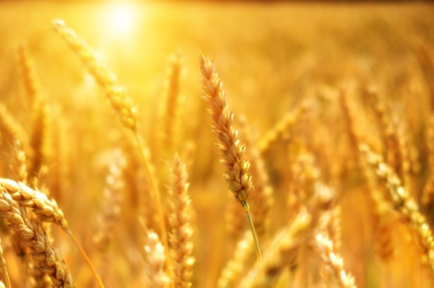
Grains
Simple whole unrefined grains.
The simple grains, fruits of the trees, and vegetables have all the nutritive properties necessary to make good blood. {PC 362.2}
Notes:
Diet of grains, with fruits, nuts, and vegetables:
It is a mistake to suppose that muscular strength depends on the use of animal food. The needs of the system can be better supplied, and more vigorous health can be enjoyed without its use. The grains, with fruits, nuts, and vegetables, contain all the nutritive properties necessary to make good blood. These elements are not so well or so fully supplied by a flesh diet. Had the use of flesh been essential to health and strength, animal food would have been included in the diet appointed man in the beginning. {CG 384.1}
Tree fruits and vegetables not meat
When I hear those who profess to believe the truth for this time pleading for the use of flesh meats, I am forcibly reminded of the complainings of the children of Israel because they were not favored with a meat diet. The diet of animals generally used for food is vegetables and grains. Must the vegetables be animalized before we can eat them? Must they be incorporated into the system of an animal before we can digest them? Must we obtain our vegetable diet by eating the flesh of dead creatures? God provided fruit in its natural state for our first parents. He gave Adam charge of the garden to dress it and to care for it, saying, "To you it shall be for meat." The plan was not for one animal to destroy another animal for food. After the fall, the eating of flesh was suffered in order to shorten the period of the existence of the long-lived race. It was allowed because of the hardness of the hearts of men. One of the great errors that many insist upon is, that muscular strength is dependent upon animal food. But the simple grains, fruits of the trees, and vegetables have all the nutritive properties necessary to make good blood. This a flesh diet cannot do. {PC 362.2}
Simple grains, fruits, and vegetables have all the nutrient properties necessary to make good blood. This a flesh diet cannot do.—Unpublished Testimonies, November 5, 1896. HL 63.5
Zhang Q, Qin G, Liu Z, Li Z, Li J, Varma DS, Wan Q, Zhao J, Min X, Han X, Liu M. Dietary Balance Index-07 and the Risk of Anemia in Middle Aged and Elderly People in Southwest China: A Cross Sectional Study. Nutrients. 2018 Jan 31;10(2):162.
A balanced diet is essential to achieve and maintain good health. In this study, we assessed diet quality of middle aged and elderly people based on Chinese Diet Balance Index-07 (DBI-07) and explored the associations between DBI-07 and anemia. Data analyzed for this study was from the 2010-2012 National Nutrition and Health Survey in Yunnan province, southwest China (n = 738, aged 50-77 years). Dietary recalls over there consecutive days were done in a face-to-face interview. The scores of DBI-07 for each component and three DBI-07 indicators ((Lower Bound Score (LBS), Higher Bound Score (HBS), Diet Quality Distance (DQD)) were calculated according to compliance with the Dietary Guidelines for Chinese residents. Hemoglobin (Hb) concentration was determined using the cyanmethemoglobin method. Univariate and multivariate linear regression models were used to explore the associations between DBI-07 indicators and anemia, as well as scores of DBI-07 components and Hb level. The sample included 336 men and 402 women. Inadequate intakes of vegetables, fruits, dairy, soybean, eggs, fish and excessive intakes of cereals, meat, cooking oil, salt were both common. 91.3% of the participants had moderate or high levels of inadequate food intake, while 37.7% had moderate or high levels of excessive food intake. The mean Hb was 14.2 ± 1.7 g/dL, with a prevalence of anemia of 13.0%. Subjects with high LBS and DQD were more likely to be anemic (all p < 0.05). After adjustment for potential confounders, there were positive correlations between Hb level and the intakes of vegetables and soybean (βvegetables = 1.04, p < 0.01; βsoybean = 0.82, p = 0.04). In conclusion, dietary imbalance and anemia are common in middle aged and elderly population in southwest China and inadequate intakes of vegetables and soybean may increase the risk of anemia.

Slide 21
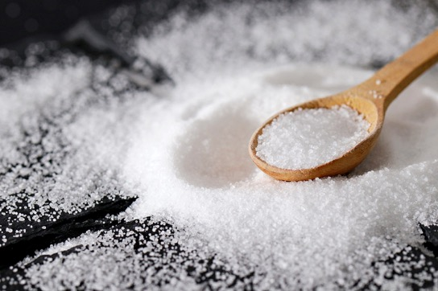
Good Salt
“I use some salt, and always have, because salt, instead of being deleterious, is actually essential for the blood.” {9T 161.4}
“Do not eat largely of salt,...” {CD 345.5}
Notes:
Some of our people, while conscientiously abstaining from eating improper foods, neglect to supply themselves with the elements necessary for the sustenance of the body. Those who take an extreme view of health reform are in danger of preparing tasteless dishes, making them so insipid that they are not satisfying. Food should be prepared in such a way that it will be appetizing as well as nourishing. It should not be robbed of that which the system needs. I use some salt, and always have, because salt, instead of being deleterious, is actually essential for the blood. Vegetables should be made palatable with a little milk or cream, or something equivalent. {9T 161.4}
Do not eat largely of salt, avoid the use of pickles and spiced foods, eat an abundance of fruit, and the irritation that calls for so much drink at mealtime will largely disappear. {CD 345.5}

Slide 22
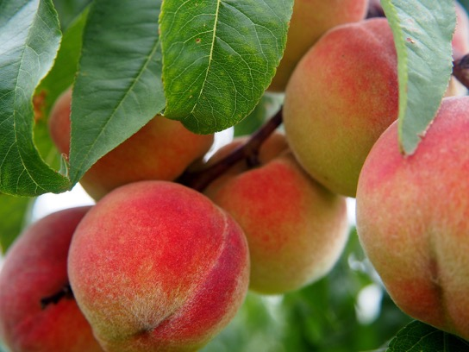
Fruits
Fruits of the trees
“The grains, with fruits, nuts, and vegetables, contain all the nutritive properties necessary to make good blood.” {CG 384.1}
“Fruit and vegetables taken at one meal produce acidity of the stomach; then impurity of the blood results, and the mind is not clear because the digestion is imperfect." {CD 112.6}
Notes:
Diet of grains, with fruits, nuts, and vegetables:
It is a mistake to suppose that muscular strength depends on the use of animal food. The needs of the system can be better supplied, and more vigorous health can be enjoyed without its use. The grains, with fruits, nuts, and vegetables, contain all the nutritive properties necessary to make good blood. These elements are not so well or so fully supplied by a flesh diet. Had the use of flesh been essential to health and strength, animal food would have been included in the diet appointed man in the beginning. {CG 384.1}
Tree fruits and vegetables not meat
When I hear those who profess to believe the truth for this time pleading for the use of flesh meats, I am forcibly reminded of the complainings of the children of Israel because they were not favored with a meat diet. The diet of animals generally used for food is vegetables and grains. Must the vegetables be animalized before we can eat them? Must they be incorporated into the system of an animal before we can digest them? Must we obtain our vegetable diet by eating the flesh of dead creatures? God provided fruit in its natural state for our first parents. He gave Adam charge of the garden to dress it and to care for it, saying, "To you it shall be for meat." The plan was not for one animal to destroy another animal for food. After the fall, the eating of flesh was suffered in order to shorten the period of the existence of the long-lived race. It was allowed because of the hardness of the hearts of men. One of the great errors that many insist upon is, that muscular strength is dependent upon animal food. But the simple grains, fruits of the trees, and vegetables have all the nutritive properties necessary to make good blood. This a flesh diet cannot do. {PC 362.2}
Some people need a more special diet to make good blood. Fruit is mentioned.
You have thought that almost anything which could be eaten was good enough, if you could live upon it and retain strength. You have pleaded the necessity of spare diet to your feeble wife. But she cannot make good blood or flesh upon the diet to which you could confine yourself, and flourish. Some persons cannot subsist upon the same food upon which others can do well, even though it be prepared in the same manner. 2T 254.1
You are in danger of becoming an extremist. Your system could convert a very coarse, poor diet into good blood. Your blood-making organs are in good condition. But your wife requires a more select diet. Let her eat the same food which your system could convert into good blood, and her system could not appropriate it. She lacks vitality, and needs a generous, strengthening diet. She should have a good supply of fruit, and not be confined to the same things from day to day. She has a slender hold of life. She is diseased, and the wants of her system are far different from those of a healthy person. 2T 254.2

Slide 23
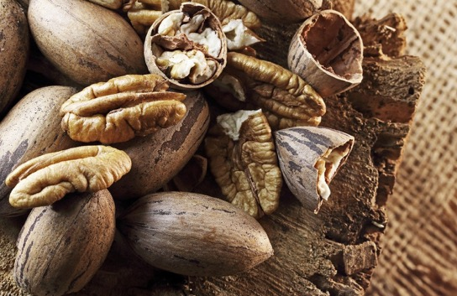
Nuts
“The grains, with fruits, nuts, and vegetables, contain all the nutritive properties necessary to make good blood.” {CG 384.1}
Notes:
Diet of grains, with fruits, nuts, and vegetables:
It is a mistake to suppose that muscular strength depends on the use of animal food. The needs of the system can be better supplied, and more vigorous health can be enjoyed without its use. The grains, with fruits, nuts, and vegetables, contain all the nutritive properties necessary to make good blood. These elements are not so well or so fully supplied by a flesh diet. Had the use of flesh been essential to health and strength, animal food would have been included in the diet appointed man in the beginning. {CG 384.1}

Slide 24

Vegetables
Vegetables have all the nutritive properties necessary to make good blood.
Notes:
Diet of grains, with fruits, nuts, and vegetables:
It is a mistake to suppose that muscular strength depends on the use of animal food. The needs of the system can be better supplied, and more vigorous health can be enjoyed without its use. The grains, with fruits, nuts, and vegetables, contain all the nutritive properties necessary to make good blood. These elements are not so well or so fully supplied by a flesh diet. Had the use of flesh been essential to health and strength, animal food would have been included in the diet appointed man in the beginning. {CG 384.1}
Tree fruits and vegetables not meat
When I hear those who profess to believe the truth for this time pleading for the use of flesh meats, I am forcibly reminded of the complainings of the children of Israel because they were not favored with a meat diet. The diet of animals generally used for food is vegetables and grains. Must the vegetables be animalized before we can eat them? Must they be incorporated into the system of an animal before we can digest them? Must we obtain our vegetable diet by eating the flesh of dead creatures? God provided fruit in its natural state for our first parents. He gave Adam charge of the garden to dress it and to care for it, saying, "To you it shall be for meat." The plan was not for one animal to destroy another animal for food. After the fall, the eating of flesh was suffered in order to shorten the period of the existence of the long-lived race. It was allowed because of the hardness of the hearts of men. One of the great errors that many insist upon is, that muscular strength is dependent upon animal food. But the simple grains, fruits of the trees, and vegetables have all the nutritive properties necessary to make good blood. This a flesh diet cannot do. {PC 362.2}
I hope, Doctor _____, that you will learn more and more how to cook healthfully. Provide an abundance of good, wholesome food. Do not practice economy in this direction. Restrict your meat bills, but have plenty of good fruit and vegetables, and then you will enjoy seeing the hearty appetites with which all will partake of your preparations. Never feel that good, hygienic food that is eaten is lost. It will make blood and muscle, and give strength for daily duties. {CD 409.4}
It is a mistake to suppose that muscular strength depends on the use of animal food. The needs of the system can be better supplied, and more vigorous health can be enjoyed, without its use. The grains, with fruits, nuts, and vegetables, contain all the nutritive properties necessary to make good blood. These elements are not so well or so fully supplied by a flesh diet. Had the use of flesh been essential to health and strength, animal food would have been included in the diet appointed man in the beginning. {MH 316.2}

Slide 25
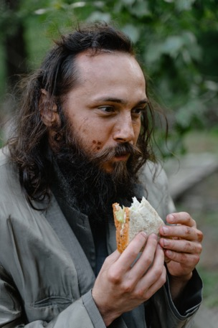
Scanty, Ill-Cooked Food
“Scanty, ill-cooked food depraves the blood by weakening the blood-making organs.” {MH 302.2}
Variety and sufficient supply of good food.
Notes:
Scanty, Ill-Cooked Food
Scanty, ill-cooked food depraves the blood by weakening the blood-making organs. It deranges the system and brings on disease, with its accompaniment of irritable nerves and bad tempers. The victims of poor cookery are numbered by thousands and tens of thousands. Over many graves might be written: "Died because of poor cooking;" "Died of an abused stomach." {MH 302.2}
Variety and sufficient supply of good food
There are some who go to extremes. They must eat just such an amount and just such a quality, and confine themselves to two or three things. They allow only a few things to be placed before them or their families to eat. In eating a small amount of food, and that not of the best quality, they do not take into the stomach that which will suitably nourish the system. Poor food cannot be converted into good blood. An impoverished diet will impoverish the blood. {CD 199.1}

Slide 26

Appetizing good food
“But more important still is the art of preparing food so that it is both healthful and appetizing.
“It should receive more attention; for in order to make good blood, the system requires good food.” CD 263.1
Notes:
Appetizing good food
393. Some are called to what are looked upon as humble duties—it may be, to cook. But the science of cooking is not a small matter. The skillful preparation of food is one of the most essential arts, standing above music teaching or dressmaking. By this I do not mean to discount music teaching or dressmaking, for they are essential. But more important still is the art of preparing food so that it is both healthful and appetizing. This art should be regarded as the most valuable of all the arts, because it is so closely connected with life. It should receive more attention; for in order to make good blood, the system requires good food. The foundation of that which keeps people in health is the medical missionary work of good cooking. CD 263.1

Slide 27

Perverted appetite: meat, grease, spices.
A trained health conscious appetite can be trusted to appreciate that, “which could be assimilated and converted into good blood. But a perverted appetite will not call for the food required by the system.” Ms1-1876.4
Notes:
Perverted appetite
Parents who are indulging a false appetite cannot make use of this theory. If their children had been trained from their infancy to eat only plain, simple food, prepared as nearly as possible in its natural state, if meat had been discarded, together with grease and all spices, which are deleterious, and should not be used in the preparation of food, the appetite might indicate the food best adapted to the wants of the system, which could be assimilated and converted into good blood. But a perverted appetite will not call for the food required by the system. Ms1-1876.4

Slide 28
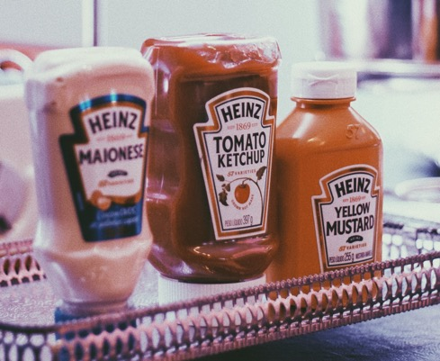
Condiments And Spices Corrupt The Blood
Food prepared with condiments and spices inflames the stomach, corrupts the blood and paves the way to stronger stimulants. It induces nervous debility, impatience and lack of self-control. Tobacco and the wine-cup follow. ST January 6, 1876, Art. A, par. 9
The salads are prepared with oil and vinegar, fermentation takes place in the stomach, and the food does not digest, but decays or putrefies; as a consequence, the blood is not nourished, but becomes filled with impurities, and liver and kidney difficulties appear. {CD 345.6}
MSG: natural flavors, etc.
Fermented adulterated ingredients.
Excessive fats.
Notes:
Condiments And Spices Corrupt The Blood
Food prepared with condiments and spices inflames the stomach, corrupts the blood and paves the way to stronger stimulants. It induces nervous debility, impatience and lack of self-control. Tobacco and the wine-cup follow. ST January 6, 1876, Art. A, par. 9
The salads are prepared with oil and vinegar, fermentation takes place in the stomach, and the food does not digest, but decays or putrefies; as a consequence, the blood is not nourished, but becomes filled with impurities, and liver and kidney difficulties appear.
[PERSONAL EXPERIENCE IN CONQUERING THE VINEGAR HABIT-- APPENDIX 1:6] {CD 345.6}

Slide 29
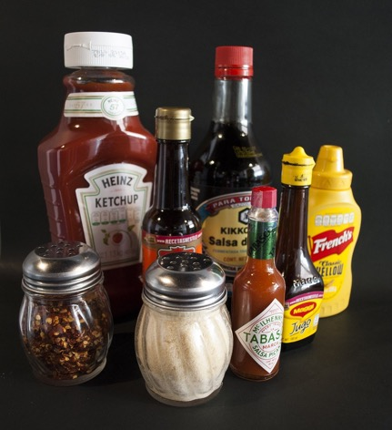
Mustard and Pepper
“Mustard, pepper, spices, pickles, and other things of a like character, irritate the stomach and make the blood feverish and impure. The inflamed condition of the drunkard's stomach is often pictured as illustrating the effect of alcoholic liquors. A similarly inflamed condition is produced by the use of irritating condiments.” {MH 325.2}

Slide 30
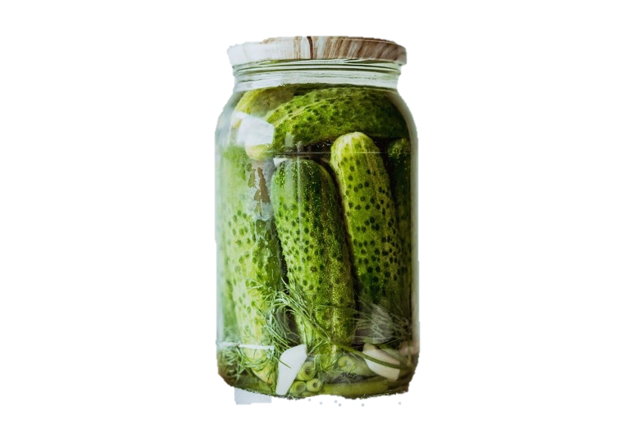
Pickles, mince pies, spices, diseased flesh meats are not helpful
The blood-making organs cannot convert spices, mince pies, pickles, and diseased flesh meats into good blood. {2T 383.2}
Stimulating irritating food does not make the best blood. {2T 359.2}
Notes:
Pickles, mince pies, spices, diseased flesh meats not helpful
The blood-making organs cannot convert spices, mince pies, pickles, and diseased flesh meats into good blood. And if so much food is taken into the stomach that the digestive organs are compelled to overwork in order to dispose of it and to free the system from irritating substances, the mother does injustice to herself and lays the foundation of disease in her offspring. If she chooses to eat as she pleases, and what she may fancy, irrespective of consequences, she will bear the penalty, but not alone. Her innocent child must suffer because of her indiscretion. {2T 383.2
Stimulating Irritating food does not make the best blood
As I said before, we live in a corrupt age. It is a time when Satan seems to have almost perfect control over minds that are not fully consecrated to God. Therefore there is a very great responsibility resting upon parents and guardians who have children to bring up. Parents have taken the responsibility of bringing these children into existence; and now what is their duty? Is it to let them come up just as they may, and just as they will? Let me tell you, a weighty responsibility rests upon these parents. "Whether therefore ye eat, or drink, or whatsoever ye do, do all to the glory of God." Do you do this when you prepare food for your tables and call your family to partake of it? Are you placing before your children only the food that you know will make the very best blood? Is it that food that will preserve their systems in the least feverish condition? Is it that which will place them in the very best relation to life and health? Is this the food that you are studying to place before your children? Or do you, regardless of their future good, provide for them unhealthful, stimulating, irritating food? {2T 359.2}
Paramastri R, Hsu CY, Lee HA, Lin LY, Kurniawan AL, Chao JC. Association between Dietary Pattern, Lifestyle, Anthropometric Status, and Anemia-Related Biomarkers among Adults: A Population-Based Study from 2001 to 2015. Int J Environ Res Public Health. 2021 Mar 26;18(7):3438.
Inadequate dietary intake, poor nutritional status, heavy smoking, and alcohol consumption are associated with the risk of anemia. The objective of this study was to investigate the associations between dietary patterns, lifestyle, nutritional status, and anemia-related biomarkers among adults using a multivariable regression model. Taiwanese adults aged 20-45 years (n = 118,924, 43,055 men and 75,869 women) were obtained from the Mei Jau Health Management Institution database, between 2001 and 2015, for data analysis. The anemia-inflammation-related dietary pattern was derived by reduced rank regression analysis. Dietary patterns with high intakes of eggs, meat, organ meats, rice or flour products, fried foods, sugary beverages, and processed foods significantly increased the risk of anemia, and was associated with decreased hemoglobin, hematocrit, and red blood cells, but increased white blood cells and C-reactive protein levels. Moreover, current alcohol drinkers, as well as people who were underweight, overweight, obese, and central obese, were more likely to increase their risk of anemia by 46%, 20%, 23%, 34%, and 28%, respectively. Interestingly, participants who are current or past smokers were inversely associated with risk of anemia. In conclusion, adherence to the anemia-inflammation dietary pattern was associated with an increased risk of anemia in Taiwanese adults. Furthermore, abnormal weight status and alcohol drinking were correlated with an increased risk of anemia.

Slide 31

Expensive food preparations not necessary
“Be content to take the products of the soil, the fruits and grains and vegetables, and prepare them in a healthful way. We need not the most expensive food preparations that men can provide.”
Be satisfied with the simple preparations that give just as good blood, just as good physical strength. Ms115-1906.22
Notes:
Expensive food preparations not necessary
Where are the wise men who will voice the words of Christ. Study the thirteenth chapter of Matthew. It is all important. They are the words of the great Medical Missionary. Here are revealed the two working forces. Study the Word. Become familiar with the lessons of Christ. I want all to turn away from the deceptive wiles of the enemy that would allure you into works and ways that God has not called you to. Be content to take the products of the soil, the fruits and grains and vegetables, and prepare them in a healthful way. We need not the most expensive food preparations that men can provide. If men of the world desire to handle these expensive foods, let them do so; but let the children of God be satisfied with the simple preparations that give just as good blood, just as good physical strength. Yield not to the temptation to so tie up the means we need in the cause of God, to thus bind up men of talent. The Lord will bless the simple foods prepared for His people. This I give to you as the light God has given me. Ms115-1906.22
Tallman PS, Valdes-Velasquez A, Sanchez-Samaniego G. The "Double Burden of Malnutrition" in the Amazon: dietary change and drastic increases in obesity and anemia over 40 years among the Awajún. Ecol Food Nutr. 2022 Jan-Feb;61(1):20-42.
Undernutrition and overnutrition are interconnected. Yet few studies have examined the "double burden of malnutrition" (DBM) over time in indigenous communities. We investigated changes in the food systems and nutritional health of Awajún communities in the Peruvian Amazon in the 1970s and in 2013. Methods included ethnography, 24 hr food recalls, and biological measures. In 2013, the number of traditional foods consumed decreased to 10% of levels in the 1970s and the number of market foods consumed increased 40-fold. Rates of anemia and obesity were also substantially higher in 2013 compared to the 1970s (23% vs 6% for anemia and 30% vs. 0% for obesity) indicating a DBM has emerged. Examining the predictors of hemoglobin levels and body mass indices in the 2013 sample reveals that this DBM is differentially impacting women and that risk for obesity among the Awajún is associated with multiple proxies of market integration beyond just the consumption of market foods. These findings highlight the complex pathways by which rapid lifestyle changes are creating gendered health inequalities within indigenous communities over time.

Slide 32

Must replace discarded food items with wholesome food items
Do not adopt merely a meat avoidant diet.
“With many persons the reform consists merely in discarding certain unwholesome foods.”
“Some are unable to obtain the most desirable foods, and, instead of using such things as would best supply the lack, they adopt an impoverished diet. Their food does not supply the elements needed to make good blood.” MH 318
Notes:
Must replace discarded food items with wholesome food items
Not all who profess to believe in dietetic reform are really reformers. With many persons the reform consists merely in discarding certain unwholesome foods. They do not understand clearly the principles of health, and their tables, still loaded with harmful dainties, are far from being an example of Christian temperance and moderation. MH 318.1
Another class, in their desire to set a right example, go to the opposite extreme. Some are unable to obtain the most desirable foods, and, instead of using such things as would best supply the lack, they adopt an impoverished diet. Their food does not supply the elements needed to make good blood. Their health suffers, their usefulness is impaired, and their example tells against, rather than in favor of, reform in diet. MH 318.2

Slide 33

Overeating Counterproductive
“You indulge your appetite by eating more food than your system can convert into good blood.”
“Overeating, even of the simplest food, benumbs the sensitive nerves of the brain, and weakens its vitality.” {CD 102.3}
“All that is taken into the stomach, above what the system can use to convert into good blood, clogs the machinery; for it cannot be made into either flesh or blood, and its presence burdens the liver, and produces a morbid condition of the system.” {CD 103.1}
“Taking more food into the system than it can convert into good blood causes a depraved quality of blood and taxes the vitality to a much greater degree than labor or physical exercise.” {2T 428.1}
“She eats nearly double the amount which she ought to eat. All that she takes into her stomach, above that which her system can convert into good blood, becomes waste matter, to burden nature in the disposal of it. Her system is clogged with a mass of matter which hinders her in her work, clogs the machinery, and weakens the life forces.” {2T 427.2}
Notes:
Overeating
My brother, you have much to learn. You indulge your appetite by eating more food than your system can convert into good blood. It is sin to be intemperate in the quantity of food eaten, even if the quality is unobjectionable. Many feel that if they do not eat meat and the grosser articles of food, they may eat of simple food until they cannot well eat more. This is a mistake. Many professed health reformers are nothing less than gluttons. They lay upon the digestive organs so great a burden that the vitality of the system is exhausted in the effort to dispose of it. It also has a depressing influence upon the intellect; for the brain nerve power is called upon to assist the stomach in its work. Overeating, even of the simplest food, benumbs the sensitive nerves of the brain, and weakens its vitality. Overeating has a worse effect upon the system than overworking; the energies of the soul are more effectually prostrated by intemperate eating than by intemperate working. {CD 102.3}
The digestive organs should never be burdened with a quantity or quality of food which it will tax the system to appropriate. All that is taken into the stomach, above what the system can use to convert into good blood, clogs the machinery; for it cannot be made into either flesh or blood, and its presence burdens the liver, and produces a morbid condition of the system. The stomach is overworked in its efforts to dispose of it, and then there is a sense of languor, which is interpreted to mean hunger, and without allowing the digestive organs time to rest from their severe labor, to recruit their energies, another immoderate amount is taken into the stomach, to set the weary machinery again in motion. The system receives less nourishment from too great a quantity of food, even of the right quality, than from a moderate quantity taken at regular periods. {CD 103.1}
Taking more food into the system than it can convert into good blood causes a depraved quality of blood and taxes the vitality to a much greater degree than labor or physical exercise. This overeating causes a dull stupor. The brain nerves are called upon to aid the digestive organs, and are thus constantly overtaxed, weakened, and benumbed. This leaves a sense of dullness in the head, and makes your wife liable to a shock of paralysis any day. What she requires is not encouragement to cease exercise. There would be nothing so dangerous for her as to remain where her physical powers would not be called into active exercise. Physical exercise is very essential. This will strengthen her body and mind. When she awakes to the responsibility of her position, and sees the benefit which will result from her seeking to have an aim in life, she will not be so disposed to sink down in indolence and to shun hardships. She does not put her heart into what she does; therefore she moves about too much like a machine, feeling that labor is a burden. She cannot, while she feels thus, realize that new life and vigor which it is her privilege to have. She lacks spirit and energy. She is too much inclined to be lost in dullness and leaden insensibility. The heavy torpor she feels can only be overcome by a spare diet, perfect control over her appetite and all her passions, and by calling her will to aid her in taking exercise. She wants the will to electrify the nerve power so that she may resist indolence. 2T 428.1
I was shown that your wife does not understand herself. She shunned caretaking in her youth and is not disposed to engage in it even now. She is inclined to lean upon others, rather than upon her own powers. She has not encouraged a noble independence. She should, for years back, have been educating herself to bear burdens. She is not in health. She is predisposed to torpidity of the liver and is not inclined to exercise. She has not the faculty of setting herself to work unless she sees that she must. She eats nearly double the amount which she ought to eat. All that she takes into her stomach, above that which her system can convert into good blood, becomes waste matter, to burden nature in the disposal of it. Her system is clogged with a mass of matter which hinders her in her work, clogs the machinery, and weakens the life forces. {2T 427.2}

Slide 34
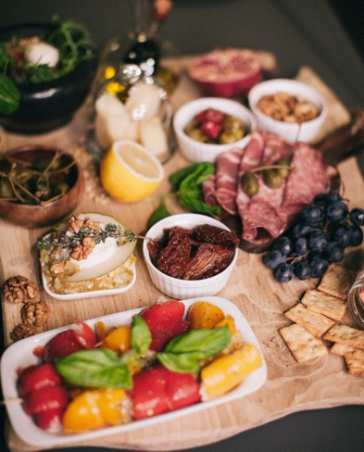
Complex combinations counterproductive
“We need to study the art of preparing in a simple manner the fruits, grains, and vegetables. We do not need these complex combinations that are provided.”
“We should put into our stomachs only those things that will make good blood.” {8MR 172.3}
Notes:
Complex combinations counterproductive, as processed or prepared meals
As the situation has been presented before me, I have felt that there should be a thorough examination of those who are connected with our restaurants to see if they stand on the platform of genuine health reform. We should put into our stomachs only those things that will make good blood. We need to study the art of preparing in a simple manner the fruits, grains, and vegetables. We do not need these complex combinations that are provided. As the matter now stands we are in danger of making dyspeptics. I would ask, How many are standing by the old principles of health reform, as they were given to us years ago? 8MR 172.3
At bountiful tables men often eat much more than can be easily digested. The overburdened stomach cannot do its work properly. The result is a disagreeable feeling of dullness in the brain, and the mind does not act quickly. Disturbance is created by improper combinations of food; fermentation sets in; the blood is contaminated and the brain confused. {7T 257.2}
The habit of overeating, or of eating too many kinds of food at one meal, frequently causes dyspepsia. Serious injury is thus done to the delicate digestive organs. In vain the stomach protests and appeals to the brain to reason from cause to effect. The excessive amount of food eaten, or the improper combination, does its injurious work. In vain do disagreeable premonitions give warning. Suffering is the consequence. Disease takes the place of health. {7T 257.3}

Slide 35

Prepared Meals Counterproductive
Fast food, fast death.
8MR 172.3
Notes:
Complex combinations counterproductive, as processed or prepared meals
As the situation has been presented before me, I have felt that there should be a thorough examination of those who are connected with our restaurants to see if they stand on the platform of genuine health reform. We should put into our stomachs only those things that will make good blood. We need to study the art of preparing in a simple manner the fruits, grains, and vegetables. We do not need these complex combinations that are provided. As the matter now stands we are in danger of making dyspeptics. I would ask, How many are standing by the old principles of health reform, as they were given to us years ago? 8MR 172.3

Slide 36

Chew Your Food Well For Good Blood
“The transformation of food into good blood is a wonderful process, and all human beings should be intelligent upon this subject. In order that the digestive fluids may be called into action, and the saliva become mixed with the food, the teeth must do their work carefully and thoroughly.” {3MR 350.3}
Notes:
Careful thorough mastication
The human organism is a wonderful piece of machinery, but it can be abused. The stomach can be, and often is, overtaxed, and compelled to serve its tyrannical master like a slave. The transformation of food into good blood is a wonderful process, and all human beings should be intelligent upon this subject. In order that the digestive fluids may be called into action, and the saliva become mixed with the food, the teeth must do their work carefully and thoroughly. Each organ of the body gathers its nutrition to keep its different parts in action. The brain must be supplied with its share, the bone with its portion. The great Master Builder is at work every moment, supplying every muscle and tissue, from the brain to the ends of the fingers and toes, with life and strength. {3MR 350.3}

Slide 37
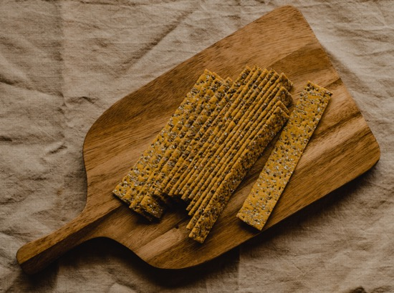
Dry Food Makes for Better Blood! Dispense with juice.
“Taken in a liquid state, your food would not give healthful vigor or tone to the system.” {CD 105.1}
“Dry food is better than so much wet food. Eat what the system requires to produce good blood.” {1SAT 12.3}
Notes:
Dry food (not juices, smoothies, soups, broths) and meal schedule regularity
Dry food is better than so much wet food. Eat what the system requires to produce good blood. Poverty of diet will produce disease of the blood. Be regular in your meals. Have wholesome food at all times, and make no difference for company.—Ms 5, 1884. (MR 900.48) 1SAT 12.3
Liquid foods not as good
Had your physical health been unimpaired, you would have made an eminently useful woman. You have long been diseased, and this has affected your imagination so that your thoughts have been concentrated upon yourself, and the imagination has affected the body. Your habits have not been good in many respects. Your food has not been of the right quantity or quality. You have eaten too largely, and of a poor quality of food, which could not be converted into good blood. You have educated the stomach to this kind of diet. This, your judgment has taught you, was the best, because you realized the least disturbance from it. But this was not a correct experience. Your stomach was not receiving that vigor that it should from your food. Taken in a liquid state, your food would not give healthful vigor or tone to the system. But when you change this habit, and eat more solids and less liquids, your stomach will feel disturbed. Notwithstanding this, you should not yield the point; you should educate your stomach to bear a more solid diet. {CD 105.1}

Slide 38
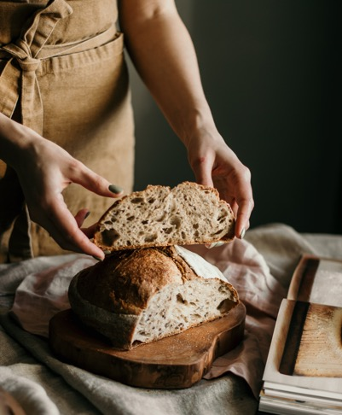
The good and bad of bread
Unleavened flat breads, “require thorough mastication, which is a benefit both to the teeth and the stomach. They make good blood, and impart strength. With such bread, and the abundant fruits, vegetables, and grains with which our country abounds, no greater luxuries should be desired.” {RH, May 8, 1883 par. 6}
“That which we eat cannot be converted into good blood unless it is of a proper quality, simple and nutritious. The stomach can never convert sour bread into sweet. Food poorly prepared is not nutritious and cannot make good blood.” {2T 537.3}
Notes:
Unleavened flat breads
To make rolls, use soft water and milk, or a little cream; make a stiff dough, and knead it as for crackers. Bake on the grate of the oven. These are sweet and delicious. They require thorough mastication, which is a benefit both to the teeth and the stomach. They make good blood, and impart strength. With such bread, and the abundant fruits, vegetables, and grains with which our country abounds, no greater luxuries should be desired. {RH, May 8, 1883 par. 6}
Sourdough bread not good
That which we eat cannot be converted into good blood unless it is of a proper quality, simple and nutritious. The stomach can never convert sour bread into sweet. Food poorly prepared is not nutritious and cannot make good blood. These things which fret and derange the stomach will have a benumbing influence upon the finer feelings of the heart. Many who adopt the health reform complain that it does not agree with them; but, after sitting at their tables, I come to the decision that it is not the health reform that is at fault, but the poorly prepared food. 2T 537.3
Poor cookery is slowly wearing away the life energies of thousands. It is dangerous to health and life to eat at some tables the heavy, sour bread and the other food prepared in keeping with it. Mothers, instead of seeking to give your daughters a musical education, instruct them in these useful branches which have the closest connection with life and health. Teach them all the mysteries of cooking. Show them that this is a part of their education and essential for them in order to become Christians. Unless the food is prepared in a wholesome, palatable manner, it cannot be converted into good blood to build up the wasting tissues. Your daughters may love music, and this may be all right; it may add to the happiness of the family; but the knowledge of music without the knowledge of cookery is not worth much. {2T 538.1}

Slide 39


Egg in Grape Juice for a Blood Booster.
“You must not deprive yourself of that class of food which makes good blood.”
“Get eggs of healthy fowls. Use these eggs cooked or raw. Drop them uncooked into the best unfermented wine you can find. {12MR 168.2}
Notes:
May need some eggs in grape juice
Dear Brother and Sister Kress: I am deeply pained to learn that Brother Kress is ill. We have not yet heard the particulars. {12MR 168.1}
I have some things I wish to send you, if I can get them off in this mail. Several cases have been presented to me, which I will speak of in time; meanwhile, do not put yourself through [such an extreme regimen] as you have done, and do not go to extremes in regard to the health reform. Some of our people are very careless in regard to health reform. But because some are far behind, you must not, in order to be an example to them, be an extremist. You must not deprive yourself of that class of food which makes good blood. Your devotion to true principles is leading you to submit yourself to a diet which is giving you an experience that will not recommend health reform. This is your danger. When you see that you are becoming weak physically, it is essential for you to makes changes, and at once. Put into your diet something you have left out. It is your duty to do this. Get eggs of healthy fowls. Use these eggs cooked or raw. Drop them uncooked into the best unfermented wine you can find.[DR. KRESS ACCEPTED THIS COUNSEL. HE FOLLOWED THE RAW-EGG AND GRAPE-JUICE REGIMEN REGULARLY UNTIL HIS DEATH IN 1956 AT THE AGE OF 94.] This will supply that which is necessary to your system. Do not for a moment suppose that it will not be right to do this. There is one thing that has saved life--an infusion of blood from one person to another; but this would be difficult and perhaps impossible for you to do. I merely suggest it. {12MR 168.2}

Slide 40
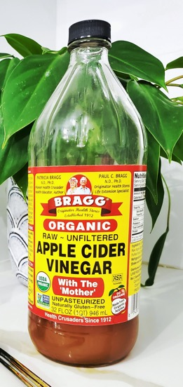
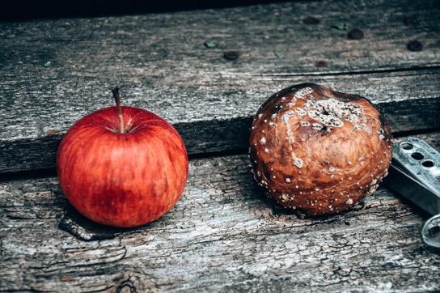
Fermented foods poison
“More die by eating decayed fruit and decayed vegetables which ferment in the stomach and result in blood poisoning, than we have any idea of.” {CD 309.6}
Notes:
Nicely prepared vegetables and fruits in their season will be beneficial, if they are of the best quality, not showing the slightest sign of decay, but are sound and unaffected by any disease or decay. More die by eating decayed fruit and decayed vegetables which ferment in the stomach and result in blood poisoning, than we have any idea of.
310
{CD 309.6}

Slide 41

Tea, Coffee, Tobacco, Or Liquor Does Not Make Good Blood
Notes:
Tea, Coffee, Tobacco, Or Liquor Does Not Make Good Blood
God has written His law upon every nerve and muscle, every fibre and function of the human body. The indulgence of unnatural appetite, whether for tea, coffee, tobacco, or liquor, is intemperance, and is at war with the laws of life and health. By using these forbidden articles, a condition of things is created in the system which the Creator never designed. This indulgence in any of the members of the human family is sin. But how much more sinful is it in those who profess to be Christians, who say they are Abraham's children. They are not, because they do not practice the works of the Lord. If they were following Jesus, they would deny unnatural appetite. Every gratification of unnatural appetite produces disease in the physical system. The eating of food that does not make good blood is working against the laws of our physical organism, and is a violation of the law of God. The cause produces the effect. Suffering, disease, and death are the sure penalty of indulgence. BEcho September 18, 1899, Art. A, par. 11

Slide 42

Wine Corrupts The Blood
“Luxurious living and the use of wine corrupt the blood, inflame the passions, and produce diseases of every kind.
“But the evil does not end here. Parents leave maladies as a legacy to their children. As a rule, every intemperate man who rears children transmits his inclinations and evil tendencies to his offspring; he gives them disease from his own inflamed and corrupted blood.” 4T 30.1
Notes:
Wine Corrupts The Blood
All this weight of woe and accumulated suffering can be traced to the indulgence of appetite and passion. Luxurious living and the use of wine corrupt the blood, inflame the passions, and produce diseases of every kind. But the evil does not end here. Parents leave maladies as a legacy to their children. As a rule, every intemperate man who rears children transmits his inclinations and evil tendencies to his offspring; he gives them disease from his own inflamed and corrupted blood. Licentiousness, disease, and imbecility are transmitted as an inheritance of woe from father to son and from generation to generation, and this brings anguish and suffering into the world, and is no less than a repetition of the fall of man. 4T 30.1

Slide 43

Tobacco Not Helpful
“Many chew and smoke until the blood is corrupted and the nervous system undermined.
“The words of the apostle Paul are applicable to them: ‘Having therefore these promises, dearly beloved, let us cleanse ourselves from all filthiness of the flesh and spirit, perfecting holiness in the fear of God.’ ‘I beseech you therefore, brethren, by the mercies of God, that ye present your bodies a living sacrifice, holy, acceptable unto God, which is your reasonable service.’" {5T 440.2}
Notes:
Tobacco not helpful
Physicians cannot perform their duties with fidelity to God or to their fellow men while they are worshiping an idol in the form of tobacco. How offensive to the sick is the breath of the tobacco user! How they shrink from him! How inconsistent for men who have graduated from medical colleges and claim to be capable of ministering to suffering humanity, to constantly carry a poisonous narcotic with them into the sickrooms of their patients. And yet many chew and smoke until the blood is corrupted and the nervous system undermined. It is especially offensive in the sight of God for physicians who are capable of doing great good, and who profess to believe the truth of God for this time, to indulge in this disgusting habit. The words of the apostle Paul are applicable to them: "Having therefore these promises, dearly beloved, let us cleanse ourselves from all filthiness of the flesh and spirit, perfecting holiness in the fear of God." "I beseech you therefore, brethren, by the mercies of God, that ye present your bodies a living sacrifice, holy, acceptable unto God, which is your reasonable service." {5T 440.2}
Inherited With Bad Habits
Our accountability extends as far as our influence reaches, and that is constantly affecting others, either for good or for evil. In a pre-eminent degree is this true of parents. Fathers and mothers who gratify inclination and appetite at the expense of health, not only work against their own physical health and moral advancement, but leave to their children their perverted appetite and enfeebled moral power. Liquor drinkers and tobacco devotees transmit to their offspring their own insatiable craving, their irritable nerves, and their inflamed, corrupted blood. The licentious hand down as an inheritance to their children their own weakness and wickedness, with a host of vile and loathsome diseases the result of their transgressions. {BEcho, March 1, 1887 par. 1}

Slide 44
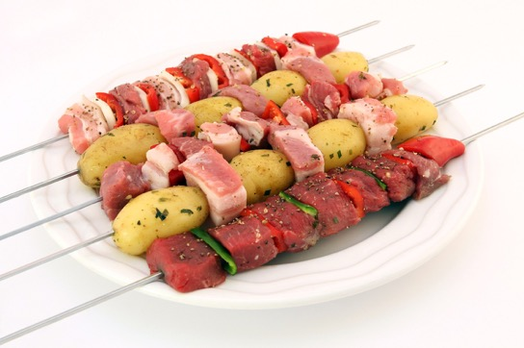
Flesh meats not helpful
“Flesh meats will depreciate the blood.”
“Cook meat with spices, and eat it with rich cakes and pies, and you have a bad quality of blood.”
“The mince pies and the pickles, which should never find a place in any human stomach, will give a miserable quality of blood.”
“And a poor quality of food, cooked in an improper manner, and insufficient in quantity, cannot make good blood.”
“Flesh meats and rich food, and an impoverished diet, will produce the same results.” {2T 368.3}
Notes:
Flesh meats not helpful
Flesh meats will depreciate the blood. Cook meat with spices, and eat it with rich cakes and pies, and you have a bad quality of blood. The system is too heavily taxed in disposing of this kind of food. The mince pies and the pickles, which should never find a place in any human stomach, will give a miserable quality of blood. And a poor quality of food, cooked in an improper manner, and insufficient in quantity, cannot make good blood. Flesh meats and rich food, and an impoverished diet, will produce the same results. {2T 368.3}

Slide 45
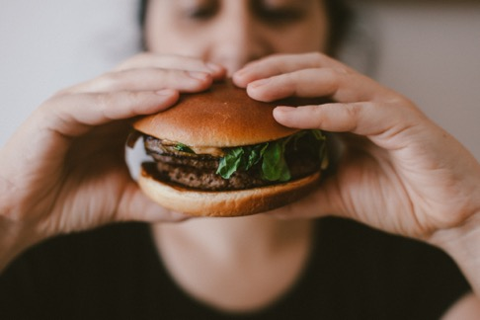
The Liability To Take Disease Is Increased Tenfold By Meat Eating
“Those who subsist largely upon flesh cannot avoid eating the meat of animals which are to a greater or less degree diseased.
“The fluids and flesh of these diseased animals are received directly into the blood, and pass into the circulation of the human body, becoming fluids and flesh of the same. Thus humors are introduced into the system.
And if the person already has impure blood, it is greatly aggravated by the eating of the flesh of these animals. The liability to take disease is increased tenfold by meat eating.” {2T 63.3}
Notes:
Parents can secure small homes in the country, with land for cultivation, where they can have orchards and where they can raise vegetables and small fruits to take the place of flesh meat, which is so corrupting to the life-blood coursing through the veins. CD 400.2
Will the people who are preparing to become holy, pure, and refined, that they may be introduced into the society of heavenly angels, continue to take the life of God's creatures and subsist on their flesh and enjoy it as a luxury? From what the Lord has shown me, this order of things will be changed, and God's peculiar people will exercise temperance in all things. Those who subsist largely upon flesh cannot avoid eating the meat of animals which are to a greater or less degree diseased. The process of fitting animals for market produces in them disease; and fitted in as healthful manner as they can be, they become heated and diseased by driving before they reach the market. The fluids and flesh of these diseased animals are received directly into the blood, and pass into the circulation of the human body, becoming fluids and flesh of the same. Thus humors are introduced into the system. And if the person already has impure blood, it is greatly aggravated by the eating of the flesh of these animals. The liability to take disease is increased tenfold by meat eating. The intellectual, the moral, and the physical powers are depreciated by the habitual use of flesh meats. Meat eating deranges the system, beclouds the intellect, and blunts the moral sensibilities. We say to you, dear brother and sister, your safest course is to let meat alone. {2T 63.3}

Slide 46

Eating Sick Animals Produces Sick Blood
“Those who subsist largely upon meat cannot avoid sometimes eating flesh which is more or less diseased. In many cases the process of fitting animals for market produces an unhealthy condition. Shut away from light and pure air, inhaling the atmosphere of filthy stables, the entire body soon becomes contaminated with foul matter; and when such flesh is received into the human body it corrupts the blood, and disease is produced.” CH 115.2
“I have shown them that their meat diet, which was supposed to be essential, was not necessary, and that, as they were composed of what they ate, brain, bone, and muscle were in an unwholesome condition, because they lived on the flesh of dead animals; that their blood was being corrupted by this improper diet; that the flesh which they ate was diseased, and their entire system was becoming gross and corrupted.” {CD 387.2}
Notes:
Eating Sick Animals Produces Sick Blood
Those who subsist largely upon meat cannot avoid sometimes eating flesh which is more or less diseased. In many cases the process of fitting animals for market produces an unhealthy condition. Shut away from light and pure air, inhaling the atmosphere of filthy stables, the entire body soon becomes contaminated with foul matter; and when such flesh is received into the human body it corrupts the blood, and disease is produced. If the person already has impure blood, this unhealthful condition will be greatly aggravated. But few can be made to believe that it is the meat they have eaten which has poisoned their blood and caused their suffering. Many die of diseases wholly due to meat eating, when the real cause is scarcely suspected by themselves or others. Some do not immediately feel its effects, but this is no evidence that it does not hurt them. It may be doing its work surely upon the system, yet for the time being the victim may realize nothing of it. CH 115.2
I have felt urged by the Spirit of God to set before several the fact that their suffering and ill health was caused by a disregard of the light given them upon health reform. I have shown them that their meat diet, which was supposed to be essential, was not necessary, and that, as they were composed of what they ate, brain, bone, and muscle were in an unwholesome condition, because they lived on the flesh of dead animals; that their blood was being corrupted by this improper diet; that the flesh which they ate was diseased, and their entire system was becoming gross and corrupted. {CD 387.2}
Again I will refer to the diet question. We cannot now do as we have ventured to do in the past in regard to meat eating. It has always been a curse to the human family, but now it is made particularly so in the curse which God has pronounced upon the herds of the field, because of man's transgression and sin. The disease upon animals is becoming more and more common, and our only safety now is in leaving meat entirely alone. The most aggravated diseases are now prevalent, and the very last thing that physicians who are enlightened should do, is to advise patients to eat meat. It is in eating meat so largely in this country that men and women are becoming demoralized, their blood corrupted, and disease planted in the system. Because of meat eating, many die, and they do not understand the cause. If the truth were known, it would bear testimony it was the flesh of animals that have passed through death. The thought of feeding on dead flesh is repulsive, but there is something besides this. In eating meat we partake of diseased dead flesh, and this sows its seed of corruption in the human organism. {CD 412.1}

Slide 47
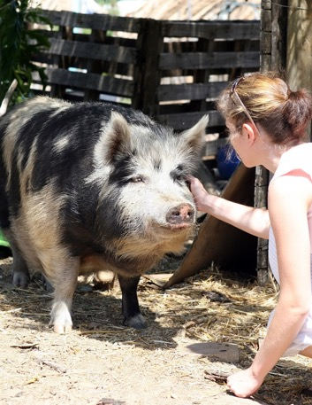
Eating Pork Makes A Bad Quality Of Blood
“The use of swine's flesh in your family has imparted a bad quality of blood.”
“It is impossible for those who make free use of flesh meats to have an unclouded brain and an active intellect.” {2T 62.1}
{2T 62.1}
Notes:
Eating Pork Makes A Bad Quality Of Blood
Sister H is a woman whose blood is corrupt. Her system is full of scrofulous humors from the eating of flesh meats. The use of swine's flesh in your family has imparted a bad quality of blood. Sister H needs to confine herself strictly to a diet of grains, fruits, and vegetables, cooked without flesh or grease of any kind. It will take quite a length of time of strictly healthful diet to place you in better conditions of health, where you will be rightly related to life. It is impossible for those who make free use of flesh meats to have an unclouded brain and an active intellect. {2T 62.1}

Slide 48
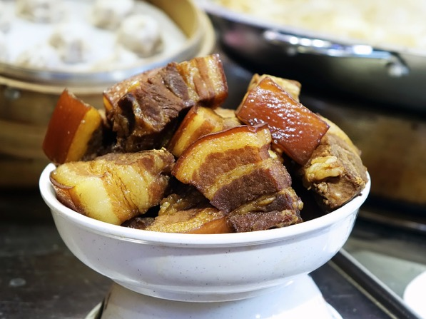
Animal Fat
“The meat is served reeking with fat, because it suits the perverted taste. Both the blood and the fat of animals are consumed as a luxury. But the Lord gave special directions that these should not be eaten. Why? Because their use would make a diseased current of blood in the human system. The disregard of the Lord's special directions has brought a variety of difficulties and diseases upon human beings.” 7MR 423.2

Slide 49

Butter, Cheese, Rich Pastries, Cannot Convert Into Good Blood
“Many a mother sets a table that is a snare to her family. Flesh-meats, butter, cheese, rich pastry, spiced foods, and condiments are freely partaken of by both old and young. These things do their work in deranging the stomach, exciting the nerves, and enfeebling the intellect. The blood-making organs cannot convert such things into good blood.
“The blood becomes fevered, the animal propensities are aroused, while the moral and intellectual powers are weakened, and become servants to the baser passions.” {CTBH 46.3}
Notes:
Flesh-meats, butter, cheese, rich pastry, spiced foods, and condiments cannot convert into good blood
It is impossible for those who give the reins to appetite to attain to Christian perfection. The moral sensibilities of your children cannot be easily aroused, unless you are careful in the selection of their food. Many a mother sets a table that is a snare to her family. Flesh-meats, butter, cheese, rich pastry, spiced foods, and condiments are freely partaken of by both old and young. These things do their work in deranging the stomach, exciting the nerves, and enfeebling the intellect. The blood-making organs cannot convert such things into good blood. The grease cooked in the food renders it difficult of digestion. The effect of cheese is deleterious. Fine-flour bread does not impart to the system the nourishment that is to be found in unbolted wheat bread. Its common use will not keep the system in the best condition. Spices at first irritate the tender coating of the stomach, but finally destroy the natural sensitiveness of this delicate membrane. The blood becomes fevered, the animal propensities are aroused, while the moral and intellectual powers are weakened, and become servants to the baser passions. The mother should study to set a simple yet nutritious diet before her family. {CTBH 46.3}
God has furnished man with abundant means for the gratification of an unperverted appetite. He has spread before him the products of the earth, — a bountiful variety of food that is palatable to the taste and nutritious to the system. Of these our benevolent heavenly Father says we may freely eat. Fruits, grains, and vegetables, prepared in a simple way, free from spice and grease of all kinds, make, with milk or cream, the most healthful diet. They impart nourishment to the body, and give a power of endurance and a vigor of intellect that are not produced by a stimulating diet. {CTBH 47.1}

Slide 50

Get A Health Assessment On The Cows And Chickens You Obtain Your Milk And Eggs From
“Those who live in new countries or in poverty-stricken districts, where fruits and nuts are scarce, should not be urged to exclude milk and eggs from their dietary.”
“But in the case of persons whose blood-making organs are feeble,--especially if other foods to supply the needed elements cannot be obtained,--milk and eggs should not be wholly discarded.”
“Great care should be taken, however, to obtain milk from healthy cows, and eggs from healthy fowls, that are well fed and well cared for; and the eggs should be so cooked as to be most easily digested.” {MH 320.1}
“The diet reform should be progressive. As disease in animals increases, the use of milk and eggs will become more and more unsafe. An effort should be made to supply their place with other things that are healthful and inexpensive. The people everywhere should be taught how to cook without milk and eggs, so far as possible, and yet have their food wholesome and palatable.” {MH 320.2}
Notes:
Obtain Milk From Healthy Cows, And Eggs From Healthy Fowls
Those who live in new countries or in poverty-stricken districts, where fruits and nuts are scarce, should not be urged to exclude milk and eggs from their dietary. It is true that persons in full flesh and in whom the animal passions are strong need to avoid the use of stimulating foods. Especially in families of children who are given to sensual habits, eggs should not be used. But in the case of persons whose blood-making organs are feeble,--especially if other foods to supply the needed elements cannot be obtained,--milk and eggs should not be wholly discarded. Great care should be taken, however, to obtain milk from healthy cows, and eggs from healthy fowls, that are well fed and well cared for; and the eggs should be so cooked as to be most easily digested. {MH 320.1}
The diet reform should be progressive. As disease in animals increases, the use of milk and eggs will become more and more unsafe. An effort should be made to supply their place with other things that are healthful and inexpensive. The people everywhere should be taught how to cook without milk and eggs, so far as possible, and yet have their food wholesome and palatable. {MH 320.2}

Slide 51

Pleasure of doing good to others
“The pleasure of doing good to others imparts a glow to the feelings which flashes through the nerves, quickens the circulation of the blood, and induces mental and physical health.” {4T 56.2}
Notes:
When human sympathy is blended with love and benevolence, and sanctified by the Spirit of Jesus, it is an element which can be productive of great good. Those who cultivate benevolence are not only doing a good work for others, and blessing those who receive the good action, but they are benefiting themselves by opening their hearts to the benign influence of true benevolence. Every ray of light shed upon others will be reflected upon our own hearts. Every kind and sympathizing word spoken to the sorrowful, every act to relieve the oppressed, and every gift to supply the necessities of our fellow beings, given or done with an eye to God's glory, will result in blessings to the giver. Those who are thus working are obeying a law of heaven and will receive the approval of God. The pleasure of doing good to others imparts a glow to the feelings which flashes through the nerves, quickens the circulation of the blood, and induces mental and physical health. {4T 56.2}

Slide 52
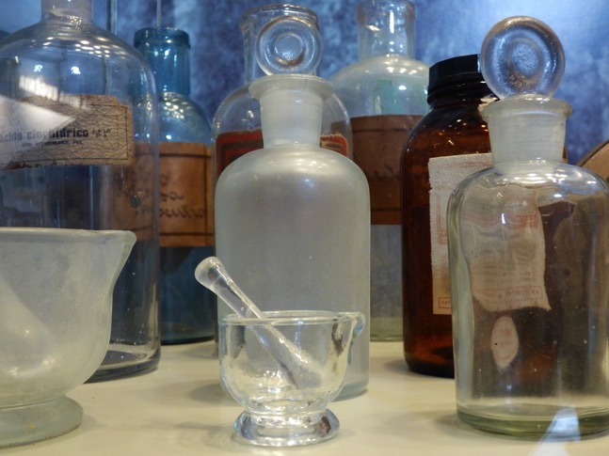
Iron
Iodine
B12
Phytonutrients
Notes:
Re: How does Iodine affect Iron leve... spudlydoo 13 years ago 31,024 RRR
spudlydoo
This is a reply to # 1,436,179
This is one thing that I can confidently give some info on. I have had severe anemia all my life, due to a genetic condition where my body does not absorb iron very well. I have been a guinea pig for a group of researchers studying this condition for the last 19-20 years. For most of my life I have had iron injections every 3-4 weeks to keep my iron levels up.
Since starting on Iodine and companion supps I have not had an iron shot, (much to the doctors and researchers surprise), my ferritin levels went from 11 to 56,(normal is between 25-120) in six months, (this has never occured before), the iron levels in my blood remain unchanged.
Because of the radical changes in my wellbeing + ferritin levels, the researchers have asked me to give them a diary of the supplements I take and give them blood samples every month to track the improvements. (they are very excited about these changes). I have agreed to do this because I think its great that they will be doing some scientific research into the effects of Iodine supps on iron levels, and in particular my genetic problem.
So it appears, at this early stage, that Iodine and companion supps do have a marked effect on the ability of the body and in particular the liver, to absorb iron.
Spud
https://www.curezone.org/forums/am.asp?i=1436017

Slide 53
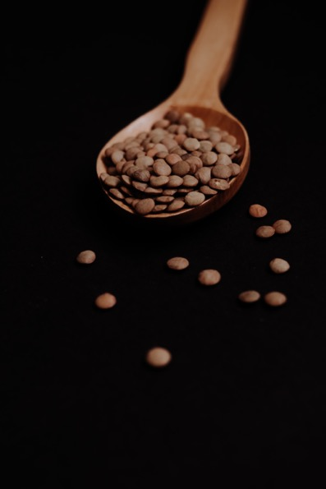
Iron
Soybeans
Sesame
Lentils
Oats
Olives
Spinach
Peas

Slide 54
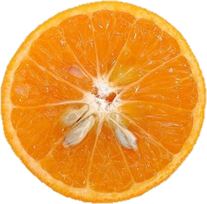
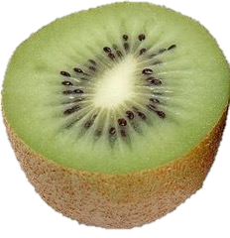

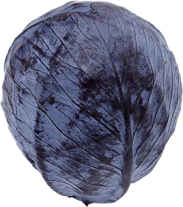
Vitamin C
Notes:
Rocha Dda S, Capanema FD, Netto MP, de Almeida CA, Franceschini Sdo C, Lamounier JA. Effectiveness of fortification of drinking water with iron and vitamin C in the reduction of anemia and improvement of nutritional status in children attending day-care centers in Belo Horizonte, Brazil. Food Nutr Bull. 2011 Dec;32(4):340-6. doi: 10.1177/156482651103200405. PMID: 22590967.
Eftekhari MH, Simondon KB, Jalali M, Keshavarz SA, Elguero E, Eshraghian MR, Saadat N. Effects of administration of iron, iodine and simultaneous iron-plus-iodine on the thyroid hormone profile in iron-deficient adolescent Iranian girls. Eur J Clin Nutr. 2006 Apr;60(4):545-52.

Slide 55

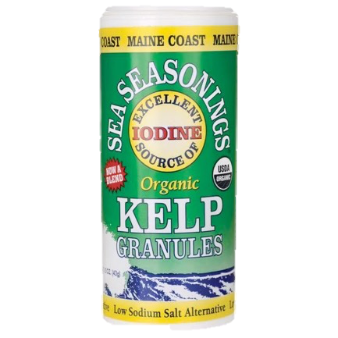
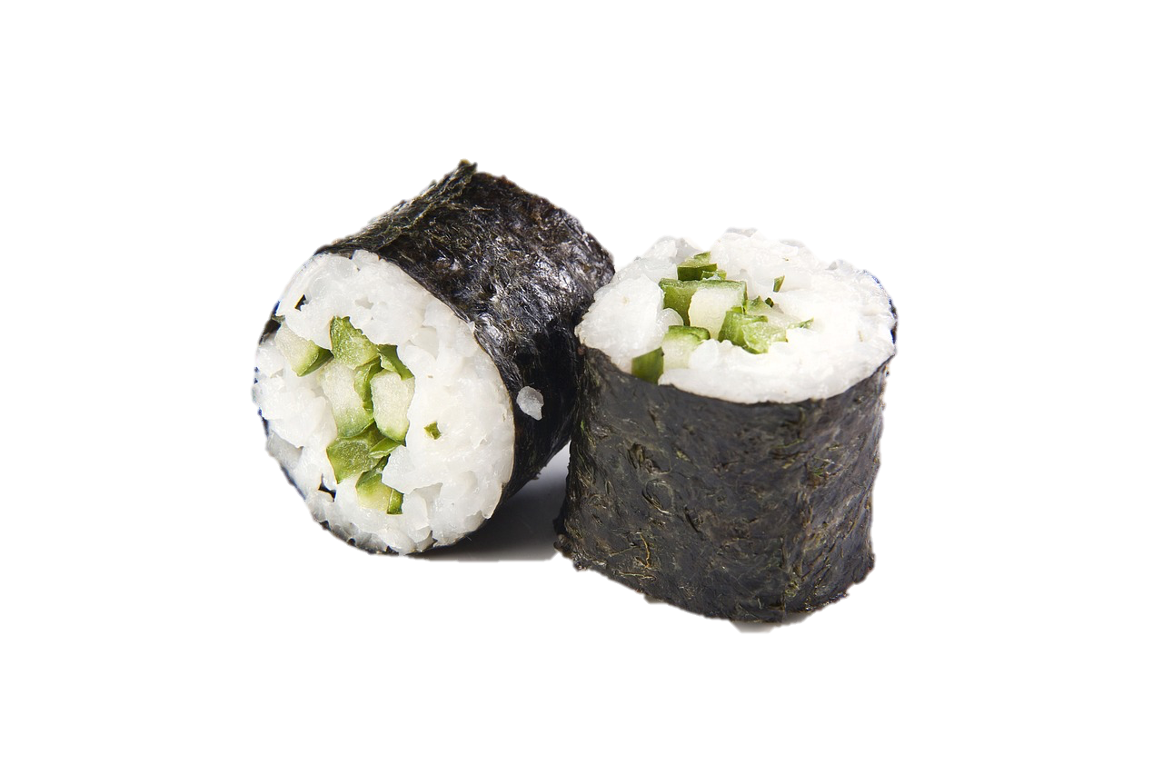
Iodine

Slide 56

B12

Slide 57

Drugs
“We discourage the use of drugs, for they poison the current of the blood. In these institutions sensible instruction should be given how to eat, how to drink, how to dress, and how to live so that the health may be preserved.” {CD 303.5}

Slide 58

Quick fix please
“A practice that is laying the foundation of a vast amount of disease and of even more serious evils, is the free use of poisonous drugs.”
“When attacked by disease, many will not take the trouble to search out the cause of their illness.”
“Their chief anxiety is to rid themselves of pain and inconvenience.”
“So they resort to patent nostrums, of whose real properties they know little, or they apply to a physician for some remedy to counteract the result of their misdoing, but with no thought of making a change in their unhealthful habits.” {CH 89.1}

Slide 59
Anemia Summary
“For the life of the flesh is in the blood:” Lev 17:11.

Slide 60
Anemia Summary
“Perfect health depends upon perfect circulation.” 2T 531.

Slide 61
Anemia Summary
Good blood is the result of good adherence to the physical laws God has ordained in our being.

Slide 62
Anemia Summary
“Pure air, sunlight, abstemiousness, rest, exercise, proper diet, the use of water, trust in divine power--these are the true remedies.” {MH 127.2}

Slide 63
Anemia Summary
“For I have no pleasure in the death of him that dieth, saith the Lord GOD: wherefore turn yourselves, and live ye.” Ezekiel 18:32.

Slide 64
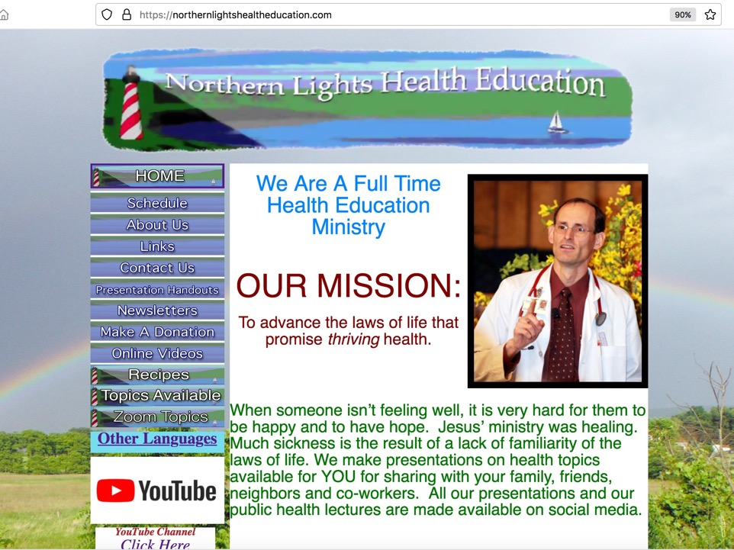
NorthernLightsHealthEducation.com

Slide 65
Anemia
How to Have Good Blood
Notes:
Perfect health depends on perfect circulation. People with anemia do not have good blood for good circulation. Anemia makes you feel fatigued and have recurring low blood counts. In the presentation, “Anemia: How to Have Good Blood” I explore some of the little known, and often missed causes of poor blood and what you can do to correct these and experience life to the full again. Don’t miss this lecture, everyone needs to have good blood to feel good all the time.
Story
Benefit/problem solved
Recurring low blood counts
Nutritional deficiencies
Bullet points
Inspire
Call to action

